Slide 1
A4: kin
Team 3 – Jack Clark, Shuvi Jha, Jasmine Narine, Steven Pu

Slide 2


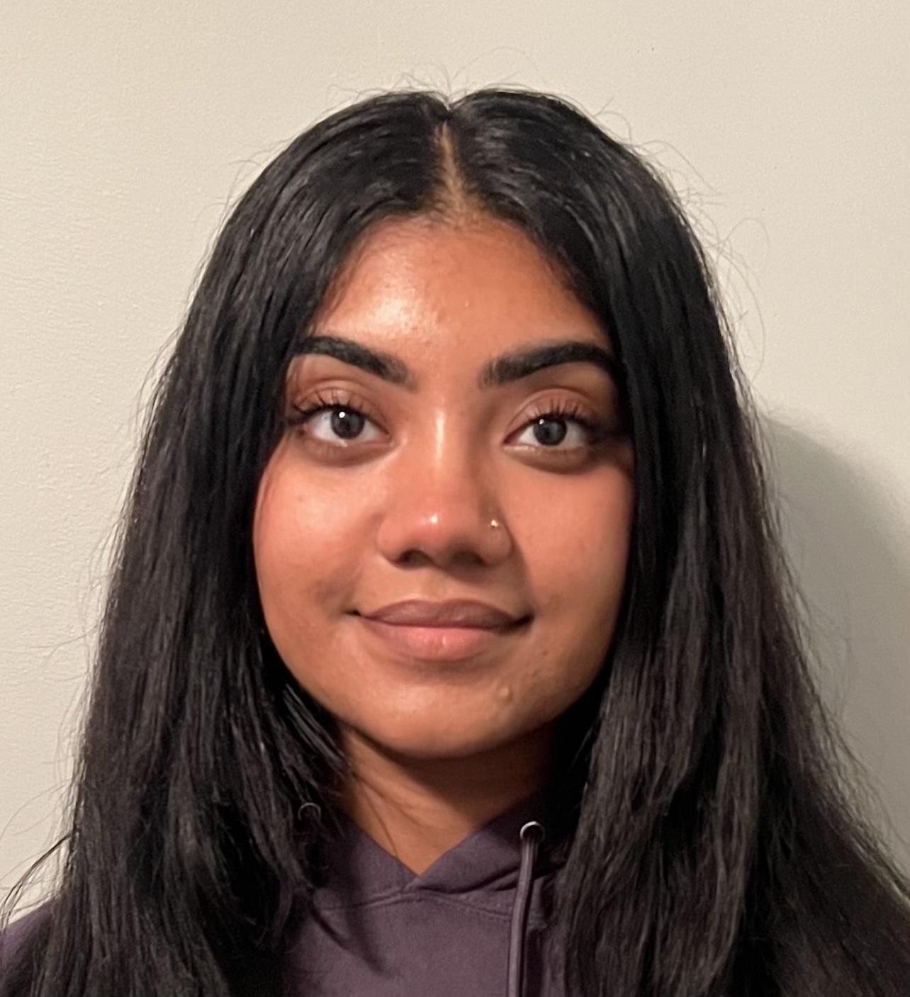

The team
Jack Clark
Shuvi Jha
Jasmine Narine
Steven Pu
MS CS (HCI)
BS MS&E
CS (HCI); Feminist, Gender, & Sexuality Studies
Senior
SYMSYS (HCI)
Senior
SYMSYS (HCI)
Senior

Slide 3
Table of contents
01
02
03
Our Project
Problem/Solution
Market
Research
04
05
06
Values in Design
Storyboard
Appendix

Slide 4
01
Our Project

Slide 5
Name and Value Proposition
kin
In German, kin means “people of the same family.” We find this word imbued with a sense of warmth and positivity, mirroring the very experience we aim to cultivate through our app.
Our one-liner
“Weave your family story one thread at a time”
Our value proposition
“kin seeks to make the uncovering of family stories inviting by initiating daily, bite-sized conversations that facilitate and chronicle our familial connections”

Slide 6
At the end of our Assignment 2 presentation, we had initially planned to progress with a version of our “Conversation Helper” concept.
Since then, we’ve made some changes…

Slide 7
What we learned in our experience prototypes
“Memory Game”
Apples to Apples style card game with prompts to foster conversation
“Conversation Helper”
Help young people and their older loved ones share productive conversation
“Timeline”
A timeline interface to see your collection of family stories organized
“Fun and engaging” at first but became “jarring” when they did not switch topics or stop quickly enough
The game successfully produced insights and new information
Parents said young people could “learn how to converse”
Questions were “robotic” and “impersonal”
The young user was bored after a few minutes
The timeline did not seem useful
Much more of a UI idea than a feature

Slide 8
Incorporating A2 feedback into our concept
“Fun and engaging” at first but became “jarring” when they did not switch topics or stop quickly enough
What we changed
Bite-sized app usage and gameplay
Design the app to only be used for a few minutes/day and not every day
The young user was bored after a few minutes
The game successfully produced insights and new information
Keep the app as fun as possible and record the prompt responses
Parents said young people could “learn how to converse”
Young people can learn conversation patterns from the app and can submit questions of their own
AI will provide better prompts over time, and family-submitted prompts are hyper personal
Questions were “robotic” and “impersonal”
The timeline did not seem useful
Allow for customization for the organization of family-submitted information

Slide 9
Our New idea
Our new concept is akin to Duolingo but for family stories.
We want to make sharing, asking, and taking in family stories as casual and fun as possible.
We hope to bring families together by incentivizing spontaneity and unobtrusive-ness through only promoting a few minutes of app usage every day or every few days. Users can engage in diverse conversations to stay in touch with each other while assembling a larger family story “one thread at a time” and through bite-sized conversation, rather than all at once.

Slide 10
Additional App Context
The vision
We want to lower barriers to storytelling as much as possible by making it fun and easy
“We talk she'll be cooking and I'm sitting there watching her on football. You know, we were talking casually like that” - Krishna
We want a way to engage young people
“You can just get a nod in… you're like yes, yes… she's [my grandmother] rambling” - Catherine
“I want something interactive with back and forth conversation” - Henry RE: Conversation Helper experience prototype
The idea of recording an entire family history is daunting, but it is never too late to begin
“I remember like during high school I sort of thought about medical partying my grandmother telling stories, but I just didn't. And I don't know why I did it” - Catherine
We foresee a Duolingo-type system where we promote only a few minutes of app usage each day (or whenever you want), which incentivizes straight-forward conversation that is easy to tell and digest and can help you strengthen your family relationships
“How I will approach [older relatives] is just straight topics so that they can stay focus on imparting wisdom” - Clare
Notes:
Meant to serve as additional context for some of our decisions and our big ideas/goals with the app!

Slide 11
02
Problem/Solution

Slide 12
Problem and New Solution
Primary User
Families with interest in preserving stories, including both elderly and young people.
It can be difficult for people to learn, share, discuss, and preserve family stories due to physical separation, hectic schedules, language barriers, and generational gaps in communication.
Problem
An innovative tool designed to effortlessly construct a memoir or story database by providing AI-generated and family-contributed daily prompts. Over time, these stories accumulate like interwoven threads, crafting a rich family history.
Solution

Slide 13
03
Market Research

Slide 14

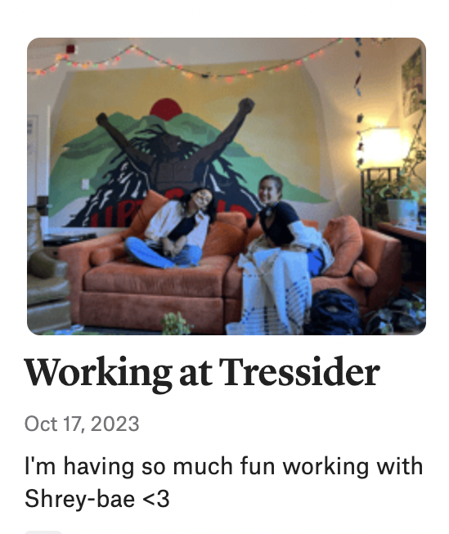
#1
Market Research
Family history platform that allows users to
Create and explore their family trees
Search historical records and newspapers
Collect and share memories via photos and text
Tag friends and family
Use the app on both free and premium plans starting at $4.99
Limitations
Limited acceptance of multimedia format – only text and pictures allowed
No way to engage with existing posts and content
Building a family tree/history requires background knowledge
Implications
There’s value in mapping out family relationships via a visual format
Geared towards people who know how to use technology
People need to be self-motivated in order to use the app
Our app guides users to build their family history memoir gradually through prompts, which creates incentive for users and encourages consistent engagement and storytelling. We appreciate Storied’s focus on visualizing family history, which serves as a source of inspiration for our metaphor that each story will be a thread in a woven family history. We will focus on visualization.
What it means for us?
Notes:
https://storied.com/

Slide 15
#1
Comparison
 | kin | Storied
Value proposition | “Bite-sized conversation to detail your entire family story” | “The next chapter in family history”
Users and story flow | Everyone in the family is a storyteller and a listener | Younger and abled people with knowledge of technology focused on capturing stories as opposed to directly sharing their own
Conversational? | Yes, with multiple people adding to one prompt | Non-conversational, emphasis on capturing stories and presenting them either through text or family tree
Accessibility | Hope to also have a very simple interface | Somewhat complex interface, lengthy sign-up process as users have to answer multiple family-tree related questions to make an account
Differentiating features | Creates incentive for users to engage with app, emphasis on conversation and community-building in addition to capturing and sharing stories | Use of a visual format such as a family tree to show the “building” of family history Use of both texts and photos

Slide 16

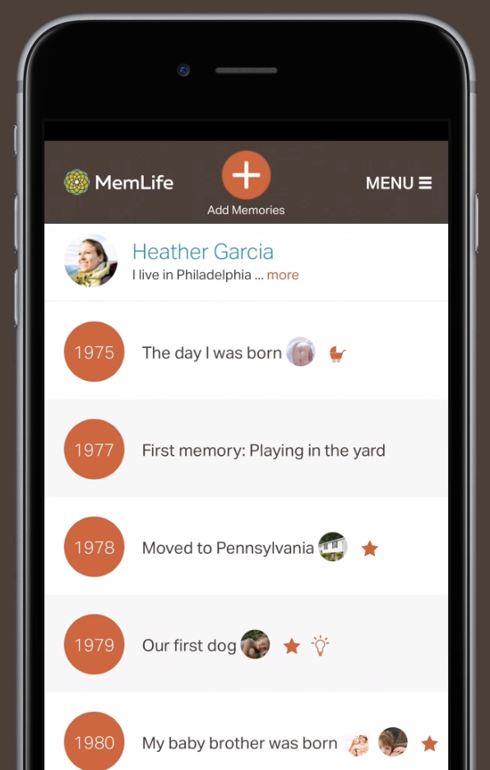
#2 Market Research
Application which seeks to preserve memories
Families are encouraged to record their most meaningful experiences
Option to collaborate to preserve the legacy of and remember past loved ones
Add memories and photographs to an organized timeline
Whenever the user is ready to get a tangible version of this memory, memLife sends a free book
Limitations
Interface seems to be difficult to use + non-intuitive
The timeline is vertical as opposed to horizontal, making it difficult to use it as intended
Lots of bugs + users note an excessive number of ads
No password protection -> makes users wary of the privacy of their data
Implications
Users are invested in the idea of this app, but struggle to support this specific realization of the idea
People want personability, and excessive ads feel transactional in a space that should be focused on family, not monetization
To make a user centered book requires significant time and a level of investment that is difficult to demand from every user
What it means for us?
We can capitalize on promoting accessibility through more mindful and adaptive UI/UX design. For an app meant to be used for an entire family, an intuitive interface should be a non-starter

Slide 17
#2
Comparison
 | kin | MemLife
Value proposition | “Bite-sized conversation to detail your entire family story” | “Preserve memories and milestones from your life, or the lives of family and friends ”
Users and story flow | Everyone in the family is a storyteller and a listener | Everyone in the family is a storyteller and a listener
Conversational? | Yes, with multiple people adding to one prompt | There is no conversation happening – users input a story of their choice
Accessibility | Hope to also have a very simple interface | Non-intuitive and cluttered interface
Differentiating features | Ideally, user interacts with app in short, but frequent daily bursts | Ideally, user invests lots of time into the app, but less often

Slide 18

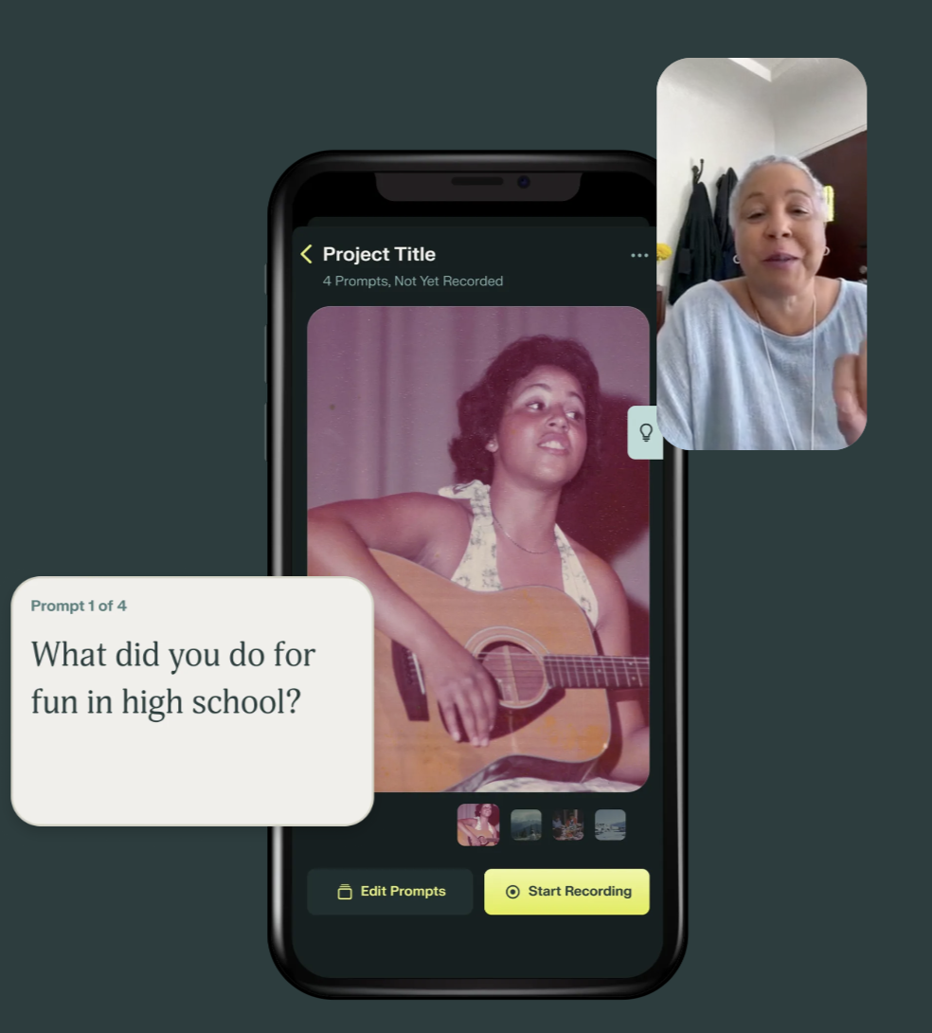
#3
Market Research
A tool to “capture and organize every word and every nuance of family stories”
You are supposed to record a video yourself reading an app-given prompt that will be sent to your family member to respond with a video of your own
Multimedia element through the inclusion of photos with accompanying video storytelling
The app self-organizes your stories with changeable templates and allows you to look through them after the fact
The app edits videos for a “bespoke viewing experience”
Focus on privacy - the website states that all content is stored on the device
Limitations
You can only submit video storytelling
Can upload photos, not much else e.g. no recipes, no songs
Somewhat bare bones
Pressure of submissions being all video
Implications
More personal and less transactional than Storied, with a focus on everything being yours
There is a gap in depth of storytelling and the exchange of stories – it seems a lot more focused on the old, with little focus on the young also communicating outside of a new “postcard feature”
Space for multimedia stories rather than only photos and videos
What it means for us?
We provide more modes of communication – video, text, photos, music, audio. Remento is mostly focused on photos with accompanying videos. Additionally, the idea of local data is interesting and perhaps something we incorporate into our app? To be hyper-focused on privacy feels like good practice.
Notes:
Remento:
https://www.remento.co/#value-prop
https://apps.apple.com/us/app/remento-record-family-stories/id1628933996

Slide 19
#3
Comparison
 | kin | Remento
Value proposition | “Bite-sized conversation to detail your entire family story” | “Capture your family’s most treasured memories”
Users and story flow | Everyone in the family is a storyteller and a listener | Younger people prompting older loved ones. In fact, younger people are almost exclusively the audience, not storytellers
Conversational? | Yes, with multiple people adding to one prompt | Conversation is more one-sided – you ask an old person a question, and they respond
Accessibility | Hope to also have a very simple interface | Very simple interface, usable by older people
Differentiating features | Multi-modality – Remento does not have this | Privacy: All data stored locally New feature: photo story postcards that allow people to send physical “gifts” with accompanying video through a QR code
Notes:
Remento:
https://www.remento.co/#value-prop
https://apps.apple.com/us/app/remento-record-family-stories/id1628933996

Slide 20

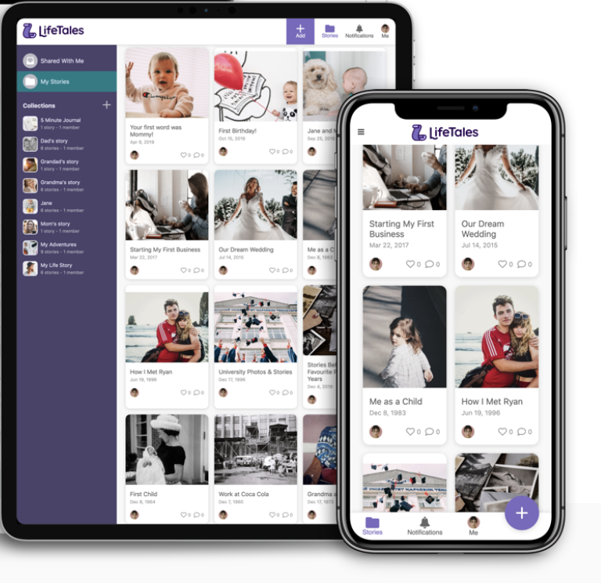
#4
Market Research
“A private social network for your stories worth remembering”
You can upload photos, videos, and text to develop a digital memoir on the app
Conversational aspect - ask questions and request stories of specific people with video
Stories sorted in “Chapters” that can be used to tag
A focus on privacy and limiting visibility of the whole database and smaller silos within it
Limitations
Geared towards older audiences with a goal of preserving
Committed to the “memoir” idea and less focused on the conversation. The conversation exists as a way to add to the memoir rather than as a way to nurture existing relationships, stay in touch, or feel currently connected
Implications
The conversational aspects are similar to our app
Data is sorted in a booklike format, without much room to adjust that. We want to offer more customization and present it more as a dynamic conversational hub that slowly builds to a full chronicle, rather than just as memoir, which implicitly feels very past-focused.
We need to differentiate by emphasizing the fun and stress-free nature of our bite-sized story concept and how our app is meant to be more of a real-time conversation than a chronicle
What it means for us?
We must lean in to the benefits of our app as something to be used in the present, and for all age groups. For the former, we can emphasize the app’s value in helping maintain and strengthen existing relationships that otherwise have been struggling due to time or distance. For the ladder, we need the app to be inviting and enjoyable to use. Of course, we also have the goal of preserving the stories, but we want to be more than that: a way to make what time we have left count, to its fullest.
Notes:
LifeTale:
https://www.lifetales.com/

Slide 21
#4
- Comparison
 | kin | LifeTales
Value proposition | “Bite-sized conversation to detail your entire family story” | “A private social network for your stories worth remembering”
Users and story flow | Everyone in the family is a storyteller and a listener | Focused more on older users preserving their own memories or adults preserving memories of their old or lost loved ones
Conversational? | Quite conversational, with multiple people adding to one prompt. The conversation is the primary allure of the app, as a way to stay in touch with loved ones through stories | It has many great conversational features. However, the conversation is a means to an end, with the end being a memoir
Accessibility | Hope to also have a very simple interface | Relatively complicated interface that essentially models a book with multiple chapters and sub-categories
Differentiating features | Bite-sized emphasis on casual conversation and storytelling, as opposed to the entire focus being on the monumental task of creating a memoir | A focus on being “a private social network”, though data is on AWS according to the “privacy and safety” section
Notes:
Remento:
https://www.remento.co/#value-prop
https://apps.apple.com/us/app/remento-record-family-stories/id1628933996

Slide 22




Suggest story prompts
Incentivize daily use
Promote familial storytelling
Emphasis on privacy
Accessible interface
kin

Slide 23
04
Values in Design

Slide 24
Stakeholders
Direct Stakeholders
Indirect Stakeholders
Families who use the app
Subjects of stories
The core user group
Storytellers
They become a part of someone’s family story even if they aren’t in the family
More specific user group of those sharing stories on the platform
The environment and human reinforcement learning testers
Audience
More specific user group of those viewing and interacting with stories on the platform
LLMs used in the app are expensive and both environmentally and mentally punishing in their training processes
Consumer privacy regulators
Competitors’ users
An app with such extensive user data would be a focus for consumer protection agencies
There are high switching costs of apps built on user data; Additionally, more competition could lead to more paid features on competing apps, negatively impacting their users

Slide 25
Our Core Values
Inclusive
Engaging
Intuitive
Community
Pleasant and enjoyable to use for all age groups, feels fun to engage with prompts
Making sure that prompts and active engagement with content help family members feel closer
Making sure all groups and communities, including elderly folks with disabilities, feel that they can use the app
Making sure that generating content in all its various multimedia formats and engaging with existing content is easy to understand

Slide 26
Underlying Frictions
There are different meanings of the word “intuitive,” especially with a diverse array of users, so inclusivity can look different depending on the user
We need to be careful with “Engaging” because too engaging can take away from the sensitivity of family stories – we may have another family story game prototype testing situation.
“Community” and “Inclusivity” could have friction, as people define their own communities and that could inherently be exclusive. We have heard of varying degrees of privacy and publicity needs from different people.
Notes:
A few off the top of my head:
- Different meanings of intuitive, especially with a diverse array of users, so inclusivity can look different depending on the user
- Being careful with “Engaging”, because too much can be too much and make for a bad experience, as seen from the family story game prototype testing
- Community and Inclusiveness could have friction, as people define their own communities and that could inherently be exclusive. We have heard of varying degrees of privacy and publicity needs from different people
A few off the top of my head:

Slide 27
Ethical Implications
Collecting and storing personal stories and family history data can be sensitive.
We need to ensure robust data security measures to protect users’ information from unauthorized access or data breaches.
THE BACKSTABBER: What could cause people to lose trust in your product? “App leaks precious family and user data!”
When AI generates prompts or content, it can sometimes introduce biases or produce content that is inappropriate or offensive.
We need to ensure that the prompts and AI-generated content are culturally sensitive and inclusive of diverse backgrounds.
THE BIG BAD WOLF: What could a bad actor do with your product? “Create prompts that are culturally insensitive, unkind, and offensive!”
Memoirs and family history can be emotionally charged. Users might be sharing deeply personal stories.
We need to provide resources and guidance for dealing with any emotional impact on users.
THE SCANDAL: What’s the worst headline about your product you can imagine? “Sharing of family stories causes more rift and division than love and unity!”

Slide 28
05
Tasks

Slide 29
Tasks
Simple Task
Moderate Task
Complex Task
A user can collaborate and interact with their family members through seeing and responding to people’s reactions and comments on a specific story
Reading and experiencing a loved one’s story
Seeing a prompt and responding to it, optionally through different mediums
Task
The most basic thing you can do is spend a minute on the app to read a story, not requiring you to say any of your own
Instead of a simple video response, you can upload multiple forms of media along with it, resulting in more work for the user; could take a few minutes
A more rich viewing and interactive experience as prompts develop multiple dimensions to explore, and adding a new axis of communication through potentially commenting and reacting; could take tens of minutes
Justification

Slide 30
05
Storyboards

Slide 31
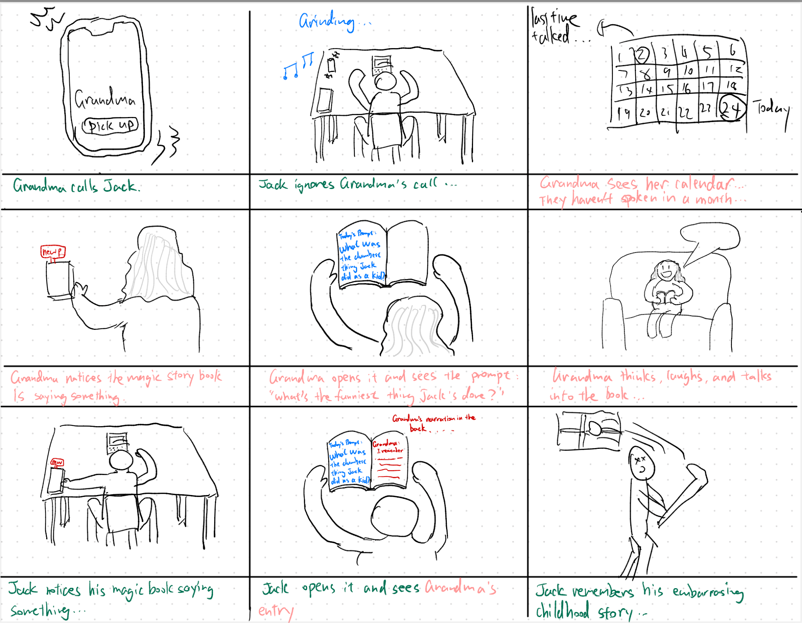
Moderate task
Simple task

Slide 32
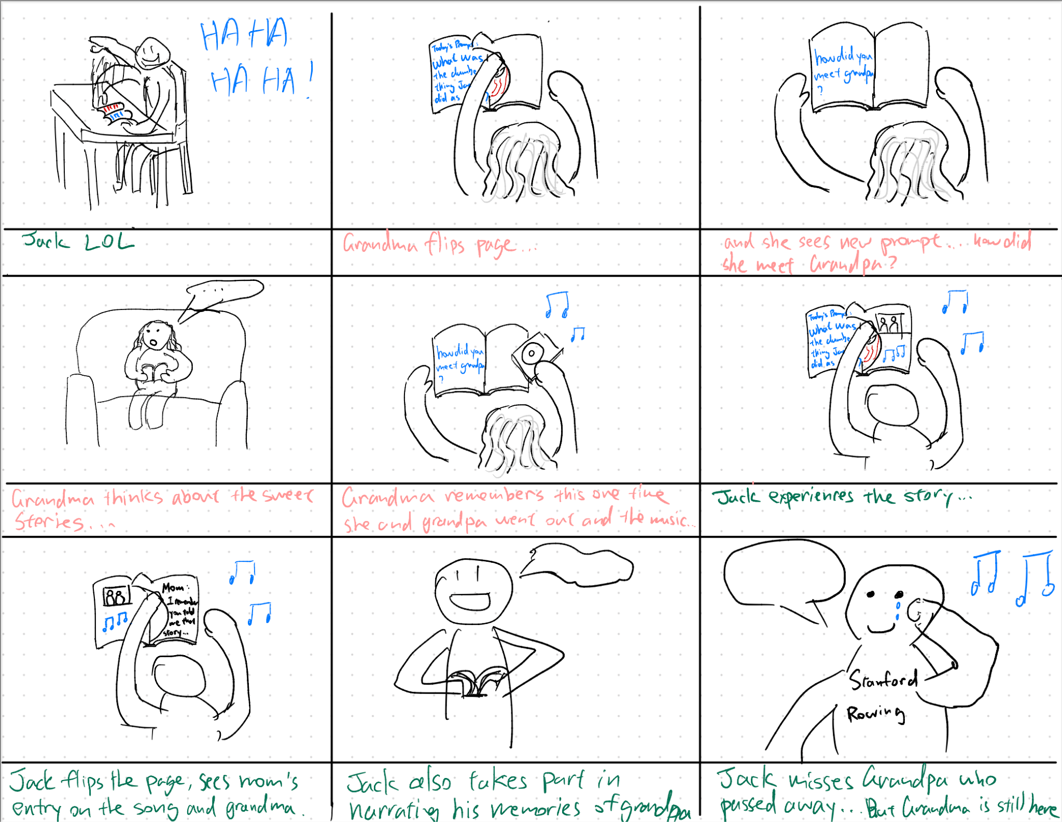
Complex task

Slide 33
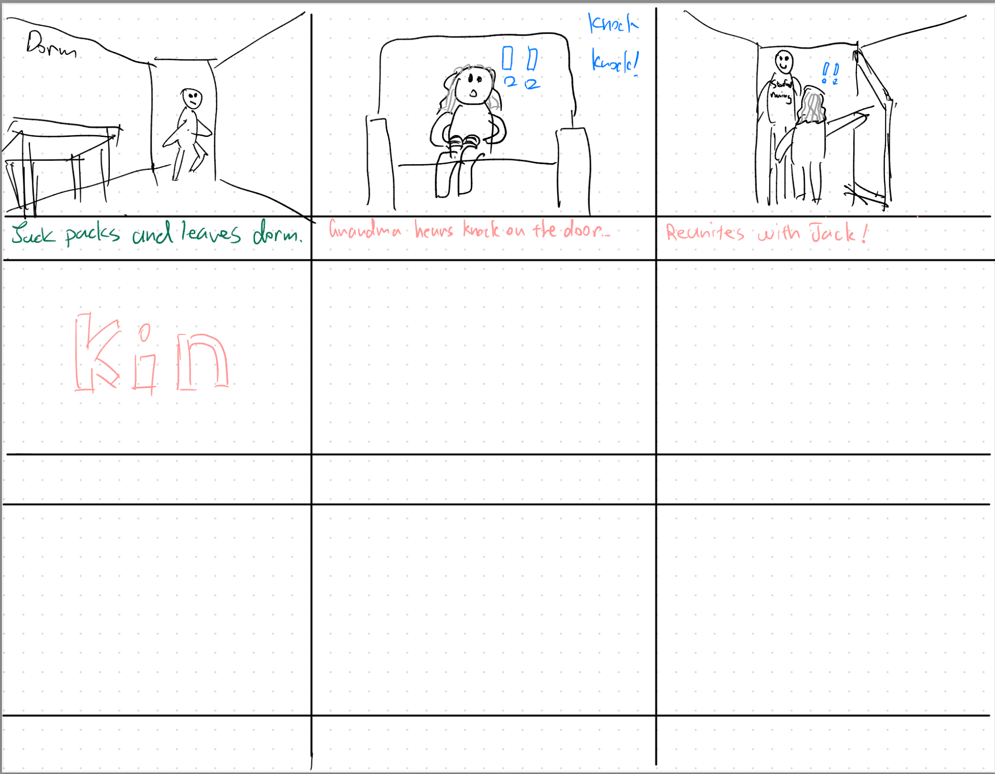

Slide 34

Our Video
Notes:
https://www.youtube.com/watch?v=qPOrWa_cGUA
Or if issues with youtube, see vimeo: https://vimeo.com/876220624?share=copy

Slide 35
06
Appendix

Slide 36
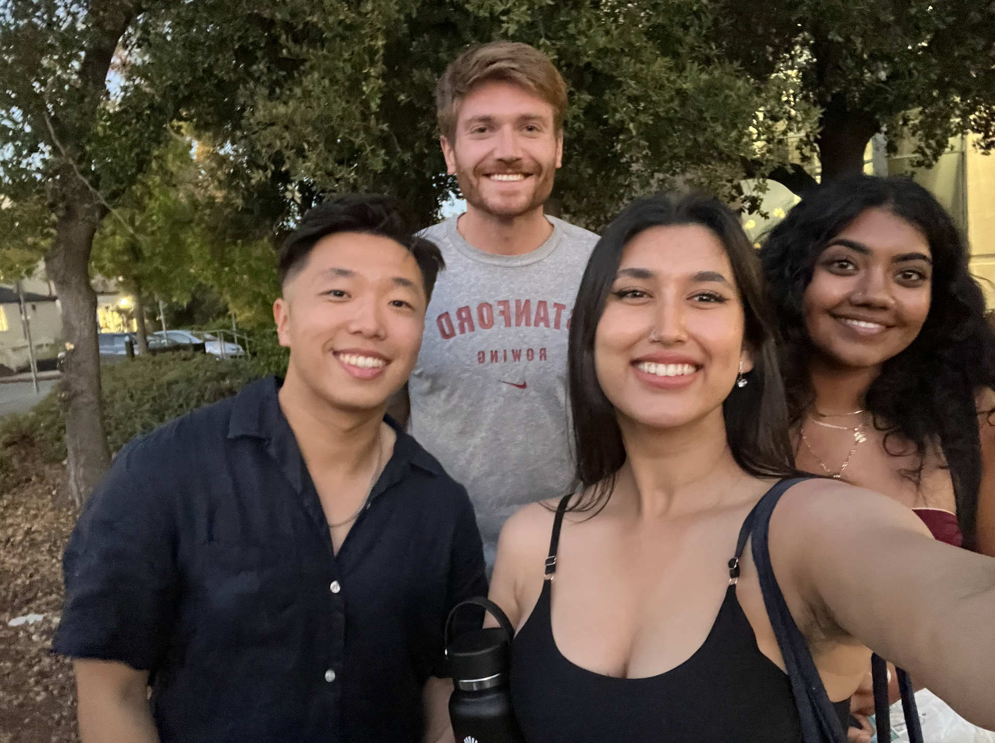

Slide 37
Story, written out - part 1
Jack, from his dorm room, is busily working, his grandma calls, and he ignores it, looking annoyed
Grandma, from her assisted living apartment, is paging through a calendar and sees that she hasn’t spent time with her family in months
Grandma sees the “FAMILY STORY” book (represents our app) as it lights up signifying a new prompt
Grandma opens the book, sees a prompt, thinks about it, and happily speaks aloud her response to the prompt MODERATE TASK: Seeing a prompt and responding to it
Jack notices a notification on his book that there is a new story, and he excitedly drops his work to check it out – signifies the value he puts in the book
Jack opens the book and sees grandma’s memory, and a video representing the memory comes on screen - SIMPLE TASK: Reading and experiencing a story
Jack beings laughing
Grandma begins flipping through pages, seeing more prompts, to which she responds with a song

Slide 38
Story, written out - part 2
Jack flips through the pages of the book, experiences the memories through seeing the photo and hearing the music aloud, and also overhears a comment from his mother, to which he replies by writing into the book (what he is writing is conveyed through a voiceover)
COMPLEX TASK: collaborate and interact with family members through seeing and responding to people’s reactions and comments on a specific story
After all the reminiscing, Jack misses his grandparents
Jack realizes he needs to go see his grandmother to reconnect
Jack runs out of the room
Grandma hears a knock on the door
Grandma and Jack reunite, making grandma less lonely and showing Jack the importance of staying in touch with family

