Slide 1
A2: kin
Team 3 – Jack Clark, Shuvi Jha, Jasmine Narine, Steven Pu

Slide 2

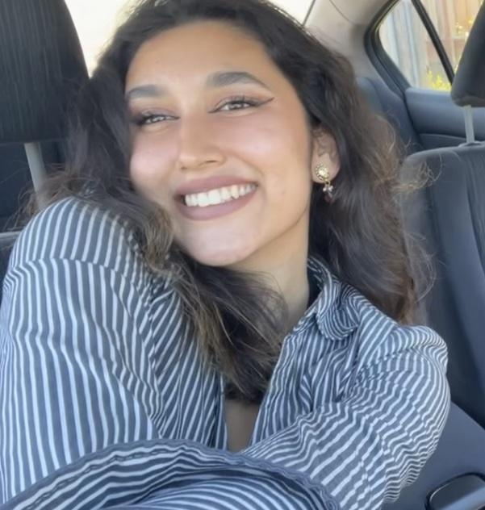
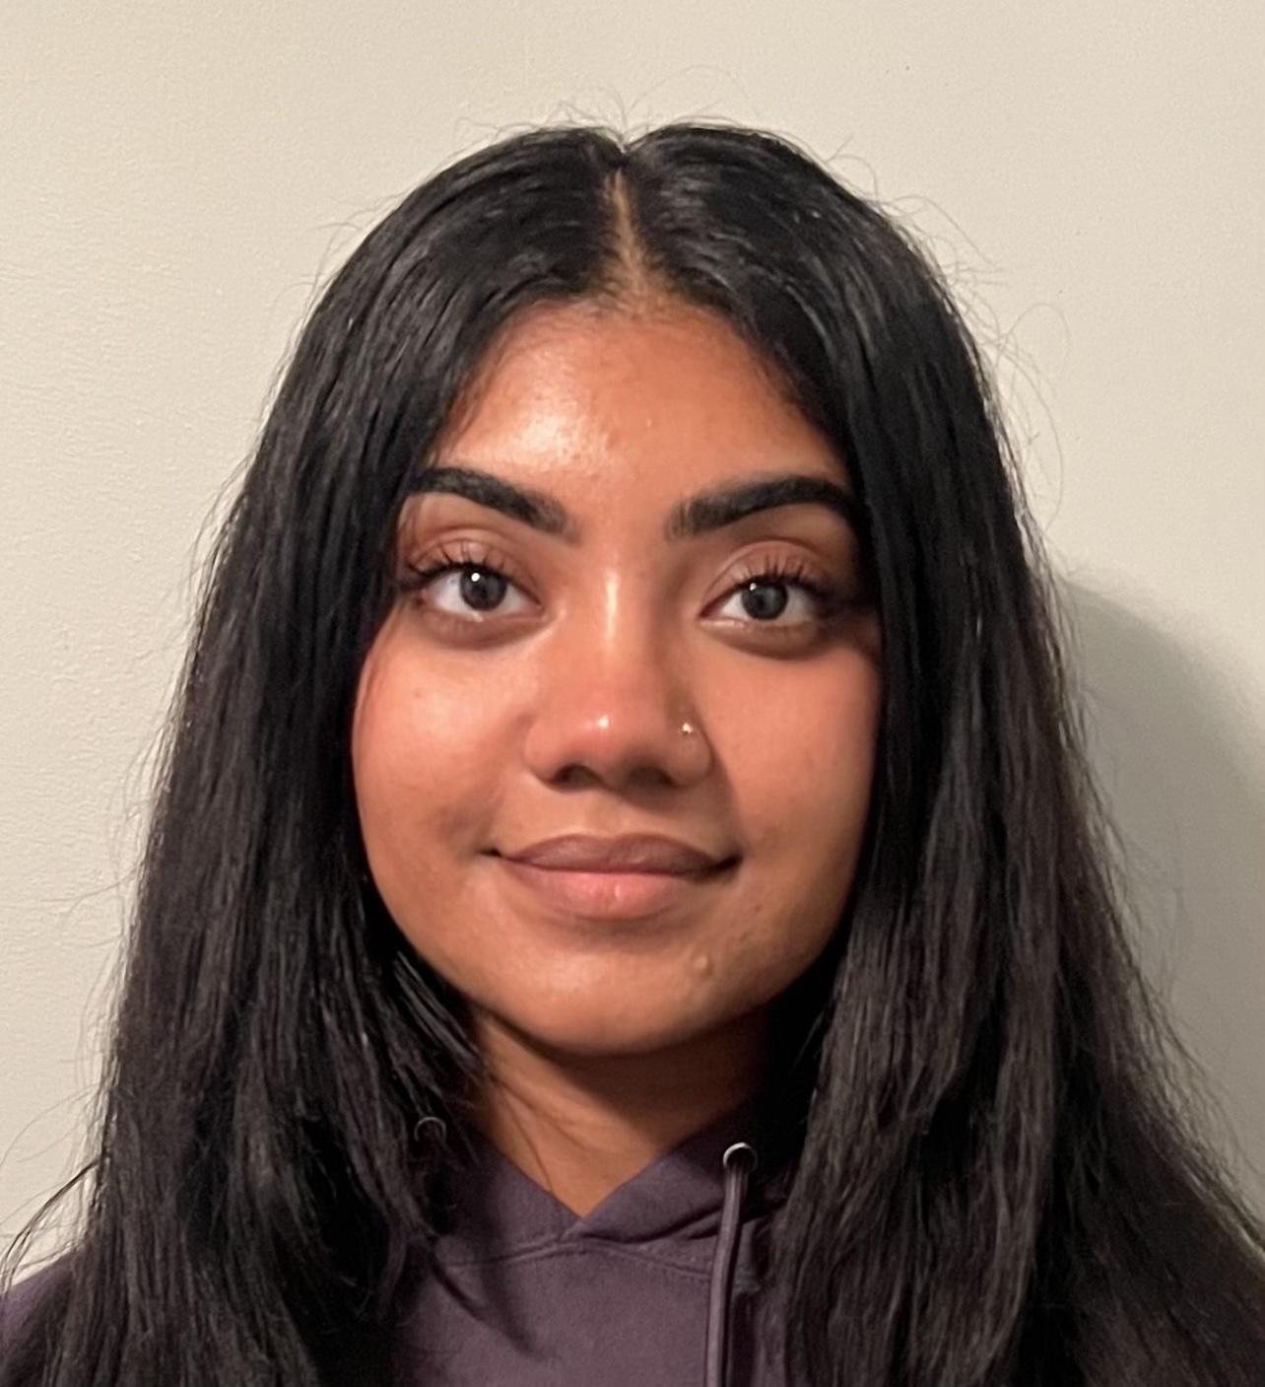
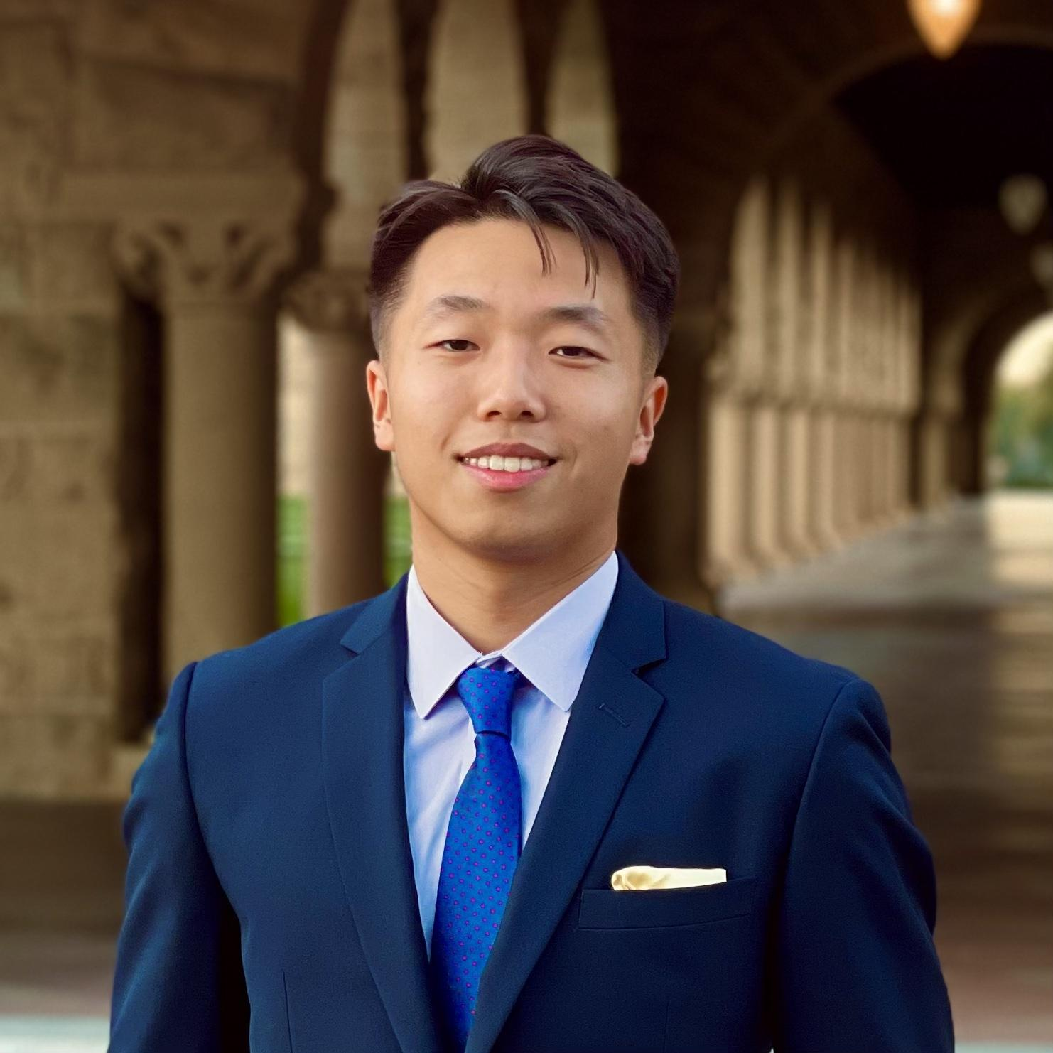
The team
Jack Clark
Shuvi Jha
Jasmine Narine
Steven Pu
MS CS (HCI)
BS MS&E
CS (HCI); Feminist, Gender, & Sexuality Studies
Senior
SYMSYS (HCI)
Senior
SYMSYS (HCI)
Senior

Slide 3
Where we are
THEN
NOW
Interested in relationships with storytelling
Learning unique needs of both the stakeholders: listeners and storytellers

Slide 4
HOW DO WE PROVIDE STORYTELLERS AND THEIR AUDIENCE WITH A MORE POWERFUL AND COMFORTING EXPERIENCE?

Slide 5
Table of contents
01
02
03
Needfinding
POVs & HMWs
Solutions
04
05
Next Steps
Appendix

Slide 6
01
Needfinding

Slide 7
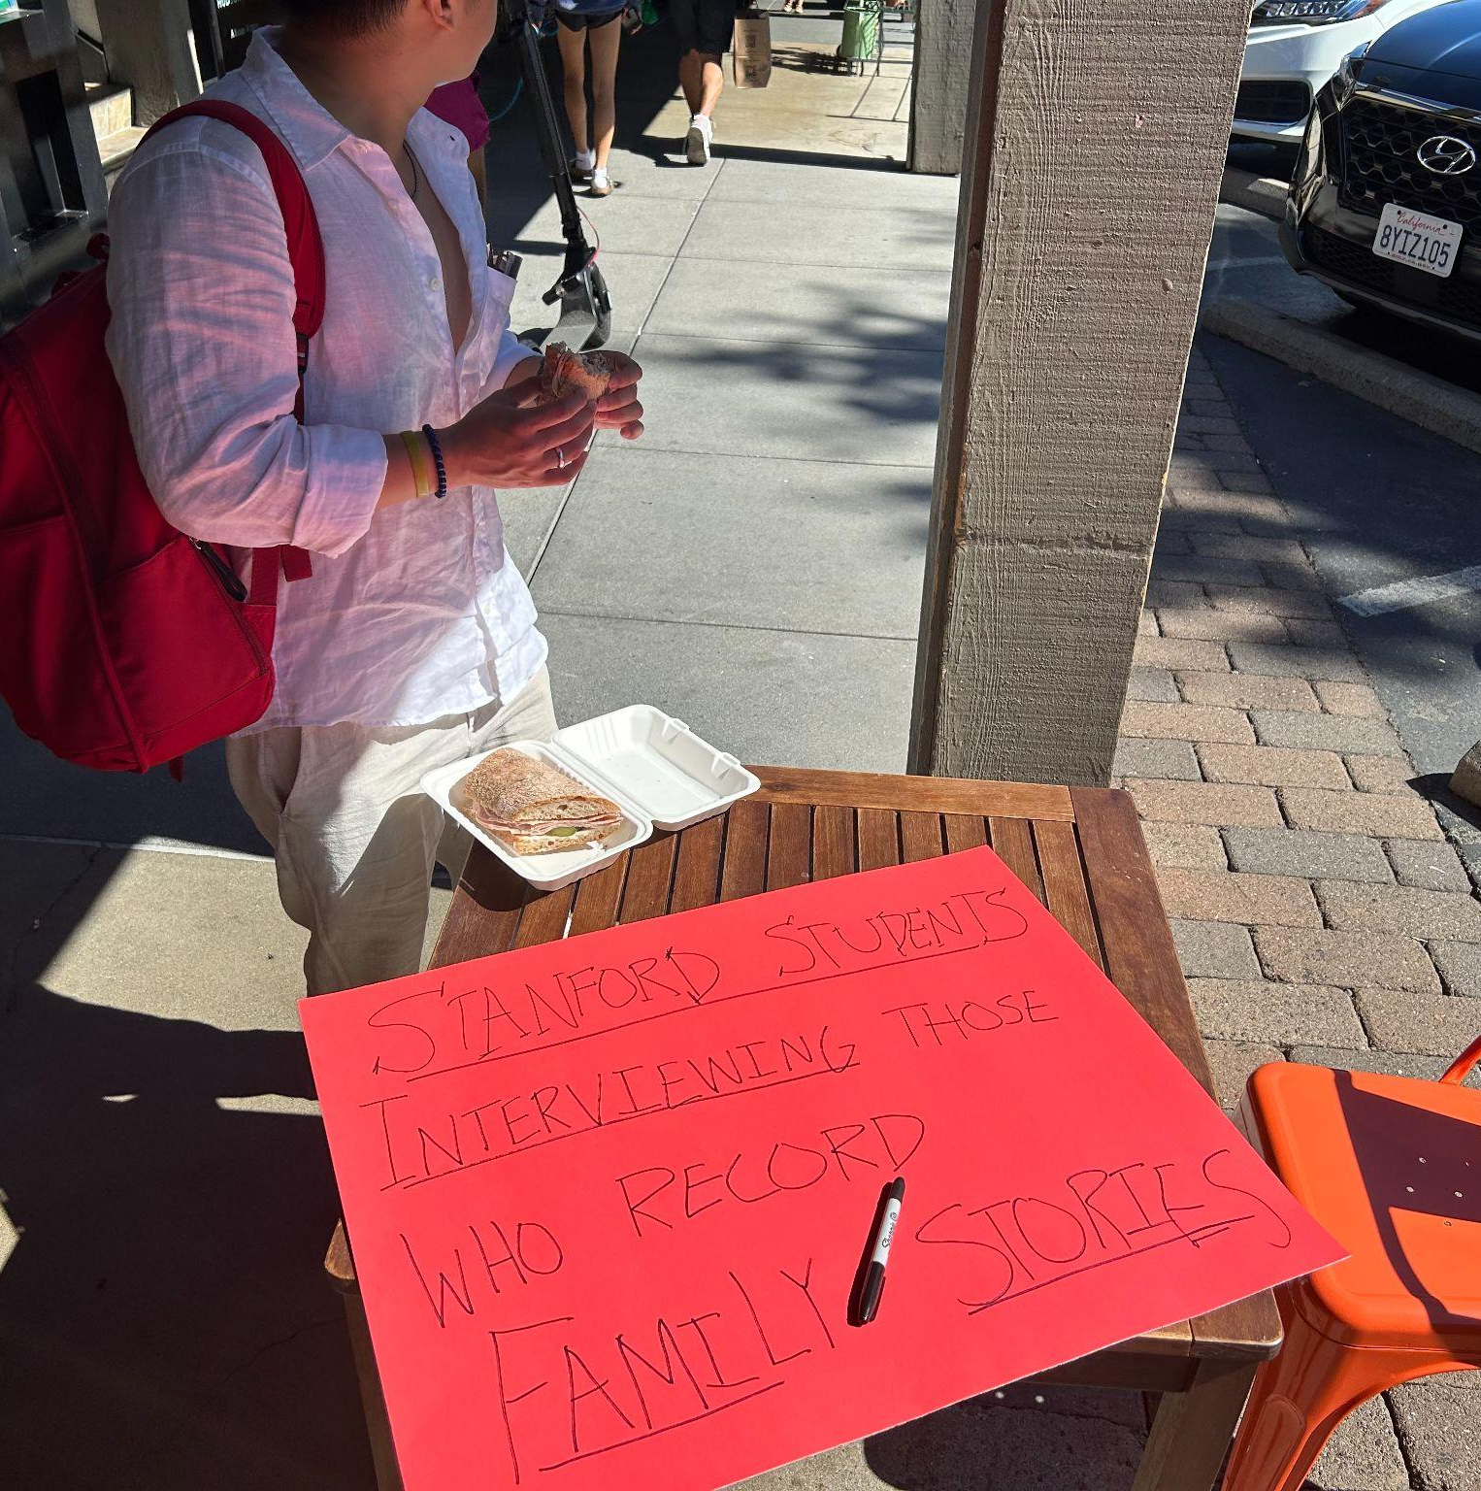
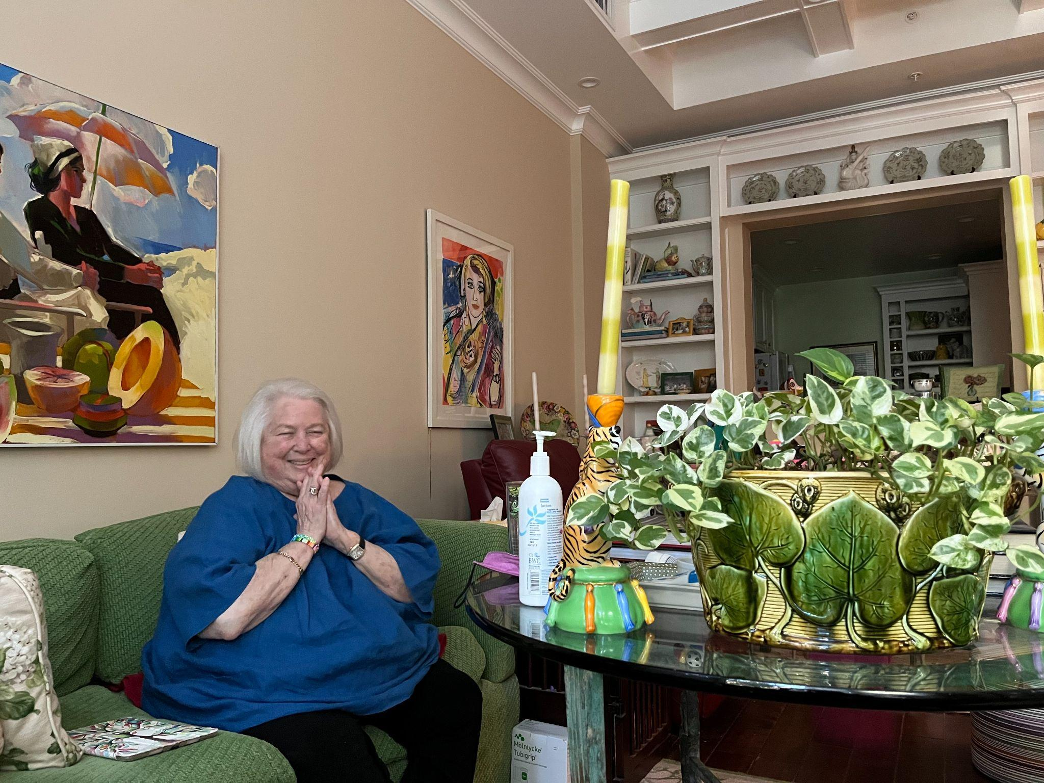
Additional needfinding
Krishna, Sunanda, and Ram
Manresa Bread in Town and Country
A son, Krishna, (28M) in the Bay on business whose parents, Sunanda and Ram, came up from SoCal for the weekend.
Parents are first-gen Indian immigrants.
Michele
Vi at Palo Alto, a retirement community
A retiree without children, 77
World traveler

Slide 8
Insights: Krishna, Sunanda, and Ram
Untold family stories can be difficult to uncover but loved ones joy
Different people value different forms of storytelling more highly than others
“Time is a lot more in your face today more than ever”, stresses the guilt some younger family members may feel

Slide 9
Insights: Michele
Storytellers have varying needs of autonomy, privacy, and mediums of communication
Currently hosts a podcast detailing her “lovecapes” - but wants to explore other mediums
Believes her life could be a “television series”

Slide 10
02
POVs & HMWs

Slide 11
Original POV: Catherine
We met
We were surprised to notice
To uncover untold family stories more easily and without pressure
Catherine valued conversation with her grandmother but complained about her “rambling”
We wonder if this means
It would be game-changing
Catherine wants to communicate effectively with her grandmother but can’t how
To make communication between the older and younger generations easier

Slide 12
POV: Sunanda, Krishna, and Ram
We met
We were surprised to notice
A family. The son, Krishna, is mid-20’s, working in tech in NYC, away from his family in LA.
Krishna brightened and started recording when his mother began sharing a story he had never heard
We wonder if this means
It would be game-changing
Krishna wants to discover more untold stories but does not have many chances/methods to do so
To uncover untold family stories more easily and without pressure
HMW Create an engaging experience for both producing and consuming storytelling that transcends generational boundaries?

Slide 13
POV: Catherine
We met
We were surprised to notice
Catherine, a mid-20’s Cantonese-American non-profit founder in Mountain View
She moved from SoCal to the Bay to be physically closer to her grandmother, but struggles to concentrate to her grandmother’s “rambling” whenever they spoke before she passed
We wonder if this means
It would be game-changing
There is a two-sided problem of young people having difficulty concentrating and older people struggling to share their thoughts concisely
To find a way to bridge the communication gap between the younger and older generations
HMW Create an engaging experience for both producing and consuming storytelling that transcends generational boundaries?

Slide 14
POV: Michele
We met
We were surprised to notice
A 77 year old childless divorcee with a penchant for storytelling, a Stanford degree, and a passion for love
That despite having a podcast during which she details her most intimate experiences with love, she is not concerned with privacy, but rather the ability
We wonder if this means
It would be game-changing
That older generations have a desire to chronicle their lives, but want to do so in a way that honors their autonomy
To ensure that the older generation has full control over how their stories are told, where these stories are distributed, and which audiences have access to them.
HMW Create an engaging experience for both producing and consuming storytelling that transcends generational boundaries?

Slide 15
03
Solutions

Slide 16
HMW Create an engaging experience for both producing and consuming storytelling that transcends generational boundaries?

Slide 17
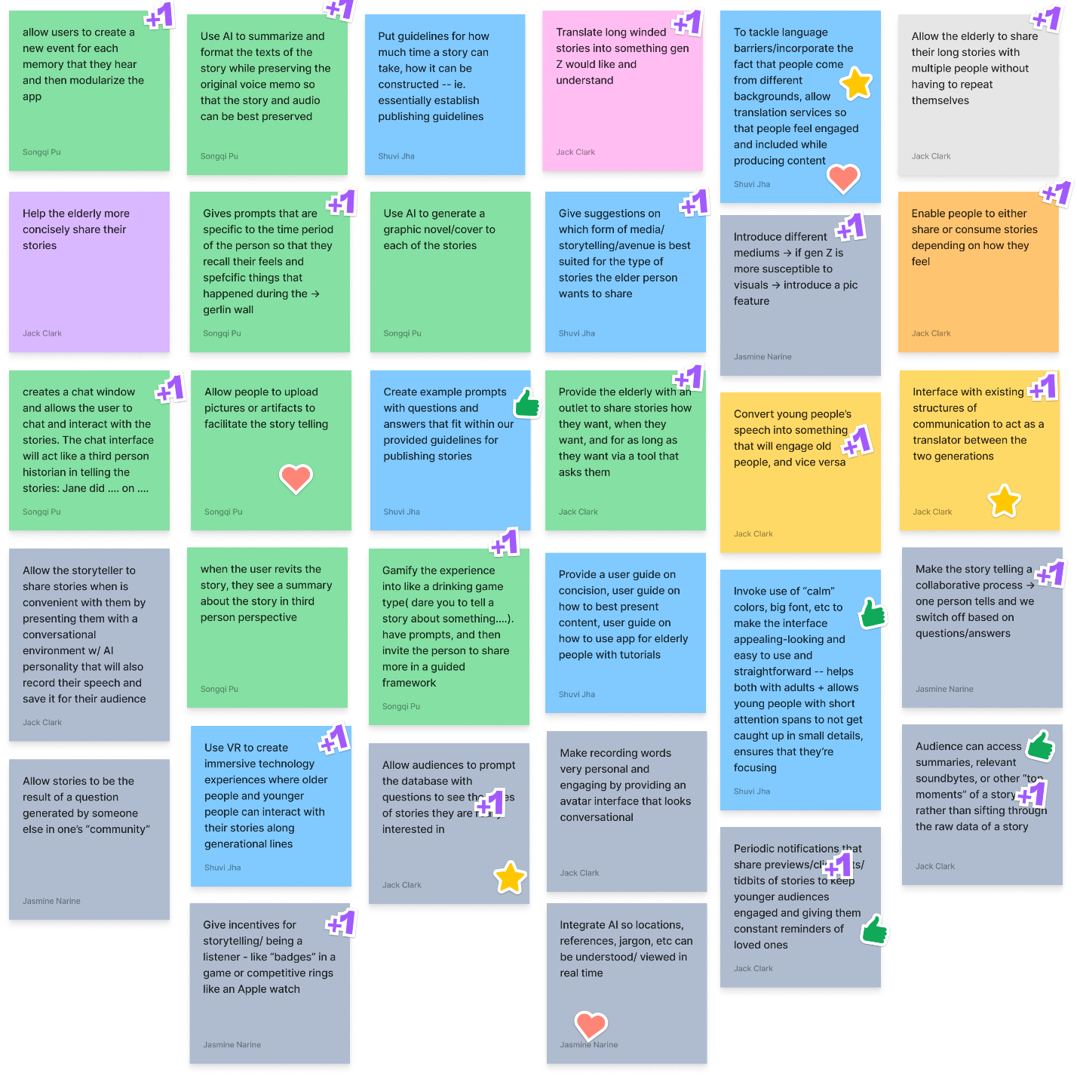
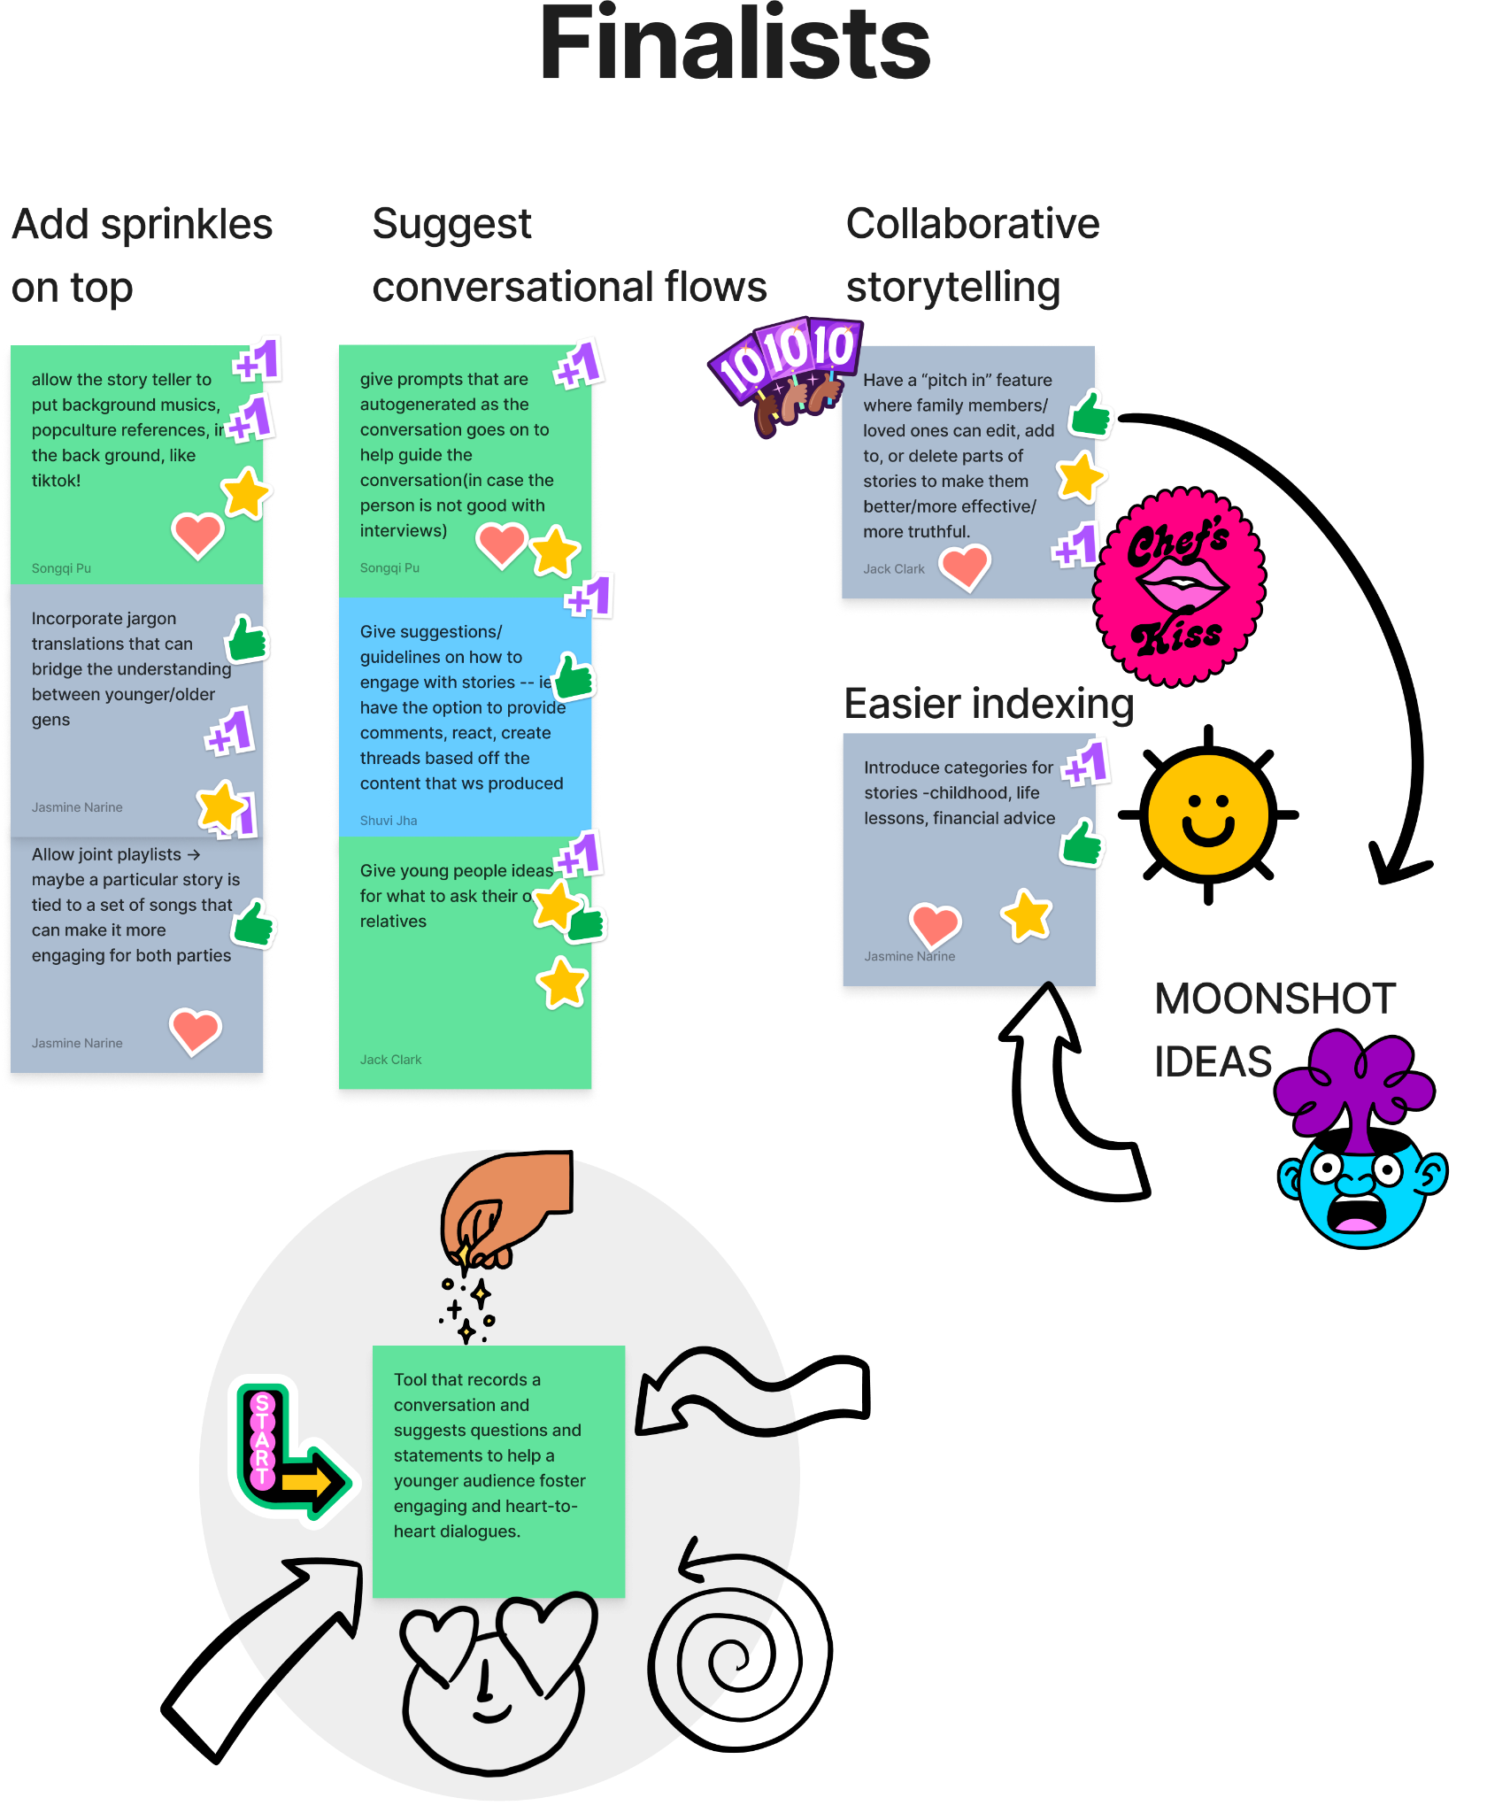
HMW Create an engaging experience for both producing and consuming storytelling that transcends generational boundaries?

Slide 18
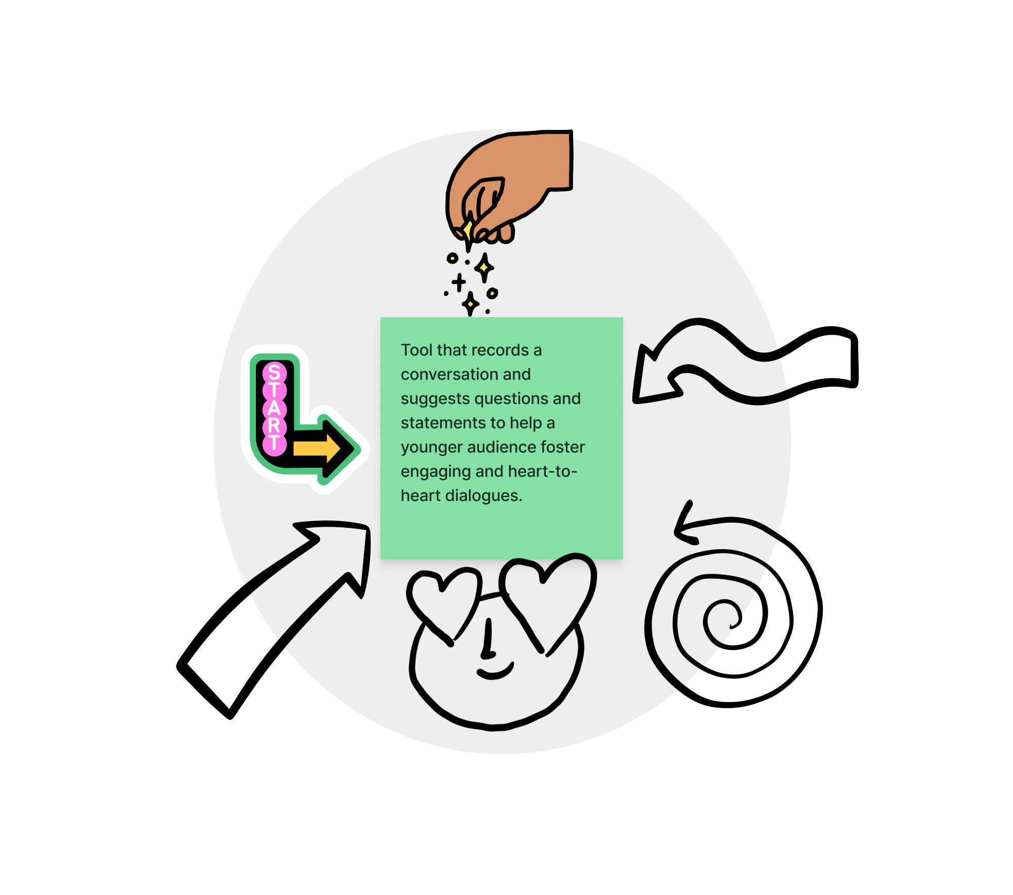
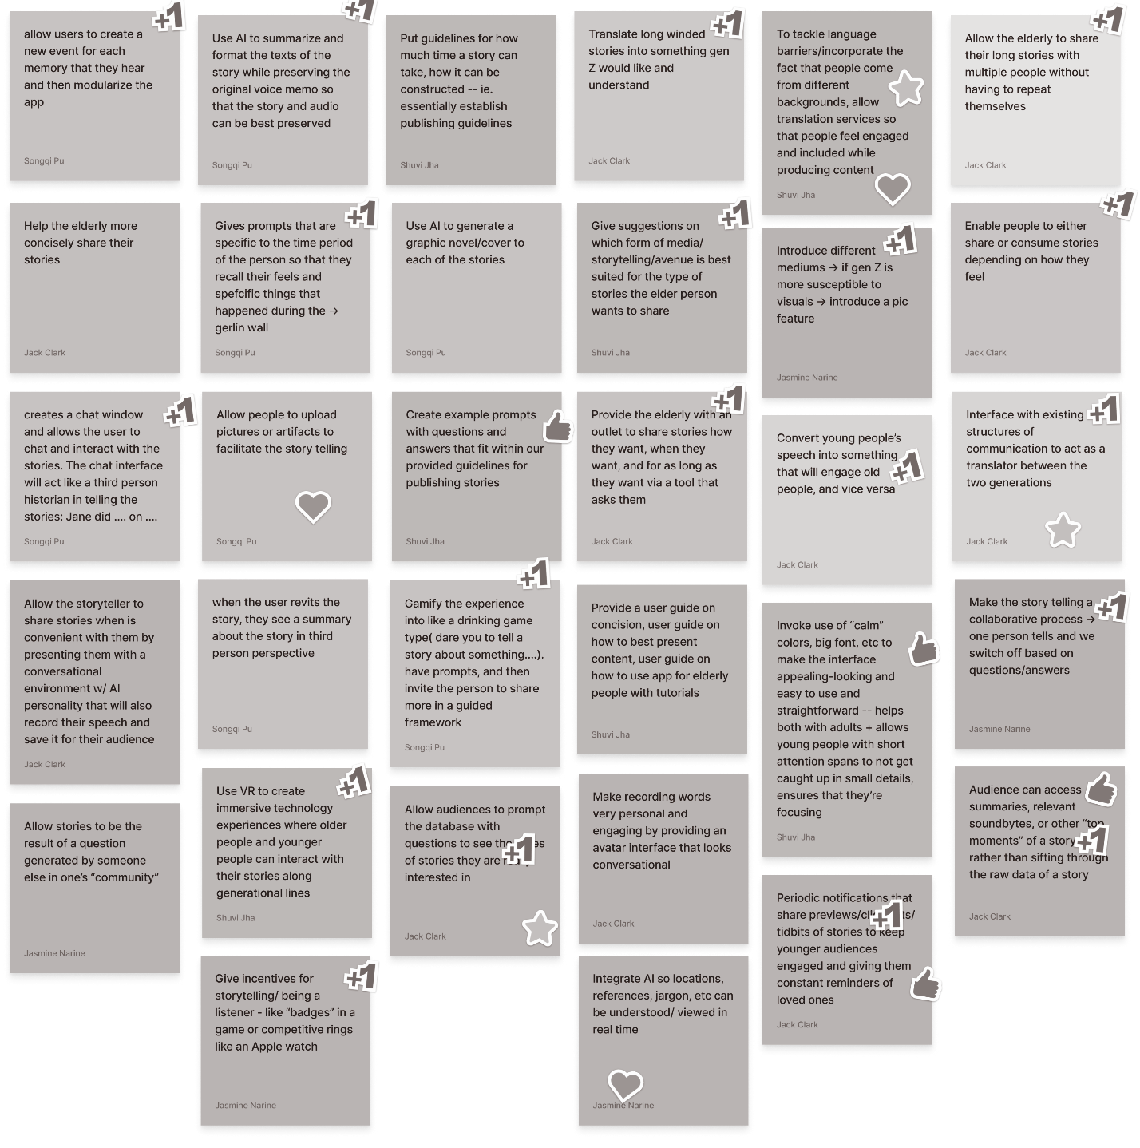
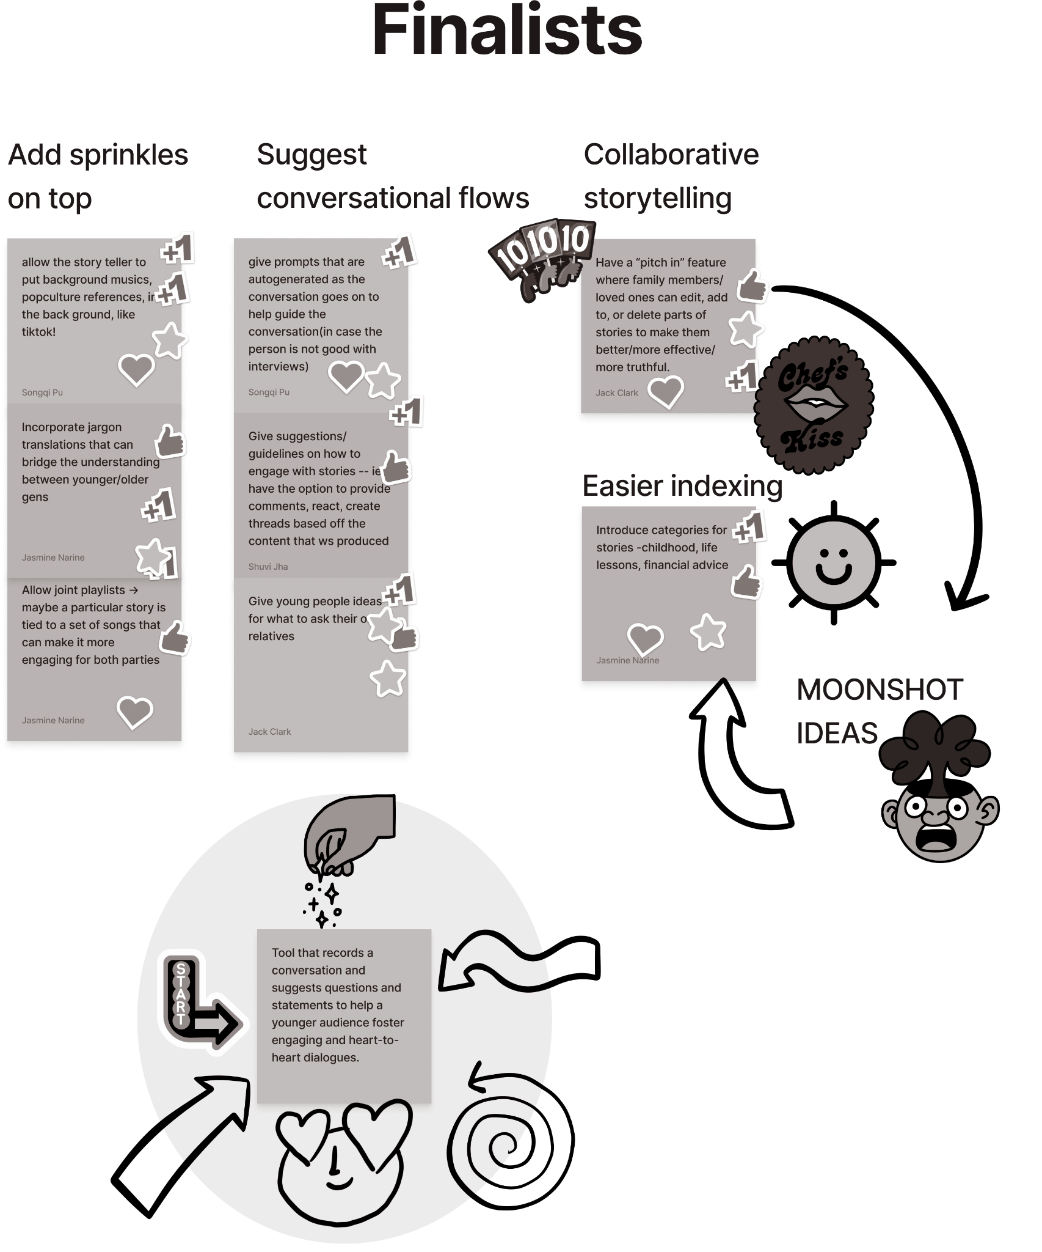
HMW Create an engaging experience for both producing and consuming storytelling that transcends generational boundaries?

Slide 19
RAPID PROTOTYPE:
Conversation Helper

Slide 20
Conversation Helper - Assumption
People want help to make their conversations with loved ones more meaningful for everyone, regardless of age
Notes:
Critical assumption

Slide 21
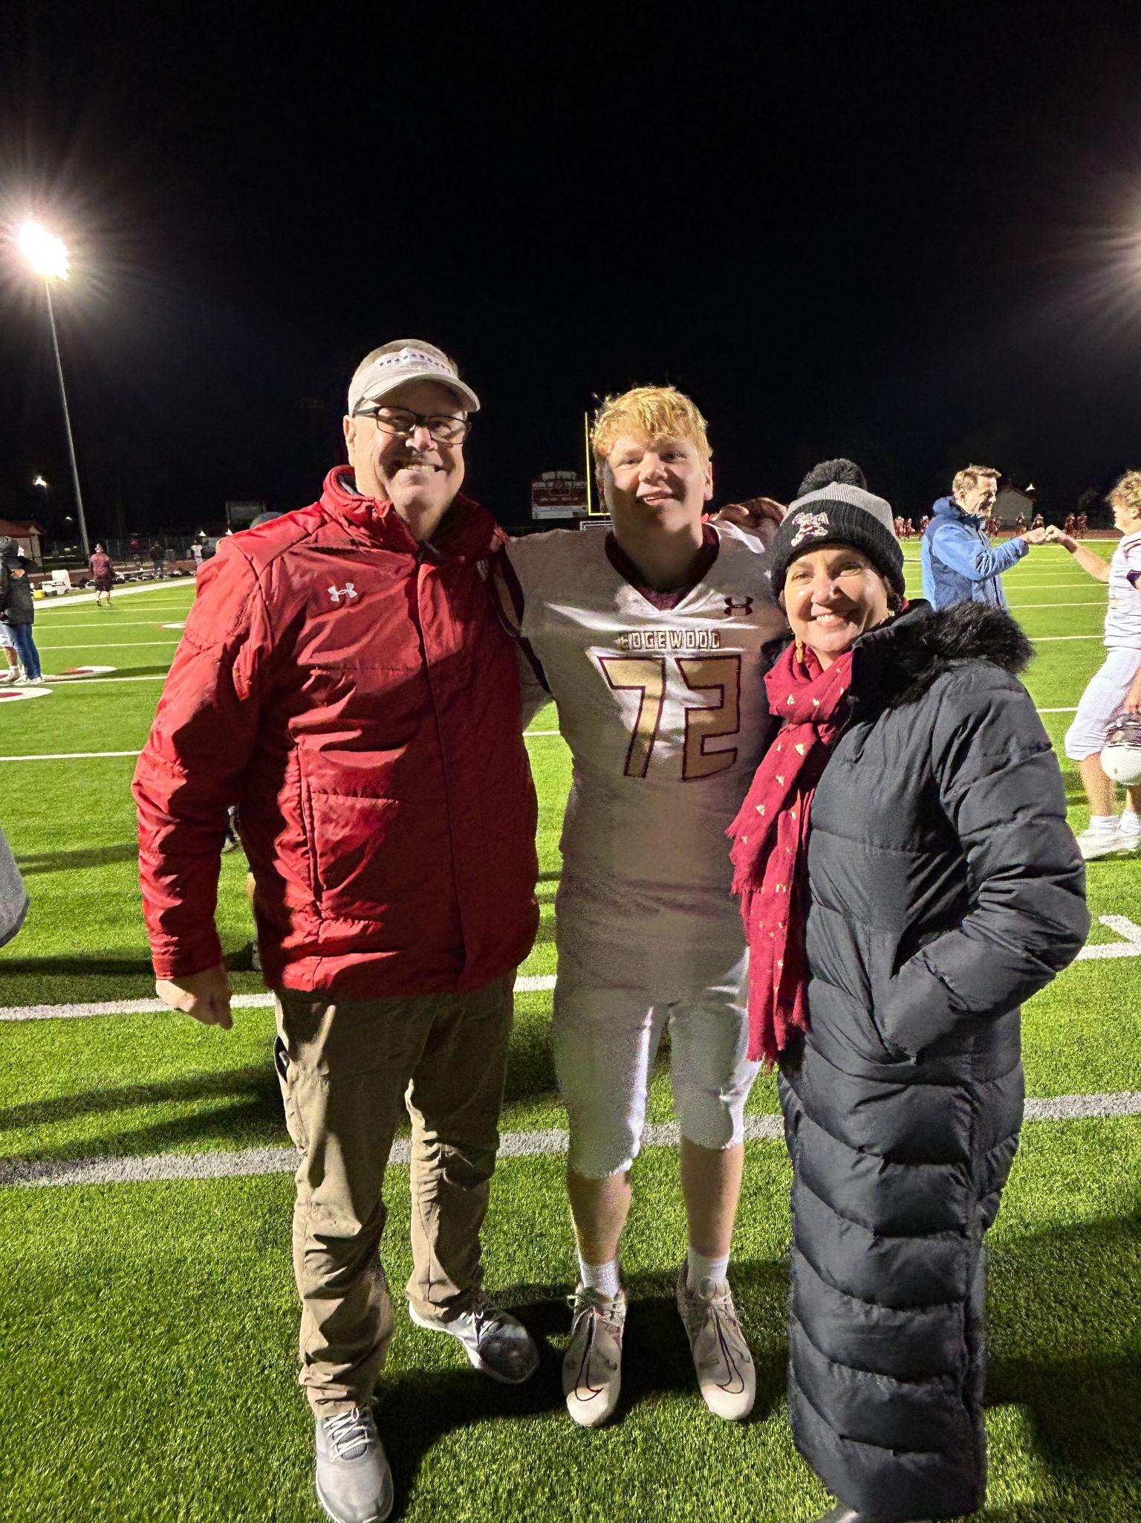
Our intent
Interview people in a family environment
Act as a middleman
Simulate GenAI
The participants are recruited by reaching out to family members
Notes:
Participants: my mom, my dad, and my brother (64, 54, 15)

Slide 22
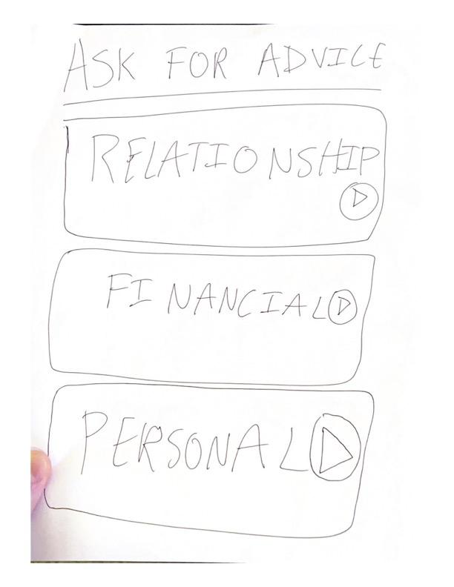
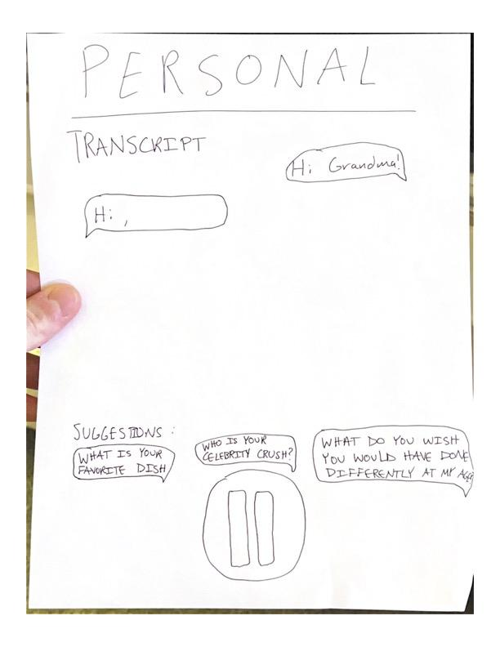
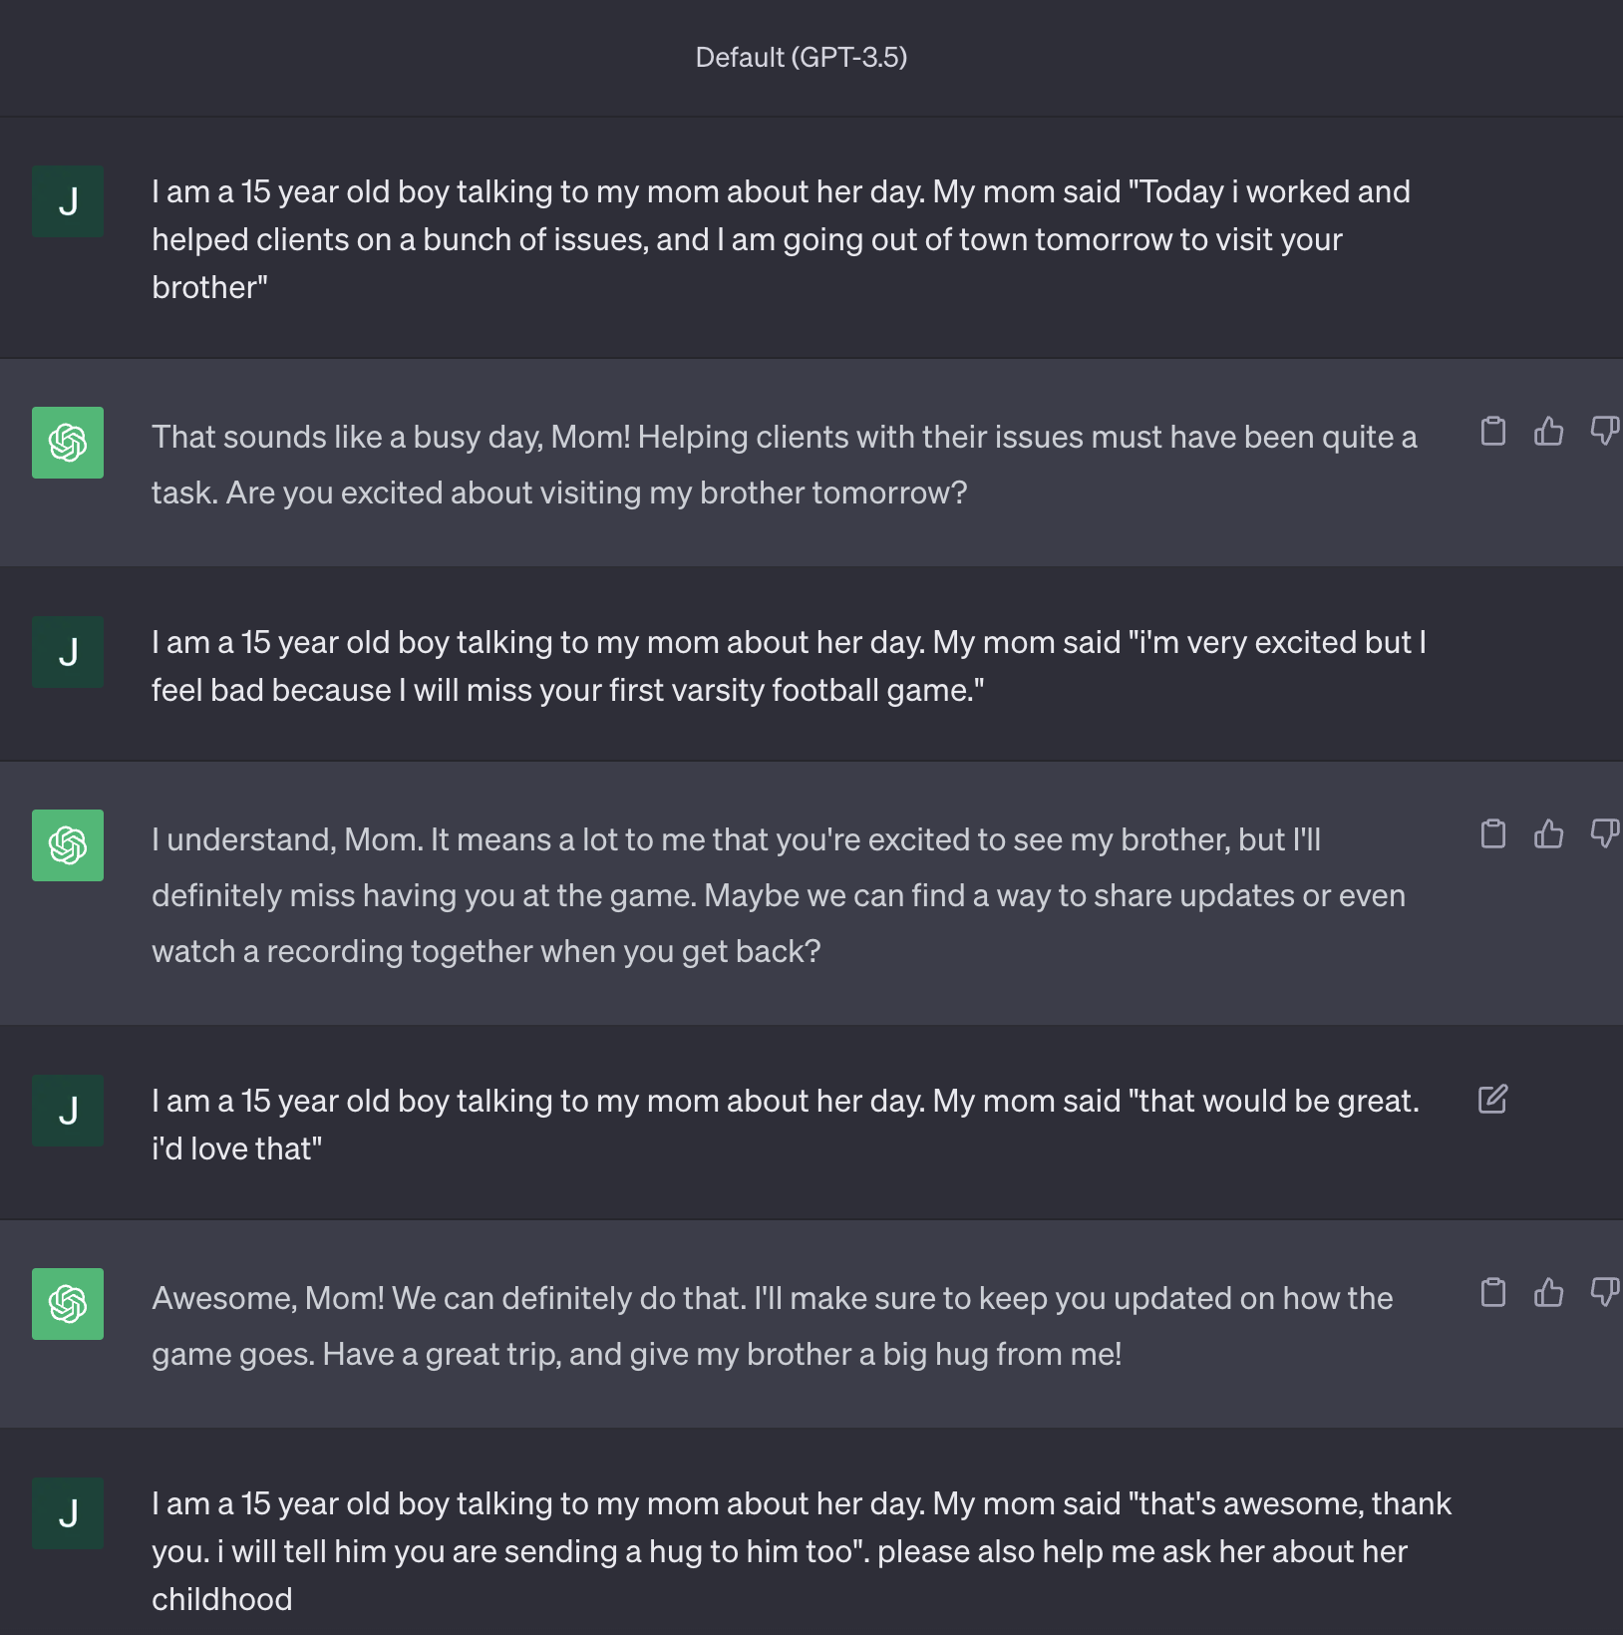
Conversation Helper

Slide 23

Conversation Helper
Assumption: People want help to make their conversations with loved ones more meaningful for everyone, regardless of age

Slide 24
Conversation Helper
Good
Bad
Outcomes
“This is a way to teach kids how to communicate”
“Helps kids use their imagination”
Many of the issues were due to “lofi-ness”, not the concept
Recommending things to both parties is a next step
Zero-time recommendations
One-sided conversation
Robotic-sounding responses
Waiting for responses
Parents more excited than children
Assumption: People want help to make their conversations with loved ones more meaningful for everyone, regardless of age
Notes:
Results

Slide 25
HMW unobtrusively capture and cherish memories during valuable face-to-face conversations within families?

Slide 26
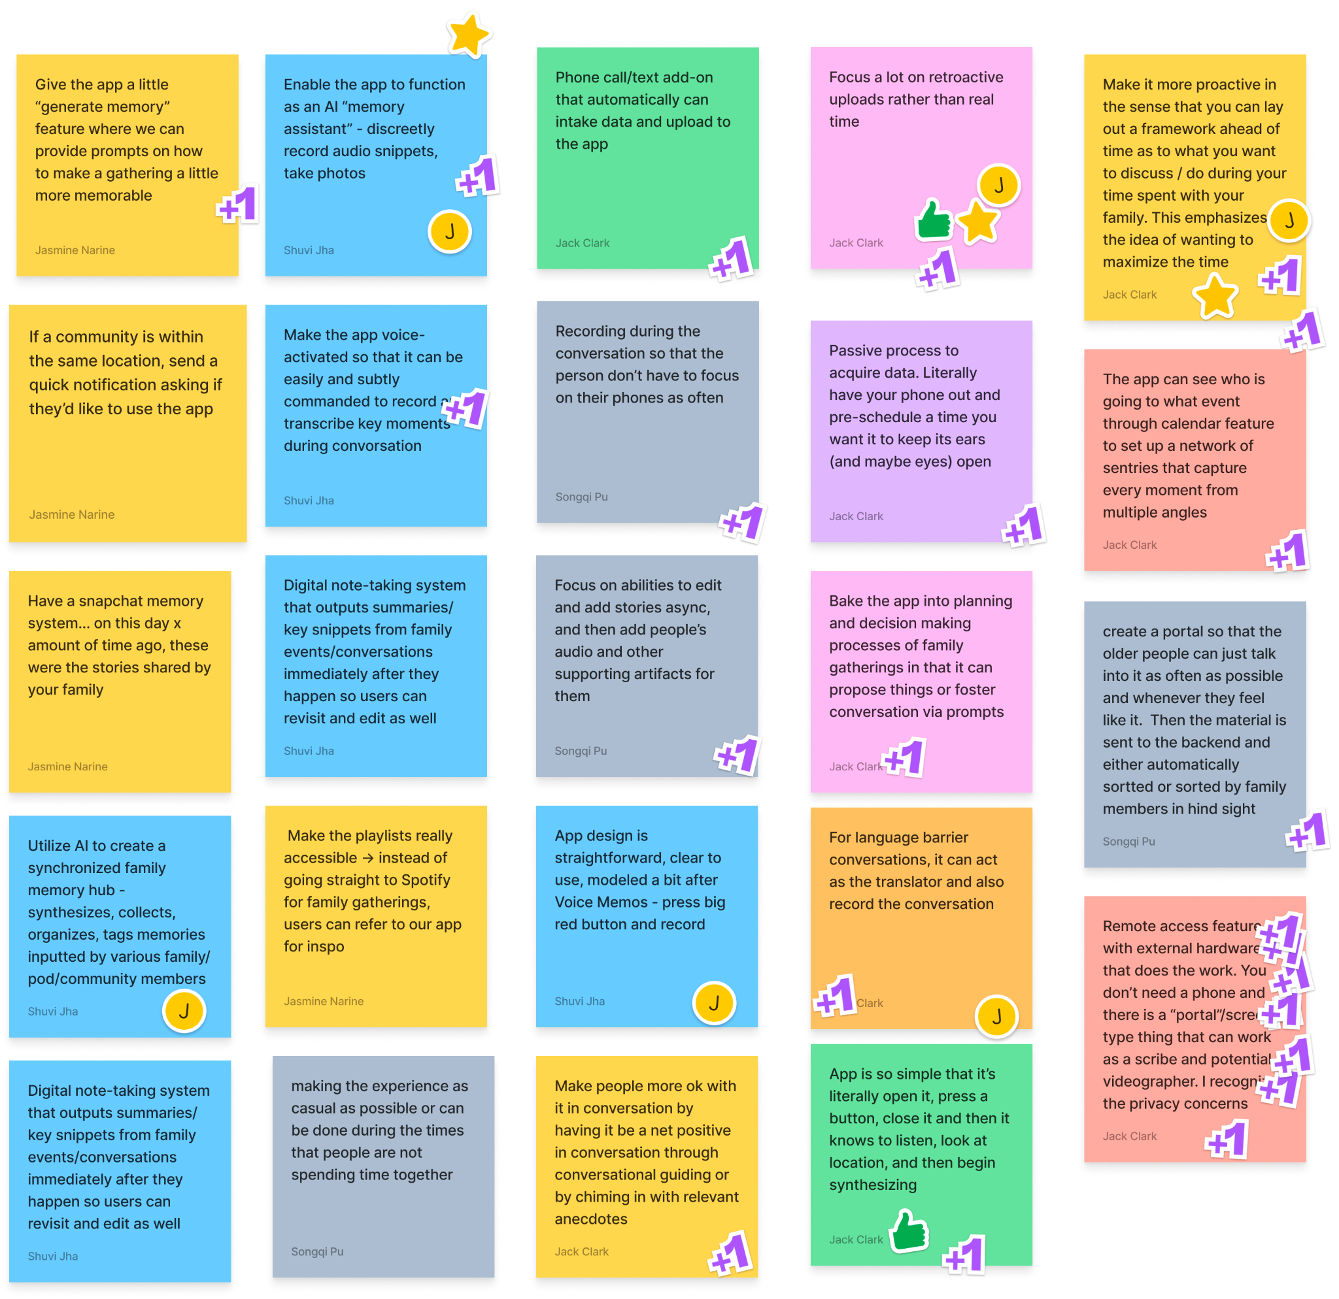
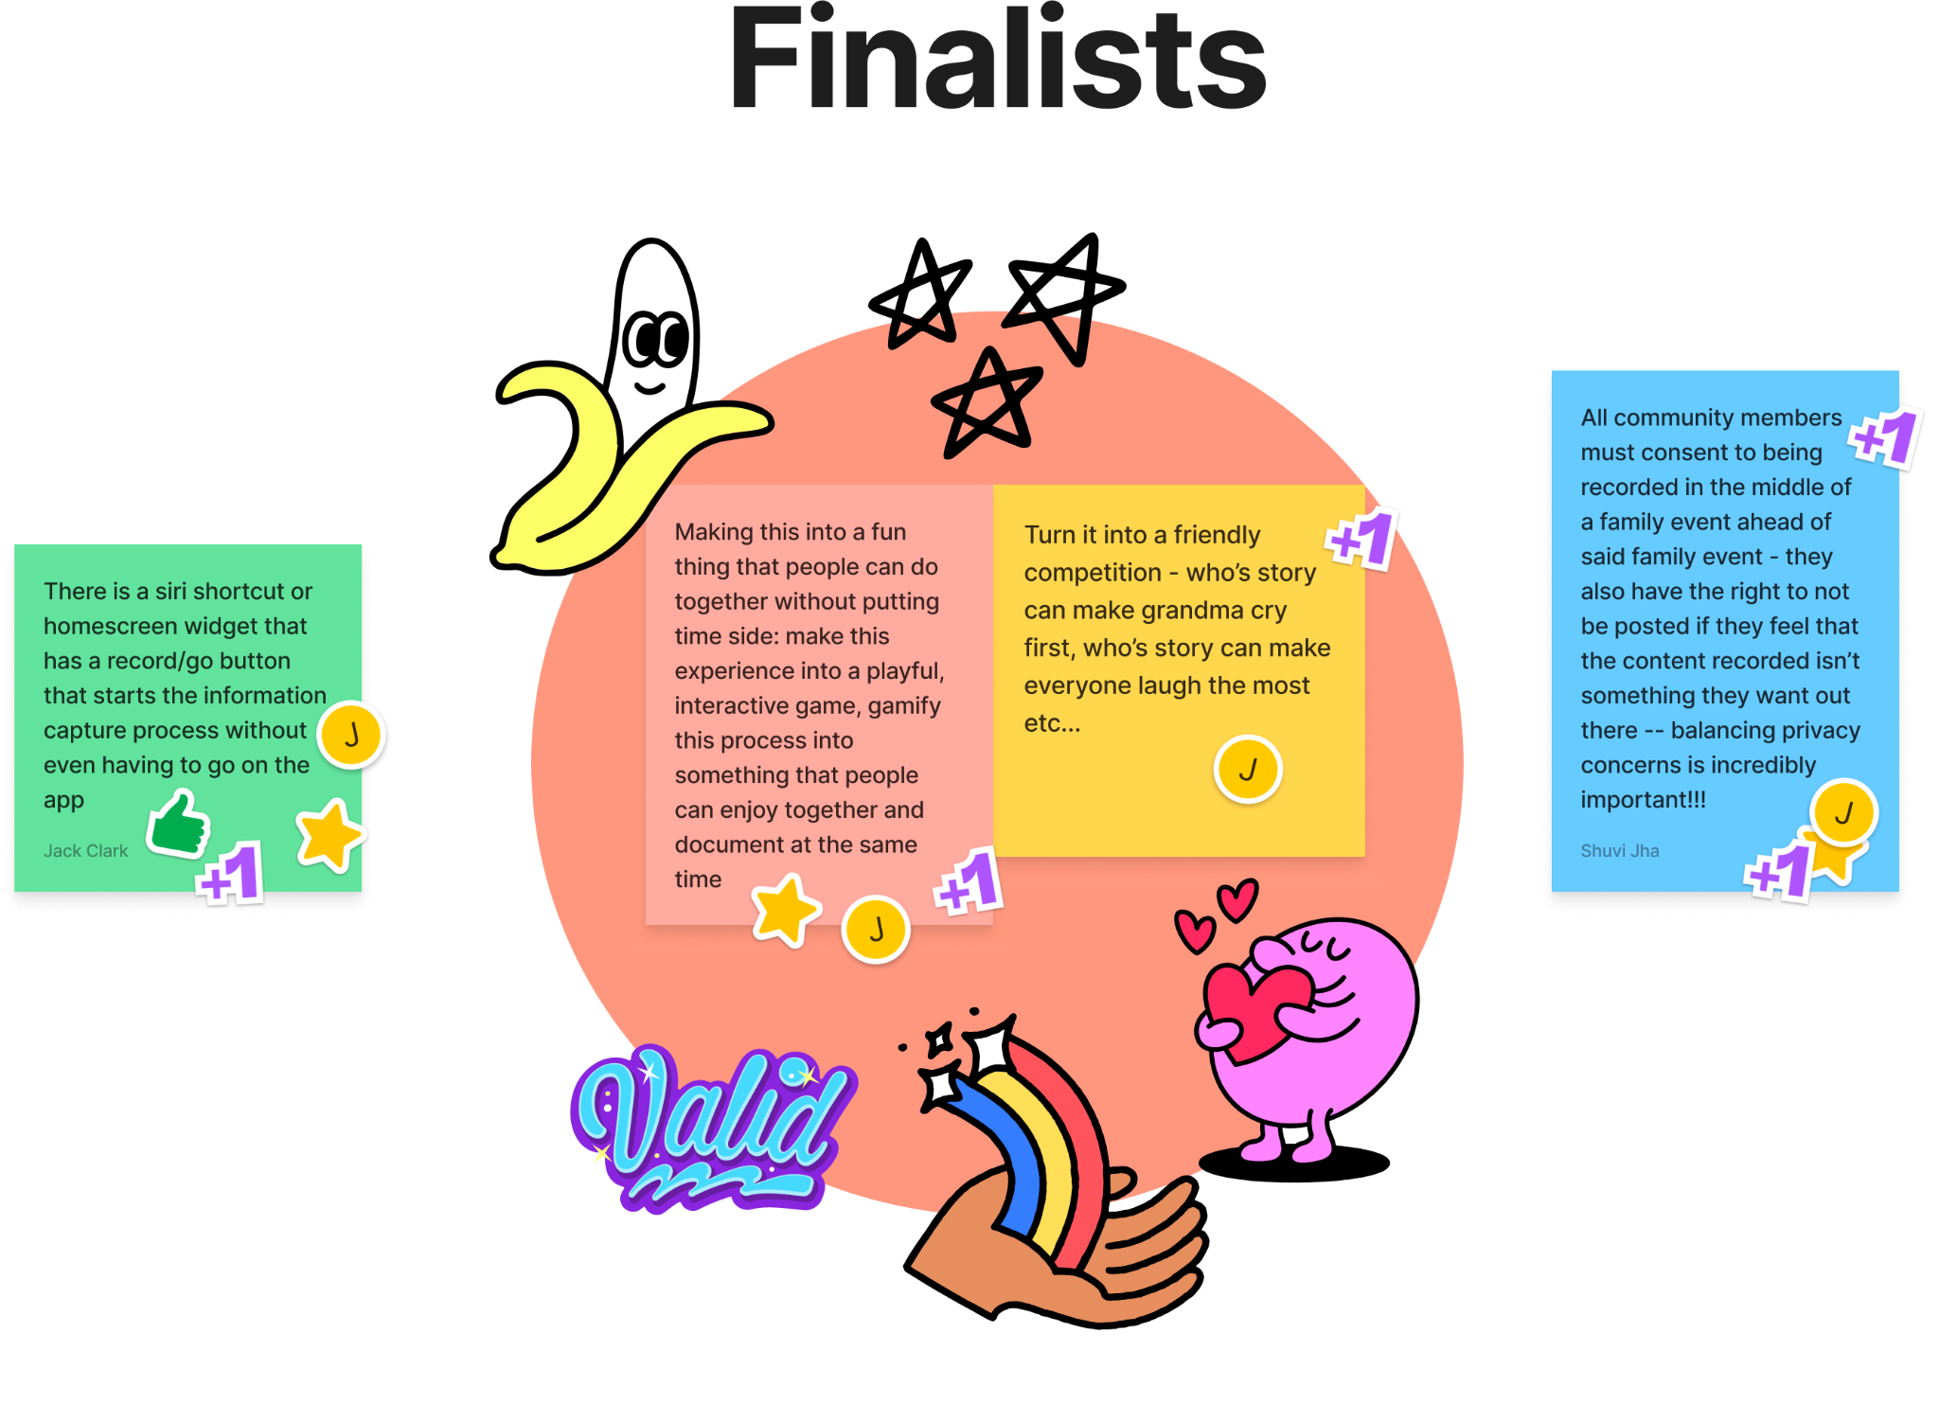
HMW unobtrusively capture and cherish memories during valuable face-to-face conversations within families?

Slide 27
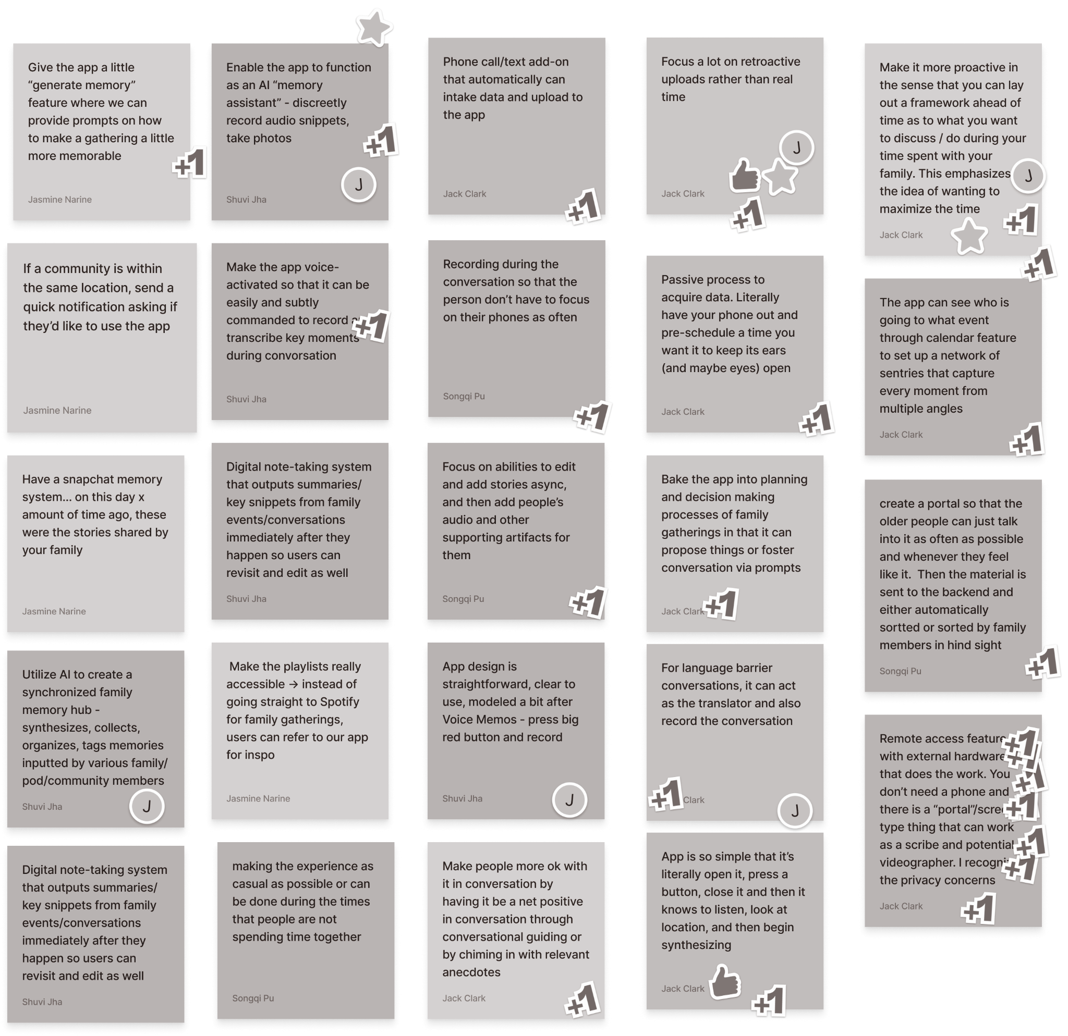
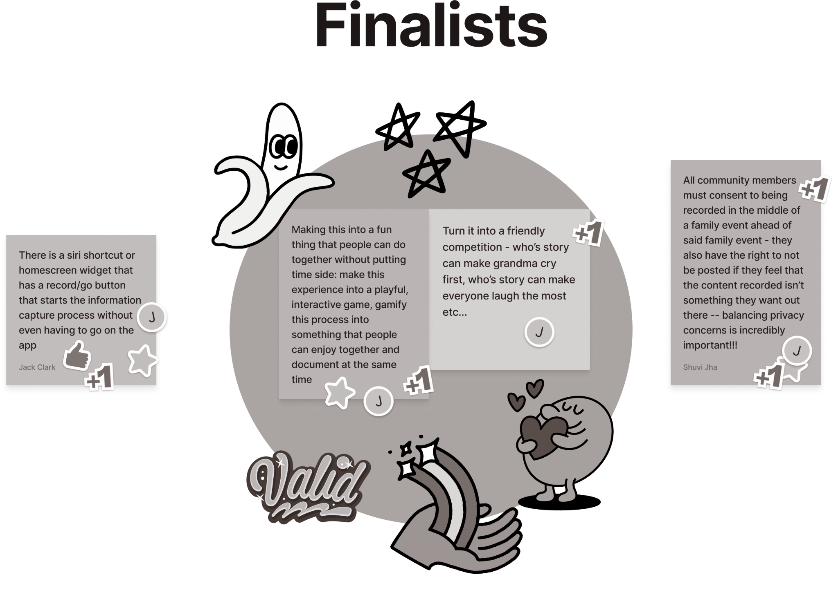
HMW unobtrusively capture and cherish memories during valuable face-to-face conversations within families?

Slide 28
RAPID PROTOTYPE:
Memory
Game

Slide 29
Memory Game - Assumption
Transforming storytelling into a game-like experience has the potential to make the process of listening to and sharing stories less tedious and more enjoyable
Notes:
Critical assumption

Slide 30
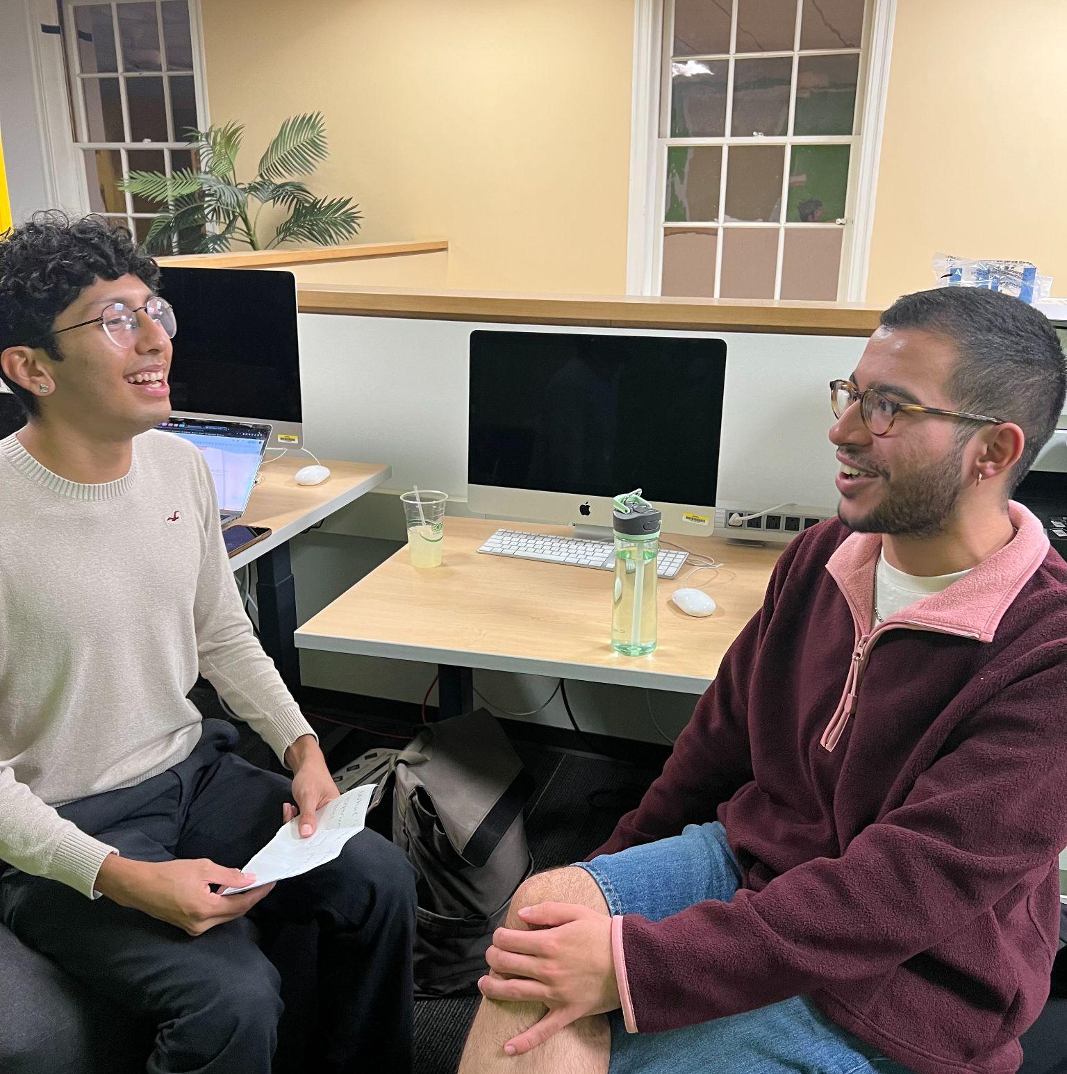
Our intent
Interview people in a (chosen) family environment
Watch two people play, no interference
Simulate GenAI
The 2 participants are recruited on campus
Notes:
Participants: 2 students

Slide 31
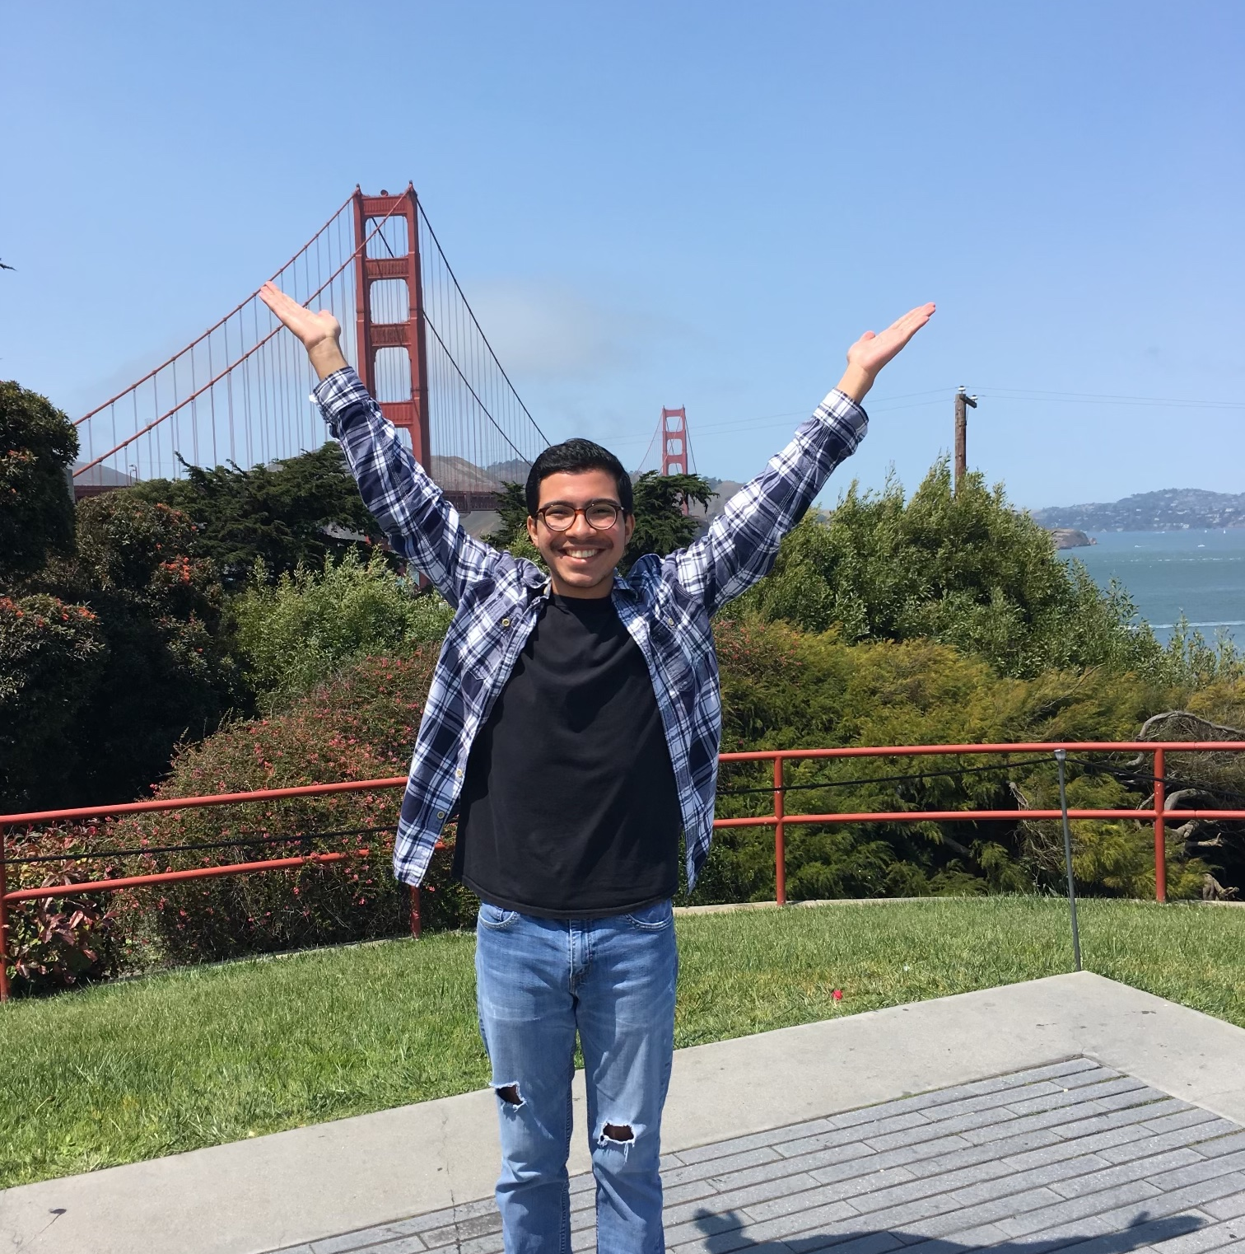
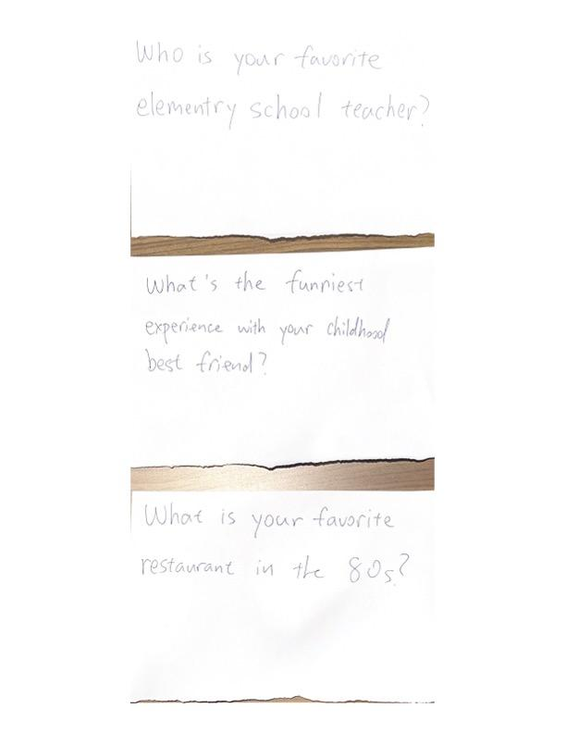
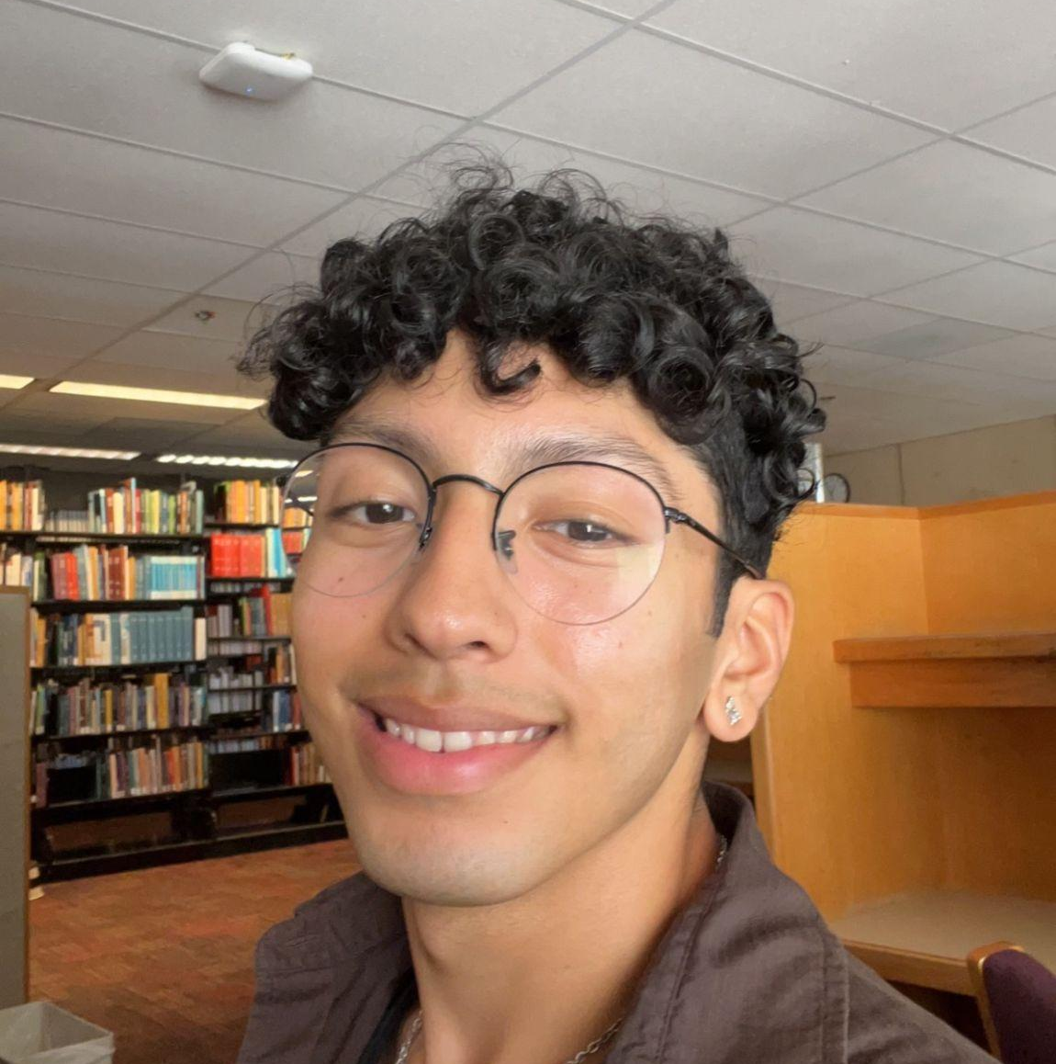
Memory Game
Assumption: Transforming storytelling into a game-like experience has the potential to make the process of listening to and sharing stories less tedious and more enjoyable

Slide 32
Memory Game
Good
Bad
Outcomes
Lightheartedness is valued
People want to choose when to stay/switch topics
More customization and autonomy is necessary to proceed
Fun and engaging at first
Encouraged vulnerability
Not necessary
Became jarring as game progressed
Wanted to stop as conversation became intense
Assumption: Transforming storytelling into a game-like experience has the potential to make the process of listening to and sharing stories less tedious and more enjoyable
Notes:
Results

Slide 33
HMW facilitate the utilization of various, preferred storytelling formats?

Slide 34
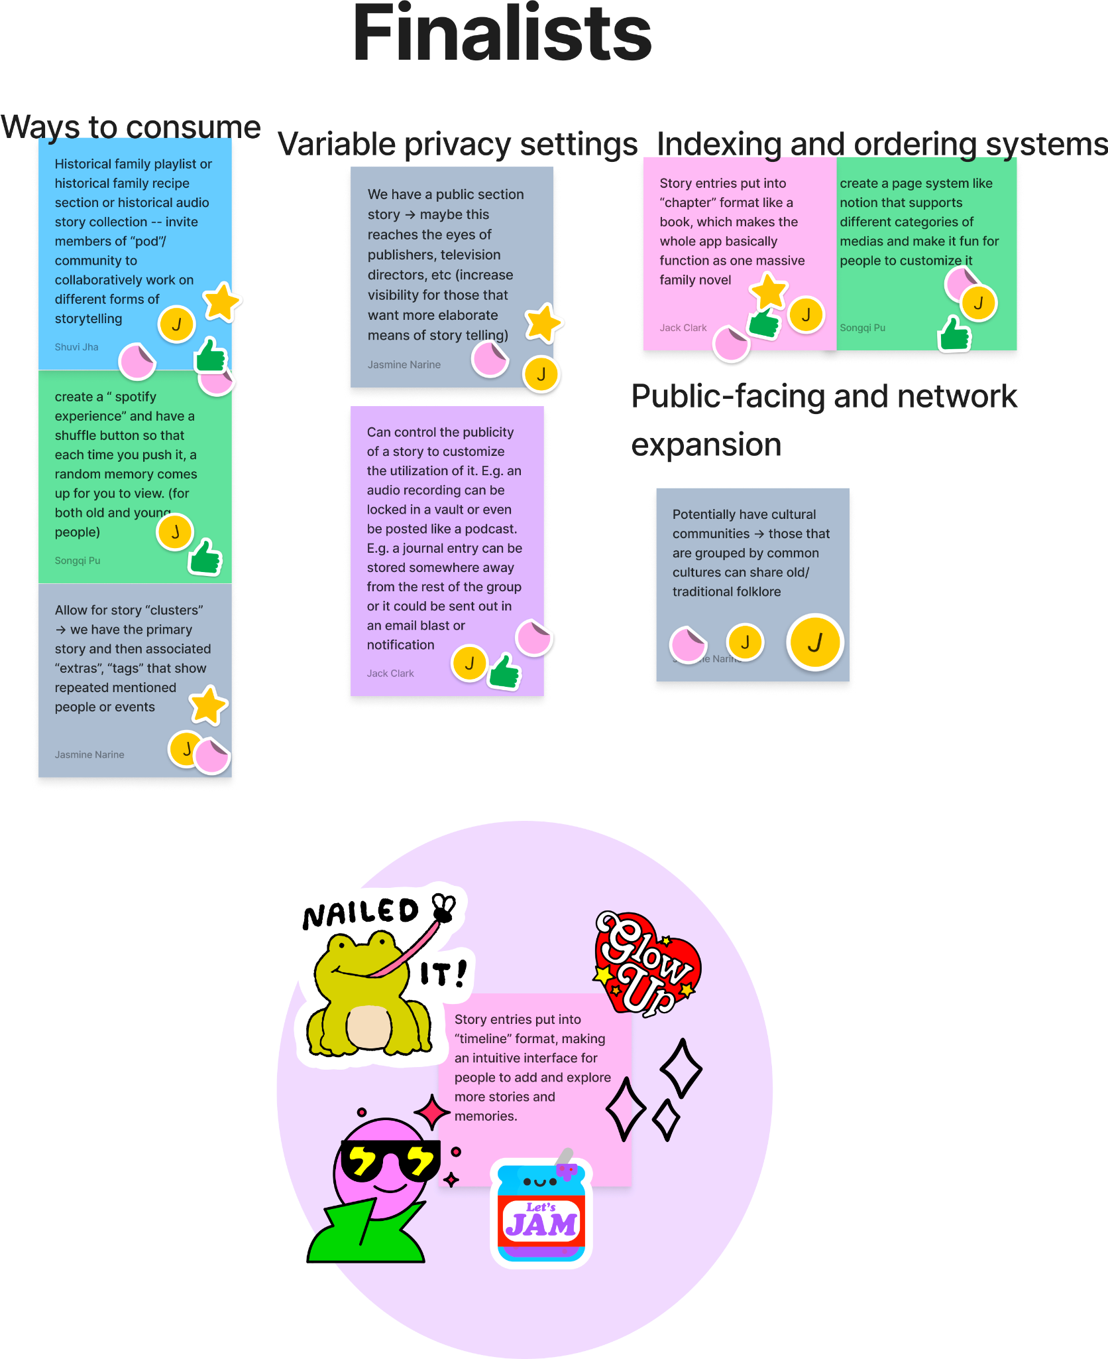
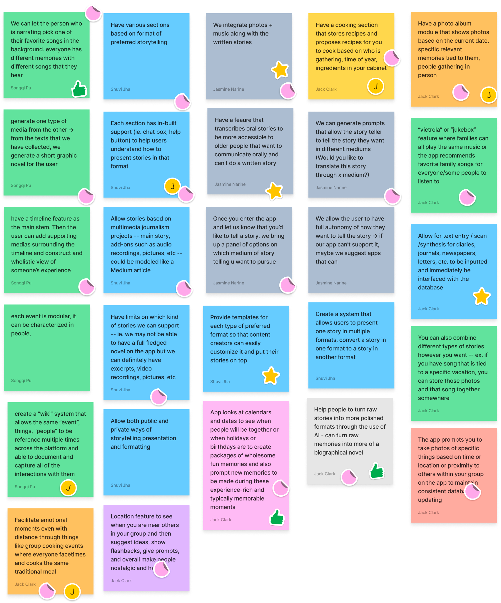
HMW facilitate the utilization of various, preferred storytelling formats?

Slide 35
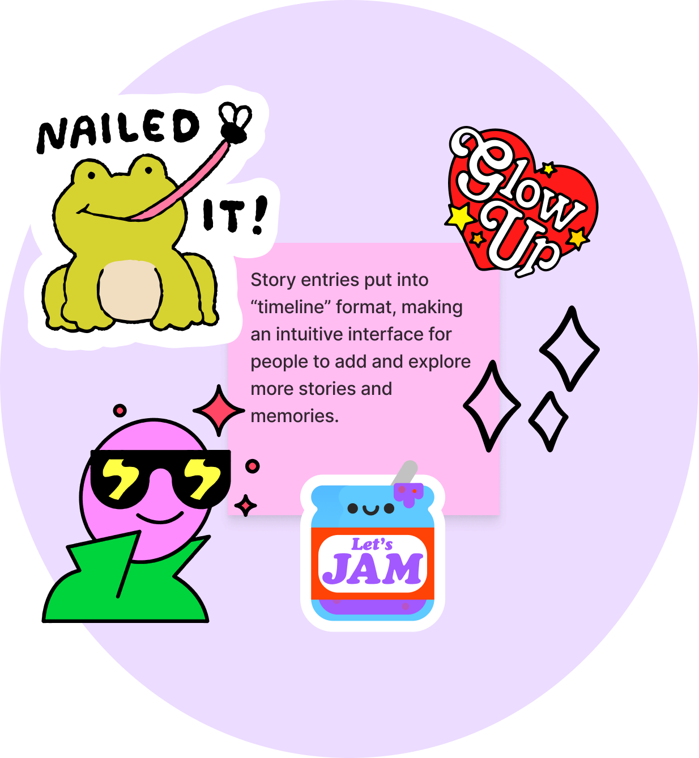
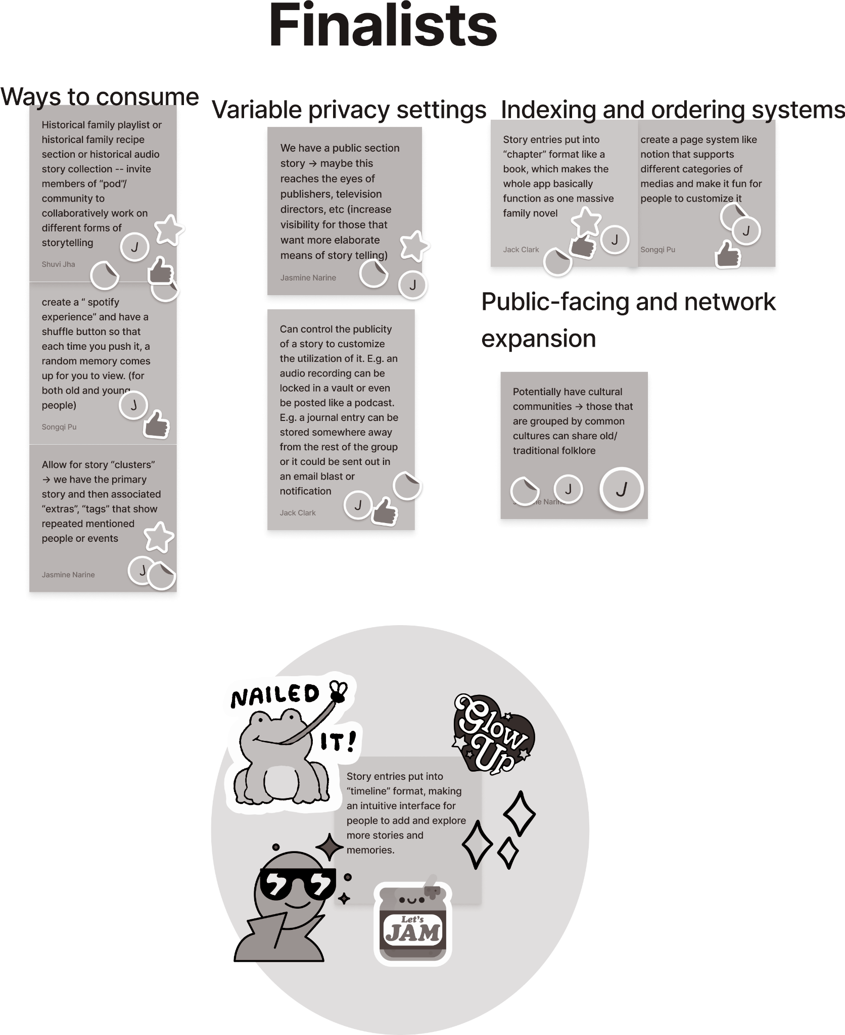
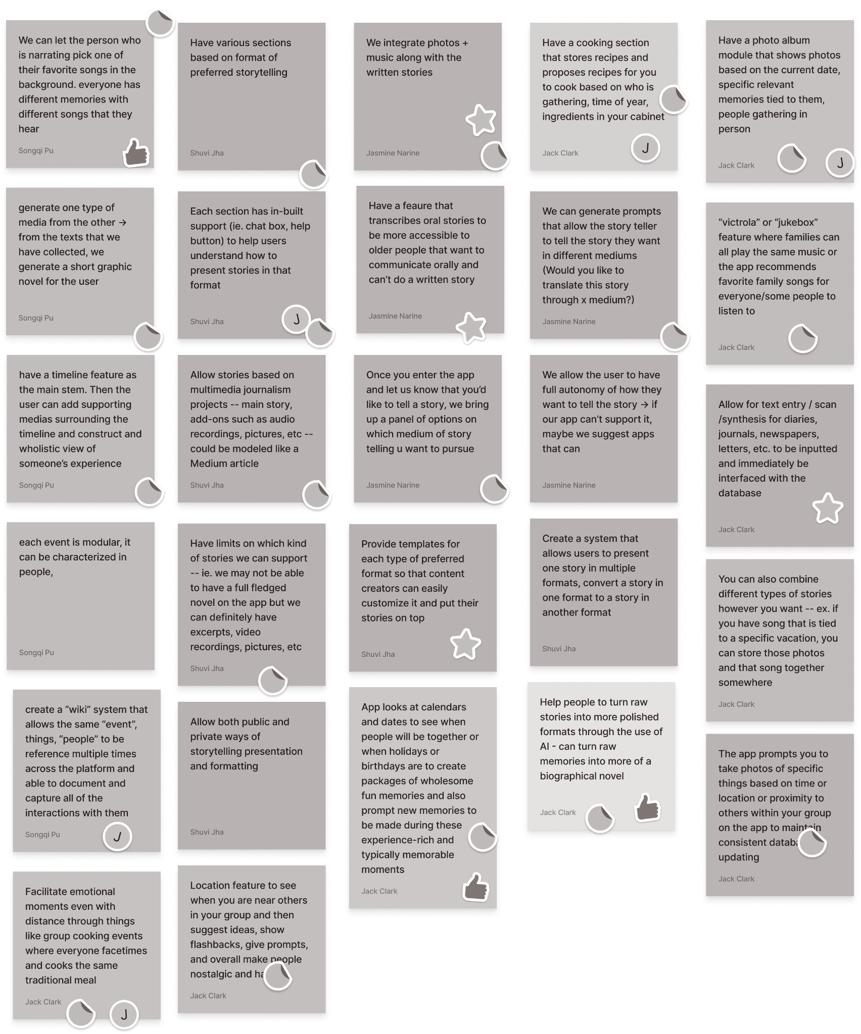
HMW facilitate the utilization of various, preferred storytelling formats?

Slide 36
RAPID PROTOTYPE:
Timeline Organization

Slide 37
Timeline Organization - Assumption
A timeline interface makes it intuitive for users to explore and add more family stories.
Notes:
Critical assumption

Slide 38
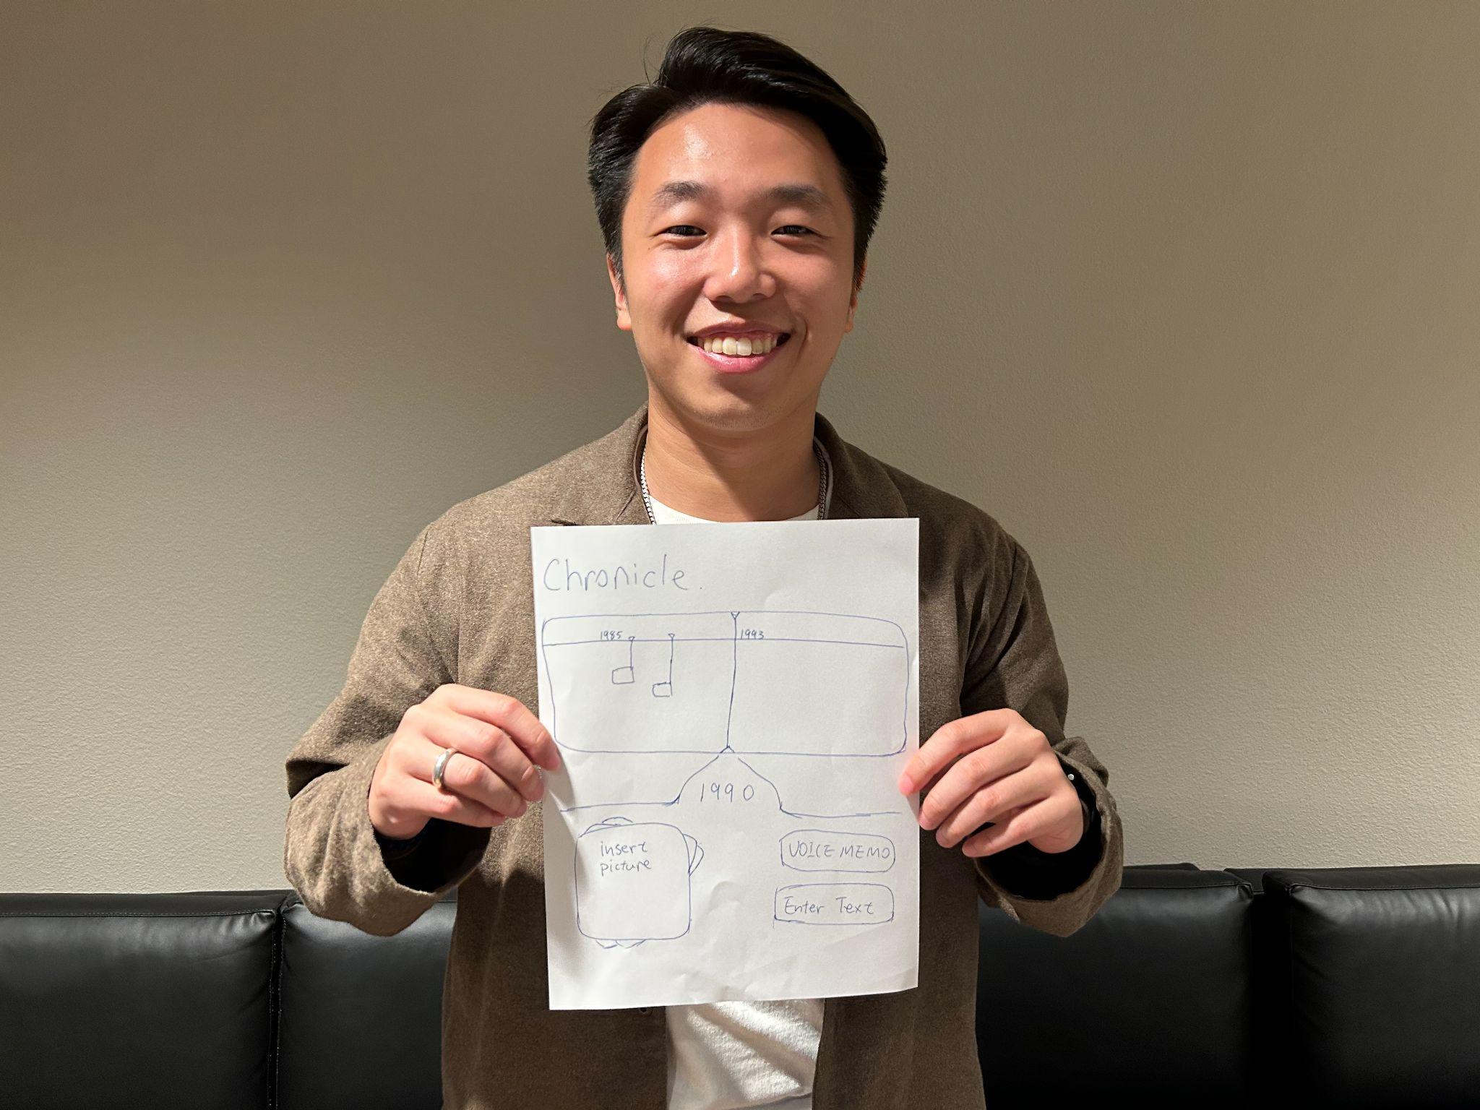
Our intent
Interview young people who would be interacting with a hypothetical database
Observe
Simulate a calendar through movable timelines
The 2 participants are recruited on campus
Notes:
Participants: 2 students

Slide 39
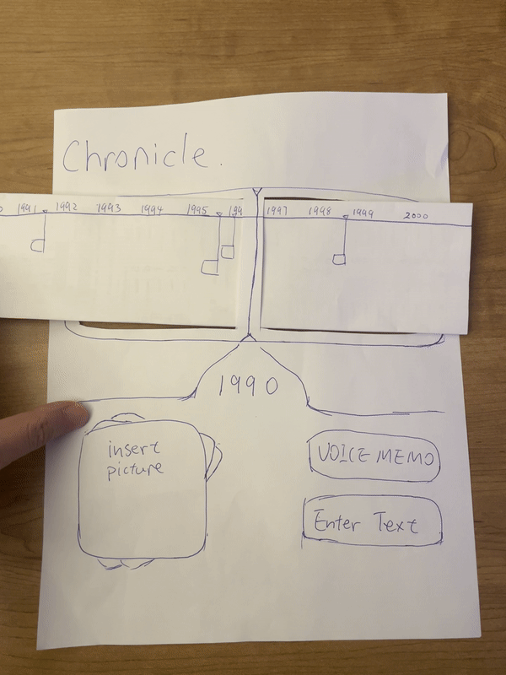
Timeline Organization
Assumption: Transforming storytelling into a game-like experience has the potential to make the process of listening to and sharing stories less tedious and more enjoyable

Slide 40
Timeline Organization
Good
Bad
Outcomes
Very much a specific utility, not something that is exciting
Concerning lack of interest
Are young people even our audience?
Intuitive to use
Not necessary
Timeline “not helpful for remembering”
Assumption: A timeline interface makes it intuitive for users to explore and add more family stories.
Notes:
Results

Slide 41
04
Next Steps

Slide 42
Next Steps
Solution
Ethics
Audience
Can we serve both old and young?
Conversations need to be two-sided
Need to re-evaluate young people’s motives
Focus on more millenial/gen X as our user base?
How would we design for the elderly?
Conversation helper? Adding playful elements?
Need more specific knowledge of people to make suggestions worth it
Helps young people conversationally and is a change of pace for older people
Using AI can lead to conversational bias
Accessibility concerns, especially around older users
Privacy concerns with recorded conversations
Notes:
Results

Slide 43
05
Appendix

Slide 44
Experience Prototyping Statistics
 | Participants | Ages | Demographic
Conversation | 3 | 64, 54, 15 | Family members; 2 working parents and high schooler
Game | 1 | 21 | College biology student
Timeline | 2 | 18, 23 | Students with older family members

Slide 45
How Might We? - Krishna
… help young people learn of the past that is otherwise only exists in the minds of their older loved ones?
… create more space for the family to share meaningful personal stories/journeys that they have not shared before?
… provide the “IKEA Effect” that Krishna spoke of for people building their family’s story collection?
… allow loved ones to maximize time spent together through engaging and spending limited time on their devices?
… decrease the amount of casual and routine conversations with the family and increases the meaningful conversations when families are together?
… help older people share the history of their home by passing it on to those who never were able to experience it?
… allow people to preserve the types stories of they want to preserve, whether they are food-related, photographs, music, or anything, all while providing the “IKEA effect” Krishna spoke of?
… create more opportunities to discover more untold stories through the mundane conversations?
… create an experience that makes it easier for people to import memories from fragmented platforms like social media, journal books, and artifacts to best preserve them?
… create an experience that makes it easier for people to import memories from fragmented platforms like social media, journal books, and artifacts to best preserve them?

Slide 46
How Might We? - Catherine
… make long-winded stories more easily digestible for younger audiences?
… help older people tell their important stories before they run out of time?
… assist old people in effectively communicating their wisdom and stories without losing train of thought?
… help young people who value time with their loved ones to maximize that time when they can find it?
… assist young people in producing thoughtful questions to ask their loved ones?
… help older people capitalize on their remaining time by telling impactful stories?
… allow young people to feel closer to elderly loved ones without the need of a physical move?
… make it easier for young people to concentrate when communicating with an older relative?
… help older people keep track of the stories that they have shared?
… provide peace of mind to younger people struggling with guilt surrounding the amount of interaction they have with elderly loved ones?

Slide 47
How Might We? - Michele
… help young people learn of the past that is otherwise only exists in the minds of their older loved ones?
… make the storytelling process more seamless and intuitive for the older gen?
… promote the stories of older gens to attract the audiences they’d like?
… garner interest for the stories of older generations?
… increase awareness of the mediums available to older people?
… we balance the storyteller’s desire for autonomy + privacy?
… make storytelling fun and relevant instead of time-consuming and inconvenient?
… preserve the autonomy of older generations interested in storytelling?
… provide older generations with inspiration to promote their story telling?
… challenge the barriers preventing older gens from being able to tell their stories?

Slide 48
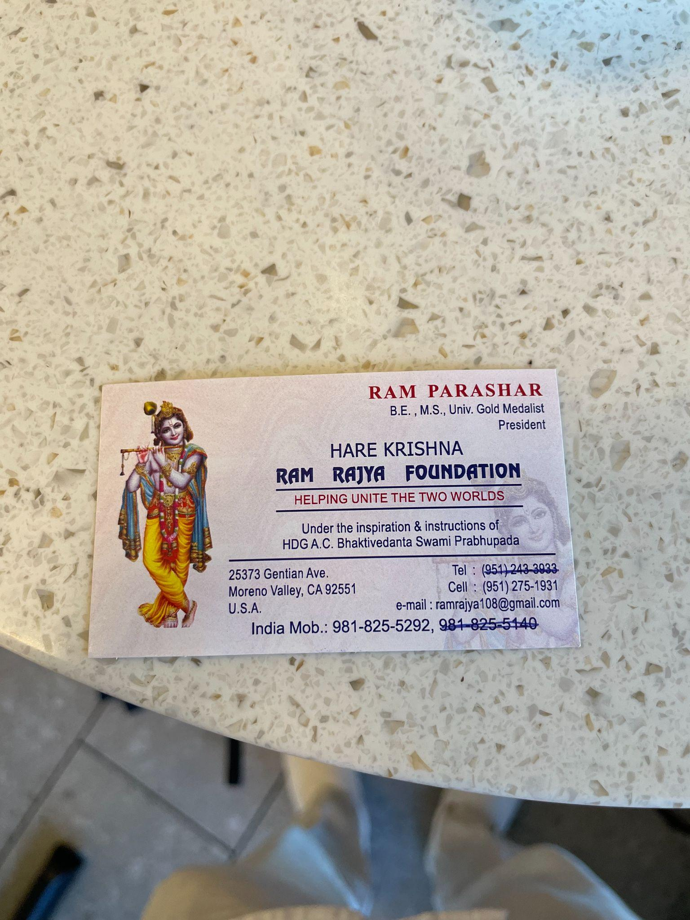
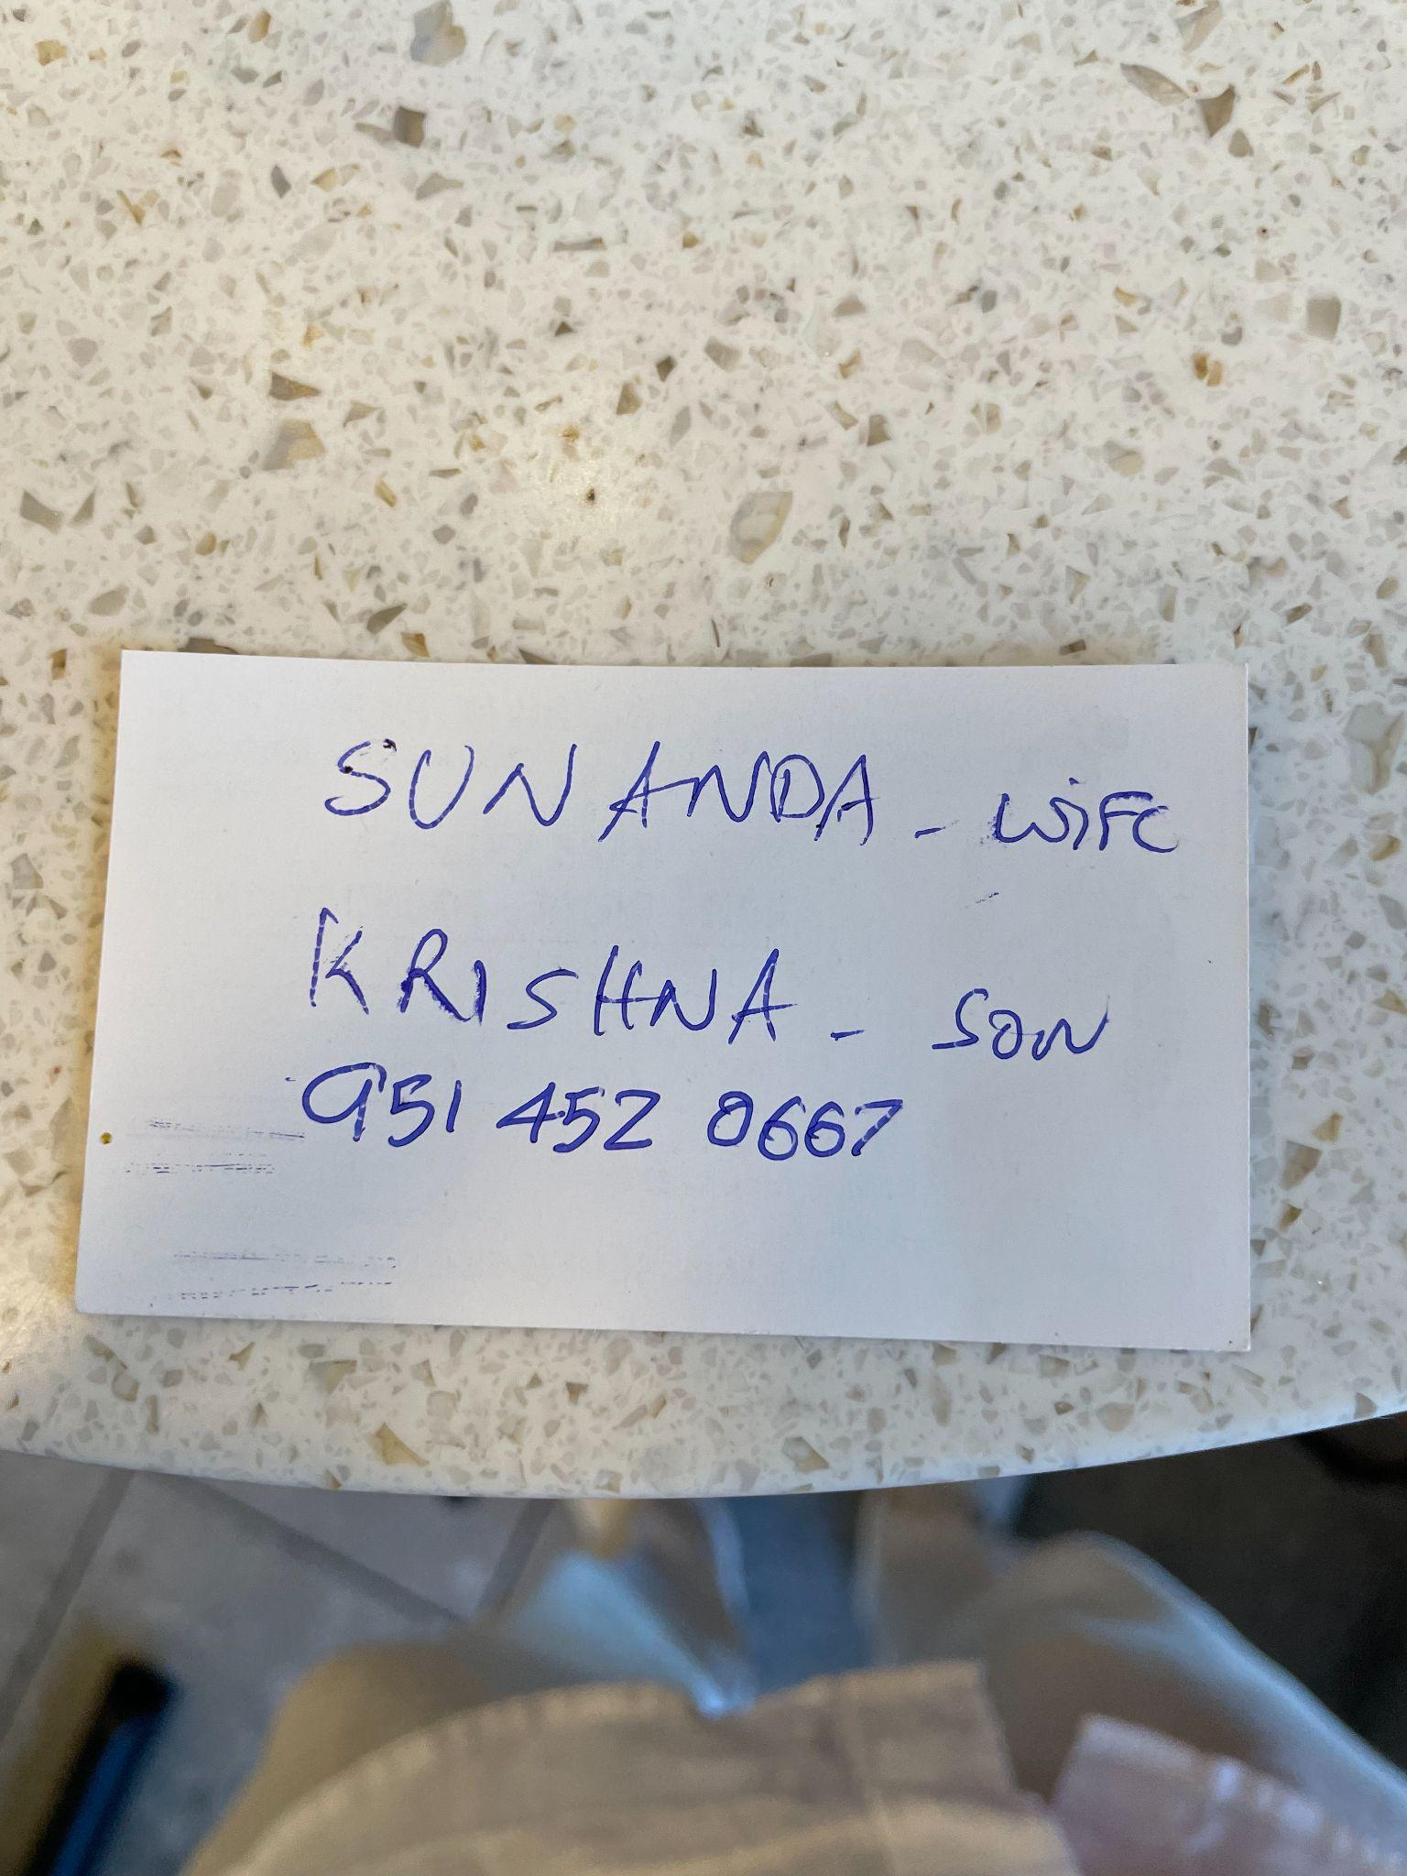
Appendix
Notes:
Sunanda and Ram gave us their contact info!!

Slide 49
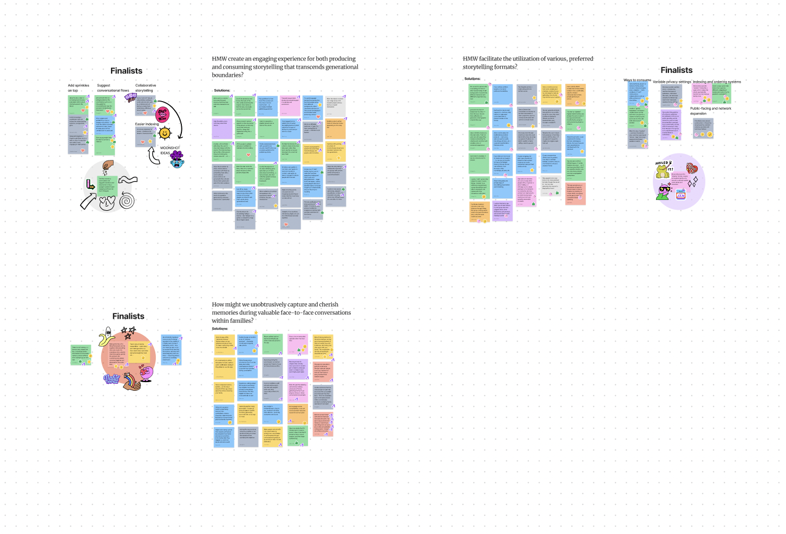
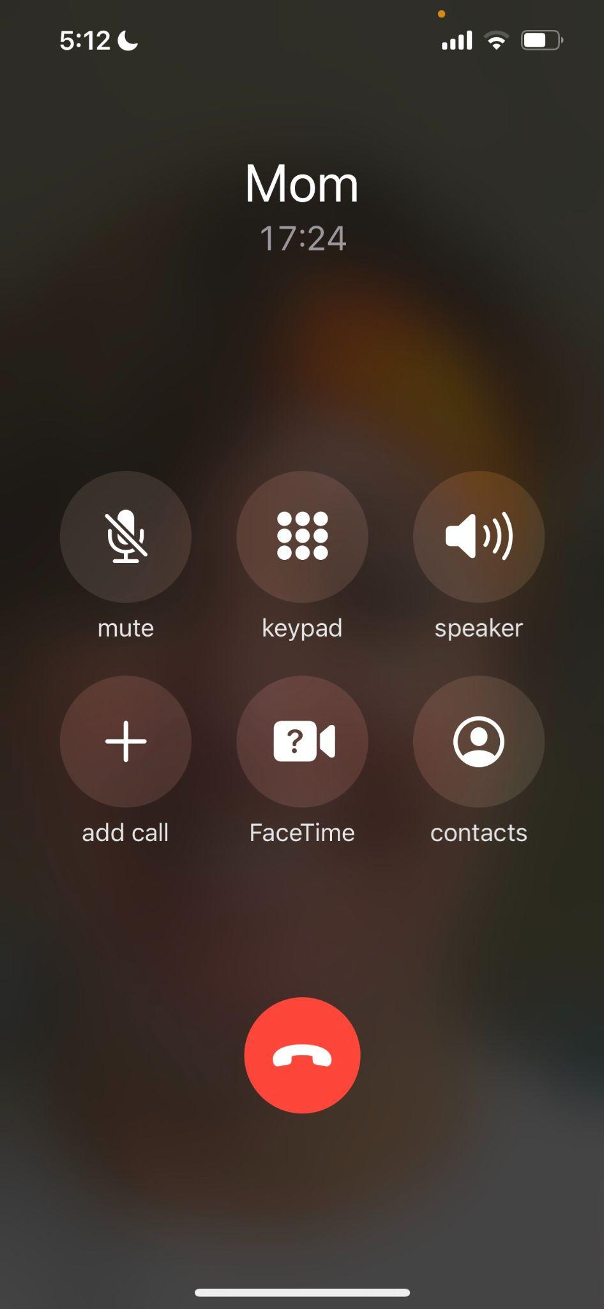
Appendix
Notes:
Our solution brainstorm

Slide 50
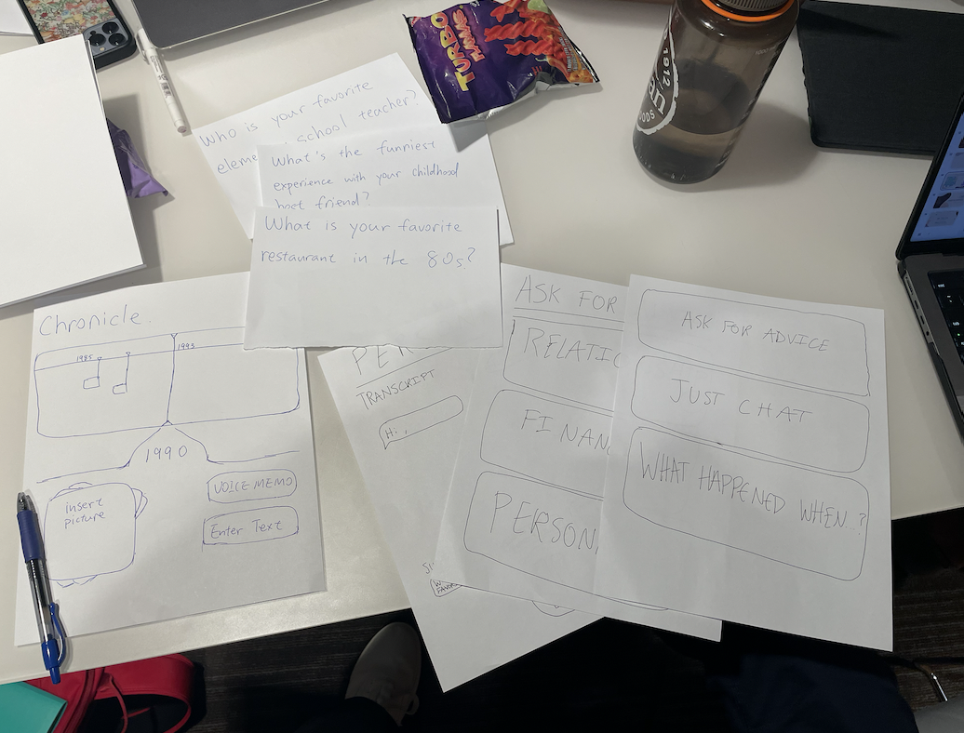
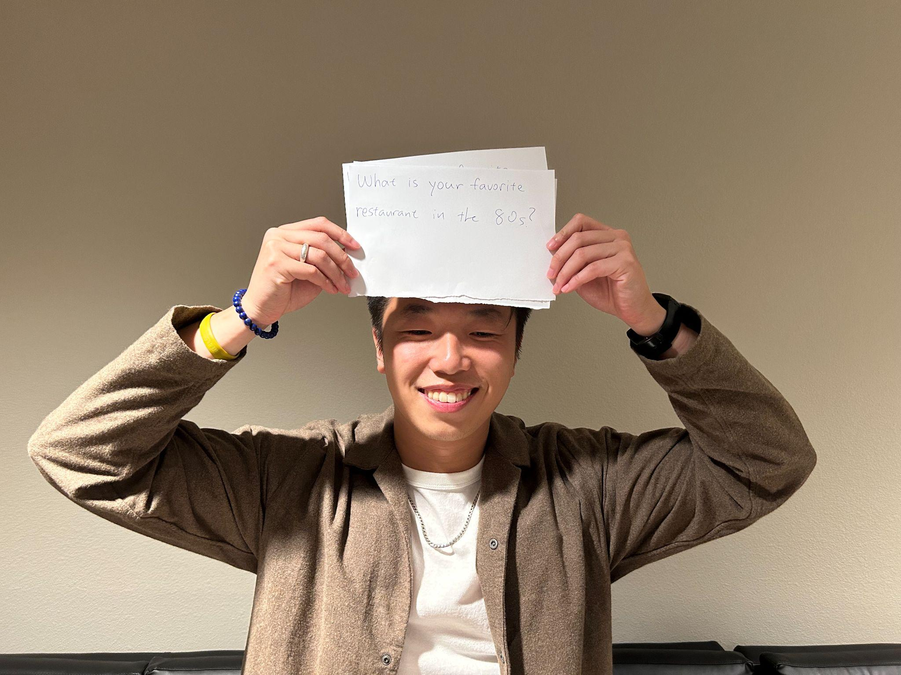
Appendix
Notes:
Rapid prototypes

Slide 51
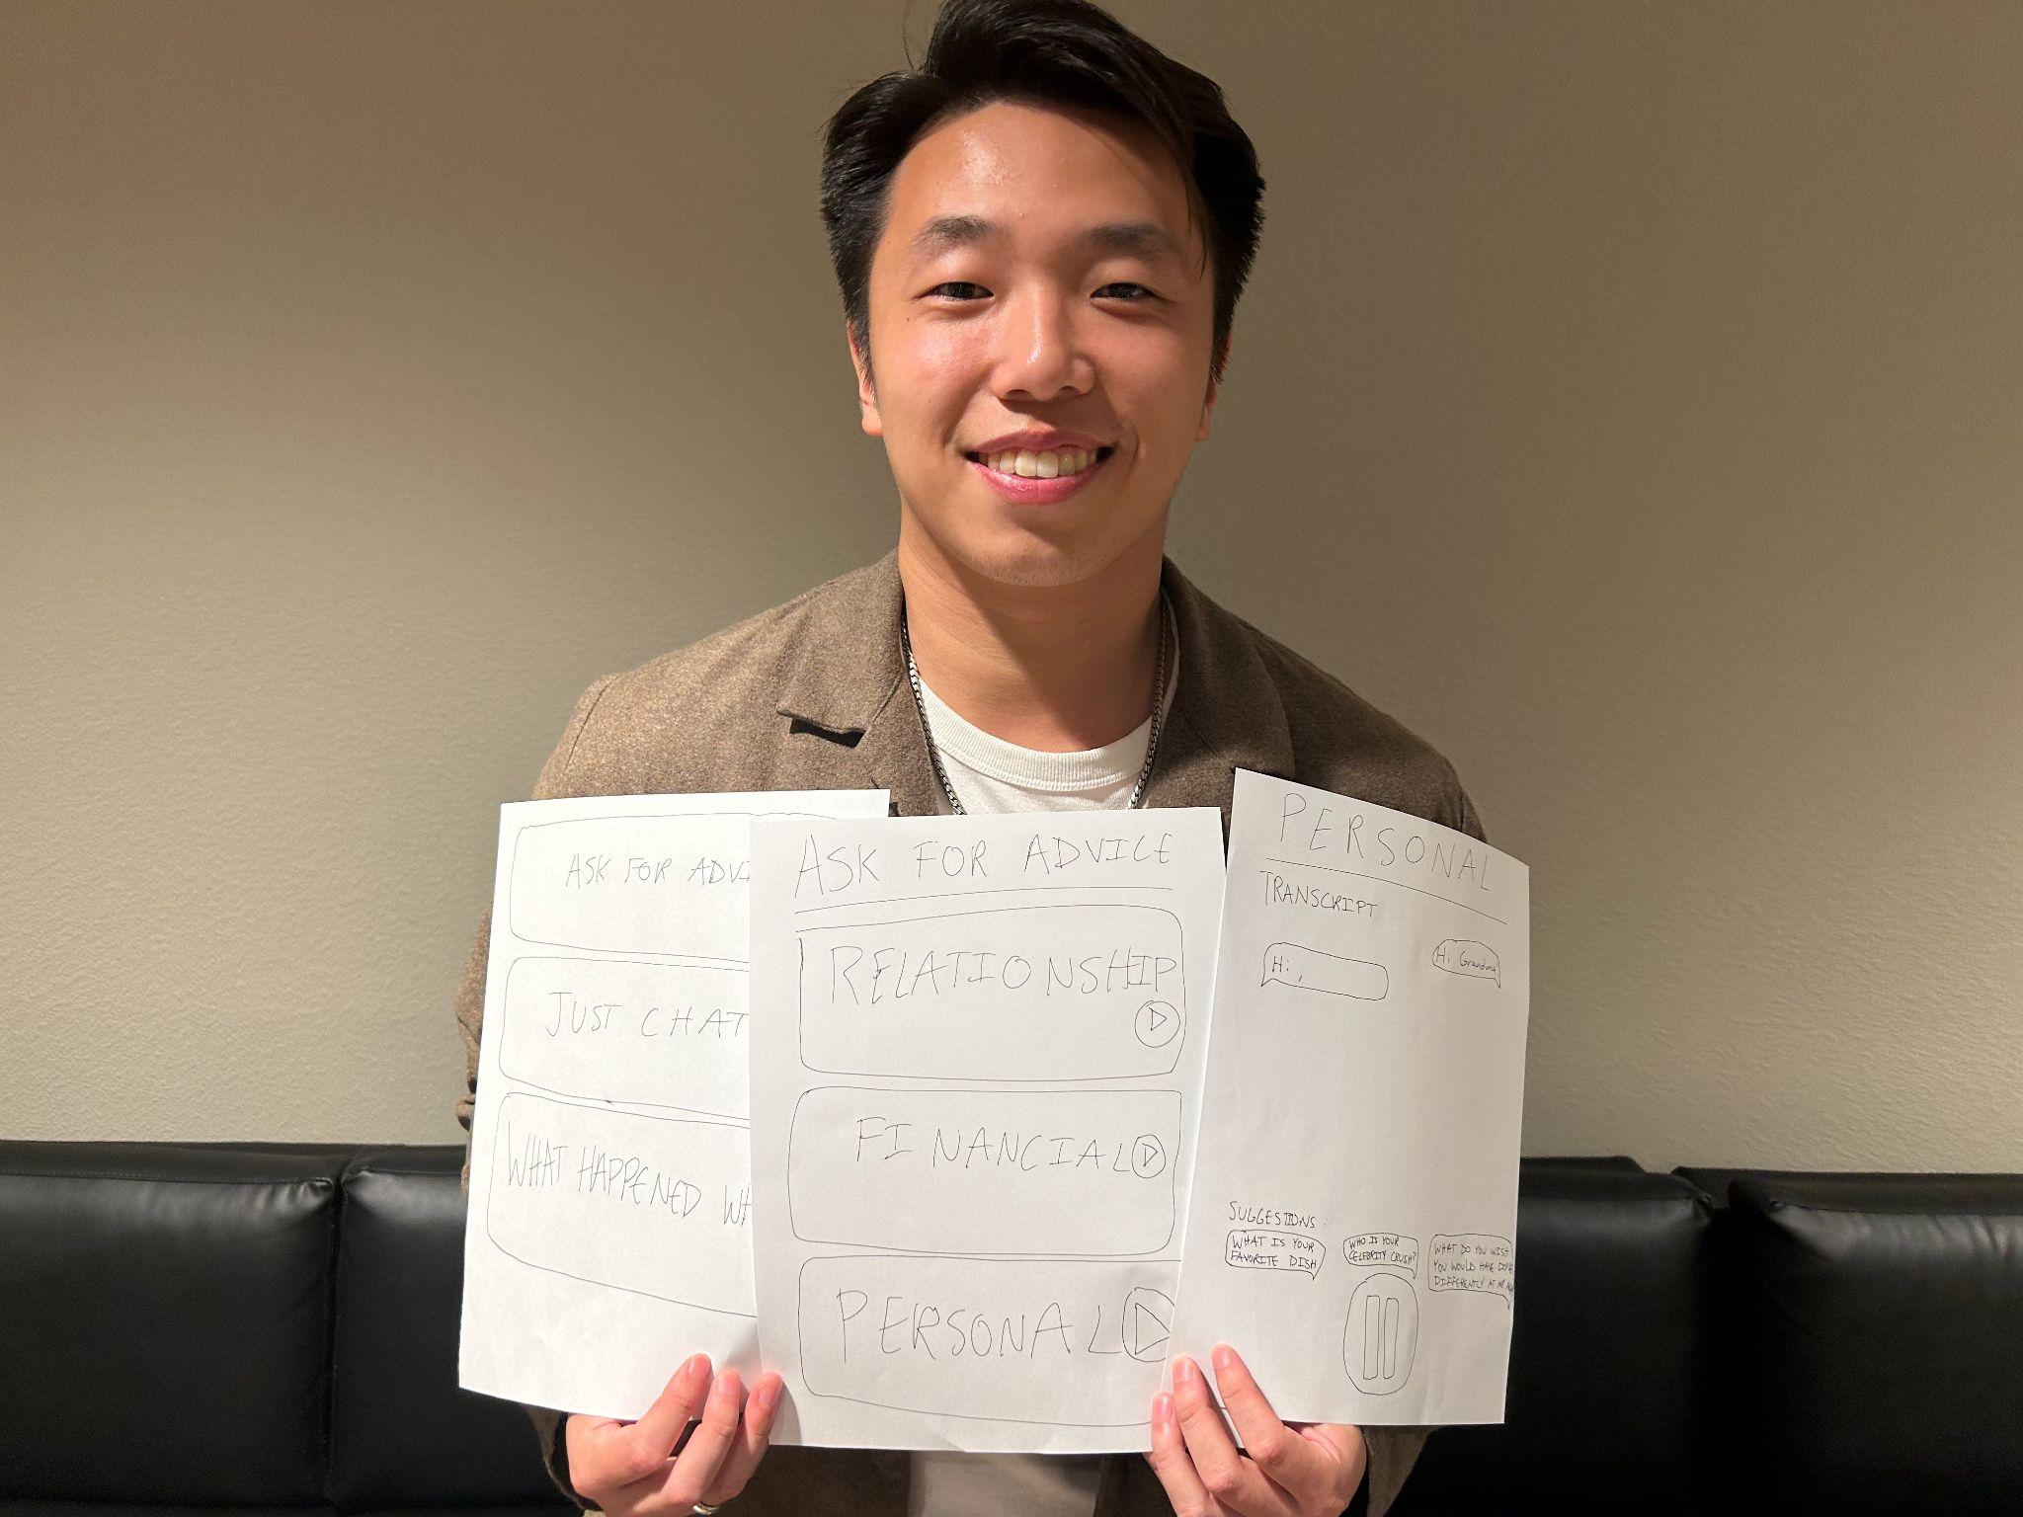
Appendix

