Slide 1





Family
Stories
Needfinding Report

Slide 2

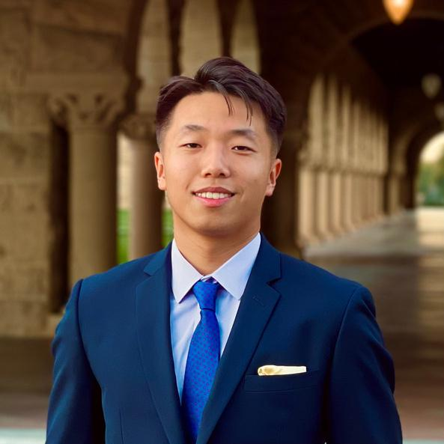
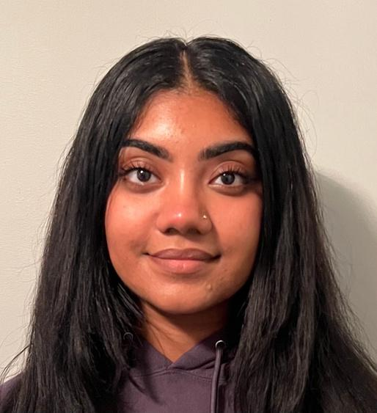

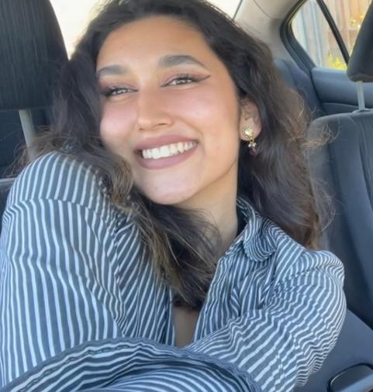
Our Team
Steven Pu
Jasmine Narine
Jack Clark
Shuvi Jha
Symbolic Systems (HCI) undergrad
Symbolic Systems (HCI) undergrad
CS (HCI) coterm,
MS&E undergrad
CS (HCI), Feminist, Gender & Sexuality Studies undergrad

Slide 3
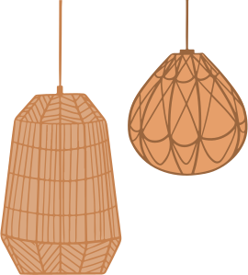
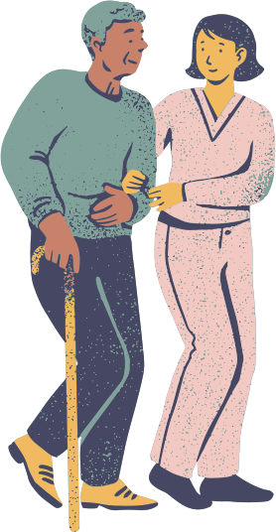
Domain of Interest
People with current & past relationships with their aging family members.
Aging
Culture
Stories

Slide 4
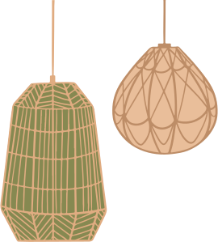
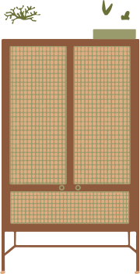
Selection Criteria
We sought diversity in:
  Age of participants
  Age of elderly family members
  Levels of closeness with elderly family members
  Views on storytelling, sharing, culture, and family stories
  Personal identifiers such as race, gender, sexuality & socioeconomic status

Slide 5
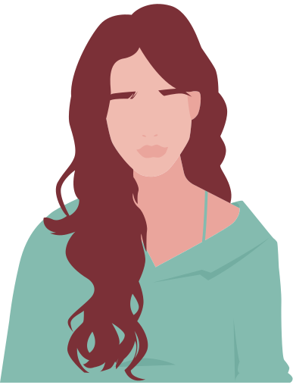

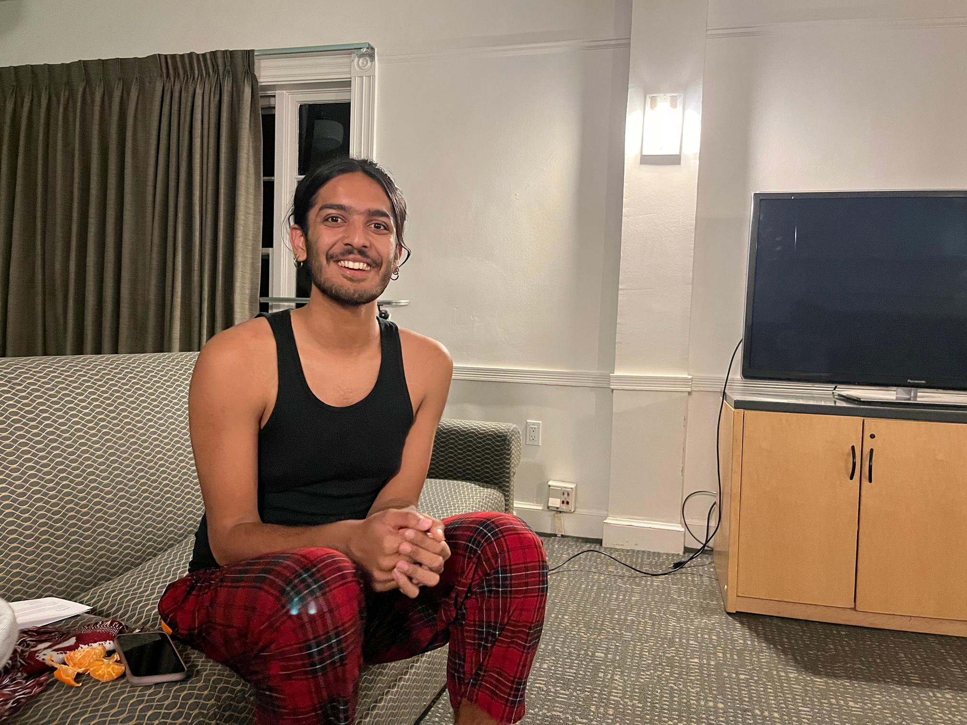
Our Participants
Catherine
Clare
Sahir
Mid 20's Cantonese-American woman, nonprofit founder based in Mountain View
Late 30's Filipina woman, healthcare worker based in Palo Alto
20-year-old queer Kashmiri individual, Urban Studies student at Stanford

Slide 6
Guiding Questions
Can you describe your relationships with your family and loved ones?
What do you want to learn about your loved ones?
What makes a story special to you?
How do you start conversations with your elders and loved ones?
What do you talk about with your family?
How do you organize and revisit your memories?
What are your favorite family stories? What draws you to these stories?

Slide 7


Interview Results & Analysis

Slide 8
Mid 20's Cantonese-American woman, nonprofit founder based in Mountain View
Bought Starbucks as compensation
Interviewed at local Starbucks in Mountain View
Found on Reddit after posting in r/MountainView
Catherine
30 minute interview recorded on Otter
Grandma passed away

Slide 9
Catherine
“Interestingly, I still have two voicemails saved from my grandmother on my birthdays, and they always followed a similar script. She would reassure us, saying, ‘If you ever need help, just ask the family. They'll talk to me.’”

Slide 10
  Cooking is a way for me to be connected to my mom's family
  I still actually have two voicemails when my grandma said happy birthday
  I remember like during high school I sort of thought about recording my grandmother telling stories, but I just didn't. And I don't know why. At the very least, I can at least record my parents.
  I have a Google doc of the reason like my dad came to America
  I have this like ambition to make a graphic novel of like my parents and my grandparents
  I always am having ideas but actually executing them is another thing
  Someone needs to be writing down recipes from older generations in the family
  Talking to her grandmother feels like she’s rambling and repeating the same thoughts
  Online meetings are much worse than in-person
  There is value in audio documentation of a family member
  There is value in images to accompany text and audio when it comes to remembering loved ones
  There is friction in actually executing an idea into reality
SAYS
THINKS
DOES
FEELS
  Direct messaged our Reddit account to set up a meeting after seeing a post in r/MountainView
  Proposed a location and asked for a drink and food without consulting the menu
  Acted defensive initially, as if she did not want to tell us much
  She got emotional and started scrunching her nose when she started talking about her grandma who passed away
  Started using Cantonese words when speaking about her family and their cooking
  Reluctant to make eye contact with the interviewer
  Appreciative for cooking as a way to explore identity and stay connected to her family
  Attached to some of the physical items that her grandmother gave her before she passed
  Regrets that she didn’t get to preserve her grandma’s recipes before she passed
  Feels close to her grandmother when she listens to the voicemail that her grandmother sent to her
  Confused about the exact recollection of events
  Frustrated that she did not remember elements of her family’s history more clearly

Slide 11
Insight
CONTRADICTION: Catherine misses speaking to her grandmother but also said that she would ramble often and Catherine would have trouble focusing.
INSIGHT: People desire to gain knowledge and wisdom from their older loved ones, yet they encounter challenges in retaining and preserving the shared information.
NEED: People need effective and concise means of preserving and accessing the wisdom and stories of older loved ones to facilitate meaningful learning and connection.

Slide 12
Late 30s Filipina woman (she/her), healthcare worker based in Palo Alto
Bought Jamba Juice as compensation
Found by randomly asking people for interview in front of Jamba Juice at Town & Country
Interviewed in front of Jamba Juice
Clare
30 minute interview recorded on Otter
Grandma is 96 years old

Slide 13
Clare
“I don't think the older generation is capable of narrating anything on their own story on social media.”
“Maybe I should actually take the time to tap on the wisdom and resources of my aunties, uncles, and grandma.”

Slide 14
  At a gathering, you see a clear divide of the old people and the young people and stories being told in those circles are different
  Maybe there's something the older generation can impart to me that they went through or how they strategically climbed up in their profession
  I think I would have made better financial decisions if I asked my parents
  Maybe I should actually take the time to tap on the wisdom and resources of my aunties, uncles, and grandma
  I think in my point of my life, if I ask my family for advice, I would actually make a conscious effort to put it on my phone
  [The cemetery] is the only physical or tangible thing that will keep that connection with his parents
  Understands that there is a divide in the family between the young generation who are more fluent in digital life and the older generation who are not
  Thinks that it is worth it to help her grandparents to share more on social media as a good way to keep track of their lives
  Really respects the advice coming from the older generation
  Thinks food as an important way to connect with family and celebrate them even when they leave this world
  Thinks that a physical thing like a book/grave serves as a tangible that helps with maintaining the relationship after death
SAYS
THINKS
DOES
FEELS
  Overheard us asking others to be interviewed and approached us to learn more about it
  Became emotional and teared up when she talked about memories of her grandmother
  Expression brightened up when she mentioned the food that her grandparents make
  Kept talking past her proposed stopping point and delayed sending her husband lunch to continue to speak to us
  Became excited when she spoke about asking more questions the next time she sees her family in person
  Was very conscious about what was “on the record” versus not
  Sad about her husband’s deceased parents and how he visits their graves to keep in touch
  Empathetic towards her husband when he visits his parents graves
  Excited about the opportunity to learn from her grandmother while she is alive
  Proud about her accomplishments
  Thankful that her grandmother was such a great role model in her life
  Satisfied with her current family situation
  Anticipation for holidays where she can see her family again
  Longing for the taste of meals cooked for her by family when she was a child

Slide 15
Insight
SURPRISE: In her current stage of life as a middle-aged woman, when Clare seeks advice from her family, she records it on her phone for documentation.
INSIGHT: Advice is valuable at all stages of life.
NEED: People need a reliable and accessible way to enable access to valuable advice at various stages of life.

Slide 16
20-year-old queer Kashmiri individual (he/they) studying Urban Studies
Grandma is 80 years old
Extreme user: took on the role of confidante, experienced and consumed trauma
Distant friendship as members of South Asian community at Stanford
Sahir
Interviewed at Slav, Stanford campus
60 minute interview recorded on Voice Memos
Bought Starbucks as compensation

Slide 17
Sahir
“My grandma was quite lonely and isolated caring for me and my brother, and I became one of her primary confidants. We had a connection where she would reveal deeply meaningful and sometimes traumatic experiences from her childhood in Kashmir, adulthood, and present struggles.”

Slide 18
  “I feel like in a way a responsibility to like, tell people like carry on the legacy”
  “I didn't feel very comfortable… publishing industry…so I'm kind of glad that they didn't accept it”
  “people were like, Whoa, like, this is cool…” (Context: about the story is his non-fiction writing class about sexuality + growing up with his grandma…)
  “I feel like I was really excited to publish them in that moment. But right now I kind of feel like, personal to me…”
  Expressed that his grandmother told graphic/traumatizing stories during mundane moments
  Writing is a form of storytelling that is more seamless and polished that oral communication
  As someone who knows his grandmother the best, he has the obligation to continue his legacy
  Thinks that he might be interested in expressing his stories through many forms of media such as music
  That it was difficult to be so young and be an emotional support system for his grandmother
  That his family uses storytelling as a means of communicating lessons, less so as a means of getting closer with one another
SAYS
THINKS
DOES
FEELS
  Wonder if he was going to cry during the interview, expressed nervousness about the prospect of him crying
  Was immediately drawn to telling the story of his grandmother -> definitely made her a central point of the interview
  Struggled to think of a particular story of his family he wanted to share -> ended up choosing an intense story
  Was very causal throughout the interview -> didn’t really become especially emotional at any point
  Repeated his feelings of contentment with the distant relationship to his grandmother
  Repeated his desire to learn more about more intimate stories of his parents
  Ashamed when someone inquires about whether his characters are inspired by those he knows in real life
  Obligated to hear the stories of his parents to get to know them better -> particularly surrounding childhood
  Conflicted about whether or not publishing is the right avenue to share his stories that include his family
  Uncomfortable sharing verbally with his family due to their reaction after his vulnerabilities surrounding queerness
  Grateful to his brother, whom he has grown closer to due to shared experiences
  Desire to know more about the less traumatic details of his grandmother’s childhood

Slide 19
Insight
CONTRADICTION: An aspiring writer and academic, Sahir wants to share stories of his grandmother but not through public avenues like publishing.
INSIGHT: People possess meaningful family stories they wish to share, but they hesitate due to concerns about respecting the privacy and intimacy of their family relationships.
NEED: People need ways they can comfortably and privately share their family stories and experiences without violating the intimacy and privacy of their families.

Slide 20
Summary

Slide 21
Key Learnings
  People struggle to communicate with older loved ones but value their advice and stories
  People want to learn more about their family's stories
  Families want these stories to remain private
  People have considered recording and documenting these stories digitally
  Food recipes hold significance as a cultural way of documenting loved ones' legacies

Slide 22
What’s Next?
  Interview people from various backgrounds, especially: older people, people with “base case” stories, extreme users
  Continue to analyze and unpack the data collected from interviews
  Further refine the specific problem domain

Slide 23
Appendix

Slide 24
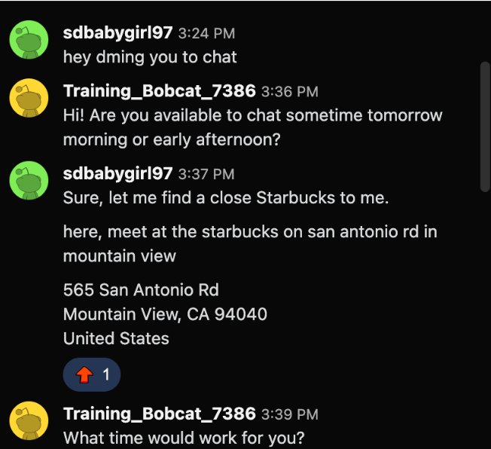
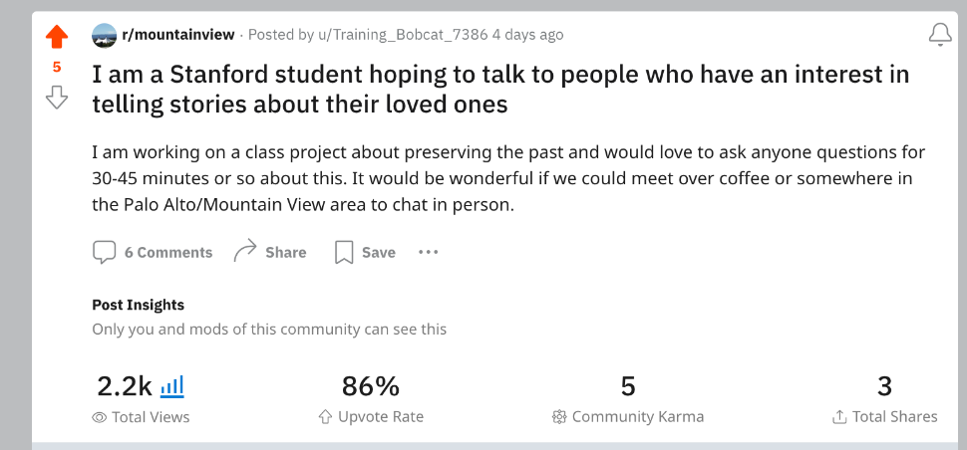

Slide 25
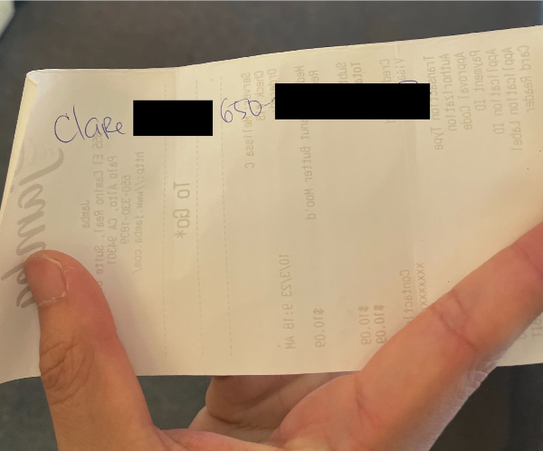

Slide 26


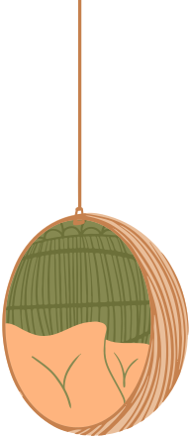


Thank you for listening!

