Slide 1
Concept Video and Storyboarding
By: Daniel, Dria, Arjun, & Jen

Slide 2

Introducing…
TrainGone!
Express yourself beyond words.
Our team name is an ASL idiom akin to the English idiom, “that ship has sailed”, meaning that the conversation subject has come and gone.
This highlights the value of our product for those “one and done” environments where you didn’t quite catch the signed word.

Slide 3
The Problem.
ASL speakers are challenged when it comes to communicating unknown words to one another. There is no intuitive platform that directly translates sign to meaning.
Our Solution.
Provide a social educational platform that allows deaf signers to define signs through video storytelling and for learners to solidify their understanding through additional context.

Slide 4
Market Research.

Slide 5
Urban Dictionary
crowd sourced English language online dictionary for slang words and phrases.
1
what works.
users can create their own word, write their own definition, and see and react to other users definitions
look up any word and multiple definitions come up from different creators
both social and educational
links to users profile and can see all written definitions
what doesn’t work.
some definitions may be inaccurate, not monitored
no visual technology, just typing
website, not mobile app

Slide 6
Urban Dictionary
crowd sourced English language online dictionary for slang words and phrases.
1
takeaways.
we will create a social - educational app with a similar mission as Urban Dictionary, except accessible to ASL speakers by video
social aspect builds community, adding profiles and likes/dislikes
searching words by categories (greetings, slang, food, etc)
ability to add a description (multiple examples of word with sign language and in a sentence)

Slide 7
TikTok
a content creation platform that allows users to create and share (primarily audio-based) videos
2
what works.
Auto captioning allows deaf community to interact with videos that have sound
Creators have the ability to edit captions after TikTok automatically transcribes their videos
what doesn’t work.
Auto-generated captions are not always accurate and can have timing / other formatting issues
Lacks an easily accessible community for deaf people
TikTok is “difficult to navigate as a deaf person”¹
Notes:
https://www.washingtonpost.com/technology/2021/03/15/social-media-accessibility-captions/

Slide 8
TikTok
a content creation platform that allows users to create and share (primarily audio-based) videos
2
takeaways.
we want to build a platform that is easier to navigate as a deaf person, as well as one that has a more immediately accessible deaf community
we will provide creators with more accessible/intuitive tools to interact with their (primarily) deaf audience

Slide 9
ASL Reverse Dictionary
user searches the meaning of a sign by identifying the handshape, movement, and location of the ASL sign.
3
what works.
user can find a definition solely by filtering through 4 out of the 5 parameters of ASL (handshape, body location, motion, and palm orientation)
includes video clip of sign in motion and english meaning
what doesn’t work.
website is not intuitive to use… categorizes the signs in boxes that the user would not be able to understand at first look, without a formal education
not social, users cannot put in their own words so not consistently updated

Slide 10
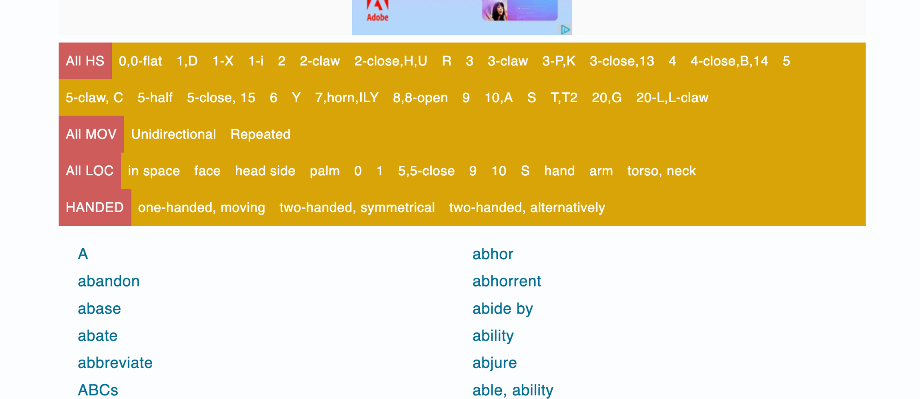

Slide 11
ASL Reverse Dictionary
user searches the meaning of a sign by identifying the handshape, movement, and location of the ASL sign.
3
takeaways.
we want to use the dictionary’s reverse concept but in a social, intuitive app that also enforces a learning community
video exemplifies sign much better than motion description

Slide 12
Chameleon
AI markerless motion capture for sign language
4
what works.
Preserves the natural fluidity and expressiveness of sign language
Preserves the comfort of the signer by capturing signing without requiring them to wear equipment.
what doesn’t work.
Requires interpretations from the users, who may not be able to express the creator’s ideas and intentions properly
Trolls would be able to create inappropriate or offensive visuals

Slide 13
Chameleon
AI markerless motion capture for sign language
4
takeaways.
we will video but not use avatars so our users can accurately express themselves and tell their own stories
video allows expression and motions of signs to be accurately shown

Slide 14
Competitive Landscape
Urban Dictionary
Reverse Dictionary
Tik Tok
Chameleon
Video |  | ✔ | ✔ | ✔
Community focus | ✔ | ✔
ASL accessible features |  |  | ✔ | ✔
Mobile app |  | ✔
Education | ✔ |  | ✔ | ✔

Slide 15
Design Values.

Slide 16
Our Core Values
Unity.
Inclusivity.
Education.
Accessibility.

Slide 17
Our Core Values
Accessibility: erasing limitations in video creation
Unity: building community to connect deaf speakers and learners
Inclusivity: making sure everyone has the opportunity to be heard
Education: teach and learn from one another

Slide 18
Conflicting Values
Alienating experience.
placing too much focus on the deaf community could result in an alienating experience for those who aren’t as integrated in the community (e.g. people of hearing who want to learn more about the deaf community). While we do want to place an emphasis on the deaf community and its values & culture, we want TrainGone to still remain accessible to people of all identities and backgrounds.

Slide 19
Tasks.

Slide 20



Moderate
User can see an ASL word in multiple contexts
Simple
Complex
User can describe ASL signs to find English words
Users can add new dictionary entries or add new contexts for existing entries

Slide 21
Storyboard.

Slide 22
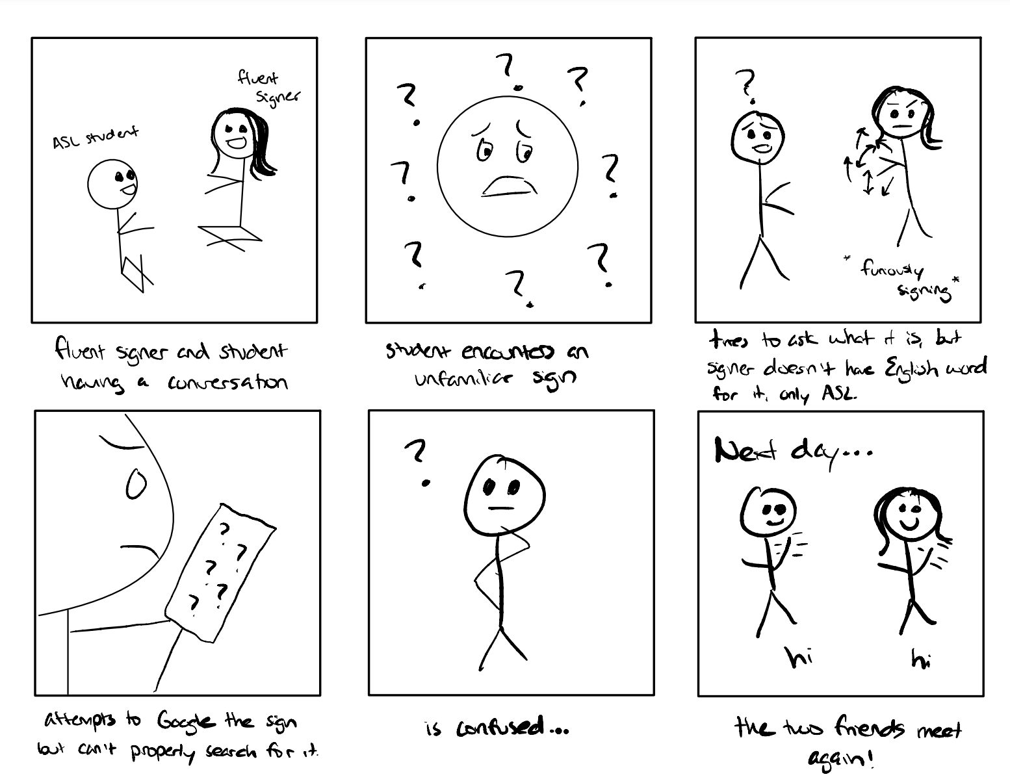

Slide 23
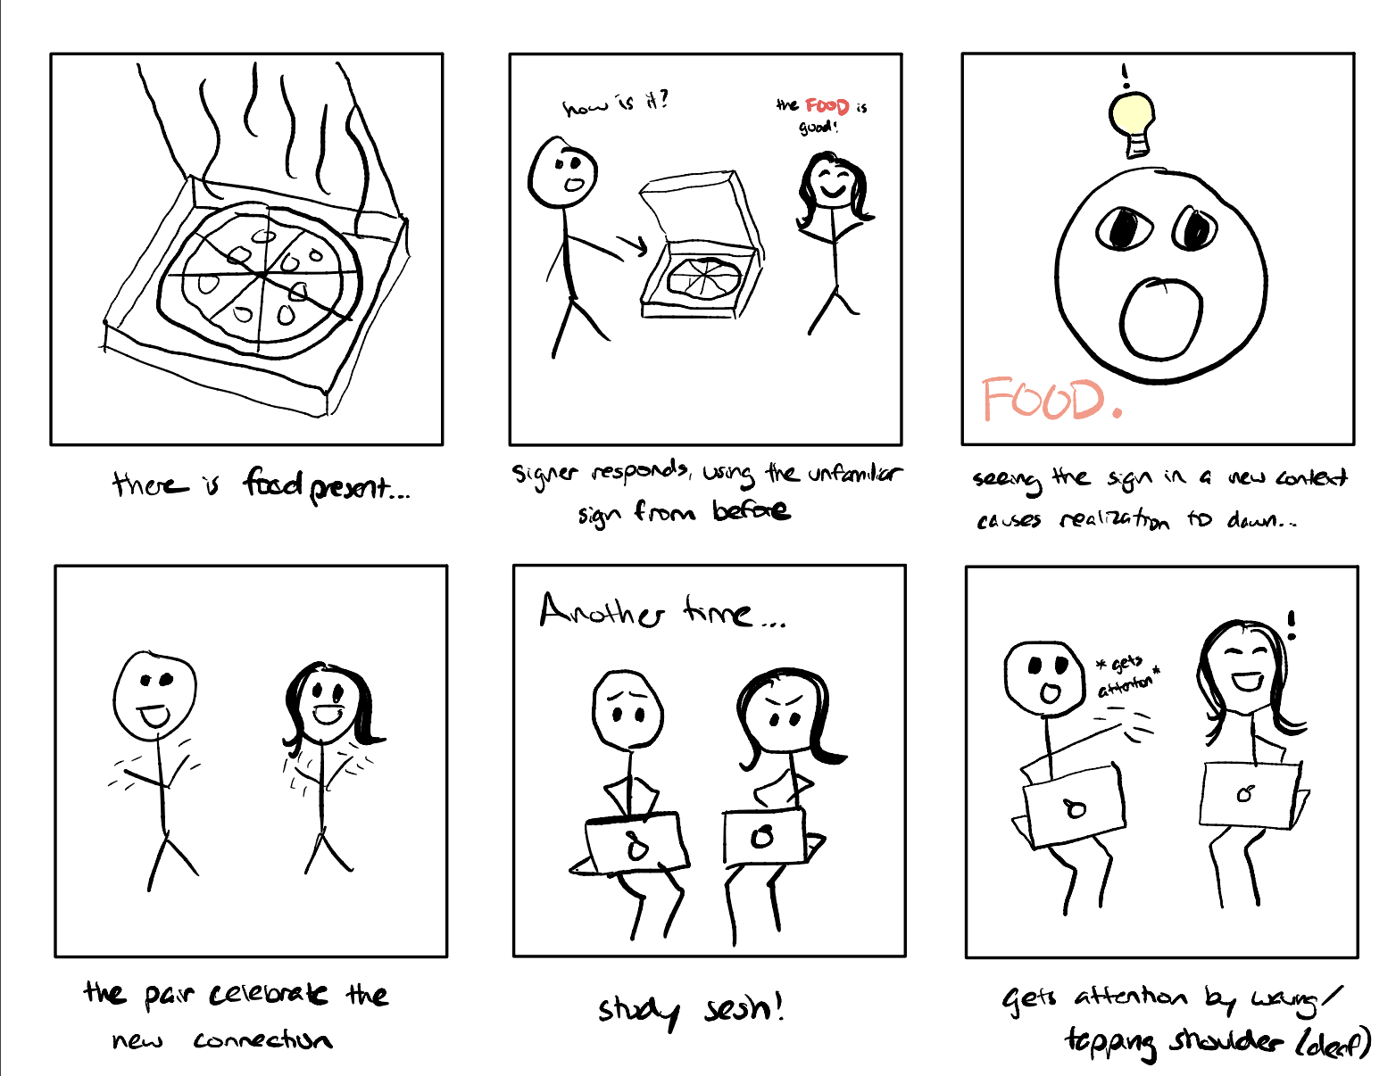

Slide 24
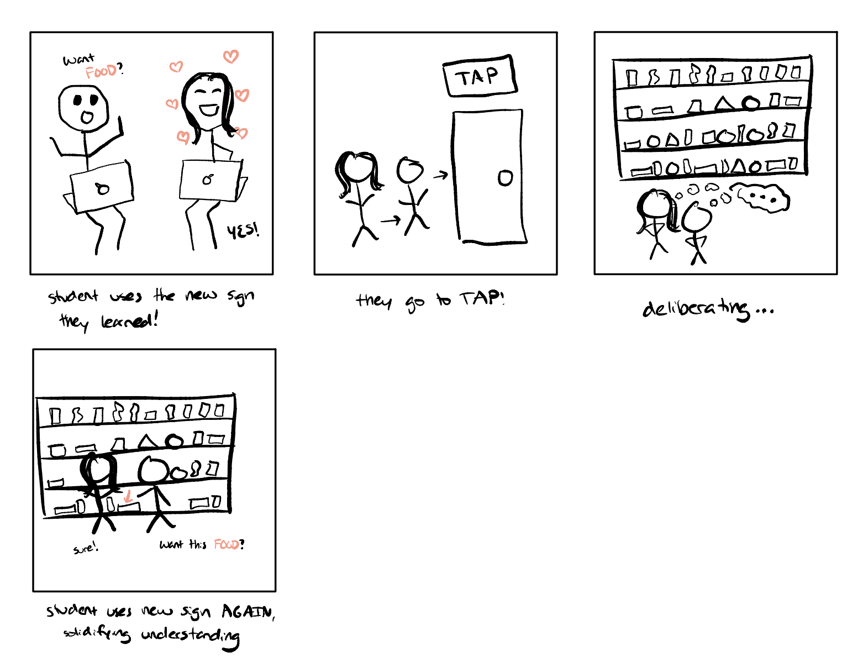

Slide 25
Concept Video.

Slide 26
