Slide 1




Preserving Language: Challenges with ASL
By: Jen, Arjun, & Dria

Slide 2
Table of contents
01
02
03
04
05
Introduction
Needfinding Methodology
Interview Results
Analysis
Summary

Slide 3
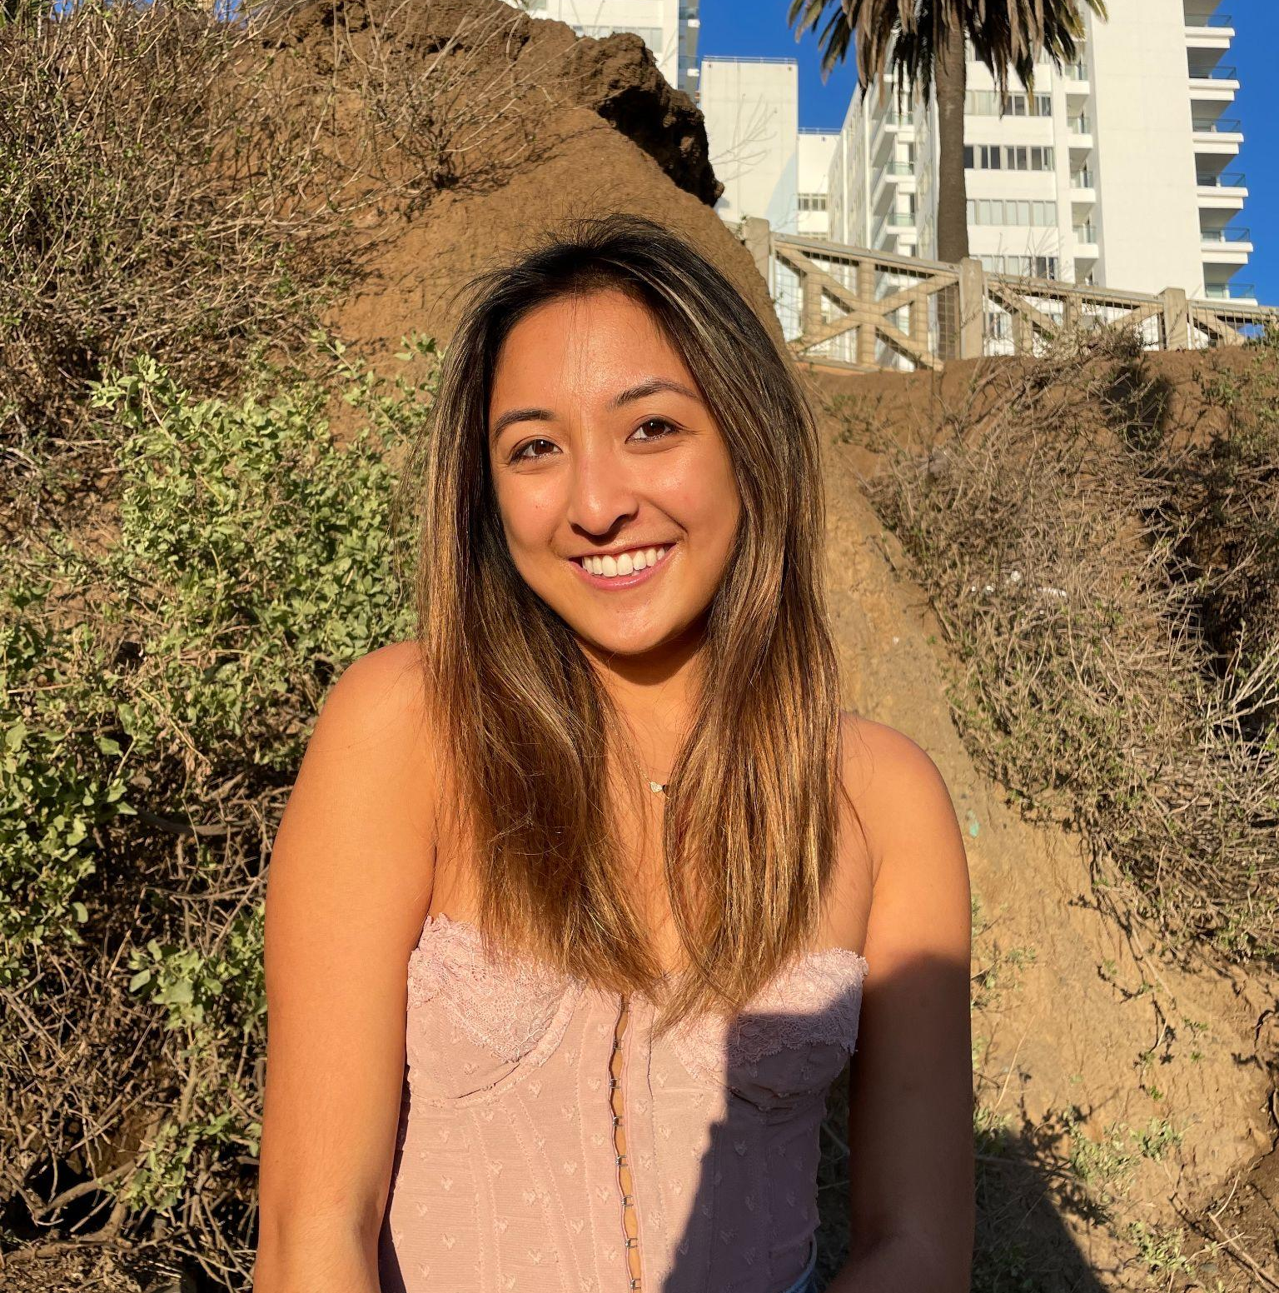
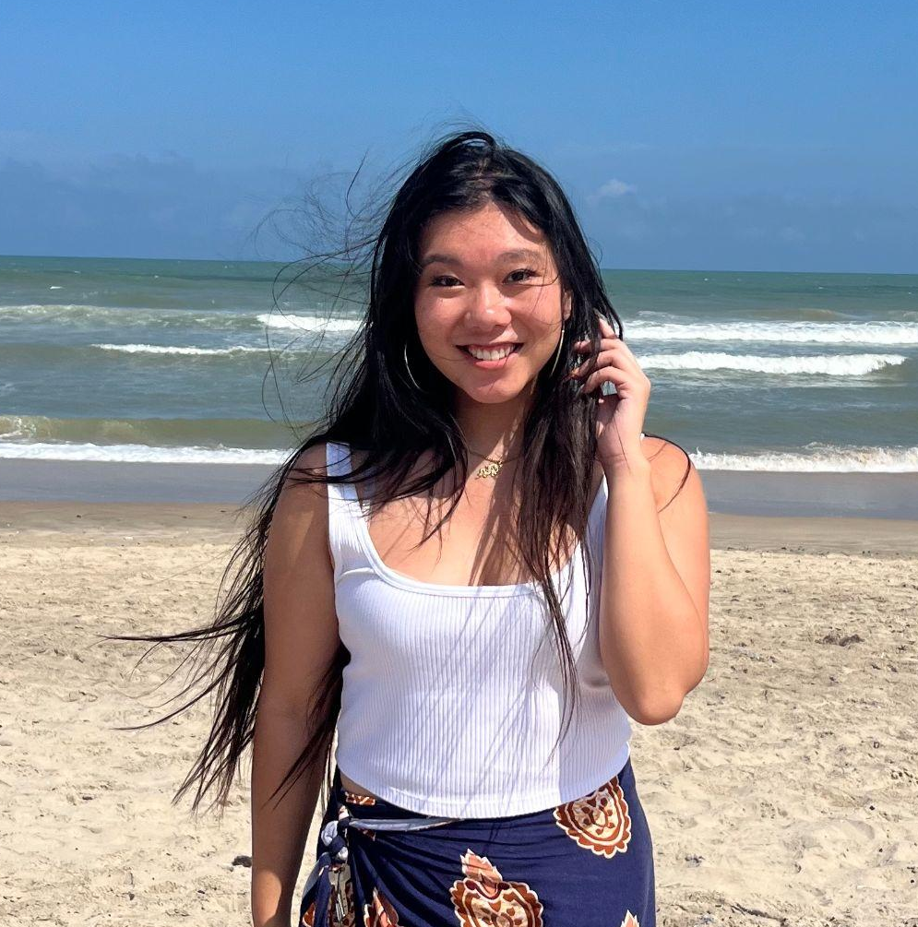
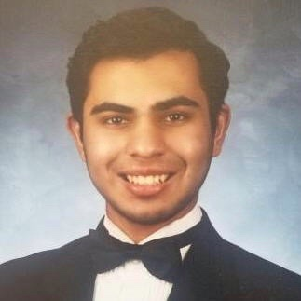

Our Team
Dria Lee
Senior
Product Design
San Francisco, CA
Jennifer Fung
Senior
Symbolic Systems
Antioch, CA
Arjun Sharma
Junior
Computer Science
Santa Clara, CA
Notes:
Introducing team members

Slide 4
Selecting our Domain
Interpretation Challenges
American Sign Language (ASL)
Preserving Language
Accessibility Challenges in Everyday Life
Notes:
Problem domain: language preservation and American Sign Language. Raises questions about access and effective interpretation. Chose this domain because Jennifer’s first language is ASL.

Slide 5

Needfinding Methodology

Slide 6
Looking for Participants
Non Stanford Students
Affiliated with the Deaf Community
Interpreters, native signers, students
Diversity
Age, gender, ASL experience and background
Notes:
Participants:
Q: Why were they chosen/why are they appropriate?
A: they were an ASL user and had some kind of connection with the deaf community
Q: How were they recruited/compensated?
A: My acquaintances or acquaintances of family friends

Slide 7
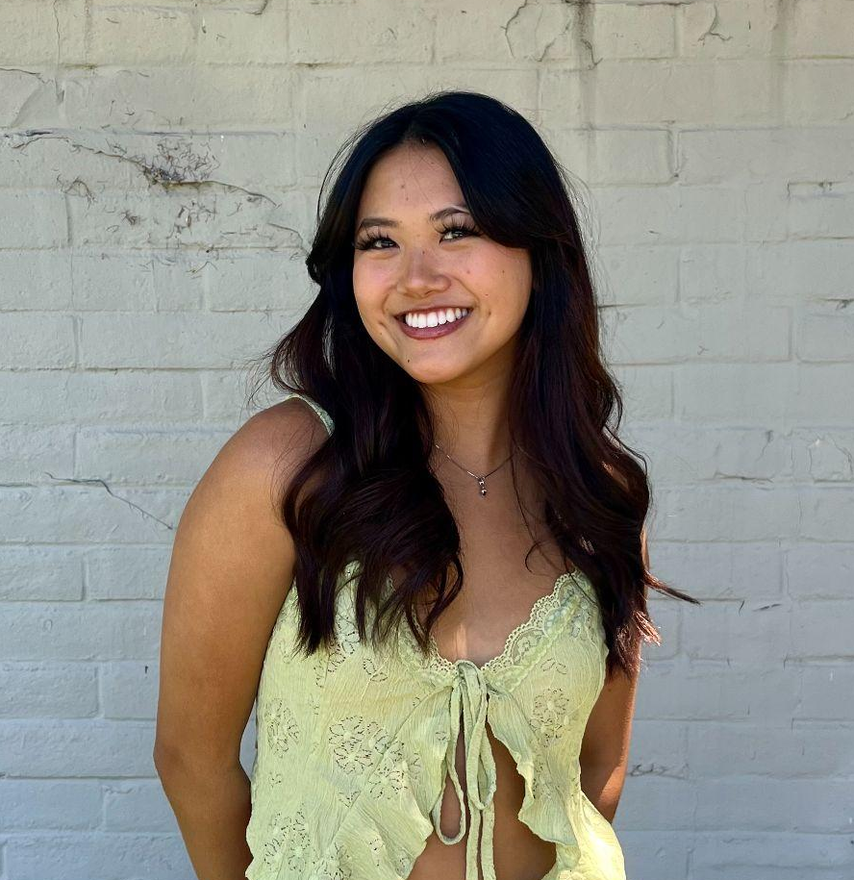
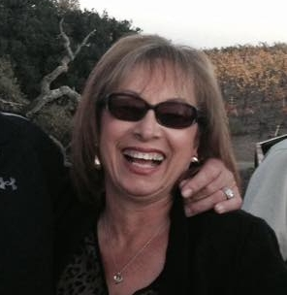
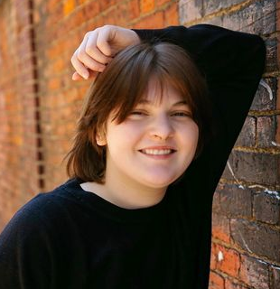
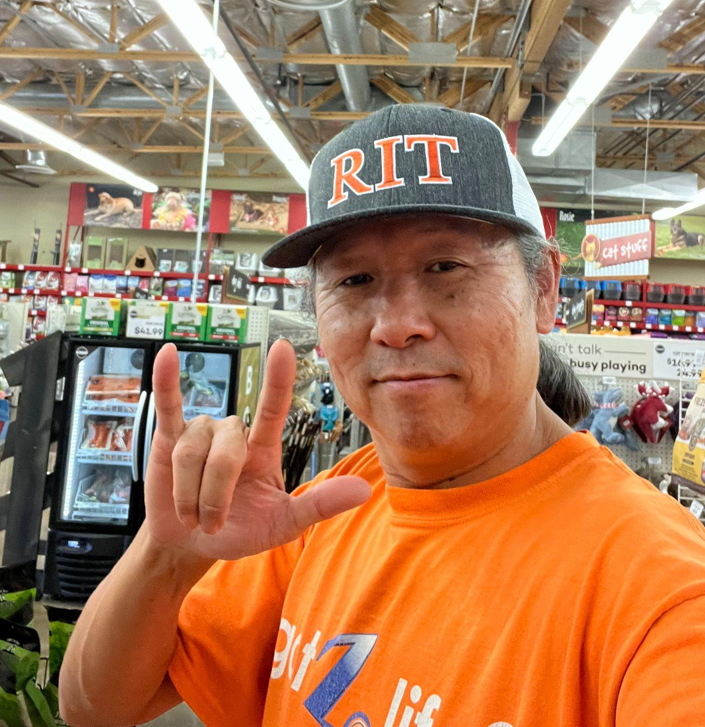
We spoke to…
Melanie Lu
ASL Student
6 years of experience
Juanita Nickerson
ASL Interpreter
25 years of experience
Trin Nobles
ASL Student (hard of hearing)
3 years of experience
Kin Lin
Born deaf and native signer
Notes:
Q: Where were the interviews conducted?
A: Melanie, Juanita, and Trin’s interviews were on campus while Kin Lin’s interview was through FaceTime
Q: Who was your “extreme user”? In what axis are they extreme?
A: Kin Lin is our extreme user as a deaf individual and a native signer who uses ASL as his primary language

Slide 8
We asked them…
What aspects of being an ASL interpreter do you find most rewarding and most challenging?
What motivated you to start learning ASL?
How do you define personal empowerment as a Deaf individual?
What linguistic or cultural aspects of ASL surprised you?
How has ASL played a role in your life and interactions with others?
Notes:
Q: What did you ask? Team member roles for each interview, any equipment or software used.
A: Jennifer conducted the interviews and used otter.ai to transcribe the interviews.
B. Dria analyzed the interviews and organized the content, prioritizing interesting quotes for the empathy maps.
C: Arjun analyzed the interviews and populated the empathy maps

Slide 9
Interview Results

Slide 10

“She looked at me and she signed she was deaf, and I signed back to her. And her jaw dropped.
I just made a part of everyday life a little bit easier and more accessible for them.”
Melanie Lu
ASL Student
6 years of experience

Slide 11
“If your heart’s not in it, don’t do it. Turn around and walk out the door.“
“In this profession, you are literally someone’s voice.”
Juanita Nickerson
ASL Interpreter
25 years of experience
Notes:
Jen interviewed and transcribed conversation. Dria analyzed conversation and took key notes. Surprised she thought ASL would be her easy class in college.

Slide 12
“Sign Language isn’t just signed English. It’s an adult language.”
“Deafness has a whole culture around it.
It’s not just a lack of hearing, it’s also respect and learning from one another.”
Trin Nobles
ASL Student
3 years of experience

Slide 13
“People have misconceptions about deaf people like thinking that deaf people can’t drive. We have eyes, we can see the road.
I don’t let hearing people tell me that I can’t do anything.”
Kin Lin
Born deaf
Native ASL speaker
Notes:
Extreme User, born deaf and native ASL speaker! Jen - Translator, Jen’s family friend. Surprised that he is very fulfilled and does not feel any limitations with speaking ASL.

Slide 14
Analysis
Notes:
At least 1 empathy map + key insights, observations, and inferences

Slide 15
Surprises
ASL is a completely different language from English. Thus, conceptually accurate interpretations (ASL) are not the same as word for word translations (Signed Exact English or SEE).
There is a halfway point between ASL and SEE called PSE (Pidgin Signed English) that follows English syntax rules but uses ASL vocabulary.
Sign languages are not universal, they are regional. While the US, England, and Australia are all English-speaking countries, each country has its own sign language. ASL is derived from French Sign Language.

Slide 16
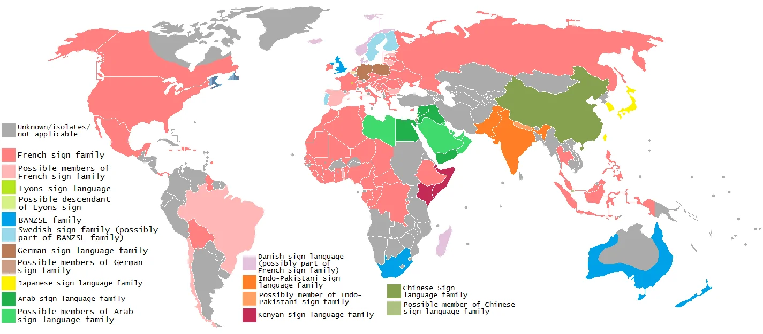
Notes:
ASL is a completely different language from English. Thus, conceptually accurate interpretations (ASL) are not the same as word for word translations (Signed Exact English or SEE).
There is a halfway point between ASL and SEE called PSE (Pidgin Signed English) that follows English syntax rules but uses ASL vocabulary.
Sign languages are not universal, they are regional. While the US, England, and Australia are all English-speaking countries, each country has its own sign language. ASL is derived from French Sign Language.

Slide 17
Contradictions
While some deaf people identify as disabled, others push back against this label as a form of self-empowerment.
Not all deaf people use sign language. Some (typically those with assistive technology or late-deafened individuals) use alternate methods of communication like lip-reading. Some use both.
Some deaf people prefer literal translations for the sake of preserving the original message while others prefer that interpreters focus on interpreting the meaning behind the message.

Slide 18
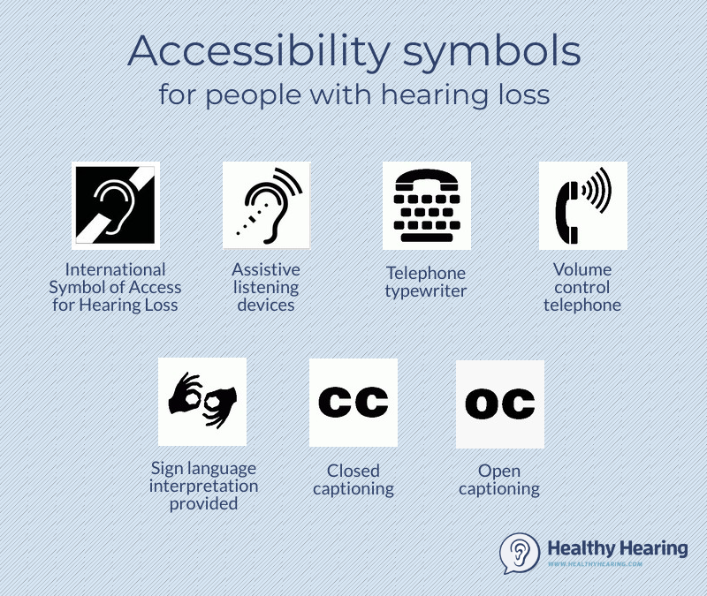
Notes:
While some deaf people identify as disabled, others push back against this label as a form of self-empowerment.
Not all deaf people use sign language. Some (typically those with assistive technology or late-deafened individuals) use alternate methods of communication like lip-reading. Some use both.
Some deaf people prefer literal translations for the sake of preserving the original message while others prefer that interpreters focus on interpreting the meaning behind the message.

Slide 19
T
E
N
S
I
O
N
S
Advanced ASL students that have a strong desire to continue learning often feel stranded if they don’t have a Deaf community to immerse themselves in.
While interpreters are committed to access, not every client will find them to be the right fit for them (depending on accent, style, etc).
Interpreters often face ethical challenges when it comes to being a neutral party.
The barrier between the hearing and deaf community is a linguistic one, rooted in the lack of a shared language.
Some people find the distinction between deaf and Deaf to foster a stronger sense of identify, while others find it to be divisive and invalidating.
“Lowercase d” deaf refers to the medical condition of hearing loss, while “capital D” Deaf refers to those who identify as not only physically deaf, but also take pride in being culturally Deaf.

Slide 20
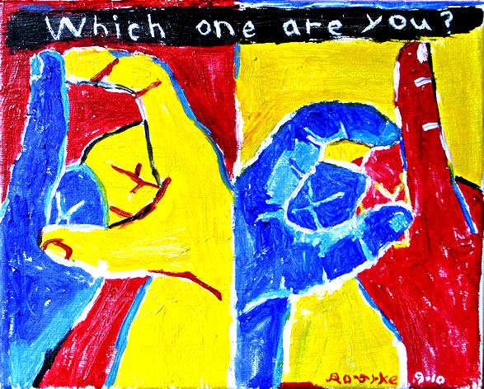
Notes:
Advanced ASL students that have a strong desire to continue learning often feel stranded if they don’t have a Deaf community to immerse themselves in.
While interpreters are committed to access, not every client will find them to be the right fit for them (depending on accent, style, etc).
Interpreters often face ethical challenges when it comes to being a neutral party.
The barrier between the hearing and deaf community is a linguistic one, rooted in the lack of a shared language.
Some people find the distinction between deaf and Deaf to foster a stronger sense of identify, while others find it to be divisive and invalidating.
“Lowercase d” deaf refers to the medical condition of hearing loss, while “capital D” Deaf refers to those who identify as not only physically deaf, but also take pride in being culturally Deaf.

Slide 21
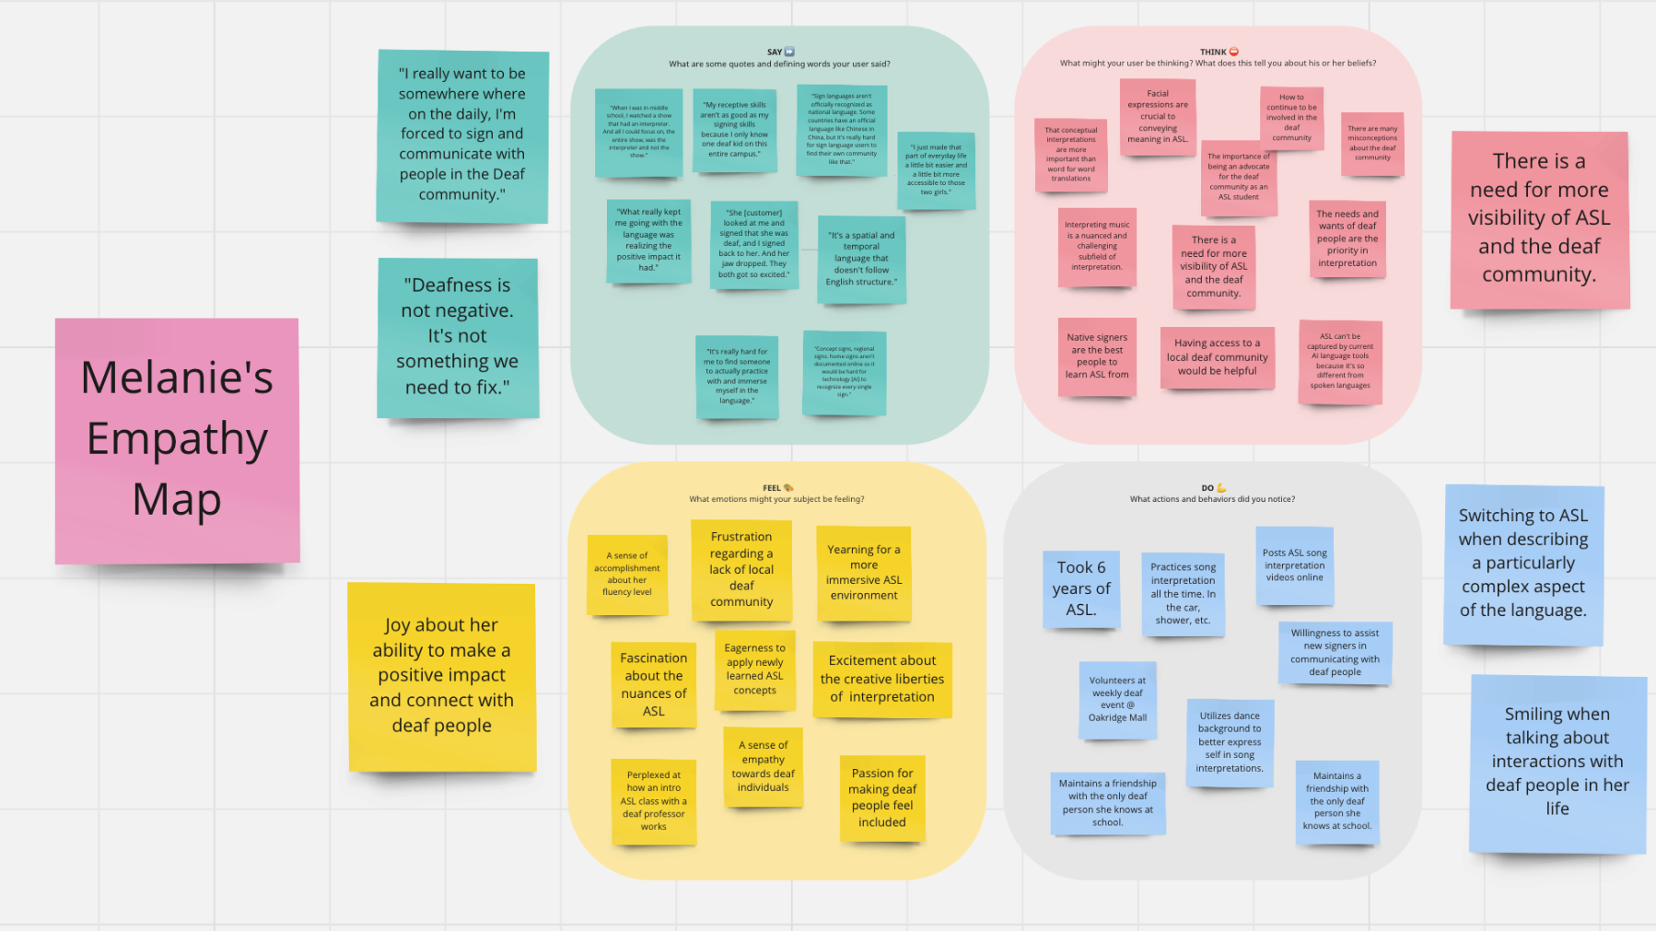
Notes:
Empathy Map

Slide 22
Insight:
Need:
ASL students feel like they’ve hit a wall when they reach the end of their ASL courses.
Without a space for continued practice and feedback, they are unable to put their newfound knowledge to use or develop a higher level of fluency.
ASL students need post-course completion support in finding an immersive environment where they can consistently practice ASL and develop their relationship with the Deaf community.
Notes:
Empathy Map

Slide 23
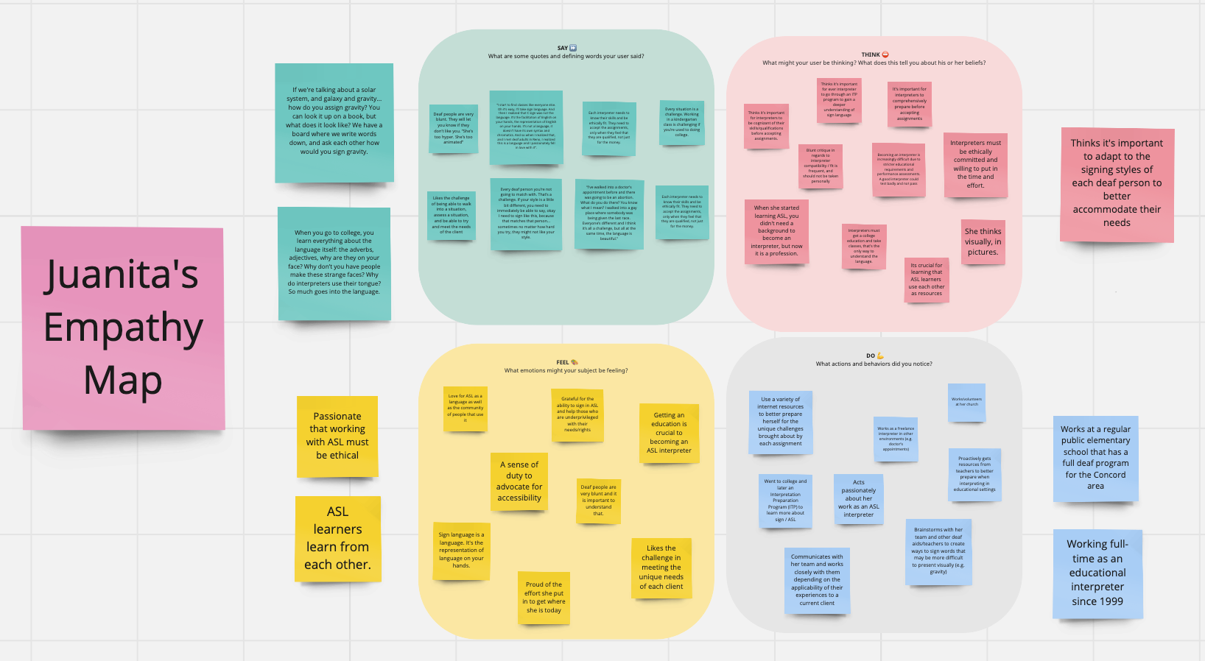
Notes:
Empathy Map

Slide 24
Insight:
Need:
The many misconceptions about ASL and deafness have a negative impact on Deaf people on an individual and societal level.
We need to foster connections between non-verbal and verbal speakers, promoting mutual understanding each other and access to everyday opportunities.
Notes:
Empathy Map

Slide 25
Summary
Notes:
Key learnings + what’s

Slide 26
What we learned after interviewing 4 ASL users…
Deafness is more than a disability, it’s a cultural and linguistic identity.
ASL is a nuanced language independent from English. The meaning of a sign can change depending on facial expression and speed.
It takes a lot of empathy and commitment to learn ASL, both for verbal and non verbal speakers.

Slide 27
What’s Next?
Narrow down problem domain, focusing either on fostering community or enhancing language learning
Create HMW statements and experience prototyping
Interview more participants within our refined scope
Notes:
Key learnings + what’s

