Slide 1

TELL ME MORE
CONNECT VULNERABLY AND CONSISTENTLY
ASSIGNMENT 8
CHLOE PAE
PAIGE OLSON
GABRIEL ILUMA

Slide 2
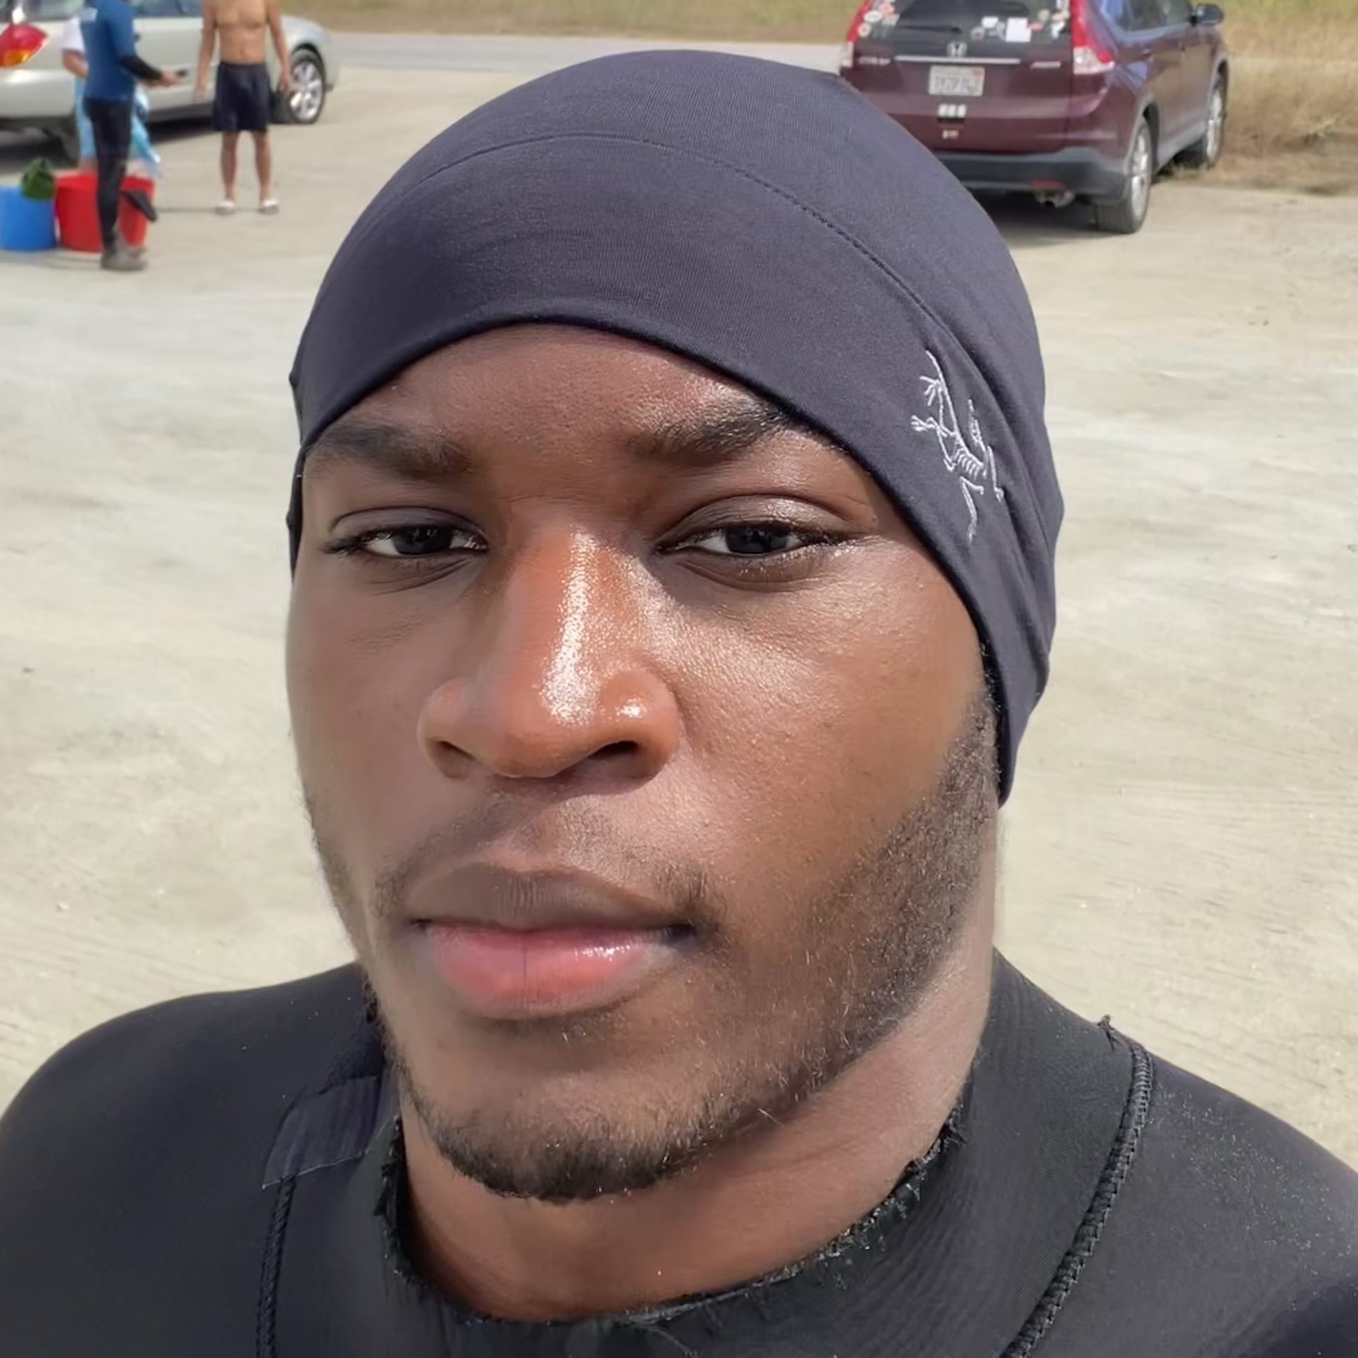
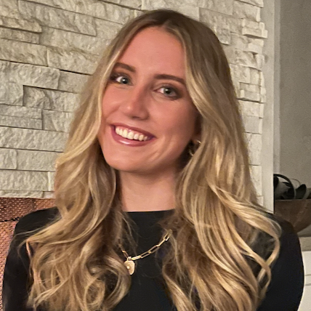
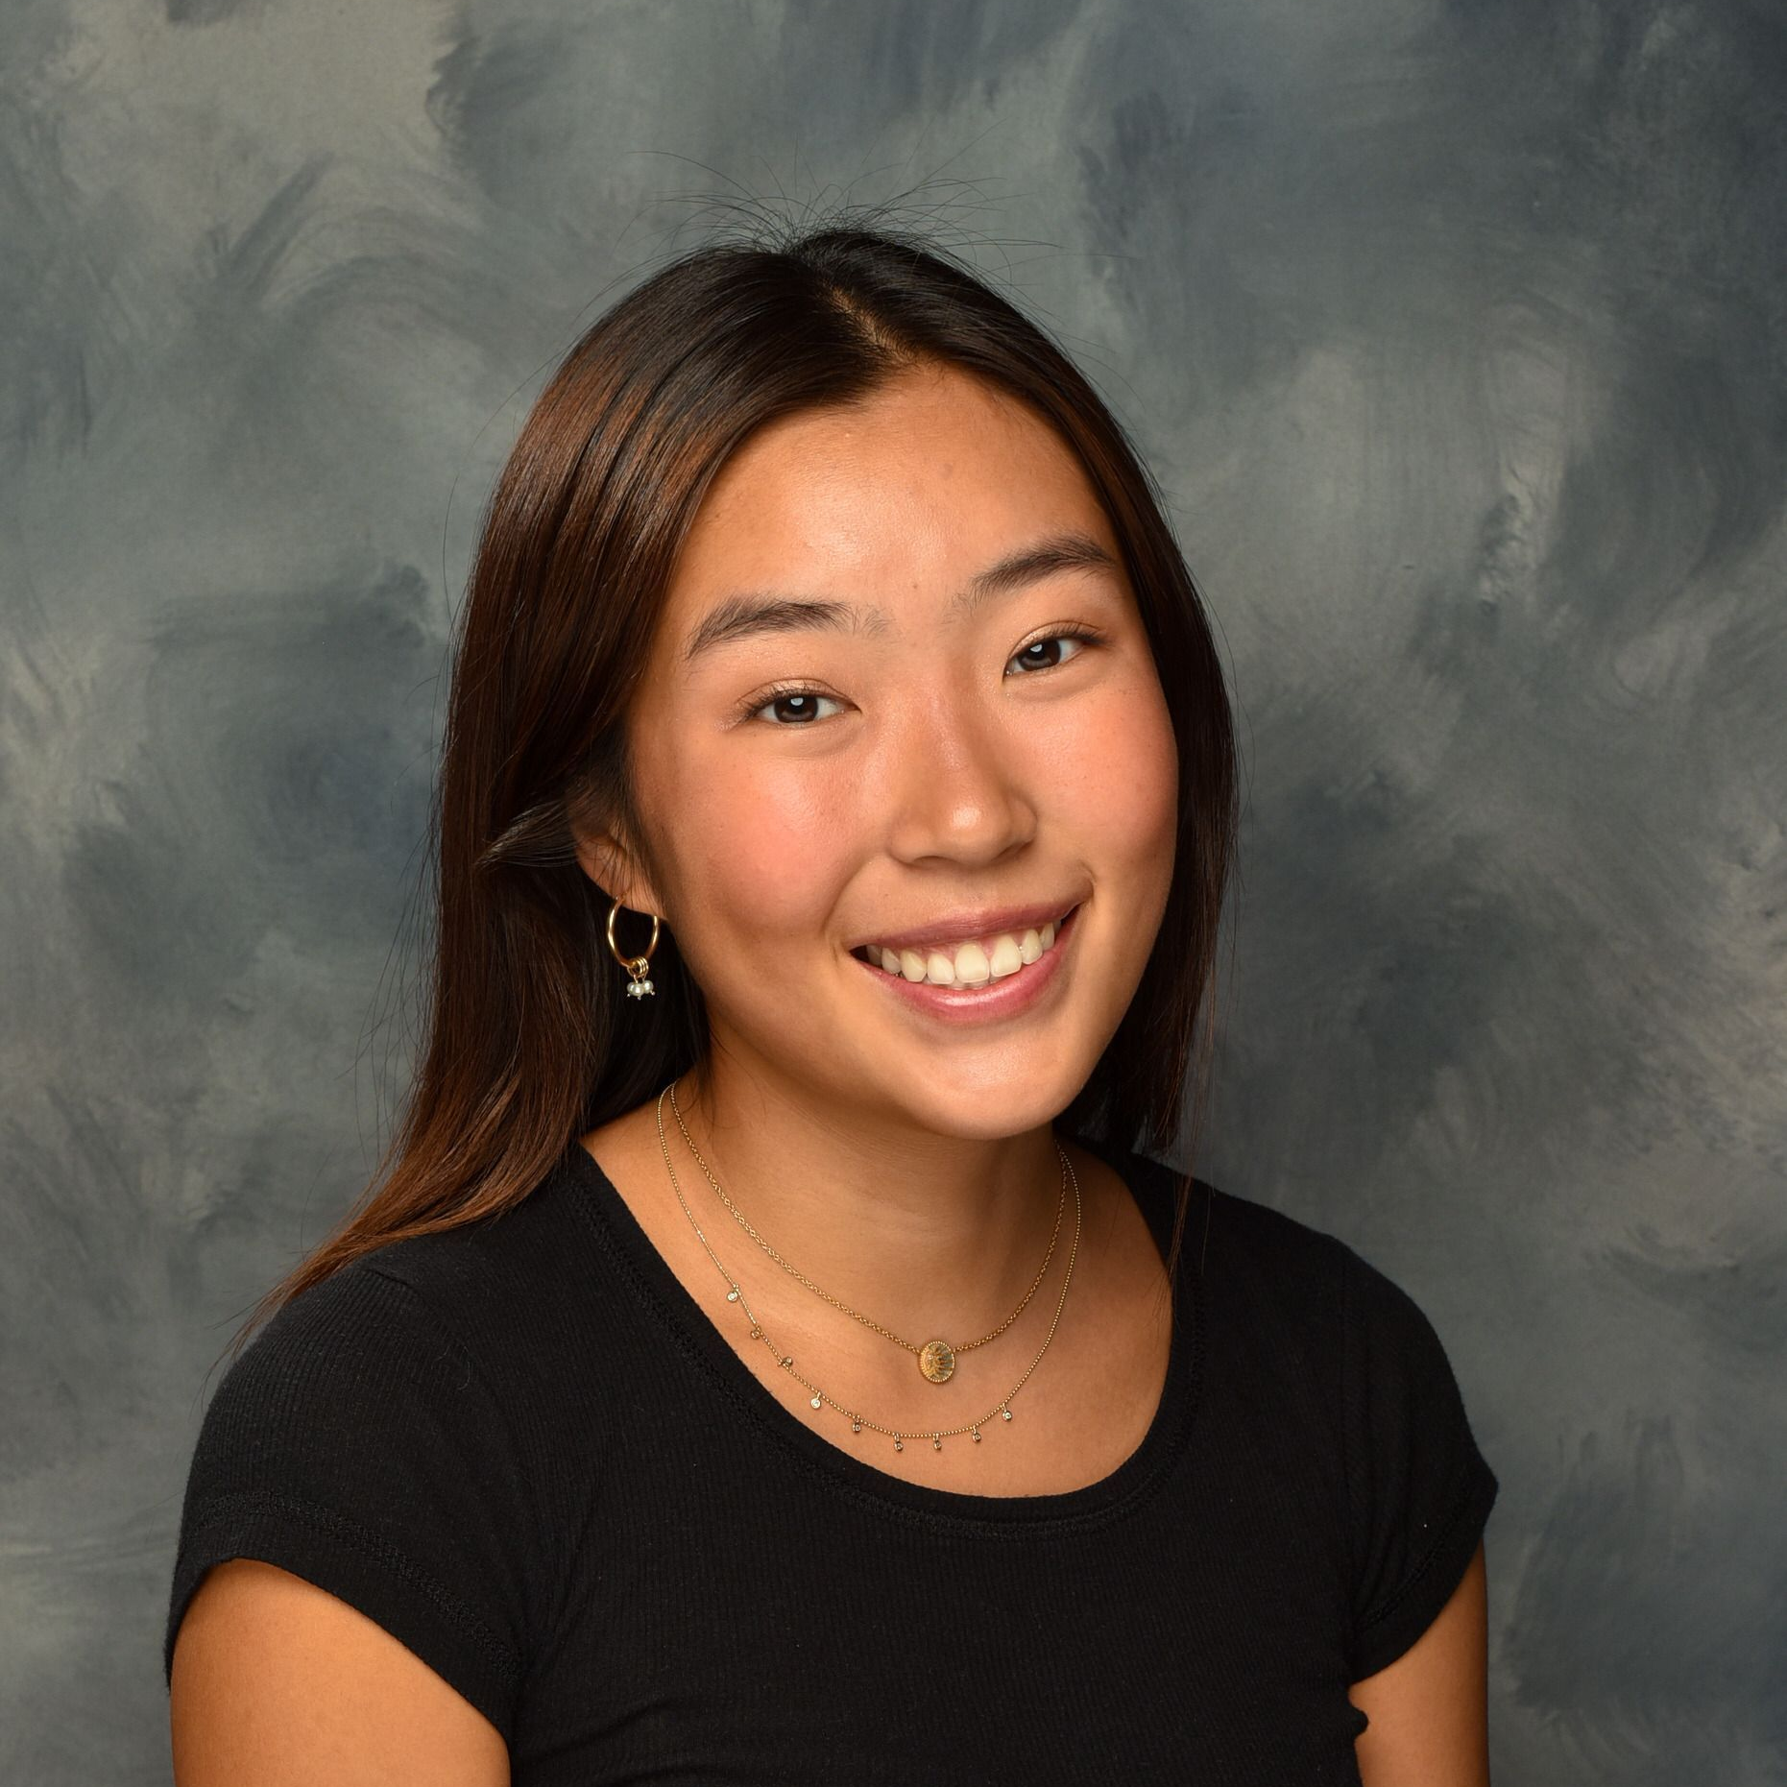
team
Gabriel Iluma
Abuja, Nigeria
Product Design & Computer Science
Class of 2024
Paige Olson
San Diego
Symbolic Systems
Class of 2024
Chloe Pae
New York City
Symbolic Systems
Class of 2024

Slide 3



Problem & Solution
PROBLEM?
Friends want to stay in touch and understand what is going on in each other's lives, but often struggle to have meaningful conversations or express vulnerabilities that could elicit support.
SOLUTION?
Tell Me More allows friends to answer a daily prompt focused on meaningful conversation, then broadcasts each friend's answer to the whole group, providing an easy outlet to express emotions or worries.

Slide 4




road map
HEURISTIC EVALUATION RESULTS
ALL UI AND PRODUCT REVISIONS
PROTOTYPE IMPLMENTATION STATUS
DEMO OF PROTOTYPE

Slide 5
heuristic evaluation results

Slide 6

53
Severity 3/4 Violations
36
Severity 1/2 Violations
32 VIOLATIONS ADDRESSED
20 VIOLATIONS ADDRESSED

Slide 7
MOST VIOLATED HEURISTICS
H3 User and Control (19)
H4 Consistency and Standards (15)
H11 Accessibility (11)

Slide 8
all UI and product revisions

Slide 9
Severity 3/4 Violation Categories
Button inconsistency
Text box inconsistency
Accessibility
Terminology
Lack of undos
Lack of instructions
Extra features (see appendix)
Figma functionality (see appendix)
Violations we did not revise (see appendix)

Slide 10
SEVERITY 3/4 VIOLATIONS
Issue #1: Button inconsistency
Heuristic | Severity | Description
H4 Consistency & Standards | 3 | “Respond now” button doesn’t match the previous “respond” button on the homepage
H4 Consistency & Standards | 3 | "Suggest a question" button does not have enough padding
H4 Consistency & Standards | 3 | "Done Adding Friends" button does not match convention of just "Done" or "Finish"
H4 Consistency & Standards | 3 | "Create Group" button is not colored in

Slide 11
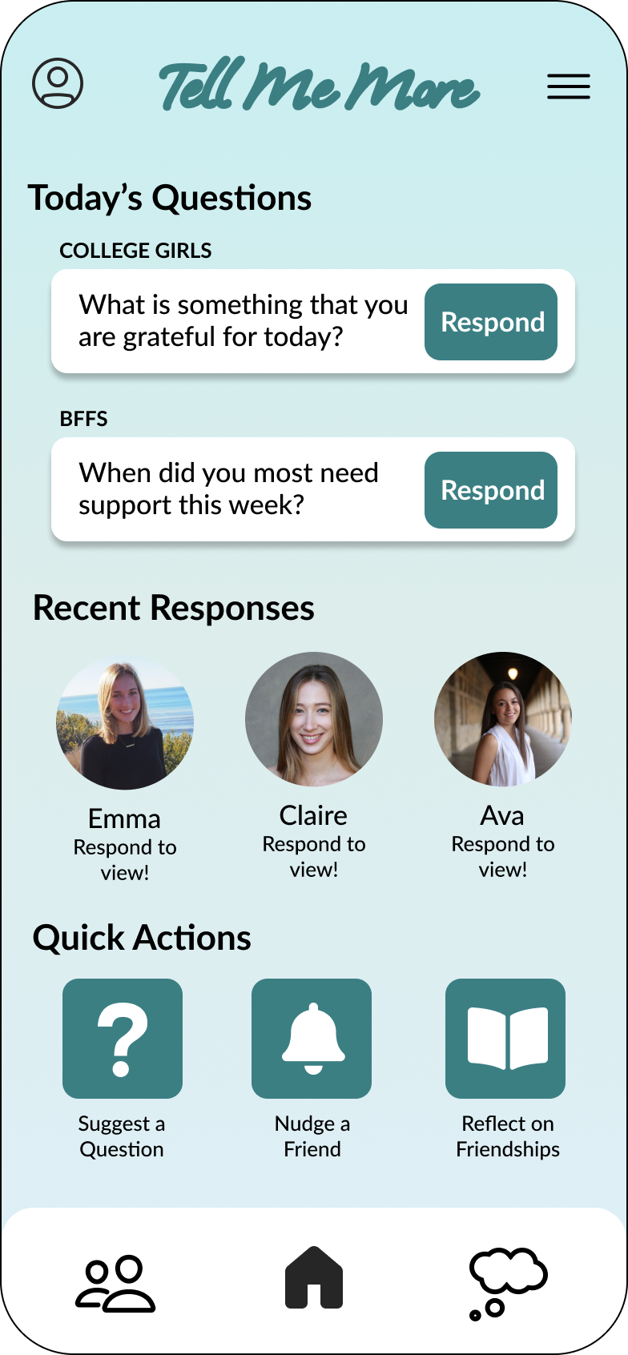
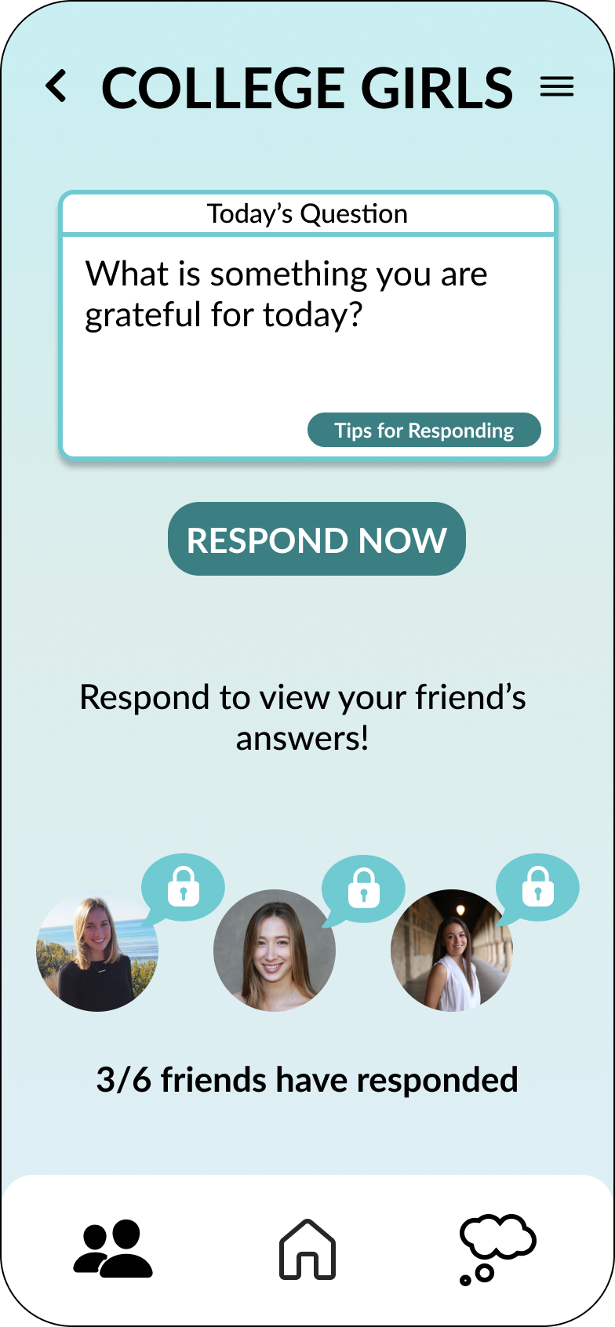

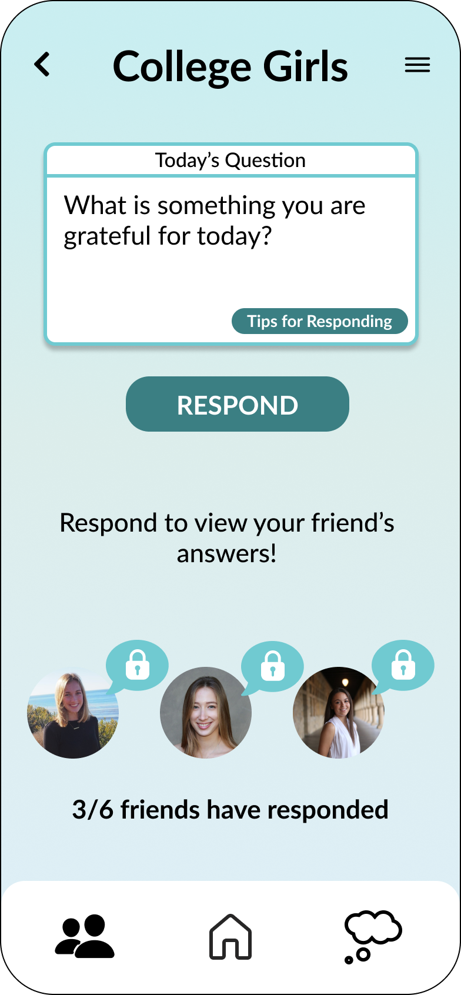
BUTTON INCONSISTENCY
Revision 1.1
Before
Home page uses "Respond" but groups page uses "Respond Now"
After
The buttons on both pages say "Respond"

Slide 12
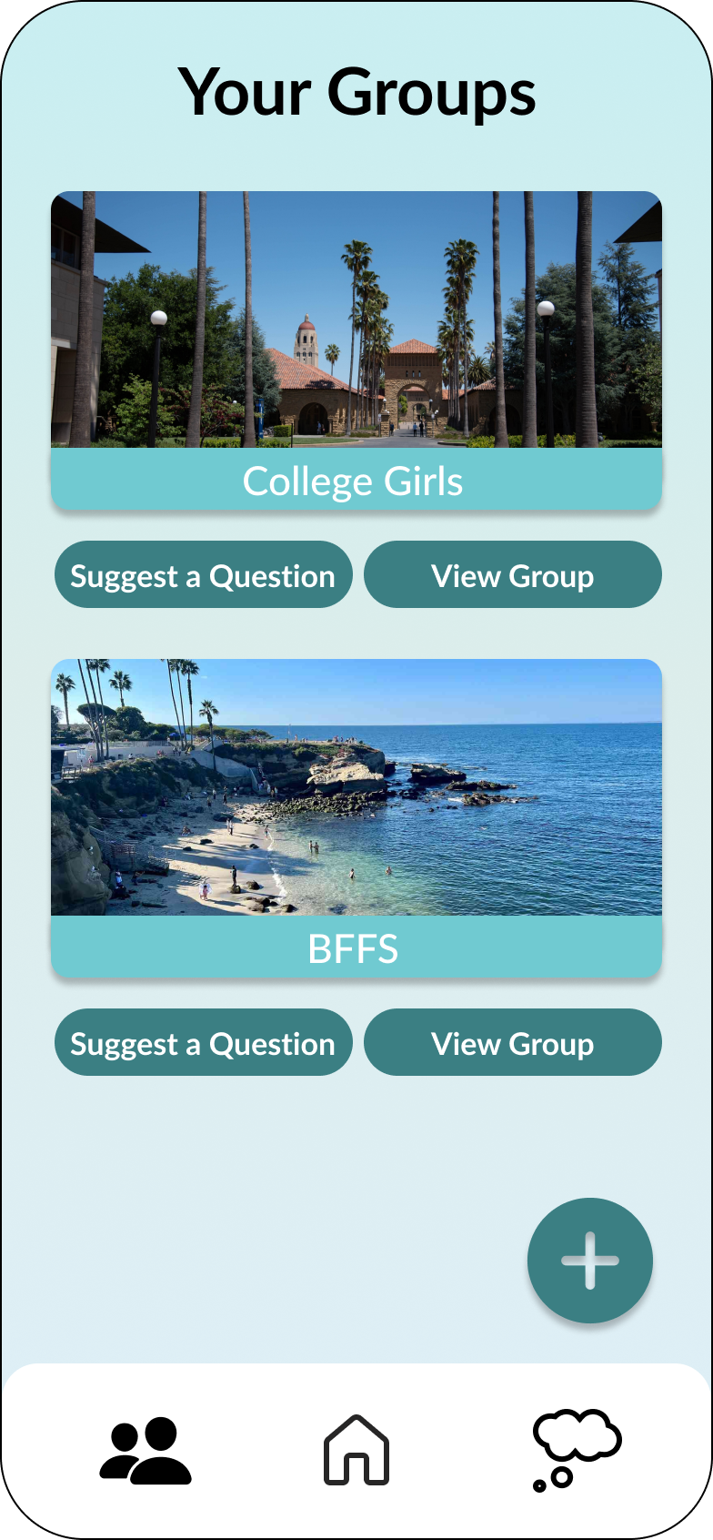
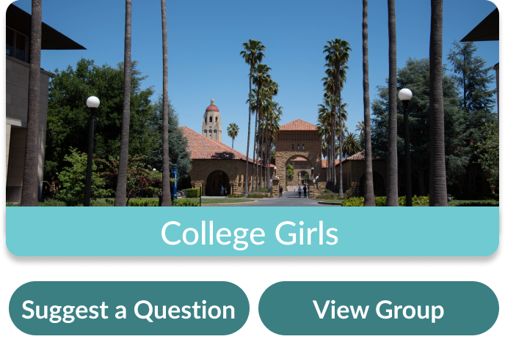
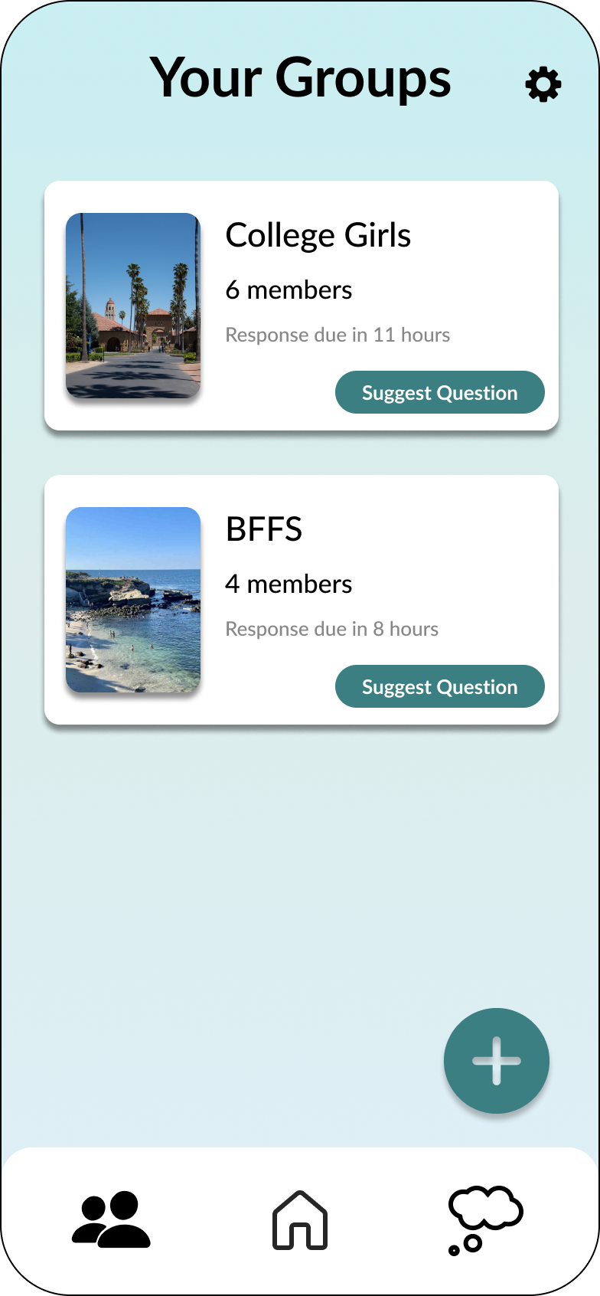
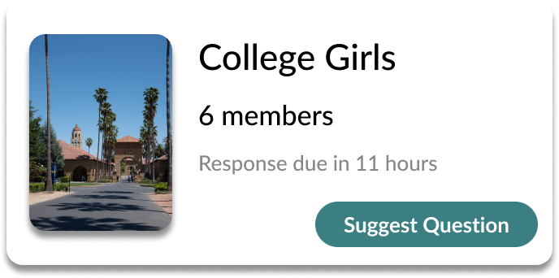
BUTTON INCONSISTENCY
Revision 1.2
Before
The padding on "Suggest a Question" is inconsistent with other buttons and looks crowded
After
"Suggest a Question" changed to "Suggest Question" to be concise and increase button padding

Slide 13
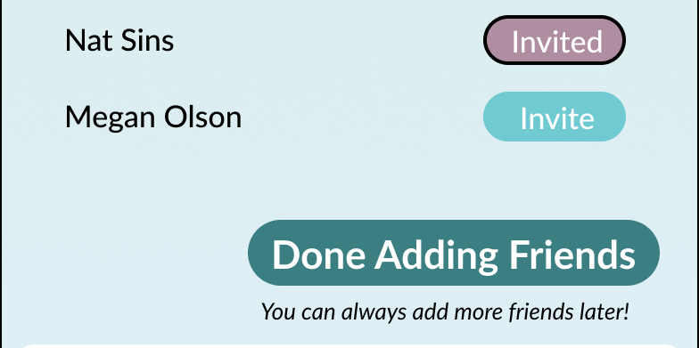
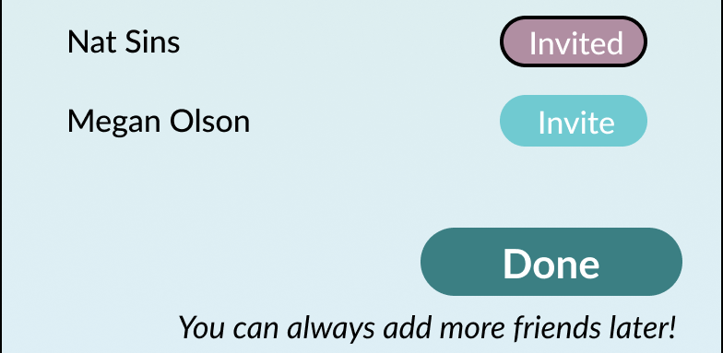
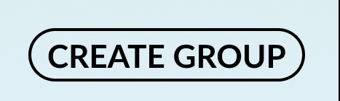
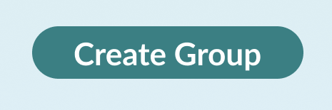
BUTTON INCONSISTENCY
Revision 1.3, 1.4
Before
"Done Adding Friends" doesn't follow convention.
After
"Done" is more consistent with other buttons.
Before
Button is in all caps and is not filled in until user has filled out the required fields.
After
Changed to match conventions.

Slide 14
SEVERITY 3/4 VIOLATIONS
Issue #2: Text box inconsistency
Heuristic | Severity | Description
H4 Consistency & Standards | 3 | The text box for responding to a prompt and suggesting a question look a little different
H4 Consistency & Standards | 3 | Some input boxes are rounded, others have square corners, some have black borders, and some have blue ones
H6 Recognition Rather Than Recall | 3 | The box where the user responds to the question has no filler text showing users that the user can type their response there

Slide 15
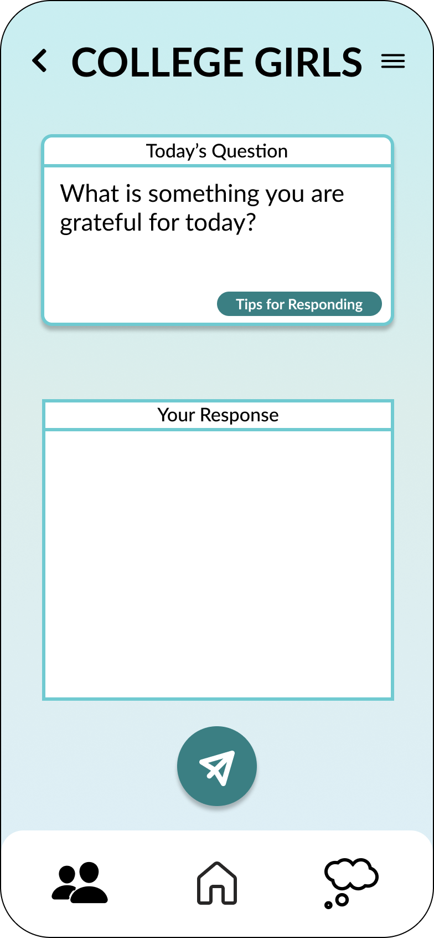
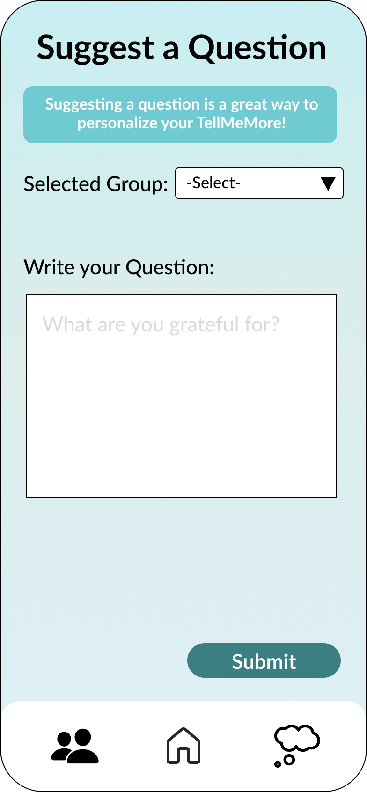
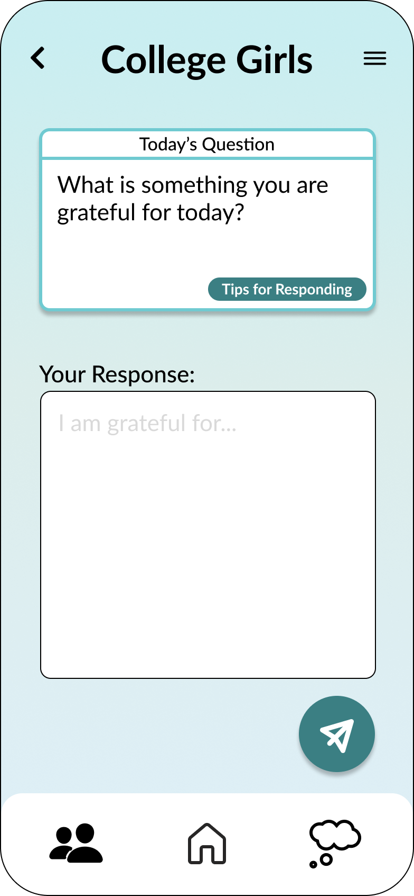
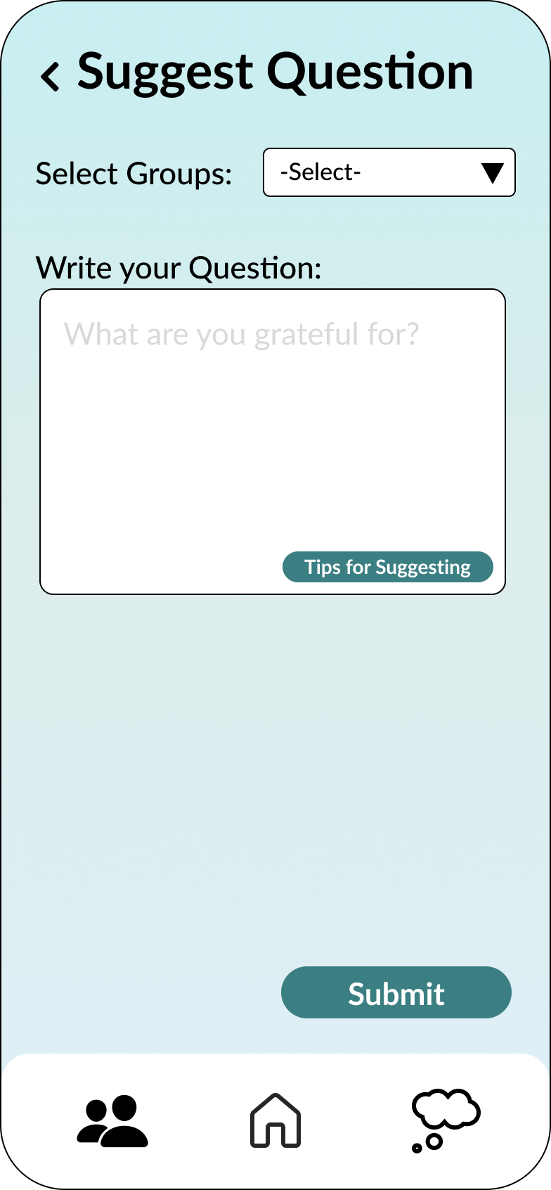
TEXT BOX INCONSISTENCY
Revision 2
Before
Text boxes have different colored borders, different prompt formatting, and different fill.
After
Text boxes are consistent in border, color, filling, and prompt.

Slide 16
SEVERITY 3/4 VIOLATIONS
Issue #3: Accessibility
Heuristic | Severity | Description
H11 Accessibility | 3 | Text in “tips for responding” button is too small to read
H11 Accessibility | 3 | Low color contrast between group names and backgrounds and suggest a question message.
H11 Accessibility | 3 | Text in the menu that pops up from the plus button was so small it was difficult to read
H11 Accessibility | 3 | The @’s and phone number text colors do not have enough contrast with the background

Slide 17
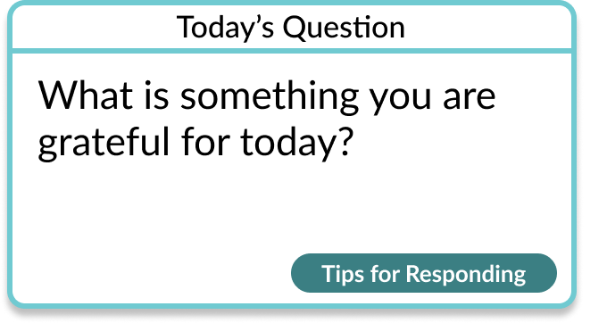
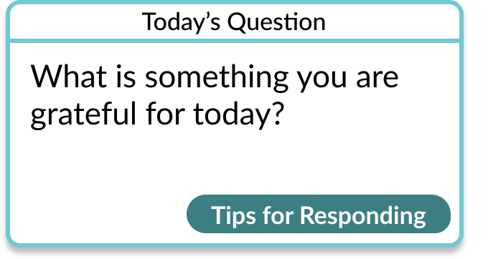

ACCESSIBILITY
Revision 3.1, 3.2
Before
"Tips for Responding" font too small.
After
Increased font size!
Before
Contrast between "College Girls" and background is too low.
After
Contrast fixed!

Slide 18
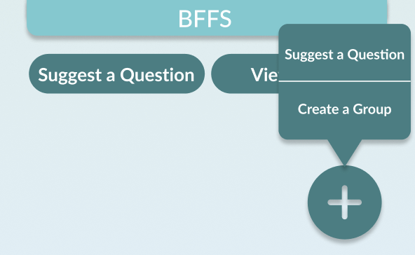
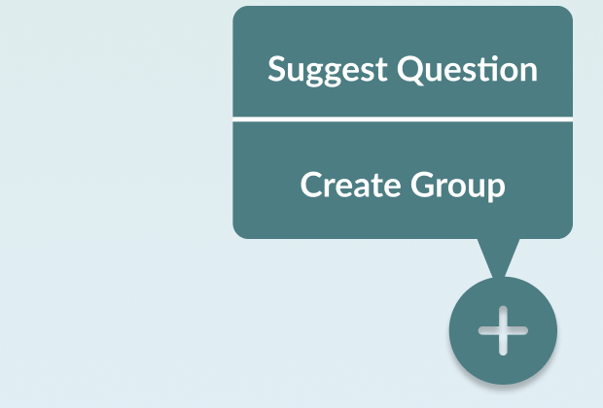
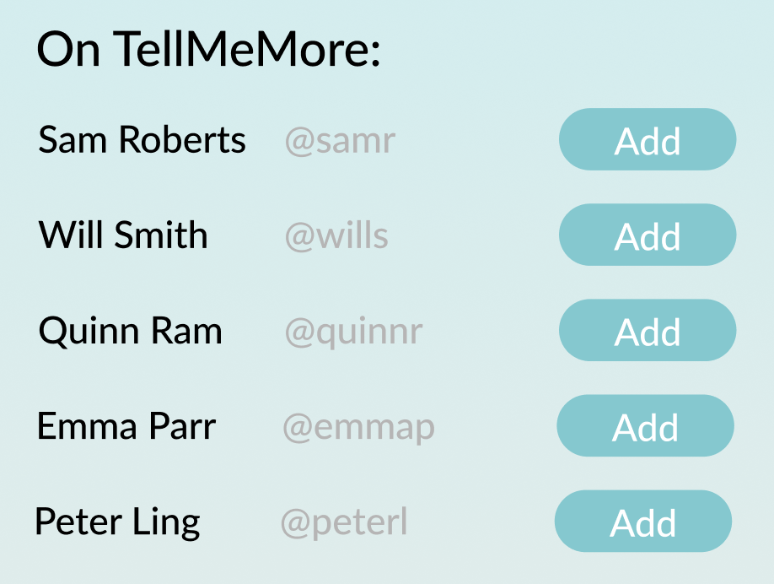
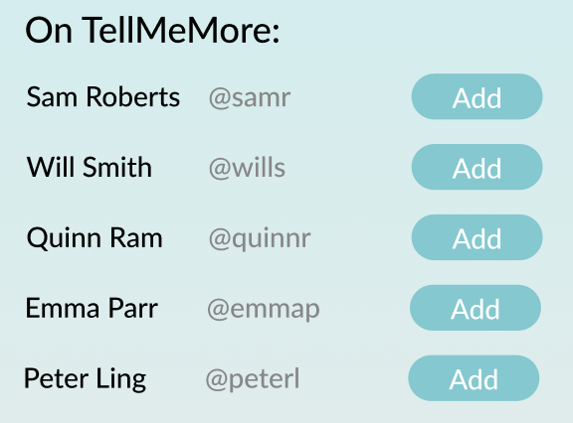
ACCESSIBILITY
Revision 3.3, 3.4
Before
Pop up font too small to read.
After
Increased font size and popup size!
Before
Contrast between usernames and background is too low.
After
Contrast fixed!

Slide 19
SEVERITY 3/4 VIOLATIONS
Issue #4: Terminology
Heuristic | Severity | Description
H4 Consistency & Standards | 3 | There is an inconsistency between invite / add friends on the create group page.
H2 Match Between System & Real World | 3 | “Cadence” is confusing as a term

Slide 20
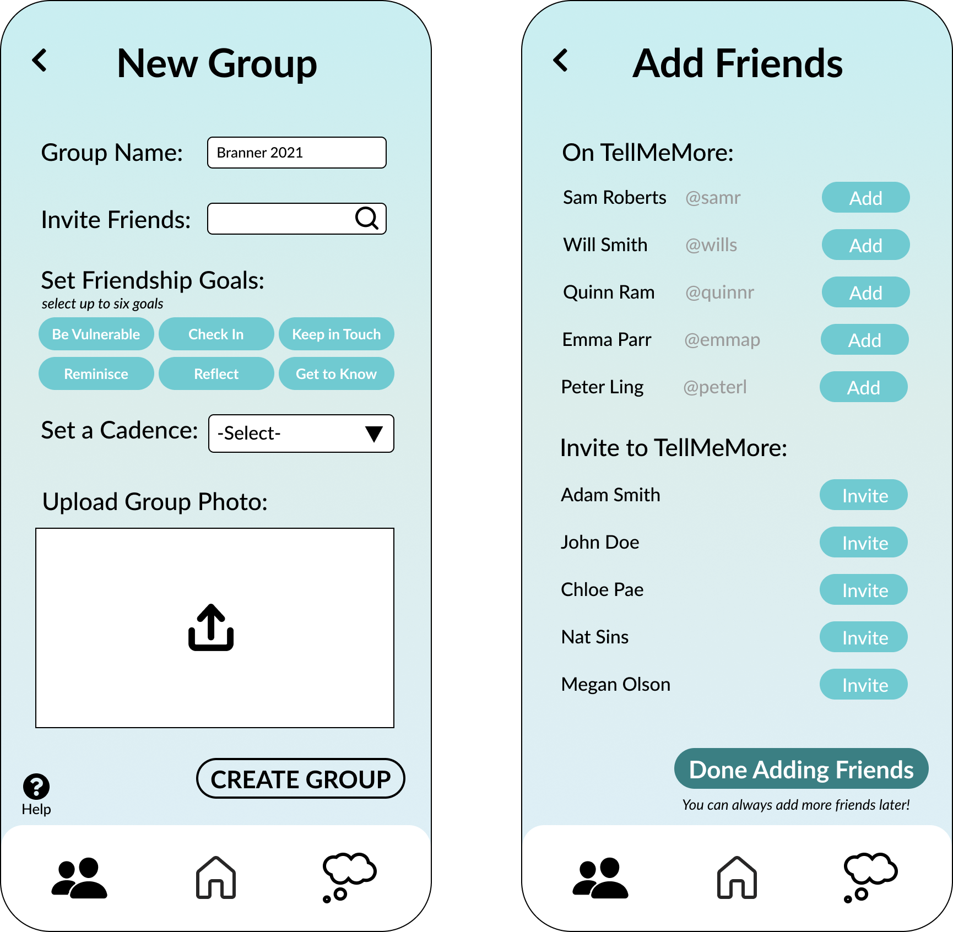
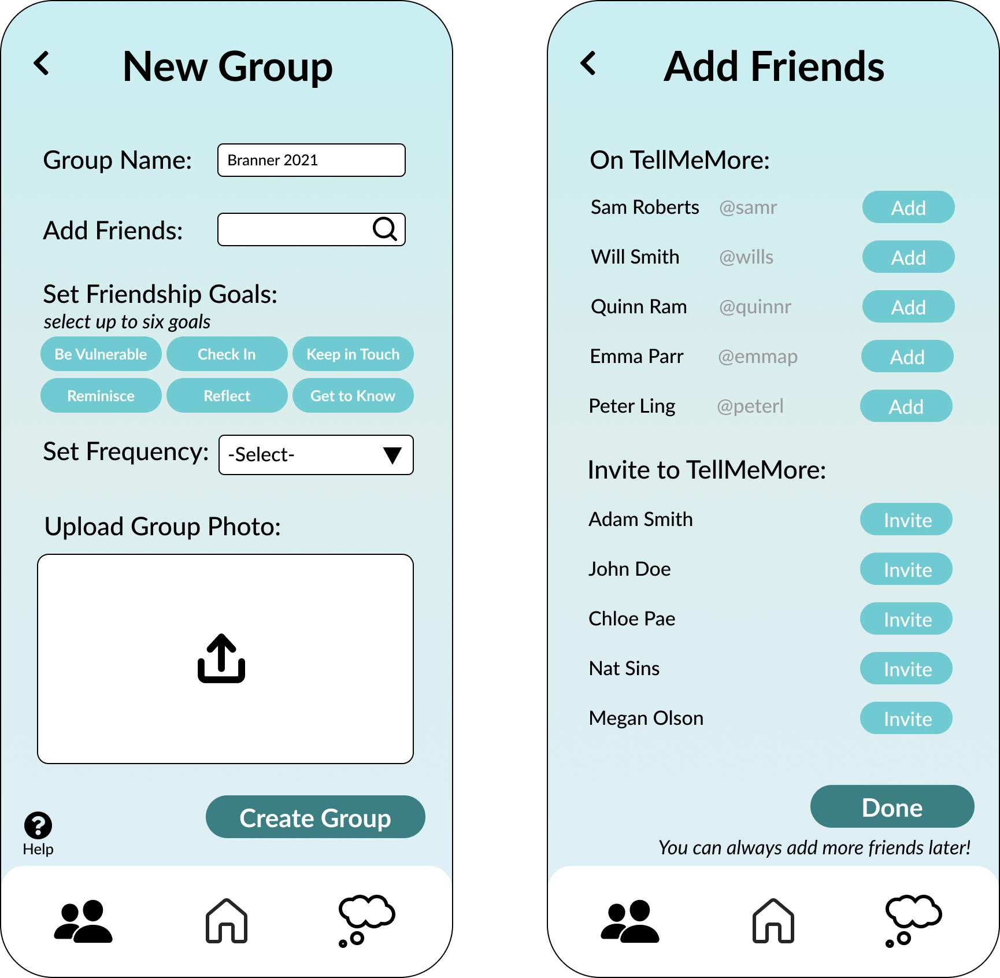
TERMINOLOGY
Revision 4.1
Before
User clicks to "Invite Friends" but is taken to a screen to "Add Friends.
After
Changed to be consistent.

Slide 21
TERMINOLOGY
Revision 4.2
Before
"Cadence" is a confusing term.
After
Changed to "Frequency."

Slide 22
SEVERITY 3/4 VIOLATIONS
Issue #5: Lack of undos
Heuristic | Severity | Description
H3 User Control & Freedom | 3 | Once the user hits send, there is no way to undo the response being sent
H3 User Control & Freedom | 3 | User cannot take back / delete a suggested question
H3 User Control & Freedom | 3 | User was prevented from exiting out of the “suggest a question” screen by the lack of back buttons
H3 User Control & Freedom | 3 | User was unable to back out of the new group page

Slide 23
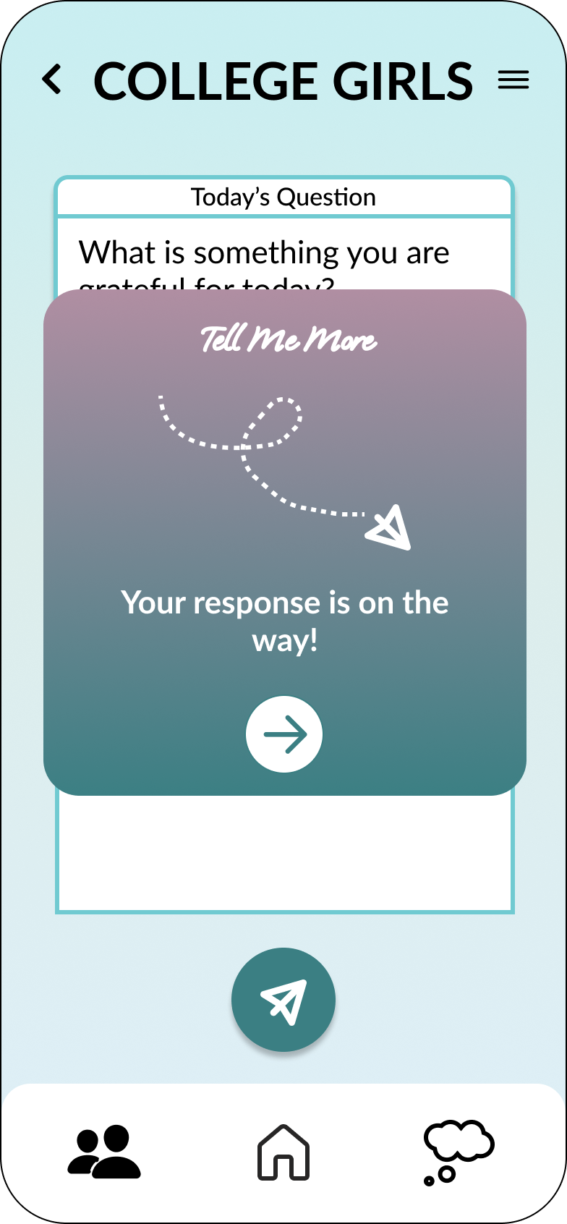
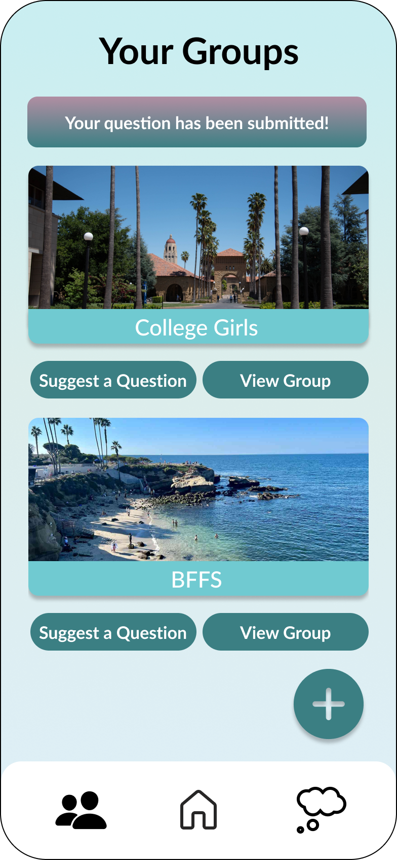
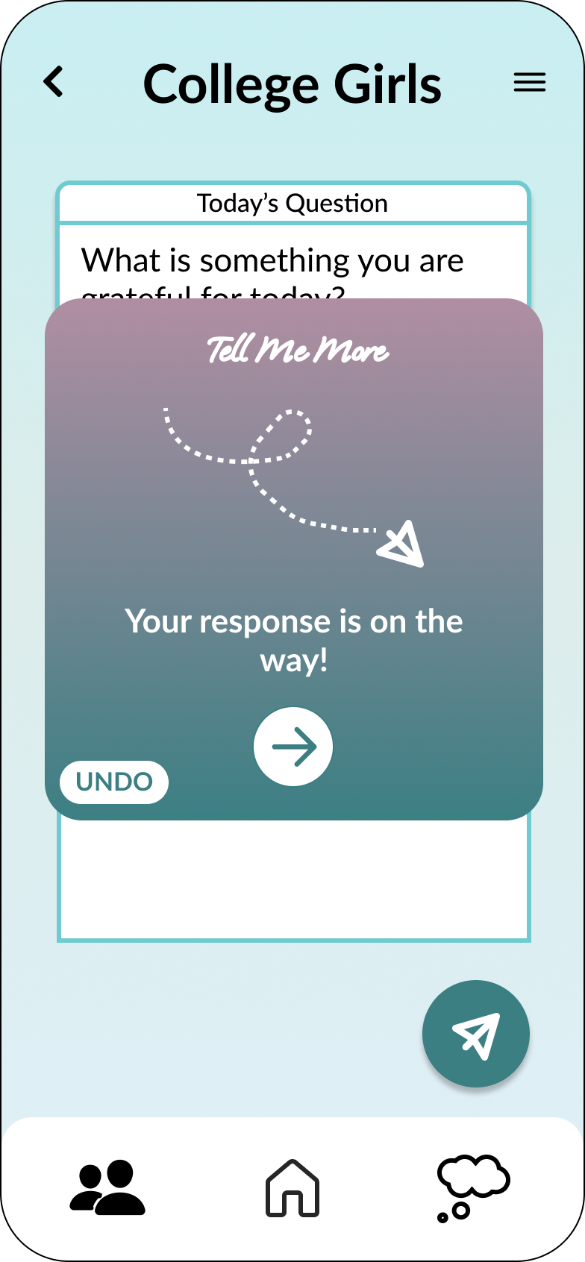
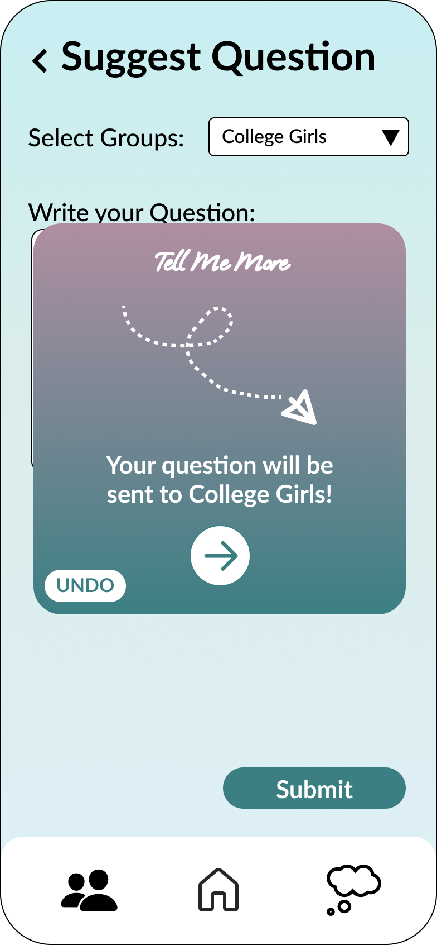
TERMINOLOGY
Revision 5
Before
No undo option for answering a prompt or suggesting a question. Back arrows missing in various places.
After
Undo options and back arrows added!

Slide 24
SEVERITY 3/4 VIOLATIONS
Issue #6: Lack of instructions
Heuristic | Severity | Description
H10 Help & Documentation | 3 | Lack of instructions leading to confusion as to what happens after a user submits a question

Slide 25
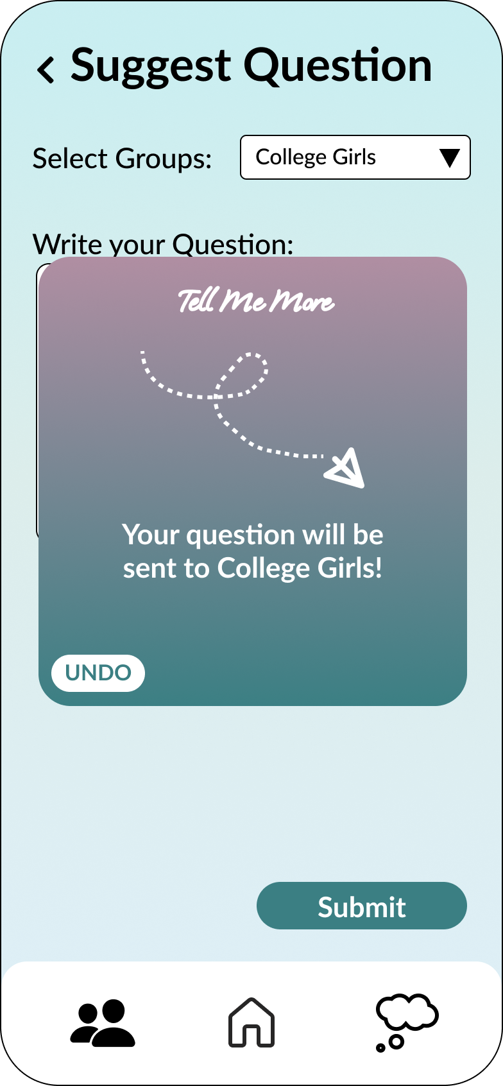
LACK OF INSTRUCTIONS - H10 HELP & DOCUMENTATION
Revision 2
Before
Pop up reads "Your question has been submitted!" but gives no other details.
After
Pop up reads "Your question will be sent to College Girls!" to provide more detail.

Slide 26
ALL UI AND PRODUCT REVISIONS
Progress Towards Usability Goals
Efficiency
We recieved good feedback from our lowfi testing and added many changes from our heuristic evaluation.
Back buttons and undos added in multiple places, decreasing time spent navigating the app.
Terminology made more clear and instructions added.
Groups Page includes more relevant information and extra buttons were deleted.

Slide 27

ALL UI AND PRODUCT REVISIONS
Progress Towards Usability Goals
Pleasing
We recieved good feedback from our lowfi testing and added many changes from our heuristic evaluation.
Added pretty and reassuring confirmation messages to multiple tasks.
Buttons and text boxes standardized to give the app a better and more consistent visual appeal.
Groups Page looks more clean and simplistic.

Slide 28
prototype implementation status

Slide 29


PROTOTYPE IMPLEMENTATION STATUS
Tools Used
Figma (to design graphics)
React Native (application framework)

Slide 30
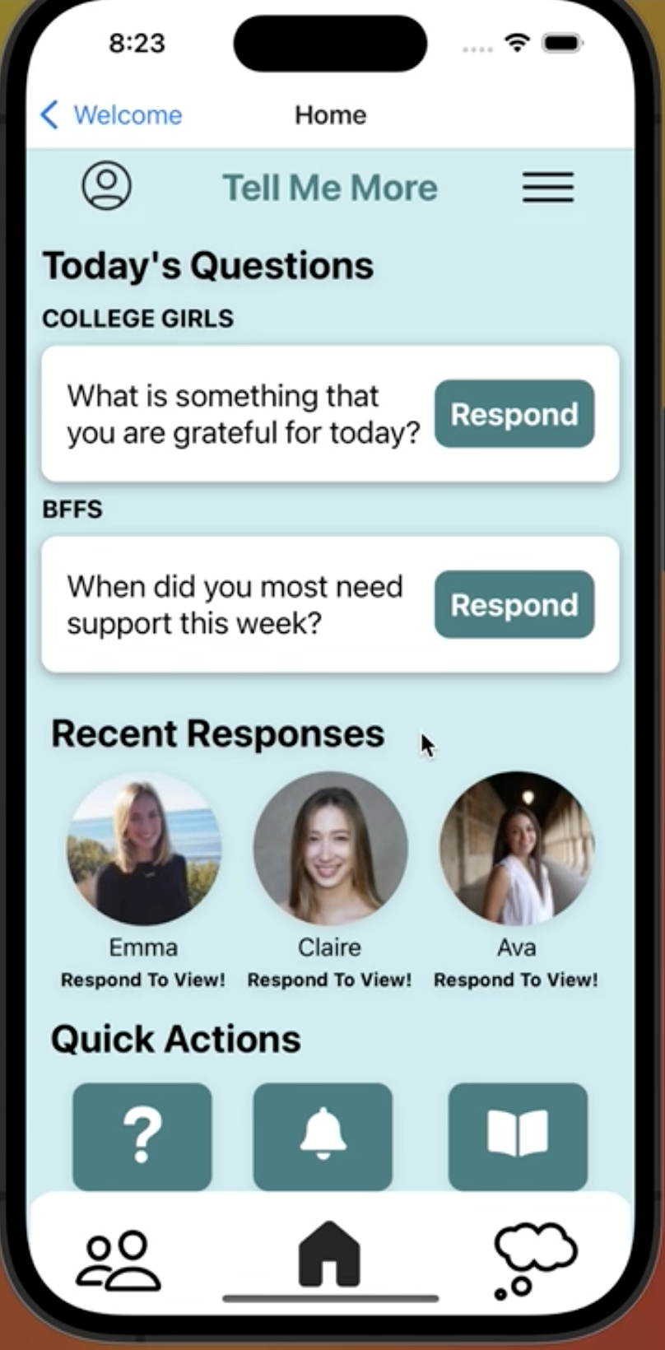
PROTOTYPE IMPLEMENTATION STATUS
Implemented Features
We implemented our Simple Task (Respond to a Question)
Home screen implementation
Clicking "Respond" button
Typing in a response and receiving a success message
Gaining access to all friends' responses, only upon responding
Viewing and reacting to friend's responses
Like count increasing/decreasing upon user interaction
Nudging friends who haven't responded yet
Updating Home page once question notification has been answered

Slide 31
PROTOTYPE IMPLEMENTATION STATUS
Unimplemented Features and Outstanding Questions
Unimplemented Features
We will implement our Moderate Task (Suggest a Question) and Complex Task (Create a Group):
Click "Suggest a Question" (multiple ways to do so) and fill out required fields
From Groups page, select ""Create Group" and fill out required fields
Display new group on Groups page
Outstanding Questions
Struggling to render specific features/visual components, specifically icons, in React
Trouble using font for our logo

Slide 32
PROTOTYPE IMPLEMENTATION STATUS
Project Plan
Step 1
Revise Figma design
Step 2
Coding Simple Task
Step 3
Implementing additional functionality
Step 4
Poster + Pitch
Done by end of quarter!
We are here!

Slide 33
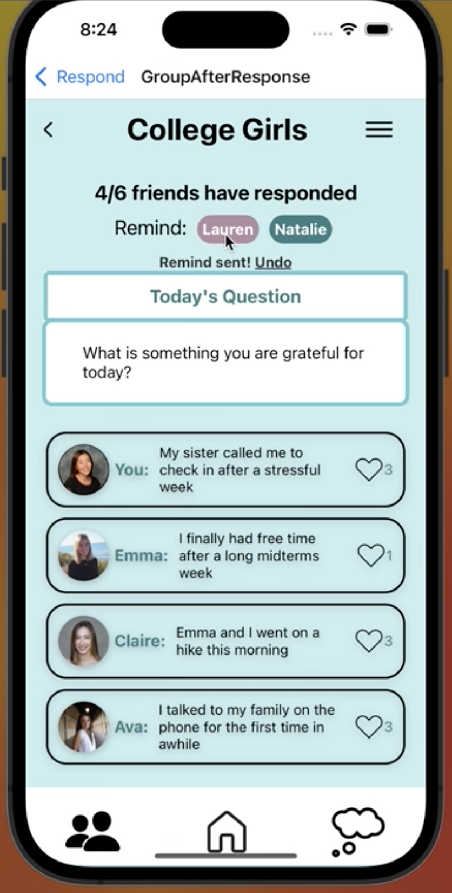
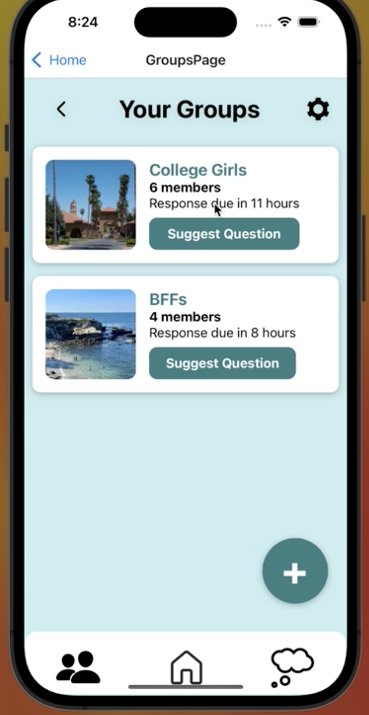
PROTOTYPE IMPLEMENTATION STATUS
Wizard of Oz Techniques
Closed system
All users, images, and posts are fake to mimick interaction
Hard Coded Aspects
Uploaded images and text
Additional user responses
Prompts
Existing groups ("College Girls", "BFFs")

Slide 34
demo of prototype (link)

Slide 35
appendix

Slide 36
HE link
Sorted HE + fixes link (full list of revisions in "compiled fixes" sheet)

Slide 37
Figma link

Slide 38
SEVERITY 3/4 VIOLATIONS
Issue #7: Extra features
Heuristic | Severity | Description
H3 User Control & Freedom | 3 | User cannot rearrange the order in which the friend groups show up in on the home page
H3 User Control & Freedom | 3 | Seems to be no way to edit the groups after they’ve been created
H3 User Control & Freedom | 3 | Seems to be no option to leave a group
H10 Help & Documentation | 3 | Users are unable to get instructions from hitting the help button
If we have time, we will implement a settings page that addresses each of these issues.

Slide 39
SEVERITY 3/4 VIOLATIONS
Issue #8: Figma functionality
Heuristic | Severity | Description
H3 User Control & Freedom | 4 | Hitting the arrow button on the “Your response is on the way!” doesn’t do anything
H3 User Control & Freedom | 4 | Hitting the “suggest a question” button did not lead anywhere, despite this being a moderate task
H3 User Control & Freedom | 4 | User has to hit the home button twice to then be able to hit the “suggest a question” button on the Home Screen
H3 User Control & Freedom | 4 | Icons on the bottom bar were functional only some of the time, many times forcing users to have to walk through entire task flows to get to a new screen
H4 Consistency & Standards | 3 | Back button in the response page did not work
H2 Match Between System and Real World | 3 | User has to hit the magnifying glass icon to be able to search for friends rather than just hitting anywhere inside the search bar for friends
H3 User Control & Freedom | 3 | Users cannot deselect a friendship goal after selecting one
H1 Visibility of System Status | 3 | The app does not automatically navigate to the next page from the splash screen. No instructions are provided; user has to know to tap the screen
H8 Aesthetic & Minimalist Design | 3 | The app has two splash screens that the user has to step through before they can get to the homepage
H2 Match Between System and Real World | 3 | If the user wanted to propose the same question to multiple groups, they have to individually send it to each group
These are violations that are Figma specific and will not be problems in our HighFi Prototype.

Slide 40
SEVERITY 3/4 VIOLATIONS
Issue #9: Violations we did not revise pt. 1
Heuristic | Severity | Description | Justification
H1 Visibility of System Status | 3 | After submitting the response, the user cannot see that is has been posted somewhere | We have a popup notifying the user that their response is on the way and users immediately see a post by "You" at the top of the feed.
H1 Visibility of System Status | 3 | After hitting “create group” user isn’t informed that their group has been created successfully; new group is shown at the top of the feed but nothing added to signify the action was successful | Visualization of new group sufficiently shows that group has been creatd.
H1 Visibility of System Status | 3 | After user send requests to add friends, there is no indication of whether or not friend accepted | If the user had accepted, they would be moved out of this page and they would now be friends.
H2 Match Between System and Real World | 3 | “Nudge” icon of a bell is unintuitive | We disagree.
H2 Match Between System and Real World | 3 | Hitting the plus button led to a dropdown menu rather than following the convention of “creating” something | This design was inspired by other apps that use the plus button to select something to create.
H3 User Control & Freedom | 3 | No way to save message responses as drafts | Drafts go against our goal of efficiency - users are meant to create quick responses, not spend lots of time editing a draft.
H4 Consistency & Standards | 3 | The tags for creating the group are of the same light bluish color that usually serves a decorative purpose | This color is actually used for all buttons that a user might click and unclick.
H5 Error Prevention | 3 | Users are not prompted with a confirmation of creating a group before the group is created | Visualization of new group sufficiently shows that group has been creatd.
H6 Recognition Rather Than Recall | 3 | Users cannot see what group they’re posting to before they post; user has to remember it themself | This is not true, the group name is displayed at the top of the scree. Additionally, the popup after submission reminds users of the group and gives an UNDO option.
H6 Recognition Rather Than Recall | 3 | No way to go back to a question and its responses | Users are automatically directed to question and its responses and can view them again by tapping on the group.
H7 Flexibility & Efficiency of Use | 3 | Extra click to respond now - not friendly to repeating users. | We do not want to remove this extra step because we think it is imporant for users to see that some of their friends have already responded.

Slide 41
SEVERITY 3/4 VIOLATIONS
Issue #9: Violations we did not revise pt. 2
Heuristic | Severity | Description | Justification
H7 Flexibility & Efficiency of Use | 3 | User hits “respond” to a question on the homepage and is taken to a redundant page with the same question and another “respond now” button | We do not want to remove this extra step because we think it is imporant for users to see that some of their friends have already responded.
H8 Aesthetic & Minimalist Design | 3 | Redundant showing that “your response is on the way,” after the response is sent. | One of our values is privacy and the popup confirms that the user has sent the response to the correct group so we believe it is necessary.
H8 Aesthetic & Minimalist Design | 3 | In the page after response, where the user is viewing their friend's responses, the “Today’s prompt box takes way too many extra spaces.” | It is imporant for the users to see the prompt and their friends answers. However, we may eventually update the prompt box size based on the length of the prompt.
H8 Aesthetic & Minimalist Design | 3 | Duplicate action buttons on the same screen | These buttons support experienced users and cannot be accomplished directly from the home screen in other ways.
H11 Accessibility | 3 | White text of the logo on the splash screen is too light against the light blue background color | This feature is meant to shown quickly when the app is loading so the low contrast is not important.
H11 Accessibility | 3 | Buttons for “suggest a question” and “view group” are both small fonts and hard to read | This is true, but we ended up removing these buttons instead.
H11 Accessibility | 3 | Only one way to input a message. | From our interviews, we found that it is difficult to be vulnerable face to face. Audio or video is more similar to face to face and may reduce vulnerability, which is our main value.
H12 Value Alignment & Inclusion | 3 | Potential gate-keeping for smaller social groups. | This app is meant for those with social connections and groups of 2 can be created to include everyone.
H12 Value Alignment & Inclusion | 3 | Not inclusive to those who have trouble accessing the keyboard | Those who cannot type on their keyboard will still have the option to use the voice option on their keyboard
H12 Value Alignment & Inclusion | 3 | Potential coercing the users to use platform - have a mechanism such that the users can still view their friends’ responses | From our interviews and experience prototypes, we inferred that people are more likely to be vulnerable when others are too.

Slide 42
