Slide 1
CS 147
Preserving the Past
Medium-Fi Prototyping
Assignment 6
Tell Me More
Medium-fi prototyping
Paige Olson Chloe Pae Gabe Iluma

Slide 2
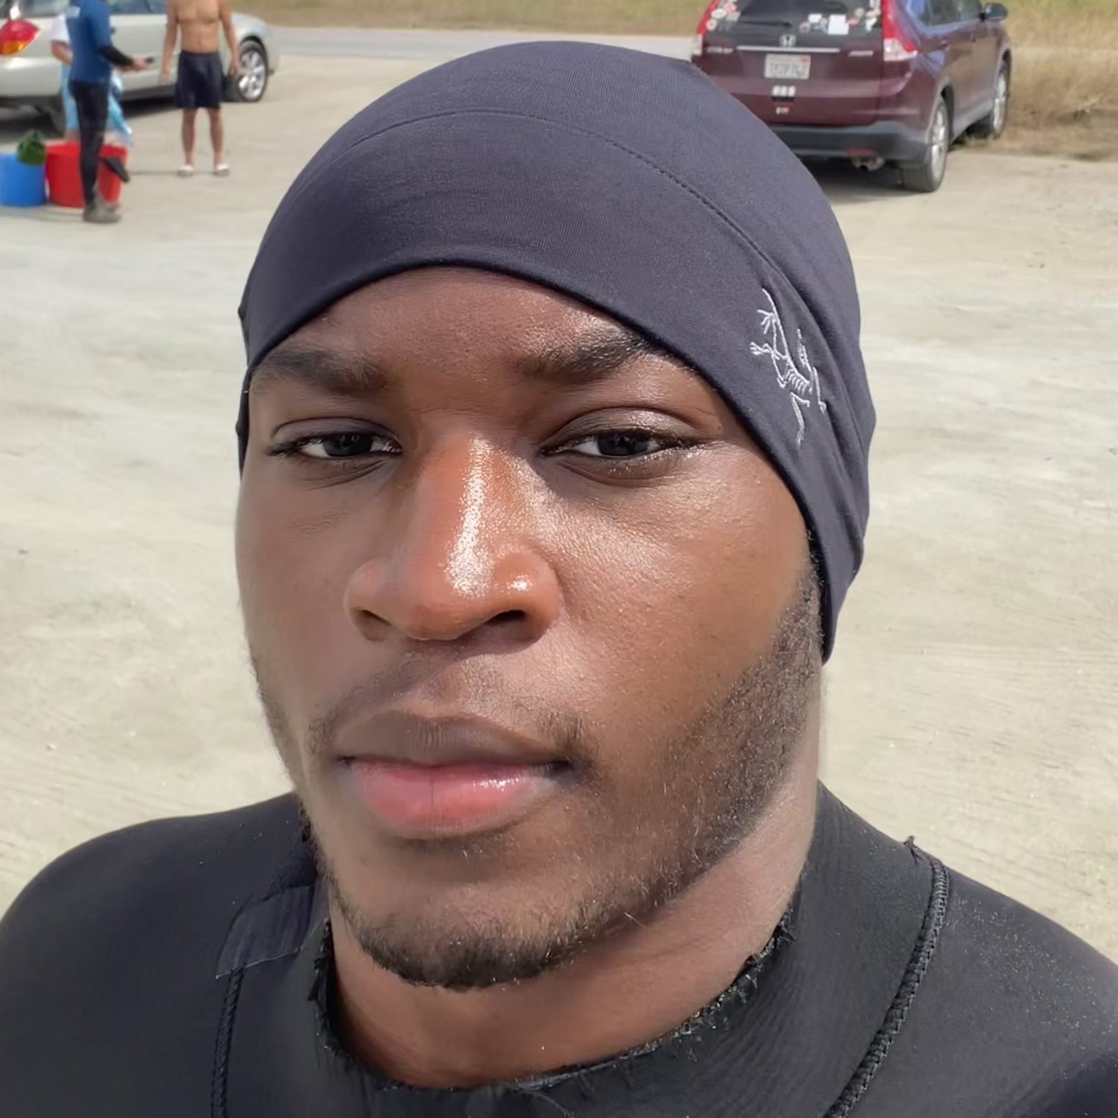
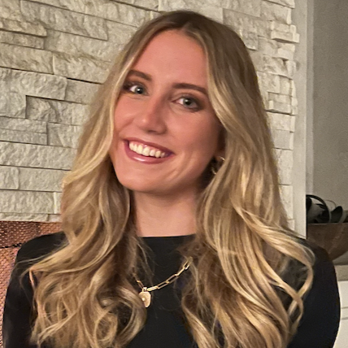

Team
Gabriel Iluma
Abuja, Nigeria
Product Design & Computer Science
Class of 2024
Paige Olson
San Diego
Symbolic Systems
Class of 2024
Chloe Pae
New York City
Symbolic Systems
Class of 2024

Slide 3







Road Map
Introduction
Values in Design
Tasks
Usability Goals
Revised Interface Sketches
MedFi Task Flows
Prototype Implementation

Slide 4
Introduction

Slide 5
Tell Me More
Value Prop: Connect vulnerably and consistently

Slide 6
Problem
Friends want to stay in touch and understand what is going on in each other's lives, but often struggle to have meaningful conversations or express vulnerabilities that could elicit support.
Solution
Tell Me More allows groups of friends seeking more meaningful connection to answer a daily prompt aiming to encouraging vulnerability, then broadcasts each friend's answer to the whole group, providing an easy outlet to express emotions or worries. ​

Slide 7
Values in Design

Slide 8
Design Values
Connection
Vulnerability
Reflection
We want friends to feel like they really understand what is going on in each other's lives and to reach out with love & support
We aim to encourage people to step out of their comfort zones and share emotions with friends
We remind users to reflect on their relationships and the support that they give their friends
Community
Privacy
Not only will we encourage individuals to check in on friends, but we hope users feel a strong sense of community within their groups
Any post that a user makes on Tell Me More will be viewed by their group only. We will not use user data without permssion.

Slide 9
Reflecting Values in TMM
Connection
Vulnerability
Reflection
Our suggested prompts attempt to elicit deeper conversations and vulnerability from our users
We use relaxing and soothing colors like light blue to evoke feelings of comfort and calmness, with the goal of eliciting vulnerability.
Prompts allow users to reflect on their own emotions. We have also dedicated a separate page to reflect on actionable steps to support one's friends.
Community
Privacy
Friends can customize their groups to create unique communities on TMM. For example, users can set a cadence for questions, friendship goals, and upload group photos.
Friend's responses will be locked until a user shares a reflection of their own. User's responses will also disappear after 24 hours.

Slide 10
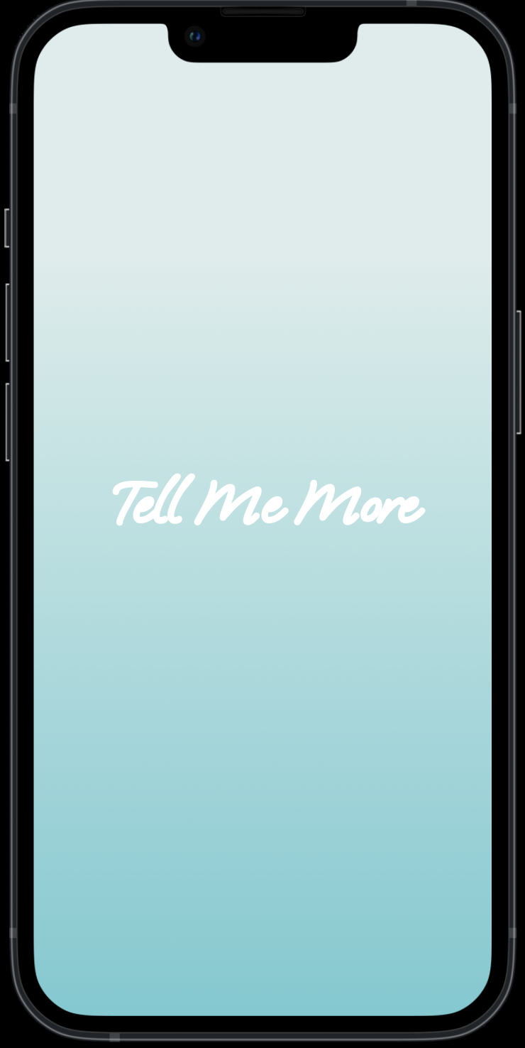
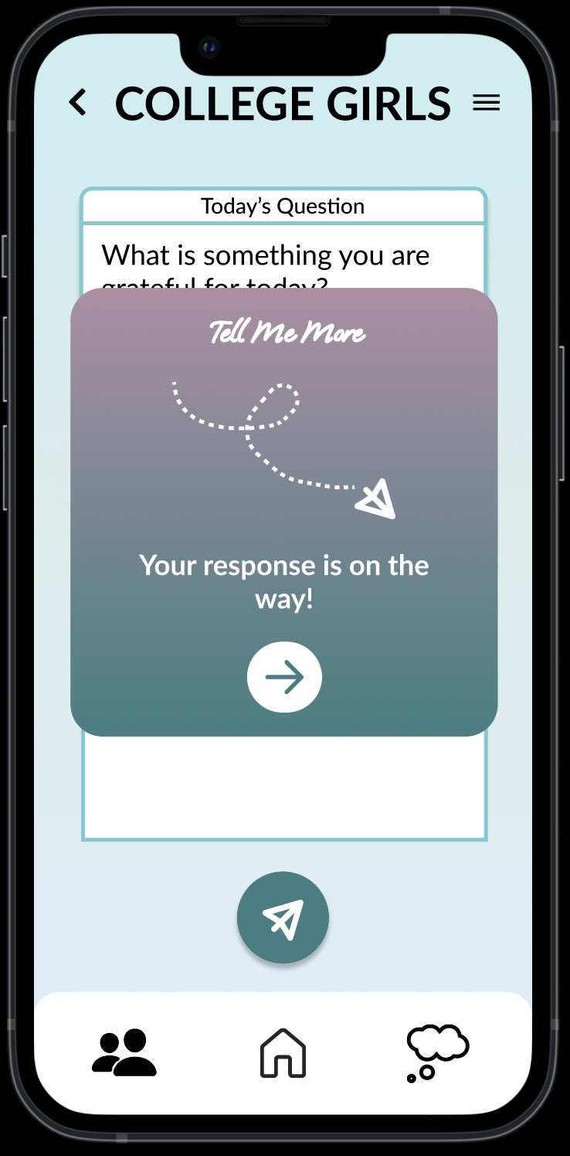
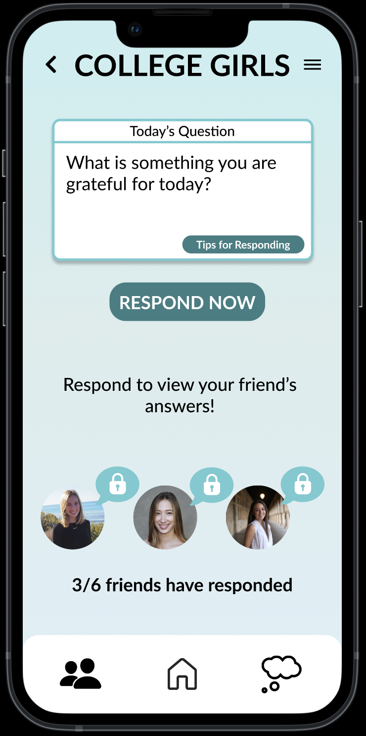
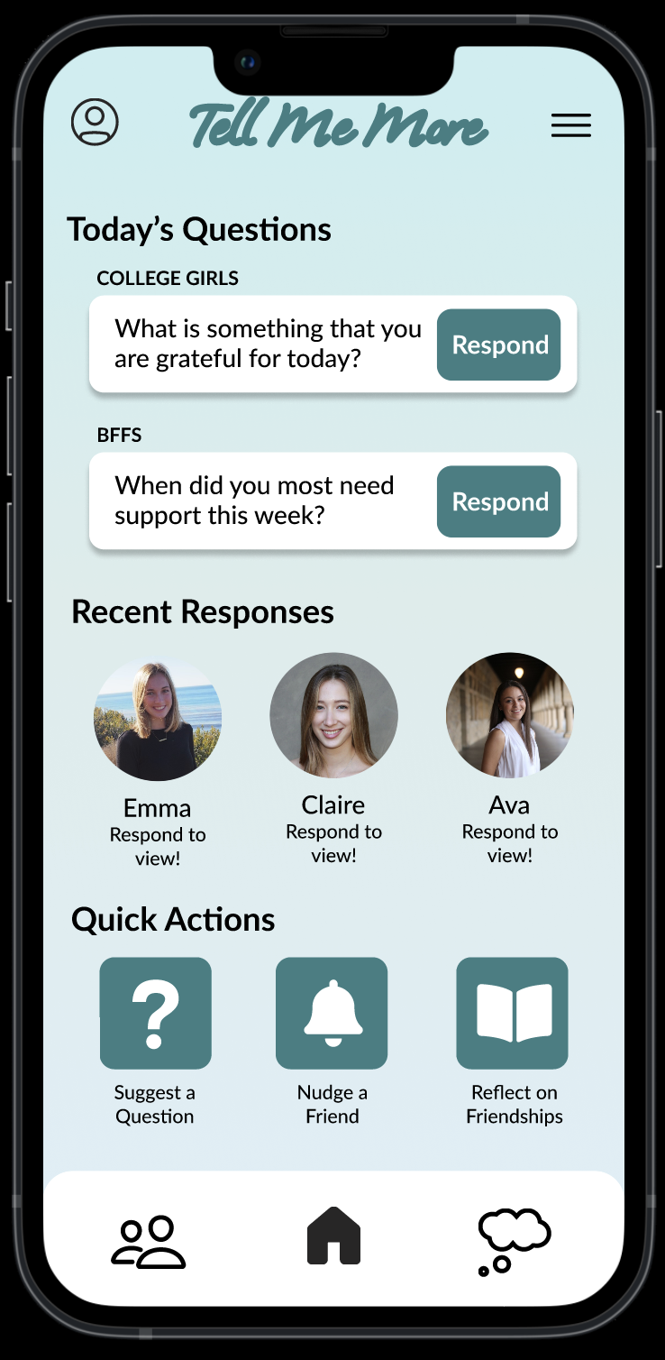
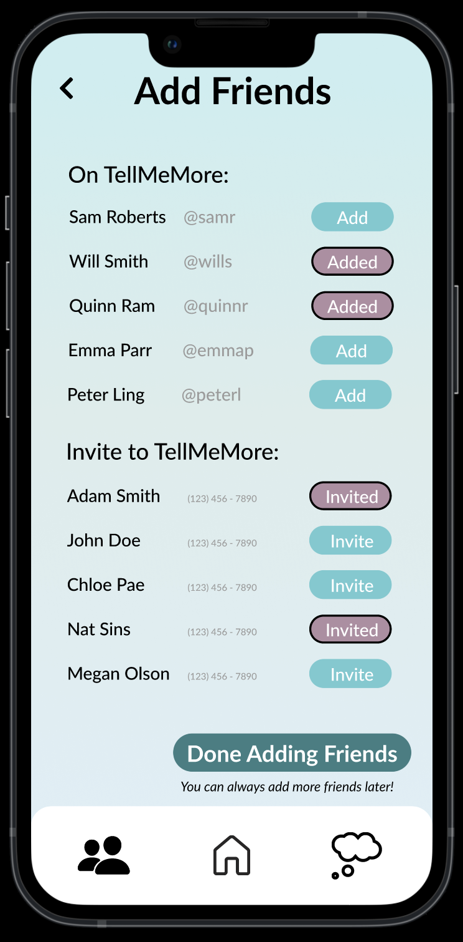
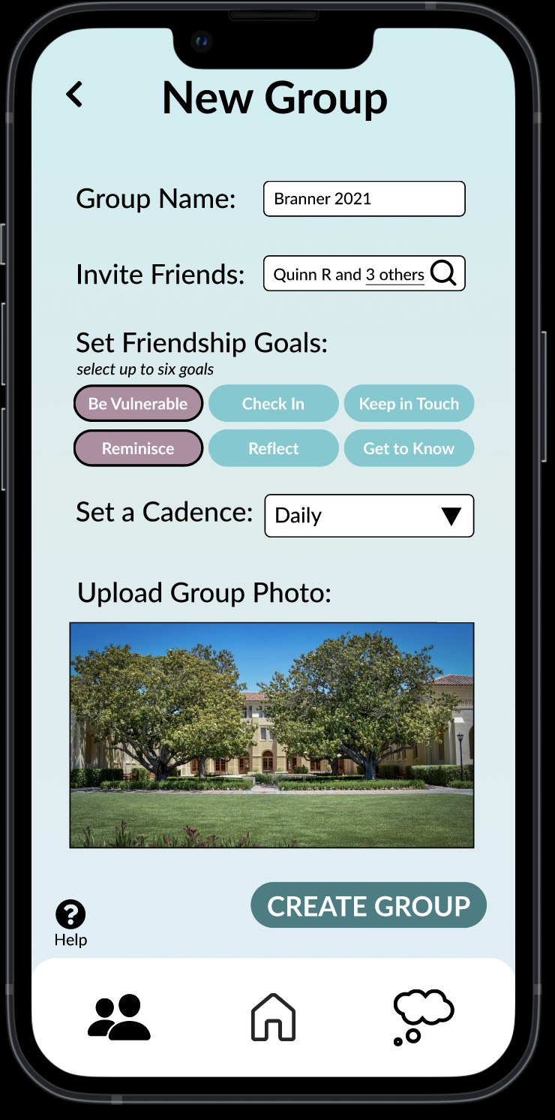
Reflecting Values in TMM
Here are some screenshotes from our Med-Fi prototype to exemplify how we seek to implement our values.
Vulnerability
Relaxing colors to evoke calmness
Privacy
Locked questions until user has reesponded
Community
Add friends and set unique Friendship Goals and Cadences

Slide 11
Value Tensions
Vulnerability vs. Privacy
We want our users to be able to initiate meaningful conversations on our platform, and be truly vulnerable. Our prompts are geared towards encouraging emotional responses. However, users may feel weary about sharing personal thoughts or moments if they fear exposure by their friends or the platform itself.
Community vs. Reflection
We want TMM users to connect with their friends, but also utilize the platform as an opportunity to reflect on their own emotions and how successful they are at showing up for their friends. There is clearly a tension here between how users should utilize and spend time on TMM, but we believe that self reflection can postively impact community and relationships and do not want to sacrifice either feature.

Slide 12
Tasks

Slide 13
Tasks
Simple
Answer a prompt in order to see your friend group’s responses
Moderate
Suggest a question for the group to answer
Complex
Build a group of friends to encourage sharing vulnerable thoughts
Note: No changes were made to the tasks from Assignment 5

Slide 14
Usability Goals

Slide 15
Usability Goals + Key Metrics
Usability Goals
Efficiency: filling out questions and interacting with others is simple, encouraging users to return
Pleasing — high enjoyability and benefit in using Tell Me More
Key Metrics
Number of errors
Time spent per task
Severity of errors
User rating & qualitative data

Slide 16
TMM's Progress on Goals
Efficiency
Pleasing
Our LowFi efficiency results were extremely positive
We hope that all our tasks can be accomplished in a "reasonable" time frame
There are multiple ways to accomplish each task, accommodating a diverse range of users and promoting user autonomy
Our home screen now features "Quick Action" buttons for our most common tasks
Our LowFi pleasing results were very positive, but users did not fully understand the purpose of our app
We made TMM more aesthetically pleasing from a visual perspective, whiich we believe will promote enjoyabiliity
Users can easily interact with mutliple friend groups one on platform through our Groups page, allowing them to consolidate efforts to check in on their friends

Slide 17
Revised Interface Sketches

Slide 18
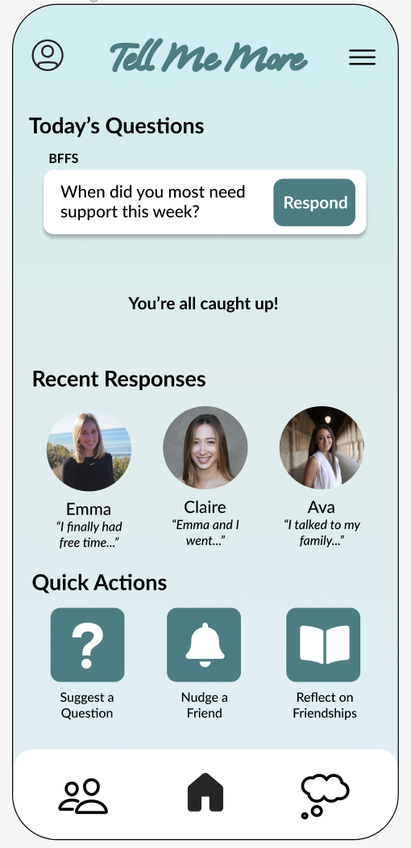
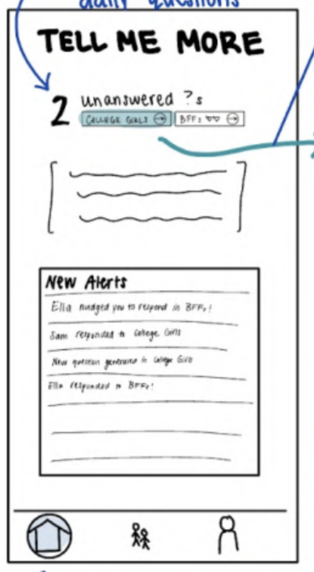
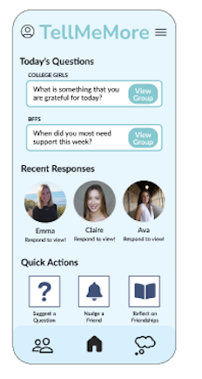
Big Change #1:
Revised Home Screen
Feedback: Lo-Fi testing suggested that users did not know how to carry out certain tasks with ease, especially when starting from the Home page. TA feedback suggested that adding the questions to the home page would make it more action-oriented.
Change: Added Recent Responses, Quick Actions, and Respond buttons. Displayed questions on screen.
Effect on Usabiliity Goals: Making our home screen more action-oriented will help our efficiency goal, as users will be able to carry out tasks directly from the home screen instead of navigating to the Groups tab. Adding questions + responses helps our pleasing goal as they are fun to see!
Effect on Key Metrics: Time spent per task and number of errors will decrease if tasks can be easily accessed via the home screen

Slide 19
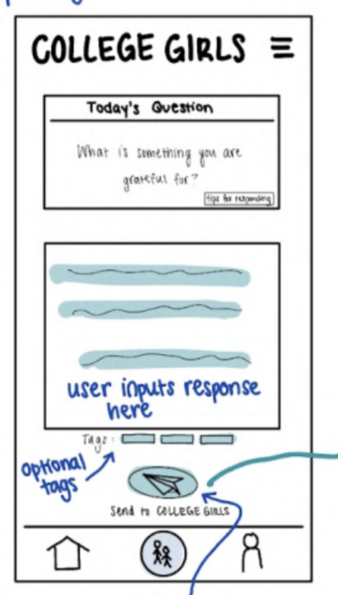
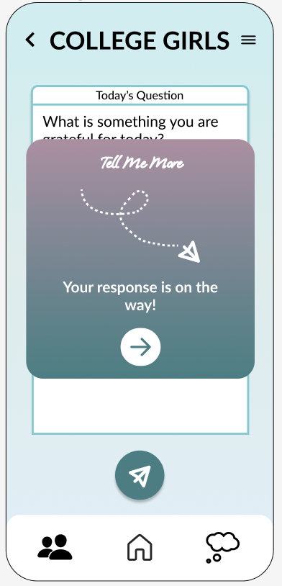
Big Change #2:
Design to Encourage Vulnerability
Feedback: Lo-Fi testing suggested that users may not share a lot of detail in their responses and may not understand that TellMeMore aims to encourage vulnerability and is not just another social media app.
Change: We added a new logo, calming colors, rounded edges, an intro page, and success messages. We used mental health and journaling apps as inpsiration to curate a calm and vulnerable theme.
Effect on Usabiliity Goals: By making our app more inviting and aesthetically welcoming, we hope that users will find the app more pleasing and feel they can be vulnerable.
Effect on Key Metrics: By creating a more calming atmosphere where users reap TMM's intended benefits, user rating's will increease

Slide 20
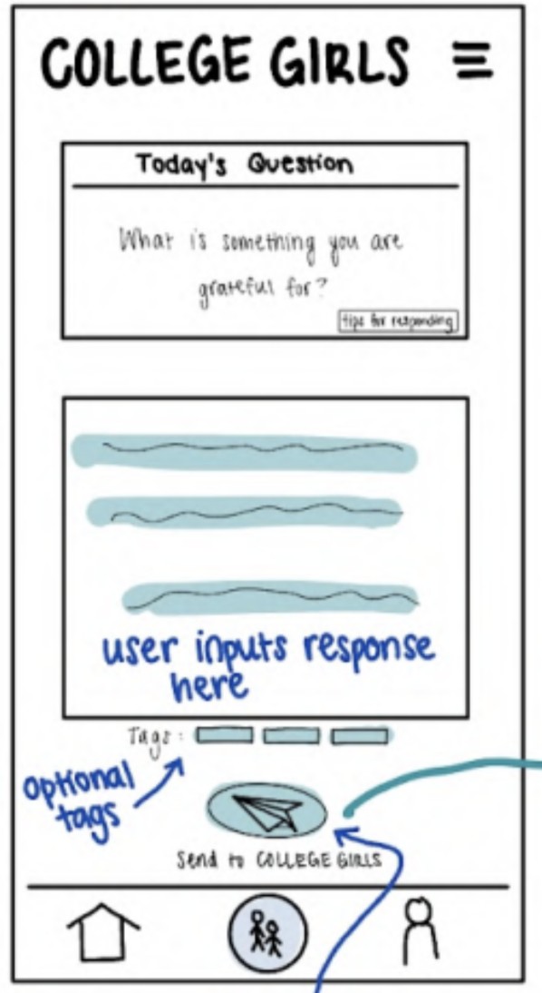
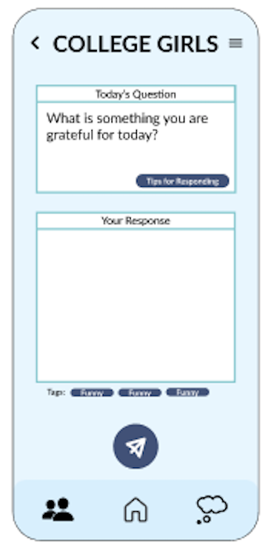
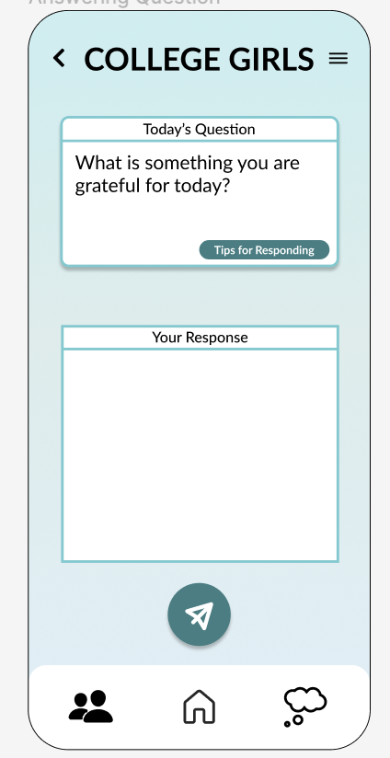
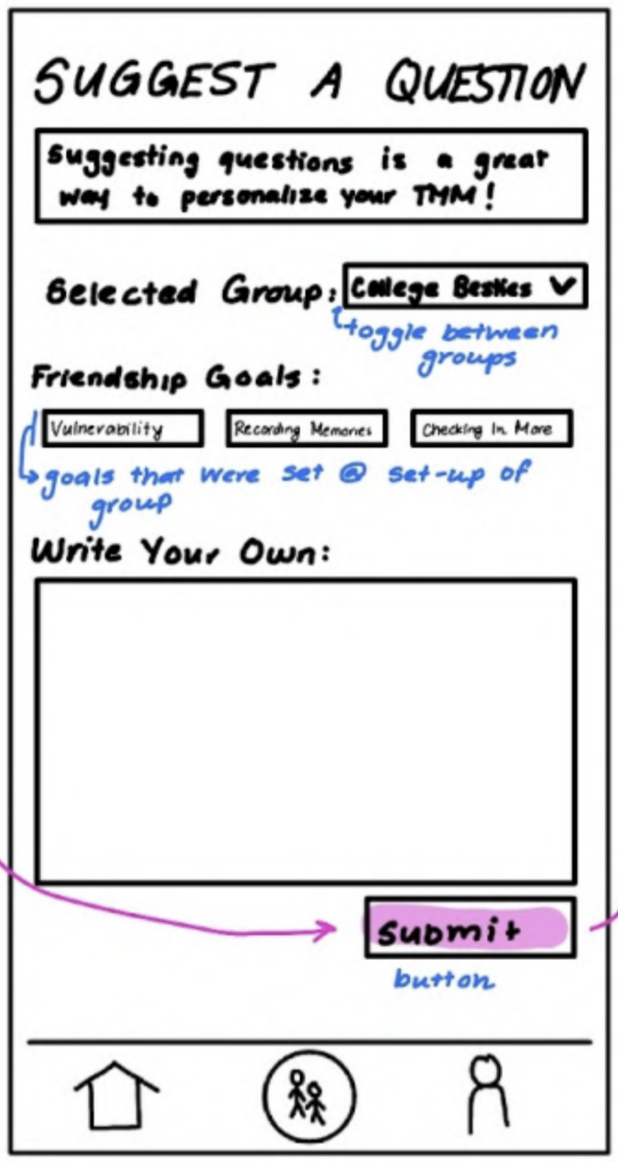
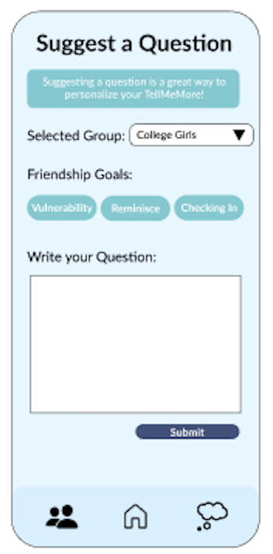
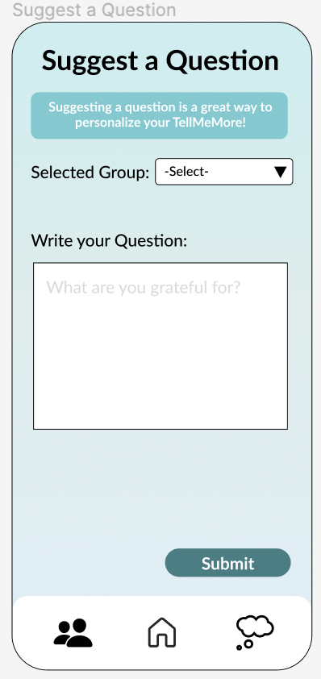
Big Change #3:
Deleted Unnecessary Buttons
Feedback: Lo-Fi testing and in-class feedback suggested that Tags and Goals were distracting and unclear when performing certain tasks. It was not clear how the tags were used later in the app.
Change: We deleted Tags (when responding to a question), Friendship Goals (when suggesting a question), and comments (on friend's responses).
Effect on Usability Goals: By getting rid of unnecessary buttons and tags, we increase user efficiency. Additionally, the buttons was unnecessarily complicated our app without increasing out pleasing goal.
Effect on Key Metrics: Removing buttons will decrease user error and the severity of the errors.

Slide 21
Medium-Fi Task Flows

Slide 22
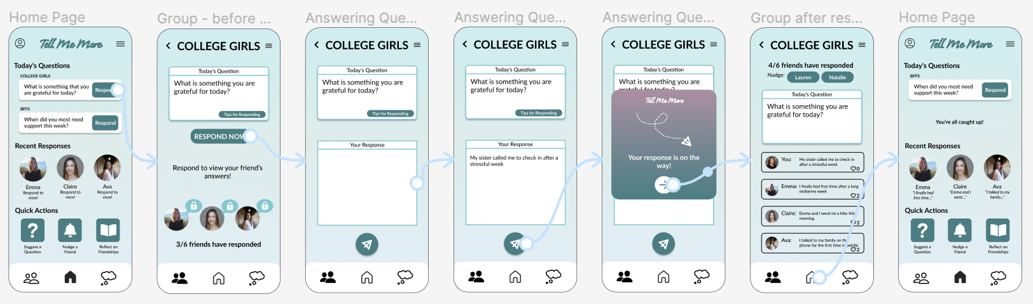
Simple
Build a group of friends to encourage sharing vulnerable thoughts
[tap on "Respond' to respond to question]
[tap on 'Respond Now' to answer]
[input response]
[tap airplane button to send response]
[tap arrow to view group responses]
[tap users to nudge, tap hearts to like, or tap home]
question is removed from home page and friends' answers are shown!
Note: this is the easiest way for a user to complete this task; alternatively, they can navigate to the groups page→view feed (see appendix with full task flow)

Slide 23
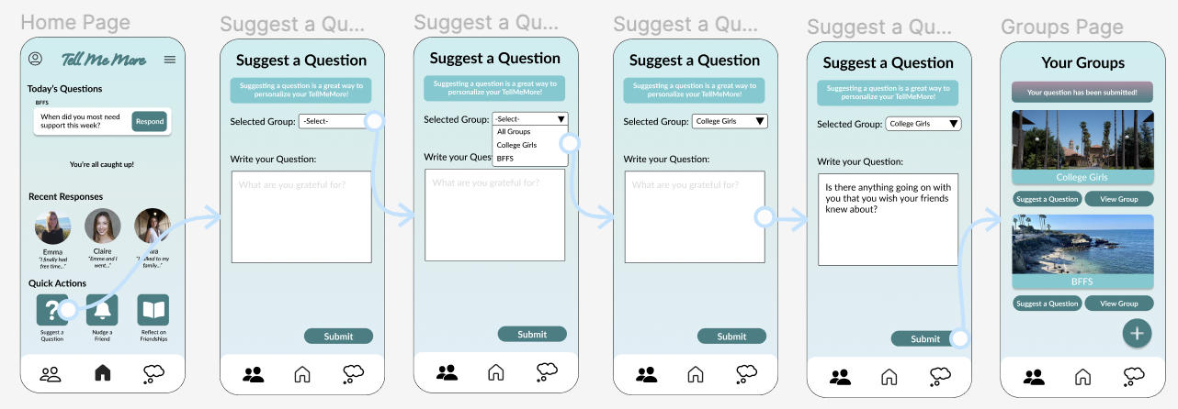
Moderate
Build a group of friends to encourage sharing vulnerable thoughts
[tap on suggest a question]
[tap on drop down bar to select group to recieve question]
[tap on selected group]
[input question]
[tap submit to send question]
confirmation banner appears at the top!
Note: this is the easiest way for a user to complete this task; alternatively, they can navigate to groups page→suggest a question or groups page→plus→suggest a question (See appendix for full task flow)

Slide 24
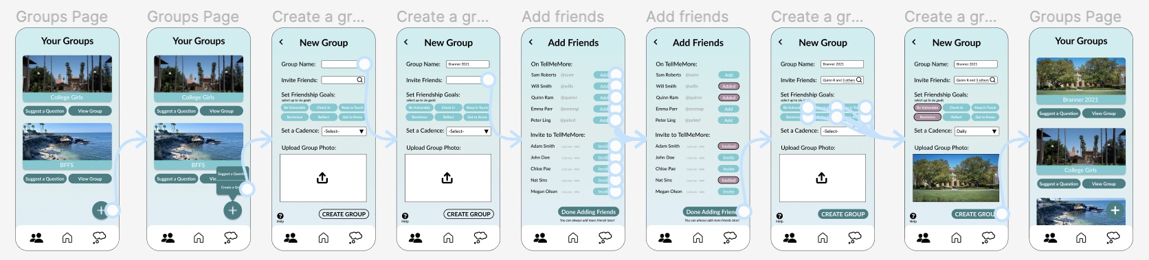
Complex
Build a group of friends to encourage sharing vulnerable thoughts
begin on groups page, [tap plus]
[tap create a group from the pop up]
[input group name]
[tap search to invite friends]
[tap add or invite to add friends to group]
[tap done adding friends]
[tap up to six friendship goals for the group], [select a cadence and upload group photo]
[tap create group]
new group is shown on the groups page!

Slide 25
Prototype Implementation

Slide 26

Primary Tool Used: Figma
Pros
Cons
Easy to collaborate with the whole group
Reasonable learning curve for beginners
Components made adjustments easy
Grids for alignment
Steep learning curve for prototype tool
Since Figma does not store data, we had to duplicate screens and frames to make changes leading to a messy space

Slide 27
Limitations
Users could not interact with their own profile
Users could not input their own desired information
Not all groups can be viewed in the same way (e.g. for some groups you could see frien'ds responses and like them, for others you could not)
The "Reflect" tab is undeveloped
Users can not see how "nudges" or notifications fully work

Slide 28
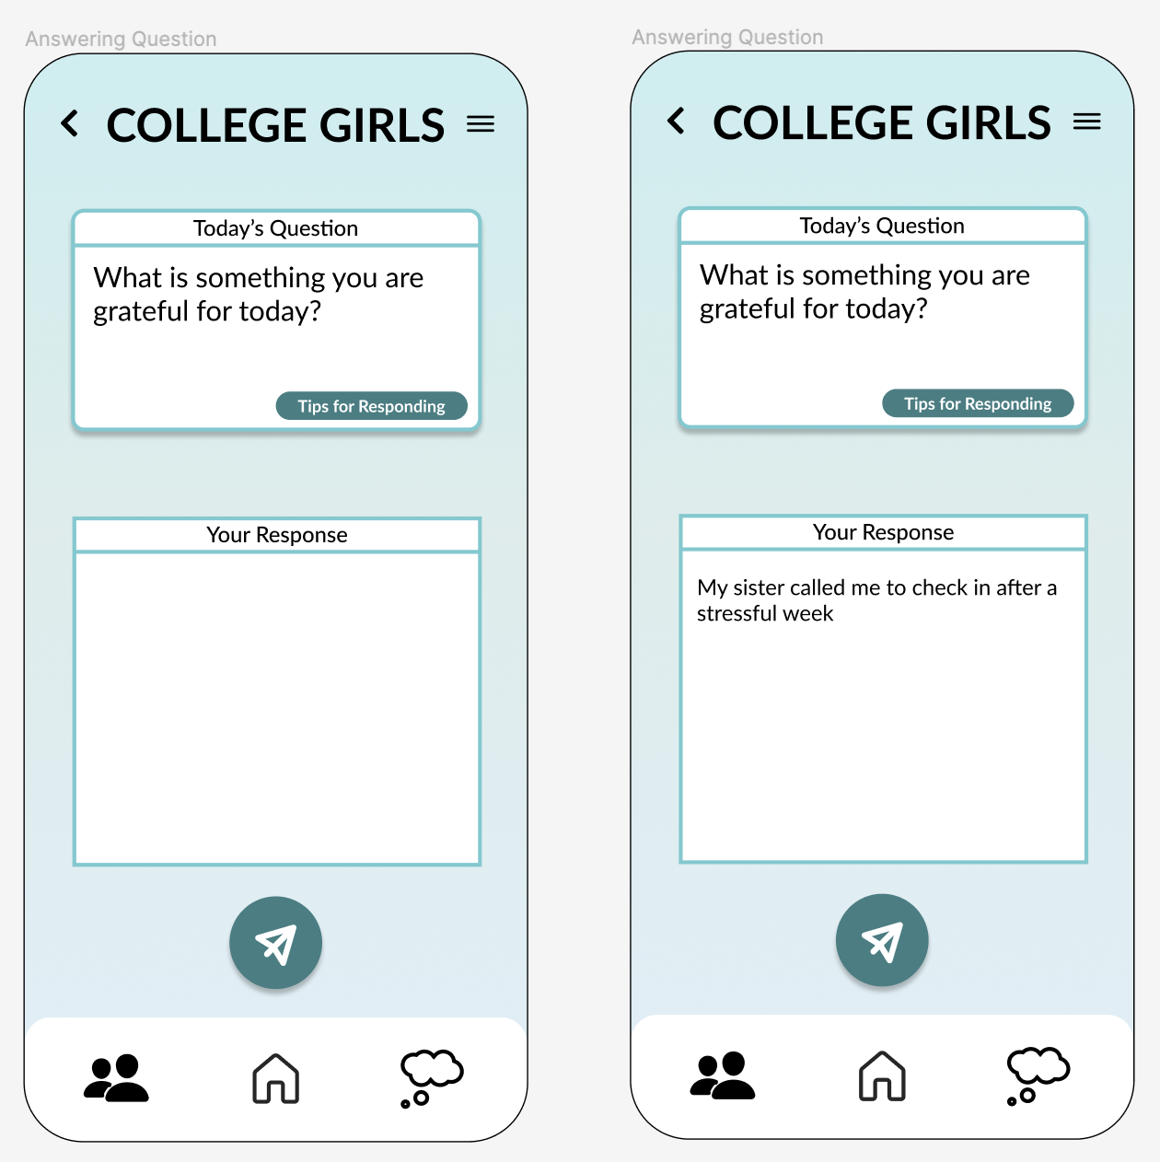
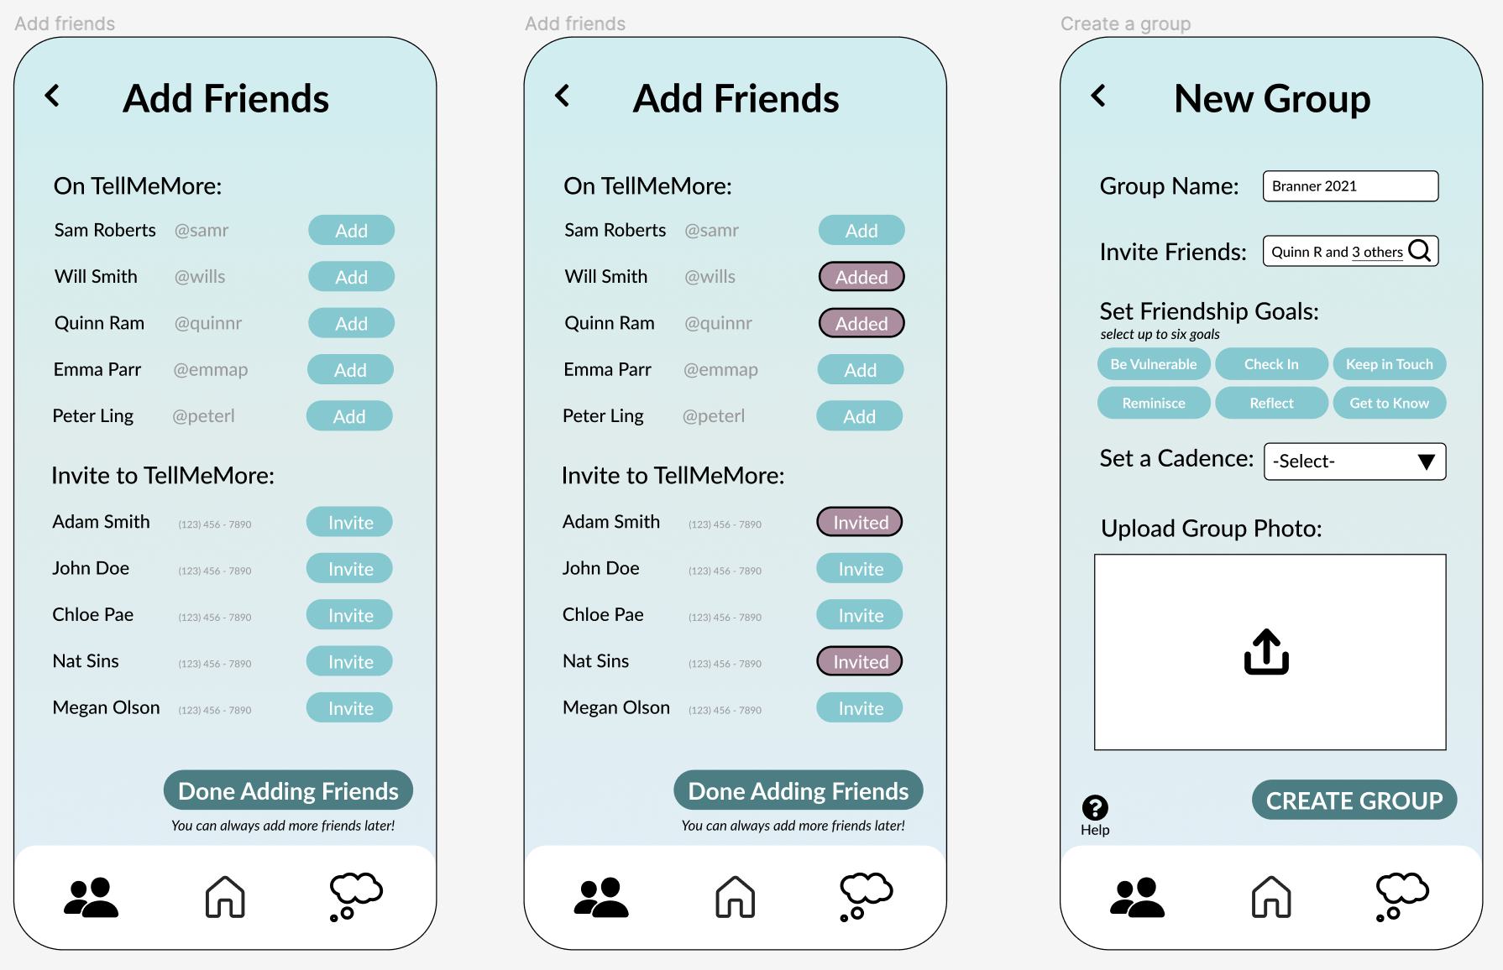
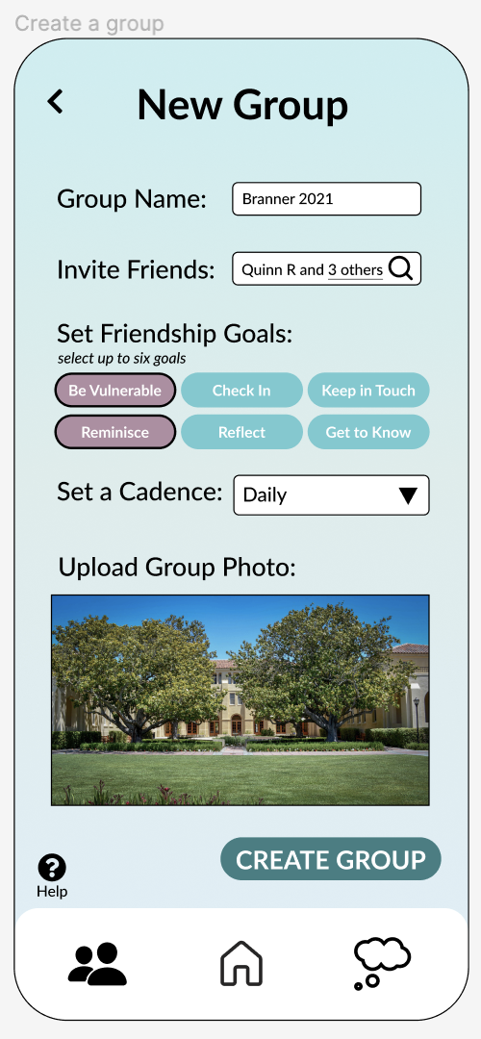
Hard Coded Wizard of Oz Features
answers to questions are prepopulated, as are suggested questions
users do not get to choose which friends are invited to the new group
users could not select their own friendship goals

Slide 29
Appendix

Slide 30
FIGMA link
(Prototype on "Medfi" page!)

Slide 31
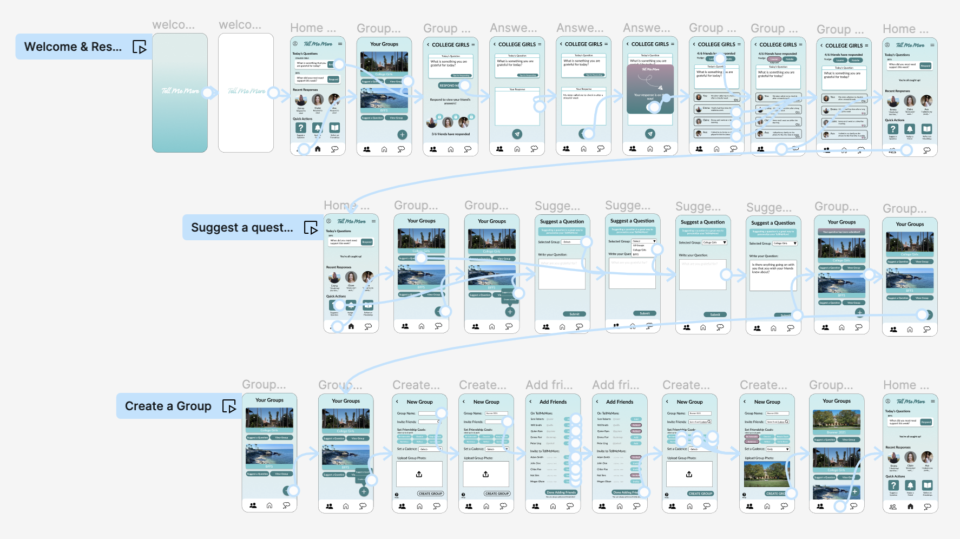
Overview of MedFi Prototype

Slide 32
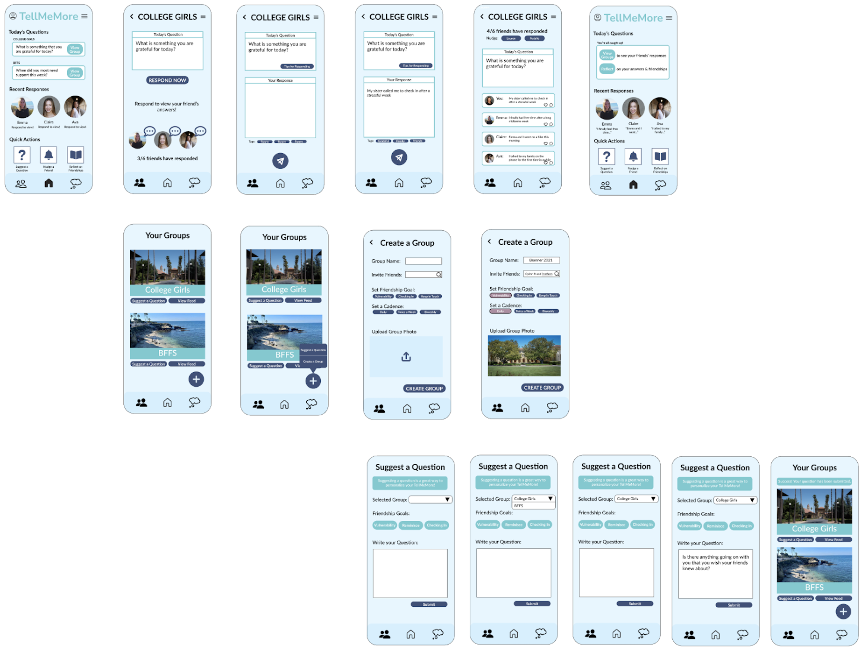
Version 1 of MedFi Prototype

Slide 33
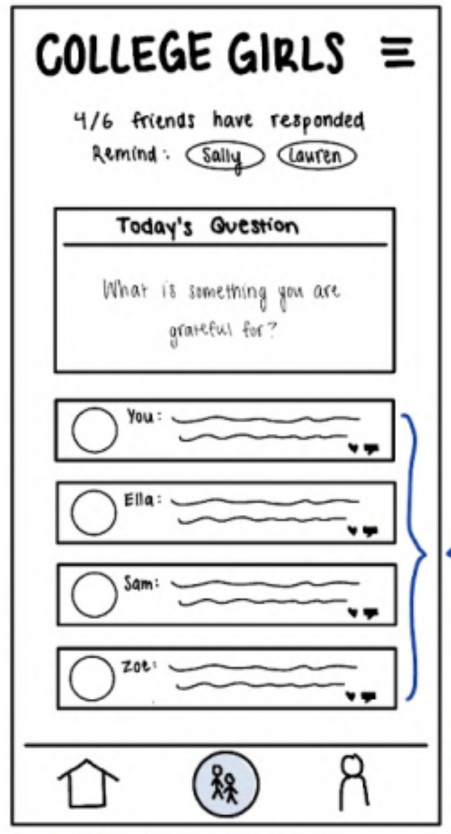
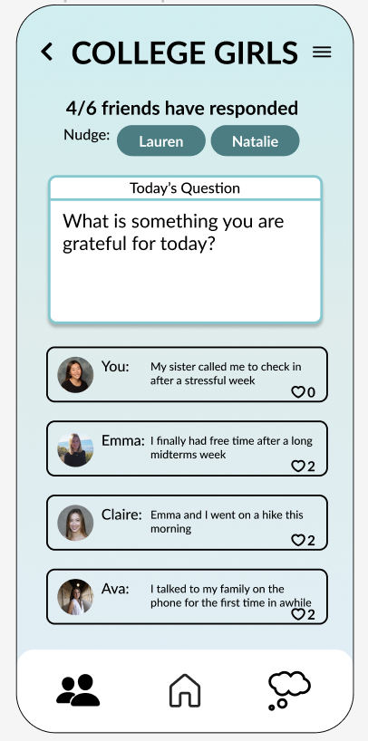
Big Change #4:
Differentiate System from User Input
Feedback: In-class feedback suggested that there was not a sufficient visual difference between content generated by TMM and users.
Change: TMM's generated question is now more visually differentiated from user generated content/input through size, spacing, and color.
Effect on Usability Goals: This contributes to our goal of efficiency by making user generated content differentiated from TMM content. This is an example of recognition rather than recall.
Effect on Key Metrics: This will decrease number of user errors and consequently, the time spent per task.

Slide 34
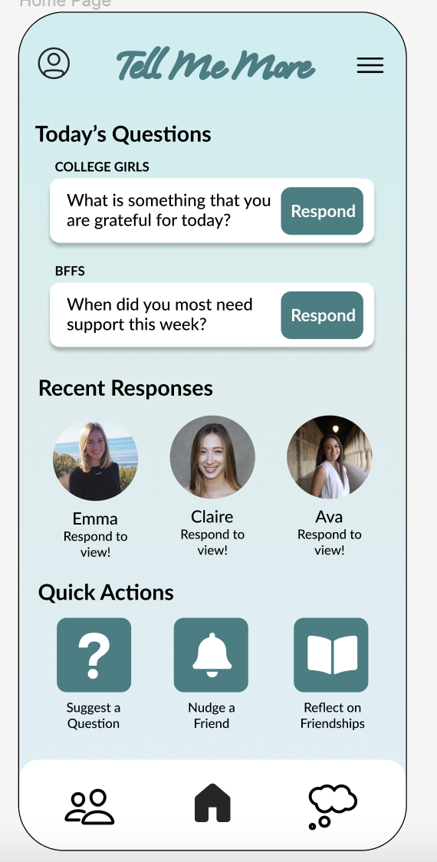
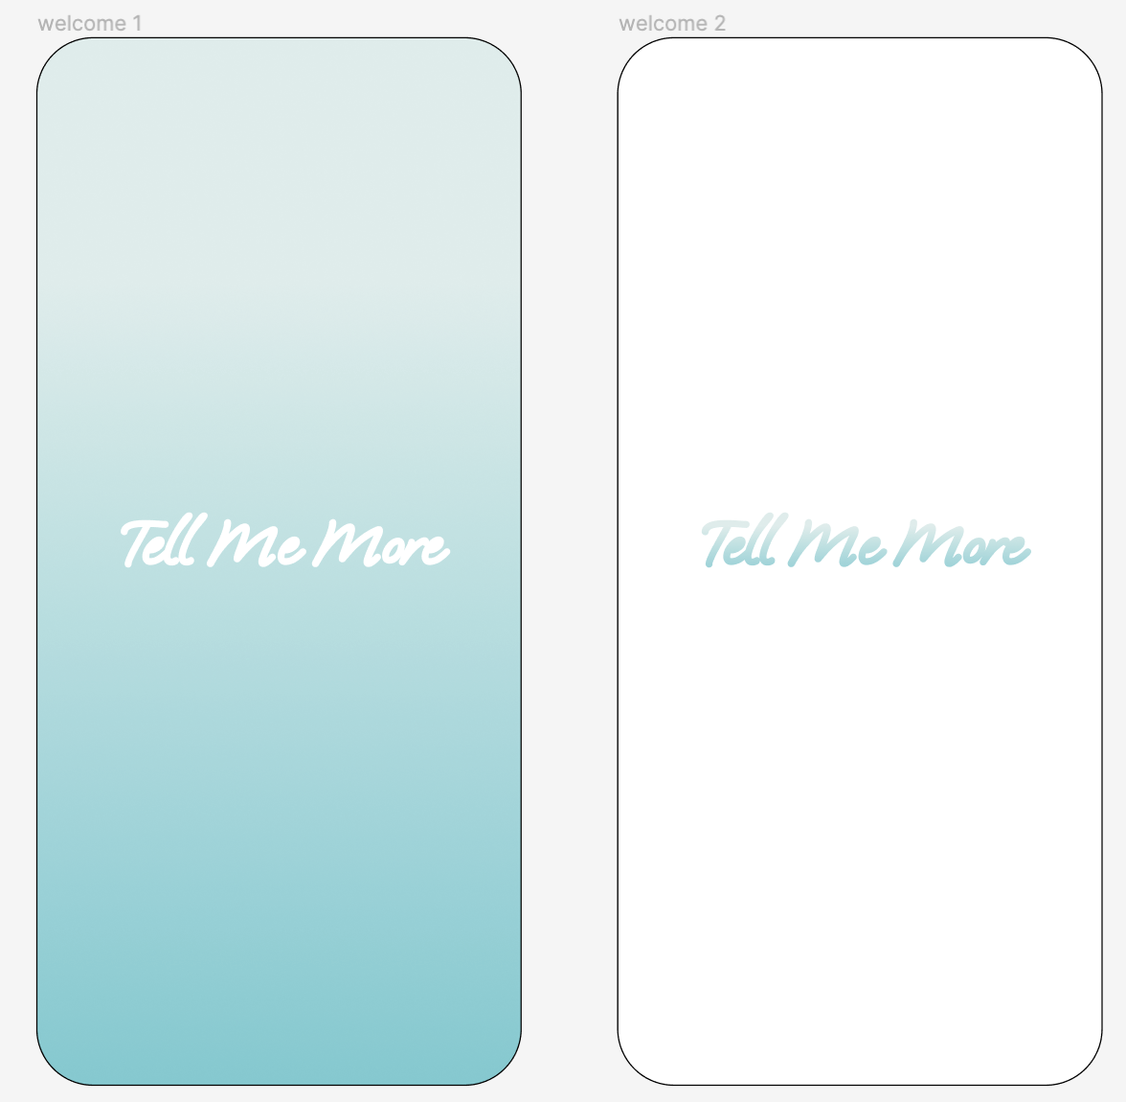
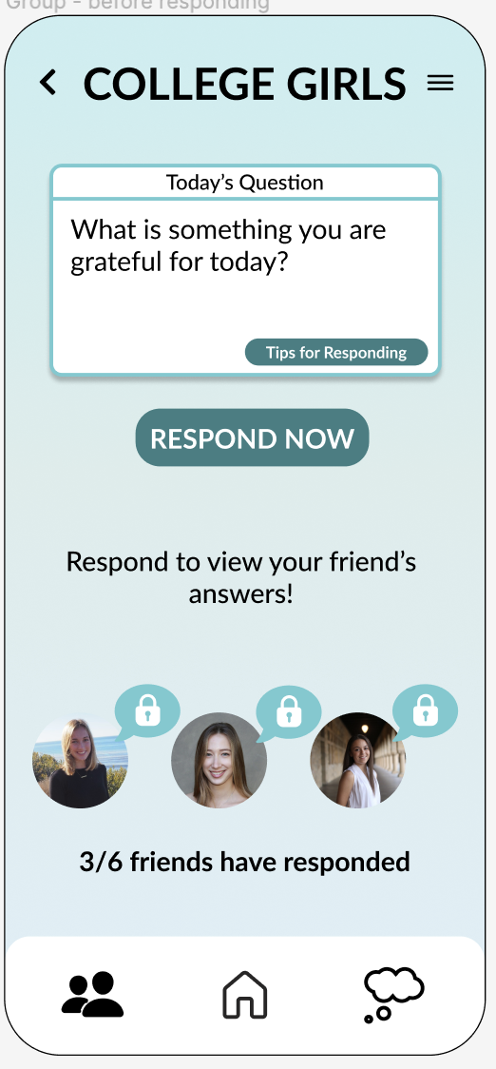
Other Changes from Section
Respond buttons are now the same style as the white box; buttons say "Respond" instead of "View Group"
Quick action buttons match the style of other buttons
lock icons no longer look like clickable buttons
welcome screens make the app feel more calm to increase vulnerability focus

Slide 35
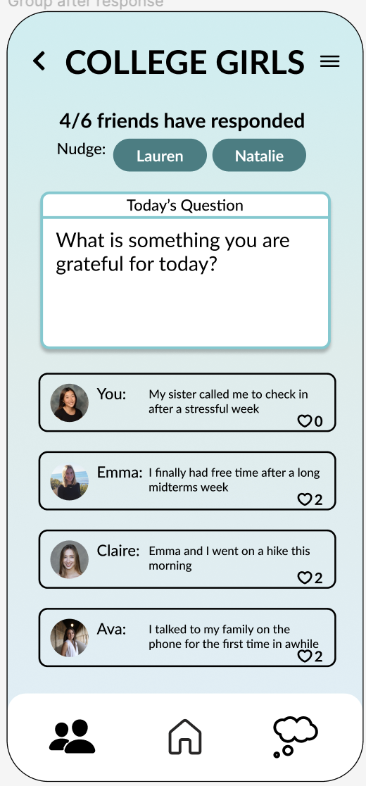
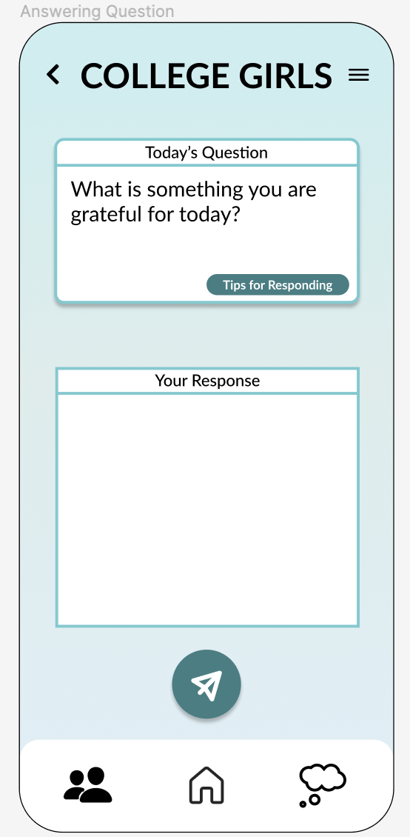
Other Changes from Section
white background removed from user responses to distinguish question from answers
send button is more clearly grouped with the response, not the question

Slide 36
