Slide 1

TELL ME MORE
CONNECT BELOW THE SURFACE
CHLOE PAE
PAIGE OLSON
GABRIEL ILUMA

Slide 2







road map
PROJECT INTRO
PROBLEM/SOLUTION
MARKET RESEARCH
DESIGN VALUES
TASKS
STORYBOARDS
CONCEPT VIDEO

Slide 3
project intro

Slide 4

PRODUCT NAME:
"TELL ME MORE"
TAGLINE:
"CONNECT BELOW THE SURFACE'
To us, "Tell Me More" embodies our product's purpose — to encourage vulnerability and deepen meaningful connections amongst friends.
"Connect Below the Surface" is unique to Tell Me More in that most social platforms do not encourage the same level of vulnerability

Slide 5
problem & solution

Slide 6



Problem & Solution
PROBLEM?
Friends want to stay in touch and understand what is going on in each other's lives, but often struggle to have meaningul conversations or express vulnerabilities that could elicit support.
SOLUTION?
Tell Me More allows friends to answer a daily prompt focused on meaingful conversation, then broadcasts each friend's answer to the whole group, providing an easy outlet to express emotions or worries.

Slide 7
market research

Slide 8
Competitive Analysis
 | TellMeMore | BeReal | We're Not Really Strangers | Cappuccino | Cherry
Emphasis on Vulnerability | ✓ | X | ✓ | ✓ / X | ✓ / X
Mobile App | ✓ | ✓ | X | ✓ | ✓
Once per day | ✓ | ✓ | X | ✓ | X
Communities | ✓ | X | X | ✓ | ✓

Slide 9

MARKET RESEARCH
BeReal
Your Friends For Real.
Daily photo-sharing app
Intended audience: Friends, family, whoever!
What works →
Strong incentive to post — only able to see friend's posts once you've posted
Novelty factor of sharing a forward and backward facing photo simultaneously
Dynamic reactions (using selfies to react)
What doesn't work →
Without significant penalty for posting "late", BeReal has transformed into another "highlight reel" photo sharing app
Takeaways →
Incentive to post is important
A goal of encouraging authenticity is commendable, but easily "hacked" by users

Slide 10

MARKET RESEARCH
We're Not Really Strangers
WARNING: Feelings May Arise
Card game with three levels of questions to encourage greater vulnerability
Intended audience: Close friends and significant others
What works →
High quality, creative questions elicit vulnerable conversations amongst participants
What doesn't work →
Finite number of cards leads to a finite number of questions, making the game hard to play again
Requires people to be together in person
Takeaways →
Creativity and quality of questions will drive users when assessing the quality of our product

Slide 11

MARKET RESEARCH
Cappucino
Stay in Touch
Audio-story sharing app
Intended audience: Close friends and family
What works →
Audio elicits emotions that writing cannot capture on its own
Users can easily listen to a compilation of their friends voice memos
What doesn't work →
Not everyone is comfortable recording their voices
Similar value proposition to WhatsApp or iMessage Voice Memos
More difficult to moderate audio content
Takeaways →
Hypothesis to test: a multi-media approach to expressing vulnerabilities is more powerful than only writing

Slide 12

MARKET RESEARCH
Cherry
Cherish your long-distance relationships, everyday
Allow users to respond quickly and creatively to auto-generated questions
Intended audience: Long-distance friends
[CS 147 Project from Winter 2022]
What works →
Ability to engage with individuals and groups
Ability to respond in multiple mediums
What doesn't work →
Questions seem "all over the place" ranging from very surface level to deeply personal. This can lead to the deeply personal questions coming across as very jarring
Takeaways →
We will want to differentiate from Cherry by focusing on our core value of encouraging vulnerability, through features and content
*PREVIOUS CS 147 PROJECT

Slide 13
design values

Slide 14
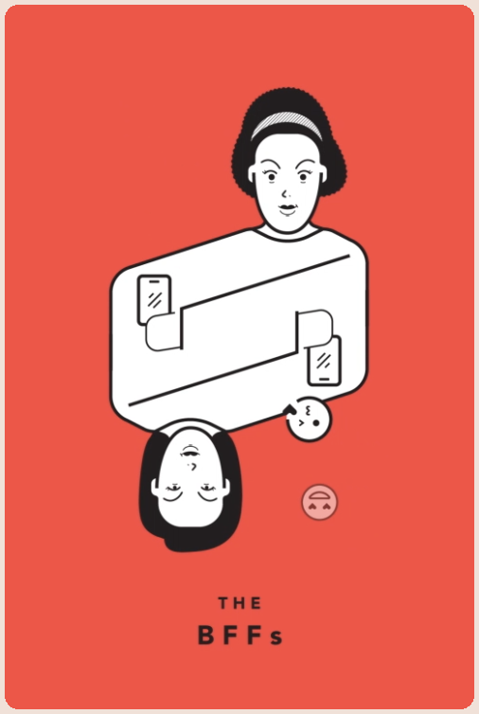

Tarot Cards of Tech
THE BFFS
THE SCANDAL
If two friends use your product, how could it enhance or detract from their relationship?
our product encourages friends to be more vulnerable and open with one another
friends might reach out with support and/or feel more empathy towards one another
one might feel badly if their friend did not share something important with them until prompted by an app
→ how can we foster connection & vulnerability without negativity?
→ how do we continue to encourage in person conversation about vulnerable topics?
What's the worst headline about your product you can imagine?
a bad headline might involve someone's extremeley vulnerable and personal response being viewed by someone who should not see it
a bad headline might involve people excluding one another in the groups they create
we want our product to be used for vulnerability and connection, not to take advantage of personal information
→ how do we design the product to protect users from bad actors?
→ how do we protect user information?

Slide 15
Values in Design
CONNECTION
VULNERABILITY
REFLECTION
We want friends to feel like they really understand what is going on in each other's lives and to reach out with love & support
We aim to encourage people to step out of their comfort zones and share emotions with friends
We remind users to reflect on their relationships and the support that they give their friends
COMMUNITY
PRIVACY
Not only will we encourage individuals to check in on friends, but we hope users feel a strong sense of community within their groups
Any post that a user makes on Tell Me More will be viewed by their group only. We will not use user data without permssion.

Slide 16

CONFLICTING VALUES?
Community / Vulnerability / Privacy
Potential Conflict:
Friends are encouraged to create communities and express vulnerable emotions with those communities. Users may feel reluctant to input vulnerable emotions into an app, especially if they are worried their answers will not be protected.
Plan of Action:
Each time a user answers a prompt, we will add a reminder that lets them know exactly who will be able to view their response. We hope that this will diffuse some negative feelings associated with being vulnerable online.

Slide 17

CONFLICTING VALUES?
Connection / Community
Potential Conflict:
While cultivating community is a key value, our top priority is empowering users to share vulnerable thoughts and emotions with their friends in order to encourage individuals to check in on one another.
Plan of Action:
Users can form tight-knit circles on our app to broadcast prompt answers to the group. This will give users a sense of belonging and comfort in knowing that a group of people understands what they are going through. However, we will refrain from adding features (such as group chats) that encourage social interaction on the app. We believe that by limiting in-app communication, users will be encouraged to intitiate conversation with individual friends, deepening connections.

Slide 18
tasks

Slide 19



SIMPLE
MODERATE
COMPLEX
Answer a prompt to see your friend group's responses
React to individual responses
Suggest a prompt for the group to answer
Reflect on the support you have given your friends
Build a group of friends to encourage sharing vulnerable thoughts

Slide 20
storyboards

Slide 21
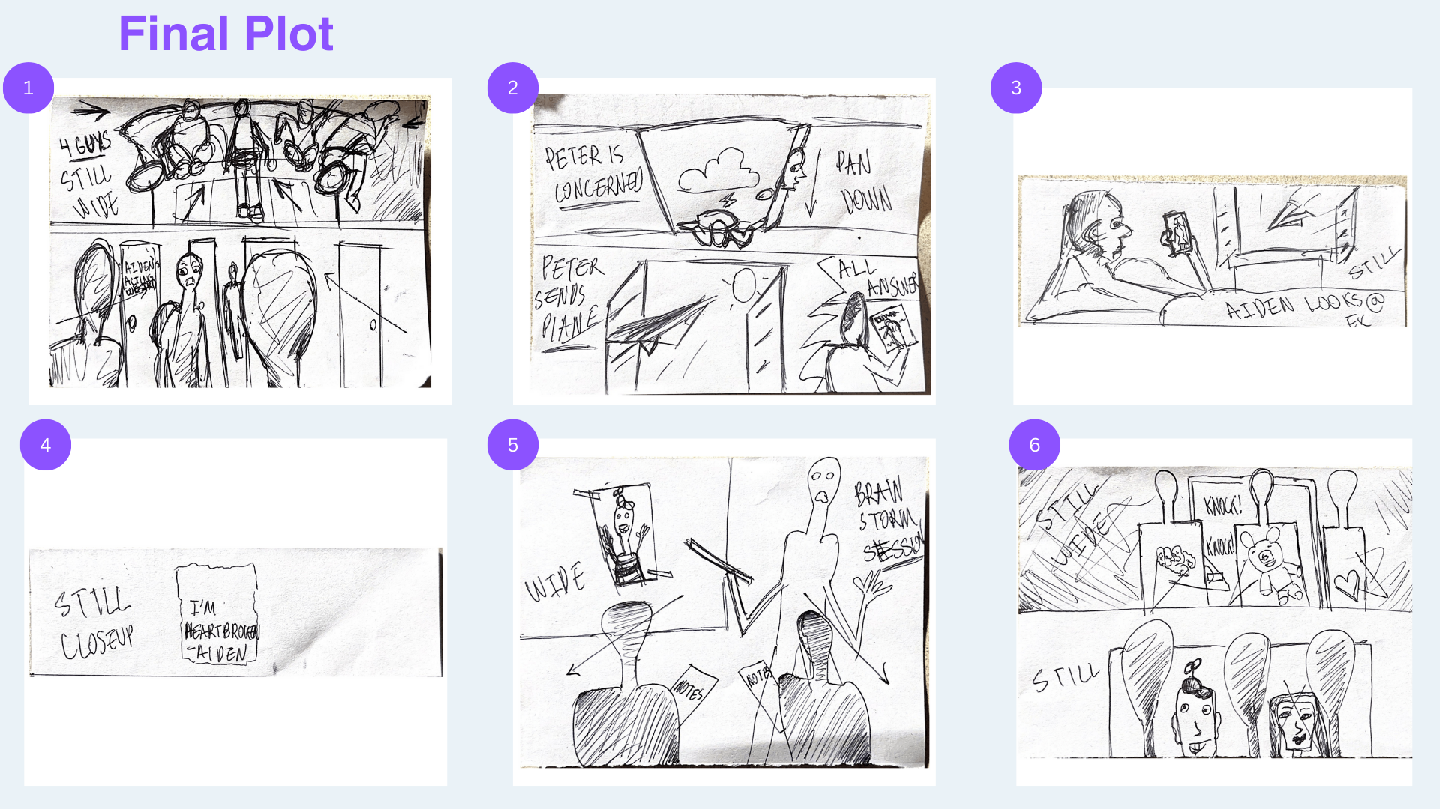
Final Storyboard

Slide 22
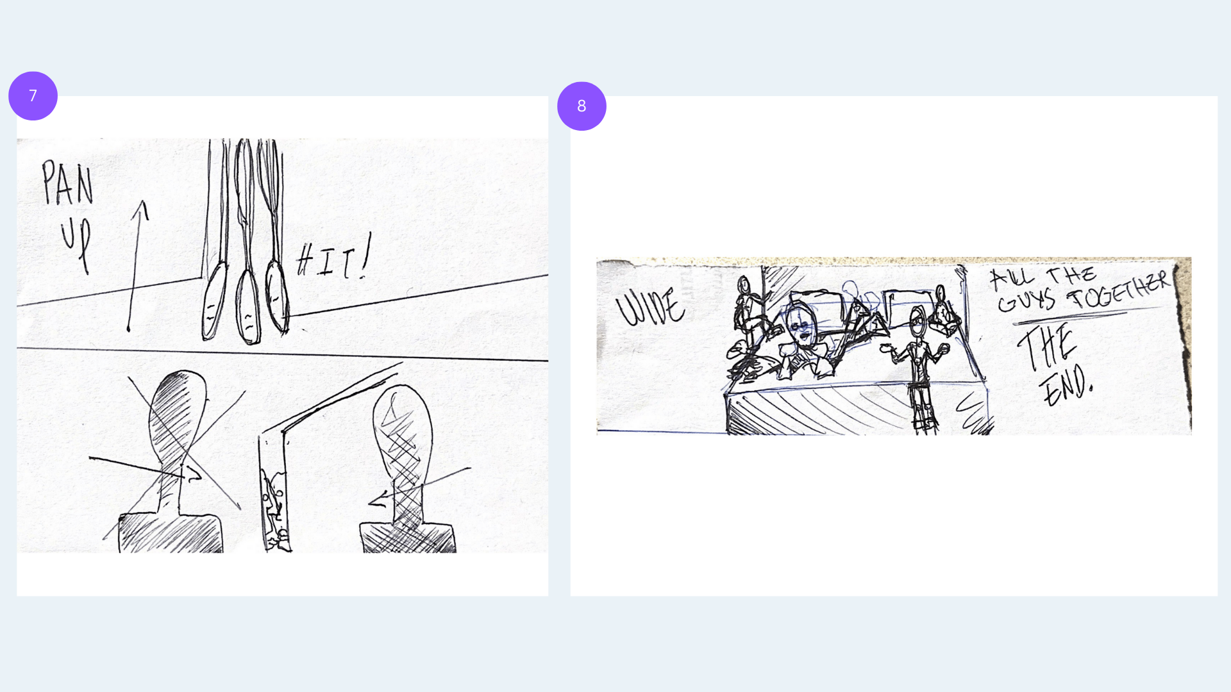
Final Storyboard

Slide 23
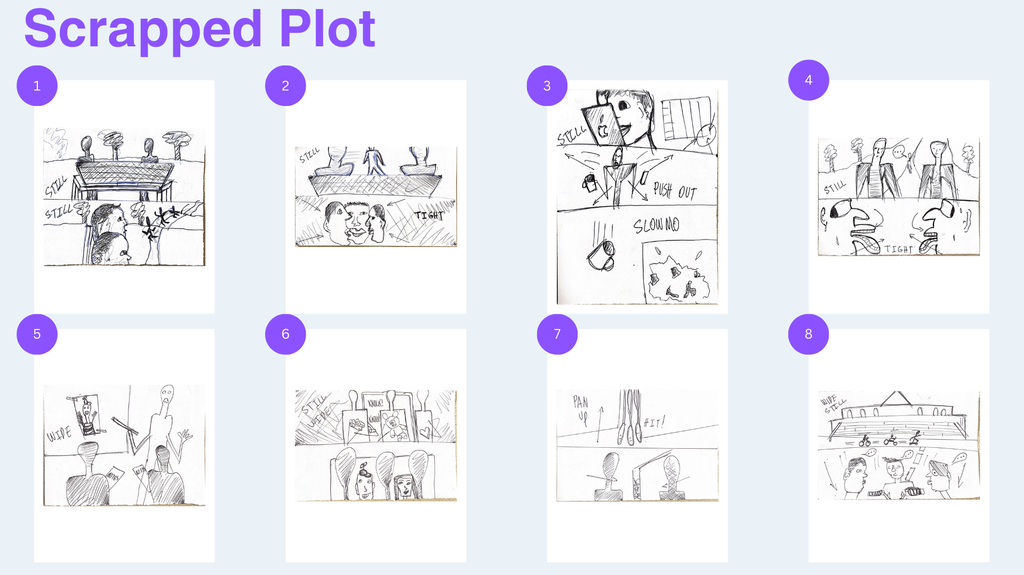
Other Iterations

Slide 24
concept video

Slide 25
TELL ME MORE

Slide 26
