Slide 1

PRESERVING RELATIONSHIPS
NEEDFINDING REPORT
Chloe Pae, Paige Olson, Gabriel Iluma
Assignment #1
CS 147, Fall 2023

Slide 2

CONTENTS
  Team Introductions
  Methods
  Findings
  Analysis

Slide 3
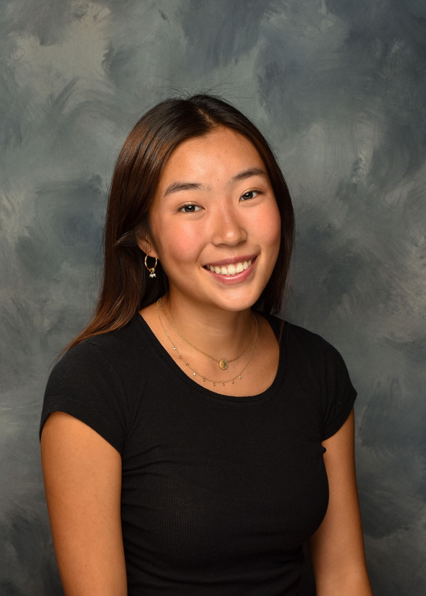
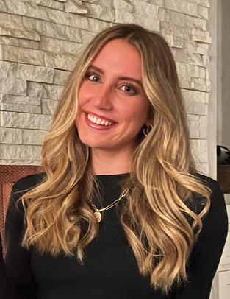
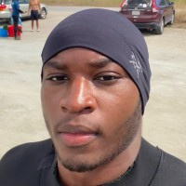
OUR TEAM
Chloe Pae
Paige Olson
Gabriel Iluma
New York City
Symbolic Systems
Class of 2024
San Diego
Symbolic Systems
Class of 2024
Abuja, Nigeria
Product Design & Computer Science
Class of 2024

Slide 4

DOMAIN SELECTION
Community
bucket
list
Staying
in
touch
Daily photos
Time capsule
Baby’s
firsts
Mapping
family
tree
Digital
journaling
Long
distance
relationships
One-year-ago reminders
Past
friendships
Documenting
family
history
Notes:
b. Problem domain and why/how you chose it

Slide 5
OVERARCHING THEME
preserving
relationships

Slide 6
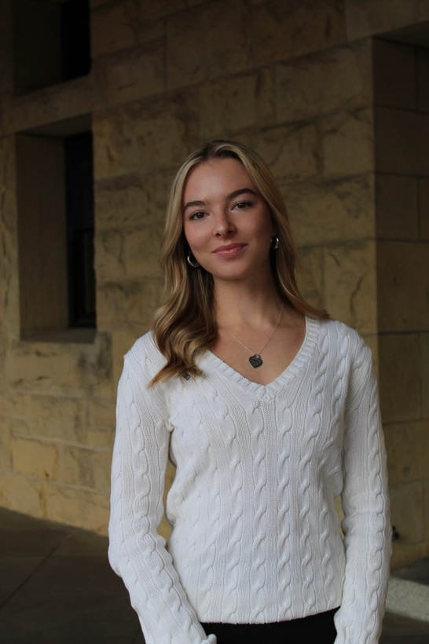
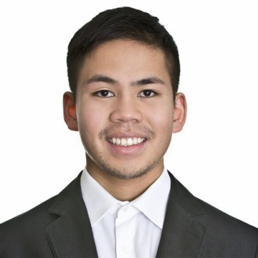

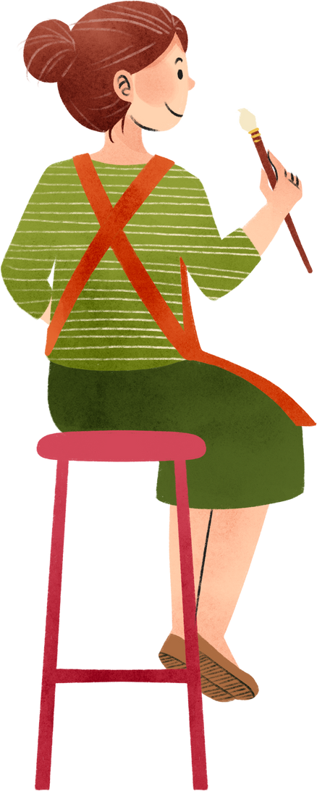
WE SPOKE TO
Sita Antel
Anton Vera
John G.
Jennie Bernheim
Student
Venture Partner
Serial Entrepreneur
Artist
Sourced through primary and secondary connections. We specifically reached out to friends via iMessage.
All participants volunteered to be interviewed.
Notes:
Why were they chosen? Why are they appropriate? How were they
recruited/compensated?

Slide 7




WE ASKED QUESTIONS LIKE...
Who have you talked to in the past 24 hours?
In what ways did you communicate with them?
Who are the closest people in your life and why?
How satisfied are you with your social life?
How satisfied are you with your ability to maintain relationships over time?
Why have some of your relationships persisted while others have deteriorated?
How do you put effort into your relationships?
Notes:
Where were the interviews conducted?
Who was your “extreme user”? In what axis are they extreme?
What did you ask?
Team member roles for each interview
Apparatus – any equipment/software used (transcribing, etc.)

Slide 8
“There are some people in my friend group who I probably wouldn’t hangout with one-on-one”
“The people I’m closest to are uniquely unlike me, but also from California, like me.”
Sita Antel
Stanford Class of 2026
History Major from San Diego, CA
In-Person Interview, Otter.ai
Chloe & Paige
Notes:
Key quotes and surprises
Pictures and relevant artifacts was phone (didn't want to invade privacy)

Slide 9
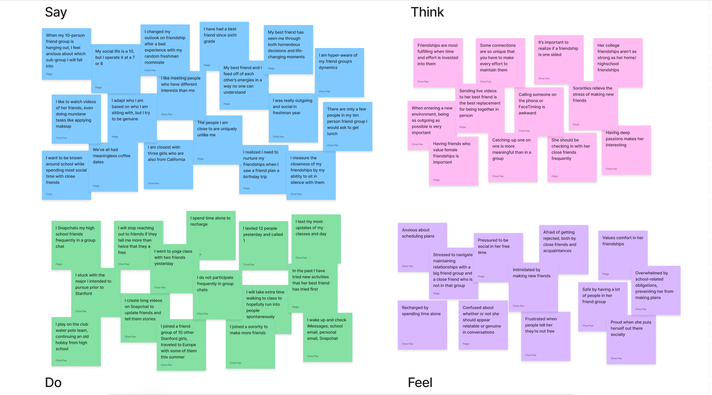
Sita Antel

Slide 10
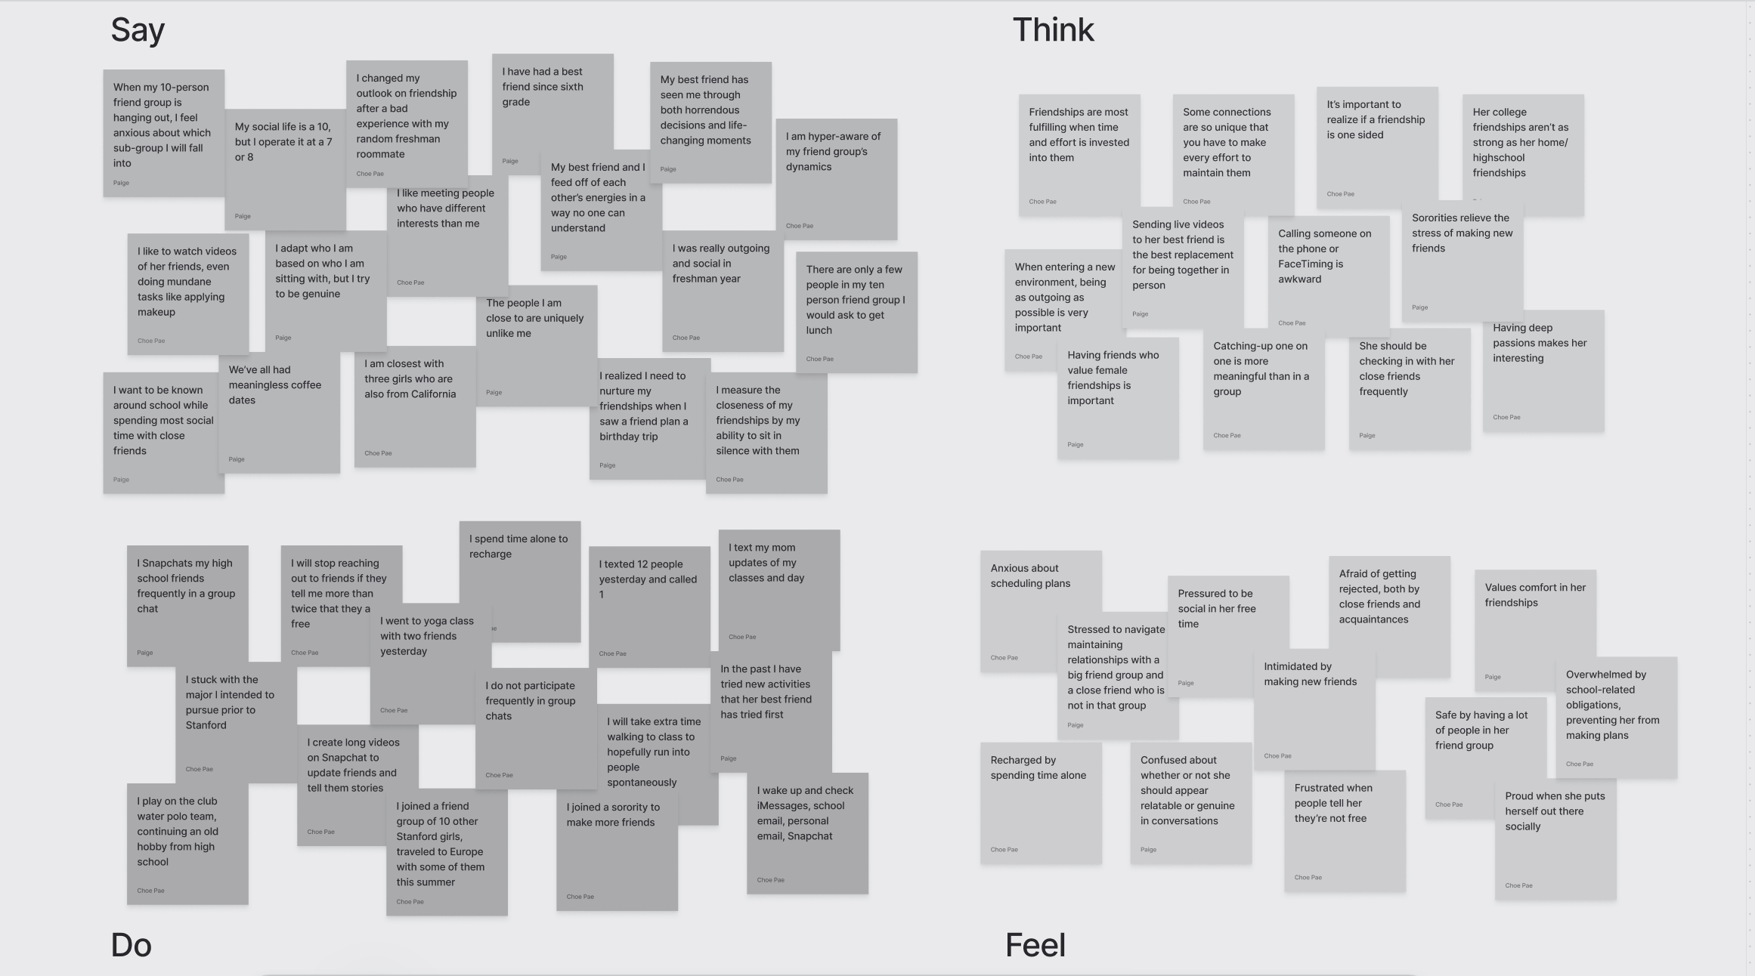




It would be nice to see my close friends more spontaneously
It is important to know what your close friends are up to
Comfortable because having a large friend group makes planning easier
I try to schedule time with my friends over iMessage
Sita Antel

Slide 11
INSIGHTS TO NEEDS
Operating a fulfilling social life requires a lot of time/effort
An easy way to have a more fulfilling social life
In person interaction is the most rewarding form of communication
Accessible opportunities for in-person hangouts
Getting rejected after initiating plans is demoralizing and embarrassing
A way to schedule plans that doesn’t make someone feel vulnerable

Slide 12
“On iMessage alone, I messaged 22 people
individually yesterday”
“If someone doesn’t respond to me,
I’m totally fine following up if I really
want to talk to them”
Anton Vera
Venture Partner
Stanford GSB Class of 2023
Phillipines and Palo Alto
Zoom, Extreme User
Chloe & Paige
Notes:
Extreme user, potential non-user due to systems in place

Slide 13
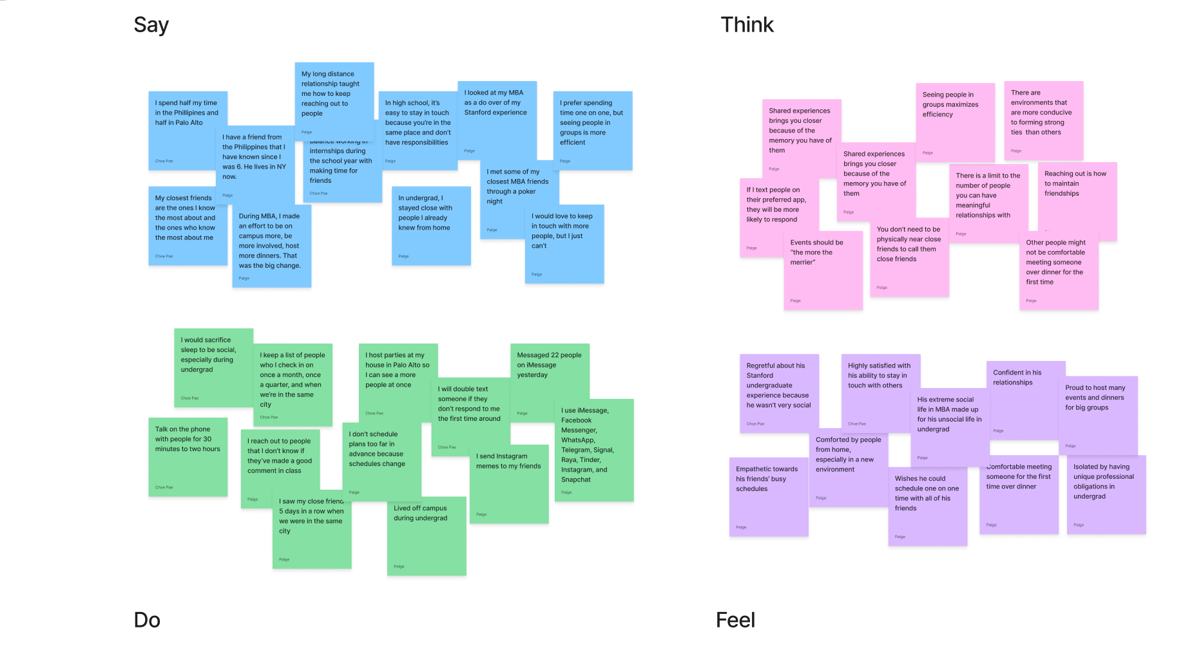
Anton Vera

Slide 14
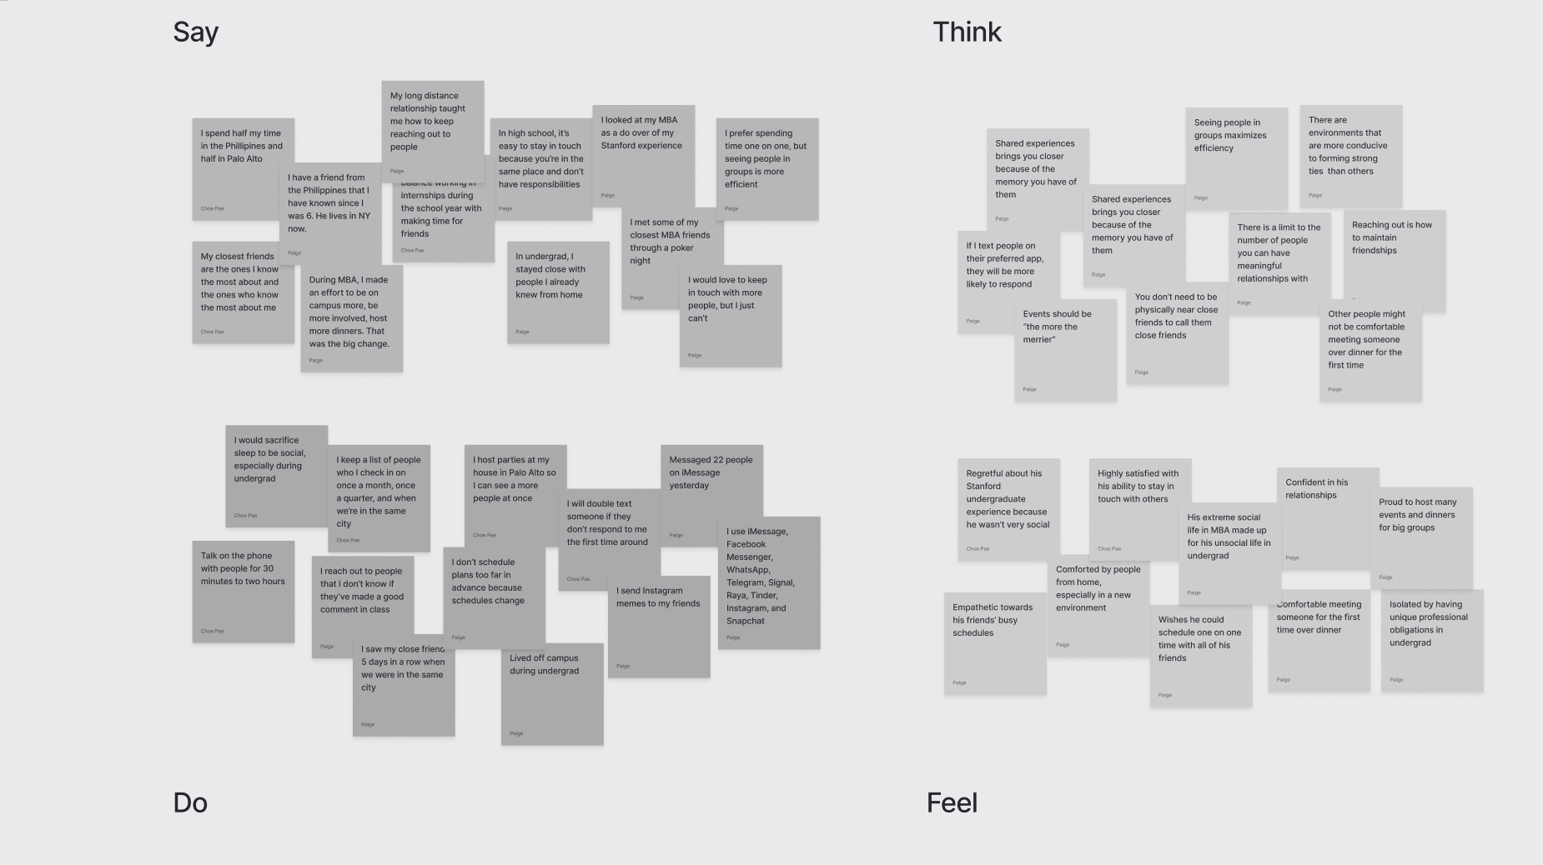
I was way better at maintaining friendships during my MBA than undergrad
Seeing people in groups is more efficient, but one-on-one time is better
I host dinner parties and expect many friends and friends of friends to be there
Feels closest to the people that know the most about him
Anton Vera

Slide 15
INSIGHTS TO NEEDS
Close friends know who you fundamentally are as a person
Opportunities for friendships to help you stay grounded in who you are
Seeing people in groups is more efficient but less meaningful
A way for people to hangout “efficiently” and “meaningfully”
Being a highly social person requires strong organizational skills
A method of organization with regard to relationships that doesn’t feel clinical

Slide 16
“I have a very hard time staying in touch with people, both because I have no social media and because I want to live in the present.”
“It’s a very abrupt transition socially to post-grad life”
John G.
Serial Entrepreneur
Stanford GSB Class of 2023
Palo Alto
In-Person, Extreme User
Chloe & Gabriel

Slide 17
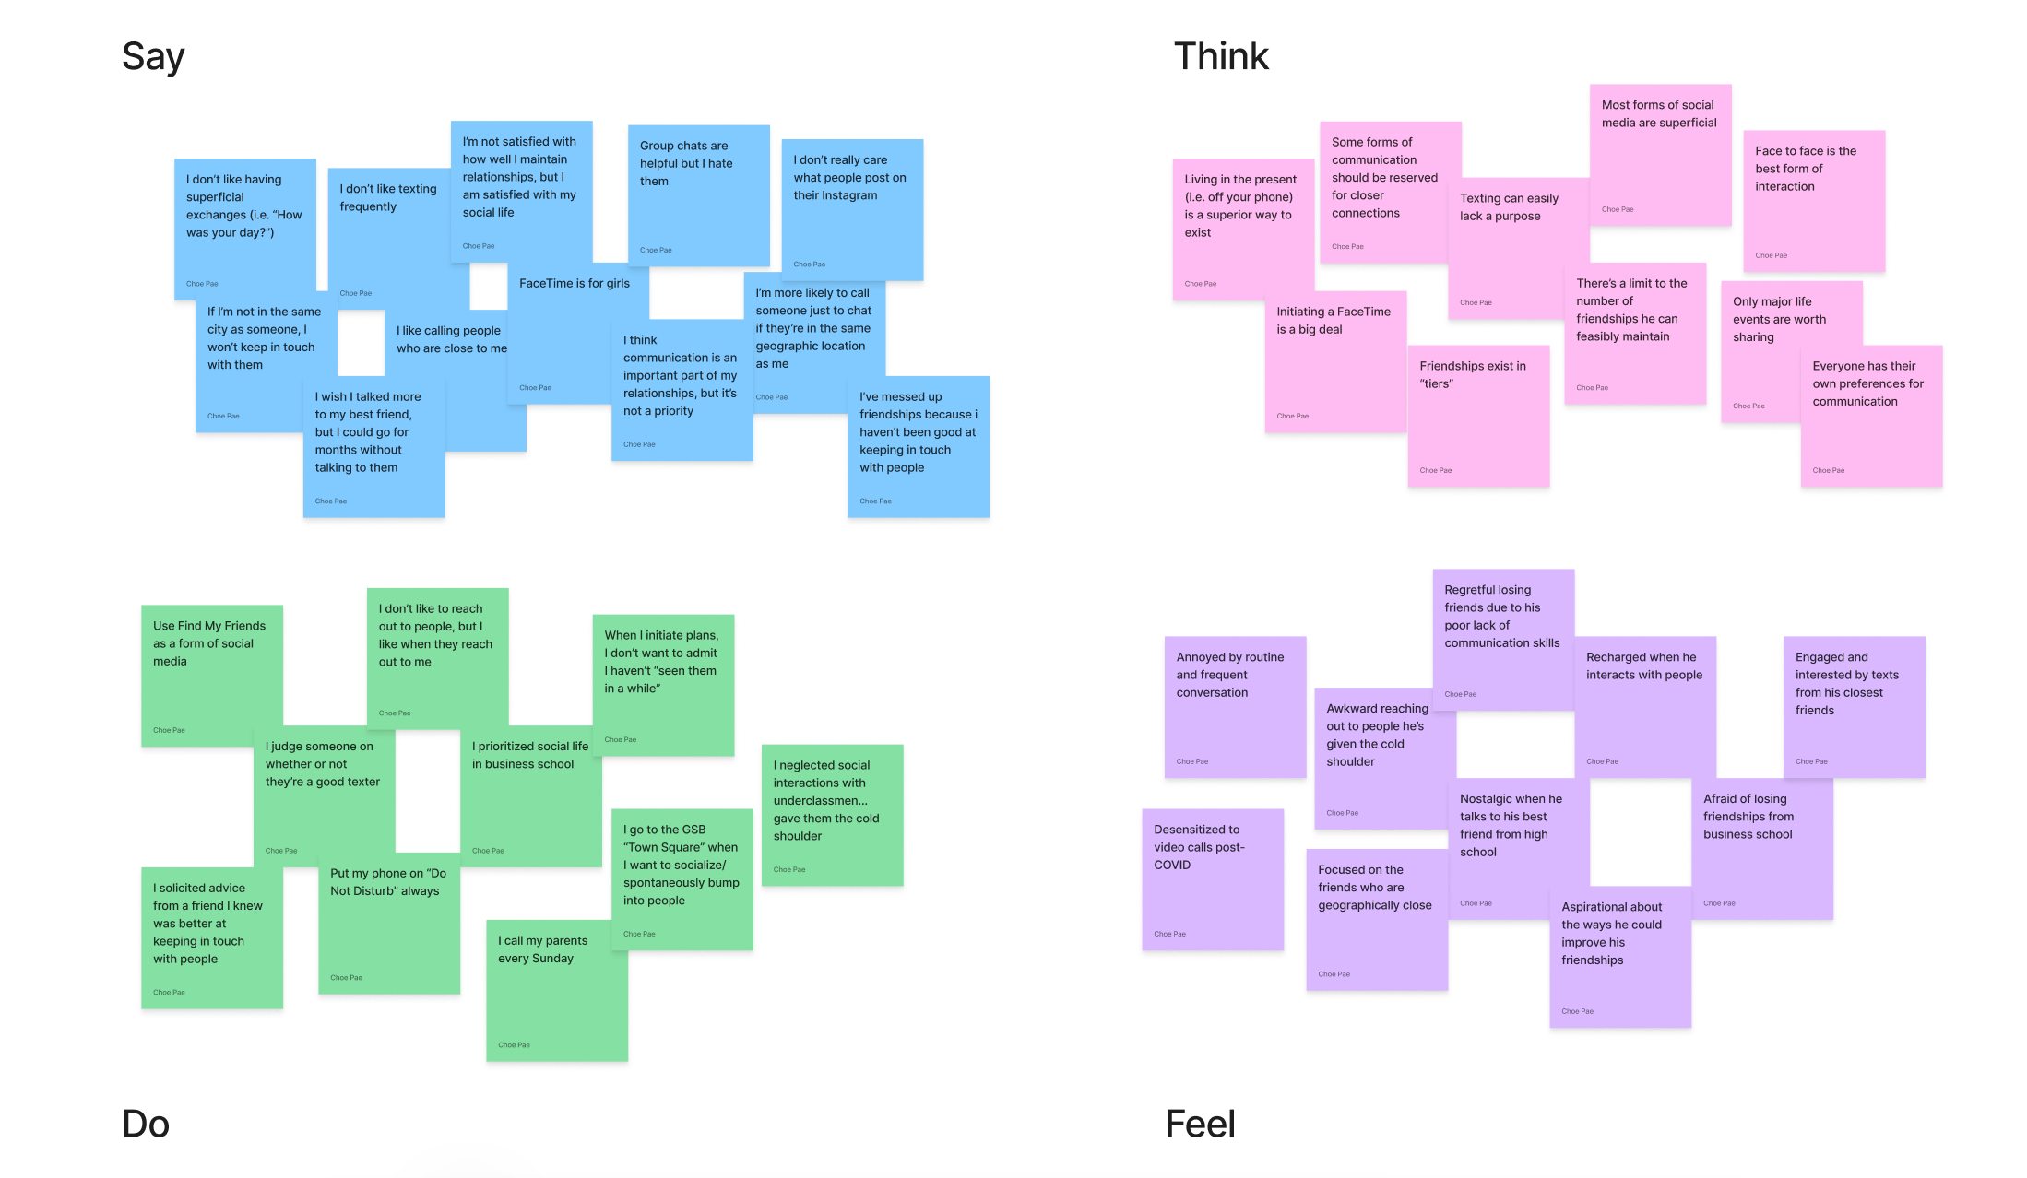
John G.

Slide 18
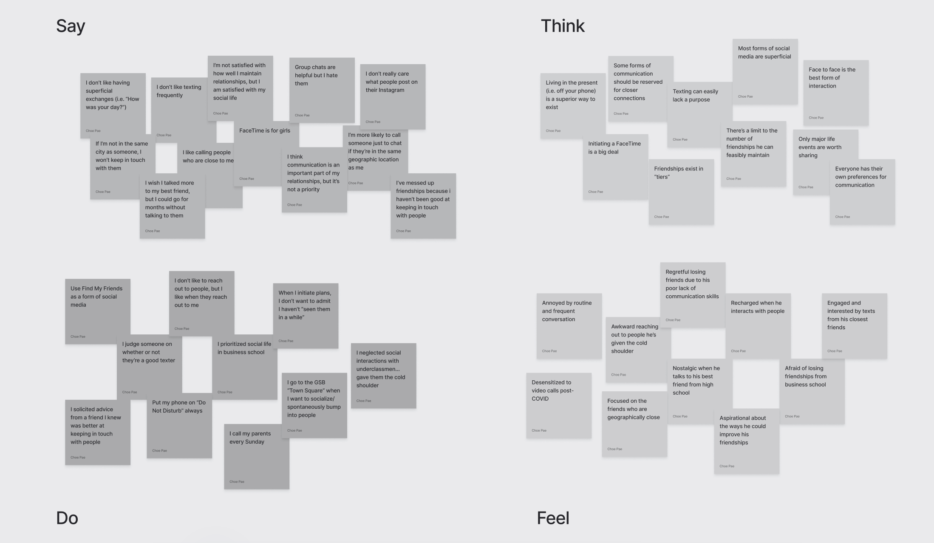
Generally avoids superficial interactions and relationships.
Intimacy should be reserved for only the closest of relationships.
Feels trapped by intimate interactions, but seeks to build meaningful connections.
Neglects communication until he feels like reaching out.
John G.

Slide 19
INSIGHTS TO NEEDS
It is easy to lose track of how long it’s been since one has seen his or her friends
A easy way to keep track of when one has last communicated with someone
Avoiding vulnerability, people seeking meaningful connections often prefer superficial interactions over intimate ones
An avenue to express intimate feelings without feeling overly exposed
Introverted qualities are sometimes indistinguishable from neglect in relationships
A way to demonstrate care without betraying one’s preferences and personality

Slide 20
“Losing friendships and growing apart is a part of life”
“I am terrible at remembering my friend’s and family’s key life moments and milestones, maybe it’s because I don’t have Facebook anymore”
Jennie Bernheim
Artist
Mom of 2 Stanford Undergrads
Palo Alto
In-Person
Chloe & Paige
Notes:
Potential non-user due to systems in place

Slide 21
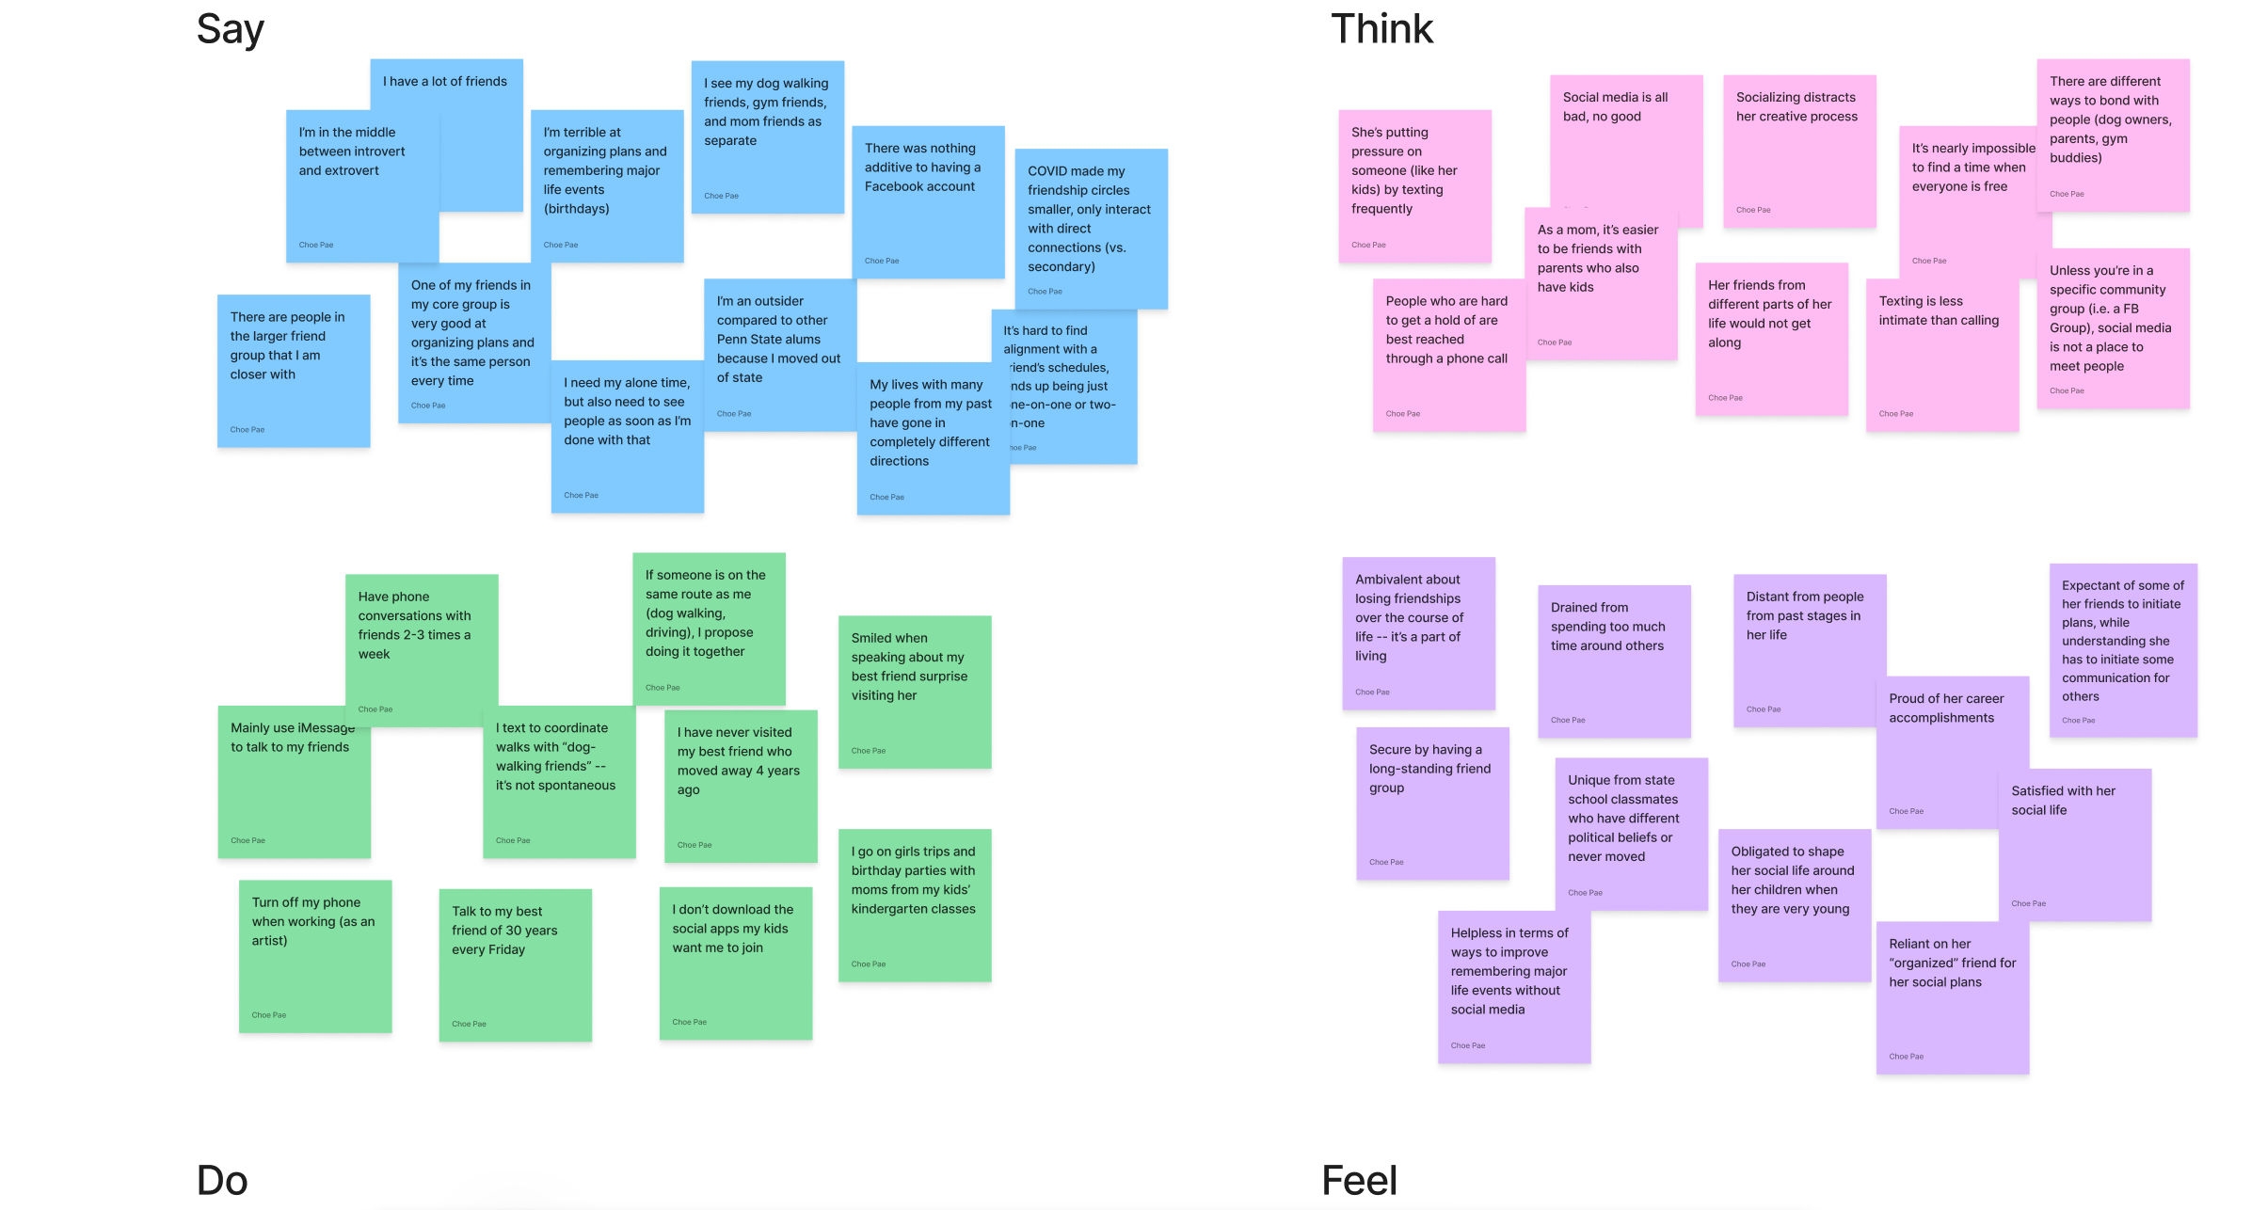
Jennie Bernheim

Slide 22
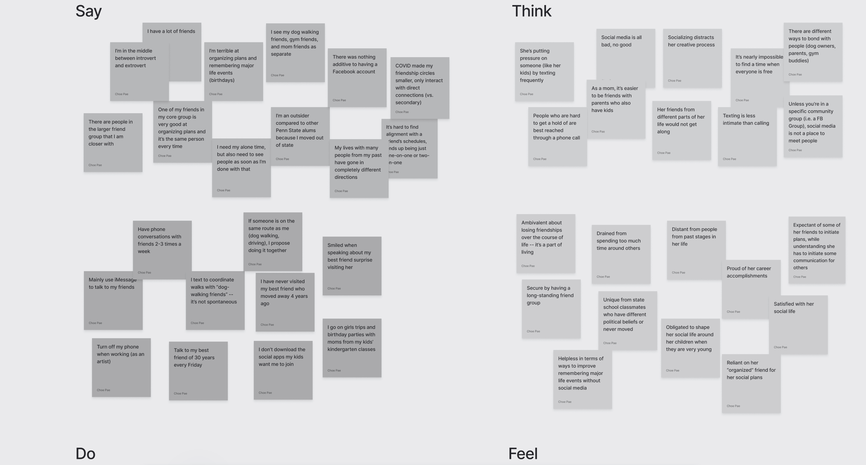
Social media is a waste of time and does not help cultivate relationships
I am terrible at making plans but I am very satisfied with my social life
I see a lot of my friends through shared activities - dog walking, going to the gym
Ambivalent about losing touch or drifting apart with some friends
Jennie Bernheim

Slide 23
INSIGHTS TO NEEDS
People think they’re either good or bad at making plans
A way to transform people’s fixed mindsets surrounding social ability
Maintaining a social life can mean engaging friends in your daily routine
Methods of inviting individuals into your preexisting routine
Having a set time to talk to a long-distance friend is a successful way to maintain connection
Tools to maintain friendship when there is long-term physical separation

Slide 24
MAJOR TAKEAWAYS
1
2
3
People are afraid of intimate connection (online or in-person) with people they don’t know well already, but want to have meaningful relationships
Even if people are satisfied with their social life, they can still think they are poor at keeping in touch with their friends
Maintaining friendships and relationships requires time and effort that is usually rewarding, but often time-consuming

Slide 25
NEXT STEPS
  Continue to analyze interview data for further contradictions, insights, and needs
  Expand horizons and interview those with different points of view
    Ideas: students at other colleges, individuals with more isolated living experiences, etc.
  POV statements and HMW Analysis

Slide 26
APPENDIX
  Link to Consent Forms: https://drive.google.com/file/d/1uSbpL-pjhQRF1xhgpbEiKriwREAmJ9e1/view?usp=drive_link
  Link to Empathy Maps: https://drive.google.com/file/d/1o80hYV62ERuyD_e0SmjzZeCKx_klx0YV/view?usp=drive_link

