Slide 1

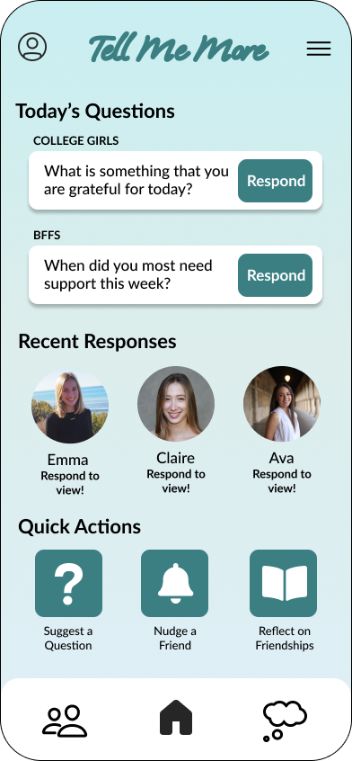

Connect vulnerably and consistently

