Slide 1
Assignment 6:
Med-Fi Prototyping
Melody Fuentes
Hamidou Guechtouli
Blaine Wells
Dante Danelian

Slide 2
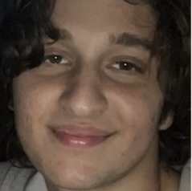

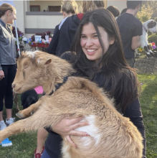
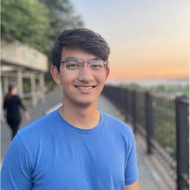
Team Arbor
Hamidou Guechtouli
Blaine Wells
Melody Fuentes
Dante Danelian

Slide 3
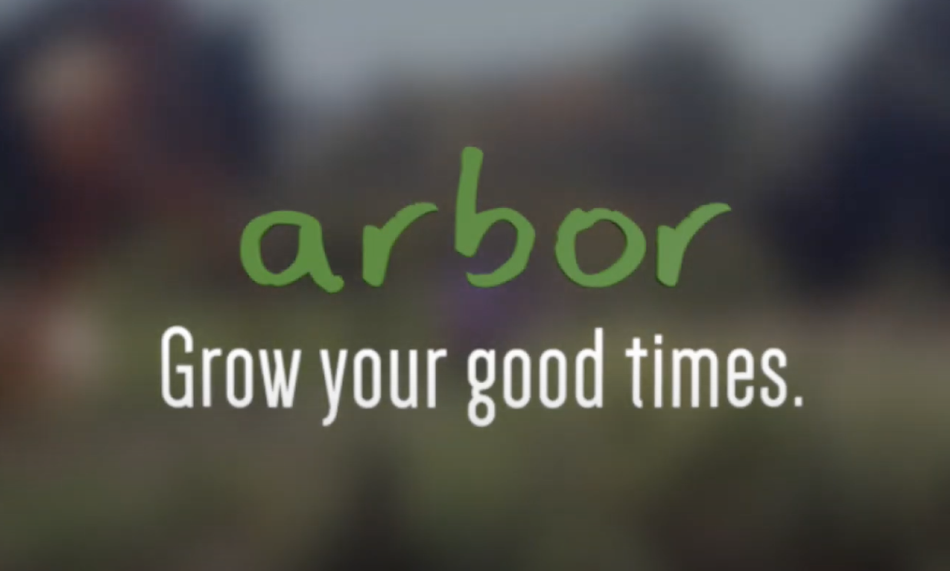

Slide 4
Problem/Solution Recap
Problem
Proposed Solution
People do not have an efficient and dedicated method to recall past positive memories.
A virtual tamagotchi-
style garden where you can plant and revisit good memories in the form of trees.

Slide 5
Values in Design

Slide 6
Core Values
Mindfulness:
Promote reflection and emotional well-being
Personal Growth:
Visual representation that individuals flourish and evolve, reflection can lead to deeper understanding of oneself
Human Connection:
Helping users to uplift each other and celebrate each other’s experiences
Positive Reflection:
Transform the way people view their past, fostering optimism and resilience
Simplicity:
Simple interface and UX to make spreading happiness as easy and fun as possible
Playful Reminiscence:
Adding joy and excitement to the process of reminiscing

Slide 7
Expressing Our Values in Our Design
Mindfulness:
Tranquil nature landscape
Opportunity to reflect
Personal Growth:
Trees’ growth stages
Changing seasons/background
Human Connection:
Share/receive memories from other in-game players on your farm
Interaction with friendly NPCs (e.g. shopkeeper)
Positive Reflection:
Prompting to revisit happy memories
Simplicity:
Minimalist sprite and background elements design
Intuitive controls (mainly tapping)
Playful Reminiscence:
Process of cultivating farm, home and customizing sprite
Playful animations

Slide 8
Value Tensions
Positive Reflection vs Realism
Balancing positive reflection with the authentic portrayal of complex memories. We don’t want to pretend like all memories can be happy all the time.
Simplicity vs Personalization
Balancing simplicity with user personalization for expressive engagement. We want to add a lot of customization features to help attach the user to their character and garden, but not make the process overly complicated for the user.
Playful Reminiscence vs Depth of Reflection
Balancing playful interaction with deeper emotional engagement in reminiscing. Although our app is game-like, we want to emphasize the importance of active and regular reflection.

Slide 9
Tasks

Slide 10
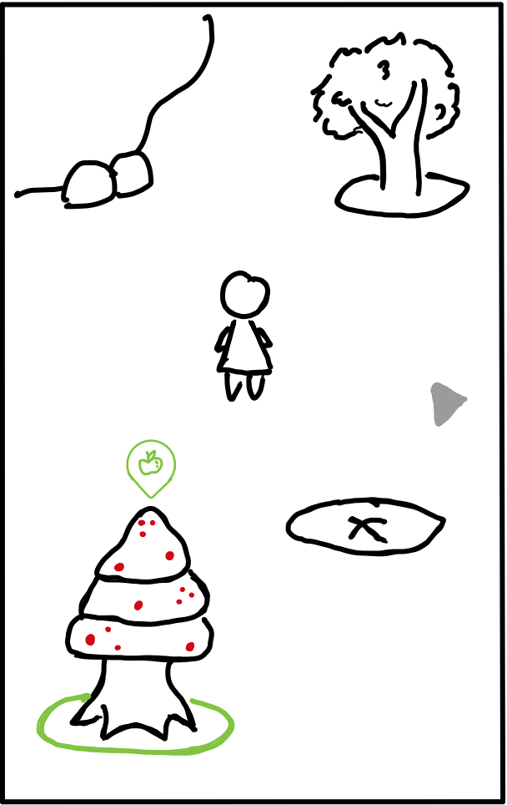
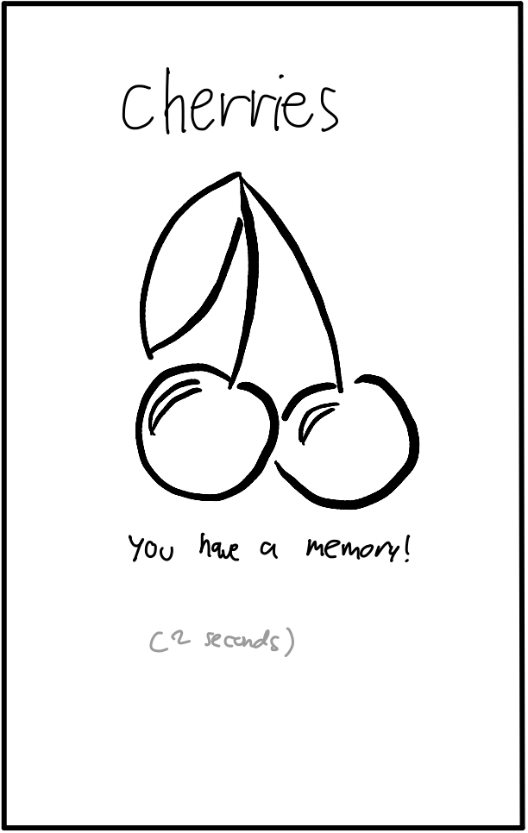
Simple Task - Accessing a Memory
This task constitutes navigating to a tree with fruit, and tapping on that fruit to view its associated memory.
This task flow remains fairly similar in terms of user inputs, but some design changes were made to help the task flow smoother.
For instance, a green circle and popup were added to indicate which tree was ready to view. Furthermore, a time limit was added to several animations so as to not rely on constant user taps.

Slide 11
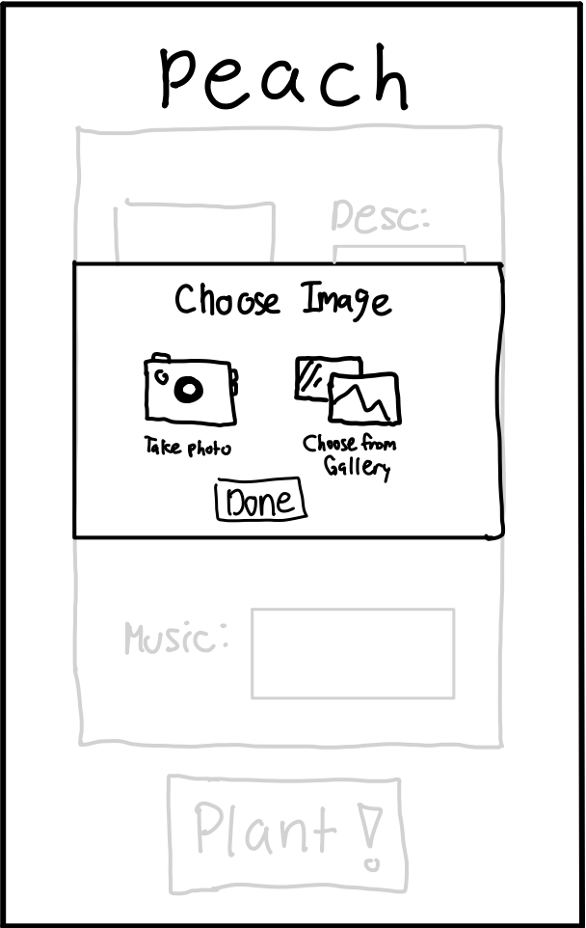
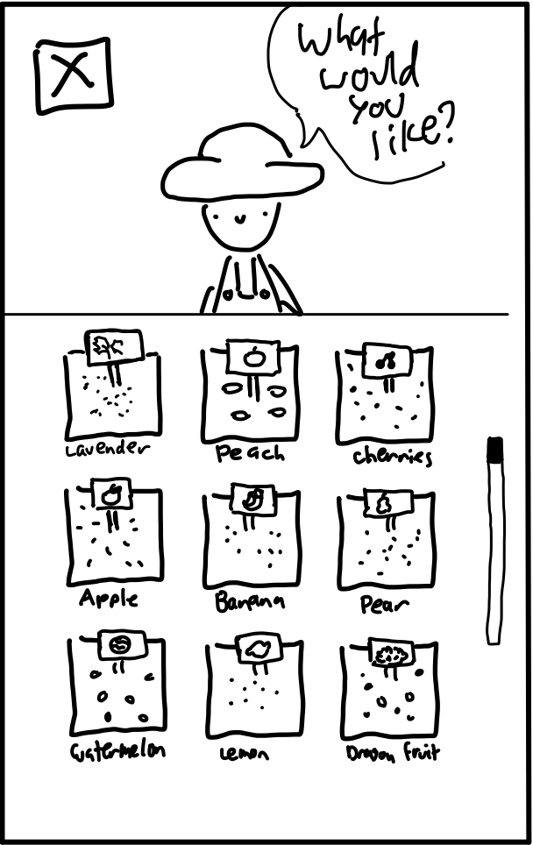
Moderate Task - Logging a Memory
This task consists of tapping on the farmer’s market, acquiring seeds, and then planting them in the garden.
Like our simple task, there were no major changes to this flow. However, we did break down the steps for inputting images, text, and emotions, to clarify how a user could go about logging their memory.

Slide 12
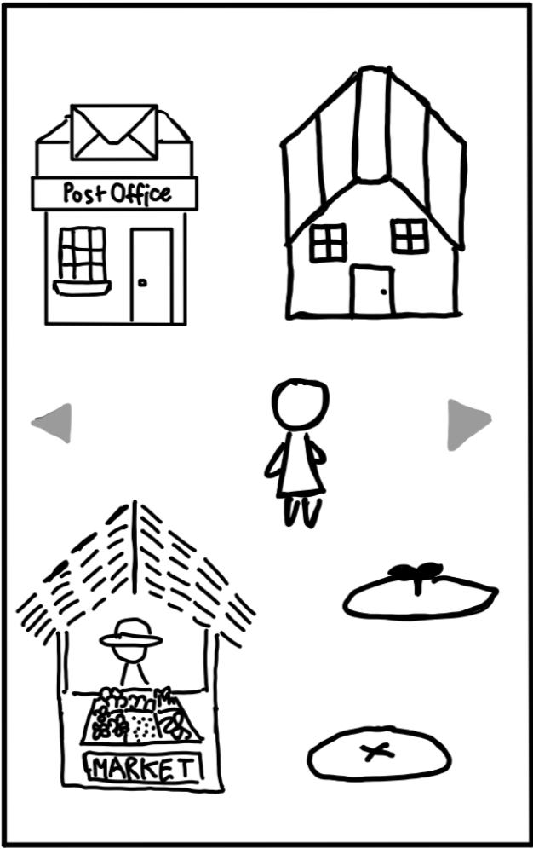
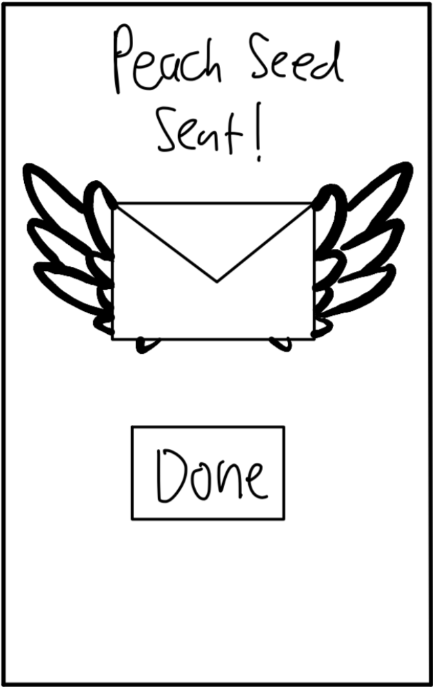
Complex Task - Sharing a Memory
Our final task requires the user to tap on the post office, pick a friend in the contacts list, and send the seed of a memory to them.
One major change was made to this task. Now, instead of tapping on the mailbox next to the house to send a seed, the user must tap on the post office—a new building in the town area.

Slide 13
Usability Goals and Key Measurements

Slide 14
Two Key Measurements
1. Time to Complete Task
2. Critical Incidents Log
3. Qualitative
User Feedback
# of minutes for each participant to complete each task. Used to assess difficulty/ efficiency of task flows.
Log of negative events scored on a scale of 0 to -3, where 0 is no issue and -3 is a usability catastrophe. Can be summed to create a CI index (CII) for each participant.
User thoughts on process in general, emotions raised, overall level of satisfaction.
Notes:
For assignment 6, we focused on two of the key measurements from last week.

Slide 15
Two Useability Goals
Under 1 minute for simple task on average
Under 2.5 minutes for moderate task on average
Under 5 minutes for complex task on average
No more than one major CI per participant
CII score >-5 per participant on average
Notes:
Specifically, we made targeted revisions with the aim of making progress toward two of our useability goals:

Slide 16
Goal #1: <5 Min for Complex Task
Updated the mailbox to a convenient post office, providing a more indicative and comprehensive service for users
Enhanced user experience with clear labeling and intuitive design, ensuring effortless navigation to the designated area
  Prominently placed an envelope atop the post office, creating an unmistakable visual marker to help users easily identify the location
  Strategically positioned the post office farther from the house, establishing a clear visual distinction between the two structures
Simplified the building and background design, resulting in a more visually appealing and user-friendly environment
One further change that could be made is to add a mail icon that the user can tap from any screen to get to the post office.

Slide 17
Goal #2: <1 Major CI per Participant
Implemented standardized transitions between screens, ensuring clear and clickable buttons to prevent confusion
Refined complex task on the previous slide, optimizing the user experience
Exploring the incorporation of an in-game tutorial that guides users as they advance through the game and tackle new challenges
Enhanced the overall design clarity, exemplified by the use of seeds instead of fruits in the market, fostering a more intuitive and user-friendly interface
One potential change that could still be made is to add shadows for all clickable objects to make them stand out more.

Slide 18
Revised Interface Sketches

Slide 19
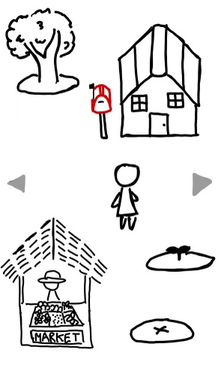
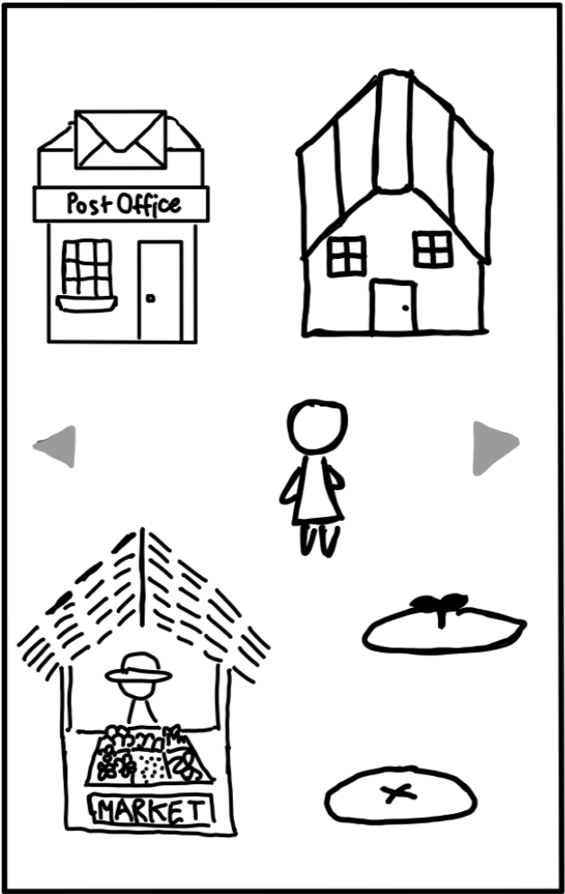
Major Revision #1: Post Office
In our Low-Fi prototype testing, we found that multiple participants could not distinguish the mailbox and house as distinct buttons. Furthermore, some did not associated the mailbox with outgoing mail, only incoming mail. To remedy this, we added a post office, which serves as a clearer center for all mail actions.

Slide 20
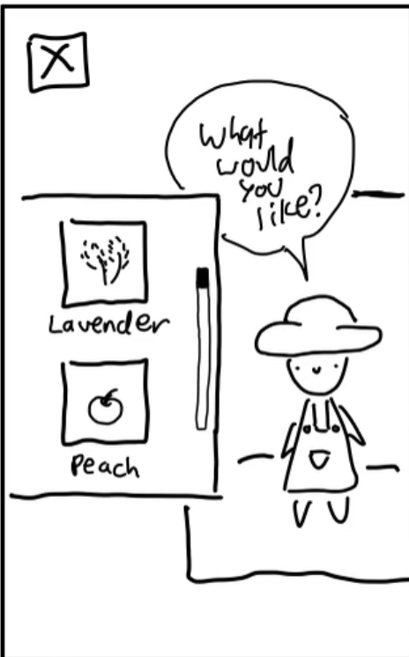
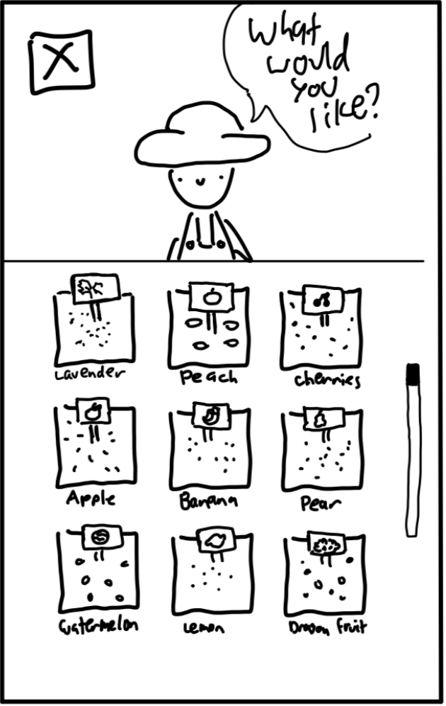
Major Revision #2: New Market
Our testing also revealed that some participants were confused by the marketplace, and believed they were acquiring fruit (when in actuality there were acquiring seeds). We also heard feedback that the window was too small, and would require too much scrolling to view all seeds. To remedy these issues, we displayed seeds instead of fruit, and added a much larger selection on the first page.

Slide 21
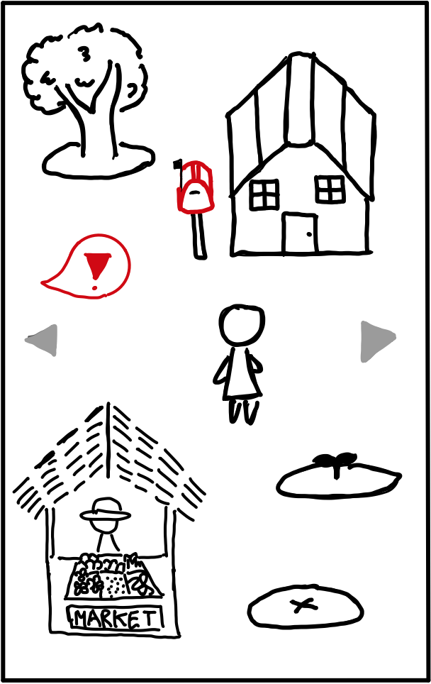
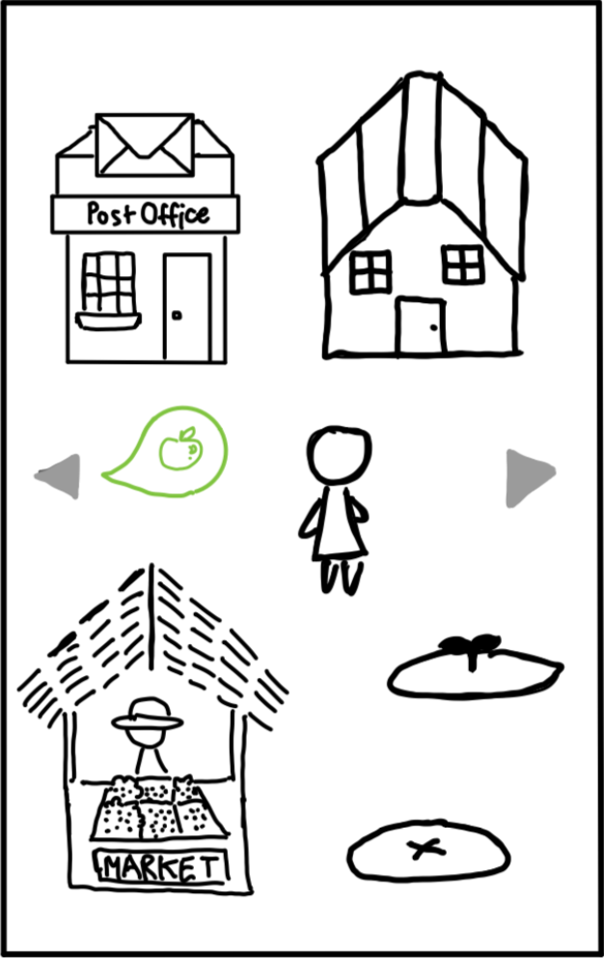
Major Revision #3: Conscious Color
One piece of feedback we received last week was that our notification for a grown fruit evoked the imagery of a warning. This was due to the use of a bright red exclamation point. This week, we were much more conscious about the colors we used, opting instead for a light green hue that aligns more with our natural theme.

Slide 22
Medium-Fi
Task Flows

Slide 23
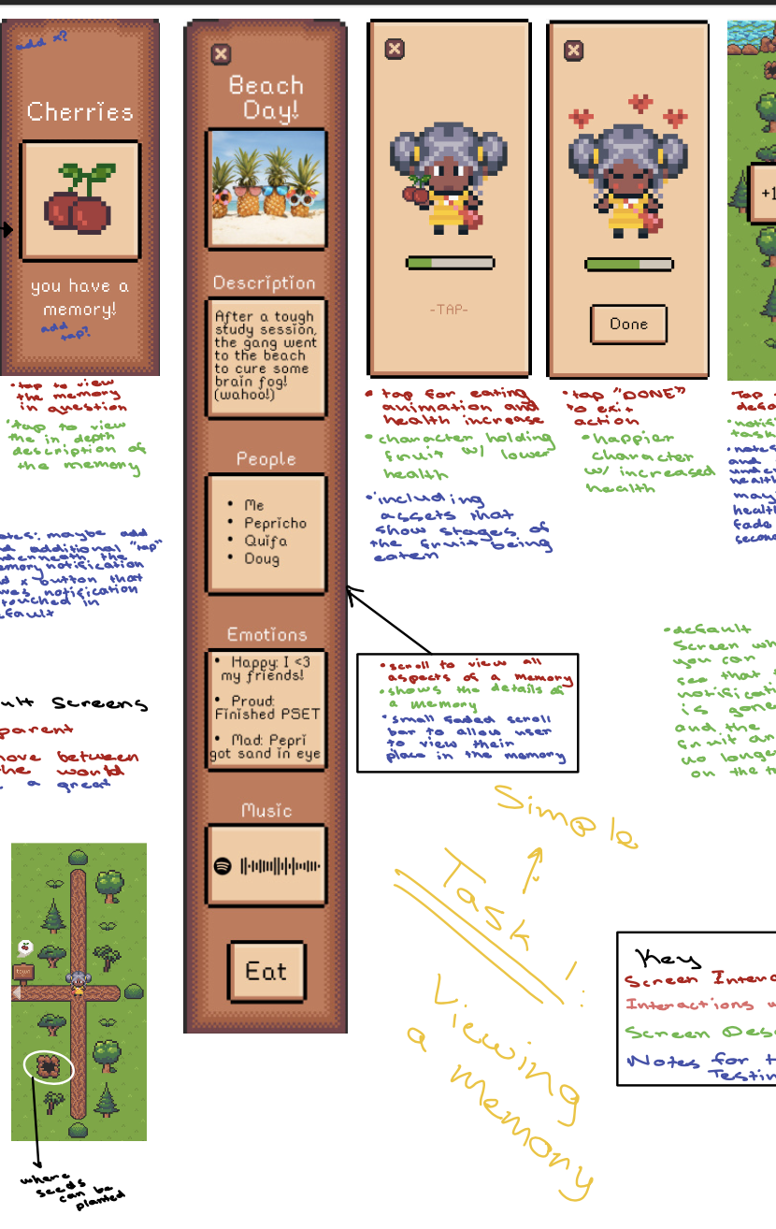
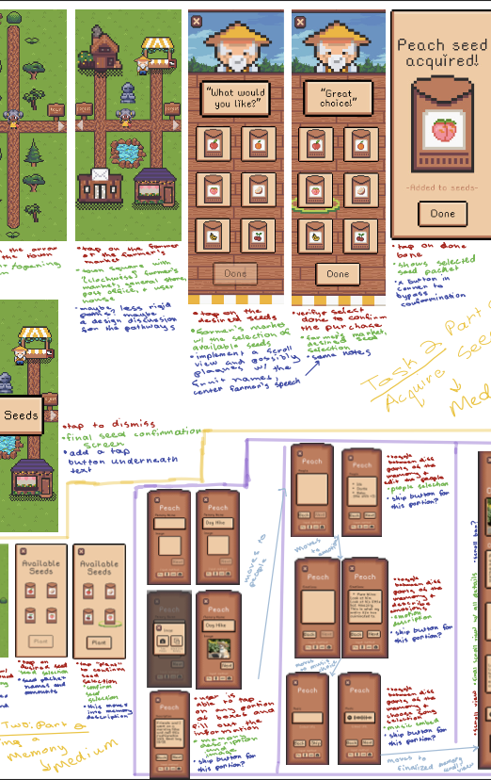
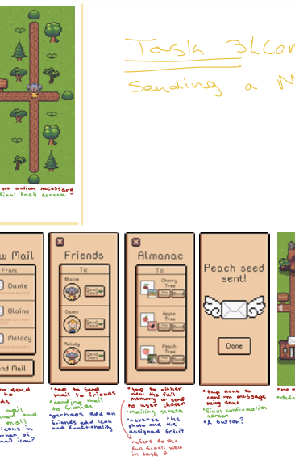
Task Flows
Simple:
Reviewing a Memory
Moderate:
Planting a Memory
Complex:
Sharing memories
Notes:
Link to full task flows: https://drive.google.com/file/d/1pa-xjD_t7XLg4kHsuNK1nl78kwWIGkdY/view?usp=sharing

Slide 24
Prototype Implementation

Slide 25


Our Tools
We relied on two main tools for this project:
- For creating/editing/animating pixel art assets
- For hosting the medium-fi prototype and
our asset/branding collection

Slide 26
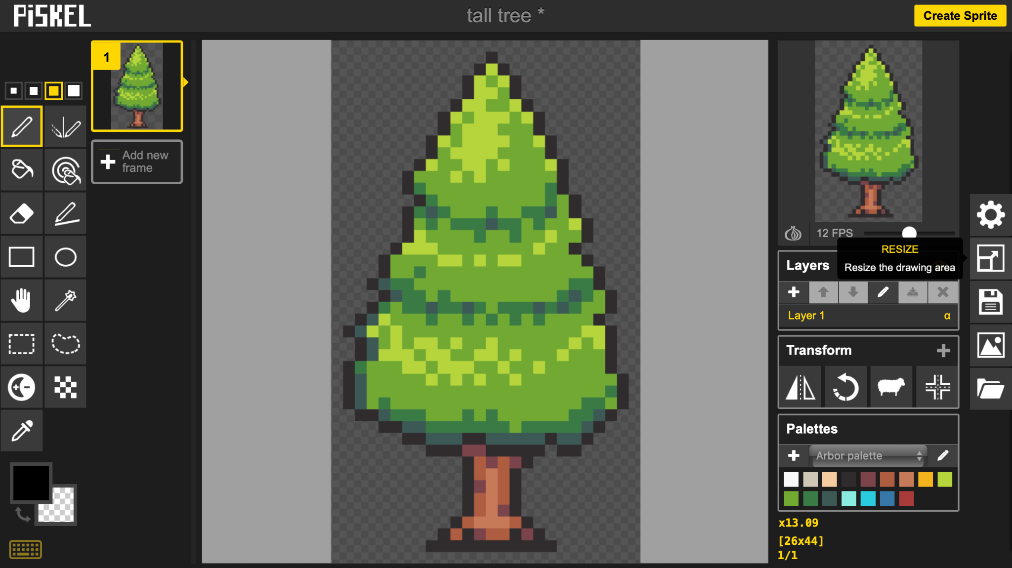
Piskel App
Pros:
Easy development of assets
Ability to create multiple keyframes for animation
Supports exporting as png, sprite sheet, or gif
Easy to resize graphics
Cons:
Limited selection of design tools
Complex design features are harder to use

Slide 27
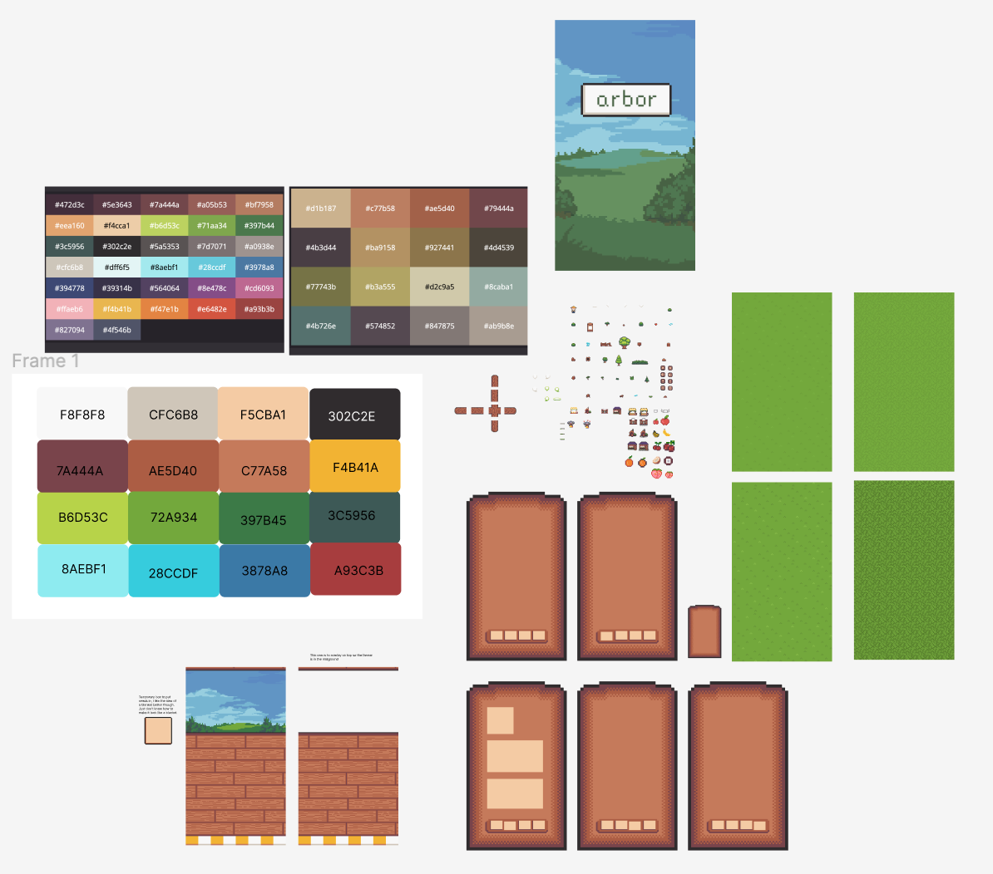
Figma
Pros:
Collaborative and intuitive
Allows for easy resizing/cropping of assets
Supports graphic design for mobile
Cons:
Some features require a premium subscription
Slight learning curve

Slide 28
Limitations
For the sake of time and complexity of implementation on Figma, several aspects of our product were left out of the medium-fi prototype.
Animation: Since we used Figma to implement our prototype, we decided to leave out animations of the assets (i.e. swaying of the trees, movement of water, character movements) which would otherwise be present.
Other Memories: Furthermore, in the actual app, you would be able to tap on any tree in the garden, and view a popup of the associated memory. However, this was not deemed relevant to our task flows, and would require hard-coding a large amount of memories.

Slide 29
Limitations
]]]]] ]]
My Home: In the final app, you will be able to tap on your character’s house, which is in the top left corner of the town. From here, there will be a customizable interior which houses an Almanac of all the seeds and a mirror for changing your character’s outfit. Given that implementing this would not affect our three task flows, and would require creating a large amount of pixel art assets, we decided to leave it out for now.
General Store: Another feature we left out of the town area (for similar reasons to the above) was the general store, where users will be able to unlock new outfits, seed types, and pets for their character.
Making Friends: Since our app does not have a user base, we had to hard-code friends into the product.

Slide 30
Limitations
]]]]] ]]
More Roaming Space: In the final app, you will also be able to move up and down the farm as well. However, this was not necessary to showcase the functionality of the app.
Information Inputs: As discussed in the next section, inputs for logging a memory are hard-coded in, as the Figma prototype does not support this feature.
Background Music: In the final version of the app, there would be music in the background to help immerse the user in the environment.
Aesthetic Customization: In the final version of the app, the user would be able to move objects around in the garden, change their character’s clothing, and customize their house’s interior. Given that these were all complex aesthetic changes, we did not include them in the medium-fi prototype.

Slide 31
Hard-Coded/Wizard of Oz Features
Several aspects of our prototype were hard-coded, so as to maintain the audience’s immersion in the product while also illustrating use cases for the product.
Multi-media Inputs: Due to implementation on Figma, our prototype does not support multimedia inputs, and thus we hard-coded text, photo, and embedded media when planting seeds and reviewing memories.
Social Component: Since our app does not yet have a user base, we hard-coded friends into the system. Thus, if you tap on the post office, there is hard-coded mail from friends, and a list of contacts you can send seeds to.

Slide 32
Hard-Coded/Wizard of Oz Features
]]]]] ]]
Customization of Garden: Seeing as our Figma prototype does not support full customization of the character or garden (as this would involve exponentially upscaling the number of screens we would have to generate), the character’s outfit and the layout of the garden are hard-coded in, as if the user set up their app this way.
Seed Inventory: For similar reasons as the previous point, we had to hard-code the seeds in the user’s inventory at the time of planting or sending mail, as keeping track of the seeds they acquired at the marketplace would be too complex for a Figma prototype.

Slide 33
Appendix

Slide 34
Link to Full Task Flows
Link here: https://drive.google.com/file/d/1pa-xjD_t7XLg4kHsuNK1nl78kwWIGkdY/view?usp=sharing

Slide 35
Sketch Revisions
Change farmer’s market to be selling seeds, not fruits themselves.
Use color, 3-D, and shadows to make clickable objects pop on screen.
Instead of mailbox, use post office instead. Add exclamation mark when mail arrives.
Changed color of new fruit notification from red to green with fruit depicted.
Pop-ups now last for two seconds maximum, before transitioning to next screen. However, they can be tapped on to expedite process.

Slide 36
Sketch Revisions (cont’d)
More seeds now featured in farmer’s market so user does not need to scroll as much.
Added textboxes to indicate where a user can input text/other media.
When choosing seeds to mail, more of the memory is displayed in a preview screen so the user knows which memory corresponds to the given seed.
View Full Revisions Here

