Slide 1
Assignment 5:
Low-Fi Prototyping
Hamidou Guechtouli
Blaine Wells
Melody Fuentes
Dante Danelian
Notes:
Welcome to our presentation on Low-FI prototyping

Slide 2
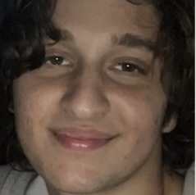
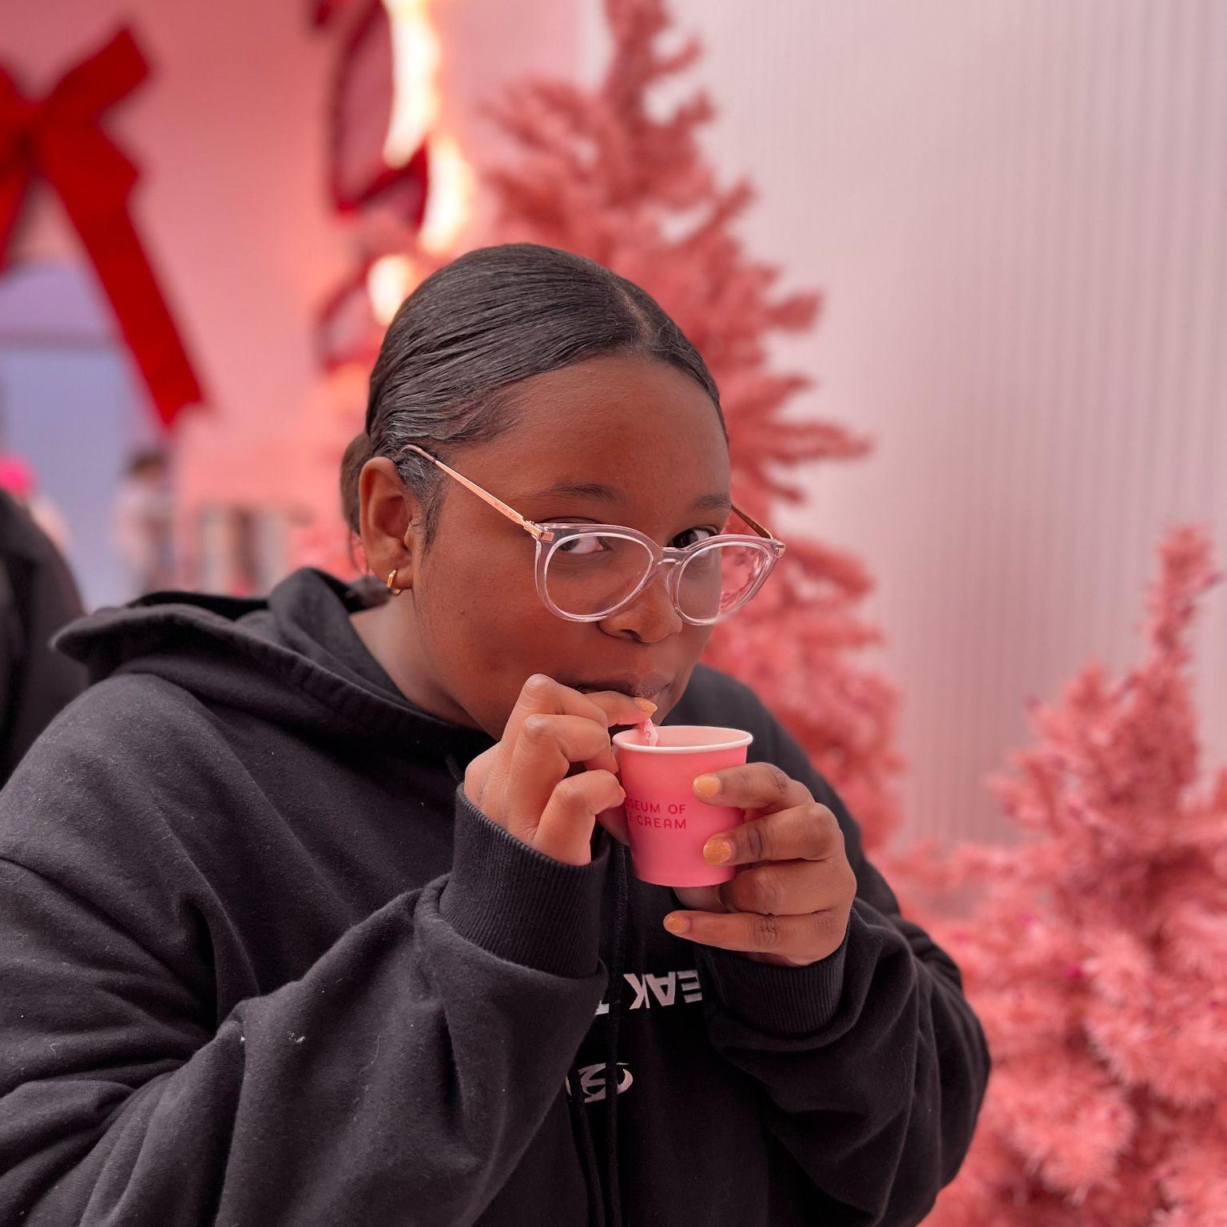
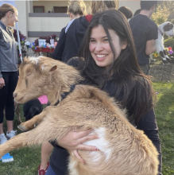
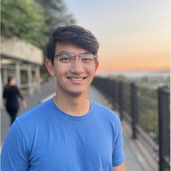
Team Arbor
Hamidou Guechtouli
Blaine Wells
Melody Fuentes
Dante Danelian

Slide 3
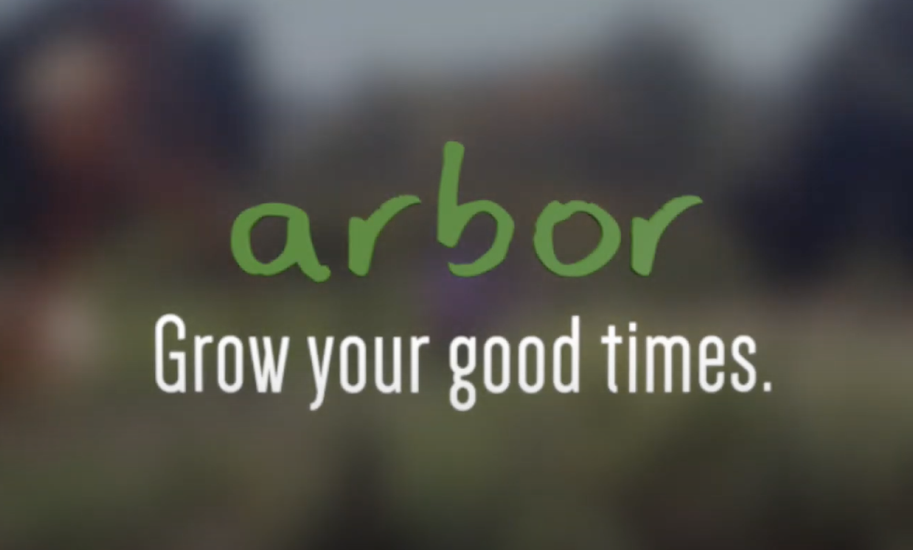

Slide 4
Problem/Solution Recap
Problem
Proposed Solution
People do not have an efficient and dedicated method to recall past positive memories.
A virtual tamagotchi-
style garden where you can plant and revisit good memories in the form of trees.

Slide 5
Overview
1
2
3
4
5
6
Sketching Explorations
Interface/
Rationale
Prototype Construction
Prototype Task Flows
Testing Methodology
Results /
Discussion

Slide 6
Overview
1
2
3
4
5
6
Sketching Explorations
Interface/
Rationale
Prototype Construction
Prototype Task Flows
Testing Methodology
Results /
Discussion
Notes:
We started by sketching three different mediums

Slide 7
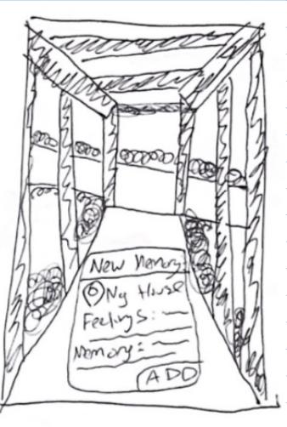
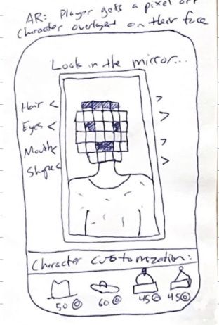
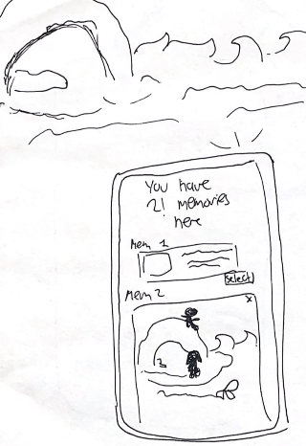
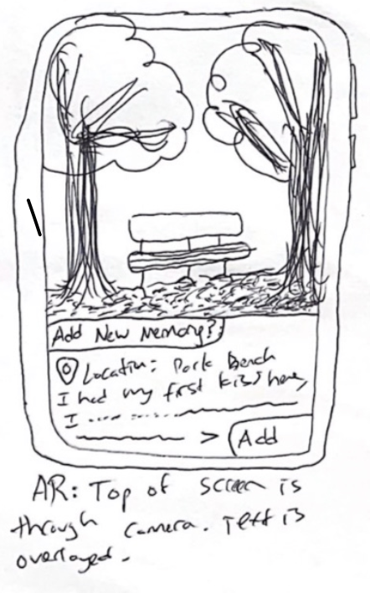
Augmented Reality Sketches

Slide 8
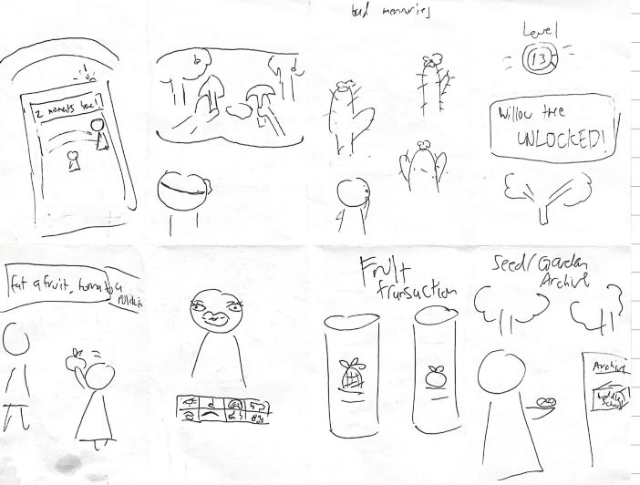
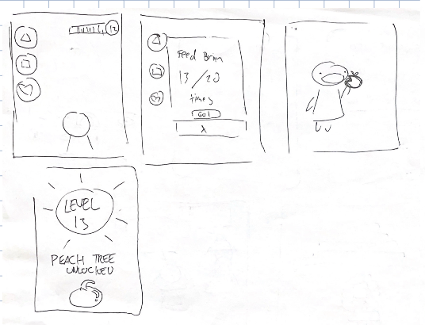
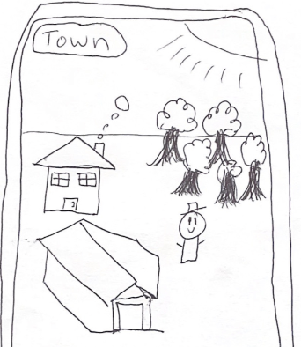
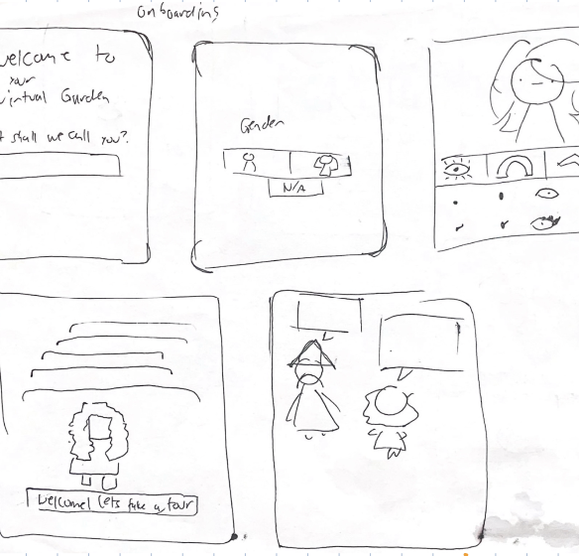
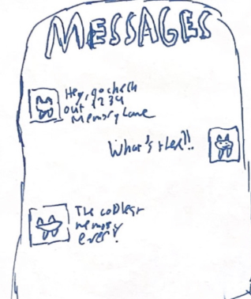
iOS Mobile Sketches

Slide 9
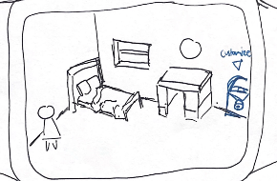
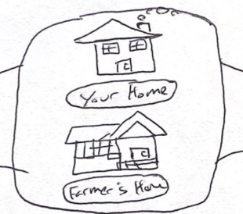
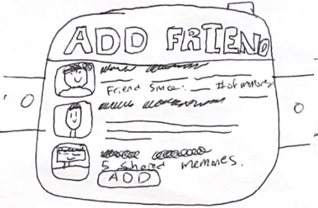
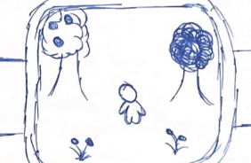
Wearable Sketches

Slide 10
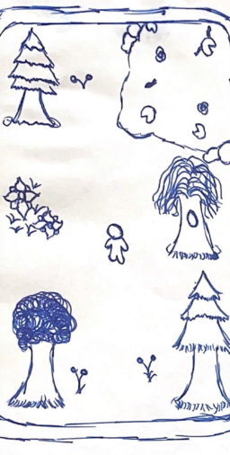
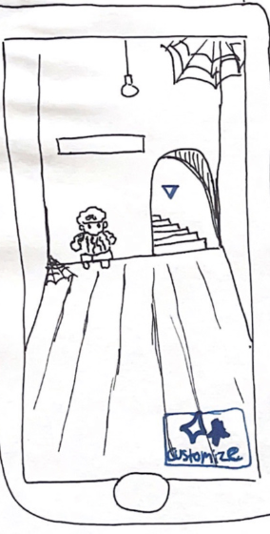
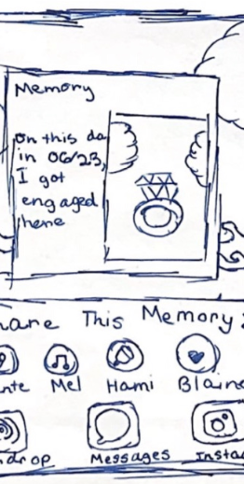
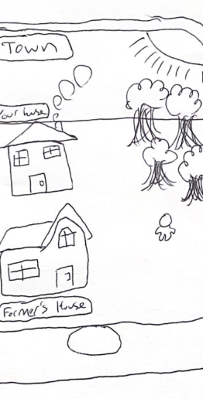
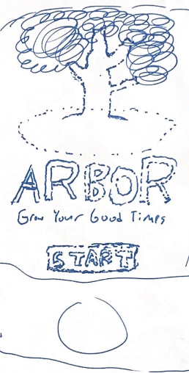
iOS Mobile Realizations

Slide 11
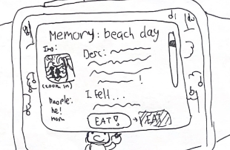
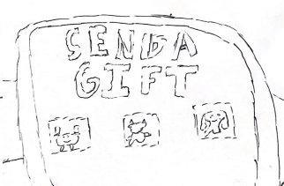
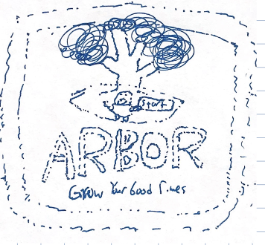
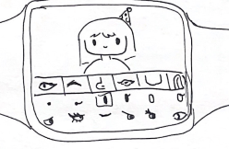
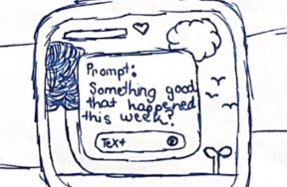
Wearable Realizations

Slide 12
Overview
1
2
3
4
5
6
Sketching Explorations
Interface/
Rationale
Prototype Construction
Prototype Task Flows
Testing Methodology
Results /
Discussion

Slide 13
Wearable vs Mobile
Pros
Simplified, minimalist user interaction/interface
Very easy and guaranteed on-person reminders
Novel app medium
Cons
Limited screen size, less immersive
Less storage space to hold all user input
Lack of detailed recording capabilities

Slide 14
Wearable vs Mobile
Pros
Larger, more detailed and immersive display
More storage space to hold all user input
High quality video, picture, and audio recording capabilities
Cons
Arbor’s reliance on multimedia could lead to high storage costs
Oversaturated mobile app market leads to visibility competition

Slide 15

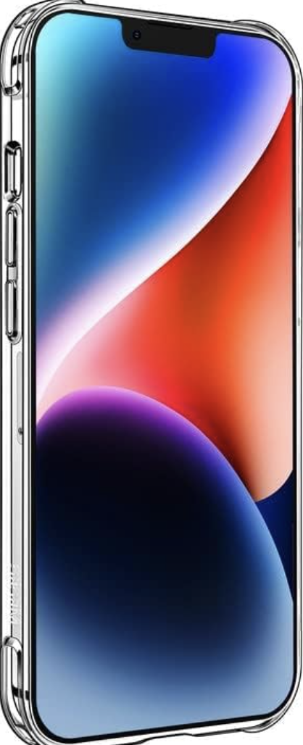
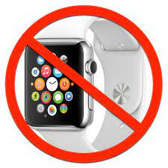
So Why Mobile?
Although a wearable design via watch would have been unique to explore, the limited screen size and lack of widespread smart watch accessibility would severely limit interactions with the app.
Mobile has more global users, a bigger screen, and more storage. This is vital as the app must take in all user-inputted information, along with making documentation easy.

Slide 16
Data
171 million smartwatches have been sold in 2022
1.39 billion smartphones sold in 2022.
By choosing mobile, we increase the accessible market of our app over tenfold.
Only 21% of users use smartwatches to interact with documentation/photos.
73% of users use smartphones for the same activity.
Mobile phones have a better interface for the goals of Arbor, and its intended use is done more by phone users
Notes:
User base 10x as big, and within that base,
more people use smartphones for documenting their lives.
Better fit for the goals of our product

Slide 17
Overview
1
2
3
4
5
6
Sketching Explorations
Interface/
Rationale
Prototype Construction
Prototype Task Flows
Testing Methodology
Results /
Discussion
Notes:
Then we got to work creating our prototype…

Slide 18
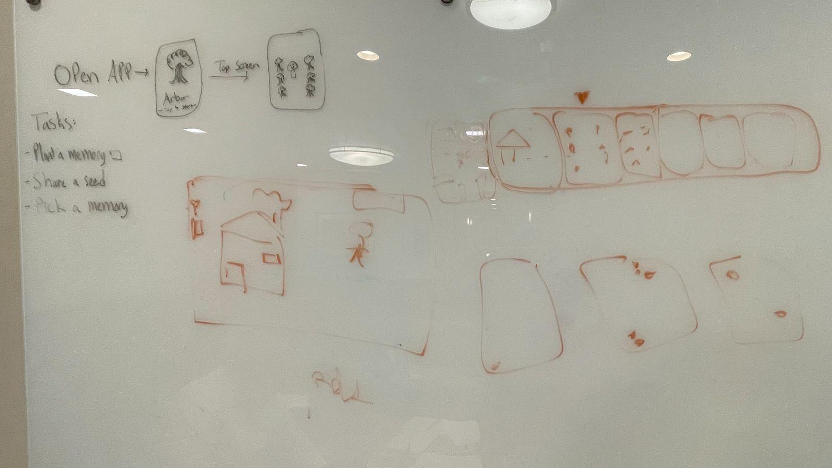
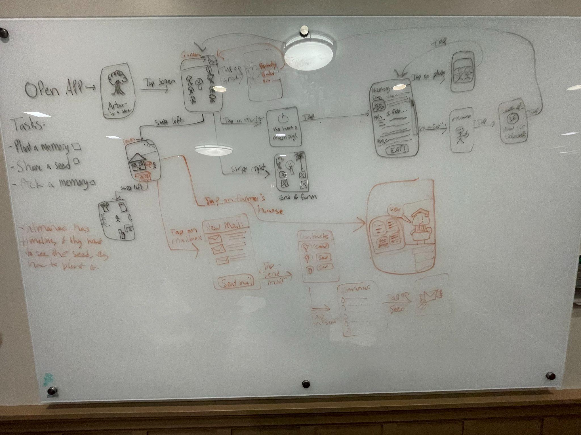
Construction
We used whiteboard and markers to brainstorm general designs + interactions before narrowing down based on what we agreed was most feasible, intuitive, and fun.

Slide 19
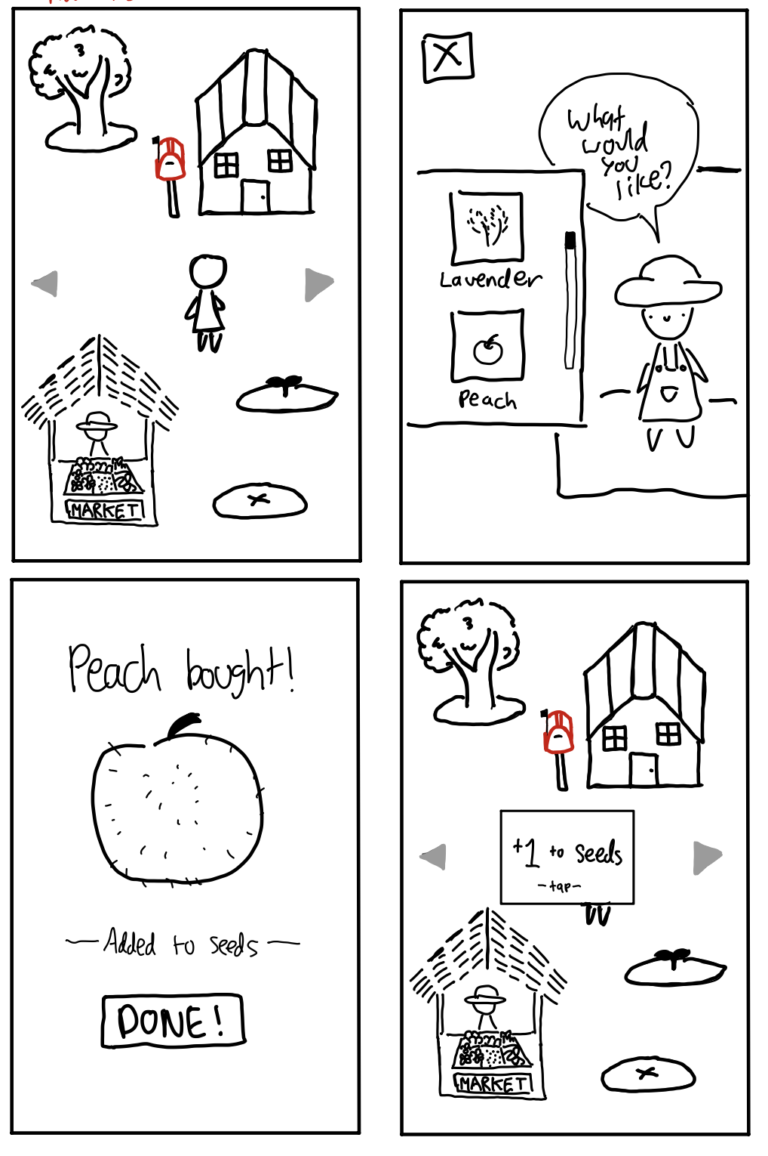
Construction
Using Goodnotes, all screens and widgets of the prototype were drawn
Screens were then printed and cut out.

Slide 20
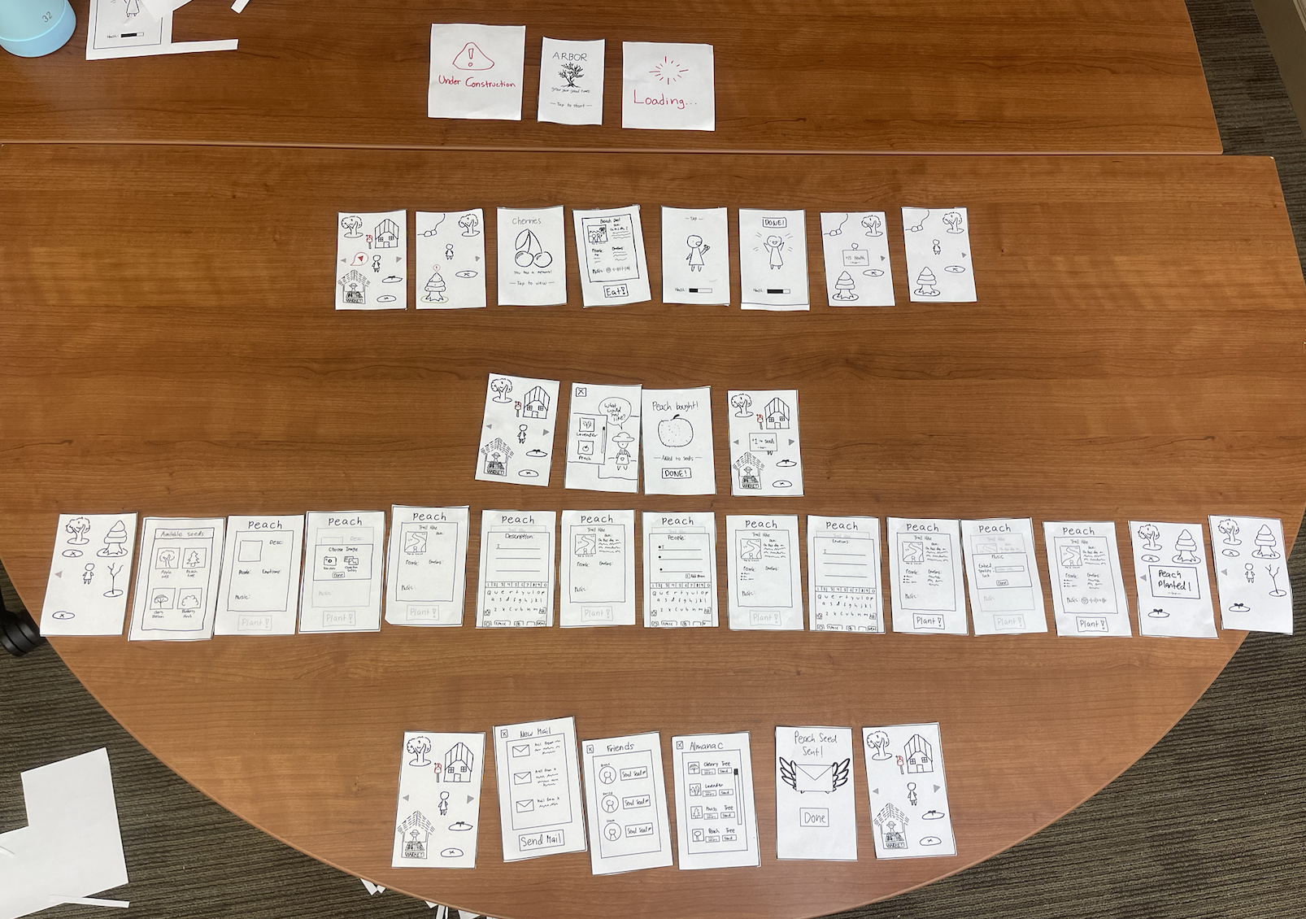
Notes:
So a quick word on how it works…

Slide 21
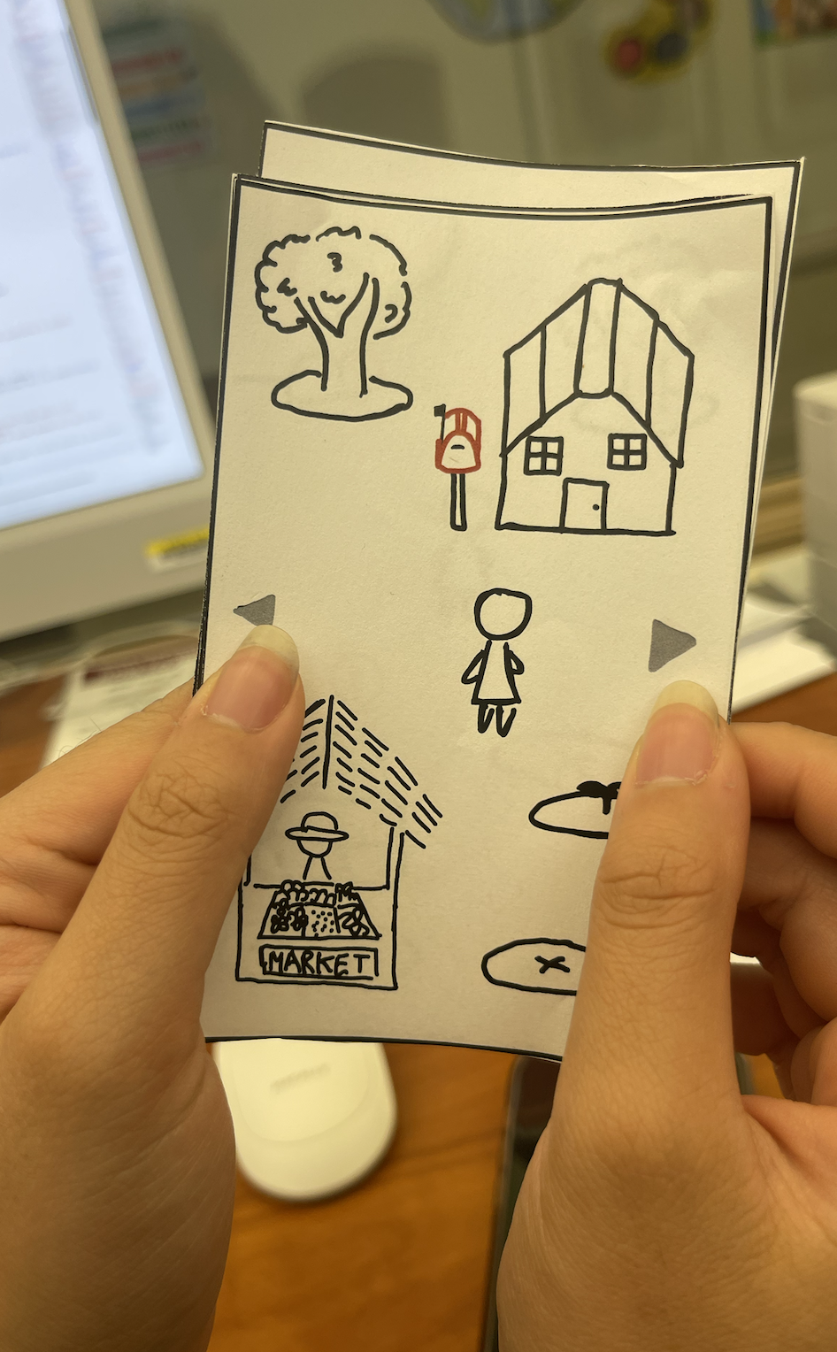
“Swiping” mechanism to move through main land.
Tapping on arrows also transitions screens
Notes:
As though it were an app, swipe to move around farm

Slide 22
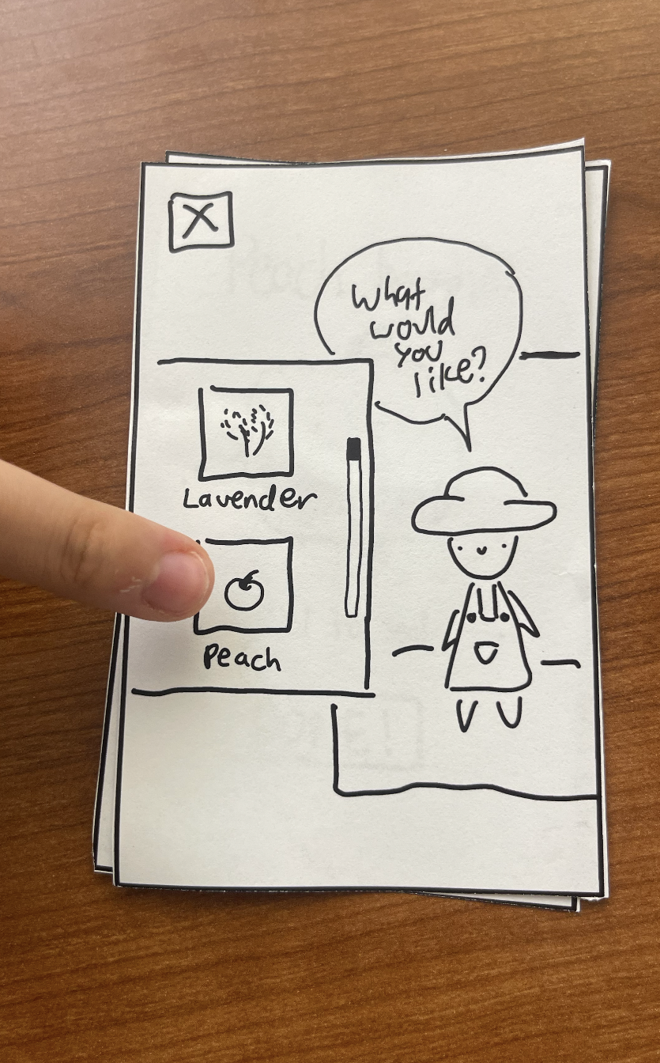
Tapping mechanisms for all character “actions”
Character-to-object interactions
Buying
Selecting any option on-screen
i.e.:

Slide 23
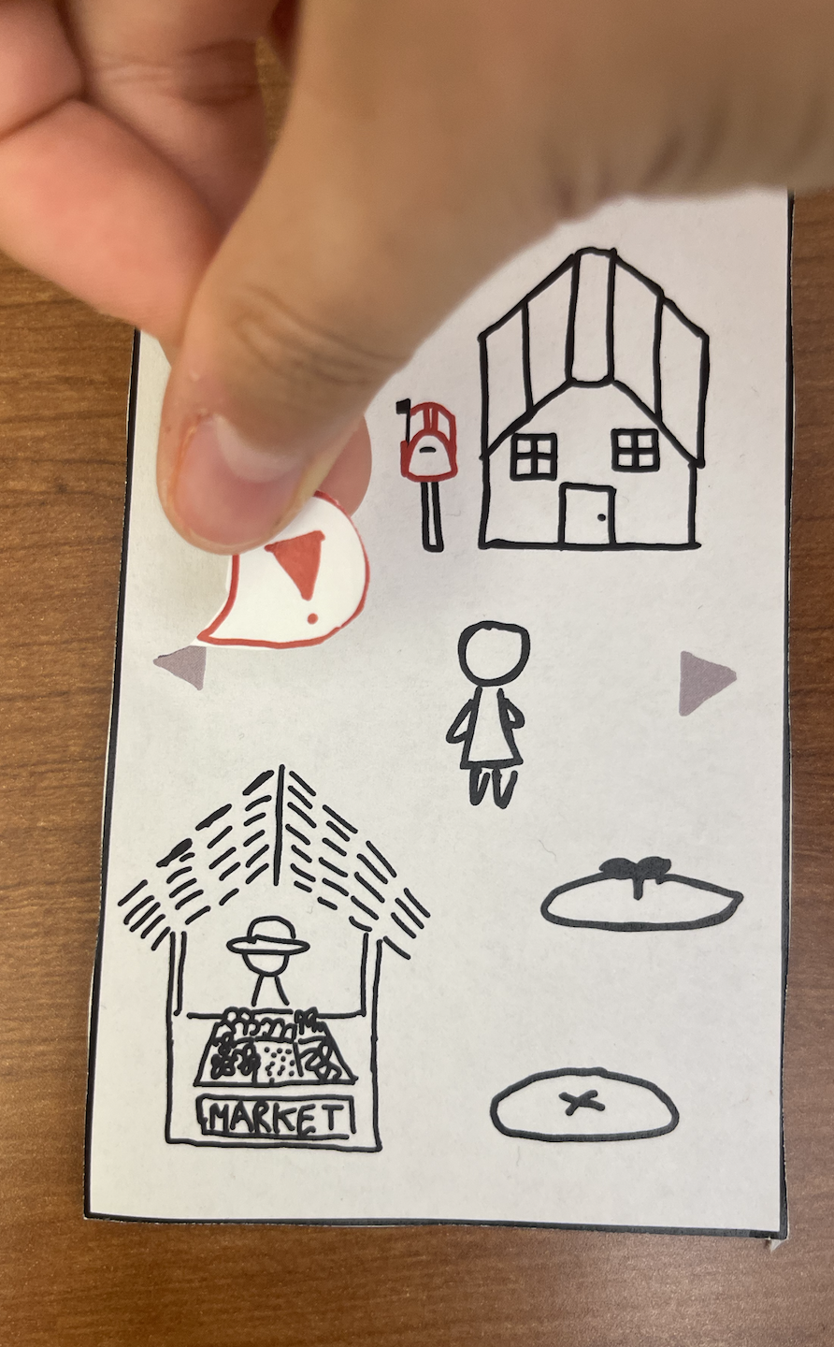
Widgets added live to display notifications/new tasks
Notes:
For a more immersive experience

Slide 24
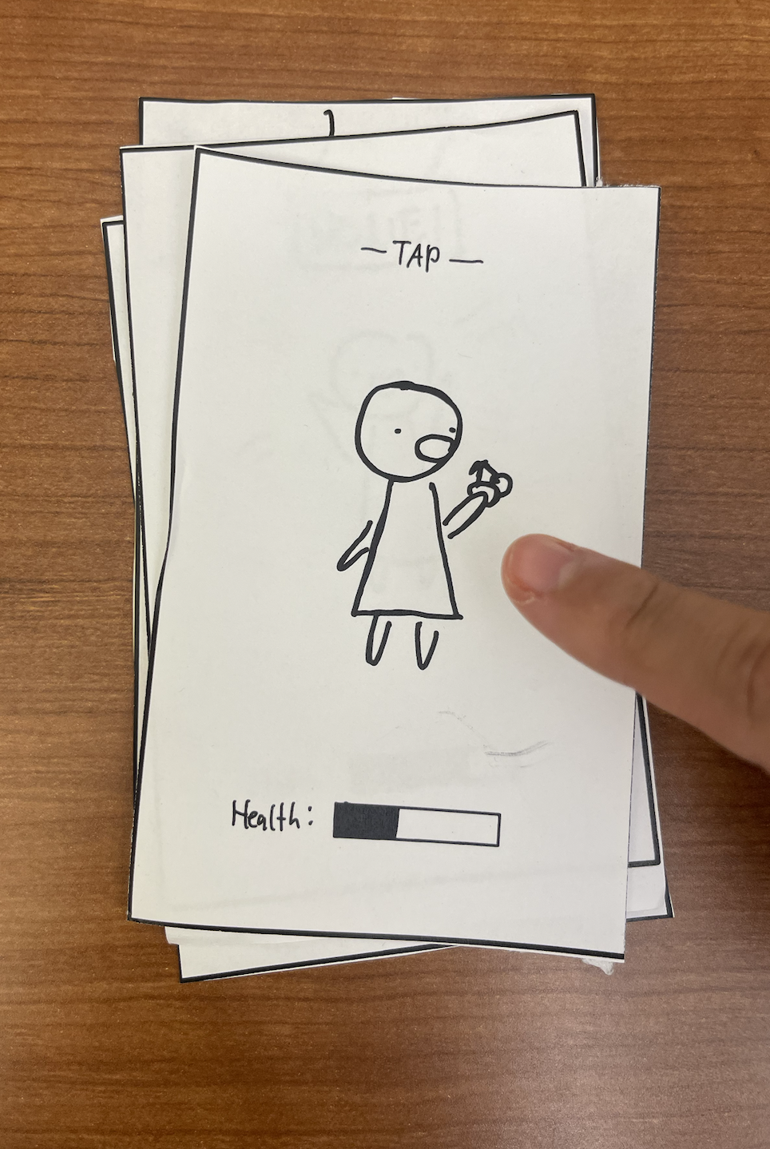
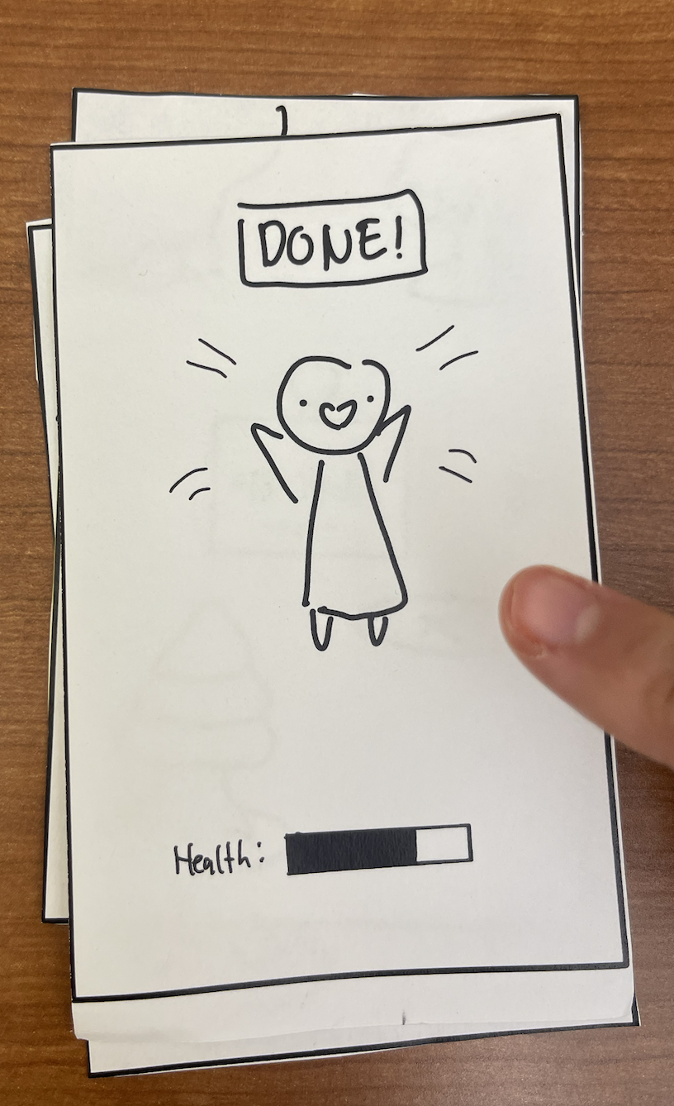
However participants interacted with the “front” screen,
the next paper screen resulting from their actions will the be slid in front.
They then interact with that new “front” screen.
Notes:
Like a paper prototype, you tap and we overlay.

Slide 25
Overview
1
2
3
4
5
6
Sketching Explorations
Interface/
Rationale
Prototype Construction
Prototype Task Flows
Testing Methodology
Results /
Discussion

Slide 26
Text Legend
Red: Screen Title
Purple: Interactions
Blue: Annotations
Arrows: What to click What it leads to

Slide 27
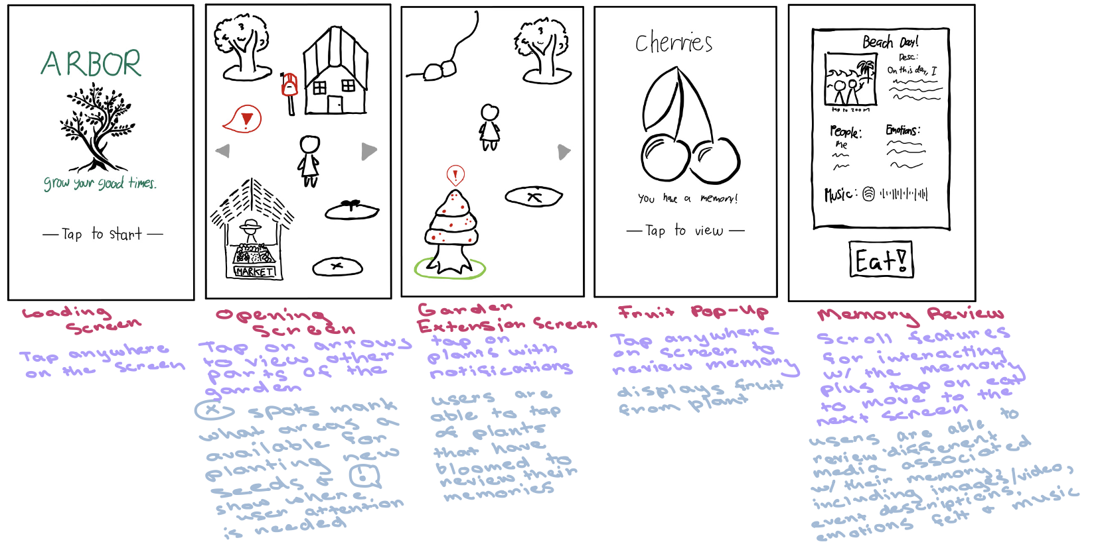
Simple Task: Viewing a Memory (1/2)

Slide 28
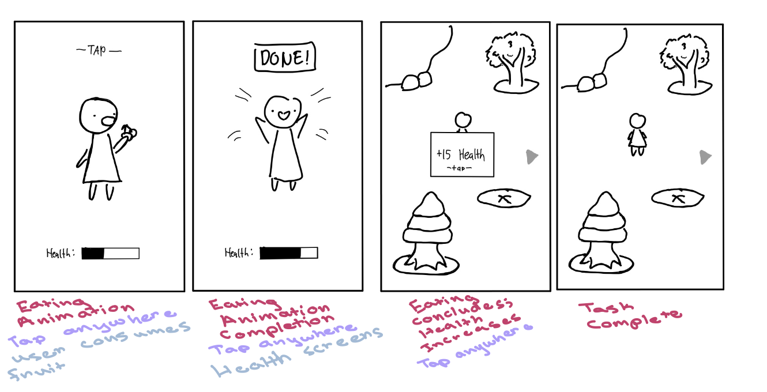
Simple Task: Viewing a Memory (2/2)

Slide 29
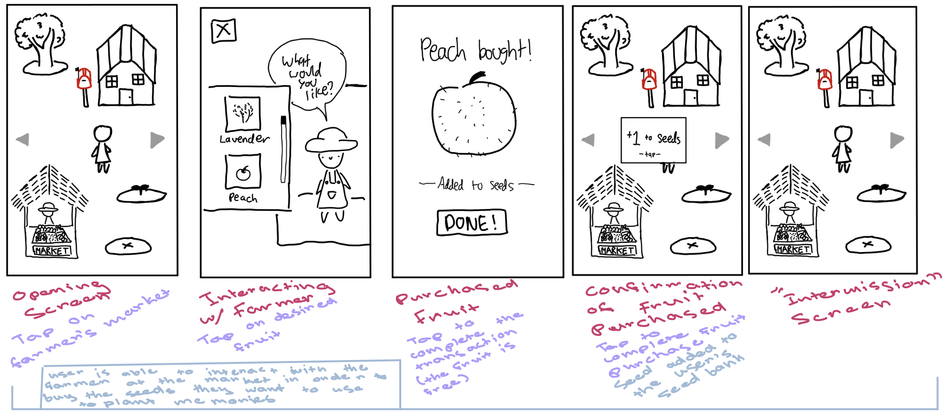
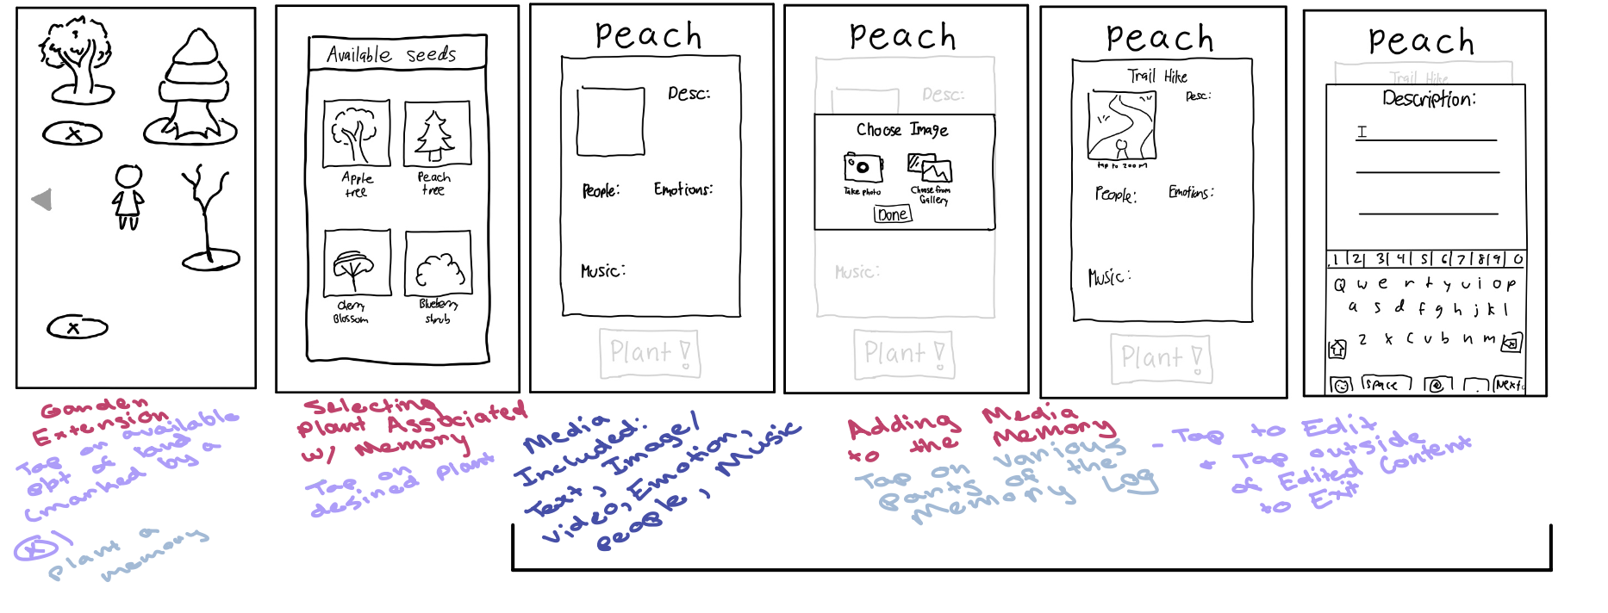
Mod. Task: Logging a Memory (1/2)

Slide 30
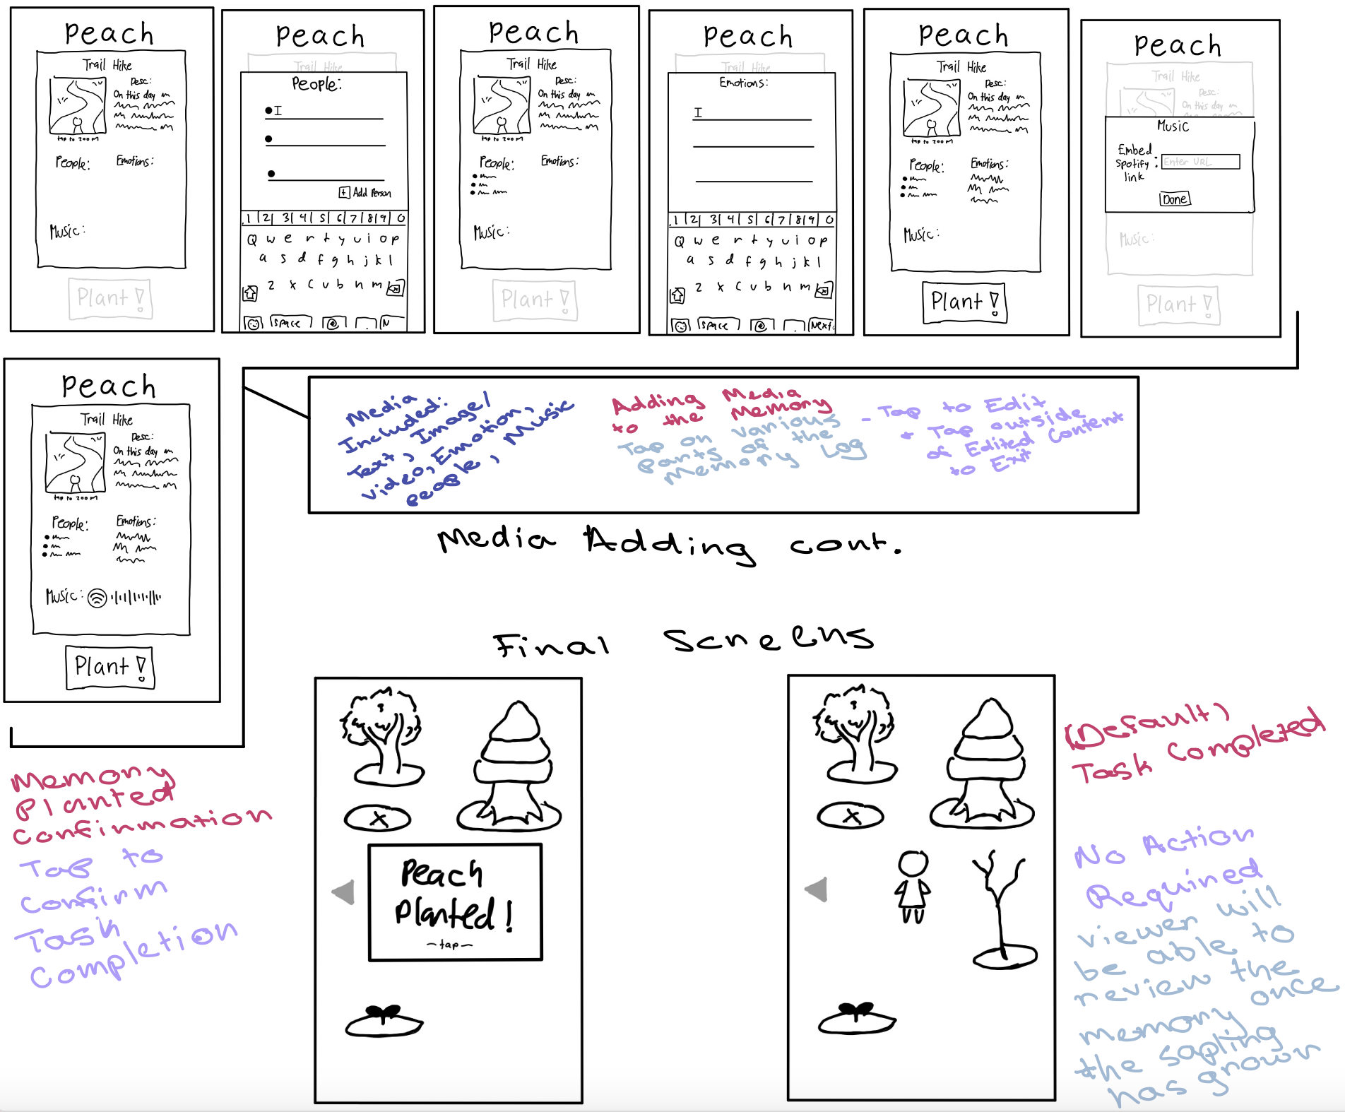
Mod. Task: Logging a Memory (2/2)

Slide 31
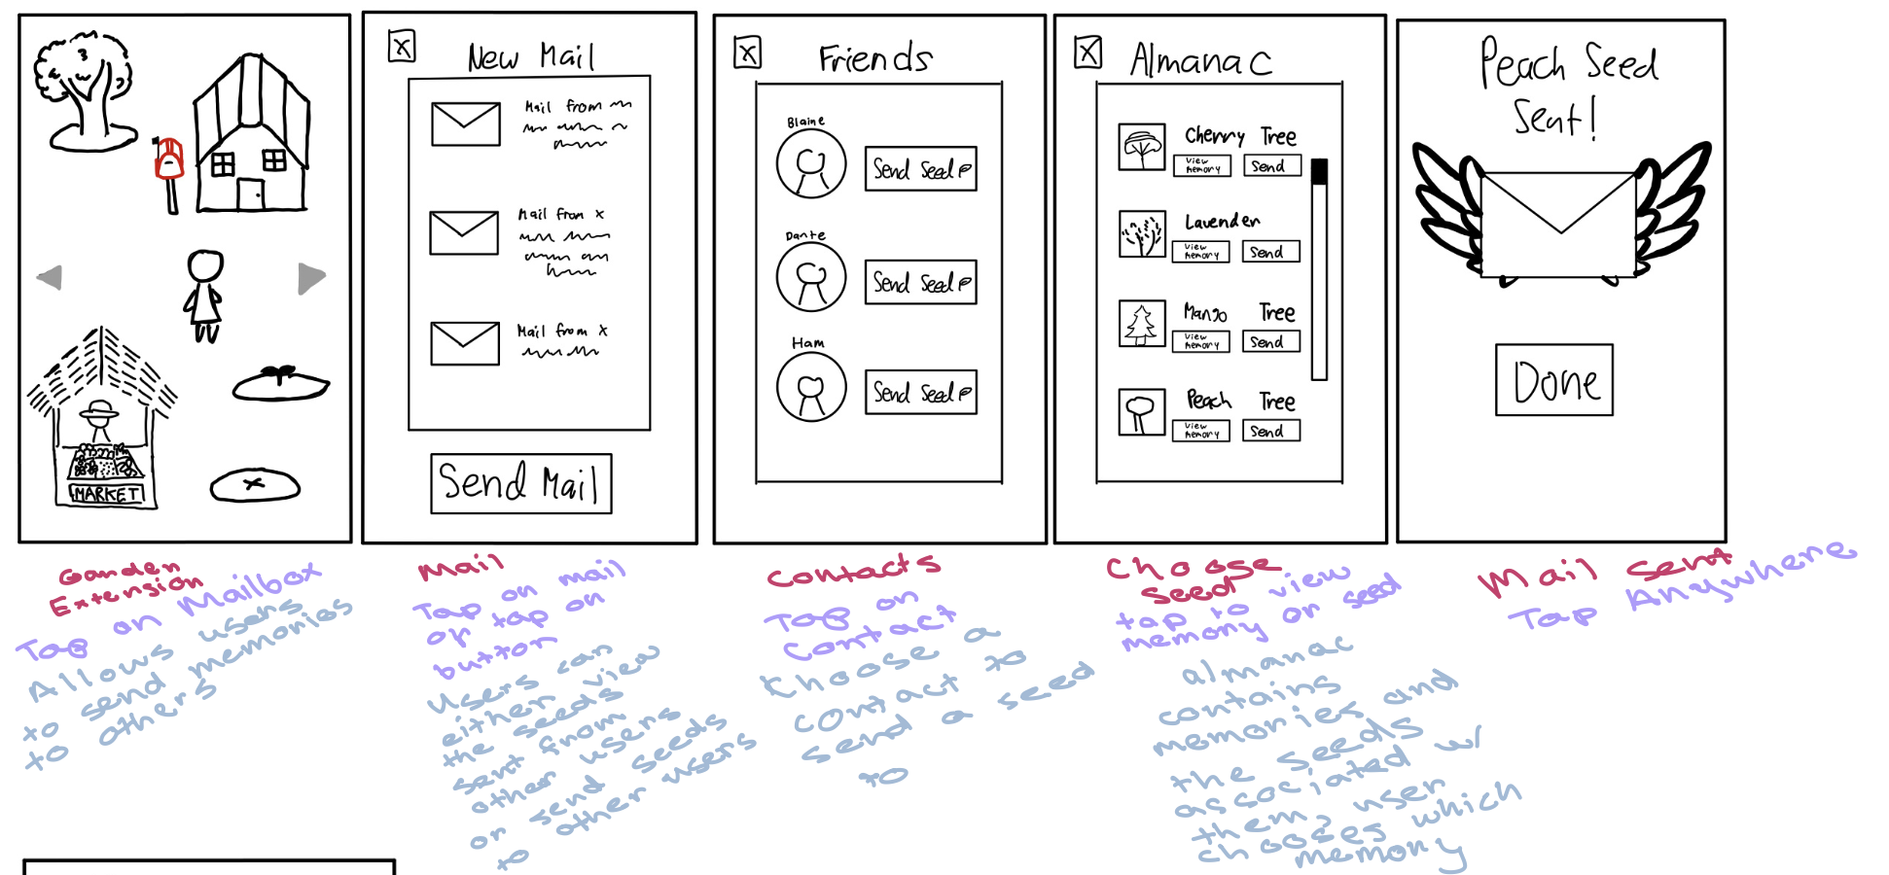
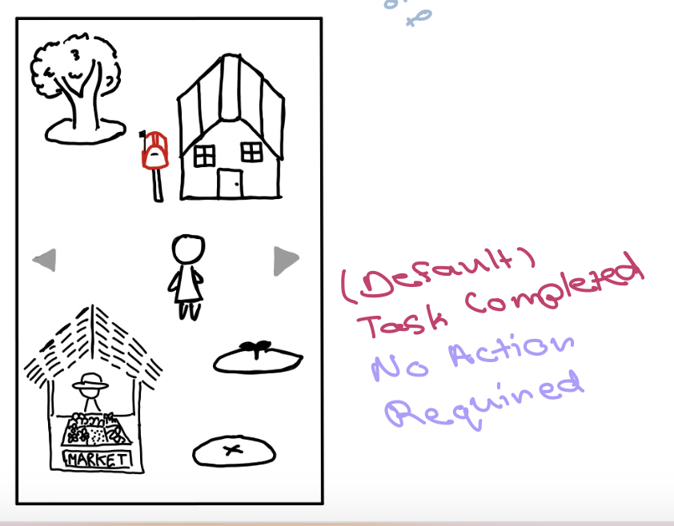
Complex Task: Sharing a Memory (1/2)

Slide 32
Overview
1
2
3
4
5
6
Sketching Explorations
Interface/
Rationale
Prototype Construction
Prototype Task Flows
Testing Methodology
Results /
Discussion

Slide 33
Pre-Testing Procedure
1
2
3
We went to Downtown Palo Alto, walked around and randomly asked individuals if they’d be willing to volunteer to participate in our test.
We aimed for a diversity of participants, but were limited by who had the time to help.
Dante, Melody, and Blaine alternated roles (greeter/facilitator, computer, observer) and used a script of questions (see appendix).

Slide 34
Example Task Prompt
In this game, positive memories are stored in the form of fruit in the garden. For your first task, could you please harvest an available fruit and review its memory?

Slide 35
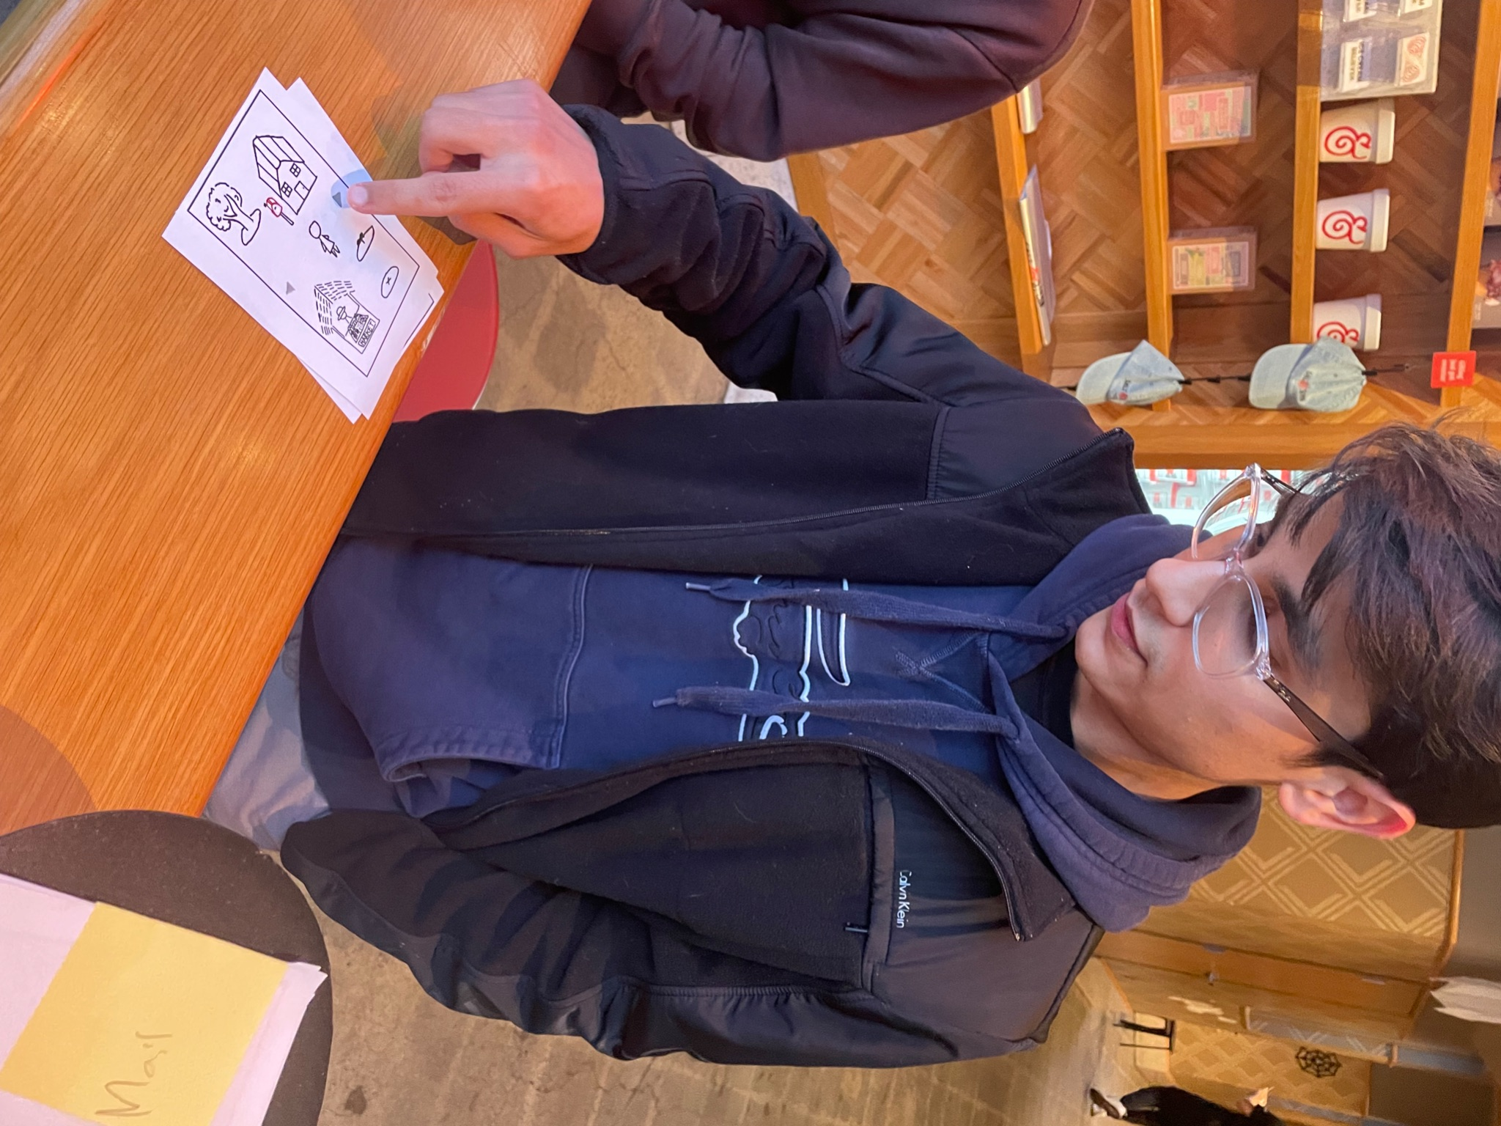
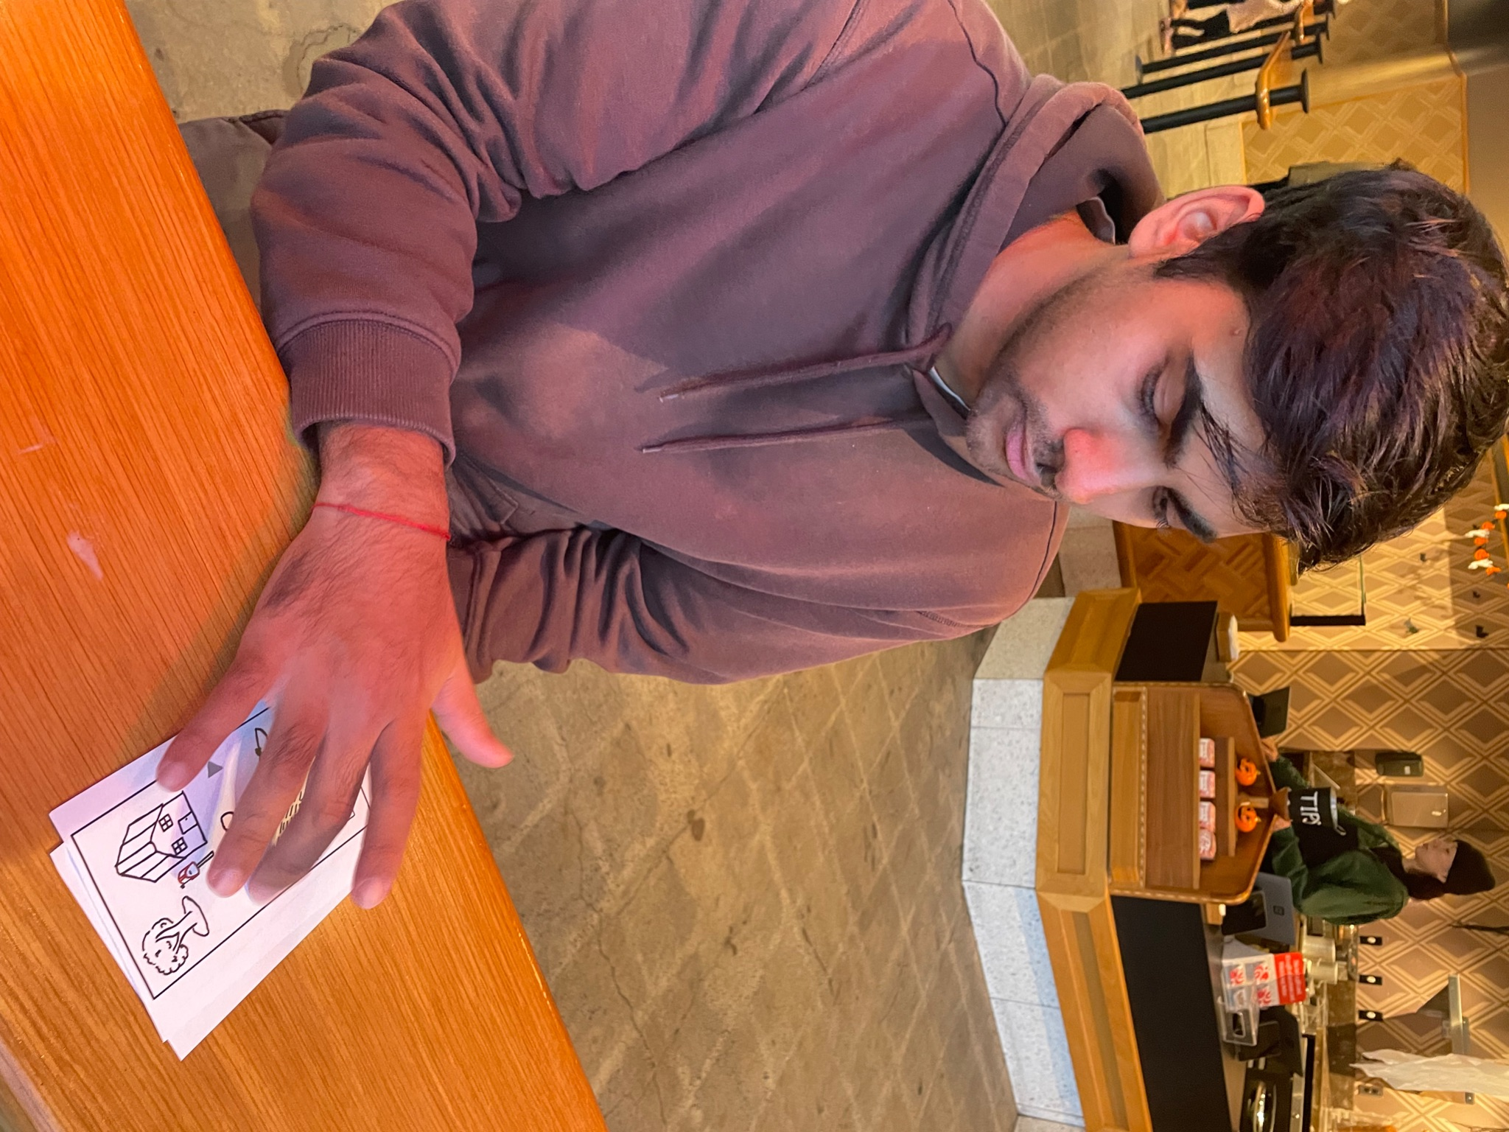
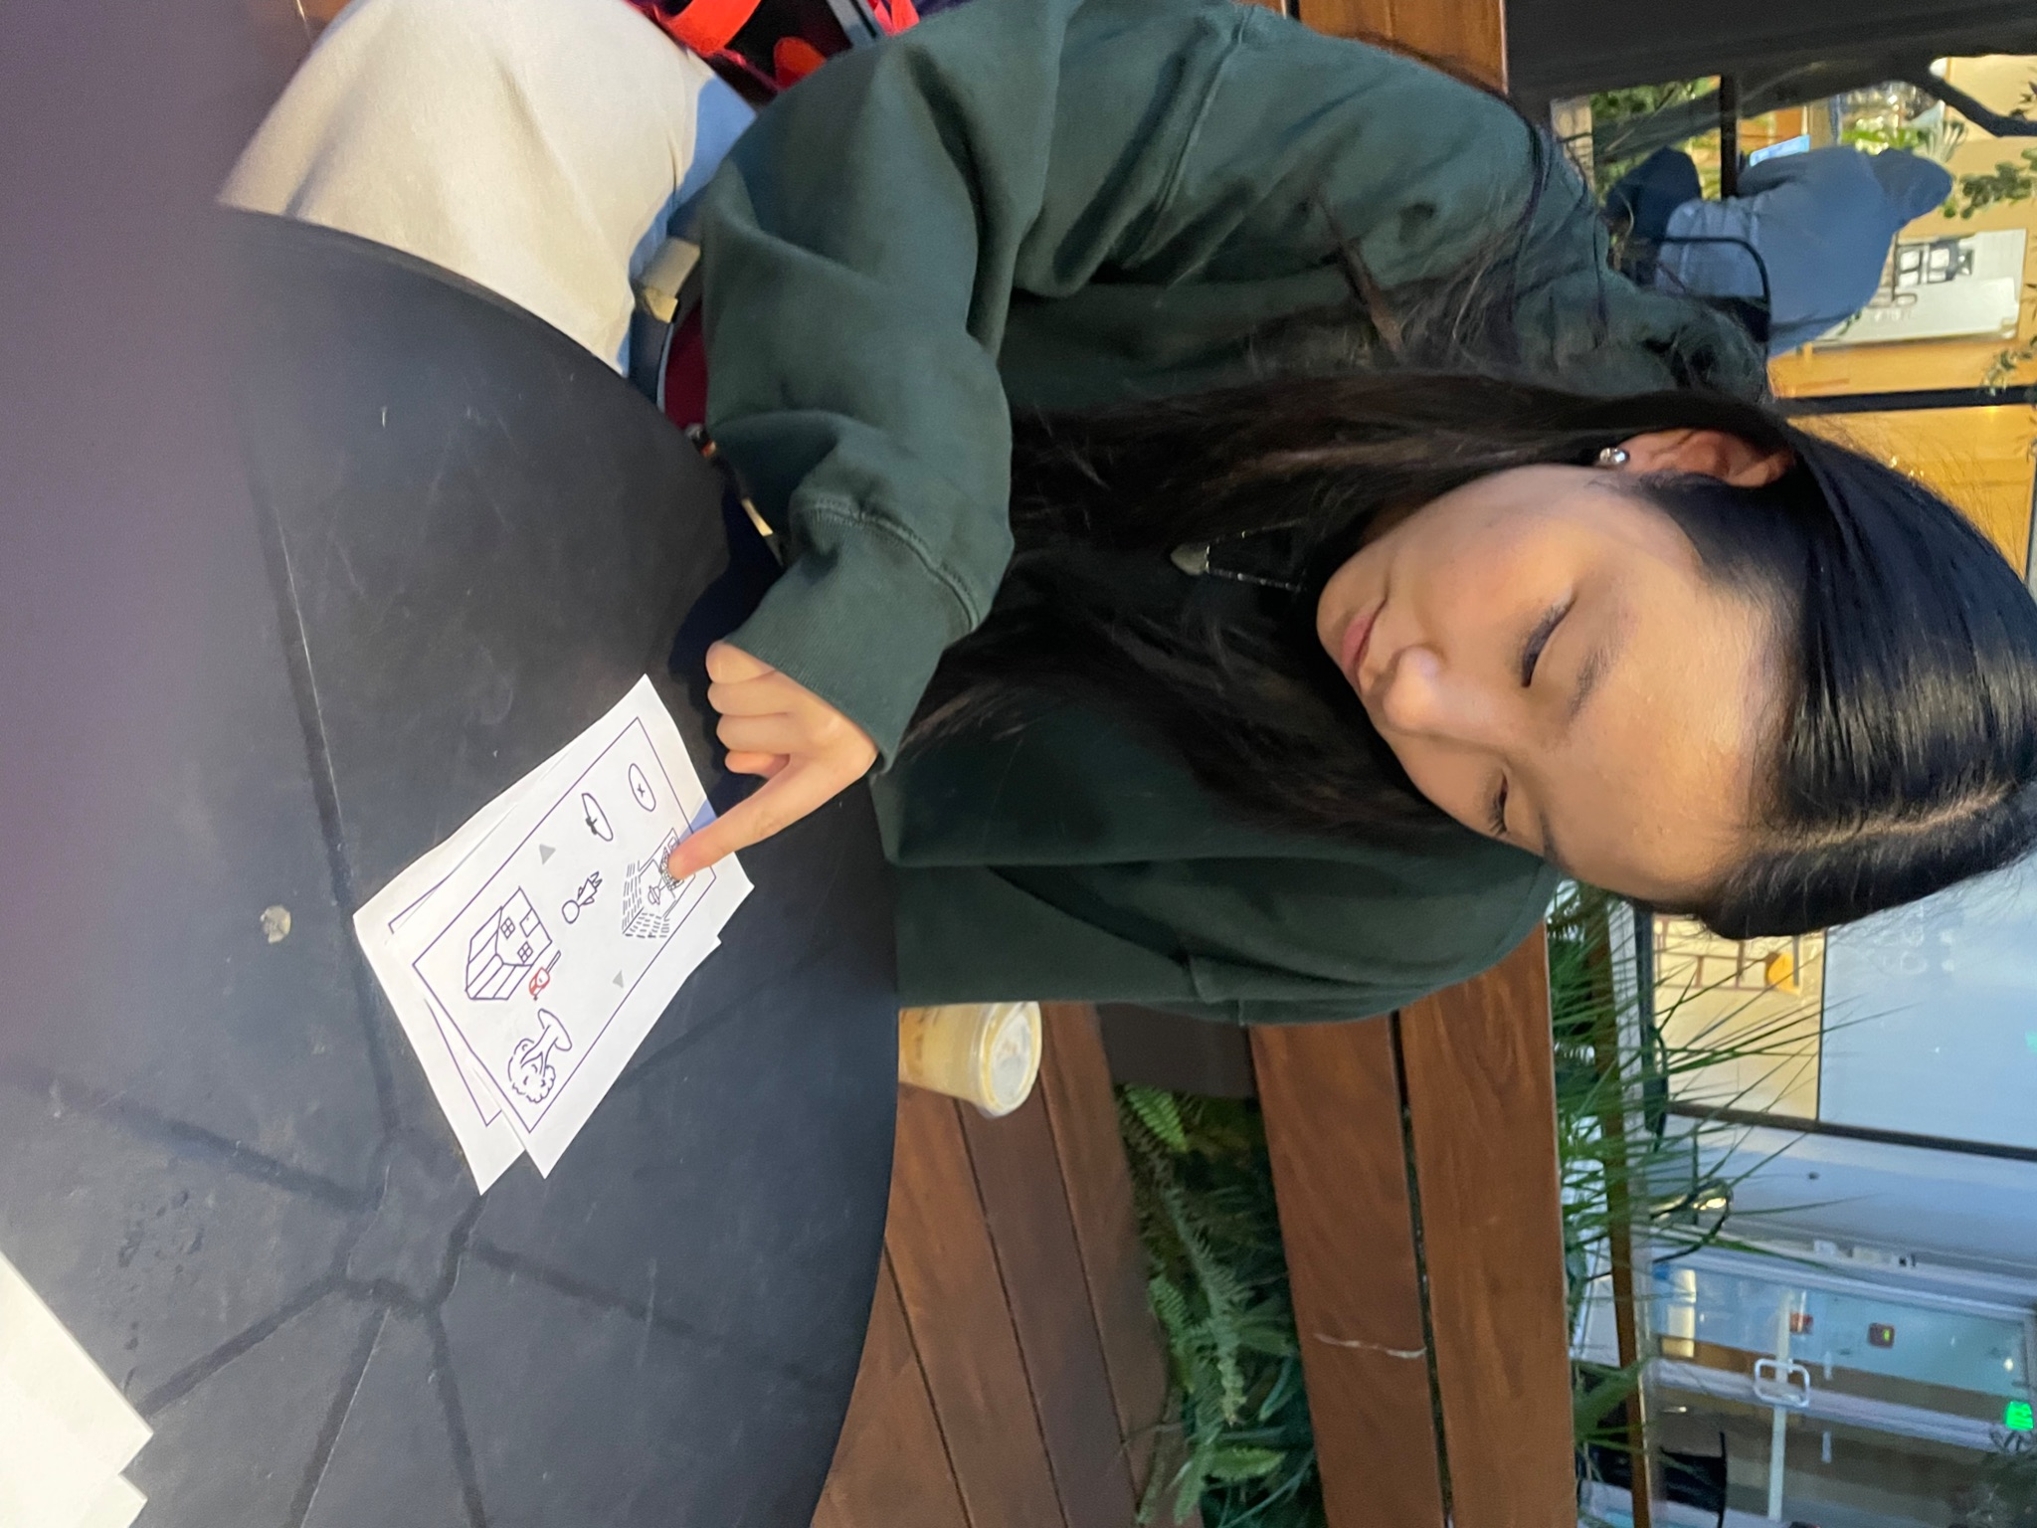
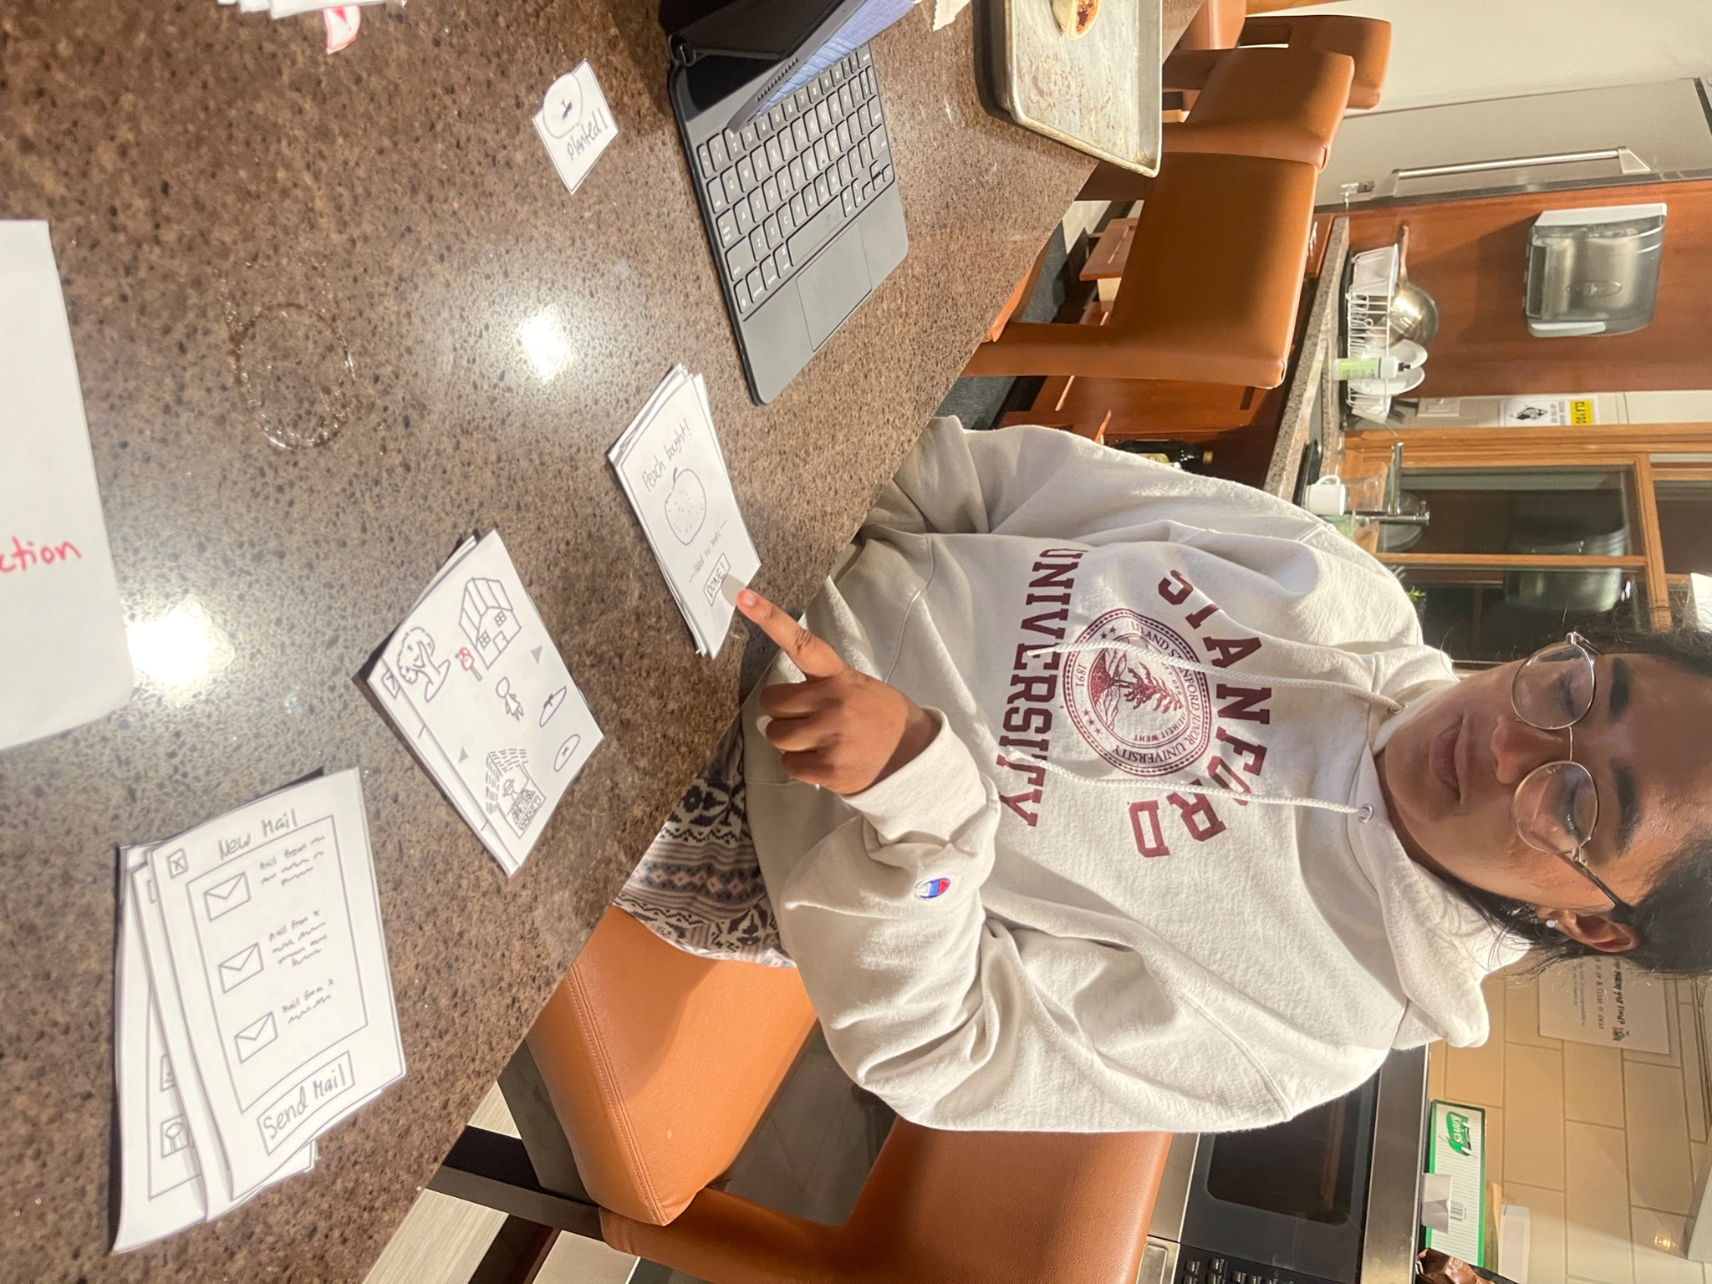
Meet the Users
P1
P2
P3
P4
UCLA Graduate
Age 22
Berkeley Graduate
Age 23
Bay Area HS Senior
Age 17
Stanford Student
Age 21

Slide 36
Three Key Measurements

Slide 37
Three Key Measurements
1. Time to Complete Task
# of minutes for each participant to complete each task. Used to assess difficulty/ efficiency of task flows.

Slide 38
Three Key Measurements
1. Time to Complete Task
2. Critical Incidents Log
# of minutes for each participant to complete each task. Used to assess difficulty/ efficiency of task flows.
Log of negative events scored on a scale of 0 to -3, where 0 is no issue and -3 is a usability catastrophe. Can be summed to create a CI index (CII) for each participant.

Slide 39
Three Key Measurements
1. Time to Complete Task
2. Critical Incidents Log
3. Qualitative
User Feedback
# of minutes for each participant to complete each task. Used to assess difficulty/ efficiency of task flows.
Log of negative events scored on a scale of 0 to -3, where 0 is no issue and -3 is a usability catastrophe. Can be summed to create a CI index (CII) for each participant.
User thoughts on process in general, emotions raised, overall level of satisfaction.

Slide 40
Our Useability Goals
Under 1 minute for simple task on average
Under 2.5 minutes for moderate task on average
Under 5 minutes for complex task on average
No more than one major CI per participant
CII score >-5 per participant on average
Notes:
Because it is so common, we want simple task to be quick, while complex task can take a little more time.

Slide 41
Our *Secret* Goal
Is it fun?

Slide 42
Overview
1
2
3
4
5
6
Sketching Explorations
Interface/
Rationale
Prototype Construction
Prototype Task Flows
Testing Methodology
Results /
Discussion

Slide 43
Testing Results

Slide 44
The Big Picture
1
2
3
Navigation and task flow was generally intuitive, and did not require tutorial or instructions.
Participants had difficulty differentiating which elements of the UI could be interacted with.
Our complex task generally took the longest time and lead to the most negative critical incidents.
Notes:
To take a more specific look at the data…

Slide 45
Critical Incidents per Task
Critical Incident | P1 | P2 | P3 | P4
Difficulty moving the character | -3 | 0 | 0 | -3
Clicked on tree with no fruits | -1 | -1 | -1 | 0
Clicked on rocks/decor | 0 | -1 | 0 | 0
Thought mailbox was part of house | -3 | -3 | -3 | -3
Clicked on exclamation immediately | 0 | 0 | 0 | 0
Couldn't figure how to plant seed | 0 | 0 | 0 | -3
Thought mailbox was for recieve | -2 | -2 | 0 | 0
Thought you couldn't choose seed | -1 | 0 | 0 | 0
Total Sum (CII): | -10 | -7 | -4 | -9
Notes:
After compiling all our notes and observations, we consolidated them into this log. It shows…

Slide 46
Critical Incidents per Task
Critical Incident | P1 | P2 | P3 | P4
Difficulty moving the character | -3 | 0 | 0 | -3
Clicked on tree with no fruits | -1 | -1 | -1 | 0
Clicked on rocks/decor | 0 | -1 | 0 | 0
Thought mailbox was part of house | -3 | -3 | -3 | -3
Clicked on exclamation immediately | 0 | 0 | 0 | 0
Couldn't figure how to plant | 0 | 0 | 0 | -3
Thought mailbox was for recieve | -2 | -2 | 0 | 0
Thought you couldn't choose seed | -1 | 0 | 0 | 0
Total Sum (CII): | -10 | -7 | -4 | -9
Notes:
An incident, and the CI score we assigned to it. So here’s one: Difficulty moving the character was seen as major

Slide 47
Critical Incidents per Task
Critical Incident | P1 | P2 | P3 | P4
Difficulty moving the character | -3 | 0 | 0 | -3
Clicked on tree with no fruits | -1 | -1 | -1 | 0
Clicked on rocks/decor | 0 | -1 | 0 | 0
Thought mailbox was part of house | -3 | -3 | -3 | -3
Clicked on exclamation immediately | 0 | 0 | 0 | 0
Couldn't figure how to plant | 0 | 0 | 0 | -3
Thought mailbox was for recieve | -2 | -2 | 0 | 0
Thought you couldn't choose seed | -1 | 0 | 0 | 0
Total Sum (CII): | -10 | -7 | -4 | -9
Notes:
Commenting that the mailbox would only be for receiving mail was a minor issue. But this is a lot to look at, so here’s the data in chart form:

Slide 48

Goal baseline
Notes:
But most CI came from complex task, better exemplified by next graph…

Slide 49

Notes:
Findings:
correlation between complexity and timing, although moderate task seemed to be the easiest.
Happily, most tasks were able to be completed fairly quickly.
Still, there were some outliers that gave us excellent feedback on how to improve. Let’s highlight a few now.

Slide 50
Notes:
P1 was an outlier for the simple task.

Slide 51

Market Side Quest
During the simple task (eat a fruit), P1 went to the market to buy a peach, because it was unclear how to obtain fruit.

Slide 52
Notes:
There were also outliers for the complex task.

Slide 53

Gestalt Psychology
Due to their close proximity, participants grouped the mailbox in with the house. As a result, they tapped on the house during the complex task.
Notes:
Participants remarked that they thought the mailbox was a part of the house, and that it was some sort of package center.
Due to their close proximity and grouping.

Slide 54
Our Useability Goals
Under 1 minute for simple task on average
Under 2.5 minutes for moderate task on average
Under 5 minutes for complex task on average
No more than one major CI per participant
CII score >-5 per participant on average
Notes:
First one is iffy because we had an outlier in P1.
We ran into a good amount of critical errors, but they mostly had to do with the complex task.

Slide 55
Goal baseline

Slide 56
Our *Secret* Goal
Is it fun?
4/4 participants remarked (unprompted) that the UI was fun to interact with! Also:
“Cute”
“Intuitive”
“Enjoyable”

Slide 57
Discussion

Slide 58
Testing Implications
Most actions are fairly intuitive.

Slide 59
Testing Implications
Most actions are fairly intuitive.
Seeds and fruits get mixed up.

Slide 60
Testing Implications
Most actions are fairly intuitive.
Seeds and fruits get mixed up.
It is unclear what is “clickable” and what is not.

Slide 61
Testing Implications
Most actions are fairly intuitive.
Seeds and fruits get mixed up.
It is unclear what is “clickable” and what is not.
Mailbox is not associated with outgoing mail.

Slide 62
Testing Implications
Most actions are fairly intuitive.
Seeds and fruits get mixed up.
It is unclear what is “clickable” and what is not.
Mailbox is not associated with outgoing mail.
The mailbox is too close to the house to be recognized as distinct.

Slide 63
Main Areas for Improvement
1
2
3
Change farmer’s market to be selling seeds, not fruits themselves.
Use color, 3-D, and shadows to make clickable objects pop on screen.
Remove mailbox, and use an envelope icon instead. Add exclamation mark when mail
arrives.

Slide 64
Limits of Testing
Could not test the user’s emotional response to viewing an actual past memory.

Slide 65
Limits of Testing
Could not test the user’s emotional response to viewing an actual past memory.
Didn’t give user much opportunity to customize/grow fond of their character.

Slide 66
Limits of Testing
Could not test the user’s emotional response to viewing an actual past memory.
Didn’t give user much opportunity to customize/grow fond of their character.
Low-Fi medium limited ability to test aesthetics.

Slide 67
Limits of Testing
Could not test the user’s emotional response to viewing an actual past memory.
Didn’t give user much opportunity to customize/grow fond of their character.
Low-Fi medium limited ability to test aesthetics.
Could not get a sense for how long it would take for user to become fluent with interface.

Slide 68
Questions?

Slide 69
APPENDIX

Slide 70
Wearable Full Pros/Cons
Pros: Seamless integration with the user's daily activities Simplified, efficient user interactions Could access health data Very easy and convenient to access Harder to misplace (since user wears it daily) Less expensive than mobile Can produce a more present reminder for the user to interact with the application, contributing to higher rates of user engagement | Cons: Limited screen size, less immersive Less storage space Lack of detailed video/picture recording capabilities Smaller user base/less accessible Limited battery life and less functional capability given the processing power of a phone compared to the watch, affecting the seamless integration of the application

Slide 71
Mobile Full Pros/Cons
Pros: Advanced display contributes to a visually appealing interface encouraging users to spend more time within the app. Allows for seamless storage and display of multimedia memories. Larger user base High quality video, picture, and audio recording capabilities Typically interface for similar games | Cons: Complexity may lead to difficulty navigating the app. Reliance on multimedia content can lead to data consumption and extensive storage usage issues. More expensive than wearable Less constant accessibility as users are more likely to frequently check a watch in comparison to a phone

Slide 72
Links to Low-Fi Prototype
Task Flows:
Full-sized Screen Drawings: https://drive.google.com/file/d/1hkCerE5yyIyuPm4D6pwGk9C3bq7bmIJ4/view?usp=sharing

Slide 73
Critical Incidents per Task
Critical Incident | P1 | P2 | P3 | P4
Difficulty moving the character | -3 | 0 | 0 | -3
Clicked on tree with no fruits | -1 | -1 | -1 | 0
Clicked on rocks/decor | 0 | -1 | 0 | 0
Thought mailbox was part of house | -3 | -3 | -3 | -3
Clicked on exclamation immediately | 0 | 0 | 0 | 0
Couldn't figure how to plant seed | 0 | 0 | 0 | -3
Thought mailbox was for recieve | -2 | -2 | 0 | 0
Thought you couldn't choose seed | -1 | 0 | 0 | 0
Total Sum (CII): | -10 | -7 | -4 | -9

Slide 74
Full Greeting Procedure/Script
Are you a Stanford student?
Would you be willing to help out with demoing the prototype for a new app?
Ask for consent form.
Explain what a paper prototype is and introduce garden premise of app. Demonstrate thinking out loud and interfacing with paper as though it were a phone.
In this game, positive memories are stored in the form of fruit in the garden. For your first task, could you please harvest an available fruit and review its memory?
In this game, you record memories through planting seeds. For your second task, could you please buy peach seeds and plant them somewhere in the garden?
For your final task, could you please mail peach seeds to a friend?
In general, how did you find the experience?
What, if anything, did you find difficult?
What are some emotions you felt while interacting with this prototype?
Which task was the easiest? Hardest? Why?
What do you think could be improved about this UI? What worked for you?
Before we wrap up, is there anything else you’d like to let us know about your experience?
Thank you so much for your participation! Have a great day.

Slide 75
Data Sources
https://www.demandsage.com/smartwatch-statistics/#:~:text=173%20million%20smartwatches%20were%20shipped%20worldwide%20in%20the%20year%202022.
https://www.pewresearch.org/internet/2011/08/15/how-americans-use-their-cell-phones/
https://www.statista.com/chart/10783/use-cases-for-smartwatches/
https://www.statista.com/statistics/263437/global-smartphone-sales-to-end-users-since-2007/#:~:text=In%202022%2C%20smartphone%20vendors%20sold,to%201.34%20billion%20in%202023.

