Slide 1
Assignment 4: Concept Video
Team SEAL:
Sophia, Ellie, Amy & Leilenah

Slide 2

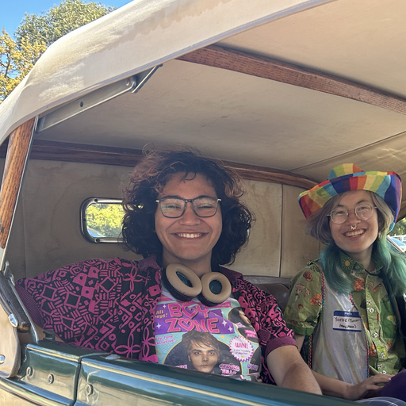


Team SEAL 🦭
Sophia Ramsey
Ellie
Vela
Amy
Lo
Leilenah Mamea

Slide 3
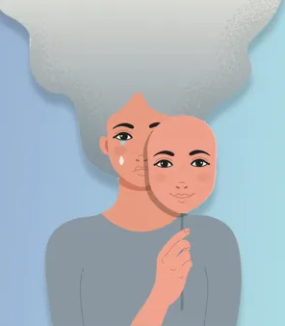
Problem
Many people struggle to connect with their emotions on a deep and meaningful level.

Slide 4
Problem
“My sadness was getting in the way of me doing things.”
– an Interviewee

Slide 5
Problem
Many of our interviewees turn to music to attempt to deal with their emotions, even though it doesn’t always work.

Slide 6
Problem
“After I had my son, and I was kind of going through postpartum depression…I really dove into music at that time.”
– an Interviewee

Slide 7
Problem
“I listen to certain playlists when I need to calm down.”
– an Interviewee

Slide 8
Problem
We asked ourselves, “How might we use music to help people analyze and reflect upon their own emotions?”

Slide 9
Solution
record
Value Proposition
Analyze your Emotions Using Music
Notes:
Notes for Jin-Hee:
How we came up with the team name:
We sat in a power-circle, brainstorming names aloud. A couple other contenders were “HarmoNote” and “Lydian.” At one point someone said “Rechord” (get it, “chord,” cuz music) but then we realized “Record" is already a music pun and also makes more sense so we went with that.

Slide 10
Solution
record
Slogan
We listen – and so do you.
Notes:
Notes for Jin-Hee:
How we came up with the team name:
We sat in a power-circle, brainstorming names aloud. A couple other contenders were “HarmoNote” and “Lydian.” At one point someone said “Rechord” (get it, “chord,” cuz music) but then we realized “Record" is already a music pun and also makes more sense so we went with that.

Slide 11

How it Works
1) User records a journal entry
2) We perform sentiment analysis
3) We select a song that aligns with the user’s emotions
4) We provide the user with the song, as well as other metrics about their emotional history
Notes:
Jin-Hee Notes:
emotional history data comes from the user’s past journal entries
we are still ironing out what this data will look like, as well as how the user records their journal entry (i.e. typing it, handwriting it or speaking it)

Slide 12
Primary User
Enjoys listening to music
Has internet access
Has access to smart devices
Is comfortable interacting with smart devices
Is interested in gaining insight into their emotions
Is technologically adventurous

Slide 13

Competitor #1
Vent
Emotion-forward social network
Create posts & tag with feeling
View trends in your feelings
Share feelings with friends
Join groups
Digital Diary (actually just a feed of private posts)

Slide 14

Competitor #2
Mood Music
Social Network for sharing feelings with music
Embed songs in posts
Set daily emotion to get song recs
Create playlists based on emotion
Join groups

Slide 15
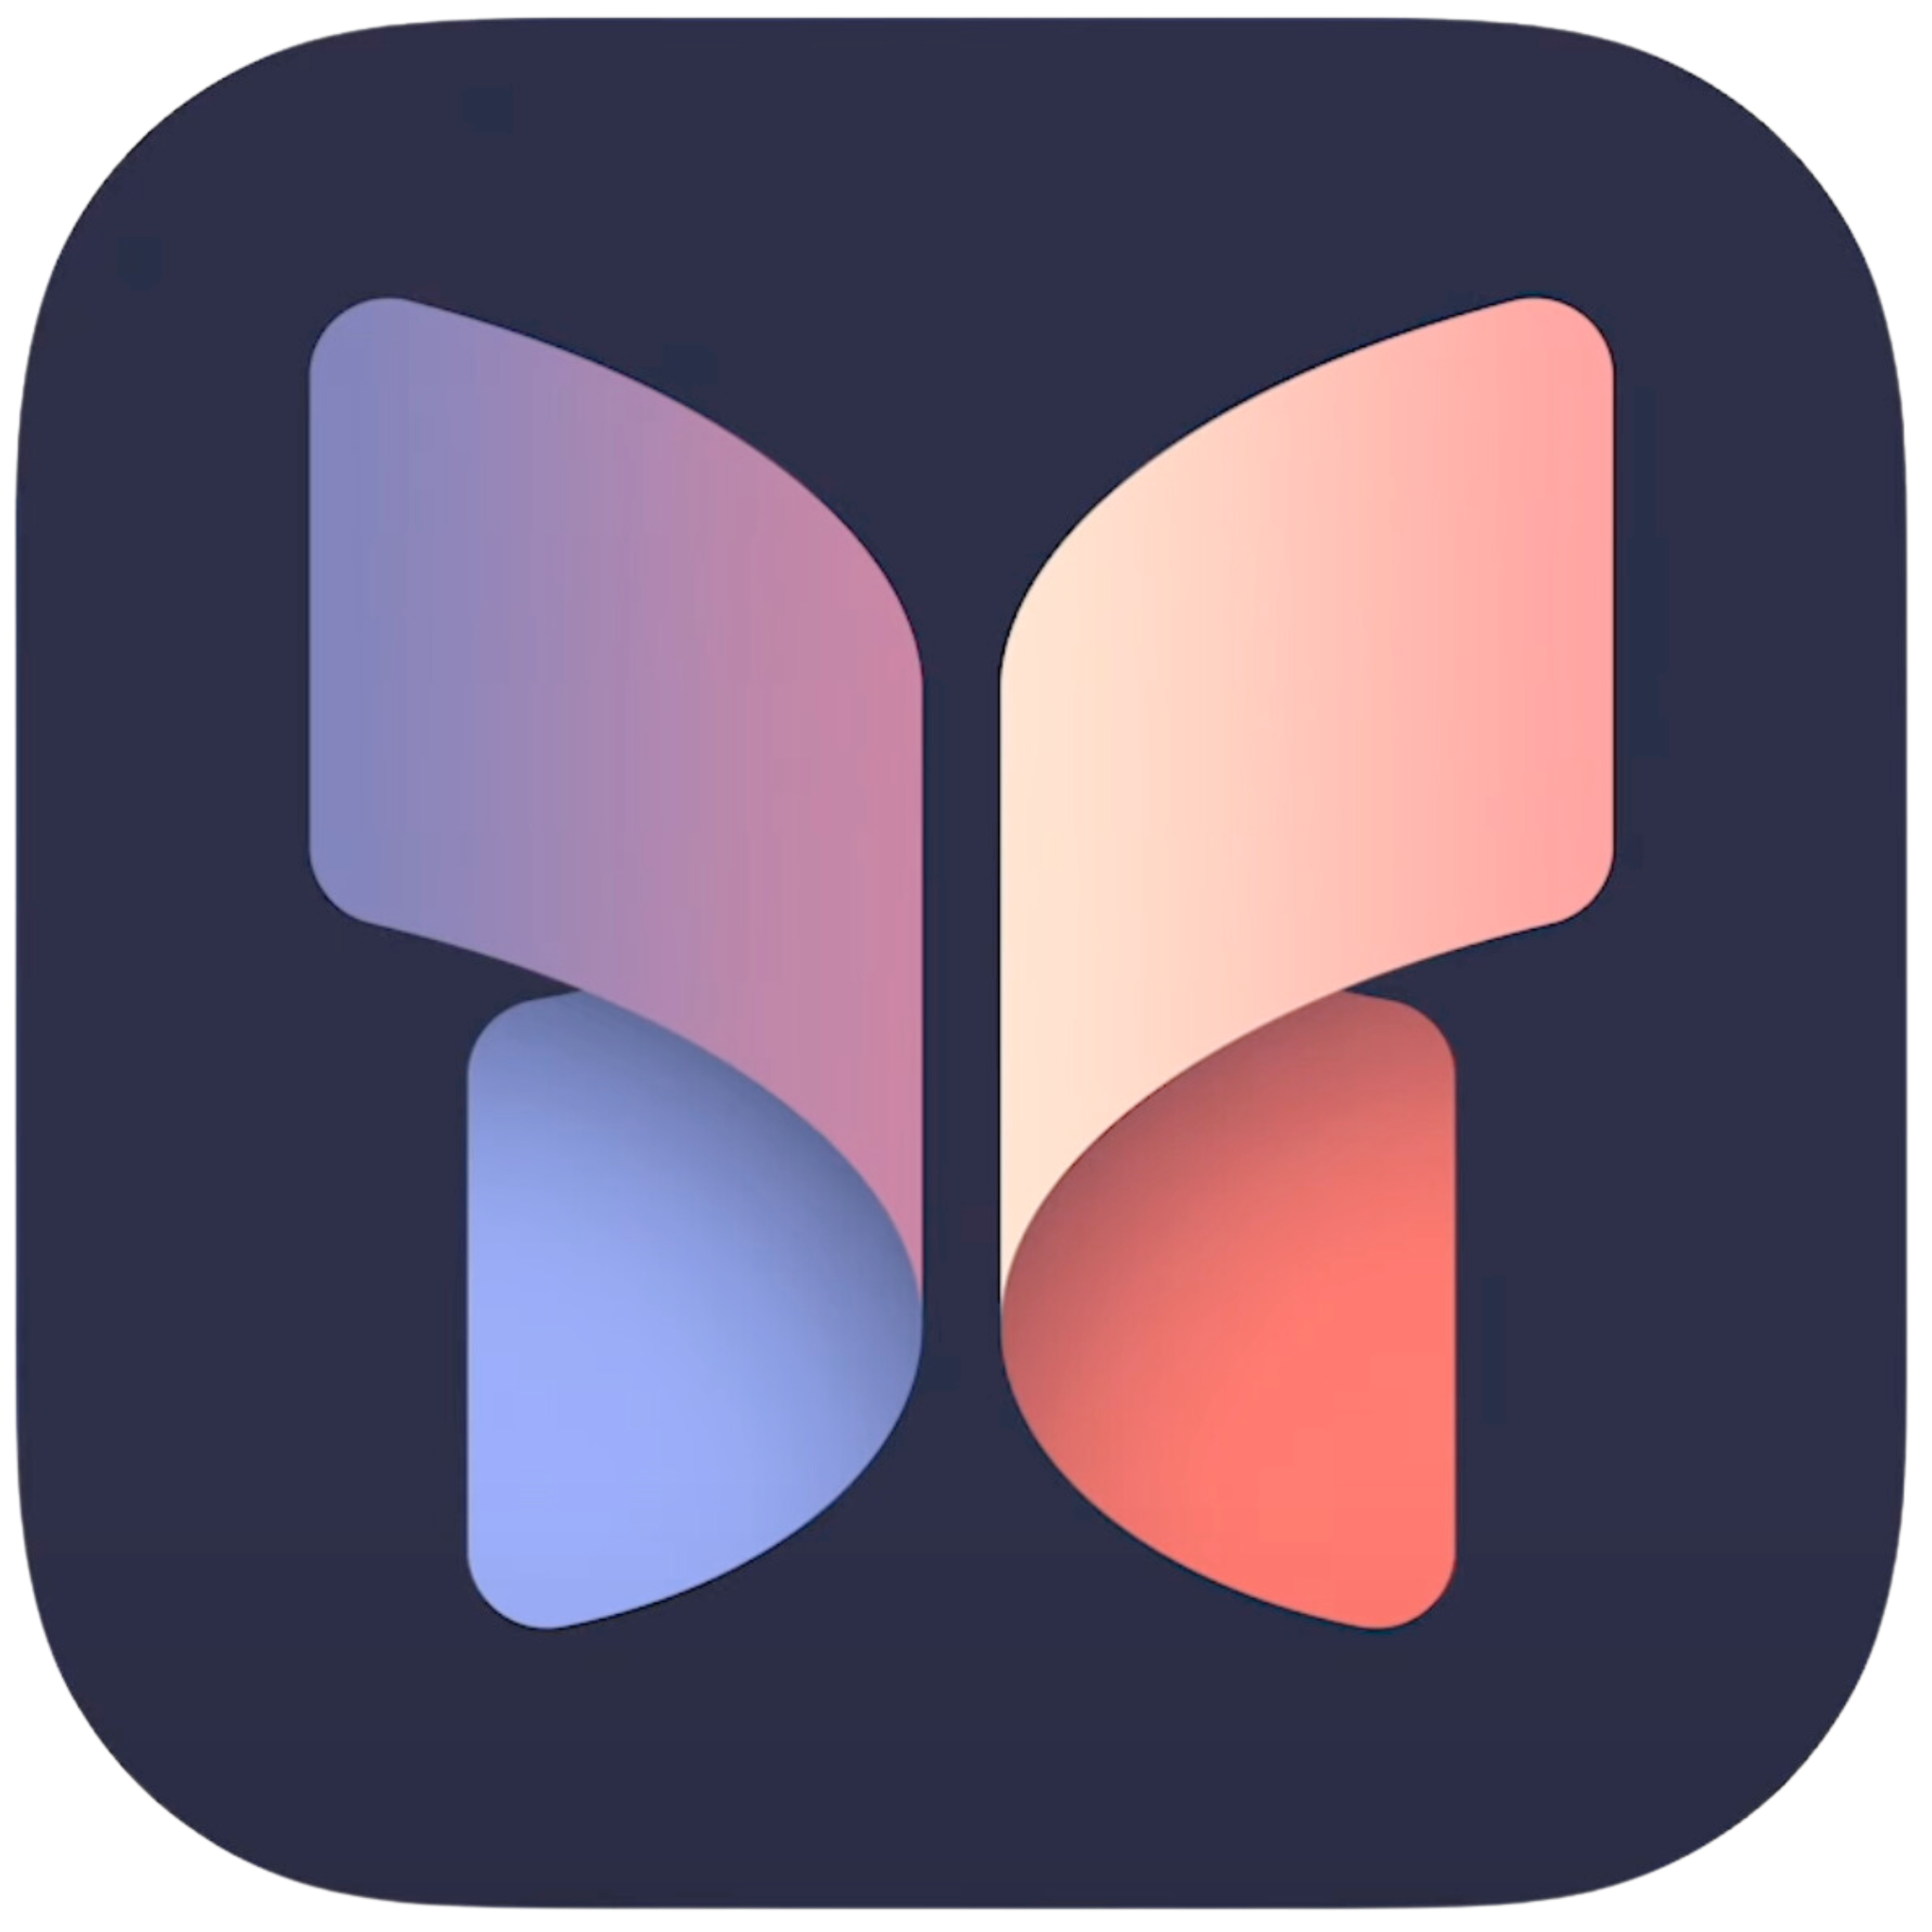
Competitor #3
Journal
Apple’s new journaling app
(iOS 17)
Uses ML to sort/ incorporate media from other apps
Prompts journaling through suggestions

Slide 16

Competitor #4
AI Diary
Digital diary that analyzes entries
Analyzes mood
Conversational
Analyzes grammar
Summarizes entries
Generates poems
Suggests topics
Smart search

Slide 17


Competitor Comparison
Features | Vent | Mood Music | Journal | AI Diary | record
Sentiment Analysis | ✘ | ✘ | ✘ | ✔ | ✔
Music integration | ✘ | ✔ | ✔ | ✘ | ✔
Analyze trends | ✔ | ✘ | ✘ | ✔ | ✔
Digital Diary | ? | ✘ | ✔ | ✔ | ✔
Notes:
Jin-Hee Notes:
❓means “kinda”

Slide 18
Stakeholders
Direct Stakeholders
  Anyone who inputs a journal entry into our product.
Indirect Stakeholders
  Musicians
  Anyone close to the user
  Mental Health Workers
  Hardware Manufacturers – e.g. Apple
  Software Manufacturers – e.g. Spotify, OpenAI
Notes:
Jin-Hee Notes:
Additional context around stakeholders:
Users
We hope to improve our users’ mental wellness, so we need to be careful not to overstate the capabilities of our app nor the mental health benefits
Musicians
Specifically the musicians whose music we recommend to our users
We may be influencing users’ listening habits, which has bearing on musicians’ livelihoods
Anyone Close to the User
I.e. anyone who may be affected by the emotional impact that our app may have on our user such as close friends and family members
Mental Health Workers
We’re creating a product aimed at mental wellness. We should be careful about changing how people view and interact with the healthcare system e.g. misunderstanding our product as a replacement for mental health services.
Hardware Manufacturers
The manufacturers who make the hardware needed to support our product.
Software Manufacturers
The companies whose software we use to support our product features.

Slide 19

Ethical Implications
The Siren
What would using your product “too much” look like?
How does it encourage people to engage, and how does it make it easy to disconnect?
How does it respect people’s boundaries and other parts of their lives?
In what situations might it be inappropriate or distracting to use?
Stewing in negative emotions; Over-interpreting suggestions e.g. as a diagnostic tool
Provides personalized music suggestions, but allows exporting them out of the app
Doesn’t import media from unauthorized sources or force users to reply to specific prompts
In times of extreme distress or as a replacement for professional help

Slide 20
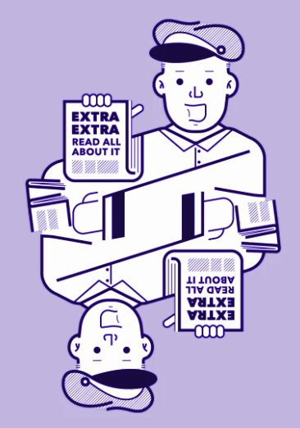
Ethical Implications
The Scandal
What’s the worst headline about your product you can imagine?
What about your business model would concern users most?
In what scenarios could your product cause harm or endanger people?
If your product was used entirely opposite of how it’s intended, what does that look like?
Security breach
Privacy, security, and encryption with sensitive personal information
If private thoughts are accessed by others, or if users use the app in place of seeking help
Knowing which songs a person was recommended and attempting to piece together their journal entries

Slide 21

Ethical Implications
The Backstabber
What could cause people to lose trust in your product?
What could make people feel unsafe or exposed?
What mechanisms are in place for listening to your users?
How will you recognize larger patterns in feedback so that action can be taken?
Security breaches, lack of passwords/two factor authentication, poor recommendations
Lack of security, passwords, or account management
We can implement a thumbs up/down rating for song selections
We can give songs scores based on whether the genre, mood, or lyrics match, and use that to improve matching for individual users

Slide 22
Simple Task:
Because writing & listening are the interactions that are most core to our app, it should be the most streamlined.
Write a new journal entry & listen to music

Slide 23
Moderate Task:
Selecting what to import and where to place it in a journal entry necessitates multiple steps, so it’s more complex than writing a new entry. But it should be as simple as possible since it’s part of the writing process.
Import media (e.g. songs) from external sources

Slide 24
Complex Task:
We want users’ stats to be personalized and highly customizable, so reviewing them will involve more complexity than other tasks.
Review trends across history of previous entries

Slide 25
Storyboard

Slide 26
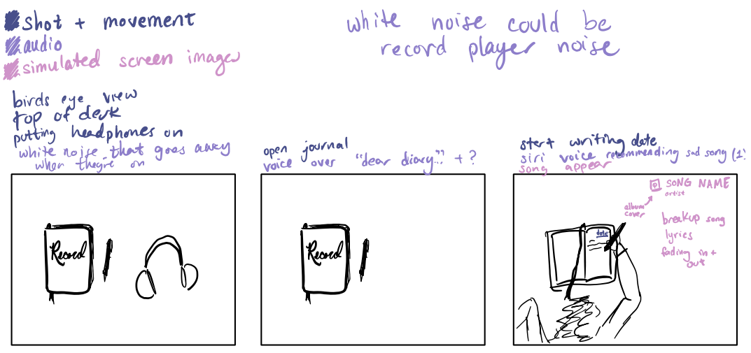

Slide 27
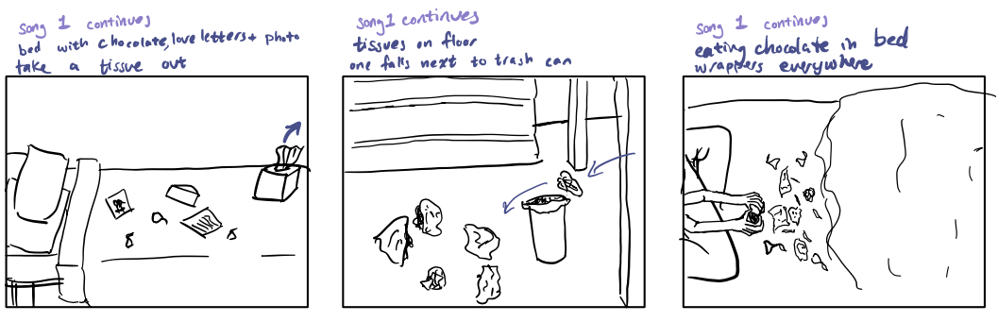

Slide 28
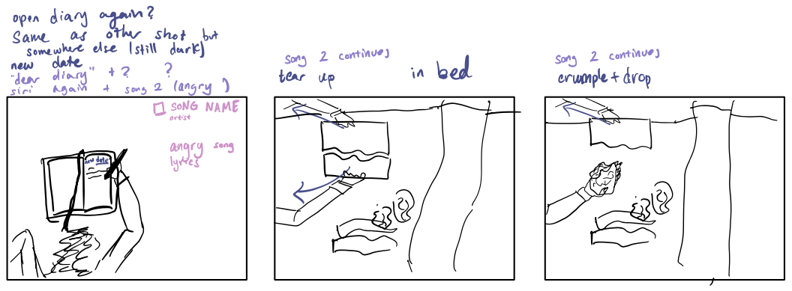

Slide 29
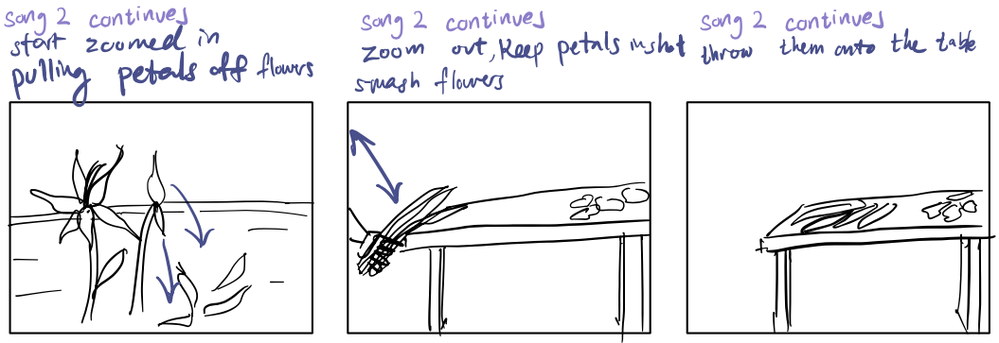

Slide 30
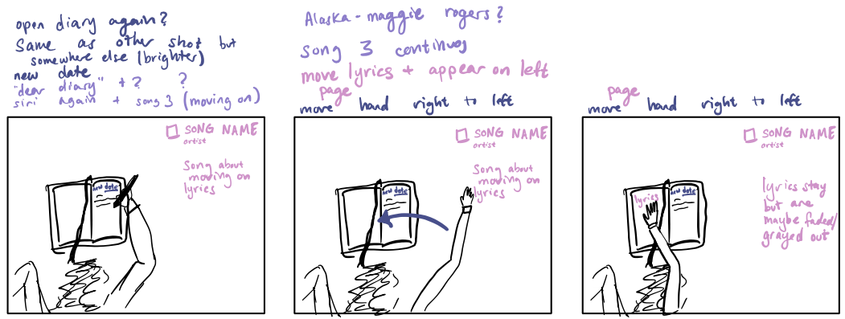

Slide 31
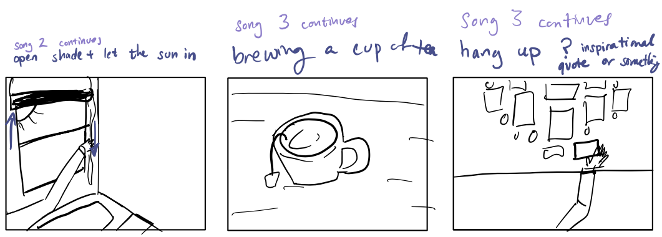

Slide 32
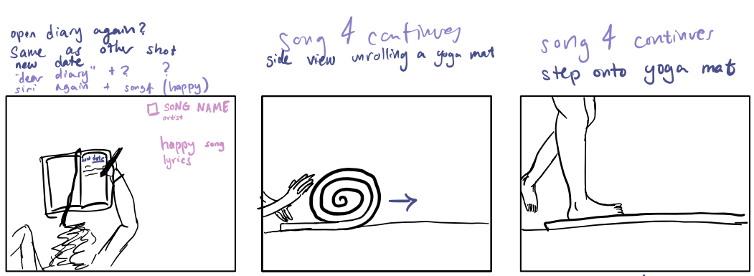

Slide 33
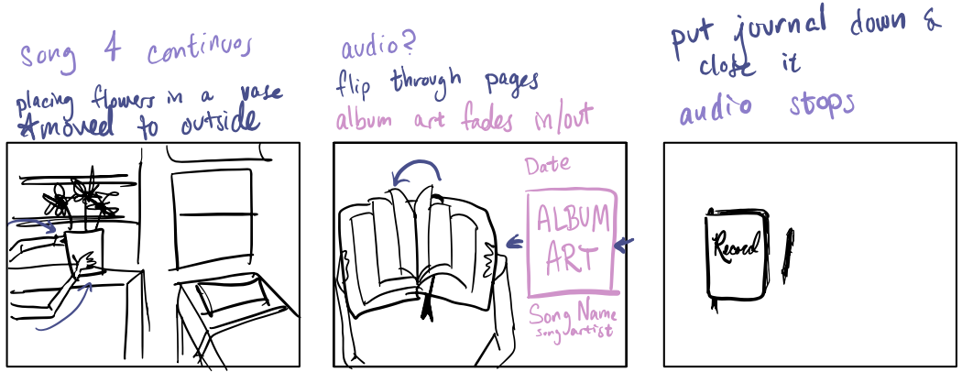

Slide 34
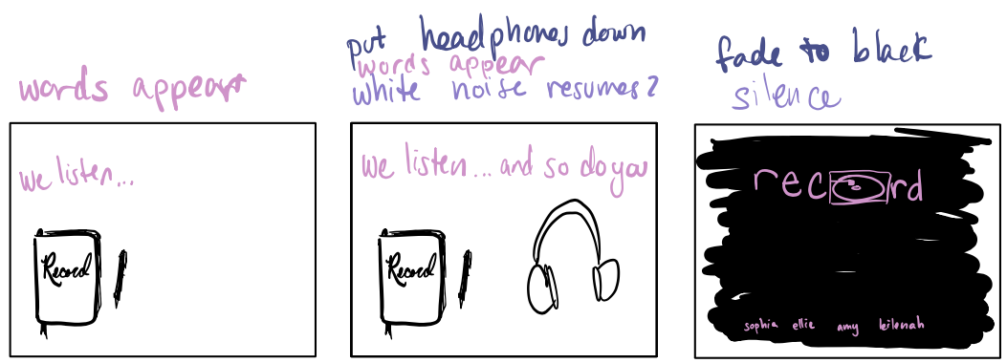

Slide 35

Concept Video
Or click here to watch on YouTube
Notes:
https://www.youtube.com/watch?v=P7ObIa27lW4

Slide 36
Appendix

Slide 37
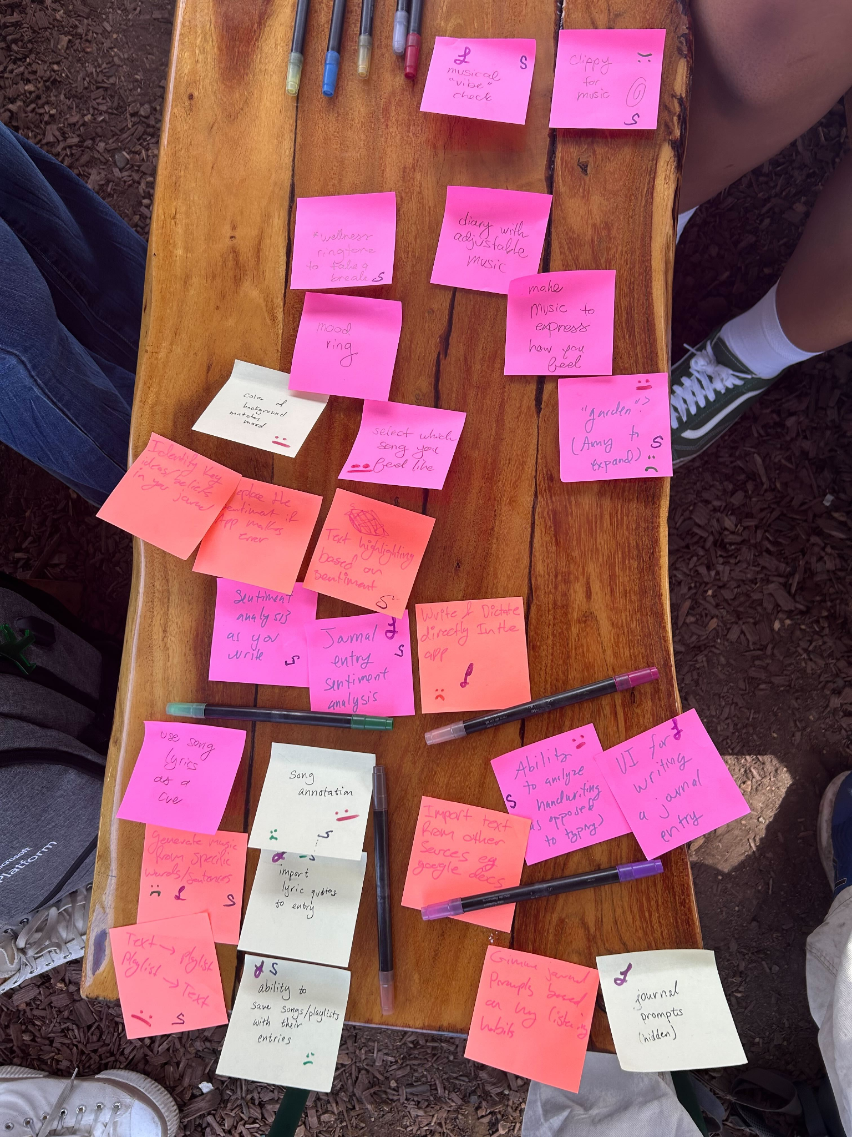
Product Ideation

Slide 38
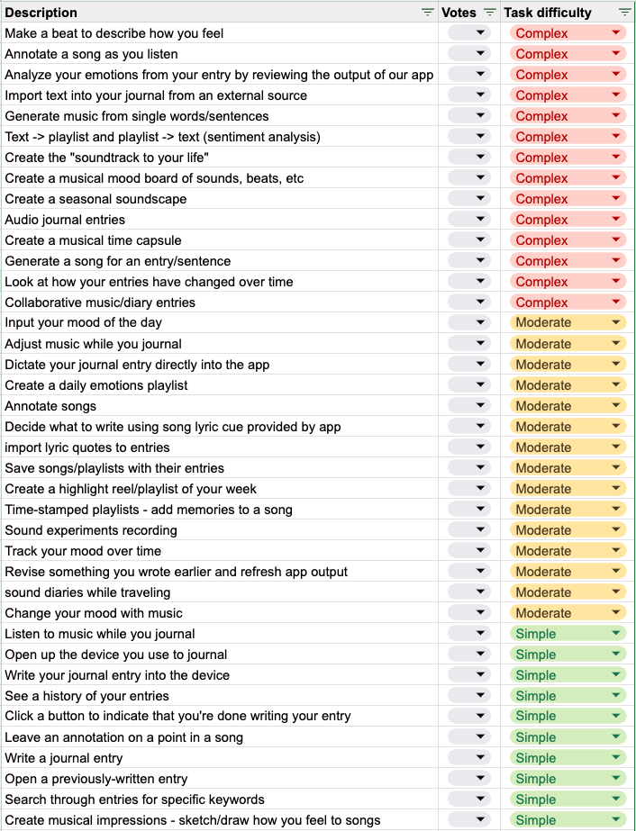
Task Ideation

Slide 39
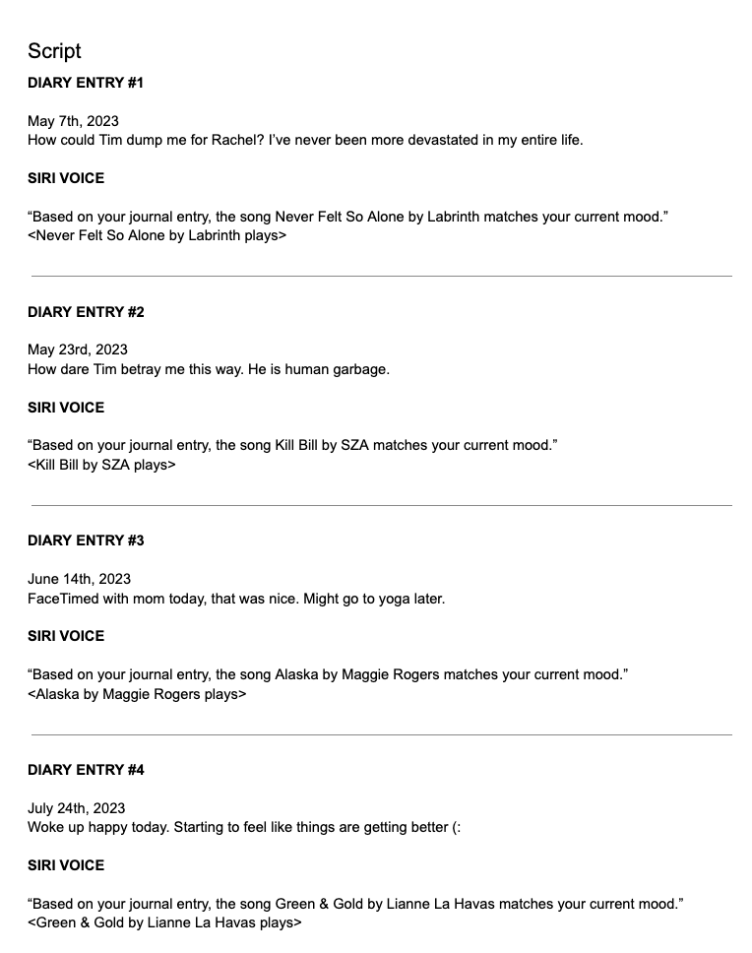
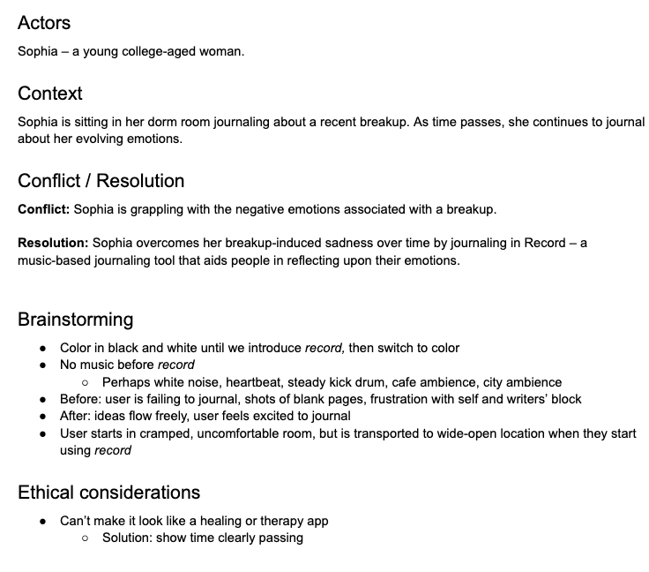
Concept video script

Slide 40

Concept Video (draft)
Before color grading, special effects
Or click here to watch on YouTube
Notes:
Before finalizing our video, we edited an initial pass of the video to make sure it hit all the points of the storyboard.

