Slide 1
Assignment 2: POVs and HMWs
Team SEAL:
Sophia, Ellie, Amy & Leilenah

Slide 2

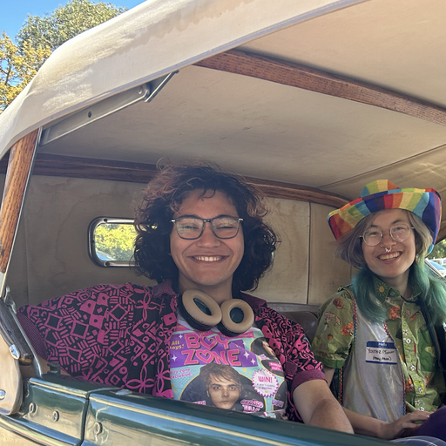

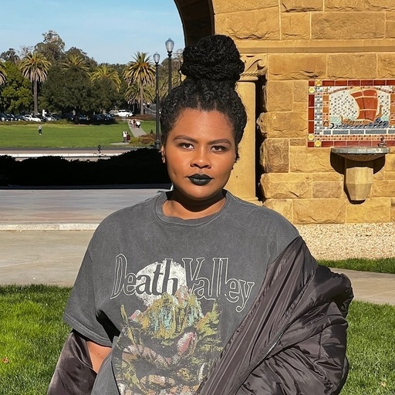
Team SEAL 🦭
Sophia Ramsey
Ellie
Vela
Amy
Lo
Leilenah Mamea

Slide 3
Highly-skilled music creators/producers
Less-skilled musicians
& music consumers
Problem Domain

Slide 4
Needfinding
Limited to moderate experience
No
professional experience
Music consumers

Slide 5

Connor
Stanford alum, former band member
“Some of my music choices are driven by mood, and some are driven by purpose.”

Slide 6
Needfinding Insights
OBSERVATION
Connor often associates songs with certain periods of their life and creates playlists to change their mood.
INFERENCE
Having an emotional connection to music gives it power to evoke different feelings.
INSIGHT
Music can be used to identify, explore, and alter emotions
+
=

Slide 7
Candice
New mother, avid music listener
“Music made me feel like I wasn’t alone. It would get me through my postpartum. Music was there with me when no one else was.”
🪈

Slide 8
Needfinding Insights
OBSERVATION
Candice enjoys listening to music sung in her partner’s native language (Spanish), even though she doesn’t understand the lyrics.
INFERENCE
Listening to her partner’s music with him makes her feel connected to his culture, and therefore closer to him.
INSIGHT
Music can be an effective tool for enhancing cultural understanding and appreciation.
+
=

Slide 9

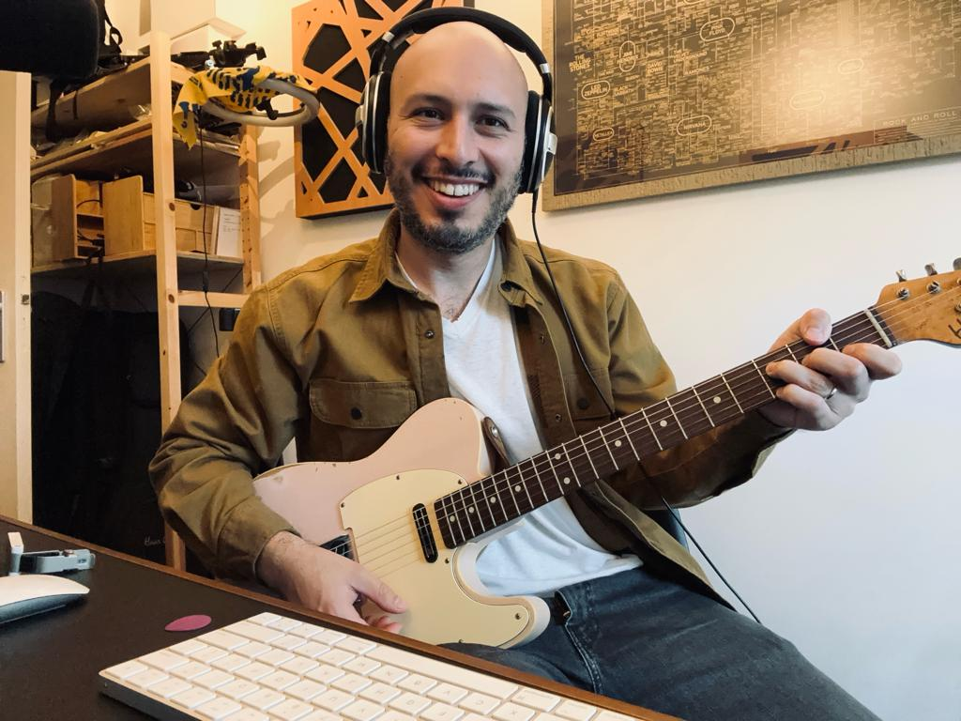
POV Development
🪈

Slide 10
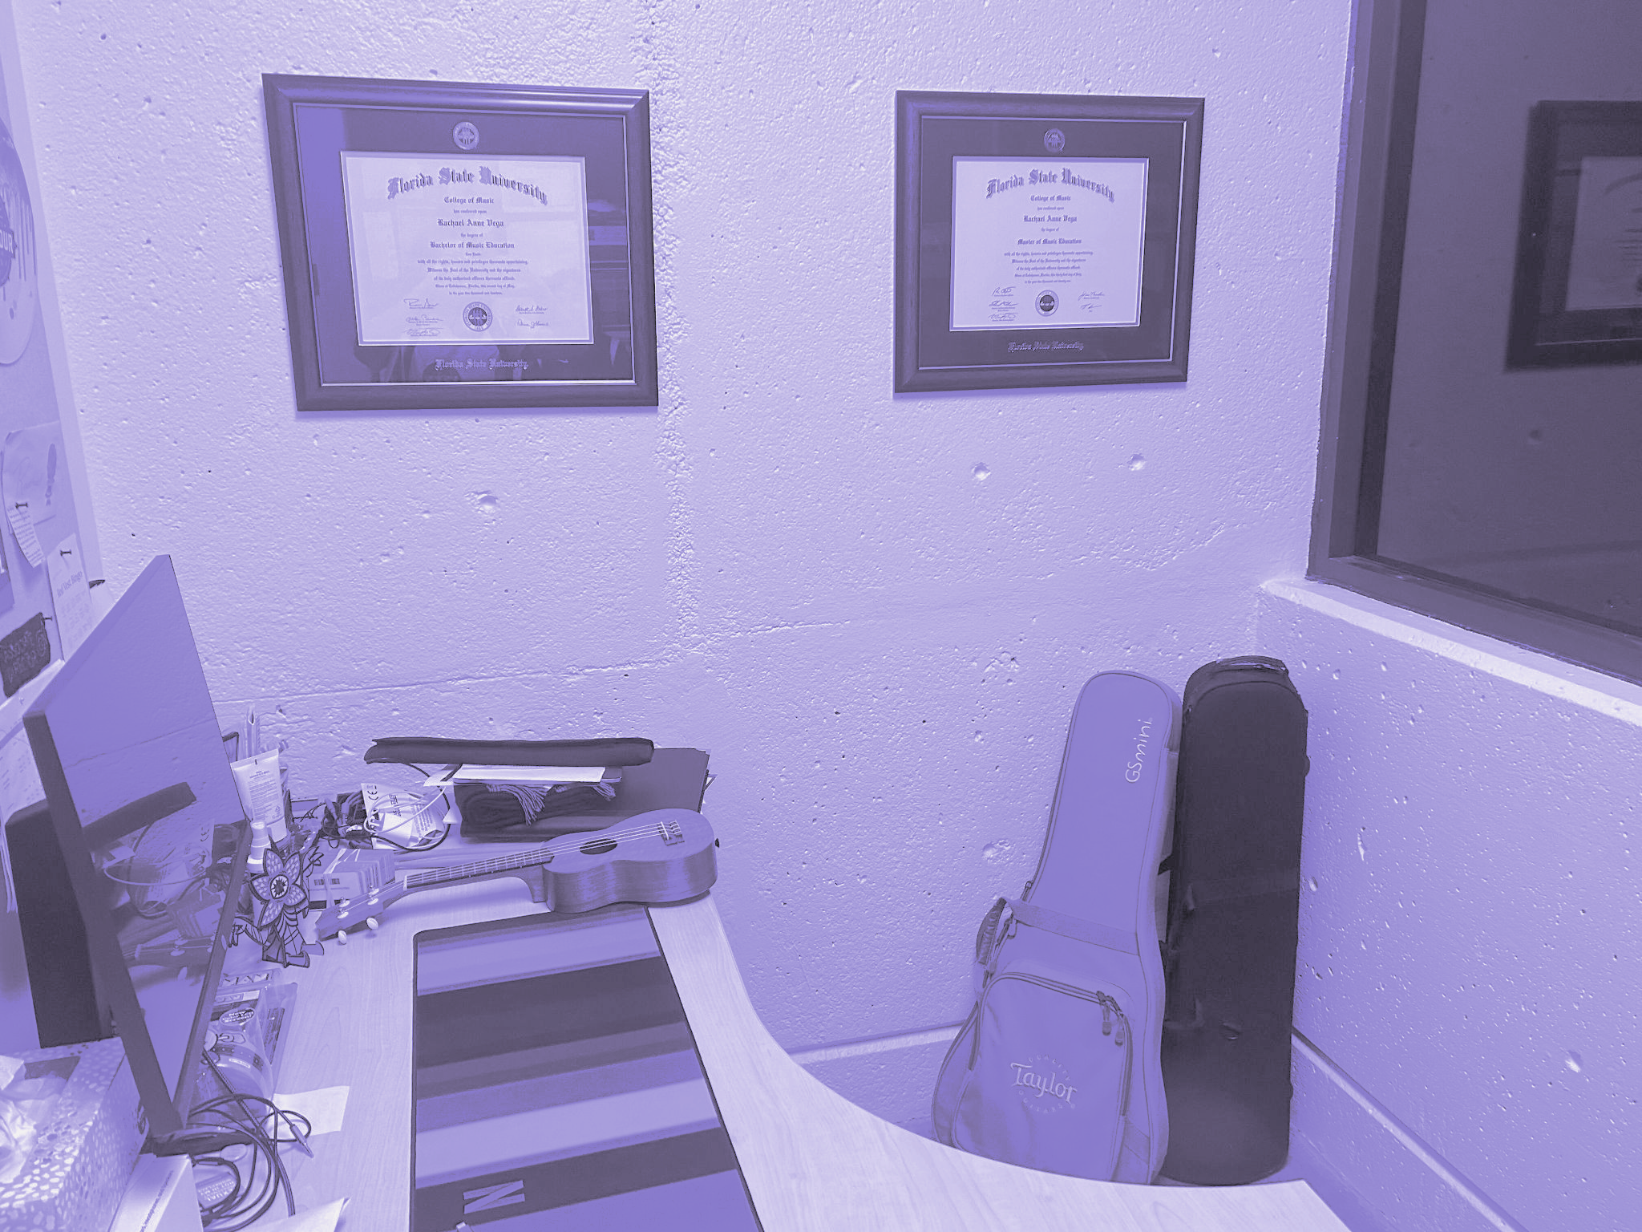
Initial POV
Rachael
Band Director, Casual musician
“I lean on my creative and improvisation skills with my personal music more than anything I do at my day-job”.

Slide 11
Initial POV
WE MET…
Rachael, a band director and casual musician who plays gigs in her free time.

Slide 12
Initial POV
WE MET…
Rachael, a band director and casual musician who plays gigs in her free time.
WE WERE SURPRISED TO REALIZE…
Rachael feels frustrated collaborating with less skilled musicians when she has to teach music, despite being a music educator.

Slide 13
Initial POV
WE MET…
Rachael, a band director and casual musician who plays gigs in her free time.
WE WERE SURPRISED TO REALIZE…
Rachael feels frustrated collaborating with less skilled musicians when she has to teach music, despite being a music educator.
WE WONDER IF THIS MEANS…
Rachael wants her collaborative experiences not to feel like a lesson plan.

Slide 14
Initial POV
WE MET…
Rachael, a band director and casual musician who plays gigs in her free time.
WE WERE SURPRISED TO REALIZE…
Rachael feels frustrated collaborating with less skilled musicians when she has to teach music, despite being a music educator.
WE WONDER IF THIS MEANS…
Rachael wants her collaborative experiences not to feel like a lesson plan.
IT WOULD BE GAME CHANGING TO…
give amateur musicians equal weight in collaboration as highly-skilled musicians.

Slide 15
POV #1
Candice
New mother, casual music consumer
“Music made me feel like I wasn’t alone. It would get me through my postpartum. Music was there with me when no one else was.”
🪈

Slide 16
POV #1
WE MET…
Candice, a casual consumer of music and 30-year-old new mother living with her husband in Southern California.

Slide 17
POV #1
WE MET…
Candice, a casual consumer of music and 30-year-old new mother living with her husband in Southern California.
WE WERE SURPRISED TO REALIZE…
her husband shares “hispanic music” with her, and she “gets down” to it, although she doesn’t speak Spanish.

Slide 18
POV #1
WE MET…
Candice, a casual consumer of music and 30-year-old new mother living with her husband in Southern California.
WE WERE SURPRISED TO REALIZE…
her husband shares “hispanic music” with her, and she “gets down” to it, although she doesn’t speak Spanish.
WE WONDER IF THIS MEANS…
she connects with her husband’s culture through his music.

Slide 19
POV #1
WE MET…
Candice, a casual consumer of music and 30-year-old new mother living with her husband in Southern California.
WE WERE SURPRISED TO REALIZE…
her husband shares “hispanic music” with her, and she “gets down” to it, although she doesn’t speak Spanish.
WE WONDER IF THIS MEANS…
she connects with her husband’s culture through his music.
IT WOULD BE GAME CHANGING TO…
help Candice to gain a deeper understanding of her husband’s culture despite the language barrier.

Slide 20
How might we
bridge the language gap for people listening to music outside their own culture?
WE MET…
Candice, a casual consumer of music and 30-year-old new mother living with her husband in Southern California.
WE WERE SURPRISED TO REALIZE…
her husband shares “hispanic music” with her, and she “gets down” to it, although she doesn’t speak Spanish.
WE WONDER IF THIS MEANS…
she connects with her husband’s culture through his music.
IT WOULD BE GAME CHANGING TO…
help Candice to gain a deeper understanding of her husband’s culture despite the language barrier.

Slide 21
Solution #1
A product, given any song in a different language, provides cultural context in your native language while listening.
Notes:
For example, if an English-speaking user is listening to the Spanish song “Bailando,” our product might show the user the English translation of the song as it’s playing, as well as provide information about the origins of “Bailando.”

Slide 22
Solution #1
A product, given any song in a different language, provides cultural context in your native language while listening.
Assumption
People want to know the history of a song and its meaning while listening to music.

Slide 23
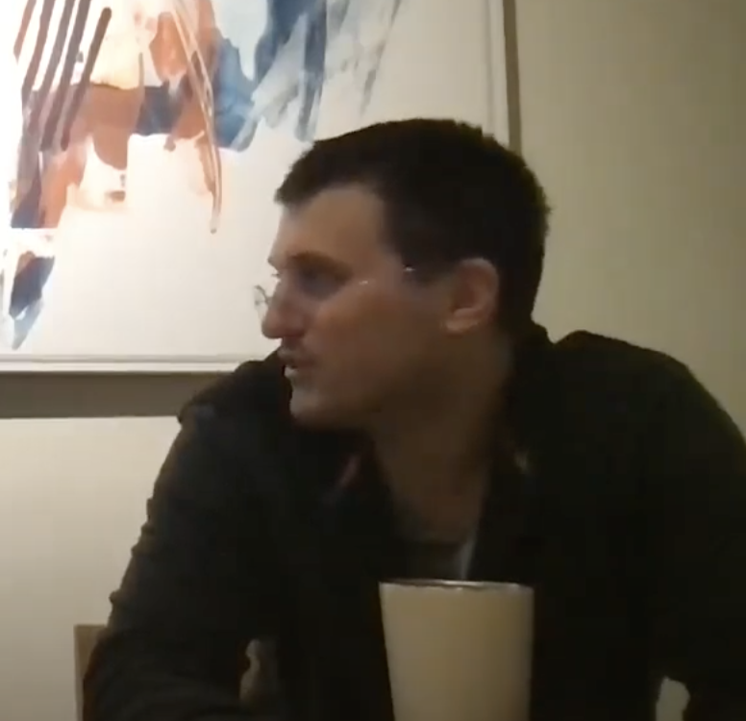
Listen & learn about culture
😃
Prototype 1
Bryan
CTO at tech startup, Bachelors in Music, plays drums and trombone

Slide 24
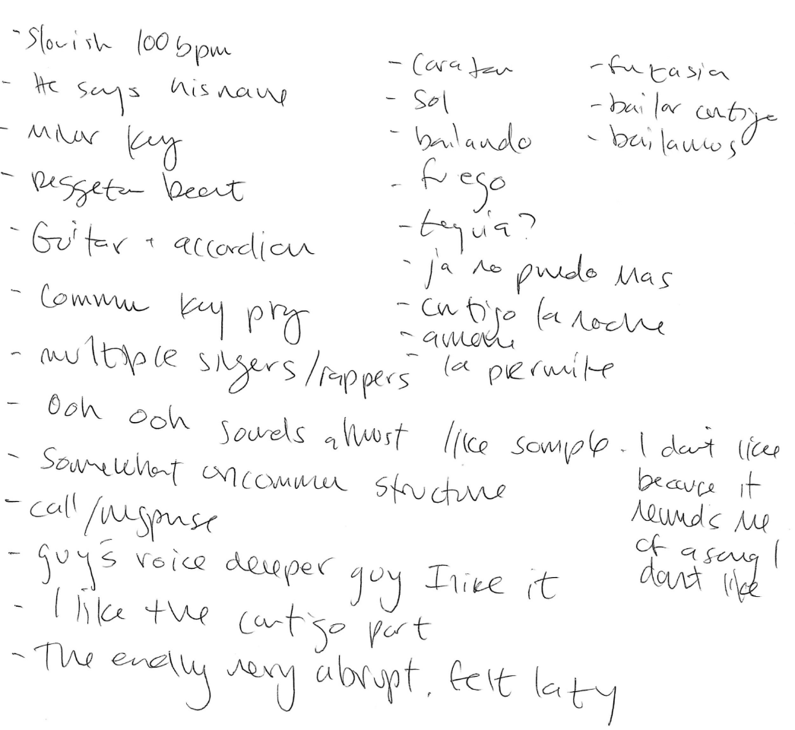

PROTOTYPE 1
Real-time annotation of song

Slide 25
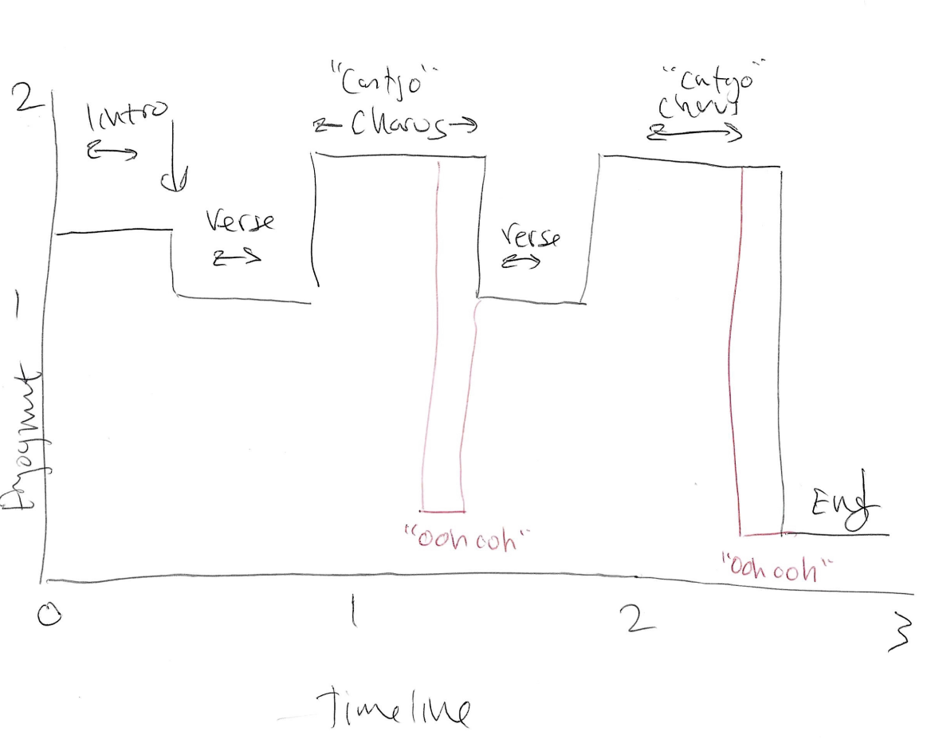
PROTOTYPE 1
Graph of emotional timeline

Slide 26
PROTOTYPE 1
SPANISH
ENGLISH
Yo te miro y se me corta la respiración
Cuando tú me miras se me sube el corazón
I see you and this takes my breath away.
When you look at me I feel my heart
“I could sense what the gist of the song was just by listening to it.”

Slide 27
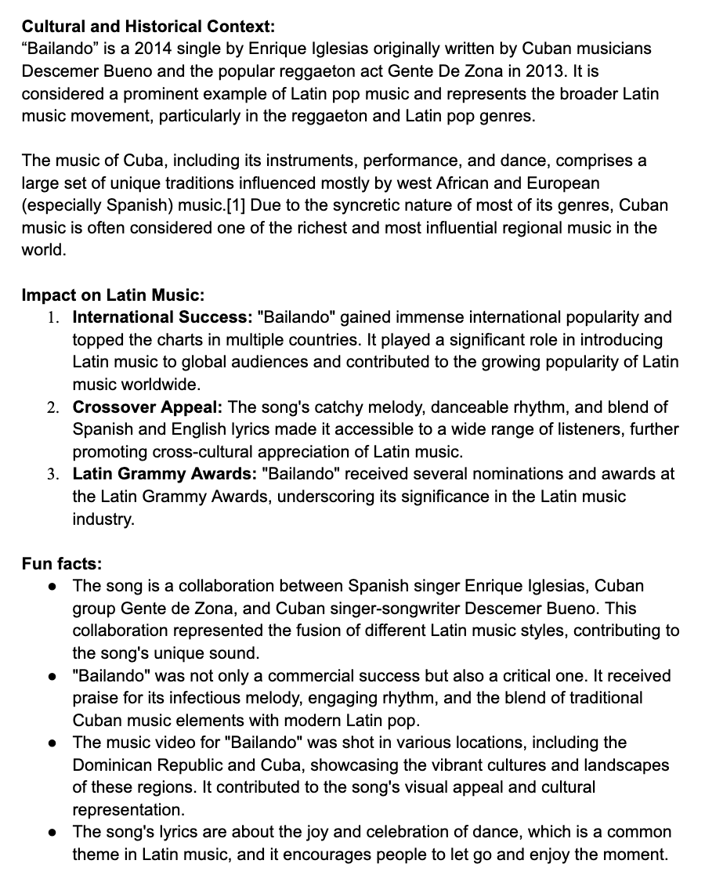
PROTOTYPE 1
🌎 Cultural context
📈 Latin impact
🤔 Fun facts
… opted in to learn about all

Slide 28
Findings (Prototype 1)
😃
What worked
What didn’t work?
Opted in to learn about cultural context and impact on latin music
Too much information all at once (lyrics, translation, song itself)
New learnings
Going forward
Listeners “happy” to learn about the culture without being a fan of the music
Focus on the listening experience
Bryan
CTO at tech startup, Bachelors in Music, plays drums and trombone
Notes:
Bryan Experience – Highlights
Participant Information
34 year old
CTO at tech startup
Musician – B.A. in Music from Berklee College of Music in Boston
Principal Instruments: Drums, Trombone
Does not speak Spanish, and does not actively seek out music with Spanish lyrics

Slide 29
POV #2
Connor
Stanford alum, former band member
“Some of my music choices are driven by mood, and some are driven by purpose.”

Slide 30
POV #2
WE MET…
Connor, a 23-year-old recent Stanford graduate who plays the trombone and was formerly in marching band.

Slide 31
POV #2
WE MET…
Connor, a 23-year-old recent Stanford graduate who plays the trombone and was formerly in marching band.
WE WERE SURPRISED TO REALIZE…
they use music to help quell feelings of anger, but are unable to use music to help quell other types of negative emotions like sadness.

Slide 32
POV #2
WE MET…
Connor, a 23-year-old recent Stanford graduate who plays the trombone and was formerly in marching band.
WE WERE SURPRISED TO REALIZE…
they use music to help quell feelings of anger, but are unable to use music to help quell other types of negative emotions like sadness.
WE WONDER IF THIS MEANS…
there is something specific about the emotion of sadness that makes it difficult to alleviate via music.

Slide 33
POV #2
WE MET…
Connor, a 23-year-old recent Stanford graduate who plays the trombone and was formerly in marching band.
WE WERE SURPRISED TO REALIZE…
they use music to help quell feelings of anger, but are unable to use music to help quell other types of negative emotions like sadness.
WE WONDER IF THIS MEANS…
there is something specific about the emotion of sadness that makes it difficult to alleviate via music.
IT WOULD BE GAME CHANGING TO…
enable Connor to resolve emotions through music, furthering their self-discovery.

Slide 34
How might we let music be the map for emotional exploration?
WE MET…
Connor, a 23-year-old recent Stanford graduate who plays the trombone and was formerly in marching band.
WE WERE SURPRISED TO REALIZE…
they use music to help quell feelings of anger, but are unable to use music to help quell other types of negative emotions like sadness.
WE WONDER IF THIS MEANS…
there is something specific about the emotion of sadness that makes it difficult to alleviate via music.
IT WOULD BE GAME CHANGING TO…
enable Connor to resolve emotions through music, furthering their self-discovery.

Slide 35
Solution #2
A digital diary that uses natural language processing to curate music that goes along with the user’s diary entries

Slide 36
Solution #2
A digital diary that uses natural language processing to curate music that goes along with the user’s diary entries
Assumption
Music consumers enjoy using personalized music to explore or alter their emotions.

Slide 37
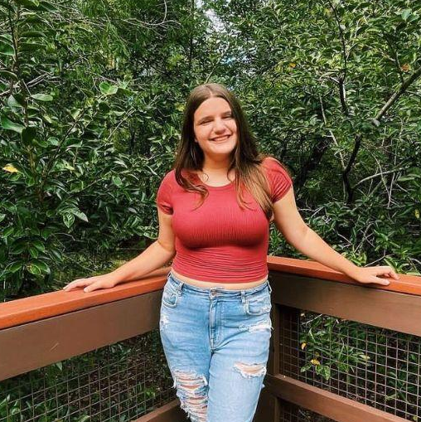
Mood journaling with music
😃
Prototype 2
NICOLE
22 year old teacher
going through a breakup

Slide 38
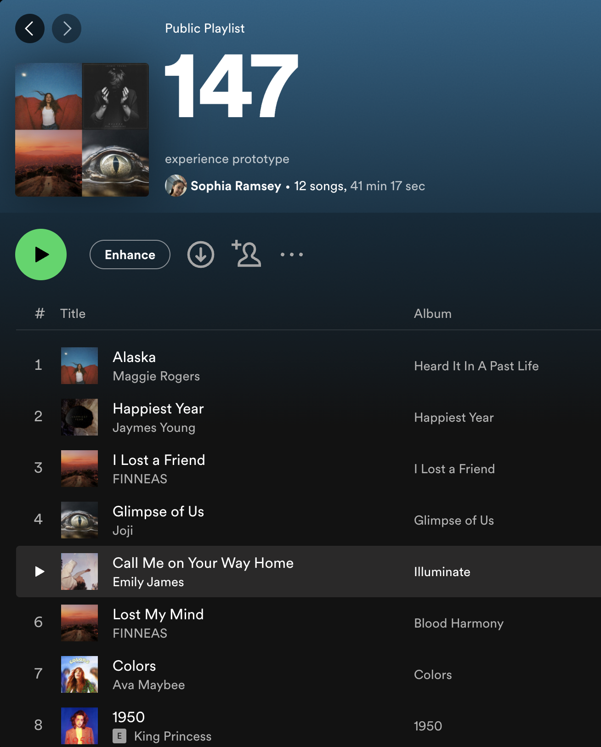
PROTOTYPE 2
😌 Mood journal
❤️ Music selection
Current mood
Ideal mood
Notes:
Was able to use knowledge of nicole’s music taste to create a playlist of songs she would like, but with different lyrics and moods

Slide 39
Our findings
😃
What worked
What didn’t work?
Personalized experience for music exploration
Only journaled about emotions she didn’t want to experience
New learnings
Going forward
Songs that are too personalized might be harmful
Filter or prioritize on matching general sentiment, vibes, or lyrics
NICOLE
22 year old teacher
going through a breakup
Notes:
User Thoughts
Enjoyed the experience
Thought it would be best for music or emotional exploration
Would enjoy a speech-to-text or voice memo feature
Would want to filter out genres and specific songs
Songs based on her current mood would have encouraged her to stay sad, but she wasn’t in the mood to write about her ideal feelings
Findings
Songs that are too personalized might be harmful, depending on the mood
We may want to allow the user to toggle priority on matching general sentiment, vibes, or lyrics

Slide 40
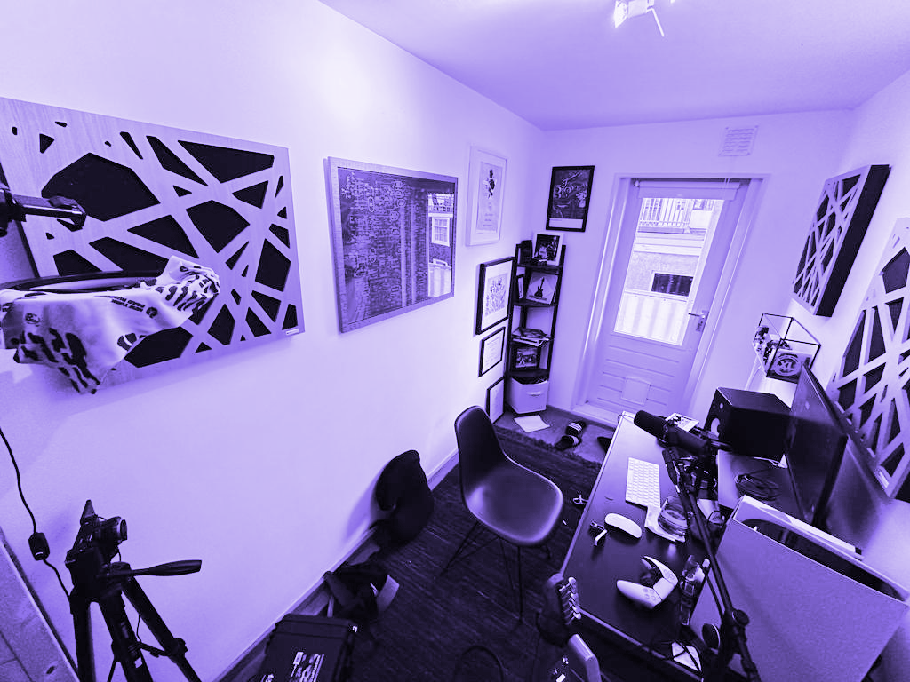
POV #2
Elliott
Professional
Guitarist, Music Youtuber & Teacher
😃
“[After COVID took away live gigs,] I guess I should start Youtube. Which is an idea I should have had four years prior.”

Slide 41
POV #3
WE MET…
Elliott, a professional guitarist, music Youtuber, and new dad in his mid-30’s, currently living with his wife in Amsterdam.

Slide 42
POV #3
WE MET…
Elliott, a professional guitarist, music Youtuber, and new dad in his mid-30’s, currently living with his wife in Amsterdam.
WE WERE SURPRISED TO REALIZE…
Elliott believes aesthetically pleasing YouTube videos helps with video performance; but he refuses to spend more than 6 hours editing a video.

Slide 43
POV #3
WE MET…
Elliott, a professional guitarist, music Youtuber, and new dad in his mid-30’s, currently living with his wife in Amsterdam.
WE WERE SURPRISED TO REALIZE…
Elliott believes aesthetically pleasing YouTube videos helps with video performance; but he refuses to spend more than 6 hours editing a video.
WE WONDER IF THIS MEANS…
musicians want to spend their time on craft, and not on other tedious tasks (even if those tasks could increase their popularity).

Slide 44
POV #3
WE MET…
Elliott, a professional guitarist, music Youtuber, and new dad in his mid-30’s, currently living with his wife in Amsterdam.
WE WERE SURPRISED TO REALIZE…
Elliott believes aesthetically pleasing YouTube videos helps with video performance; but he refuses to spend more than 6 hours editing a video.
WE WONDER IF THIS MEANS…
musicians want to spend their time on craft, and not on other tedious tasks (even if those tasks could increase their popularity).
IT WOULD BE GAME CHANGING TO…
enable Elliott to perform tedious tasks in ways that are artistically gratifying.

Slide 45
How might we make doing tedious tasks feel like making music?
WE MET…
Elliott, a professional guitarist, music Youtuber, and new dad in his mid-30’s, currently living with his wife in Amsterdam.
WE WERE SURPRISED TO REALIZE…
Elliott believes aesthetically pleasing YouTube videos helps with video performance; but he refuses to spend more than 6 hours editing a video.
WE WONDER IF THIS MEANS…
musicians want to spend their time on craft, and not on other tedious tasks (even if those tasks could increase their popularity).
IT WOULD BE GAME CHANGING TO…
enable Elliott to perform tedious tasks in ways that are artistically gratifying.

Slide 46
Solution #3
A task manager that intersperses tedious tasks with breaks of creative tasks that encourage you to make music.

Slide 47
Solution #3
A task manager that intersperses tedious tasks with breaks of creative tasks that encourage you to make music.
Assumption
People are more likely to perform tedious tasks if they can continue working on what they enjoy.

Slide 48
Tedious tasks + music making
🥁
Prototype 3
JAMES
Tech worker
Hobbyist drummer

Slide 49
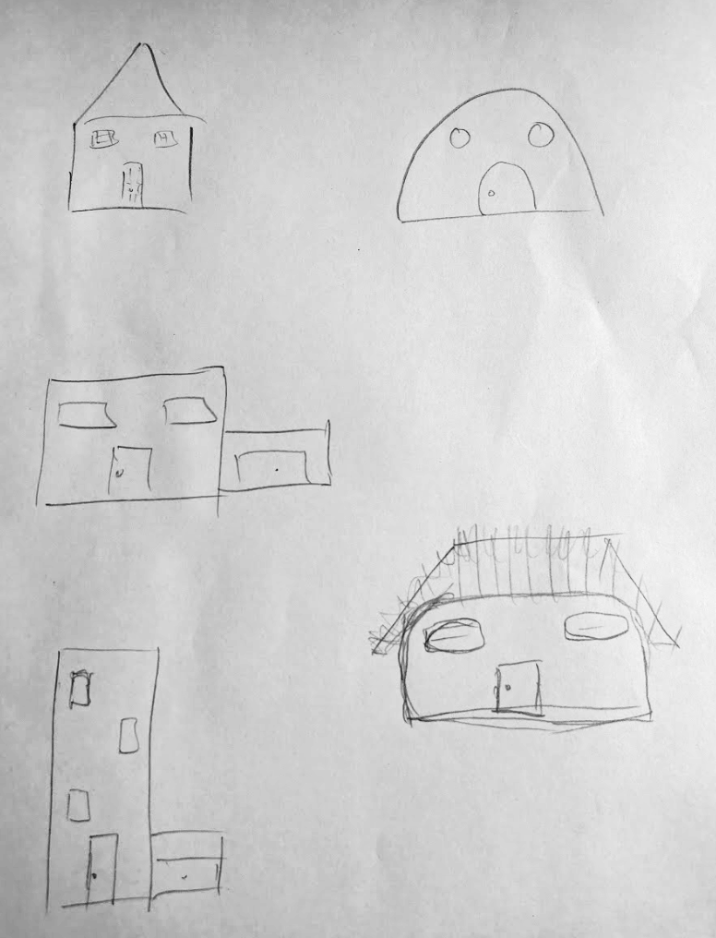
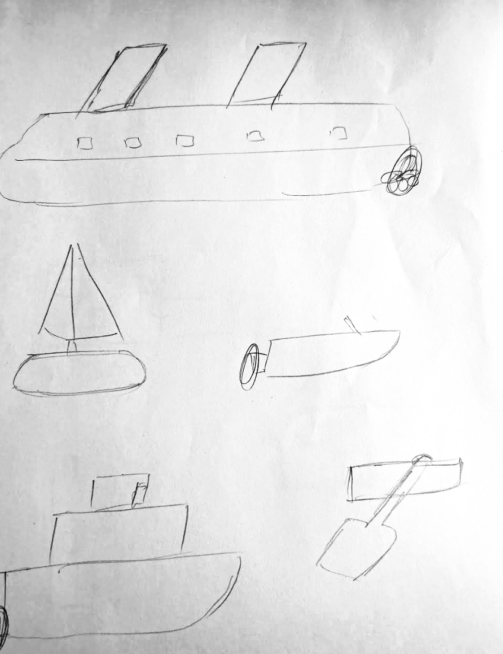
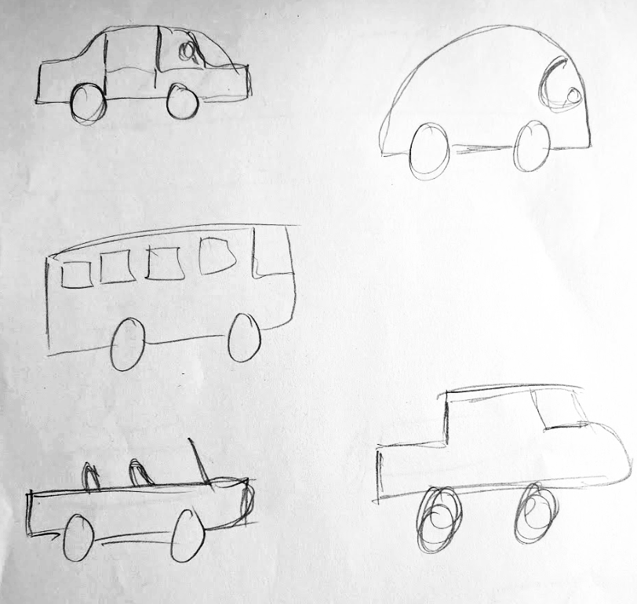
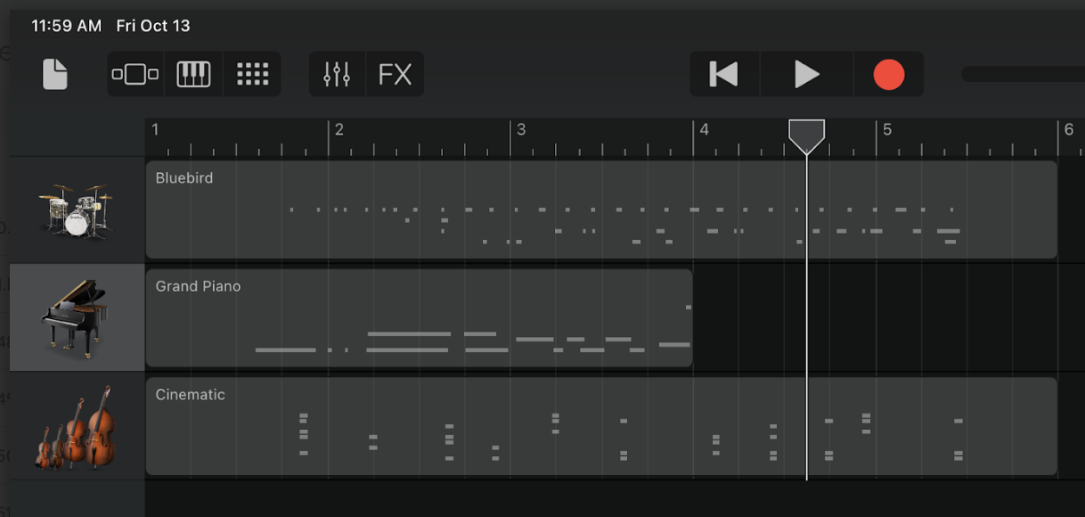

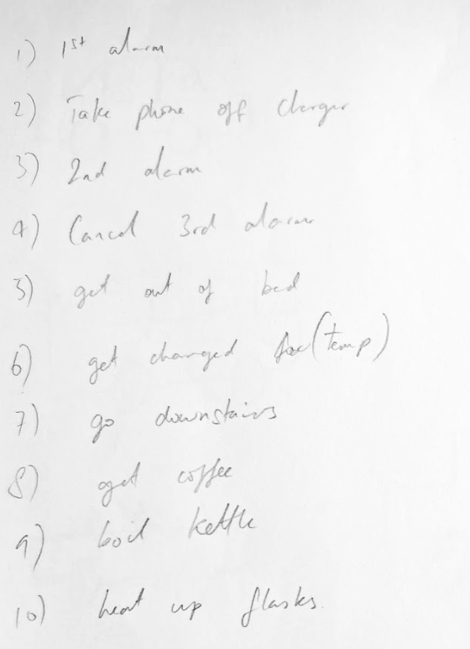
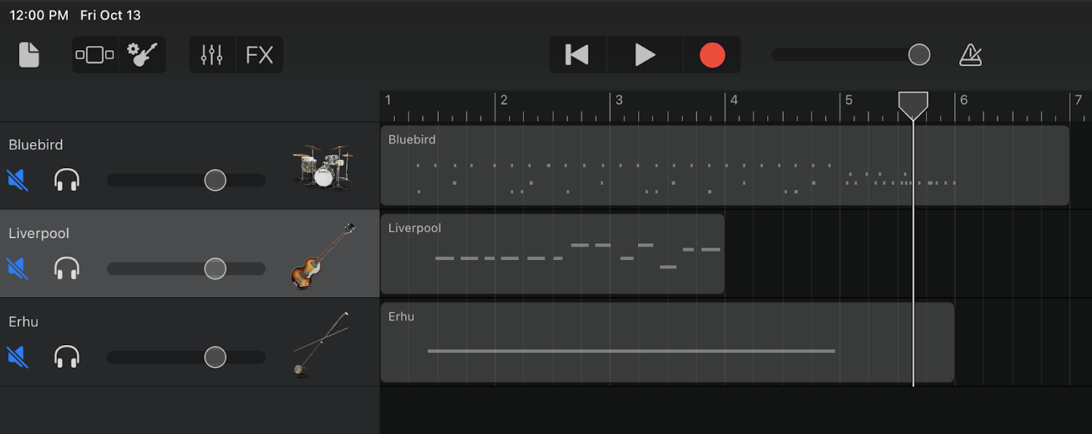
PROTOTYPE 3
Creative tasks
Music making
1
+
2
Tedious tasks
Music making
+

Slide 50
Our findings
🥁
What worked
What didn’t work?
making music felt easier when combined with the tedious tasks
the music making sessions felt too short, like they were getting cut off
New learnings
Going forward
the “breaks” to do tedious tasks took pressure off of music making
balance the tasks and music making without cutting off the creative flow
JAMES
Tech worker
Hobbyist drummer
Notes:
He considered doing the tasks as the breaks from making the music (opposite of the intended experience)

Slide 51
FINAL PROTOTYPE
Listen to personalized music and make music while you journal your emotions
Ethical implications
Privacy, data security, wellness
Who does it serve?
Novice musicians, artists, musical hobbyists
Who might it leave out?
Experienced musicians, people with severe mental health issues

Slide 52
Appendix

Slide 53
Needfinding

Slide 54
Interview Details
Connor
Interviewer: Sophia
Notetaker: Leilenah
Location: In-Person on Campus
Apparatus: Google Docs [transcription]
Discussion Topics:
Engagement with Music:
Motivation in group settings.
Spontaneity vs. Schedule in Music:
Exploration of Music Genres:
Origins of Love for Music:
Using Music to Tell a Story
Creating Playlists for Others
Impact of Songs on Playlists on Memory
Mood and Music Choices:
Managing Emotions with Music
Candice
Interviewer: Ellie
Notetaker: Amy
Location: In-Person on Campus
Apparatus: Google Docs [transcription]
Discussion Topics:
Music as Stress Relief and Emotional Connection
Music Preferences and Genres
Hispanic Music and Its Appeal:
Listening Habits:
Attending Live Music Events:
Experience with Musical Instruments:
Singing as a Form of Self-Expression:
Interest in Pursuing Music Further:
Personal Passion and Career Choice:

Slide 55
POV Ideation
We created 15 different POVs, analyzing them and voting in order to select our final 3.

Slide 56
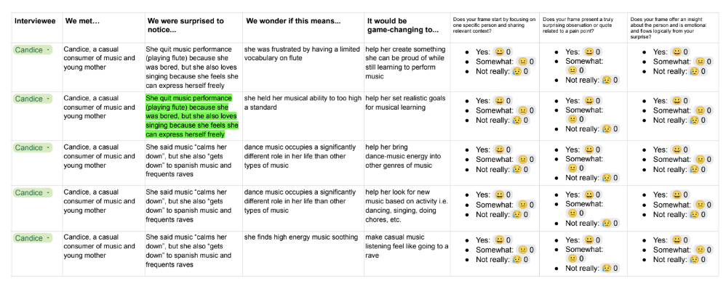

Slide 57
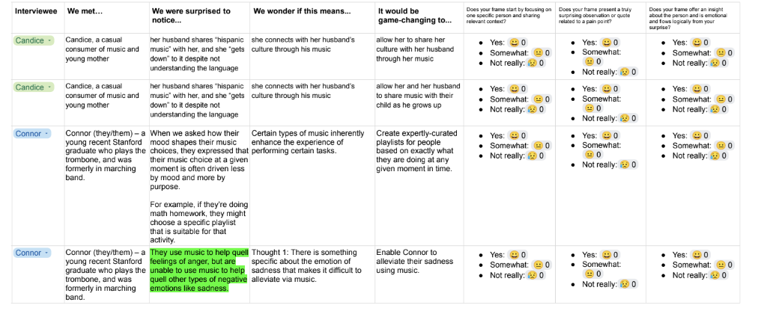

Slide 58
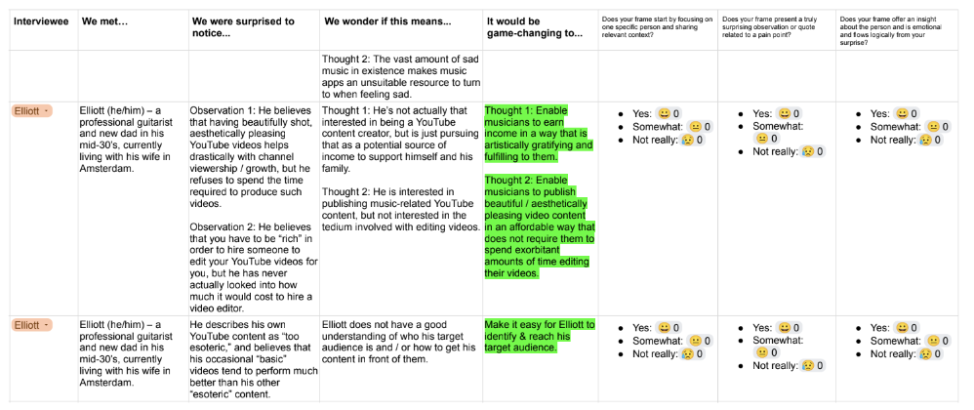

Slide 59
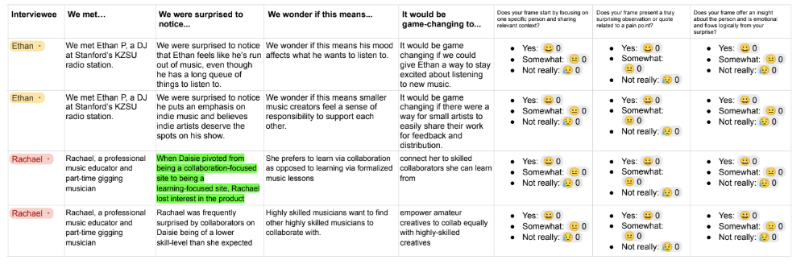

Slide 60
POV #1: Candice

Slide 61
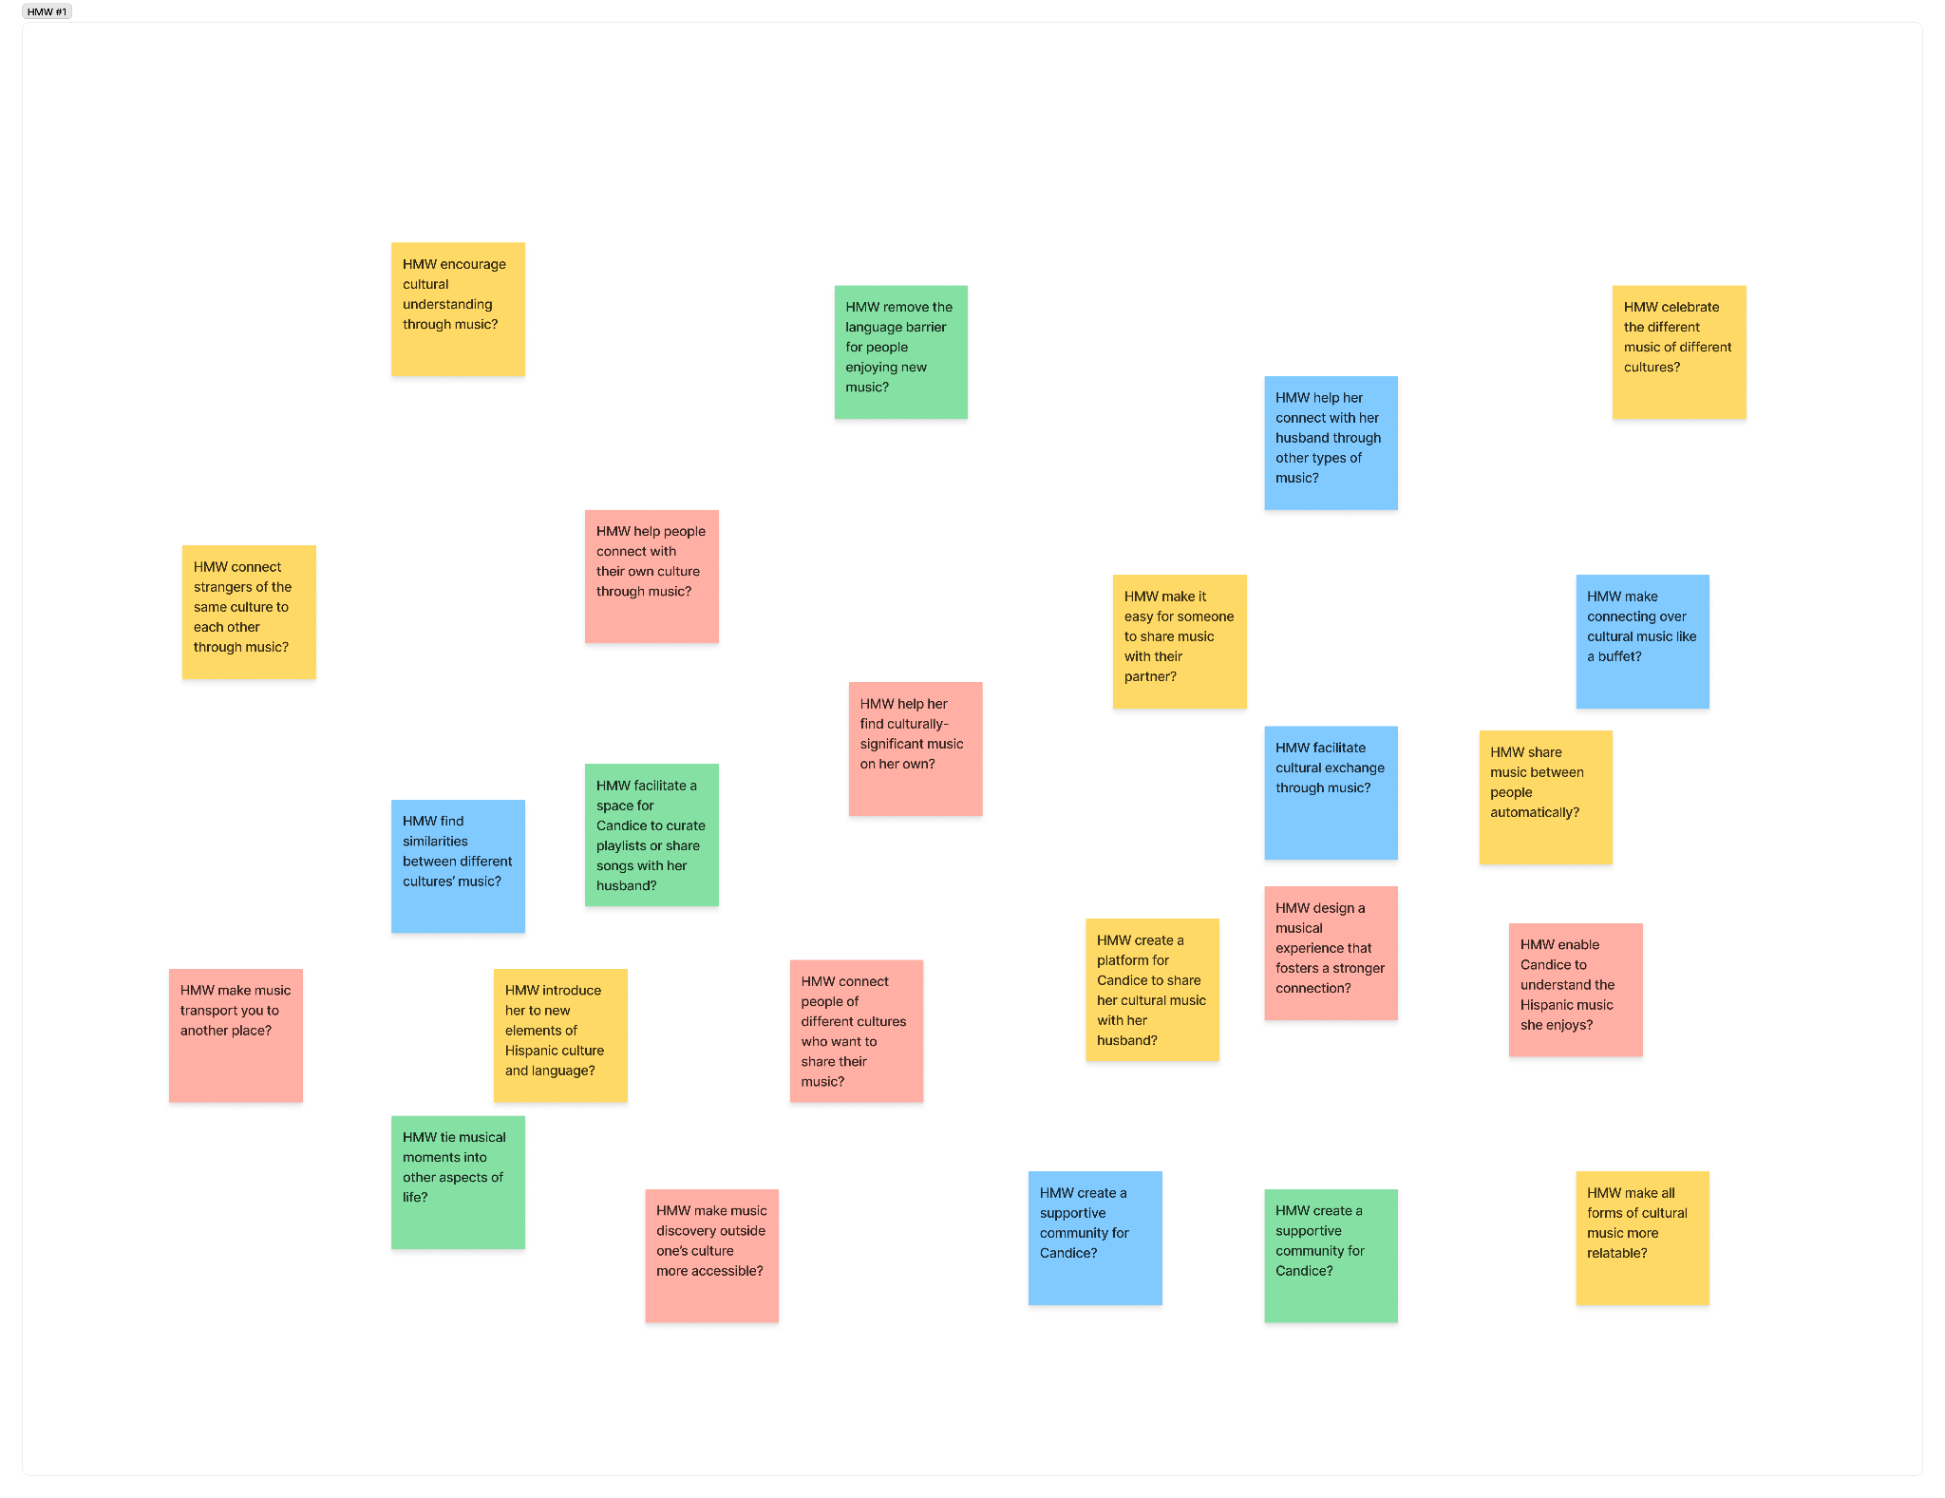
How might we…
25 HMW Questions

Slide 62
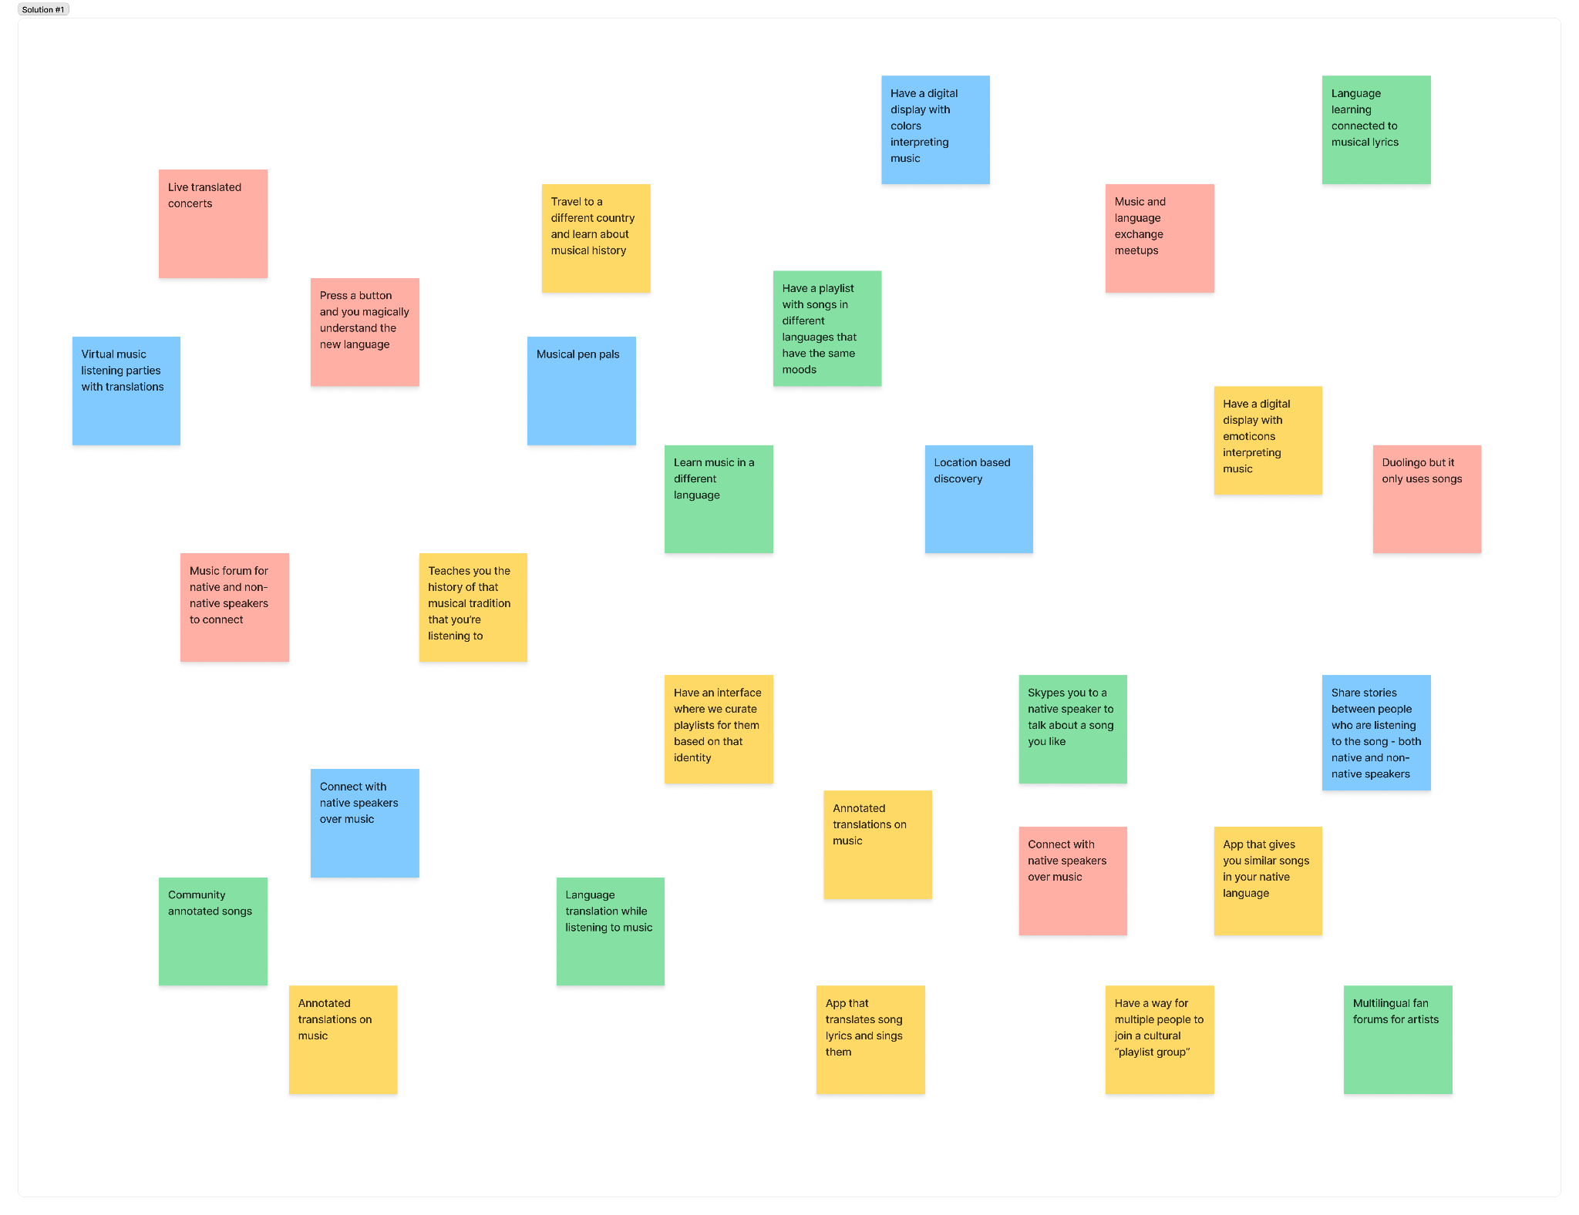
Solution Ideas
28 Ideas

Slide 63
Experience Prototype #1

Slide 64
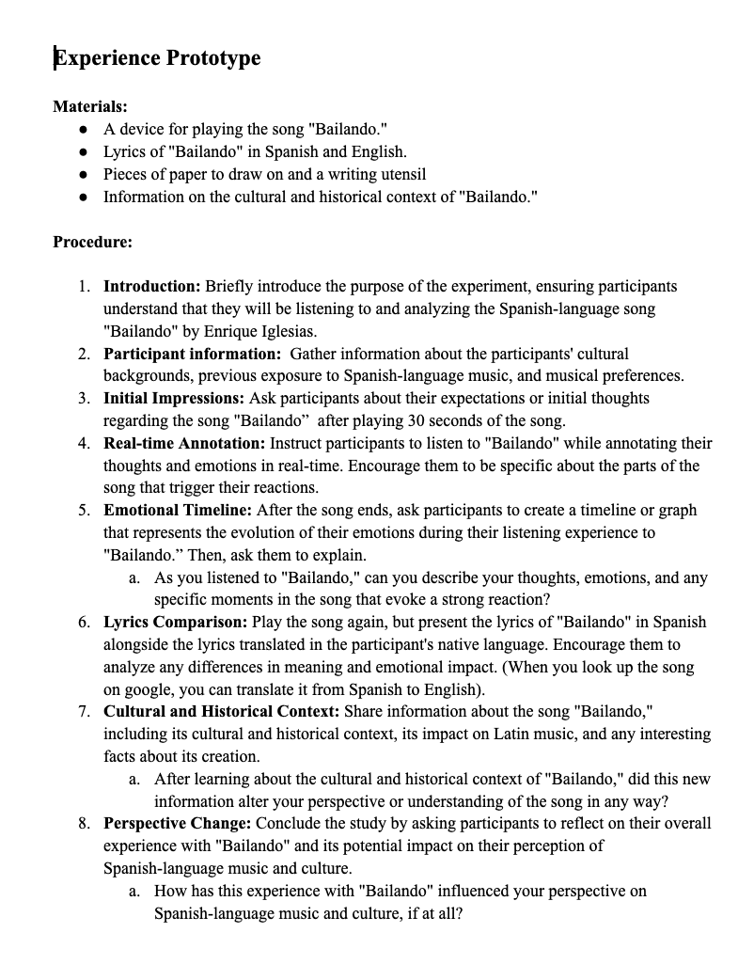
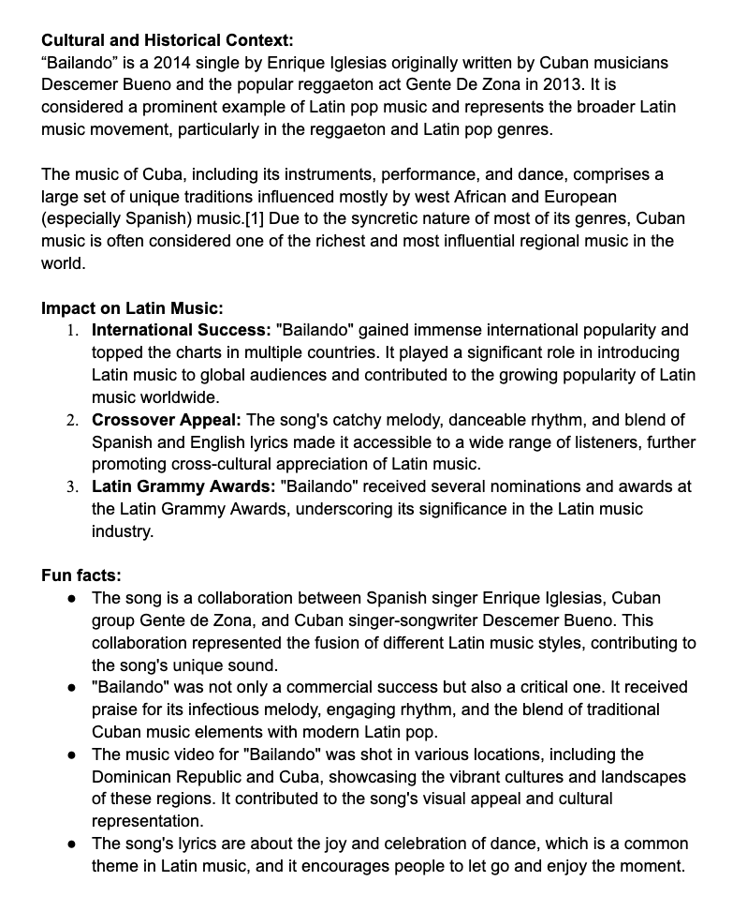

Slide 65
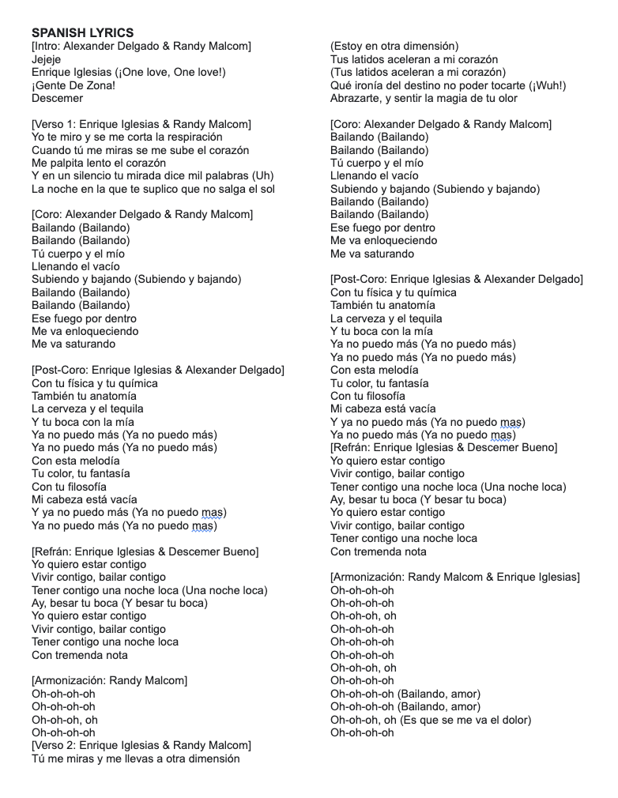
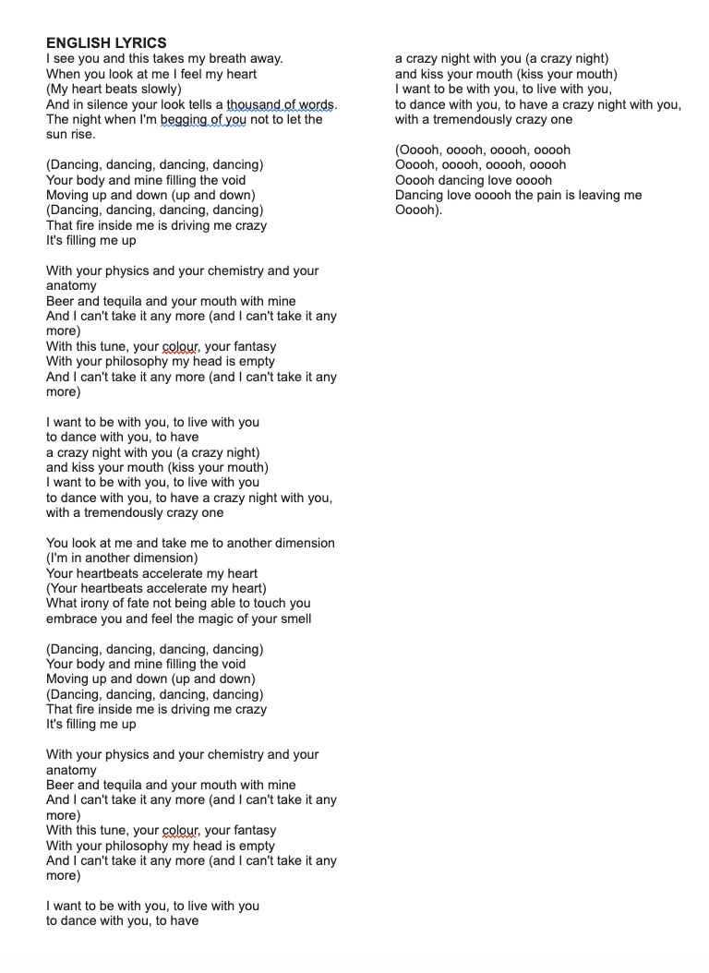

Slide 66
Real-time annotation of song
Graph of emotional timeline

Slide 67
EXPERIENCE PROTOTYPE RESULTS
It would kind of have to be primarily a journal app
  If she’s feeling really emotional she might just put on a playlist and wallow
  Not wanting to put that amount of effort just into picking a song unless she’s in the mood to explore new music or emotions
Maybe some sort of voice memo feature? Since talking about the problems might feel faster/more organic than journaling
Journaling could lead to the NLP only suggesting songs that help with wallowing
She would want a way to filter through genres and specific songs before starting
  Ex. knows she’s going to write about a breakup and being sad but not wanting to hear love songs that are too specific
  Ex. wanting to exclude songs her ex-partner showed her
Notes:
It would kind of have to be primarily a journal app
If she’s feeling really emotional she might just put on a playlist and wallow
Not wanting to put that amount of effort just into picking a song unless she’s in the mood to explore new music or emotions
Maybe some sort of voice memo feature? Since talking about the problems might feel faster/more organic than journaling
Journaling could lead to the NLP only suggesting songs that help with wallowing
She would want a way to filter through genres and specific songs before starting
Ex. knows she’s going to write about a breakup and being sad but not wanting to hear love songs that are too specific
Ex. wanting to exclude songs her ex-partner showed her
Current mood:
1950 - King Princess:
Fits the situation
Feels very sad
Feels like her ex is going to come back
Lost My Mind - Finneas
Made her more sad
Was too similar/specific
Ideal Mood:
Call Me On Your Way Home - Emily James
Doesn’t exactly fit the situation with the lyrics, but they fit where she wants to be
Reminded her of someone else (not her ex that she was heartbroken over)
Friend who moved far away
Thinking of other experiences + her current situation led to positive and negative feelings
She listens to this song a lot since a lot of her friends have moved away since graduation
Made her think back at previous experiences and reflect that this was something she can handle
Colors - Ava Maybee
Its the sentiment she wants, but not the vibe
Reminds her of something her ex would’ve liked so it still made her sad even tho it was so different than everything else lol

Slide 68
POV #2: Connor

Slide 69
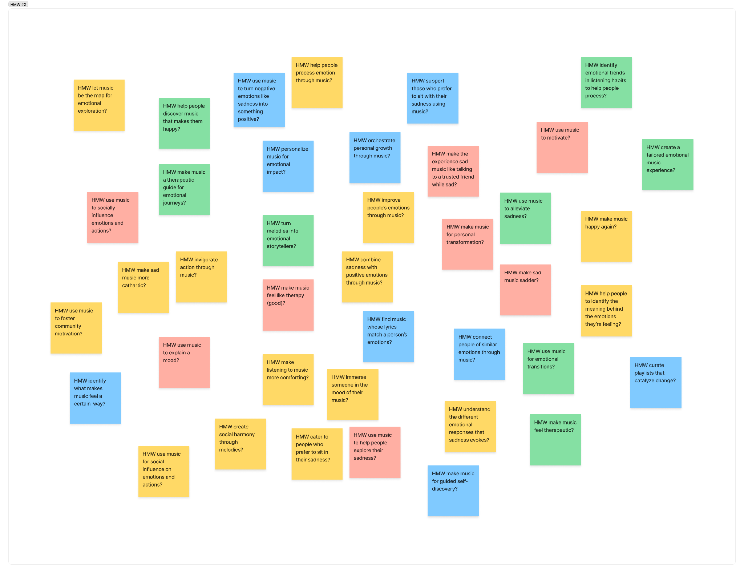
How might we…
40 HMW

Slide 70
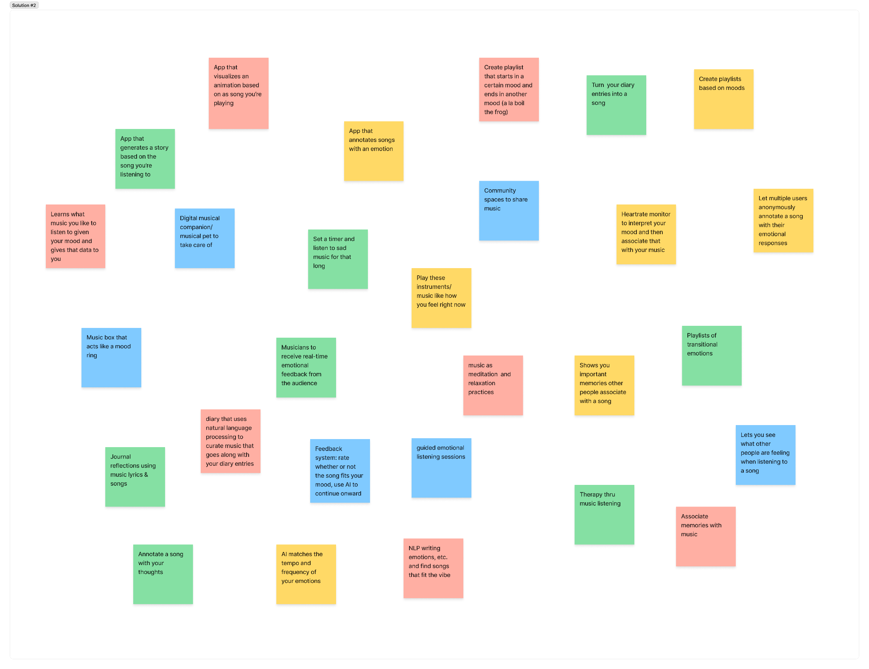
Solution Ideas
28 Solutions

Slide 71
Experience Prototype #2

Slide 72
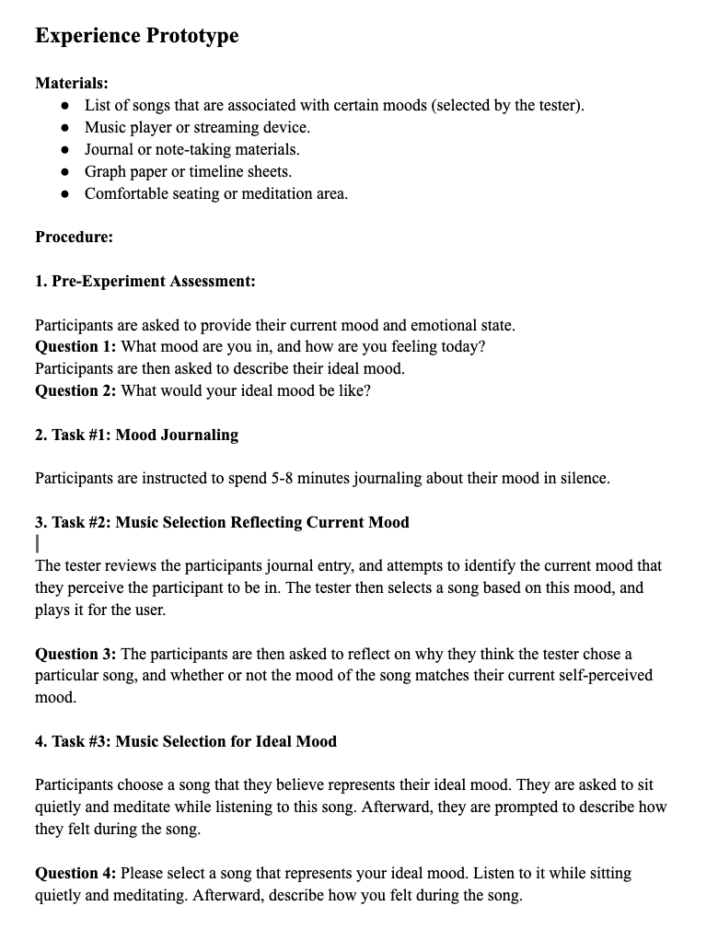

Slide 73
EXPERIMENT PROCEDURE
USER BEHAVIOR
Pre-experiment assessment
Mood journaling
Music selection for current mood
Music selection for ideal mood
Currently: “fine” but recently broken up with
Ideally: knowing she’ll be able to move on
Wrote a lot about the breakup, even though it wasn’t necessarily on her mind before
Lyrics fit too well, made her want to wallow in sadness and get sadder
Lyrics fit where she wanted to be and reminded her of previous experiences where she was okay
One song sounded like “something [her ex] would’ve liked”
Notes:
Experience Prototype
Materials:
List of songs that are associated with certain moods (selected by the tester).
Music player or streaming device.
Journal or note-taking materials.
Graph paper or timeline sheets.
Comfortable seating or meditation area.
Procedure:
1. Pre-Experiment Assessment:
Participants are asked to provide their current mood and emotional state.
Question 1: What mood are you in, and how are you feeling today?
Participants are then asked to describe their ideal mood.
Question 2: What would your ideal mood be like?
2. Task #1: Mood Journaling
Participants are instructed to spend 5-8 minutes journaling about their mood in silence.
3. Task #2: Music Selection Reflecting Current Mood
The tester reviews the participants journal entry, and attempts to identify the current mood that they perceive the participant to be in. The tester then selects a song based on this mood, and plays it for the user.
Question 3: The participants are then asked to reflect on why they think the tester chose a particular song, and whether or not the mood of the song matches their current self-perceived mood.
4. Task #3: Music Selection for Ideal Mood
Participants choose a song that they believe represents their ideal mood. They are asked to sit quietly and meditate while listening to this song. Afterward, they are prompted to describe how they felt during the song.
Question 4: Please select a song that represents your ideal mood. Listen to it while sitting quietly and meditating. Afterward, describe how you felt during the song.
Notes:

Slide 74
EXPERIENCE PROTOTYPE RESULTS
Enjoyed the experience
Thought it would be best for the purpose of music exploration or emotional exploration
  Would prefer something simple in times of “emotional crisis”
Would enjoy a speech-to-text or voice memo feature
Would want to filter genres and specific songs
  Didn’t want any love songs
  Certain songs reminded her of her ex
Songs based on her current mood (which is all she journaled about) would have encouraged her to stay sad, but she wasn’t in the mood to write about her ideal feelings
Notes:
It would kind of have to be primarily a journal app
If she’s feeling really emotional she might just put on a playlist and wallow
Not wanting to put that amount of effort just into picking a song unless she’s in the mood to explore new music or emotions
Maybe some sort of voice memo feature? Since talking about the problems might feel faster/more organic than journaling
Journaling could lead to the NLP only suggesting songs that help with wallowing
She would want a way to filter through genres and specific songs before starting
Ex. knows she’s going to write about a breakup and being sad but not wanting to hear love songs that are too specific
Ex. wanting to exclude songs her ex-partner showed her
Current mood:
1950 - King Princess:
Fits the situation
Feels very sad
Feels like her ex is going to come back
Lost My Mind - Finneas
Made her more sad
Was too similar/specific
Ideal Mood:
Call Me On Your Way Home - Emily James
Doesn’t exactly fit the situation with the lyrics, but they fit where she wants to be
Reminded her of someone else (not her ex that she was heartbroken over)
Friend who moved far away
Thinking of other experiences + her current situation led to positive and negative feelings
She listens to this song a lot since a lot of her friends have moved away since graduation
Made her think back at previous experiences and reflect that this was something she can handle
Colors - Ava Maybee
Its the sentiment she wants, but not the vibe
Reminds her of something her ex would’ve liked so it still made her sad even tho it was so different than everything else lol

Slide 75
POV #3: Elliott

Slide 76
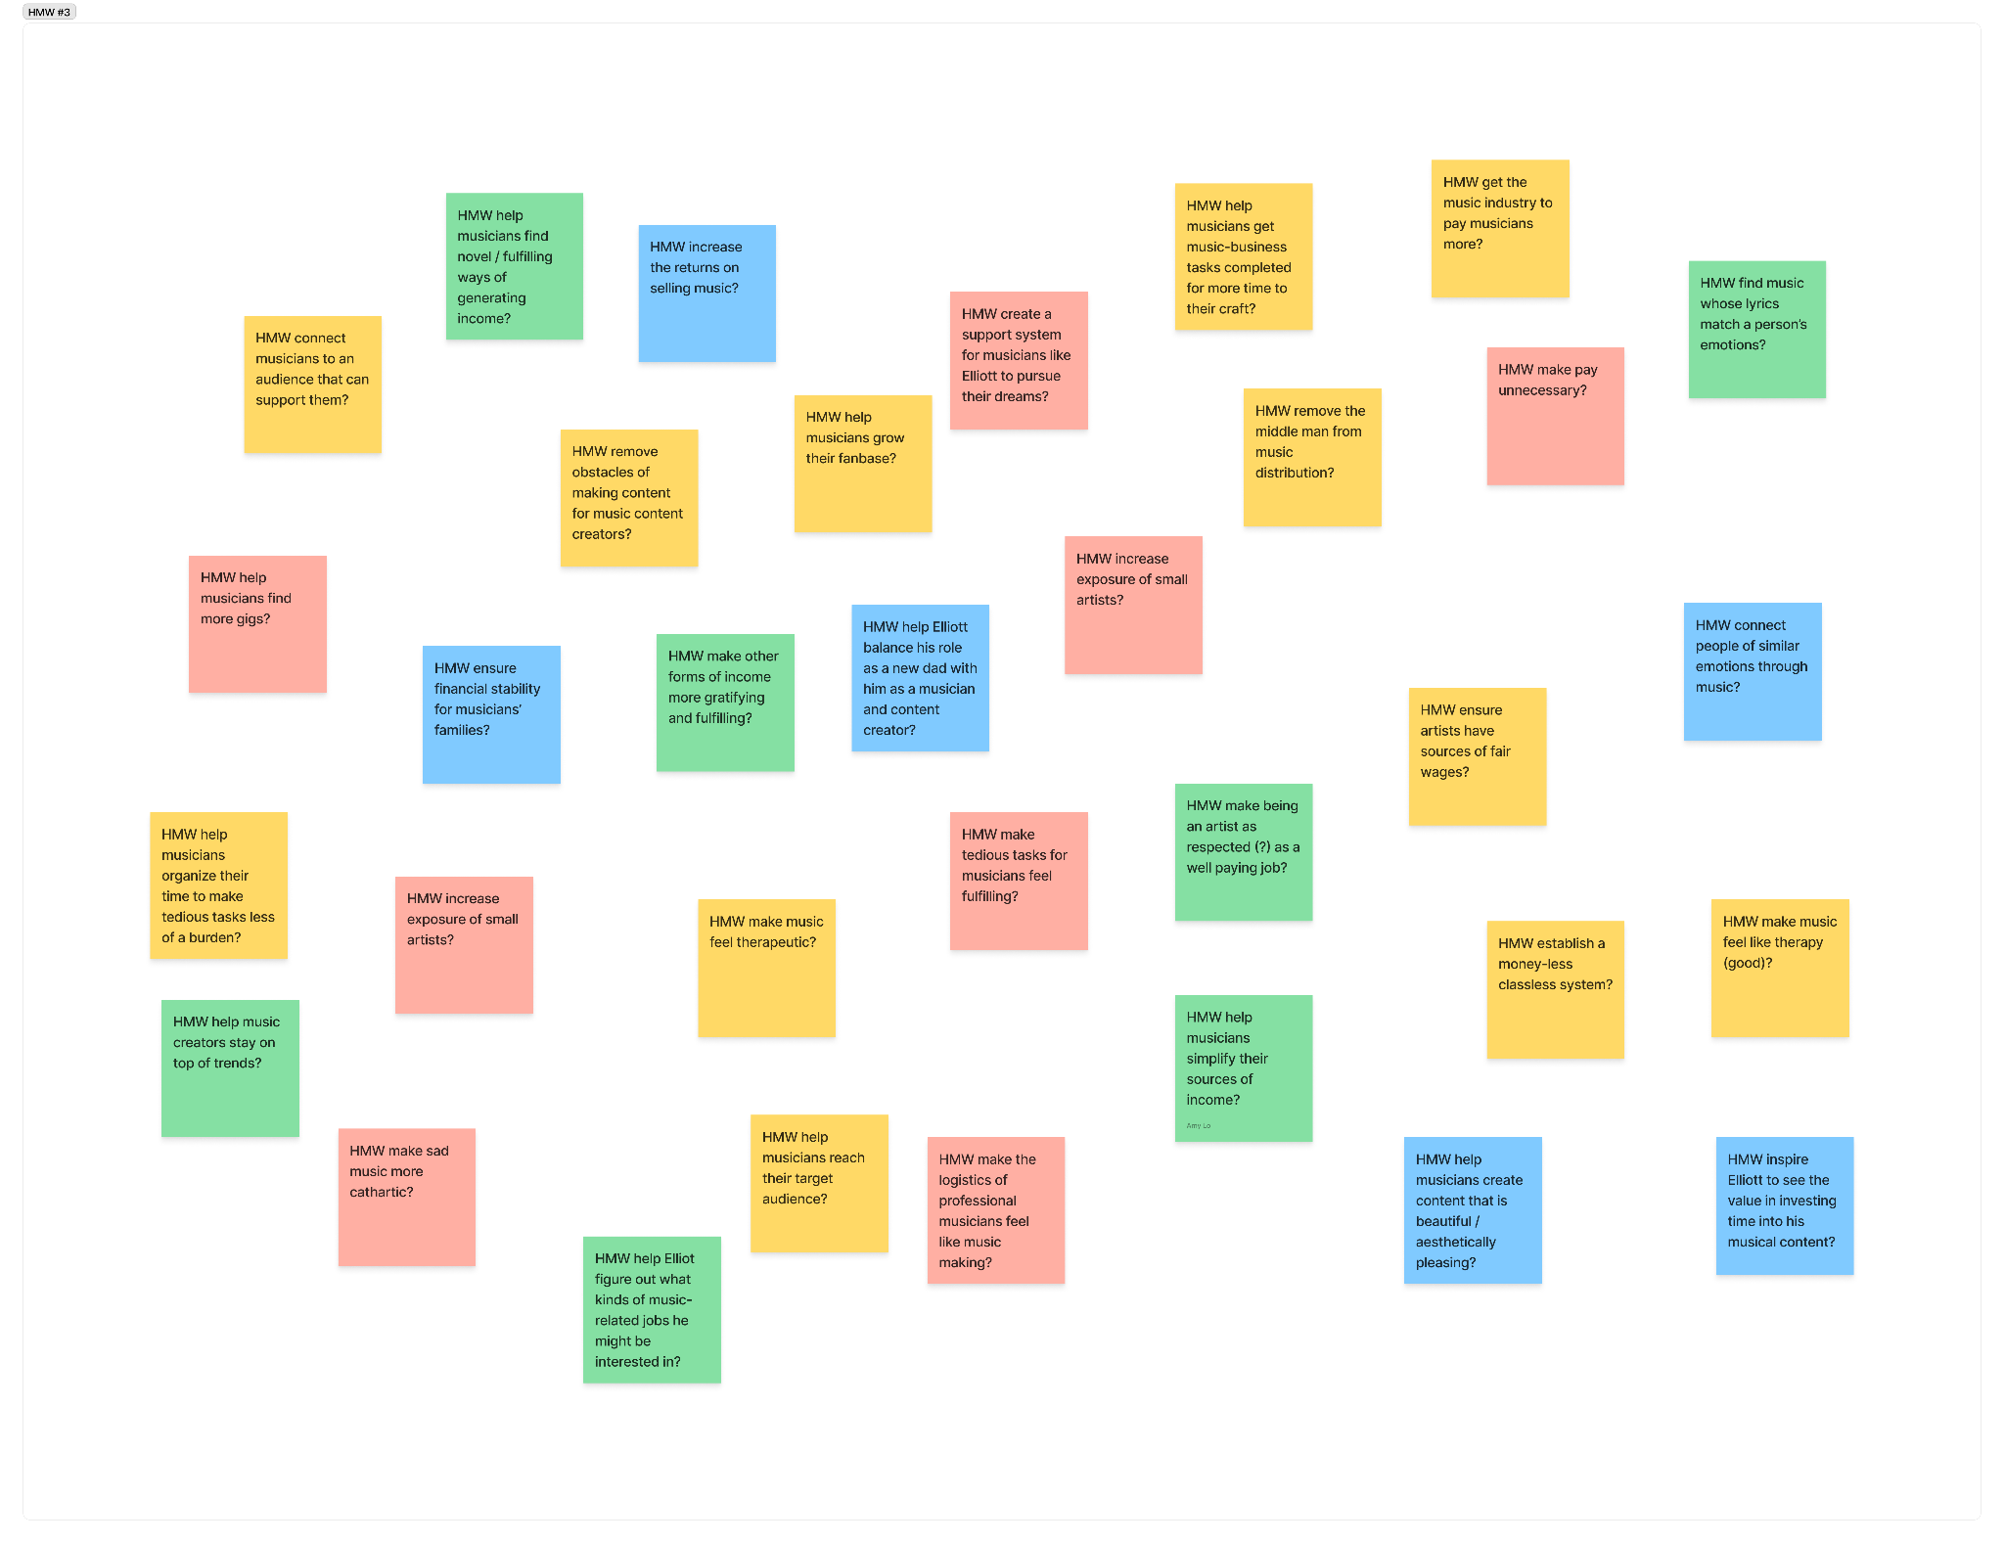
How might we…
33 HMWs

Slide 77
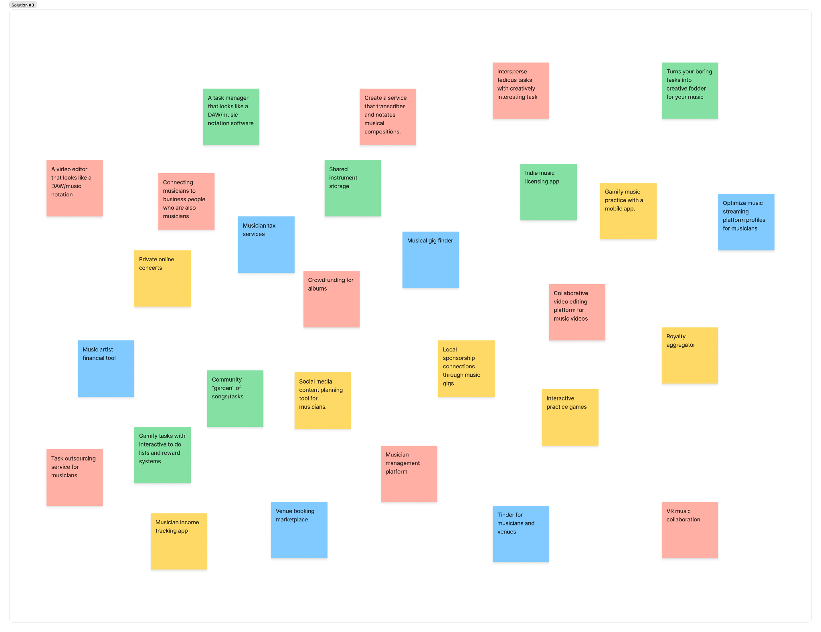
Solution Ideas
28 Ideas

Slide 78
Experience Prototype #3

Slide 79
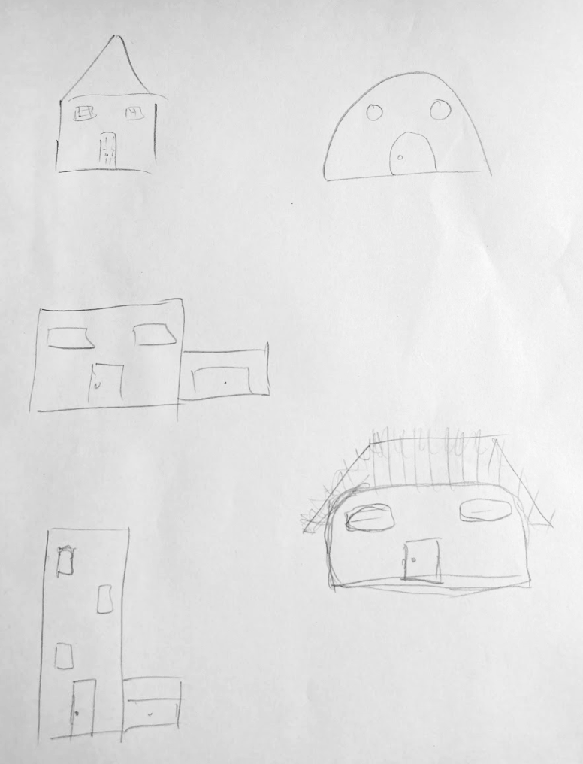
PROTOTYPE 3
Drawing
Music making
1
+
2
Tedious tasks
Music making
+

Slide 80
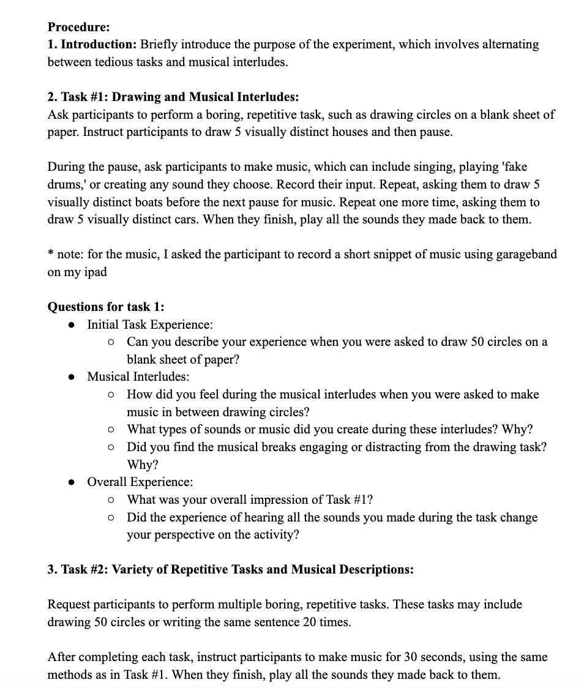
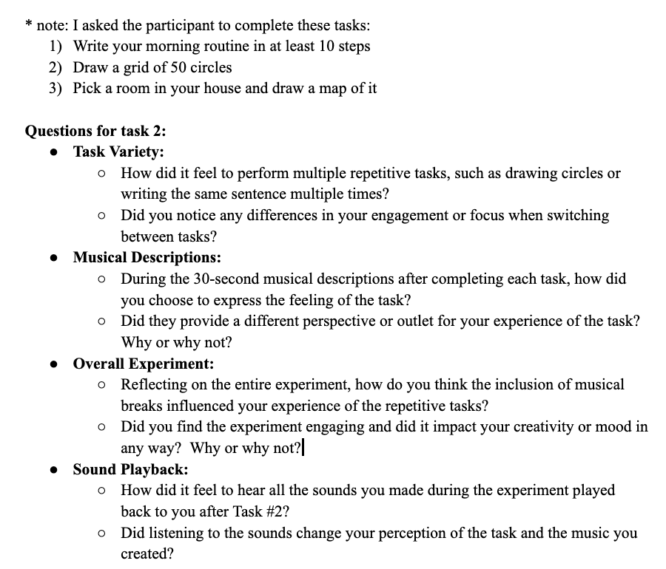

Slide 81
EXPERIENCE PROTOTYPE RESULTS
It would kind of have to be primarily a journal app
  If she’s feeling really emotional she might just put on a playlist and wallow
  Not wanting to put that amount of effort just into picking a song unless she’s in the mood to explore new music or emotions
Maybe some sort of voice memo feature? Since talking about the problems might feel faster/more organic than journaling
Journaling could lead to the NLP only suggesting songs that help with wallowing
She would want a way to filter through genres and specific songs before starting
  Ex. knows she’s going to write about a breakup and being sad but not wanting to hear love songs that are too specific
  Ex. wanting to exclude songs her ex-partner showed her
Notes:
It would kind of have to be primarily a journal app
If she’s feeling really emotional she might just put on a playlist and wallow
Not wanting to put that amount of effort just into picking a song unless she’s in the mood to explore new music or emotions
Maybe some sort of voice memo feature? Since talking about the problems might feel faster/more organic than journaling
Journaling could lead to the NLP only suggesting songs that help with wallowing
She would want a way to filter through genres and specific songs before starting
Ex. knows she’s going to write about a breakup and being sad but not wanting to hear love songs that are too specific
Ex. wanting to exclude songs her ex-partner showed her
Current mood:
1950 - King Princess:
Fits the situation
Feels very sad
Feels like her ex is going to come back
Lost My Mind - Finneas
Made her more sad
Was too similar/specific
Ideal Mood:
Call Me On Your Way Home - Emily James
Doesn’t exactly fit the situation with the lyrics, but they fit where she wants to be
Reminded her of someone else (not her ex that she was heartbroken over)
Friend who moved far away
Thinking of other experiences + her current situation led to positive and negative feelings
She listens to this song a lot since a lot of her friends have moved away since graduation
Made her think back at previous experiences and reflect that this was something she can handle
Colors - Ava Maybee
Its the sentiment she wants, but not the vibe
Reminds her of something her ex would’ve liked so it still made her sad even tho it was so different than everything else lol

