Slide 1
Assignment 1: Needfinding
Team SEAL:
Sophia, Ellie, Amy & Leilenah

Slide 2
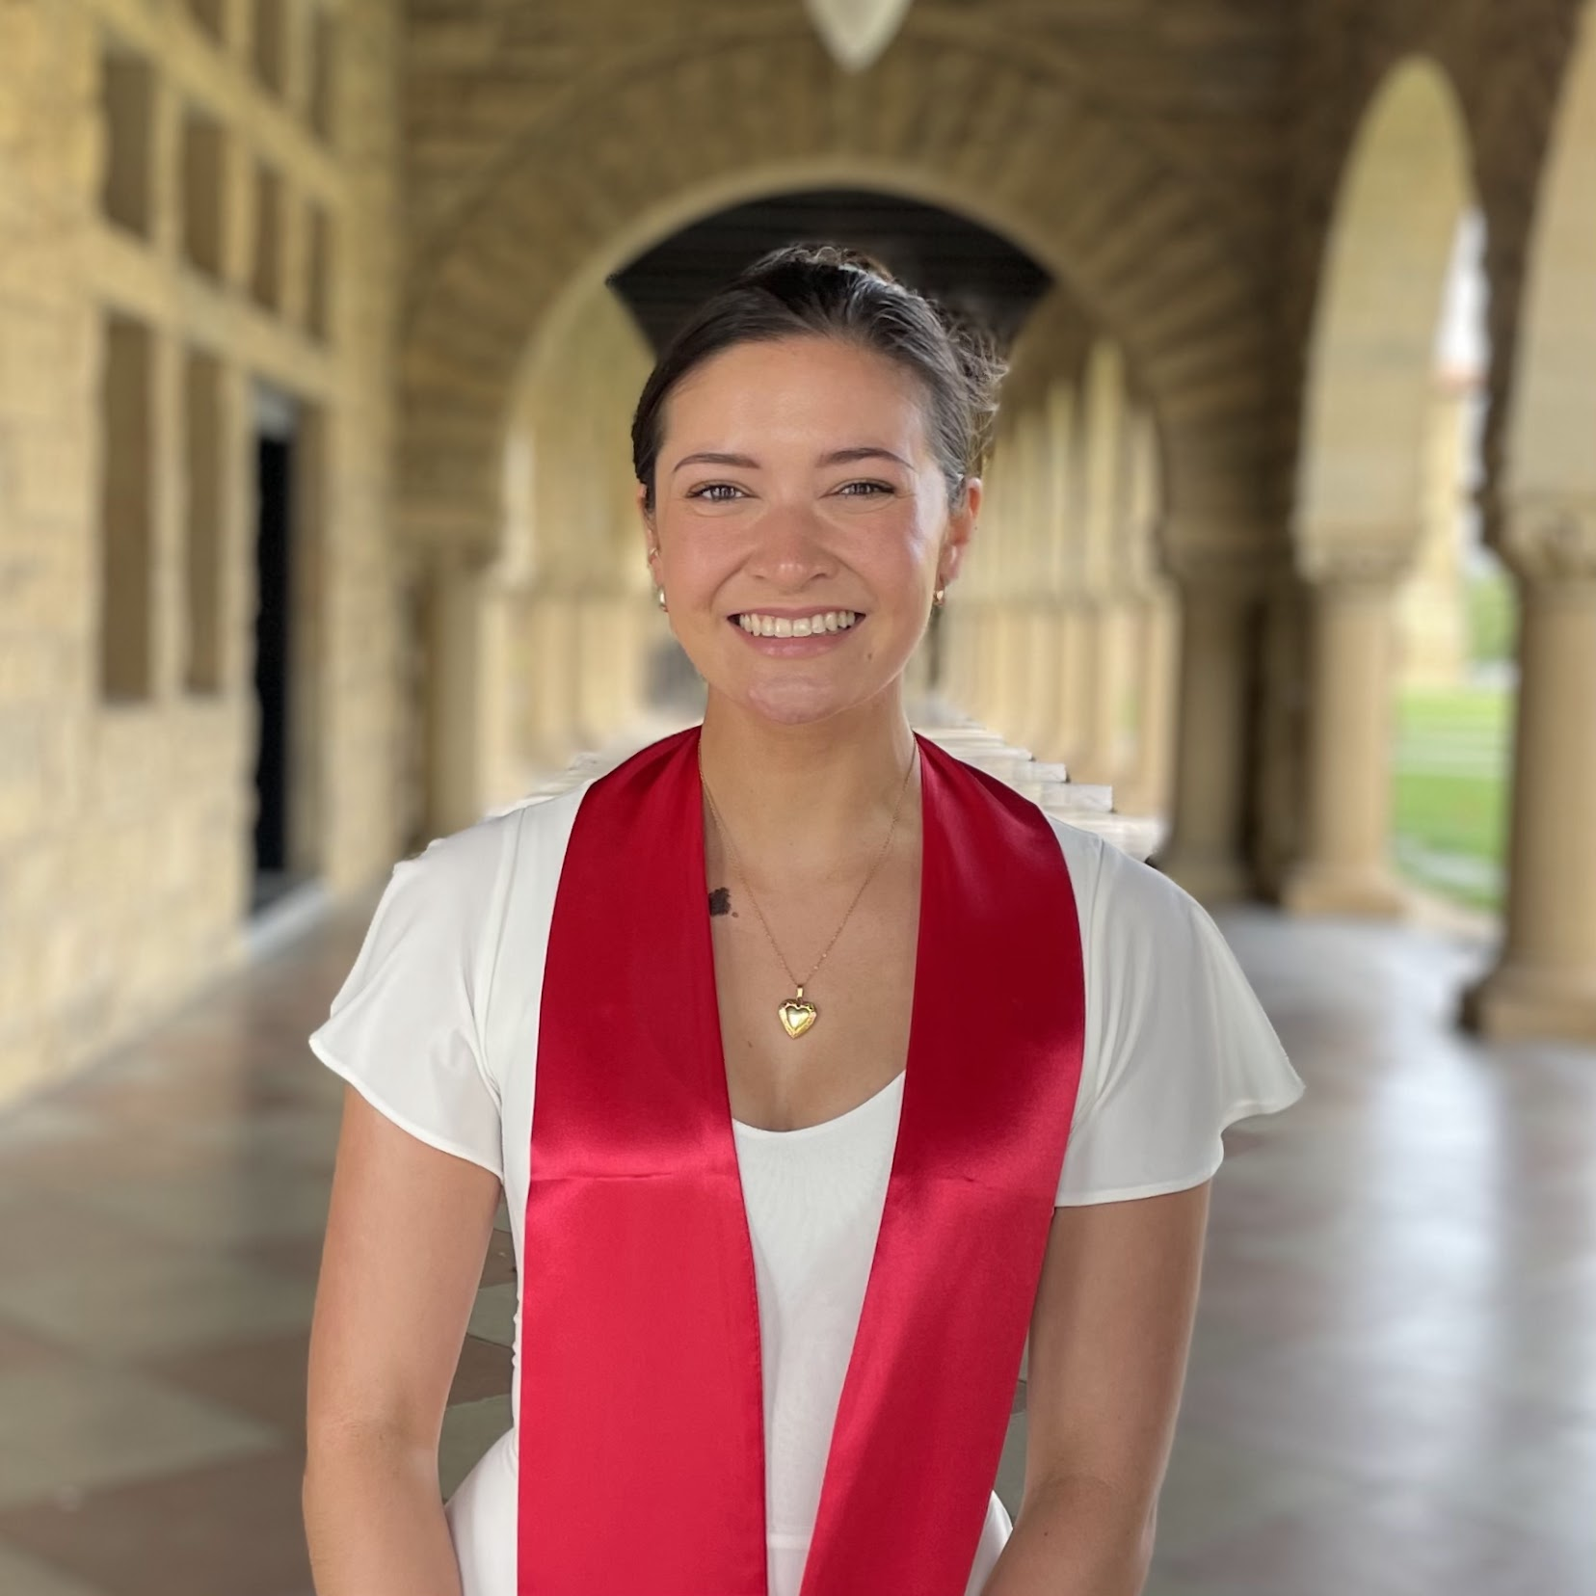
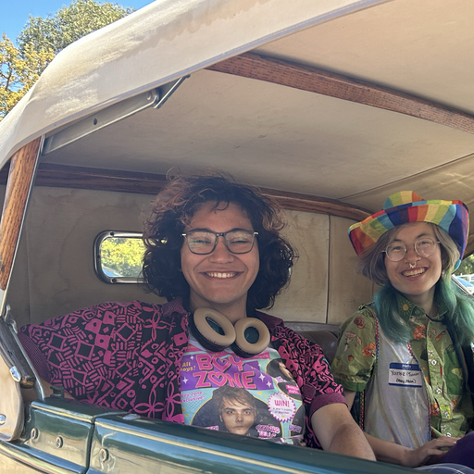

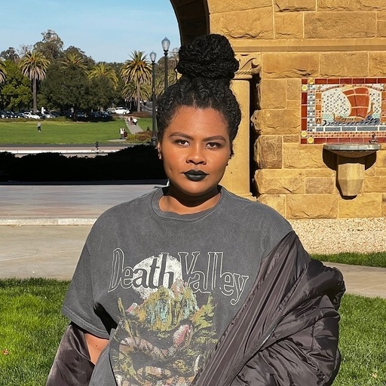
Team SEAL 🦭
Sophia Ramsey
Ellie
Vela
Amy
Lo
Leilenah Mamea

Slide 3

Problem Domain
People who play and / or produce music.
Notes:
All 4 of us seemed to be generally interested in exploring various ways that musicians can collaborate with one another.
We thought that focusing our problem domain specifically on people who create music might lead to an interesting problem for us to try to solve.
Ellie is a musician, so it’s helpful to have an insider in that regard on our team.

Slide 4
Looking for Participants
Background
in Music
Plays 1 or More Instruments
Variety of Music
Careers
Variety of
Experience

Slide 5


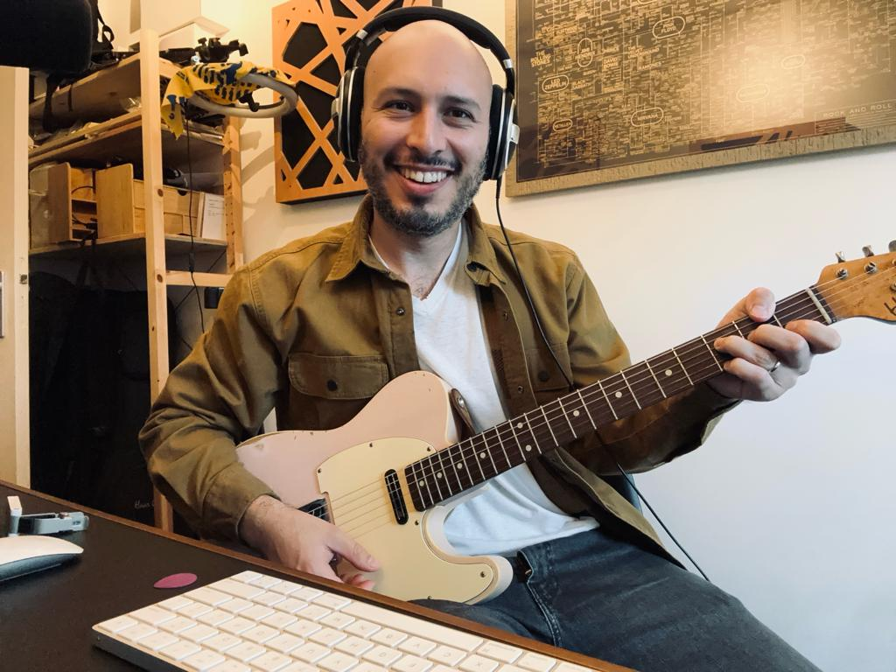
Interviewees
extreme
Ethan
Radio DJ on KZSU Stanford 90.1 FM
Rachael
Band Director,
Casual musician
Elliott
Professional Guitarist, Music YouTuber & Teacher
Notes:
Grader Notes
Between these 3 interviewees, we had a nice mix of backgrounds / experiences
While all 3 fit under the category of “musician,” they all do very different things
Each person is an acquaintance of one of the team members, so recruiting wasn’t a big obstacle
Elliott was our extreme user
professional guitarist (actively does gigs)
classically trained (Master’s degree in Music from USC)
he runs a YouTube channel dedicated to guitar content
he teaches/plays music

Slide 6
We asked them…
What problems do
you face when collaborating?
What setting are you typically in when you’re creating music?
What music are you listening to these days?
What do you think and feel when you play/make music?
Can you tell us a story of when you discovered a significant piece of music in your life?
Notes:
High-level Question Topics
Delved into their background a bit
Music collaboration
Music creation process
Music discovery
Sharing of music

Slide 7
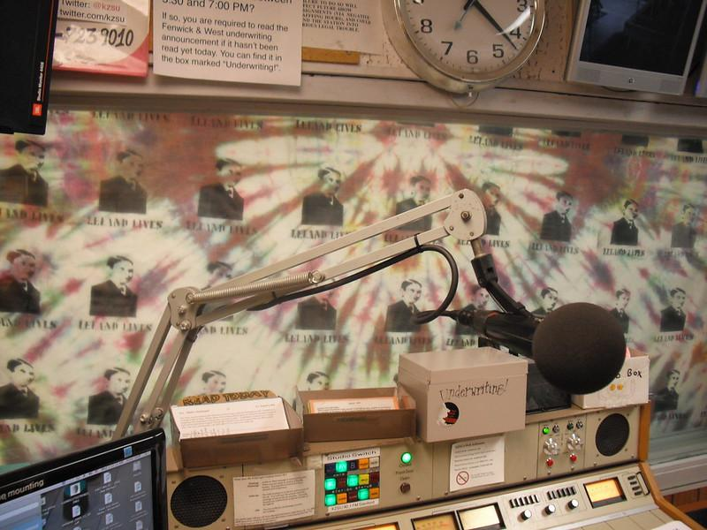

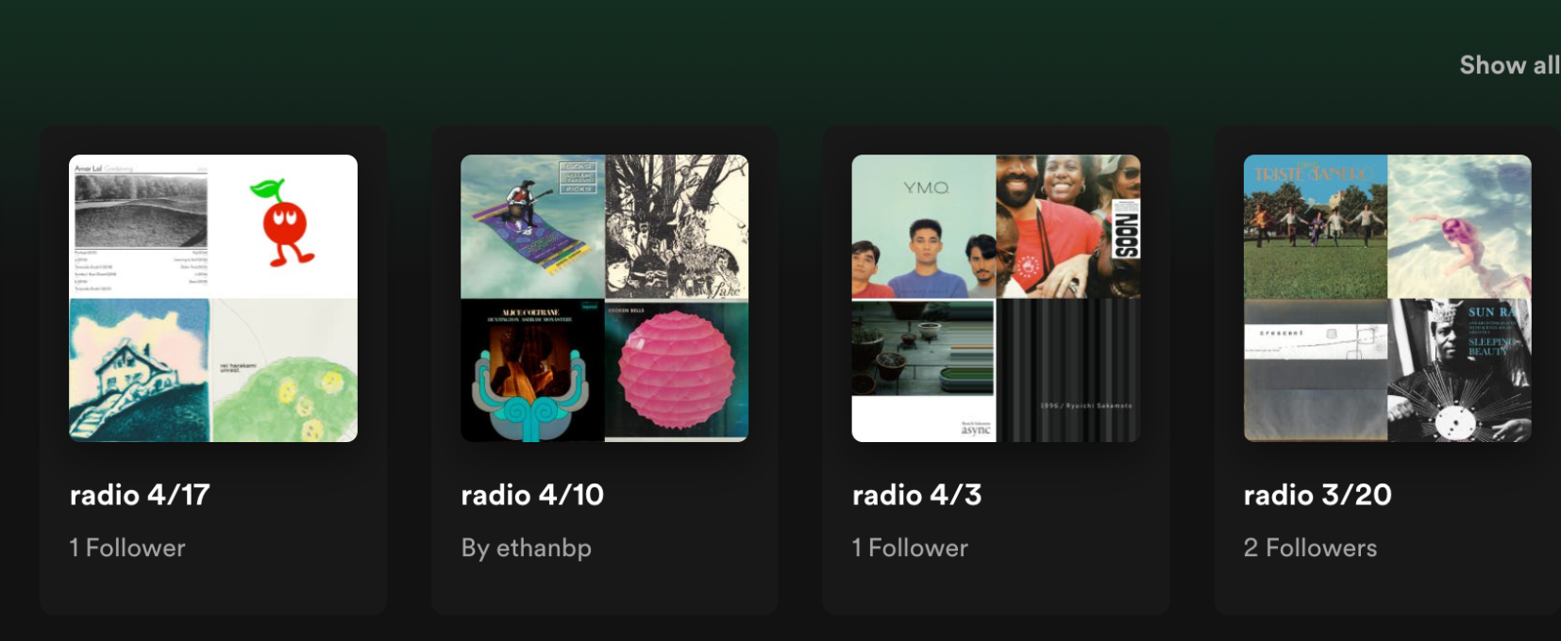
Ethan
Radio DJ on KZSU Stanford 90.1 FM
–
Notes:
“I was interested in having a show and curating music for other people to enjoy. I was very much looking forward to a community of other people who liked music.”

Slide 8
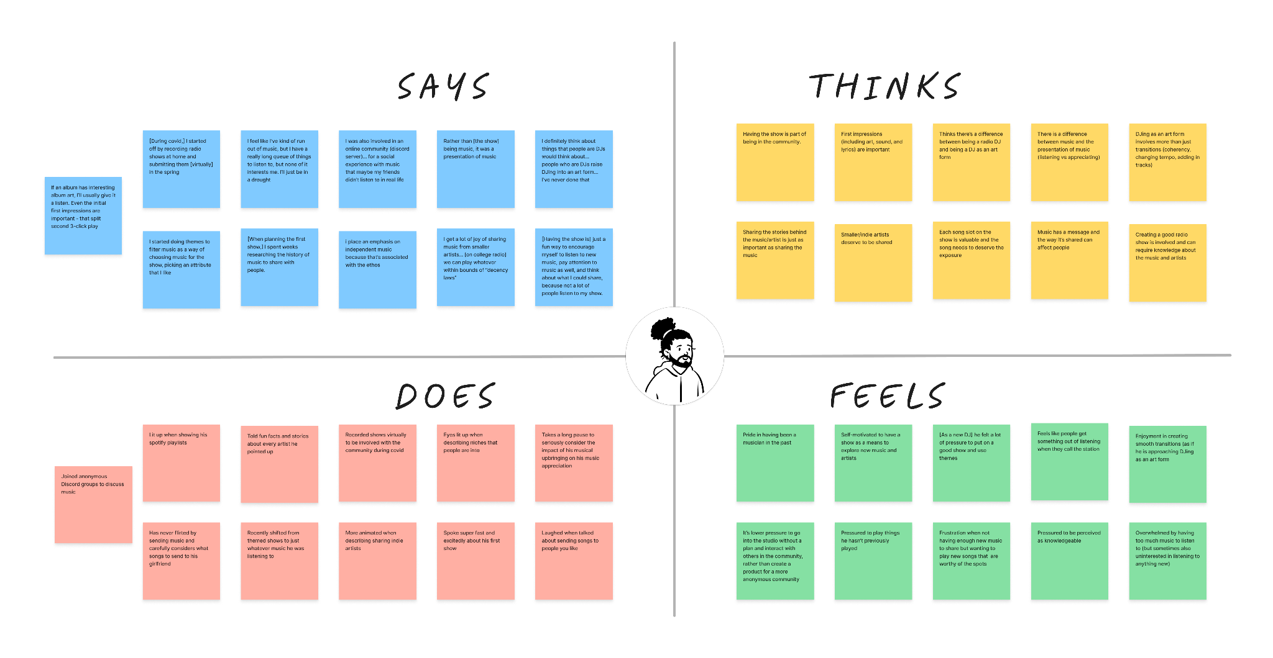
Empathy Map: Ethan

Slide 9
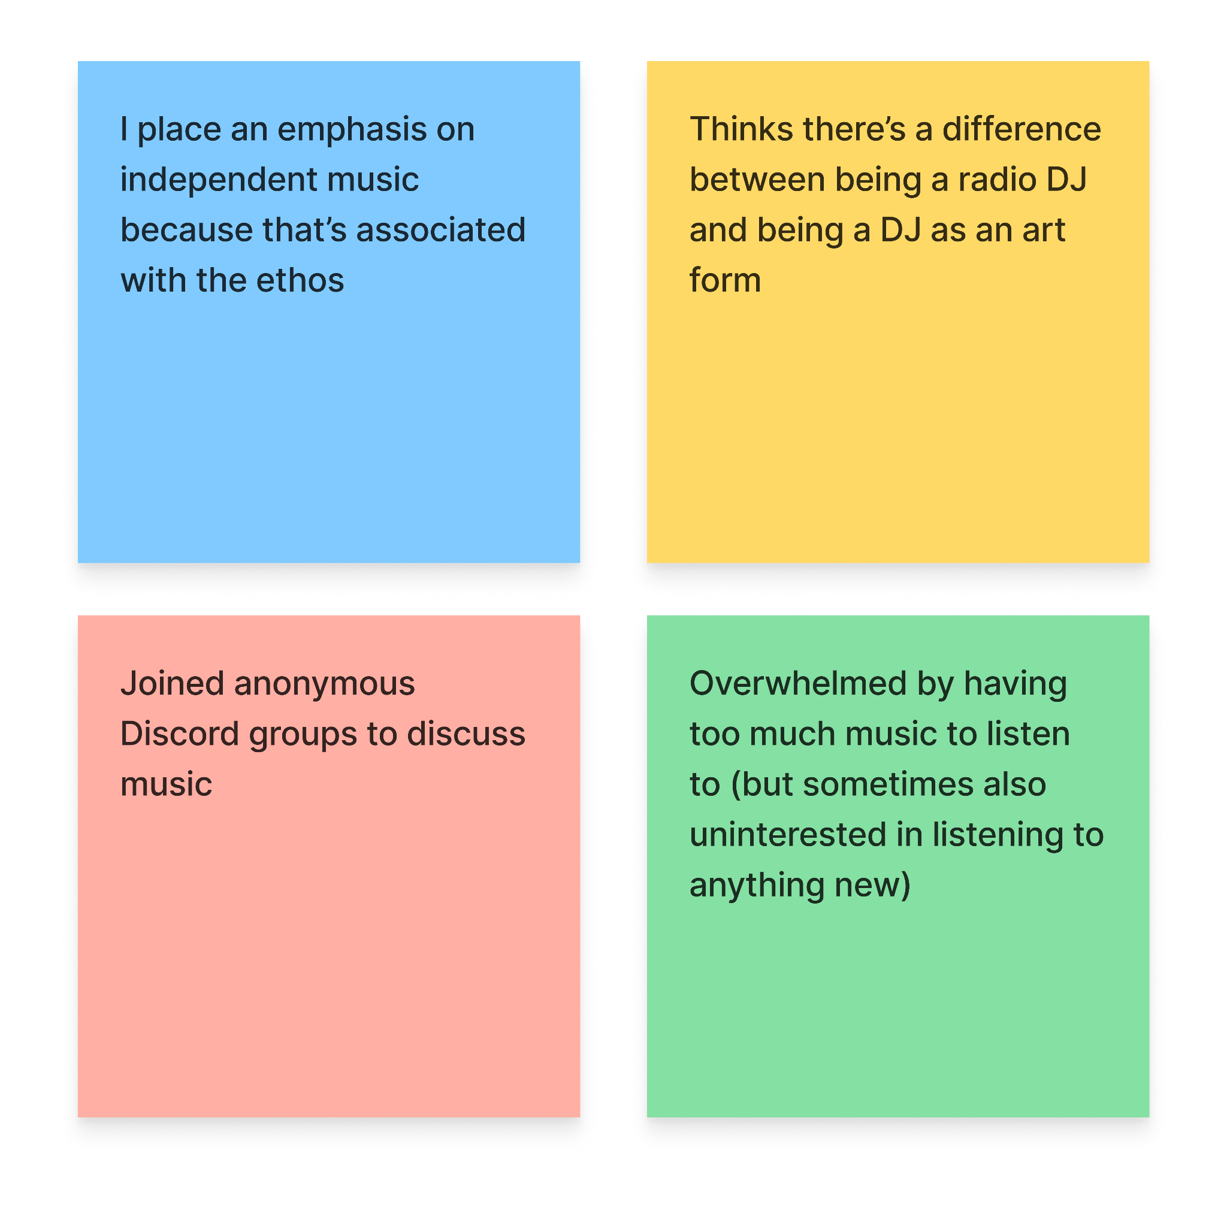
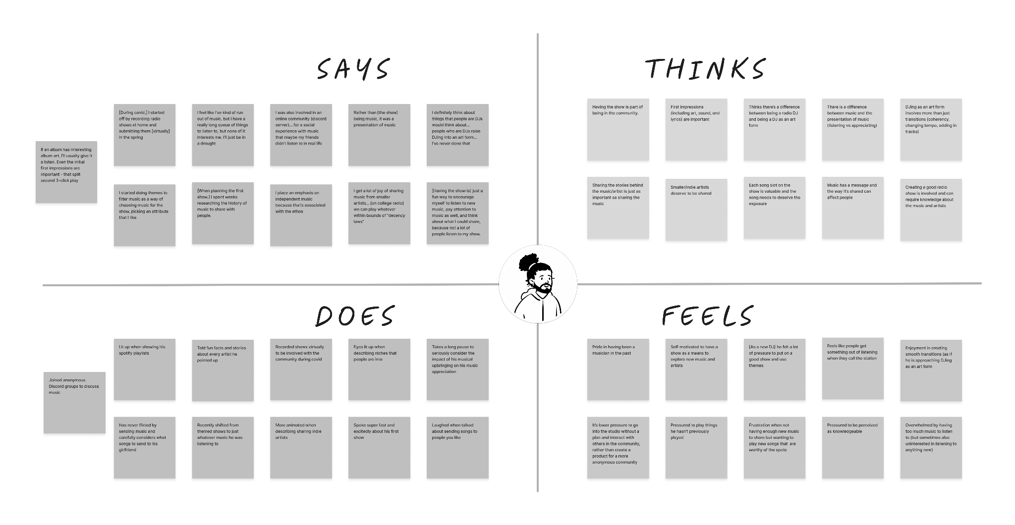
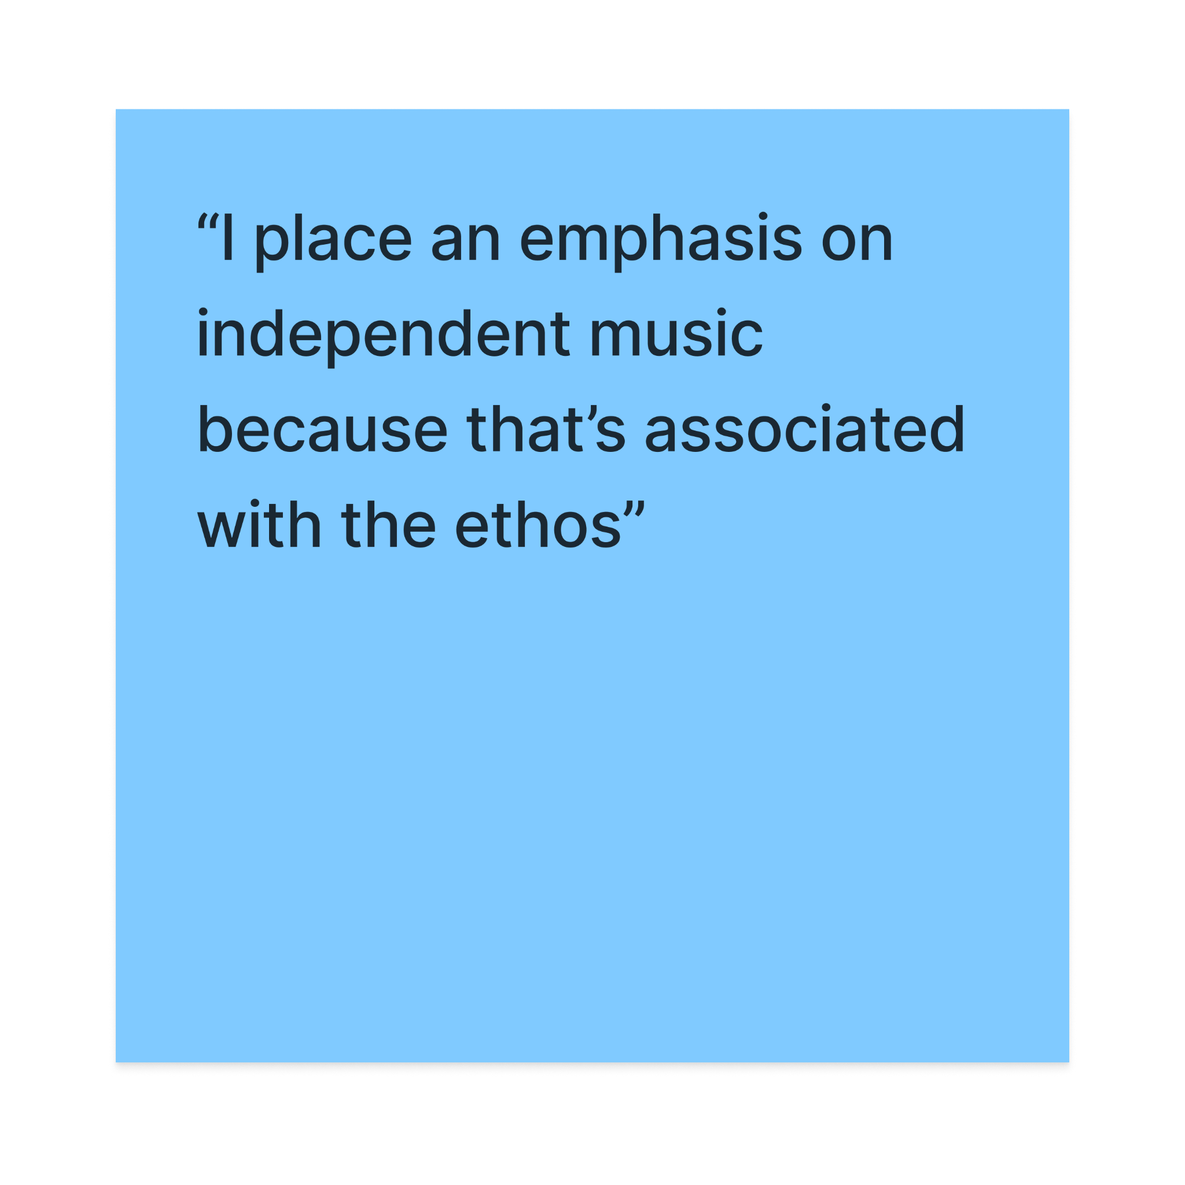
Empathy Map: Ethan
Notes:
Says
Does
Joined anonymou Discord group for the sole purpose of discussing music
Thinks
Differentiates avg radio DJ from a DJ who DJs as an art form
Feels overwhelmed by all the music there is to listen to

Slide 10
Insights from Ethan
OBSERVATION
Ethan described feeling “drowned” by the amount of music there is to listen to.
INFERENCE
He may not have an organized method for choosing what he will listen to at any given moment.
INSIGHT
The process of discovering new music can be overwhelming and anxiety-inducing.
+
=

Slide 11
Insights from Ethan
OBSERVATION
Ethan prefers to share indie music from smaller artists.
INFERENCE
This may be something that he does on principle.
INSIGHT
Indie artists feel that they have a duty to support other indie artists.
+
=

Slide 12
Insights from Ethan
OBSERVATION
Ethan joined a Discord channel where he could talk about music.
INFERENCE
This may mean that he lacked people to talk about music with in person.
INSIGHT
People who love music want to talk about it, even if that means they have to talk to strangers.
+
=

Slide 13
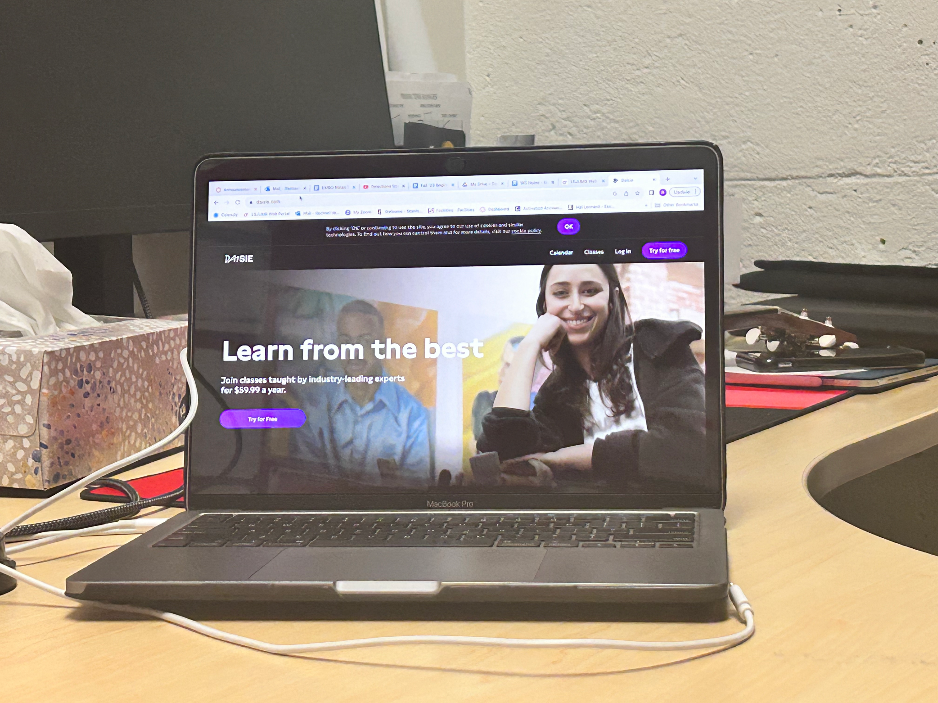
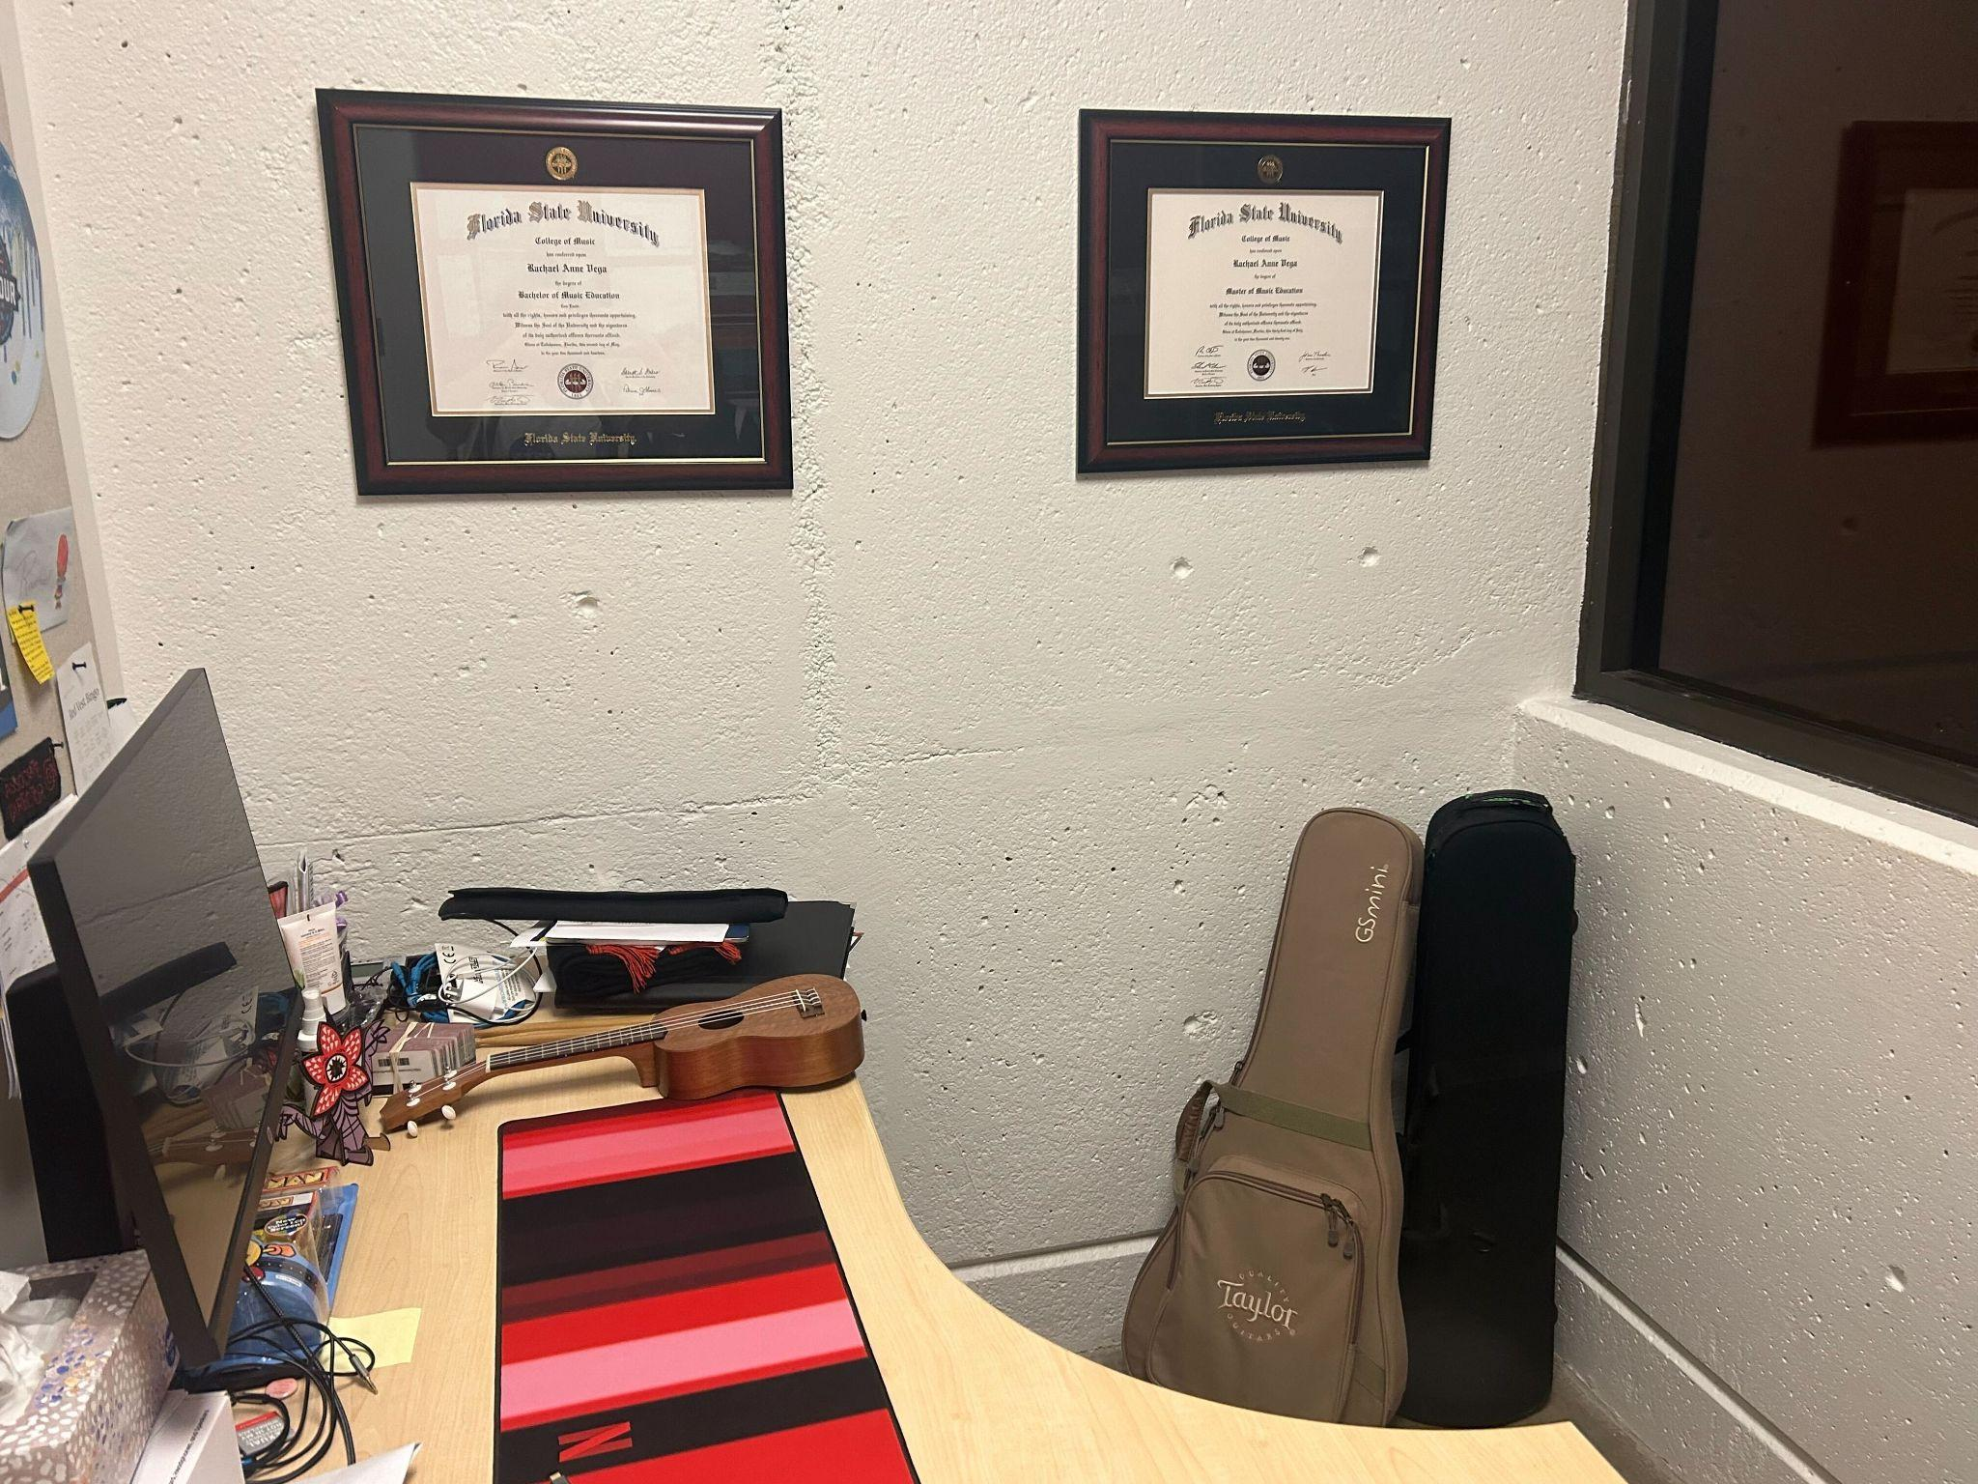
Rachael
Band Director, Casual musician
–
Notes:
“I lean on my creative and improvisation skills with my personal music more than anything I do at my day-job”.

Slide 14
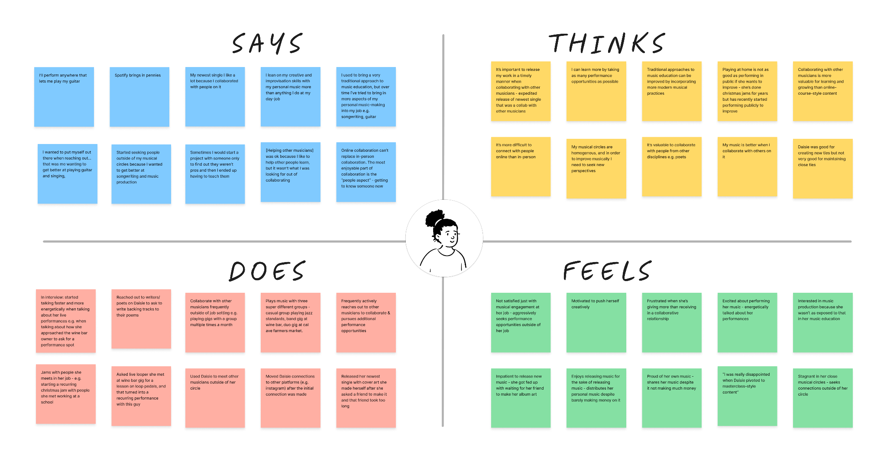
Empathy Map: Rachael

Slide 15
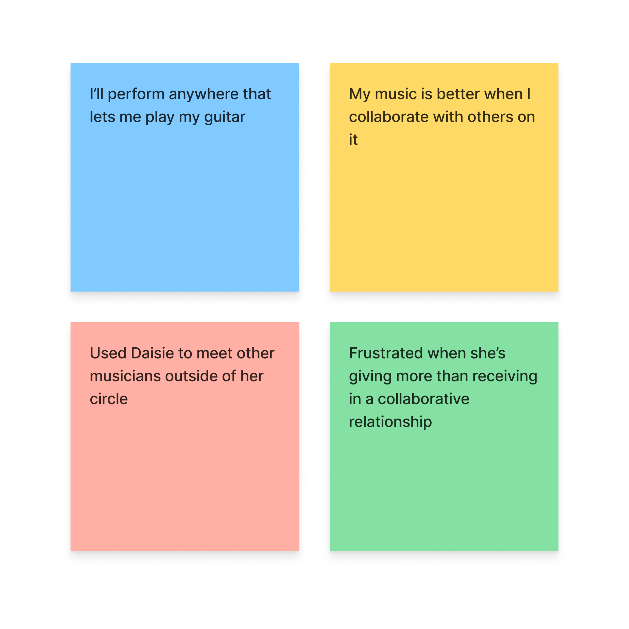
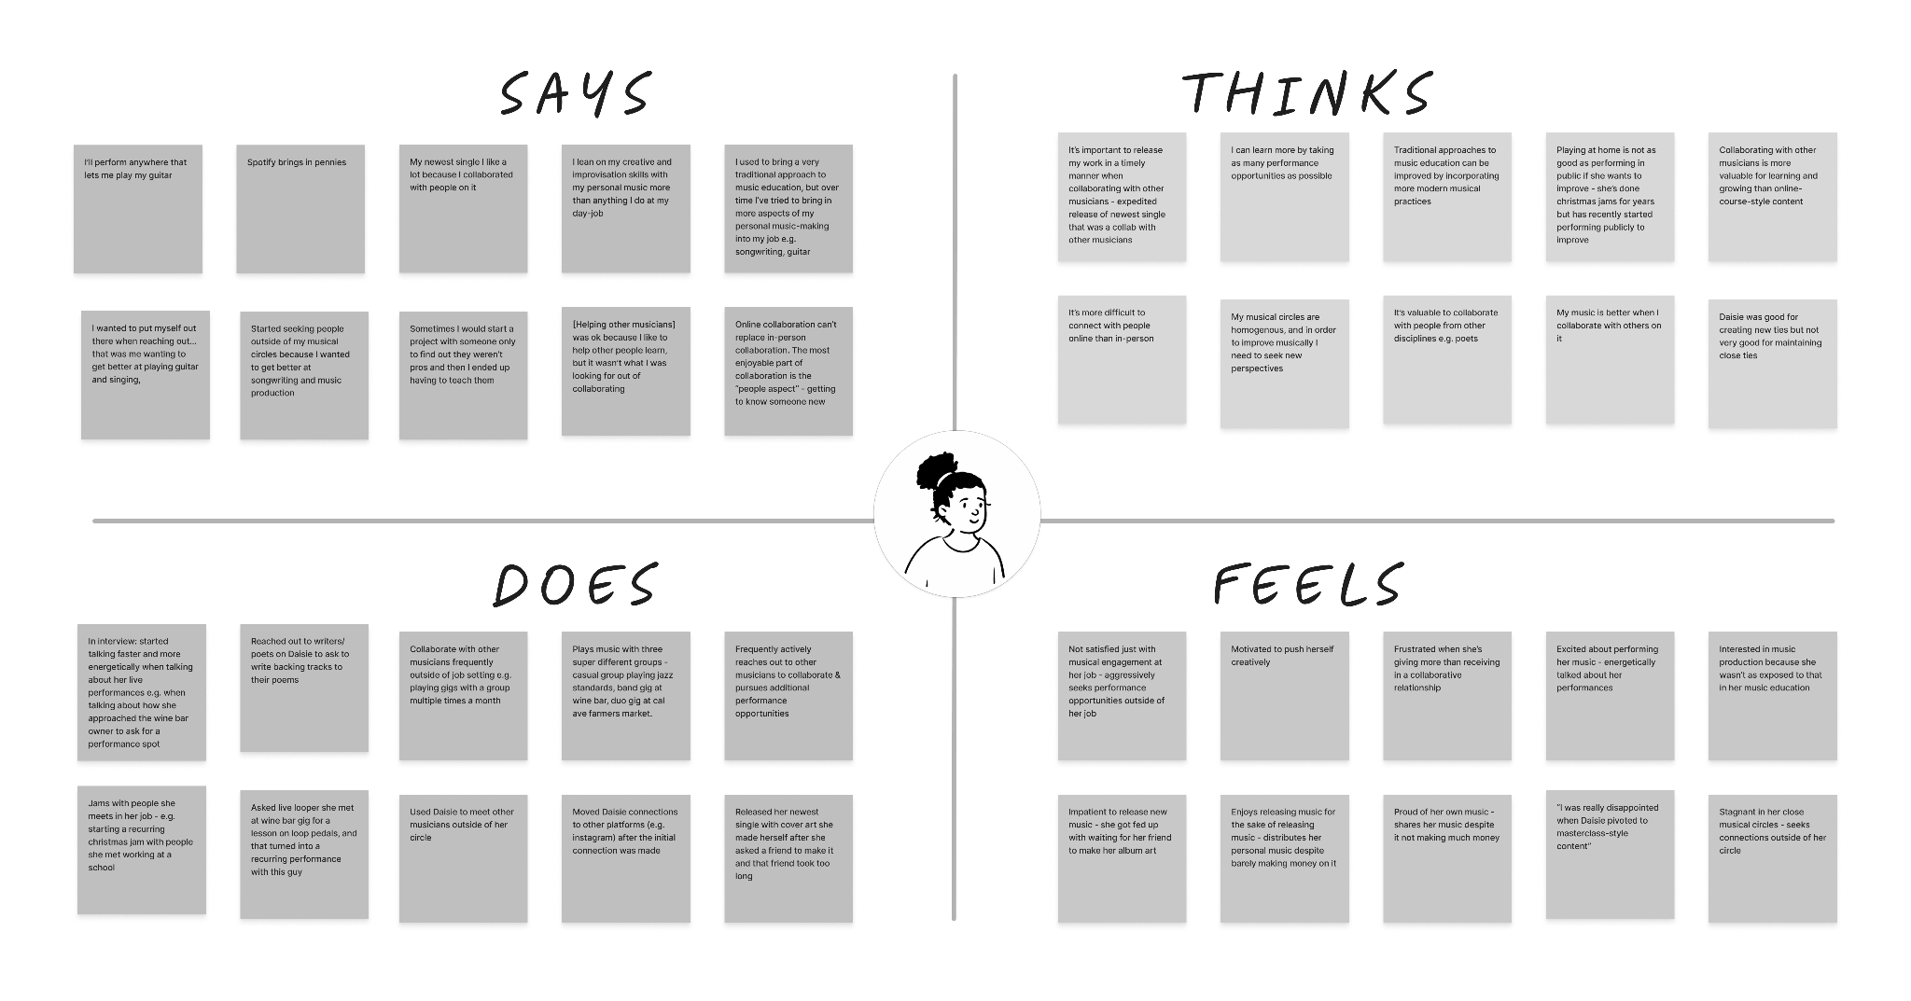
Empathy Map: Rachael
Notes:
Says
Does
Uses an app called Daisie to meet musicians to collab with
Thinks
Collaborating on music makes it better
Feels
Frustrated when she feels that there’s an imbalance in the collaboration in terms of skill sets
she sometimes feels like she’s giving more than she’s getting

Slide 16
Insights from Rachael
OBSERVATION
Rachael used a music collaboration site called Daisie to find musicians to collaborate with.
INFERENCE
There may have been a lack of musicians for her to collaborate with in person.
INSIGHT
Musicians have a hard time finding people to collaborate with in person, so they turn to apps to meet other musicians.
+
=

Slide 17
Insights from Rachael
OBSERVATION
Rachael said that working with musicians at a lower skill level “wasn’t what [she] was looking for out of collaborating” when using Daisie.
INFERENCE
Her skill level may be higher than average, so there may be a smaller pool of musicians at that same level.
INSIGHT
Highly skilled musicians want to find other highly skilled musicians to collaborate with.
+
=

Slide 18
Insights from Rachael
OBSERVATION
When Daisie pivoted from being a collaboration-focused site to being a learning-focused site, Rachael lost interest in the product.
INFERENCE
She may get more value from collaboration than she does from formalized music lessons.
INSIGHT
Some musicians prefer to learn via collaboration as opposed to learning via formalized music lessons.
+
=

Slide 19
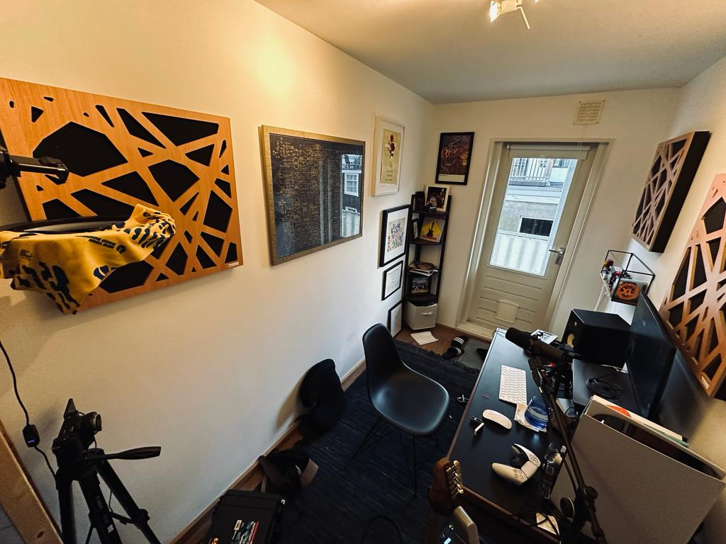
Elliott
Professional
Guitarist, Music Youtuber & Teacher
–
Notes:
“I love music, I just saw what everyone who I was shooting for was doing with their personal lives, and I was like SHIT.”

Slide 20
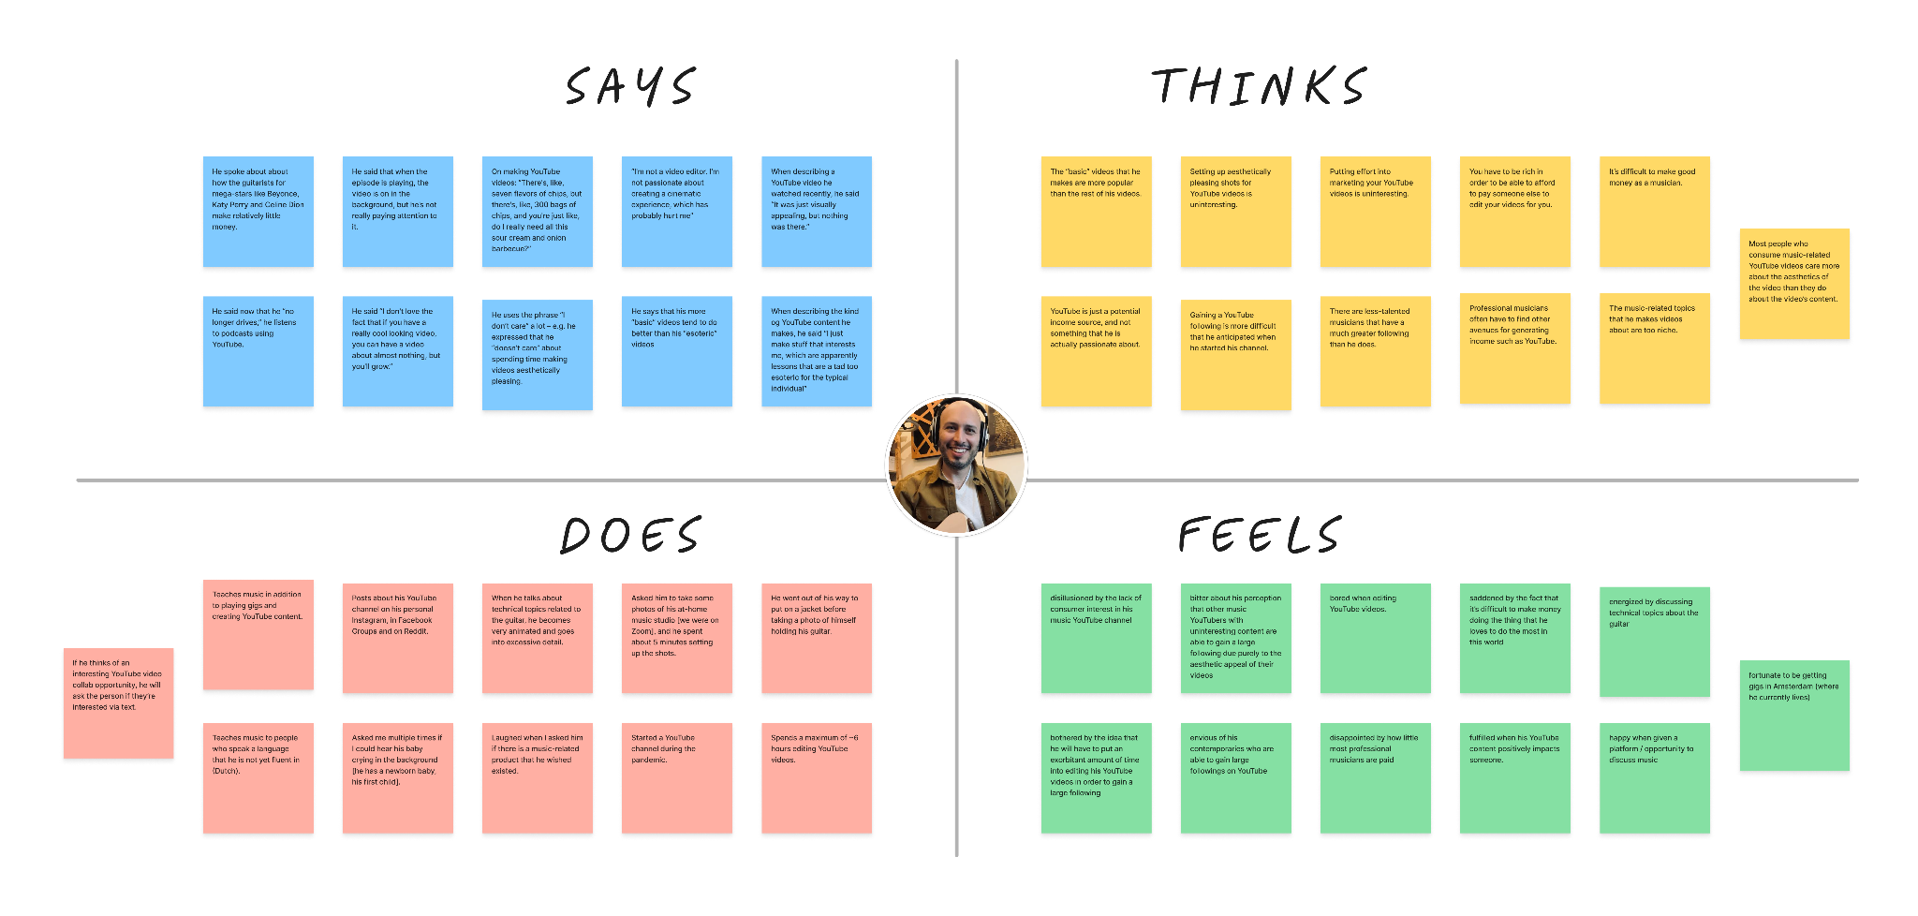
Empathy Map: Elliott

Slide 21
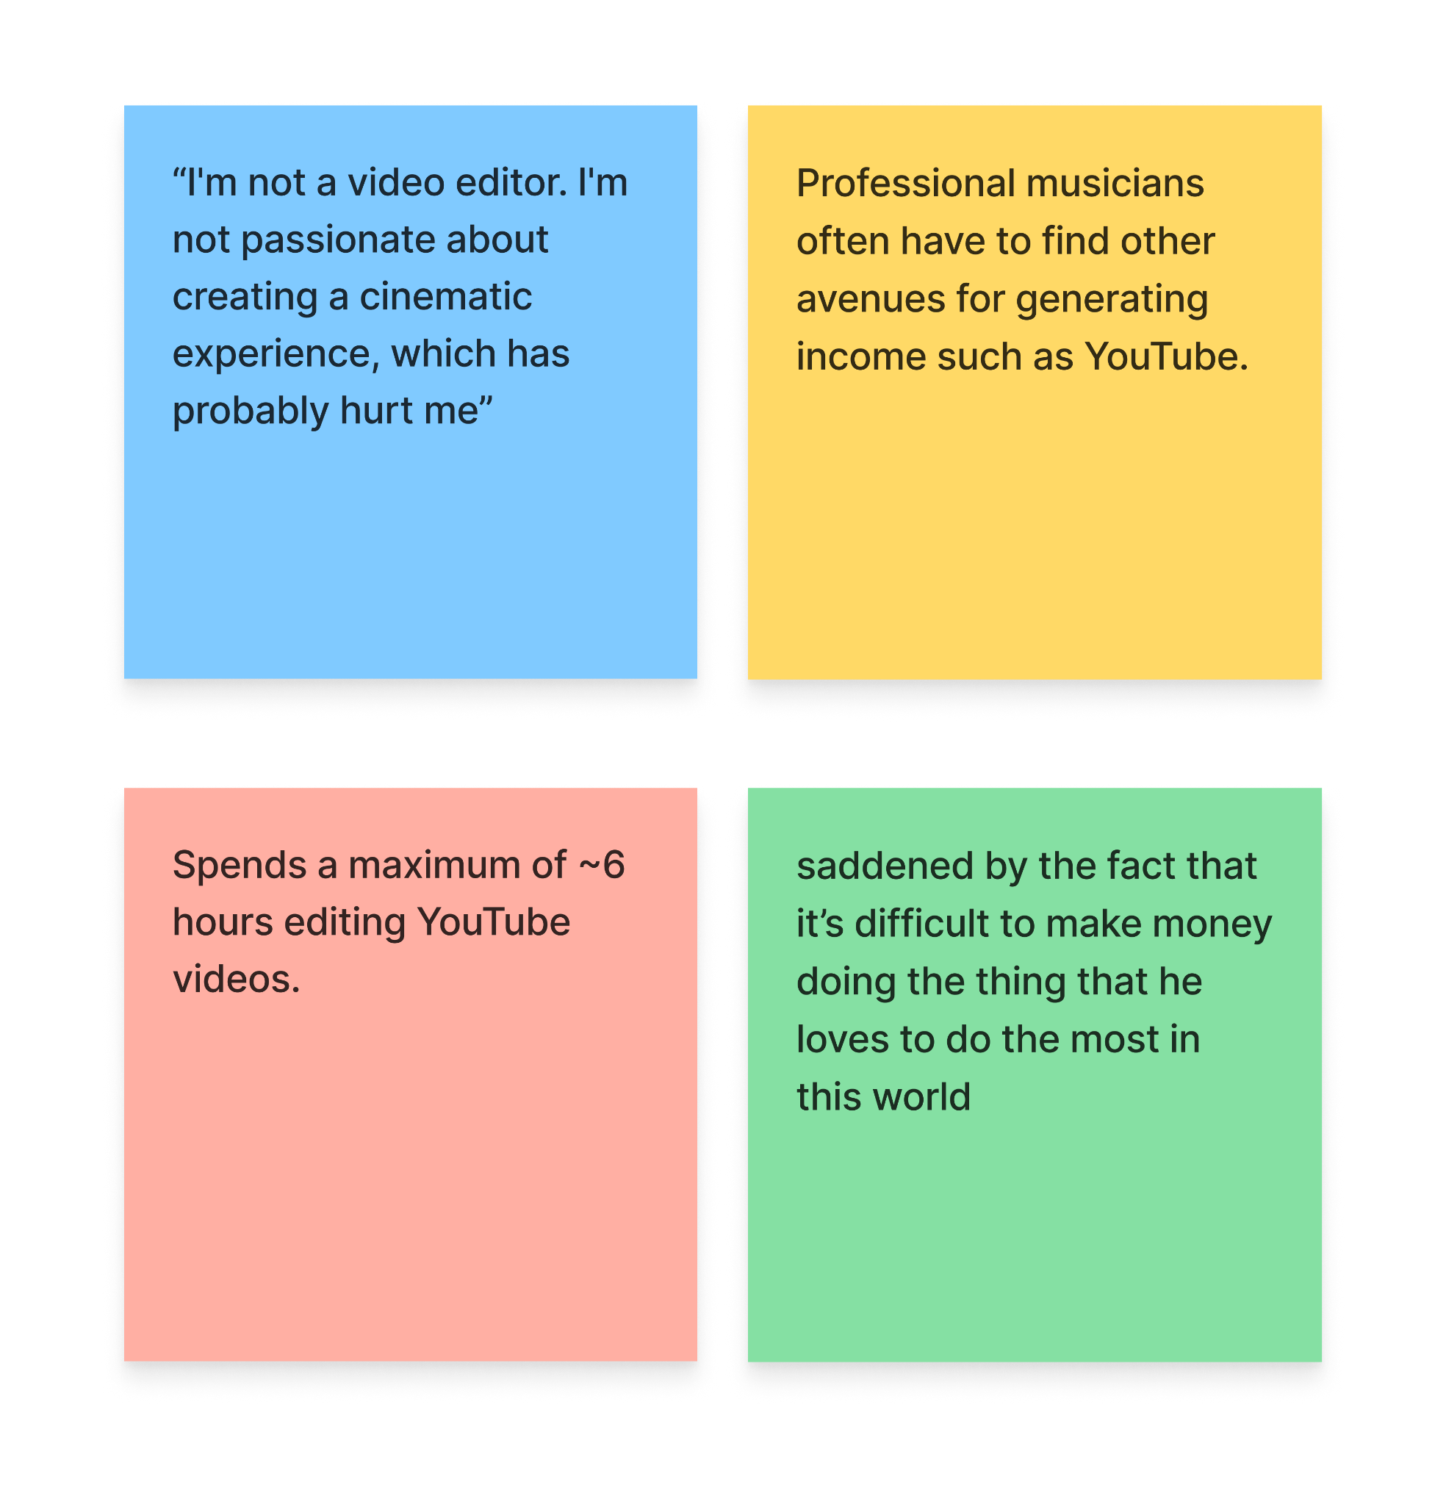
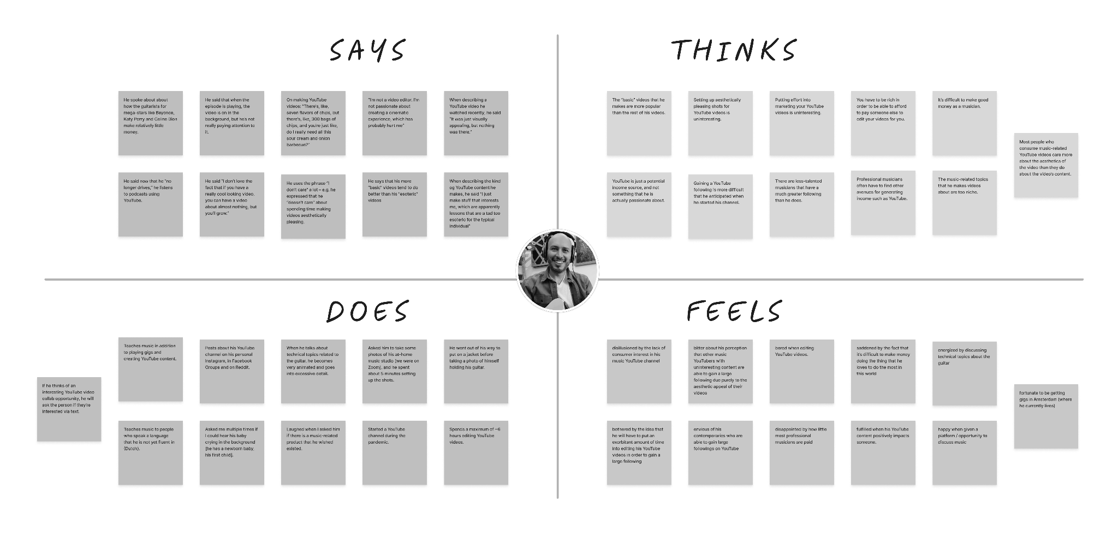
Empathy Map: Elliott
Notes:
Says
[When discussing his music YouTube channel]
Does
Puts a 6 hour limit on how long he’ll spend editing a music video
Thinks
Professional musicians are constantly needing to find other sources of revenue to supplement their income.
Feels
Quite sad about the fact that it’s difficult to make money doing what he loves to do most in this world, which is play guitar

Slide 22
Insights from Elliott
OBSERVATION
On top of playing his guitar at gigs, Elliott is also a guitar teacher; He also runs a guitar-focused YouTube channel.
INFERENCE
He may need to teach the guitar and run his YouTube channel as a means of supplementing his income.
INSIGHT
Musicians often have to work multiple jobs in order to cover their living expenses.
+
=

Slide 23
Insights from Elliott
OBSERVATION
Elliott perceives his YouTube content to be too niche, when he “make[s] stuff that interests me, which are… a tad too esoteric for the typical individual.”
INFERENCE
There may be a lot of people who would be interested in his content, but his content just isn’t getting onto their radar.
INSIGHT
Musicians are artists, not marketing strategists.
+
=
Notes:
There are a multitude of amazing musicians whose music isn’t popular purely due to a lack of marketing.

Slide 24
Insights from Elliott
OBSERVATION
Elliott noticed that having aesthetically pleasing YouTube videos helps with video performance; but he refuses to spend more than 6 hours editing a video.
INFERENCE
He may find the process of editing videos to be tedious and uninteresting.
INSIGHT
Musicians want to spend their time on their craft, and not on other tedious tasks (even if those tasks could help increase their popularity).
+
=

Slide 25
Key Insights & Potential Needs
INSIGHT
POTENTIAL NEED
The process of discovering new music can be overwhelming and anxiety-inducing.
Musicians need a way to make discovering new music a fun and exciting experience.
People who love music want to talk about it, even if that means they have to talk to strangers.
Musicians need an outlet to share their thoughts about music.
Musicians want to spend their time on their craft, and not on other tedious tasks
Musicians need a way to get tedious tasks completed in a way that doesn’t detract from time spend on their craft.
Learning via collaboration can sometimes be more valuable to a musician than learning via formal music lessons.
Musicians need a way to meet collaborators that they can learn from.

Slide 26


Next Steps
Additional musicians at lower skill levels
Needfinding at music-related events in the community
Brainstorming HMW
Notes:
conduct additional interviews
particularly with musicians at lower skill levels
attend music-related events in the community
for needfinding purposes
brainstorming

Slide 27
Thank you!

Slide 28
Appendix

Slide 29
Ethan’s Interview Details
Interviewer: Sophia
Notetaker: Amy
Location: In-Person on Campus
Apparatus: Google Docs [transcription]
Discussion Topics:
How he got into DJing
How he got into hosting a radio show
Radio station pain points
His early interest in music
His music curation process
How he discovers & explores music
Recent music he’s listened to
How his background affects his music tastes
His thoughts on indie artists
Making mixes during COVID
Music as community
Artifacts:

Slide 30
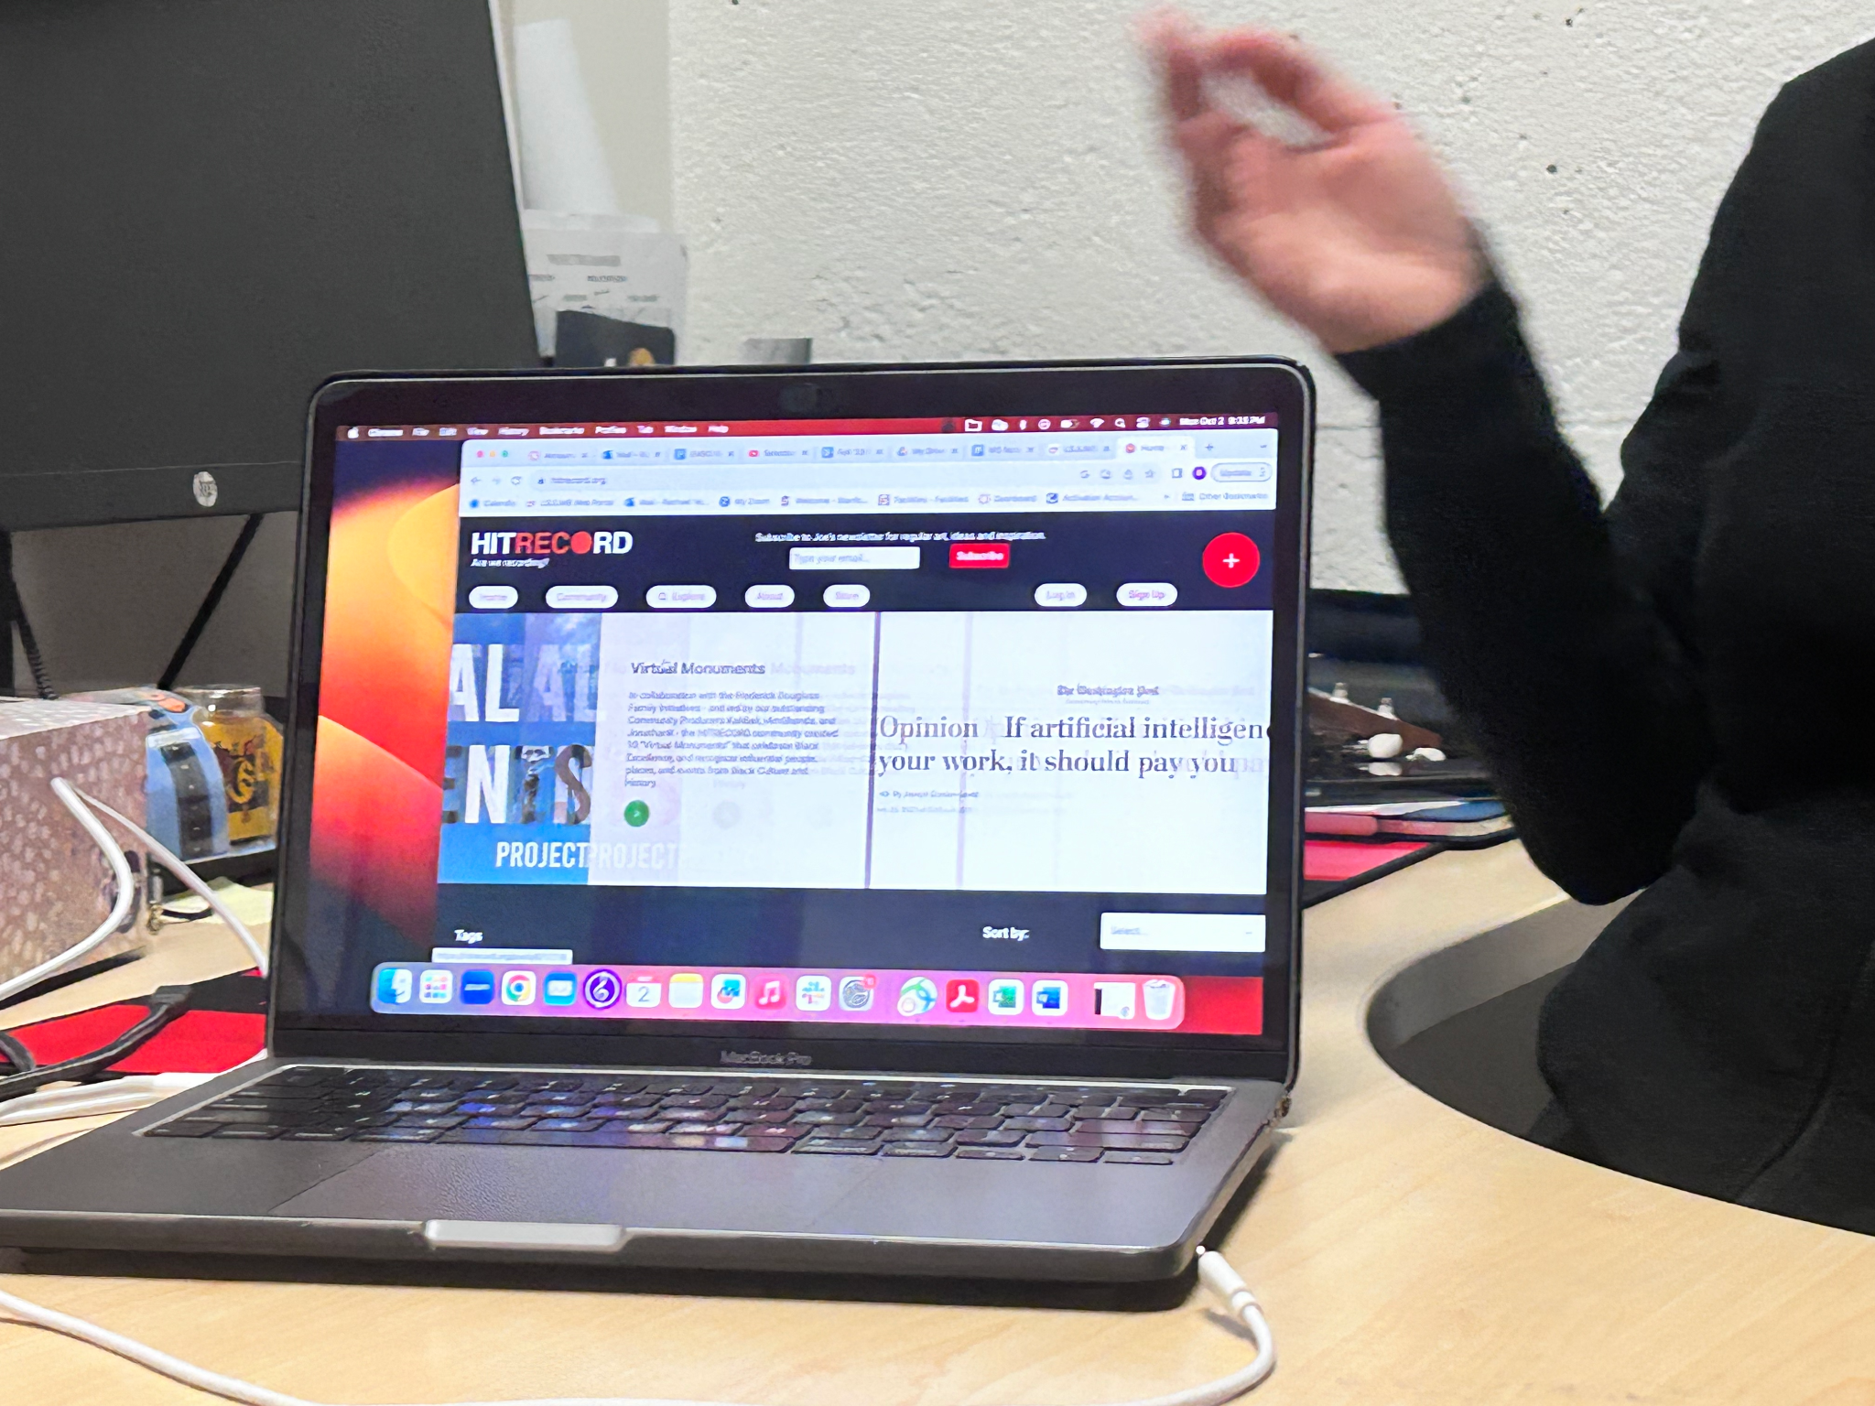
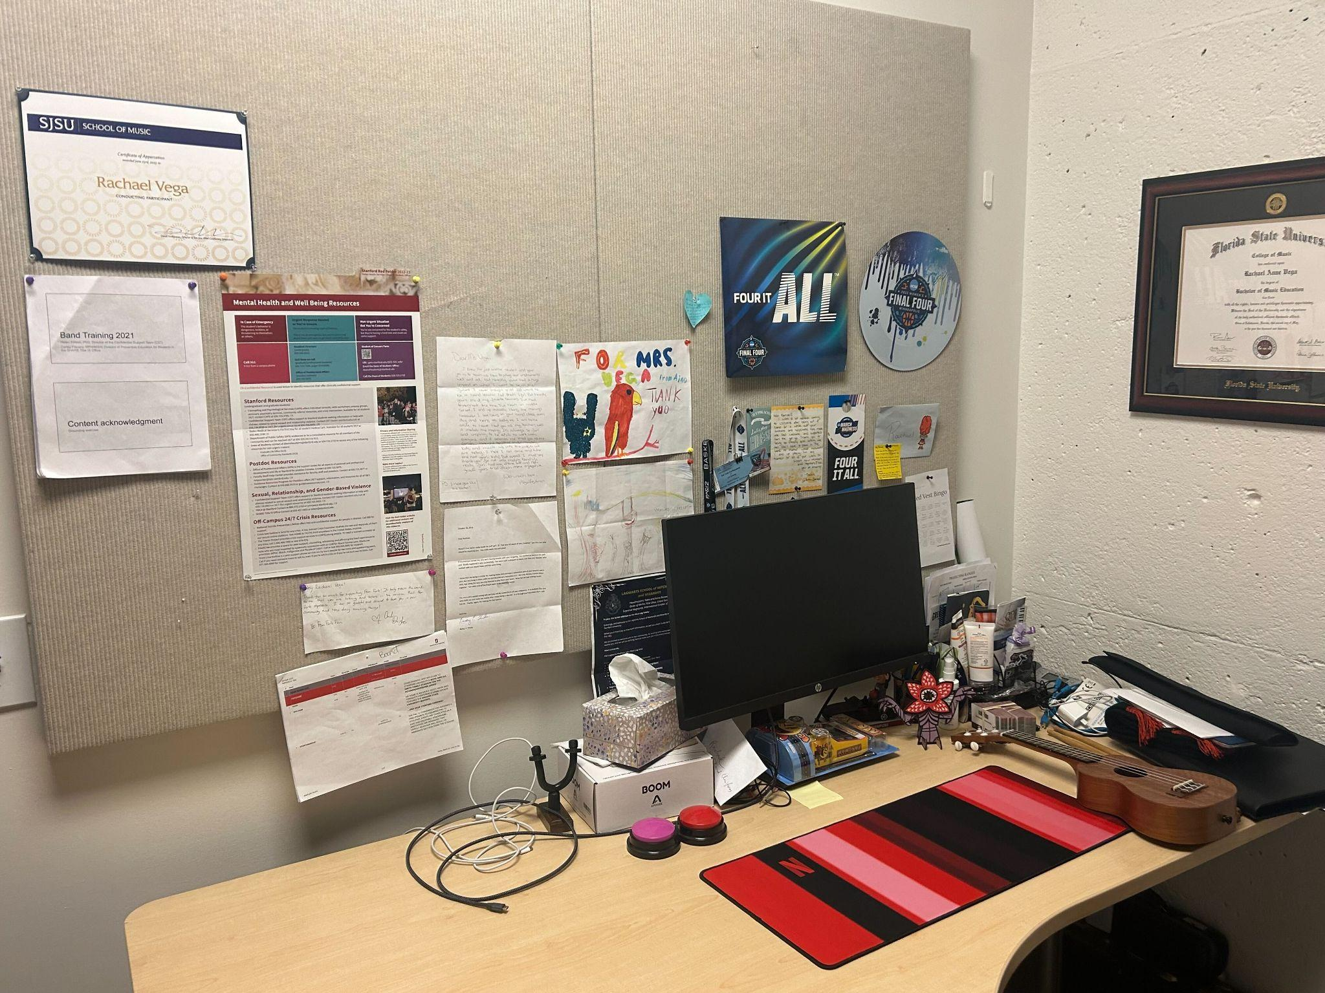
Rachael’s Interview Details
Interviewer: Ellie
Notetaker: Amy
Location: In-Person on Campus
Apparatus: Google Docs [transcription]
Discussion Topics:
How music plays a role in her life
Her experience as a live performer
  Why she took a break from it
Sharing music
  Music that she likes
  Her own music
Motivations for her personal & professional work
Seeking people outside of her domain
Frustrations with other music creators
Frustrations with teaching people
Artifacts:

Slide 31
Elliott’s Interview Details
Interviewer: Leilenah
Notetaker: Amy
Location: Remote via Zoom
Apparatus: Zoom, Google Docs [transcription]
Discussion Topics:
His background as a musician
Compensation for professional musicians
His guitar-focused YouTube channel
  The nature of his channel’s content
  His assessment on why his channel is at its current state
  His content vs the content of his contemporaries
  The marketing techniques he uses to promote his channel
Collaborating with other music YouTubers
Music-related products that he wish existed
Artifacts:

