Slide 1
Design Patterns
November 27, 2023
Notes:
First part too long (do patterns faster). 2-3 min over and only 25 min break
-- Last year ---
Broke at 63 min in, so gave a 27 min break. Will try to finish in 20 min. Finished 3 min early. Can add another dark pattern next year.
Also update the design example in 2nd half to be a mobile design based on apple or google maps.
---------
Need to get to break by 55 min
two years ago: Broke at 1:15 in, so with 30 min break, only had 15 min to finish (which is probably 5 min short)
3 years ago: Took 60 min to the break. Then had 30 min break and 20 min to finish last bit (which takes the full 20 min)

Slide 2

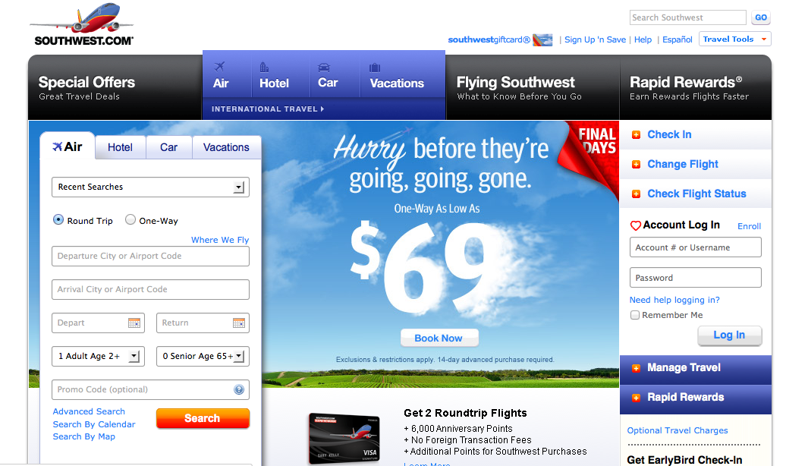
Hall of Fame or Shame?
Southwest.com
Notes:
This is the web site for southwest airlines (as of 2021)… let’s zoom in

Slide 3
Hall of Fame or Shame?
Southwest.com
Notes:
The positives?
Note how it highlights the obvious things you’ll want to do on an airline web site.
Purchase air flights
Hotels, cars, vacations
Frequent flyer
Special offers

Slide 4

Hall of Shame!
Southwest.com
  hard to notice key functions on far right
  ads dominating the screen
Notes:
What do I come to an airline site to do????

Slide 5
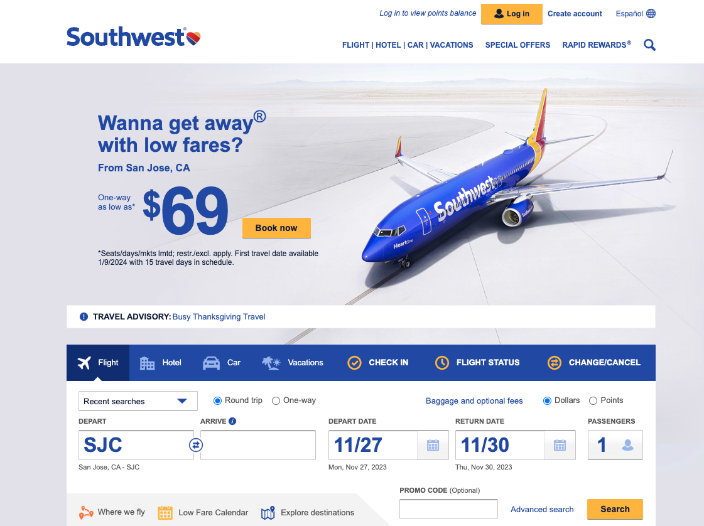
Improved southwest.com
Notes:
Southwest.com as of 11/26/2023
all the key tasks together in the large blue bar
Big advertisement up top

Slide 6
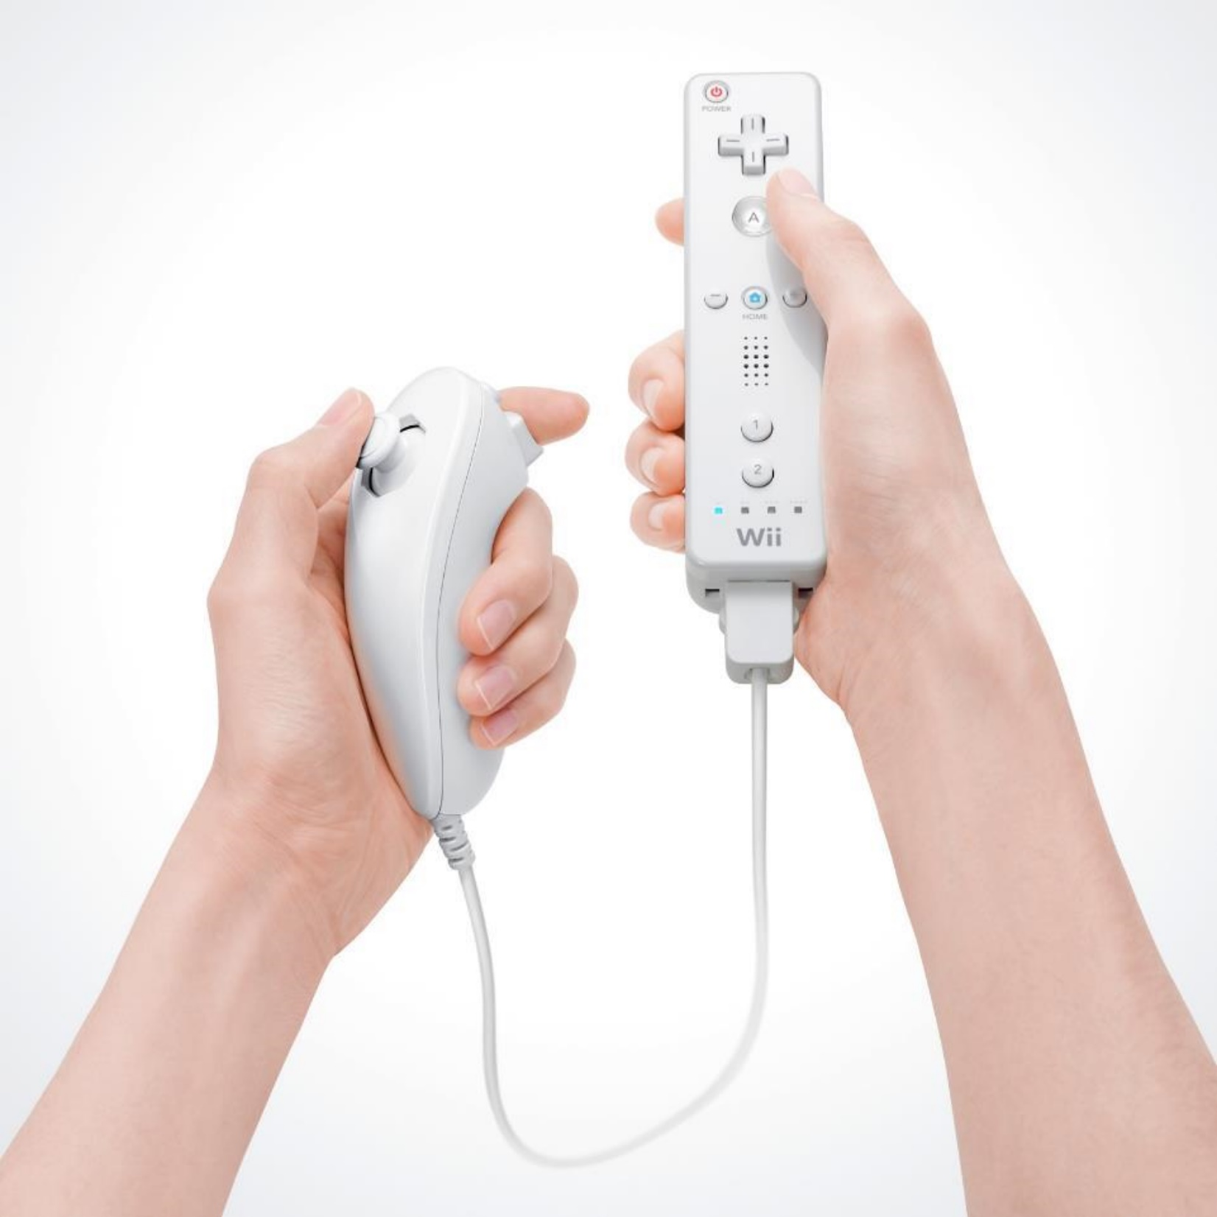
Hall of Fame or Shame?
Wiimote
By Nintendo
Notes:
Whose used this?
What was good about this when it came out?
What might have been wrong?

Slide 7
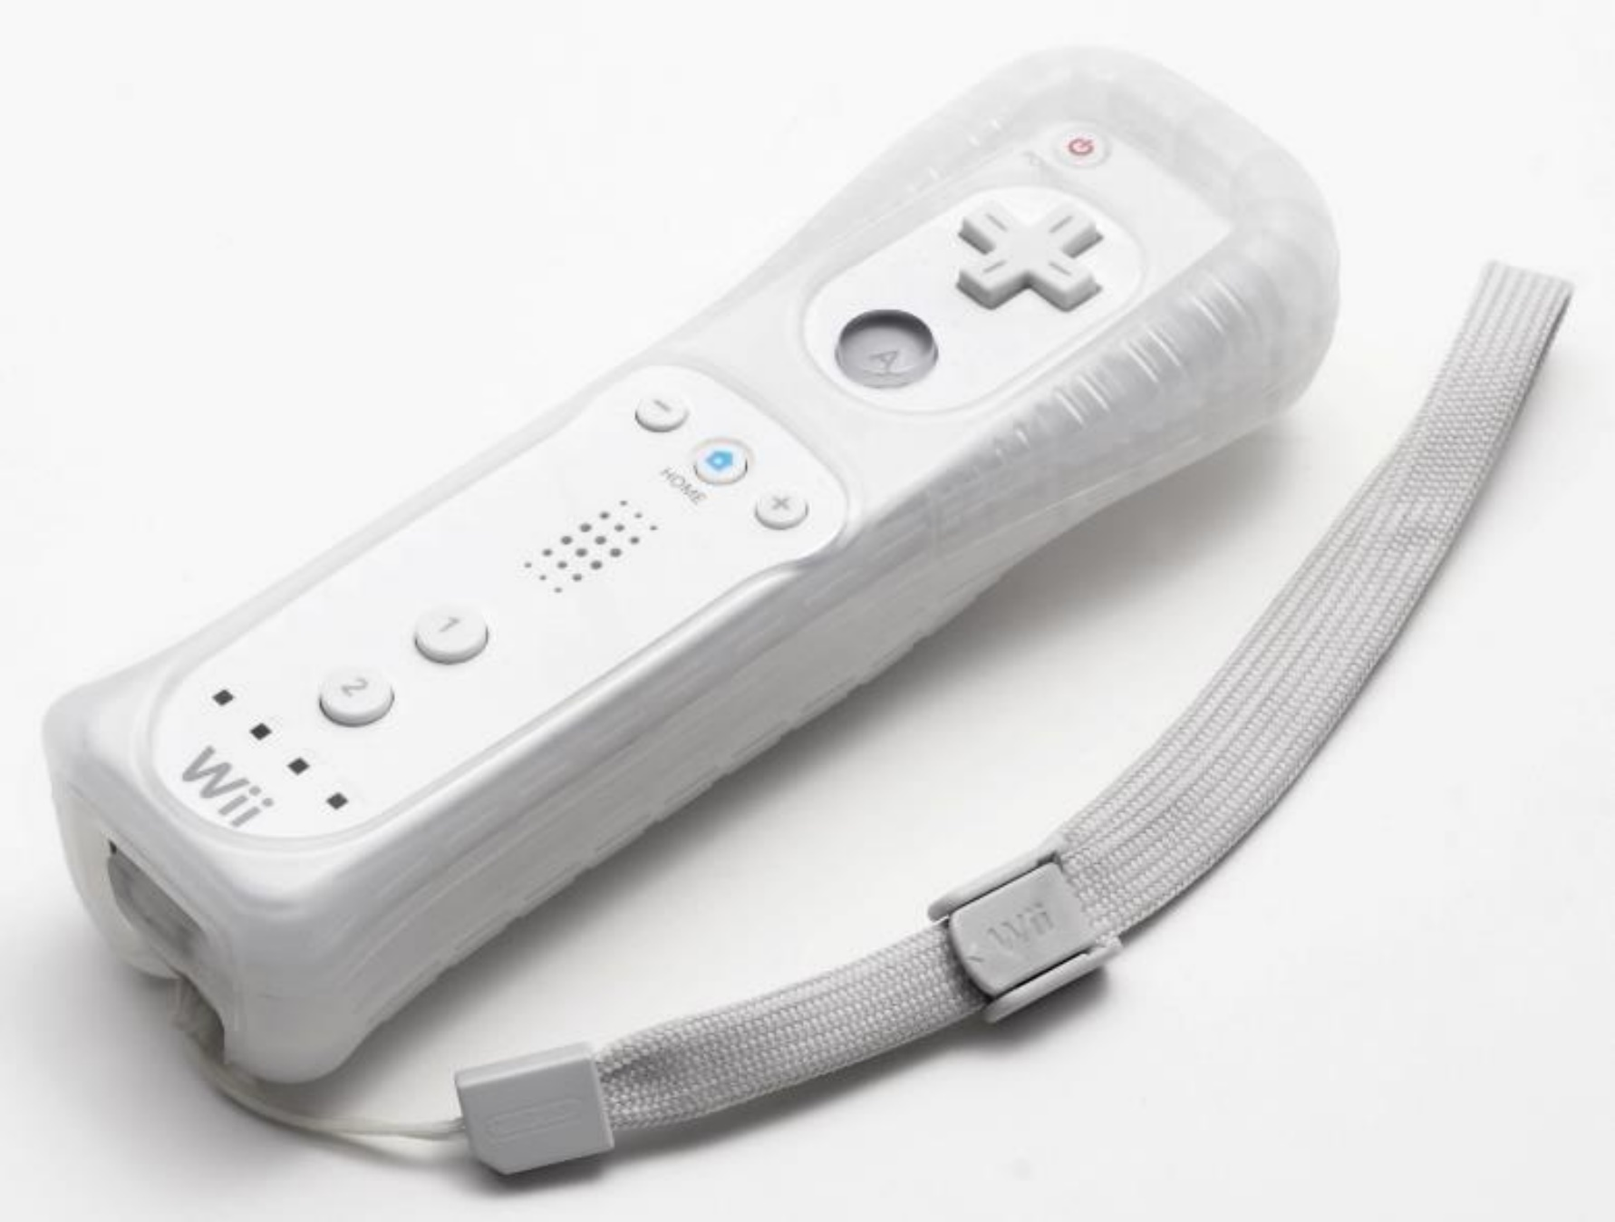
Hall of Fame/Shame!
Great at opening up gaming to a wider audience but…
the main thing that differentiated the product (movement in gaming)
resulted in it being thrown at windows/TVs
slippery plastic hard to hold. Later designs added rubber case & strap
lack of a joystick was initial problem resulting in a second controller
Notes:
mixed result and some of the initial problems were fixed.

Slide 8
Design Patterns
November 27, 2023
Notes:
I introduced to you the idea of Design Patterns in the lecture on Visual Design. Now we will go into it much more deeply.
Why are we learning this?
Design patterns are an important way of communicating design knowledge in a reusable form.

Slide 9
Outline
Detailed Design Example
Web Design Patterns
Patterns in the Design Exploration Phase
Dark Patterns

Slide 10
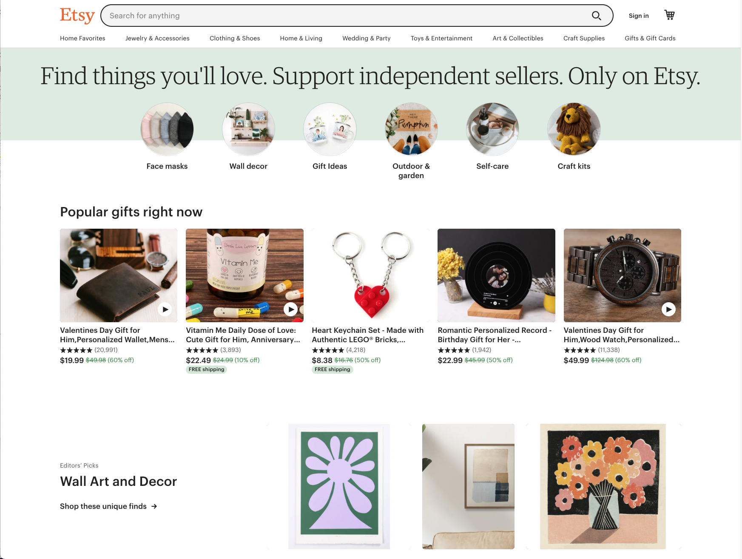
1
Notes:
I made this example February 2022. The old example I last did in 2015-16 and the site, half.com, no longer exists.
But making this new version was easy as almost all the ideas are identical. Its amazing. Almost any other e-commerce web site could be substituted

Slide 11
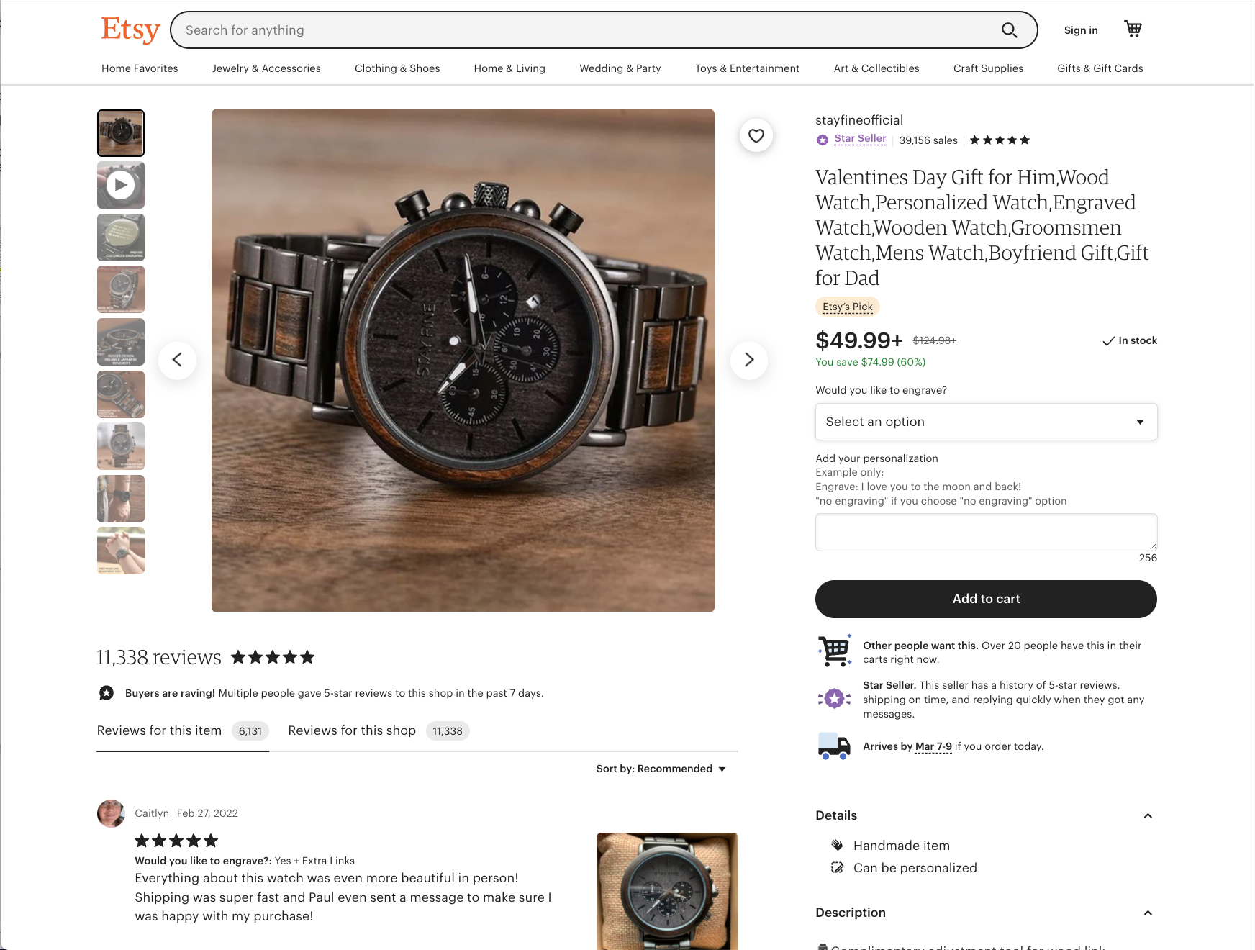
2

Slide 12
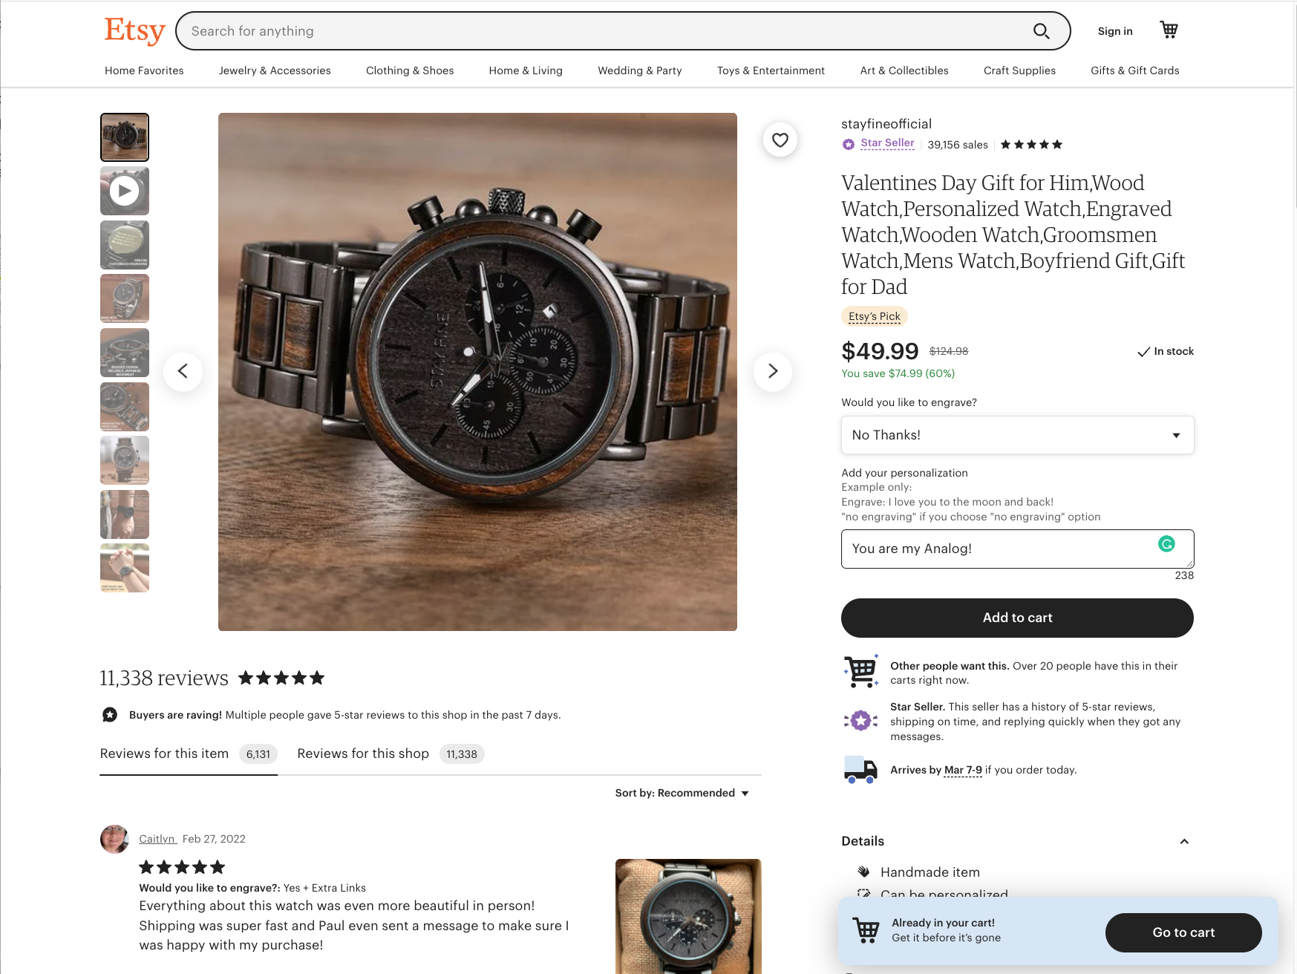
2

Slide 13
2

Slide 14
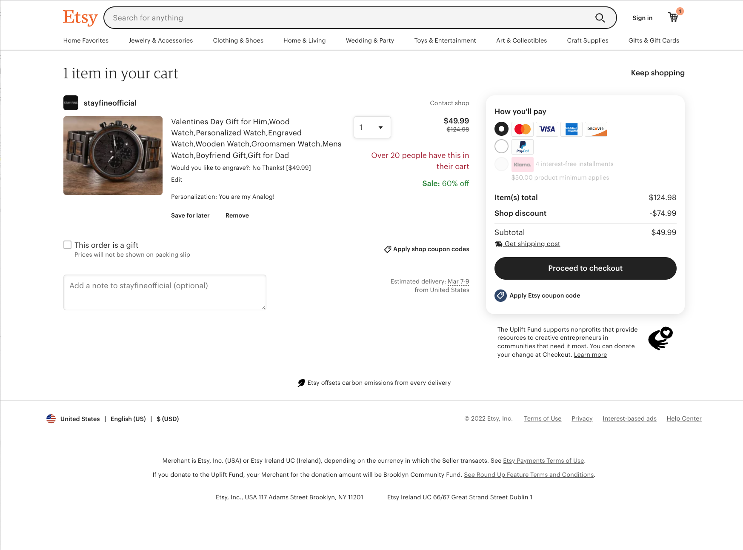
3

Slide 15
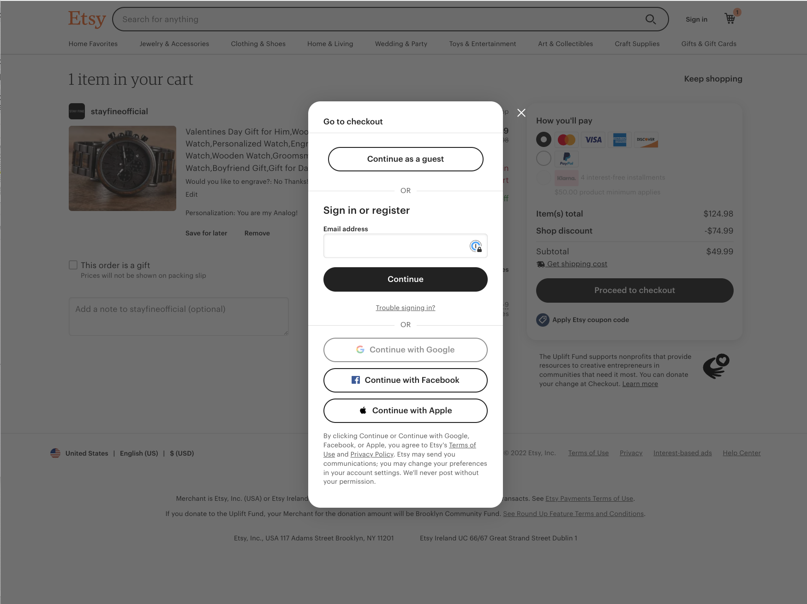
4

Slide 16
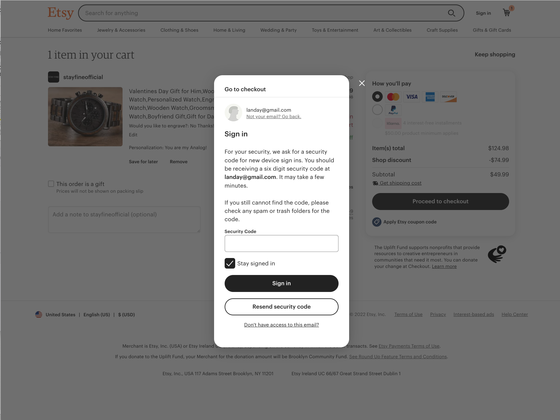
4

Slide 17
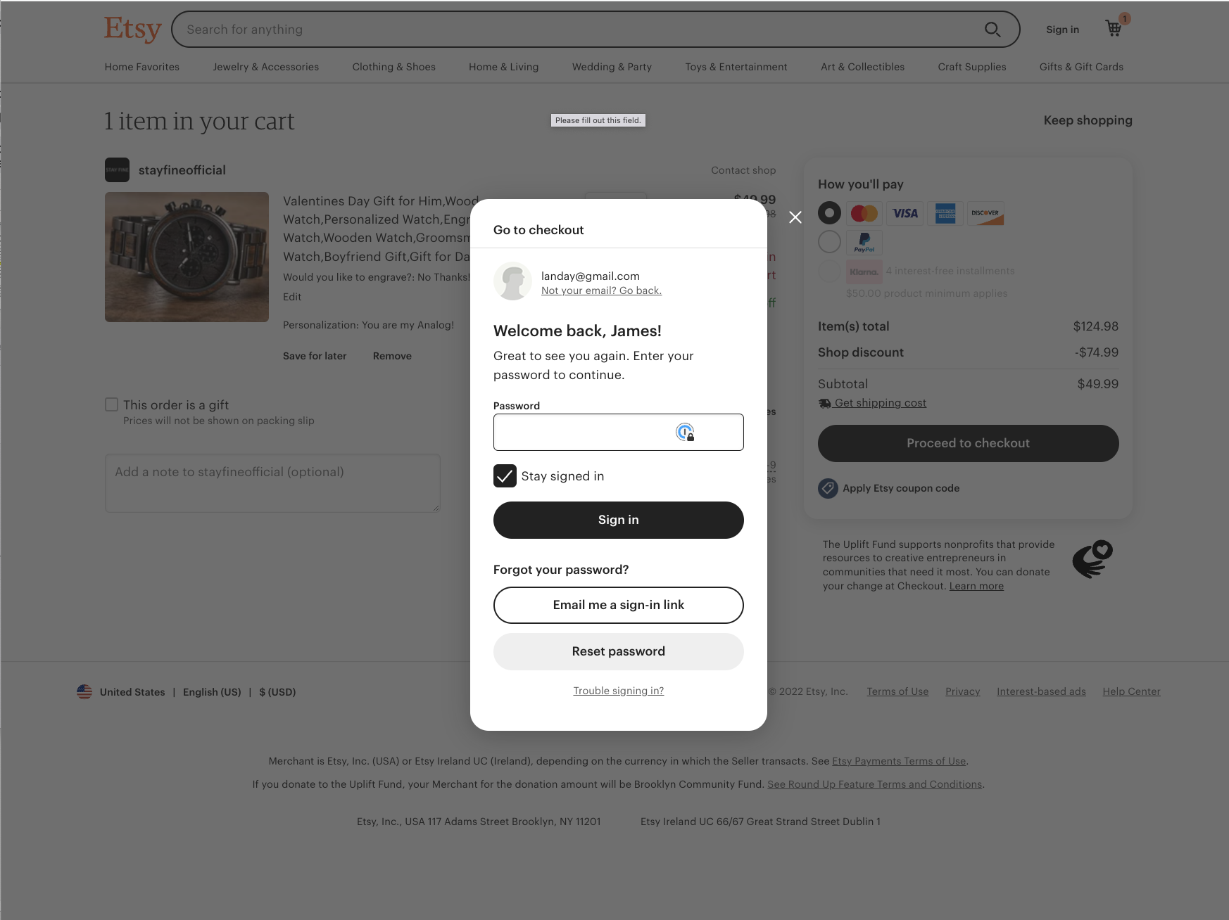
4

Slide 18
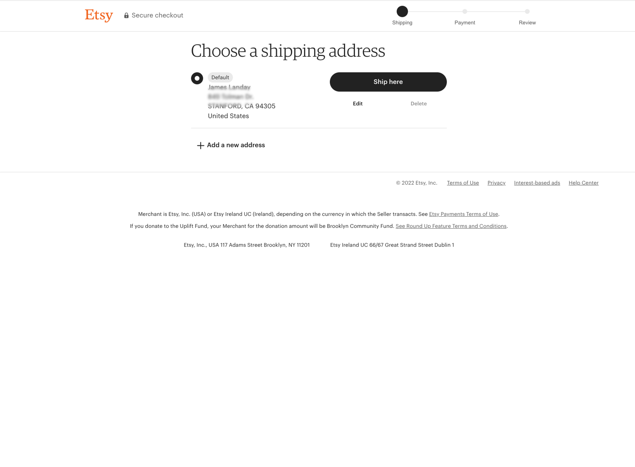
5

Slide 19
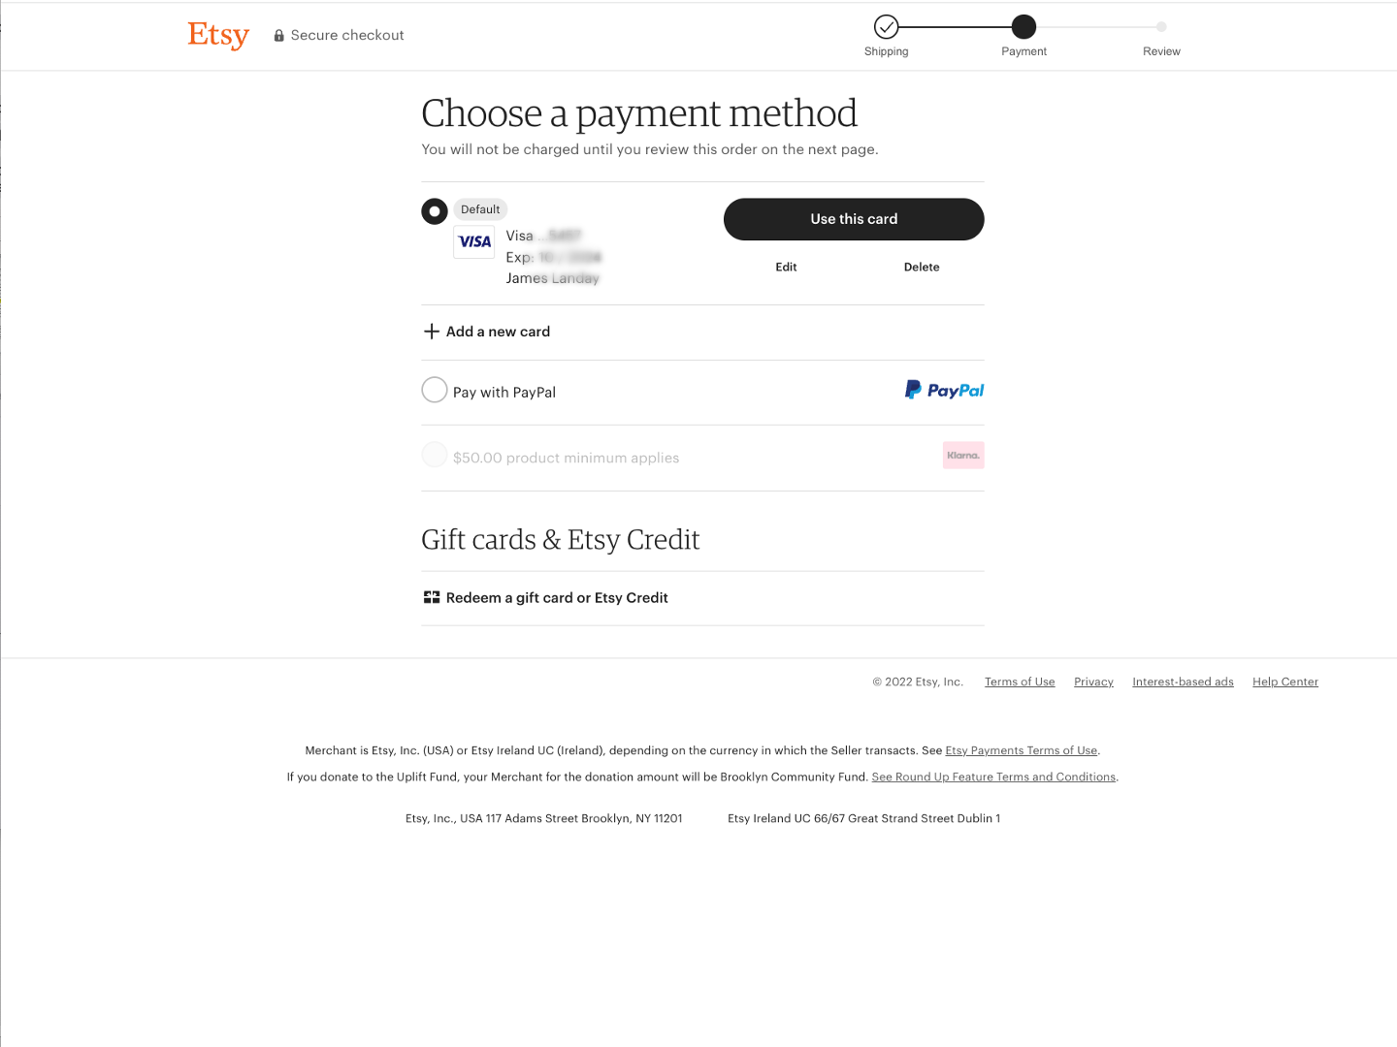
6

Slide 20
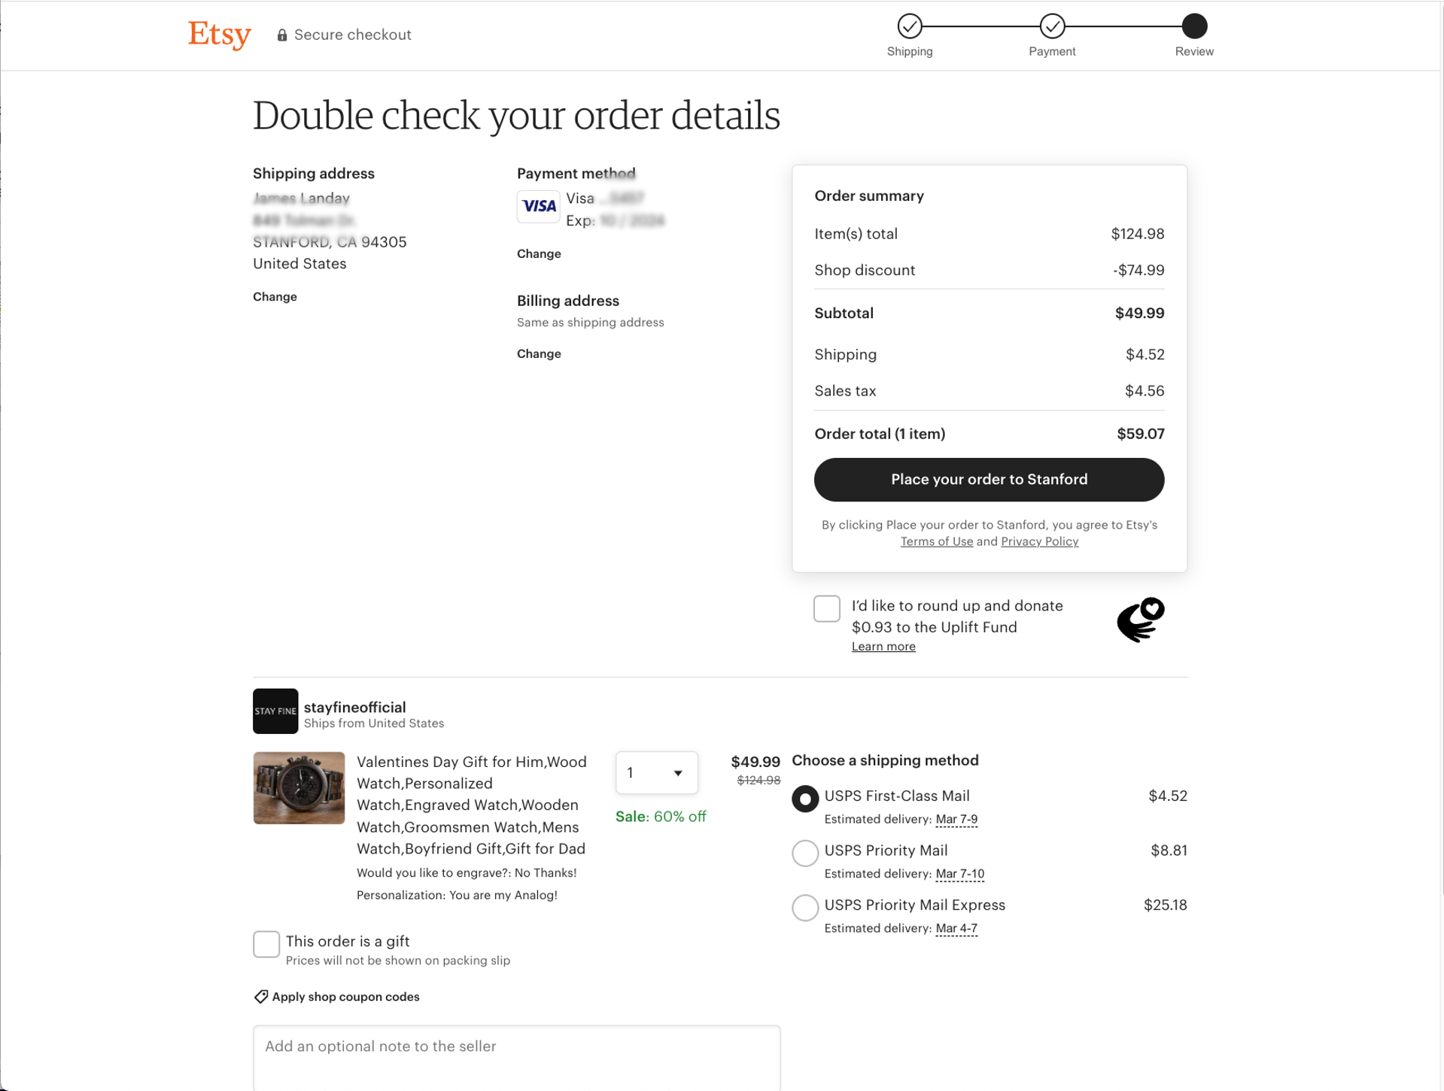
7

Slide 21
Basic Web Design
Let’s take a closer look page by page

Slide 22
1
Notes:
Here is the home page again.

Slide 23
1
What site is this?
  Logo in top-left corner denotes the site
  examples of SITE BRANDING (E1)
Notes:
Clear logo in top-left corner (a standard), click to go home

Slide 24
1
What kind of site is this?
  Shopping cart icon
  Tab row categories/featured navigation
  UP-FRONT VALUE PROPOSITION (C2)
  example of PERSONAL E-COMMERCE (A1)
Notes:
shopping cart, suggests that it's an ecommerce site even if you've never seen it before
Tab row (another standard) along with the items in the featured navigation below it, reinforce that it's an ecommerce site and suggests what this site sells
“Find things you’ll love…” makes it easy for people who don't know anything about this site to learn what it does [UPFRONT VALUE PROP]
These are all things that hint that this is a personal e-commerce site.

Slide 25
1
What can I do here?
  Support sellers → buy
  Tab row / Search on top
  Click on popular gifts
Notes:
The value proposition tells me I can “Support independent sellers” – how buying things!
Tab row (another standard), reinforcing that it's an ecommerce site and suggests what this site sells
A large content area in the center where you can click on popular gifts

Slide 26
1
Most important info visible without scrolling
ABOVE THE FOLD (I2)
Notes:
Majority of the content "Above the Fold”

Slide 27
2

Slide 28
2
What site am I at?
  Logo in upper-left reinforces brand, can click to go to home
  Same font, layout, color scheme also reinforces
  examples of SITE BRANDING (E1)
  price emphasizes I can buy
  i.e., PERSONAL E-COMMERCE (A1)

Slide 29
2
Where am I in the site?
  This is one place Etsy falls down
  Could have had
    “Home > Watches” as
    LOCATION BREADCRUMBS (K6)
    “Jewlery & Accessories” could be selected in
    TAB ROW (K3) & SEARCH ACTION MODULE (J1)
Notes:
Let me show you how they could have done it.
[ADVANCE]

Slide 30
2
Watches
Jewelry & Accessories
Home > Jewelry & Accessories > Watches
Where am I in the site?
  This is one place Etsy falls down
  Could have had
    “Home > Watches” as
    LOCATION BREADCRUMBS (K6)
    “Jewlery & Accessories” could be selected in
    TAB ROW (K3) & SEARCH ACTION MODULE (J1)
Notes:
I did a quick redesign on this page.
[ADVANCE]
[ADVANCE]
[ADVANCE]
These three changes would make it much clearer where I was in the site

Slide 31
2
Can I trust this seller?
  Who am I buying from?
  Are they reputable?
    aside: what do stars mean?
  Do people like the product?
  What about shipping cost?

Slide 32
2
The Fold
  Hmm, what’s below here?

Slide 33
2
Notes:
We can see reviews for the item
And more details (it is handmade)
And finally, if we scroll further
[ADVANCE]

Slide 34
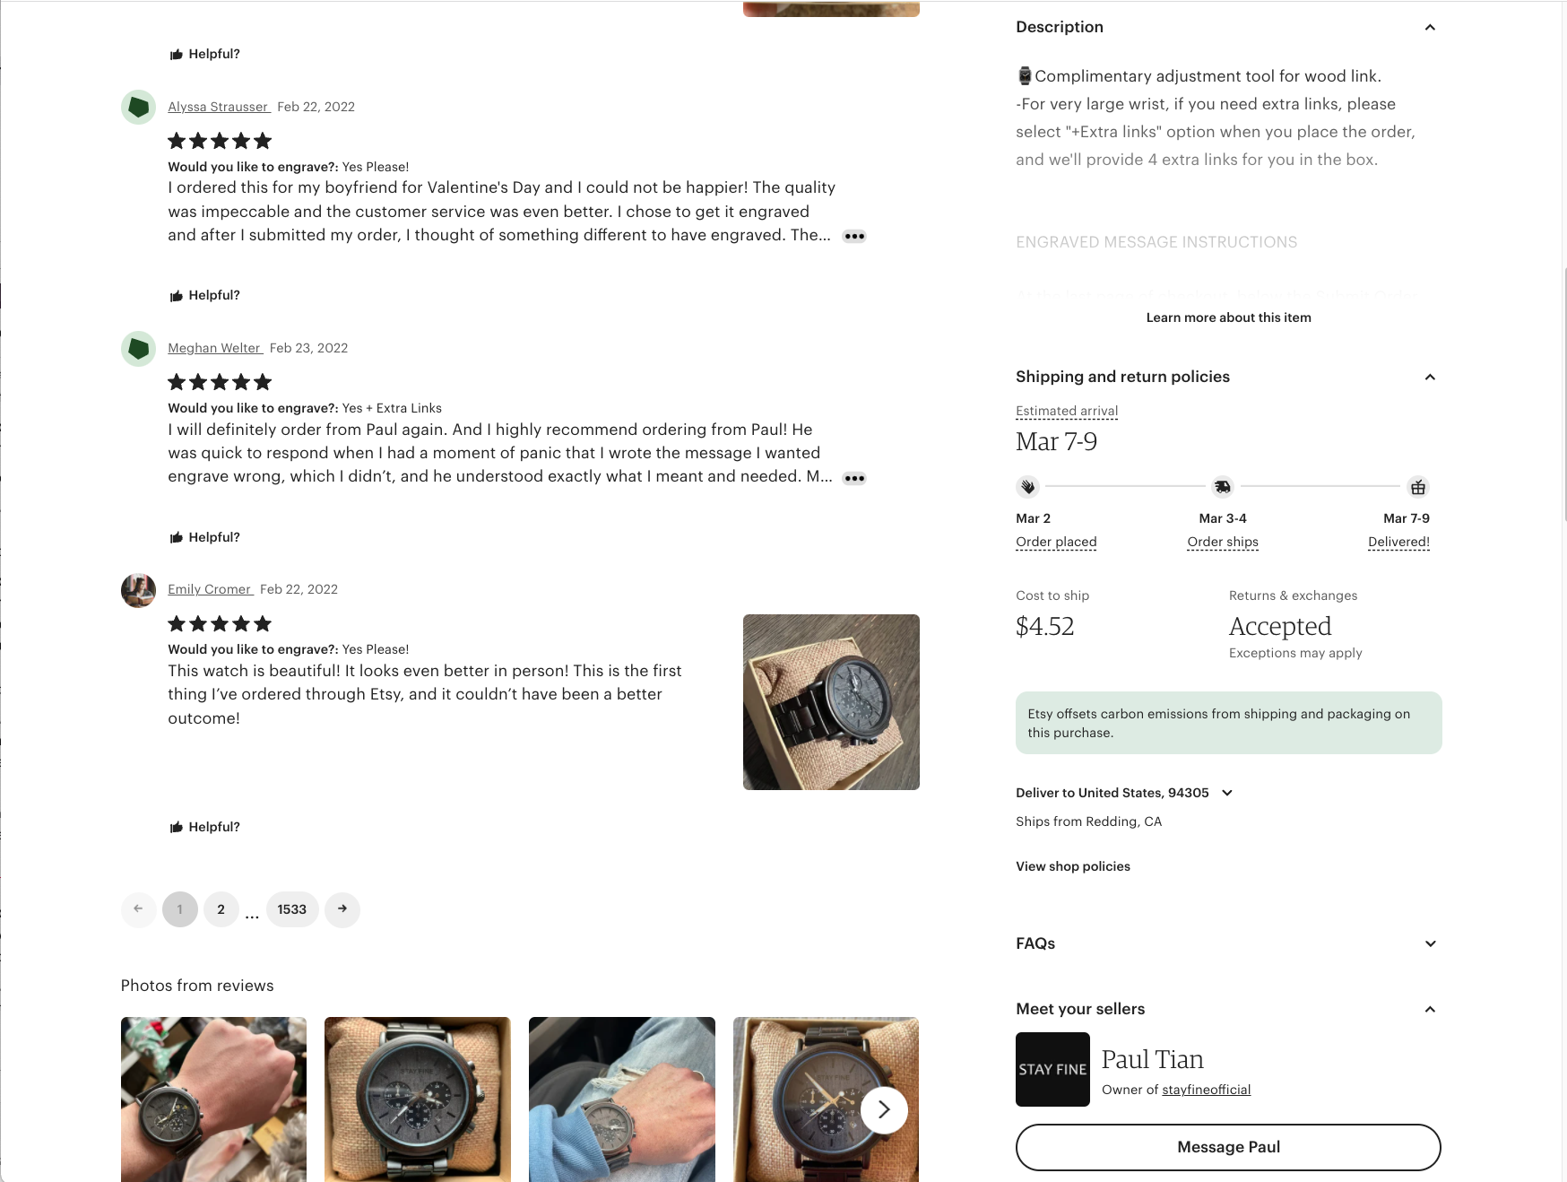
2
Notes:
We see more reviews on the left,
A detailed description on the right
Shipping and return policies, as well as the cost & time estimates
Finally, if we scroll down further
We find out more about who is selling it and we can contact them
This information is useful, but not essential for everyone who buys it.

Slide 35
3
Notes:
Let’s add the watch to the shopping cart and we get to this page

Slide 36
3
What site am I at?
  Logo in upper-left
  Colors, layout, font
  examples of SITE BRANDING (E1)
Notes:
Let’s add the watch to the shopping cart and we get to this page

Slide 37
3
Where am I in the site?
  Last button clicked was “Add to cart!”
  “in your cart” & “Proceed to Checkout” reinforce I’m on “the right page”
  shopping cart icon changed
  SHOPPING CART (F3)

Slide 38
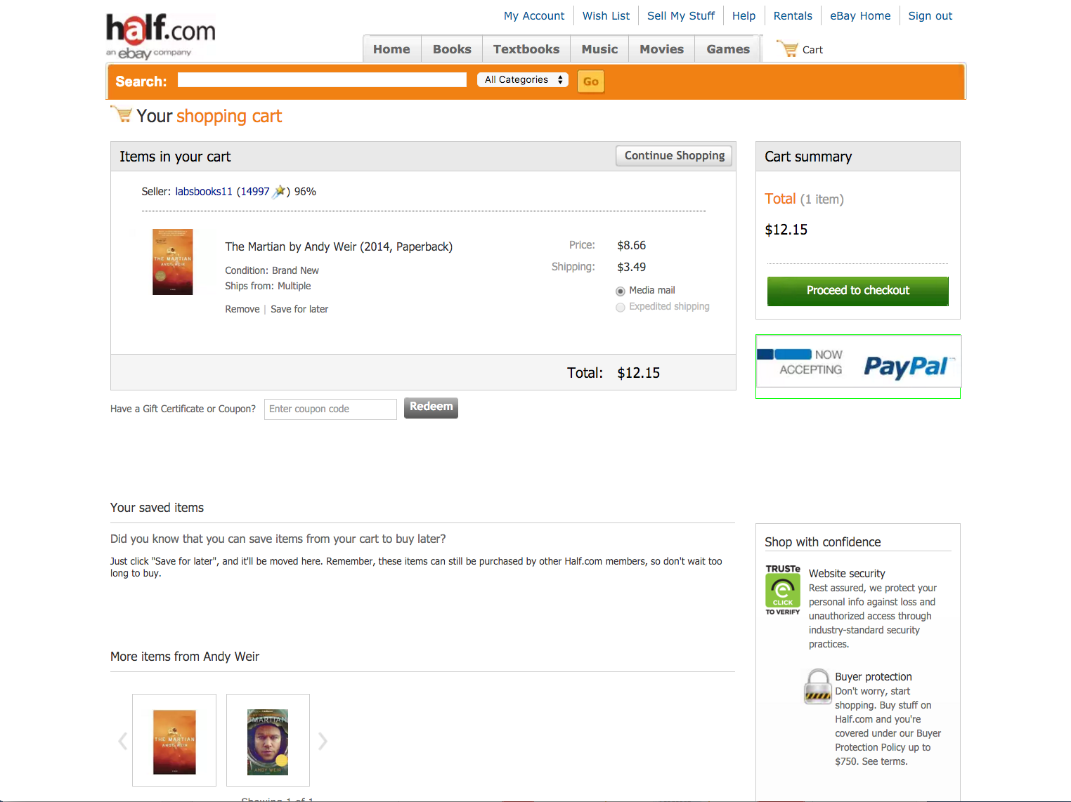
3
Cross-selling
  Possibly a pleasant surprise
  Impulse buy
  CROSS-SELLING & UP-SELLING (G2)

Slide 39
3
What am I going to buy?
  Easy to remove & save for later
How much will it cost?
  Could be better as need to click for shipping costs – surprise!
SHOPPING CART (F3)
Notes:
Let’s add the watch to the shopping cart and we get to this page

Slide 40
3
What can I do (they want me to do)?
  “Proceed to Checkout”
  HIGH VISIBILITY ACTION BUTTON (K5)
    visually distinct, looks clickable
    large
Notes:
…..
Now, let’s proceed to checkout
[ADVANCE]

Slide 41
4
What if I don’t have a User ID?
SIGN-IN/NEW ACCOUNT (H2)
Notes:
The last one (using 3rd party sites to authenticate wasn’t a thing when we wrote the book, but it is now part of the pattern that is out there.

Slide 42
4
What if I’m using a new device?
- 2-factor auth
SIGN-IN/NEW ACCOUNT (H2)
Notes:
This wasn’t in my book because nobody did 2-factor back then (was a research thing), but if rewriting it I’d add it to the SIGN-IN/NEW ACCOUNT pattern

Slide 43
4
What if I forgot my password?
SIGN-IN/NEW ACCOUNT (H2)
Notes:
We do a “Reset Password” here. Or email a link. The later wasn’t in my book as that again is a newer part of the pattern, so we could easily add it.

Slide 44
5
Notes:
So after we sign in we get to the shipping page

Slide 45
5
What site?
  Logo, layout, color, fonts
Where in site?
  Checkout, step 1 of 3
  “Choose a shipping address”
  QUICK-FLOW CHECKOUT (F1)
Notes:
So after we sign in we get to the shipping page

Slide 46
5
Note what’s different (?)
  No tab rows
  No impulse buys
  Only navigation on page takes you to next step
This is a PROCESS FUNNEL (H1)
  Extraneous info & links removed to focus customers
Notes:
But there are SOME BIG DIFFERENCES!
What’s different?????
[ADVANCE]
Let’s use my default shipping address and click “Ship here”

Slide 47
6
Notes:
Now we get to pay for it.
We see we are in the next step (payment) and shipping is done
We see a very prominent “Use this card” button”. Large and lots of white space around it
Again, these are examples of QUICK-FLOW-CHECKOUT
Let’s click on the “Use this card” button to use my default credit card.

Slide 48
7
Notes:
We get to the last step of the checkout, the review.
[ADVANCE]

Slide 49
7
Last step of process
  Step 3, “Review/Place Order”
  “Place your order” button
HIGH-VISIBILITY ACTION BUTTON (K5)
Notes:
[ADVANCE]
We get to the last step of the checkout, the review.
[ADVANCE]
We have a prominent “Place your order to Stanford” button

Slide 50
7
No nasty surprises
  Can see order
  Total price is same as shopping cart
  ORDER SUMMARY (F7)

Slide 51
7
Easy to change shipping & billing
All of these things are part of the design pattern
  QUICK-FLOW CHECKOUT (F1)

Slide 52
Design = Solutions
Design is about finding solutions
Unfortunately, designers often reinvent
    Hard to know how things were done before
    Why things were done a certain way
    How to reuse solutions
Notes:
What are these design patterns all about?
Design is about finding solutions

Slide 53
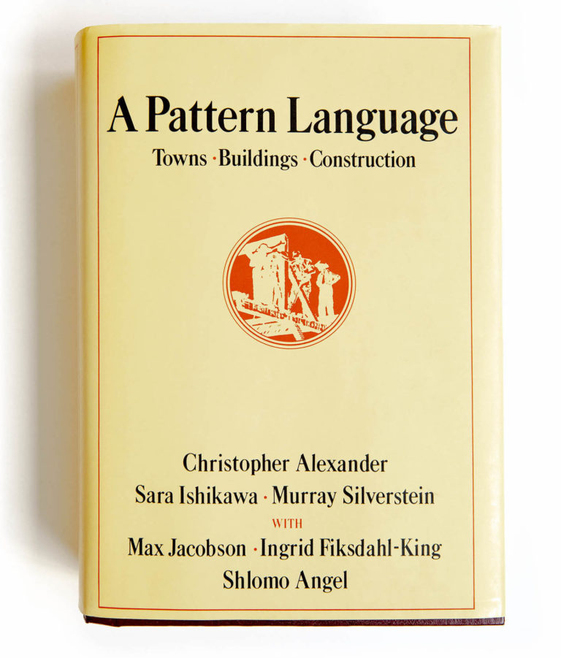
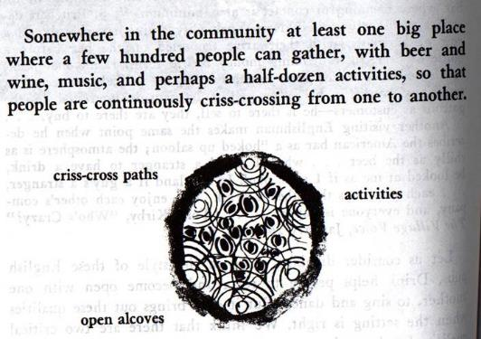
Design Patterns
Communicate common design problems & solutions
  First used in architecture [Alexander]
    Ex. How to create a beer hall where people socialize?
Notes:
[ADVANCE]
describe beer hall on next slide

Slide 54
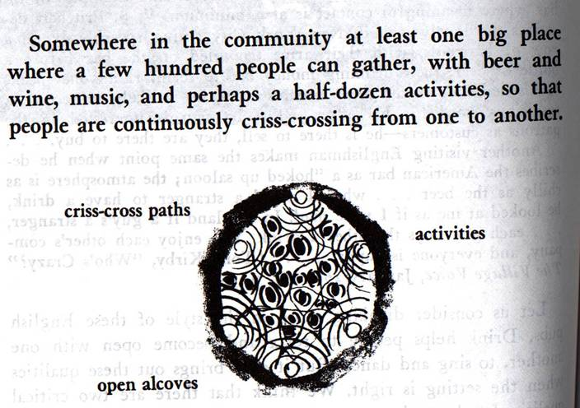
Notes:
Here is the pattern summary for beer hall
Notice the style. What is included and what isn't.
It is really a rough sketch as is the solution diagram below it. This is NOT a blueprint.

Slide 55
Using Design Patterns
Not too general and not too specific
  use a solution “a million times over, without ever doing it the same way twice”
Design patterns are a shared language
  for “building and planning towns, neighborhoods, houses, gardens, & rooms.”
  Ex. Beer hall is part of a center for public life…
  Ex. Beer hall needs spaces for groups to be alone… ALCOVES

Slide 56
A Web of Design Patterns
(8) Mosaic of Subcultures
Cities
& Towns
(31) Promenade
(33) Night Life
(90) Beer Hall
Local
Gatherings
(95) Building Complex
(179) Alcoves
(181) The Fire
Interiors

Slide 57
Web Design Patterns
Also used in UI design
Communicate design problems
& solutions
  how to create navigation bars
  for finding relevant content…
  how to create a shopping cart
  that supports check out…
  how to make e-commerce sites where people return & buy…

Slide 58
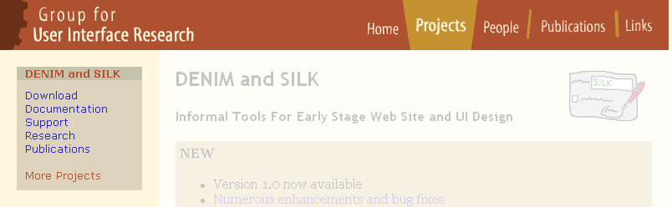
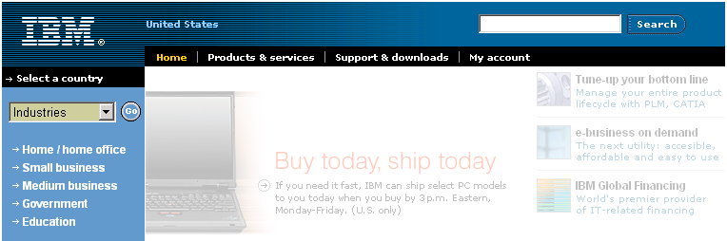
NAVIGATION BAR (K2)
Problem: Customers need a structured, organized way of finding the most important parts of your Web site
Notes:
Here is a simple example from web design to give you more of the flavor.
[ADVANCE]
This is my old research web site (this represented about 10-15 people)
[ADVANCE]
Here was IBM's web site at the same time (100K+ employees)
They are VERY similar in structure.

Slide 59
NAVIGATION BAR (K2)
Solution diagram
  captures essence on how to solve problem
First-level navigation
Link to home
Second-level navigation
Notes:
The solution diagram captures that essence on how to solve the problem.
Link to home... first level nav... second level nav...
And just like in Alexander's architectural patterns, it is a sketch. Just the essence.

Slide 60




Pattern Groups
Our patterns organized by group
  Site genres
  Navigational framework
  Home page
  Content management
  Trust and credibility
  Basic ecommerce
  Advanced ecommerce
  Completing tasks
  Page layouts
  Search
  Page-level navigation
  Speed
  The mobile web
Notes:
organized by group
from high level to low level
If I rewrote the book, "M - The mobile web" might be the entire book or at least several chapter groups.

Slide 61
PROCESS FUNNEL (H1)
Problem: Need a way to help people complete highly specific stepwise tasks
  Ex. Create a new account
  Ex. Fill out survey forms
  Ex. Check out
Notes:
Let's review one of the ones I showed you at the start.
Process Funnel...

Slide 62
PROCESS FUNNEL (H1)
Notes:
When we clicked on the “Proceed to checkout” button (after logging in)….

Slide 63
What’s different?
  No tab rows
  No impulse buys
  Only navigation on page takes you to next step
What’s the same?
  Logo, layout, color, fonts
Notes:
We got into the funnel..
[ADVANCE]
Notice what is different.
[ADVANCE]
What's the same
branding

Slide 64
PROCESS FUNNEL (H1)
Problem: What if users need extra help?
Notes:
Patterns need to evolve with design and the technology. Here is one example from when we wrote the first edition of the book.
[ADVANCE]

Slide 65
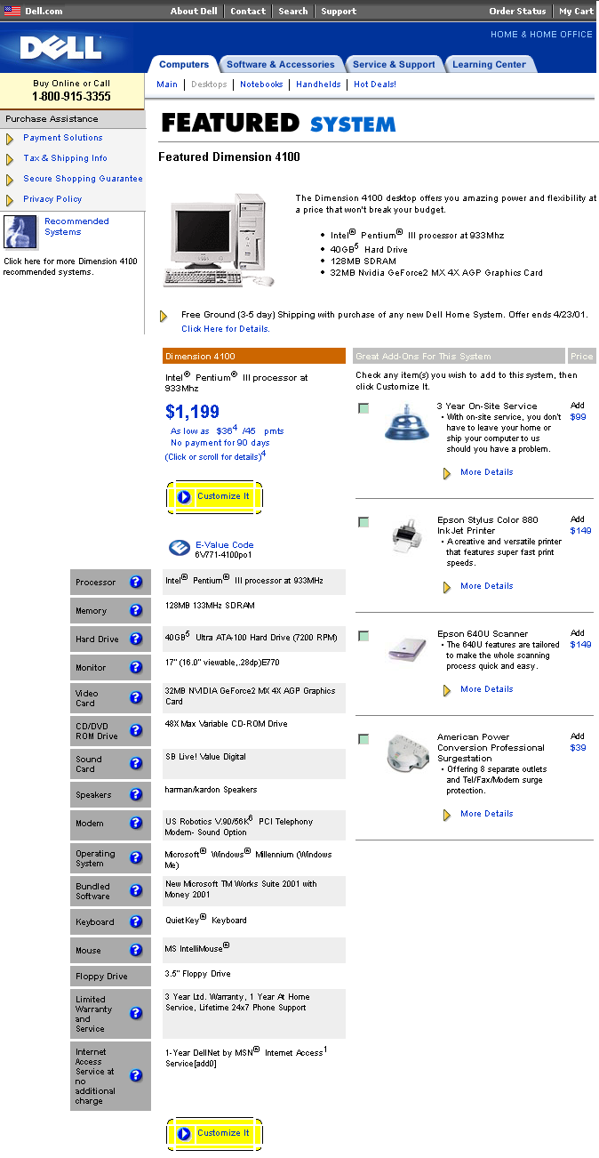
Process Tunnel
Notes:
You might be trying to keep people focused as they are buying something on your site. But what if they want extra help, you might not want them leaving to another page.

Slide 66
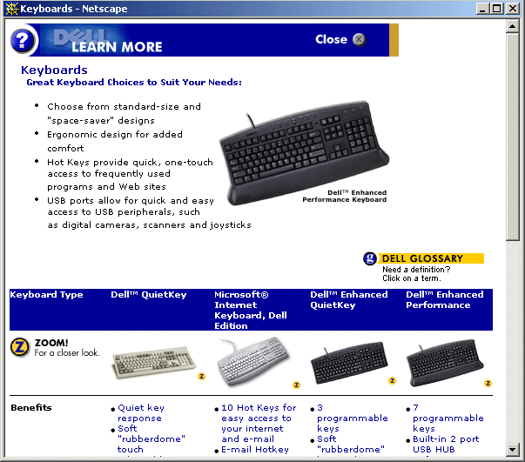
CONTEXT-SENSITIVE HELP (H8)
Notes:
The solution was a pop-up window with extra information overlaid, that could easily be dismissed and keep the user focused where you wanted them.
If you search for this topic on Google, you will come up with thousands of articles on how to disable popup blocking so contextual information can show – problem!
And every browser now offers the ability to simply block by default.

Slide 67
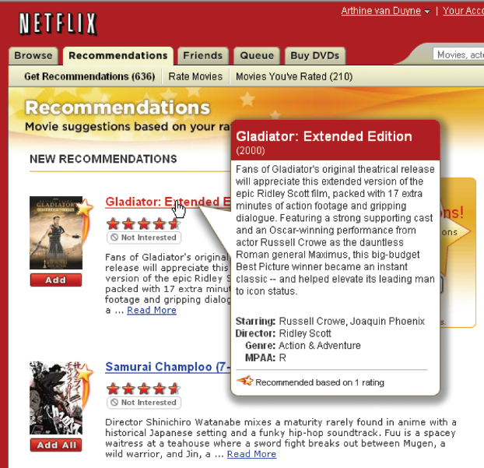
FLOATING WINDOWS (H6)
Notes:
Netflix was one of the early companies with a nicely designed solution. Floating windows. Appears like a pop-up but is still really part of the same page.

Slide 68
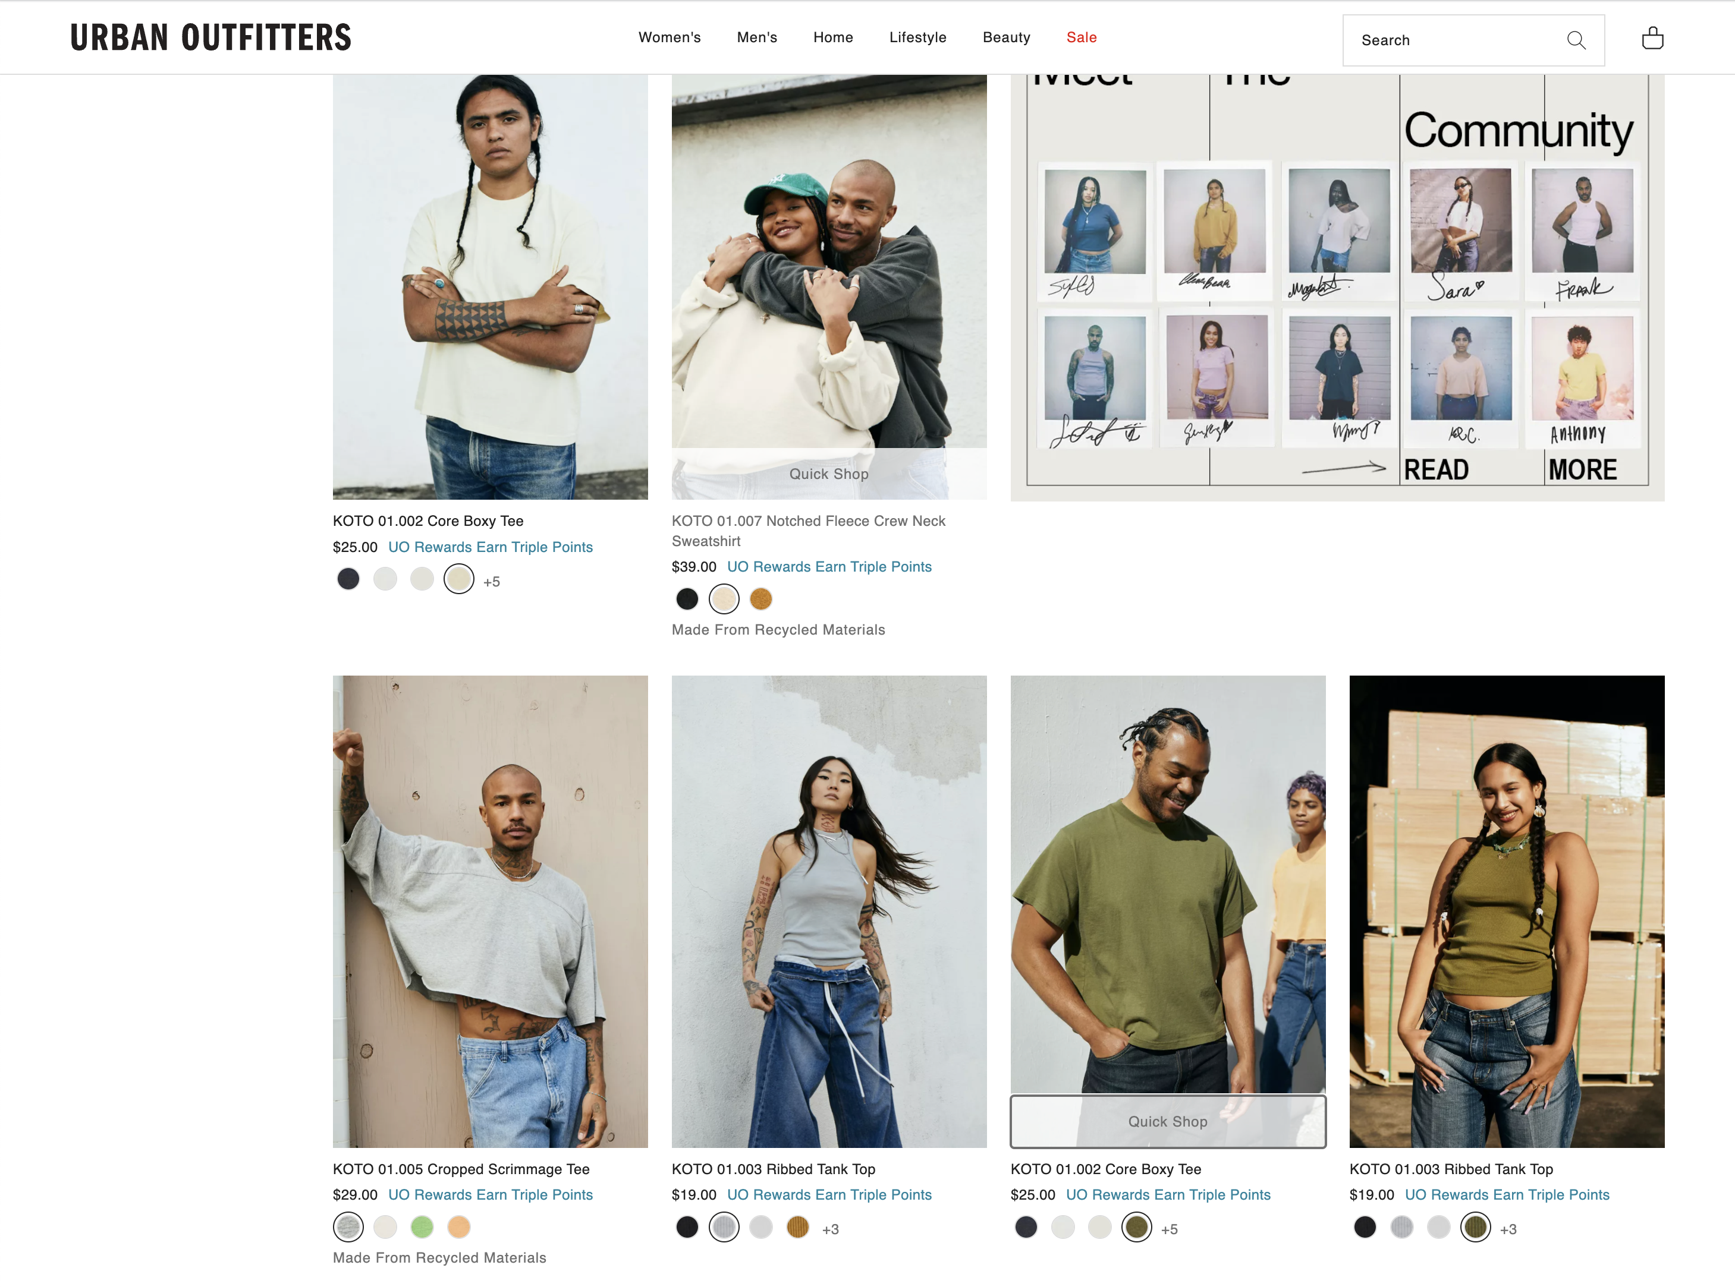
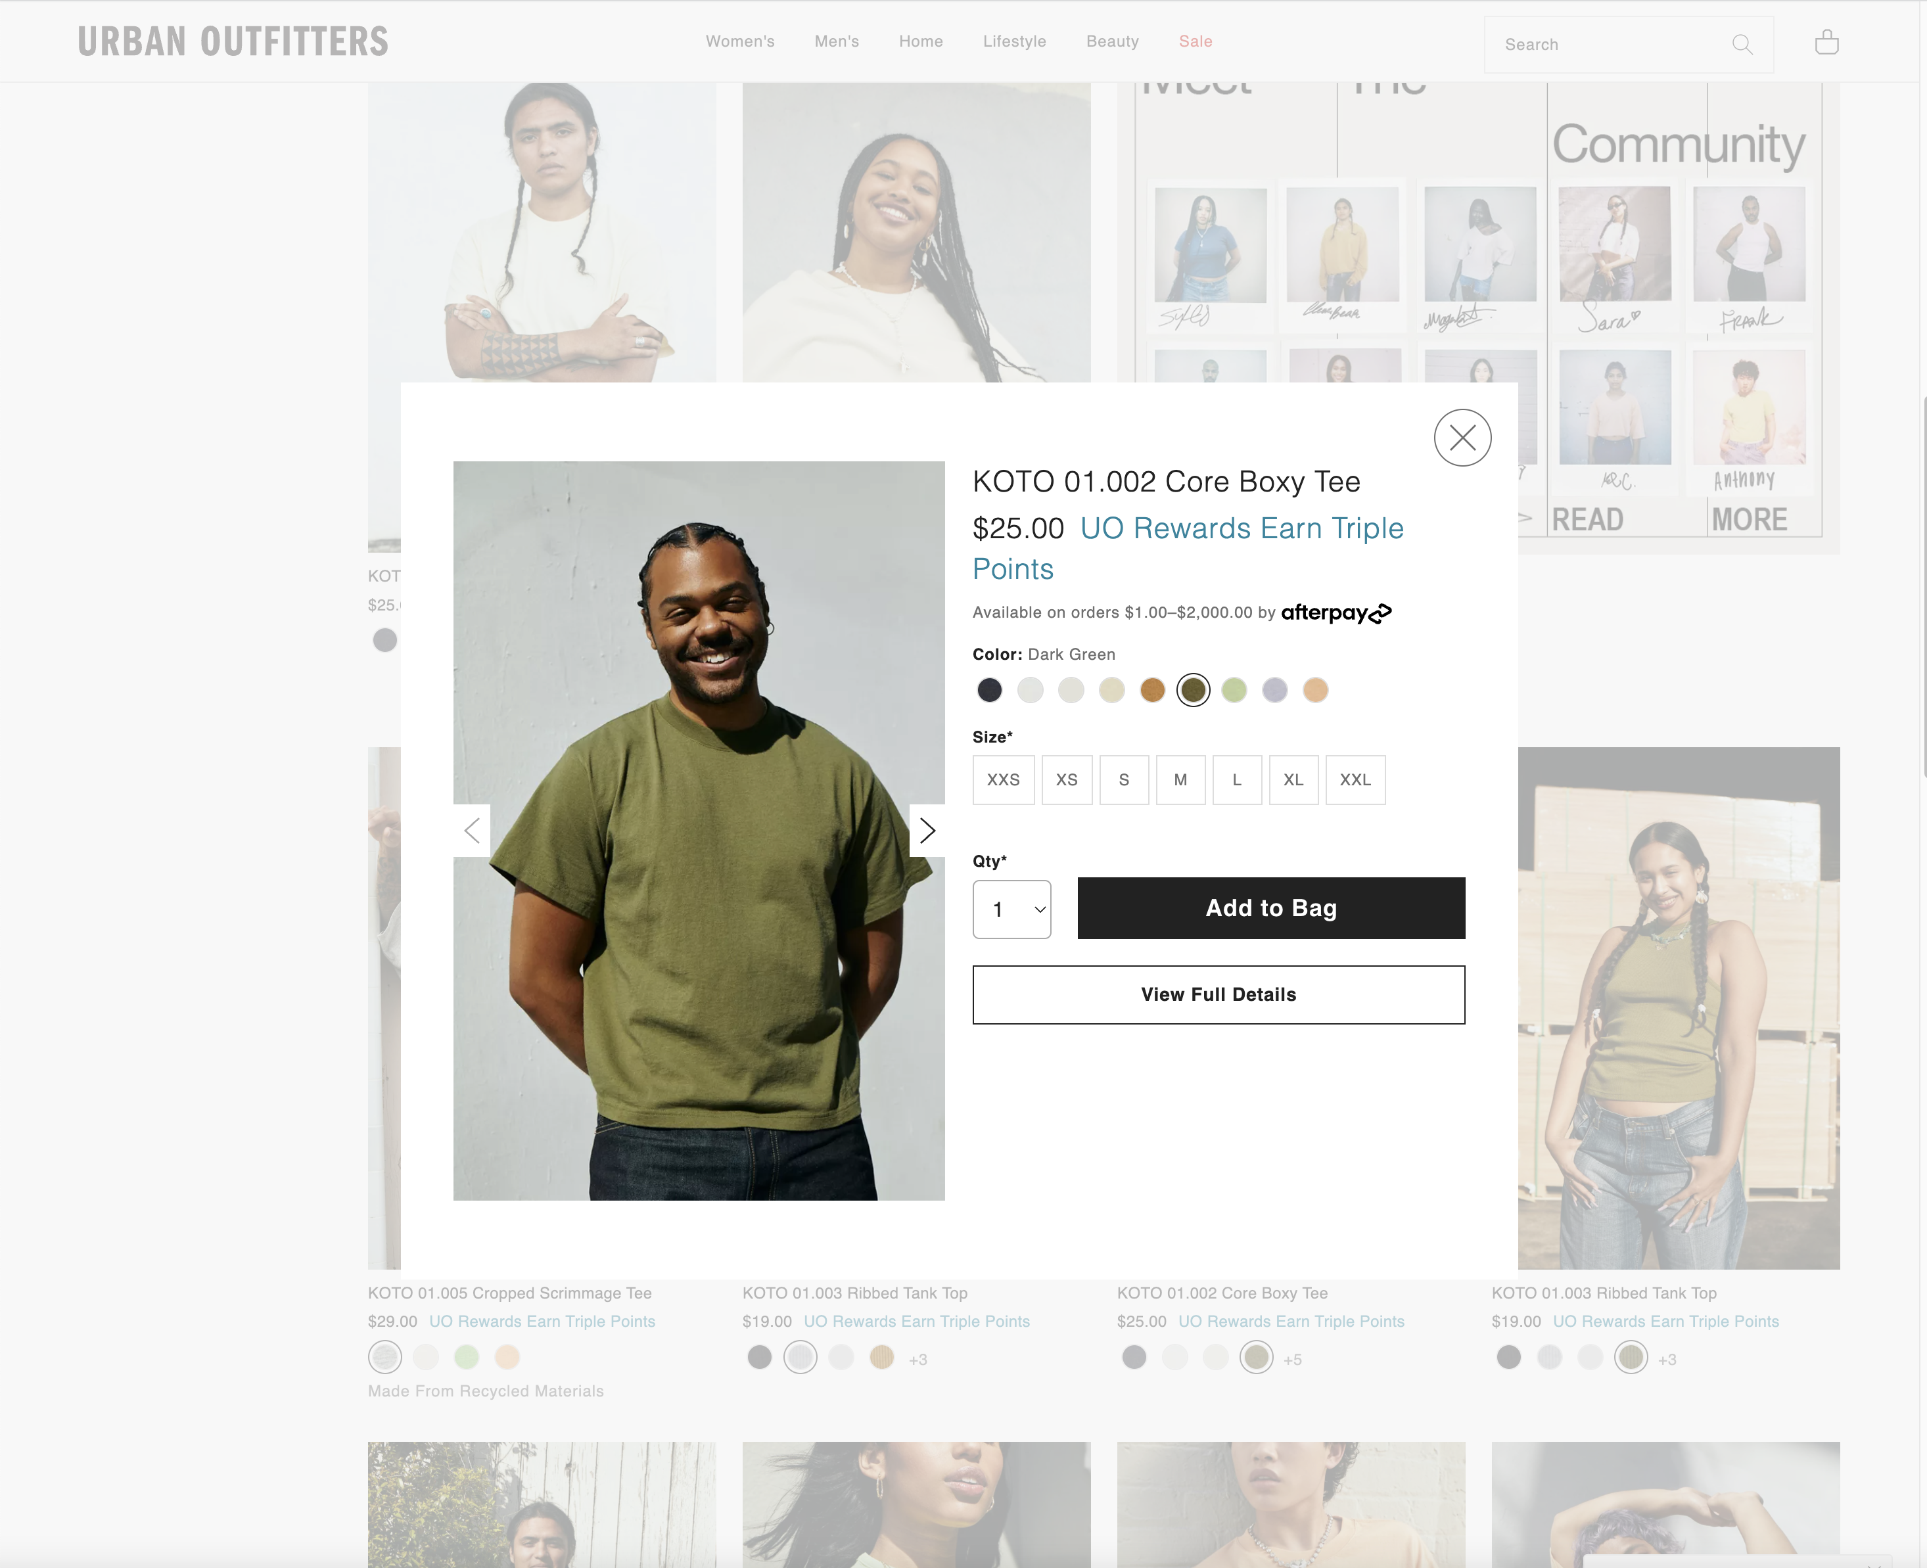
FLOATING WINDOWS (H6)
Notes:
Here we see the idea of floating windows at Urban Outfitters. You see something you want to know more about and click on “Quick Shop”
[ADVANCE]
and get this floating window with more information. Colors, sizes, and add to bag.

Slide 69
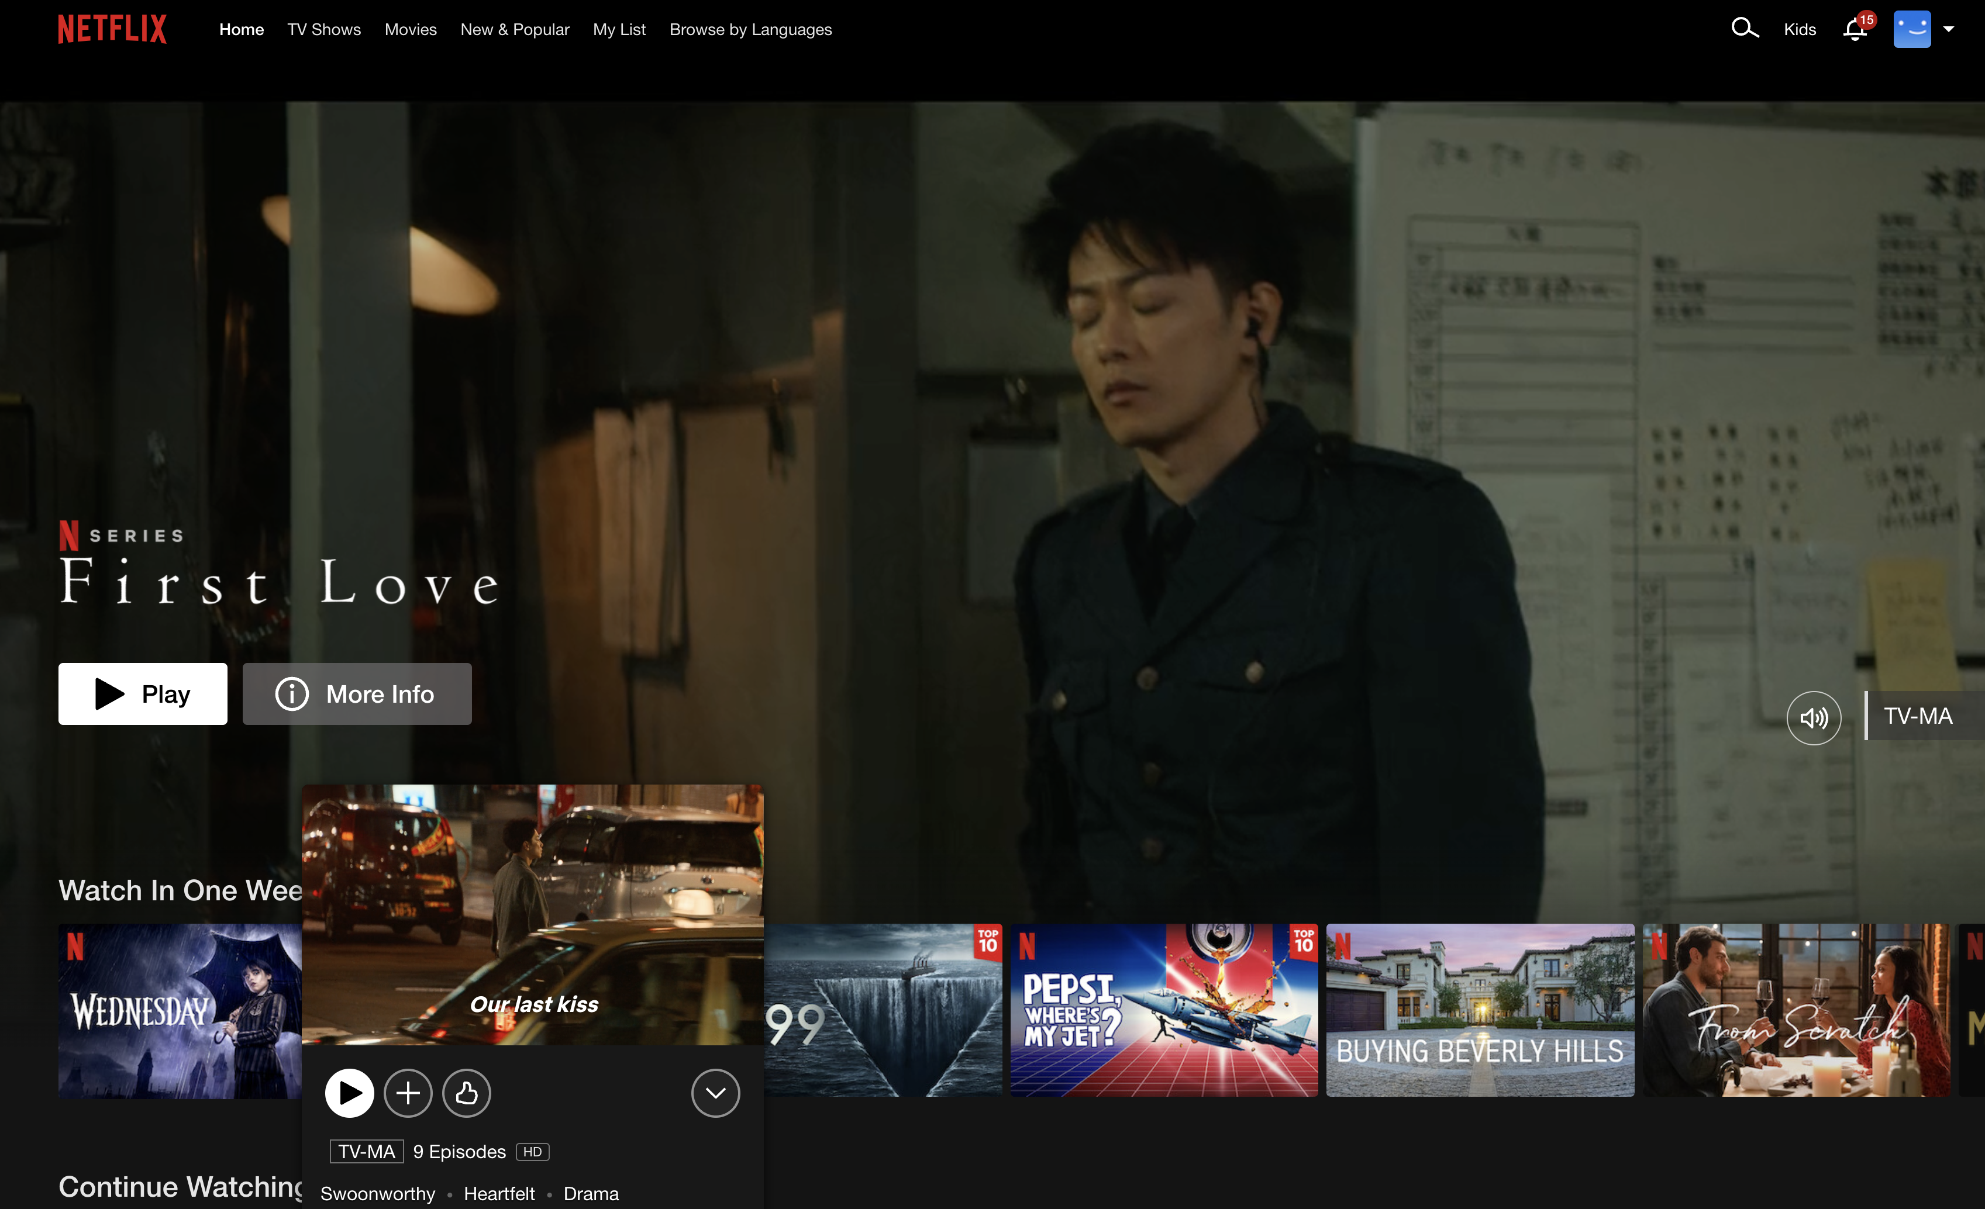
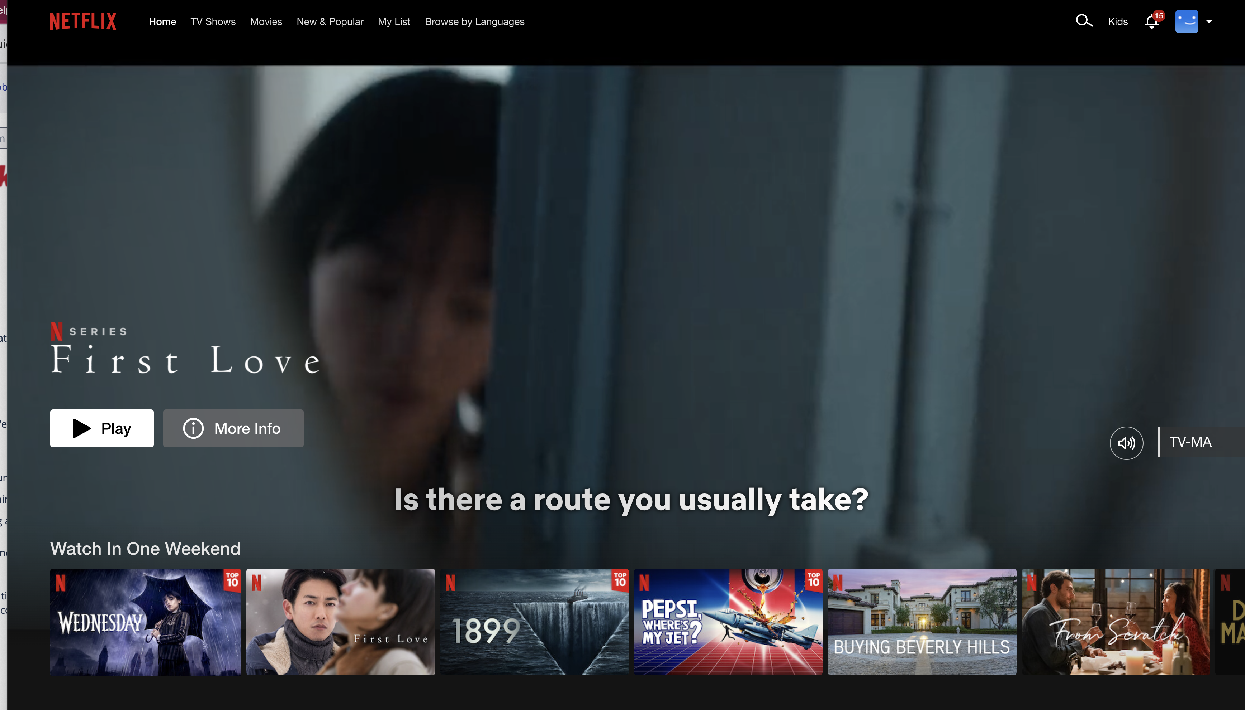
FLOATING WINDOWS (H6)
Notes:
Today’s Netflix does the same thing but is more video oriented
If I hover over one of these thumbnails, say this one named “First Love”,
[ADVANCE]
I get a little more info (its swoonworthy, heartfelt, and drama, 9 episodes) and a video starts playing.
If I click on the down arrow icon in the lower right of that it brings up more info.
[ADVANCE]

Slide 70
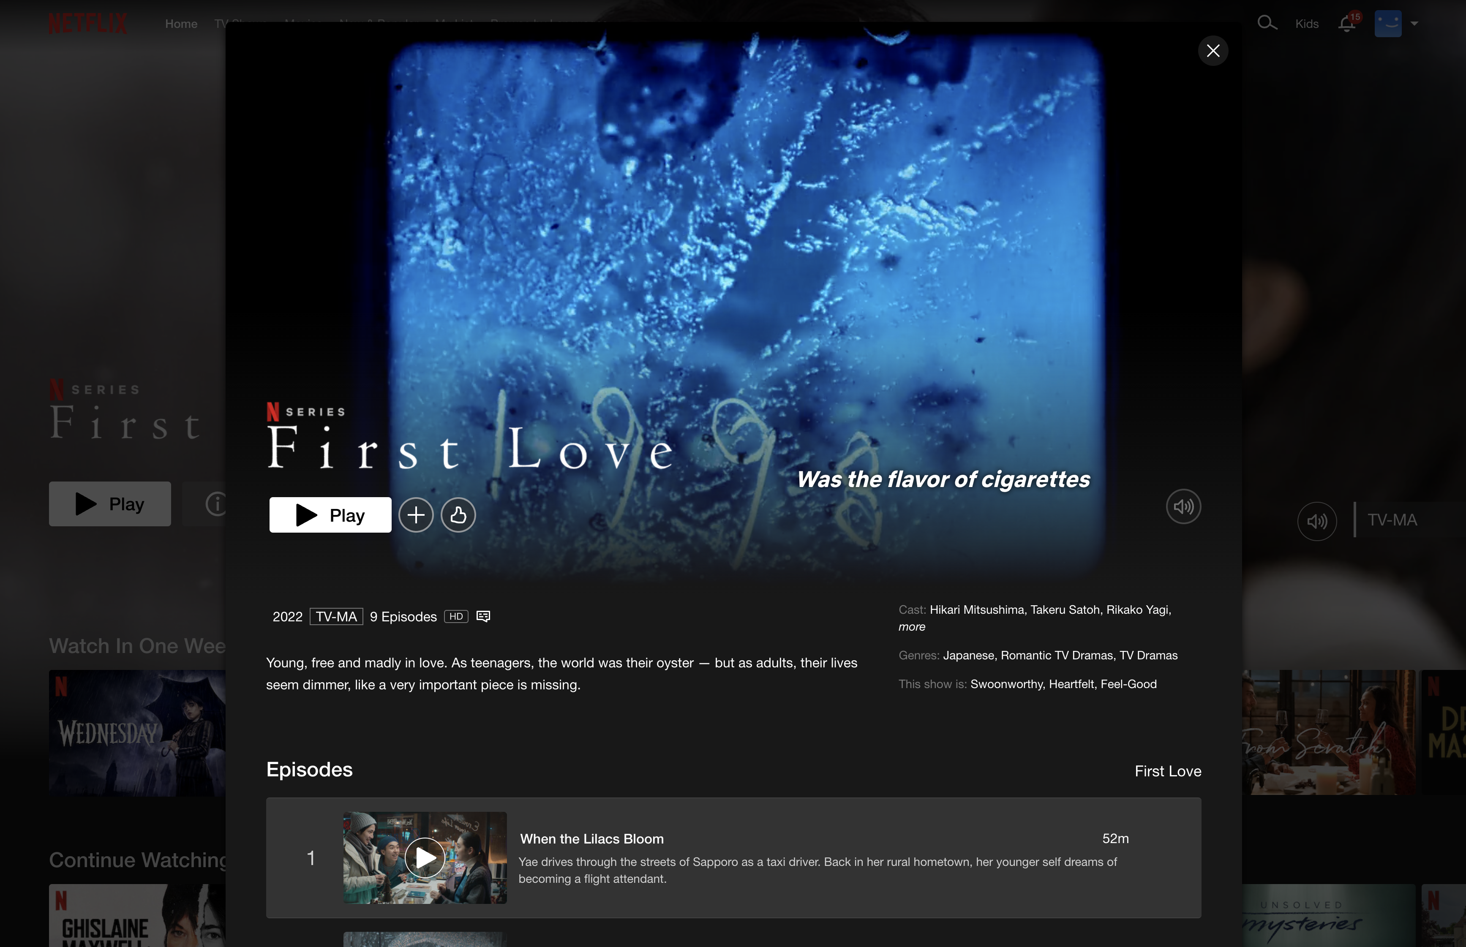
FLOATING WINDOWS (H6)
Notes:
but it it is still a floating window on top of my content, in context, and I can get rid of it by clicking on the X.

Slide 71
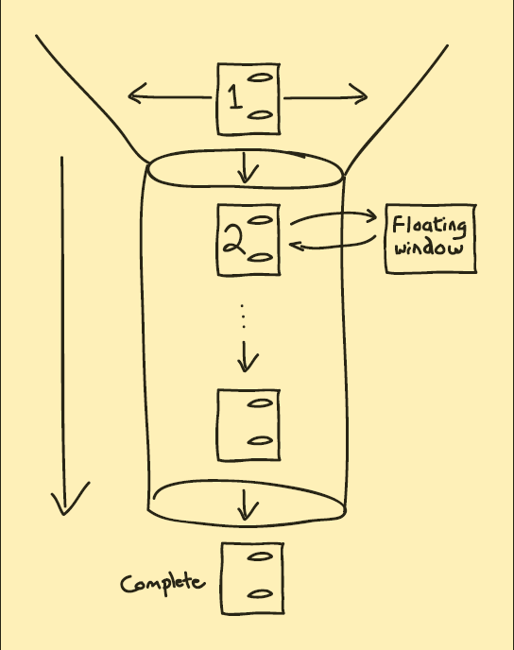
PROCESS FUNNEL (H1)
Solution Diagram
Notes:
So, the solution diagram for the process funnel looks like this.
You take an action that gets you into the funnel (page 1 -- but note on that page 1 there is still a lot of navigation).
But once you get into the funnel (page 2), not a lot of navigation except to go forward in the funnel and if you need more info, it uses floating windows.
This goes on until you complete the process.

Slide 72
PROCESS FUNNEL (H1)
Related Patterns
(A11) Intranets
(A1) E-Commerce
(A10) Web Apps
(H1) Process Funnel
(K2) Navigation Bars
(H8) Context-Sensitive Help
(I2) Above the Fold
(K3) Tab Rows
(K5) High-Viz Action Buttons
(K4) Action Buttons
(K12) Preventing Errors
(K13) Meaningful Error Messages
Notes:
Its related to these other patterns...
point to floating windows

Slide 73
Patterns Support Creativity
Patterns come from successful examples
  sites that are so successful that lots of users are familiar with their paradigms (e.g., Google, Amazon, Yahoo, Facebook, Instagram…)
  interaction techniques/metaphors that work well across many sites (e.g., shopping carts)
Not too general & not too specific
  you need to specialize to your needs
Patterns let you focus on the hard, unique problems to your design situation
  every real design will have many of these
Notes:
I want to talk about one criticism of design patterns. “design patterns take away my creativity as a designer”
Patterns come from successful examples....

Slide 74
Patterns Offer the Best of Principles, Guidelines & Templates
Patterns help get details right, without over-constraining the solution
  unlike principles, patterns not too general, so can see how to apply to your situation
  unlike guidelines, patterns discuss tradeoffs, show good examples & tie to other patterns
  unlike style guides, patterns not too specific, so can still be specialized
  unlike page templates, patterns illustrate flows among different pages
Patterns can serve as documentation for teams
Often used along with or as part of design systems

Slide 75
Format of Web Design Patterns
Pattern Name and Number
Exemplar
Background
Problem
Forces
Solution
Solution Diagram
Related Patterns

Slide 76
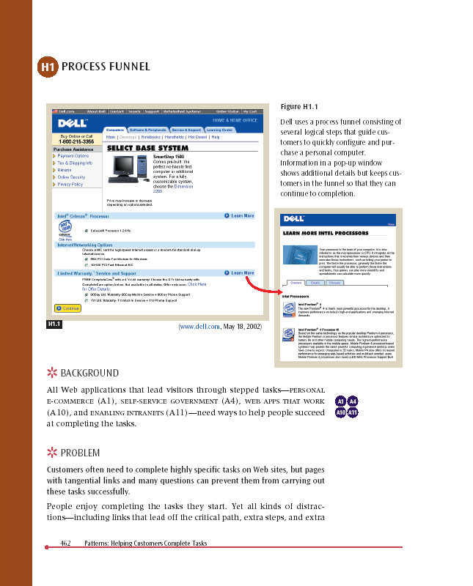
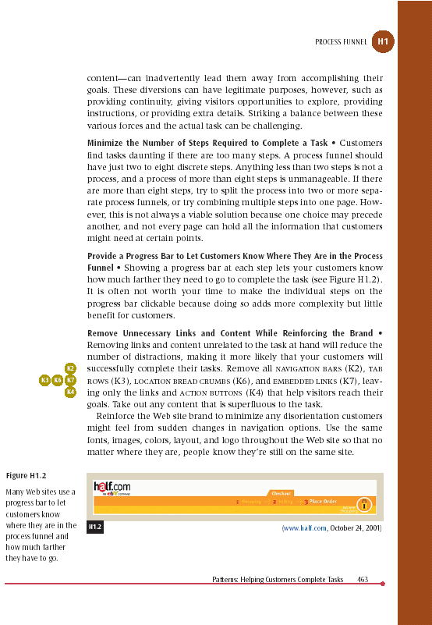
Pattern Name and Number
Exemplar
Forces &
Solution
Background
Problem Statement

Slide 77
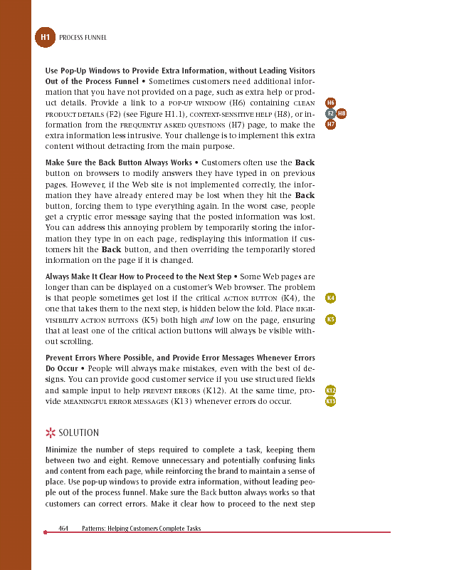
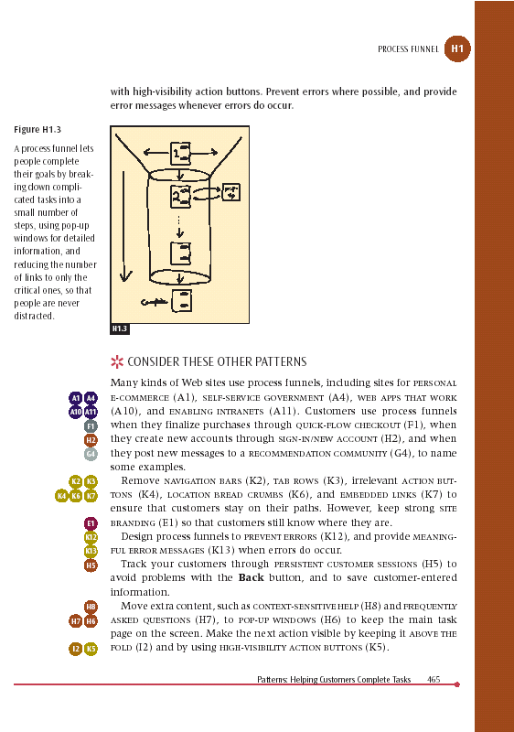
Bus Stops
Solution
Diagram
Related
Patterns
Solution
Summary

Slide 78
Administrivia
Project Questions?
Project Fair Questions?

Slide 79
Grading on the Heuristic Eval Assignments
Assignment #7 Heuristic Evaluation (individual)
A7 HE (individual): -: 2% ✓--: 4% ✓-: 7% ✓: 42% ✓+: 45% ✓++: 1%
A7 HE (individual) Avg: 91%
Assignment #9 Heuristic Evaluation (group)
A9 HE (group): -: 0% ✓--: 0% ✓-:8% ✓: 35% ✓+: 58% ✓++: 0%
A9 HE (group) Avg: 93%
Notes:
Here you can see the averages for the individual and group heuristic evaluation assignments.
Overall average, individual 91% and group, 93%.
After these the in class exercise, these two assignments, and the exam, you should now KNOW how to do heuristic evaluation and you will hopefully use it again and again.
People had the most problems in coming up with some of the statistics. This had to do with people finding WAY more violations than in the past. Not sure where that came from as I’m not sure your interfaces are any worse than in the past. Next year, we will have a spreadsheet with formulas to help the students do this more efficiently.

Slide 80
team break
work on FINAL DELIVERABLES
  PROTOTYPE
  Posters
  Pitch slides
  DEMO VIDEO
  report
Notes:
This year:
Broke at 70 min in,
gave 25 min break (restart 3:05 PM)
need to finish in 15 min
Last Year:
Broke at 63 min in, so gave a 27 min break. Will try to finish in 20 min
---------
Need to break by 55 min if want 30 min break. Cut break in 5 min increments as appropriate.
Last year:
Broke at 1:15 in, so with 30 min break, only had 15 min to finish (which is probably 5 min short)
30 minutes if that will leave me with at least 15 min at the end
[two years ago 1st part was 60 minutes which gave easy 17 min after the break – could use a full 20]

Slide 81
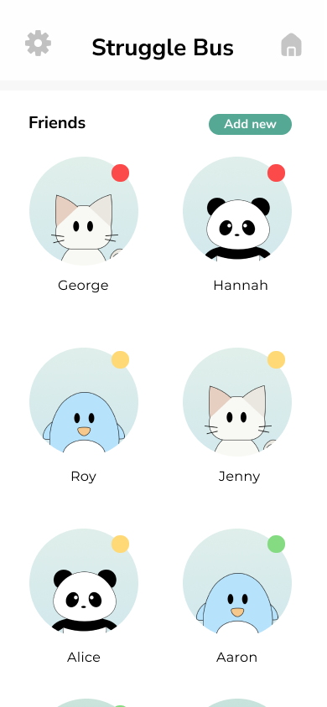
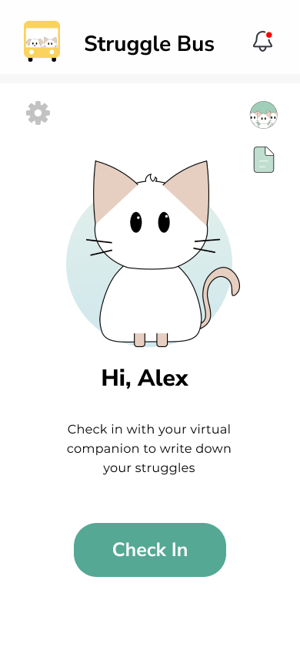
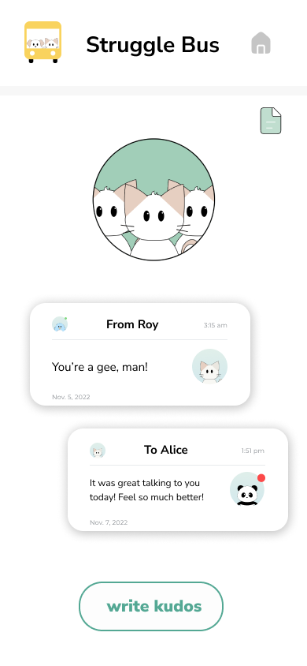
A6 Highlights:
Struggle Bus
Hand-drawn icons/animals
Minimalist UI caters to user needs.
Use of animations and scrolling

Slide 82
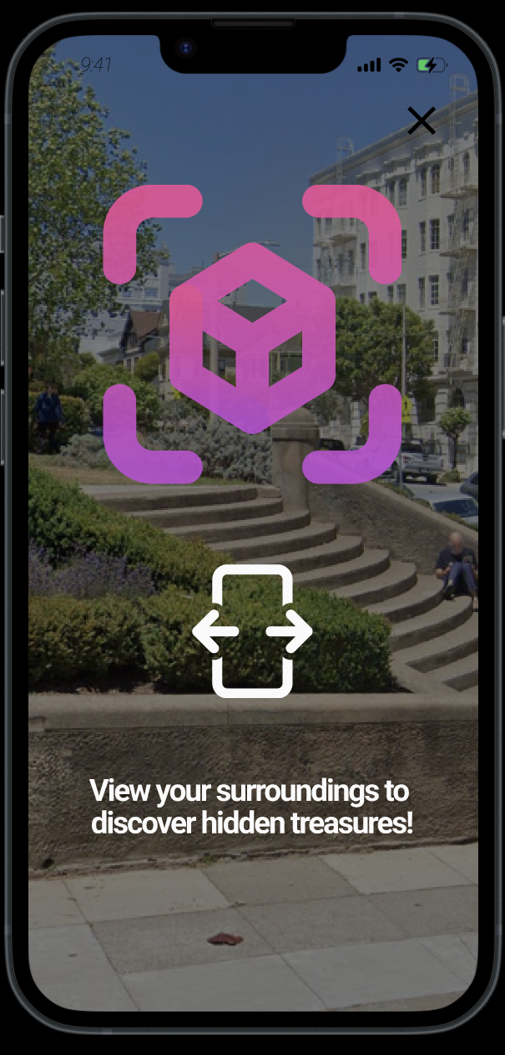
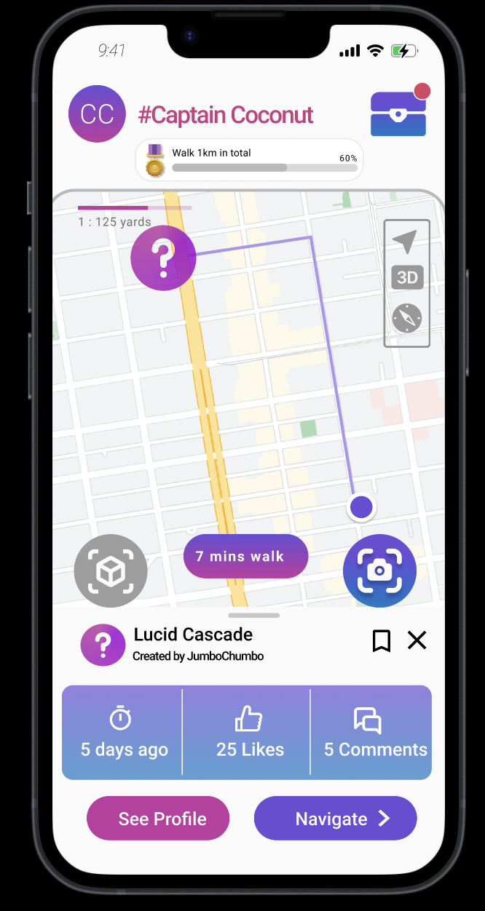
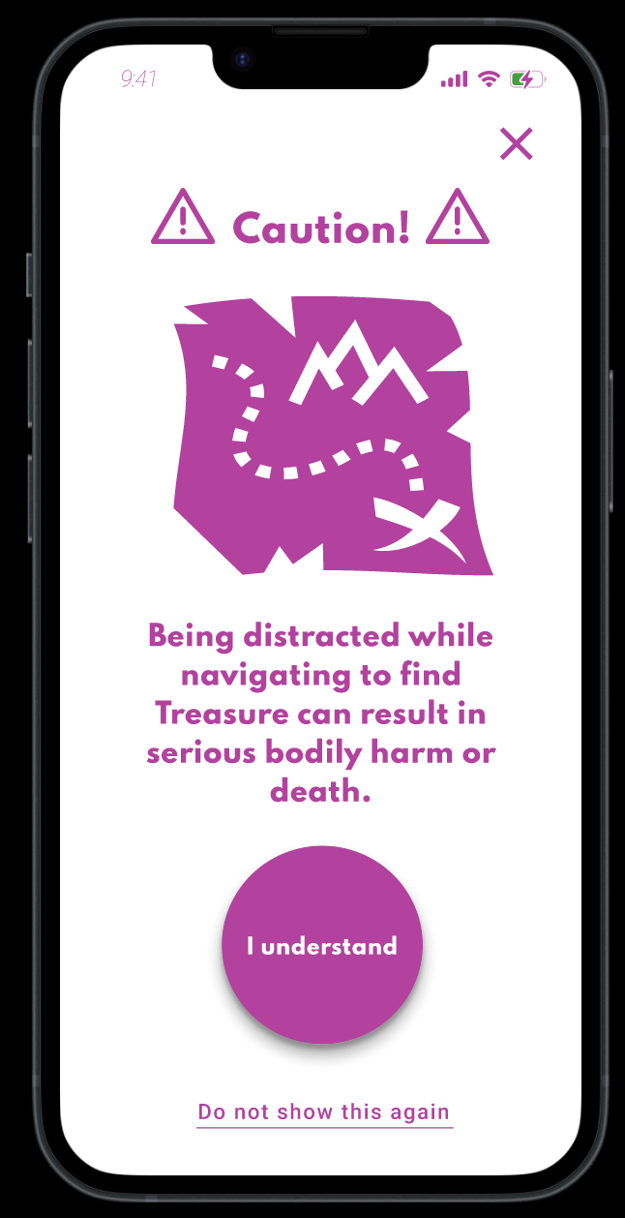
A6 Highlights:
Trove
Very interactive and dynamic
Error handling and preventing user errors
Encoding values of safety
Could easily give to an engineer for development

Slide 83
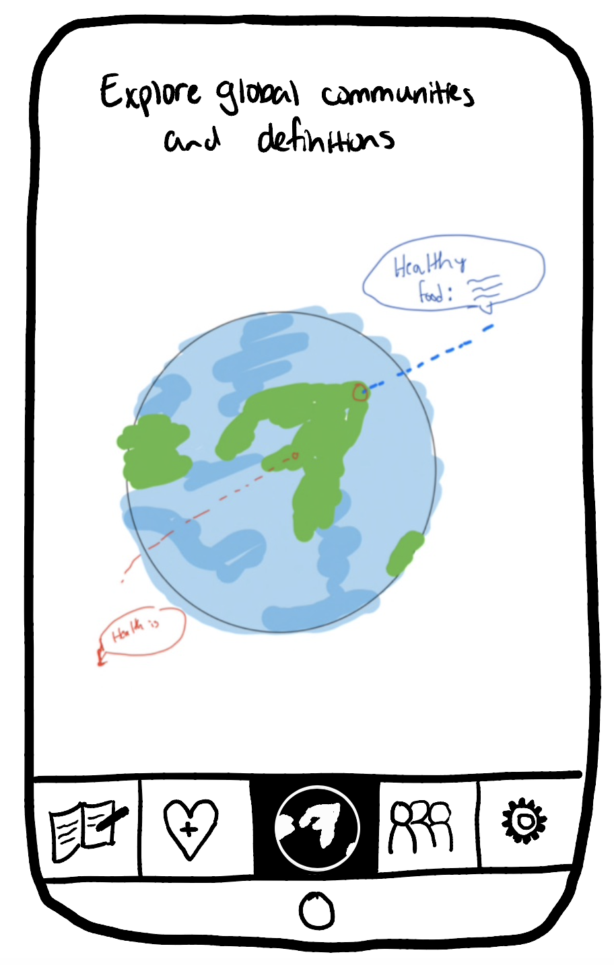
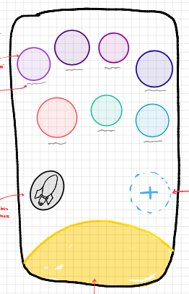
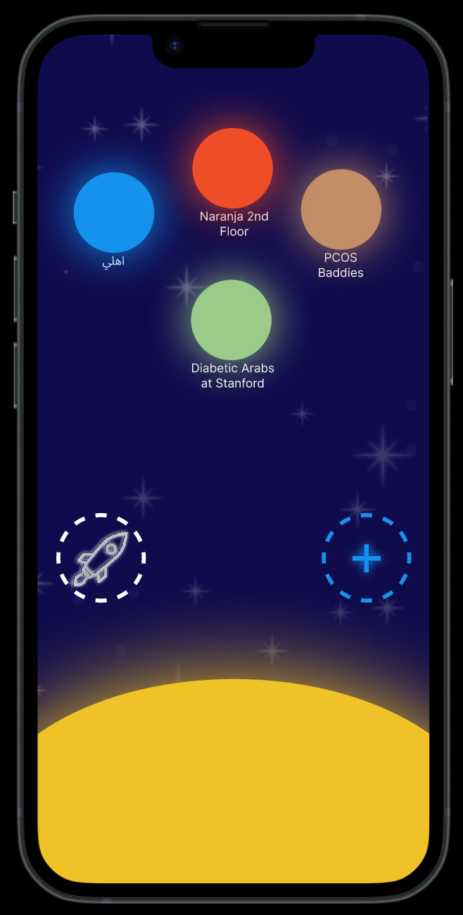
A6 Highlights:
Synastry
Redesign to better meet values and usability goal.
Novel UI to meet goal of combatting western bias in health while avoiding reinforcing existing biases
Notes:
Before: confusing interactions, no space for non-localized communities
After: simple interactions (tapping), allows for non-localized communities
Usability goal: fewer steps to find relevant communities
Why not Pear? Synastry omg what happened?!?!?! →
Well, we had a HUGE sit down conversation with everyone in our group and went all the way back to square one with our interviews. Was Pear addressing our interview pain points? We decided no, we were so focused on combating a western bias in health, that we overlooked what new bias we may be exposing participants to with the global approach. Basically, we initially wanted to zone it in earth, but that neglected our very own bias — just because health isn’t projected in a western lens, it’s no longer bias free. All definitions around earth are both rooted in negative + positive definitions. There are patriarchal, colonial, and ageist undertones in what it means to be healthy all around the globe — so is earth the best place to define that definition? We thought no, when it's your health — you need to craft something thats all your own — your own health universe. That goes beyond just what is on earth and takes the positives (to you) from each health definition you join and discover. You can create your own solar system of health. Here, the user is the center of their solar system. They’re able to add planets (communities) they feel connected to, and really have the ownership of their own health journey even by the spaces they enter. This galaxy approach also allows communities not represented through geographical mediums to be included in one’s health journey – like diabetes, or PCOS groups which are not exclusive to a particular geographical region which the globe depended on.

Slide 84
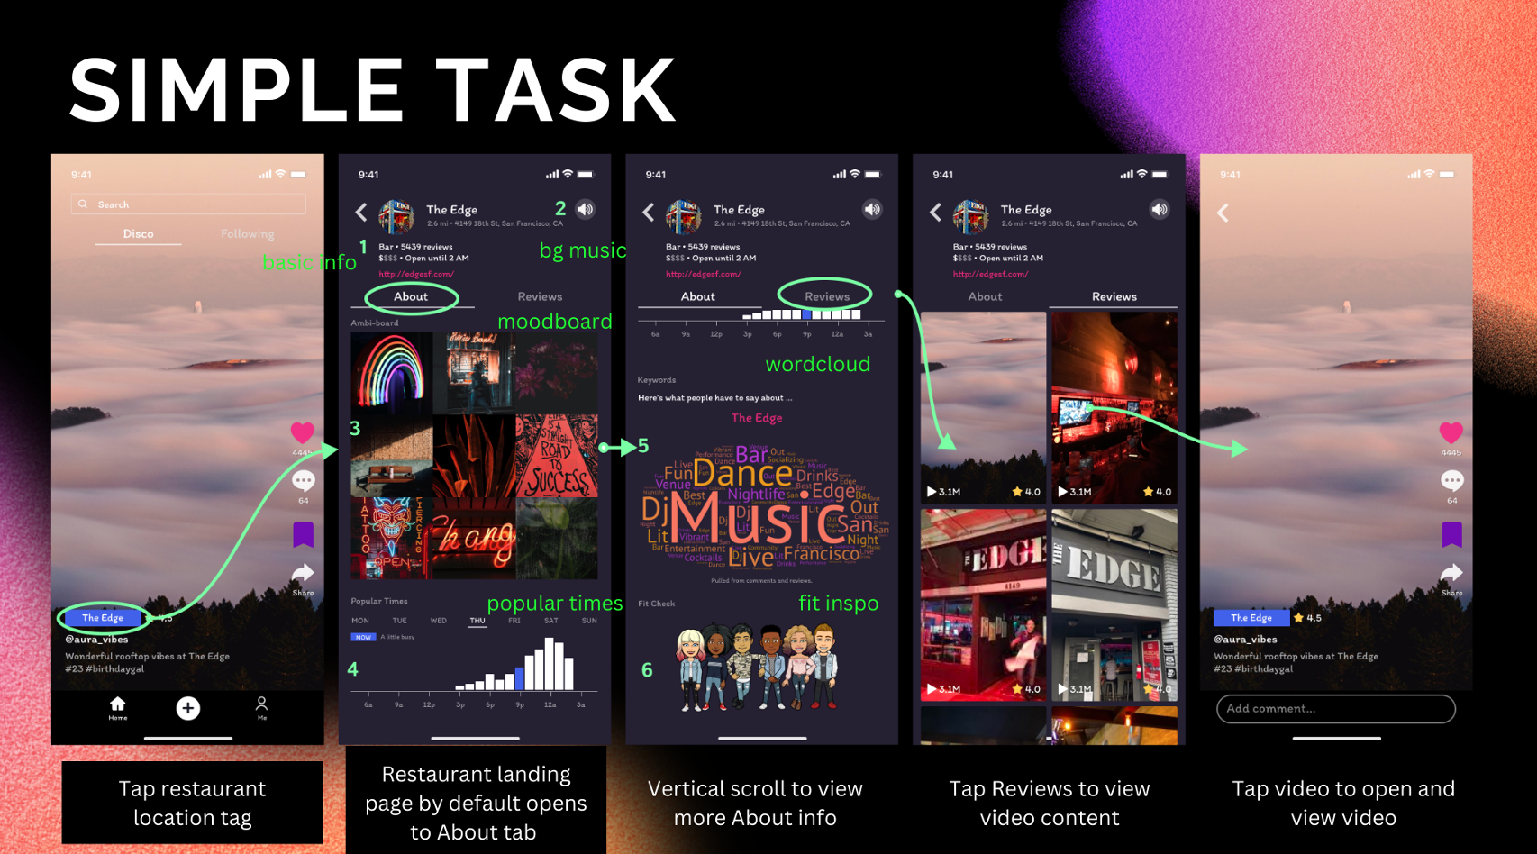
A6 Highlights
Ambi
Dynamic and scrollable!
Lots of different media utilized to capture the ambience
Intuitive UI - cleverly uses common UI patterns that adapt to their solution
Pretty good use of whitespace.
Notes:
Before: confusing interactions, no space for non-localized communities
After: simple interactions (tapping), allows for non-localized communities
Usability goal: fewer steps to find relevant communities
Why not Pear? Synastry omg what happened?!?!?! →
Well, we had a HUGE sit down conversation with everyone in our group and went all the way back to square one with our interviews. Was Pear addressing our interview pain points? We decided no, we were so focused on combating a western bias in health, that we overlooked what new bias we may be exposing participants to with the global approach. Basically, we initially wanted to zone it in earth, but that neglected our very own bias — just because health isn’t projected in a western lens, it’s no longer bias free. All definitions around earth are both rooted in negative + positive definitions. There are patriarchal, colonial, and ageist undertones in what it means to be healthy all around the globe — so is earth the best place to define that definition? We thought no, when it's your health — you need to craft something thats all your own — your own health universe. That goes beyond just what is on earth and takes the positives (to you) from each health definition you join and discover. You can create your own solar system of health. Here, the user is the center of their solar system. They’re able to add planets (communities) they feel connected to, and really have the ownership of their own health journey even by the spaces they enter. This galaxy approach also allows communities not represented through geographical mediums to be included in one’s health journey – like diabetes, or PCOS groups which are not exclusive to a particular geographical region which the globe depended on.

Slide 85
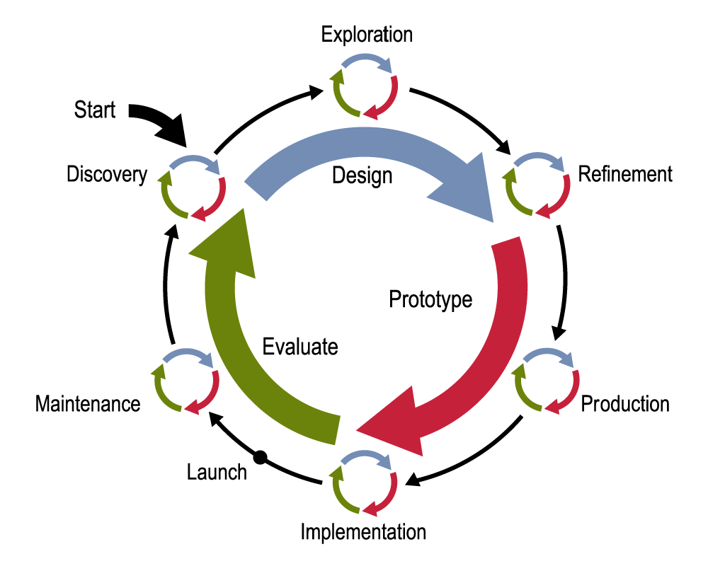
Design Process
Notes:
Patterns can easily be used in later phases as you refine a design, but they can even be used in the early exploration phase

Slide 86
Patterns in Exploration Phase
Exploration-level patterns to design overall structure
  different choices will give radically different designs
For example, how to organize information
  HIERARCHICAL ORGANIZATION (B3)
  TASK-BASED ORGANIZATION (B4)
  ALPHABETICAL ORGANIZATION (B5)
  …

Slide 87
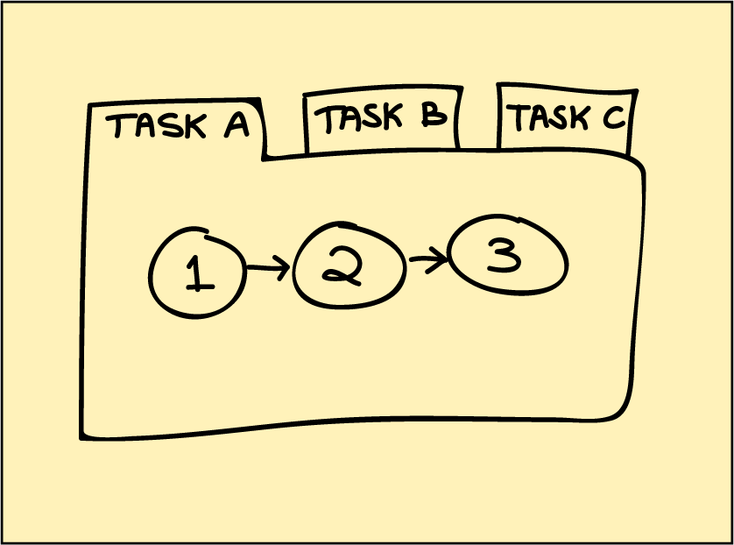
Patterns in Exploration Phase
TASK-BASED ORGANIZATION (B4): Link the completion of one group of tasks to the beginning of the next related task(s)
Notes:
Here is one example of how you might use design patterns early on.
Lets look at some of the exploration phase patterns.

Slide 88
Design Exploration Example
John given the task of designing a new subsite for showing maps to businesses
  listings found by typing in address
  key feature: show nearby businesses
John comes up with two design sketches
  Design #1 uses ALPHABETICAL ORGANIZATION (B5) for list of all nearby businesses
  Design #2 uses TASK-BASED ORGANIZATION (B4) for list of related nearby businesses

Slide 89
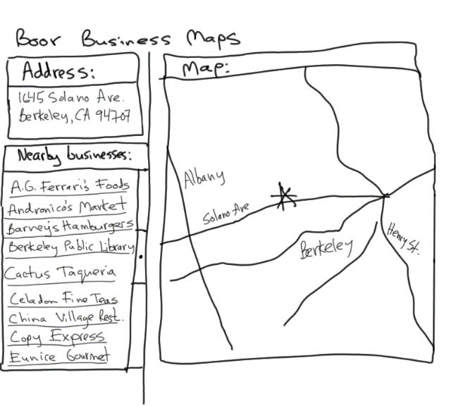
Design #1
ALPHABETICAL ORGANIZATION (B5)

Slide 90
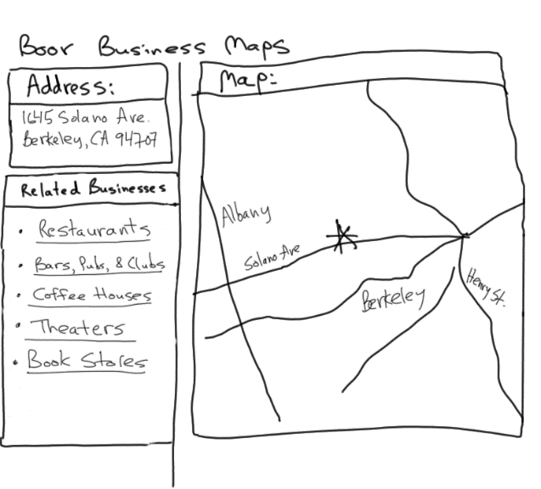
Design #2
TASK-BASED ORGANIZATION (B4)

Slide 91
Evaluating Which Design to Choose
Low-fidelity Usability Test
  sketches the rest of the key screens on paper
  brings in 5 participants to his office
  asks each to carry out 3 tasks while colleague Sam “plays computer”
  John observes how they perform
Tasks
  look up 1645 Solano Ave., Berkeley CA
  look up 1700 California Ave, San Francisco CA & find Tadich Grill
  look up 2307 Birch St., Palo Alto CA & find a Sushi restaurant nearby

Slide 92
Evaluating Which Design to Choose
Results with Design #1 (Alphabetical)
  Task 1: look up 1645 Solano Ave
    no difficulties encountered – warm-up task!
  Task 2: look up 1700 California & find Tadich Grill
    several users didn’t notice that the list of nearby businesses was scrollable (due to paper affordances?)
    those that scrolled took awhile to find in list of over 500
  Task 3: look up 2307 Birch St. & find nearby Sushi restaurant
    3 users only picked restaurants that had “restaurant” in the name & thus couldn’t find “Daigo”

Slide 93
Evaluating Which Design to Choose
Results with Design #2 (Task-based)
  Task 1: look up 1645 Solano Ave
    no difficulties encountered – warm-up task!
  Task 2: look up 1700 California & find Tadich Grill
    1 user took awhile to figure out that Tadich Grill was a restaurant & to click on the “Restaurants” link
    all others found it in 2 clicks (Restaurants->Tadich Grill)
  Task 3: look up 2307 Birch St & find nearby Sushi restaurant
    3 found “Daigo” in 2 clicks
    2 others asked for a listing of Japanese restaurants

Slide 94
Evaluating Which Design to Choose
General comments
  2 users said they often want to email/text maps to friends who they will be meeting (task-based)
  3 users wanted driving directions (task-based)
→ TASK-BASED ORGANIZATION (B4) worked better, but still had some minor problems

Slide 95
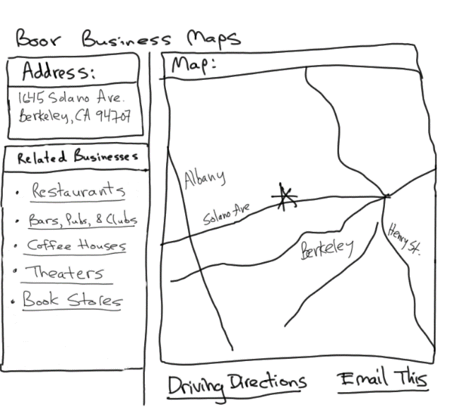
Design #2 – Revision 1
Adding More Related Tasks

Slide 96
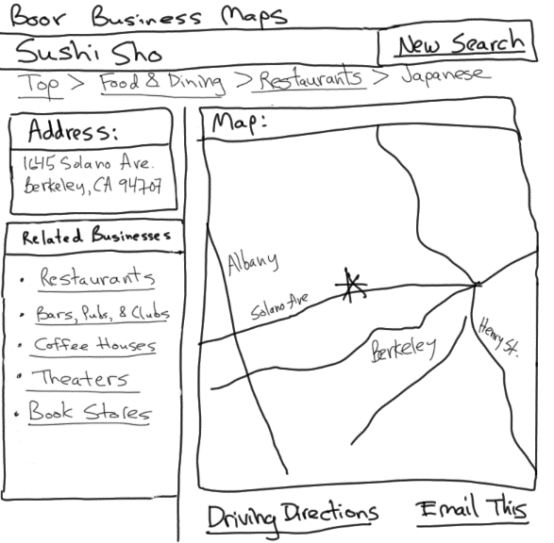
Design #2 – Revision 2
Adding HIERARCHICAL ORGANIZATION (B3) & LOCATION BREADCRUMBS (K6)

Slide 97

Design #2 – Revision 3 Hi-Fi Prototype
Adding SEARCH ACTION MODULE (J1)

Slide 98

Anything wrong here?

Slide 99
Anything wrong here?
Makes the default to switch to their browser overly easy
https://twitter.com/mciarlo/status/1549367530032185345

Slide 100

Anything wrong here?

Slide 101
Dark Patterns (AKA Deceptive Patterns)
Trick questions
  meaning of checkboxes alternates so 1st is “opt out” but 2nd is “opt in”
Many other types of dark patterns
  confirmshaming
  bait & switch
  hidden costs
  friend spam…
https://www.darkpatterns.org/ or https://deceptive.design

Slide 102
Exit Ticket
https://bit.ly/CS147-2023au-exit-ticket-9-926

Slide 103
Summary
Lots of issues involved in designing compelling, usable interfaces (web or mobile)
Design patterns are one way of capturing good design knowledge
  generative (help you create new designs)
  consider trade-offs
  concrete examples of successful uses
  a networked language that works together

Slide 104
Further Reading
Books on Web Design
The Design of Sites. Doug Van Duyne, James Landay, Jason Hong. Addison-Wesley. 2nd edition. 2007. [at this point out of date]
Information Architecture for the Web and Beyond. Louis Rosenfeld, Peter Morville, Jorge Arango. O'Reilly. 4th edition. 2015
Don’t Make Me Think!, Revisited. Steven Krug. Que. 3rd edition. 2014.

Slide 105
Further Reading
Websites on Web Design
digital.gov, for building accessible websites & more
User Interface Engineering, at http://www.uie.com
Mark Hurst’s creativegood.com
Jakob Nielsen’s www.nngroup.com
What are your favorite web design blogs?

Slide 106
Next Time
Lecture
  Special career panel with 5 former CS147 CAs who are:
    Product Designers, Product Managers, Software Engineers, & UX Researchers
  lots of time for Team Work on Project
Studio
  A8 mid-way presentations & Team Work on Project
Next week (required attendance – this is your final exam!)
  Project Expo (70+ guests have RSVPd so far!)

