Slide 1

The best way to monitor your carbon emissions.
Parbon is a collaborative social feed that allows individuals to compare their monthly carbon emissions to others around them and build analogies to other carbon consumption.
Transportation & Mobility Studio
January 2022

Slide 2
Market Research
Capture
Presents essentially the same data as what we envisioned
Transportation (planes, commute)
Record emission
Diet
Call to action
Basic social function
Facilitates offsetting of carbon emissions.
Education function
Minimal network effect. Few people use this app, even though it is well designed and useful, as it has no avenue for growth. The obvious SOLUTION is to engineer this on top of platforms like Instagram, which are massive and have many users who are willing to get involved in progressive movements.
Direct Messaging. Users should be able to share their strategies for decreasing their carbon footprint. Instead, they are only blog posts, which are largely made by one individual who is on their founding team.
Minimal offsetting projects. It is obvious that Capture is partnering with the projects on their platform. They only have 3. SOLUTION: focus on being a platform rather than partnering with offset businesses.
Invasive. This app asks for a number of security permissions. Some users might shy away from use due to this.
Issues

Slide 3
Tasks
Simple: Allows users to report their emissions from commute. Keep track of your individual emissions.
Medium: Analogize your emissions to other aspects of your life in order to buy offsets.
Complex: Share your emission data with friends/colleagues to see how you can engage in more sustainable habits.

Slide 4
Values in Design
Embedded
Utility
Interpretability
Natural
Insightful
Usability
Goal-oriented
Social
Duty

Slide 5
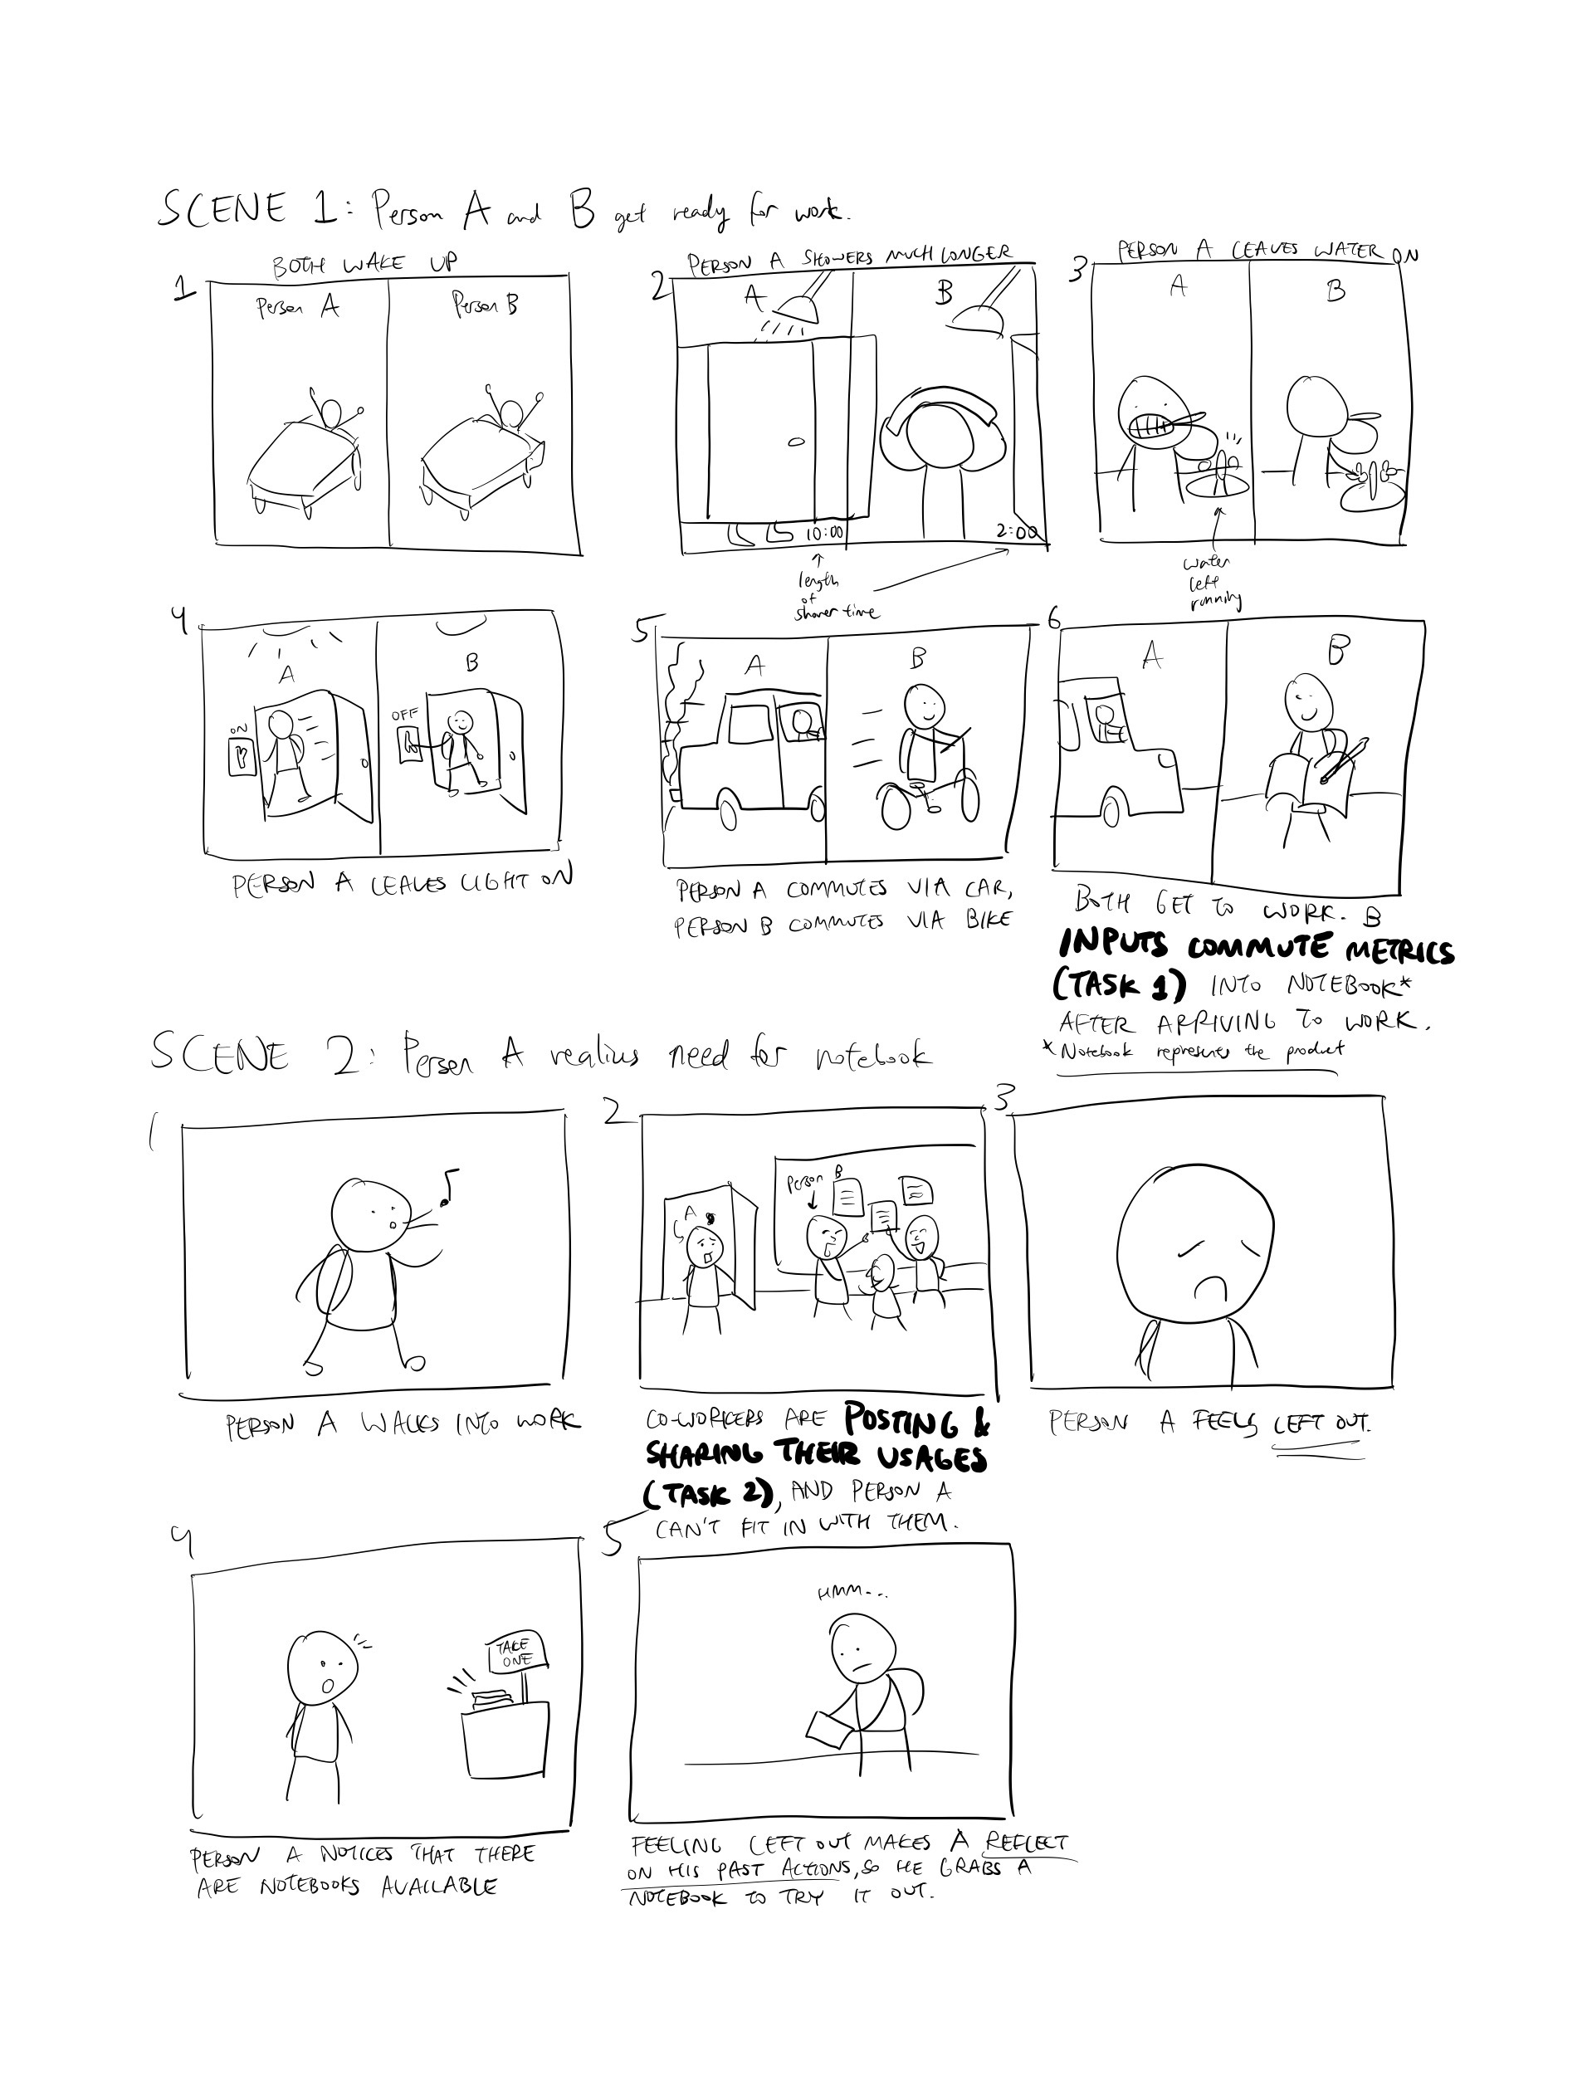
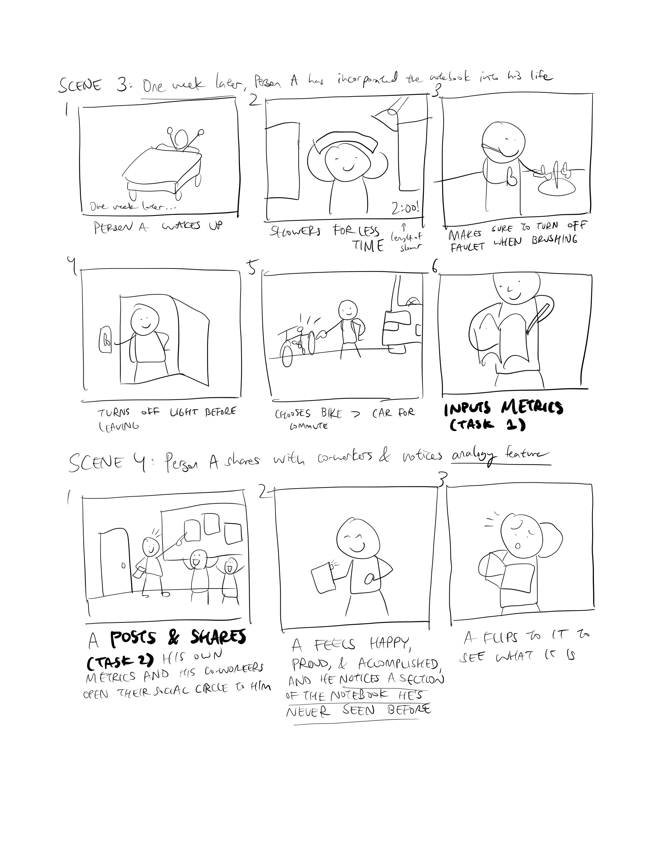
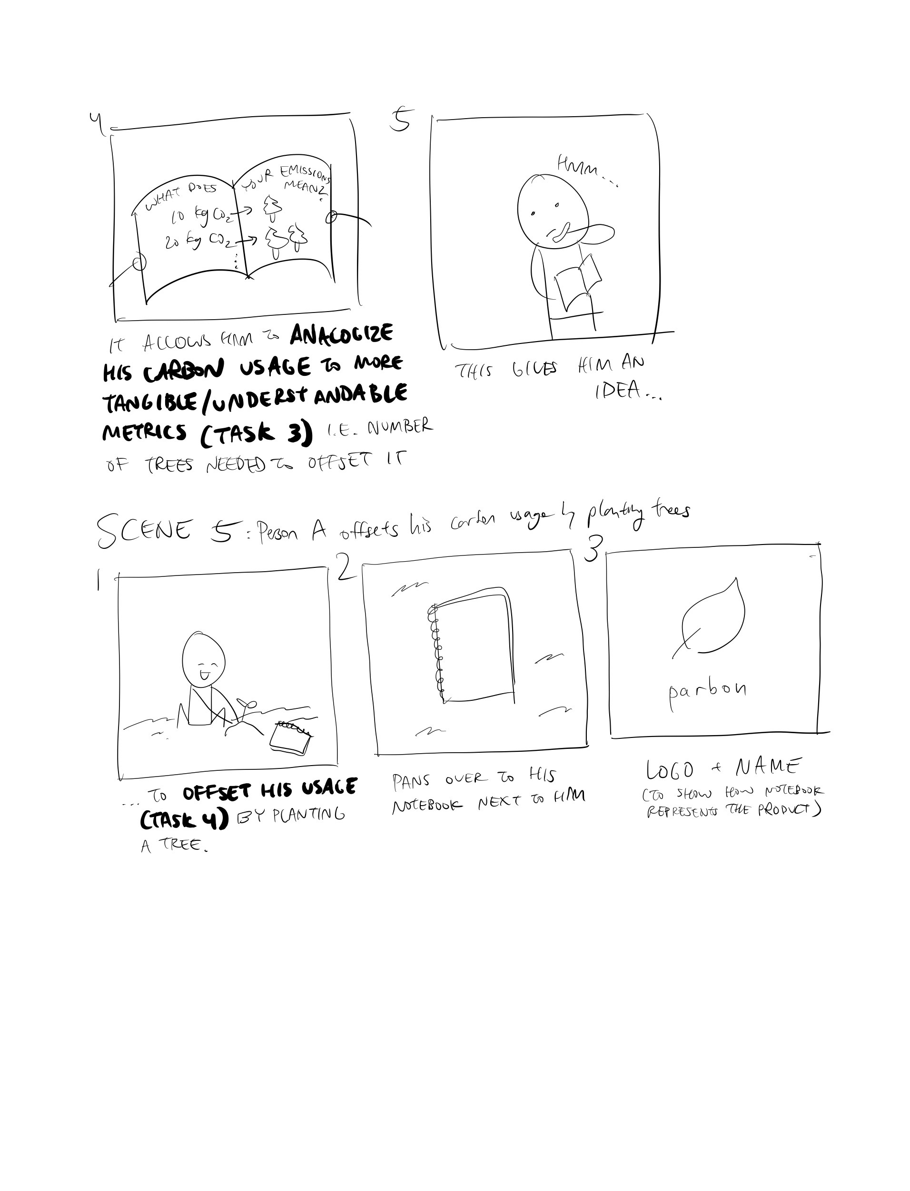
Storyboard

