Slide 1
Exploring...
the MetaGym
VR/AR x Edu
Team 5
Start

Slide 2
Meet our Team
Rachel
Melinda
Chloe
Shimea
Computer Science
Junior
Fairfax, VA
Computer Science
Sophomore
Atlanta, GA
Product Design
Senior
Los Angeles, CA
Computer Science
Junior
Long Island, NY

Slide 3
Problem Domain
The fitness
instruction
experience

Slide 4
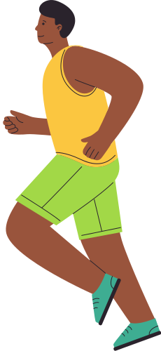
Initial POV
We met...Khalil, a 19 year old black male at Howard University and a workout beginner from Queens, NY.

Slide 5
Initial POV
We met...Khalil, a 19 year old black male at Howard University and a workout beginner from Queens, NY.
We were surprised to notice...he would prefer to work out with other people, but works out alone.

Slide 6
Initial POV
We met...Khalil, a 19 year old black male at Howard University and a workout beginner from Queens, NY.
We were surprised to notice...he would prefer to work out with other people, but works out alone.
We wonder if this means...he would work out with other people if he could find other people that had the same fitness goals.

Slide 7
Initial POV
We met...Khalil, a 19 year old black male at Howard University and a workout beginner from Queens, NY.
We were surprised to notice...he would prefer to work out with other people, but works out alone.
We wonder if this means...he would work out with other people if he could find other people that had the same fitness goals.
It would be game-changing to...be able to find a community that shared his fitness goals.

Slide 8
James is a 20-year old white male and a D1 varsity track athlete at Stanford.
What we learned...
When learning a new jump technique, James often felt frustrated for not being able to pinpoint where he needed to be. He was also the only male high jumper, so he was learning the technique alone.
James wishes for more consistency, as he usually focused on something different every practice. Consistency would include focusing on x for a number of weeks, then y for another few weeks.
James's biggest motivator is the cumulative experience with people on the team. Training with his teammates was a huge plus and he really valued the community aspect of training.
Additional Needfinding: James
James's motivation: “Allen and I build off each other. one of us wants to lift more weights than the other, then we’ll se each other do it and try to outdo the other. Constant back and forth and competitiveness.”

Slide 9
Oscar, a 52-year old self-employed father/husband living in Los Angeles.
What we learned...
Limited time and a busy lifestyle is what prevents many people his age from working out; Cutting commute time would be valuable
It's hard for him to find fitness classes that are customized to his lifestyle and expectations
Avatars could help users focus less on social valuation and more on the workout itself
The issue with team sports such as basketball is finding people of similar skill & ability to play with
Leveraging immersive tech to train with sports legends in iconic locations is highly motivating
Feeling like a superhero when learning new workouts can be fun
Additional Needfinding: Oscar
Oscar's Hot Take: “If I could play basketball with Magic Johnson and Kareem Abdul Jabbar and not be judged but instead be praised, I would be incentivized to train all the time”

Slide 10
Revised POV: Oscar
We met...
Oscar, a 52-year old self-employed father/husband living in Los Angeles who enjoys sports but struggles to stay consistent.
We were surprised to notice...
it's hard to stay consistent with sports because lack of partners of similar level tailored instruction/feedback
We wonder if this means...
he would improve faster and stay more consistent with his regimen if he had instruction/friends that matched his skill level.
It would be game-changing to...
Give Oscar the opportunity to learn/improve sports from legends and experts
Notes:
How might we...
1) HMW incentivize Oscar to stay consistent with sports in the midst of his busy life?
2) HMW incorporate instruction from sports legends/experts while tailoring the lessons to his skill level?
3) HMW help Oscar save time/effort to make the training experience seamless & accessible?
4) HMW define Oscar's presence in relation to others when training for group-based sports
5) HMW identify other "partners of similar level" to Oscar who feel the same way as him?
6) HMW define Oscar's skill level at any point in time during his training/practice? (e.g. amateur, beginner, intermediate, advanced) and track Oscar's progress through the skill levels?
7) HMW make exercising the part of his day that Oscar looks forward to the most?
8) HMW remove any feelings of judgment to allow Oscar to have a productive learning environment?
9) HMW create AI partners that always match Oscar's skill level?
10) HMW provide immediate tailored feedback on Oscar's skills?

Slide 11
Revised POV: Khalil
We met...Khalil, a 19 year old workout beginner who is an undergrad student at Howard University.
We were surprised to notice...how he felt like quitting sometimes because he wasn't getting the instant gratification he got from video games
We wonder if this means...he would feel more motivated to keep exercising if there were other noticeable changes he could see other than changes in his body
It would be game-changing to...help him see changes more quickly by making him aware of the skills that he obtained during his workout session.
Notes:
How might we...
1) HMW make working out more like a video game?
2) HMW reward people more at the end of work out session?
3) HMW teach Khalil new skills that are in line with his goals?
4) HMW give Khalil the ability to review what he's learned/accomplished at the end of a workout?
5) HMW give Khalil gratification during his workout by showing him what he's learned so far?
6) HMW give Khalil a varied workout each time so that he feels like he's learning new skills?
7) HMW provide Khalil the repetition required for gaining muscle but also give him the gratification of learning something new?
8) HMW create a new sport/game that helps Khalil grow muscle but also gives Khalil skills to work on improving?
9) HMW make Khalil aware of these intangible changes learned?
10) HMW disincentive quitting exercise vs. incentivize consistent exercise? (e.g. utilizing loss aversion principles)?

Slide 12
Revised POV: Kenza
We met...Kenza, a 21-year old student at London School of Fashion who's a workout class enthusiast & frequent traveler.
We were surprised to notice...how much more she was willing to pay to go to workout classes rather than just going to the gym
We wonder if this means...that her motivation to work out stems from quality instruction and community.
It would be game-changing to...offer her consistent quality of instruction and community no matter where she is in the world.
Notes:
How might we...
1) HMW allow Kenza to take the same instructor with her everywhere?
2) HMW make Kenza feel like the instructor/community is in the room with her?
3) HMW give Kenza the ability to receive instruction/feedback on full body movement?
4) HMW give Kenza the ability to interact with teammates during workouts while traveling?
5) HMW teach Kenza new workouts without her having to be present?
6) HMW keep up Kenza's motivation to improve through fun and engaging working experiences (environment, music) etc?
7) HMW focus on variety in Kenza's workout classes?
HMW lower the friction of the financial barrier for workout classes?
8) HMW give Kenza a constant and/or new community and the same high caliber of teaching offered in real-life to an online experience?
9) HMW let Kenza have the choice to a) keep up with the same community of workout friends and b) be able to meet new friends/communities while she travels?
10) HMW help Kenza stay consistent with her workout no matter where she is in the world?
11) HMW give Kenza a workout class environment without having her be physically present?

Slide 13
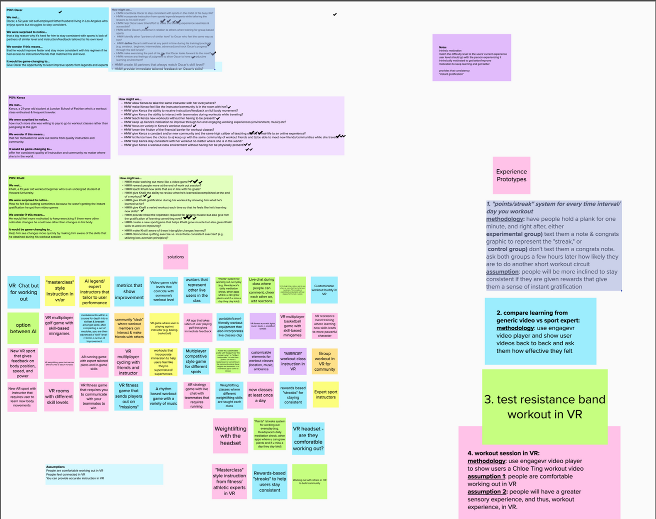
All Things Ideating

Slide 14
How Might We: Oscar
How might we incorporate instruction from sports legends/experts while tailoring the lessons to his skill level?

Slide 15
How Might We: Khalil
How might we provide Khalil the repetition required for gaining muscle but also give him the gratification of learning something new?

Slide 16
How Might We: Kenza
How might we give Kenza a constant and/or new community and the same high caliber of teaching offered in real-life to an online experience?

Slide 17
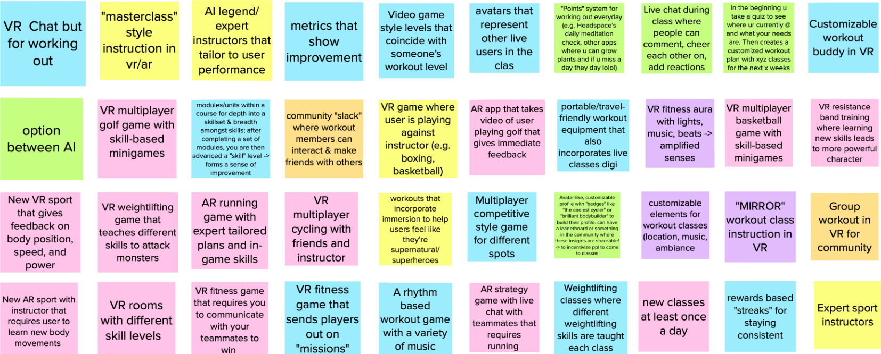
Brainstormed Solutions

Slide 18
Top 4 Ideas to Test

Slide 19
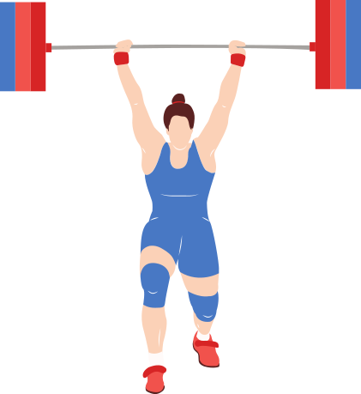
Solution 1
VR weightlifting game that teaches different skills to attack monsters

Slide 20
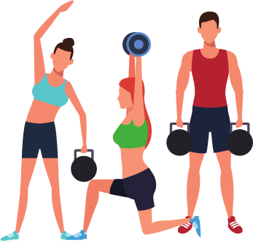
Solution 2
VR fitness class rooms with different skill levels

Slide 21
Solution 3
Fitness classes + online community with achievement badges, leaderboard, and shareable fitness insights

Slide 22
Solution 4
Learning fitness/athletic lessons from industry legends and celebrities
(rather than generic instructors)

Slide 23
Prototype 1:
Weightlifting in VR
Description: Used passthrough mode on Oculus Quest and the Oculus browser to play a weightlifting workout video.
Assumption 1: Weightlifting in VR is comfortable.
Assumption 2: Weightlifting in VR is safe.
Things That Worked:
All movements were comfortable.
Passthrough allowed user to see their body, the instruction, and surroundings
Things That Didn't Work:
Headset added weight and was humid.
Slightly worried about hitting someone.
Surprises and New Learnings:
Fun, but not that different from using a monitor.
Wished it was more interactive.

Slide 24
Weightlifting in VR

Slide 25
Prototype 1:
Weightlifting in VR
Validity: Assumptions were somewhat correct. While the passthrough feature allows users to see their surroundings, it is still a little blurry. It may also not be super comfortable if used for a prolonged period of time.
New Assumption: Weightlifting in VR will feel most comfortable + safe if users have a private place to work out and do it for short periods of time.

Slide 26
Prototype 2:
Workout Session in VR
Things that worked:
Both users agreed that the VR classroom setting made the workout more encapsulating and exciting.
Things that didn't work:
The VR headset was heavy and difficult to stay on while sweating, or in certain exercise positions such as crunches and planks, and bothers the workout.
Users were confused by the avatars, as the avatars were not shown working out
Surprises and New Learnings:
Not being able to see the body (core, legs, arms) was disorienting.
One user liked the big screen, while the other found it a pain point.
Users stated that having representative avatars would be motivating.
Description: Use EngageVR video player to have two users exercise to a 10-min Chloe Ting ab workout in a grand 'lecture hall' setting while seeing friend's avatar.
Assumption 1: Working out in VR is a comfortable user experience.
Assumption 2: Working out with avatars is motivating for users.

Slide 27
Workout Session in VR

Slide 28
Prototype 2:
Workout Session in VR
Validity: Assumption 1 was not entirely valid, as the users didn't feel comfortable doing rigorous activity with a large headset. Assumption 2 had roadblocks in testing, however with a revised methodology, a new assumption we can make is...
New Assumption: Users prefer learning in VR community when avatars are moving as realistic as possible to users' actual movement.

Slide 29
Prototype 3:
Workout Streak
Description: Have people hold a plank for one minute, and right after, either;
(experimental group) text them a note & congrats graphic to represent the "streak," or (control group) don't text them a congrats note. ask both groups a few hours later how likely they are to do another short workout circuit
Assumption: People will be more inclined to stay consistent if they are given rewards that give them a sense of instant gratification
Things That Worked:
Experimental group showed positive reactions to the given badges initially.
Control group had a hard time staying consistent.
Things That Didn't Work:
After the initial positive reactions, the experimental group showed a decrease interest in staying consistent.
Surprises and New Learnings:
The streak badges weren't enough to hold the experimental group's attention.

Slide 30
Workout Streak

Slide 31
Prototype 3:
Workout Streak
Validity: The assumption was valid, but could use some modifications. The badges weren't enough to keep the experimental group's attention
New Assumption: People will be more inclined to stay consistent if they are given a variety of rewards

Slide 32
Prototype 4:
Learning From Experts
Things That Worked:
Our user enjoyed Steph's lesson more and felt more motivated to come back for a second lesson with Steph.
Things That Didn't Work:
Our user felt that he improved the same amount through both lessons (although lesson was short)
Surprises and New Learnings:
Given that our user already knew how to shoot a basketball, he felt that getting an "advanced" tip from Steph was helpful
The celebrity "cool factor" is a motivator for him
Description: We compared the experience of learning how to shoot a basketball through a video in VR between a standard WikiHow lesson and a lesson taught by Steph Curry.
Assumption: Users will feel more engaged, excited, and learn better when learning fitness and athletics from industry legends, rather than generic modules

Slide 33
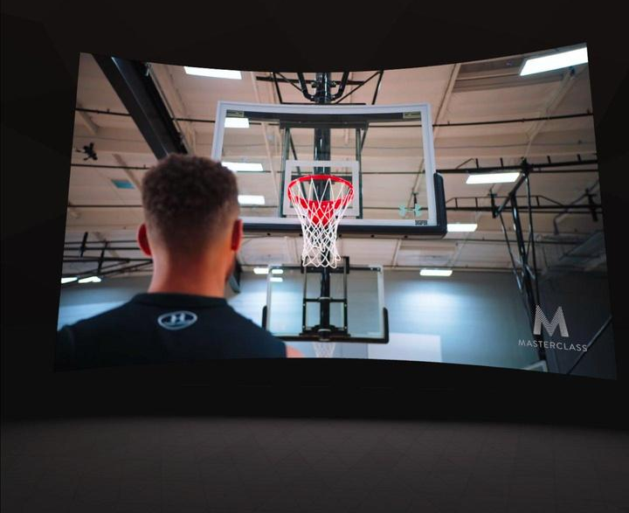
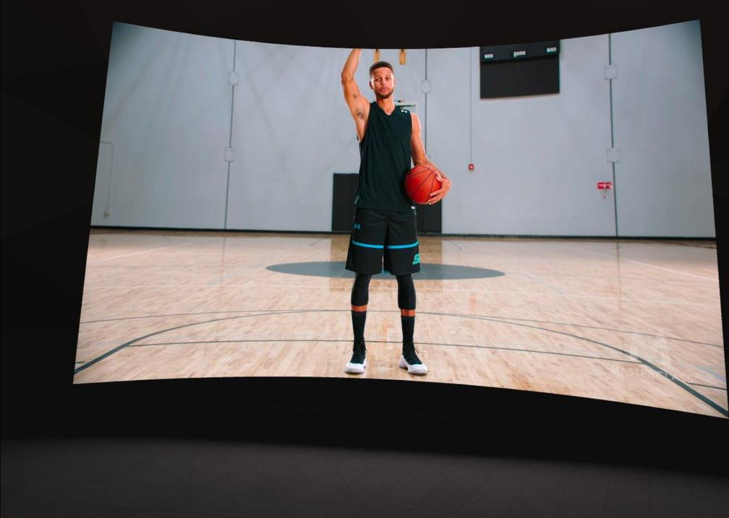
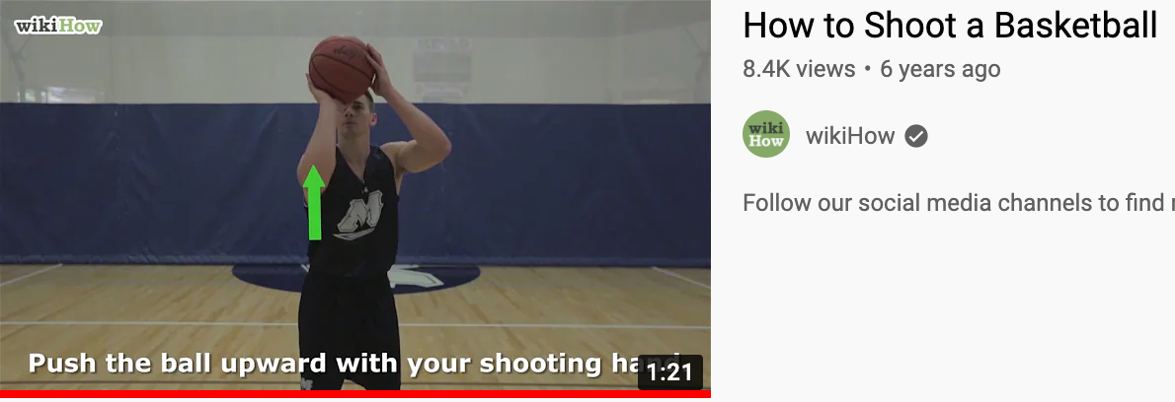
Learning from Experts

Slide 34
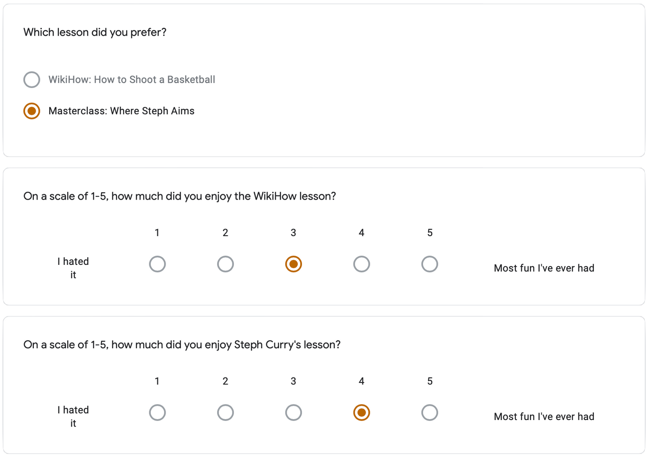
Learning From Experts: Results

Slide 35
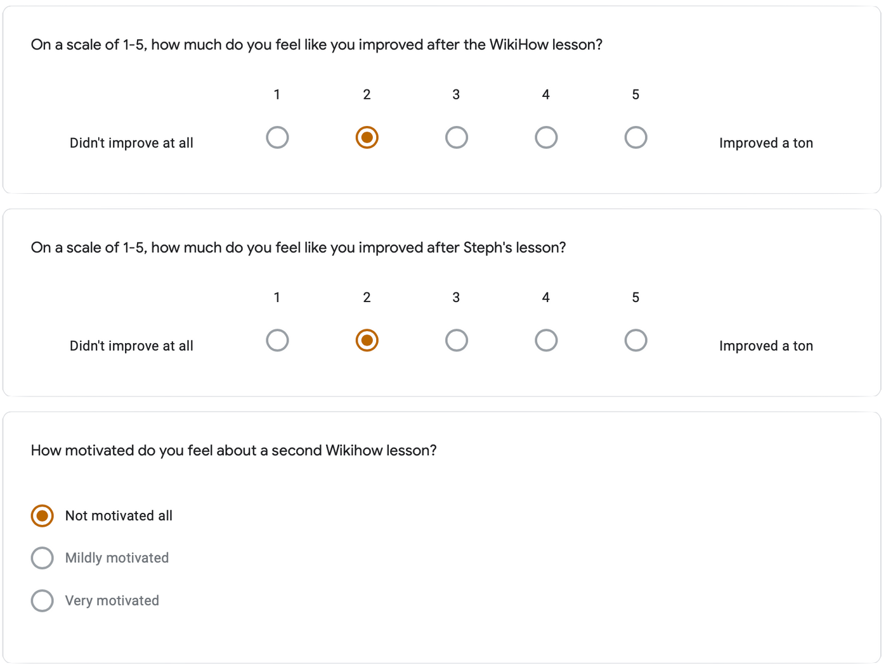
Learning From Experts: Results

Slide 36
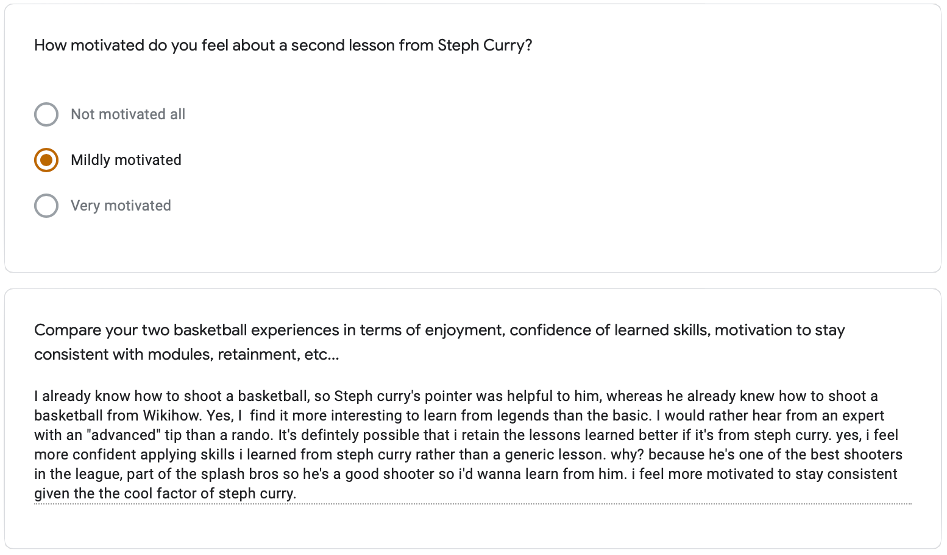
Learning From Experts: Results

Slide 37
Prototype 4:
Learning from Experts
Validity: Our assumption that people would have a more enjoyable, effective, and motivated learning experience if they were excited by the instructor/trusted their expertise was proven valid.
New Assumption: People will learn better if they feel that they are getting "industry-secret" tips from experts
+ "cool factor" motivates some users.

Slide 38
Solutions
The best approach to this problem would be a combination of learning from experts and learning within a virtual community.
In our needfinding interviews, we noticed a trend that people enjoyed exercising with others in a community. This was supported by our experience prototype testing when users noted that seeing an avatar representing their friends' workouts in the VR scape would be motivating.
In the prototype of learning from experts, we observed that the user would find it more motivating to learn from an instructor of established credibility or someone the user looks up to.
Using a VR headset may be viable, but we need avatars that better represent people's bodies. Users also need to be able to clearly see their own body and surroundings, which makes passthrough mode necessary. The clunkiness means workouts should be kept short.
Communities that our solution may leave out include users of lower-income or users who are less willing to spend extra money on virtual fitness ammenities.
End

Slide 39
Summary
This week we:
Interviewed 2 new people that expanded our sample demographic
Generated POV statements based on our learnings from them
Created more HMW statements to kickoff brainstorming
Brainstormed many potential solutions
Determined top 3-4
Prototyped top 4 concepts
Used prototypes to test our assumptions with new users
Validated/invalidated our assumptions + derived new assumptions
End

Slide 40
Key Insights
People are more engaged learners when they’re excited about the instructor
In VR, people prefer learning within a community when the avatars mimic real-life movement
People are more inclined to stay consistent w/ their learning if they are rewarded (and surprised by the reward)
Working out with a VR headset (Oculus Quest) is feasible, but has limitations
End

Slide 41
Next Steps
Create more prototypes that begin to combine our best solutions
Test on a broader audience group
Begin to solidify our selected solution
End

Slide 42
Thank you!

