Slide 1
Assignment 2: POVs and Experience Prototypes
Siddharth Gehlaut, Tolúlọpẹ́ Ògúnrẹ̀mí, Yi Feng, Alejo Navarro Goldaraz
Notes:
___User group reach (diversity - extreme users/average users/non-users, innovativeness, appropriateness) (20 points).
___Depth of the interviews (20 points).
___Number of interviews (20 points).
___Details in unpacking using chosen methodology (20 points). ___Showed tensions, contradictions, surprises, & inferences from the interviews (20 points).

Slide 2
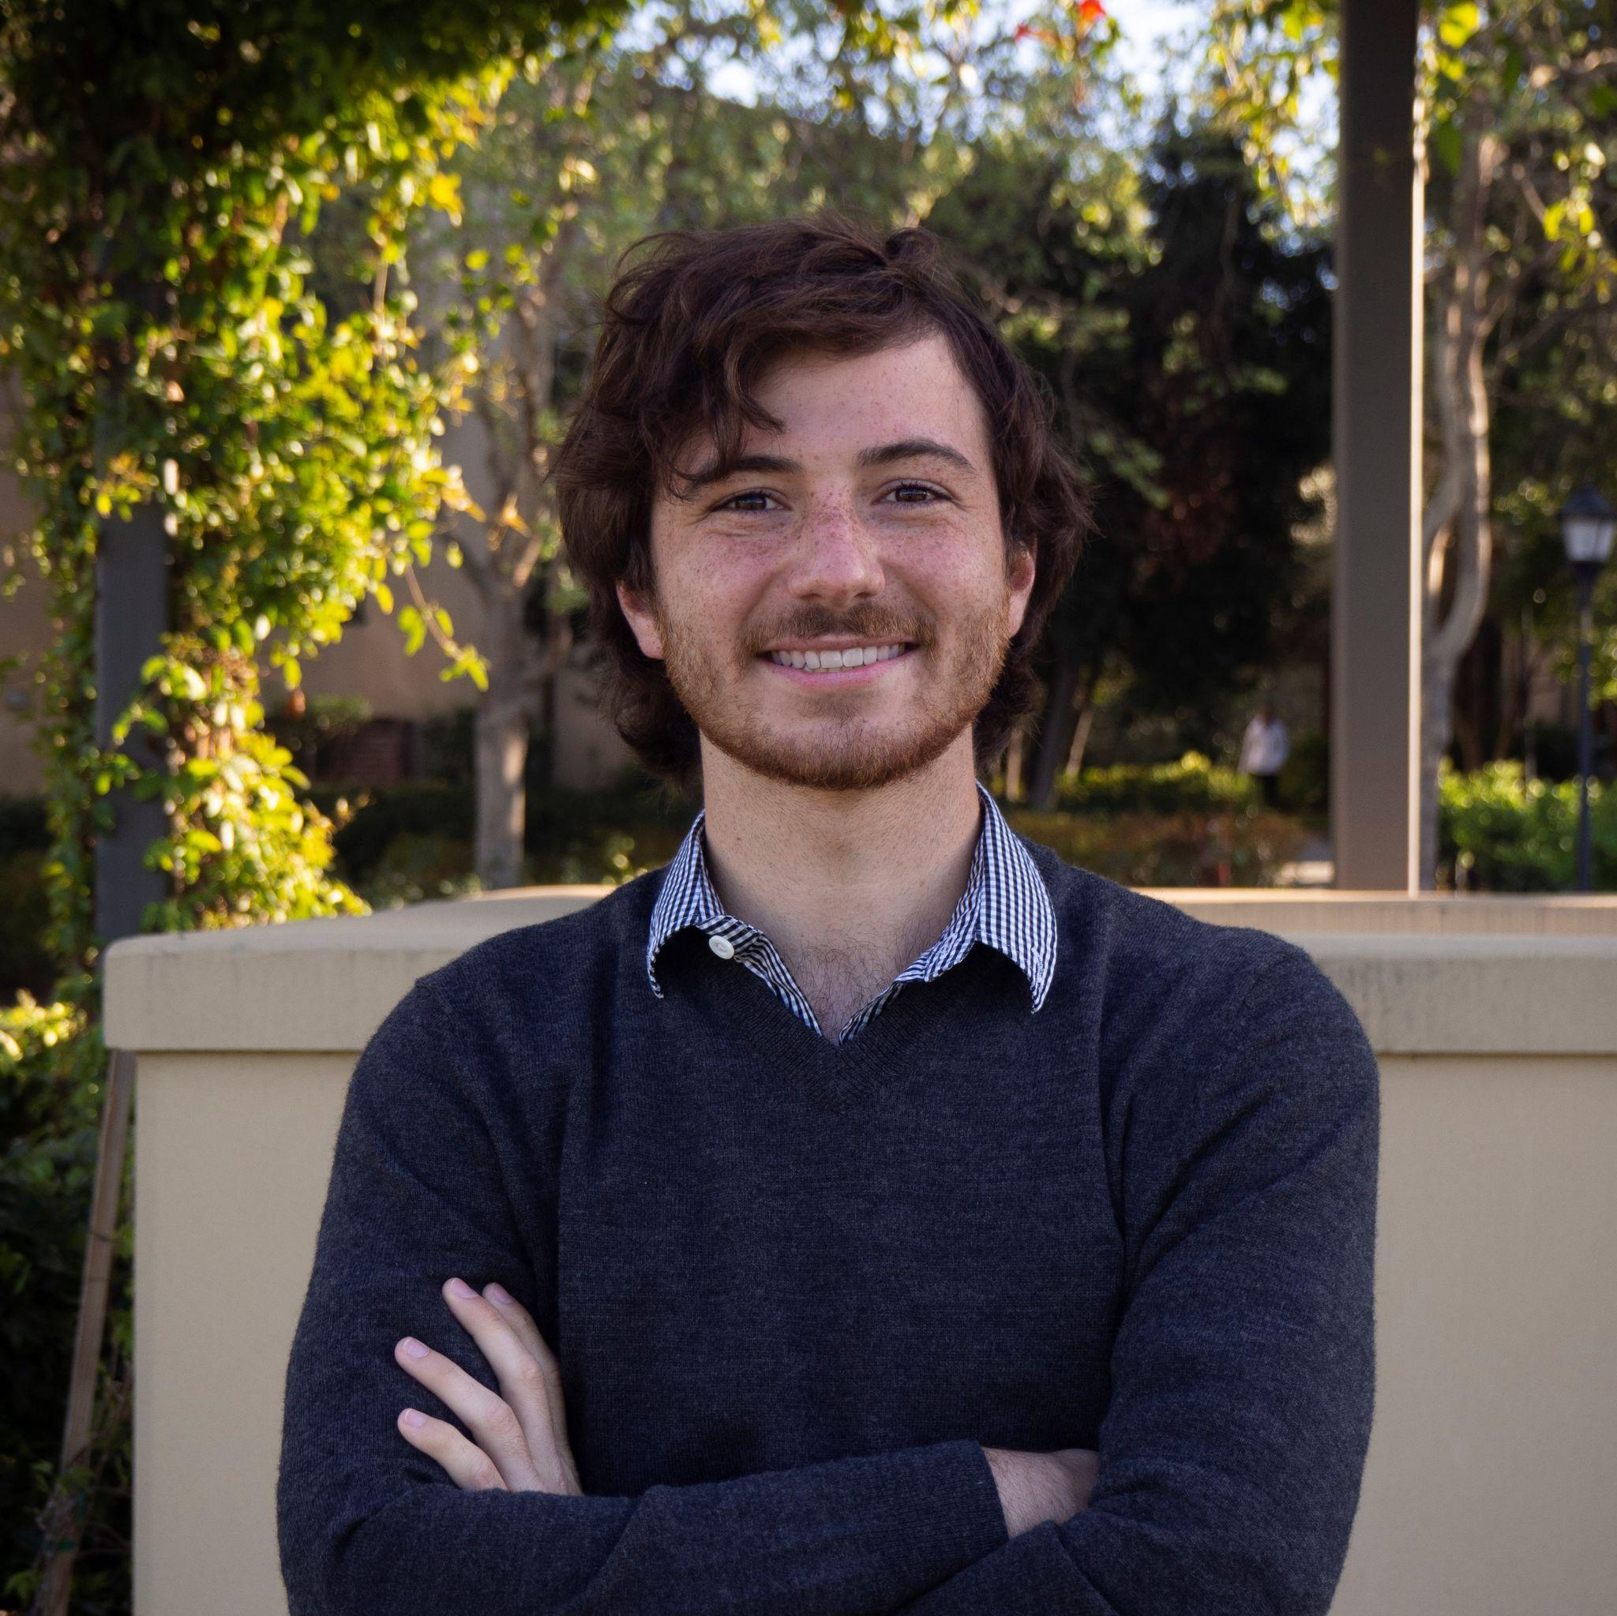
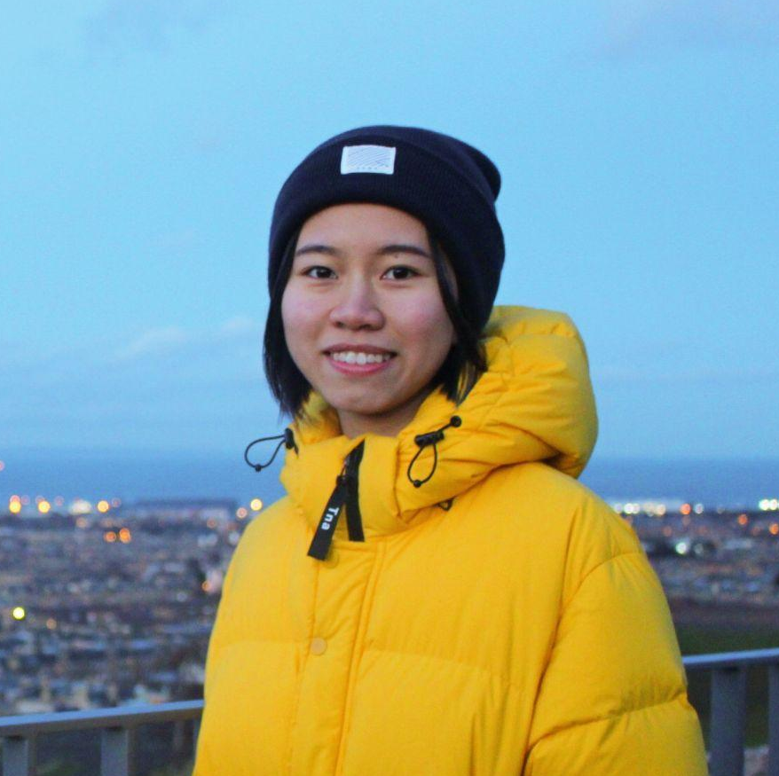
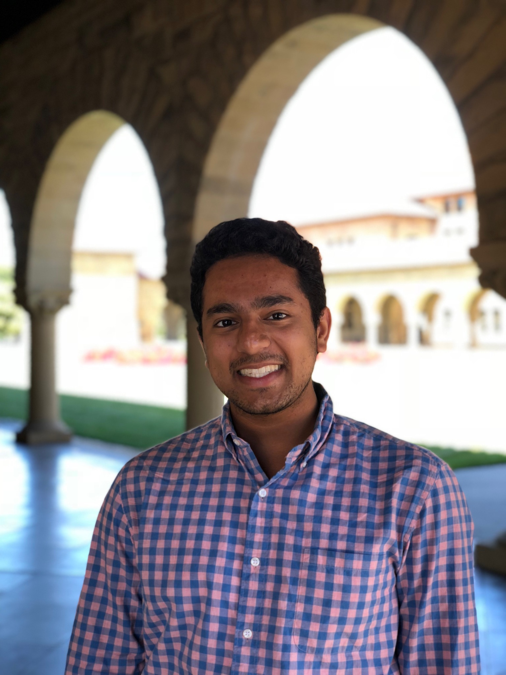
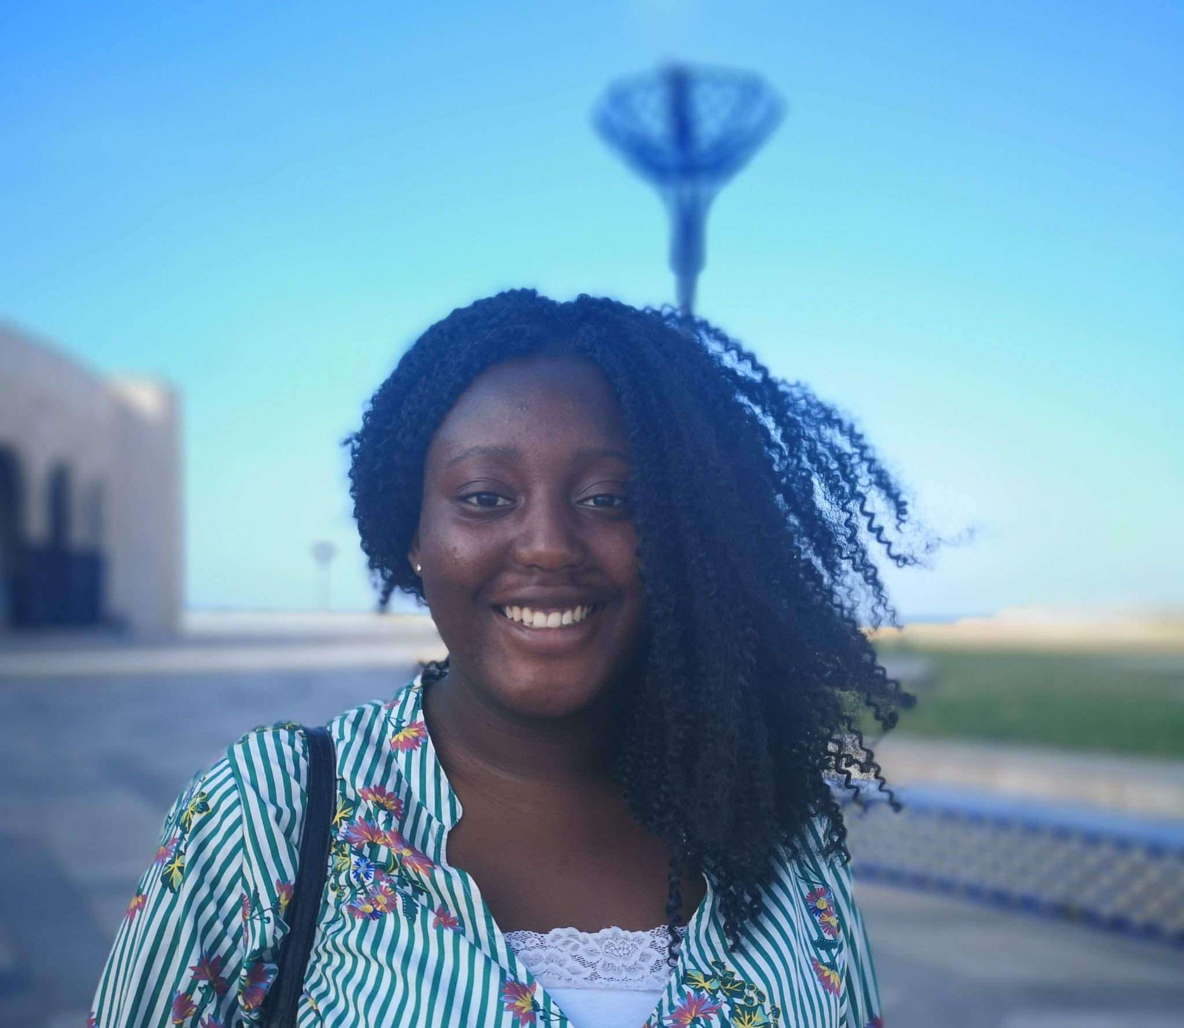
Introduce - Team Members
Alejo Navarro Goldaraz
CS Coterm Student
Buenos Aires, Argentina
Yi Feng
CS Master’s Student
Guangzhou, China
Sid Gehlaut
Economics Senior
Inverness, IL
Tolúlọpẹ́ Ògúnrẹ̀mí
CS PhD
London, England

Slide 3


Connecting Volunteers and Organizations
Domain Theme: The Future of Philanthropy and Volunteering

Slide 4
Initial POV

Slide 5
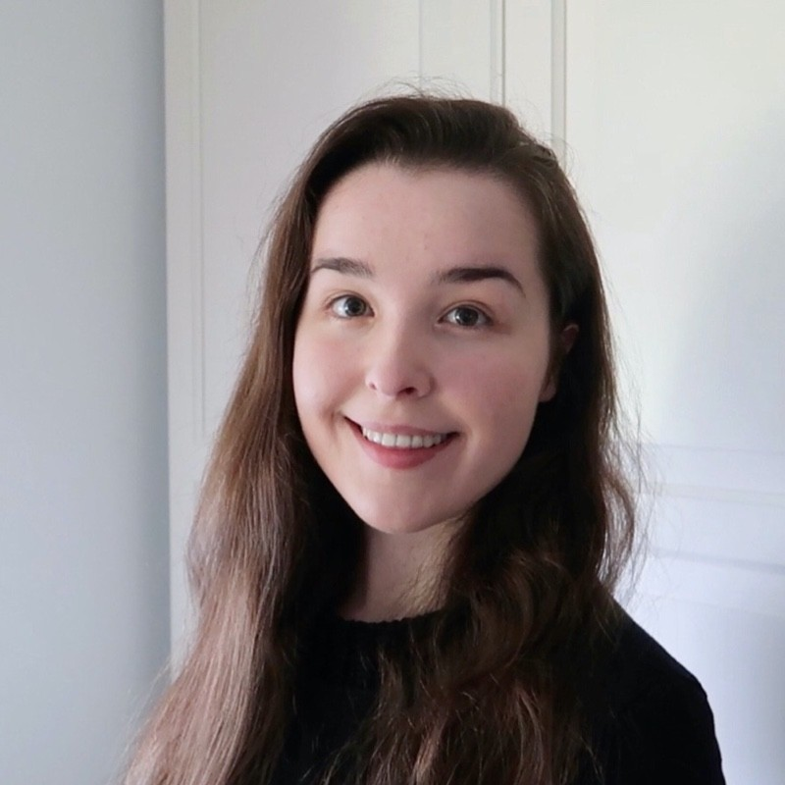
POV
We met Claire, a tech professional in Scotland who stopped volunteering when she had to balance volunteering with working
We were surprised to realize how practical her volunteering efforts were. They needed to come easy to her.
We wonder if this means Claire volunteers only if opportunities are required or extremely accessible
It would be game changing to increase the accessibility of opportunities for people like Claire

Slide 6
Think about connections
Additional Needfinding Interviews

Slide 7
Our Questions Revisited
How did you get involved with (volunteering, philanthropy, nonprofit)?
What motivates you about what you do?
What do you like/dislike about your work?
Tell us about an unexpected experience you had in your time
Tell us about a challenge you face regularly

Slide 8
Our Questions Revisited
How did you get involved with (volunteering, philanthropy, nonprofit)?
What do you look for in volunteers?
How do you keep your volunteers motivated?
What motivates you about what you do?
What do you like/dislike about your work?
What motivated you to volunteer?
Tell us about an unexpected experience you had in your time
What do you look for in organizations?
Tell us about a challenge you face regularly

Slide 9
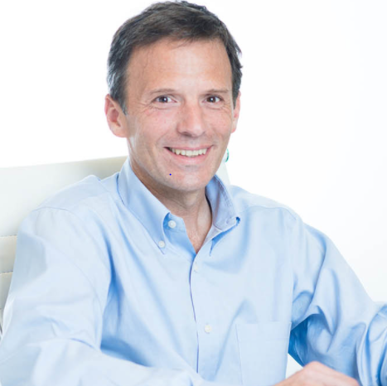
Juan Jose
[Zoom]
“We are looking for volunteers that can not only help the kids learn but also motivate them and be their role model”
Notes:
ALejo did this one in Spanish
23 y/o recent graduate
Animal lover & church volunteer
Montevideo, Uruguay

Slide 10
Insights
Uses social media (mostly Instagram) to recruit volunteers and participants for the coding clubs
Finds himself spending most of his time nurturing the community of volunteers as a strong community leads to more accountability and happier volunteers
Notes:
ALejo did this one in Spanish
23 y/o recent graduate
Animal lover & church volunteer
Montevideo, Uruguay

Slide 11
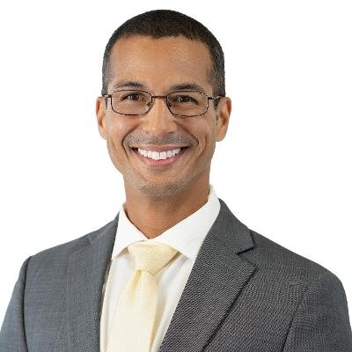
Tyler Benjamin
[Zoom]
“I dislike the need for volunteering. I dislike that there are gaps created when families lose their homes and access to medicine. That creates a need for volunteering”
Notes:
ALejo did this one in Spanish
23 y/o recent graduate
Animal lover & church volunteer
Montevideo, Uruguay

Slide 12
Insights
Tyler found his current organization by emailing all the verified Afghan resettlement groups in his Area
He sometimes finds it hard to balance med school with long hours volunteering (3+ hours at airports)
His unique skill set (speaking Pashto) gives him a sense of responsibility to help people in need
Notes:
ALejo did this one in Spanish
23 y/o recent graduate
Animal lover & church volunteer
Montevideo, Uruguay

Slide 13
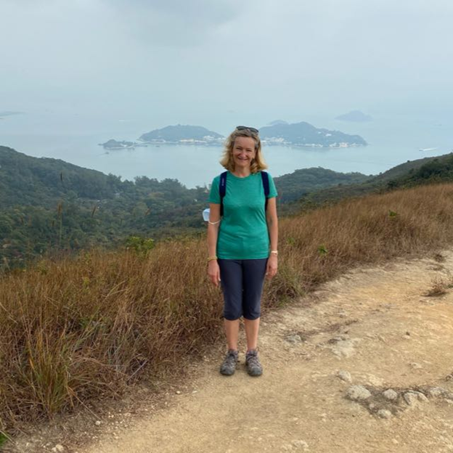
Diana Lancaster
[Zoom]
“Gone are the days of volunteering for altruistic reasons. You must understand what volunteers need and what drives them”
Notes:
ALejo did this one in Spanish
23 y/o recent graduate
Animal lover & church volunteer
Montevideo, Uruguay

Slide 14
Insights
She worked in a school and decided to step up to its board “in order to have more influence”.
Diana had a unique insight as a volunteer with Girlguiding (The Girl Guide Association) managing tens or hundreds of volunteers. She said that to help volunteers succeed at their work, she “Provid[es] an environment which is conducive enough to make them stay with ‘us’”
Notes:
ALejo did this one in Spanish
23 y/o recent graduate
Animal lover & church volunteer
Montevideo, Uruguay

Slide 15
Insights from all interviews

Slide 16
Insights
Motivation was identified as a key factor in both choosing to volunteer and recruiting volunteers
A lot of initial volunteering experiences are required
There is a correlation between passion for a cause and time dedicated to finding an opportunity or staying in it
People make time to volunteer at all ages
Many dedicated volunteers transition from being beneficiaries, to volunteers to leadership or policy roles

Slide 17
Refined POVs

Slide 18
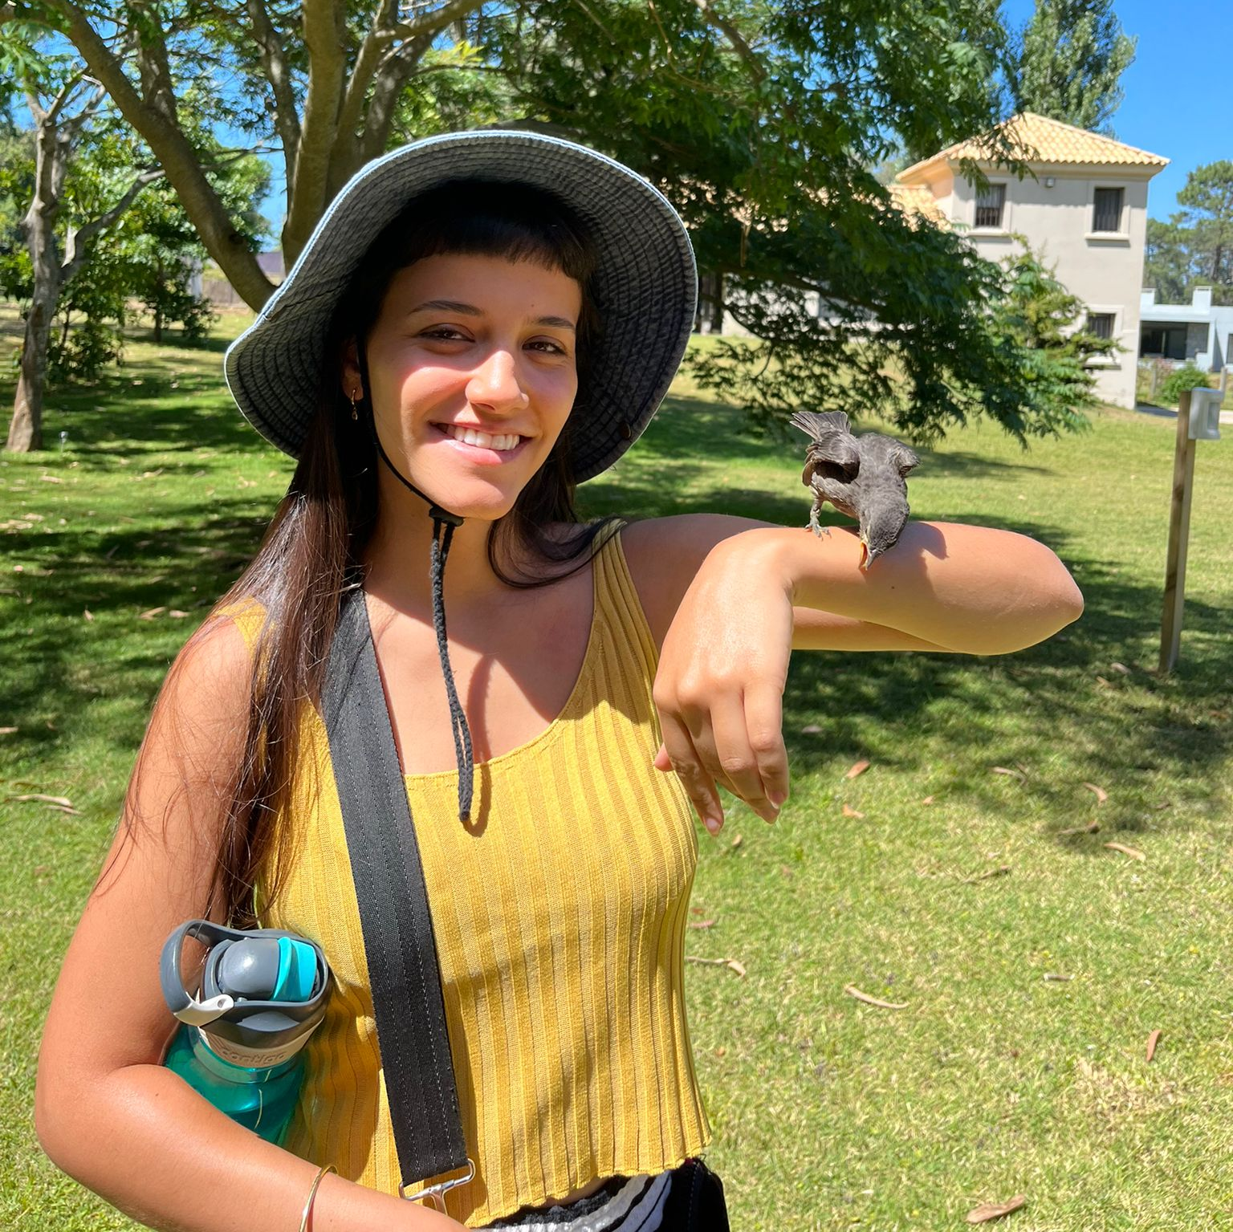
POV 1
We met Manuela, a 23 y/o volunteer from Uruguay who repeatedly volunteers at impoverished neighborhoods with her church group
We were surprised to find that Manuela only volunteers on weekends and very close to where she lives, despite wanting to volunteer more and with different communities
We wonder if this means that she has very limited time and cannot afford to volunteer further away or during the week.
It would be game changing for her if we could make less burdensome to volunteer

Slide 19
POV 2
We met Tyler, a 38 year old first year med student from Colorado who formerly served in the military for 10 years providing humanitarian aid in Afghanistan. He volunteers to resettle Afghan refugees into communities in Colorado
We were surprised to find Tyler randomly emailed organizations related to Afghan resettlement, until one responded, offering to help
We wonder if this means there aren’t many well established routes for volunteers to connect with organizations
It would be game changing if we were able to connect volunteers with organizations that can maximize their skills

Slide 20
POV 3
We met Diana, a 59 year old girl guide leader/board member from Hong Kong, who also worked closely with schools
We were surprised to find Diana regretted that she left the girl guiding association in her twenties and thirties despite wanting to continue
We wonder if this means she didn't understand how important it was for her to volunteer before she quit
It would be game changing if we could get people to understand the value their commitment to volunteering
Notes:
HMWs for Diana
HMW leverage the existing community to reminf people of their value
HMW remind people of the impact they had in the organization
HMW make the impacts they made more visible in the public
HMW relate the volunteering outcomes with what they value
HMW show volunteers how much they are being missed
HMW codify commitment to a cause
HMW make their contributions recognized by more people
HMW help people prioritize volunteering over other things
HMW help people manage their time to make volunteering easier
HMW incentivize people to remain in thei organizations
HMW change the intensity of volunteer work over time to match your commitment levels?
HMW make it easier to quantify your volunteering work
HMW help balance volunteering with other commitments?
HMW get the people helped to reach out about their need for volunteers
HMW help people measure their volunteer work?

Slide 21
Brainstorming HMW

Slide 22
It would be game changing for her if we could make it less burdensome to volunteer
POV: Manuela

Slide 23
Our favorites
HMW help her volunteer more efficiently
HMW reduce the time and effort needed to volunteer
HMW help her find local opportunities more easily
HMW remove the need for travel to volunteer
Notes:
All of the HMWs
HMW leverage the community to facilitate volunteering for Manuela
HMW remove the need for Manuela to travel in order to volunteer
HMW make it easier for Manuela to reach different communities?
HMW leverage Manuela's consistency to help others?
HMW integrate volunteering with work?
HMW motivate Manuela to invest more of her time into volunteering
HMW help Manuela find more opportunities to volunteer closer to home
HMW help Manuela find more time in order to volunteer?
HMW have more remote volunteering opportunities?
HMW reduce the time and effort needed for volunteering
HMW make the commute time productive for Manuela
HMW get the church to facilitate reaching communities
HMW increase the the incentives Manuela has to volunteer?
HMW make the process of volunteering opportunities less time-consuming
HMW help her volunteer more efficiently (so she can work with more orgs)
HMW help her find local opportunities more easily

Slide 24
Our favorites
HMW help her volunteer more efficiently
HMW reduce the time and effort needed to volunteer
HMW help her find local opportunities more easily
HMW remove the need for travel to volunteer

Slide 25
It would be game changing if we were able to connect volunteers with organizations that can maximize their skills
POV: Tyler

Slide 26
Our favorites
HMW help volunteers promote their skills
HMW NGOs build trust to attract more volunteers
HMW make it less of a time commitment for people to make and impact
HMW better promote volunteering opportunities
Notes:
All of the HMWs
HMW leverage existing volunteers to connect new volunteers
HMW ease Tyler's experience of finding causes to support?
HMW enable organisations to find and recruit the 'Tylers' of society?
HMW make it easier for volunteers to promote their skill sets
HMW make it possible to find organizations on Snapchat?
HMW automatically match nonprofits with companies?
HMW leverage Tyler's connections in the military to find NGOs
HMW make it less of a time commitment for people to make an impact
HMW better promote volunteering opportunities
HMW get the government to match NGOs with volunteers
HWM make the information of organizations more accessible
HMW make everyone in society be passionate about causes like Tyler is?
HMW set up profiles for volunteering like Linkedin?
HMW increase visibility for orgs?
HMW help verify NGOs for volunteers
HMW connect people with an organization before they leave their jobs?
HMW help him contact people from the organizations more easily
HMW create a match made in heaven of Tyler and the non-profit of his dreams?

Slide 27
Our favorites
HMW help volunteers promote their skills
HMW NGOs build trust to attract more volunteers
HMW make it less of a time commitment for people to make and impact
HMW better promote volunteering opportunities
Notes:
All of the HMWs
HMW leverage existing volunteers to connect new volunteers
HMW ease Tyler's experience of finding causes to support?
HMW enable organisations to find and recruit the 'Tylers' of society?
HMW make it easier for volunteers to promote their skill sets
HMW make it possible to find organizations on Snapchat?
HMW automatically match nonprofits with companies?
HMW leverage Tyler's connections in the military to find NGOs
HMW make it less of a time commitment for people to make an impact
HMW better promote volunteering opportunities
HMW get the government to match NGOs with volunteers
HWM make the information of organizations more accessible
HMW make everyone in society be passionate about causes like Tyler is?
HMW set up profiles for volunteering like Linkedin?
HMW increase visibility for orgs?
HMW help verify NGOs for volunteers
HMW connect people with an organization before they leave their jobs?
HMW help him contact people from the organizations more easily
HMW create a match made in heaven of Tyler and the non-profit of his dreams?

Slide 28
Solutions & Prototypes

Slide 29
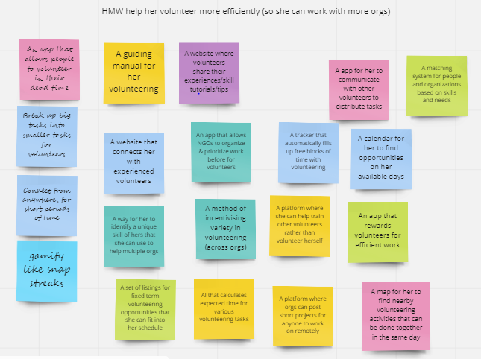
HMW help her volunteer more efficiently

Slide 30
Solution
An app that allows people to complete small tasks for NGOs in their spare time
Analogy: Duolingo for Volunteering

Slide 31
Assumption: People will actually enjoy using spare snippets of time to do such tasks

Slide 32
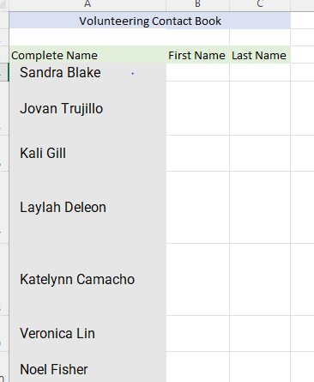
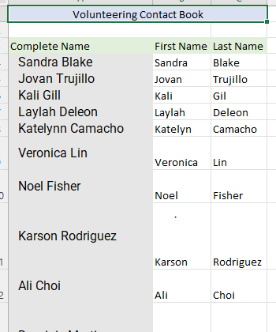
Experience Prototype #1
Asked people to do small task (splitting names) in their spare time (watching tv, procrastinating, etc.)
Told them the work would be used to help NGOs
Recorded extra any comments

Slide 33
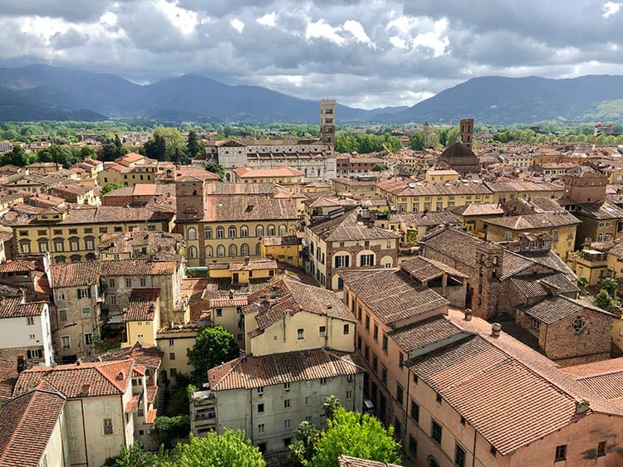
Participant
We interviewed Cecilia, a 62 year old retired mother from Lucca, Italy, now living in Houston Texas.
Cecilia did not want to be photographed. Here is a picture of Lucca, Italy instead.

Slide 34
Pros
Participant would definitely use this in their spare time (maybe 15 min a day)
They now believe volunteering can be a low commitment activity
Pre response: volunteering takes 2+ hours
Post response: 15 minutes is enough
Felt more productive than just being on their phone
Cons
They did not like how impersonal the volunteering was (would prefer an emotional connection)
The work itself was not very fulfilling. Copying names over does not seem more productive than social media (issue with prototype)
Would find it challenging to know how to break up tasks (from the perspective of the NGOs)

Slide 35
Learnings
People want the same sense of accomplishment for this form of volunteering
We need to find ways to make the experience/tasks more personal
Surprises
Participants were compelled by helping NGOs but they are not willing to complete any (boring) task
Participants expected a higher level of personal connection when “volunteering”

Slide 36
Assumption: People will actually enjoy using spare snippets of time to do such tasks
Validity
Overall positive response
Tasks need to be rethought
New assumptions
Gamifying the app will make people enjoy the experience more and complete more tasks
Adding a social validation component will make the experience more personal

Slide 37
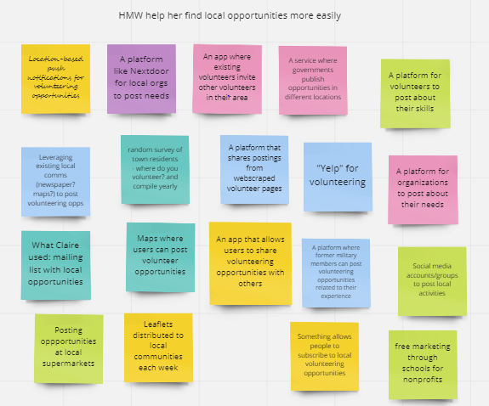
HMW help her find local opportunities more easily

Slide 38
Solution
An app that tracks daily location and provides a summary of NGOs close to the route taken
Analogy: Strava for mapping NGOs

Slide 39
Assumption: The proximity of the volunteering opportunity to the user’s route home will have an effect on their takeup of an opportunity

Slide 40

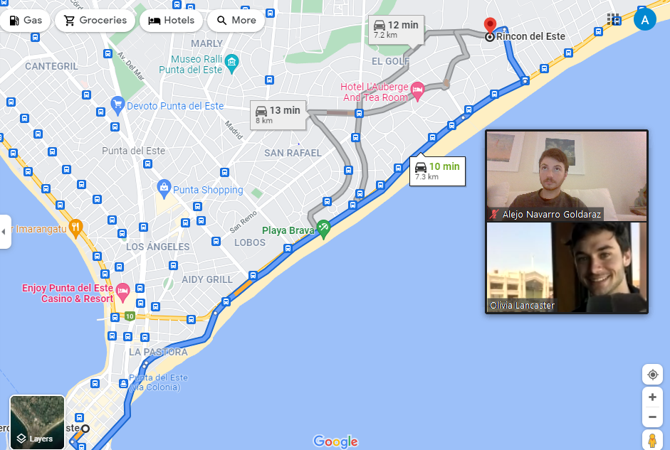
Experience Prototype #2
Asked for their most common route (home, work, etc.)
Pinned some NGOs along their way
Asked them about their likelihood to volunteer in their neighborhood
Recorded extra any comments
Volunteering Locations

Slide 41
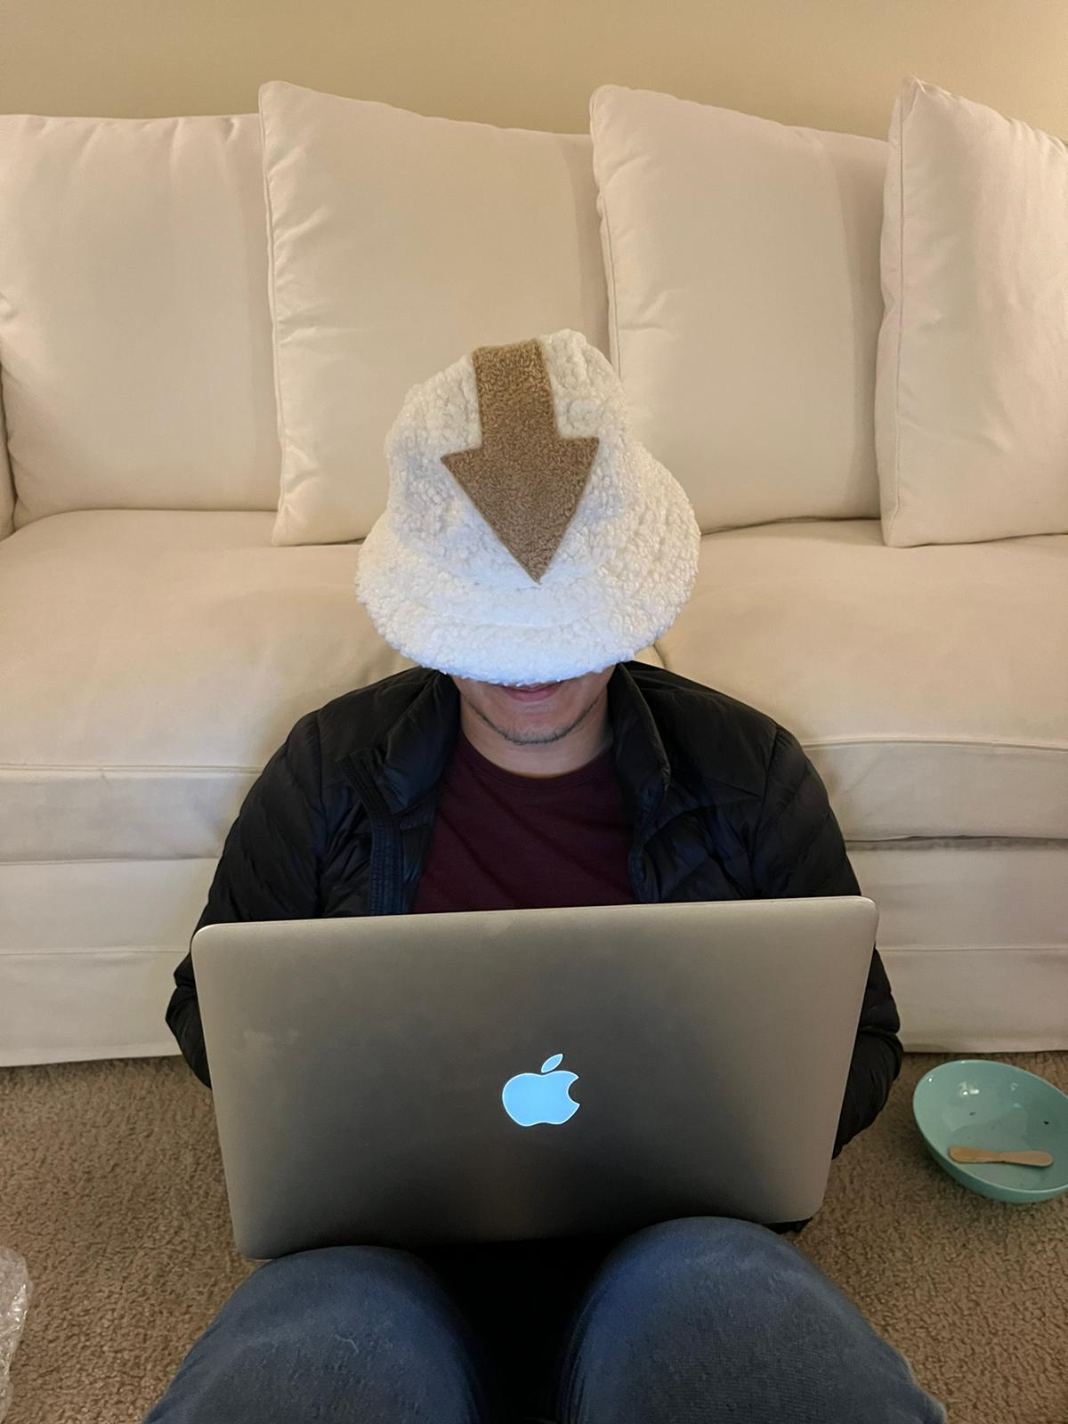
Participants
We interviewed Akshay, a 34 year old software engineer from India, now living in Menlo Park
We interviewed Lucas, a 17 year old high school student from Uruguay, living in Punta del Este.

Slide 42
Pros
Responses for how likely are you to volunteer in your neighborhood went from 1.5/5 to 3.5/5 when showed the experience prototype
Average expected volunteer time fell from around 4 hours to around 2 hours
Discovered many places to volunteer they didn’t even know existed
Could easily see themselves walking to the volunteer location
Cons
Hard to understand what each pin represents (there is very little information in the prototype)
Still don’t have too much time to volunteer
They would want to be able to specify the radius of search (given their mobility or transportation capacity)

Slide 43
Learnings
Participants would benefit from seeing the actual time it would take to volunteer
Users would benefit from more information being displayed on the map.
Surprises
People thought volunteering was a high commitment activity and they don’t have enough time
Participants wanted more information easily available before deciding when “volunteering”

Slide 44
Assumption: The proximity of the volunteering opportunity to the user’s route home will have an effect on their takeup of an opportunity
Validity
Overall positive response
Must rethink what supplemental info is shown
New assumptions
Adding more context information will make people make better decisions and try to volunteering
Showing the time requirement will encourage low activation energy people to participate

Slide 45
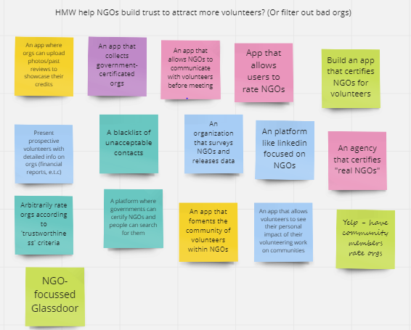
HMW help NGOs build trust to attract more volunteers

Slide 46
Solution
Collecting and showing volunteers’ reviews of the NGOs
Analogy: Yelp for NGOs

Slide 47
Assumption: Other volunteers’ reviews will attract new people to volunteer at certain NGOs

Slide 48
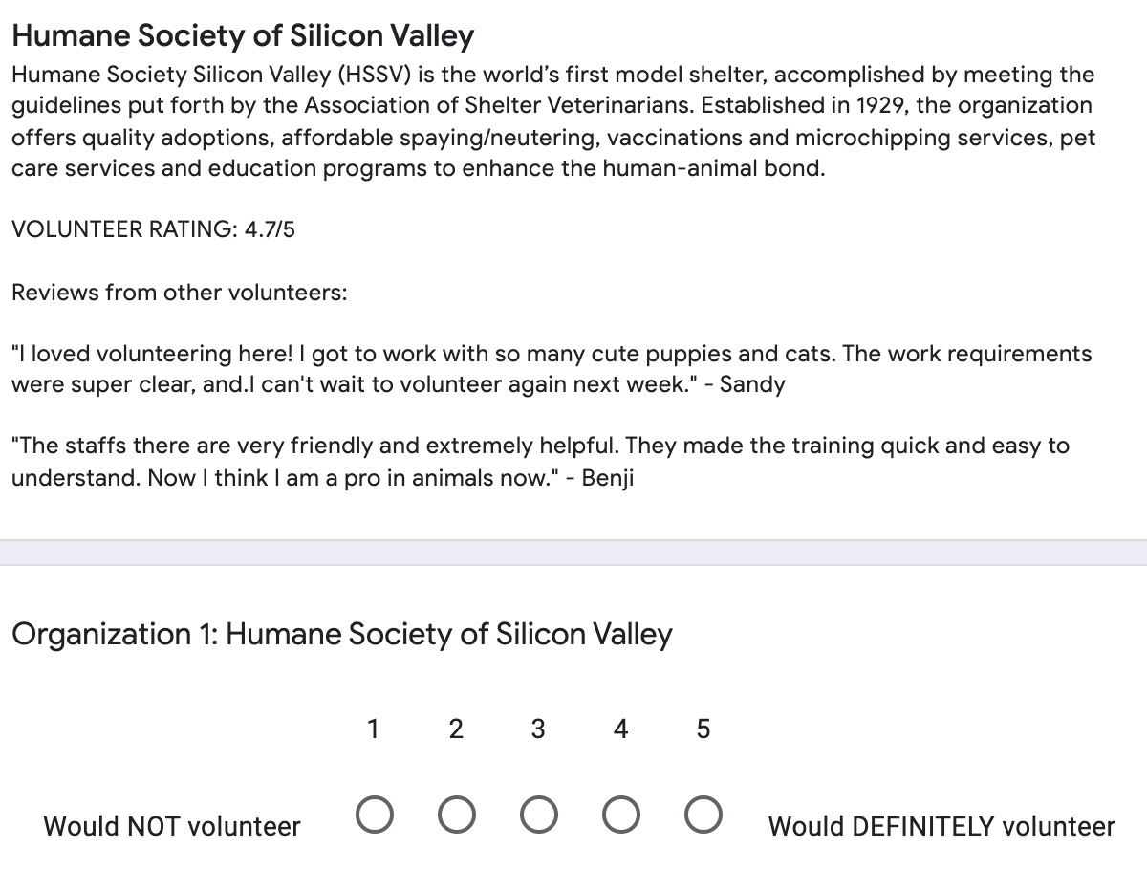
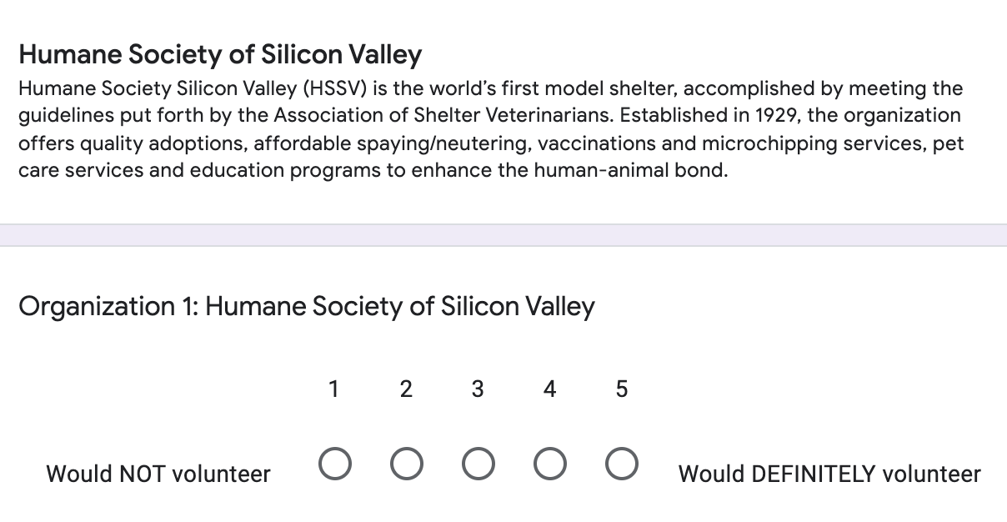
Experience Prototype #3
VS
We provided two versions of a list of NGOs, one with descriptions only and one with descriptions accompanied with ratings and either positive or negative reviews. Users were asked to rate whether they would volunteer at each NGO and interviewed afterwards.

Slide 49
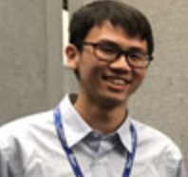
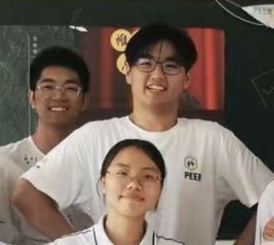
Participants
Kai, 22 yo, a researcher at a cognitive psychology lab in Waterville, Maine, volunteered at a senior living and a cat shelter in college.
HC, 23 yo, a senior student at NYU, majoring in sociology, volunteered as teachers and researchers in NGOs.

Slide 50
Pros
Good knowledge of work culture and colleagues at the NGOs from reviews
Users Trusted the NGOs more if told the reviews were from real volunteers
Users felt more motivated to volunteer at the highly-rated NGOs
Reviews were viewed as more important than the descriptions
Reviews impacted the user’s decisions of going to an NGO or not heavily
Cons
Users may doubt whether the reviews are from true volunteers if the website is not well-established
Users definitely don’t volunteer at the NGOs with terrible reviews, so we need to make sure the reviews are not biased or we screen out haters who attack with no reason

Slide 51
Learning
Users may want to volunteer at a place with very positive reviews but not the ones with mixed reviews, even when most of them are positive.
Surprise
When the rating of an NGO is 3.7/5 and reviews of are overall positive with some negatives, users feel less likely to work there than when there was no review at all
Example review: "Volunteering here was pretty fun! Got to know some great staff members and help out some sick puppies. Wish I had a bit more training but all around a solid experience."
when “volunteering”

Slide 52
Assumption: Other volunteers’ reviews will attract new people to volunteer at certain NGOs
Validity
Overall positive responses
Must rethink how users interpret negative reviews
New assumptions
The impact of the reviews on users will change based on the trustworthiness of the reviewer that wrote them
Images of people volunteering at the NGO make them look more trustworthy

Slide 53
Evaluating Solutions

Slide 54
Which solution would best solve our problem?
An app that allows people to complete small tasks for NGOs in their spare time

Slide 55
Why?
It leverages technology to connect potential volunteers and organisations, empowers people to make the most of dull moments.
Helps the organization with basic tasks and gives the users a sense of achievement.

Slide 56
Which communities that might be interested in your solution does it leave out?
Those without digital devices
Organisations that work with vulnerable populations and cannot outsource tasks in such a way
Volunteers that can give more than a few minutes a day and want to significantly contribute to an organisation

Slide 57
Summary
Notes:
We were able to interview 4 folks with a range of identities and service experiences - from founding a nonprofit to no current commitment
Next steps for interviews:
Maybe try to find people of a different age range, since we interviewed mostly our peers
Found out a lot about motivations and why people stay involved with volunteering experiences
Learned about the things that people find frustrating, and that might be good pain points to try and address

Slide 58
Key Learnings
Prospective volunteers want as much information as possible.
Organisations want honesty about commitment from volunteers
Volunteers need an emotion connection to an organisation
Volunteers trust other volunteer’s account of their experience
Next steps
Test more assumptions - new and existing assumptions
Do market research on our solutions
Try and include some already excluded communities into our solution

Slide 59
Questions?
Notes:
We were able to interview 4 folks with a range of identities and service experiences - from founding a nonprofit to no current commitment
Next steps for interviews:
Maybe try to find people of a different age range, since we interviewed mostly our peers
Found out a lot about motivations and why people stay involved with volunteering experiences
Learned about the things that people find frustrating, and that might be good pain points to try and address

Slide 60
Appendix
Notes:
We were able to interview 4 folks with a range of identities and service experiences - from founding a nonprofit to no current commitment
Next steps for interviews:
Maybe try to find people of a different age range, since we interviewed mostly our peers
Found out a lot about motivations and why people stay involved with volunteering experiences
Learned about the things that people find frustrating, and that might be good pain points to try and address

Slide 61
Extra POVs
Notes:
We were able to interview 4 folks with a range of identities and service experiences - from founding a nonprofit to no current commitment
Next steps for interviews:
Maybe try to find people of a different age range, since we interviewed mostly our peers
Found out a lot about motivations and why people stay involved with volunteering experiences
Learned about the things that people find frustrating, and that might be good pain points to try and address

Slide 62
POV
We met Claire, a tech consultant based in Scotland who did remote consulting for a local food bank.
We were surprised to realise how little she enjoyed the experience, which she attributed to a lack of social interaction.
We wondered if this means Claire connotes social interaction with a good, motivating volunteering experience.
It would be game changing to provide her with volunteering opportunities that suit her preferences.

Slide 63
POV
We met Alisha, who started volunteering in high school and led a non-profit project herself
We were surprised to realize that she was so jaded by non-profit founders working on the same thing separately and applying for the same resources.
We wondered if this means Alisha thinks non-profit founders should collaborate on their projects to avoid wasting resources.
It would be game changing to help non-profit founders with similar interests to find each other and encourage them to collaborate.

Slide 64
POV
We met Alisha, a Stanford coterm that founded her own non-profit whilst at high school.
We were surprised to realise that although she started a grassroots organisation, she prefers contributing to established causes and doing policy work.
We wondered if this means Alisha’s new set of circumstances (being a Stanford student) have impacted the type of volunteering work she now prefers to do
It would be game changing if Alisha could seamlessly transition into a different type of service (policy work).

Slide 65
POV
We met Manuela, a 23 y/o volunteer from Uruguay who repeatedly volunteers at impoverished neighborhoods with her church group
We were surprised to find Manuela only goes out to the neighborhood if her friends/congregation is going with her
We wonder if this means that she has trouble staying motivated to volunteer when not held accountable
It would be game changing for her if we managed to find ways to motivate her volunteering efforts

Slide 66
POV
We met Juan, a 57 year old businessman from Uruguay who founded Chicas Programadoras to help teach teenage girls to code and Involucrate to help connect volunteers with non-profit organizations
We were surprised to find that Chicas Programadoras focuses their efforts on Instagram to reach out to girls about participating in their clubs
We wonder if this means they are worried other conventional advertising routes will not reach young audiences
It would be game changing if we were able to help Chicas Programadoras adapt to their users needs for recruiting

Slide 67
POV
We met Juan, a 57 year old businessman from Uruguay who founded Chicas Programadoras to help teach teenage girls to code and Involucrate to help connect volunteers with non-profit organizations
We were surprised to find Juan spends most of his time nurturing the “mentor” community
We wonder if this means a strong mentoring community encourages mentors to keep volunteering
It would be game changing if we were able to help Juan strengthen the bonds between the mentors

Slide 68
HMW boards
Notes:
We were able to interview 4 folks with a range of identities and service experiences - from founding a nonprofit to no current commitment
Next steps for interviews:
Maybe try to find people of a different age range, since we interviewed mostly our peers
Found out a lot about motivations and why people stay involved with volunteering experiences
Learned about the things that people find frustrating, and that might be good pain points to try and address

Slide 69
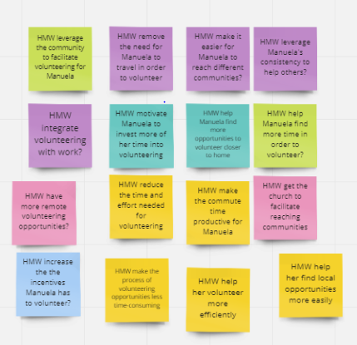
Our favorites
HMW help her volunteer more efficiently
HMW reduce the time and effort needed to volunteer
HMW help her find local opportunities more easily
HMW remove the need for travel to volunteer
Notes:
All of the HMWs
HMW leverage the community to facilitate volunteering for Manuela
HMW remove the need for Manuela to travel in order to volunteer
HMW make it easier for Manuela to reach different communities?
HMW leverage Manuela's consistency to help others?
HMW integrate volunteering with work?
HMW motivate Manuela to invest more of her time into volunteering
HMW help Manuela find more opportunities to volunteer closer to home
HMW help Manuela find more time in order to volunteer?
HMW have more remote volunteering opportunities?
HMW reduce the time and effort needed for volunteering
HMW make the commute time productive for Manuela
HMW get the church to facilitate reaching communities
HMW increase the the incentives Manuela has to volunteer?
HMW make the process of volunteering opportunities less time-consuming
HMW help her volunteer more efficiently (so she can work with more orgs)
HMW help her find local opportunities more easily

Slide 70
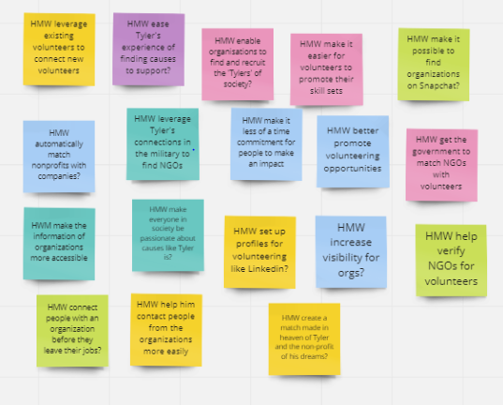
POV recap for Tyler
It would be game changing if we were able to connect volunteers with organizations that can maximize their skills

Slide 71
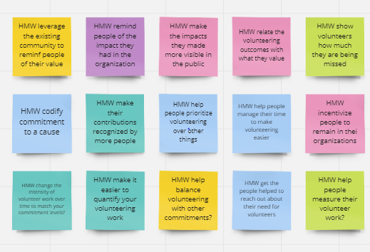
POV recap for Tyler
It would be game changing if we were able to connect volunteers with organizations that can maximize their skills

Slide 72
Participants
3 additional interviews
Nationalities: American (Colorado), Uruguayan (Uruguay), Scottish (Hong Kong)
Ages: 34, 57, 59 (complementing our previous young participants)
Experiences: range from individual volunteering to organization leading (or both)

Slide 73
Assumptions Tested: Prototype #1
People want to volunteer but don’t have enough time to do so
People will want to complete small tasks for NGOs in their spare time
If the activities are made fun, users will want to keep coming to the app
Completing small tasks for NGOs will make people want to volunteer more for these organizations (stepping stone)
A social component added to the app (seeing what tasks your friends are doing) will increase the level of involvement

Slide 74
Assumptions Tested: Prototype #2
People want to volunteer but don’t have enough time to do so
People have a hard time discovering where to volunteer and need help to find places
People are more likely to volunteer if they know about the opportunities in organizations close to where they live
Leveraging existing movement of people (going home or to work) will make it easier for them to want to travel to volunteer sites

Slide 75
Assumptions Tested: Prototype #3
Seeing other people’s reviews make people more likely to choose an NGO that works for them
Having a place to review NGOs will make people want to stay longer at companies that they value
People have a hard time deciding where to volunteer because they don’t have any knowledge about what experiences to expect
NGOs will benefit from being able to advertise their organization on a platform that reaches volunteers directly

