Slide 1
Assignment 1: Needfinding
Siddharth Gehlaut, Tolúlọpẹ́ Ògúnrẹ̀mí, Yi Feng, Alejo Navarro Goldaraz
Notes:
___User group reach (diversity - extreme users/average users/non-users, innovativeness, appropriateness) (20 points).
___Depth of the interviews (20 points).
___Number of interviews (20 points).
___Details in unpacking using chosen methodology (20 points). ___Showed tensions, contradictions, surprises, & inferences from the interviews (20 points).

Slide 2
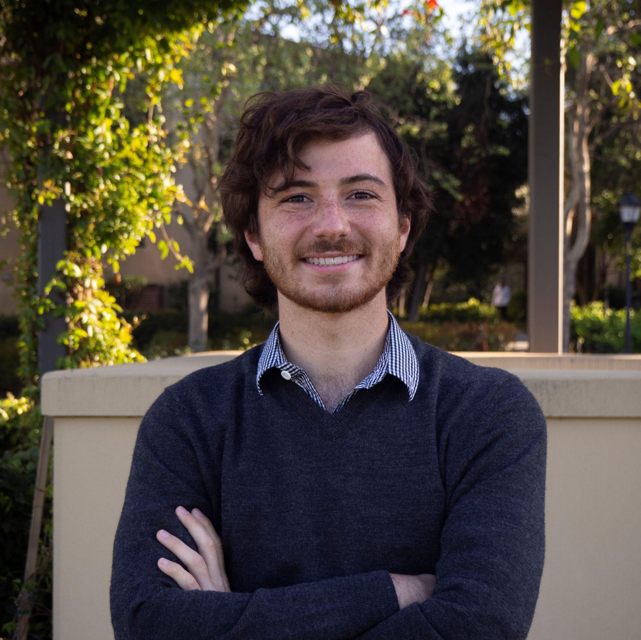
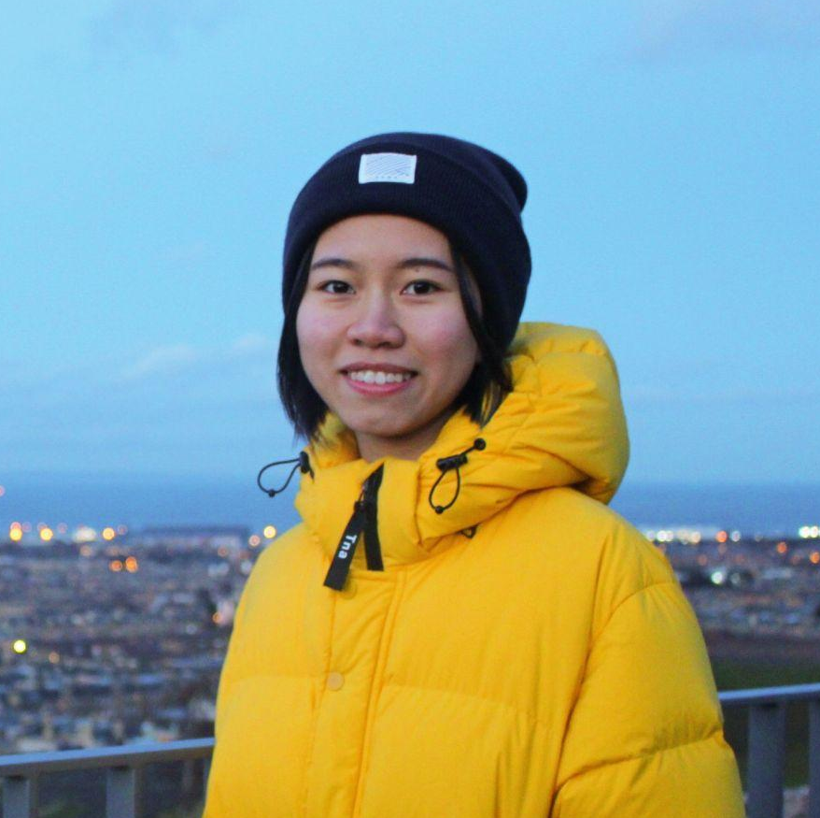
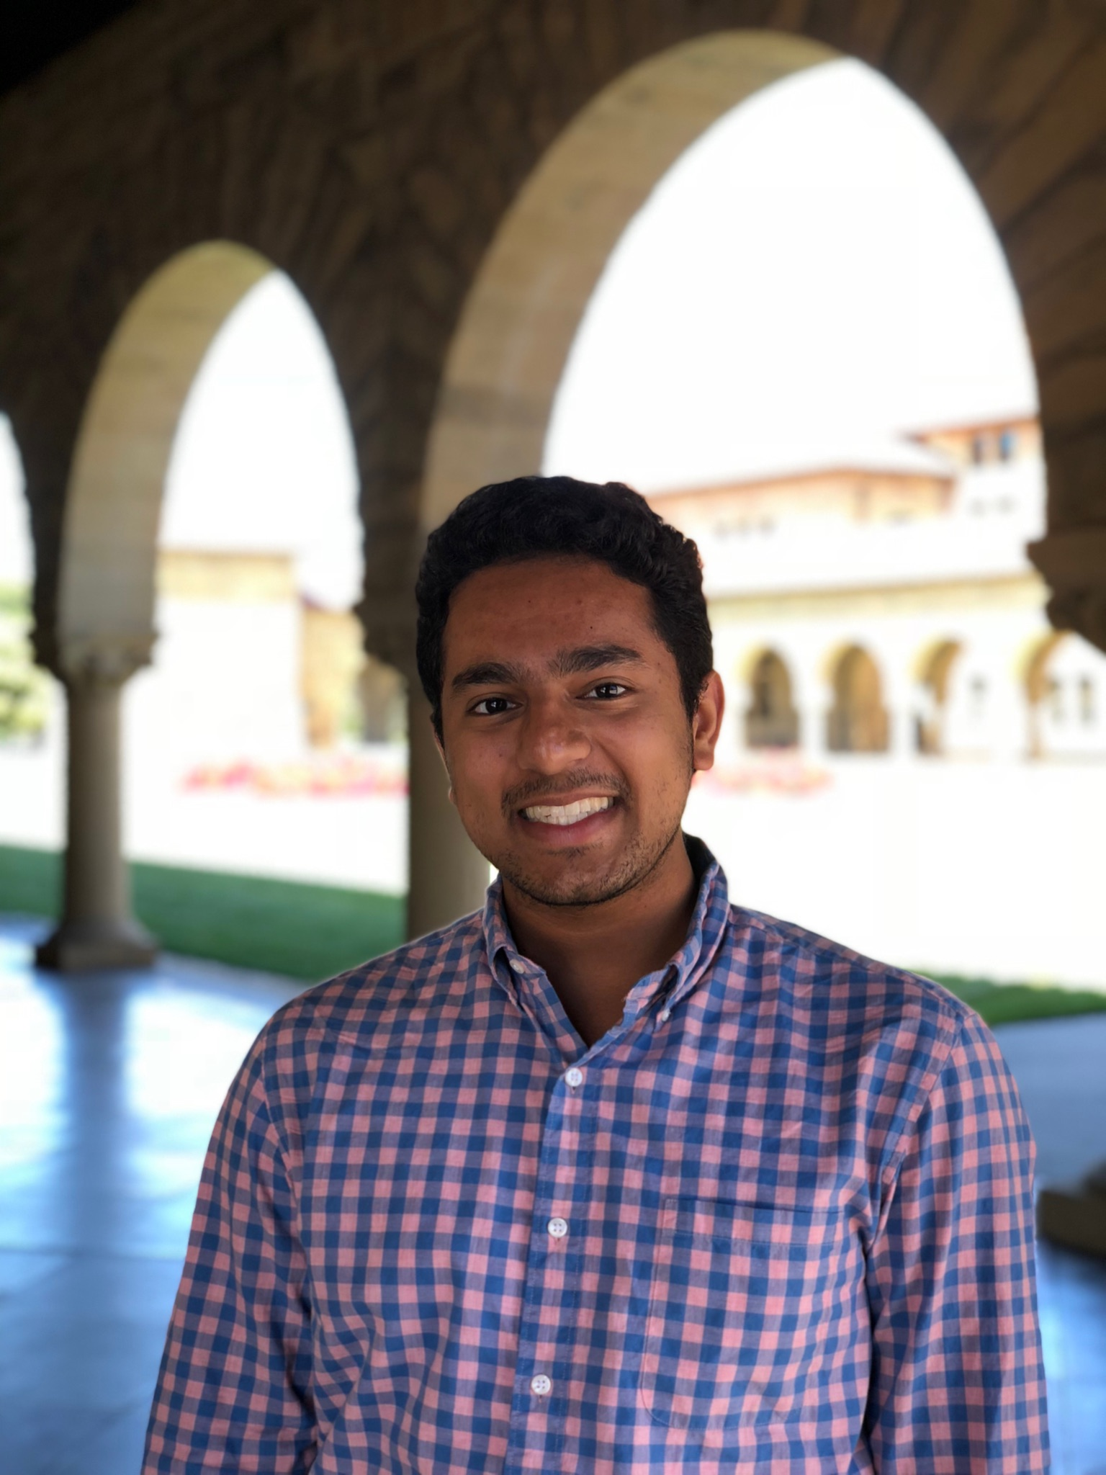
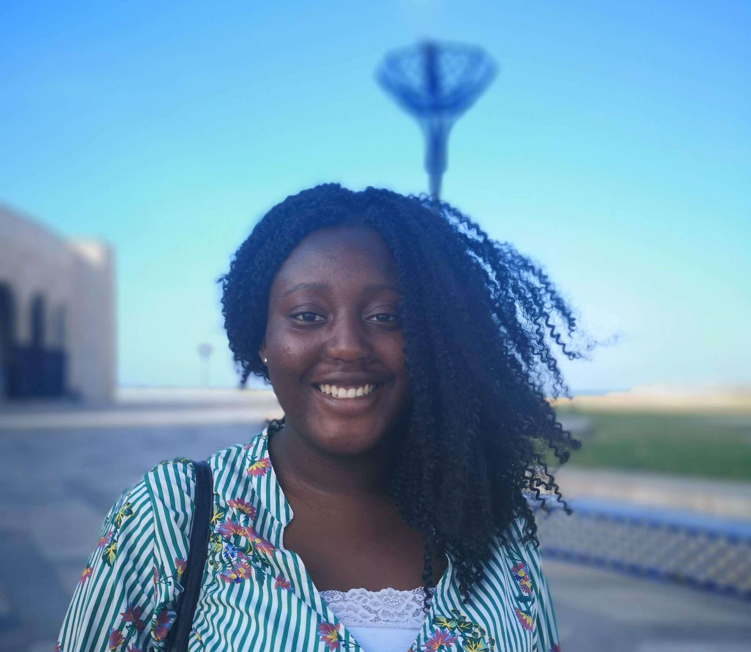
Introduce - Team Members
Alejo Navarro Goldaraz
CS Coterm Student
Buenos Aires, Argentina
Yi Feng
CS Master’s Student
Guangzhou, China
Sid Gehlaut
Economics Senior
Inverness, IL
Tolúlọpẹ́ Ògúnrẹ̀mí
CS PhD
London, England

Slide 3
Domain Theme: Volunteering and Philanthropy
???
Volunteering
Service
Philanthropy
Motivation
Fund Raising

Slide 4
Interviews

Slide 5
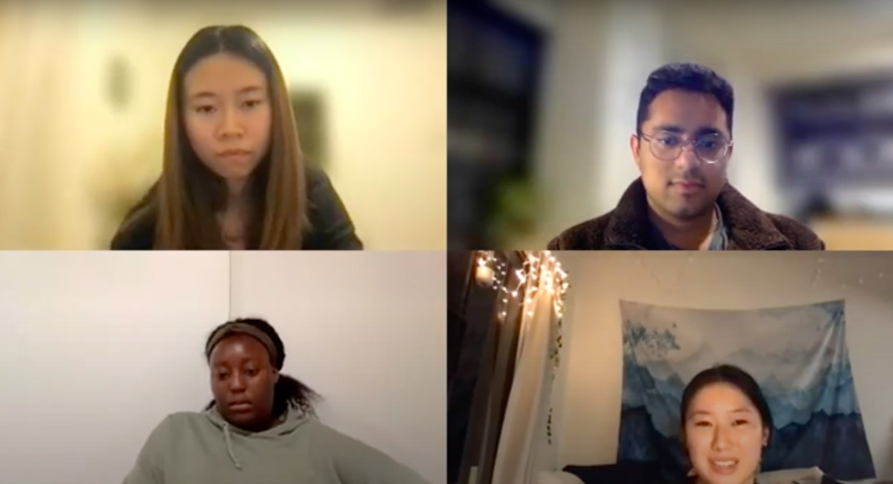

Slide 6
Our Questions
Tell us about a challenge you face regularly
How did you get involved with (volunteering, philanthropy, nonprofit)?
What do you like/dislike about your work?
Tell us about an unexpected experience you had in your time
What motivates you about what you do?

Slide 7
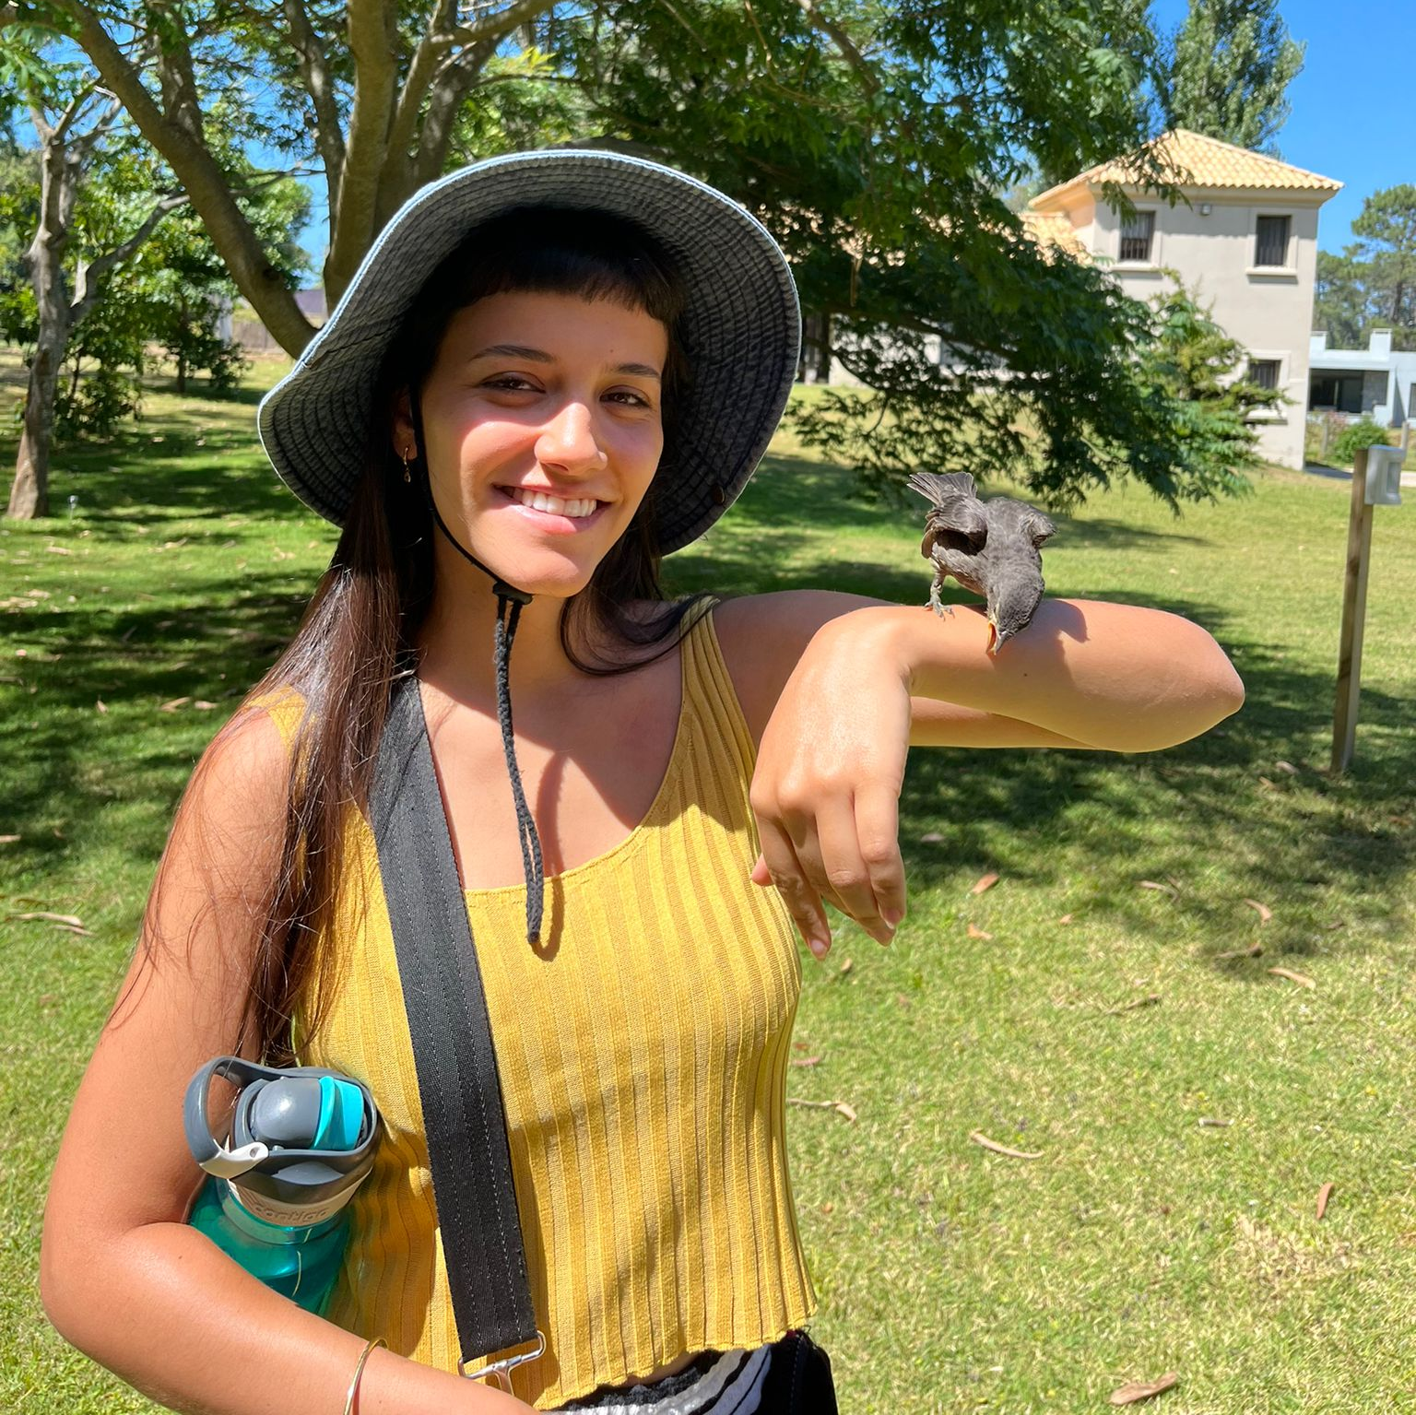
Manuela Vetrale
[Beach, Punta del Este]
“Little by little we had gained the trust of a lot of people there. They knew who we were”
Notes:
ALejo did this one in Spanish
23 y/o recent graduate
Animal lover & church volunteer
Montevideo, Uruguay

Slide 8
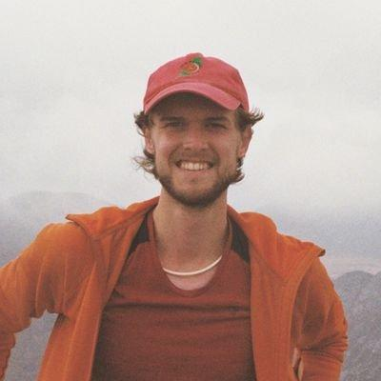
Seth Aycock
[Zoom]
"Travel helps, but I like to back [the organization's] goals"
Notes:
Seth mostly volunteers at the yearly Linguistics Olympiad!
NLP Researcher
Isle of Man, United Kingdom

Slide 9

Alisha Zhao
[Zoom]
“Within the young non-profit founder community, I just became really jaded with, like five different people working on menstrual hygiene justice and doing the exact same work. But rather than collaborating, it was very much applying for the same resources...”
Notes:
Sociology coterm
Founder of housing justice nonprofit
Stanford, CA

Slide 10
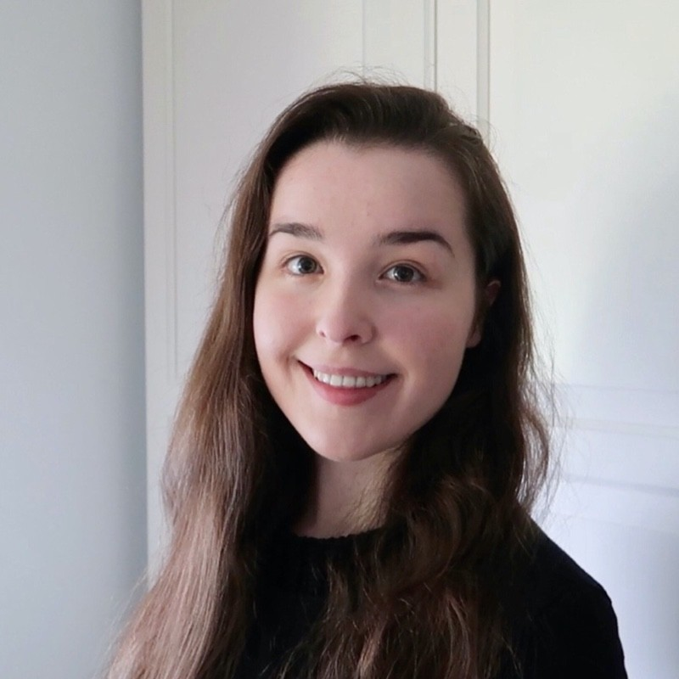
Claire Mackie
[Zoom]
“First two [experiences] were teaching, volunteering for a foodbank was not academic. I preferred teaching due to more experience in academia.”
Notes:
Tech consultant at Big 4 Firm
Edinburgh, Scotland

Slide 11
Empathy Maps

Slide 12
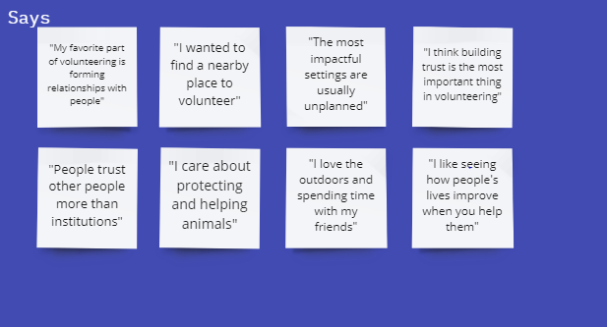
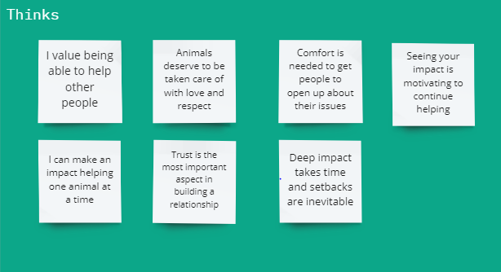


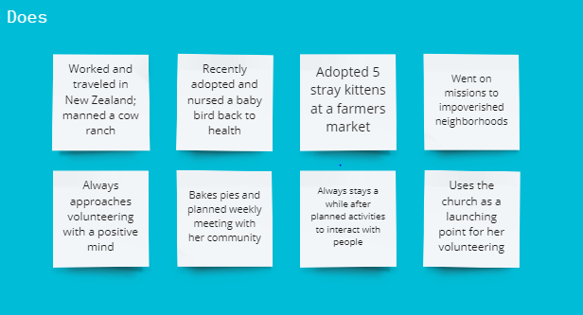

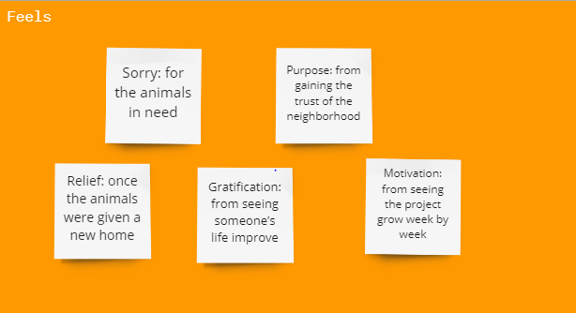

Slide 13
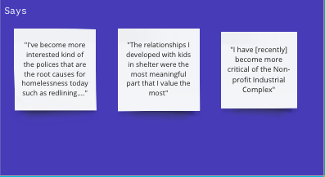
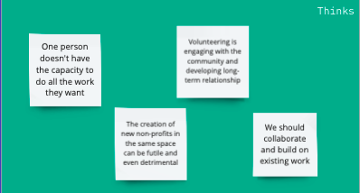
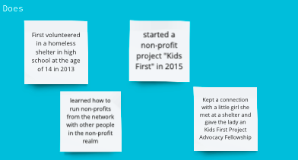
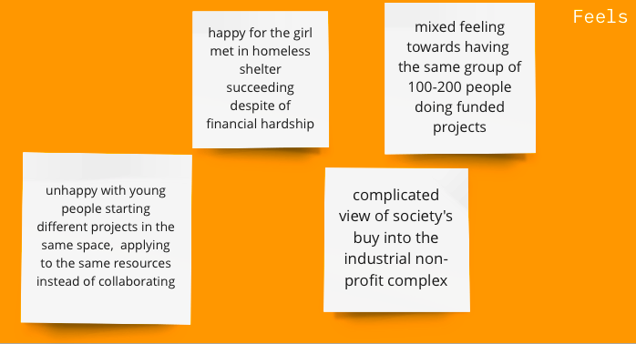

Slide 14
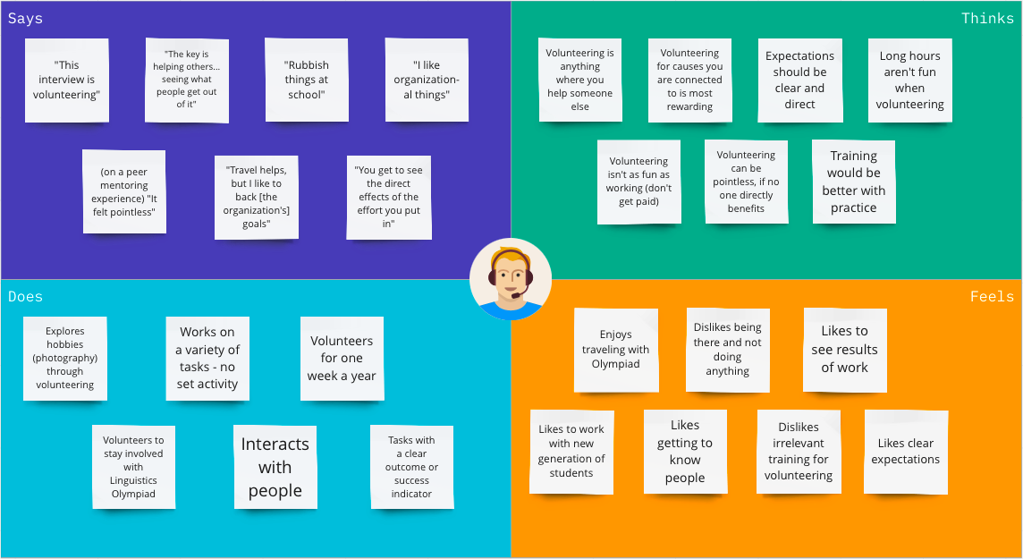

Slide 15
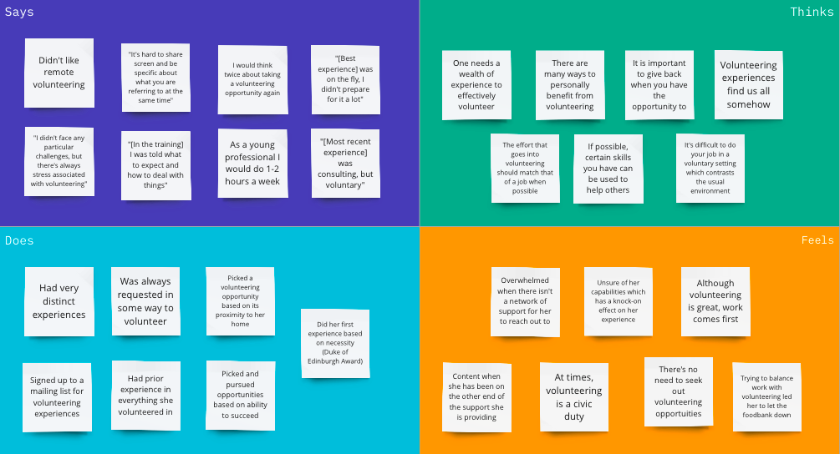

Slide 16
Synthesized Map

Slide 17
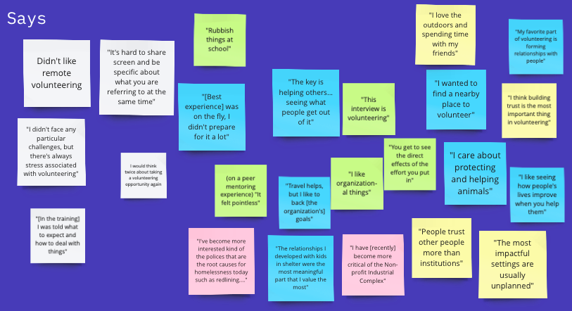
Notes:
Everyone says that seeing the impact was very valuable
Ease of volunteering made it easier to stay committed

Slide 18
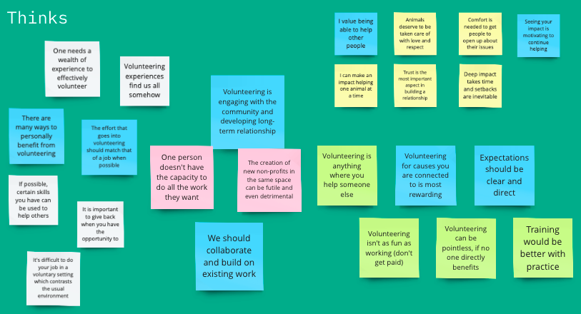
Notes:
Intentionality
Collaboration and community aspect

Slide 19
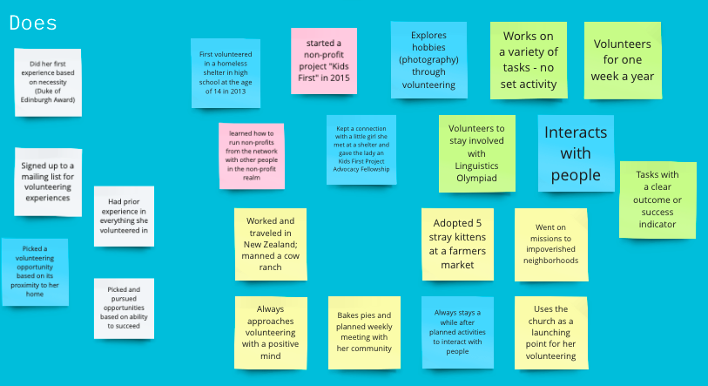
Notes:
A lot of people started in their community
Do things with others

Slide 20
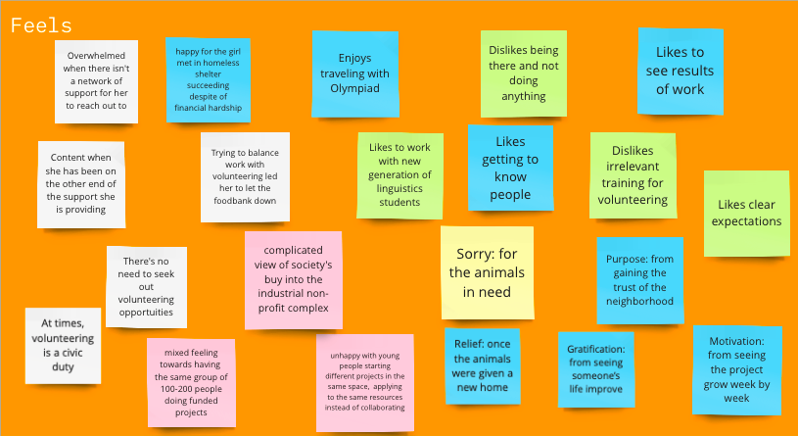
Notes:
Positive feelings associated with doing work for others, supporting others, seeing impact of work!
Negative feelings: systemic aspect of it, how do we balance things like work

Slide 21
Tensions, Contradictions & Surprises

Slide 22
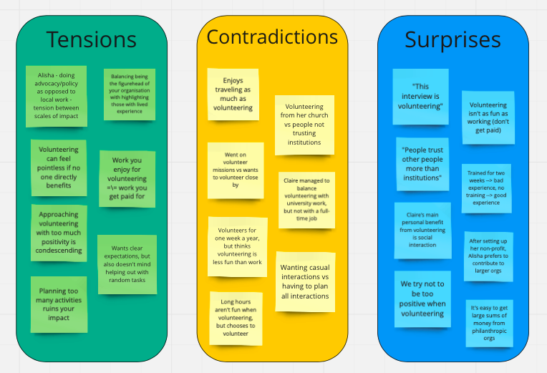
Notes:
Tensions:
WIth our extreme user, one of the most interesting tensions was between advocacy on a larger level and direct service on the community level
Volunteering can feel pointless if the impact isn’t seen immediately
Contradictions:
Volunteering could be even more stressful than a job - less organized, more work required - but people still choose to do it
Surprises
Sometimes, overly preparing can take away from the experience.

Slide 23
Insights

Slide 24
“It was incredibly motivating to be able to see the positive impact we were having on people and the community”
“Trust is the single most important component of being able to form deep connections with the communities we serve”
Notes:
Insight:
Being able to see their impact/potential impact motivates people to continue/start helping others
Need:
Find better ways to show people the impact of their work
Insight:
In order for practices be adopted and help accepted you must first lay a foundation of trust
Need:
Help volunteers/organizations earn the trust of the people they are helping

Slide 25
“But rather than collaborating, it was very much like applying for the same resources and just having to all be dispersed in a way that was more detrimental to like the communities and issues that they sought to serve.”
“HERlead was the first influential fellowship. When I went there and I met other people that created nonprofits, I was like, wow, this is not something that I thought people could do at that age. And it was through these friends that I made and learning their process that I realized, oh, this is something I can do. And I learned from them how to actually do it.”
Notes:
Insight:
It is better for young people to collaborate with others than each starting their own projects in the same space
Need:
A method to collaborate with like-minded people
Insight:
Experience and network in the field show beginners possibilities of what they can accomplish
Need:
Access to fellowship opportunities and/or network in the field

Slide 26
“Travel helps, but I like to back [the organization’s] goals”
“Rubbish things at school… felt pointless”
“Training would be better with practice”
Notes:
Insight:
While the volunteering activity itself might be fun and important, it is more important to feel a connection to the cause
Need:
Volunteers need to connect with organizations that align with their values and motivation
Insight:
If you have a good training method, but the training isn’t pertinent to the work, it can cause a disconnect early on
Need:
Organizations need to have relevant training to the task at hand

Slide 27
“[During my remote volunteering experience I] never met anyone I was working for. There were also technology issues such as explaining things when on screen share or internet issues”
“I would think twice about balancing a job with volunteering - I wouldn’t do more than 1-2 hours a week as a young professional”
Notes:
Insight:
For those that thrive off social interaction for volunteering, remote volunteering proves to be difficult.
Need:
Improve the remote volunteering experience to keep volunteers engaged enough to remain in their roles.
Insight:
Young people may stop volunteering when entering the workforce.
Need:
Provide them with volunteering opportunities that match their capacity to prevent total dropout.

Slide 28
Summary
Notes:
We were able to interview 4 folks with a range of identities and service experiences - from founding a nonprofit to no current commitment
Next steps for interviews:
Maybe try to find people of a different age range, since we interviewed mostly our peers
Found out a lot about motivations and why people stay involved with volunteering experiences
Learned about the things that people find frustrating, and that might be good pain points to try and address

Slide 29
Selection Criteria
Category
Background diversity
Experience diversity
Extreme User
Grading
Comments
Different nationalities, ethnicities, socioeconomic status. To improve: age diversity
Different volunteering/philanthropy types & positions & organizations. To improve: non-users
Extremely involved in service groups

