Slide 1

SNIPPETS
Microvolunteer in your spare time
Mobile app to facilitate microvolunteering for people in their spare time.
Notes:
\

Slide 2
Snippets Vision

Slide 3
Snippets’ Vision
Mission Statement
Value Proposition
To empower people to microvolunteer in their spare time
Repurposing spare time and promoting volunteering

Slide 4
What is Snippet trying to solve?
Problem
Solution
We learned from the needfinding interviews that interviewees often find themselves overwhelmed with life and can’t commit regularly to donate their time to NGOs.
An mobile app that enables people to microvolunteer any time and any place. They can complete small tasks for NGOs in minutes, leveraging their skills and their spare time.

Slide 5
Values Encoded

Slide 6
VALUES IN DESIGN
01
02
03
04
SERVICE
PRODUCTIVITY
Allow users to volunteer their time for a good cause
Provide an alternative to mindless scrolling
DYNAMISM
FUN
Allow for low commitments and fast changes to tasks
Create an enjoyable experience for volunteers

Slide 7
How our values guide our choices
Service
Productivity
We designed our app to be a “service first” platform
The main action buttons in all pages encourage users to complete Snippets
Organizations are promoted through prominence in the Snippets
Leveling up is based on quantity and quality of service
Repurposing wasted time gives an intrinsic sense of productivity
We clearly outline the purpose of the Snippet (NGO goal) to make users feel productive
We stand as a (productive) replacement for endless scrolling
All Snippet work is directly tied to a greater purpose

Slide 8
How our values guide our choices
Dynamism
Fun
Our app is meant to be used for a few minutes as a time
We placed a strong emphasis on the time commitment of each Snippet
Task flows are optimized to spend the least amount of time possible on each Snippet
We added instant feedback for users to feel like they come in, help out and leave
Nothing would work if users don’t enjoy the experience
We added progress tracking and leveling up as a way to increase engagement
Animations will be added to make the app more playful (hard to prototype)
We added a social component to make the experience a shared one

Slide 9
VALUE CONFLICTS
SERVICE
DYNAMISM
Organizations need users to commit for them to have a long impact on a community
Dynamism encourages fast changing activities and low commitment from volunteers
Notes:
Addressing the conflict: As users worked on more and more projects for an organization, they can join the organization for long-term commitments

Slide 10
Possible resolutions
As users worked on more and more projects for an organization, they can join the organization for long-term commitments
We can adjust recommendations in the filters to reflect this
We can add highlights within history or profile
Organizations can contact frequent users to encourage them to join for different roles
We can send notifications to NGOs with people interested in in their mission

Slide 11
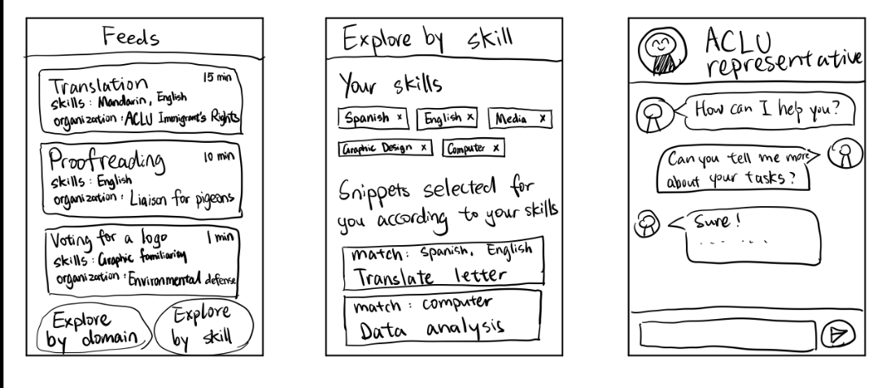
Mobile App - Snippets in your pocket

Slide 12
Tasks

Slide 13
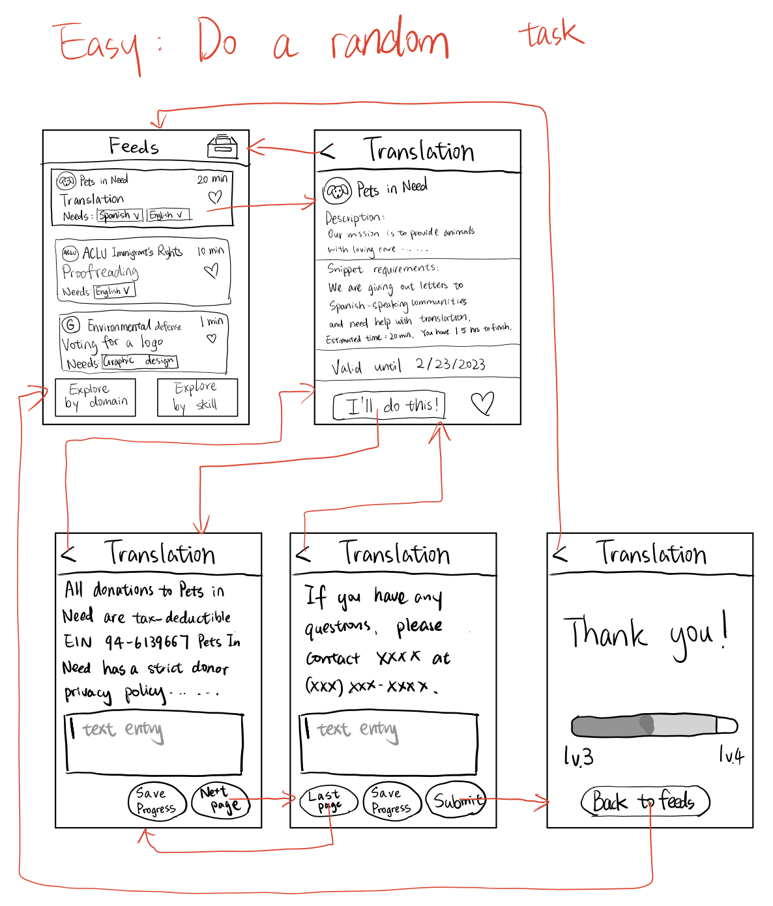
Lo-fi Prototype Tasks - Easy
Complete a random snippet
If a user clicks a snippet on the Feeds page, they will be directed to the task details and choose to do it or not.

Slide 14
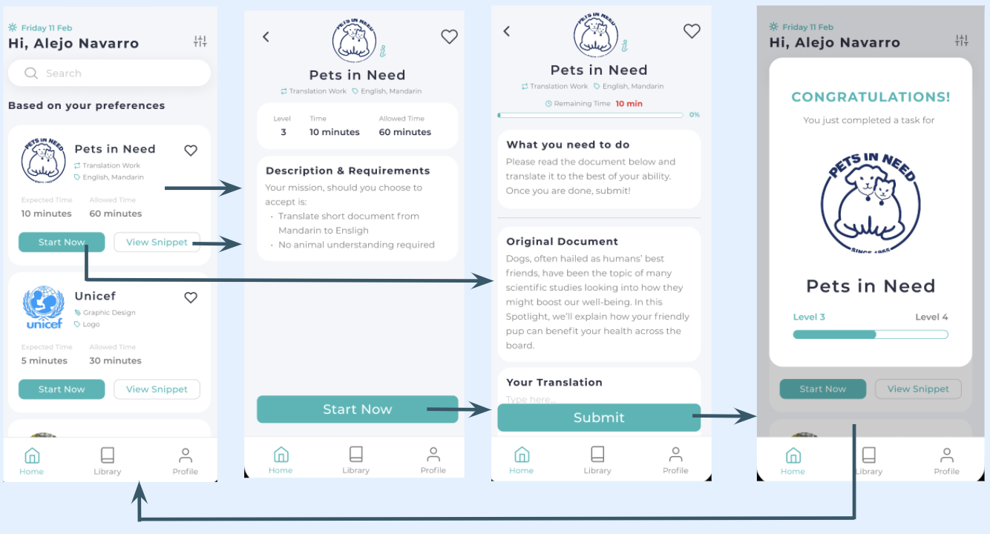
Med-fi Prototype Revision - Easy
Most parts of the easy task remains unchanged, except that we allows the user to start without seeing the description from the snippet cards.

Slide 15
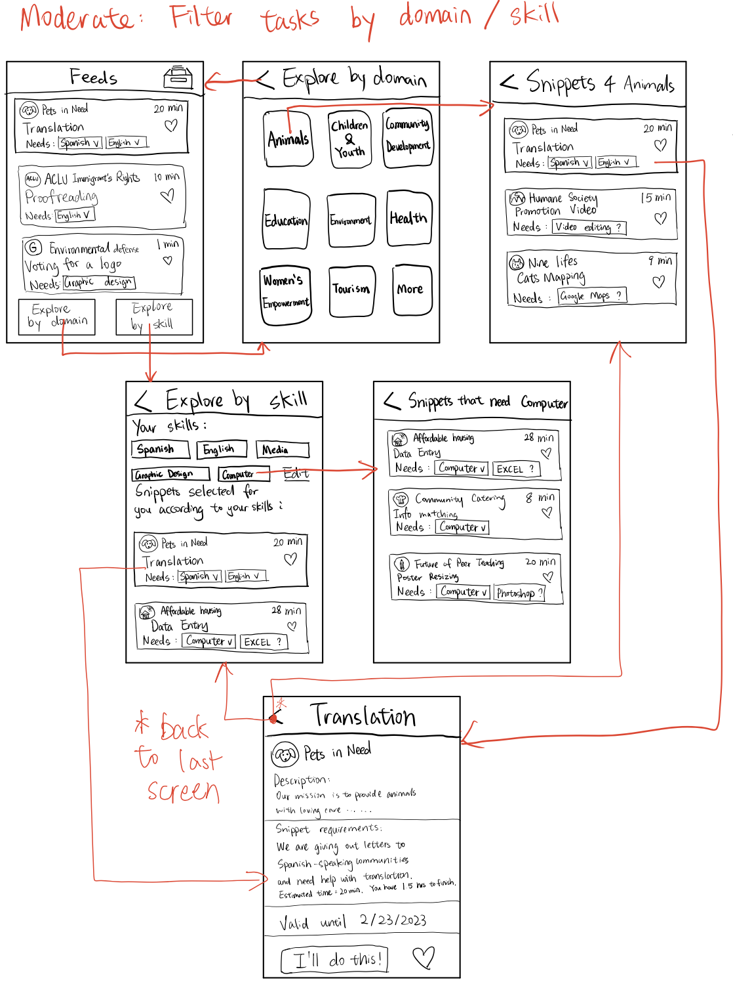
Lo-fi Prototype Tasks - Moderate 1
Filter snippets by domains or skills
When user clicks [Explore by domain/skill], they will be directed to the page where they can select specific domain/skill and get a list of snippets in that domain/need that skill.

Slide 16
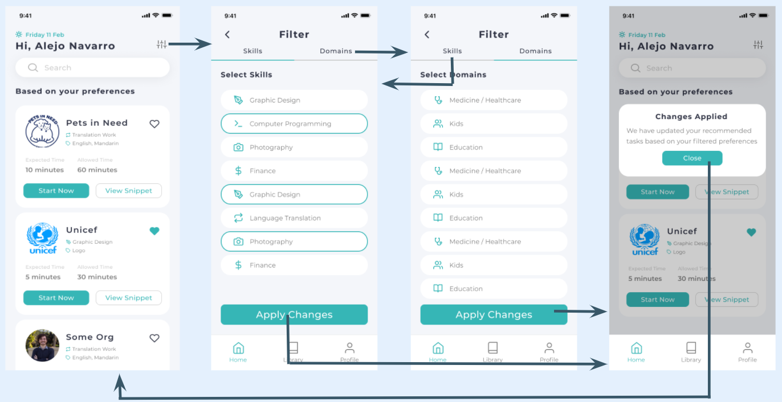
Med-fi Prototype Revision - Moderate 1
We simplified the filtering task a lot according to the feedbacks we got from our lo-fi prototype. It seemed unnecessary to have filtering pages for skills and domains separated so we combined them.

Slide 17
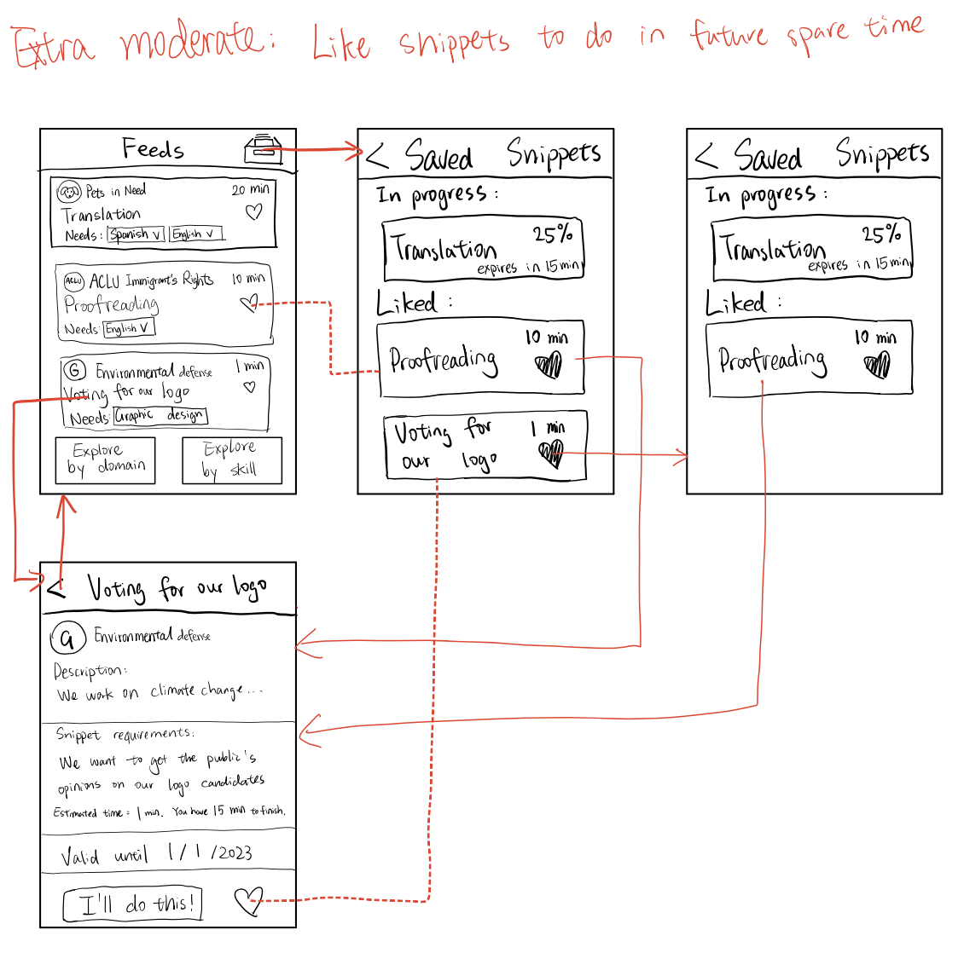
Lo-fi Prototype Tasks - Moderate 2
Like a snippet for future spare time
When a user finds an interesting snippet but doesn’t want to do that immediately, they can click the heart in the snippet banner or in the details page and the task will be flagged and put in the Saved folder.

Slide 18
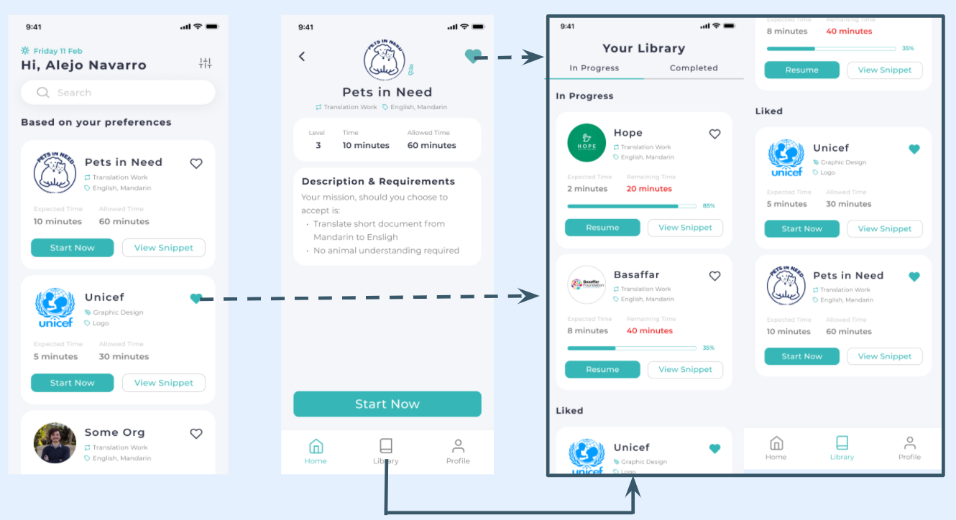
Med-fi Prototype Revision - Moderate 2
Most parts of this task remains unchanged, except that the liked tasks are now in the Library page.

Slide 19
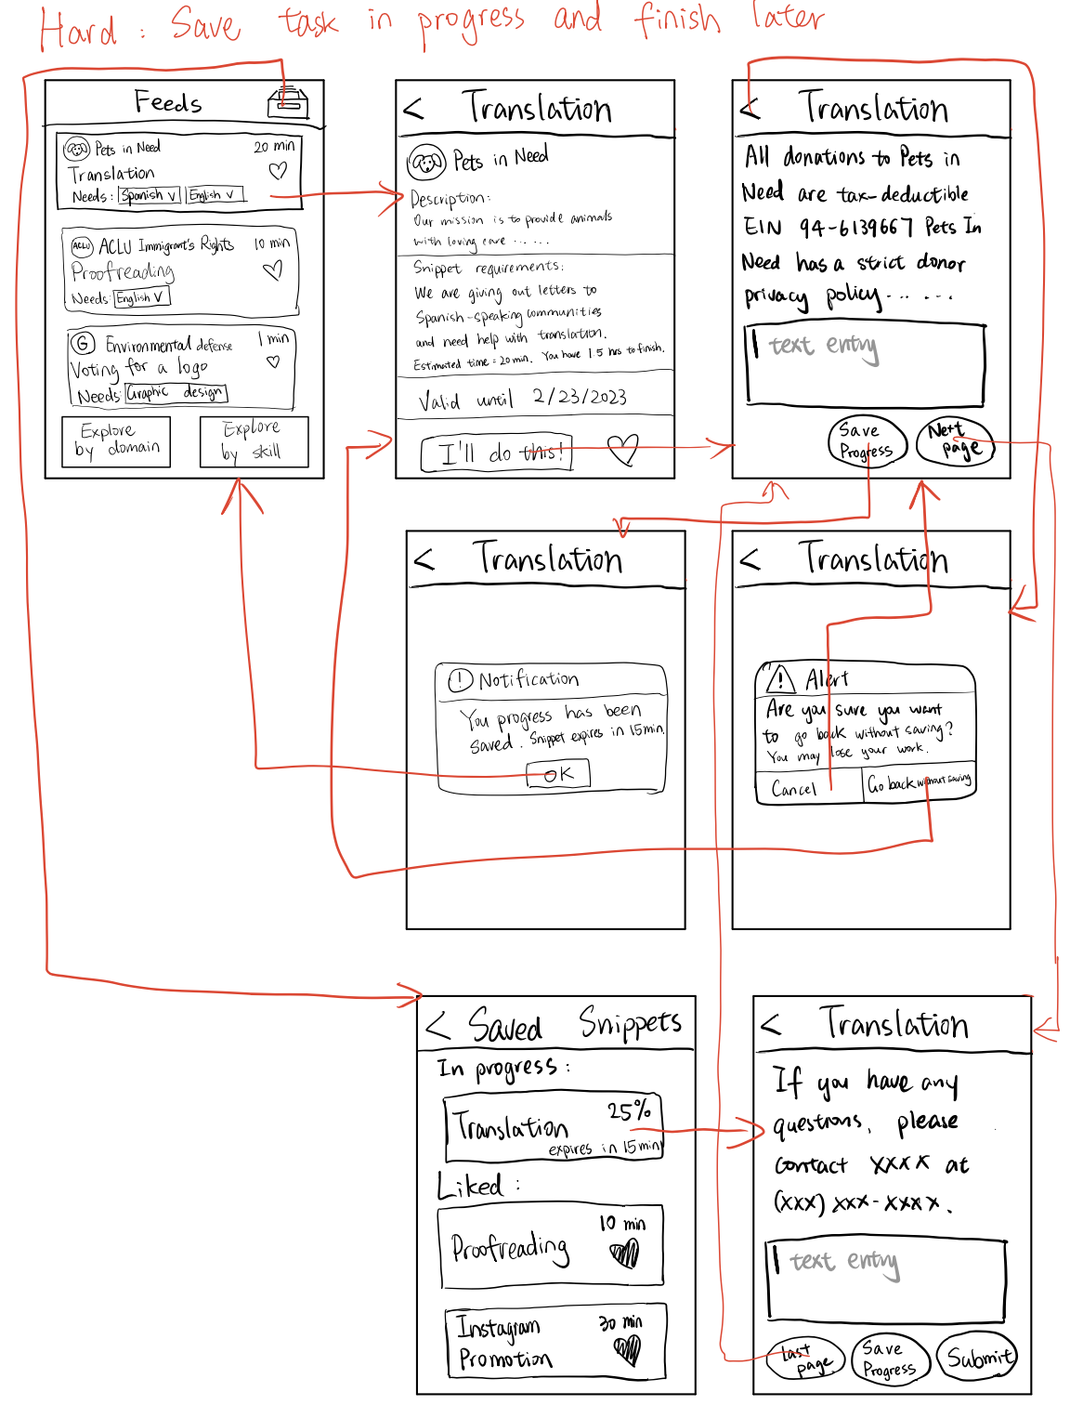
Lo-fi Prototype Tasks - Hard
Save a snippet to complete later
If a user started snippet and wants to quit the app mid-way, they can save their progress and resume later from the Saved folder.

Slide 20
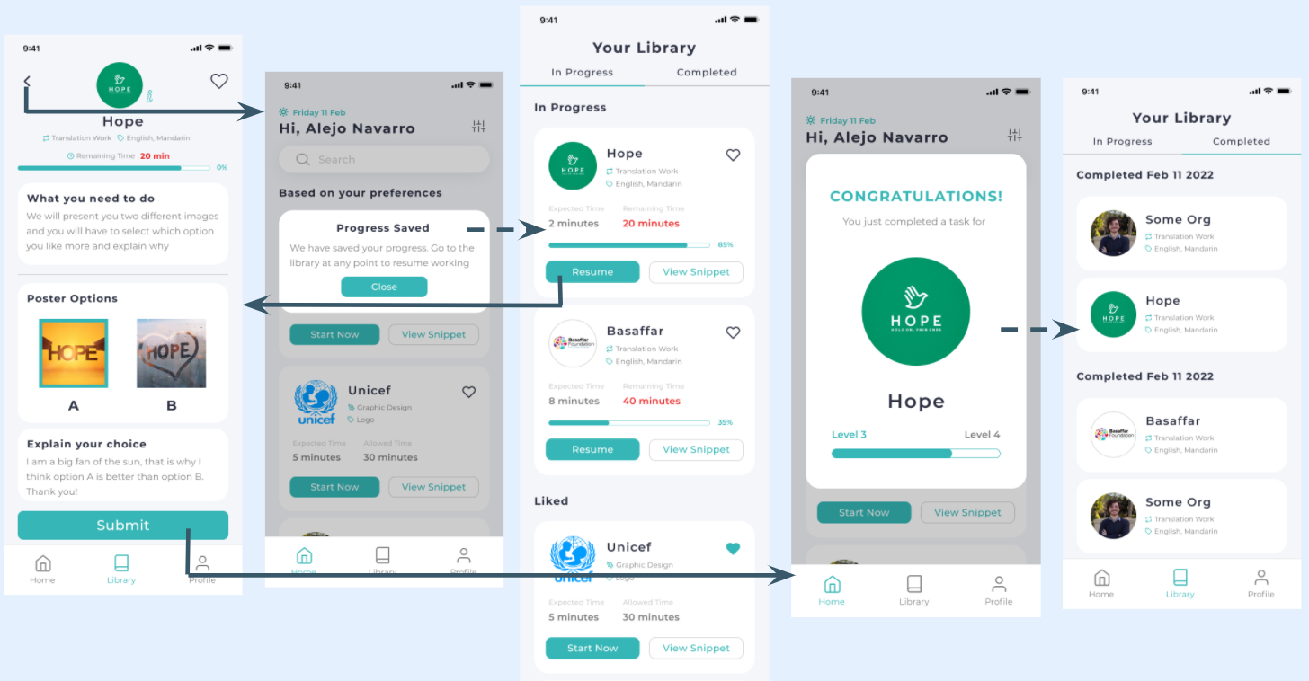
Med-fi Prototype Revision - Hard
Users wanted their progress to be saved automatically instead of they saving their work manually, so we removed that saving feature. Users will be noticed that their work was saved when they exit their in-progress snippet, and will be able to find that in their library and resume later.

Slide 21
Usability Goals and Key Measurements

Slide 22
Usability Goals
Usability Goal
Ease of use or efficiency
Discoverability
Robustness
Measurement Metric
Clicks required to complete a task
How easy it is for users to find the tasks
Amount of errors completing the task

Slide 23
How we are progressing…
Removing redundant screens and action buttons for Snippet completion
Working in iconography, layout and spacing to increase discoverability
Focusing on being consistent and intuitive with our designs to minimize the chances of errors in flow
We allow for user errors but add safety nets and feedback
Overall positive results; will be addressed in later slides
Usability Goal
Ease of use or efficiency
Discoverability
Robustness

Slide 24
Major Design Changes

Slide 25
Change #1: App Navigation
Our users complained that the navigation was not intuitive. They wanted to easily move between screen and be able to break the linear flow if they made a mistake.

Slide 26
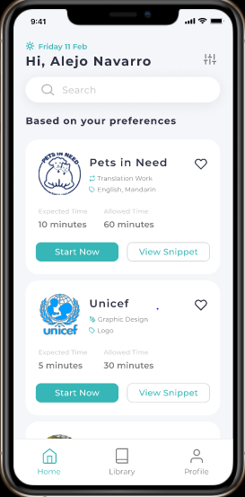
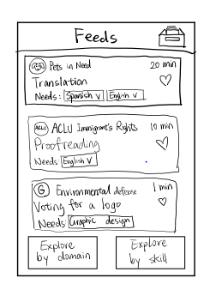
New
Old
Changes
Added a simple search bar
Moved Filtered feature to the top
Combined both types of filtering
Added Bottom Navigation Bar
Should help with discoverability and ease of use

Slide 27
Change #2: Snippet Card
Our users wanted to see more information for each Snippet. They wanted to track progress, understand why they were seeing that Snippet and how long it would take them to complete it

Slide 28
Old
New
Changes
Added easy view and start buttons
Added more detailed tags for the type of work and skill required
Added data on the time taken and allowed
Should help with ease of use and Robustness

Slide 29
Change #3: Completion flow
Our users were confused about the save buttons, why they needed multiple screens and were annoyed by the button redundancy in the congratulations screen

Slide 30
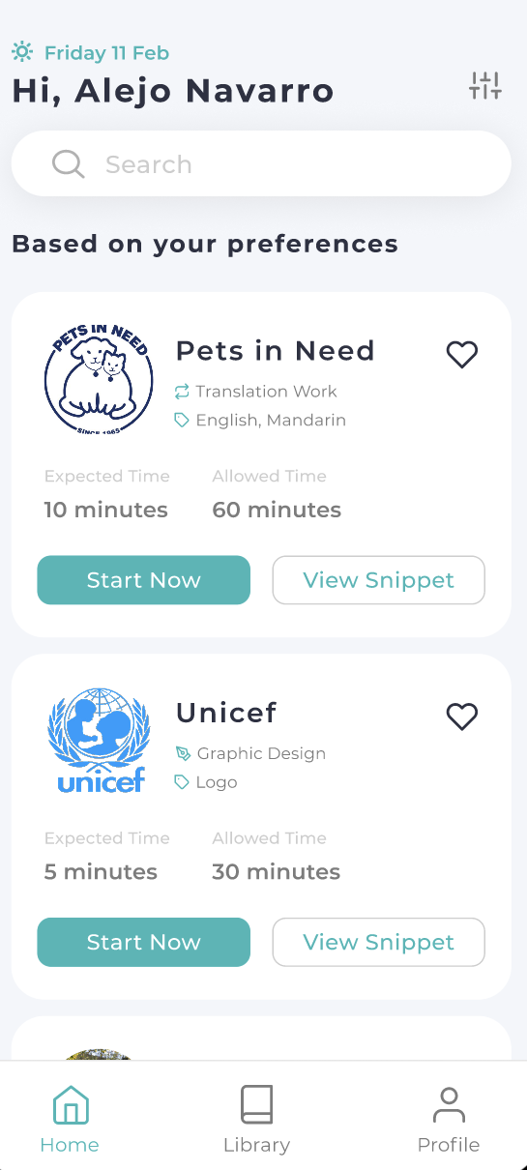
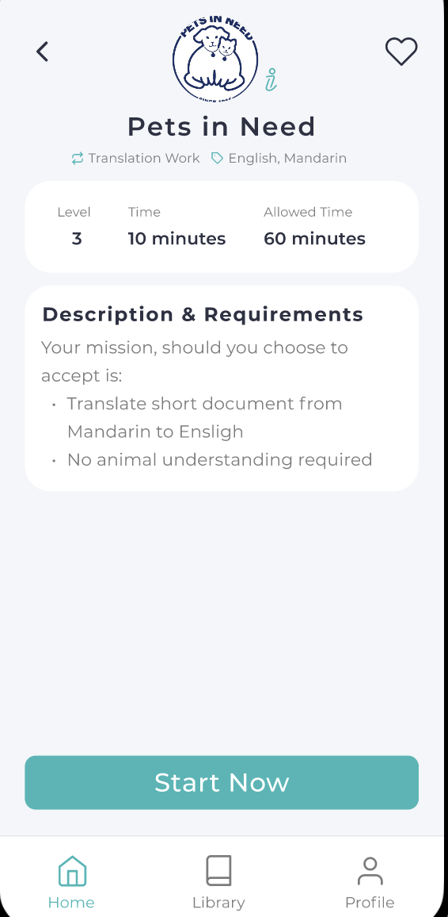
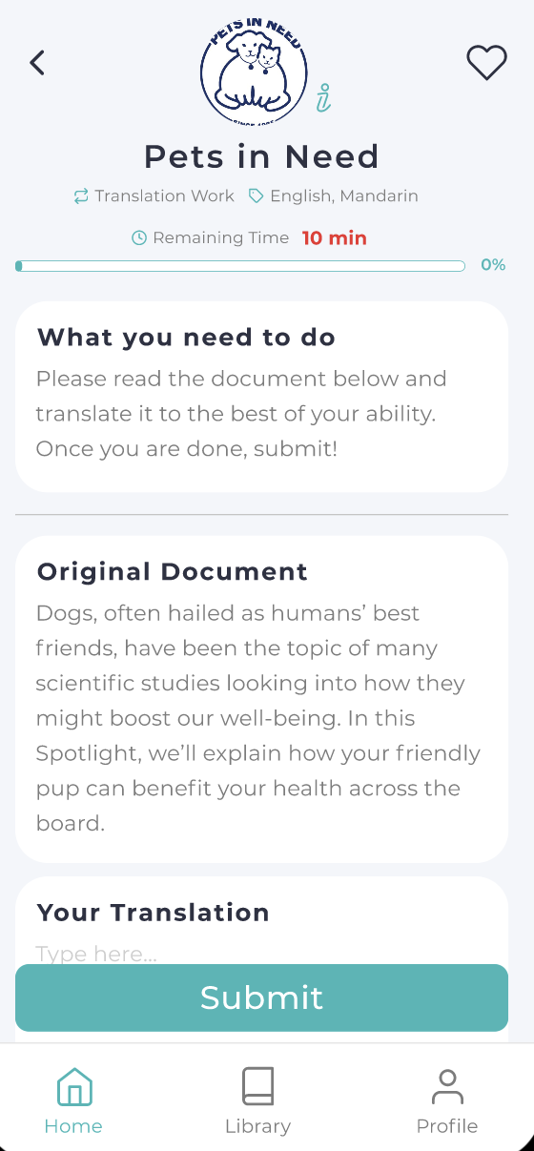
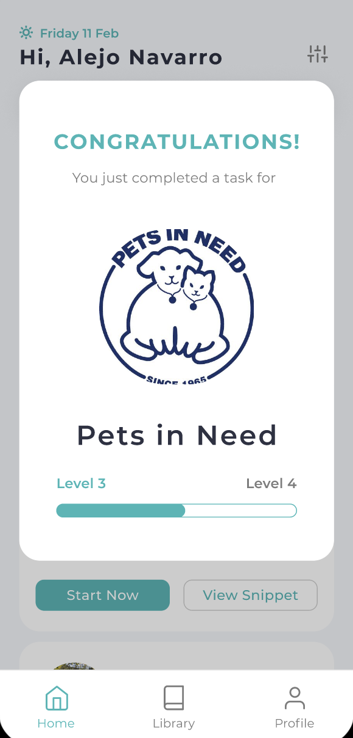
Old
New
Changes
Reduced the number of screens from 5 to 3 (and a pop-up module)
Removed save buttons
Added autosaving
Added progress tracking
Should help with ease of use

Slide 31
Change #4: Filtering Categories
Our users seemed to like the domain filtering selection more than the skills filtering. We wanted a consistent UI for quick selection and easy shifts between domain/skill

Slide 32
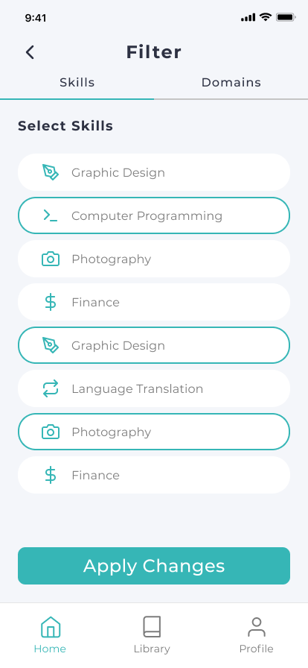
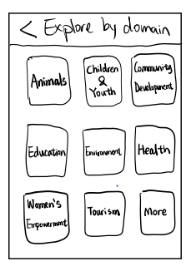
Old
New
Changes
Easy navigation between Skills and Domain
Single Filtering UI
Easier selection of categories
Simple Apply Changes
This also allows us to have a single feed and not specific feeds based on the selected filters
Good for robustness and ease of use

Slide 33
Change #5: Saving, Liking and History
Our users were confused by the difference between liked and saved Snippets and also wanted the ability to see old Snippets they had already completed

Slide 34
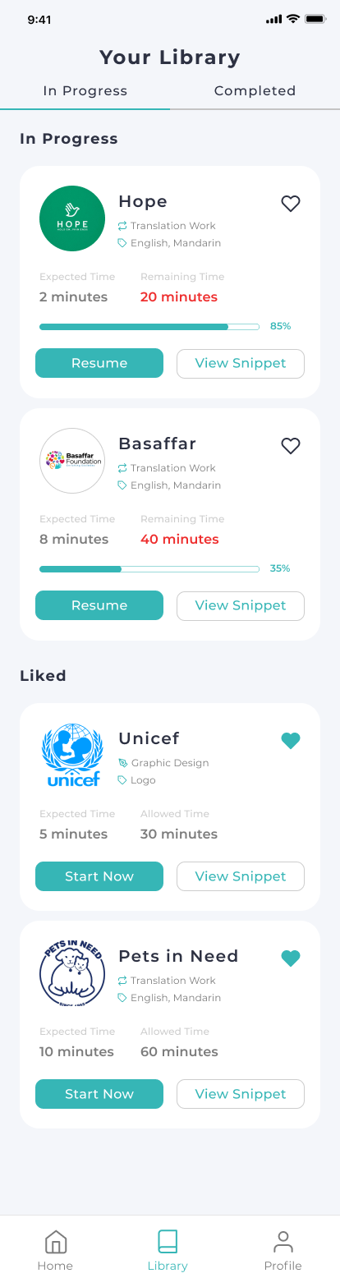
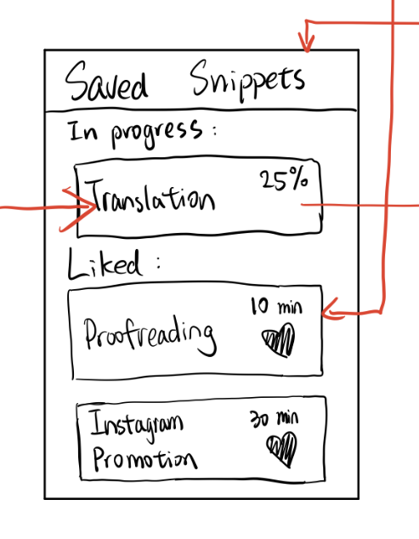
Old
New
Changes
Removed all Save Buttons and added autosave
Added ability to see history
Added key metrics for in progress snippets
Clarified distinction between saved and liked snippets
Improves discoverability and robustness

Slide 35
Change #6: User Feedback
We wanted to add ways for our app to tell the user when they were about to do something important or when they had just done something important for them to understand their action had gone through

Slide 36
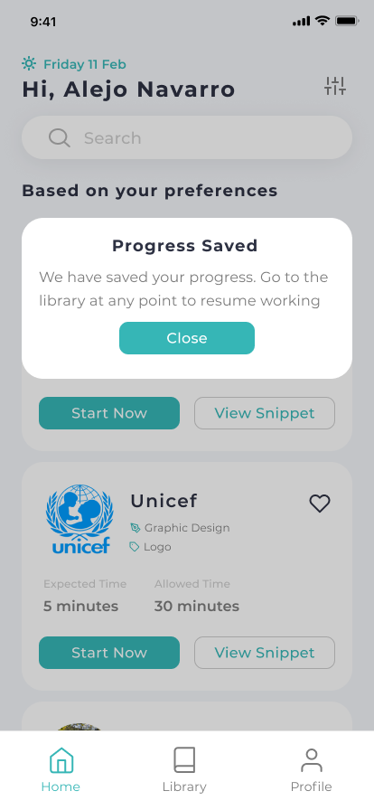

Old
New
Changes
Added pop-up for: progress saved (snippet completion), changed applied (for filtering), changed discarded (filtering) and a congratulations pop-up (snippet completion)
This should improve the overall experience as well as decrease confusion (robustness)
None!

Slide 37
Change #7: Onboarding
We wanted to add an onboarding component to our app to explain to users how to complete tasks. This was entirely new but based on feedback we got about how some features could be confusing at first

Slide 38
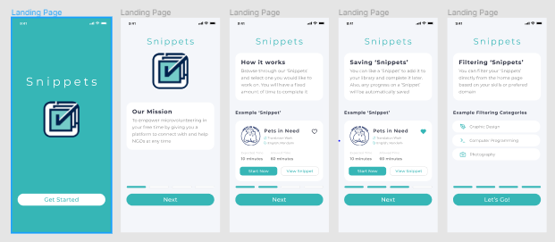
Onboarding

Slide 39
Medium-Fi Prototype Task Flow

Slide 40
Easy: Complete a Random Snippet

Slide 41
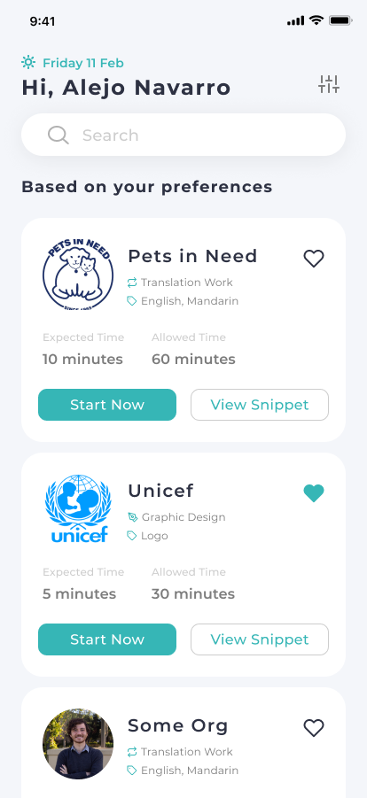
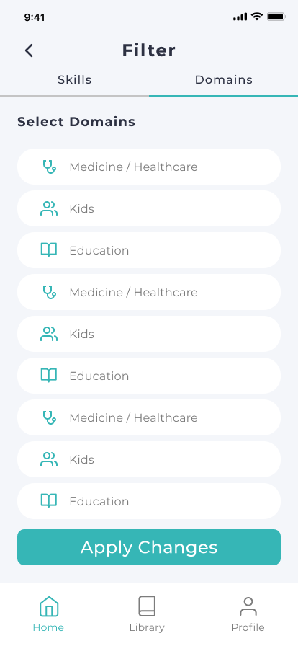
Moderate 1: Filter Snippets by Skills or Domains

Slide 42
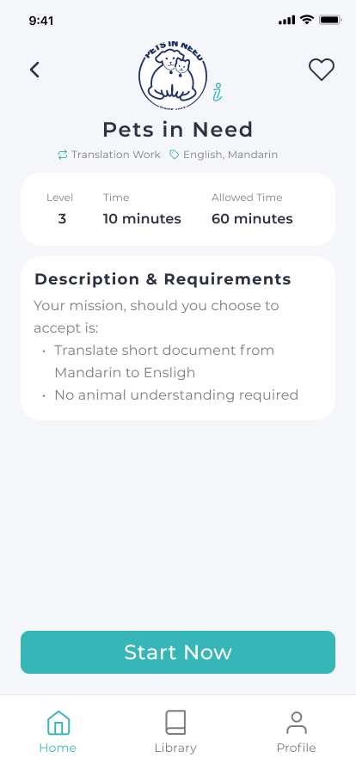

Moderate 2: Like Snippets and Do Later

Slide 43
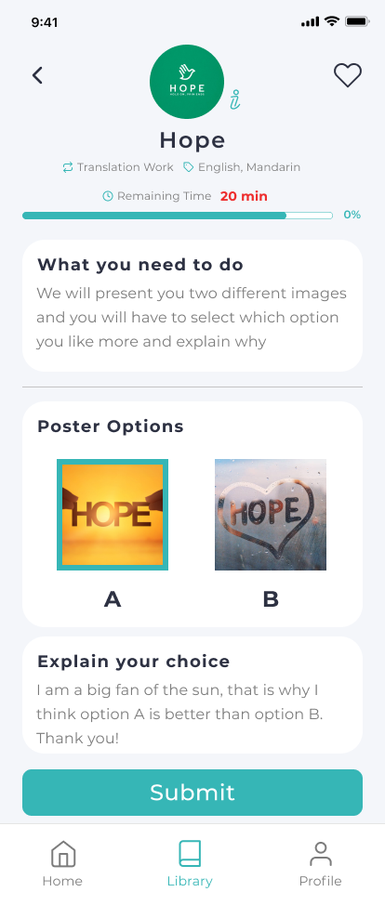
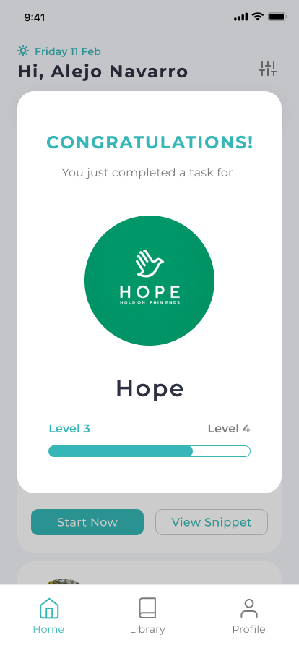
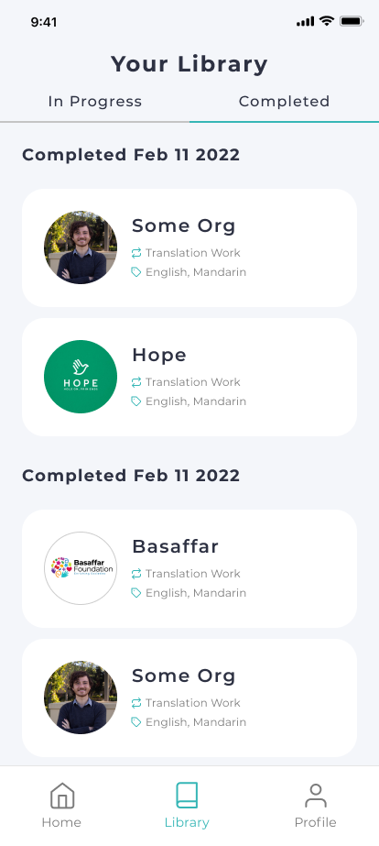
Hard: Resume In-progress Snippets

Slide 44
Prototype Overview

Slide 45
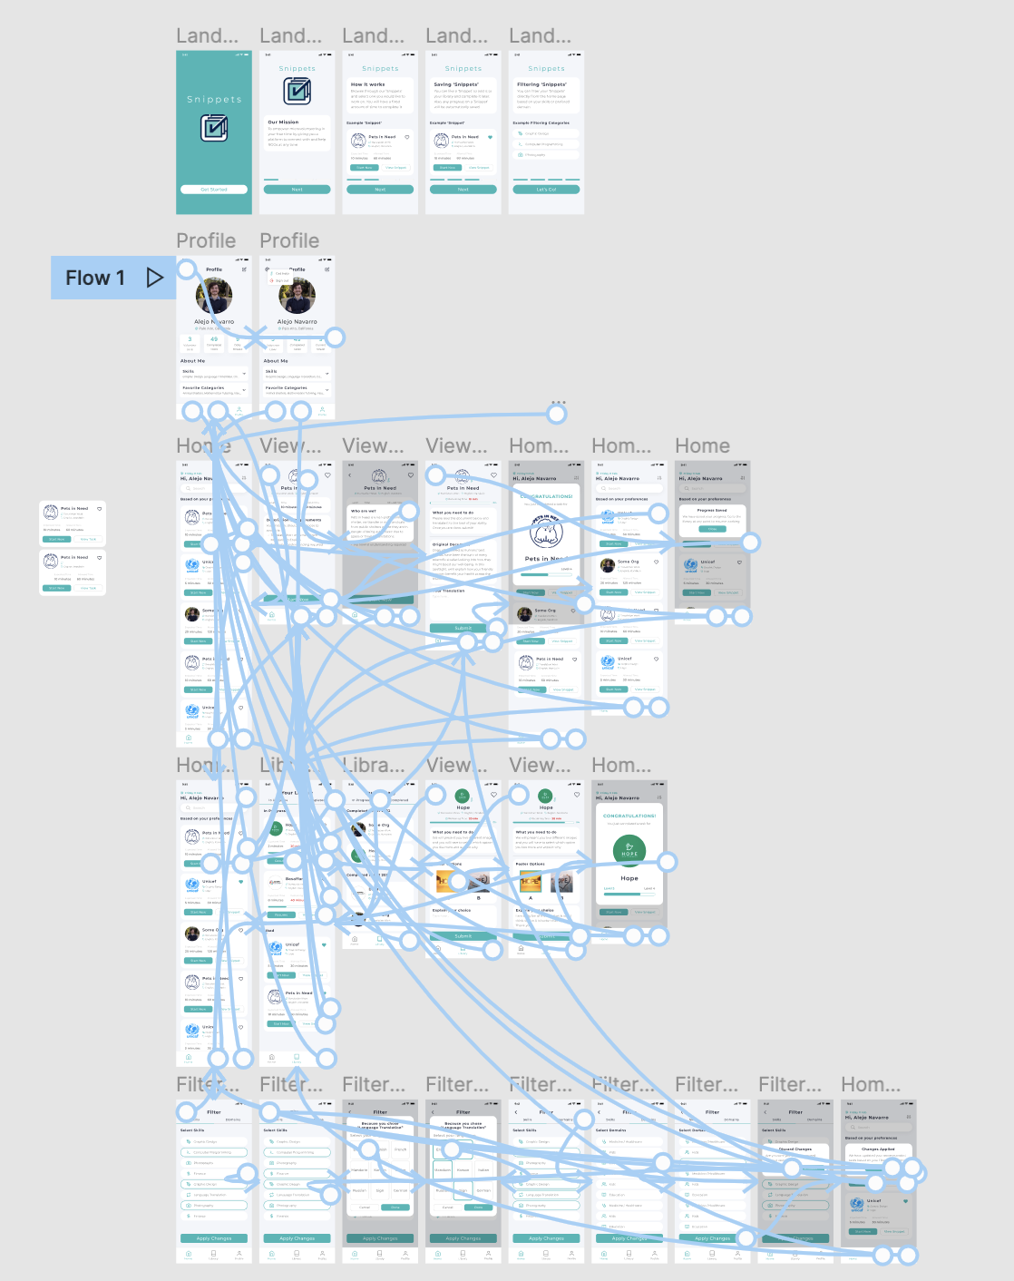
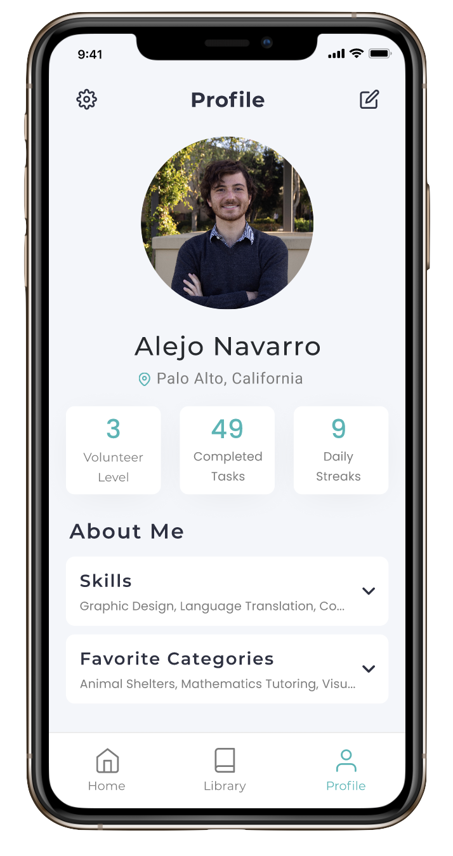
Figma Prototype
Try it!

Slide 46
Design Tool - Figma
Positives…
Negatives…
Very easy to use drag and drop features
Great component reusability
Prototyping is made very easy (arrows to screens)
A lot of open sourced support (we used a Feather plugin for our icons)
Grid system made layout process easier
Steep learning curve for Figma
Very time consuming (especially when fixing details)
Limited animation and transition capabilities
Notes:
Addressing the conflict: As users worked on more and more projects for an organization, they can join the organization for long-term commitments

Slide 47
Current Limitations/Tradeoffs
Only a few of the Snippets are actually clickable (and connected)
We can’t prototype actual Snippet completion (as this would require having fully functioning NGO tasks)
Functionality (saving, filtering, completing, uploading) it not present in the prototype

Slide 48
When user applies filter, we manually change the Snippets on the Feed (no actual algorithm)
When user completes Snippets, we manually level up
We skip the Snippet completion process altogether
Wizard of Oz Technique

Slide 49
Most aspects of the app are hard-coded:
User information and data
NGO information
Snippet content
Hard coded features

Slide 50
Progress towards goals
Overall we were able to:
Reduce the number of screen required for our main tasks and our additional tasks
Facilitate navigation between screens and tasks
Make design more intuitive (expected) and consistent for users
Add safeguards for users

Slide 51
Summary
For future improvement, we need to…
Run more tests to see what the next pain points are
Try to test some real snippets on people (or find a better simulation strategy)
Continue to get UI/UX feedback for spacing and clarity

Slide 52
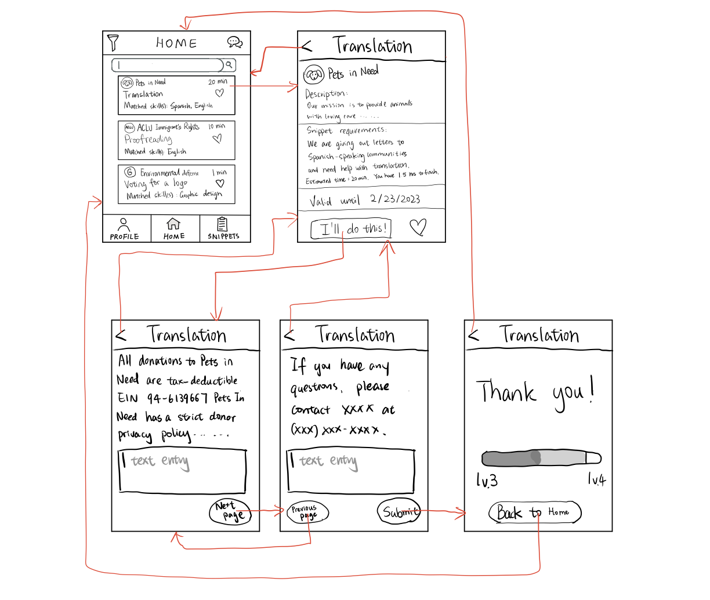
Appendix - Task flows iteration 2
Easy: Complete a Random Snippet
Notes:
This is what we designed after getting feedback from our lo-fi prototype. We then got more feedback on this design and built on it when we develop our med-fi prototype.

Slide 53
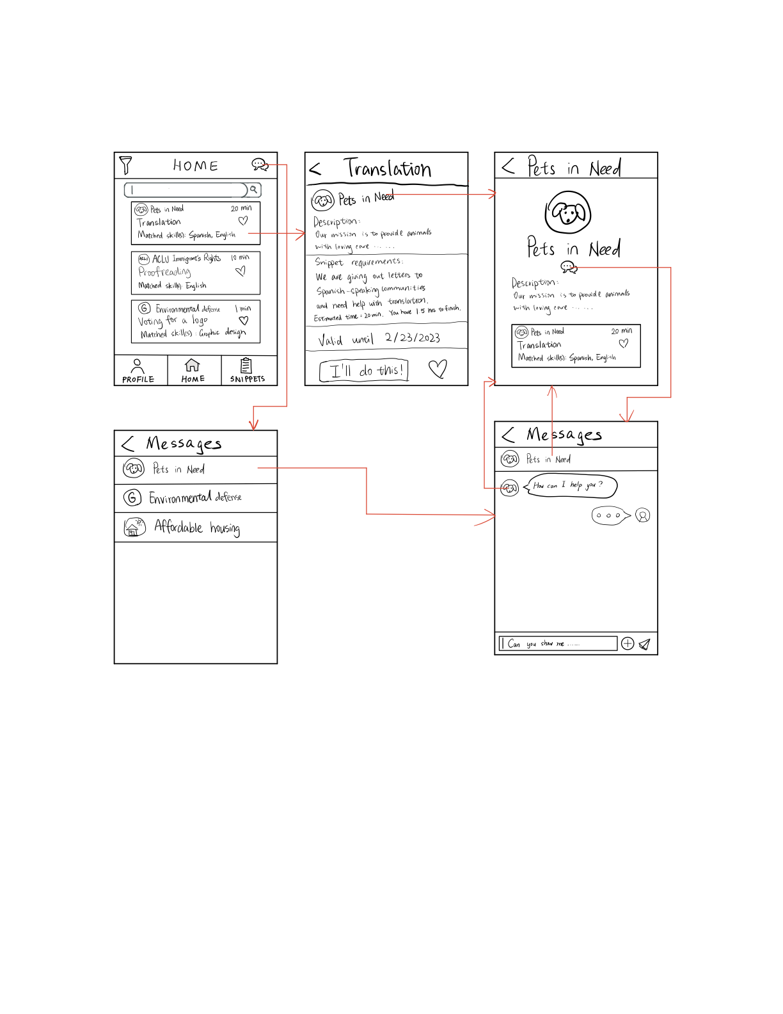
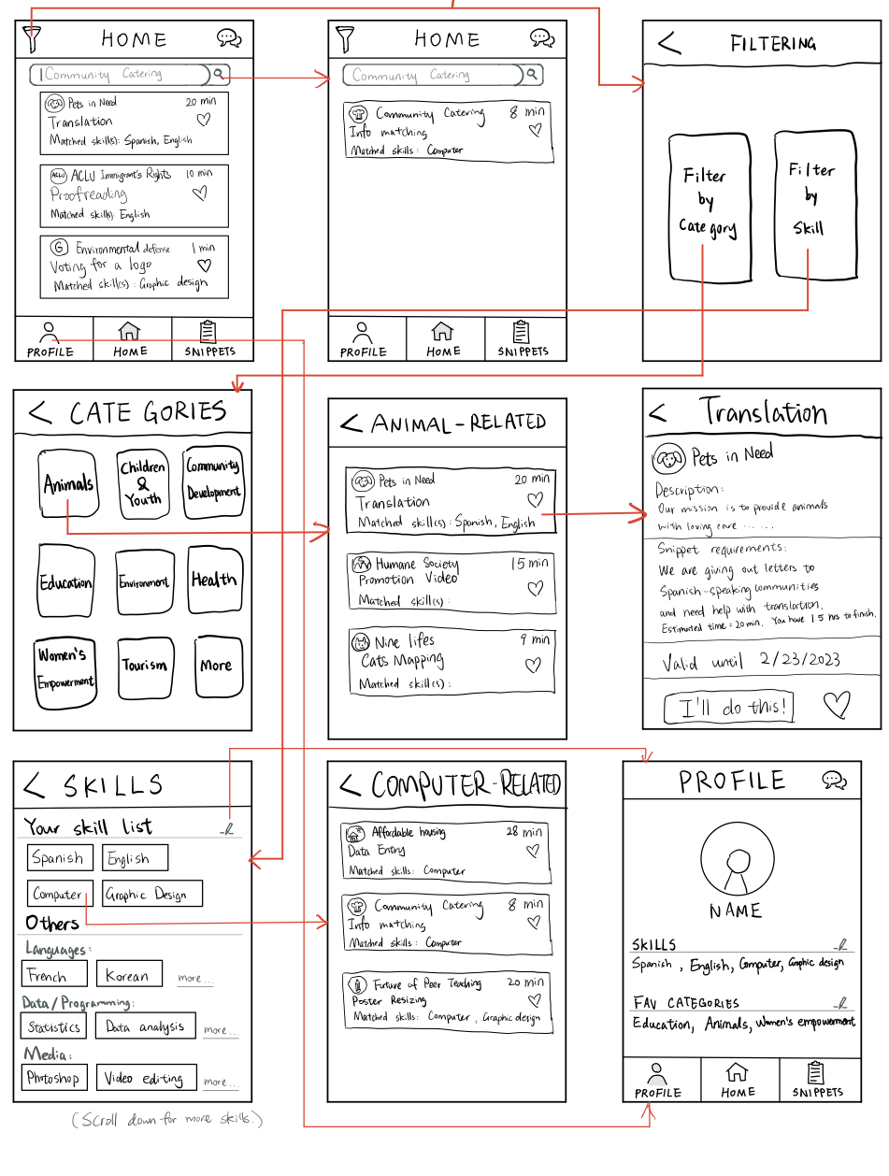
Appendix - Task flows iteration 2
Moderate 1: Filter Snippets by Skills or Domains
Moderate 2: Like Snippets and Do Later

Slide 54
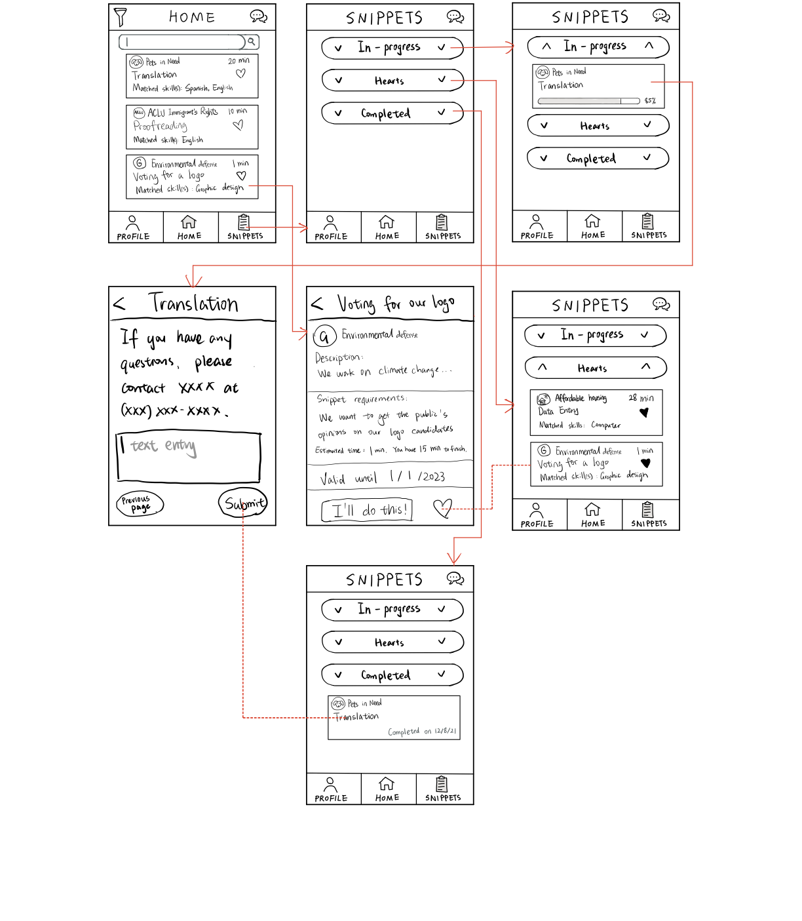
Appendix - Task flows iteration 2
Hard: Resume In-progress Snippets

