Slide 1
SNIPPETS
Microvolunteer in your spare time
Mobile app to facilitate microvolunteering for people in their spare time.
Notes:
Team Snippets. A quick recap, from the needfinding interviews we did before, we found, despite that our interviewees are super passionate about volunteering and eager to help, they found it difficult to volunteer as much as they want because of the time and effort needed for volunteering. They are just too busy to do those work. So, their needs inspired us to come up with Snippets, a product that allows people to microvolunteer in their spare time.

Slide 2
Snippets Vision

Slide 3
Snippets’ Vision
Mission Statement
Value Proposition
To empower people to microvolunteer in their spare time
Repurposing spare time and promoting volunteering

Slide 4
Selected Interface
Notes:
We considered different modalities of interface including voice interface, wearables, screens on public transportation, etc. We finally settled for the mobile app.

Slide 5
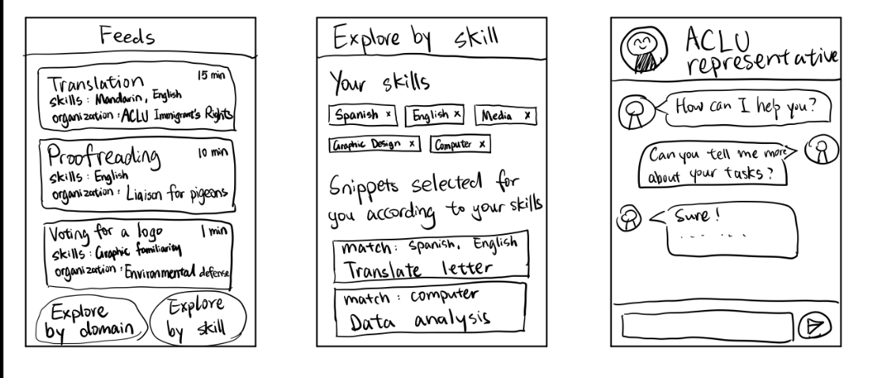
Mobile App - Snippets in your pocket

Slide 6
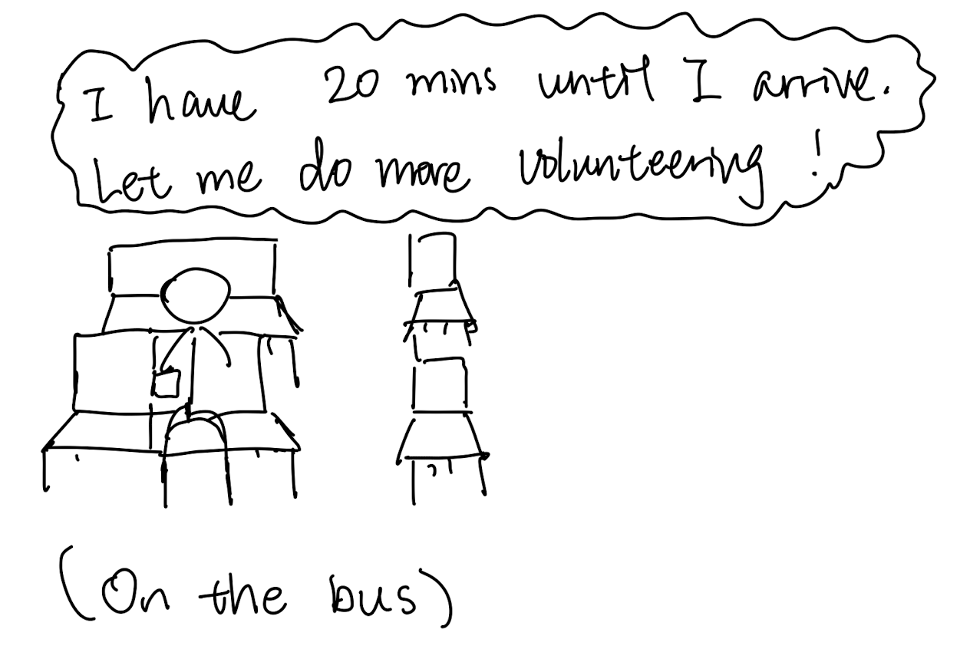
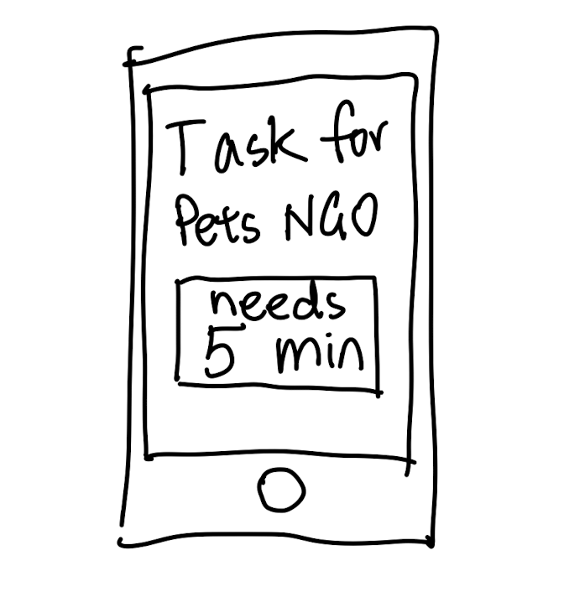
Mobile App - Snippets in your pocket
Reasoning
Leverages several modalities (audio, video, text, etc.)
Most versatile to user’s needs/availability; can be used anywhere
Easiest adoptance of modality as users are used to using their phone
Potential Concerns
A lot of weight is placed on the NGOs
Less motivated to do long-term volunteering
Notes:
https://www.catchafire.org/volunteer-discover/
Less motivated to do long-term

Slide 7
Low-fi Prototype

Slide 8
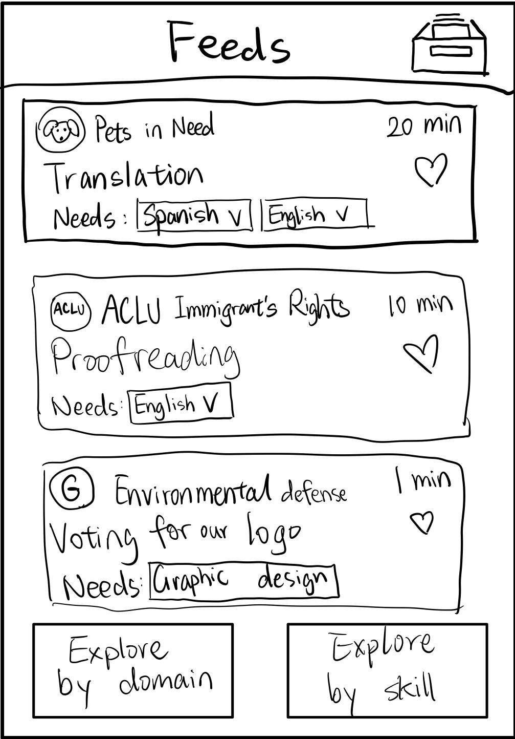
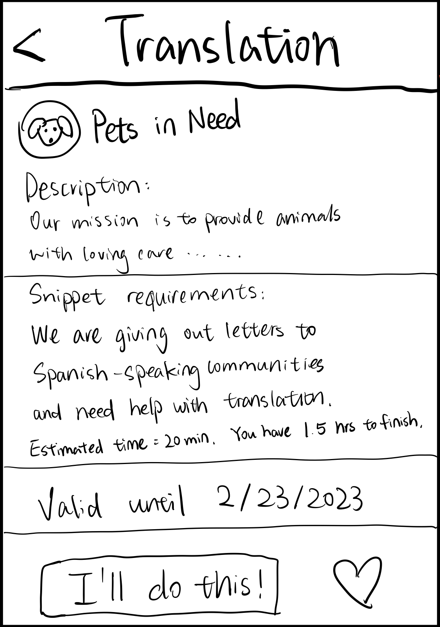
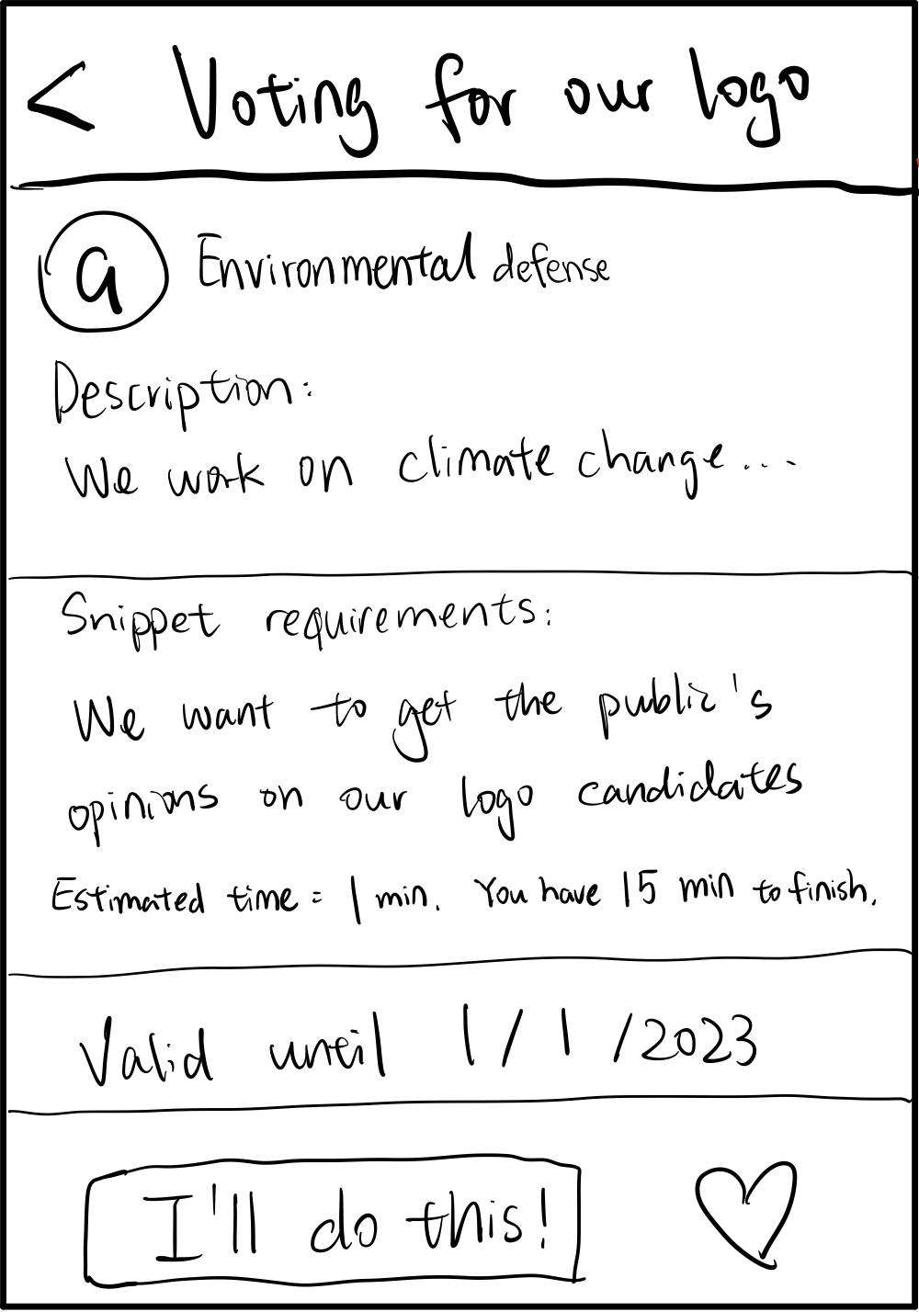
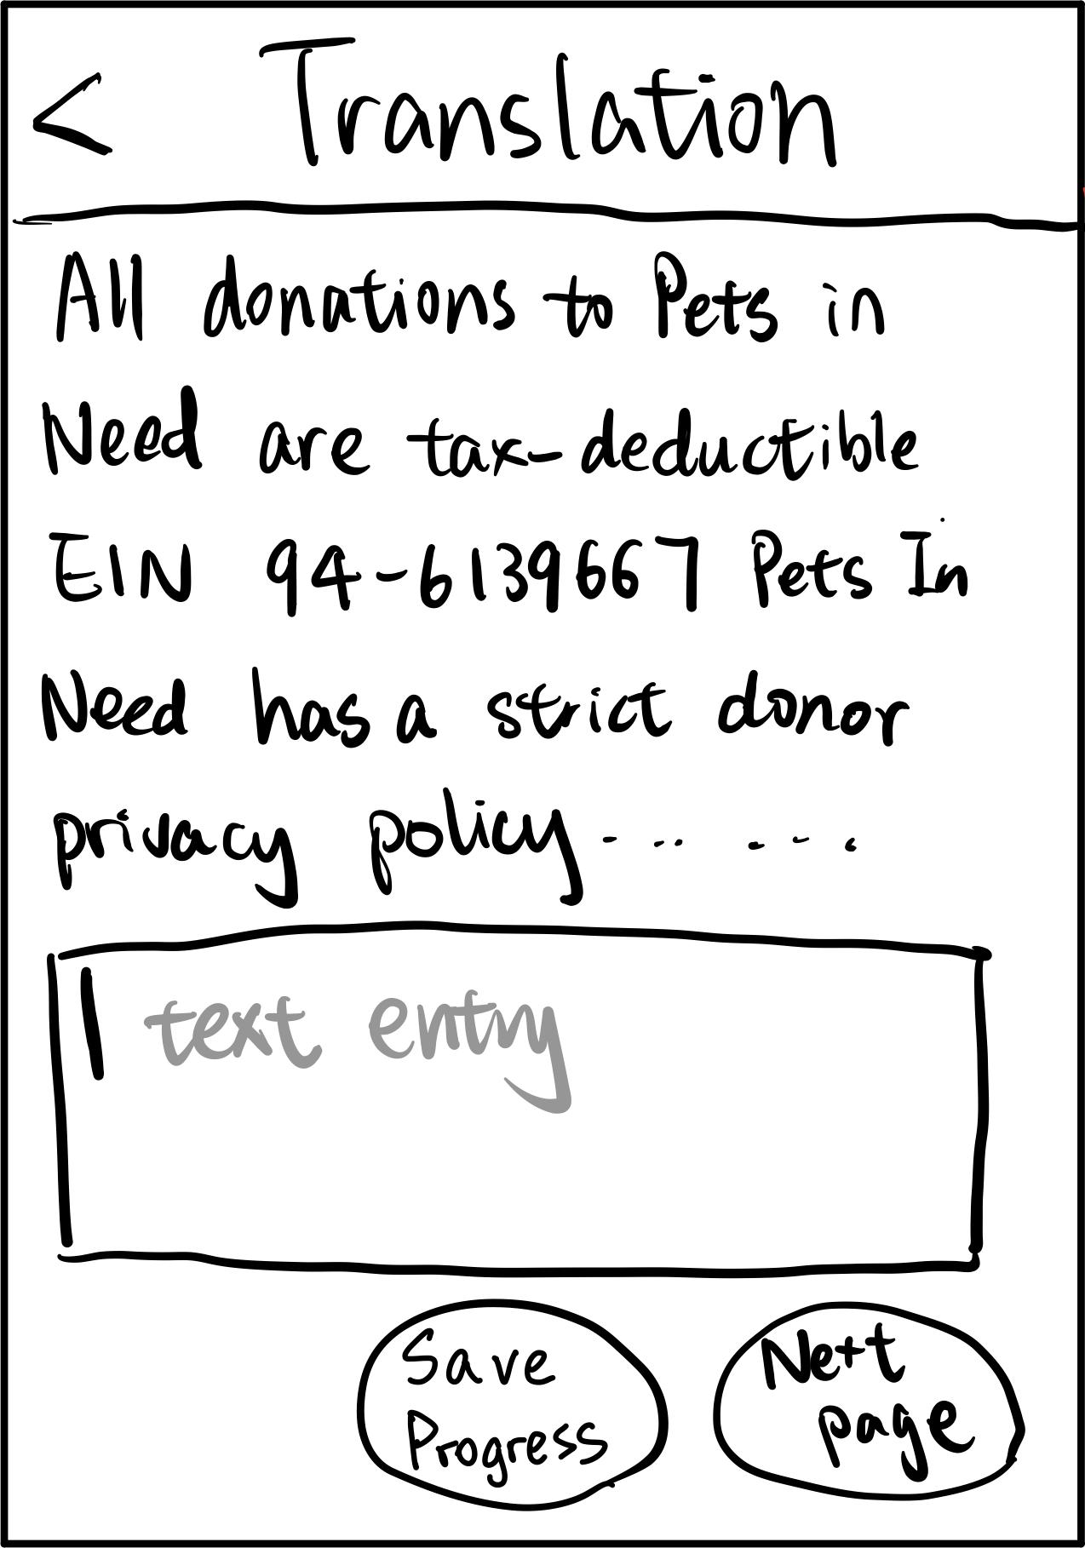
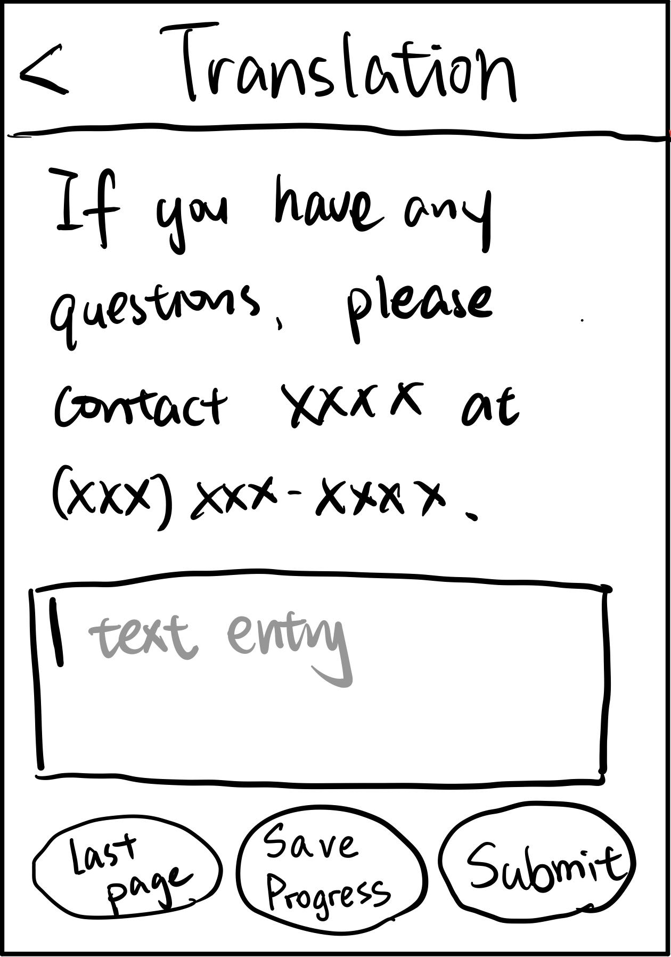
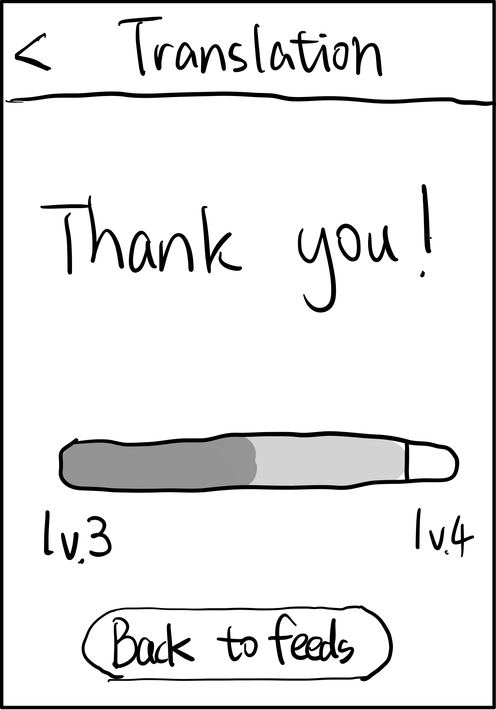
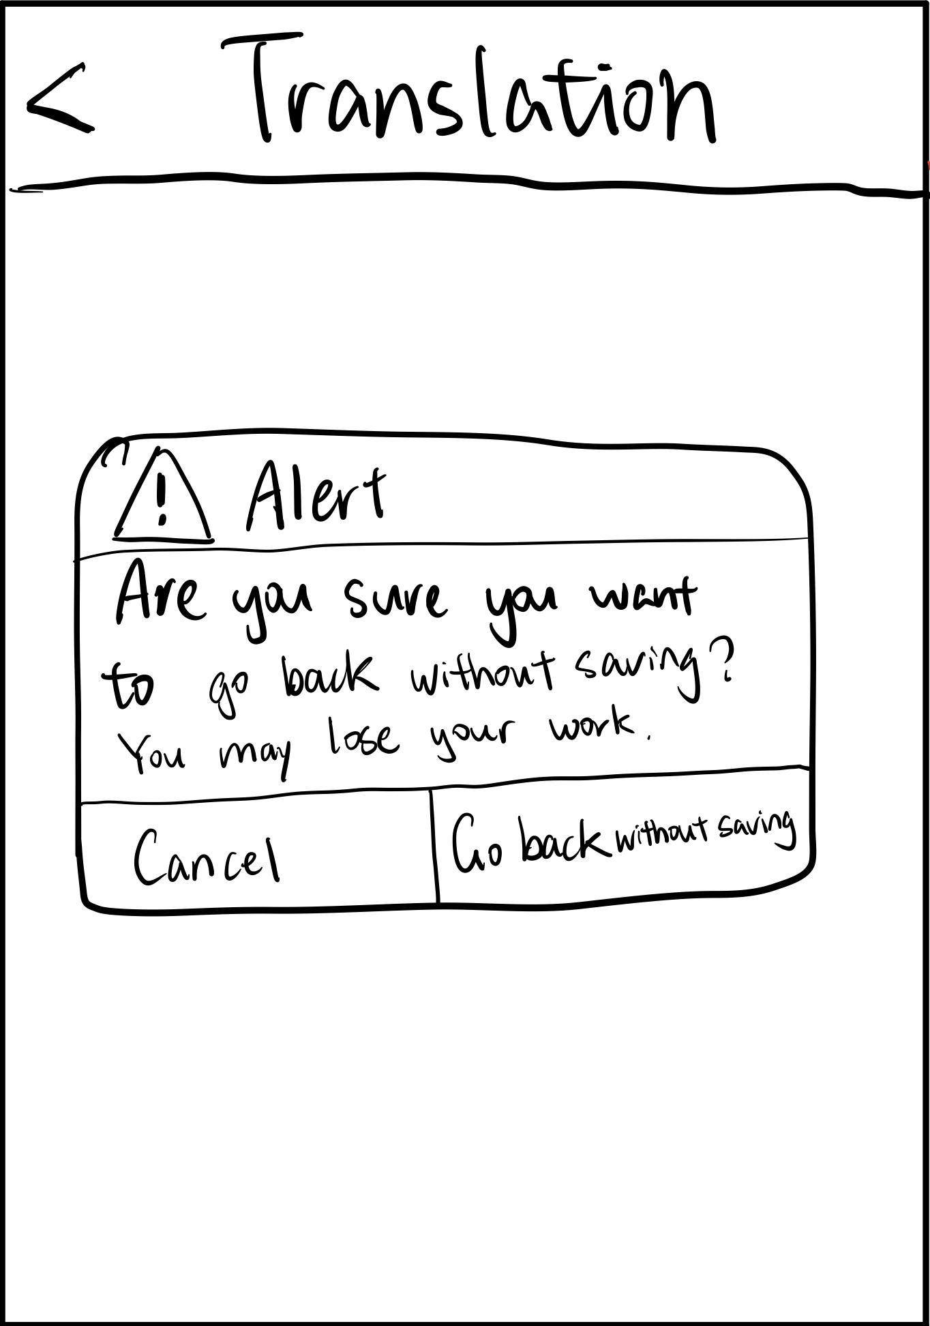
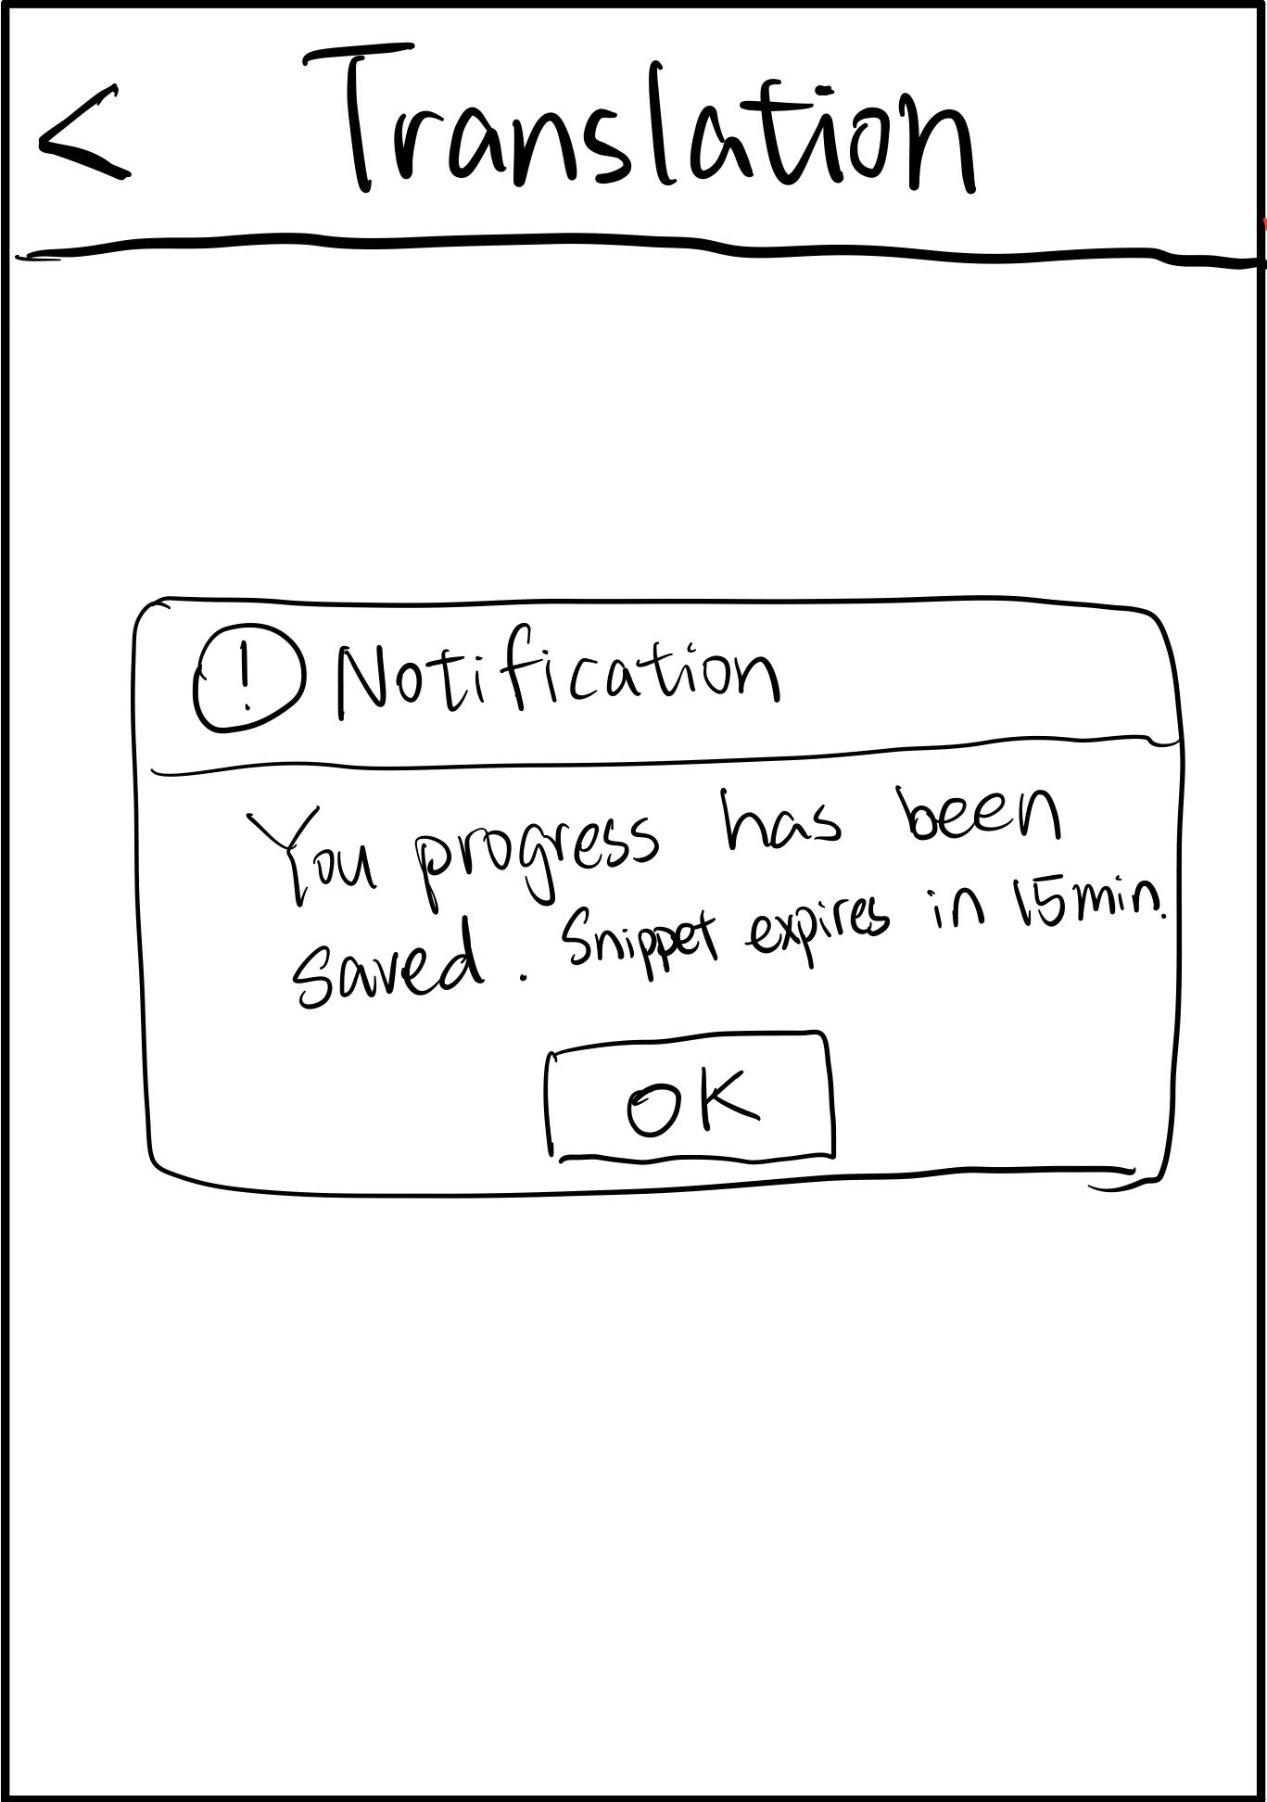
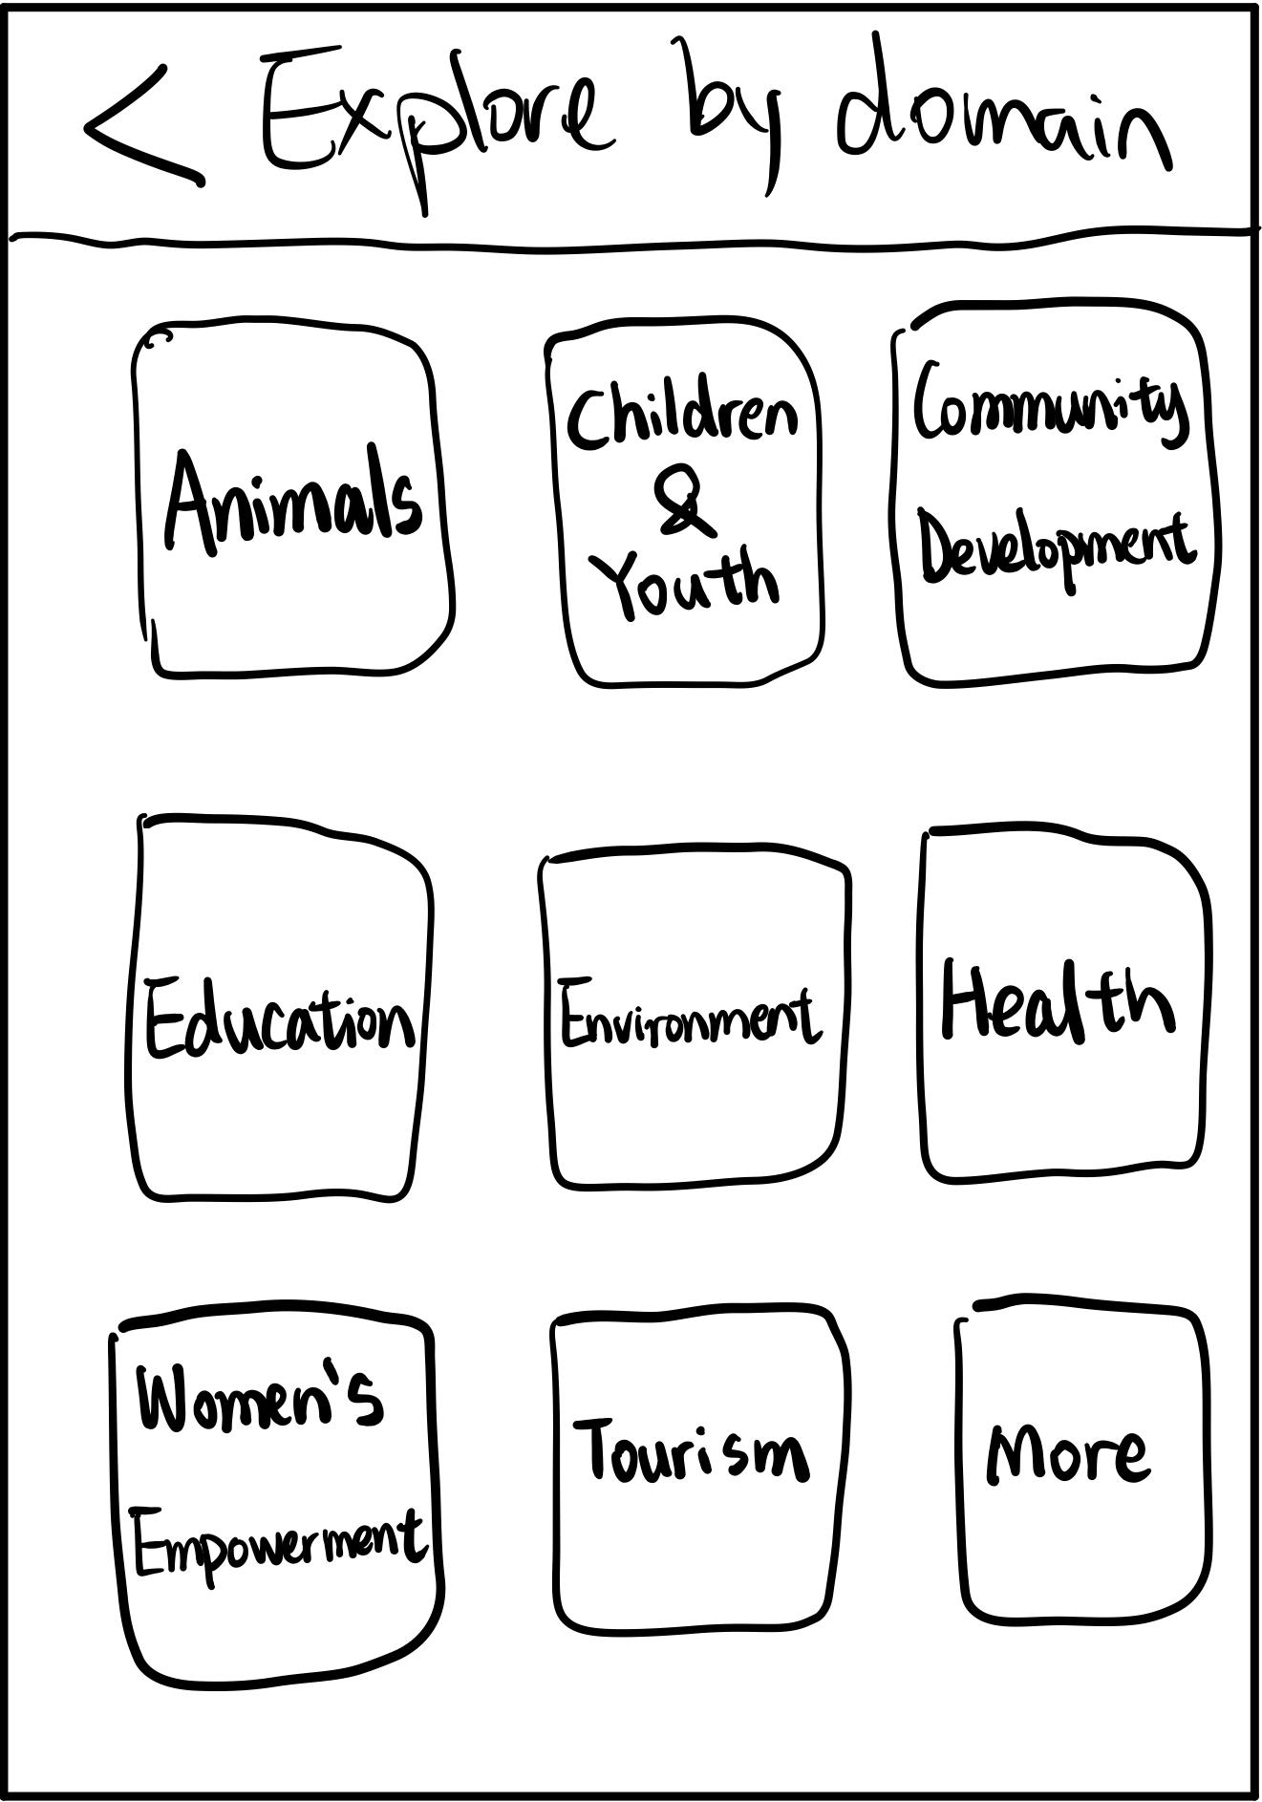
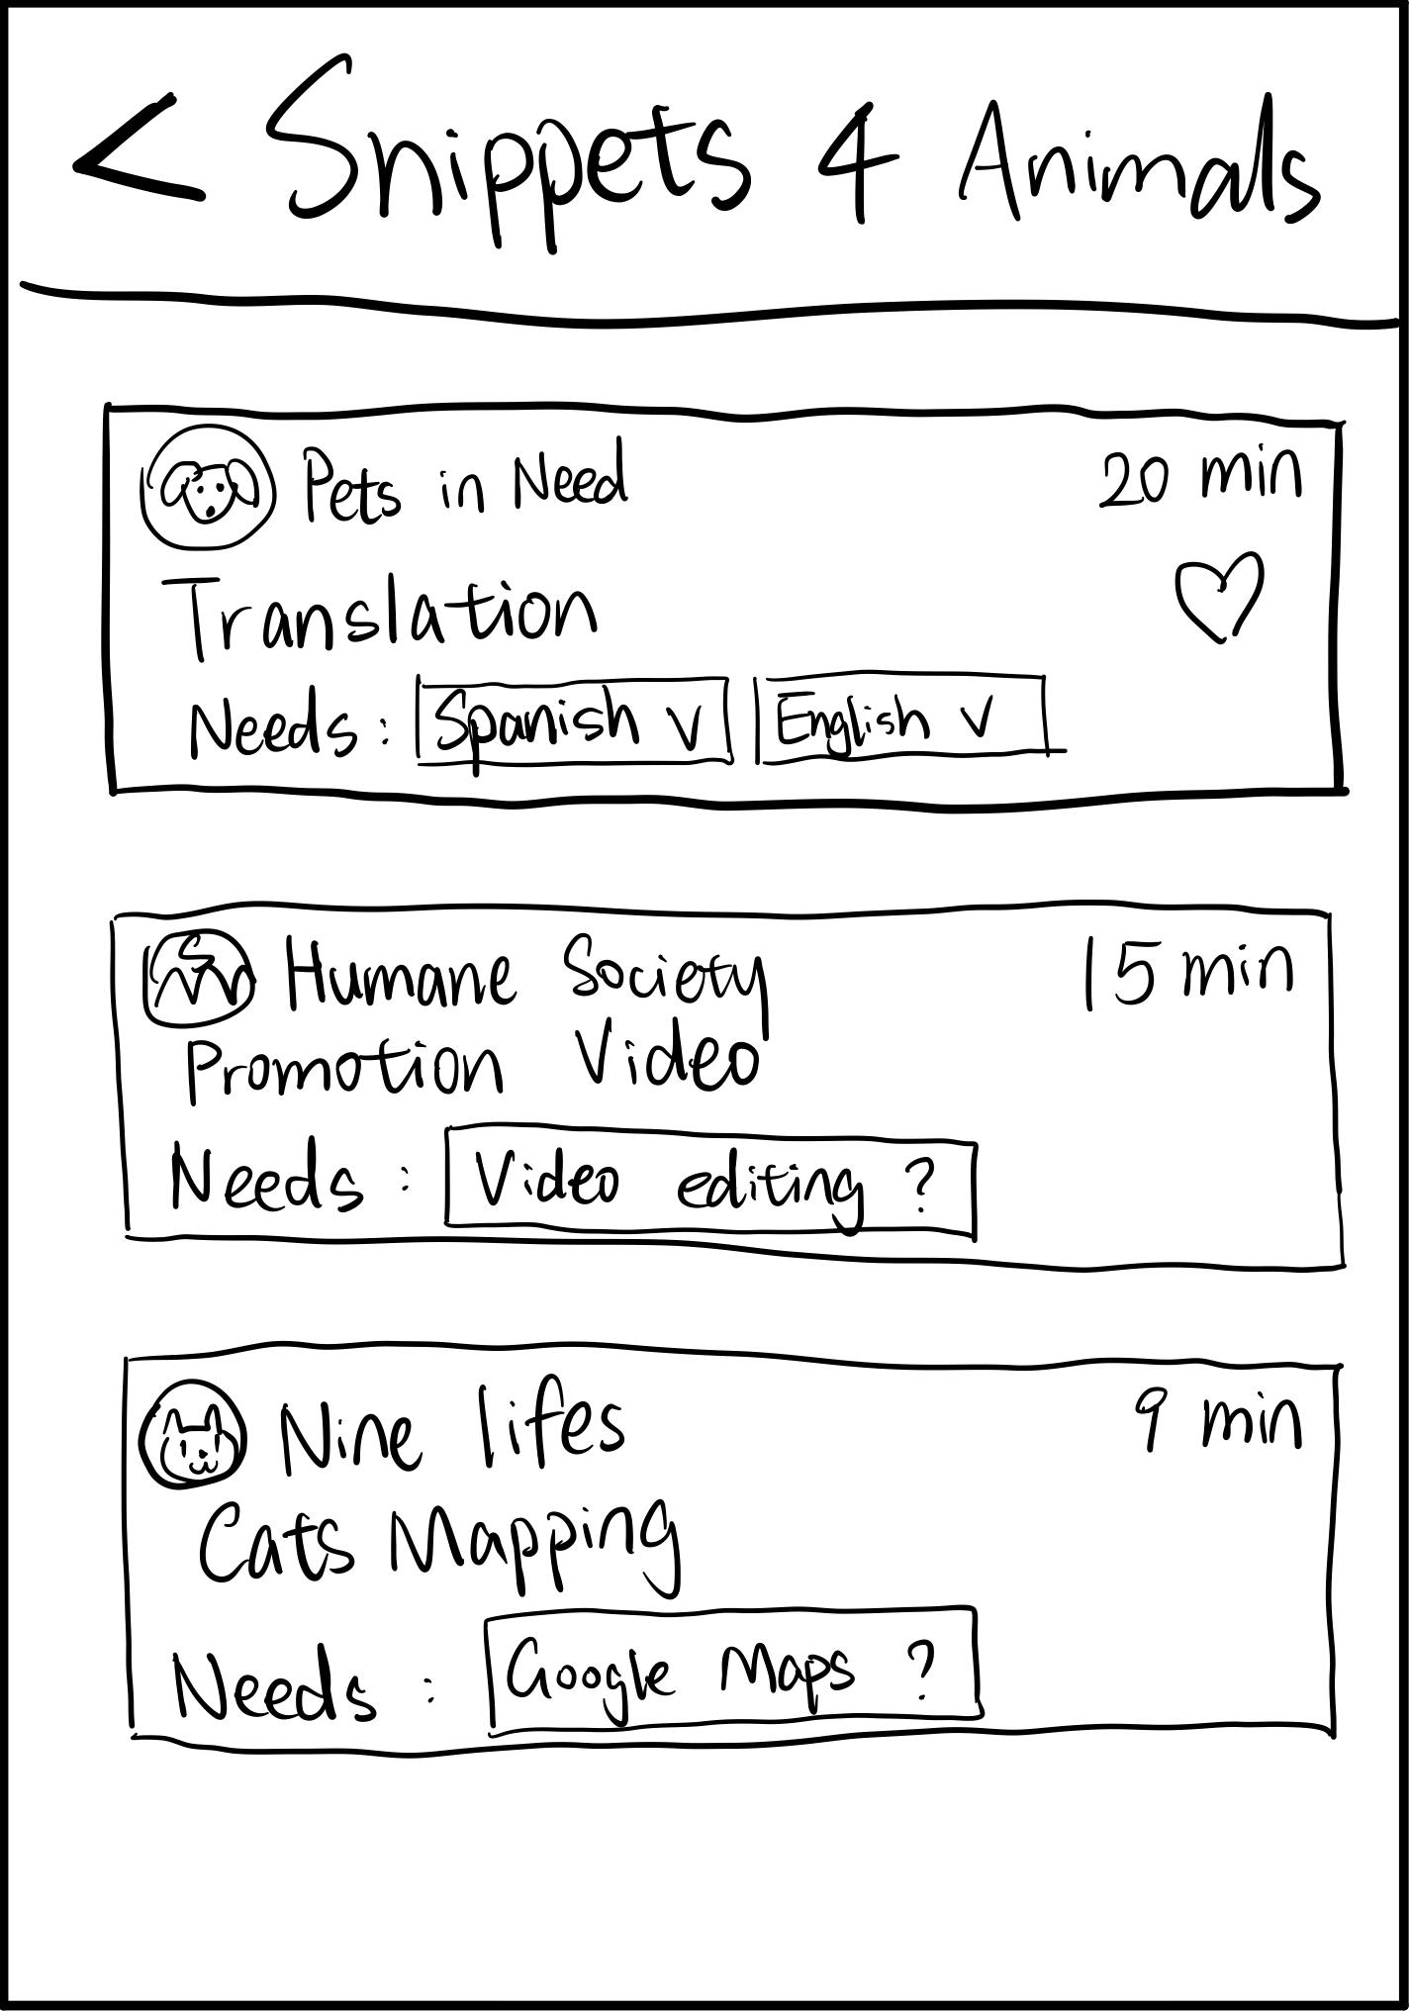
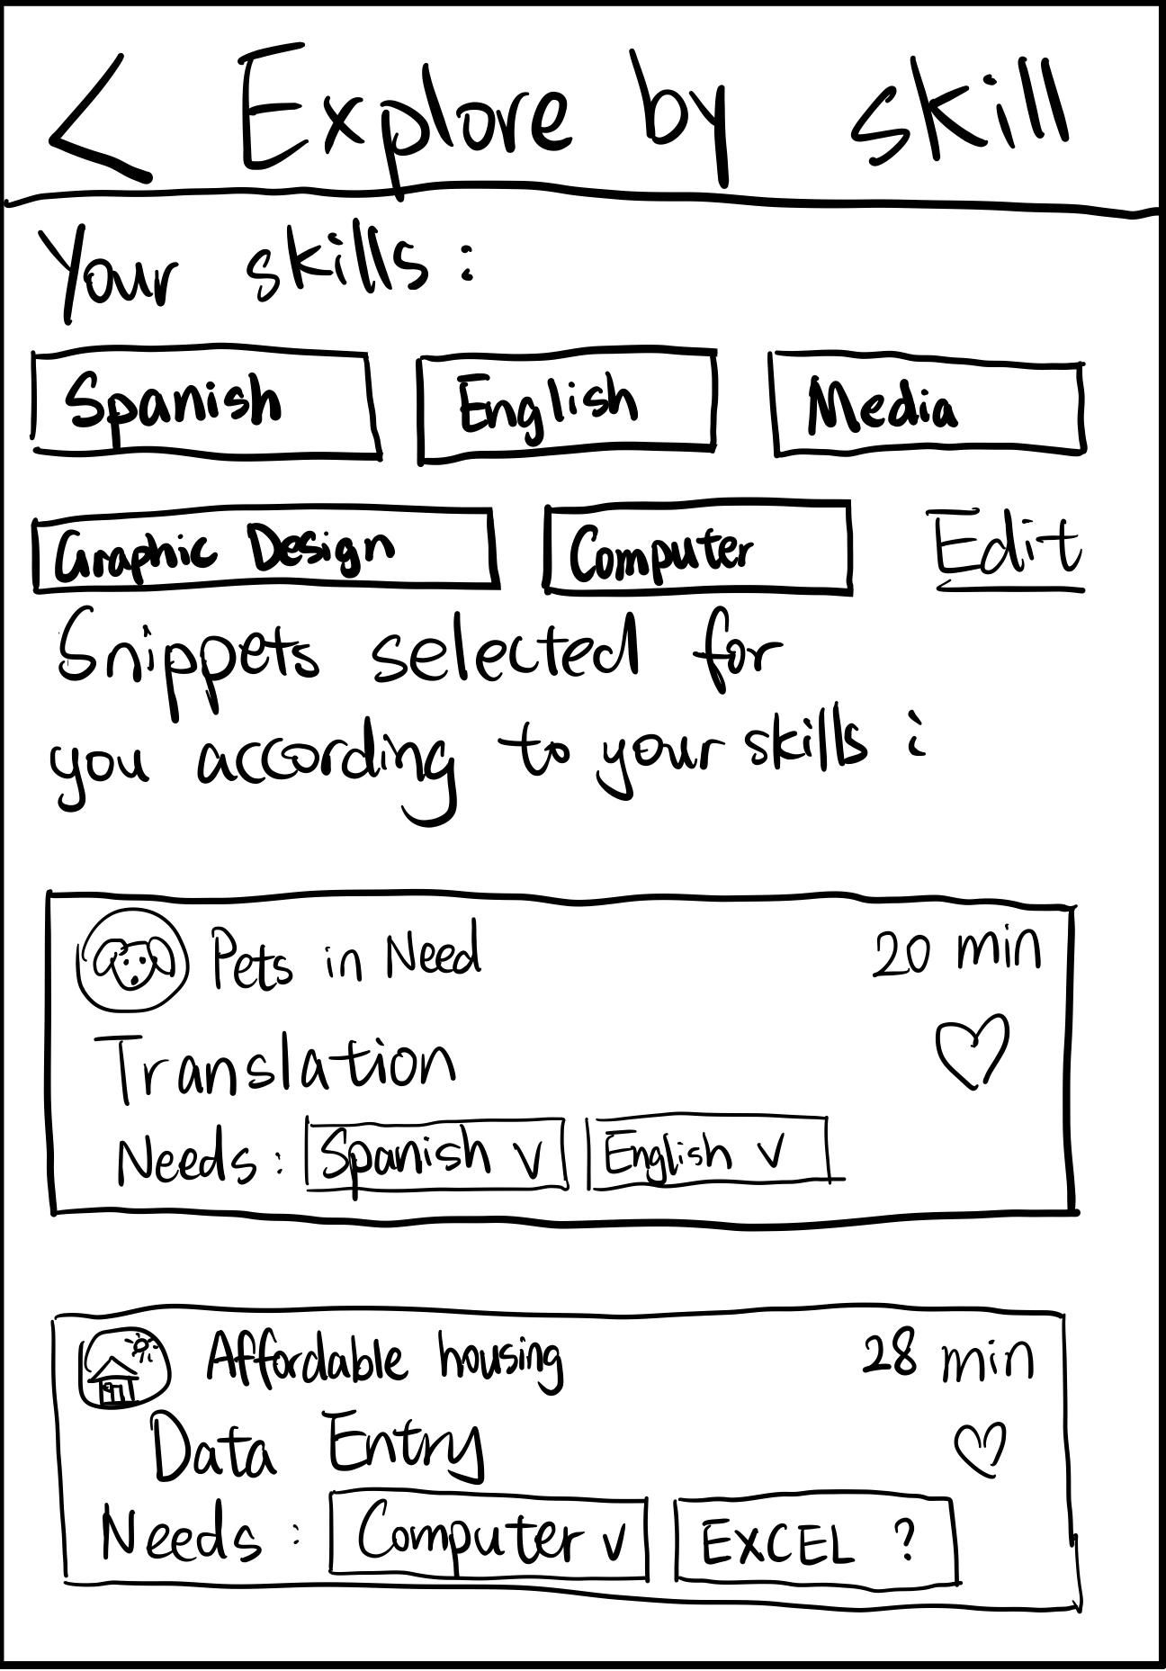
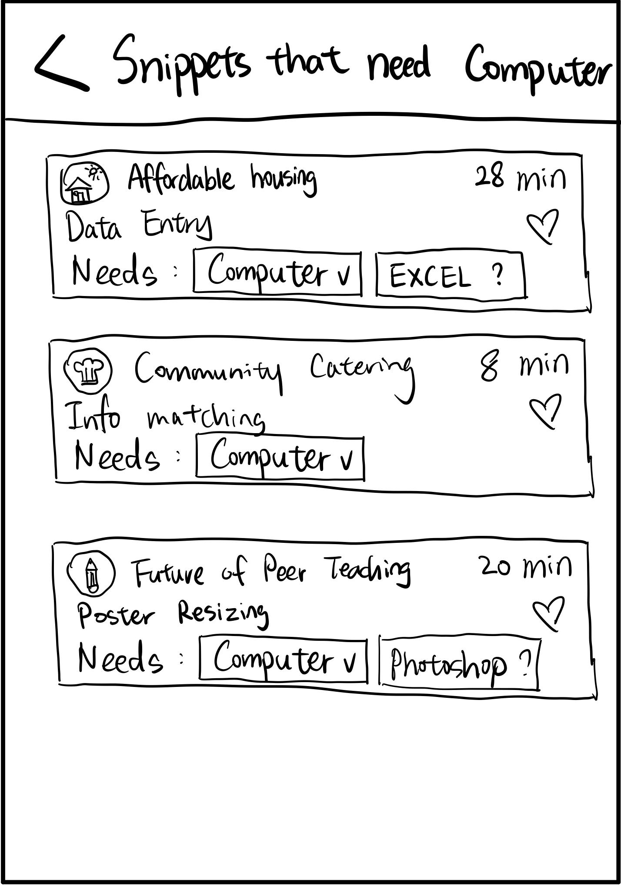
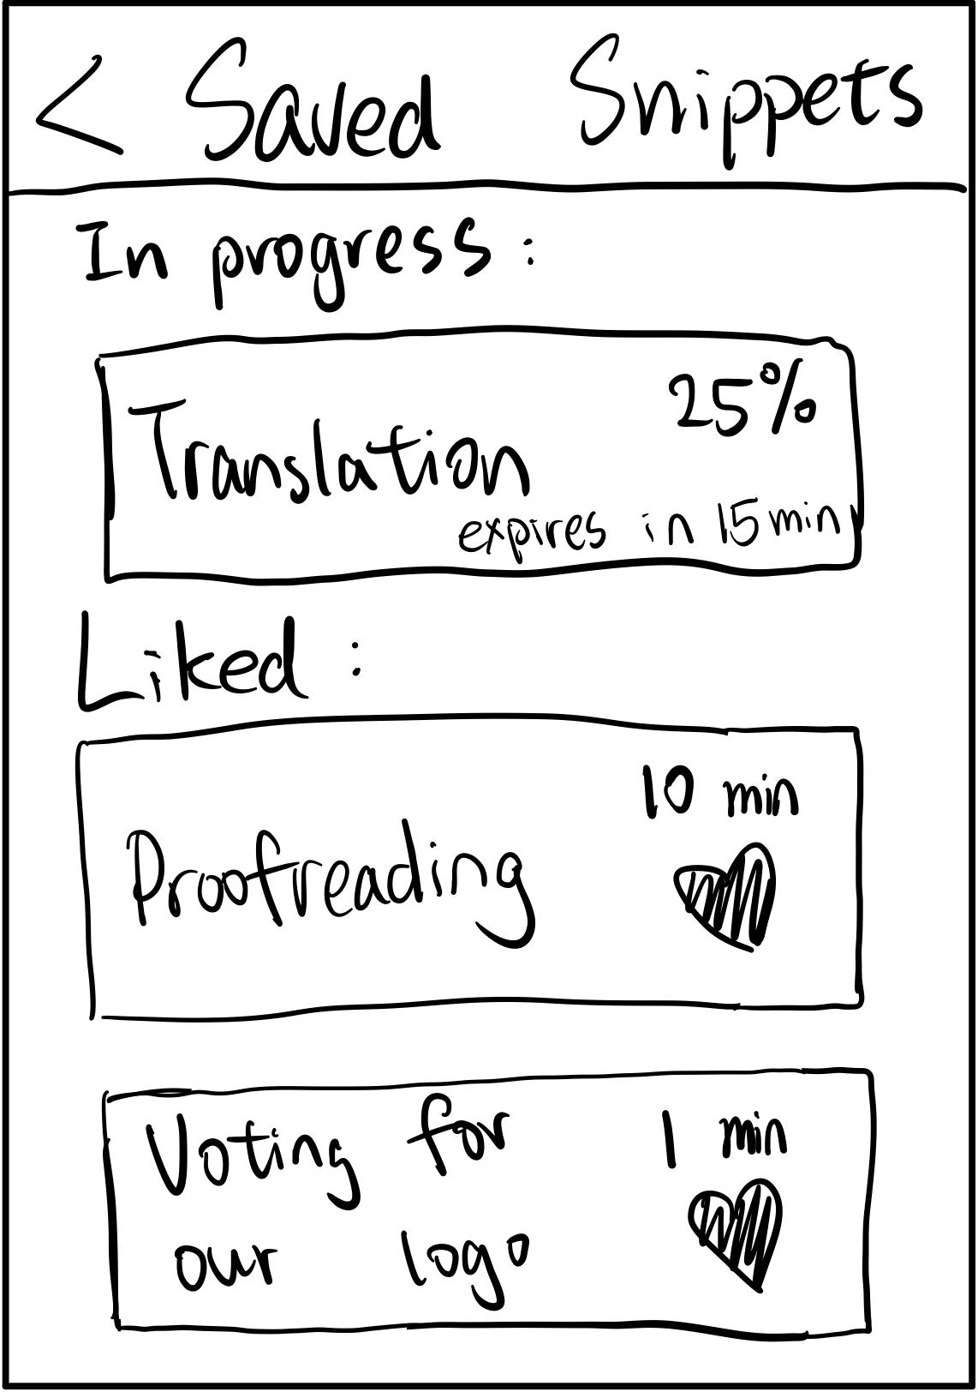
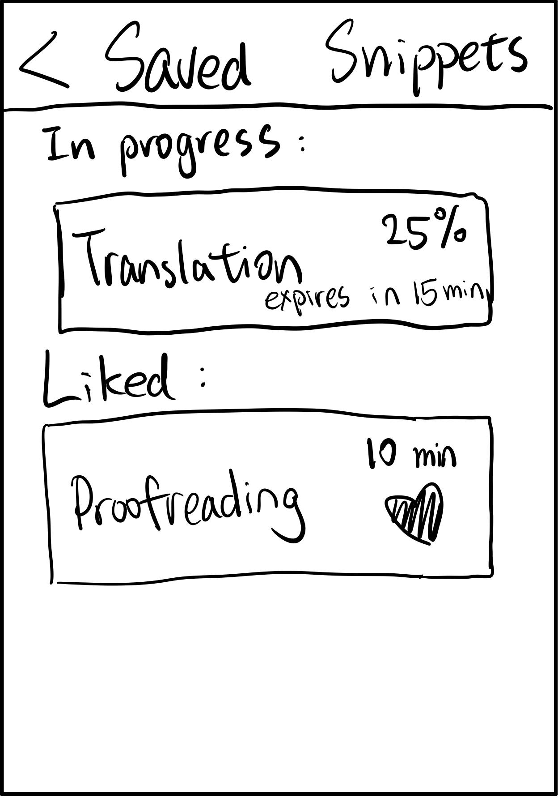
Low-fi prototype structure
Home Screen
Task Descriptions
Working on Task
Saving Notices
Filter by Domain
Filter by Skill
Saved Tasks

Slide 9
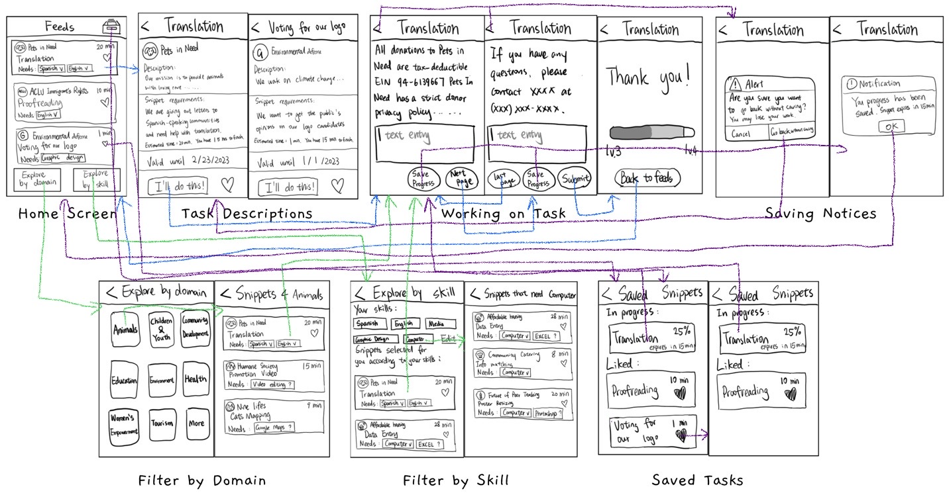
Low-fi prototype structure

Slide 10
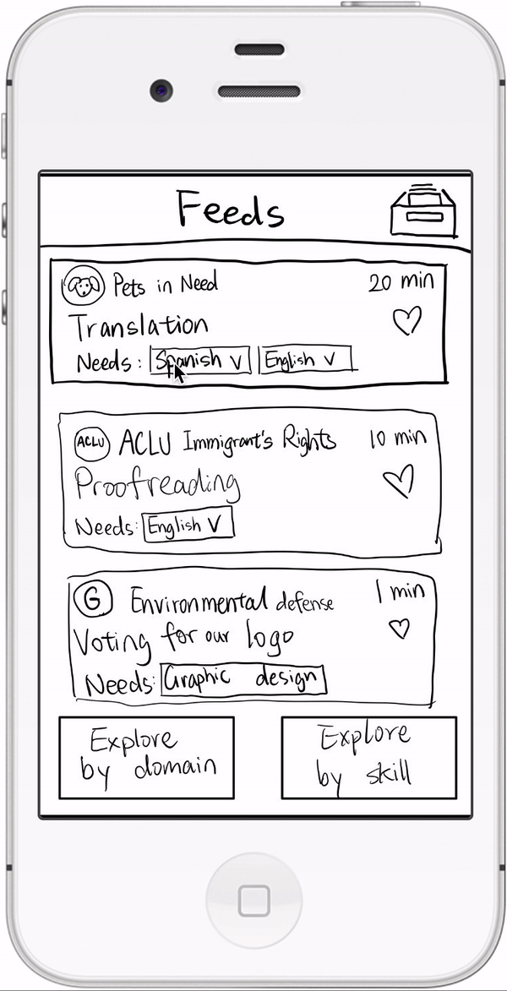
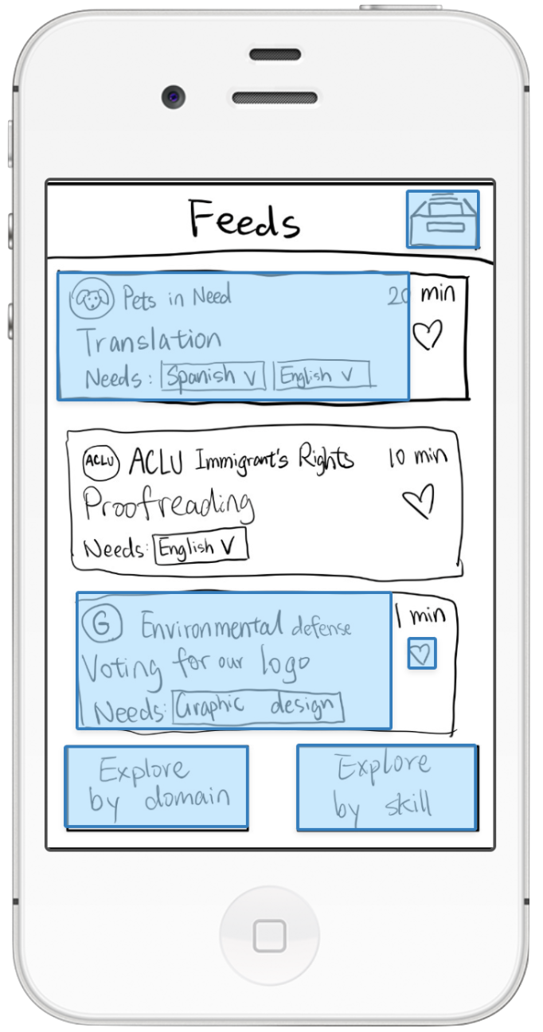
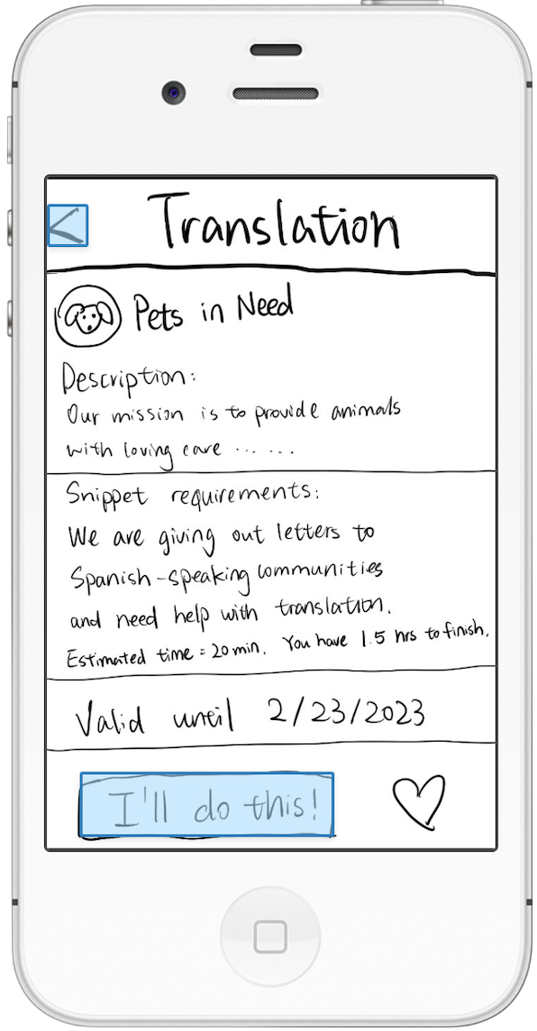
Low-fi prototype structure
Marvel App
User can click on the buttons to simulate the actual experience using the app
User can see what buttons are clickable

Slide 11
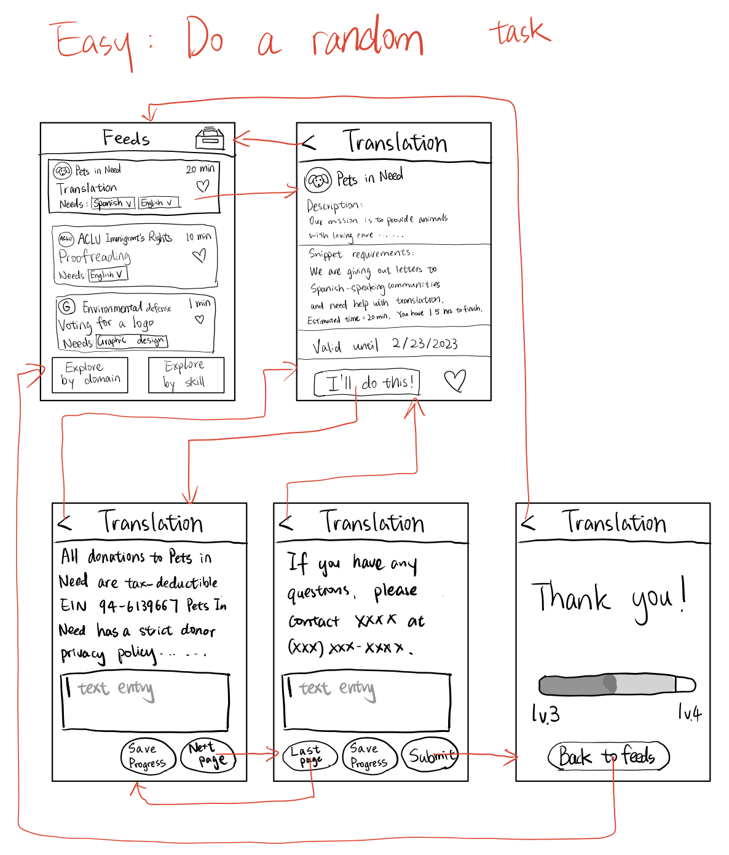
Easy: Complete a random task
If a user clicks a task on the Feeds page, they will be directed to the task details and choose to do it or not.

Slide 12
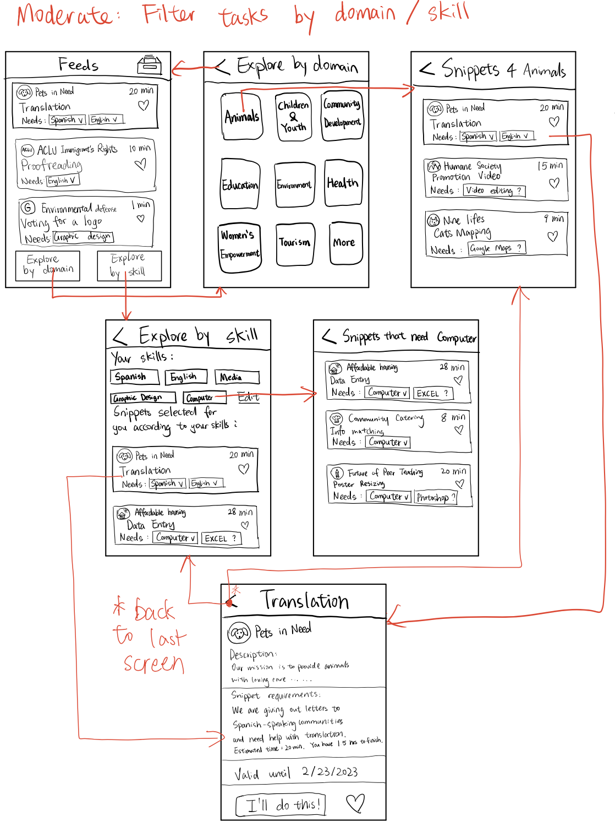
Moderate:
Filter tasks by domains or skills
When user clicks [Explore by domain/skill], they will be directed to the page where they can select specific domain/skill and get a list of tasks in that domain/need that skill.

Slide 13
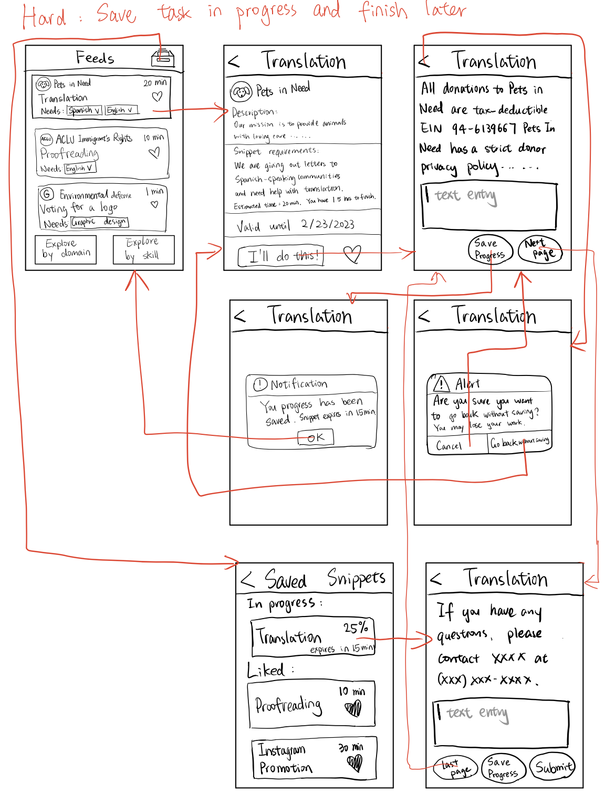
Hard:
Save a task to complete later
If a user starts a task and wants to quit the app mid-way, they can save their progress and resume later from the Saved folder.

Slide 14
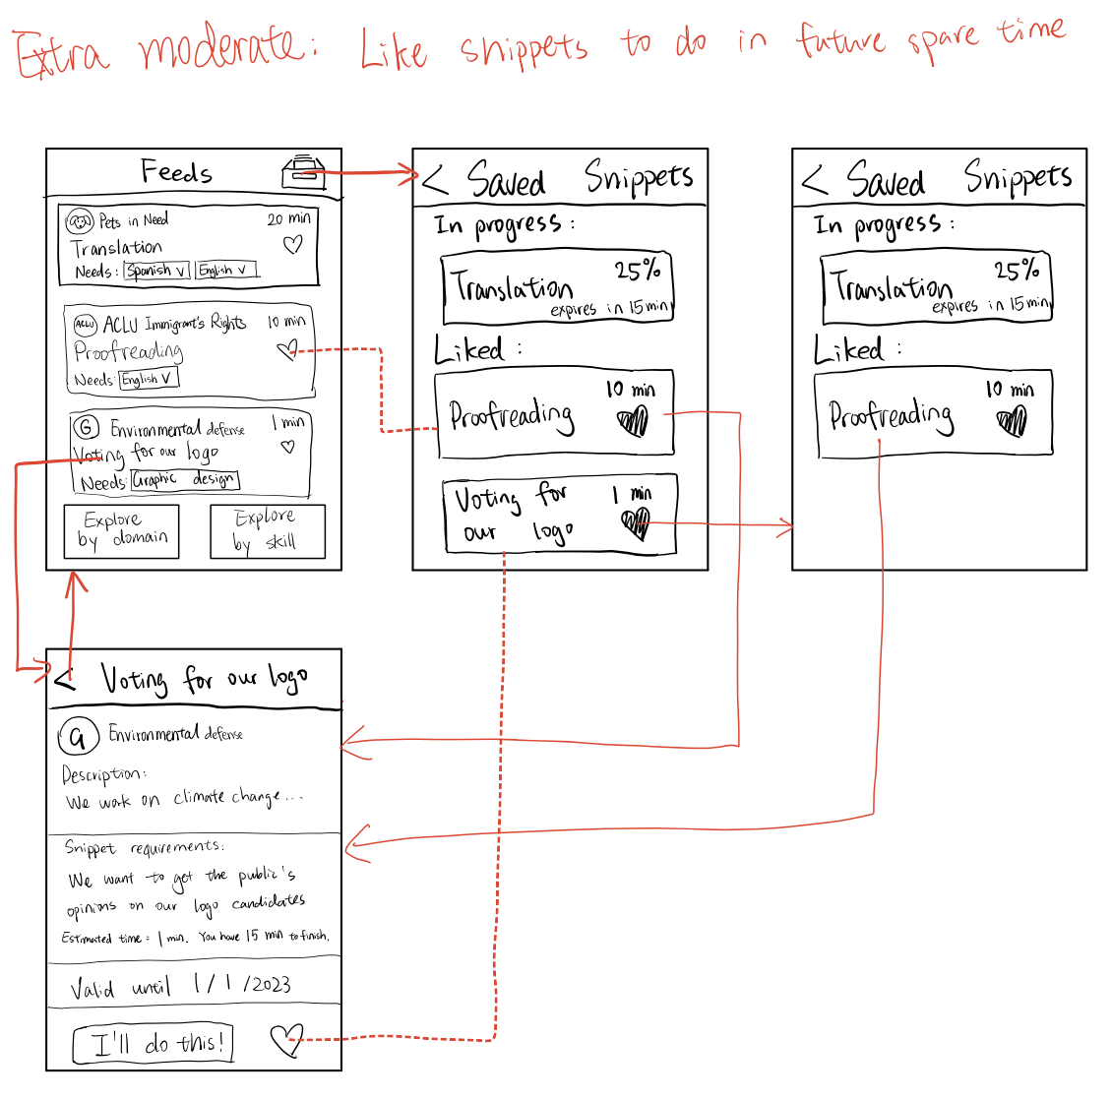
Extra moderate:
Like a task for future spare time
When a user finds an interesting task but doesn’t want to do that immediately, they can click the heart in the task banner or in the details page and the task will be flagged and put in the Saved folder.

Slide 15
Experimental Results

Slide 16
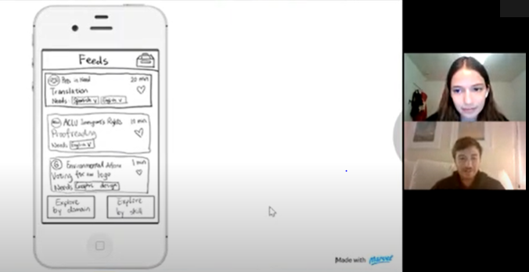
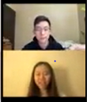
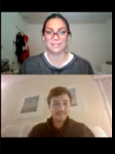
Fengzhou(20 y/o)
Julia (21 y/o)
Josefina (25 y/o)

Slide 17
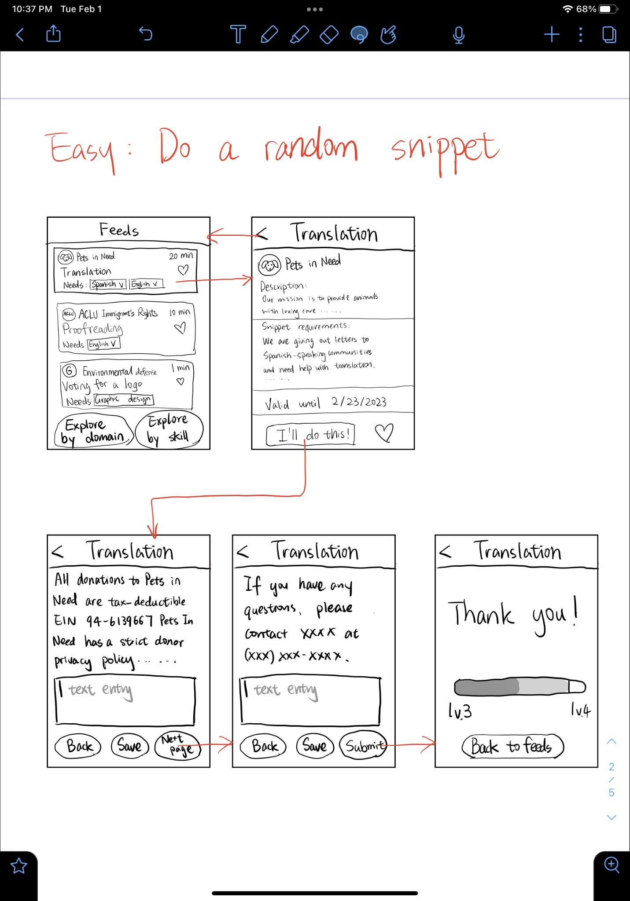
Task 1: Complete a Snippet

Slide 18
Observations:
Easy to find

Slide 19
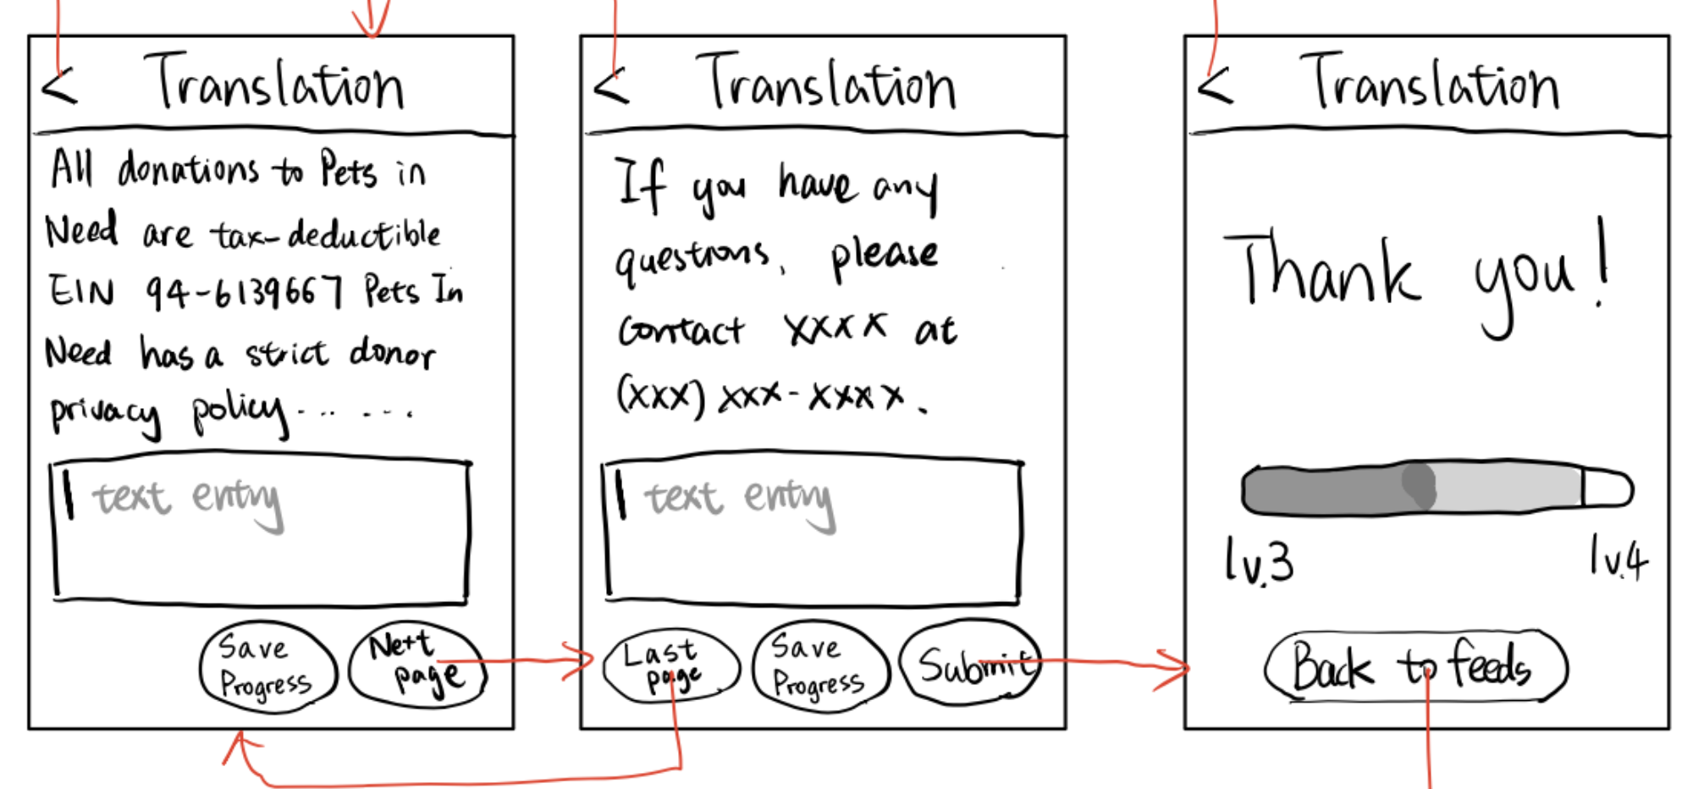
Observations:
Easy to find
Intuitive end-to-end

Slide 20
Observations:
Easy to find
Intuitive end-to-end
Enjoyed post completion reward

Slide 21
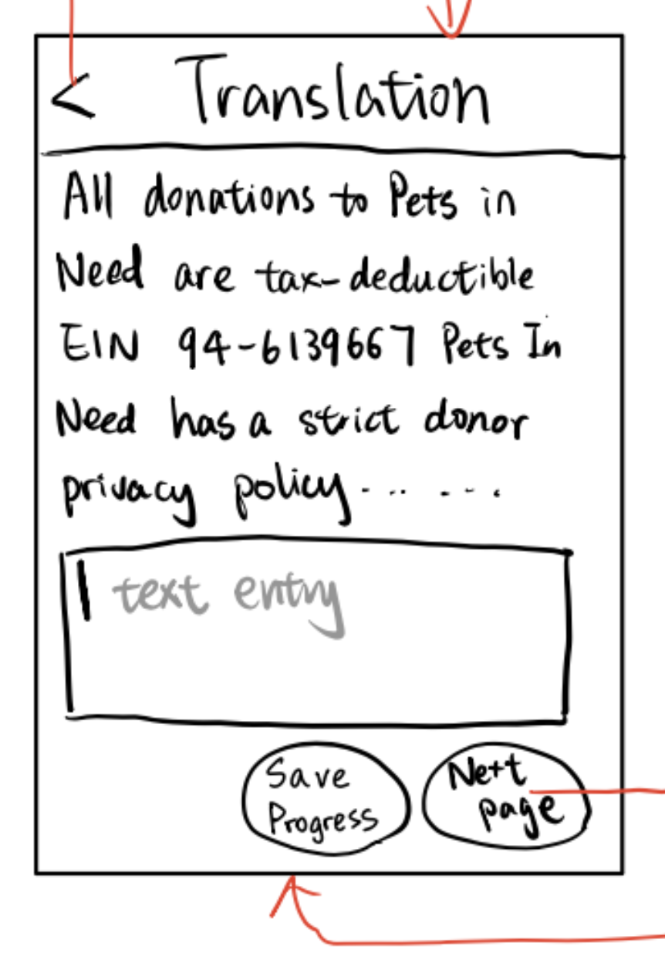
Observations:
Easy to find
Intuitive end-to-end
Enjoyed post completion reward
Confused by “Save Progress”

Slide 22
Observations:
Easy to find
Intuitive end-to-end
Enjoyed post completion reward
Confused by “Save Progress”
No errors

Slide 23
Task 2:
Filter Snippets

Slide 24
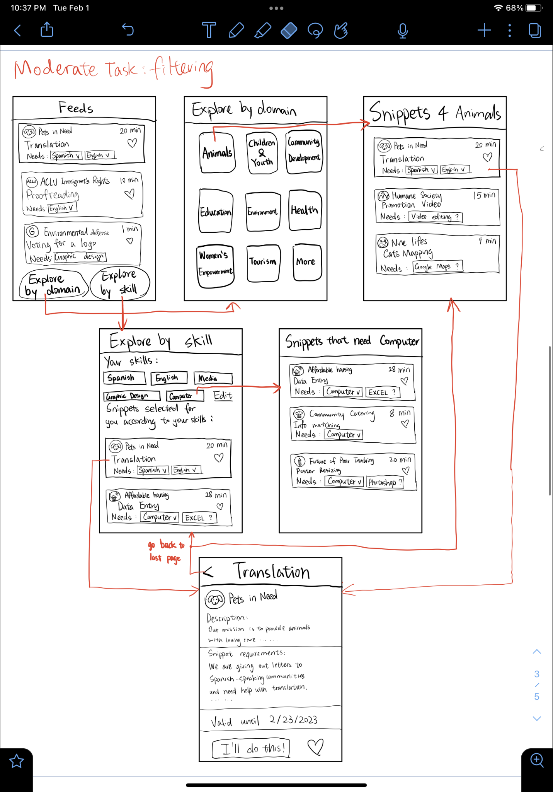
Observations:
Easy to find

Slide 25
Observations:
Easy to find
Button placement seems unnatural

Slide 26
Observations:
Easy to find
Button placement seems unnatural
Preferred domain explore over skill explore

Slide 27
Observations:
Easy to find
Button placement seems unnatural
Preferred domain explore over skill explore
Liked ability to select multiple

Slide 28
Observations:
Easy to find
Button placement seems unnatural
Preferred domain explore over skill explore
Liked ability to select multiple
Minor confusion

Slide 29
Task 3:
Save Snippets for Later

Slide 30
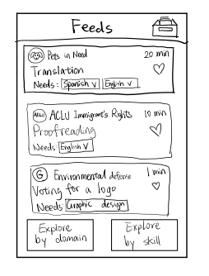
Observations:
Easy to find - saved icon could be better

Slide 31
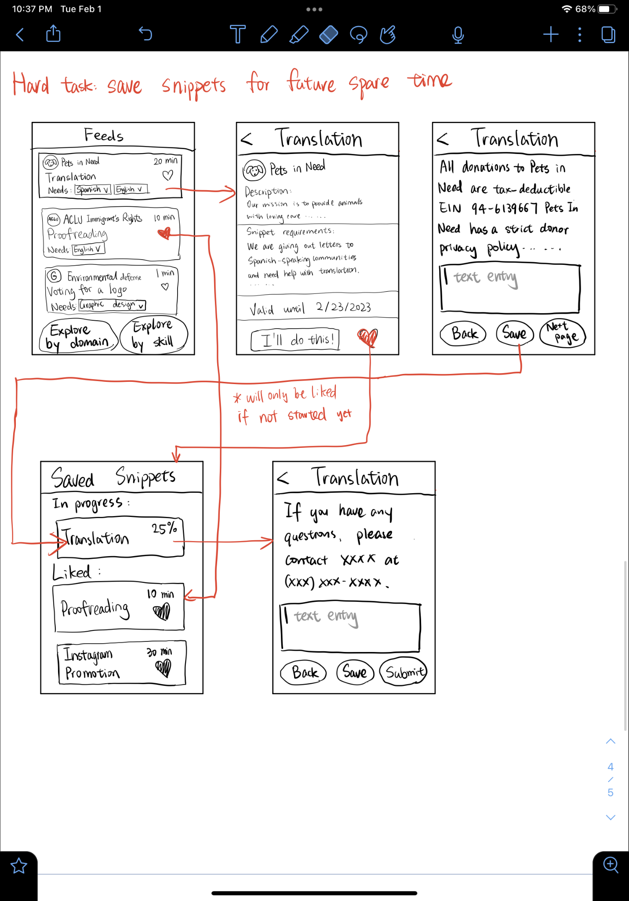
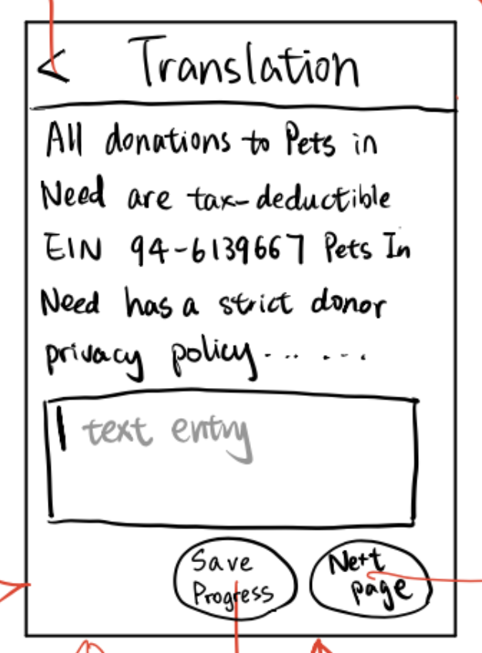
Observations:
Easy to find - saved icon could be better
Confused about what is meant by “Saving a task”

Slide 32
Observations:
Easy to find - saved icon could be better
Confused about the difference between liked and saved
Did not expect heart to navigate to Saved page

Slide 33
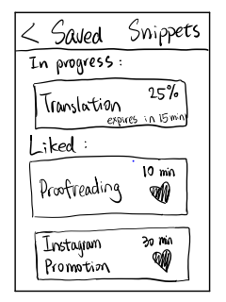
Observations:
Easy to find - saved icon could be better
Confused about the difference between liked and saved
Did not expect heart to navigate to saved
Enjoyed progress tracking

Slide 34
Observations:
Easy to find - saved icon could be better
Confused about the difference between liked and saved
Did not expect heart to navigate to saved
Enjoyed progress tracking
Several errors

Slide 35
Usability Goals
Usability Goal | Measurement Metric
Ease of use or efficiency | Clicks required to complete a task
Discoverability | How easy it is for users to find the tasks
Robustness | Amount of errors completing the task

Slide 36
Grading Performance
Ease of use
Discover
Robustness
Easy
Moderate
Hard

Slide 37
Suggested UI Changes

Slide 38
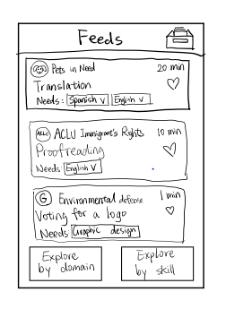
Navigation:
Add bottom navigation bar (Feed, Archive, Profile)
Move archived to the navigation bar
Move filters to the header section

Slide 39
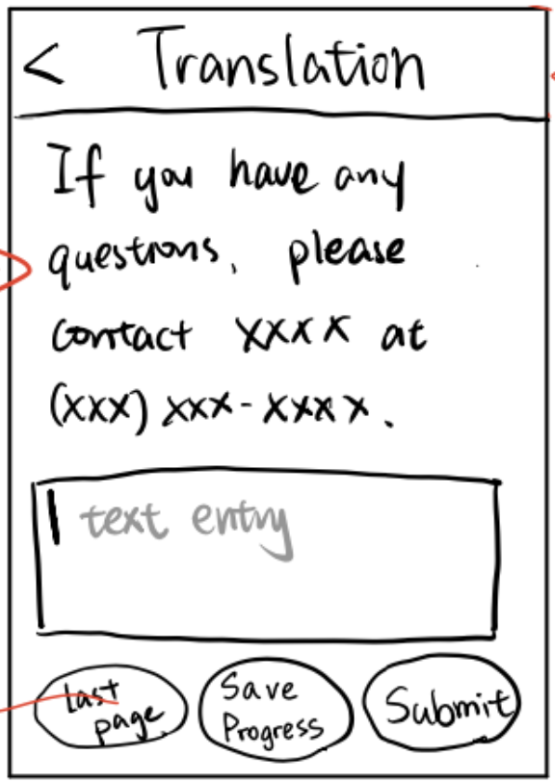
Saving:
Automatically save progress (remove save button)
Hearts only for “like” which archives the snippet
No navigation when snippet is saved
Change archive icon to better represent liked snippets

Slide 40
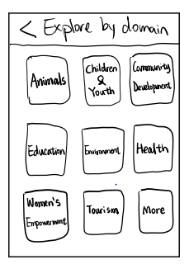
Unify Filtering:
We need a common filtering interface for domain & skills
Leaning towards domain UI as it is more visual (less text)
Still need to allow selecting multiple

Slide 41
Summary
For future improvement, we need to…
Be more intentional about the use of icon and button positioning
Differentiate similar tasks better or remove one (like and save)
Allow for snippet history

Slide 42
Questions?

