Slide 1
SNIPPETS
Microvolunteering in spare time
Mobile app to facilitate microvolunteering for people in their spare time.

Slide 2
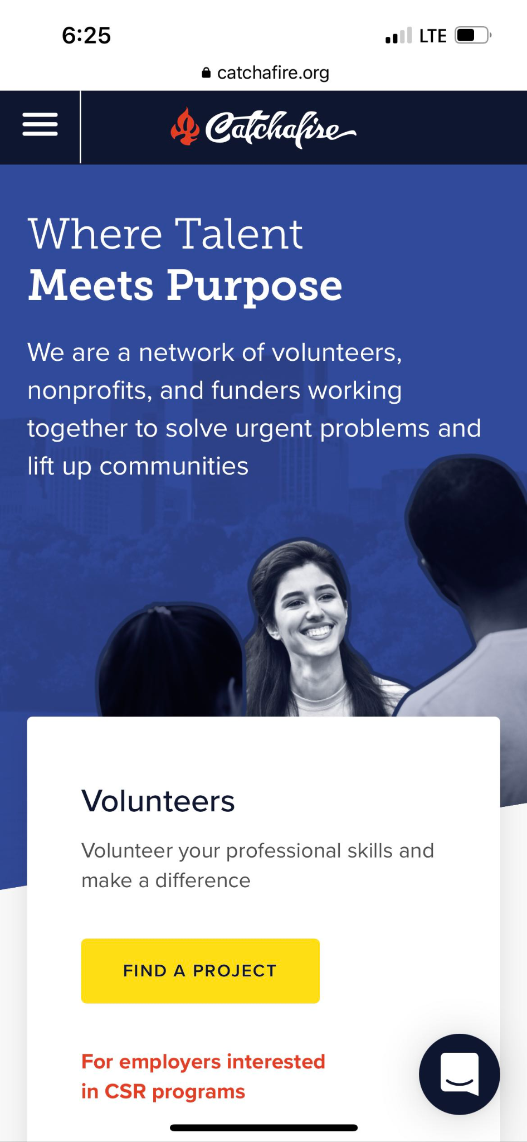
MARKET RESEARCH
What’s common with Catchafire (what worked for them)?
Matching volunteers’ skills with needs
Providing many different types of volunteer opportunities to users
What’s novel about our solution?
Mobile App
Smaller tasks that can be done in spare time (microvolunteering)
Gamified concept
Notes:
https://www.catchafire.org/volunteer-discover/

Slide 3
OUR TASKS
SIMPLE TASK
MODERATE TASK
HARD TASK
Finish a random snippet
Filter snippets by skill/domain
Saving tasks and doing them later

Slide 4
VALUES IN DESIGN
SERVICE
PRODUCTIVITY
01
Allow users to volunteer their time for a good cause
02
Provide an alternative to mindless scrolling
DYNAMISM
FUN
03
Allow for low commitments and fast changes to tasks
04
Create an enjoyable experience for volunteers

Slide 5
VALUE CONFLICTS
SERVICE
DYNAMISM
Organizations need users to commit for them to have a long impact on a community
Dynamism encourages fast changing activities and low commitment from volunteers
Notes:
Addressing the conflict: As users worked on more and more projects for an organization, they can join the organization for long-term commitments

Slide 6
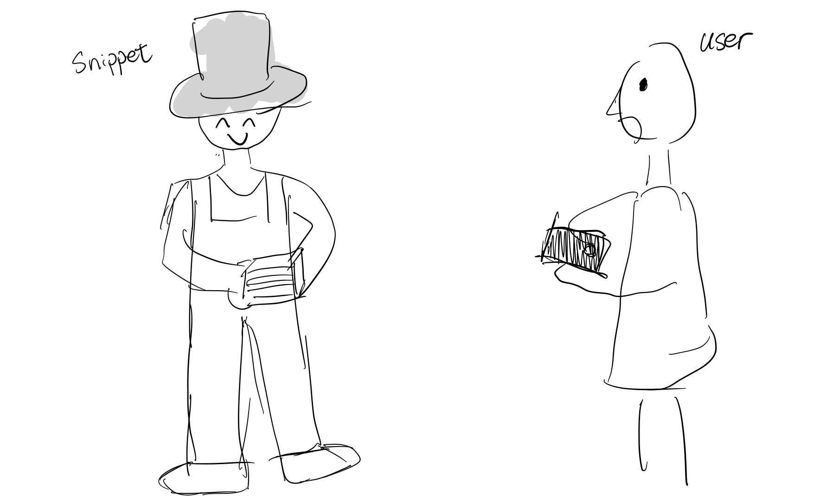
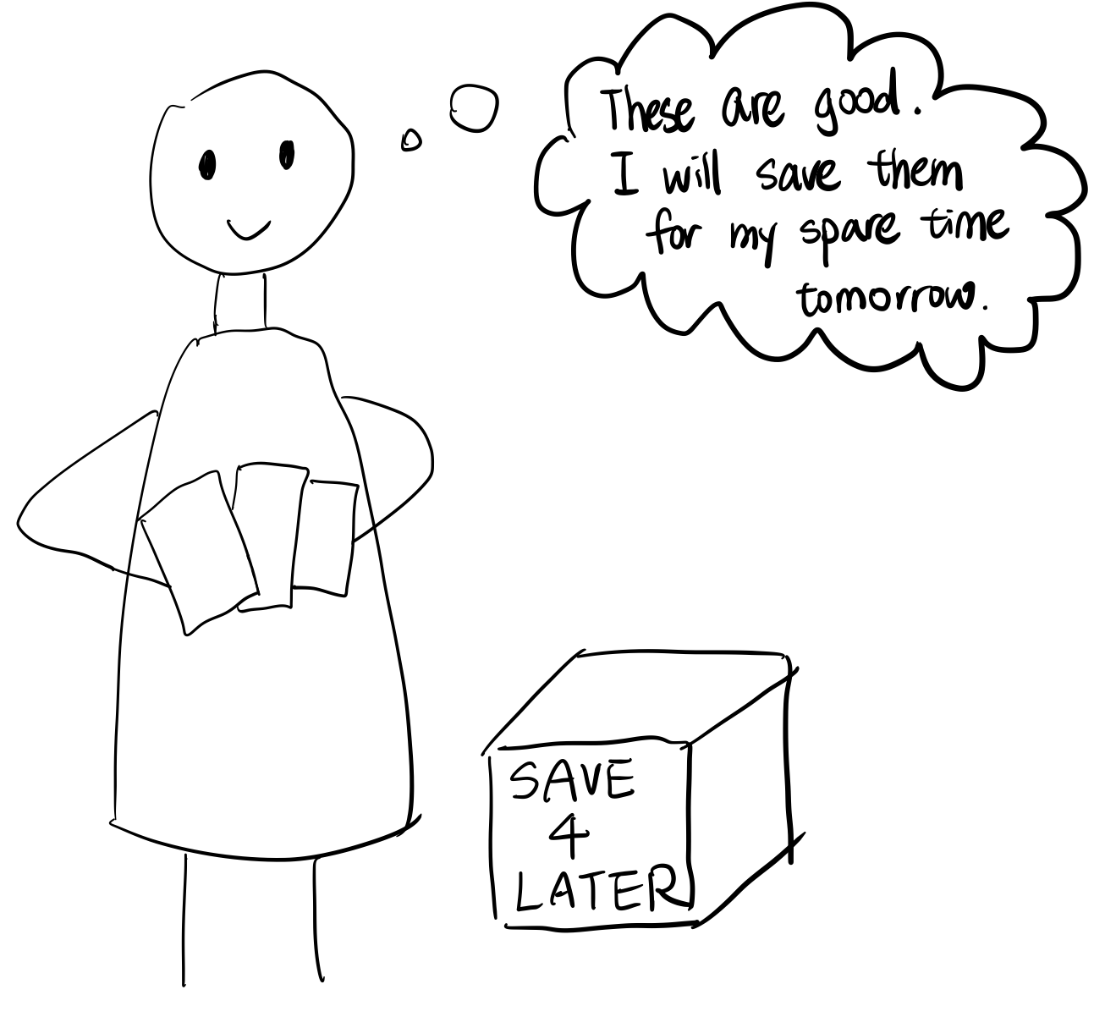
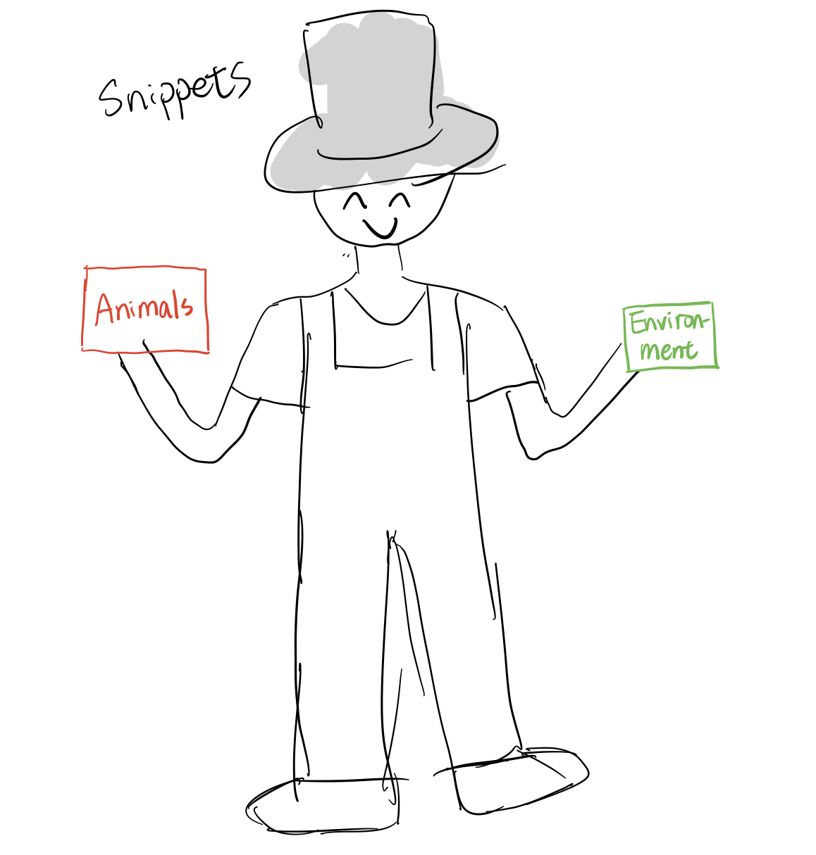
STORYBOARDS
The user was scrolling the phone boringly until Snippets showed up and presented volunteer tasks. The user randomly picked one to finish.
The user found some interesting tasks and saved them to retrieve and finish in future spare time.
Snippets provided tasks in different domain/need different skills for the user to choose from.

