Slide 1
Needfinding
Alissa, Uma, & Olivia

Slide 2
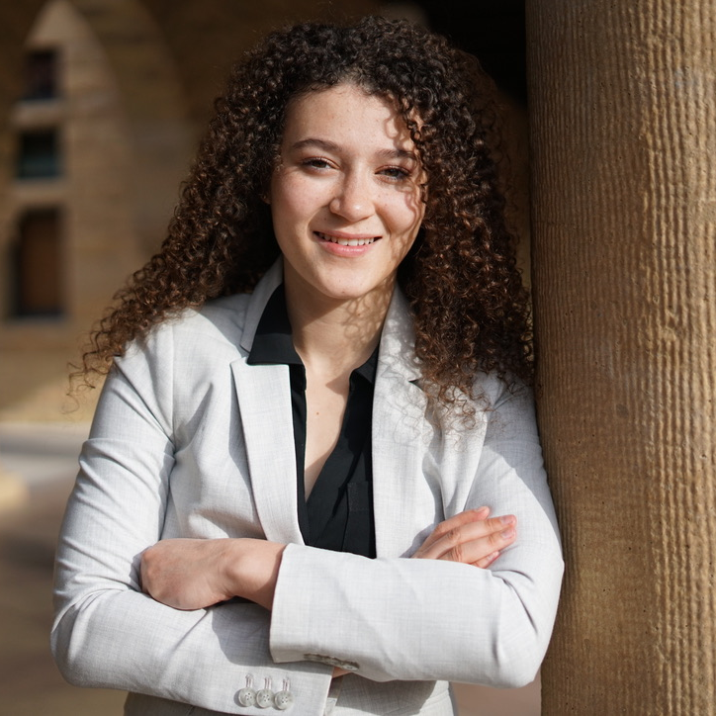
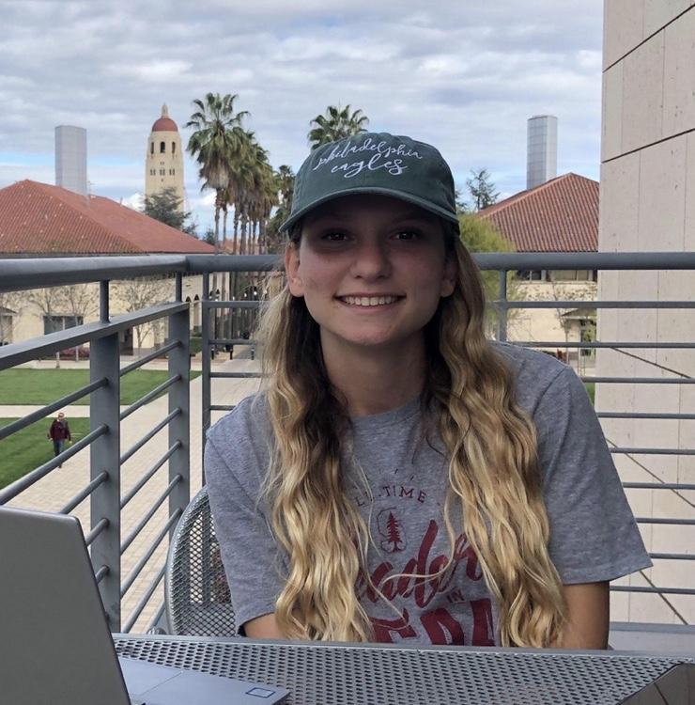
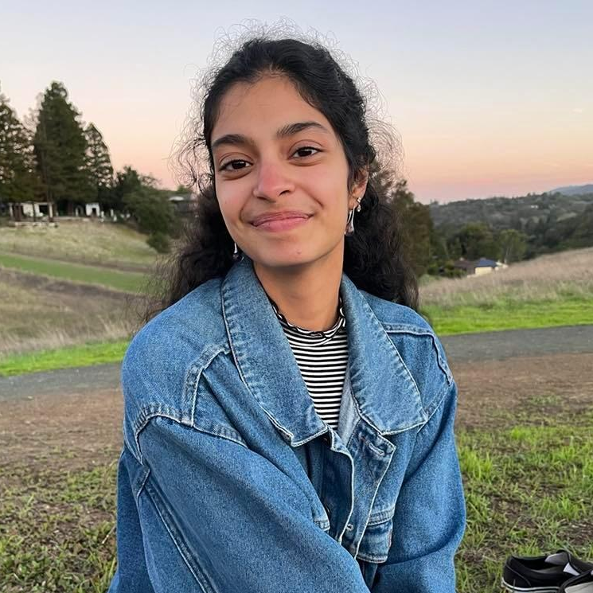
Our Team
Alissa Vuillier CS + POLISCI
Olivia Otto CS + DATA SCIENCE
Uma Phatak CS + SPANISH

Slide 3
Exploring domains
Access to benefits?
Political tech?
Self-representation?
Housing injustice?
SYSTEMIC JUSTICE & EQUITY

Slide 4
Questions
Tell us about your background as an organizer or researcher in your field.
What are some of the best tools you have used in this area, and why?
Why did you choose to focus on this space?

Slide 5
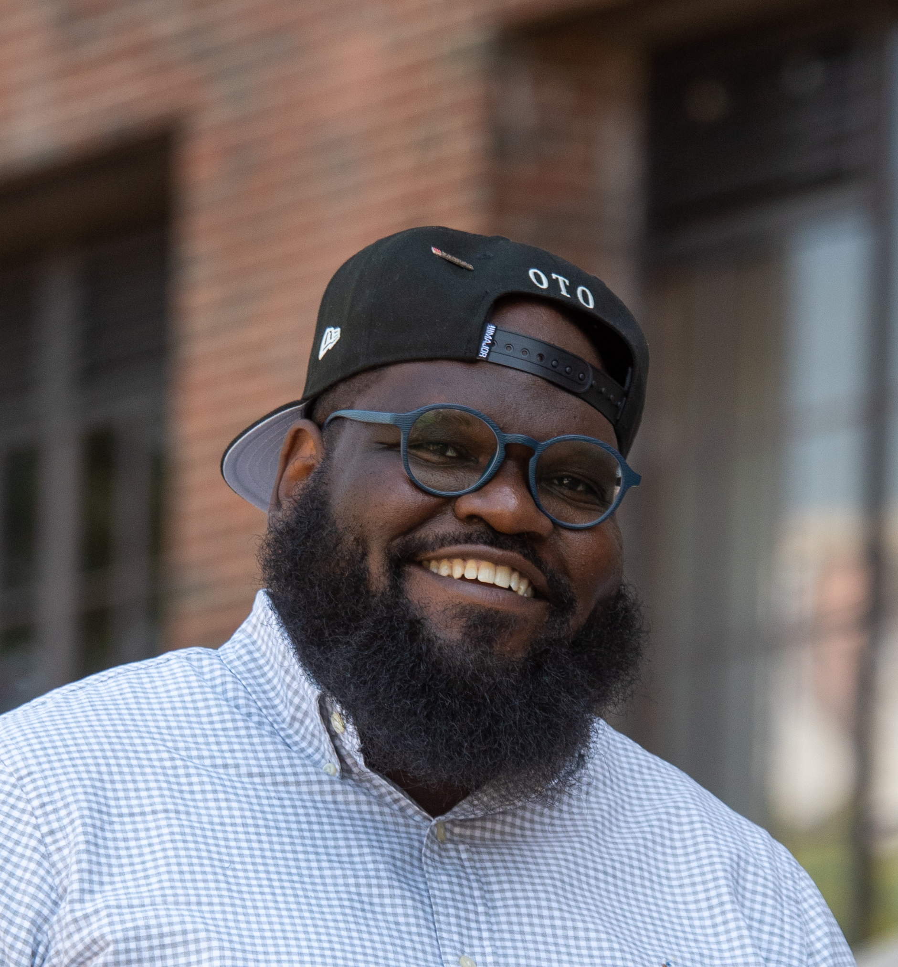

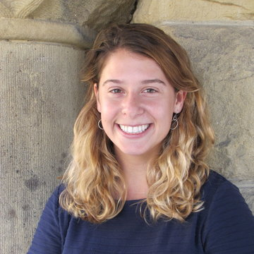
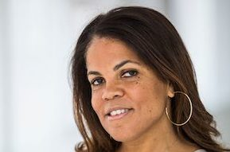
Interviewees
Kwesi
Amelie
Sophie
Sheena

Slide 6
Interviews

Slide 7
Kwesi
#Case4Reparations Campaigns Advisor at the Decolonizing Wealth Project
Senior Political Director at Color of Change
30 minute Zoom

Slide 8
“People [have been] so mad about the tech in the progressive movement… data costs too much, and tools just weren’t hitting.” -Kwesi

Slide 9
Amelie
Founder of Formally, a tech startup improving access to legal resources
30 minute Zoom

Slide 10
“If a product doesn’t have recommendations on what next steps you need to take, it can only take you so far.” -Amelie

Slide 11
Sophie
Former co-leader of the Stanford Prison Education Project
30 minute Zoom

Slide 12
“People rack up twelve FTAs without even knowing they have court.” -Sophie

Slide 13
Sheena
Director of Resource Mobilization at the Decolonizing Wealth Project
30 minute Zoom

Slide 14
“My ability as a fundraiser, to appeal to you, should not be a determiner of how much money you choose to give to [my] organization.”
-Sheena

Slide 15

FAILURE-
TO-
APPEARS
defn. When a criminal defendant is required to appear in court for a mandatory hearing, but they do not show up.
Notes:
4 mins.

Slide 16
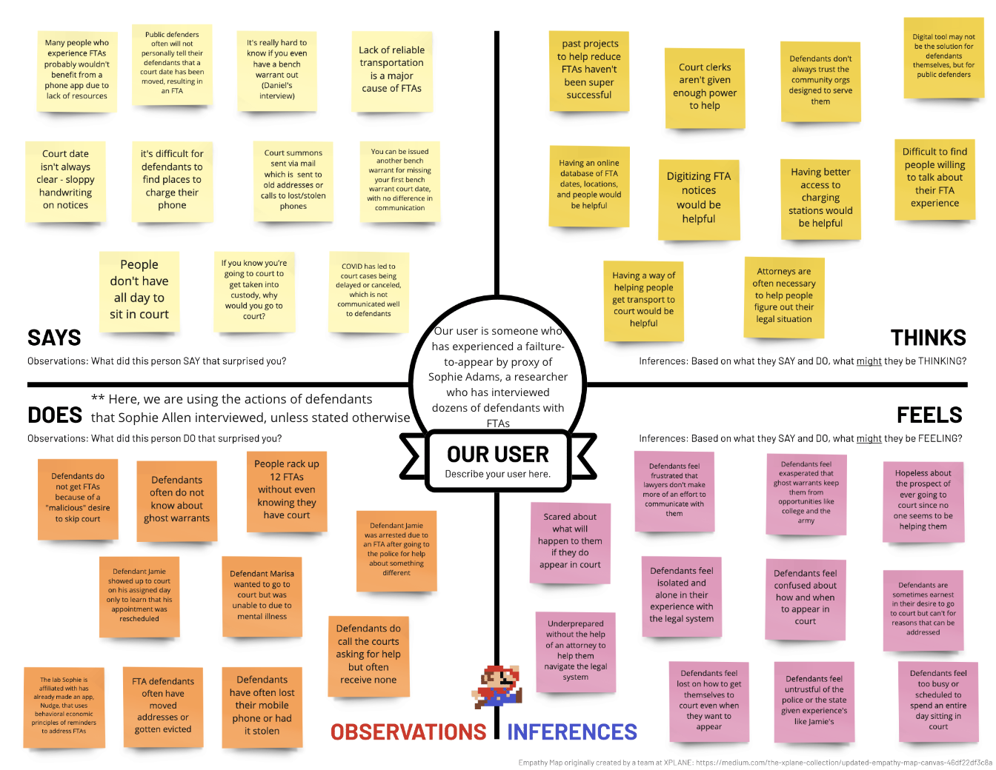
Sophie’s Empathy Map

Slide 17
Analysis

Slide 18
SAYS
“Lack of reliable transportation is a major cause of FTAs”
“The court date isn't always clear due to sloppy handwriting on notices”
“Reminder calls are useless if people have dead or stolen phones”
“I showed up on the fifteenth and they said I had no court.”
“[Colleges did] a background check… and it came up that I had a warrant out for my arrest. And so I was like, I have a warrant? “

Slide 19
DOES
People can rack up 12 FTAs without even knowing they have court
Defendants do call the courts asking for help, but often receive none
Defendants often do not know about “ghost warrants”
One defendant was arrested due to an FTA, after going to the police for help about something different
** We are analyzing the actions of defendants that Sophie interviewed

Slide 20
THINKS
Past projects to help reduce FTAs haven't been super successful – what’s to say future projects will?
If only there were an easy way to get to court, many of these related barriers might feel less overwhelming.
Defendants don't always trust the community organizations designed to serve them
Digitizing FTA notices would be extremely helpful

Slide 21
FEELS
Scared about what will happen to them if they do appear in court
Confused about how and when to appear in court
Frustrated that lawyers and clerks don't make more of an effort to communicate with them
Mistrustful of the police or the state
** We are analyzing the feelings of defendants that Sophie interviewed

Slide 22
Tensions
Defendants would benefit from notifications, but often lack reliable phone access
Court dates are mailed to defendants, but can be so sloppy that they aren’t even legible

Slide 23
Contradictions
People appear in court and are turned away, but then are later issued a fail-to-appear because their court date was changed without notice
A FTA is a crime committed usually without intent

Slide 24
Surprises
The biggest problem is people not knowing they have a court date
Lack of access to mobile chargers is a large problem as well

Slide 25
Insights Needs
Even when a defendant is motivated to get to court, getting there is hard.
It’s extremely hard to know or confirm when your court date is.
It’s easy to forget when to appear in court – it’s just another task.
Illegibility of forms giving court dates seems like a trivial issue but is a huge problem.
People need a reliable and flexible mode of transportation to court.
People need a real-time, updating tool to look up when their court date is.
People need reminders to appear in court.
Defendants need clearer forms and courts need better methods of giving out forms.

Slide 26
Final thoughts

Slide 27
Hard to meaningfully address problems in the space of systemic justice & equity using tech, due to lack of resources
Super hard to get end-users to interview (working on this right now!)
How can we design for a specific subset of people who might find an app helpful?

Slide 28
Summary
Insights: We learned that…
failures-to-appear are rarely intentional
barriers include lack of transportation, reliable phone or internet access, and communication channels
even with internet access problems, there are still ways to help
Domain finding: We talked to four experts about access to justice ecosystems
End-user focus: We narrowed in on failure to appears and empathy mapped for Sophie

Slide 29
Questions?

