Slide 1

Value Proposition:
Court, with support.
Problem: Being summoned to court can be a stressful and overwhelming process, especially when combined with a lack of resources and information. The consequences of failing to appear in court when summoned are disruptive, ranging from a fine to an arrest.
Solution: Our app provides defendants with ways to track and confirm the logistics of their court dates (e.g. arranging transportation, legal representation, and more) to help people feel more confident leading up to their court hearing.

Slide 2


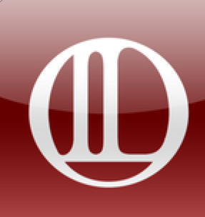
Market Research
Nudge - text reminders for court appointments
difference: only text reminders, no other resources
what worked: text reminders proved to reduce FTA rates
what didn’t work: doesn’t address all the other issues that cause FTAs besides forgetting
CitizenshipWorks - walks immigrants through naturalization process (eligibility, documents, etc.)
difference: just focused on citizenship, not other legal issues
what worked: step-by-step guidance, free and easy, gives legal help and guidance
what didn’t: doesn’t help with issues that impact immigration process (ex. childcare), limited
to citizenship
Illinois Legal Aid App - step-by-step guides to “demystify the law”
difference: only provides steps to guide through legal process, not adjacent tasks
what worked: gives resources and information you need step-by-step through the process
what didn’t: not at scale or interactive, doesn’t help w/ issues like transportation or
representation

Slide 3
Tasks
Simple Task:
Check date (days until hearing) and location of court hearing
Moderate Tasks:
Determine options and track coordination attempts for securing legal representation (check who has been reached out to, who has accepted)
Determine options and track coordination attempts for securing transportation
Complex Tasks:
Reaching local court to discuss upcoming hearing information
Access and/or add testimonials about how court went

Slide 4
Values in Design
Our project enforces the value of equity in justice by embedding accountability and transparency into the process of appearing in court.
A tension exists in that the justice system is currently inequitable; by helping defendants feel motivated to appear in court, we are not targeting the cycle of injustice often perpetuated by the legal system. However, given that FTAs generally affect those with less resources, creating even more disproportionate and unequal situations, our solution tries to mitigate the worst disparities by helping people appear in court.

Slide 5
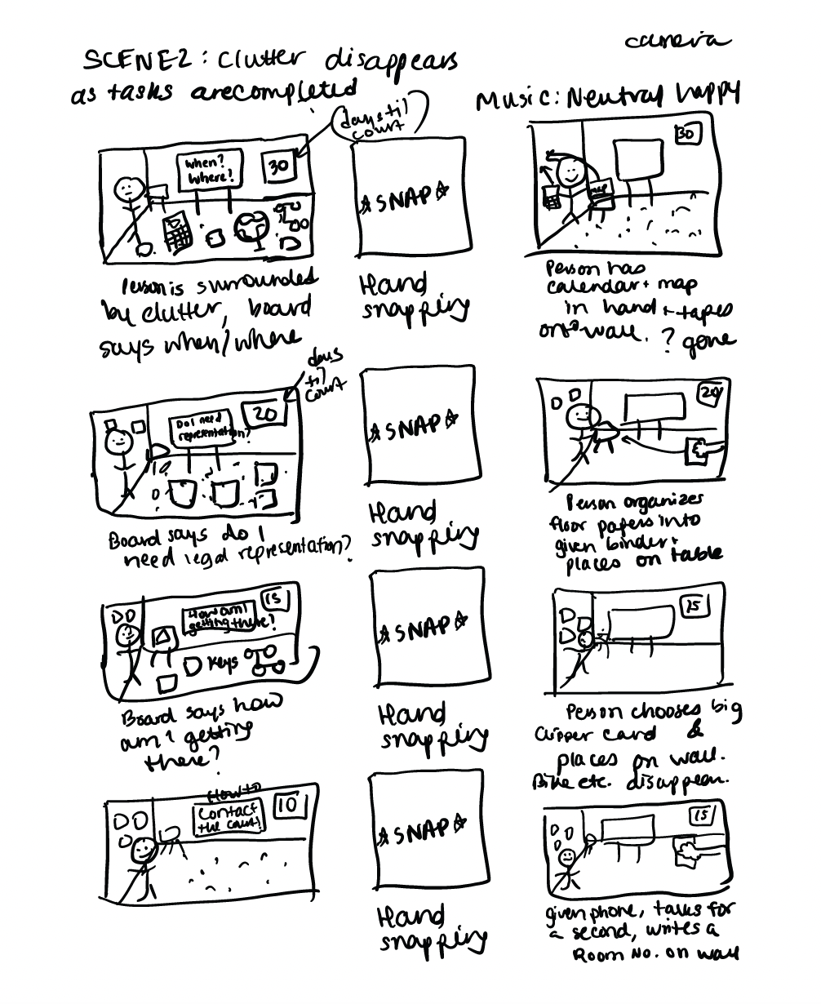
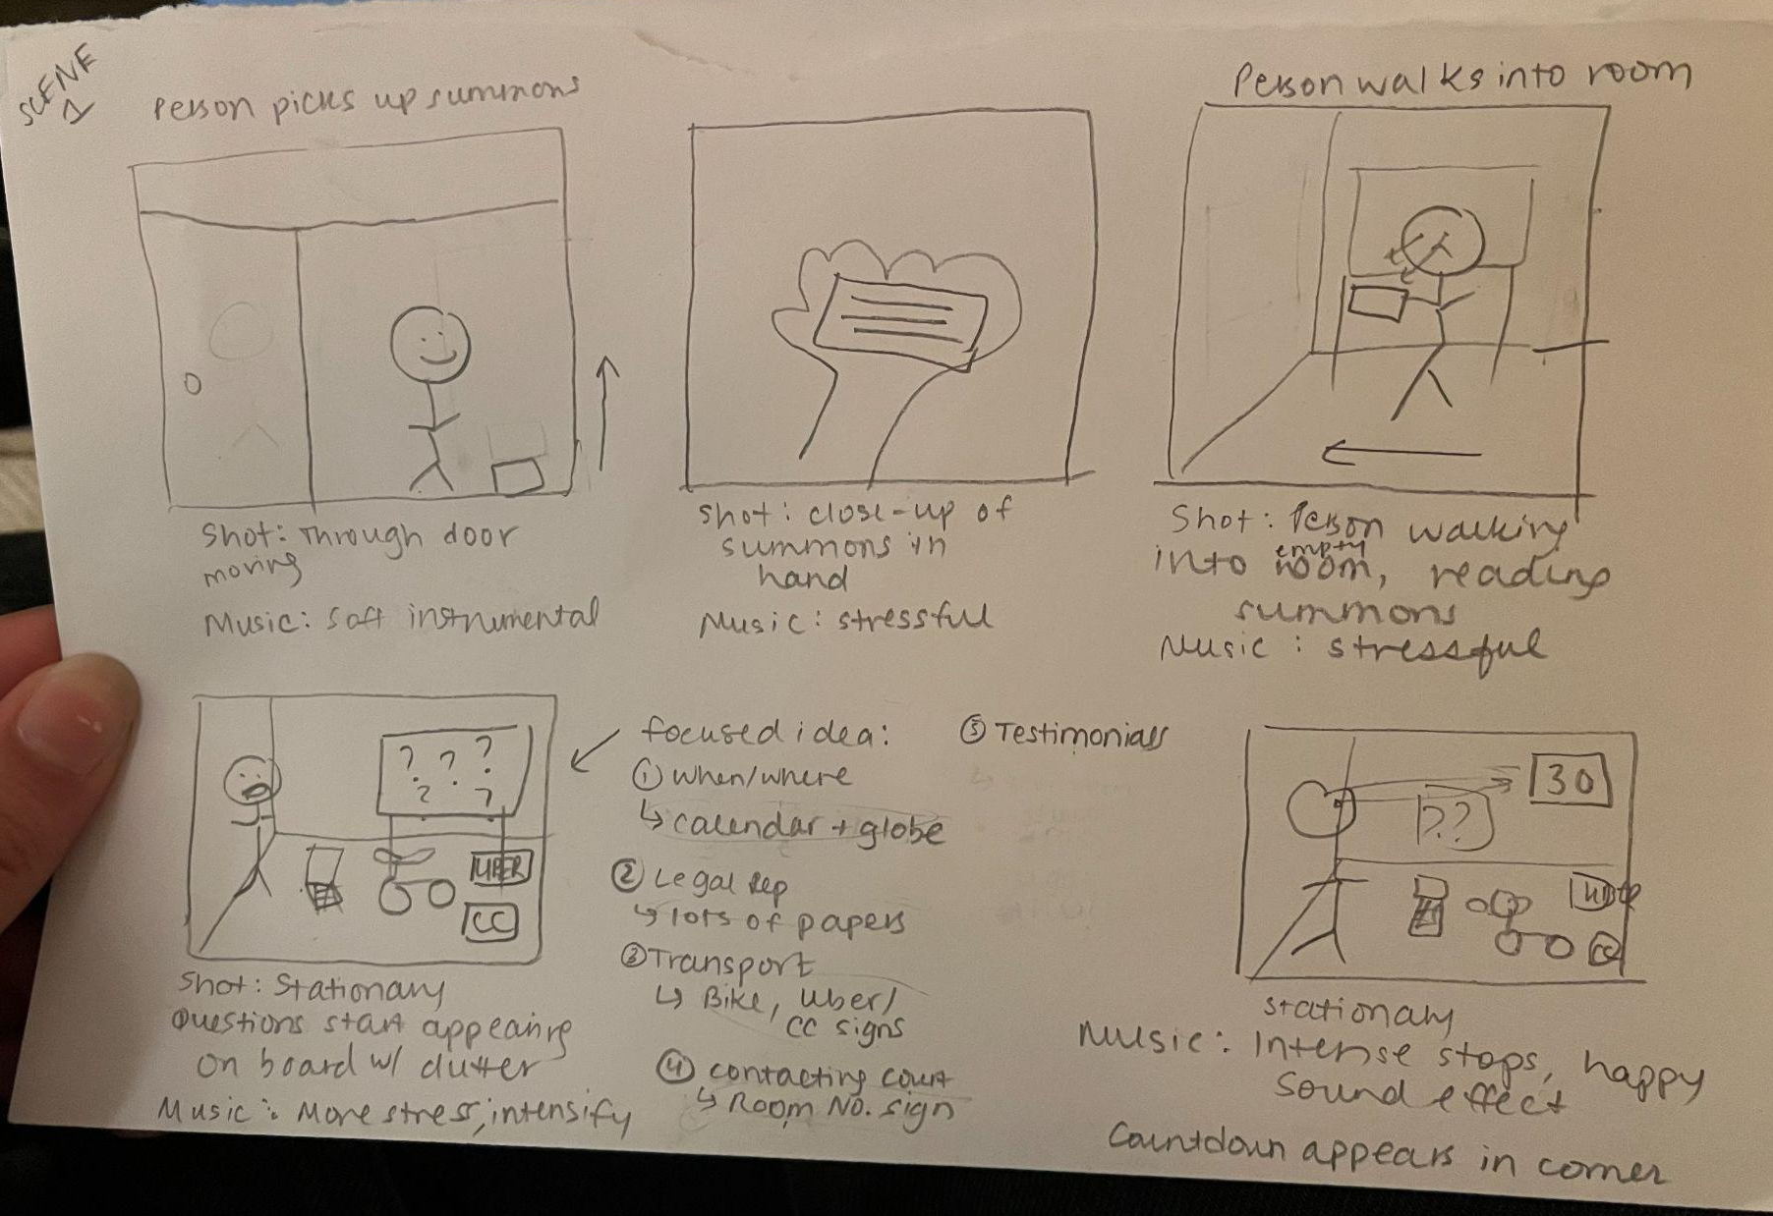
Storyboards

Slide 6
