Slide 1

Cookee
High-Fi Prototype
Cook efficiently; Cook enjoyably; Cookee
Kendall, Taylore, Timi, Tiffany

Slide 2
Introduction
Value Prop
Making meal time easy and fun for busy people.
Problem
Working individuals often skip meals and often don’t have time to enjoy the cooking process

Slide 3
a streamlined platform to help busy people prioritize mealtimes in an efficient and enjoyable manner
Cookee provides:
calendar interface for meal planning
meal suggestions based on ingredients in the users' pantry
curated group cooking experiences for every meal
Solution Overview
Notes:
Problem:
Many working individuals de-prioritize mealtimes due to their hectic work schedules. Preparing meals often becomes an afterthought or another annoying task to add to the to-do list.
Solution Overview:

Slide 4
Overview
1. Heuristic evaluation results
2. Overview of revised design
3. Prototype implementation
4. Demonstration of prototype
5. Summary

Slide 5
Heuristic Evaluation Results

Slide 6
Heuristic Evaluation
2. H3 User control and freedom / Severity 4 From the calendar screen I cannot add a new meal plan directly. This feels a bit restrictive and also doesn’t resemble a physical calendar that you can immediately add things to or take things away from. Fix: Add a way to create a new meal plan directly from the calendar view (as long as it doesn't mess with the other goals of the app)
3. H2: Match between the system and real world / Severity 4 The hover feature in the calendar is a nice idea except it doesn’t really work on a mobile phone. The hardware doesn’t match with this feature. Fix: Change the hover feature to be a “click and hold” type of thing that expands the meal plan only when holding down on it.

Slide 7
Heuristic Evaluation
6. H3 User control and freedom/Severity 3 Whole in the calendar view and viewing my meal plans I cannot click on the meal plan to expand it and show me more details or edit it. This makes that screen feel restrictive. Fix: Add a direct link to edit existing plans right in the calendar view
17. H7 Flexibility and efficiency of use/ Severity 3 The cooking rooms aren’t searchable, even though there is a filter option. THis results in a fair amount of extra searching that could be quickly avoided using a search bar in conjunction with the filter. Fix: Add a search bar at the top of the Cookee rooms screen so that users can type the beginnings of a dish and see the relevant rooms

Slide 8
Heuristic Evaluation
21. H11 Accessible/ Severity 4 Users that cannot speak aren’t able to add things to the pantry because there is no manual method (no writing method). Fix: Add a way to add ingredients with the keyboard, and perhaps even suggest some common ones that are selectable so they don’t have to type everything out. Also provide a live-update suggestion bar as they type so they don’t have to type it all out
23. H1 Visuality of System Status/ Severity 3 While inside of the Cookee room there is no way to indicate which step you are on/have moved on. Users should be able to select which step they are on and update their friends along the way. Fix: when you first join, step #1 will be highlighted and its details will be opened. When you click on step #2 it will highlight it, open it, and move your status to that one.

Slide 9
Heuristic Evaluation
25. H2 Match Between System and the Real World / Severity 3 The concept of a Cookee room is not intuitive to users (who is inside them and what happens within them?). Fix: Add a short explanation for what a Cookee room is during the onboarding process.
26. H3 User Control and Freedom / Severity 3 While adding ingredients to the pantry, there is no way to edit or delete the added ingredients. Fix: After the Cookee stops recording, users should be allowed to edit the ingredients.

Slide 10
Heuristic Evaluation
Other Heuristic Results
28. H5 Error Prevention/ Severity 3 There aren’t any instructions while adding pantry ingredients by voice that makes it easier for when program is being used to parse it and split it into a list of ingredients. It could be less prone to recording errors that way.
Dated overall color scheme/aesthetic
Heading space too large
Font too large

Slide 11
Revised Design Overview

Slide 12
REMINDER!
Usability Goals & Key Measurements
Goal 1 – Efficiency: Navigate the app with ease
Measurement: measured ratio of correct clicks to incorrect clicks by recording the time it took each user to complete a given task
Goal 2 – Enjoyment: Pleasing app experience
Measurement: had participants rate their experience satisfaction on a scale from 1-4

Slide 13
Task 1 Simple
Goal: Establish healthy and consistent eating habits
Task: Navigate the Cookee app to find your Saturday dinner plans

Slide 14
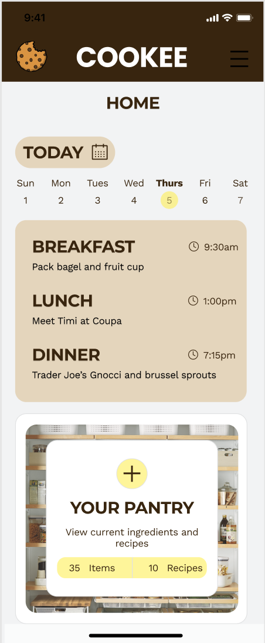
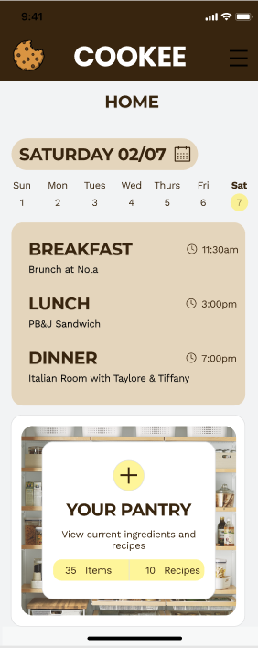
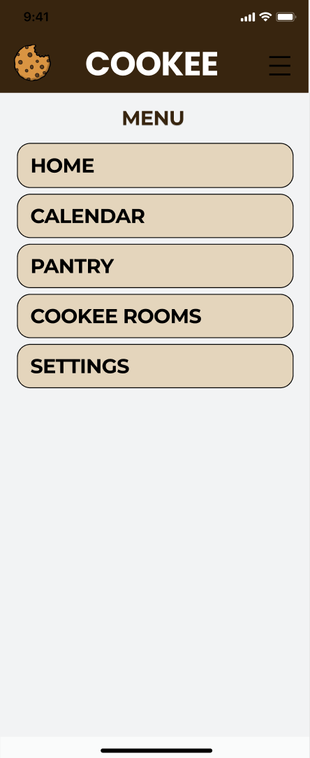
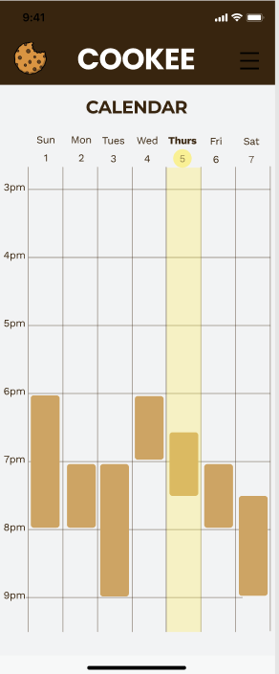
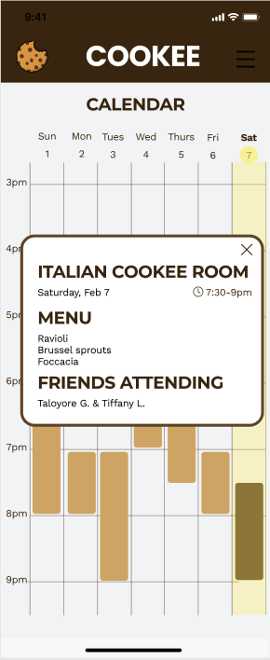
Cookee home page opens with Today’s day view. Click on the cal buttons to go to another day
Click on Saturday day view to see Dinner plans. or…
Click on the menu button to navigate to calendar
Calendar highlights the current date
Hover over saturday dinner block to see pop up window

Slide 15
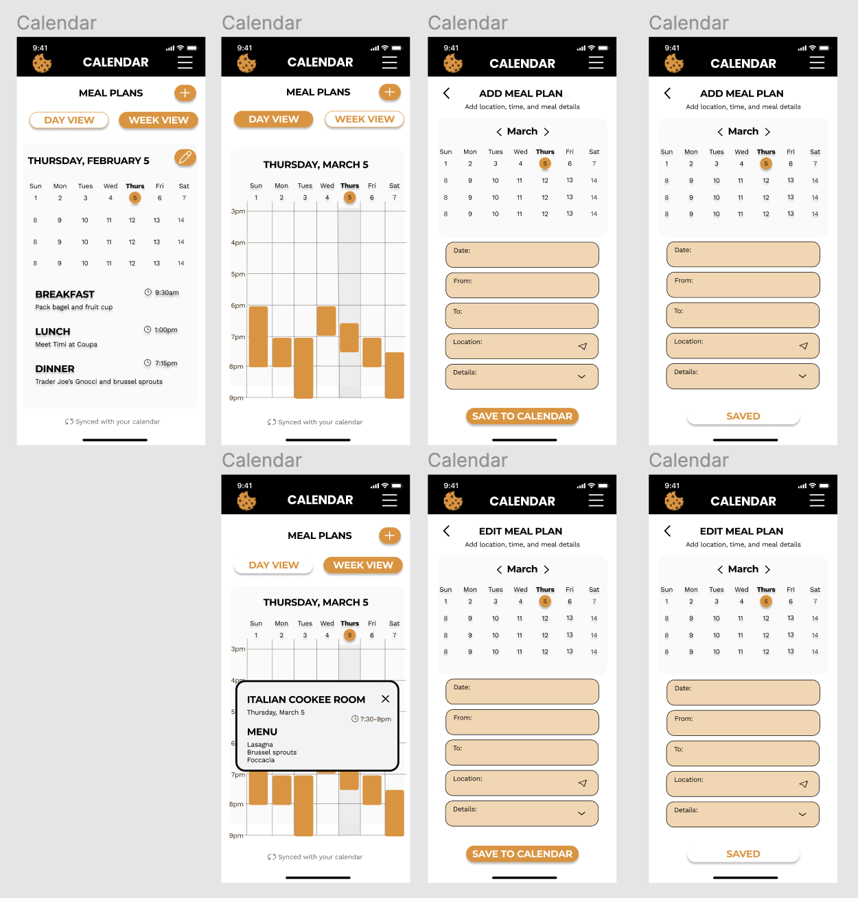
Changes/Additions
Day and week view
Ability to add new meal plans
Ability to edit planned meals
Replaced hover meal details with a pop up upon click
Created screens to add/edit meal plans

Slide 16
Task 2 Moderate
Goal: Bring community to the kitchen
Task: Navigate the Cookee app to join the Italian cooking room

Slide 17
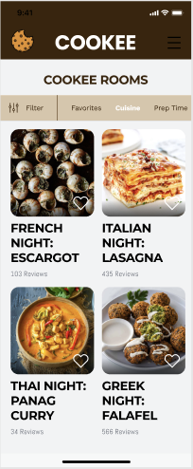
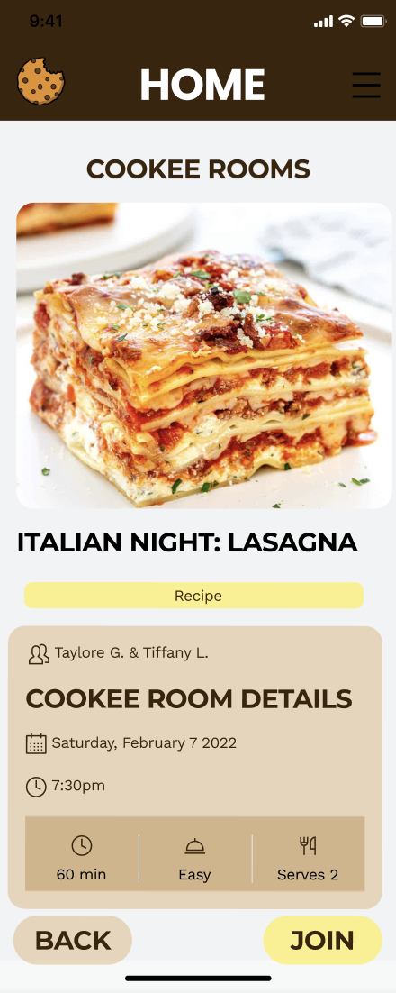
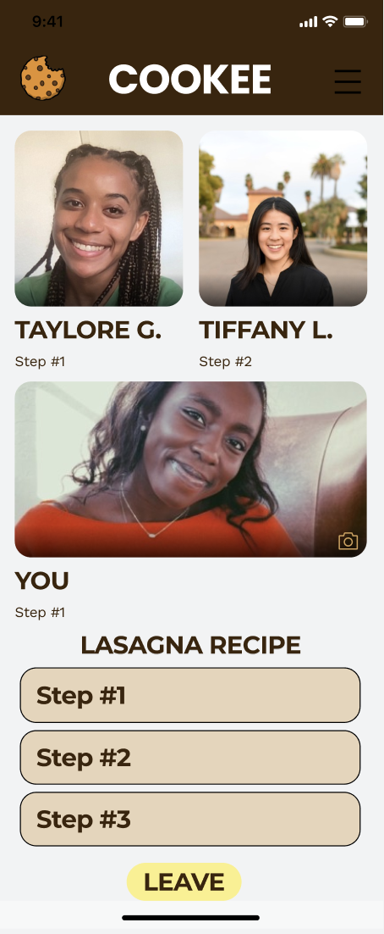
Cookee menu page to navigate to the rooms
Page for Cookee room availabilities
Cookee menu page to navigate to the rooms
Inside the video chat room

Slide 18
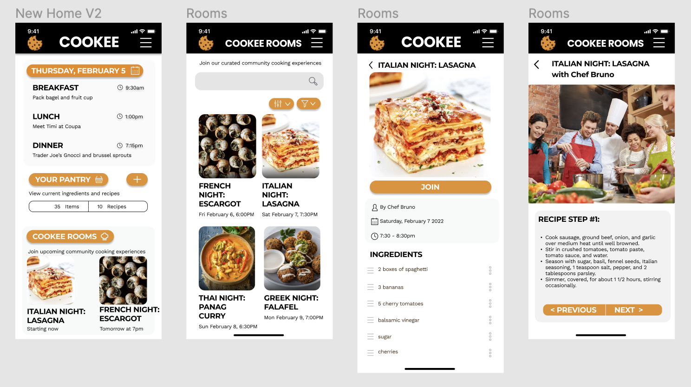
Changes/Additions
Overall aesthetic changes from dated look
3 tasks accessible from home screen
Searchable cookee rooms
More details about what cookee rooms are
See ingredients before joining
Control steps recipe in cookee room
7. Cookee rooms with chef, less of a social aspect

Slide 19
Task 3 Complex
Goal: Create nutritious meals from available ingredients
Task: Tell Cookee what is in your pantry to generate recipes

Slide 20
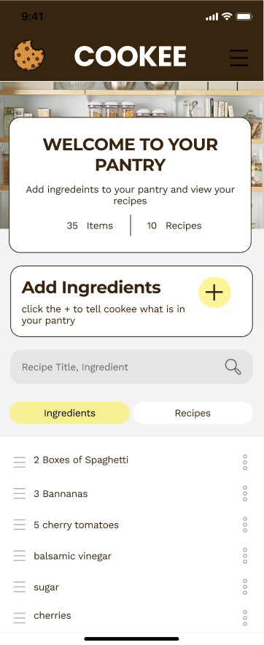
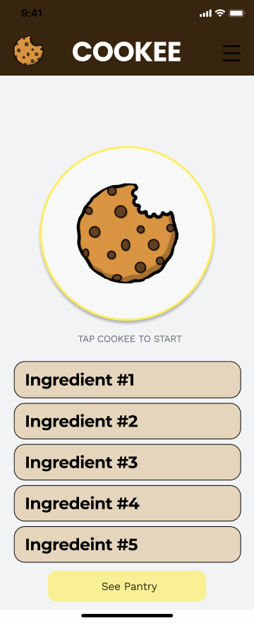
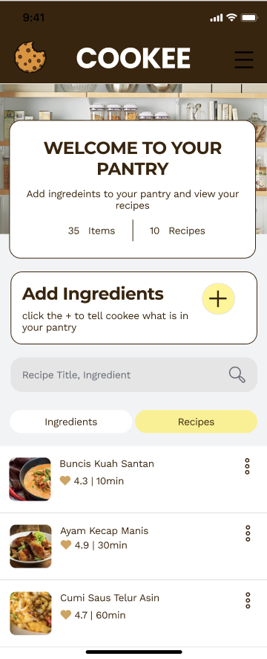
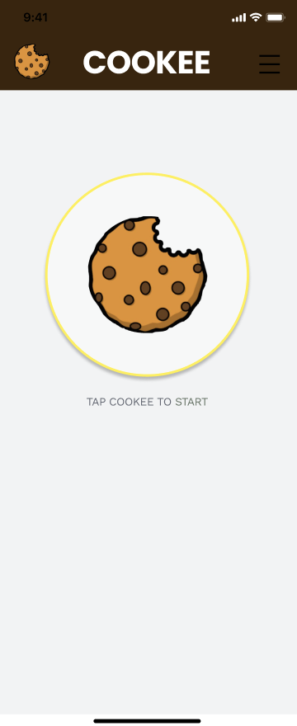
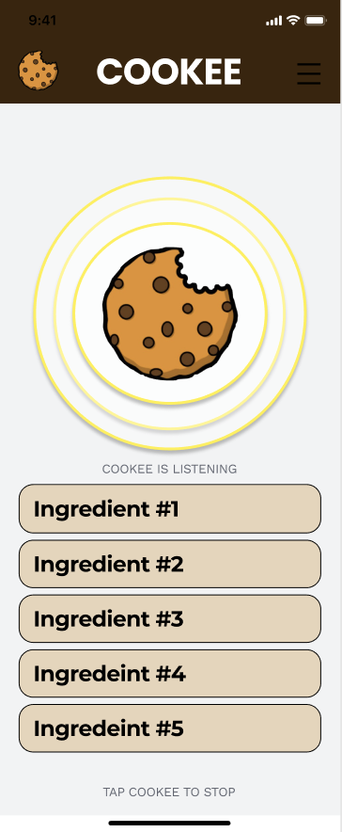
The Cookee pulses as it records the ingredients in your pantry
Tap the Cookee to stop pulsing/recording and see pantry when done
Return to the pantry home and see the new recipes
Create nutritious meals from available ingredients (Voice to Recipe)
Tap the Cookee so it can start recording

Slide 21
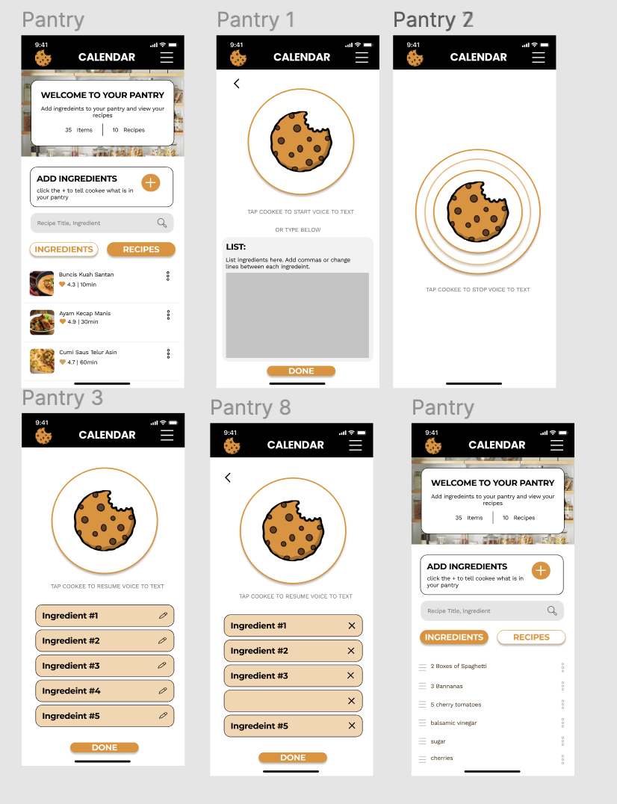
Changes/Additions
Ability to type ingredients or speak ingredients
Ability to edit ingredients before adding to final list
More detailed voice to text instructions

Slide 22
Prototype Implementation

Slide 23





Tools Used
React Native
application framework
Expo software development kit
Visual Studio Code
IDE
Figma
design components
Firebase
cloud storage

Slide 24
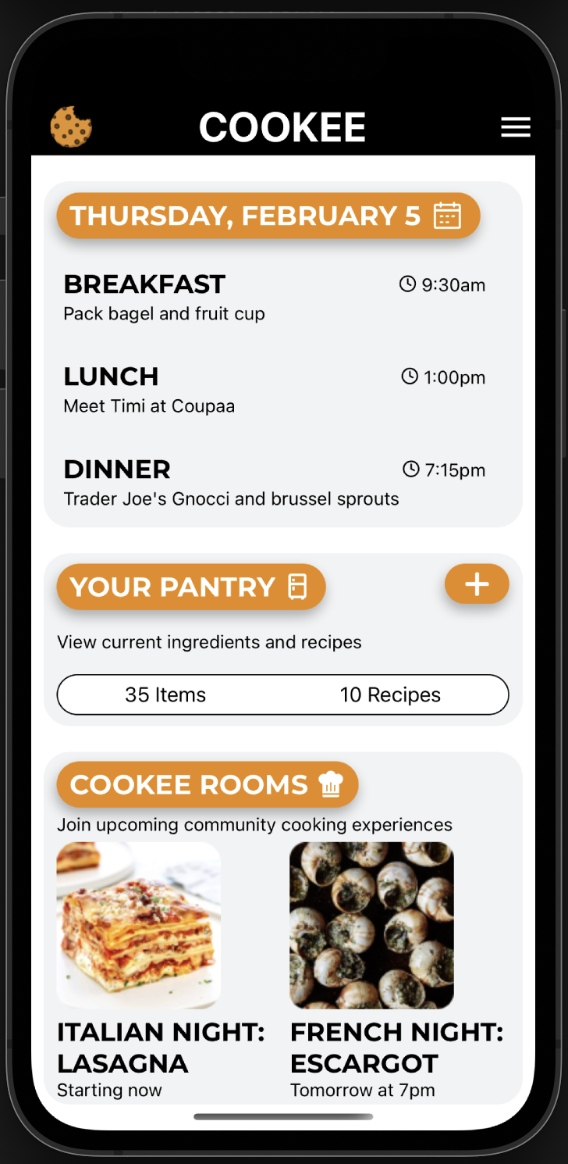
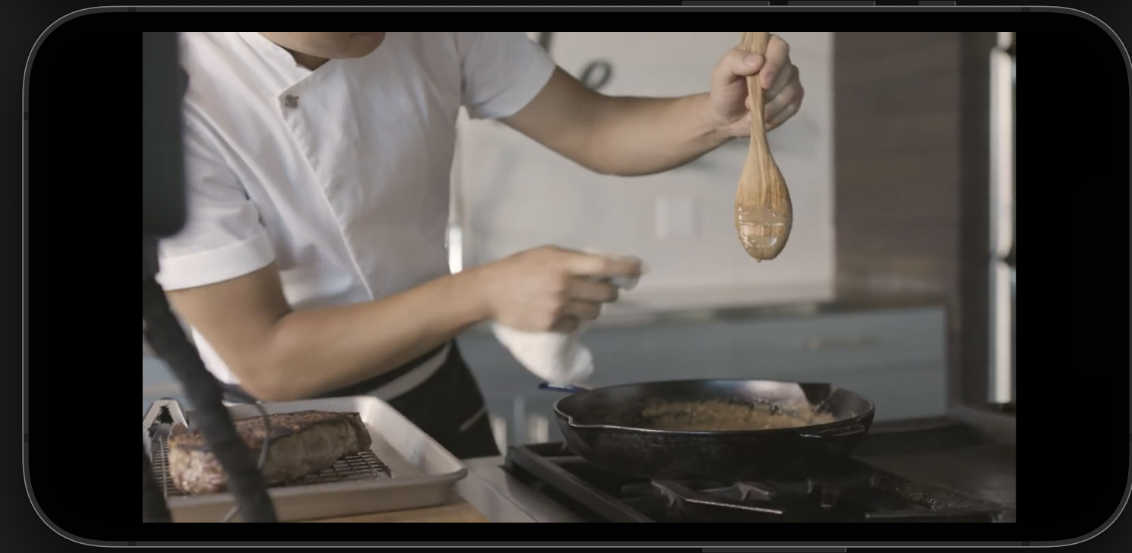
Moderate Task-Implemented
Task:
bring community into the kitchen
Users enter a Cookee Room where they can watch a livestream masterclass from a professional chef

Slide 25
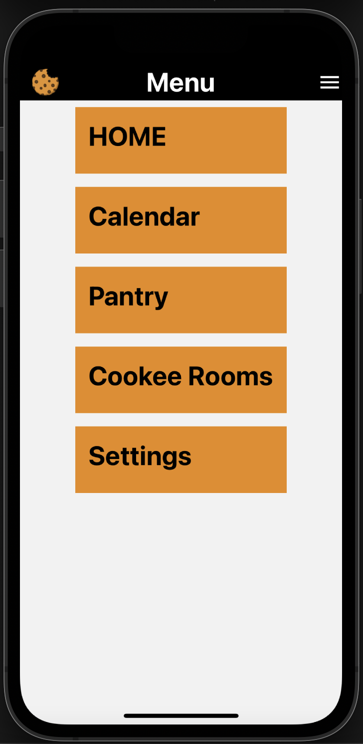
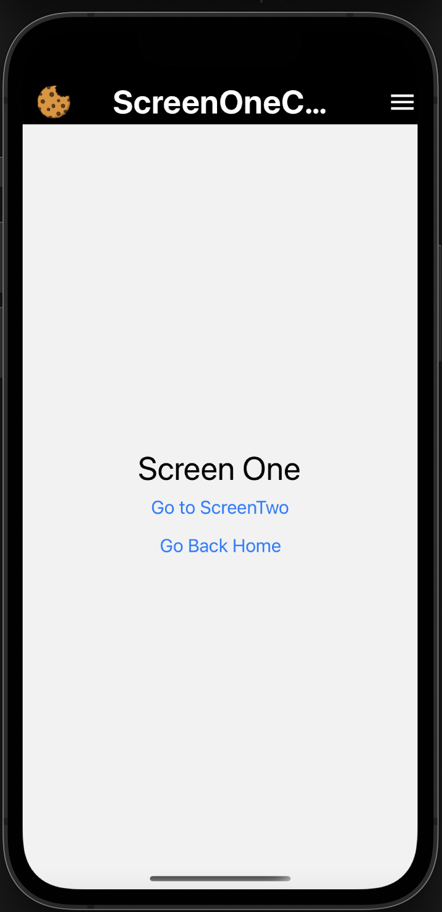
Menu Navigation - Implemented
Users are able to use our menu to navigate the app

Slide 26
Unimplemented Features
Calendar Task:
screen to view meal planning calendar and edit calendar
Voice to Ingredients Task:
screens that take the user through dictating their ingredients, generating ingredients list, and generating a recipes list from the ingredients
Cooke Rooms Task:
screens to see all Cookee Rooms
screen to see information about a Cookee Room before joining

Slide 27
Our Plan
Friday March 4th- Saturday March 5th: Start calendar task and refine cooker rooms task
Sunday March 6th: MVP for the calendar task
Monday March 7th: Start “voice to ingredients” task
Wednesday March 8th: Complete MVP for “voice to ingredients” task
Thursday March 9th - Friday March 10th: Refine all tasks

Slide 28
Wizard of Oz
Issues/Questions
Hard-Coded
Using Zoom instead of building embedded video call feature
Best design to implement recurring events on calendar task
Implement voice to text feature with API
Suggested recipes
Notes:
Techniques: using zoom in place of building out video calls
Hard-coded data: giving the Issues/Questions: Anything you are unsure of how to do?

Slide 29
Demonstration

Slide 30
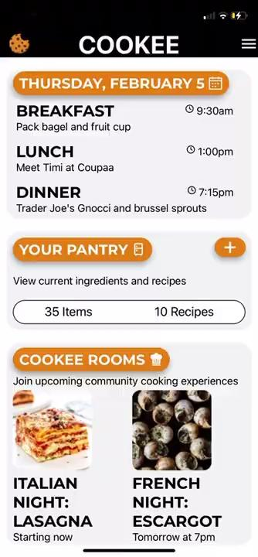
Demonstration of Implemented Features
From the menu, able to navigate to ScreenOne and ScreenTwo which will be implemented soon
By clicking the image for Italian Night Lasagna able to navigate to a Zoom room which is our Wizard of Oz representation of a Cookee Room livestream with a chef.

Slide 31
Summary
Major design changes complete
New changes will be made if coding limitations arise
Cookee rooms task is functional, some edits/additions to be made
MVP of tasks to be completed by Wednesday
Edits to be made Thursday
Report and Poster pending

