Slide 1




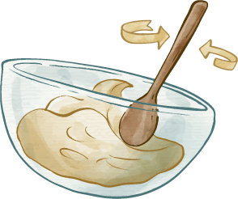
Cookee
Cook Efficiently and Enjoyably
A platform that empowers users to plan ahead, be resourceful, and incorporate community into every meal.

Slide 2
Market Research:
Platejoy
Super Cook
Yummly
Perks
Custom meal plans
Custom grocery lists
Accommodation of dietary restrictions
Cons
Lack of diverse recipes
Perks
Add all ingredients in your home
Filter recipes
Shop smarter
Cons
Glitches with the shopping vs. pantry lists
Perks
Discover personalized recipes
Save favorites
Shop
Cons
Too many ads
Too many clicks to get to recipe

Slide 3
Tasks
01
02
03
04
Simple
Complex
Bring community into the kitchen
Establish healthy and consistent eating habits
Moderate
Simple
Create nutritious meals from available ingredients
Set a positive mood for the kitchen environment
Notes:
Scheduling mealtimes autonomously at the onset of your day - even planning with friends virtual or not
Syncing reminders with others to make even grocery shopping social as well

Slide 4

Values in Design
Enjoyment
Incorporating community, providing variability in meals through new recipes, setting a positive mood for the cooking experience
Efficiency
Encouraging working women not to skip meals by making them more efficient
Addressing the conflict…
Embracing the juxtaposition of productivity and wellness eliminates the need to pick one or the other. Cookee aims to make cooking more efficient without sacrificing joy.
Notes:
Productivity is often at odds with Wellness
Embracing the conflict between productivity and wellness
Efficiency and enjoyable recipes are not always necessarily the best for health

Slide 5

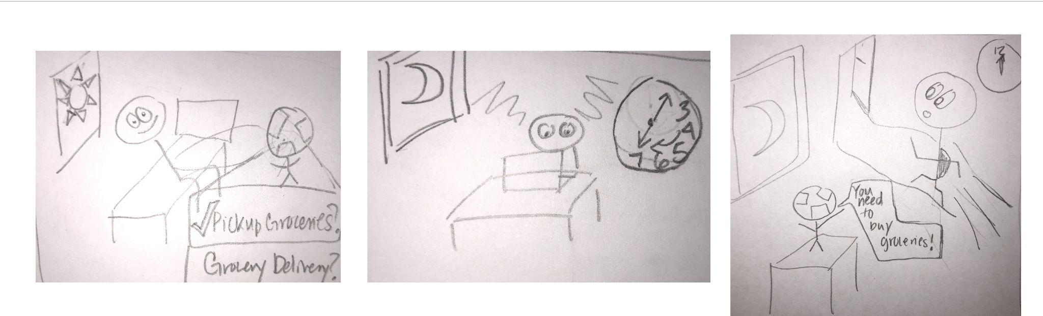
Task 1: Establish healthy and consistent eating habits
Notes:
Wakes up and checks w Cookee to meal plan for the day
options on the index:
Pickup groceries
schedule delivery
2. Gets busy at work and forgets to pickup groceries and misses Cookee’s reminder

Slide 6
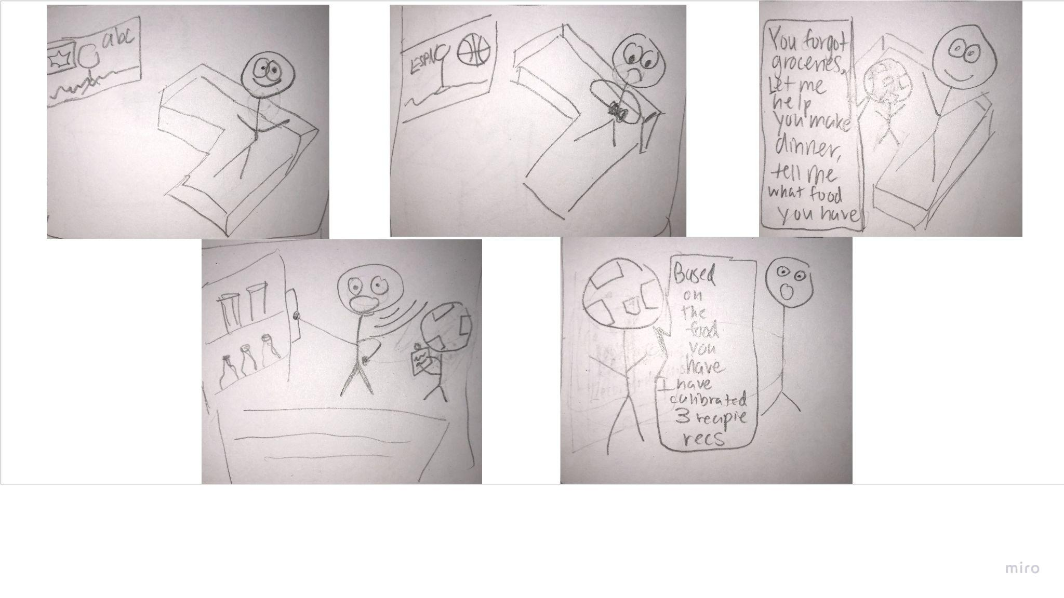
Task 2: Create nutritious meals from available ingredients
Notes:
plops back on their couch, looks at phone, sees missed notification from cookie an hour before
new notification:
tell us what is in your pantry

Slide 7
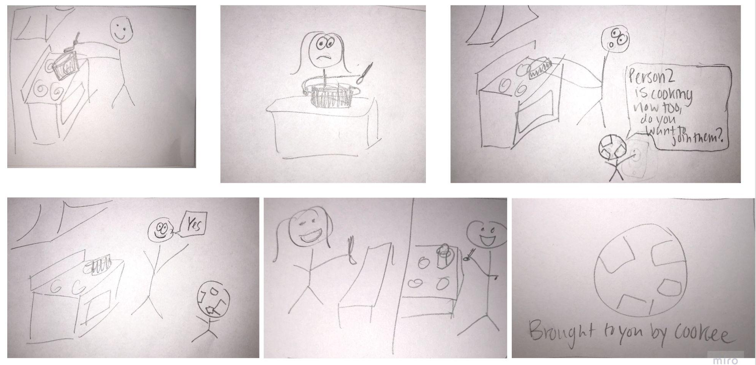
Task 3: Bring community into the kitchen
Notes:
Cooker notifies person1 “person2 is making a meal rn do you want to join?”
person 2 cooking sad
person 2 joins person 1 and they cook virtually together
**brought to u by cookee**

Slide 8

End presentation

