Slide 1
Med-Fi Prototype
Kelly C., Zander L., Sam S., & Ben T.
CS147 Winter 2022

Slide 2
MISSION STATEMENT
enhances team collaboration and communication by building empathy and trust.
VALUE PROP
Building stronger teams through collaborative journaling

Slide 3
Problem
In hybrid collaboration settings, it is harder for both facilitators and team members to monitor and regulate team dynamics.
Solution Overview
leverages the power of journaling and reflection after collaboration sessions to help facilitators and teams open up more honest lines of communication, build trust, and empathize with each other.

Slide 4
Embedded Values
Empathy
Being aware of, understanding, and sharing team members’ emotional states
Journaling and team reflection fosters empathy between teammates
Transparency & Openness
Supporting an individual’s ability to truthfully share feelings and opinions in a trusting environment
Feedback between teams and facilitators enables transparent communication of needs and emotions

Slide 5
Embedded Values in Design Features 1
No Anonymous Entries
To establish the most trusting and open team dynamic, Journy will not allow team members to submit journals anonymously. This will increase transparent lines of communication.
No Direct-to-Facilitator Entries
To establish an equitable team and diminish power dynamics, team members’ entries will be viewable by the whole team and the facilitator.
Values of empathy & openness may conflict because we want to support productive collaboration while remaining cognizant of individual needs in team settings. Although some team members may want anonymous journaling, we are not allowing for that in order to create the best collaboration experience for the entire team.

Slide 6
Embedded Values in Design Features 2
Organic, Natural Aesthetic
Recreating the feel of a physical journal establishes a mood for openness and reflection.
Similarly, the color palette is warm and inviting.
Aggregate Statistics & Tracking
Team members and facilitators have access to aggregate statistics (productivity, communication, synergy) that paint a more detailed picture of collaboration dynamics and serve as a reflective conversation starter.

Slide 7
Embedded Values in Design Features 3
Prompts & Templates
Time is a crucial resource, especially for busy educators and managers. Journy shows empathy towards facilitators by enabling them to choose from templates and prompts; this makes their monitoring process speedier and more efficient.
Multiple Modalities
Team members and facilitators are able to express themselves through text, speech, and images. These accessibility features making journaling possible for more people, but also display empathy for catering to people’s preferred modes of communication.

Slide 8
Tasks
Overview of Task Flows &
Changes from Lo-Fi

Slide 9
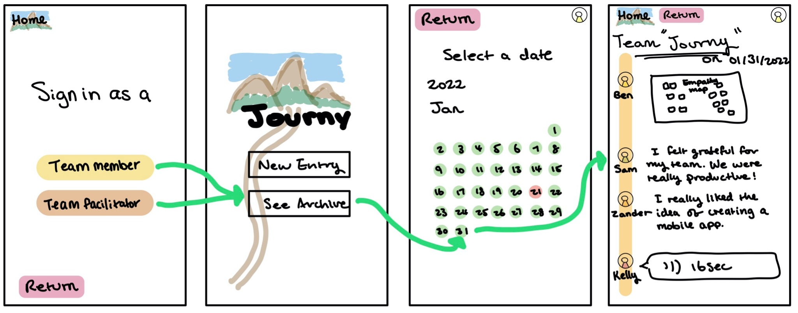
Simple Task
Low-fi Storyboard
The simple task is for users to view a past journal entry.
The changes we’ve made include:
Users select which team journal prior to accessing past entries.
Calendar view navigation
Instructor feedback is attached to the calendar view
Med-fi Storyboard
Notes:
In the med-fi view, the calendar function is improved by clarifying where teams have or do not have entries. In addition, the emojis give a quick summary of how the team felt on a given day.

Slide 10
Moderate Task
Low-fi Storyboard
The moderate task is for users to submit a journal entry and view team’s journy on that day.
Changes we’ve made include:
Users select which team journal prior to creating a new journal.
A collaboration rating has been added as a part of journaling.
Pick which prompt to write about
Med-fi Storyboard
Notes:
The added collaboration rating features 3 data entry points: overall collaboration, productivity, and communication. These anonymous insights are used to aggregate how the team is feeling across a variety of areas on a given day. In addition, the team journal view has been enhanced for a better viewing experience. Users are able to click on each entry to expand it into its full form.

Slide 11
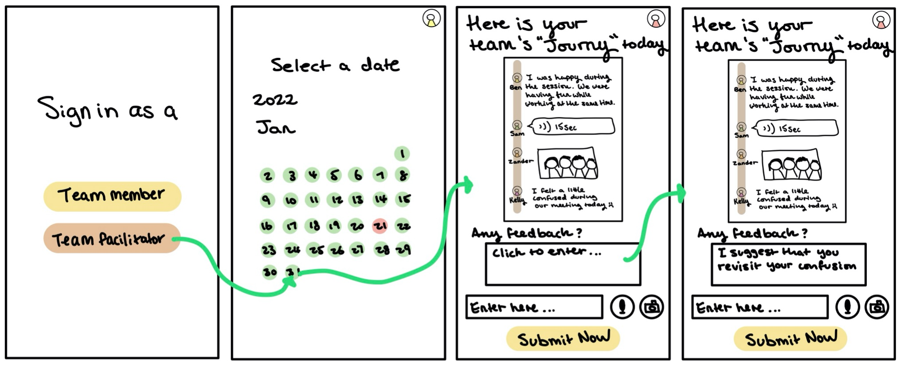
Complex Task
Low-fi Storyboard
The complex task is for users who are signed in as facilitators to send feedback to the team.
The changes we’ve made include:
Users select which team journal prior to accessing past entries.
Users are provided with additional options (pregenerated templates and words of affirmation OR write their own) to guide the feedback giving process.
Med-fi Storyboard
Notes:
Facilitators are given more scaffolding during the feedback-giving process; pre-filled templates and prompts are available for them to choose from.

Slide 12
Usability Goals

Slide 13
Usability Goals Revisited
1. Robust
Users understand how to accomplish the tasks with minimal error and confusion
2. Flexible
Users understand how to make different choices that the prototype offers

Slide 14
Measurements
Key Measures
Are users aware of all the available features?
How often are users unsure of how to progress?
Other Measures
Does the concept make sense?
Would users utilize Journy to support collaboration?

Slide 15
Med-Fi Progress towards Usability Goals
Overall Progress
The med-fi prototype retains the handwritten, organic look that users praised from the low-fi version, but has a cleaner and more readable aesthetic. Expanded task-related functionalities (gathering data, viewing aggregate statistics) create a more fully-realized version that early testers wanted.
Robustness
A streamlined Journal Entry page eliminates the confusion that low-fi testers had during this task flow. In addition, the confusing Archive calendar section has been redesigned to enable more easily accessible and readable previous journal entries.
Flexibility
More obvious icons and labels for journal prompts and entry modalities (text, speech, image) enable users to take advantage of all the app’s capabilities. In addition, we have provided more ways for facilitators to provide feedback to their teams.
Notes:
In user testing of the first prototype, these goals were largely met. The med-fi prototype seeks to streamline some of the robustness issues regarding journal entry creation as well as increased options (flexibility) for how they would like to enter the journal.

Slide 16
Revised Interface Design
3 Major Design Changes & Task Flows

Slide 17
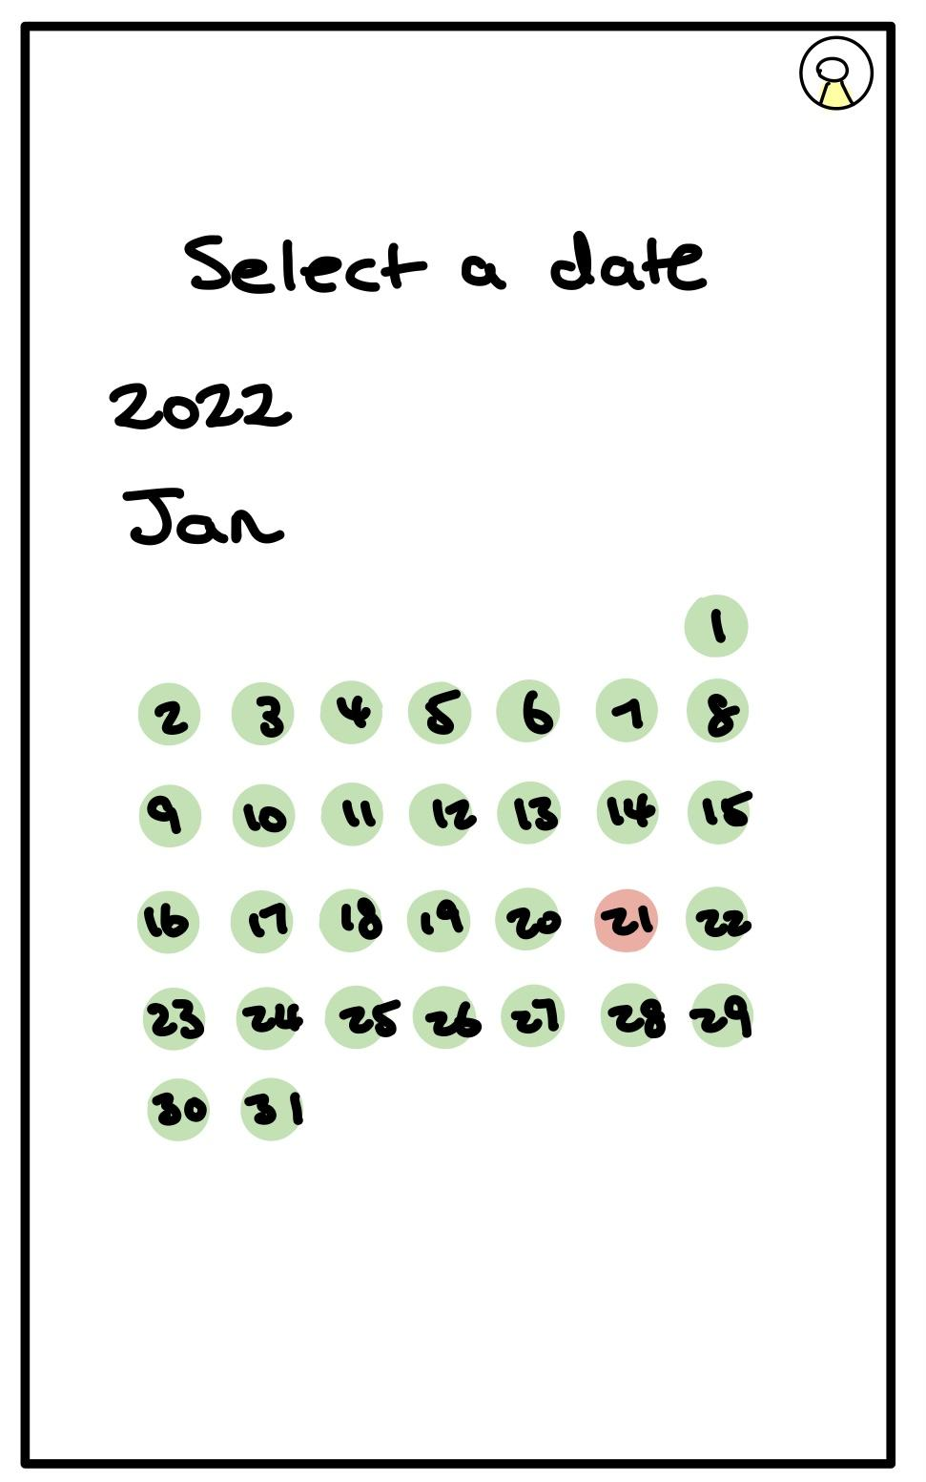
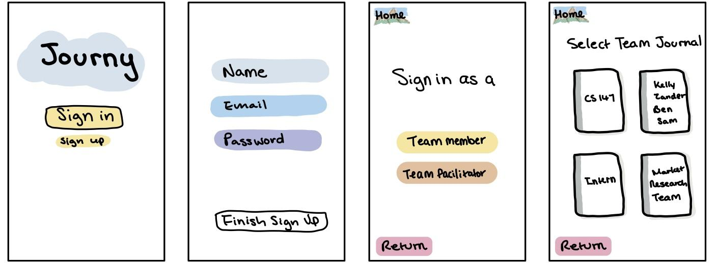
Design Change 1 - Sign in Setup (Multiple Teams)
Before:
After:
In the original version, signing in as a team member or a facilitator resulted in completely different tasks flows: team members were guided to either create a new entry or see archive whereas the facilitator was directed to the archive automatically.
The original version did not include a space for new users of this app.
Design Change Rationale:
We want to enhance the flexibility of our app to meet different users’ needs.
The updated design enables the possibility of a user being both a team member on a team and a facilitator for another. Also, this design enables users to join or facilitate multiple teams and easily navigate through different teams by selecting different team journals.
The updated design includes a sign-up page for new users and allows them to create a new team journal.

Slide 18
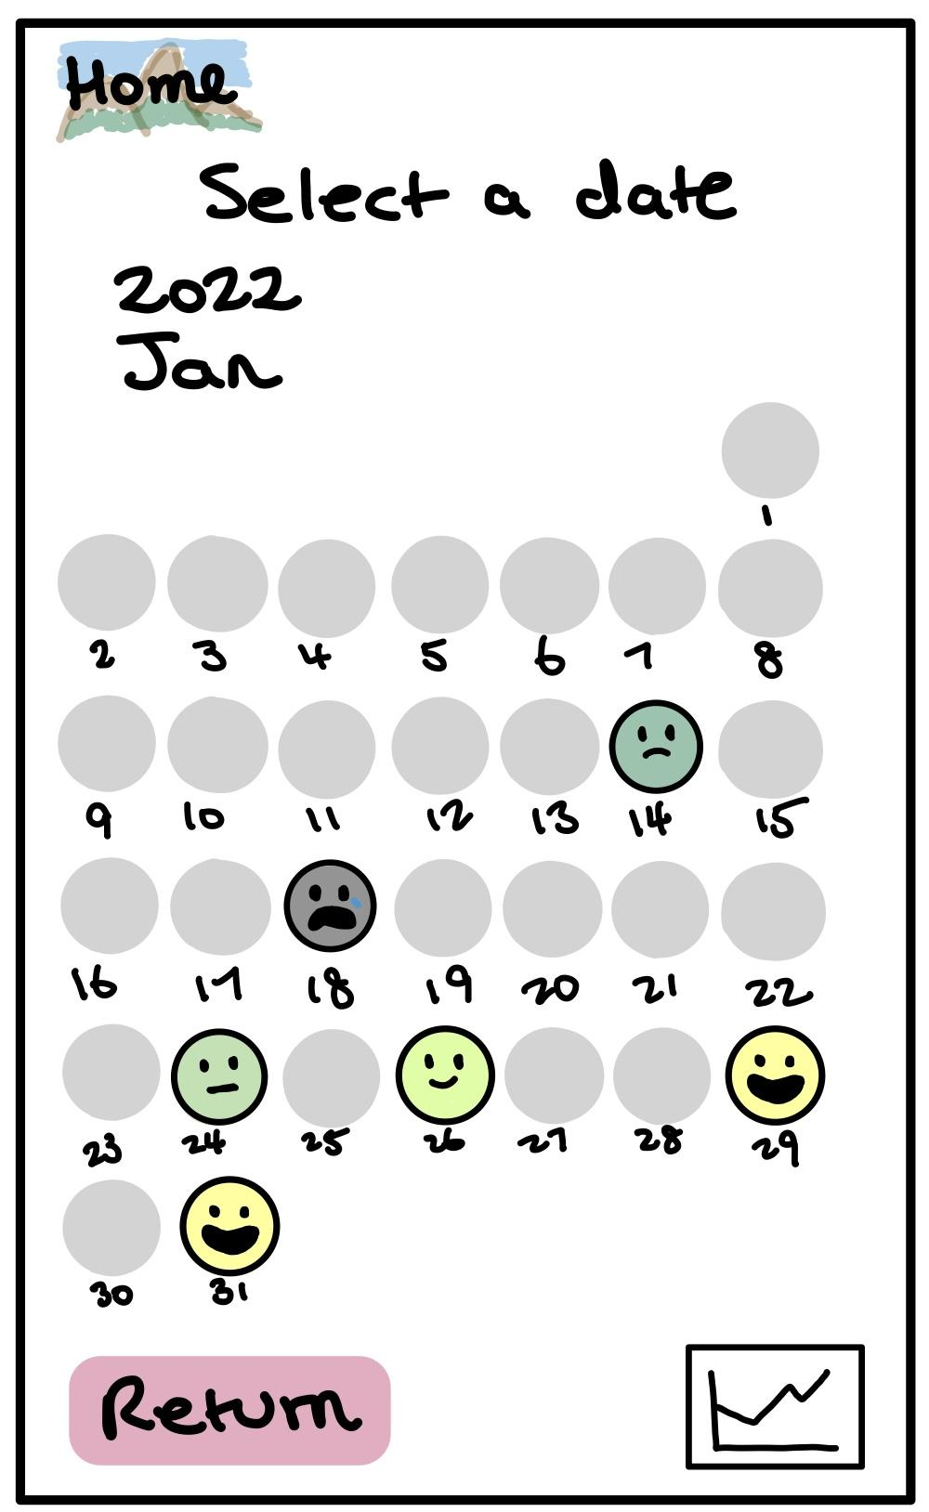
Design Change 2 - Archive and Calendar Navigation
Before:
After:
A gray dot represents a day without a journal entry.
When there is a journal entry on the day, the average of teammates’ collaboration ratings will show. This makes it easier for both team members and facilitators to reflect on positive/negative team collaboration on a specific day.
The red dot in the calendar was confusing to our users: some perceived it as the most recent date whereas others thought it represented a missing journal. The users wished that the calendar was more robust than just an archive.
Design Change Rationale:
We want the calendar view to be more straightforward in communicating team performance to both team members and facilitators. The updated design enables more robust utility and clearer navigation for users.
“Statistics” view function has been added so that users can more easily track performance over time.

Slide 19
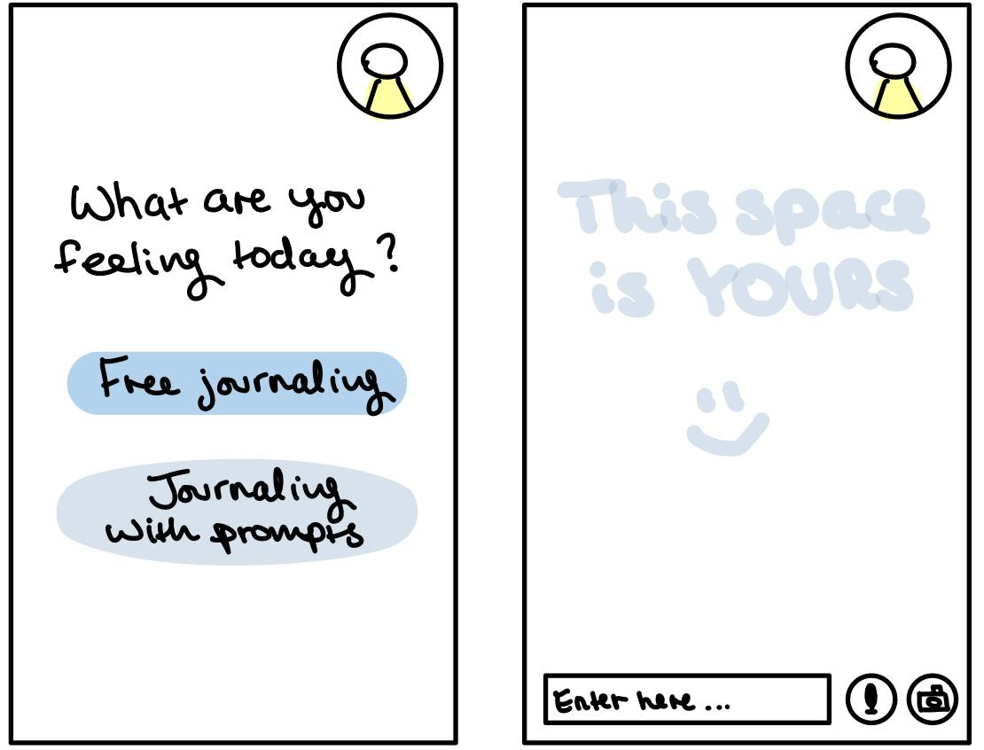
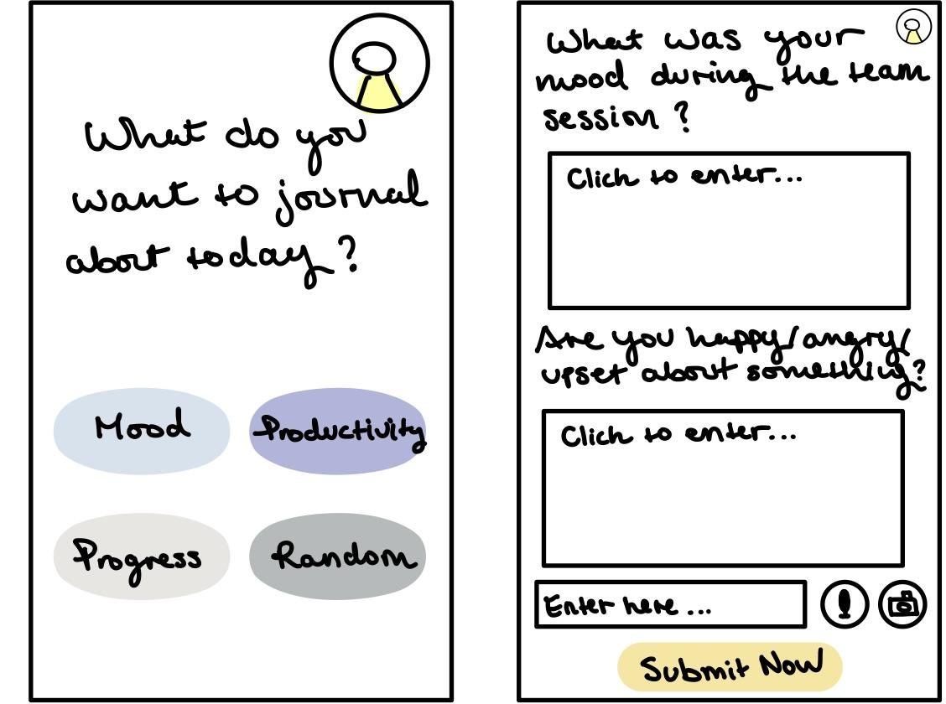
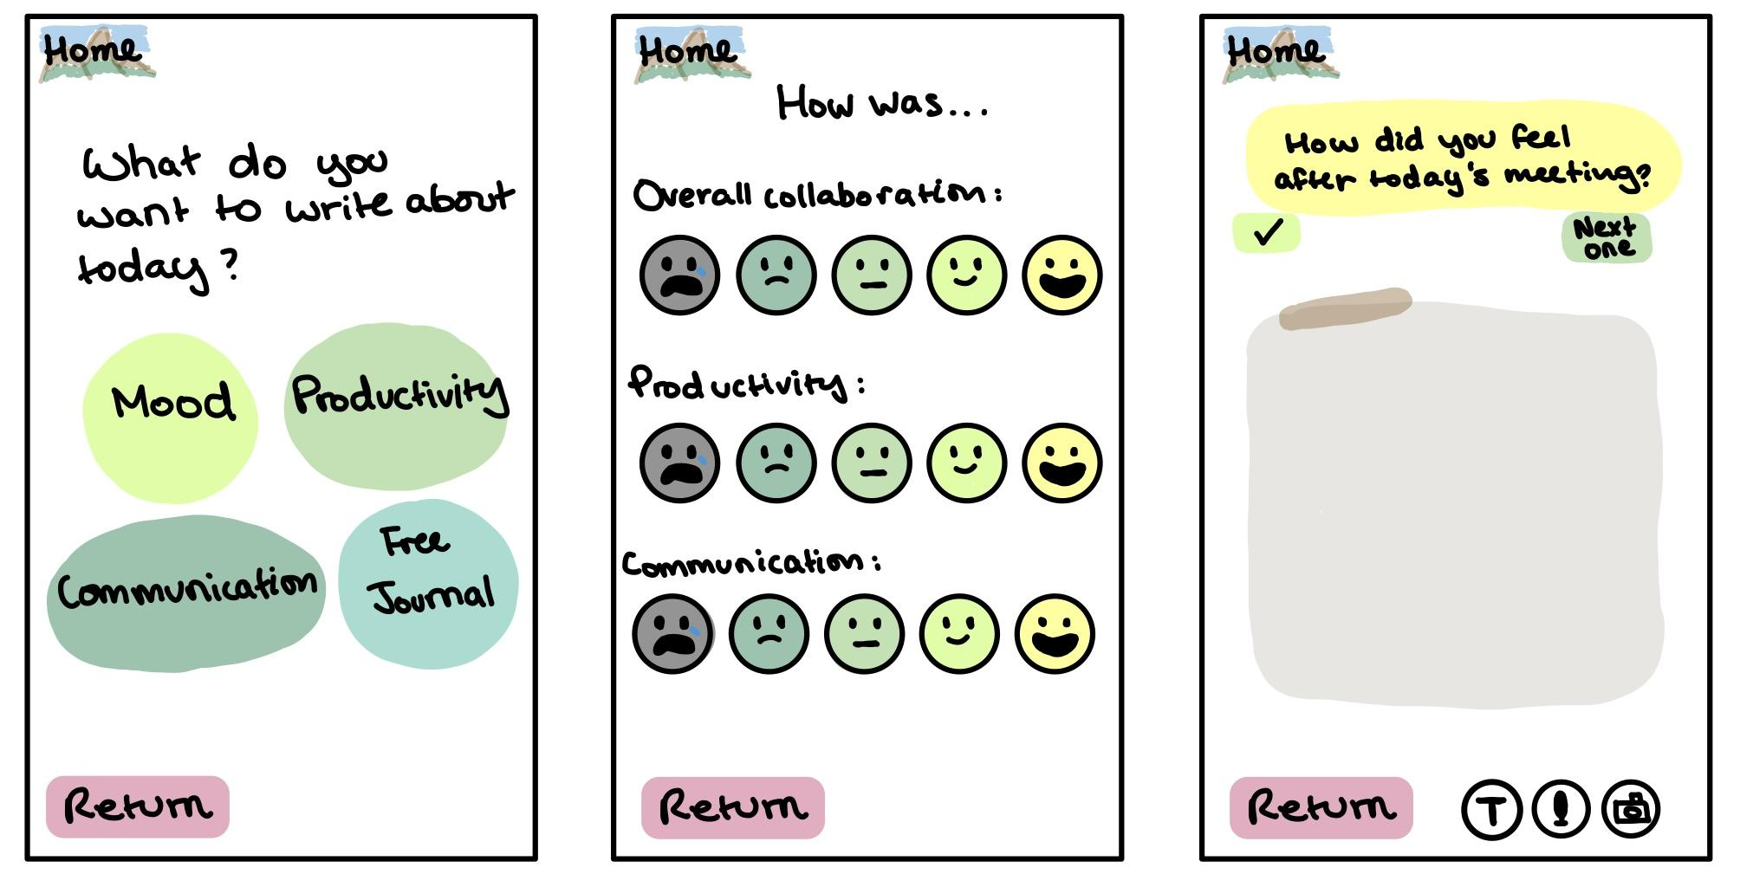
Design Change 3 - Journal Entry
Before:
Having multiple prompts on the same page was confusing and even overwhelming to users. Multiple fields for journal entry also made the navigation unclear.
The original version had two separate sections for free journaling and prompted journaling. This could be misleading as users are not able to view categories of prompts before making a choice.
Design Change Rationale:
We want the journal entry process to be clear and efficient for users. Also, by allowing users to either accept/reject different prompts, we aim to promote a sense of personalization in users’ journaling experiences.
After:
In addition to having only one prompt in each frame, we have also incorporated a prompt selection function to allow users to either accept or reject a randomly generated prompt. Also, instead of having multiple fields for entry, the updated version only has one designated area.
The updated version includes different prompts and free journaling in the same frame. In this way, we are assigning the same weighting to prompted journaling and free journaling. Also, users will be able to choose the type of journal entry in less clicks.
A rating system has been incorporated to ease the reflection process. Also, this enables progress tracking over time.

Slide 20
Design Change 4 - More Robust Facilitator Functions
Before:
In the original version, after the facilitator selected a past entry from the calendar, they will be directed to the feedback giving page directly. The design provided minimum guidance and lacked robust functionality.
The updated version includes pre-generated templates and words of affirmation as well as the option to draft their own message.
Design Change Rationale:
Since providing feedback to the team as a facilitator is the complex task in our design, we want to support the user with more robust functionality and provide more guidance in their use.
The pre-generated templates cover a variety of topics for the facilitator to select from.
After:
The facilitator is able to provide their feedback based on the template in either text-based or audio format.

Slide 21
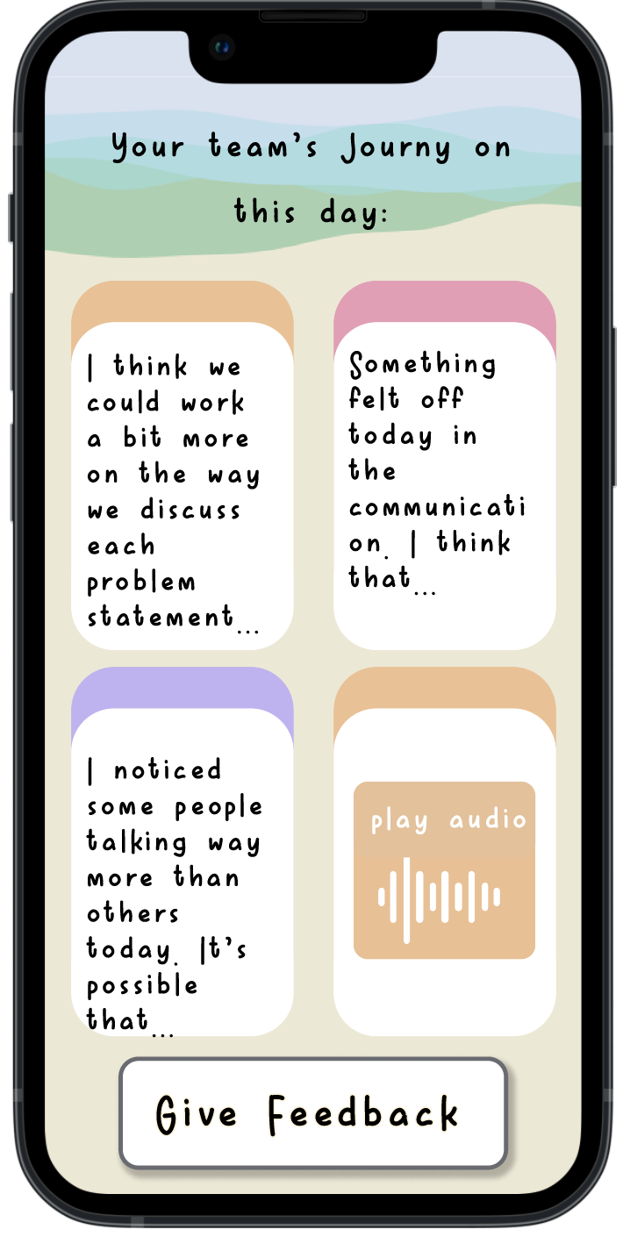
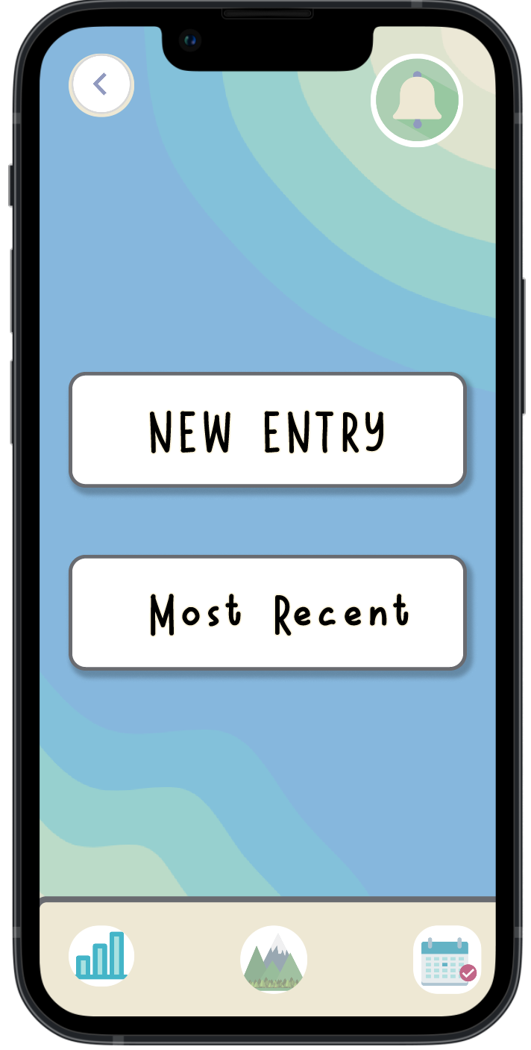
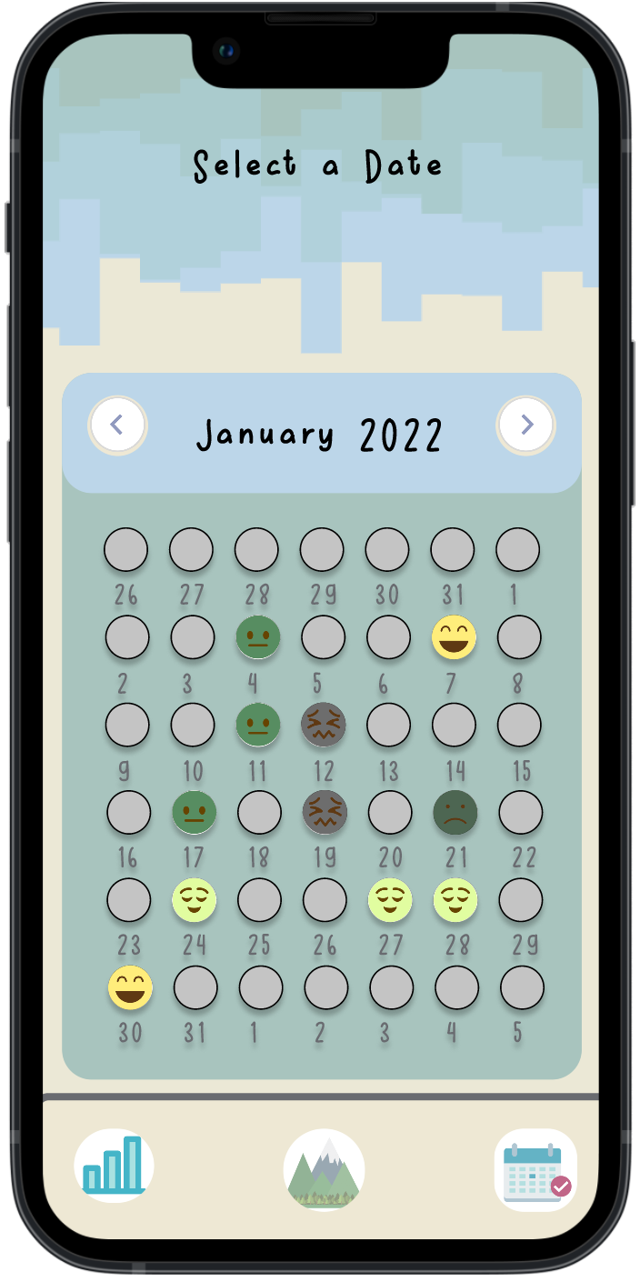
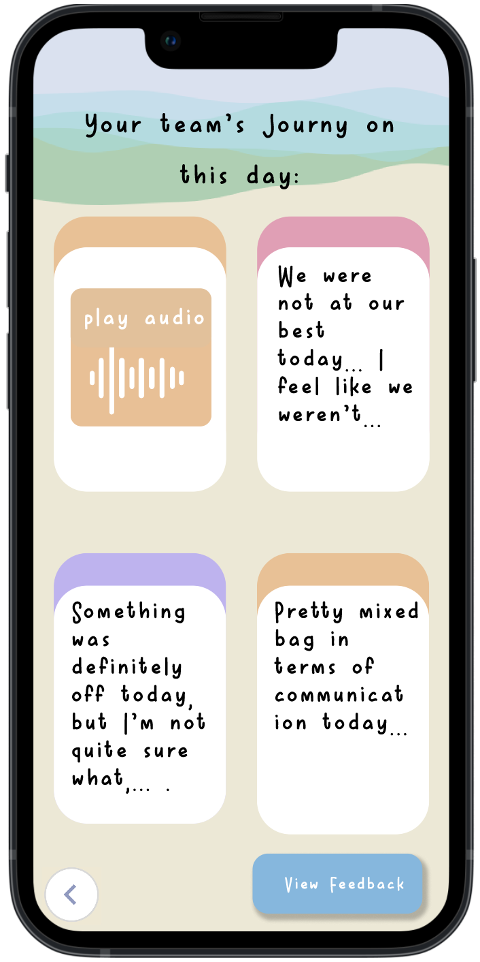
Med-Fi Simple Task Flow: Team Members Access Past Entries
Users see the most recent entry
Users can either:
- view the most recent past entry (click most recent)
- view past entries of earlier dates (click calendar view)
Click on a specific day on the calendar
Users see the entry on selected date
Notes:
Usability is improved due the emoji feature on the calendar that gives a quick glimpse into team dynamics.

Slide 22
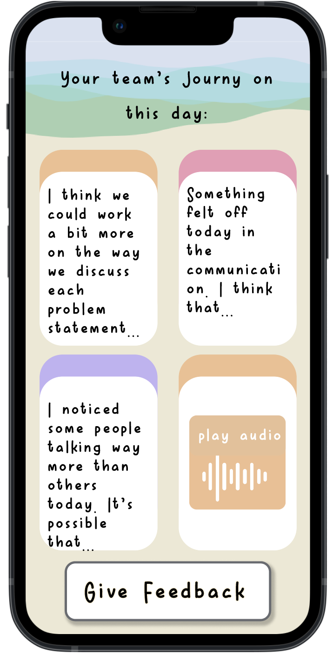
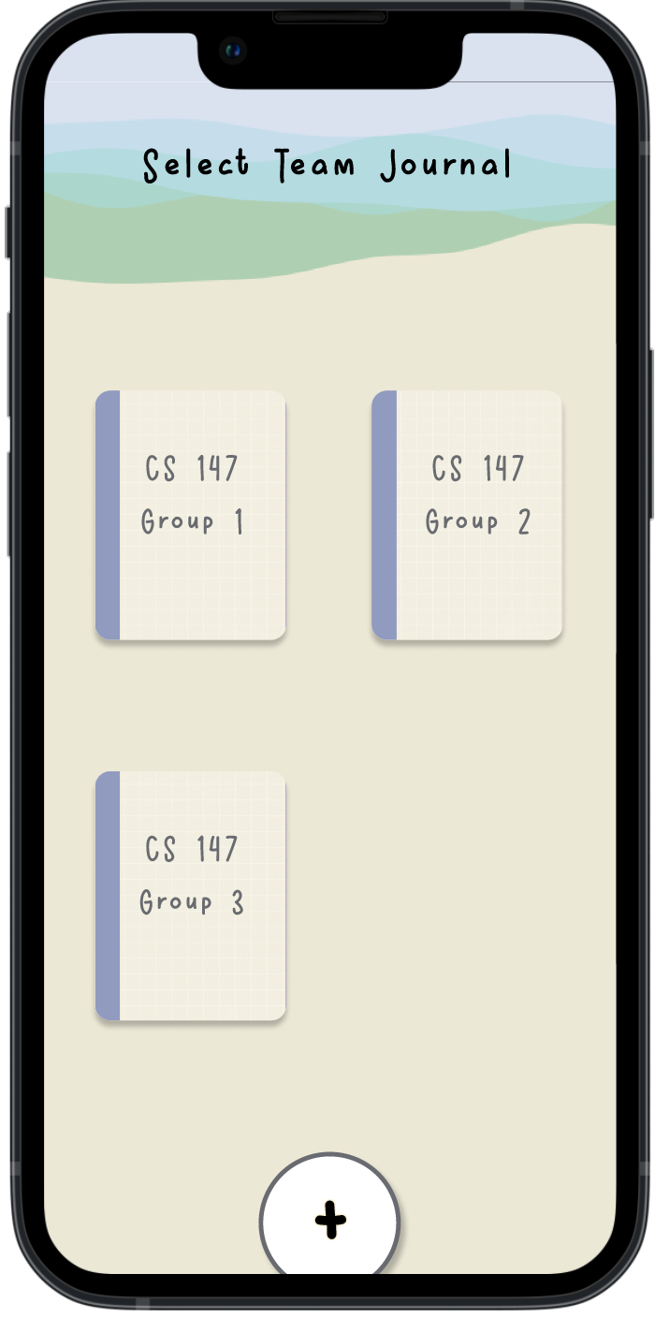
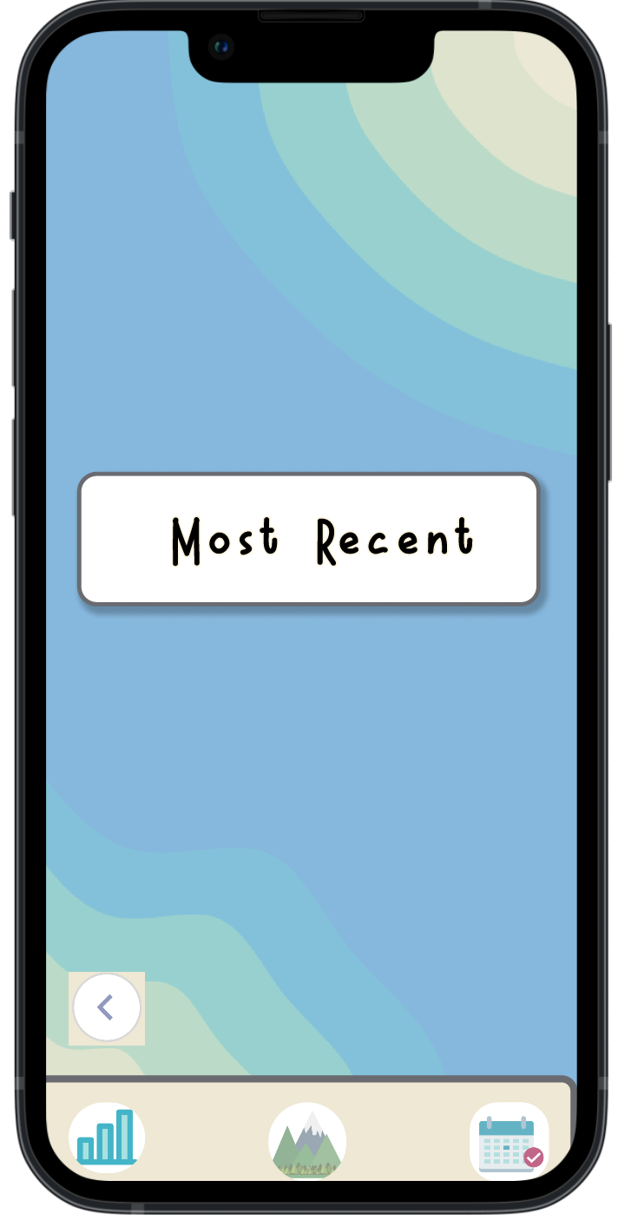
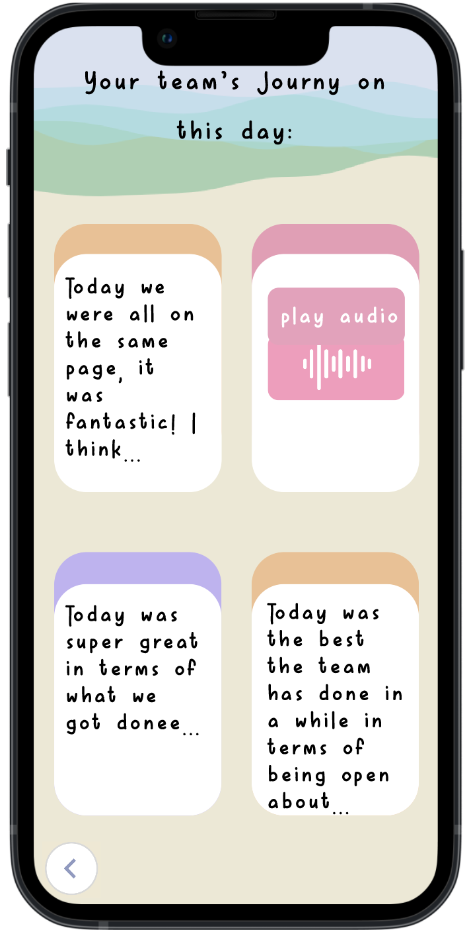
Med-Fi Simple Task Flow: Facilitators Access Past Entries
Users see the most recent entry
Select a team journal
Users can either:
- view the most recent past entry (click most recent)
- view past entries of earlier dates (click calendar view)
Click on a specific day on the calendar
Users see the entry on selected date
Notes:
Usability is improved due the emoji feature on the calendar that gives a quick glimpse into team dynamics

Slide 23
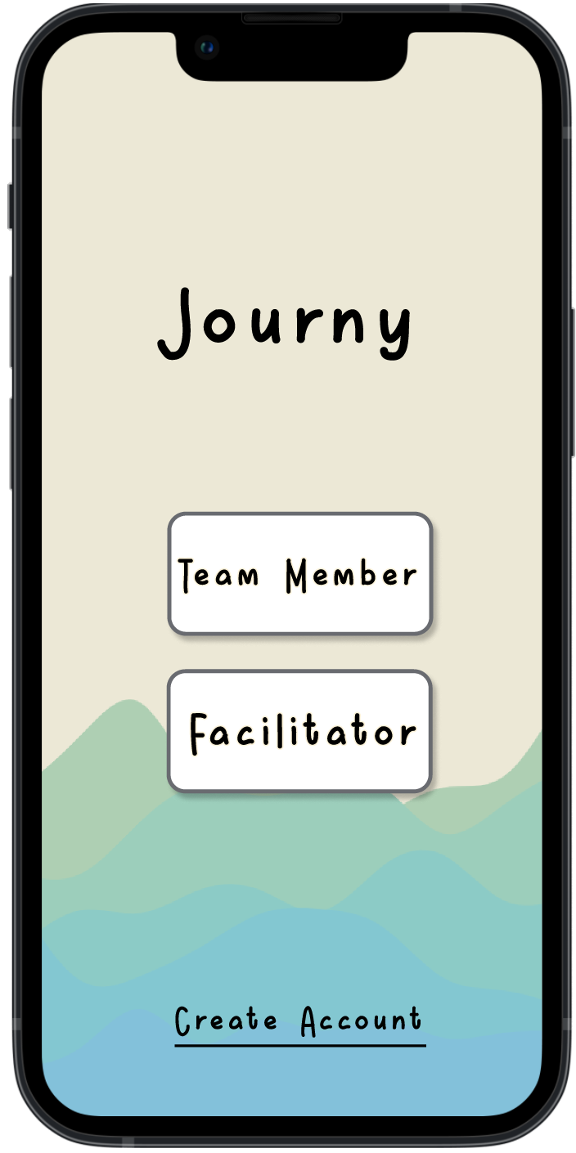
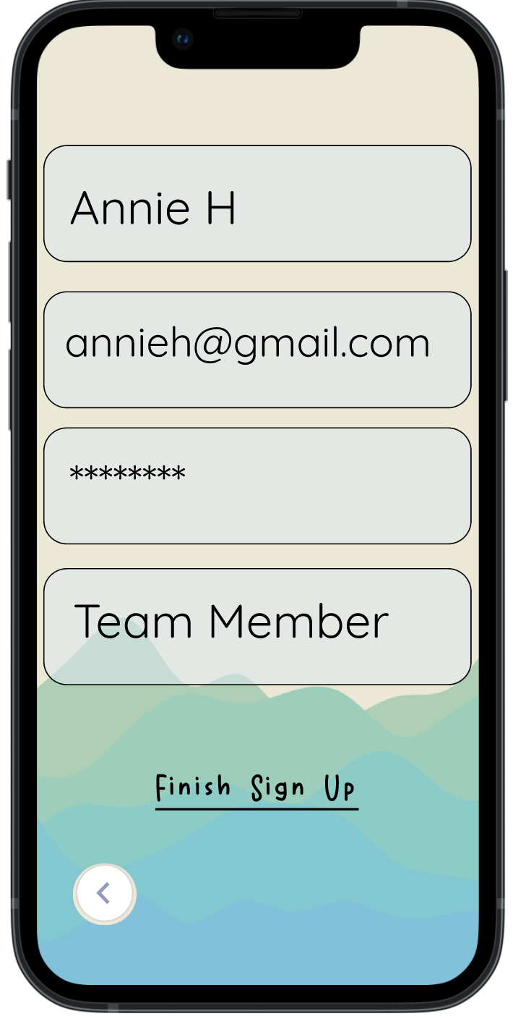
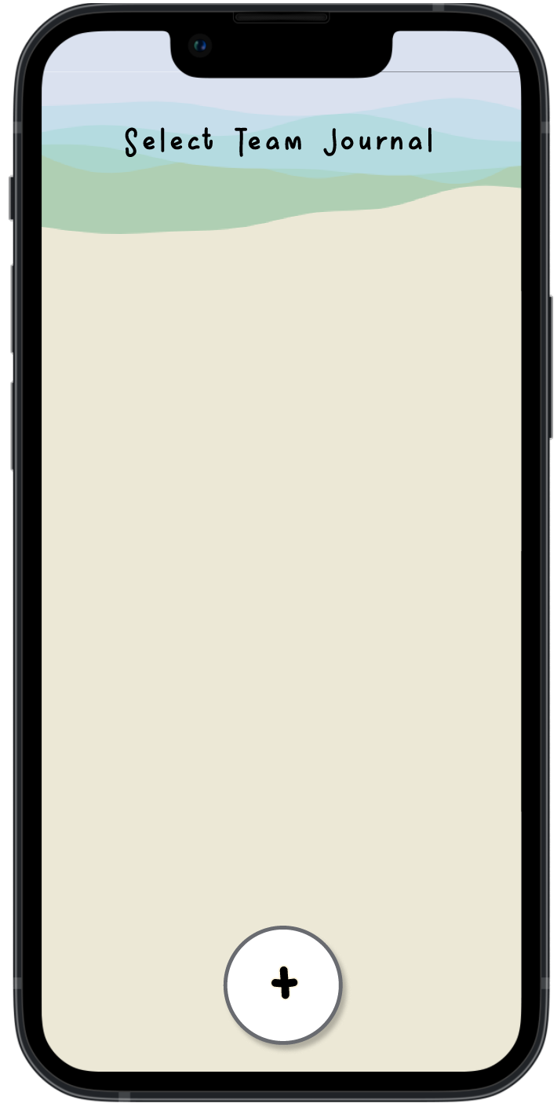
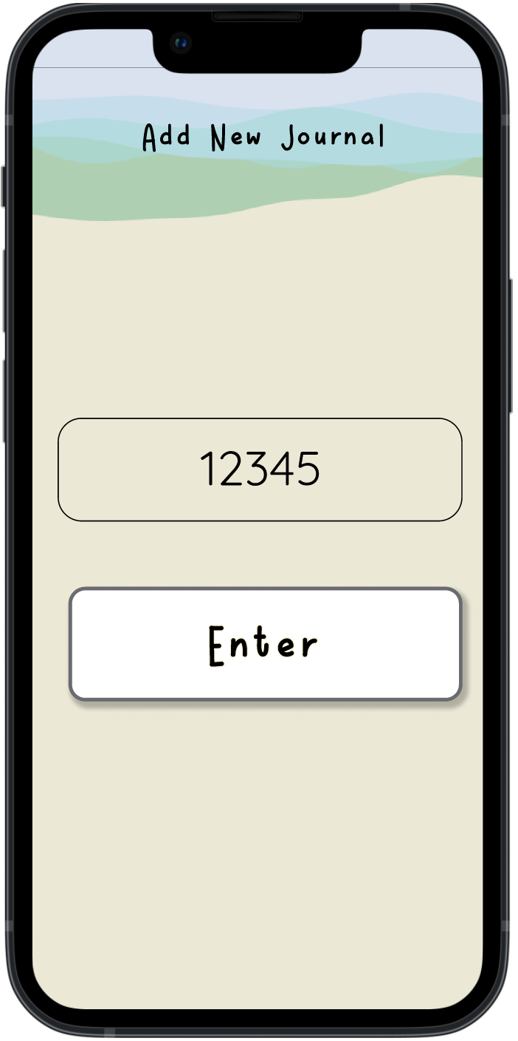
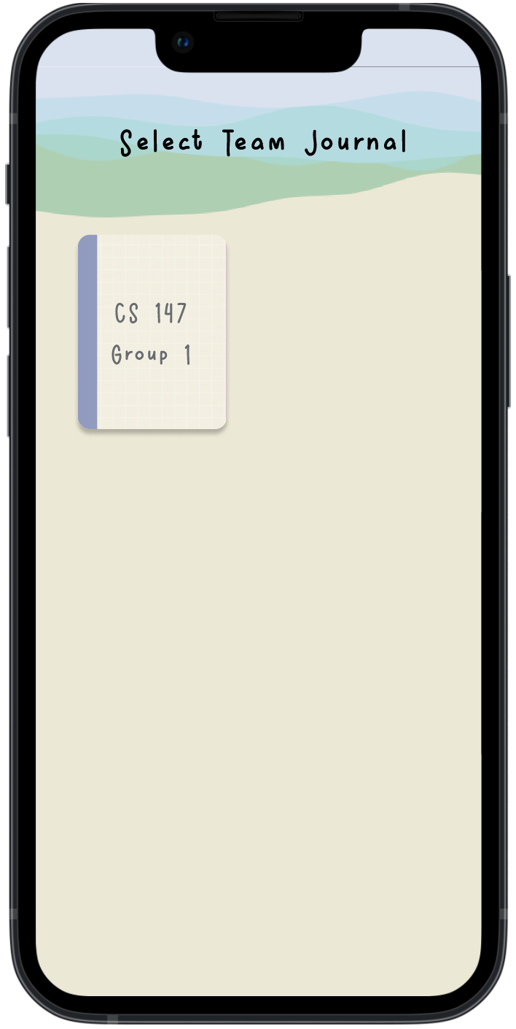
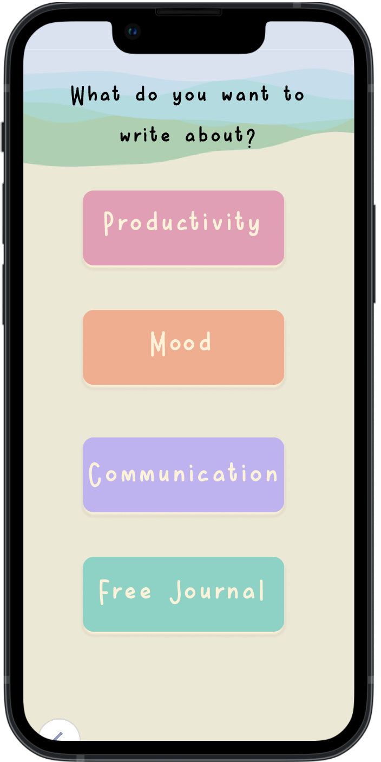
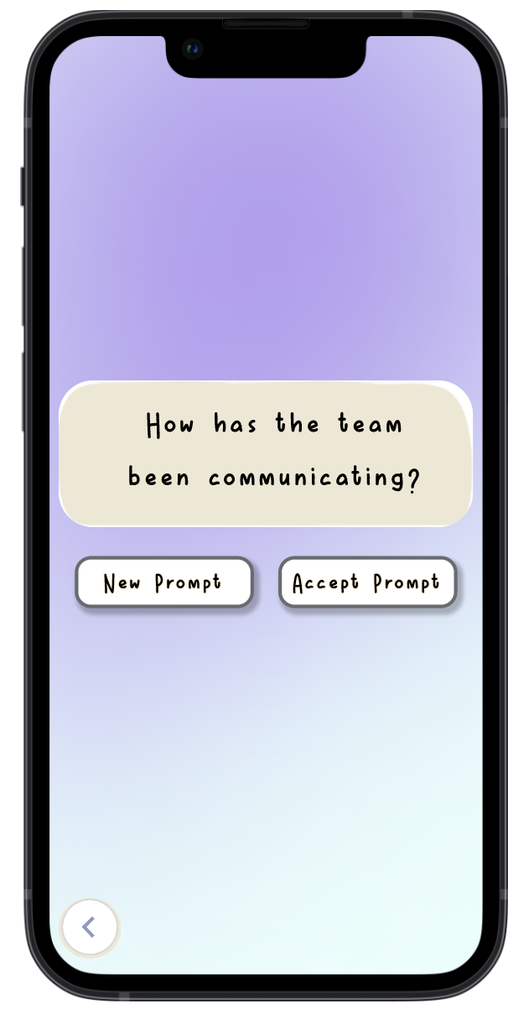
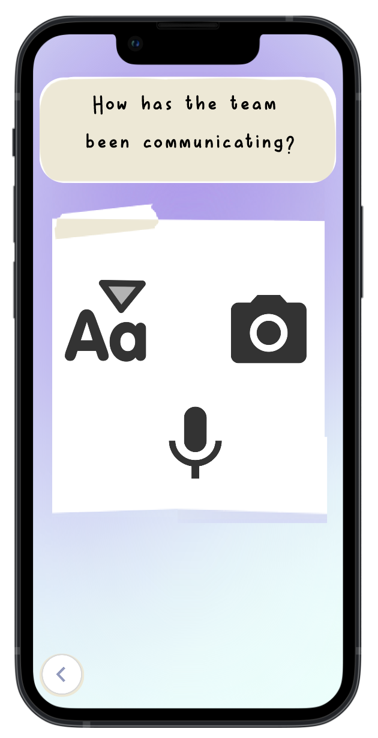
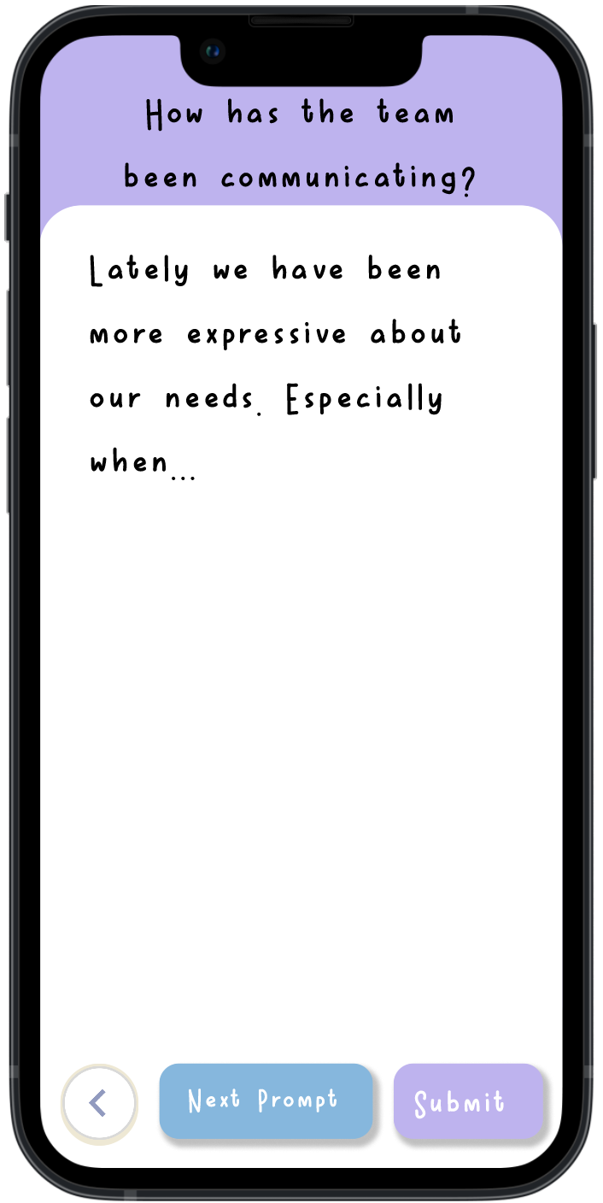
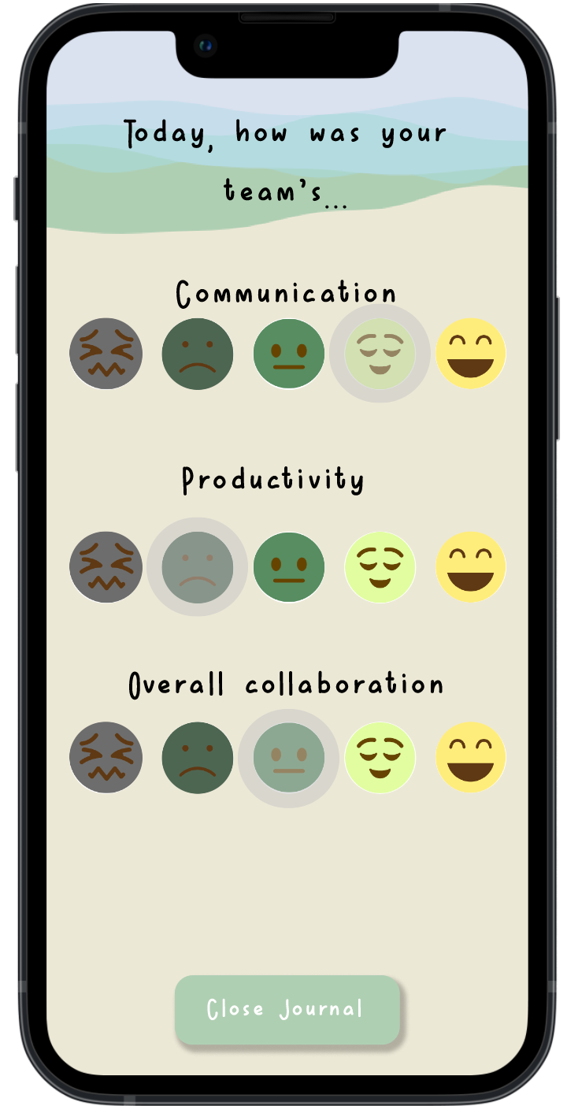
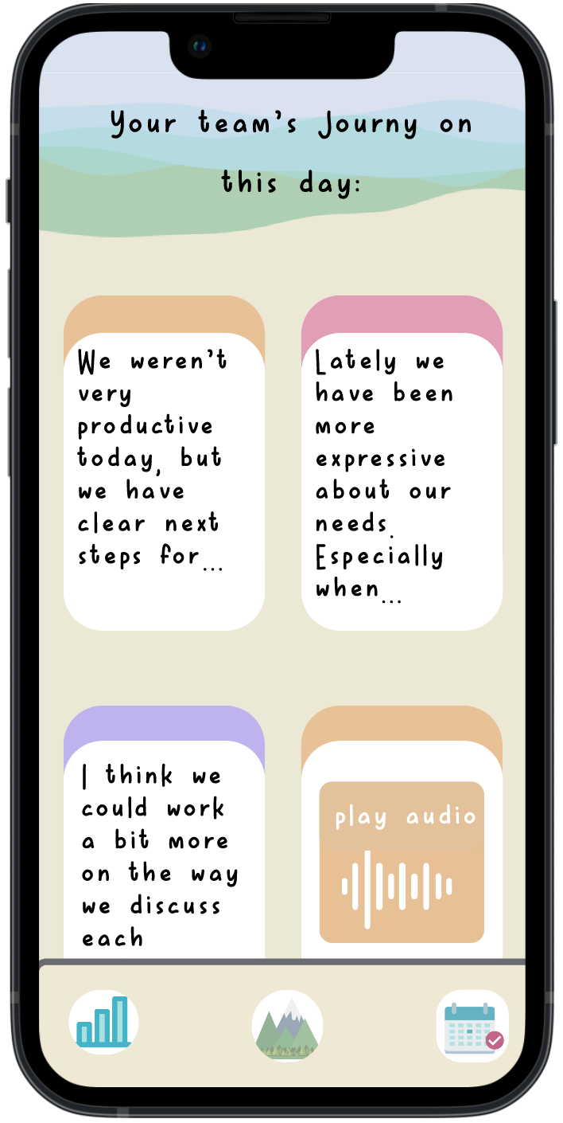
Med-Fi Moderate Task Flow: Journal Entry
Create Account
Sign up as a team member
Create a journal for the team
Enter the journal code
Select the created journal
Select new entry
Choose a specific prompt category
Accept a generated prompt or pick a new one
Choose mode
of entry
Submit after done journaling
Rate the collaboration session
Journal entry finished - view group journy
Notes:
The med-fi prototype now includes the ability to create an account and add a new team journal from a code generated by the facilitator. Team members are able to choose from a variety of prompts in each category before choosing their mode of entry. After team members have written their journal, they are now prompted to provide data on three metrics (communication, productivity, and overall collaboration) that are aggregated for the team statistics page. The last page of the flow enables users to see the team’s journal for the day and click on an entry to expand it into its full form.

Slide 24
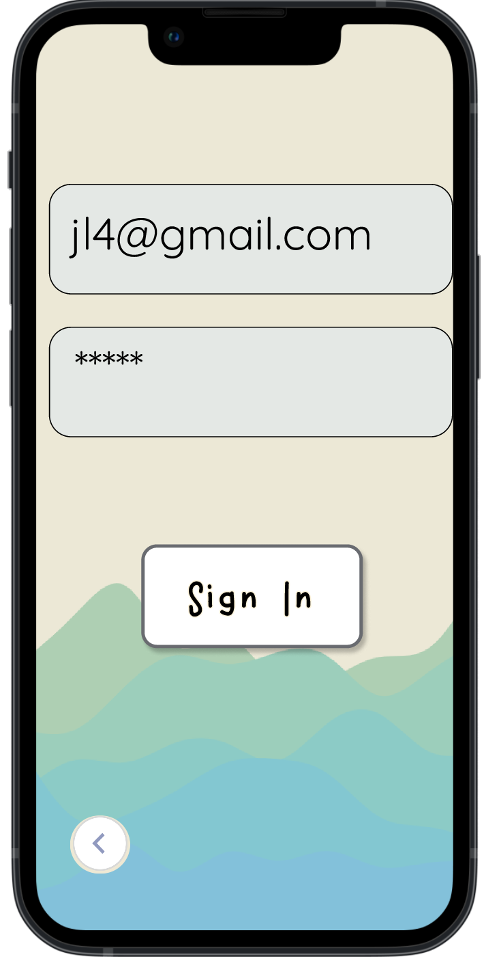
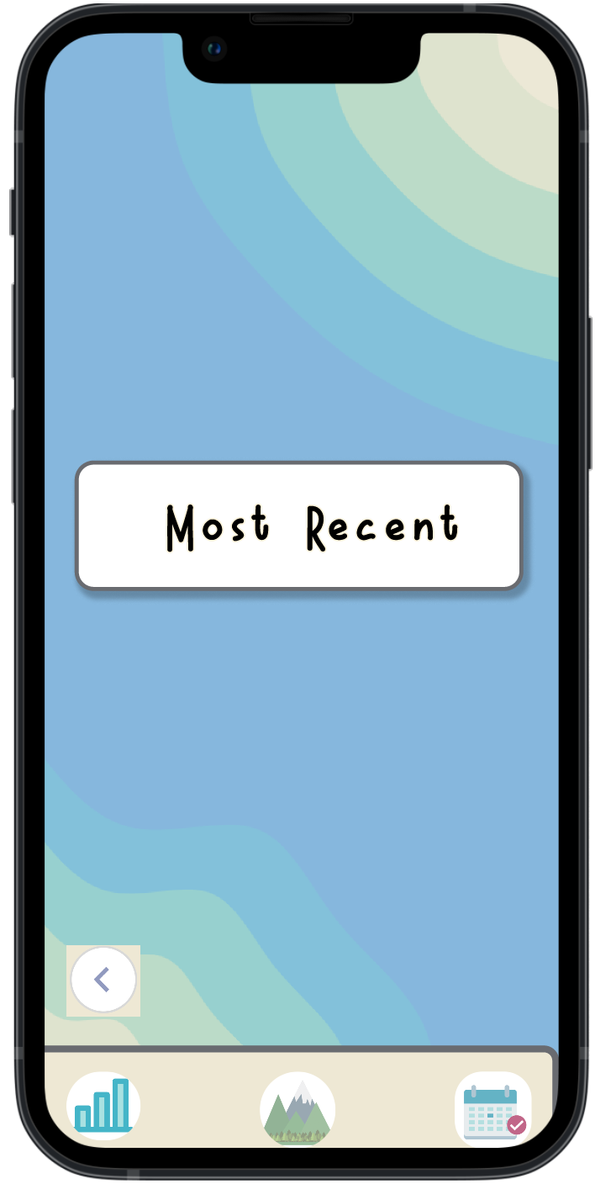
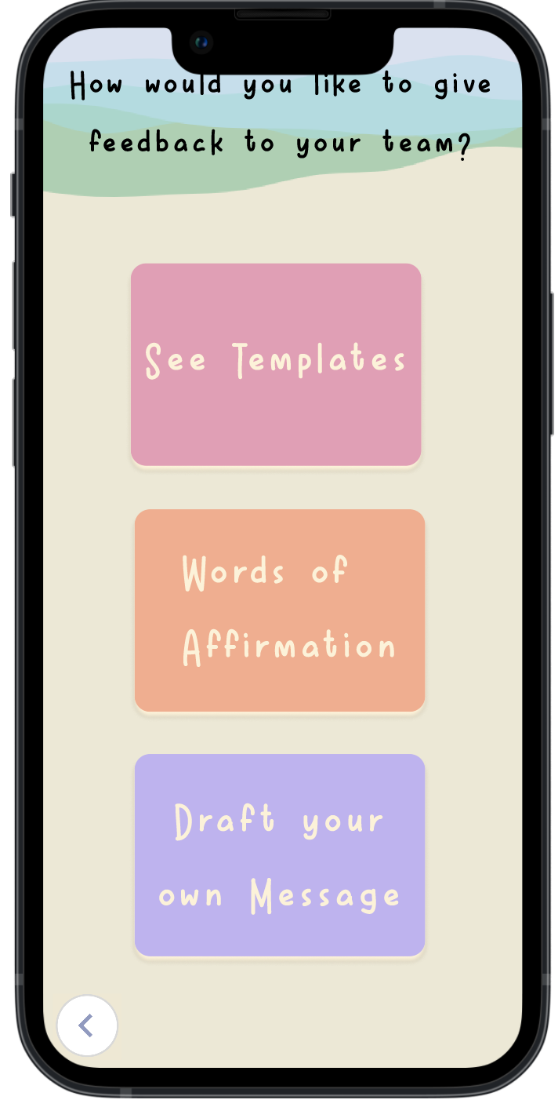
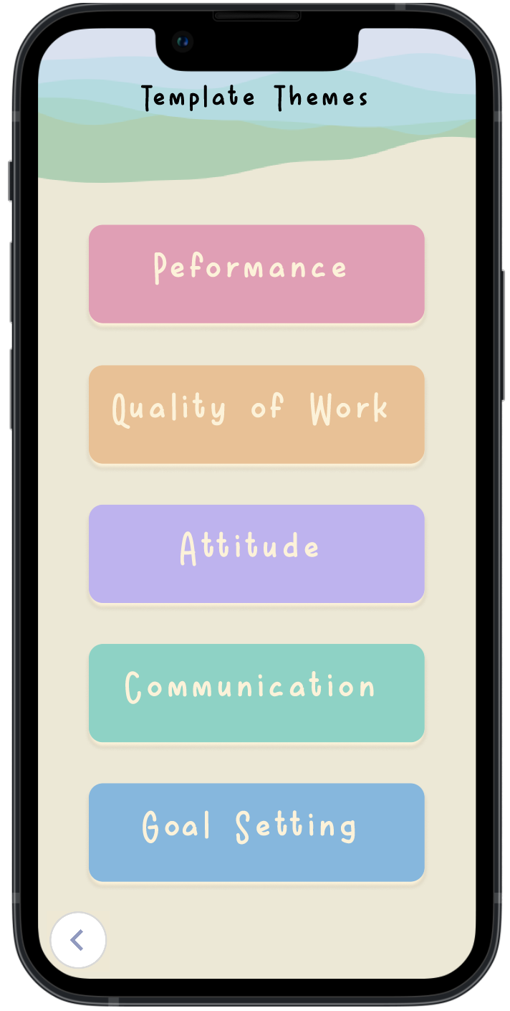
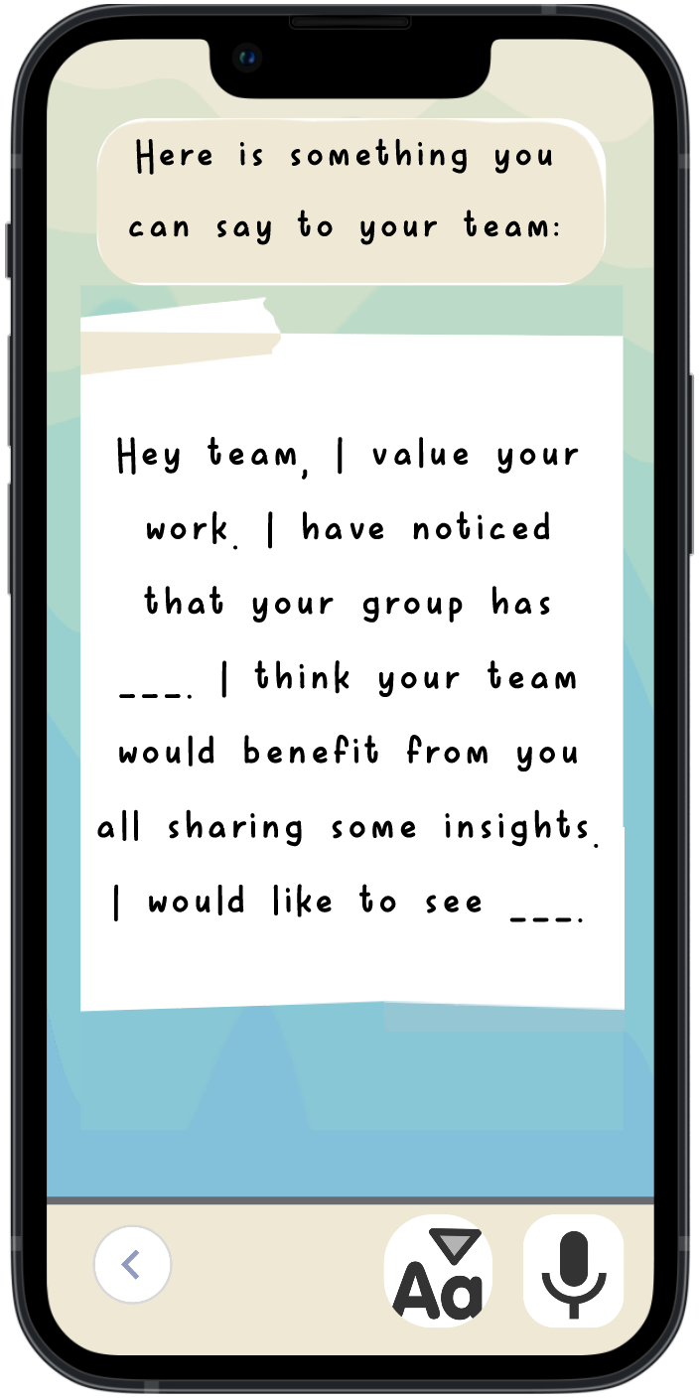
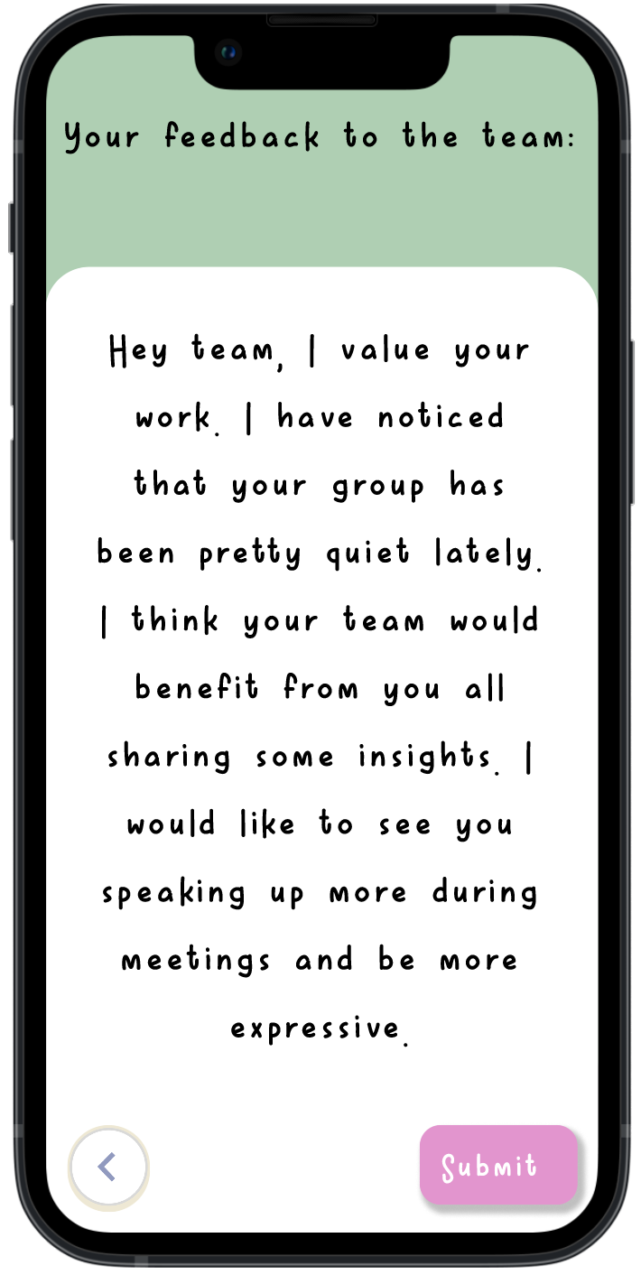
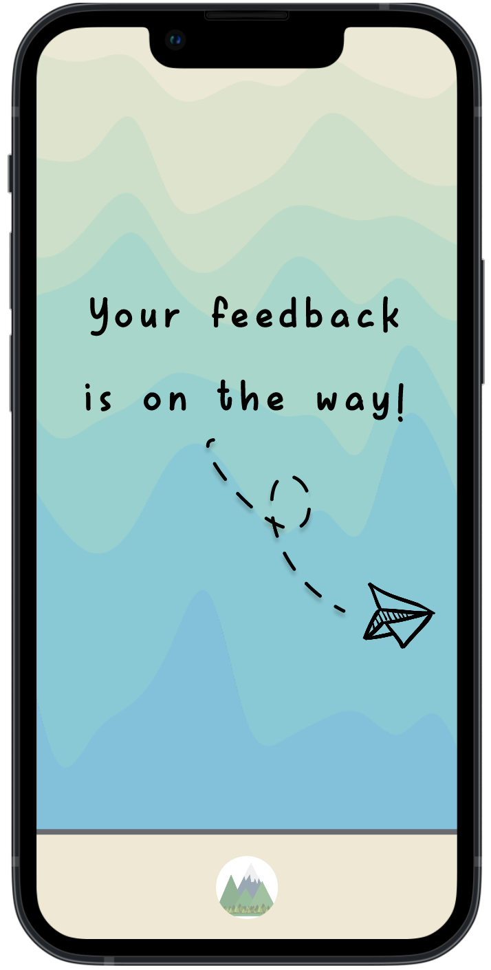
Med-Fi Complex Task Flow: Facilitator Feedback
Sign in as Facilitator
Enter account info and sign in
Choose a team
View most recent entry
Team’s most recent journy
Select templates
View communication template
Choose text entry
Submit text entry
Feedback sent
Notes:
In this flow, facilitators sign in, choose one of the their team’s journals, and give feedback on the latest entry. The med-fi prototype expands options for feedback, with templates for a variety of categories, words of affirmation, or the ability to freewrite the feedback. The last slide also makes it more clear that the feedback has been successfully submitted.

Slide 25
Med-Fi Prototype Overview

Slide 26
Med-Fi Overview
Click-Through Figma
The easy: Figma helps us document our design system and keep an easily interable record of previous flows and designs.
The hard: As Figma does not easily allow for users to enter in their own text/audio data as they would in the real Journy app, we hard-coded some of these flows to give users a sense of what opportunities are possible. We hard-coded more possible options into the med-fi prototype to offer greater flexibility.
Limitations/Tradeoffs
The med-fi prototype does not give users total free exploration of Journy’s offerings. For example, the current prototype allows users to select from a few of the available prompts (e.g. Productivity, Collaboration, Free Journal) but not all. In addition, whereas the hi-fi application will include a more robust slide of possible journal prompts for each category that users can swipe through, the med-fi prototype has just one prompt per category. These were left out for simplicity’s sake during user exploration of the prototype.
Wizard of Oz techniques requiring human interaction were not employed in the click-through.

Slide 27
All Hard-Coded Features
Create Account/Sign In: users will be able to simulate creating a new account and signing in, but will not be able to input their own name, email, and password. Fake details will be loaded automatically.
Create Journal/Generate Journal Code: users will be able to simulate creating a new journal and generating a journal code, but will not be able to input the journal code or name. A fake journal code and name will be loaded automatically.
Journal entries: users will be able to select the modality of their entry (text, speech, image) but will not be able to create their own entry. Sample entries for each modality will be loaded automatically. The same is true for the ratings page where users are asked to rate the team’s collaboration dynamics using facial expressions.
Voice modality: all voice options are represented by a audio wave button; the button is not clickable to hear any audio.
Feedback: users will be able to select from a variety of templates and prompts for submitting feedback to teams, but will not be able to write in the feedback on their own.
Statistics page: the team statistics page will display sample statistics from a fake team.
Calendar: users are only able to view from a selection of days on the calendar that contain sample entries.
Notes:
Given this is a self-paced click-through Figma prototype, there is no need to implement Wizard of Oz features that require another human to control the system. That being said, due to user entry limitations on Figma, there are several hard-coded items in the prototype that users should be aware of. These features were hard-coded so that users could simulate the journal creation/entry and feedback-giving flows without having to input any original content themselves.

Slide 28
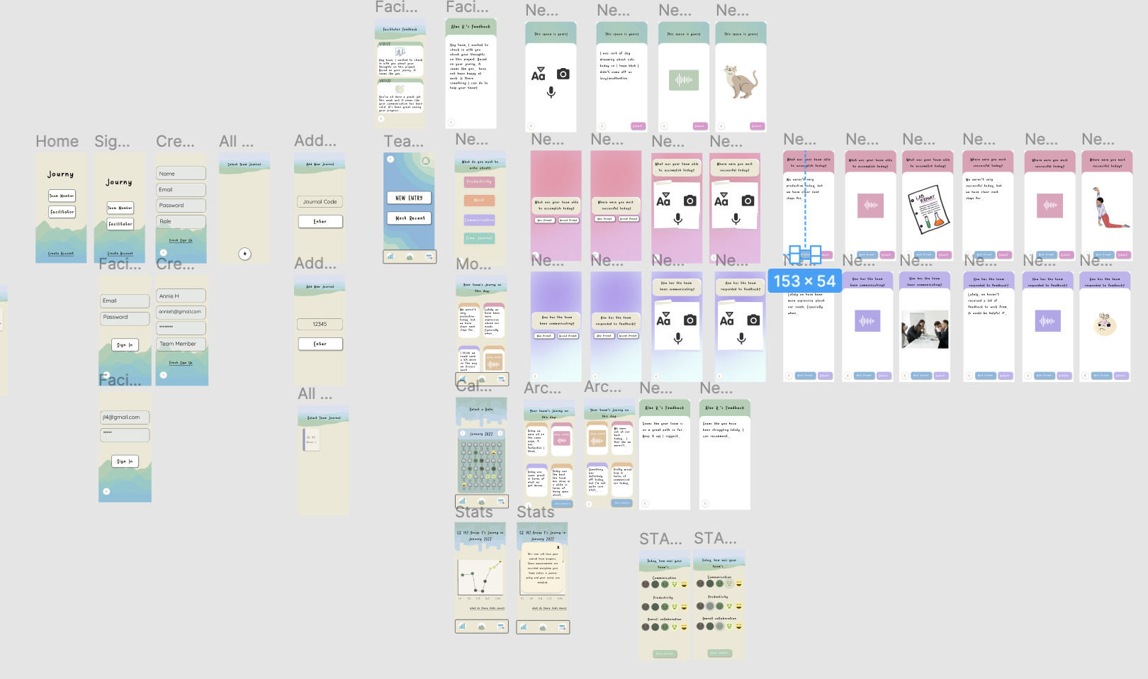
Overview of the Med-Fi Prototype Design (Team Member Flows)

Slide 29
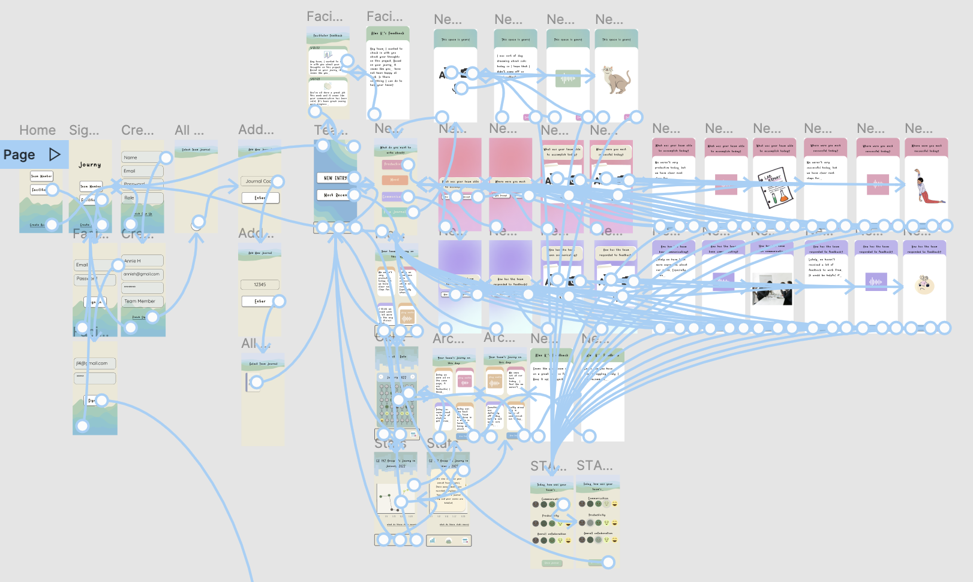
Overview of the Med-Fi Prototype Interactions (Team Member Flows)

Slide 30
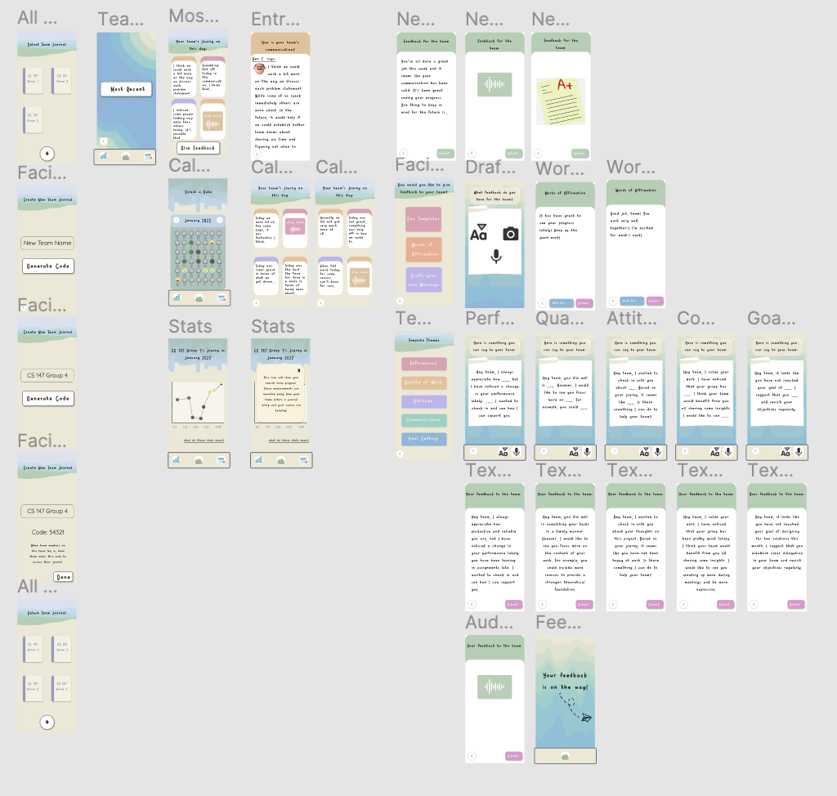
Overview of the Med-Fi Prototype Design (Facilitator Flows)

Slide 31
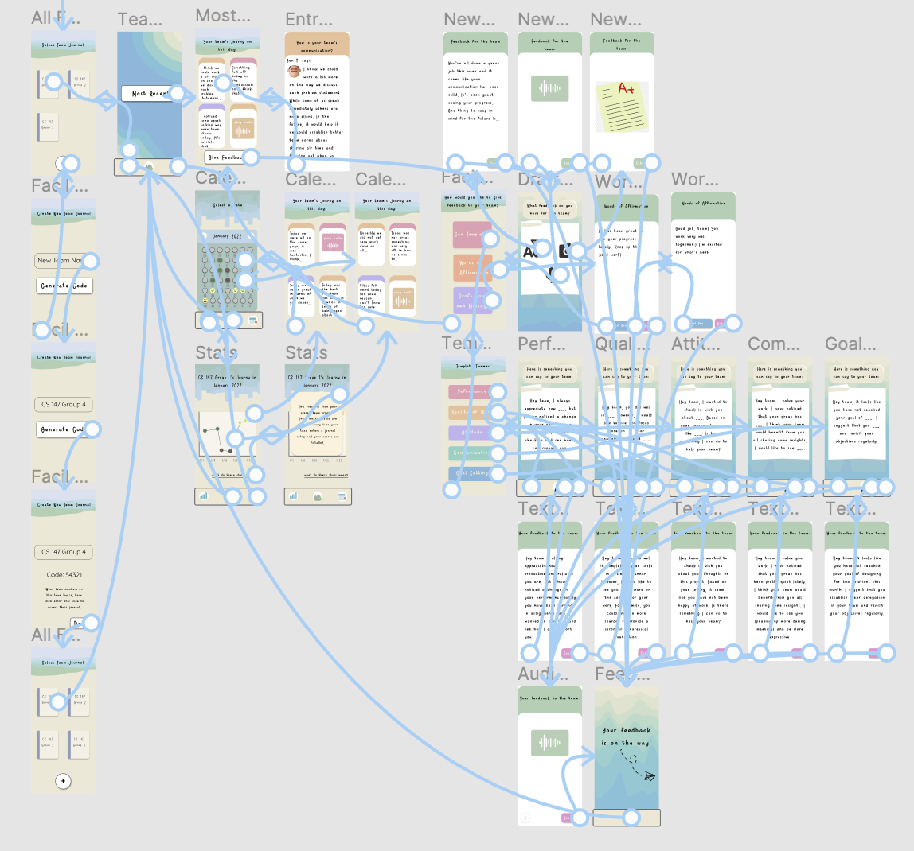
Overview of the Med-Fi Prototype Interactions (Facilitator Flows)

