Slide 1
Lo-Fi Prototype and
Usability Testing
Kelly C., Zander L., Sam S., & Ben T.
CS147 Winter 2022

Slide 2
Overview
1
Design Ideas and Sketches
2
Lo-fi Prototype
3
Usability Testing

Slide 3
MISSION STATEMENT
Enhance within-team collaboration and facilitator-team communication in both academic and professional settings.
VALUE PROPS
Building stronger teams through collaborative journaling

Slide 4
Design Ideas and Sketches
1

Slide 5
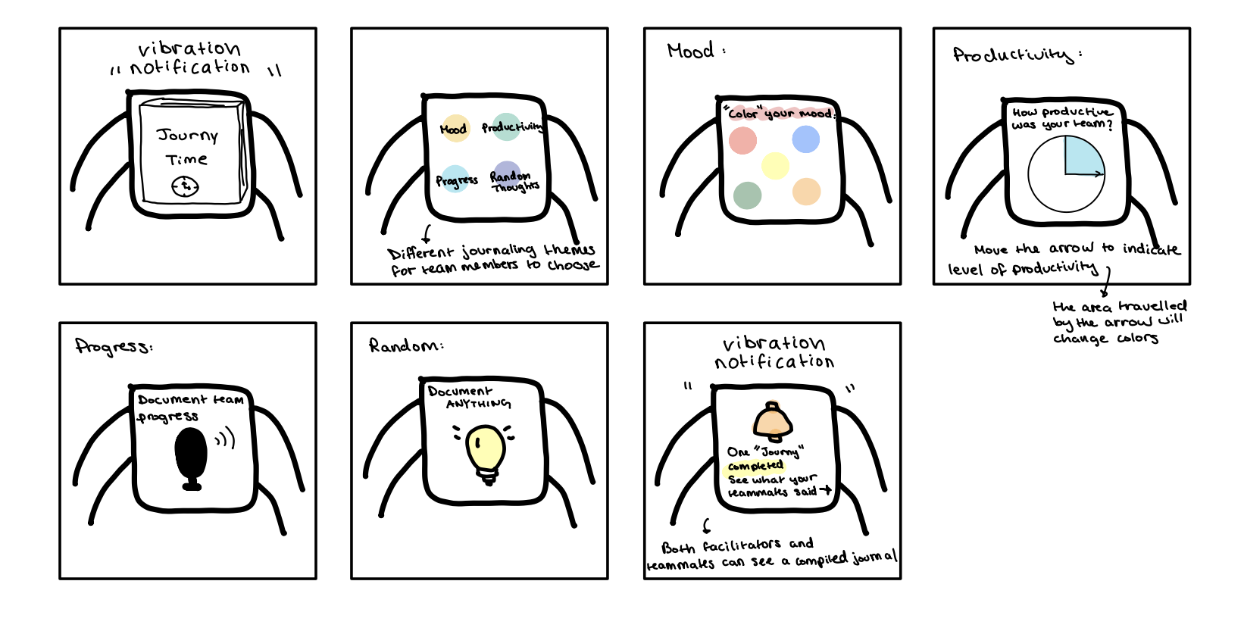
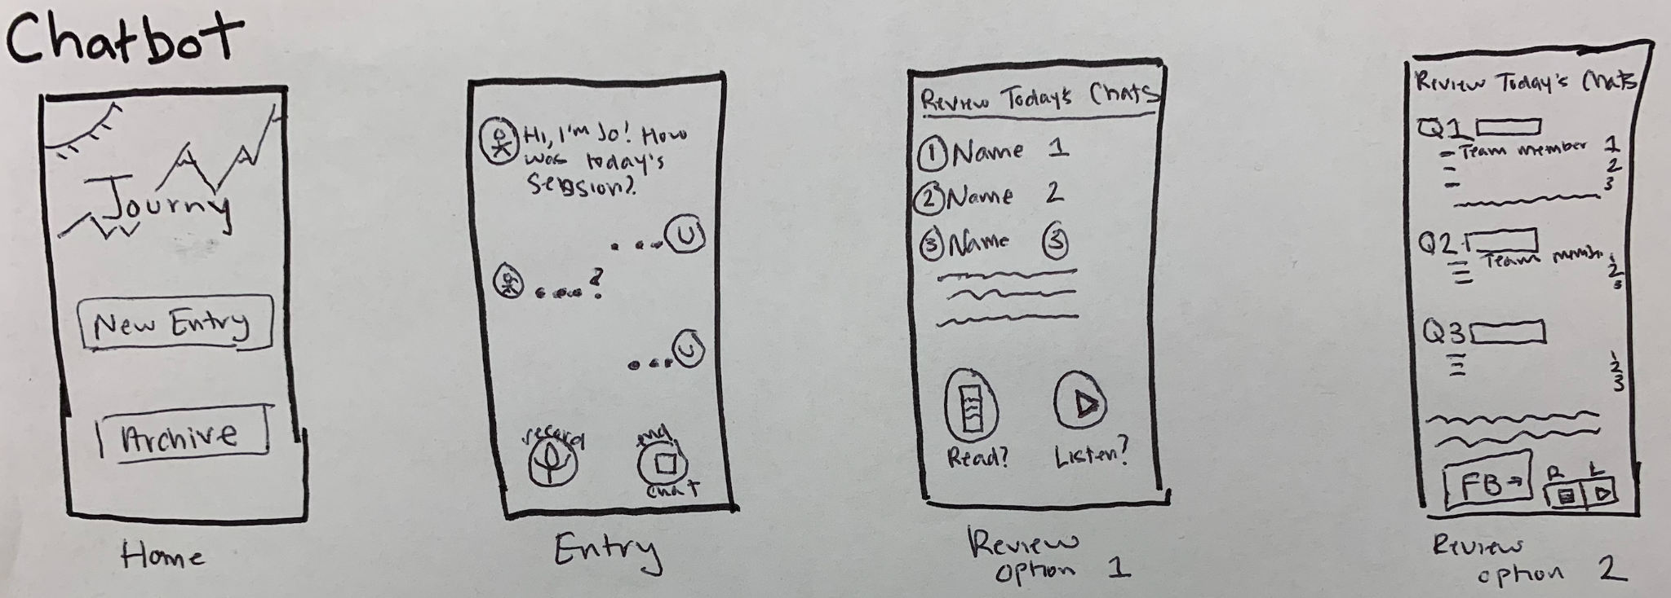
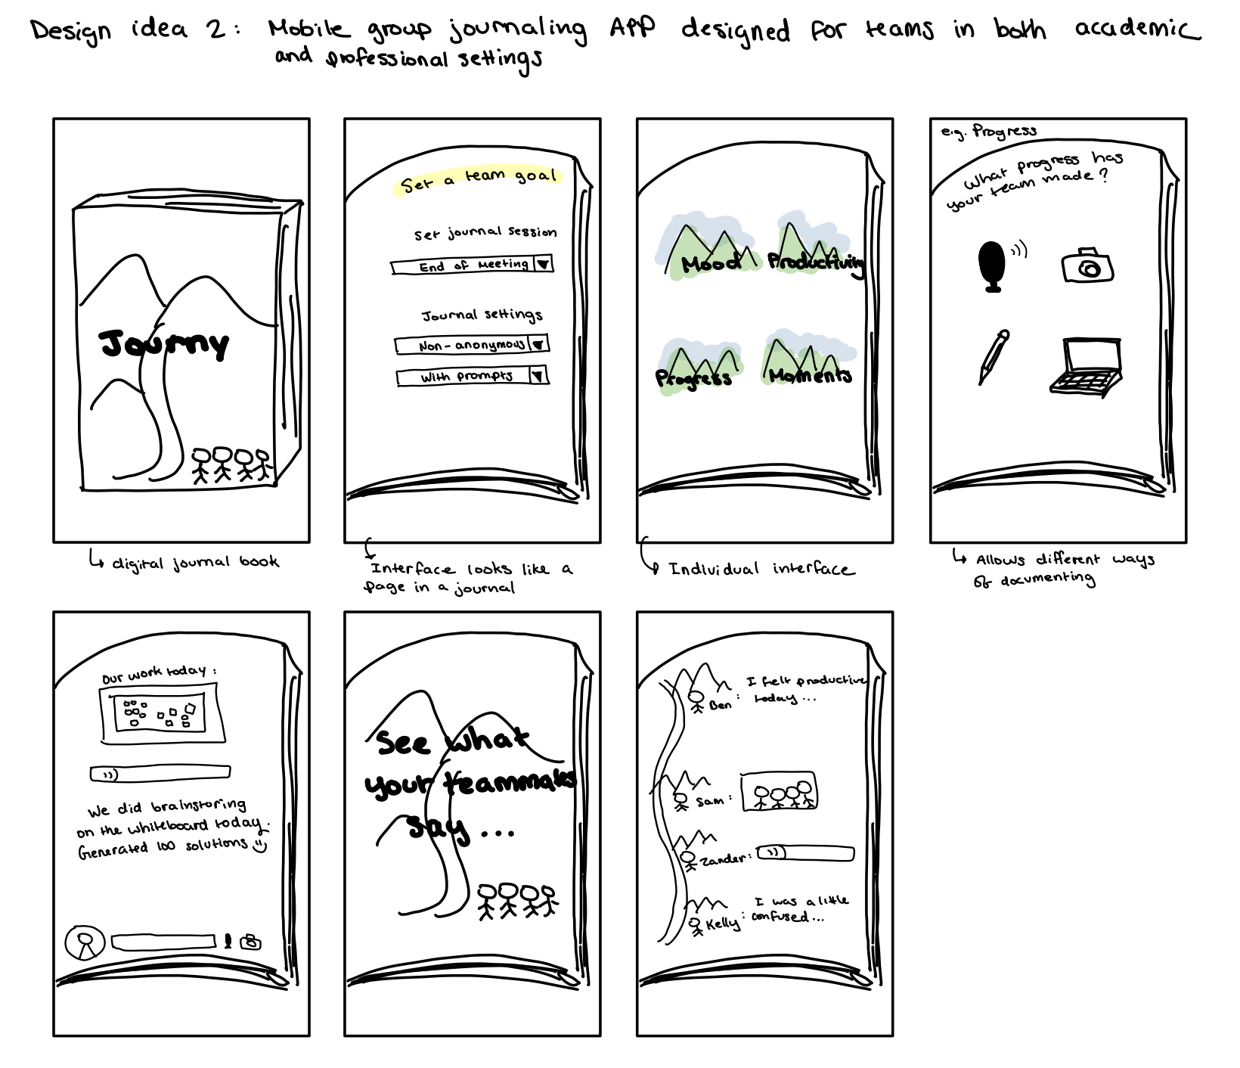
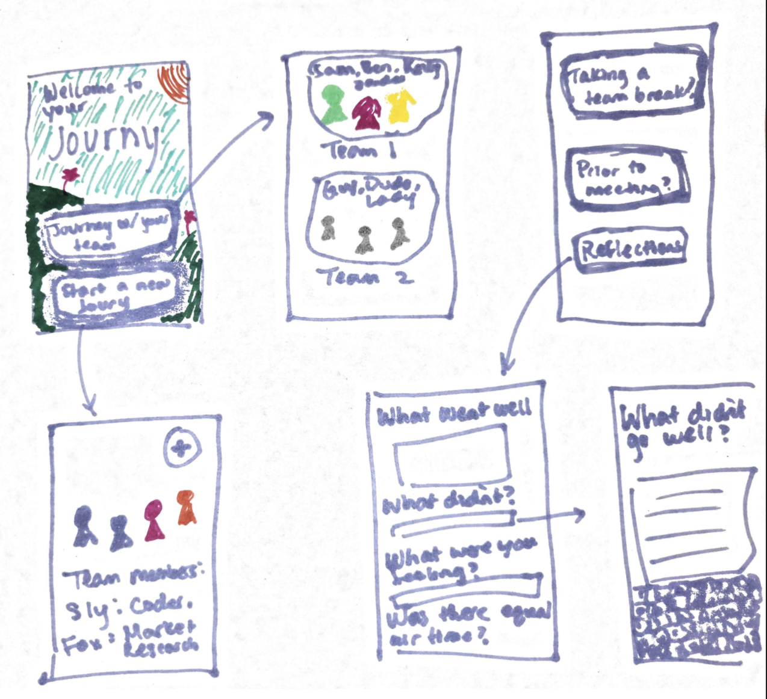
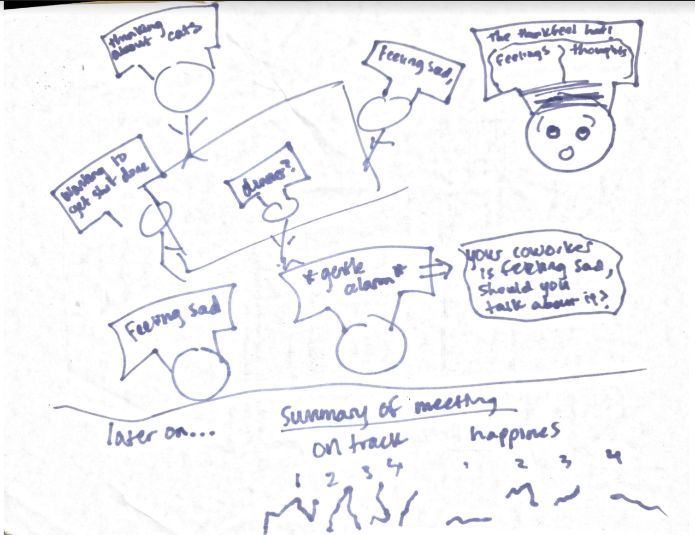
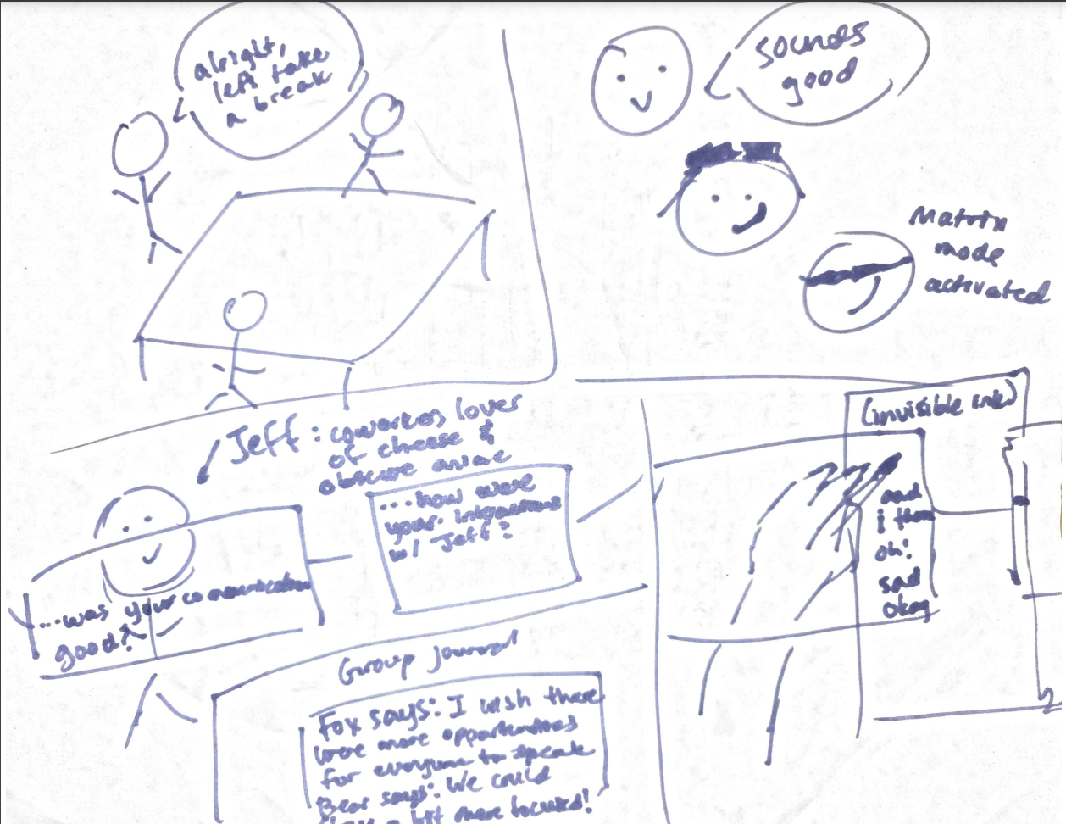
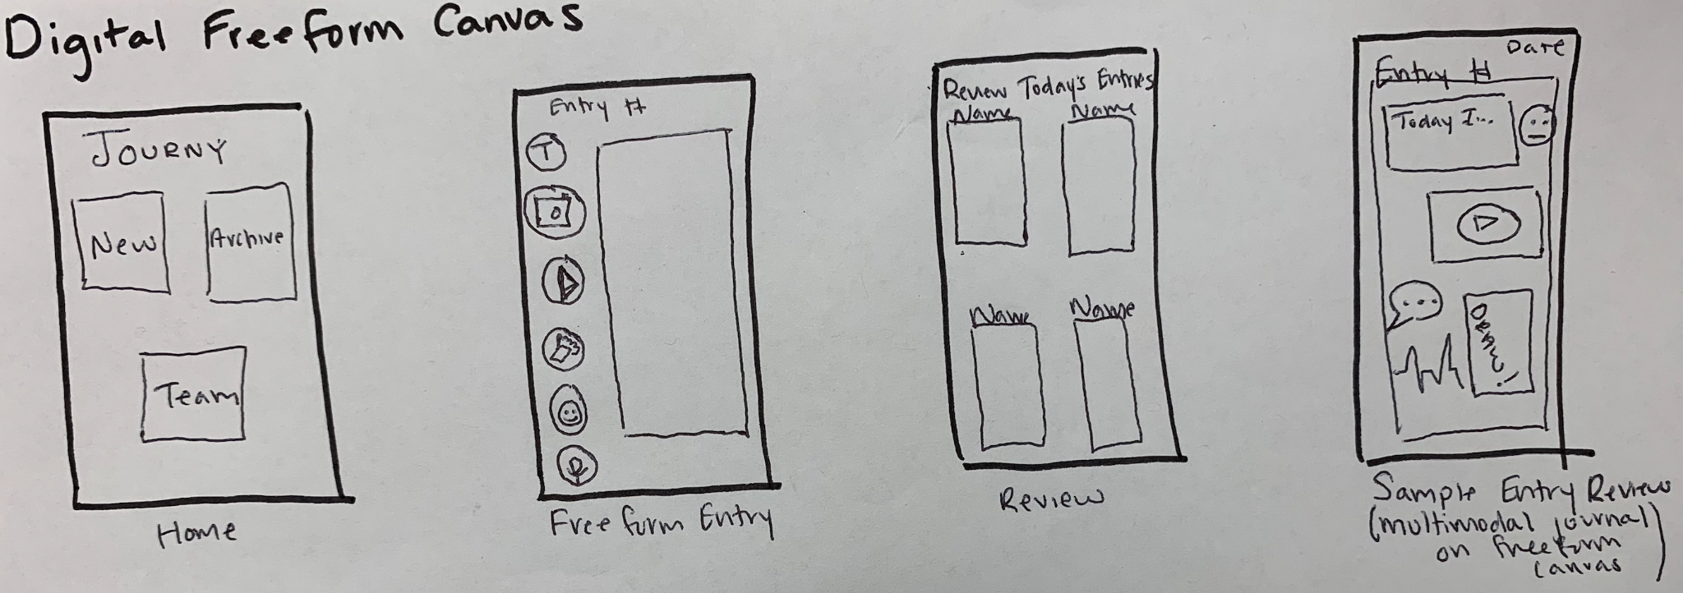
Narrowing Down

Slide 6
Narrowing Down
Mobile App
Ar Glasses

Slide 7
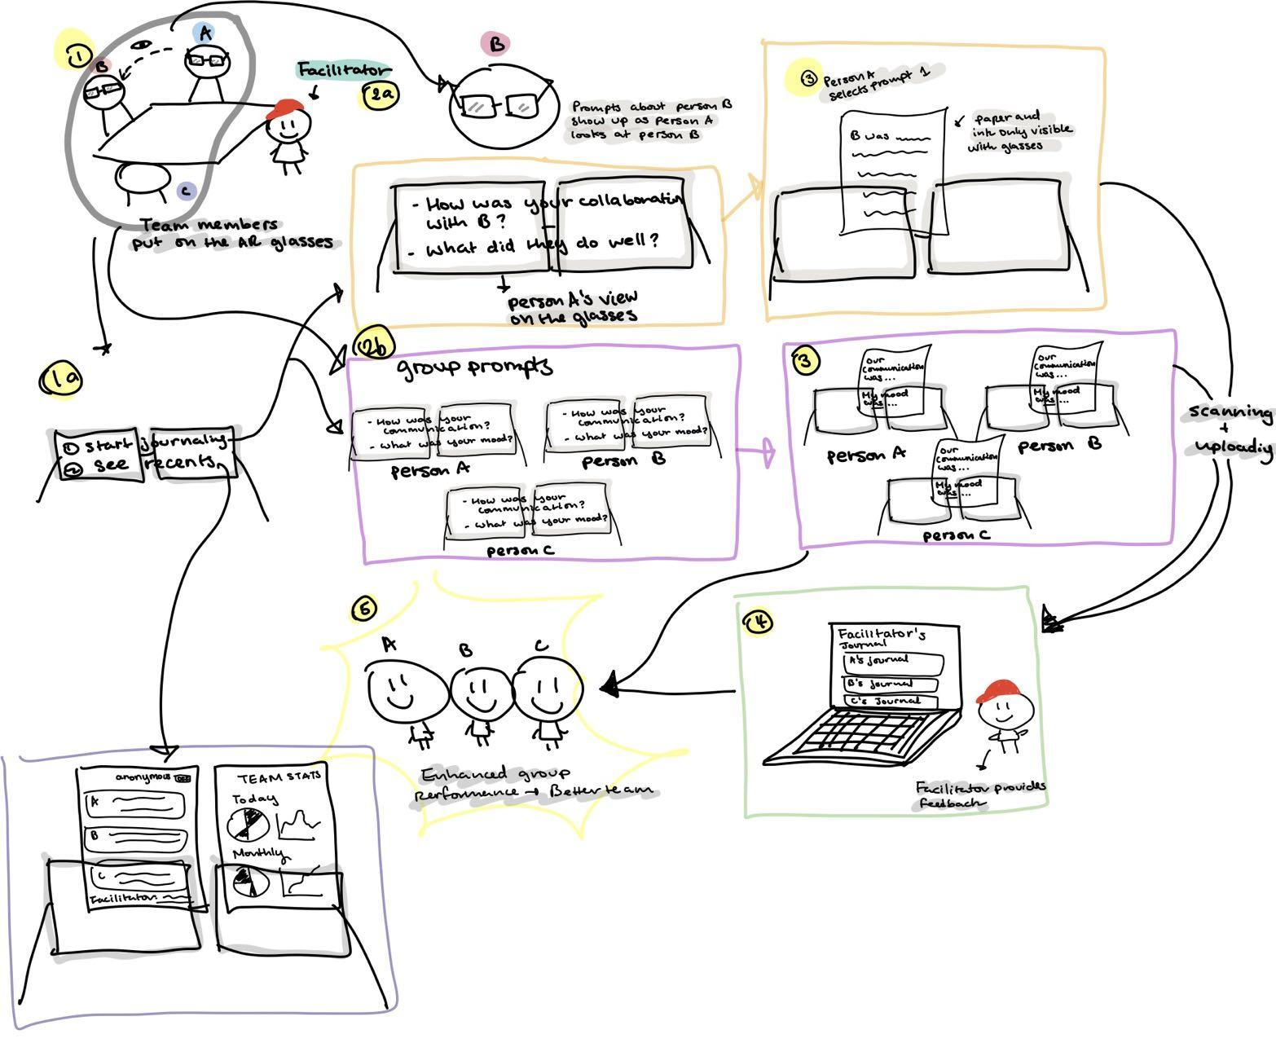
AR Glasses Storyboard

Slide 8
AR Glasses Storyboard
👍
More natural
Adaptable information to interactions
Higher engagement and novelty

Slide 9
AR Glasses Storyboard
👎
Costly
Text placement distracting
Not accessible to people who wear glasses
Another thing to remember to bring to meetings

Slide 10
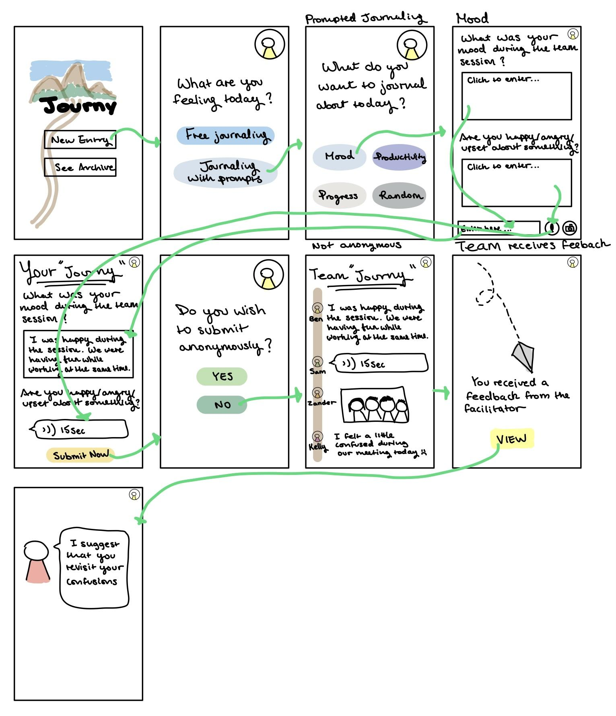
Mobile App Storyboard

Slide 11
Mobile App Storyboard
👍
Technology is accessible
Allows text, video or speech
Small screen shifts focus to task
Phone familiarity is stickier

Slide 12
Mobile App Storyboard
👎
Limited variety of interactions
Potential for distraction
Different OS systems

Slide 13
Mobile App Storyboard
👍

Slide 14
Lo-Fi Prototype
2

Slide 15
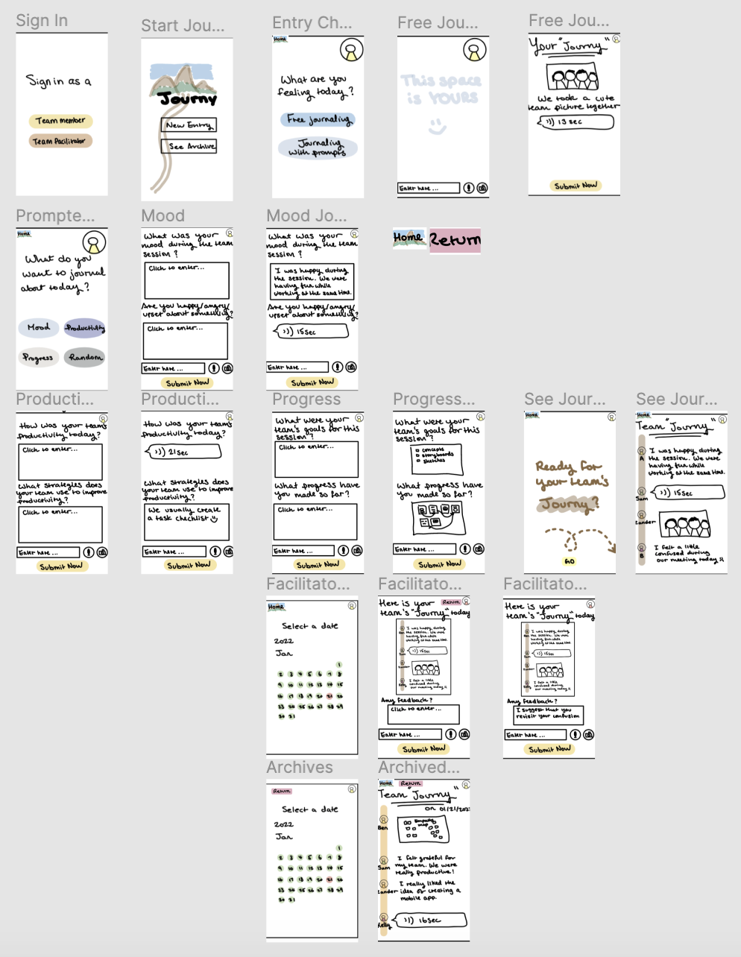
Prototype Structure
Team member
Facilitator

Slide 16
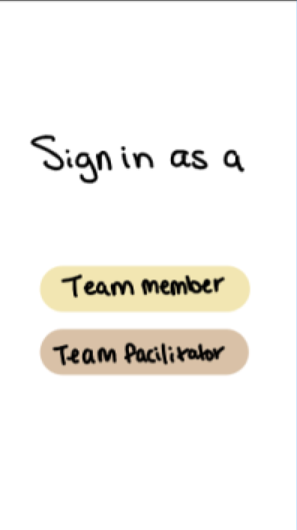
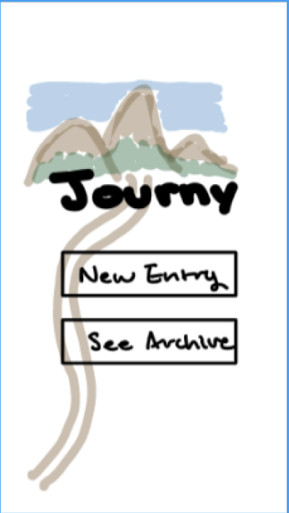
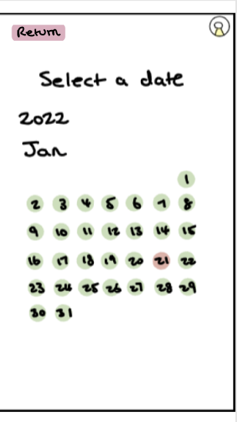
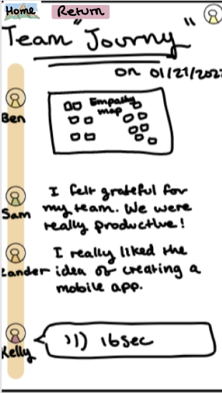
Simple Task: View an old journal entry

Slide 17
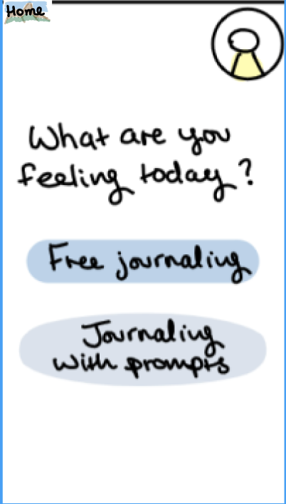
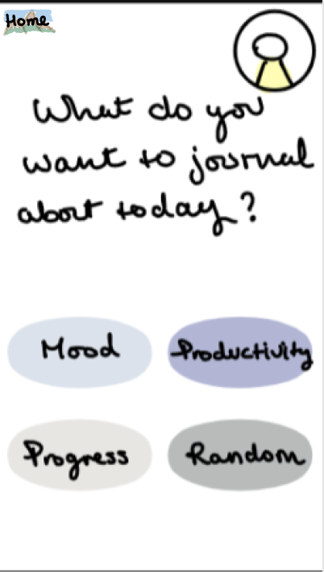
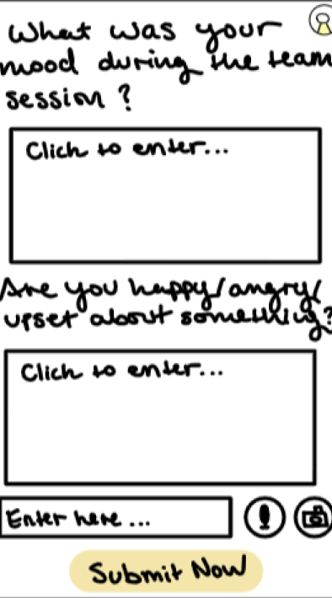
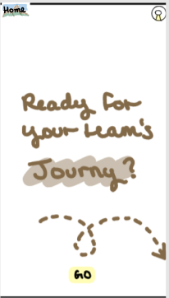
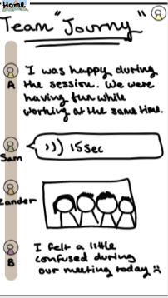
Moderate Task: Submit a journal entry and view team journal

Slide 18
Moderate Task: Submit a journal entry and view team journal

Slide 19
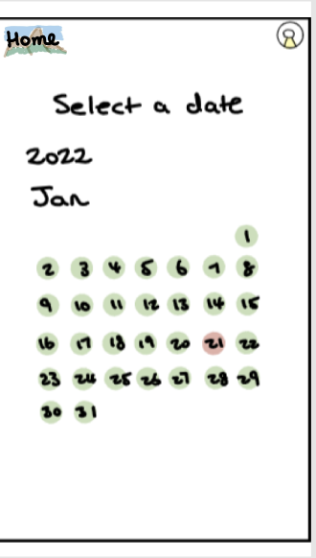
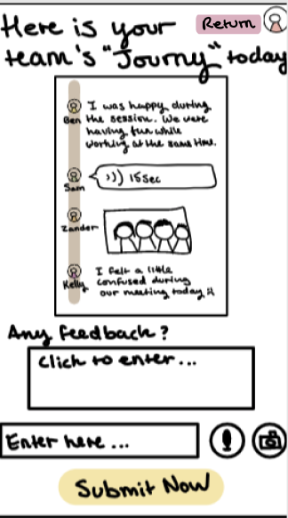
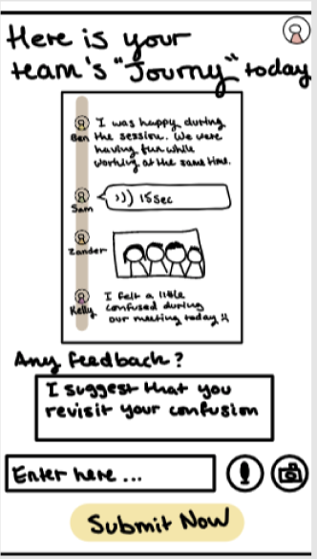
Complex Task: Send feedback as a facilitator

Slide 20
Usability Testing
3

Slide 21
Participant Selection
Michael
Alexa
Stanford student in the LDT program
Full-time software developer working remotely
Aurora
Lisa
Grad student at Columbia University
Podcast producer who oversees multiple remote teams

Slide 22
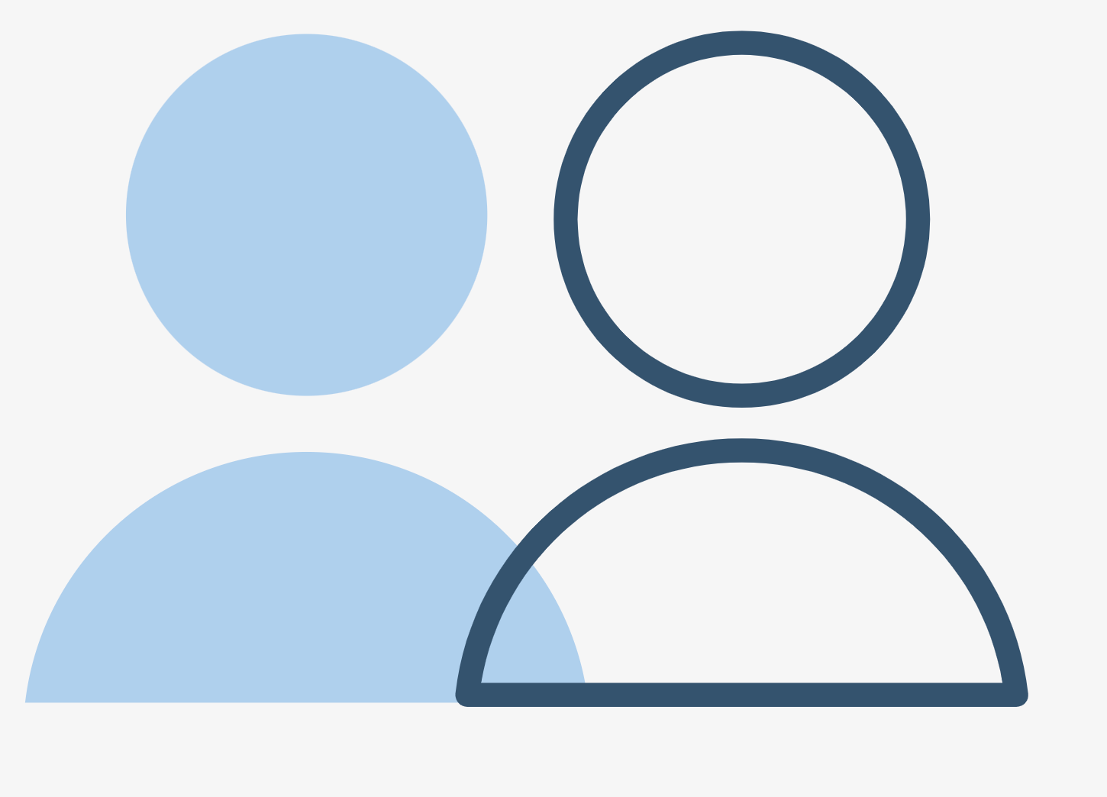
Academic
Professional
Michael
Alexa
Stanford student in the LDT program
Full-time software developer working remotely
Aurora
Lisa
Grad student at Columbia University
Podcast producer who oversees multiple remote teams

Slide 23
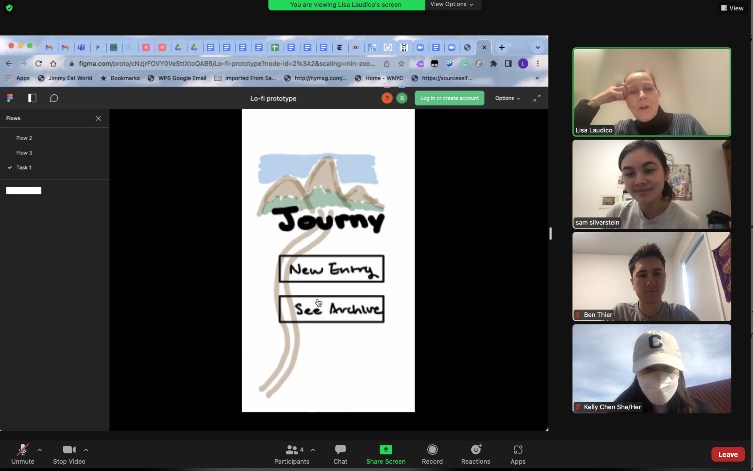
Methodology
Zoom interview & in-person with participant sharing screen
Participant uses Figma to click through app
Participant offers feedback and talks through actions/decisions
Note takers observe and write down interactions

Slide 24
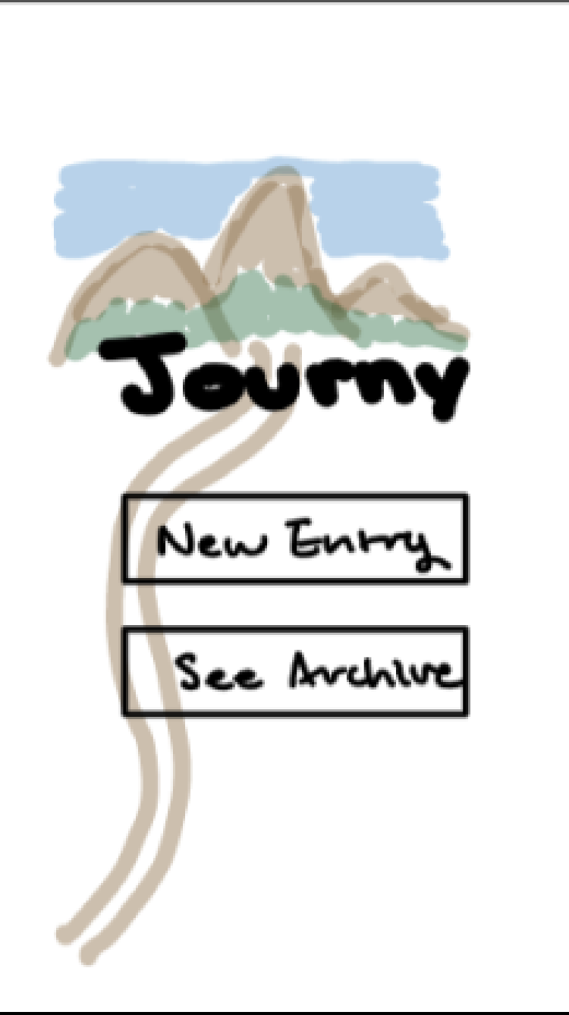
Results: Successes
Handled tasks efficiently and quickly
Obvious interface interactions
Praised the simple and “organic” aesthetic
Indicated they would use this as both a team member and facilitator

Slide 25
Keep the vibe of this low-fi prototype. We need more organic stuff.

Slide 26
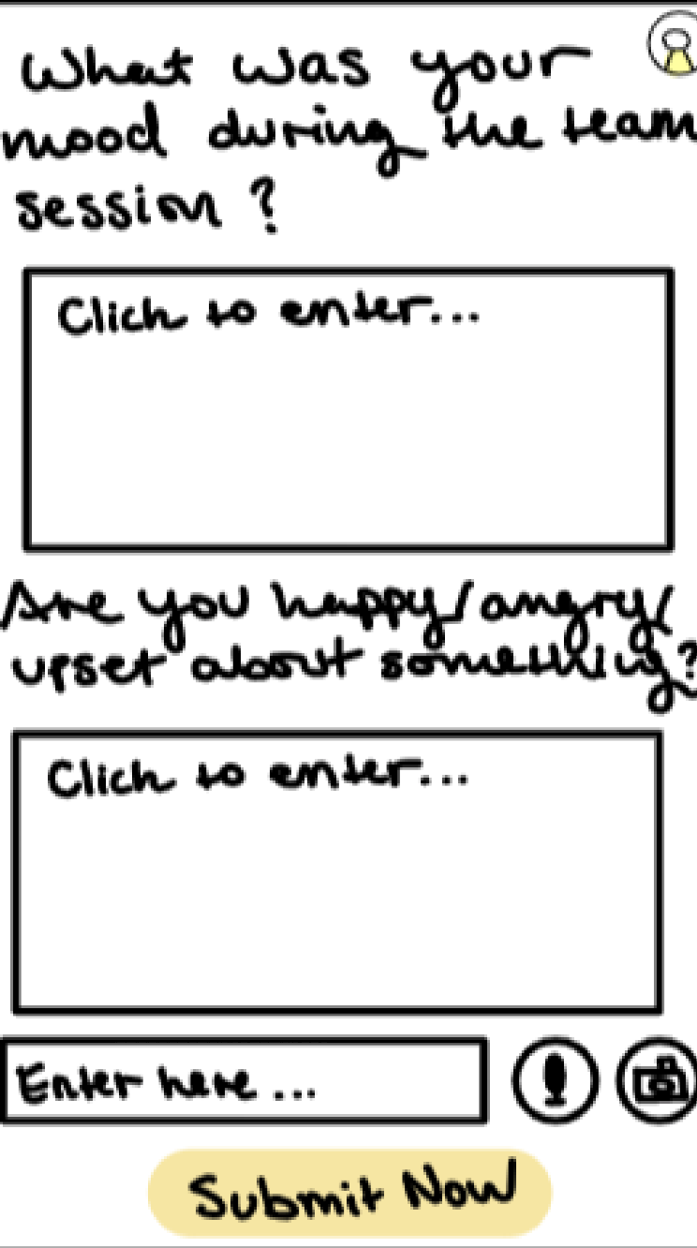
Results: UI problems
Multiple labels
Confusion on where to click to enter a response
“I didn’t know what the third one was for”

Slide 27
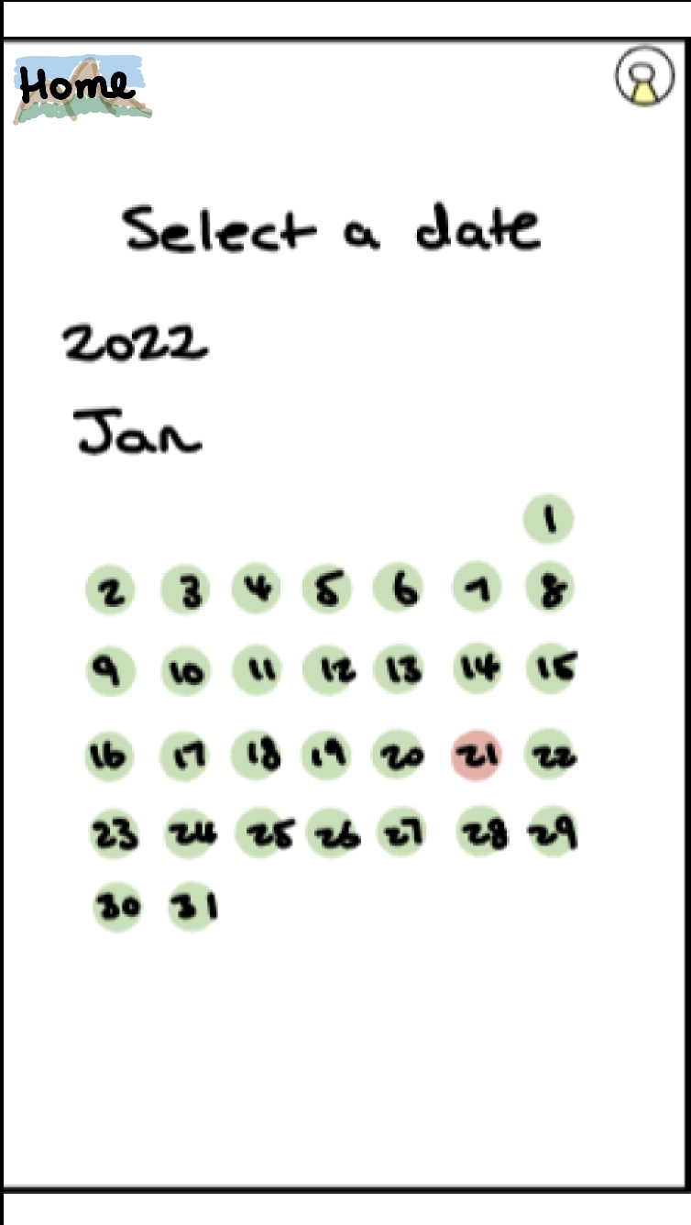
Results: UI problems
Confusing Colors
Mixed ideas of what the red date represented
Recent entry or no entry?

Slide 28
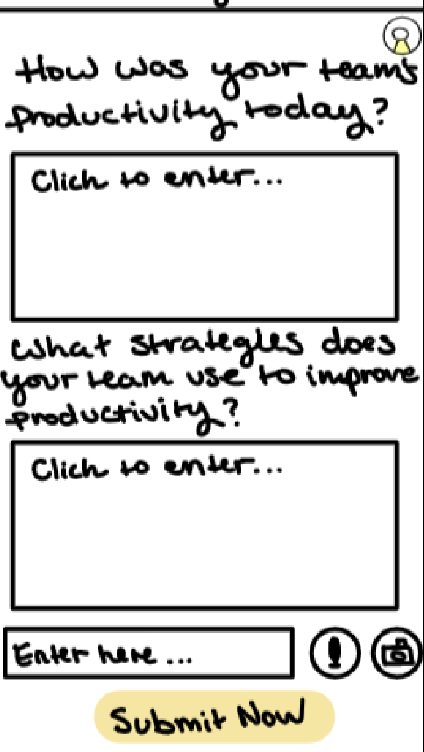
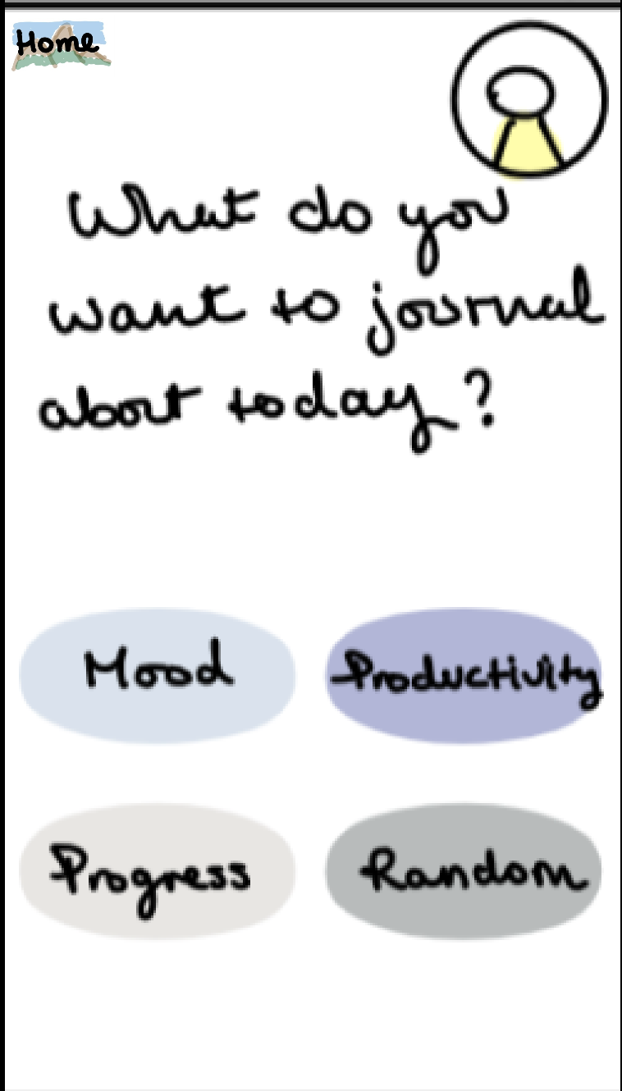
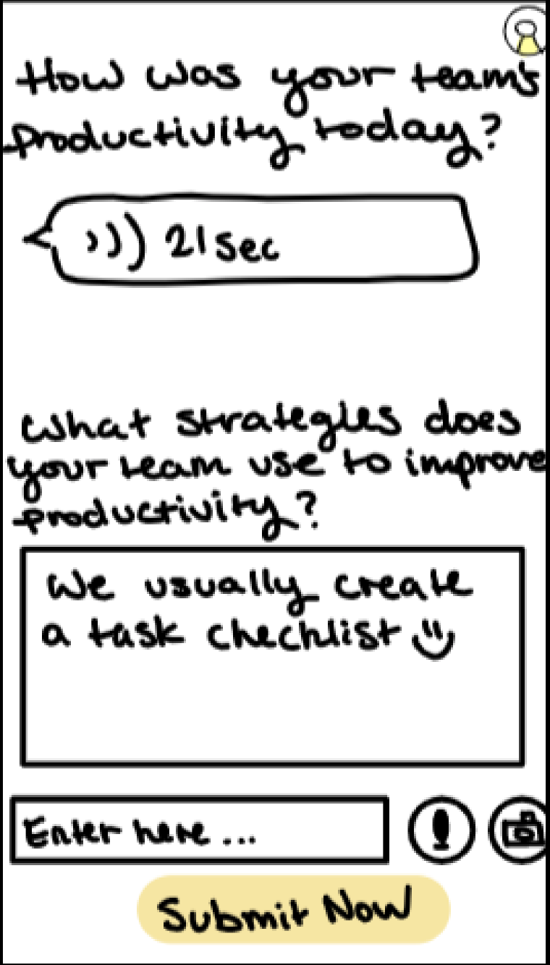
Results: UI problems
Limited Navigation
Surprised that clicking the prompt led immediately to a filled out response
“I did assume that I would come back and do the second one.”

Slide 29
If I need to process other things … for example, if I am not happy with a teammate, then I would not bring it into open journal or shared journal

Slide 30
Feature Requests
Robust Facilitator Features
Desire for a facilitator’s-eyes only feature
Need for a direct line between the team member and the facilitator

Slide 31
Feature Requests
Anonymity
Addition of anonymity for sensitive comments
However, does that conflict with the trust-building our app is intended to facilitate?

Slide 32
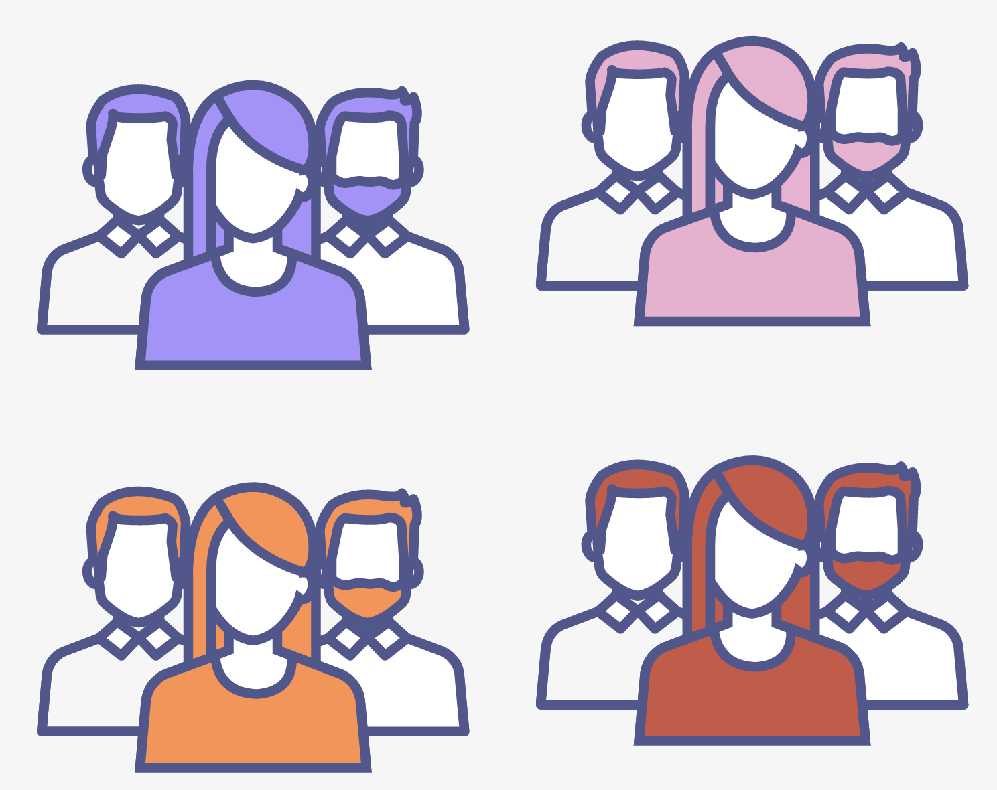
Feature Requests
Multiple Teams
Ability to join or facilitate multiple teams
Easily navigate between different teams

Slide 33
Feature Requests
Utility of Archive
Reconsider the usefulness of viewing past journal entries for team members

Slide 34
UI Change
Calendar Navigation
Have a separate button/popup to select the most recent journal entry

Slide 35
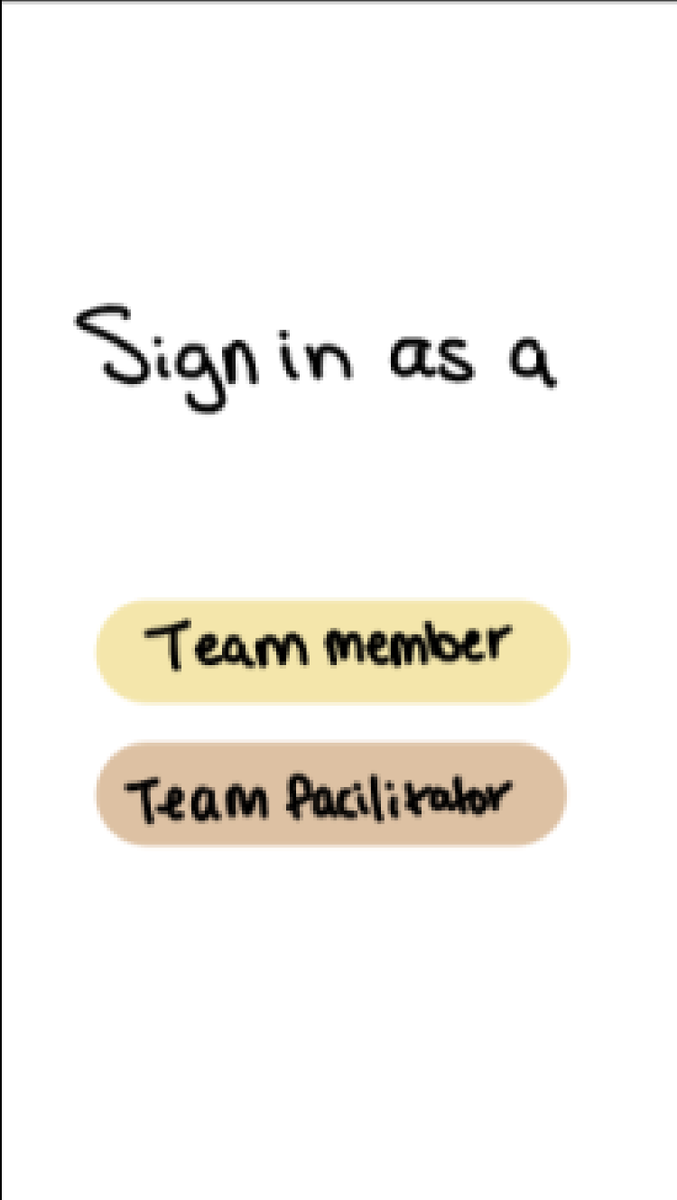
UI Change
Multiple Teams
Have a separate button/popup to select the most recent journal entry

Slide 36
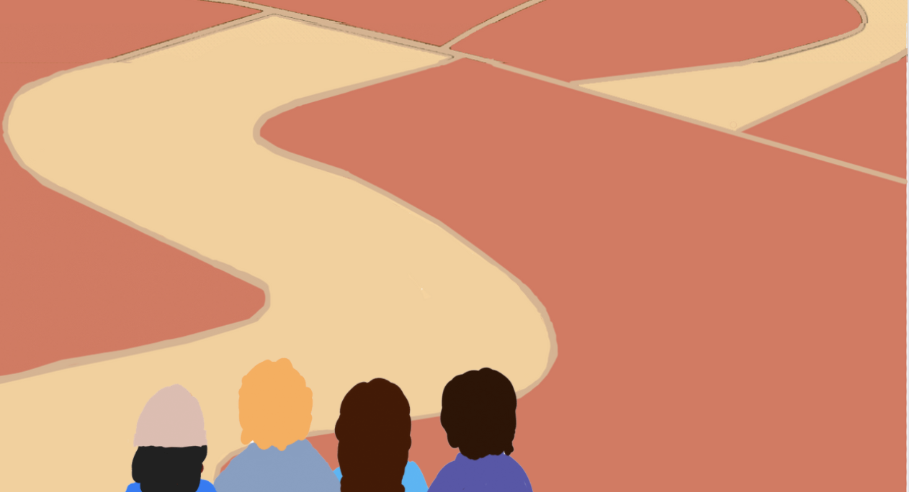
Where we go from here
Reconsider the issue of anonymity
Create a clean design that maintains the organic aesthetic
Develop the facilitator integration with teams

