Slide 1
POVs and Experience Prototypes for Hybrid Collaboration

Slide 2
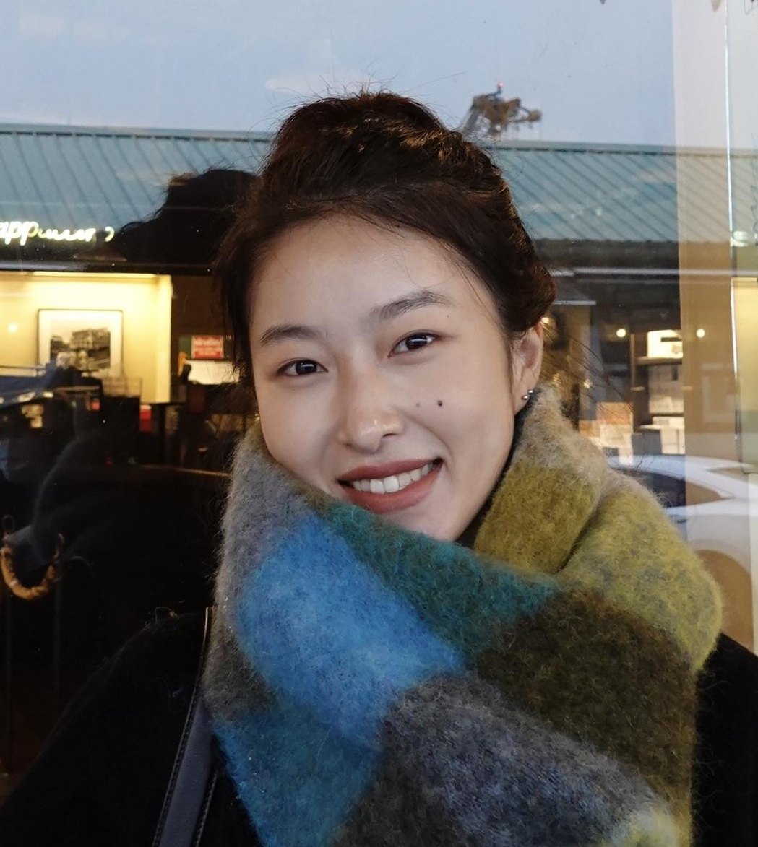
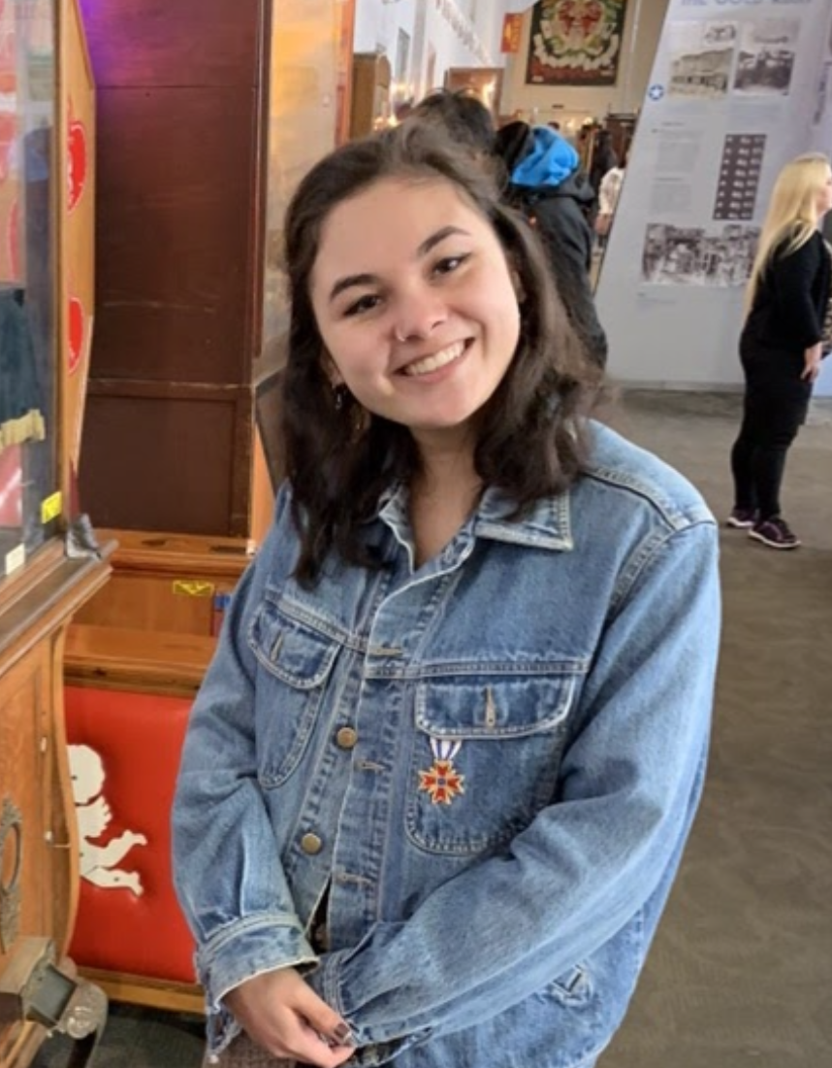
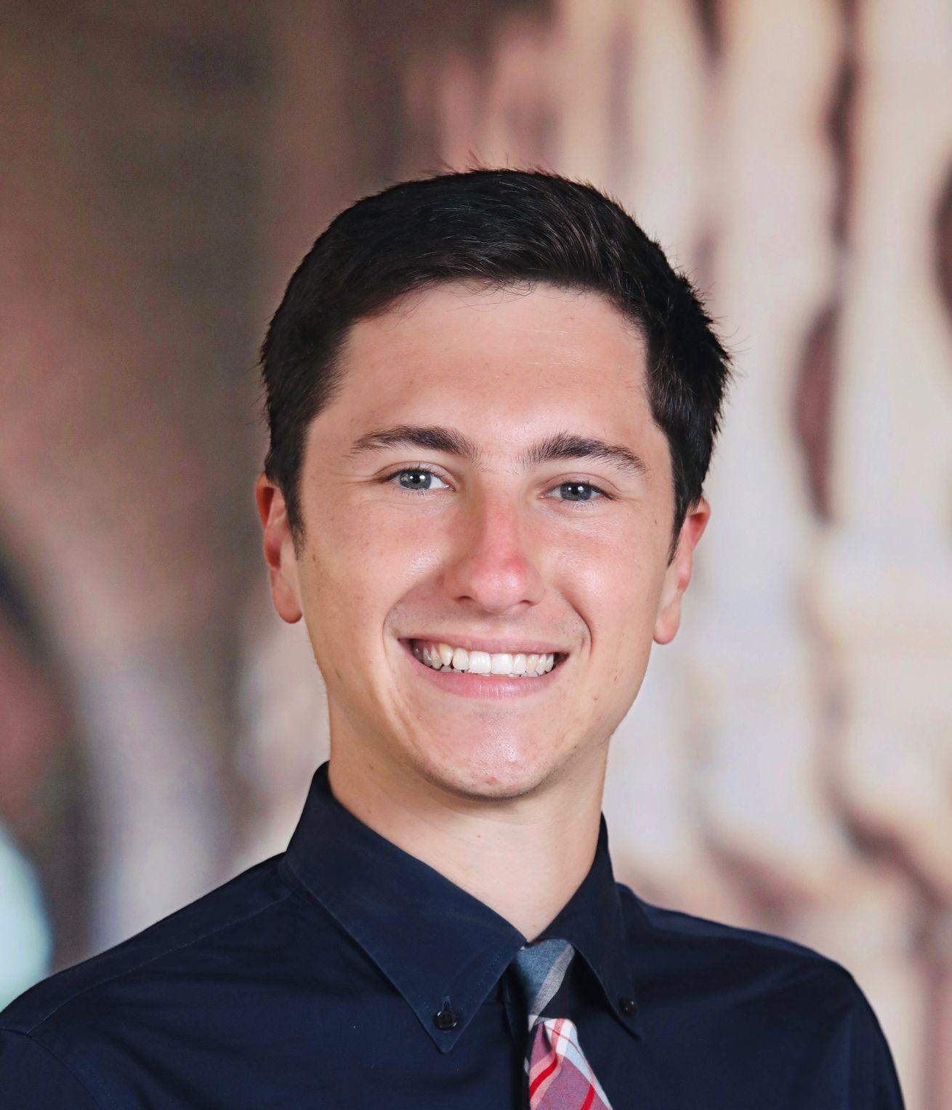
Meet the TEAM
Kelly C.
M.S. LDT ‘22
Zander L.
CS ‘24
Sam S.
Symbolic Systems ‘22
M.S. CS ‘23
Ben T.
M.S. LDT ‘22

Slide 3
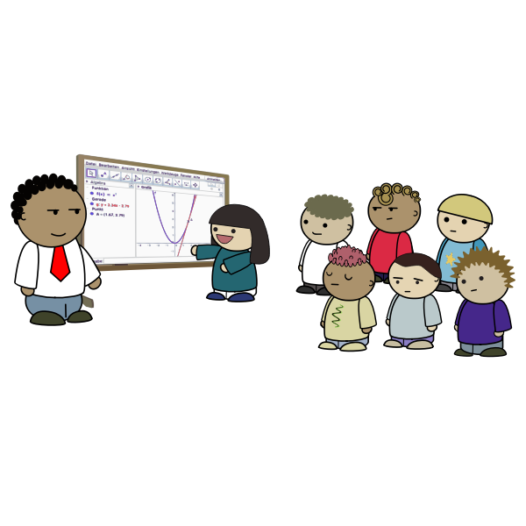
Problem Domain
Technology-
Supported Mediation of Teamwork
Learning Environments
Professional Environments

Slide 4
Initial POV
We met Tracy, a research-oriented PhD candidate in Consumer Behavior. Her research moved online due to the pandemic.
We were surprised to notice that Tracy felt like her research was able to improve and thrive in the new online setting due to increased reach and more access to participants. Similarly, her social connections with colleagues improved drastically as well thanks to her facilitation of bonding events.
We wonder if this means there are positive elements of the online work and social experiences that can transfer to a physical setting.
It would be game-changing to explore how flexibility and increased choice in online settings can be incorporated into hybrid collaboration experiences.

Slide 5
Additional Needfinding

Slide 6
Additional Needfinding Interviews
Tony
Buy-side Analyst at Bloomberg HK
Claire
Fundraising Team for US Senator

Slide 7
She uses a wheelchair, so the hybrid work environment makes life more comfortable, convenient, and affordable.
She uses the chat function on Zoom way more than her team.
Need: a way to simulate the ‘vibes’ of in-person collaborative campaign meetings
Claire
Fundraising Team for US Senator
(Her team is in New Hampshire while she is in DC)

Slide 8
He relies on messaging and conferencing tools in Bloomberg Terminal for checking in and handovers with global colleagues on a daily basis.
He prefers built-in functions and simple UI.
“Clicking on something is more straightforward than typing the whole thing out.”
Need: a built-in language/communication system that improves efficiency of team collaboration outside the context of his work
Tony
Buy-side analyst at Bloomberg HK
(collaborates with colleagues globally)

Slide 9
Participants in Needfinding
Technology-
Supported Mediation of Teamwork
Learning Environments
Professional Environments
E
T
S
E
C
T

Slide 10
Revised POVs and HMWs

Slide 11
POV 1
We met Tracy, a PhD candidate in Consumer Behavior at Washington University whose entire lab moved online due to the pandemic.
We were surprised to notice that despite Tracy’s reluctance to socialize with colleagues before the pandemic, her bonds actually improved in quality and quantity due to attending online social events with her labmates.
We wonder if Tracy feels she has formed better social bonds due to the more accessible nature of online social events.
It would be game-changing to utilize technology to create possibilities and remove restrictive barriers to social bonding within collaborative teams.
Notes:
HMW motivate people to feel excited about socializing with teammates/colleagues?
HMW encourage the use of online social events post-pandemic?
HMW encourage colleagues to bond outside of work hours?
HMW increase the ease of scheduling/coordinating in-person meetings?
HMW increase the diversity of in-person social events at a low cost?
HMW encourage teams to creatively design their own social events?
HMW make online events interesting and low-no cost?
HMW enable teams to figure out what social events they would like to engage in?
HMW design the worst possible online social experience for teammates?
HMW online social interactions feel more like a casual gathering of friends?
HMW provide in-person resources for all attendees of virtual gatherings?
HMW facilitate colleagues bonding in the workplace/lab?
HMW design fun icebreakers to increase trust and social bonding in new teams?
HMW integrate new team members to already existing social dynamics within a team?
HMW select teams that are predisposed to bond faster?

Slide 12
POV 2
We met Soren, a co-instructor of the Stanford LDT Master’s Program and peer collaboration researcher.
We were surprised to notice that despite Soren’s expertise in facilitating in-person student collaboration, he does not always implement this knowledge in online collaborative settings due to the more invasive nature of monitoring.
We wonder if this means he does not feel invited to engage in best monitoring practices in online settings.
It would be game-changing to explore how the more authentic feeling of monitoring in-person collaboration can be transferred to hybrid and online settings.
Notes:
HMW give instructors more data about teams collaborating online?
HMW enable teams to become more self-sufficient at monitoring their collaboration skills?
HMW encourage teams to be more vocal about their needs in learning experiences?
HMW remove virtual barriers to viewing online collaboration?
HMW remove the need for instructor oversight of teams altogether?
HMW allow instructors to monitor multiple groups simultaneously online?
HMW create new collaboration tools that are unique to a hybrid setting?
HMW have virtual teams indicate when they want facilitation?
HMW make the online classroom feel more like a real classroom?
HMW translate natural visual signals into virtual cues?
HMW make facilitation online into a routine/expected event for students?
HMW equip virtual teams to mirror in-person help-seeking techniques?
HMW alleviate the burden and invasiveness of online monitoring for instructors?
HMW facilitate trust-building between teams and the technology they use?
HMW overcome social pressures that burden online facilitation and collaboration?
HMW make students more likely to invite their facilitator into discussions?

Slide 13
POV 3
We met Erika, an ear training professor at Stanford who is averse to using technology in her classroom and adapts her lesson plans based on real-time visual cues from students.
We were surprised to notice that despite her frustration with Zoom and her initial panic about having to teach online, she found that she was able to trust the technology to act as a co-facilitator of her students’ learning experiences regardless of their skill level.
We wonder if this means Erika feels more supported as an educator in an online environment due to the addition of technology as a successful co-facilitator.
It would be game-changing to explore how technology can assist educators to accommodate students’ individual needs in in-person learning environments.
Notes:
HMW allay educators’ fears of letting go of some control over their classroom to technology?
HMW encourage teachers to use technology to keep students accountable for work?
HMW encourage students to be more vocal about their individual learning needs?
HMW facilitate trust-building between educators and the technology they use?
HMW utilize technology to offer a separate space/time for students to engage with material independent of the teacher?
HMW slow down the classroom pace without compromising the lesson plans?
HMW encourage teachers to use technology to motivate students to engage with material beyond assigned work?
HMW integrate digital tools in a classroom where the teacher is technology-avoidant?
HMW incorporate technology in a way that does not conflict with the traditional methods necessitated by a class such as ear training?
HMW encourage faster students to take time to interact with/help encourage slower students to engage with material/feel more comfortable?
HMW encourage more advanced students to interact with less advanced students in a way that improves both groups’ learning experiences?
HMW make an educational space more like a hangout?
HMW connect students with the classroom material?
HMW help teachers to get students excited about the classroom material?
HMW encourage slower students to engage with material more and not give up?

Slide 14
POV 2 (Soren)
How might we facilitate trust-building between collaborative TEAMS and the technology they use?
Notes:
We met Soren, a co-instructor of the Stanford LDT Master’s Program and peer collaboration researcher.
We were surprised to notice that despite Soren’s expertise in facilitating in-person student collaboration, he does not always implement this knowledge in online collaborative settings due to the more invasive nature of monitoring.
We wonder if this means he does not feel invited to engage in best monitoring practices in online settings.
It would be game-changing to explore how the more authentic feeling of monitoring in-person collaboration can be transferred to hybrid and online settings.

Slide 15
POV 2 (Soren)
How might we translate natural visual signals into virtual cues?
Notes:
We met Soren, a co-instructor of the Stanford LDT Master’s Program and peer collaboration researcher.
We were surprised to notice that despite Soren’s expertise in facilitating in-person student collaboration, he does not always implement this knowledge in online collaborative settings due to the more invasive nature of monitoring.
We wonder if this means he does not feel invited to engage in best monitoring practices in online settings.
It would be game-changing to explore how the more authentic feeling of monitoring in-person collaboration can be transferred to hybrid and online settings.

Slide 16
POV 2 (Soren)
How might we encourage teams to be more vocal about their needs in learning experiences?
Notes:
We met Soren, a co-instructor of the Stanford LDT Master’s Program and peer collaboration researcher.
We were surprised to notice that despite Soren’s expertise in facilitating in-person student collaboration, he does not always implement this knowledge in online collaborative settings due to the more invasive nature of monitoring.
We wonder if this means he does not feel invited to engage in best monitoring practices in online settings.
It would be game-changing to explore how the more authentic feeling of monitoring in-person collaboration can be transferred to hybrid and online settings.

Slide 17
Solutions

Slide 18
HMW translate natural visual signals into virtual cues?
Multisensory feedback system: sounds, colors, finger gestures used to indicate various emotions/states

Slide 19
HMW facilitate trust-building between collaborative TEAMS and the technology they use?
Virtual teammate pings the team to remind them of best collaboration practices

Slide 20
HMW encourage teams to be more vocal about their needs in learning experiences?
Anonymous reporting of feedback in groups: group gets alerted when someone would like to regulate the group dynamic/interject

Slide 21
Experience Prototypes

Slide 22
Experience Prototype 1
Solution: Virtual teammate pings the team to remind them of best collaboration practices
Assumption: Team members do not feel distracted by a ‘virtual collaboration facilitator’ that periodically sends prompts.

Slide 23
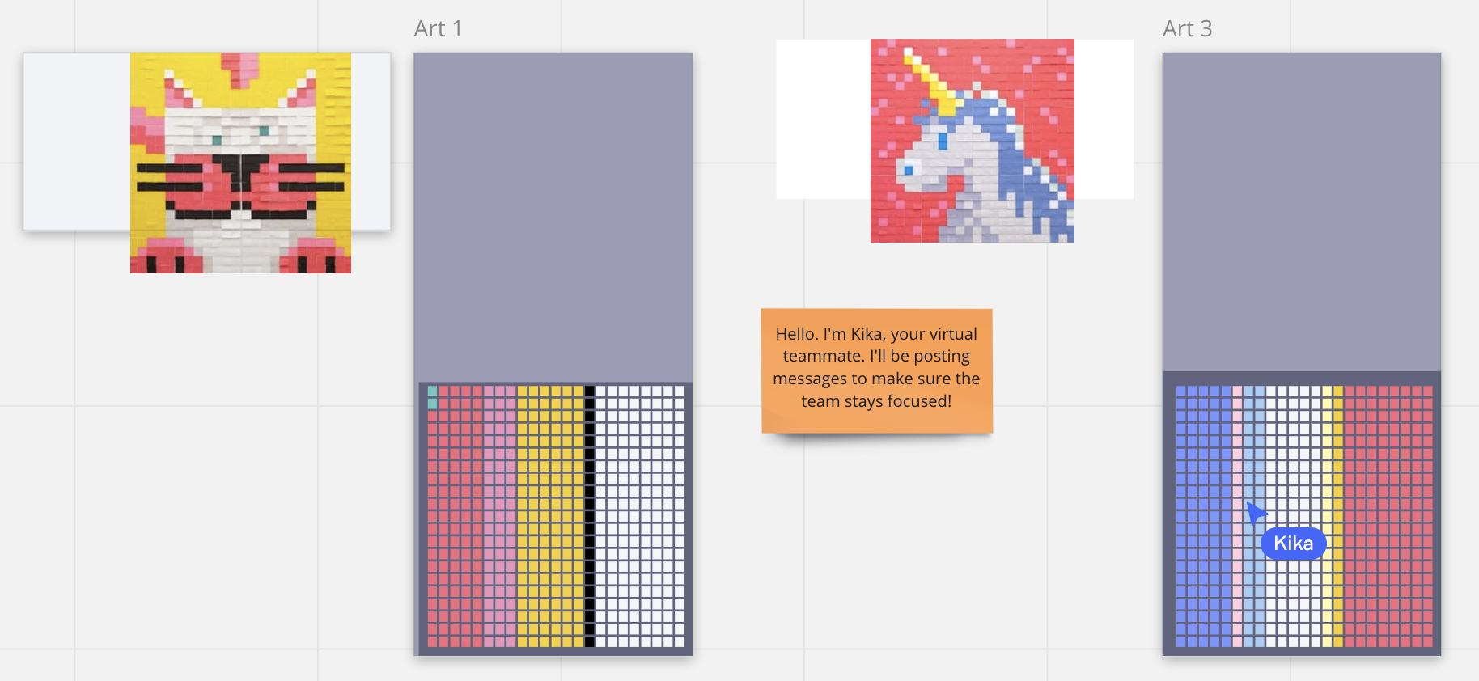
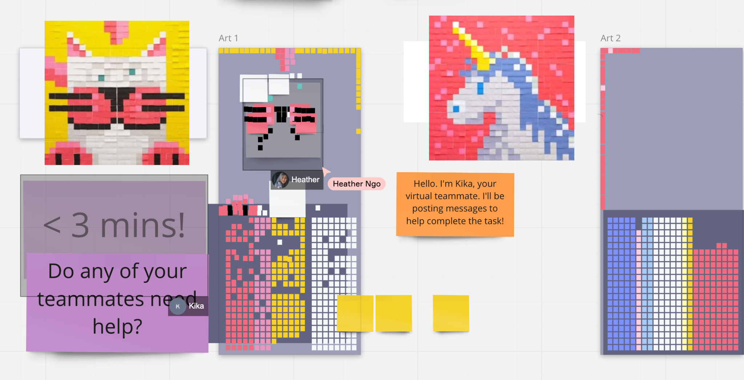
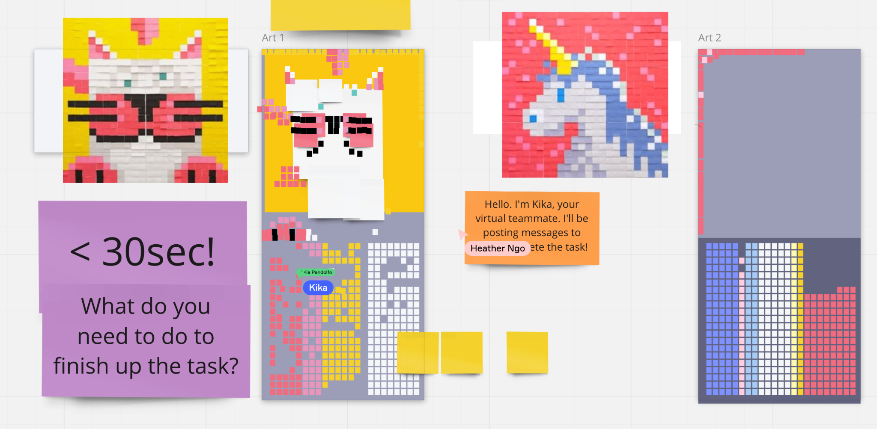
Collaborative task with Julia and Heather (non-Stanford participants) on Miro with a Wizard of Oz virtual teammate named Kika. (shown in the orange sticky note)
Kika would help the team keep track of time, progress of completion, and periodically provides prompts to ensure good collaboration. (shown in purple sticky notes)

Slide 24
Results and Insights
(participants did not interact with the virtual teammate at all) — FAILED
Julia: “Because we’re doing a visual task it doesn’t really make sense for the notifications to also be visual because then you’re dividing our attention.”
Julia: “Because heather and I were so focused on making [the artwork] I feel like I wasn’t paying attention to really anything else that was happening”
Medium of the alert shouldn't match the medium of the task (e.g. visual task/visual note is not as good as visual task/audio alert)
Teams should have the ability to 'resolve' the comments or make them go away
Preference for a virtual teammate may depend on the nature of the task.

Slide 25
Experience Prototype 2
Solution: Multisensory feedback system: sounds, colors, finger gestures used to indicate various emotions/states
Assumption: People are able to associate colors with particular emotions in a consistent and widespread way.

Slide 26
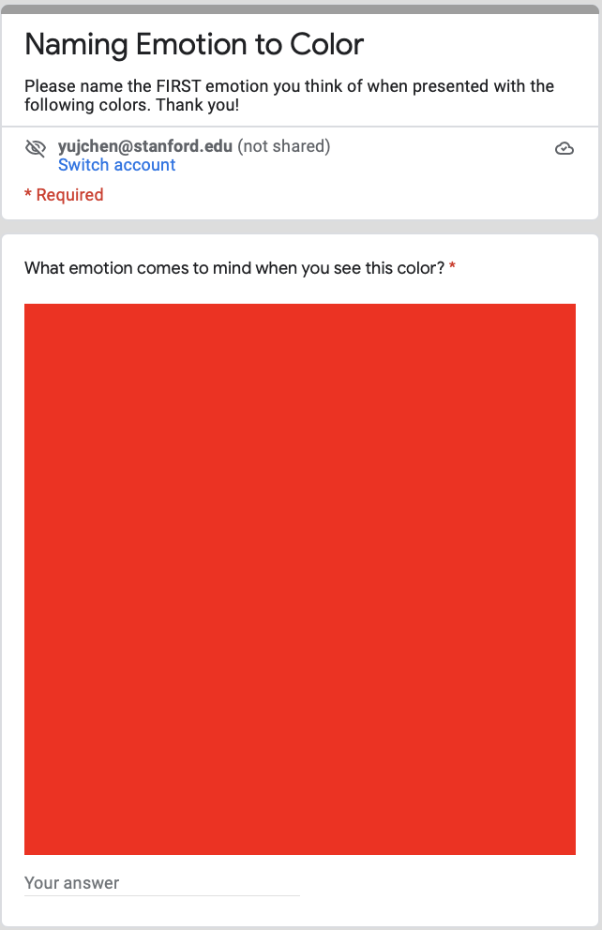
Widespread survey of color/emotion associations based on a total of 12 colors created with Google Form.
17 non-Stanford participants filled out the survey.

Slide 27
Results and Insights
Participants provided more consistent responses for colors that are common/frequently used.
Participants provided a wide variety of responses for colors that are less common.
People tend to associate typical colors (e.g. red, blue, green) with specific emotions in a consistent way.

Slide 28
Experience Prototype 3
Solution: Anonymous reporting of feedback in groups: group gets alerted when someone would like to regulate the group dynamic/interject
Assumption: People actually feel comfortable interjecting with feedback about group dynamics during collaboration sessions

Slide 29
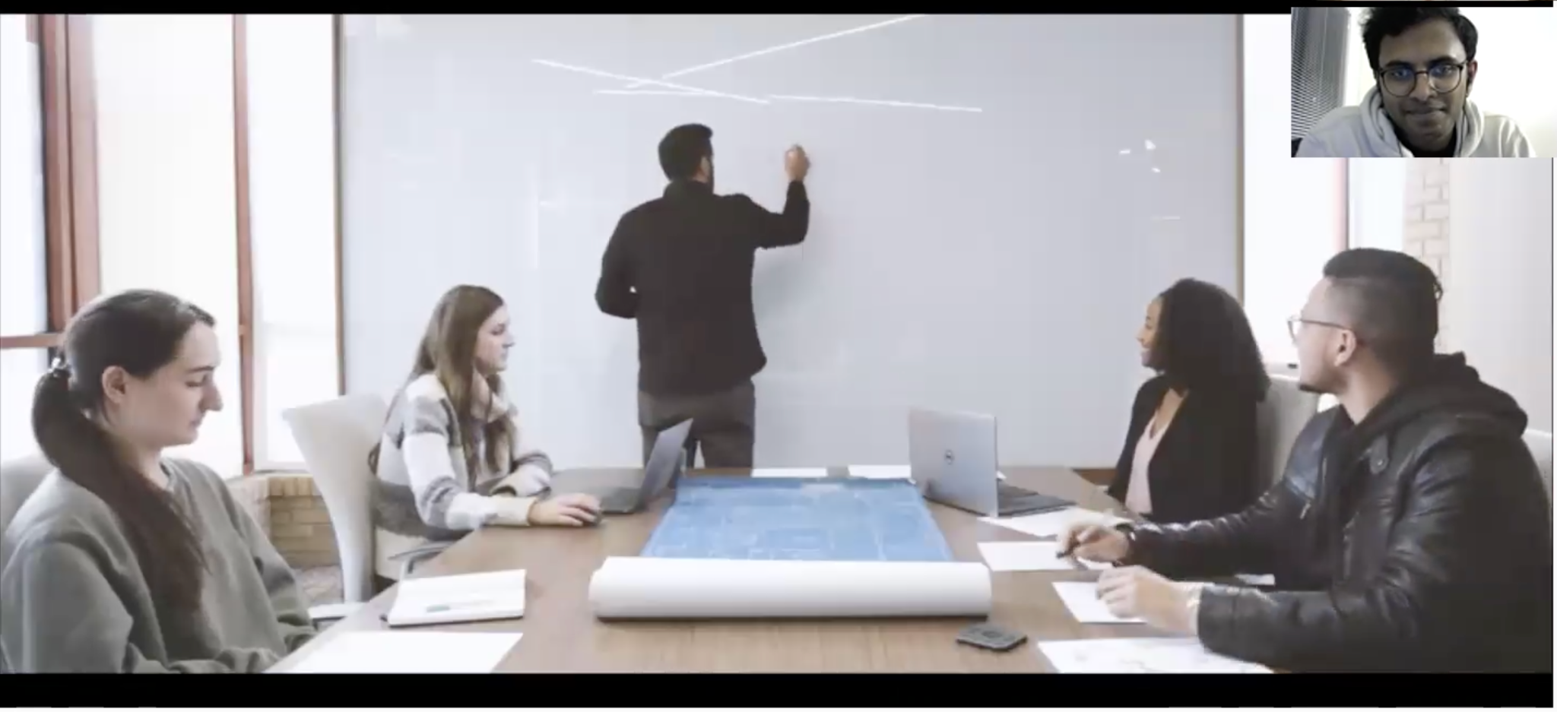
M.S. student at Stanford
A video of a real-life “bad” team collaboration scenario
Have participants watch a video of bad collaboration over zoom and see whether and where they would feel comfortable butting in or giving feedback (by pressing the raising hand button ✋)

Slide 30
Results and Insights
“[Pressing a button] let me take a feeling before figuring out what I’d actually say.”
“This did not feel as realistic.”
“This is what I would ideally do. Not sure what I would realistically do in a situation like this.”
Easing the feedback giving process may increase people’s motivation in providing feedback.
People have different reasons for interjecting with feedback:
“I personally don’t care as much about silence or conversations not being productive, I would say something when someone is being rude or the group dynamic is really off.”

Slide 31
Revisiting the Assumptions and Validity
Assumption 1: Team members do not feel distracted by a ‘virtual collaboration facilitator’ that periodically sends prompts.
Assumption 2: People are able to associate ^ colors with particular emotions in a consistent and widespread way.
Assumption 3: People actually feel comfortable interjecting with feedback about group dynamics during collaboration sessions. ☑️
certain

Slide 32
Solution and Summary
Medium: revisit presentation of virtual teammate with an emphasis on trust–building among team members and between teams and technologies
Interested communities: academic and professional teams

Slide 33
Thanks!
Any questions?

Slide 34
Additional Materials

Slide 35
List of Additional Materials
Empathy map for additional needfinding
Solutions brainstormed for our chosen HMWs

Slide 36
Empathy Map: Tony (Buy-side analyst at Bloomberg)
“We have people with different specialties located in different office… It’s important to draw on different teams’ expertise.”
“I value flexibility a lot.”
“It’s like zoom, but more simplistic. Each person has a conferencing room under their name. When we want to gather in a room, we don’t need to generate a link.”
The internal communication tools (messaging and video conferencing) are very helpful in his work.
Having built-in features in a communication tool is effective and helpful.
Having the option to work from home has given him more flexibility and improved his productivity.
Say
“In in-person work, if I have something that I want to ask my colleague, I will walk towards the person and ask directly… Texting is simpler than having to walk all the way. .”
“When you want the other party to run the command, you will be able to send the code for them to click on instead of having to type the whole thing. This helps alleviate burden in communication because clicking on something is more straightforward than typing the whole thing. ”
“When we are working in the office, I do find advantages because I can get someone’s attention immediately.”
It’s inconvenient to schedule meetings with the London office due to the time difference.
Simpler UI is more straightforward. (Dislikes that you need to remember different codes for Zoom meetings)
It’s relatively easy to learn commands once you understand the logic of these commands.
Think
More at-ease during communication while working from home because texting requires less effort than walking to the person.
Understanding perspectives of different client populations (cultural backgrounds) is important.
Frequently sends built-in commands of the Bloomberg terminal to expedite the communication process.
Frustrated when scheduling with international teams due to time difference
Collaborates with colleagues globally (HK, Shanghai, Singapore, London, US) using mainly Bloomberg Terminal
Uses messaging tool to send not only text messages but also files. Transfers files very frequently.
Do
Response time for receiving text messages is much longer than talking in person.
In contact with global colleagues and clients on a daily basis.
In the work handover process of client cases, he sends email updates when not urgent but utilizes the “work center (internal)” to ensure real-time handover during urgency.
Communicates and checks in with team members much more frequently when working from home.
Upset with the time wasted during commuting when having to work in the office
Relaxed when working from home. More focused when wfh (potential contradiction)
Feel

Slide 37
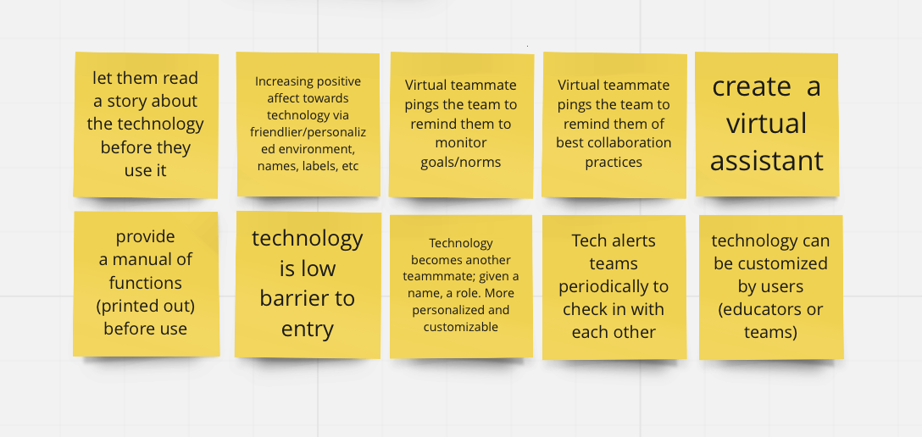
HMW facilitate trust-building between collaborative TEAMS and the technology they use?

Slide 38
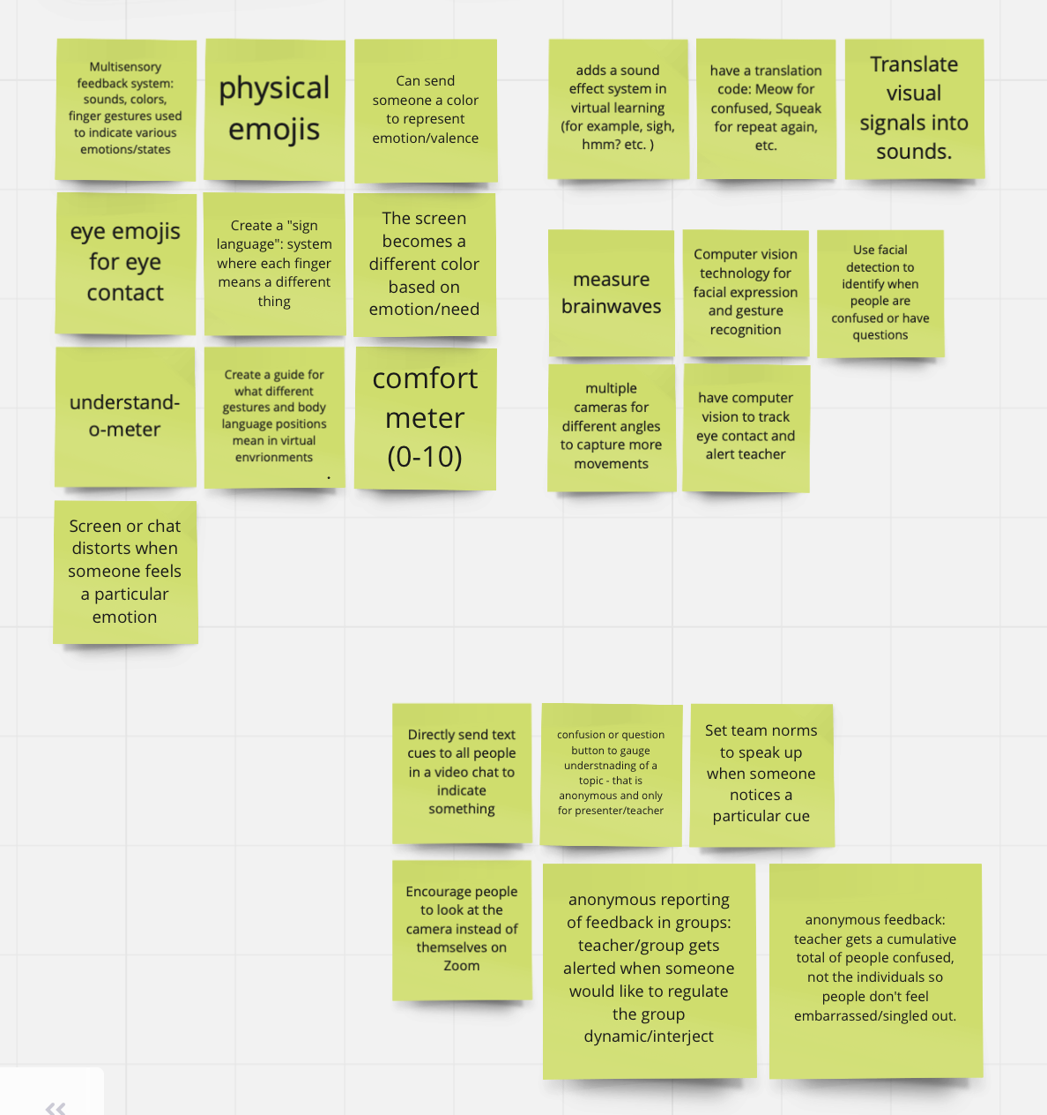
HMW translate natural visual signals into virtual cues?

Slide 39
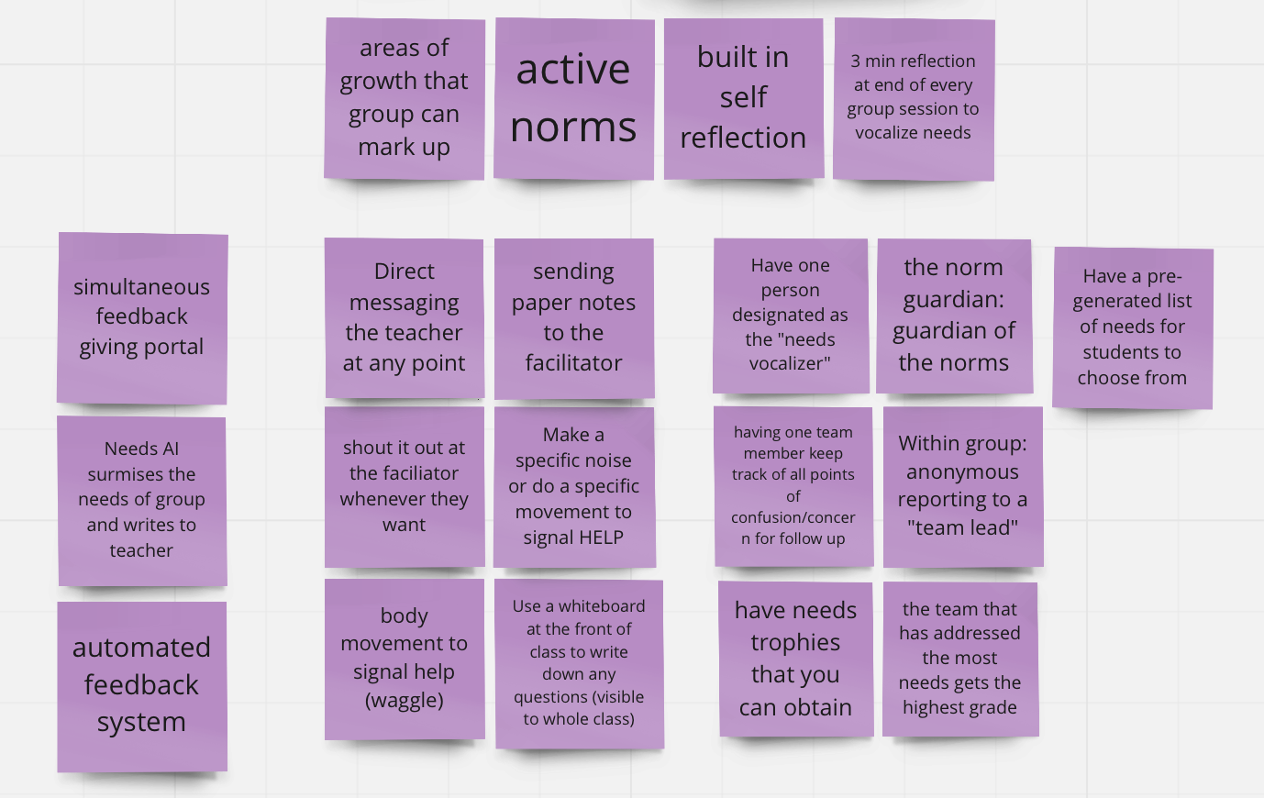
HMW encourage teams to be more vocal about their needs in learning experiences?

Slide 40
Credits
Special thanks to all the people who made and released these awesome resources for free:
Presentation template by SlidesCarnival

