Slide 1
Needfinding for Hybrid Collaboration
January 14, 2022

Slide 2
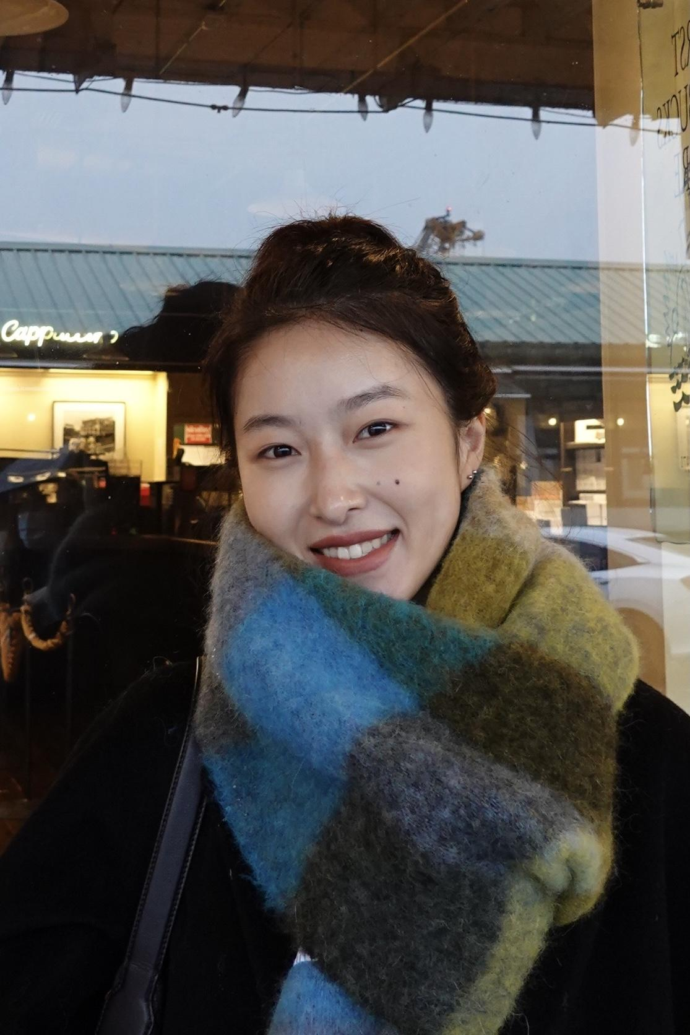
Meet the Team
Sam Silverstein
Symbolic Systems ‘22
M.S. CS ‘23
Kelly Chen
M.S. LDT ‘22
Zander Lack
CS ‘24
Ben Thier
M.S. LDT ‘22

Slide 3
Domains in Hybrid Collaboration
Learning
Environments
Professional
Environments
(Schools Week)
(Offset)
Technology-Supported Mediation of Teamwork

Slide 4
Participant Selection
Environments
Academic
Tech Experiences
Subject Domains
Tech-Averse
Tech-Willing
Professional

Slide 5
Interview Participants
Soren
Erika
Tracy
Eric
Ear training teacher
@ Stanford
Data Scientist
@ energy company
Co-Instructor
@ Stanford LDT Master’s Program
PhD candidate in Consumer Behavior
@ WashU

Slide 6
Participant Selection
Environments
Academic
E
T
Tech Experiences
Subject Domains
Tech Averse
Tech-Savvy
S
?
E
Professional

Slide 7
Participant Selection
Environments
Academic
E
T
Tech Experiences
Subject Domains
Tech Averse
Tech-Savvy
S
Extremes
?
E
Professional

Slide 8
Guiding Questions
01
02
03
04
How do you monitor collaborative work?
How did your collaboration change after moving online?
Can you walk me through a time when you ran into a problem in working virtually?
What was your initial reaction to teaching on Zoom?

Slide 9
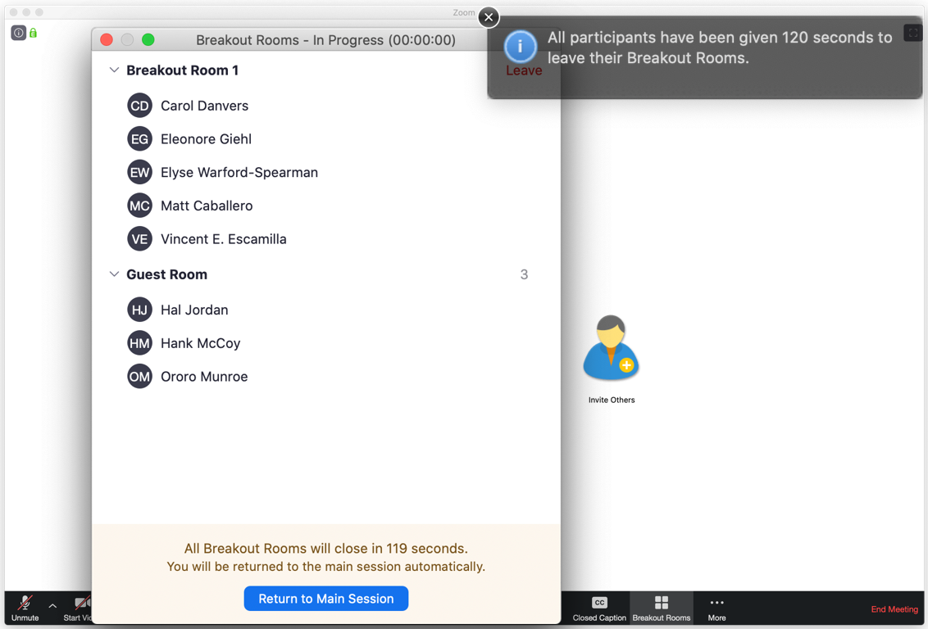
Interview Results
“I see a list of breakout rooms - which one do I jump into? There’s no direction. You don’t want to feel like you’re picking on people or arbitrarily jumping in.”
“Monitoring how people are talking to each other feels more invasive.”
Soren on monitoring virtual collaboration
(Zoom)

Slide 10
Interview Results
“Zoom is tiring… it can leave people with a real sense of disconnected association.”
“Students on the slower end of transcribing have more time to digest the material and feel proud of what they’ve done”
(ComposerCode)
Erika on virtual class community and teaching

Slide 11
Interview Results
“But after the pandemic, we were able to recruit participants from… all over the world.”
“We were able to recruit much more participants and run a lot of study sessions.”
Tracy on the unforeseen benefits to research on Zoom
(VectorStock)

Slide 12
Empathy Map: Tracy
“But after the pandemic, we were able to recruit participants from… all over the world.”
“Most problems are because of tech issues in the virtual lab.”
“In this virtual world… people schedule meetings back to back… because Zoom is too convenient.”
The virtual lab gave her more flexibility in scheduling.
Facial expressions are important in interactions.
Hybrid mode works very well for her research but not classes.
Say
“We were able to recruit much more participants and run a lot of study sessions.”
“On Zoom, you don’t know when is the right time for you to start talking… Everyone is muted. There is always silence.”
“Everyone should be open and say ‘I really need a 10-min break’.”
Turning the camera on leads to better engagement.
Breakout rooms are helpful.
Silence in conversations signals that it’s her turn to talk.
Think
Embarrassed when another person and her unexpectedly start talking at the same time on zoom.
Teaches participants basic functions and conducts a Zoom prescreening to ensure participants understand them.
Collaborates with other RAs across different breakout rooms to run multiple studies simultaneously.
Surprised by increased connections she has with coworkers.
Frustrated when people run into technical issues.
Runs experiments with participants in a virtual lab over Zoom
Do
Works on different studies multiple times a week instead of only on one specific study on Sundays.
Organizes social events via Zoom for the lab. (movie nights, self-care nights etc.)
Prepares a meeting agenda in a separate Google Doc.
Surprised that team bonding got better post-pandemic.
Exhausted after being on zoom for 3 hrs.
Weird to use the ‘raise hand’ function in just a small meeting.
Feel

Slide 13
Say
“On Zoom, you don’t know when is the right time for you to start talking… Everyone is muted. There is always silence.”
“…eye contact matters.. I need to actively see what’s on a piece of paper”
“Does that create an unrealistic sense of.. goals.. we’re moving towards a flexible and rapid ear.”
“Zoom is tiring… it can leave people with real sense of disconnected association”
“You get no feedback it’s very difficult to read faces”
“But after the pandemic, we were able to recruit participants from… all over the world.”
“In this virtual world… people schedule meetings back to back… because Zoom is too convenient.”
“Instantaneous communication… allows conversation to feel more informal”
“Having people with a diversity of skill sets is important”
“students on the slower end of transcribing have more time to digest the material and feel proud of what they’ve done”
“If people in breakout rooms were able to signal when they want the facilitator to enter the room, I would feel more invited.”
“The primary thing is to have trust with your teammates”
“Monitoring how people are talking to each other feels more invasive.”
“Walking around a room and being curious about a conversation that’s happening, stopping in, feels a little more natural.”
“Everyone should be open and say ‘I really need a 10-min break’.”

Slide 14
Do
Have a way to check base with teammates over a communication tool
Runs experiments with participants in a virtual lab over Zoom
Works on different studies multiple times a week instead of only on one specific study on Sundays.
Changed class from 3 times a week to just once a week on Zoom
Actively adjusts her teaching material based on visual cues
Teaches participants basic functions and conducts a Zoom prescreening to ensure participants understand them.
Assigns peer feedback opportunities to lessen teaching load
Collaborates with other RAs across different breakout rooms to run multiple studies simultaneously.
Walks around her classroom to see how each student is handling the material.
Plans next steps while groups are collaborating
Works closely with students who are struggling
Stays in the main Zoom room during breakout sessions
Organizes social events via Zoom for the lab. (movie nights, self-care nights etc.)
Prepares a meeting agenda in a separate Google Doc.
Assesses energy and productivity of in-person teams
Distribute roles in teams to match skill sets
Prepares a meeting agenda in a separate Google Doc.

Slide 15
Think
Teaching is about trade-offs
He needs better online monitoring tools
Giving students more time with material is good.
Zoom accommodated more experience leves
Facial expressions are important in interactions.
Turning the camera on leads to better engagement.
Teams do not utilize norms well
Students should receive feedback every time they do thoughtful work
The virtual lab gave her more flexibility in scheduling.
Breakout rooms are helpful.
Zoom offers more reflection
Zoom leaves people feeling disconnected
Teammates are useful for providing different perspectives and approaches
Teams with diverse backgrounds are more creative
Real-time communication leads to optimal information exchange in teams.
Trust improves team effectiveness
Team dynamics change depending on the setting and goal.
Zoom class necessitates individual learning.

Slide 16
Feel
Apprehensive when first working with a new team
Trusting of reliable and consistent teammates
Single-minded in work settings, more gregarious in academic settings
Surprised about the benefits Zoom offered for slower students
Unsure of how to balance Zoom tradeoffs.
Less comfortable teaching without in-person feedback
Embarrassed when another person and her unexpectedly start talking at the same time on zoom.
More resigned during online monitoring
More capable with faster communication tools
Less pressing need to monitor teams he trusts
Disdain for lack of connection from Zoom (like it adds a wall)
Attached to traditional methods of teaching
More equipped to monitor in-person collaboration
Uninvited to join online collaborative sessions
Sense of arbitrariness in online monitoring
Surprised that team bonding got better post-pandemic.
Exhausted after being on zoom for 3 hrs.
Weird to use the ‘raise hand’ function in just a small meeting.

Slide 17
Surprises Contradictions Tensions
Feedback mechanisms
Transfer of skills to virtual world
Trust
Similarity across environments
Willingness to engage virtually for different purposes
Negative & positive emotion

Slide 18
Needs Driving Insights
What role does technology play in mediating collaborative interactions that take place in person?
How might we extract the positives of virtual collaboration and transfer them to better facilitate in person collaboration?

Slide 19
Acknowledgements
Slide layout from Slidesgo and Freepik
Image credits provided under images

Slide 20
Empathy Map: Tracy
“But after the pandemic, we were able to recruit participants from… all over the world.”
“Most problems are because of tech issues in the virtual lab.”
“In this virtual world… people schedule meetings back to back… because Zoom is too convenient.”
The virtual lab gave her more flexibility in scheduling.
Facial expressions are important in interactions.
Hybrid mode works very well for her research but not classes.
Say
“We were able to recruit much more participants and run a lot of study sessions.”
“On Zoom, you don’t know when is the right time for you to start talking… Everyone is muted. There is always silence.”
“Everyone should be open and say ‘I really need a 10-min break’.”
Turning the camera on leads to better engagement.
Breakout rooms are helpful.
Silence in conversations signals that it’s her turn to talk.
Think
Embarrassed when another person and her unexpectedly start talking at the same time on zoom.
Collaborates with other RAs across different breakout rooms to run multiple studies simultaneously.
Surprised by increased connections she has with coworkers.
Frustrated when people run into technical issues.
Runs experiments with participants in a virtual lab over Zoom
Teaches participants basic functions and conducts a Zoom prescreening to ensure participants understand them.
Do
Works on different studies multiple times a week instead of only on one specific study on Sundays.
Organizes social events via Zoom for the lab. (movie nights, self-care nights etc.)
Prepares a meeting agenda in a separate Google Doc.
Surprised that team bonding got better post-pandemic.
Exhausted after being on zoom for 3 hrs.
Weird to use the ‘raise hand’ function in just a small meeting.
Feel

Slide 21
Empathy Map: Soren
“I’ve read a lot about what makes for good teams.”
“If people in breakout rooms were able to signal when they want the facilitator to enter the room, I would feel more invited.”
He doesn’t incorporate his research into his teaching practice often enough
Teaching is about trade-offs
He needs better online monitoring tools
Say
“Walking around a room and being curious about a conversation that’s happening, stopping in, feels a little more natural.”
“Monitoring how people are talking to each other feels more invasive.”
Teams do not utilize norms well
Students should receive feedback every time they do thoughtful work
If he’s good at teaching something, he should teach it again
Think
Assigns peer feedback opportunities to lessen teaching load
Monitors in-person collaboration more closely
Stays in the main Zoom room during breakout sessions
Uninvited to join online collaborative sessions
More equipped to monitor in-person collaboration
Sense of arbitrariness in online monitoring
Do
Assesses energy and productivity of in-person teams
Plans next steps while groups are collaborating
Researches peer to peer learning
Less pressing need to monitor teams he trusts
More resigned during online monitoring
Passionate about his research and job
Feel

Slide 22
Empathy Map: Erika
“It was a real panic moment…
…eye contact matters.. I need to actively see what’s on a piece of paper”
Zoom leaves people feeling disconnected
Zoom offers more reflection
Zoom accommodated more experience leves
Say
“You get no feedback. it’s very difficult to read faces”
“Zoom is tiring… it can leave people with real sense of disconnected association”
Giving students more time with material is good.
Zoom class necessitates individual learning.
Giving students more time works against training students to have a fast ear
“students on the slower end of transcribing have more time to digest the material and feel proud of what they’ve done”
“Does that create an unrealistic sense of.. goals.. we’re moving towards a flexible and rapid ear.”
Think
Actively adjusts her teaching material based on visual cues
Changed class from 3 times a week to just once a week on Zoom
Less comfortable teaching without in-person feedback
Disdain for lack of connection from Zoom (like it adds a wall)
Unsure of how to balance Zoom tradeoffs.
Do
Walks around her classroom to see how each student is handling the material.
“Works closely with students who are struggling”
Feel
Attached to traditional methods of teaching
Surprised about the benefits Zoom offered for slower students

Slide 23
Empathy Map: Eric
“Instantaneous communication… allows conversation to feel more informal”
“My teammates brought a lot of out-of-the-box solutions”
“At a company you just need to get it done, but in school everybody needs to learn”
Real-time communication leads to optimal information exchange in teams.
Teammates are useful for providing different perspectives and approaches
Team dynamics change depending on the setting and goal.
Say
“I got a lot of value where I was the one explaining, just the act of that helps”
“The primary thing is to have trust with your teammates”
“Having people with a diversity of skill sets is important”
Teams with diverse backgrounds are more creative
Trust improves team effectiveness
In person collaboration is better than virtual collaboration
Think
Communicate on tools like Slack over Email
Asks teammates for ideas and encourages participation of others
Be reliable and consistent to establish trust with teammates
Need for an informal environment is important for effective communication
Trusting of reliable and consistent teammates
Single-minded in work settings, more gregarious in academic settings
Do
Distribute roles in teams to match skill sets
Be on the lookout to help your teammates
Have a way to check base with teammates over a communication tool
Apprehensive when first working with a new team
More capable with faster communication tools
Grateful to have completed a large project
Feel

