Slide 1
Ping!
So your LDR doesn’t become TL;DR
Emily, Mhar, Bryan, & Ada

Slide 2
Problem:
When people move, leaving friends behind, in the face of distance, new stressors, and perhaps even timezones, relationships inevitably shift. People can no longer share their lives with friends in the same manner: some try to keep up through long texts or long calls but those feel high stakes and require schedule alignment to keep up, while maintaining a brief ‘daily streak’ results in meaningless conversations. People lose serendipitous, quick and meaningful ways to share with their loved ones and show they are thinking of them in the moment.
Notes:
NEEDS EDITING
When people move away, leaving friends behind, in the face of distance, new stressors, environment and perhaps even timezones, relationships inevitably shift.
People can no longer share their lives with friends in the same manner: some try to keep up through long texts or scheduling long calls but those require a lot of time, effort and schedule alignment to keep up, while maintaining a brief ‘daily streak’ results in meaningless conversations. People lose serendipitous, quick and meaningful ways to share with loved ones and show they are thinking of them in the moment.
show their loved ones they are thinking of them in the moment.
\On the other side of the spectrum, maintaining short,
People lose those serendipitous, quick and meaningful ways to show their loved ones they are thinking of them in the moment.
the pressure to reply ASAP,
relationships shift, immune
inevitably their life changes due to the c timezone, environment, distance, people the distance, timezone and environment,
away, their relationships with friends and family who were once close by inevitably undergo change, flux
When people move, they undergo a period of flux where
When people move, due to the circumstances, distance, timezones, stress
People struggle with their relationships changing, unable to have continue the same kind of bond prior to a move.
Readjust
Circumstances
Relationships morph into a new
Relationships with friends and family who were once close by change
People can no longer share their life in the same manner
relationships inevitably change
their relationships with friends and family
When people move away, leaving friends and family behind, their life becomes a stressful whirlwind, perhaps even in an entirely flipped timezone. People are left to send huge text blocks to keep up with friends and lose serendipitous, quick meaningful ways to show their loved ones they are thinking of them in the moment. The stakes are too high to reply to long messages ASAP to keep up friendships or, on the opposite side of the spectrum, the expectation to maintain a quick, meaningless ‘daily streak’ results in bland, mundane conversations.

Slide 3
Solution:
A way to show your friends you are thinking of them, even when you’re far apart, and to keep yourself accountable to your communication goals
Introducing Ping! Centered around tokens that have low stakes yet big meaning, “Ping!” makes it easy to manage communicating across time-zones, keep track of important friendship dates and set/maintain personal communication goals. It’s a hub for small spontaneous tokens and an angel on your shoulder reminding and helping you to show your loved ones you care, even when you’re busy.
Notes:
Needs editing

Slide 4
🗒️
Tasks
Send an immediate thoughtful token (eg. an emoji or short string of emojis) [SIMPLE TASK]
Receive and save a thoughtful token [SIMPLE TASK]
Schedule a token to send at a specific time in your friend’s time zone [MODERATE TASK]
Set a communication goal for yourself [COMPLEX TASK]
Keeping track of important dates and moments with your friend [COMPLEX TASK]
Notes:
Three to Five Tasks: Capture the core tasks that your project enables. Together, they should capture the core value prop of your product and address the problem you’re tackling. Label them as simple, medium, and complex
Your tasks will be graded on how well they match the needs of your target user, represent real goals they might have, have variety, and are complete tasks (rather than sub-tasks) that have the necessary details.
Send a thoughtful token (eg. an emoji or short string of emojis) [SIMPLE TASK]
Opening and keeping a thoughtful token [SIMPLE TASK]
Save a token to your favorites list [SIMPLE TASK]
Schedule a token to send at a specific time in your friend’s time zone [MODERATE TASK]
Set a communication goal for yourself [COMPLEX TASK]
OTHER SCHEDULING TASK ????
TODO: NEEDS MORE DETAIL and REVIEW !!!
SEE SPEAKER NOTES !!!!!

Slide 5
🖌️
Values in Design
Our project is centered around the value of meaningful, thoughtful communication. We also value convenience amidst stressful, busy days. While these two ideas, meaningful communication and convenience, might seem to be conflicting values, we are striving to enable ways that they can live in harmony.
We hope to encode these values through applying a constraint on the length of messages to inspire thoughtful, creative, and quick “Ping!”. A token sent to one person, might mean an entirely different thing to another. We also plan to limit the ability to share potentially harmful, non-consensual messages (and other potential misuses).
Notes:
Values in Design: Include a statement about the values embedded in the project and how you intend to encode these values. ○ Are there conflicting values? ○ If so, how are you addressing such conflicts?
Our product is centered around the value of meaningful, thoughtful communication. We also value convenience amidst stressful, busy days. While these two ideas, meaningful communication and convenience, might seem to be conflicting values, we are striving to find a way that they can live in harmony.
We are accomplishing meaningful communication through XXXXXXXXXX, and we are ensuring convenience by XXXXXXXXXXX

Slide 6
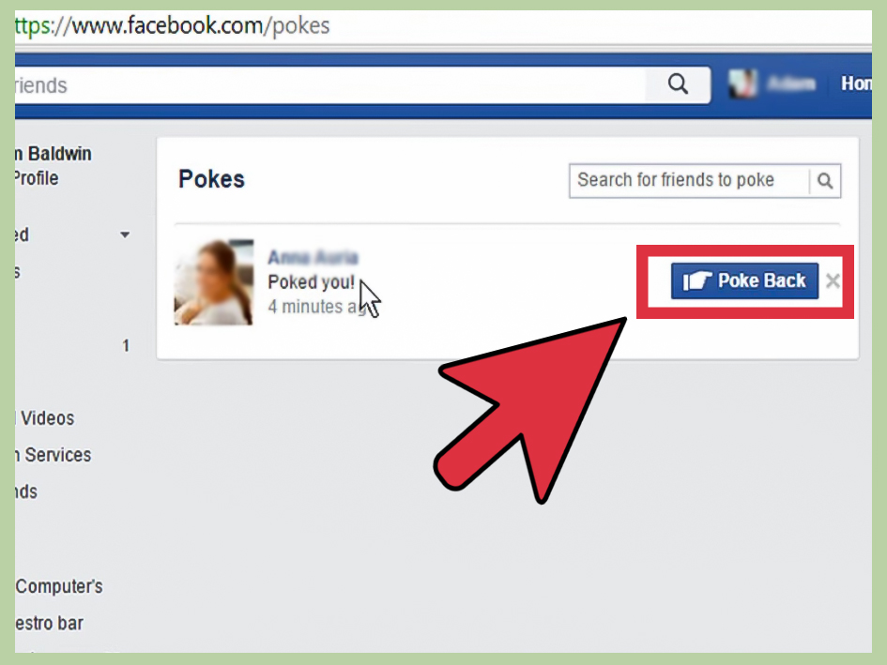
SIMILARITIES: Same idea of low-commitment interaction, a poke lets the other person they are thinking of you. Poke, while still a thing, is largely unused and not as visible on someone’s profile anymore.
How their solution differs from ours:
You can poke anyone
Not a substantial, meaningful interaction – no content
What worked:
"My actual friends and I would keep poking each other like idiots and that part of it was fun." - Meena Das (in an interview with Gadgets 360)
What worked for this person is the idea of “poking” your friends–our idea that low-level interactions can be fun and meaningful if they are between people who share a connection.
What didn’t work:
"From disgust, boredom to gluttony, one can explicitly express all of this using emojis, stickers, and the feelings/ activities feature on Facebook, so the fact that poke is still around is surprising." - Priya Saini (in an interview with Gadgets 360)
As this person said, stickers and emojis convey more emotions than a single poke
The generality of a poke made it ambiguous and sometimes creepy when given by strangers.
What makes our solution unique:
Ours will fix this by making the interaction more personal: through emojis, drawings, friend calendars, friend push notifications, etc. while remaining the low-level commitment that Poke was intended for. You can also only send Pings to your friends.
Market Research #1: Facebook’s “Poke”
SOURCES: Sathe, G. (2018, February 21). What is a facebook poke? is it still a thing? NDTV Gadgets 360. from https://gadgets.ndtv.com/social-networking/features/what-is-facebook-poke-how-to-facebook-poke-1815275

Slide 7
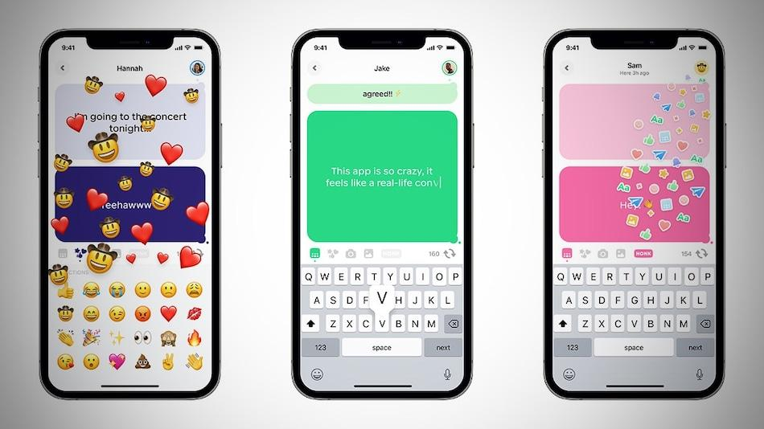
Market Research #2: HONK
SIMILARITIES: Have an option in its live chat feature where you can react with emojis and it will float in the screen like the picture on the left. One of the features where the app’s concept might be similar is: “Honk friends to get their attention” (from the App Store description).
How their solution differs from ours: The app has a different purpose – it is used for live chat like Omegle and you can either interact with entirely new people or your friends.
What worked: (Quotes from App Store Reviews)
I’d say this app is good for quick conversation that you don’t want saved because everything is in real time, and it’s a good way to quickly get ahold of someone.
“+2 stars for having an option to send pics n audio messages! V much enjoy much fun”
“The customizable magic words are super cute.”
What didn’t work:
Users reported that there are not a lot of users in the app and therefore they cannot meet new people
Limited range of emojis
Harassment from strangers
Lack of group chats
What makes our solution unique:
Our app is different in that it is not a “live-messaging” app. One of our features, where you can schedule Pings or get reminders for Pings, is the opposite of Honk’s purpose.
Our emojis and Pings would have a larger range. For example, you can send personalized drawings or short song snippets.
OTHER NOTES:
Two of our teammates tried the app. Here’s our brief review:
Really clean UI.
Emojis are very limited. The feature where you can see what the other person is typing is interesting, but doesn’t seem to be good for longer-types of texting.

Slide 8
Video Storyboards
Notes:
We also want to make sure you know how to use storyboards to plan your video shooting. You will be graded on how well these video planning storyboards document the scenes in your eventual video.

Slide 9
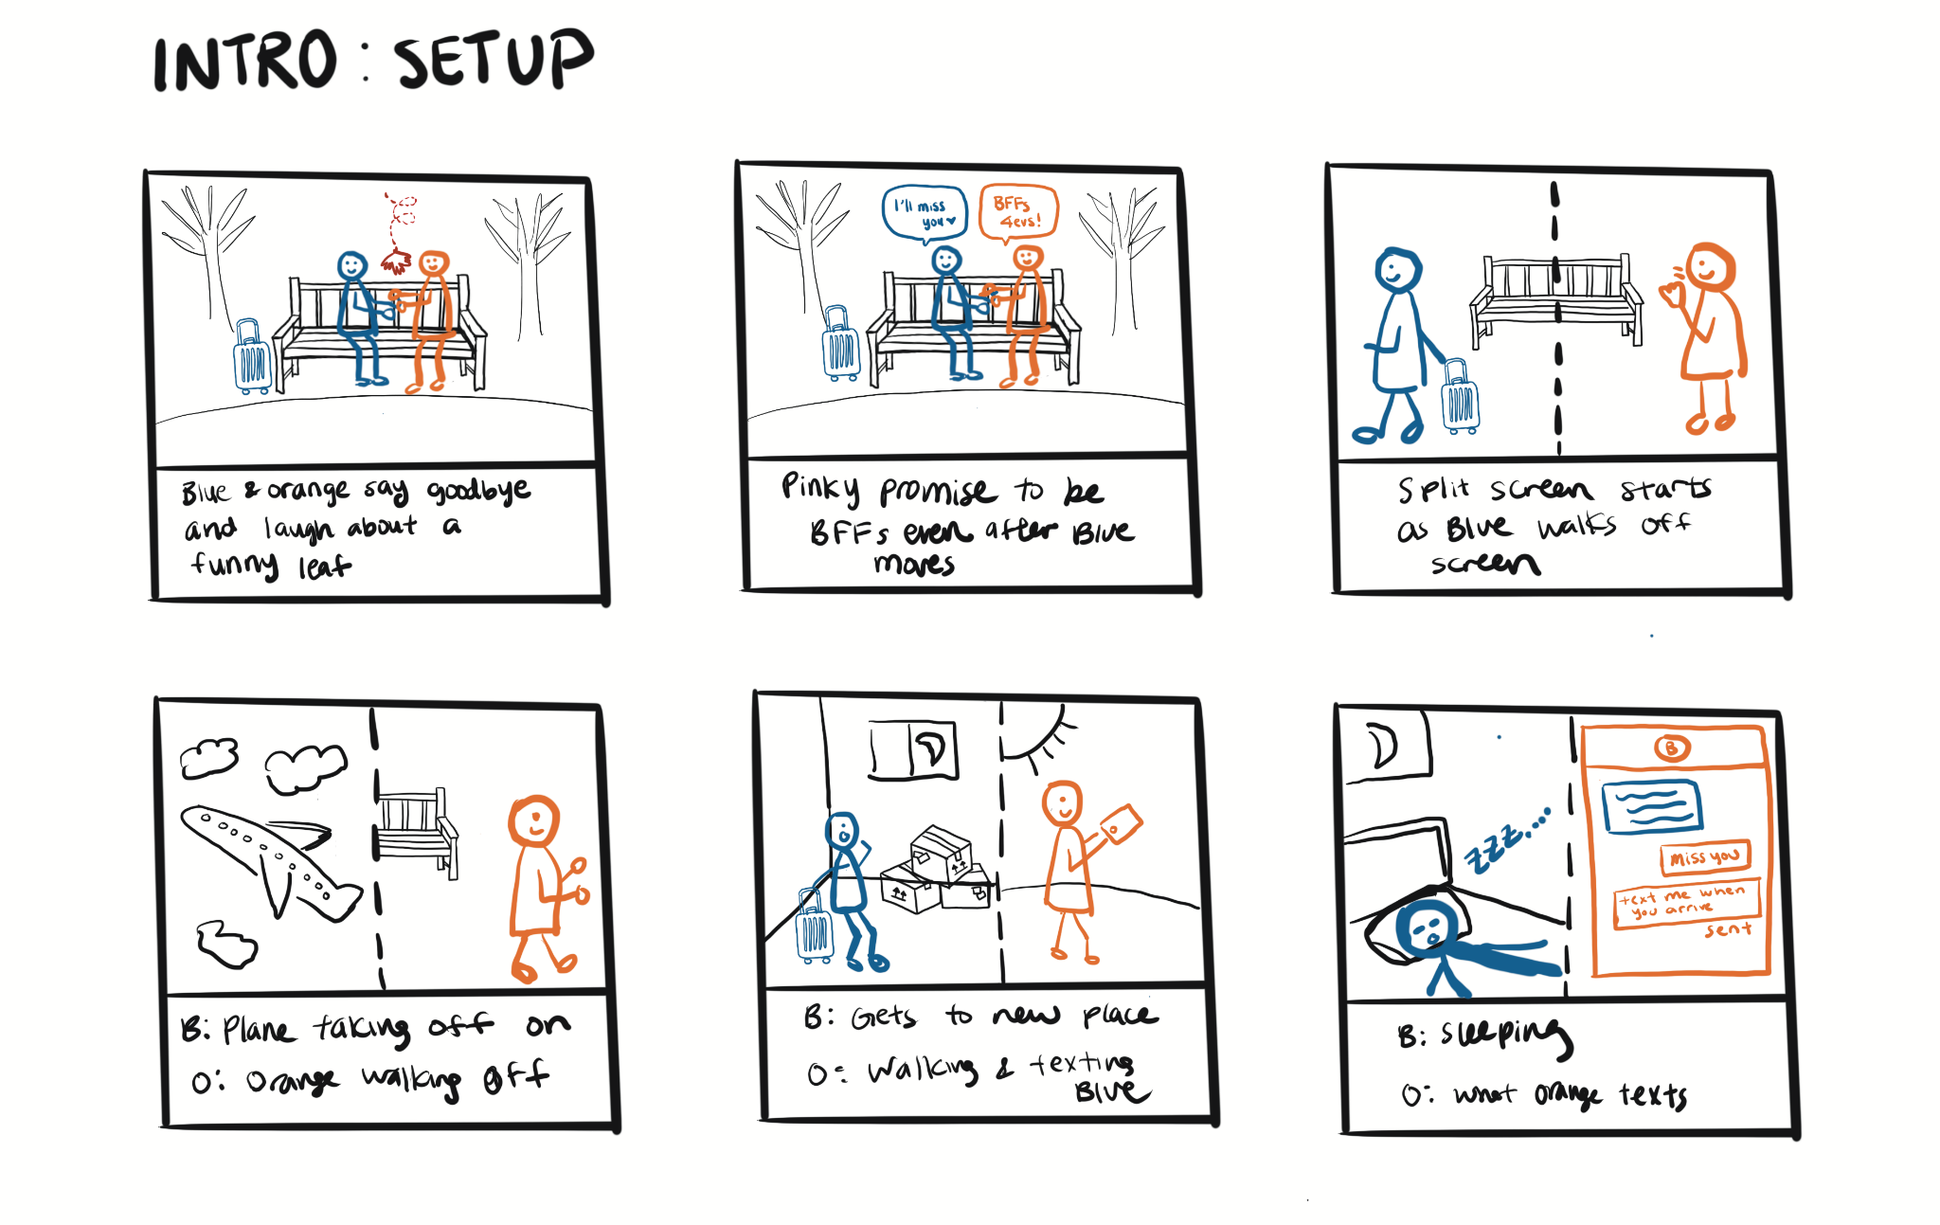

Slide 10
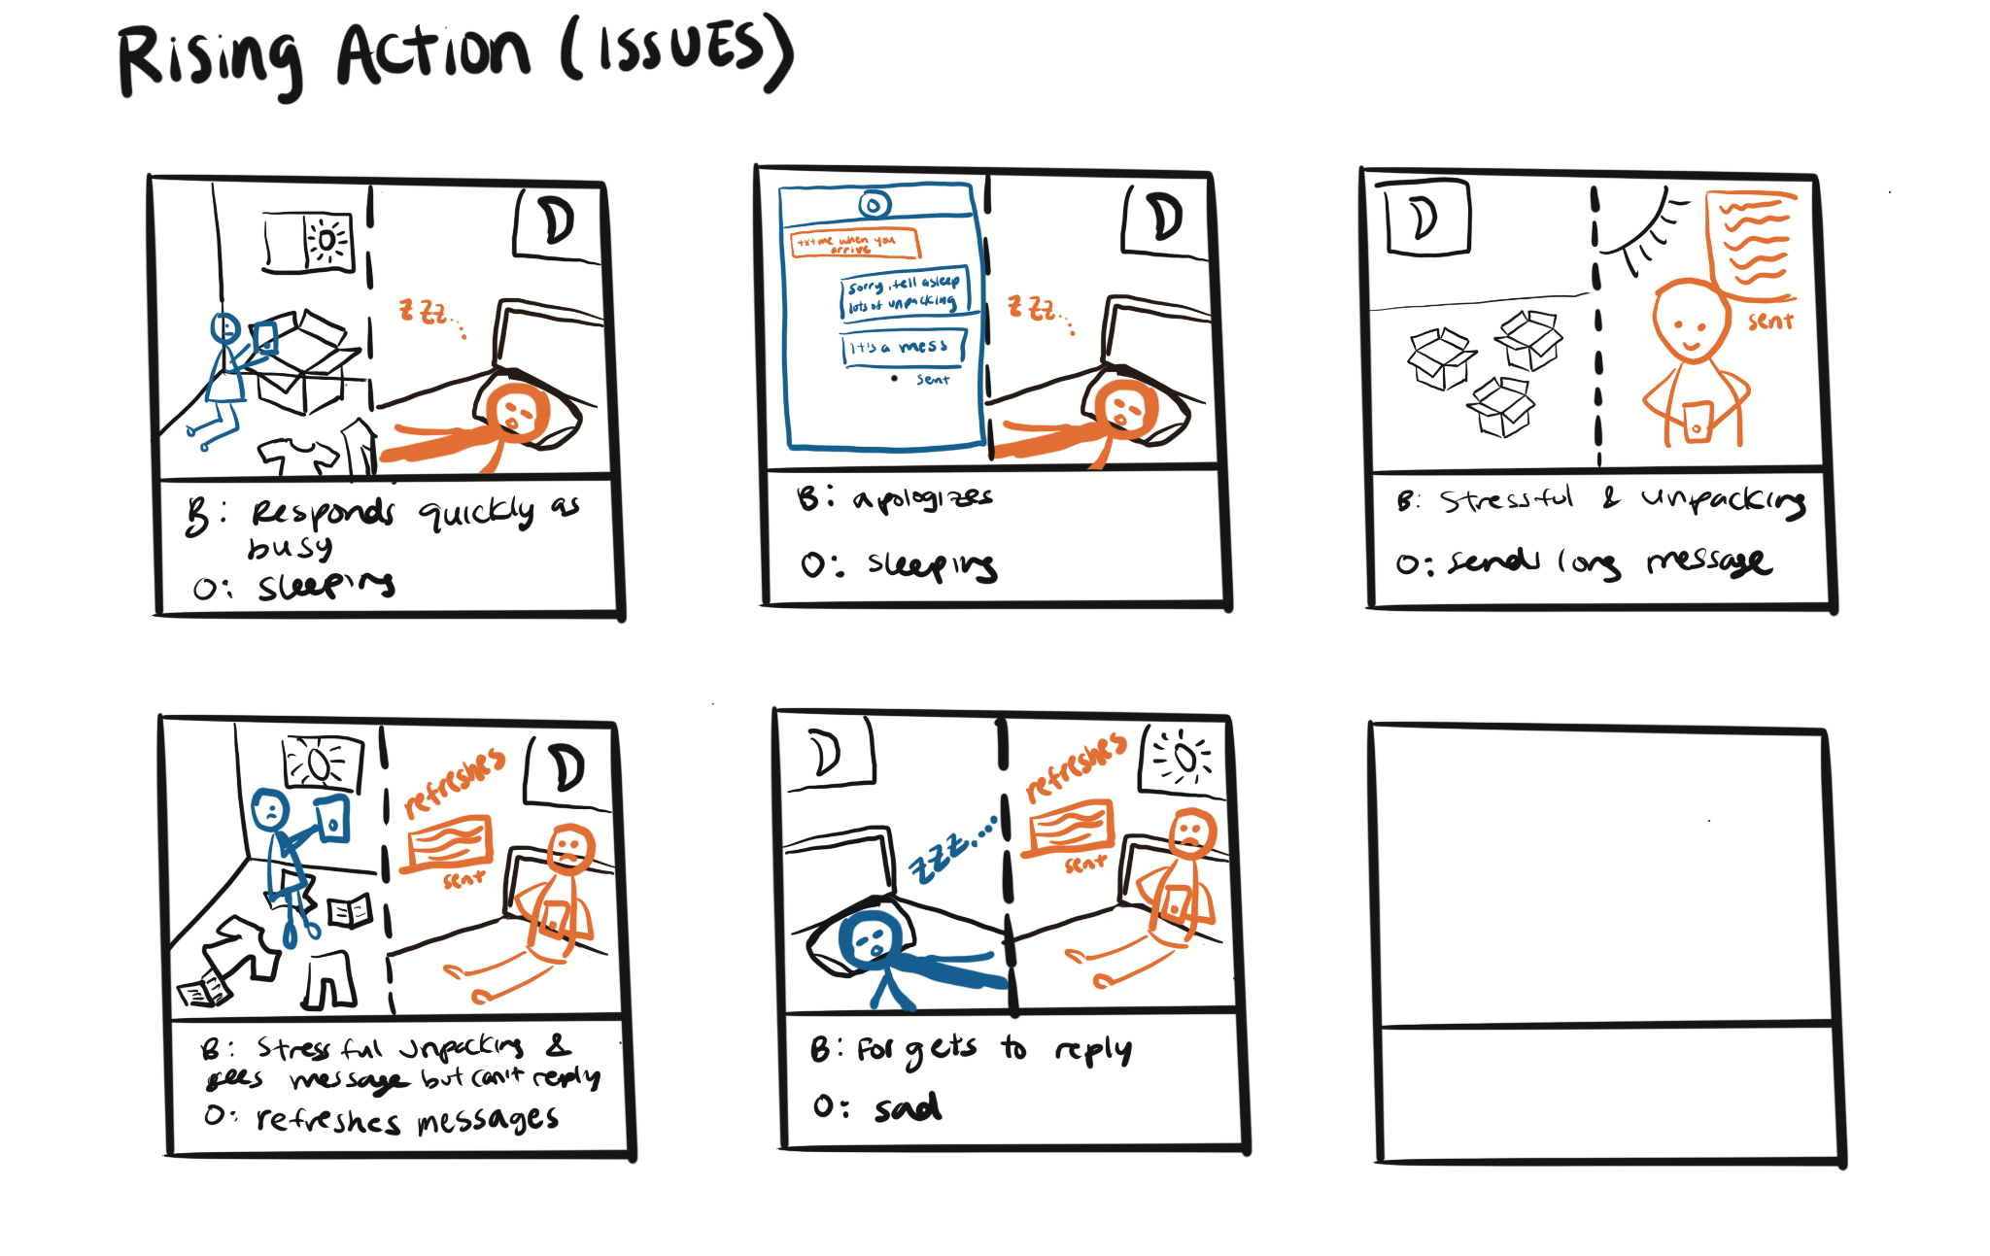

Slide 11
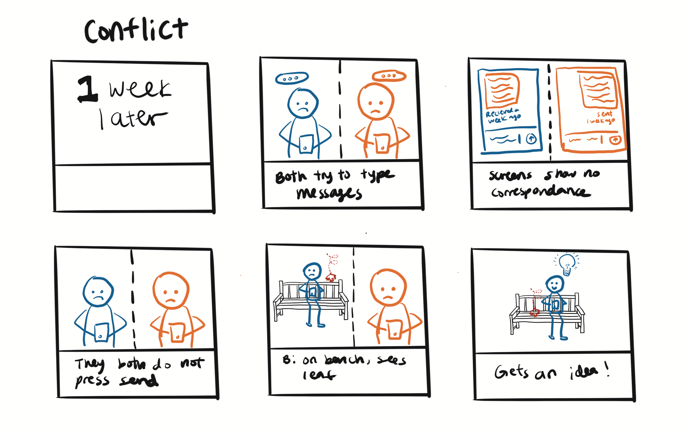

Slide 12
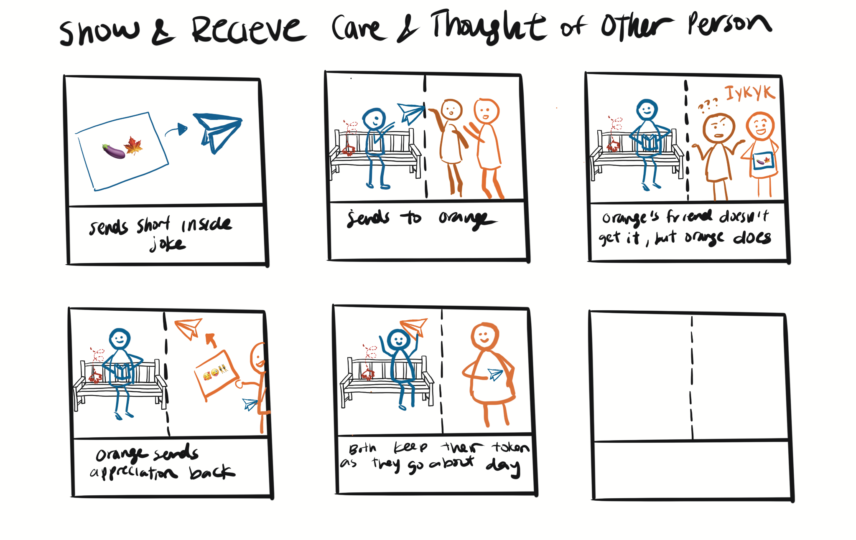

Slide 13
