Slide 1
So your LDR doesn’t become TL;DR

Slide 2
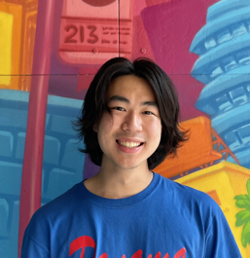
Team
Designer,
UX Researcher
Designer,
UX Researcher
Designer,
Developer
Designer,
Developer

Slide 3
Problem
Staying close to friends and family is stressful amidst hectic days, different time zones, and awkward, high-stakes communication platforms. In fact, it’s nearly impossible and often results in personal guilt and fallen friendships.
Notes:
M

Slide 4
Solution
Introducing Ping, a low-stress, convenient hub to show your loved ones you are thinking of them by sending thoughtful tokens, sharing meaningful moments, and maintaining connection goals. It’s an angel on your shoulder reminding you to show your loved ones you care, even when you’re busy or far apart.
Notes:
M

Slide 5
Overview
1
2
3
4
Heuristic Evaluation
Revised Design
Prototype Implementation
Prototype
Demo

Slide 6
1
Heuristic Evaluation

Slide 7
Heuristic Evaluation Results
5
Severity 4 violations
22
Severity 3 violations
55
Severity 1-2 violations

Slide 8
Heuristic Evaluation Results
Severity 3-4 violations for each task:
General (11)
Create a moment (2)
Communicate thoughtful token (13)
Make connection goal (1)
Mostly:
H5: Error Prevention
H1: Visibility of Status
]
5
Severity 4 violations
22
Severity 3 violations
55
Severity 1-2 violations

Slide 9
2
Revised Design

Slide 10
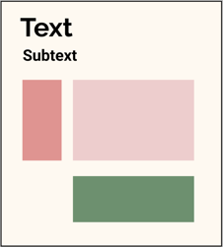
Severity 1-2 Violations Briefly
Majority were H4: Consistency & Standards
Fixes:
Color Scheme
Standardizing Headers
Standardizing Buttons
Increasing Text Sizes
Improving transition flows between screens
Standardizing to user friendly time display

Slide 11
Severity 3-4 Violations: General
Problem:
Our value is meaningful connection but are only emojis in tokens enough?
Suggested fix:
Adding more to tokens such as a voice note, text, photos, etc. might make them more meaningful.

Slide 12
Our Thinking:
Constraints are not restraints (feedback from user testing)
Moments (more on this later) and Tokens
Platform for low stakes yet meaningful connection (this is a balancing act)
Notes:
We don’t think token should be the only form of connection to form a bond but an additional medium for connection particularly for when you’re busy, far away, stressed
User tests both from our assumption testing and low-fi prototype testing - we heard users say they loved it!
Design change inspired by this comment and something we heard from our user during low-fi testing: she was delighted by the poop emoji which she never used - the sample tokens we show on the app are more of a mixture of unique and common emojis now.

Slide 13
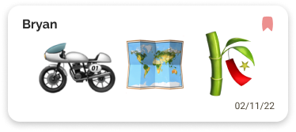
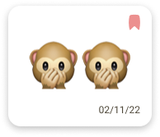
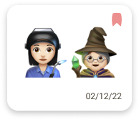
Our Thinking:
Constraints are not restraints (feedback from user testing)
Moments (more on this later) and Tokens
Platform for low stakes yet meaningful connection
before
after
Notes:
We don’t think token should be the only form of connection to form a bond but an additional medium for connection particularly for when you’re busy, far away, stressed
User tests both from our assumption testing and low-fi prototype testing - we heard users say they loved it!
Design change inspired by this comment and something we heard from our user during low-fi testing: she was delighted by the poop emoji which she never used - the sample tokens we show on the app are more of a mixture of unique and common emojis now.

Slide 14
Severity 3-4 Violations: General
Problem:
Unintuitive to have app design predominantly separated by task rather than person

Slide 15
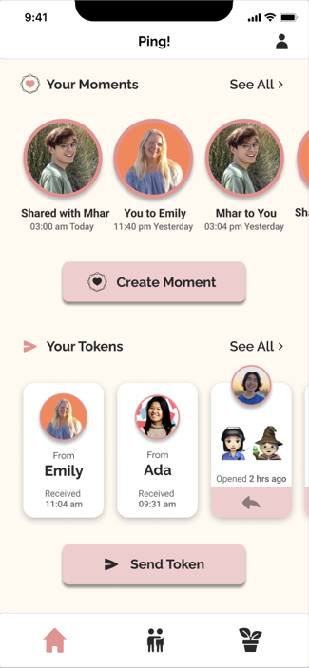
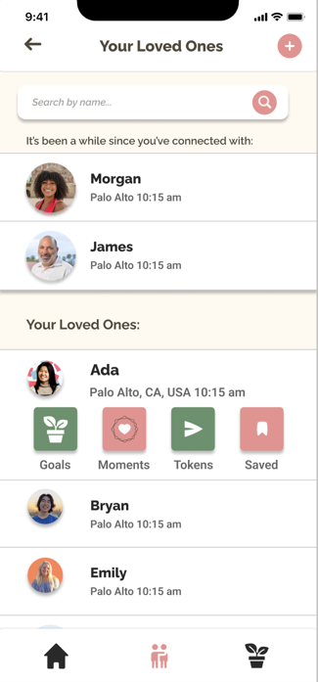
Our Thinking:
Home page has a balance of user initiating connection and user viewing previous connection
Friends List page supports ability to choose friend first then task
Notes:
[Delight]
Being able to respond to recent tokens by individuals through homepage
More efficient

Slide 16
Severity 3-4 Violations: General
Problem:
New users won’t be able to tell the difference between moments and tokens and cannot find documentation on features.

Slide 17
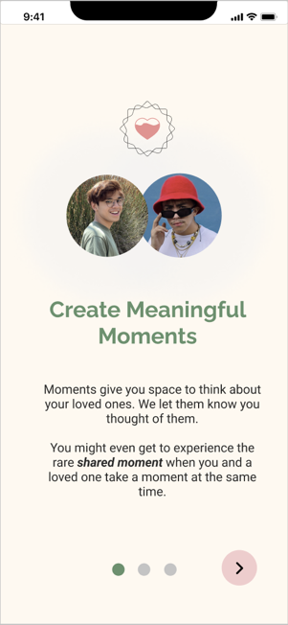
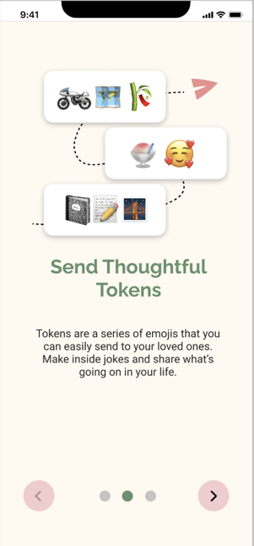
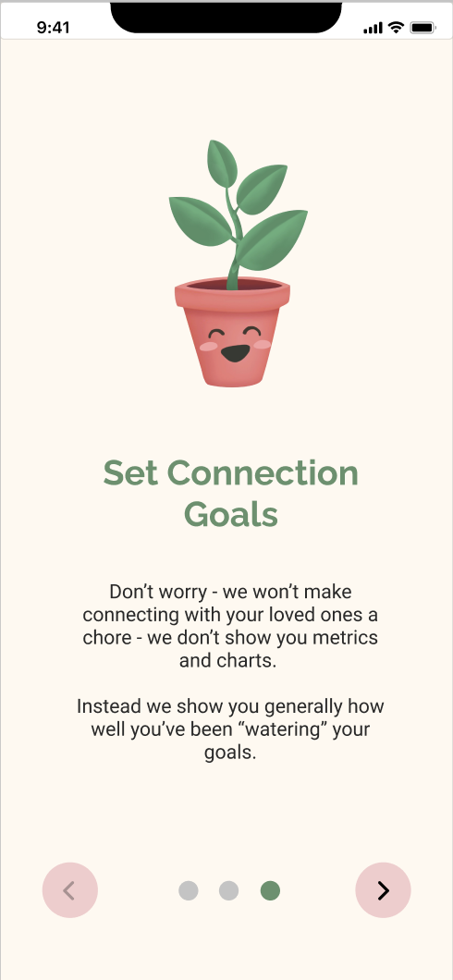
Fix:
Adding onboarding screens for new users
Notes:
[Delight]
Being able to respond to recent tokens by individuals through homepage

Slide 18
Severity 3-4 Violations: Moments Task
Problem:
Stressful for user to respond to a friend wanting to share a moment within 30 seconds.

Slide 19
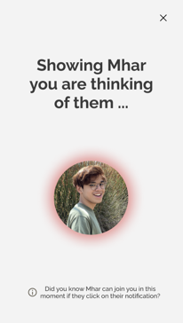
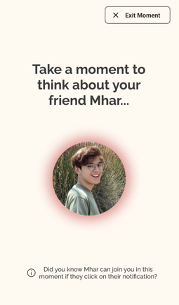
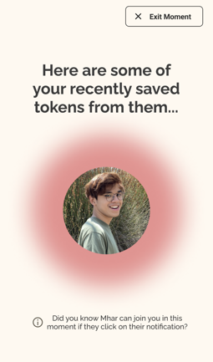
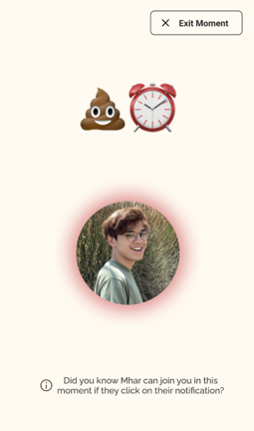
Fix:
Restructured moments to be about making space to think of your loved one instead of waiting for them to join.
“Sharing a moment” is an incredible bonus if it happens, but no longer the main goal.
before
after
Notes:
Expectation is moment is for you to think of your friend and they will get notified of that
“Secret pathway” if your friend happens to be on their phone and want to take the time to share with you – so they’re not waiting – Delight

Slide 20
Severity 3-4 Violations: Tokens Task
Problem:
Sent token confirmation screen that disappears is jarring.
Users expect to see what tokens they’ve sent.

Slide 21
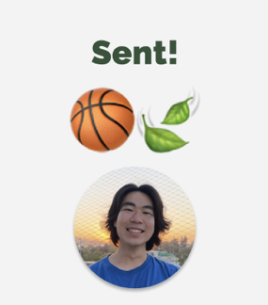
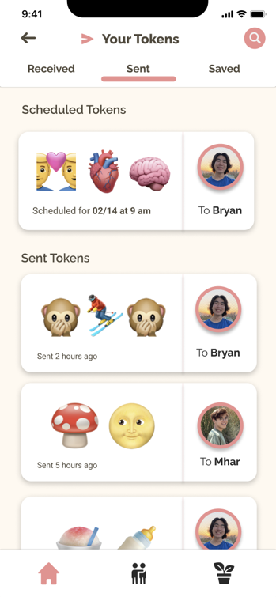
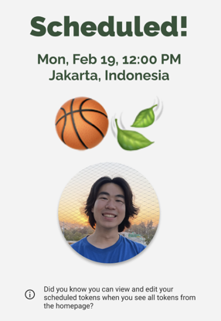
before
after
Fix:
Making a sent tab in “Your Tokens.”
Sending users to the sent tab after they click send a token.

Slide 22
Severity 3-4 Violations: Tokens Task
Problem:
Overly restrictive for users to only be able to save one token.

Slide 23
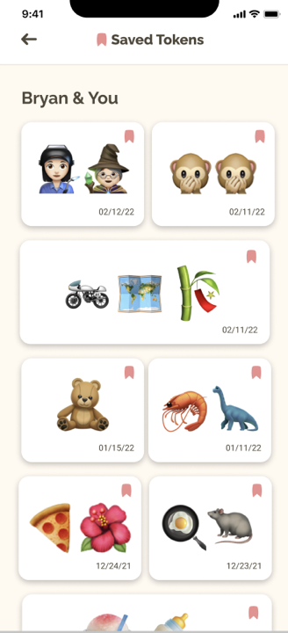
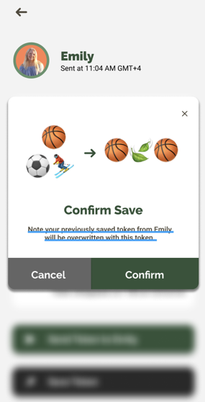
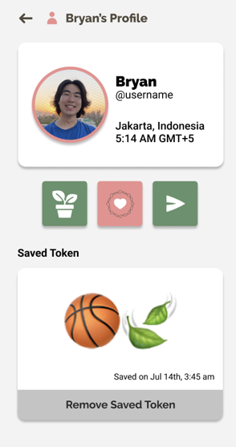
before
after
Fix:
Allow users to save more than one token per person.
Changed friend profile to saved tokens page.

Slide 24
Severity 3-4 Violations: Tokens Task
Problems:
Users can’t remove a prompt once they’ve chosen it
Difficult for vision-impaired folks to select emoji message
User cannot see last sent token from friend when creating a token to send to them requiring user to remember.
No error prevention for crafting a token or indication of max number of emojis in a token
Scheduling button is too close to Send and confusingly labeled as “Now”

Slide 25
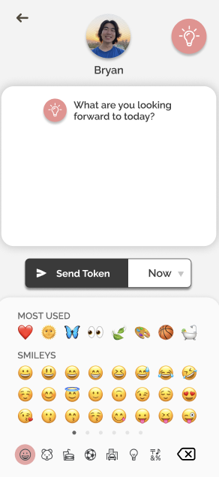
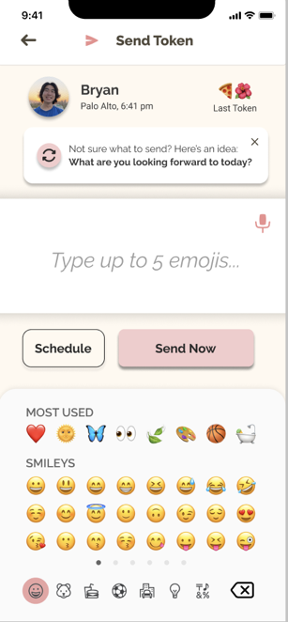
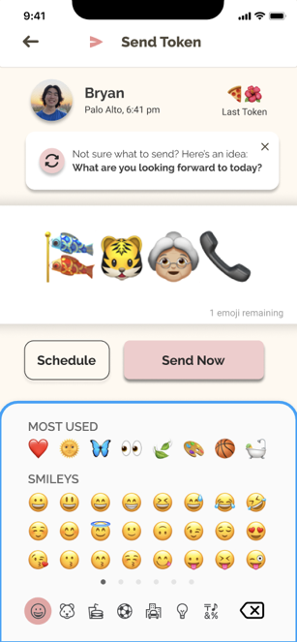
before
after
Fixes:
Separated prompt from token
Added audio activation
Added last token received
Made a distinct Schedule Button
Added clear marker for max emoji count

Slide 26
3
Prototype Implementation

Slide 27
Implementation Tools
React Native (Application Framework)
Expo (Simulator)
Github (Version Control)
Figma (Design)

Slide 28
Feature Implementation (User Tasks)
[~30%]
[~5%]
[100%]
[~25%]
[~5%]
[100%]
Simple: Create a moment
Joining an active moment
Initiating a moment
Moderate: Communicate thoughtful token
Complex: Create a connection goal
Creating a new goal
Editing an existing goal

Slide 29
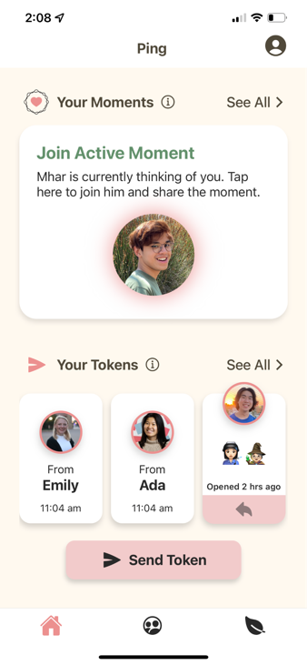
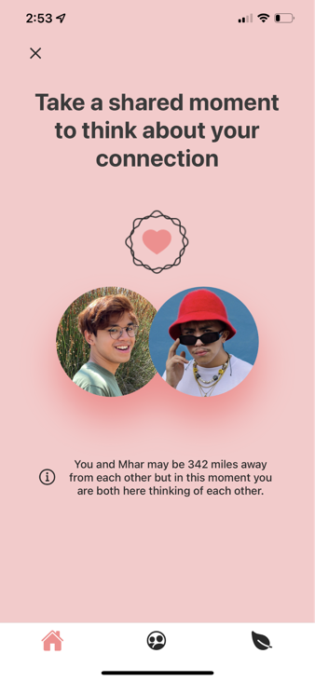
Implemented Features
Simple Task:
Create a moment
Active moment is clickable and joinable

Slide 30
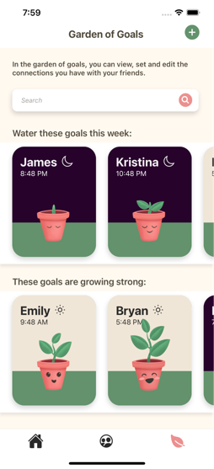
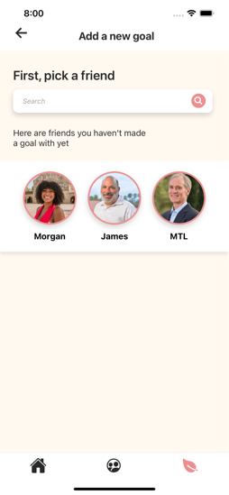
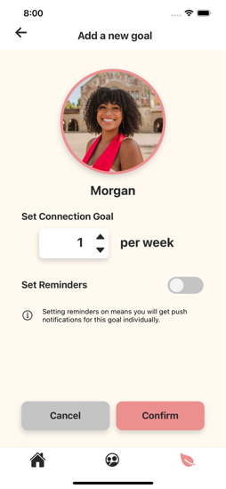
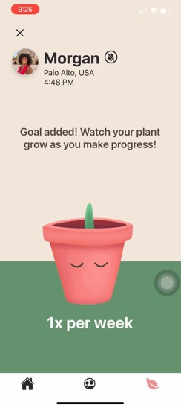
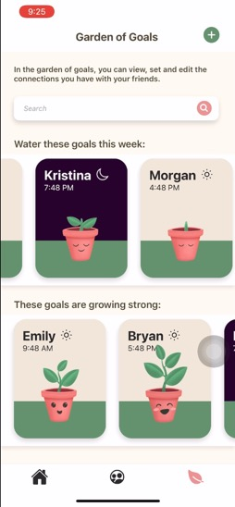
Implemented Features
Complex Task: Create a Connection Goal
User can:
add a new goal
select a friend
search for a friend
toggle reminder
confirm goal
see confirmation page
exit confirmation page
see new goal on goals page
Not yet implemented:
Number dropdown menu

Slide 31
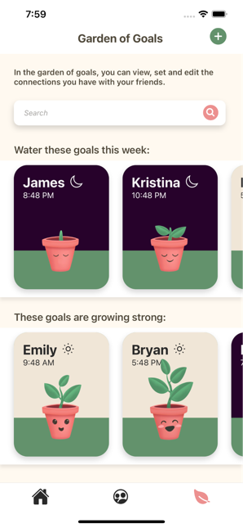
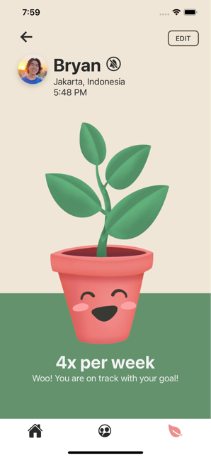
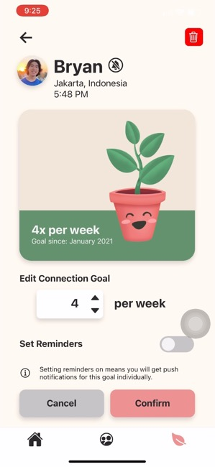
Implemented Features
Complex Task: Edit a Connection Goal

Slide 32
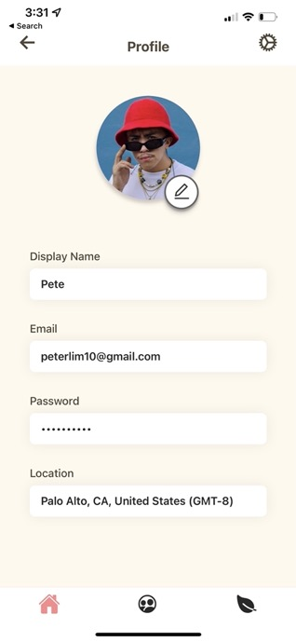
Implemented Screen:
User Profile Page

Slide 33
Unimplemented Features
General
Onboarding Screens
Home Screen without active moment (In progress)
Friend List (In progress)
Communicate Thoughtful Token
Create New Token
Token Log
Open Received Token
Save Received Token
Create a Moment
Moment Animations (Reach feature)
Moment Log

Slide 34
Plan
Communicate
Thoughtful Token
Explore simple send/open interaction
General
Finishing
Touches
Create a Moment
Explore Animation and Haptics
Support
Notes:
copy

Slide 35
Wizard of Oz
Share a moment: Since we only have one user, we will have one moment where they “join” a friend and one moment where they initiate and the friend does not end up joining.
Sending or scheduling a token: It will not be sent anywhere (no backend)
Receiving a token: Since we only have one user, we simulate receiving a token from a friend
General
Share a moment
Communicate through small token
Make connection goal

Slide 36
Hard Coded
Timezones
Existing goals
Existing friends
Existing logs of moments and tokens
User’s Profile
General
Share a moment
Communicate through small token
Make connection goal

Slide 37
Issues/Questions
What is sufficient for showcasing receiving, opening, sending tokens in terms of interactivity? Will a simple backend be the simplest implementation?
What will animation and/or haptics look like for moments?

Slide 38
4
Prototype
Demo

Slide 39
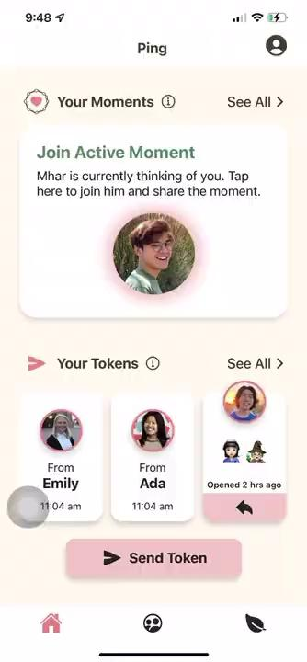
Demo

Slide 40
Summary
15+ significant changes based on severity 3-4 heuristic evaluation
Many smaller changes based on severity 1-2 heuristic evaluation
Need to implement:
Sending and receiving tokens [Aiming for Sunday]
Finish moments [Aiming for Friday]

Slide 41
Thank You!

