Slide 1
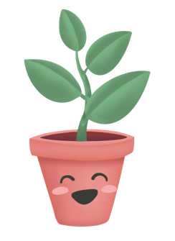
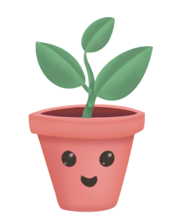
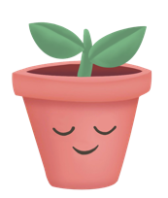
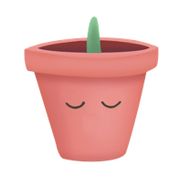
Ping
Medium-Fi Prototype
Ada Z.
Bryan D.
Emily R.
Mhar T.

Slide 2
Value Proposition
So your LDR doesn’t become TL;DR
Notes:
MISSION STATEMENT / VALUE PROPOSITION
So that your LDR, doesn’t become TL;DR
PROBLEM AND SOLUTION OVERVIEW
When people move, they not only leave the place behind but also their relationships. Distance, time zones, and new stressors make it hard to keep up with loved ones. Introducing Ping!, a low-stress, convenient hub to show your friends you are thinking of them by sending thoughtful tokens, sharing meaningful moments, and maintaining connection goals. It’s an angel on your shoulder reminding you to show your loved ones you care, even when you’re busy or far apart.

Slide 3
Problem & Solution Overview
Staying close to friends and family is stressful amidst hectic days, different time zones, and awkward, high-stakes communication styles. In fact, it’s nearly impossible and often results in personal guilt and fallen friendships.
Introducing Ping, a low-stress, convenient hub to show your loved ones you are thinking of them by sending thoughtful tokens, sharing meaningful moments, and maintaining connection goals. It’s an angel on your shoulder reminding you to show your loved ones you care, even when you’re busy or far apart.
Notes:
MISSION STATEMENT / VALUE PROPOSITION
So that your LDR, doesn’t become TL;DR
PROBLEM AND SOLUTION OVERVIEW
When people move, they not only leave the place behind but also their relationships. Distance, time zones, and new stressors make it hard to keep up with loved ones. Introducing Ping!, a low-stress, convenient hub to show your friends you are thinking of them by sending thoughtful tokens, sharing meaningful moments, and maintaining connection goals. It’s an angel on your shoulder reminding you to show your loved ones you care, even when you’re busy or far apart.

Slide 4
Values Encoded
Values:
Meaningful connection
Convenience
Features that express values:
The “share a moment” feature provides a unique opportunity for connection. Sharing a moment affords a loving, “shared space” that is two-ways and centers the people in the moment (literally and metaphorically).
Our quippy tokens ensure convenience. Because both you and your friend can only send a small string of emojis, there is no pressure or expectation to pour too much time into a message, yet there is still so much users can say with these expressive characters.
Notes:
– Efficiency – Privacy – Beauty – Truth – Justice - Equity - Safety - Transparency - Accountability - Inclusion - Sustainability
What values (see lecture 6-design exploration slides 46-67) do you intend to encode in your product? (make your definition as precise as possible)
What design features of your product (or combination thereof) express these values?
Do you foresee any conflicts between values (either explicit or collateral) arising as a consequence of your design decisions?

Slide 5
Values Encoded
Conflicts between values:
There seems to be an inherent conflict between “connection” and “convenience”. While this an impossible balance to guess for everyone, we believe our approach speaks to overwhelmed young people, with good intentions for communication, but small bandwidths and overwhelming inboxes.
While a token is quick and easy, they can also carry impactful meaning. When it comes to inside jokes or special momentos, the same string of emojis can have an entirely different meaning for two different people, making them so special. Moreover, classic tokens like a red heart can say more than words when sent at thoughtful times, which is made convenient with our time-zone scheduling feature.
Notes:
– Efficiency – Privacy – Beauty – Truth – Justice - Equity - Safety - Transparency - Accountability - Inclusion - Sustainability
What values (see lecture 6-design exploration slides 46-67) do you intend to encode in your product? (make your definition as precise as possible)
What design features of your product (or combination thereof) express these values?
Do you foresee any conflicts between values (either explicit or collateral) arising as a consequence of your design decisions?

Slide 6
3 Key Tasks
Simple Task: Share a moment
Moderate Task: Reply to a recent token
Complex Task: Create a connection goal
Notes:
3 representative tasks to test your interface (labeled simple, medium, complex)
Note any changes you’ve made from the tasks on the low-fi prototype assignment.
the organization of the three main tasks and the subtasks that fell under them in the report was very clear and felt like three full tasks.

Slide 7
3 Key Tasks
Simple Task: Share a moment
Key changes:
Accessible from home screen and labelled
More visual and haptic feedback for the user starting the Moment and the user joining the Moment. Ie. profile photos of both participants, tap-feedback.
Added notification design for Moments.
Defined a “thought log” to provide a satisfying/meaningful experience for both parties if the other user is not able to join the Moment within 30 seconds (ie. “Mhar was thinking of you at 3:05pm”.
Notes:
3 representative tasks to test your interface (labeled simple, medium, complex)
Note any changes you’ve made from the tasks on the low-fi prototype assignment.
the organization of the three main tasks and the subtasks that fell under them in the report was very clear and felt like three full tasks.

Slide 8
3 Key Tasks
Moderate Task: Reply to a recent token
Key changes:
Recent tokens better labelled on home screen
Button to reply to a token directly from home screen is more clear
Emoji keyboard updated with backspace
Scheduling input is more intuitive
Confirmation screen shows emojis sent/scheduled
Notes:
3 representative tasks to test your interface (labeled simple, medium, complex)
Note any changes you’ve made from the tasks on the low-fi prototype assignment.
The main functionality and subtasks of replying to a token remain the same:
Can schedule a token for your friend’s time zone OR send token immediately
Receive confirmation
The main change on this task is access
The action of getting to the friends list itself quite similar to our low fi prototype.
We improved the experience of viewing the friends list by using a more standard, expected list format
While we added extra functionality from the friends list screen, getting to the friends list itself is quite similar to our low-fi

Slide 9
3 Key Tasks
Complex Task: Set a connection goal
Key changes:
Added plus icon to easily create a new goal
Added ability to search for a friend
Aded visual feedback for strength of current goals (ie. plant height/health)
Ability to customize notifications for individual goals
Notes:
3 representative tasks to test your interface (labeled simple, medium, complex)
Note any changes you’ve made from the tasks on the low-fi prototype assignment.

Slide 10
Usability Goals & Key Measurements
EFFICIENT: we want the user experience and completion of tasks to be quick and intuitive and not require intense learning.
DELIGHTFUL: we want the user to be able to feel the connection to their relationships through the interface of the app.
SUCCESS
User can complete tasks intuitively and finds it delightful
User can navigate screens with no external help
ERRORS
User has trouble navigating to the right screens while completing a task
User is confused or frustrated with specific elements of the interface (logos, buttons, etc.)
Notes:
3 representative tasks to test your interface (labeled simple, medium, complex)
Note any changes you’ve made from the tasks on the low-fi prototype assignment.

Slide 11
Usability Goals & Key Measurements
REFLECTION
Lo-fi interviewees found lack of visual cues (text, icons, clear buttons) made prototype less delightful. We decided to rework screens that users expressed a lack of functionality about (e.g. Friend List) to be more compact interviewees Overall, to heighten efficiency and delight, we focused on trying to make individual screens more actionable while trying to minimize the number of overall screens. Interviewees reported that delight primarily stemmed from Garden of Goals and the emotional idea that your friends are thinking about you through Tokens and Moments. To emphasize these responses, we not only focused on visual/aesthetic qualities (in particular with the Garden) but also including a token and moment history (as desired by two interviewees) and even the ability to save favorite tokens. We also hashed out details that interviewees brought up such as backspace buttons and search bars that we had initially overlooked to make the prototype more delightful for users.
Notes:
3 representative tasks to test your interface (labeled simple, medium, complex)
Note any changes you’ve made from the tasks on the low-fi prototype assignment.

Slide 12
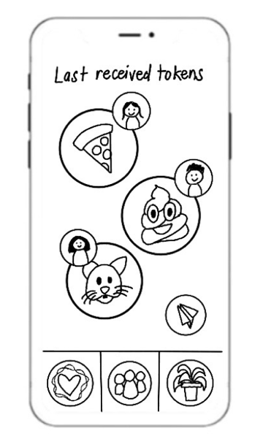
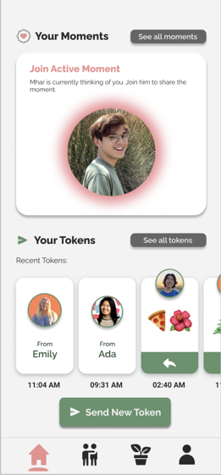
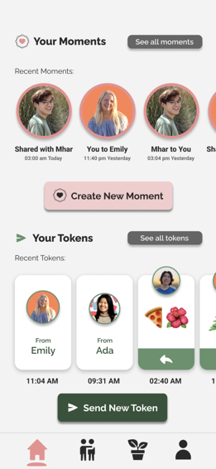
Revised Interface Design #1: Home Screen
Before
After
Notes:
3 representative tasks to test your interface (labeled simple, medium, complex)
Note any changes you’ve made from the tasks on the low-fi prototype assignment.

Slide 13
Revised Interface Design #1: Home Screen
Before
Feedback from both CA and lo-fi interviewees pointed to a lack of actionable tasks on the home screen.
Timing of last received tokens was unclear. Overall, needs more text for guidance. What are these buttons? Who are these people?
Particularly, icons without accompanying text (e.g. paper plane) may be inaccessible to older users, thus decreasing delight.
Design hierarchy suggests Tokens is the sole important function of our app—we want both Tokens and Moments to be balanced.
After
Added Moments to Home Screen to equalize Moments and Tokens functions. Main functions all on home screen for efficiency.
Active Moment—most time-sensitive task—are scaled large on top, glowing pink. When there are no active moments, user sees their recent moment history.
Lo-fi interviewees desired to view their token and moments history, which we’ve accounted for with buttons to view all moments/tokens.
Created hierarchy of buttons with sending token and creating moment as biggest ones.
Recent tokens are put in (horizontal scrollable) stack where the most recent one is on the left, captioned with time received.
Added text to icons to prompt action from users, aligning with usability goal of fast learning.
Notes:
3 representative tasks to test your interface (labeled simple, medium, complex)
Note any changes you’ve made from the tasks on the low-fi prototype assignment.

Slide 14
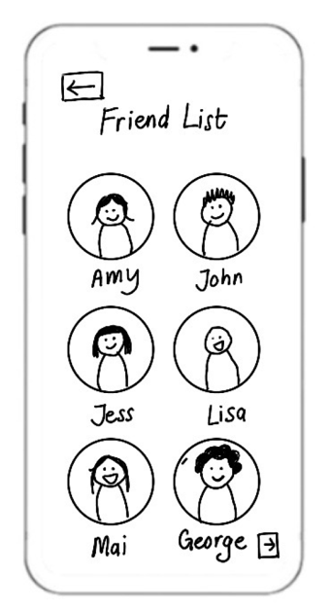
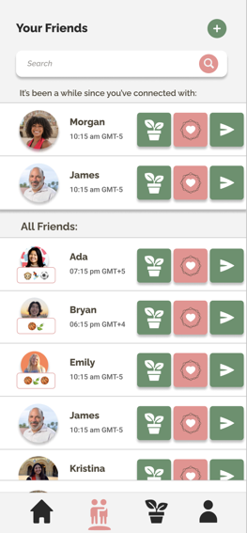
Revised Interface Design #2: Friend List
Before
After
Notes:
3 representative tasks to test your interface (labeled simple, medium, complex)
Note any changes you’ve made from the tasks on the low-fi prototype assignment.

Slide 15
Revised Interface Design #2: Friend List
Before
Lo-fi interviewees emphasized lack of functionality with friend list—only purpose is to view friends—felt it was incomplete.
Redundancy—you have to go through a friend list every time you start/reply/view a moment/token/goal.
No way to search for particular friend.
Unclear arrangement—hierarchy of friends? Alphabetical?
After
Greatest change was functionality and making screen actionable. View the friend list to instantly view connection goal, send a token, or start a token. More efficient overall.
Included user’s timezones, search bar, and add friend button for functionality. Friends arranged alphabetically.
Per lo-fi interviewee feedback, included friends you haven’t spoken to in a long time to remind viewer to maintain connection—relieving stress/thinking energy, adding delight.
Notes:
3 representative tasks to test your interface (labeled simple, medium, complex)
Note any changes you’ve made from the tasks on the low-fi prototype assignment.

Slide 16
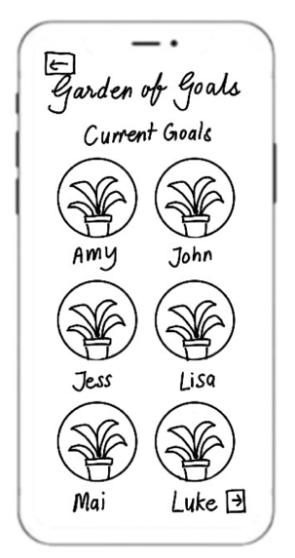
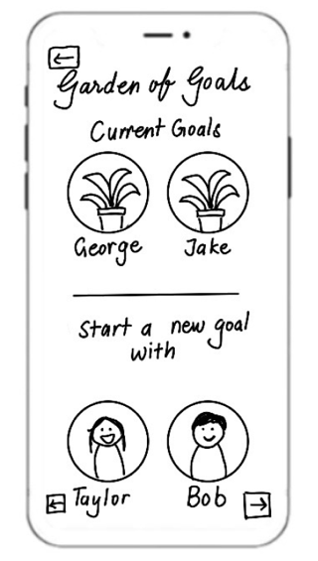
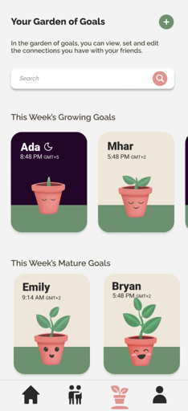
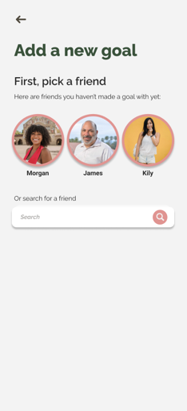
Revised Interface Design #3: Garden of Goals
Before
After
Notes:
3 representative tasks to test your interface (labeled simple, medium, complex)
Note any changes you’ve made from the tasks on the low-fi prototype assignment.

Slide 17
Revised Interface Design #3: Garden of Goals
Before
Interviewee expressed frustration at difficulty in starting new goal—required multiple swiping.
Feedback given to focus on existing plants more instead of both existing plants and potential plants (friends you have no goals with).
CA noted how newly added goal did not appear on front of Garden—unclear arrangement.
Interviewees wanted improvements to visual metaphor of plant growth to add delight—current plant is static.
After
Decluttered page by only showing existing plants, click (+) button to add a new goal if desired—simpler.
Added search feature to look for a particular goal.
Interviewees want to know which plants to attend to most—we’ve separated goals to “growing” and “mature”. Within these, most recently added plants are at the front.
Plants now show 4 stages of goals (fully grown plant = goal met) and day/night background depending on friend’s timezone to add user delight.
Notes:
3 representative tasks to test your interface (labeled simple, medium, complex)
Note any changes you’ve made from the tasks on the low-fi prototype assignment.

Slide 18
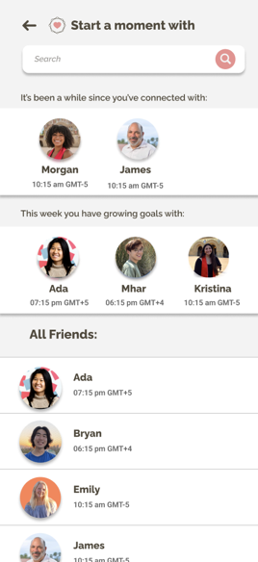
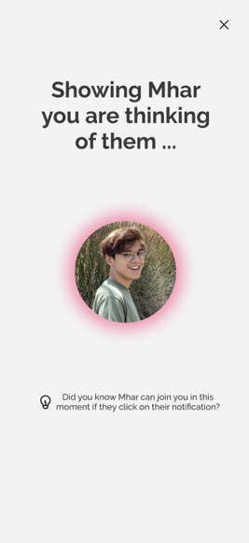
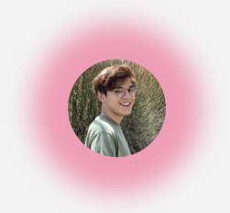
Simple Task Flow: Share a Moment
User clicks “Create New Moment” on Home Screen
User is asked to choose a Friend to start a moment with
User is taken to the moment waiting screen (more next slide)
Glow animation that pulses bigger and smaller in and out!
Notes:
3 representative tasks to test your interface (labeled simple, medium, complex)
Note any changes you’ve made from the tasks on the low-fi prototype assignment.

Slide 19
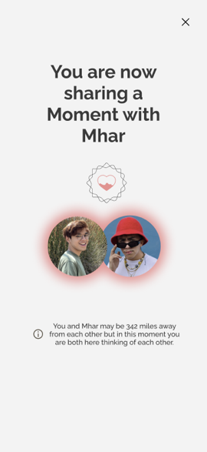
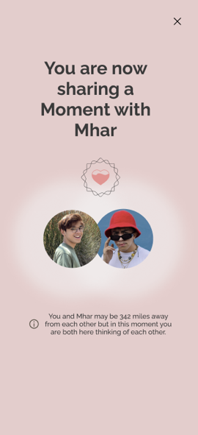
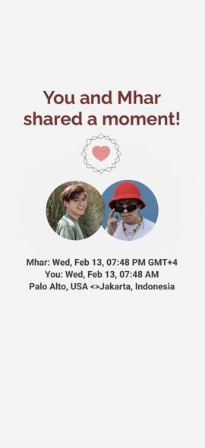
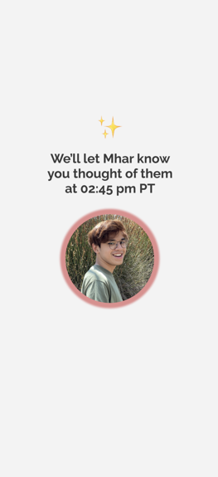
Simple Task Flow: Share a Moment
If friend responds within 30 seconds, this animation will play for 20 seconds on both user’s screens
After 20 seconds
If friend doesn’t respond within 30 seconds
Notes:
3 representative tasks to test your interface (labeled simple, medium, complex)
Note any changes you’ve made from the tasks on the low-fi prototype assignment.

Slide 20
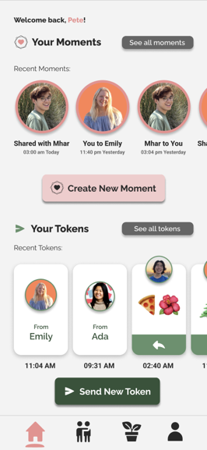
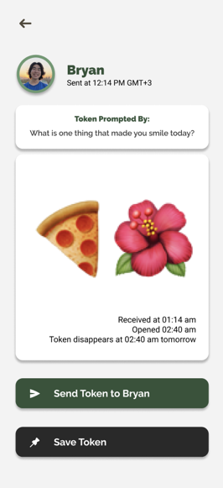
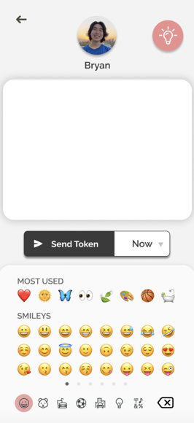
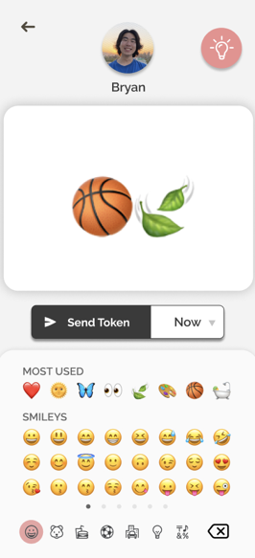
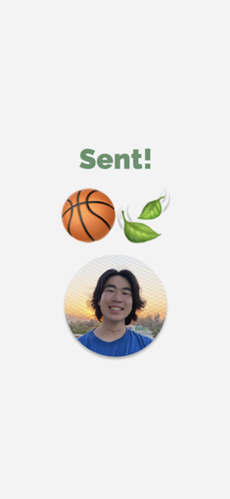
NOTE: There are several ways to reply a token depending on the user’s actions. This is one pathway we believe the user will use frequently.
Moderate Task Flow: Reply to a recent token
User sees a recent token on home screen
User chooses a token to reply to
User is taken to the messaging screen and types a message
User clicks “Send Token”
Notes:
3 representative tasks to test your interface (labeled simple, medium, complex)
Note any changes you’ve made from the tasks on the low-fi prototype assignment.

Slide 21
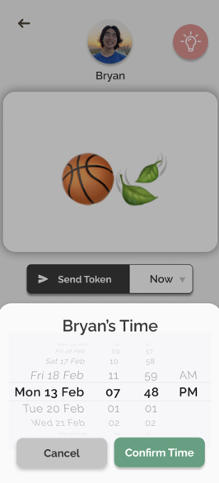
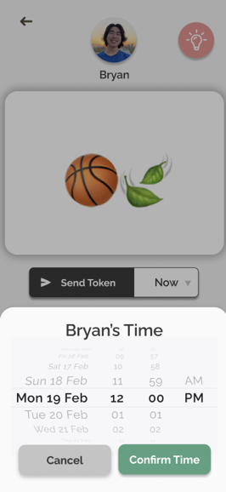
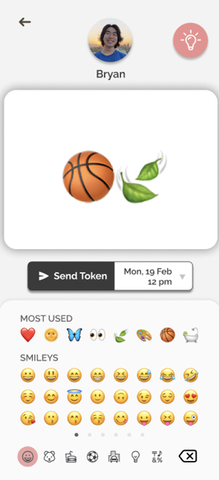
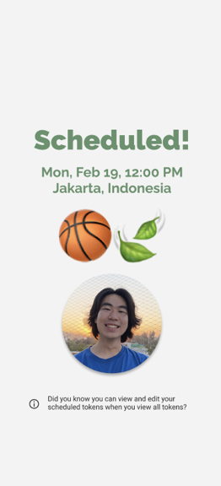
Moderate Task Flow: Reply to a recent token (Optional Subtask: Scheduling)
User has to option to schedule the token instead of sending “Now”
Scrollable time window pops up, User chooses a time based on the Friend’s timezone
User clicks out of time window, clicks “Send Token” for it to be scheduled
Notes:
3 representative tasks to test your interface (labeled simple, medium, complex)
Note any changes you’ve made from the tasks on the low-fi prototype assignment.

Slide 22
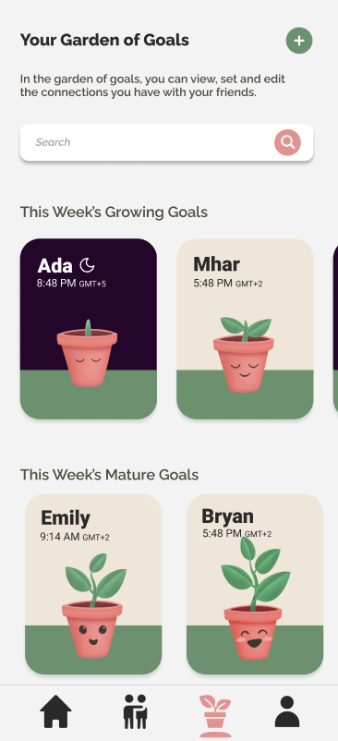
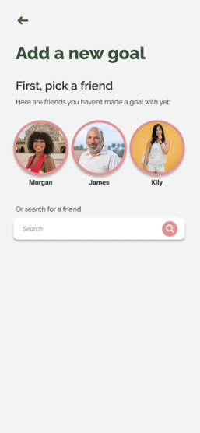
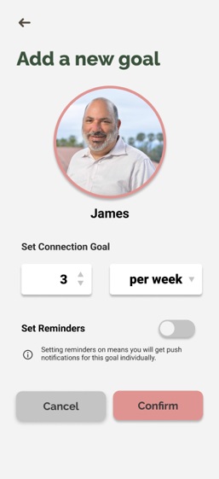
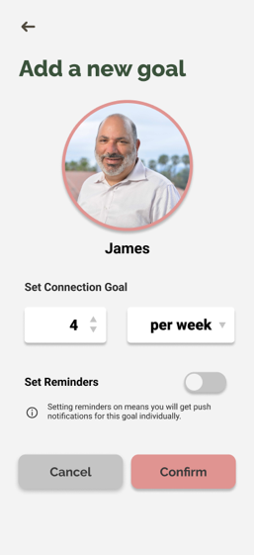
Complex Task Flow: Set a Connection Goal
Start from Garden of Goals
Click (+) to add goal
Pick a friend
Edit goal (/week) - Optional
Notes:
3 representative tasks to test your interface (labeled simple, medium, complex)
Note any changes you’ve made from the tasks on the low-fi prototype assignment.

Slide 23
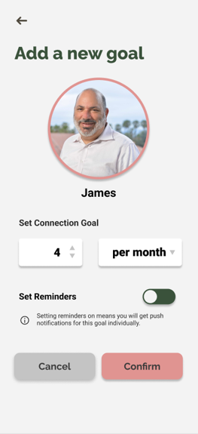
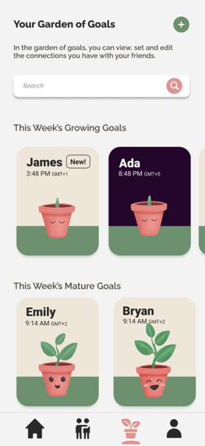
Complex Task Flow: Set a Connection Goal
Edit goal (/month) - Optional
Set reminders - Optional
Confirm and takes you back to Garden of Goals
Notes:
3 representative tasks to test your interface (labeled simple, medium, complex)
Note any changes you’ve made from the tasks on the low-fi prototype assignment.

Slide 24
Prototype Overview
Design Prototype Tools:
We started by using paper and pen sketches to brainstorm on how we can improve from our lo-fi prototype. After that, most of the prototyping was done on Figma for our Med-Fi prototype.
How the tools helped:
Collaborative – making standardization easier and combining our works easier
Able to copy dimensions of an iPhone screen
Can emulate interactivity to demonstrate task flows through prototyping
Auto-alignment of elements for visual cohesiveness
How the tools did not help:
Have to create individual screens to account for as much user action/input as possible
Individually connecting the wireframing took time
Limitations in how many buttons we can make to be clickable due to having to create individual screens
Notes:
Design/Prototyping Tools - What tools did you use? - How did the tools help? (what was easy) - How did the tools not help? (what was hard)
Limitations/tradeoffs of the current prototype (what was left out of the prototype & why)
Any Wizard of Oz techniques required to make it work d. Hard-coded features and why required e.g. What progress do you think this prototype will make towards your 2 key goals?

Slide 25
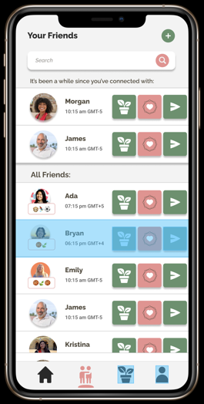
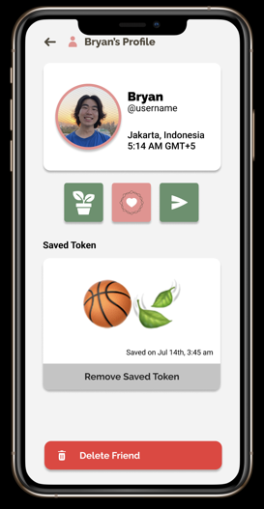
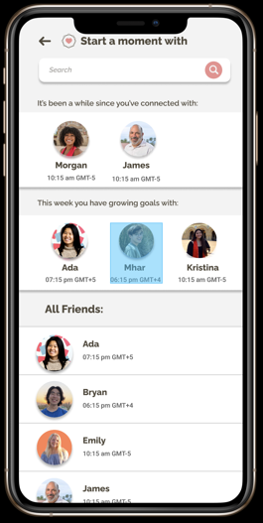
Limitations/Tradeoffs
#1
One limitation of this prototype is that not every action can be taken. For example, only certain profiles or goals can be clicked and you can only open certain tokens or share a moment with certain users.
We cannot account for every possible action in this prototype because there is no sort of memory or network where we can store user actions and adjust based on that through Figma. Therefore, we will have to create every screen for every action.
[For example, only Bryan’s profile can be visited]
[We cannot set a layout that will automatically create a profile for our users in Figma]
[You can only share a new moment with Mhar]]
Notes:
Design/Prototyping Tools - What tools did you use? - How did the tools help? (what was easy) - How did the tools not help? (what was hard)
Limitations/tradeoffs of the current prototype (what was left out of the prototype & why)
Any Wizard of Oz techniques required to make it work d. Hard-coded features and why required e.g. What progress do you think this prototype will make towards your 2 key goals?

Slide 26
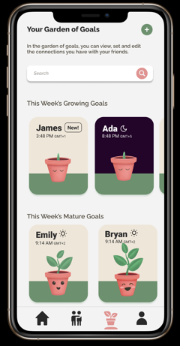
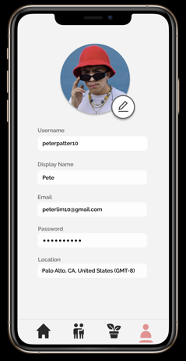
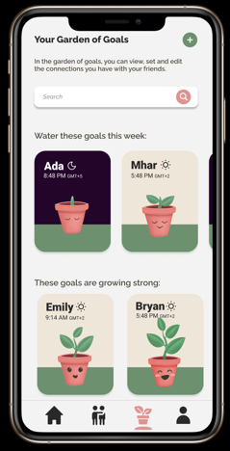
Limitations/Tradeoffs
#2
Changes, like editing an existing goal or creating a new goal, might not persist as you navigate through the app because we cannot accommodate for an infinite amount of combinations of actions. There is also no way to make conditional wireframing in Figma (no way to create “if new goal is added change goals screen to this screen” option) and each screen has to be created separately.
[For example, after creating a new goal, you will see the goal in your garden. However, if you go to any other screen in the bottom tab navigator and then back to garden of goals, you will not see your newly added goal]
Notes:
Design/Prototyping Tools - What tools did you use? - How did the tools help? (what was easy) - How did the tools not help? (what was hard)
Limitations/tradeoffs of the current prototype (what was left out of the prototype & why)
Any Wizard of Oz techniques required to make it work d. Hard-coded features and why required e.g. What progress do you think this prototype will make towards your 2 key goals?

Slide 27
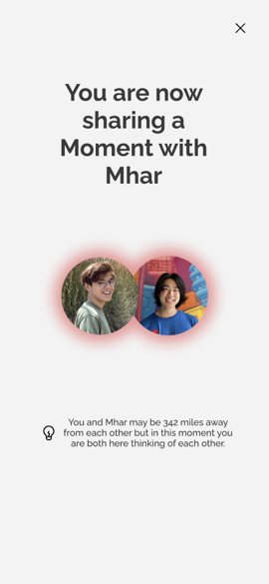
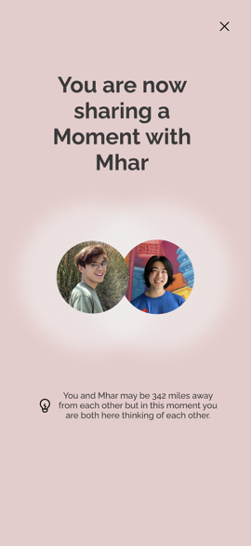
Limitations/Tradeoffs
#3
Another limitation is missing cues from sharing a moment. In the hi-fi prototype, we plan to include other cues, such as haptic vibrations when two people share a moment. However, this is not possible to emulate through a Figma demo.
[The only cue we can implement in Figma is visual, which is why in the med-fi prototype, simultaneously sharing a moment only shows a changing color screen]
Notes:
Design/Prototyping Tools - What tools did you use? - How did the tools help? (what was easy) - How did the tools not help? (what was hard)
Limitations/tradeoffs of the current prototype (what was left out of the prototype & why)
Any Wizard of Oz techniques required to make it work d. Hard-coded features and why required e.g. What progress do you think this prototype will make towards your 2 key goals?

Slide 28
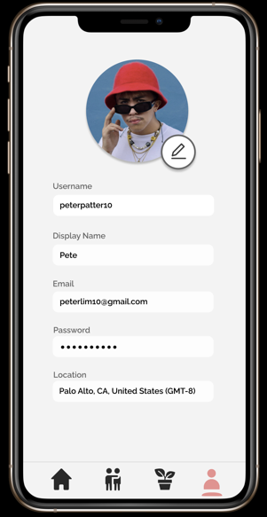
Limitations/Tradeoffs
#4
Lastly, we left out some user-interactions that an actual app might have, such as creating an account, logging-in or out, adding friends, or changing your personal information. We did so because they did not directly pertain to the tasks we wanted to demonstrate.
[The current profile screen is static and doesn’t allow for much changes in personal information. Options like logging out are also not visible.]
Notes:
Design/Prototyping Tools - What tools did you use? - How did the tools help? (what was easy) - How did the tools not help? (what was hard)
Limitations/tradeoffs of the current prototype (what was left out of the prototype & why)
Any Wizard of Oz techniques required to make it work d. Hard-coded features and why required e.g. What progress do you think this prototype will make towards your 2 key goals?

Slide 29
Wizard of Oz
#1
When the user tries to type a series of emojis to send to another user, the demo will automatically fill in the text box with emojis. When users try to set or edit the number of connection goals, clicking the box in the prototype immediately changes the number, instead of emulating a vertical number slider. This is because we have no way of saving distinct text input from users. Emoji keyboards and sliders also might vary by operating systems.
[The emoji keyboard is not functional and clicking anywhere in the keyboard will generate a hard coded emoji combination to send.]
[The slider is also not functional and clicking anywhere in that box will increase the goal number.]
Notes:
Design/Prototyping Tools - What tools did you use? - How did the tools help? (what was easy) - How did the tools not help? (what was hard)
Limitations/tradeoffs of the current prototype (what was left out of the prototype & why)
Any Wizard of Oz techniques required to make it work d. Hard-coded features and why required e.g. What progress do you think this prototype will make towards your 2 key goals?

Slide 30
Wizard of Oz
#2
When users either share or send a moment, we will let users click away whenever they want, instead of having a concrete time limit into how long before the other user can join the moment or how long two users can share a moment for. We did so because we cannot implement such features on Figma.
[We will let user exit out of the moment through the ‘x’ button on the upper right corner]
Notes:
Design/Prototyping Tools - What tools did you use? - How did the tools help? (what was easy) - How did the tools not help? (what was hard)
Limitations/tradeoffs of the current prototype (what was left out of the prototype & why)
Any Wizard of Oz techniques required to make it work d. Hard-coded features and why required e.g. What progress do you think this prototype will make towards your 2 key goals?

Slide 31
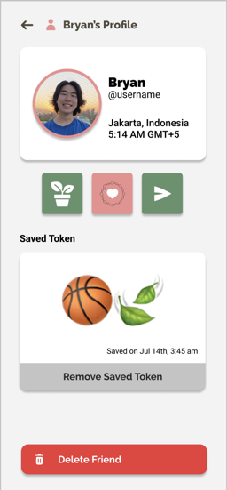
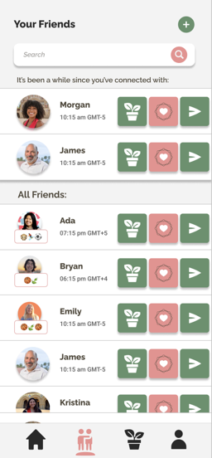
Hard coded features
#1
We have no users, networks, or databases in Figma, therefore we hard coded the profiles, the friends (and their profiles), and existing goals.
Notes:
Design/Prototyping Tools - What tools did you use? - How did the tools help? (what was easy) - How did the tools not help? (what was hard)
Limitations/tradeoffs of the current prototype (what was left out of the prototype & why)
Any Wizard of Oz techniques required to make it work d. Hard-coded features and why required

Slide 32
Hard coded features
#2
We also hard coded any social interactions the user can have, such as who they can share a moment with, whose profile or goal they can visit, with whom they can create a goal with, etc to account for limitation #1 in Figma.
Notes:
Design/Prototyping Tools - What tools did you use? - How did the tools help? (what was easy) - How did the tools not help? (what was hard)
Limitations/tradeoffs of the current prototype (what was left out of the prototype & why)
Any Wizard of Oz techniques required to make it work d. Hard-coded features and why required

Slide 33
Hard coded features
#2
We hard-coded most of the user input, such as setting the number of goals that one can create or change to or the emojis that they can send for simplicity and minimizing the amount of screens we create. Coordinating user input in between screens is also not possible through Figma.
[Emojis and numbers are hard coded and not manually inputted by user.]
Notes:
Design/Prototyping Tools - What tools did you use? - How did the tools help? (what was easy) - How did the tools not help? (what was hard)
Limitations/tradeoffs of the current prototype (what was left out of the prototype & why)
Any Wizard of Oz techniques required to make it work d. Hard-coded features and why required

Slide 34
Additional prototype screenshots

Slide 35
Figma workspace: https://www.figma.com/file/rQy3oNk2LARTPyho1ApoM6/Ping!---Med-Fi?node-id=0%3A1
Clicking on the workspace will allow you to have four starting points:
1. Opening App to an Active Moment
2. Opening App to no active moments
3. Getting a notification about a friend starting a moment with you
4. Getting a notification about a friend sending you a token.
Notes:
MISSION STATEMENT / VALUE PROPOSITION
So that your LDR, doesn’t become TL;DR
PROBLEM AND SOLUTION OVERVIEW
When people move, they not only leave the place behind but also their relationships. Distance, time zones, and new stressors make it hard to keep up with loved ones. Introducing Ping!, a low-stress, convenient hub to show your friends you are thinking of them by sending thoughtful tokens, sharing meaningful moments, and maintaining connection goals. It’s an angel on your shoulder reminding you to show your loved ones you care, even when you’re busy or far apart.

Slide 36
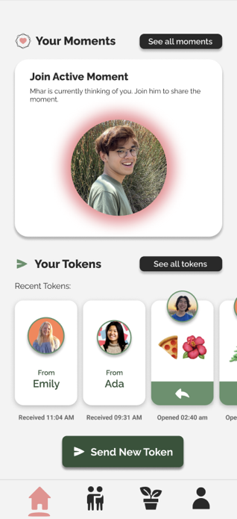
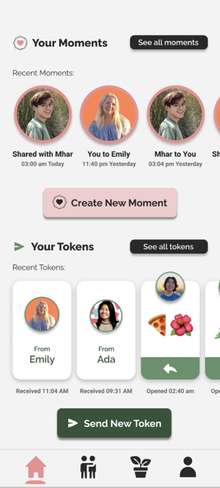
Home screen
Home screen with an active moment
Home screen with no active moment – user can see their moments log
Notes:
Since CAs will be grading the slides without you speaking to them directly, please include as much clarification as you need in the slide notes to make it easy for your CA to understand what you did and why. You can also create an “appendix” of extra slides at the end containing any other information you want your CA to see.

Slide 37
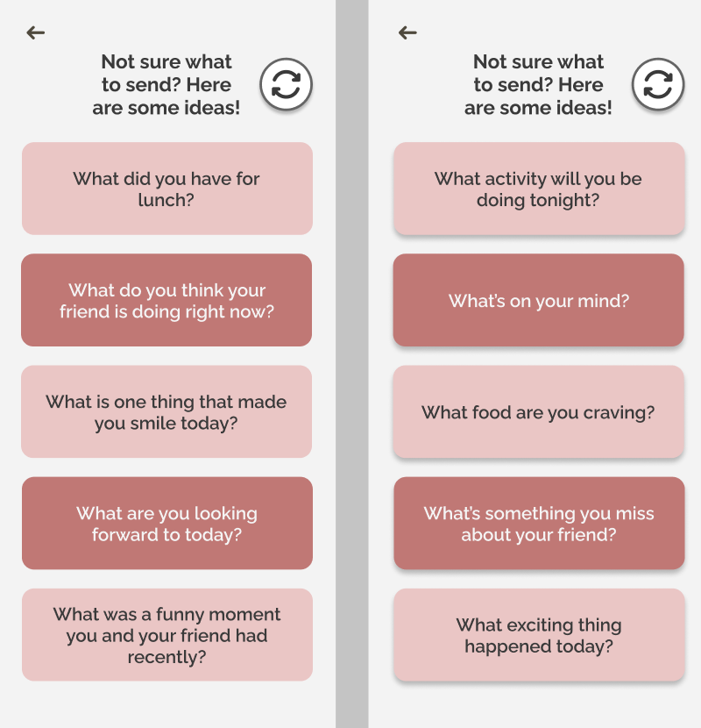
Prompts List
Click back to return to texting screen
Click refresh for new prompts
Notes:
Since CAs will be grading the slides without you speaking to them directly, please include as much clarification as you need in the slide notes to make it easy for your CA to understand what you did and why. You can also create an “appendix” of extra slides at the end containing any other information you want your CA to see.

Slide 38
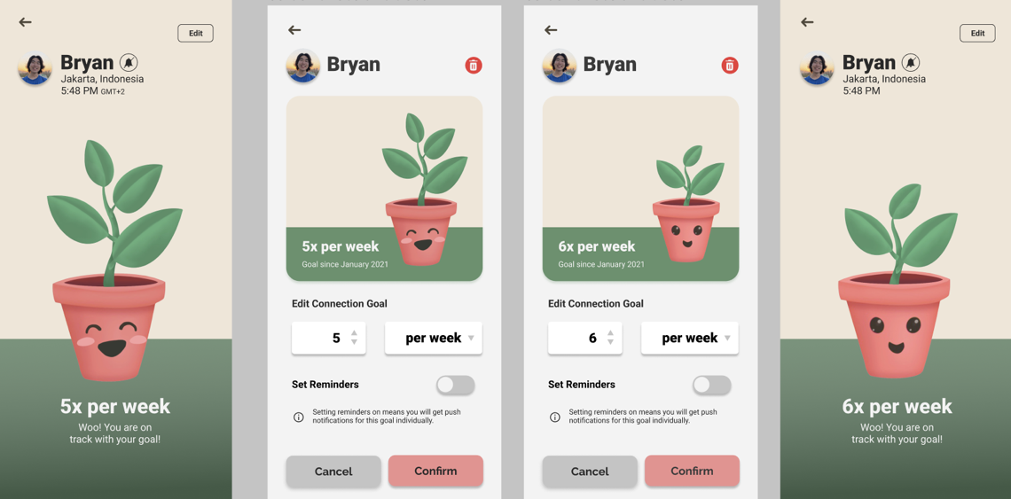
Edit a Connection Goal

Slide 39
See All Tokens
Toggle between Received and Scheduled Tokens

Slide 40
Saving a friend’s token
[Saved tokens would appear in user’s thumbnail and in their profile page]
Notes:
Since CAs will be grading the slides without you speaking to them directly, please include as much clarification as you need in the slide notes to make it easy for your CA to understand what you did and why. You can also create an “appendix” of extra slides at the end containing any other information you want your CA to see.

Slide 41
Viewing Moments Log
[Click see all moments]
[Click search]
[Search for specific friend]
[Hold down on a moment log]
Notes:
Since CAs will be grading the slides without you speaking to them directly, please include as much clarification as you need in the slide notes to make it easy for your CA to understand what you did and why. You can also create an “appendix” of extra slides at the end containing any other information you want your CA to see.

Slide 42
Notifications
Notes:
Since CAs will be grading the slides without you speaking to them directly, please include as much clarification as you need in the slide notes to make it easy for your CA to understand what you did and why. You can also create an “appendix” of extra slides at the end containing any other information you want your CA to see.

