Slide 1
PING!
CS 147 Winter 2022
Easing Life Transitions
Bryan D., Emily R., Mhar T., Ada Z.

Slide 2
OVERVIEW
01
02
03
04
PROJECT DIRECTION
Lo-fi prototype
Mission statement, selected interface, rationale
Prototype, tasks, and task flows
Testing & RESULTS
NEXT STEPS
Discuss method and results from lo-fi testing
Use results to explore changes to our solution

Slide 3
01
PROJECT DIRECTION

Slide 4
abby
Worried that her friends might not communicate with her as much after moving, losing their level of closeness
HMW help loved ones show they are thinking of each other conveniently yet still meaningfully?
Notes:
We met Abby, 24, who moved to college and has recently moved back home to NYC, leaving behind the close friends she lived with over the past 4 years.
We were surprised to notice she gave up Snapchatting, which she felt best emulated the daily communication she used to have with her roommates.
We wonder if this means she was embarrassed that her frequent Snapchats made her seem more committed to the long-distance relationship than her friends.
It would be game-changing to facilitate a way for Abby to comfortably share her new life with a long distance friend without comparing efforts.

Slide 5
MISSION
A way to show your friends you are thinking of them through low-stakes yet meaningful tokens – even when you’re far apart.

Slide 6
VALUE PROPOSITION
So that your ldr doesn’t become tl;dr

Slide 7
AUGMENTED REALITY PHONE FEATURE
SMART WATCH
MOBILE APP
SMART HOME PRODUCT
AR SMART GLASSES

Slide 8
AUGMENTED REALITY PHONE FEATURE
SMART WATCH
MOBILE APP
SMART HOME PRODUCT
AR SMART GLASSES

Slide 9
WHY MOBILE?
More familiar interface
Many existing tools and resources for making mobile apps
Many people own smartphones
Allows for familiar visual, audio and haptic feedback
Can incorporate AR-inspired features
Notes:
CONS OF VR
Users would have to buy a physical device (having AR is less accessible)
Current technical capacity would make visuals clunky and the physical glasses might be uncomfortable
Greater learning curve as most users will not be used to AR
Could be obtrusive to have AR visuals block physical scenes
CONS OF PHONE
Restricted with what u can send

Slide 10
02
Low-fidelity
PROTOTYPE

Slide 11
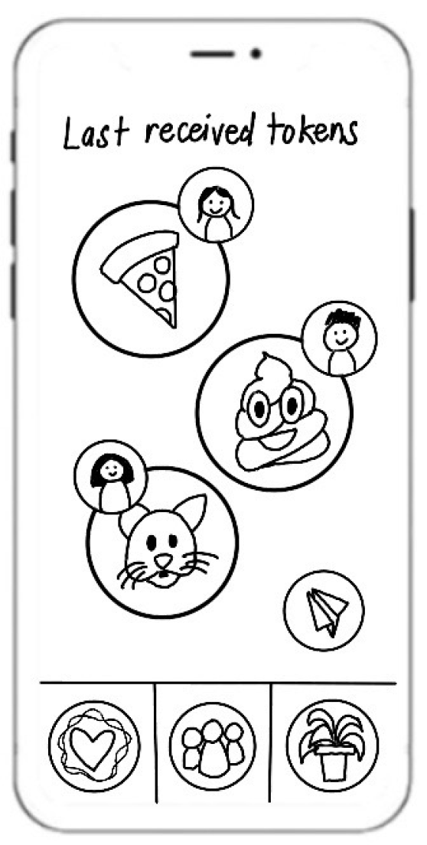

Slide 12
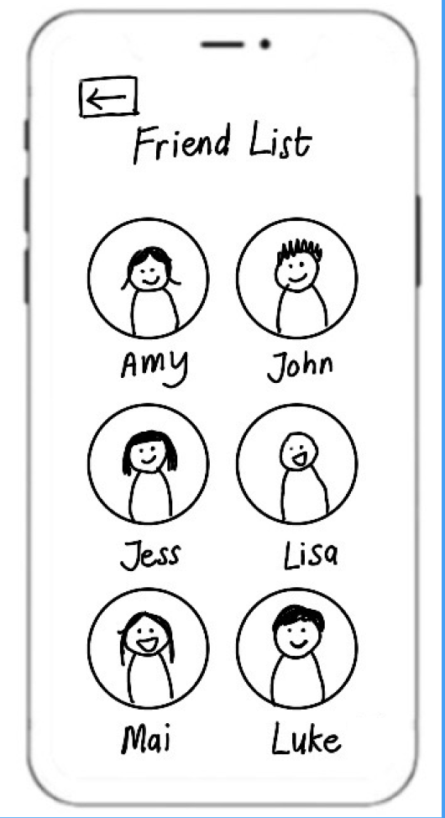

Slide 13
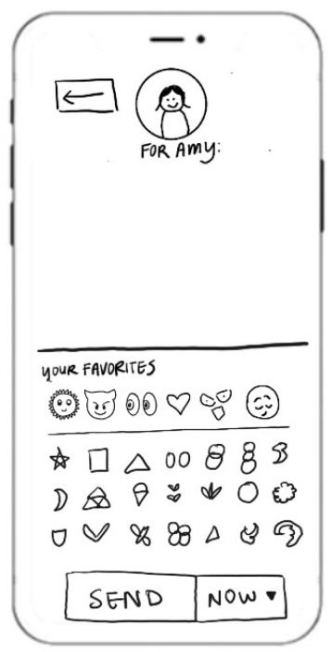
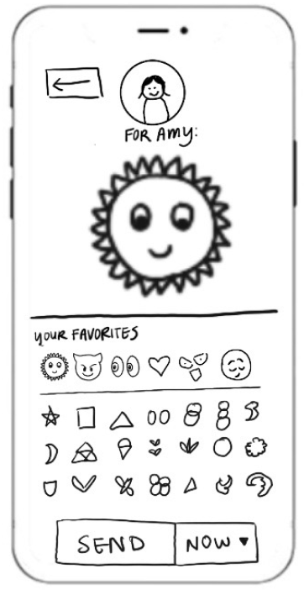
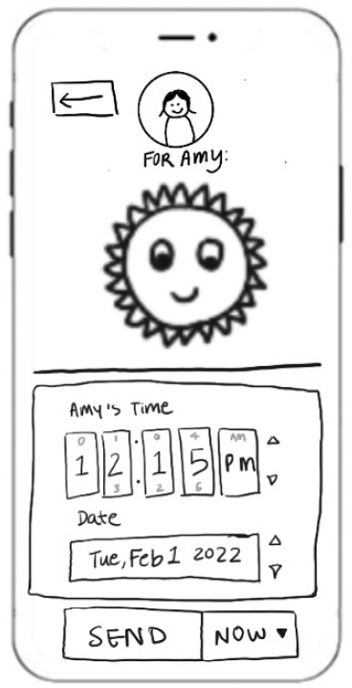
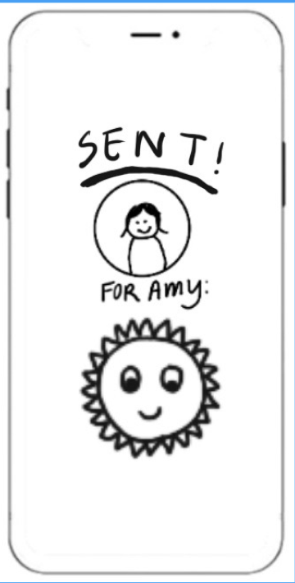
Notes:
No chat history - the appeal of the app is to feel in the moment
Scrolling through past messages might lead to pressure

Slide 14
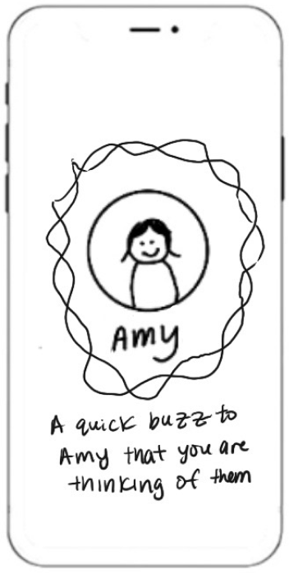
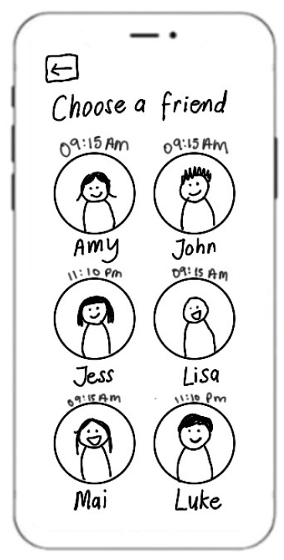

Slide 15
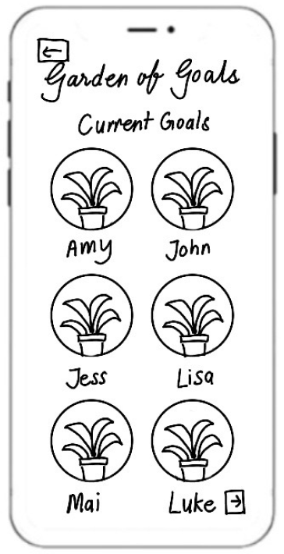
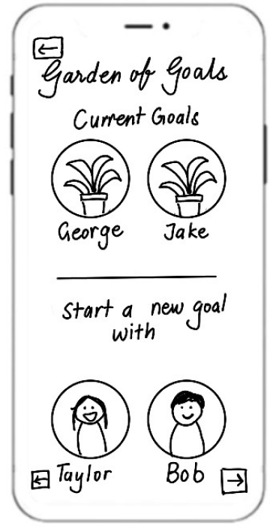
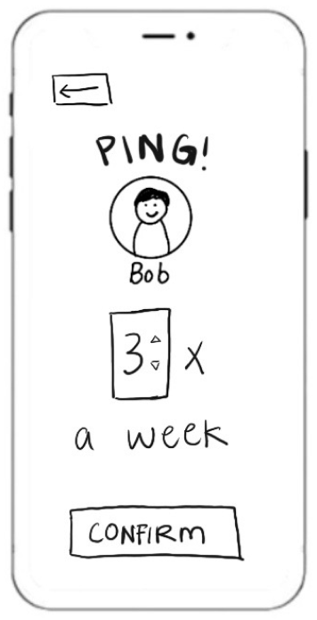
Notes:
Connection goals

Slide 16
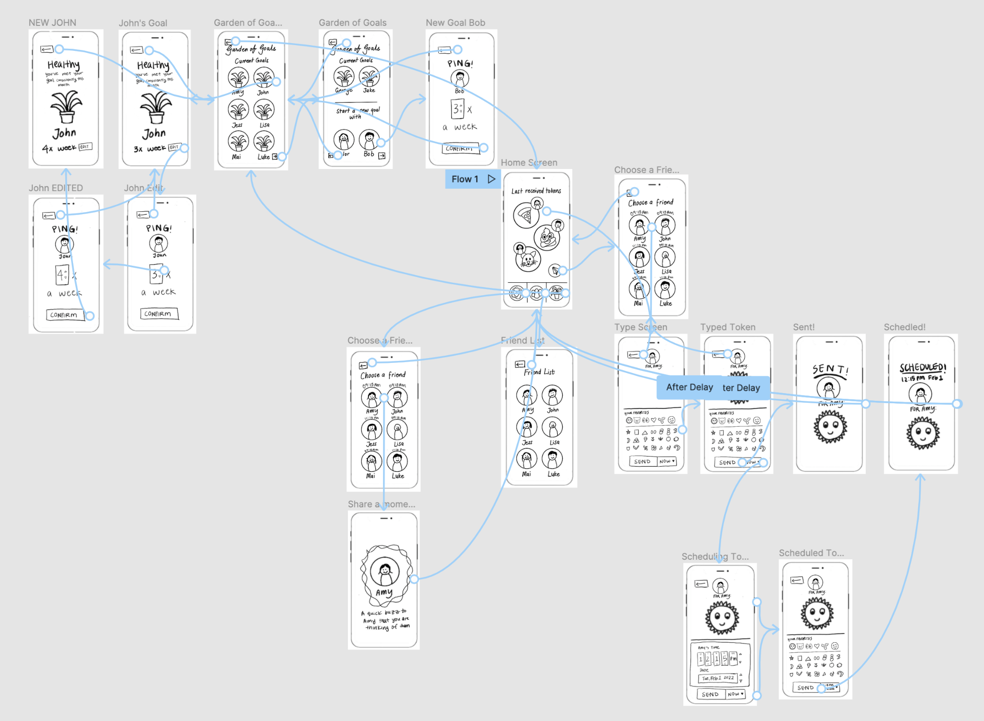

Slide 17
4 tasks + 2 subtasks
TASKS & TASK FLOWS

Slide 18
[SIMPLE TASK]
1
View your friend list.

Slide 20
[SIMPLE TASK]
2
Share a quick moment with Amy.

Slide 22
[MODERATE TASK]
3
Reply to the most recently received token.

Slide 24
[MODERATE TASK]
3.2
Amy is currently in Asia. You want to let her know you are thinking about her despite time zone differences. Schedule a Sun token to Amy for 12:15 pm in Amy’s timezone.

Slide 25
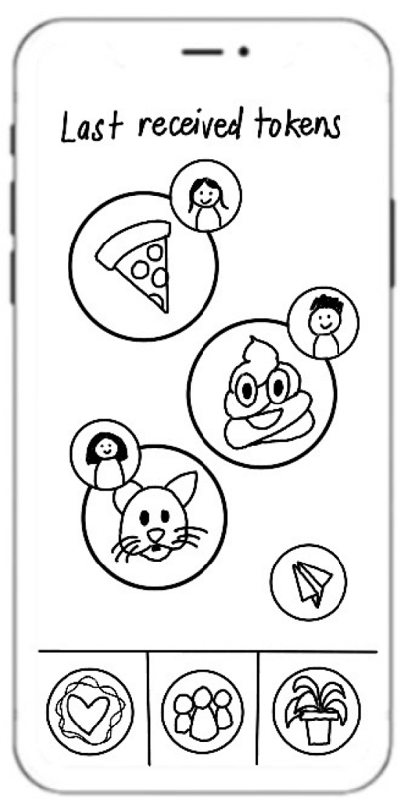
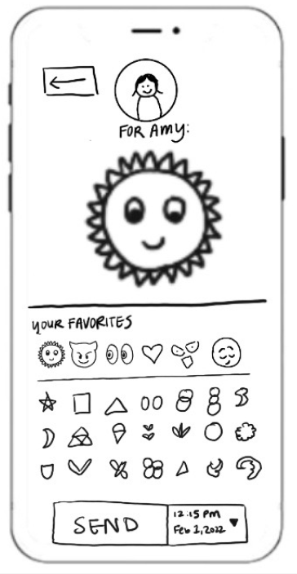
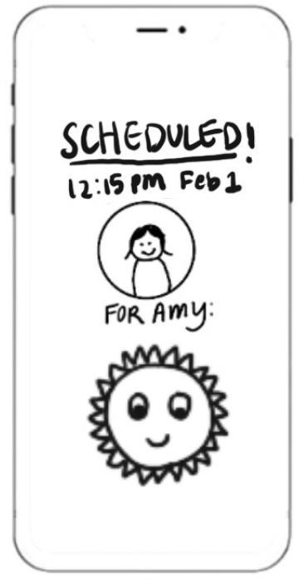

Slide 26
[COMPLEX TASK]
4
You want to strengthen your relationship with Bob. Set a goal to communicate with him 3x a week.

Slide 28
[COMPLEX TASK]
4.2
You feel like you are not talking to John enough. Increase your goal to communicate with John.

Slide 29
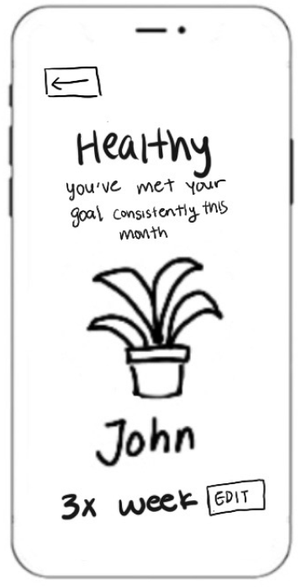
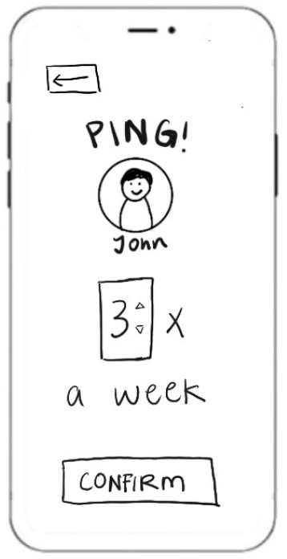
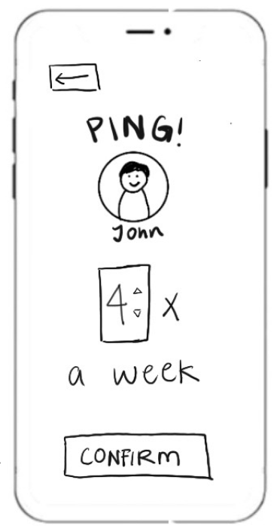
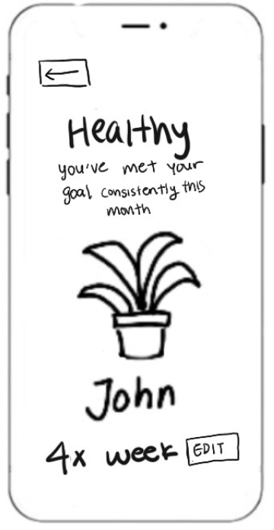

Slide 30
03
TESTING &
RESULTS

Slide 31
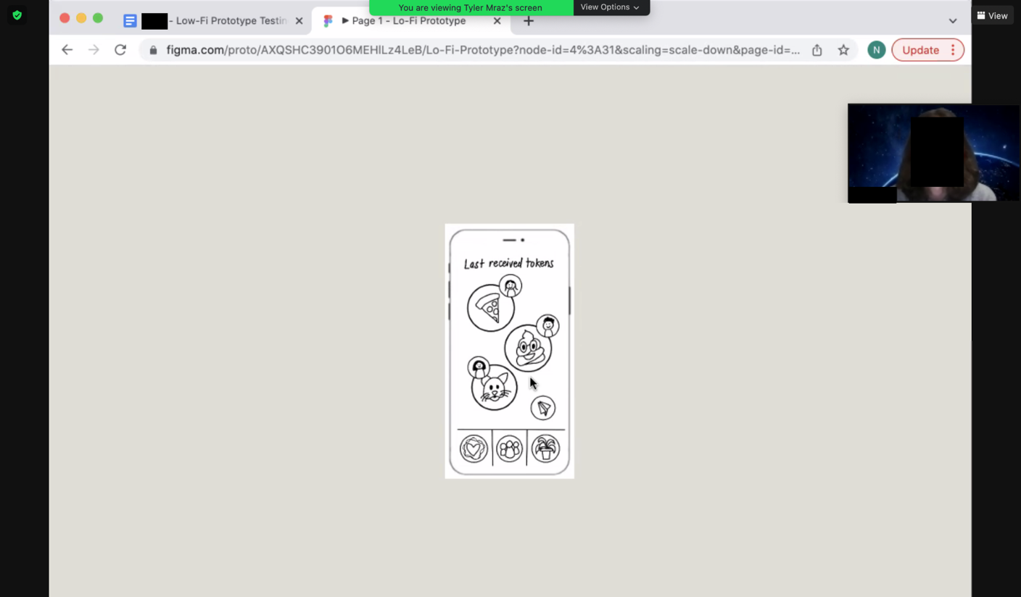
TESTING METHODS
We tested our lo-fi prototype…
Using Figma
Over Zoom
Switched roles each interview

Slide 32
participants
#1, 14 y/o
#2, 22 y/0
#3, 23 y/0
#4, 50 y/0
Teenager demographic,
Have long-distance relationships
Currently in 12 hour time difference with family and friends after moving countries
First time in his life living in a different city than his parents
Oldest user, did not have a permanent home at one point
Used stock images.

Slide 33
RESULTS: POSITIVE
App’s simplicity—minimalist interfaces fulfill app’s purpose
Strong validation regarding emotional pain point that app attempts to ease
All younger users shared enthusiasm for app’s novelty
Task flows were convenient and intuitive
Notes:
Pain point: too exhausted or avoidant to communicate with loved one

Slide 34
RESULTS: NEGATIVE
Confusion over “share a Moment with a user”
Disconnect between text and feature, e.g. text on Moment screen did not reflect purpose
Notes:
You’re used to looking at a heart (e.g. “like” on social media symbolized by love, 3 friends symbolize friends/followers, “send” button is a paper plane) and there’s alr a meaning attached to it

Slide 35
RESULTS: NEGATIVE
Most users were unsure about which token was the most recently received one
Users felt some flows could have been tighter
Users desired a search bar
Notes:
You’re used to looking at a heart (e.g. “like” on social media symbolized by love, 3 friends symbolize friends/followers, “send” button is a paper plane) and there’s alr a meaning attached to it

Slide 36
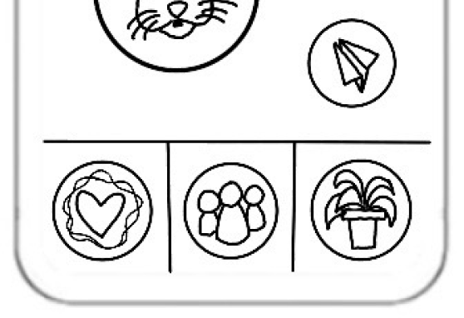
RESULTS: NEGATIVE
Intergenerational differences in feedback – older user responded less positively
Home bar icons need to be clearer
Notes:
You’re used to looking at a heart (e.g. “like” on social media symbolized by love, 3 friends symbolize friends/followers, “send” button is a paper plane) and there’s alr a meaning attached to it

Slide 37
04
NEXT
STEPS

Slide 38
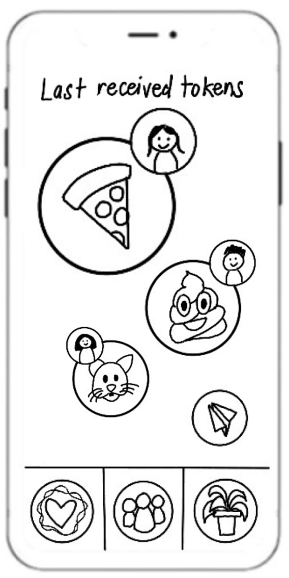
HOME SCREEN
Make more obvious the order of the most recently received tokens.
2:00 PM
9:00 AM
7:30 AM
Notes:
And find a way to make it look less of a messaging thread between three people

Slide 39
HOME SCREEN
One way to send a token is through this paper airplane.
Change paper airplane and “share a moment” icons to make their functionalities more obvious.
“Share a moment” icon

Slide 40
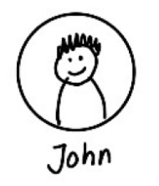
Friend list
+
Add more functionality to friend list.
Send token
Share a moment
View goals
View statistics

Slide 41
Garden of goals
+
Make it easier to view current goals and make new ones
Notes:
We also want the experience of viewing ur garden more dynamic, and not just a list

Slide 42
Share a moment
Make the screen more visually appealing to signal that its functionality was achieved

Slide 43
SUMMARY
Maintain app’s simplistic appeal—interface, functionality, aesthetic
Tighten task flows while adding clarity to unclear UI

Slide 44
THANKS!
Please keep this slide for attribution

