Slide 1
POVs & Experience Prototypes

Slide 2
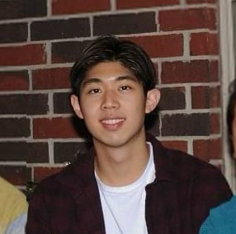
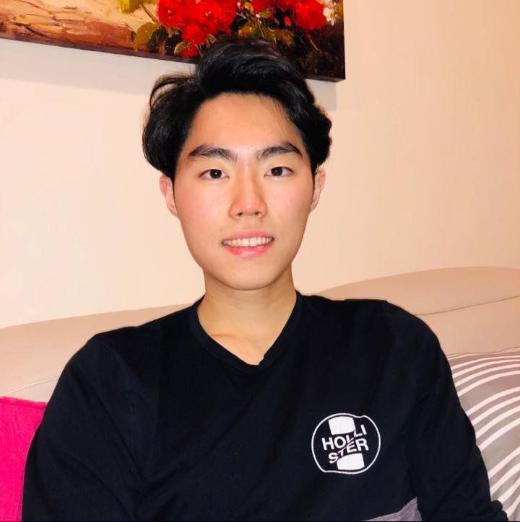
Our Team: Connectors
Emily T. CS (2024)
Taipei, Taiwan
Ekin T.
CS (2024)
Houston, TX
Enok C. CS (2023)
Leonia, NJ
Christian F. CS (2023)
Wasco, CA
Studio Theme: Life Transitions
Problem Domain: Social Transition for College Students

Slide 3
Initial POV
We met Jacqueline, a Korean immigrant and a 25-year-old extroverted college student who goes to a commuting school in New York City.
We were surprised to notice that she met her current best friends in line at a nightclub.
We wonder if this means in an unstructured environment, she makes her closest friends by chance.
It would be game-changing to increase opportunities for Jacqueline to meet more people of her own age who she clicks with.

Slide 4
Additional Interviews

Slide 5
About Vy
21 year old, female
Foothill college transfer to UC Berkeley
First-generation college student
International student from Vietnam
"As a transfer student, you're already like feeling a little bit lost. And I know some people don't feel that sense of belongingness. And I think being so far away from everybody just amplifies that. Just because you're literally alone at home."
Vy
she/her, 21
UC Berkeley
Notes:
Found her on LinkedIn,

Slide 6
Vy’s Insights
Transfer students lack sense of belonging, difficult to engage in the community
Most of her friends were other transfer students (first group of people she met and have similar experiences)
Closest group of friends were from study groups because they “struggled together”
Vy
she/her, 21
UC Berkeley
Notes:
Found her on LinkedIn,

Slide 7
About Benjamin
20 year old, male
Junior at University of Pittsburgh
From Leonia, NJ
“I know right off the bat if [a relationship with a new acquaintance] clicks, if things are going well, and if there’s a [deeper] friendship here.”
“[Attraction of close friends] is like intrinsic or something.”
Benjamin
he/him, 21
University of Pittsburgh
Notes:
Found her on LinkedIn,

Slide 8
Benjamin’s Insights
Finds that friendship is a matter of having an immediate connection with a person
Finds that his closest friends are the ones who he reconnected with from high school
Gravitates towards people that are like-minded and have the same goals
Benjamin
he/him, 21
University of Pittsburgh
Notes:
Found her on LinkedIn,

Slide 9
About Dennis
20 year old, male
Junior at Stanford
From Saratoga, CA
“Physical proximity has a heavy influence. When I’m at home, not at Stanford, I spend a lot of time with high school friends. [But] When I’m on campus, I would have less interaction with [those high school friends] and others at home.”
Dennis
he/him, 20
Stanford
Notes:
Found her on LinkedIn,

Slide 10
Dennis’ Insights
Physical proximity is a critical factor to who he interacts with at a given time
“Trauma bonded” with his friends: spending hours a week studying together, going to office hours, and staying up very late
Joining a small community was important to him, growing closer with fewer people
Dennis
he/him, 20
Stanford
Notes:
Found her on LinkedIn,

Slide 11
Revised POVs

Slide 12
POV 1
We met Jared, an introverted sophomore at Northwestern University who has just spent his first quarter on campus.
We were surprised to notice that although Jared was an introvert, he would try to strike up conversations with the people he runs into in his dorm bathroom.
We wonder if this means when he happens to be in the same environment with strangers and without something to be occupied with, he feels the urge to start a conversation.
It would be game-changing to use Jared’s urge to help him engage with strangers to form meaningful relationships.
HMW create an environment that induces conversation?
HMW make it easier to develop a connection with a total stranger?
Notes:
HMW introduce him to random people to interact with?
HMW make it easier to develop a connection with a total stranger?
HMW help humans become more sociable creatures?
HMW leverage common spaces to increase the chance of meeting people?
HMW encourage people to engage with their community?
HMW remove the stigma of talking to unacquainted others in a shared setting?
HMW create an environment that induces conversation?
HMW make it safer to approach strangers?
HMW find people nearby that have similar interests?
HMW simplify the process of reaching out to strangers?
HMW remove the sense of awkwardness that comes with being in the same environment with strangers without something to be occupied with?
HMW increase urges to strike up conversation?
HMW give people something to talk about?
HMW leverage awkward silences to increase social interaction?
HMW introduce people to strangers that they vibe with?
HMW help people discover if they vibe with another person?
HMW help people quickly develop meaningful conversations?

Slide 13
POV 2
We met Vy, a transfer student from UC Berkeley who identifies herself as an extrovert, and did her entire sophomore year online.
We were surprised to notice that she developed her closest relationships in study groups because they “struggled together”.
We wonder if this means she can form stronger connections with people that go through similar experiences as her.
It would be game-changing to help Vy build a deeper connection with her friends through shared experiences.
HMW help friends sustain and create shared experiences?
Notes:
HMW increase the number of study groups people are involved with?
HMW induce more meaningful shared experiences between people?
HMW divvy the burden of struggles between friends?
HMW make studying more personal?
HMW make it more likely that you’ll run into the same people (your friends) by chance?
HMW make common struggles the best part of friends’ lives?
HMW make common struggles refreshing instead of painful?
HMW help friends sustain and create shared experiences?
HMW remove the need to have shared experiences to build a deeper connection?
HMW artificially create non-artificial experiences?
HMW make it easier to share real experiences online instead of in person?

Slide 14
Brainstorming
HMW make it easier to develop a connection with a total stranger?
HMW create an environment that induces conversation?
HMW help people create and sustain shared experiences?
Reminder to reach out to friends you haven't talked to in a while (Solution 3)
Based on photos and videos
Import photos, Find faces
Recommend nearby places/events
Find mutual connections between friends
…
Have a way to know what that stranger is interested in
Sets of questions to ask to get to know what they're like
Matchmake (based on courses) to facilitate new connections (Solution 1)
Get a group of people share their deepest darkest secrets
Hot seat but w only two people and you ask unlimited questions
Force four people to take CS147 together 👀
…
Have like a wristband or something that says how open you are to meeting people
Potential friends near you radar (people who would be open to conversation)
Automatically schedule time and place to meet someone new
Deep conversation starters (make people vulnerable) (Solution 2)
Superlatives for friend groups
Virtual group call rooms that people can join at any time
…

Slide 15
Solution 1: Matchmaking based on shared courses, clubs, etc.
HMW make it easier to develop a conversation with a total stranger?

Slide 16
Assumption: People will put in the effort to meet up with someone with common attributes as them

Slide 17
Experience Prototype
Found two friends (Tim and Michelle) taking the same class
Connected the two by introducing Tim to Michelle, and vice versa, and observed whether they reach out to one another
Once they did, asked Tim about the overall experience
*Brief initial conversation with Michelle + Enok on common class

Slide 18
Result
Tim
He/him, 21
Stanford
Having both Tim and Michelle reach out to us whether we have the same classes as them or not
Tim had a “very smooth and efficient” interaction with Michelle from the start
Things that worked
Things that didn’t work
Getting to know one another deeper in personal contexts outside of the class material
Surprises
Tim was willing to interact actively with Michelle (and vice versa) from the get-go

Slide 19
New Learnings
Become friends right away
E.g. shared with one another about how everything is going, and common friends
Way to know more people
“I think it’s great to get to know more people on campus!”
More companionship
“It’s very nice to have a friend taking a same class with me, so it doesn’t feel like I’m all alone.”

Slide 20
Validity + New Assumptions
Assumption: People will put in the effort to meet up with someone with common attributes as them
Valid? Yes!
Both Tim and Michelle was more than willing to reach out to one another due to their shared class
New Assumption:
People can develop deeper relationships beyond class material

Slide 21
Solution 2: Deep conversation starters
HMW create an environment that induces conversations?

Slide 22
Assumption: People will be willing to open up to surface-level friends

Slide 23
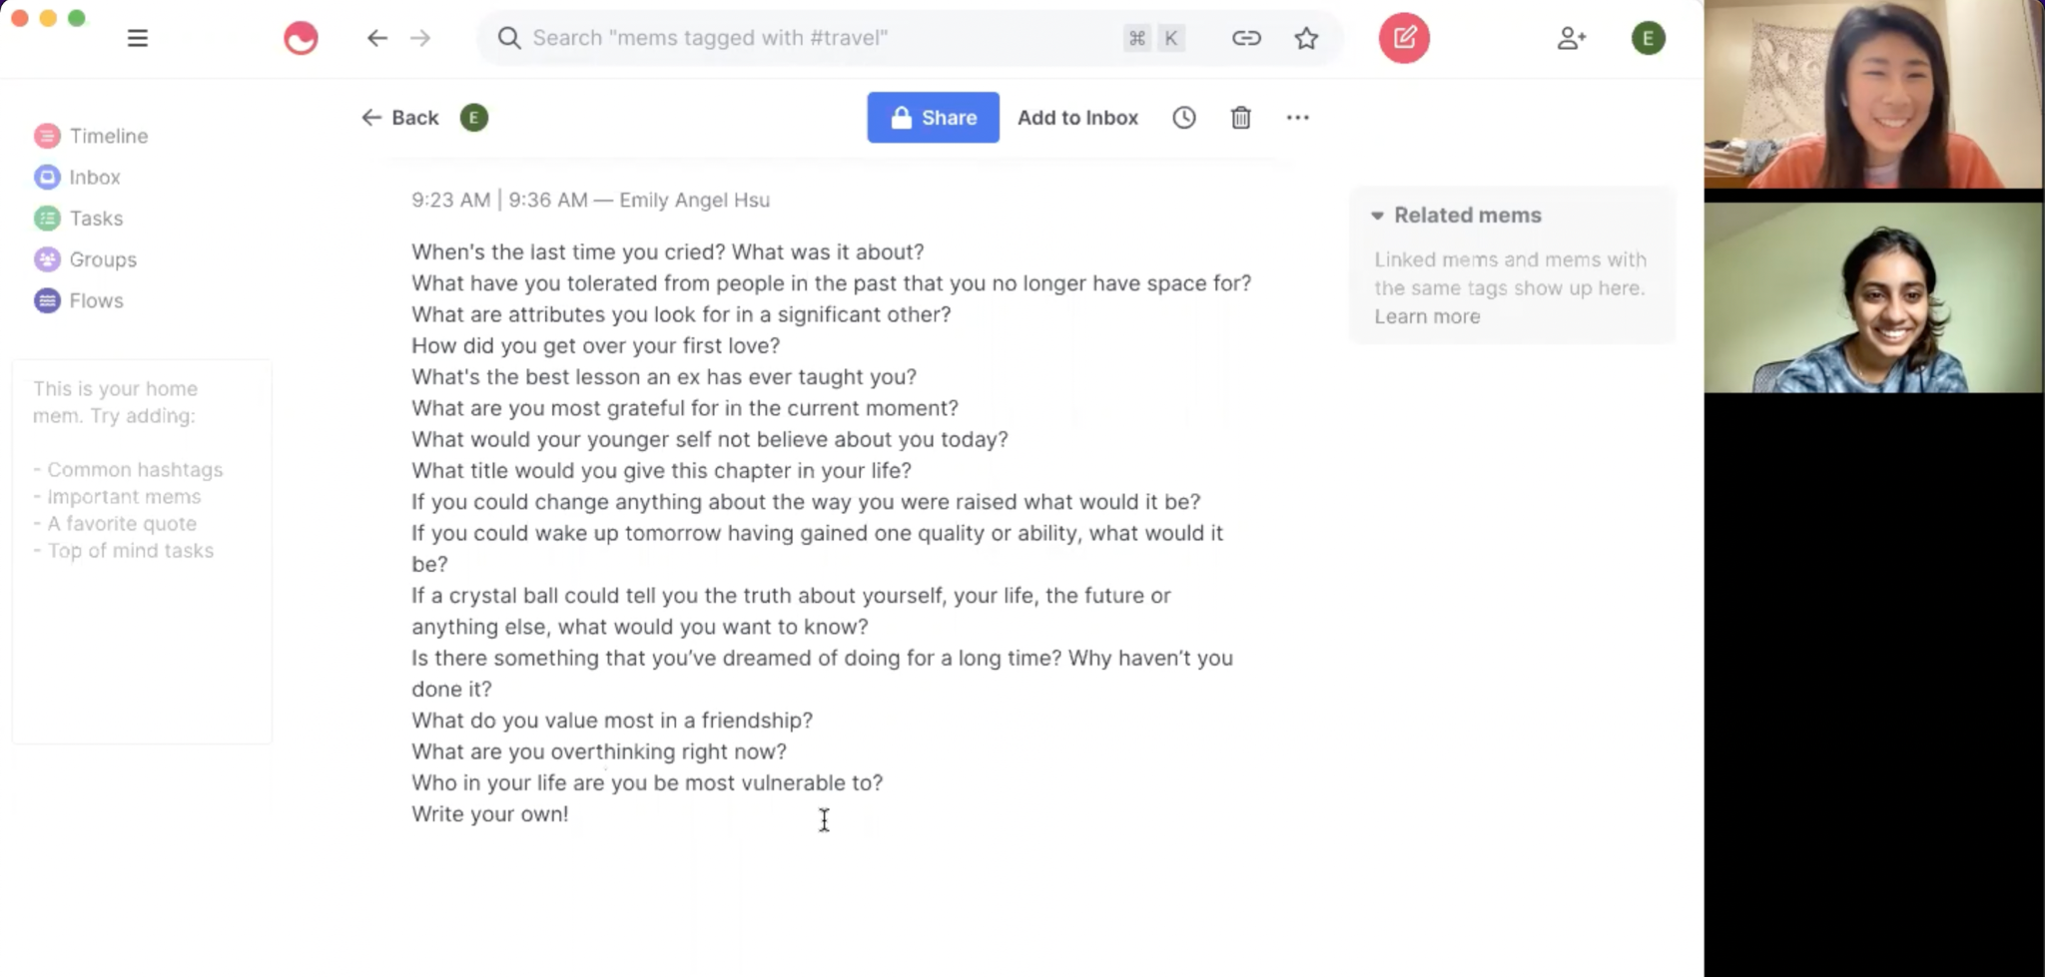
Experience Prototype
Prepared a set of personal questions → Reached out to an acquaintance → asked questions on zoom → received feedback

Slide 24
Result
Sriya
she/her, 19
UPenn
Questions prompted a lot of conversation topics that we would not have otherwise talked about
Things that worked
Things that didn’t work
Had already done something similar with friends (wasn’t new to her)
Opened up to us about her past including information about her family, relationships, and friends
Surprises

Slide 25
New Learnings
Opportunity to open up
“It creates a foundation that both groups can be really open with each other… rather than just letting for fate control how well you know each other.”
Deepen existing bonds
“I think I would do this with my best friend just because I feel like she knows so much about me but also we're constantly changing humans.”

Slide 26
Validity + New Assumptions
Assumption: People will be willing to open up to surface-level friends
Valid? No
Sriya was very open to answering all of our “deep” questions
BUT she mentioned that she would do this with her best friend

Slide 27
Solution 3: Photo reminder to reconnect with old friends
HMW help friends sustain and create shared experiences?

Slide 28
Assumption: A photo is able to reignite past connections

Slide 29
Experience Prototype
Reached out to Karen with a photo of Karen and a friend of hers
Asked her if she would feel inclined to reach out to that friend
Observed how how she and her friend would react
*Did not have permission to share her photo / texting content

Slide 30
Result
Result
Karen
she/her, 21
First Generation Student
Felt encouraged to reach out to her friend that she hadn’t thought about in a few months.
Things that worked
The friend she reached out to did not respond, so it ended up unfortunately being a one-way interaction
Things that didn’t work
Surprises
Karen reached out to her friend very quickly (within a day!!)

Slide 31
New Learnings
Someone reaching out to you doesn’t necessarily make you feel inclined to reach back
Photos may or may not ignite emotions for different people
People prefer just texting to reach out, rather than photo + text

Slide 32
Validity of Initial Assumption + New Assumptions
Assumption: A photo is able to reignite past connections
Valid? Both Yes & No
Karen reached out to her friend that she otherwise would not have
But her friend didn’t reach back
New Assumptions:
Seeing an old photo with a friend creates a sense of nostalgia for most.
Reaching out to person X means that person X will reach out back to you

Slide 33
Summary
Solution 1: People are willing to put the effort to reach out to someone with shared courses
Solution 2: Worked but was not new to the person (had already done something similar with her friends)
Solution 3: Some may be willing to reach out, but others not

Slide 34
Thank you!
What questions do you have?

Slide 35
Appendix I
HMWs based on POV1:
HMW introduce him to random people to interact with?
HMW make it easier to develop a connection with a total stranger?
HMW help humans become more sociable creatures?
HMW leverage common spaces to increase the chance of meeting people?
HMW encourage people to engage with their community?
HMW remove the stigma of talking to unacquainted others in a shared setting?
HMW create an environment that induces conversation?
HMW make it safer to approach strangers?
HMW find people nearby that have similar interests?
HMW simplify the process of reaching out to strangers?
HMW remove the sense of awkwardness that comes with being in the same environment with strangers without something to be occupied with?
HMW increase urges to strike up conversation?
HMW give people something to talk about?
HMW leverage awkward silences to increase social interaction?
HMW introduce people to strangers that they vibe with?
HMW help people discover if they vibe with another person?
HMW help people quickly develop meaningful conversations?

Slide 36
Appendix II
HMWs based on POV2:
HMW increase the number of study groups people are involved with?
HMW induce more meaningful shared experiences between people?
HMW divvy the burden of struggles between friends?
HMW make studying more personal?
HMW make it more likely that you’ll run into the same people (your friends) by chance?
HMW make common struggles the best part of friends’ lives?
HMW make common struggles refreshing instead of painful?
HMW help friends sustain and create shared experiences?
HMW remove the need to have shared experiences to build a deeper connection?
HMW artificially create non-artificial experiences?
HMW make it easier to share real experiences online instead of in person?

Slide 37
Appendix III
New POV3:
We met Dennis, a junior at Stanford who enjoys fostering community in his dorm and wishes to interact with friends who are far away from him more easily. We were surprised to notice physical proximity plays a big role in the relationships he both purposefully and inadvertently decides to engage with. We wonder if this means he has a hard time maintaining online interaction, and thus, prefers in-person interaction. It would be game-changing to use the concept of proximity to help online interaction more engaging.
HMWs based on POV3:
HMW make virtual spaces like a dorm?
HMW reframe what proximity means in a virtual world?
HMW decrease friction in online interactions?
HMW make online interactions more like in person?
HMW normalize online friendships?
HMW build a physical connection online?
HMW create shared online spaces?
HMW make online interactions more engaging?
HMW remind people to engage with long-distance friends?
HMW give people an incentive reconnect with long-distance friends
HMW make virtual spaces more like physical spaces?
HMW decrease the sense of distance between two people?

Slide 38
Appendix IV
Potential Solutions based on (HMW help people create and sustain shared experiences?)
Give media recommendations (e.g. TV shows, movies, books, podcasts, news articles, etc.) to groups of friends
Recommend nearby places/events (e.g. restaurants, raves, concerts, etc.) for groups of friends to go to
Gamepigeon but with a random person on campus
Shared memories album for friend groups
Games/competitions you can play with your friends
Write down experiences you had with friends to reminisce on later (like photos but textual)
Reminder to reach out to friends you haven't talked to in a while
Based on photos and videos –
Import photos, Find faces,
Hobby matching (e.g. sports, shows)
Photos/Videos-Places Association App
Mapping of photos/videos with places (on a world map), and you can filter by friend name as to where you took the photo
Gives you like a facebook memories
Share entire life history with friends
Get friends’ families to reach out to each other
Find mutual connections between friends
Superlatives for friend groups – random generator; games for friend groups
Create a library, work ambiance with friends

Slide 39
Appendix V
Potential Solutions based on (HMW create an environment that induces conversation?)
Organize and advertise events (kinda like on calls tho)
Have ice breaker ideas on the wall
Have like a wristband or something that says how open you are to meeting people
Potential friends near you radar (people who would be open to conversation)
Automatically schedule time and place to meet someone new
Set up a group chat
Deep conversation starters (make people vulnerable)
Superlatives for friend groups – random generator; games for friend groups
Get people to know each other better, how to get closer to one another
Game where a topic comes up, and people are supposed to talk about it
Game where you do charades but for other people in a group and people try to guess who you’re imitating
Virtual group call rooms that people can join at any time
Transport people to social environment
People are provided with Icebreaker questions
Platform that provides an anonymous Q&A for groups that one would normally feel uncomfortable reaching out to

Slide 40
Appendix VI
Potential Solutions based on (HMW make it easier to develop a connection with a total stranger? )
Matchmake (sophmates style) – friend tinder idea – facilitate new connections
Give a pair or a group of strangers a set of challenges/tasks to complete
Have pre-packaged conversation topics
Have a way to know what that stranger is interested in
Sets of questions to ask to get to know what they're like
Icebreaker app, add people to your contacts directory, and there’s some sort of preliminary question
Group matchmaking app
Games/competitions you can play with random people to meet them
Matchmaking based on shared classes, clubs, etc.
See strangers’ past
Access to all strangers’ photos
Force two people to stay in a room with each other for 20 hours straight
Fly people to an island for one month
Put people in a game show
Force two people to get to know each other and then quiz them (like the newlywed game)
Get a group of people share their deepest darkest secrets
Hot seat but w only two people and you ask unlimited questions
Force two people to build a start-up together
Force four people to take CS147 (any class) together
Speed dating for strangers
Force four strangers to take a class together
Recommends people who share the same courses and matches them

