Slide 1
Easing Life Transitions:
Student Life

Slide 2
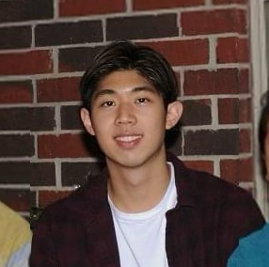
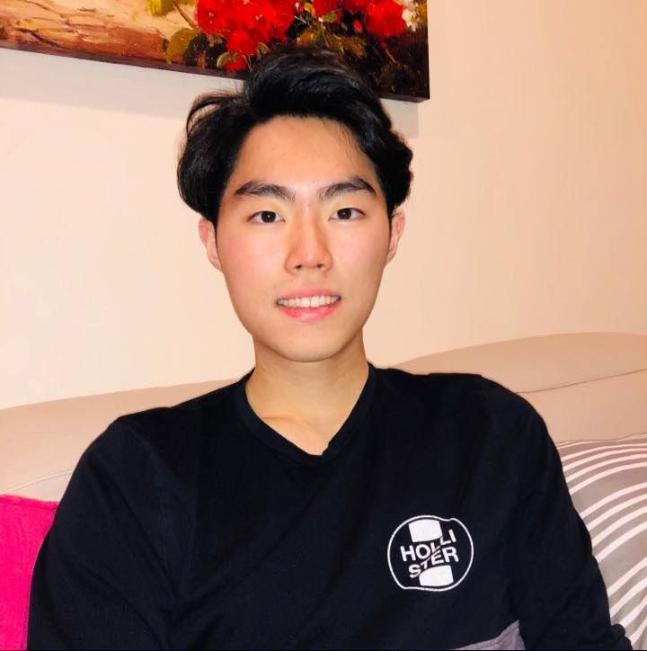
Our Team
Emily CS (2024)
Taipei, Taiwan
Ekin
CS (2024)
Houston, TX
Enok CS (2023)
Leonia, NJ
Christian CS (2023)
Wasco, CA

Slide 3
Needfinding Methodology
1
User interviews

Slide 4
Our Participants
Jared
he/him, 19
Northwestern
Nicholas
he/him, 21
UPenn
Christine
she/her, 21
Fresno State

Slide 5
Extreme User
Designlab
UX Academy
CUNY: Baruch College
B.A. Business Administration
Queensborough Community College
A.S. Business Administration
South Dakota State University
Jacqueline
she/her, 25

Slide 6
Interview Questions
Tell me about a big transition you had to go through as a student.
What challenges did you face when you started school at ______?
What was the hardest thing to adjust to?
Tell me about a time you felt unsure about yourself during your transition.
During those transitions, what helped you the most?
Where did you turn to to find resources or help in facing [your challenge]?
What are ways you’ve met some of your closest friends/mentors?
How did [your transition] change due to COVID?
Could you tell me more about how you felt when facing [your challenge]?
Notes:
Background, building rapport, seeking stories and emotions
Explored extremes: What was the hardest thing to adjust to? What helped you the most?
Changes over time:
Pulling strings

Slide 7
Interview Results
2
Key quotes

Slide 8
Time management [was a significant life transition] because classes don't take up much more of your time. There's a lot of extra time, and I have to manage it in a way that's more efficient.
Jared
he/him, 19
Northwestern

Slide 9
I have to figure out how to work, but also go to school, but also give myself enough time to study, but also give myself enough time for self-care and to hang out with friends.
Christine
she/her, 21
Fresno State

Slide 10
Re-discovering who I am is a significant life transition going into college and/or moving to a different country because no one is there to hold your hands.
Nicholas
he/him, 21
UPenn

Slide 11
I realized my identities were clashing so badly, like, you know, what a lot of immigrant kids go through in their teenage years. Yeah, I felt it in my 20s.
Jacqueline
she/her, 25
CUNY: Baruch College

Slide 12
Analysis
3
Empathy maps, insights, and needs

Slide 13
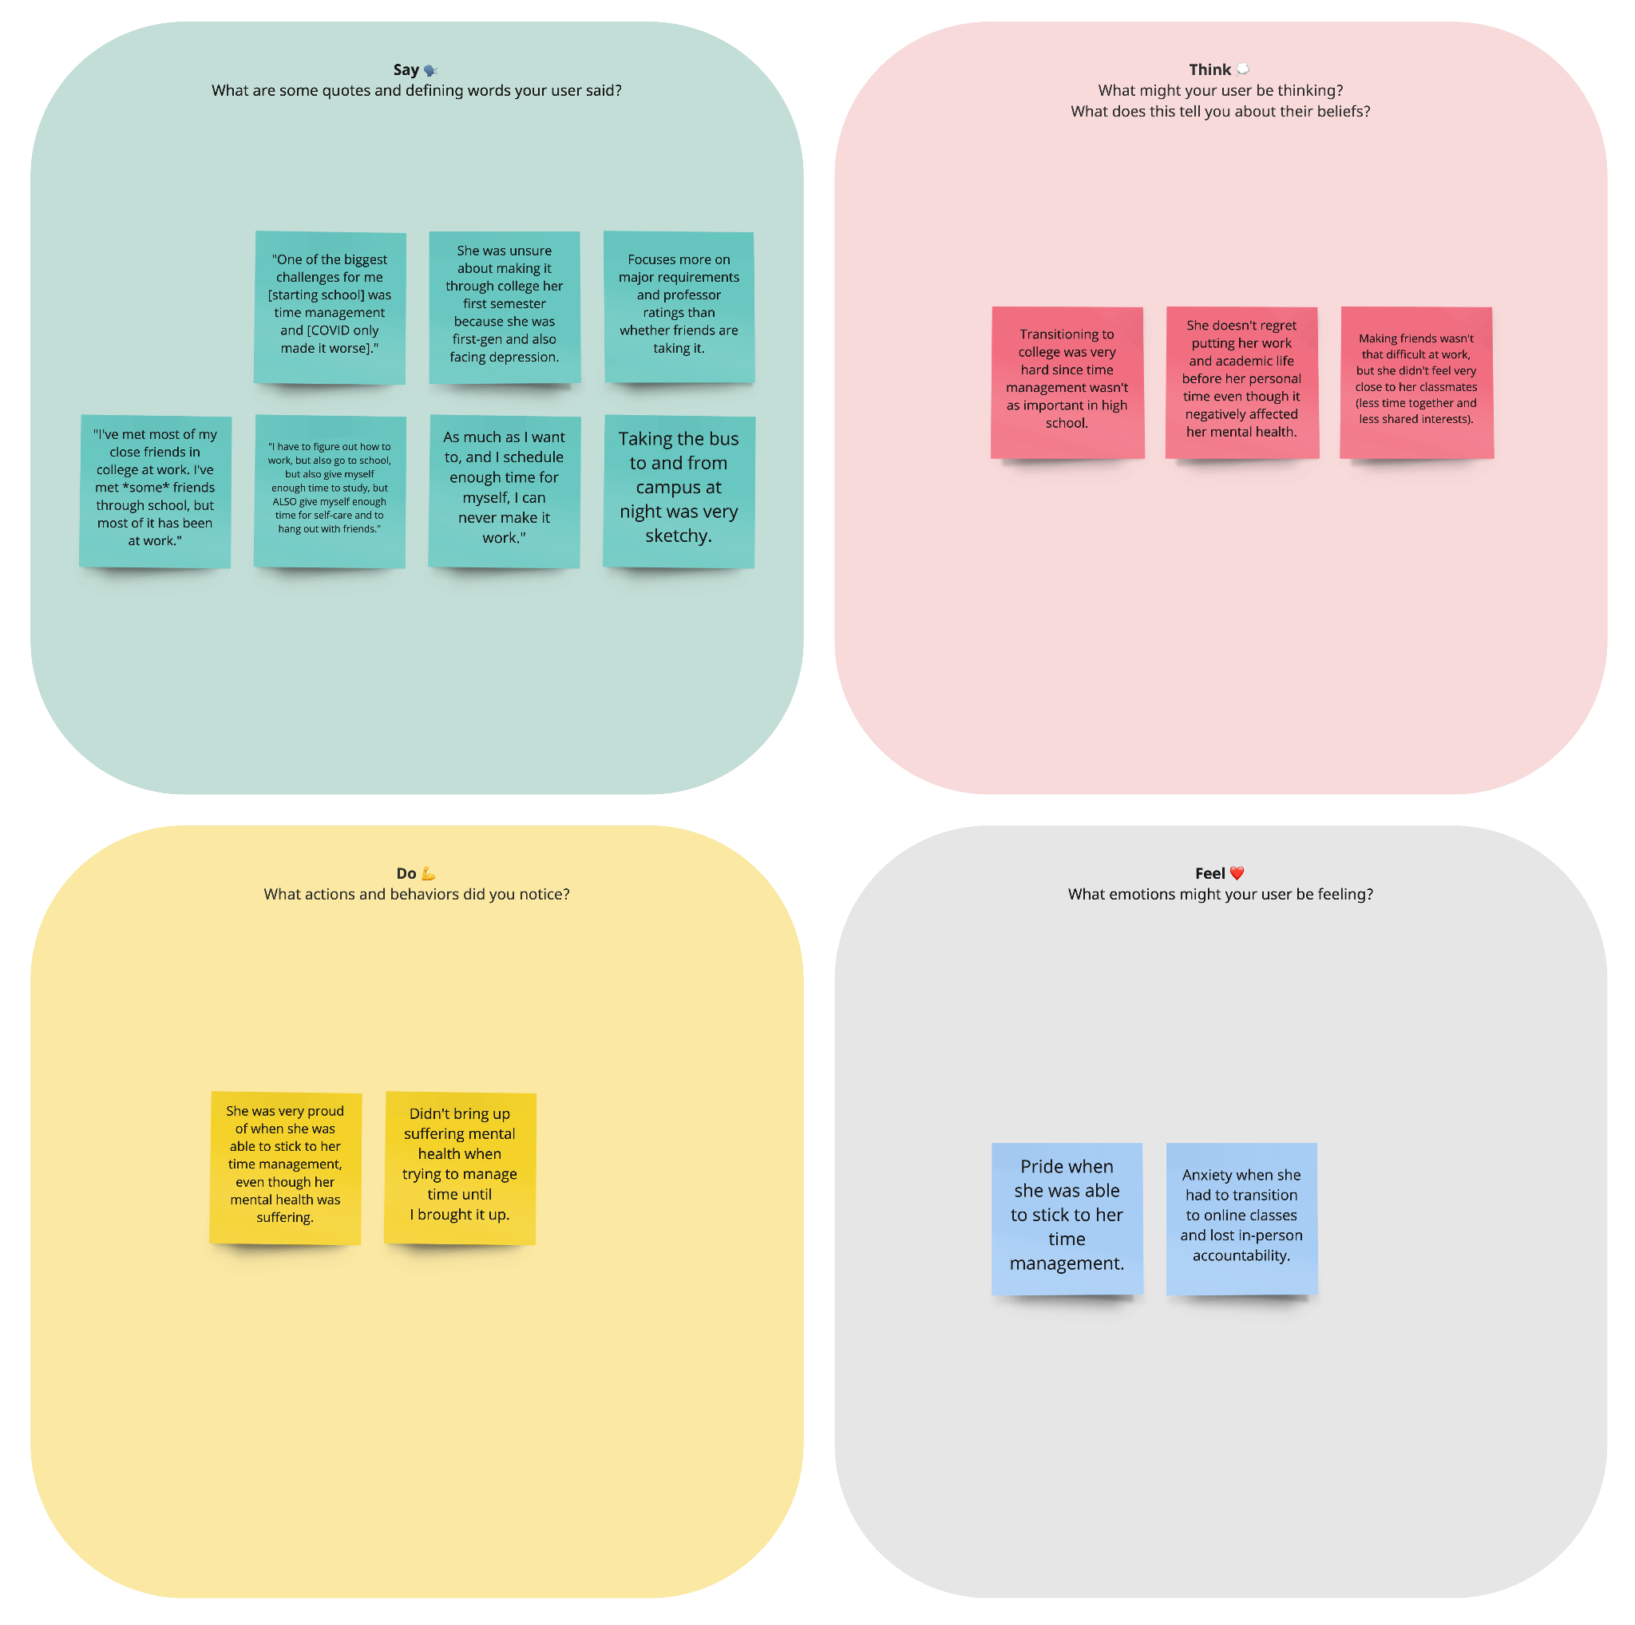
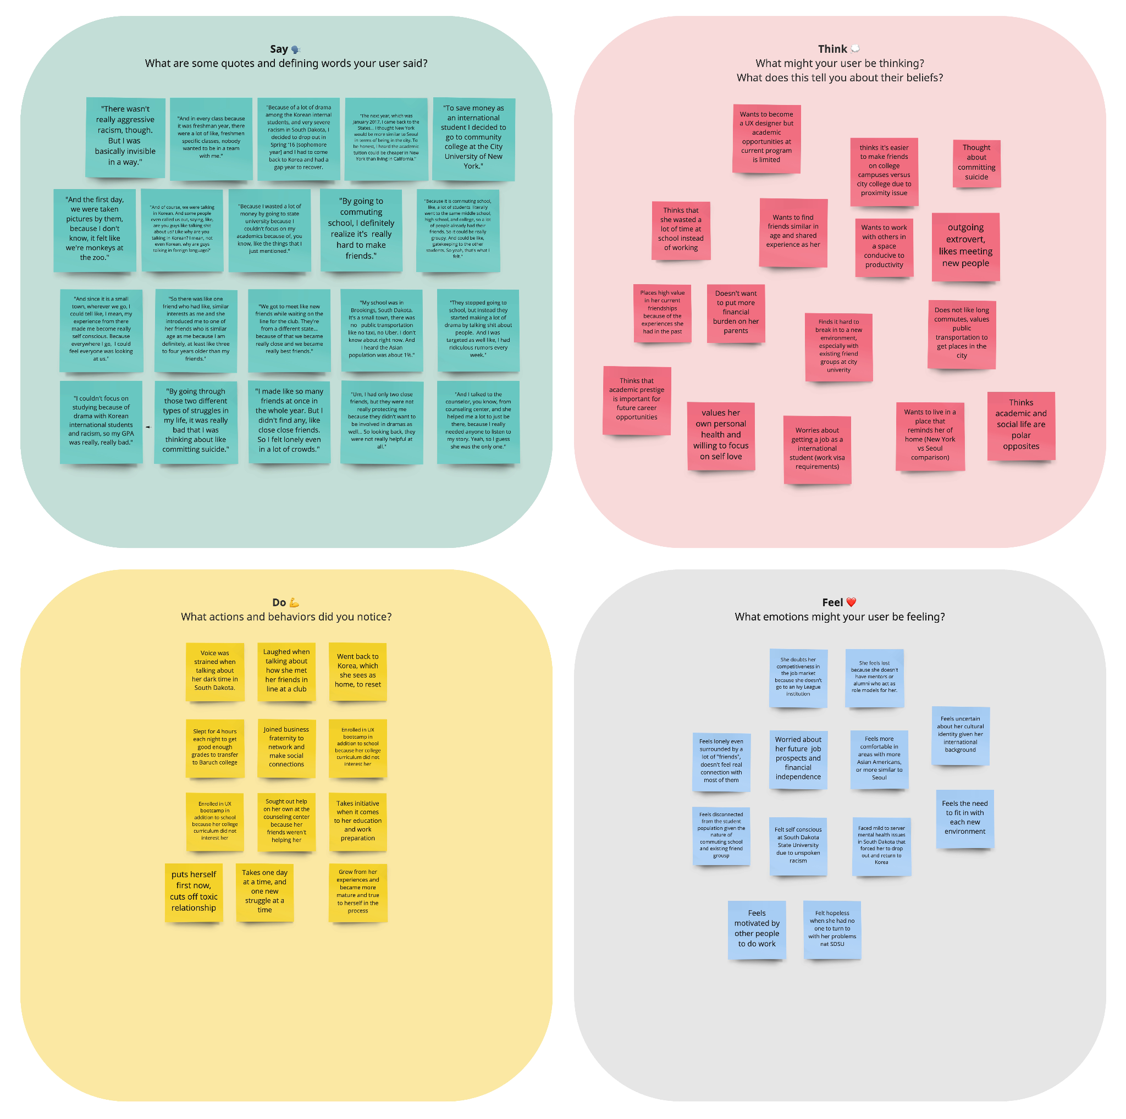
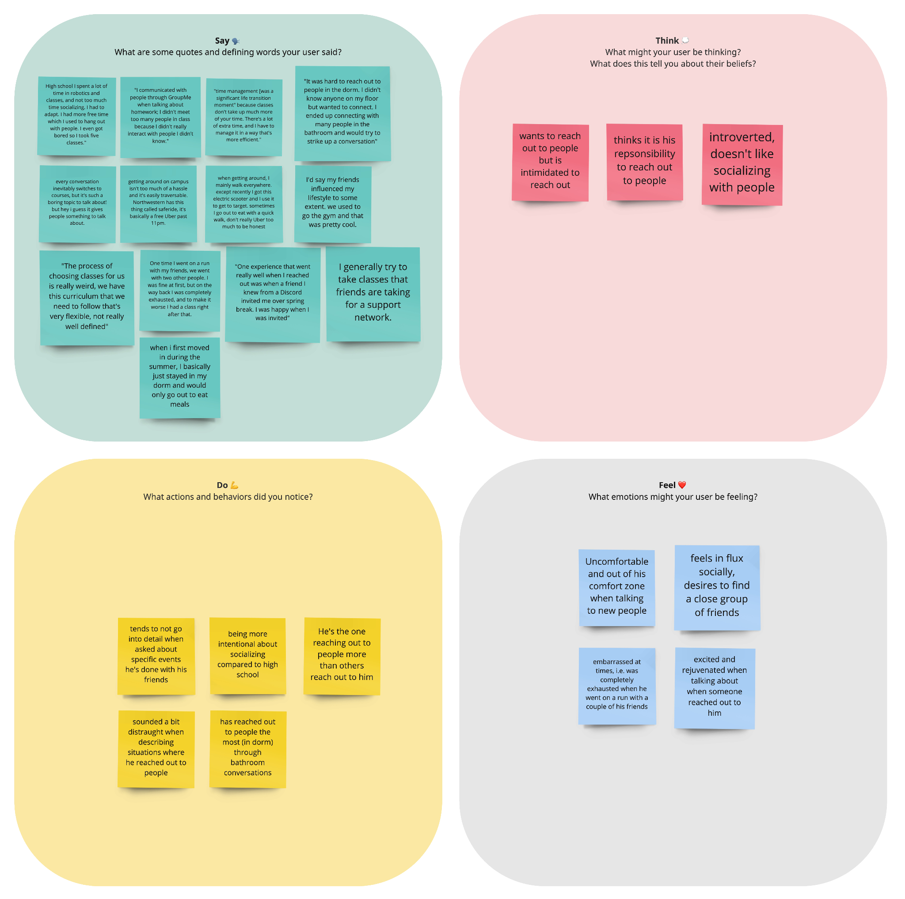
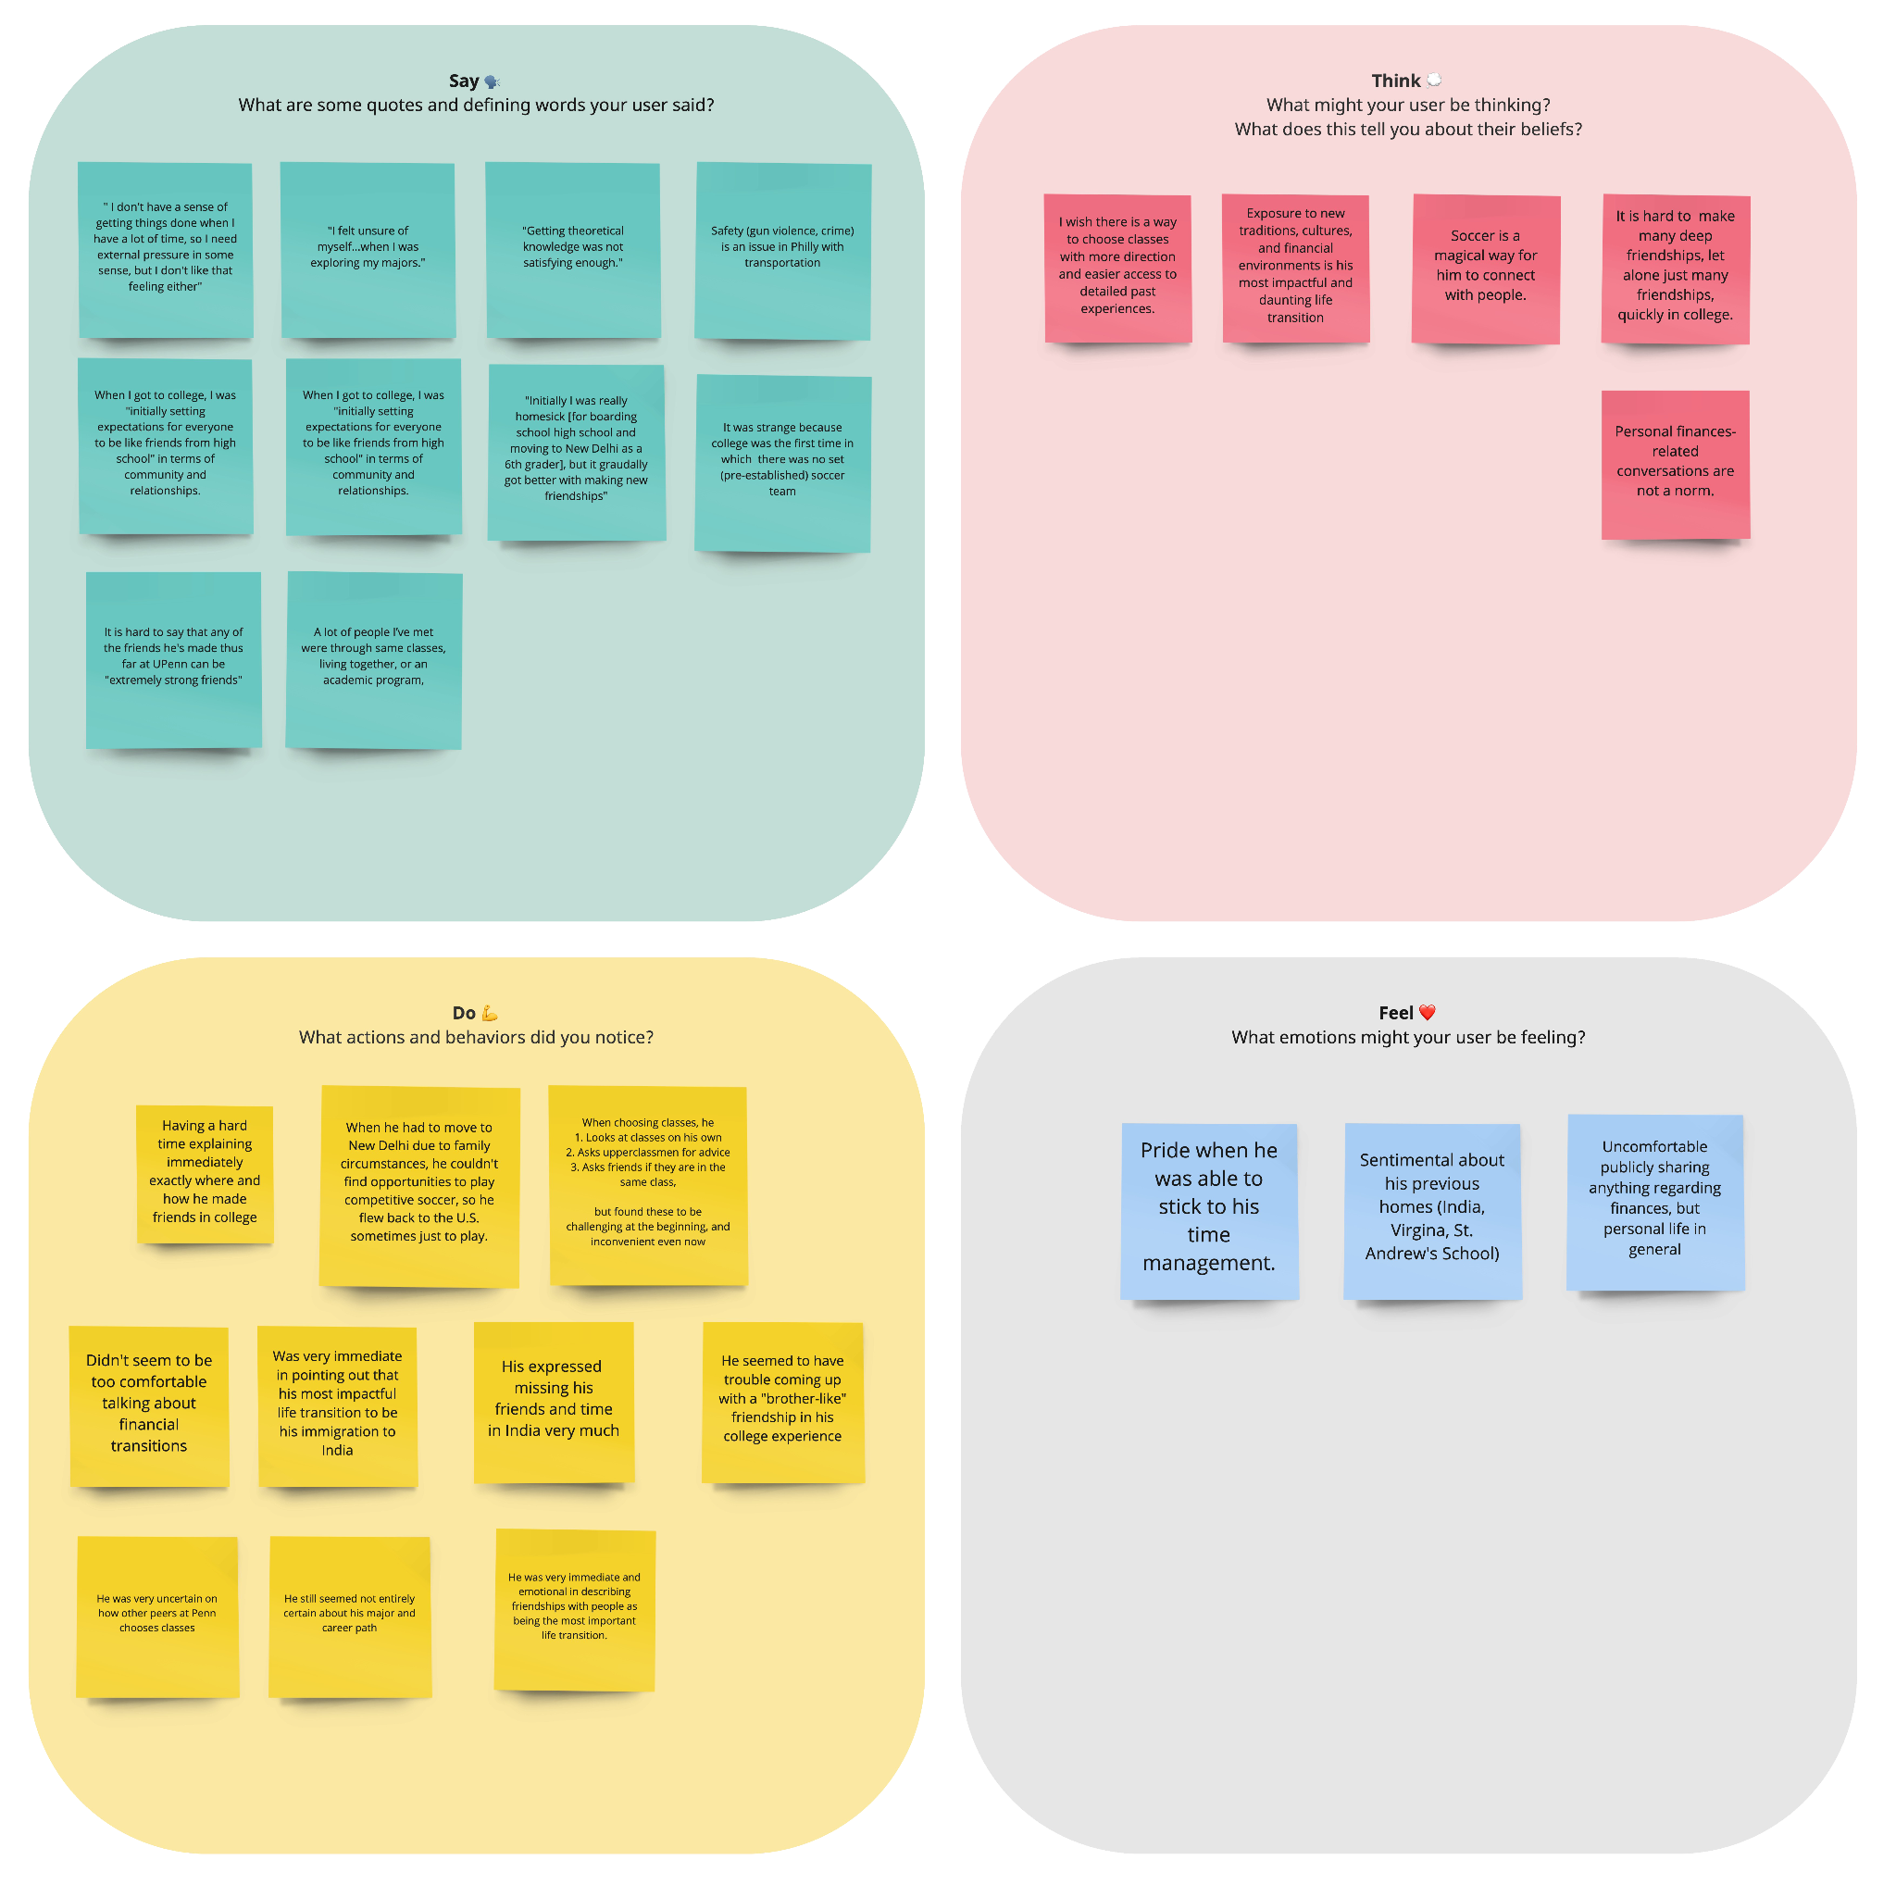
Empathy Maps

Slide 14
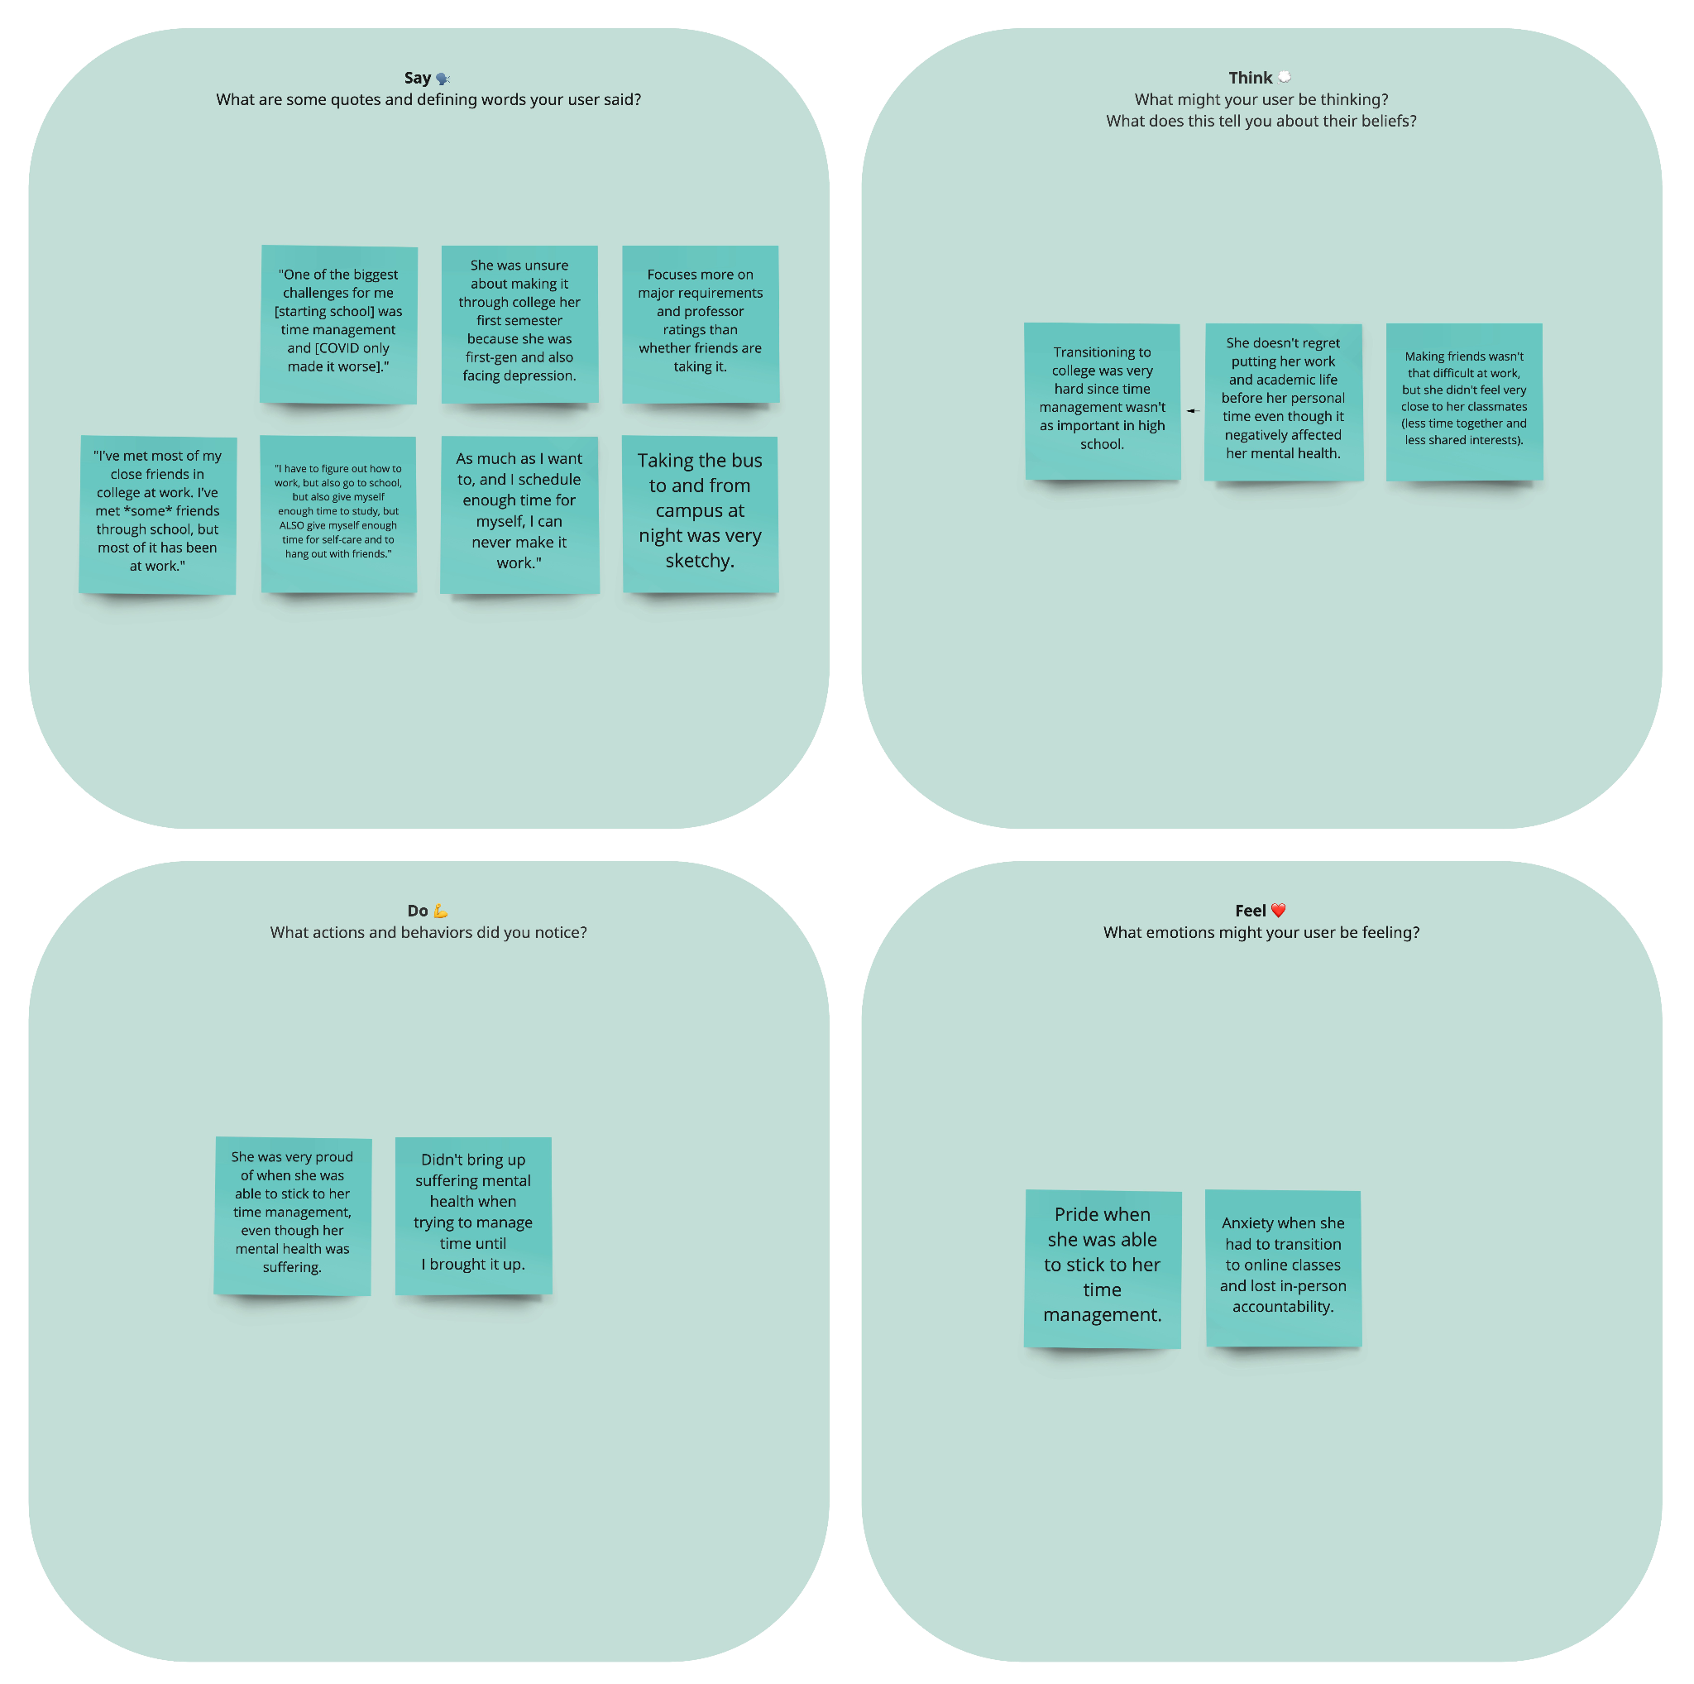
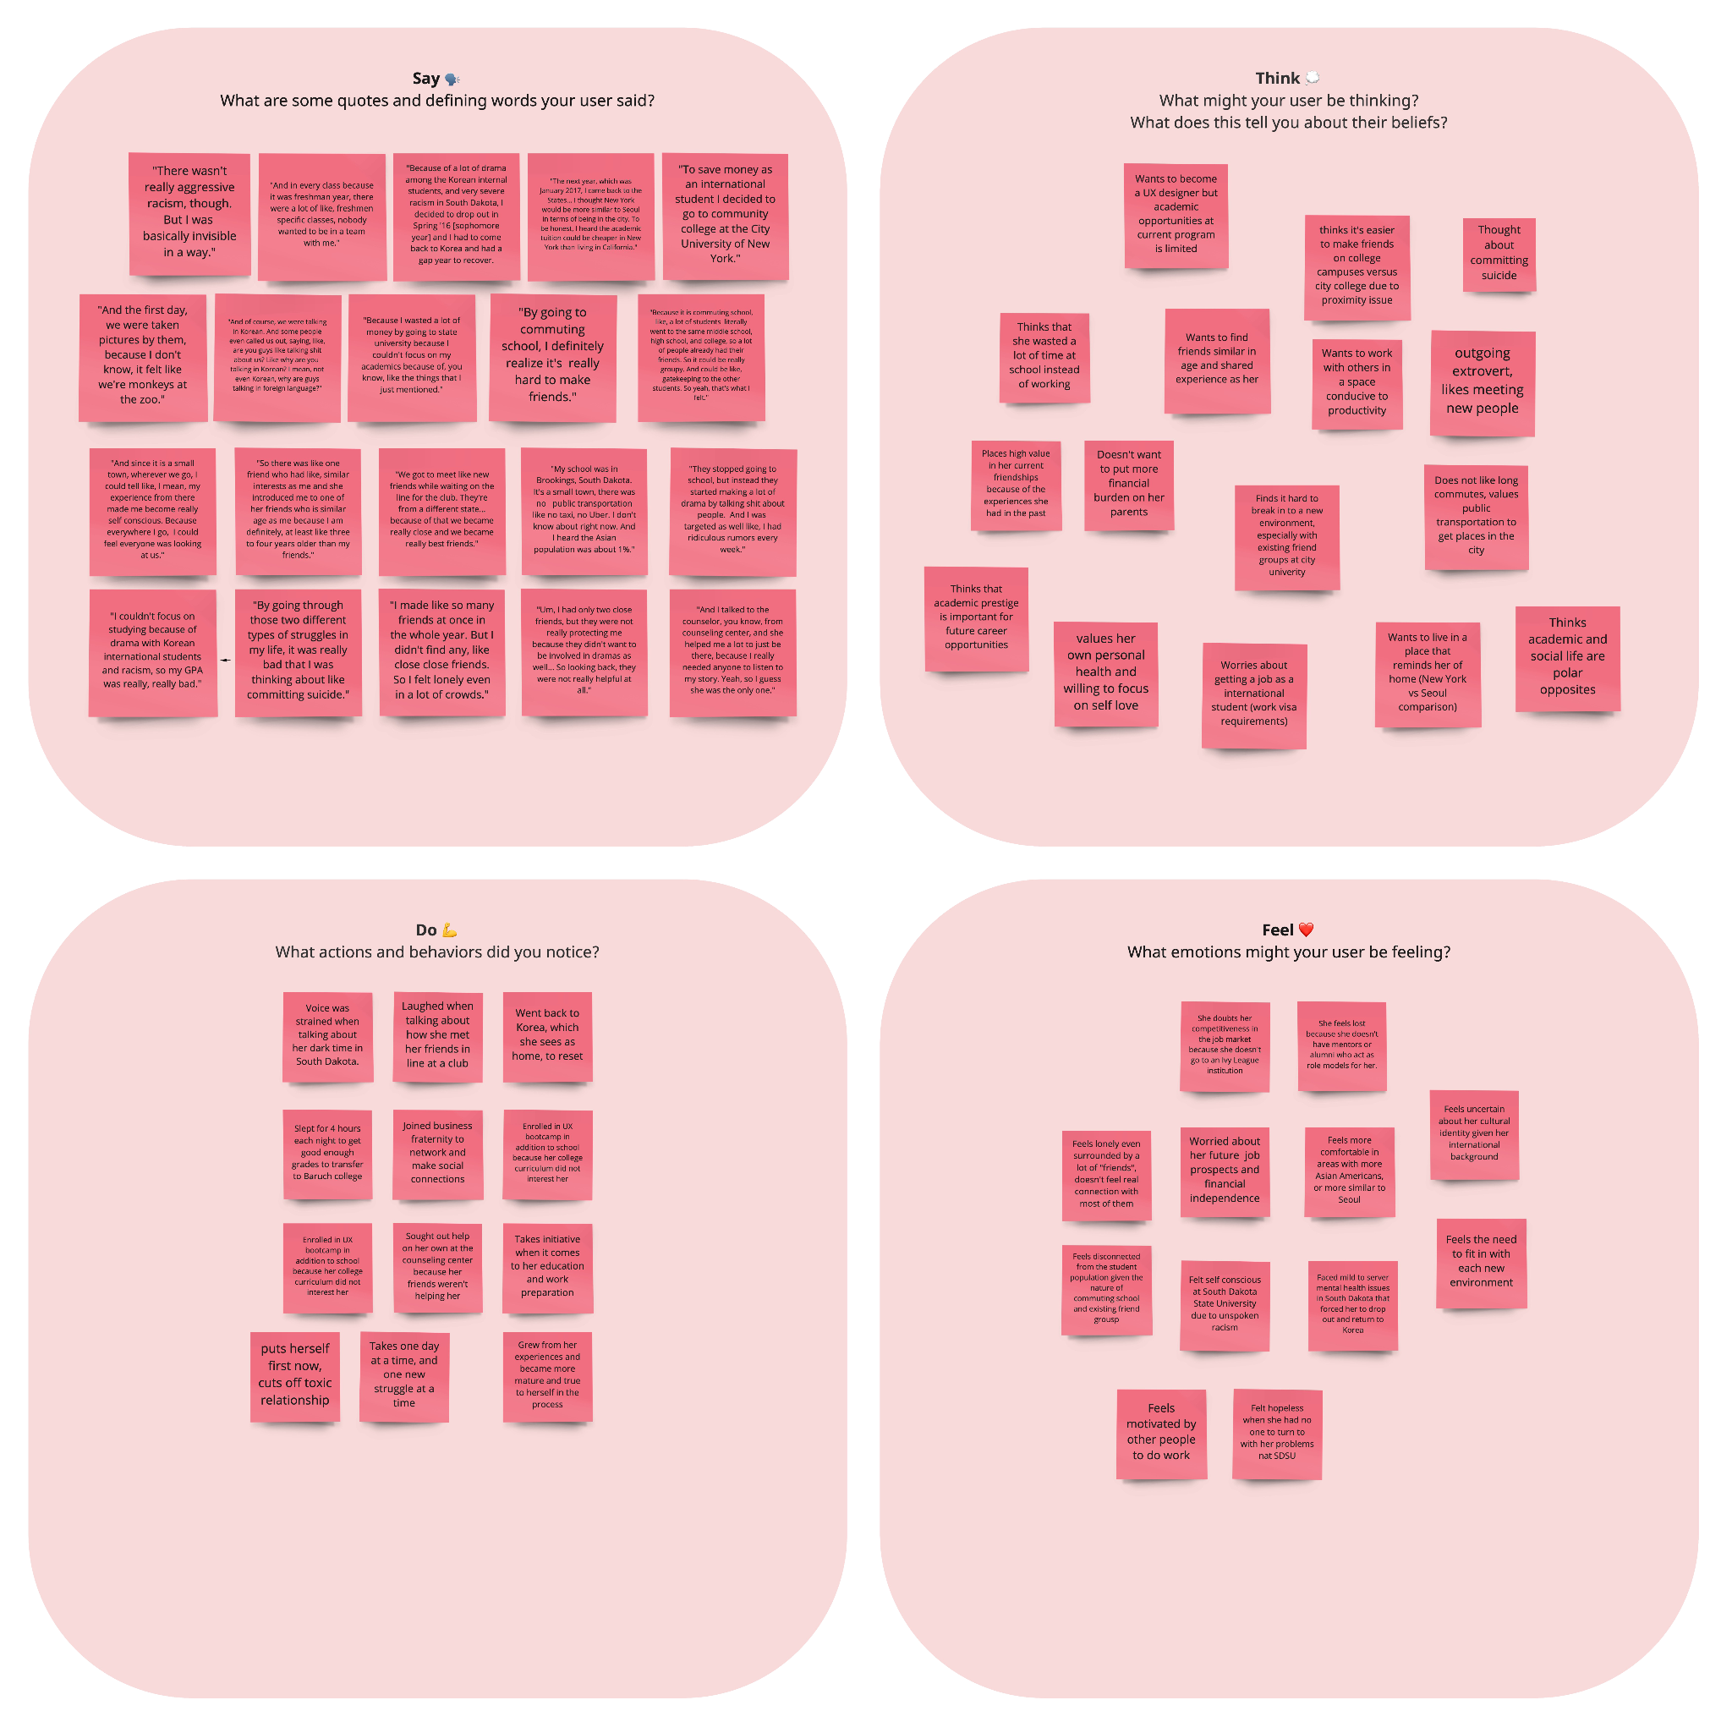
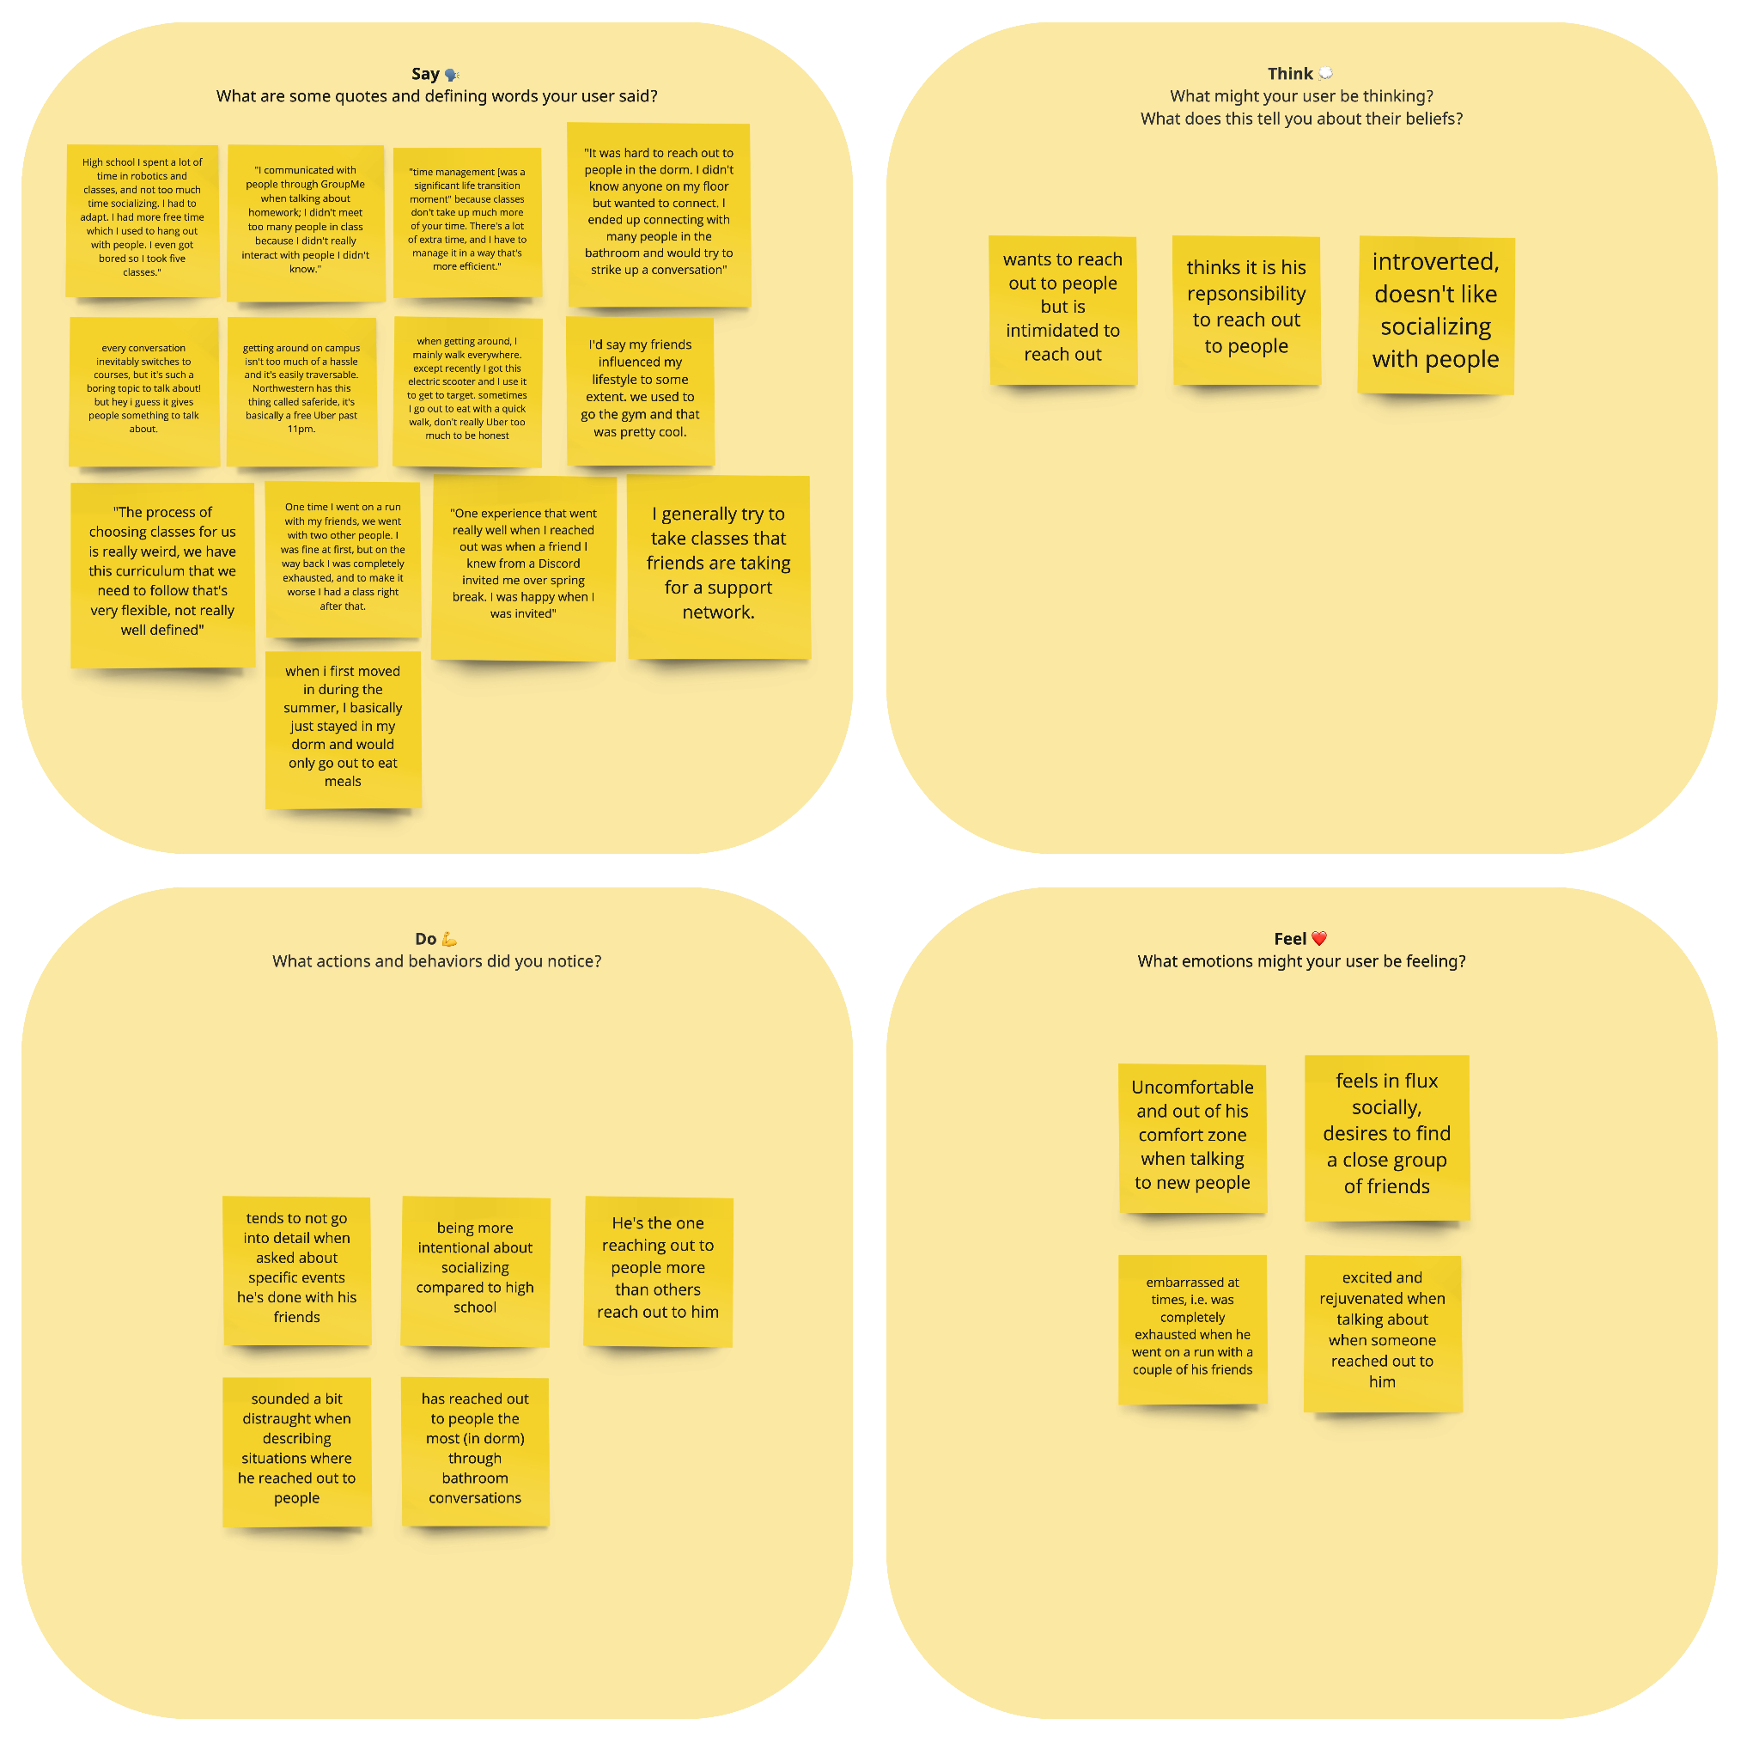
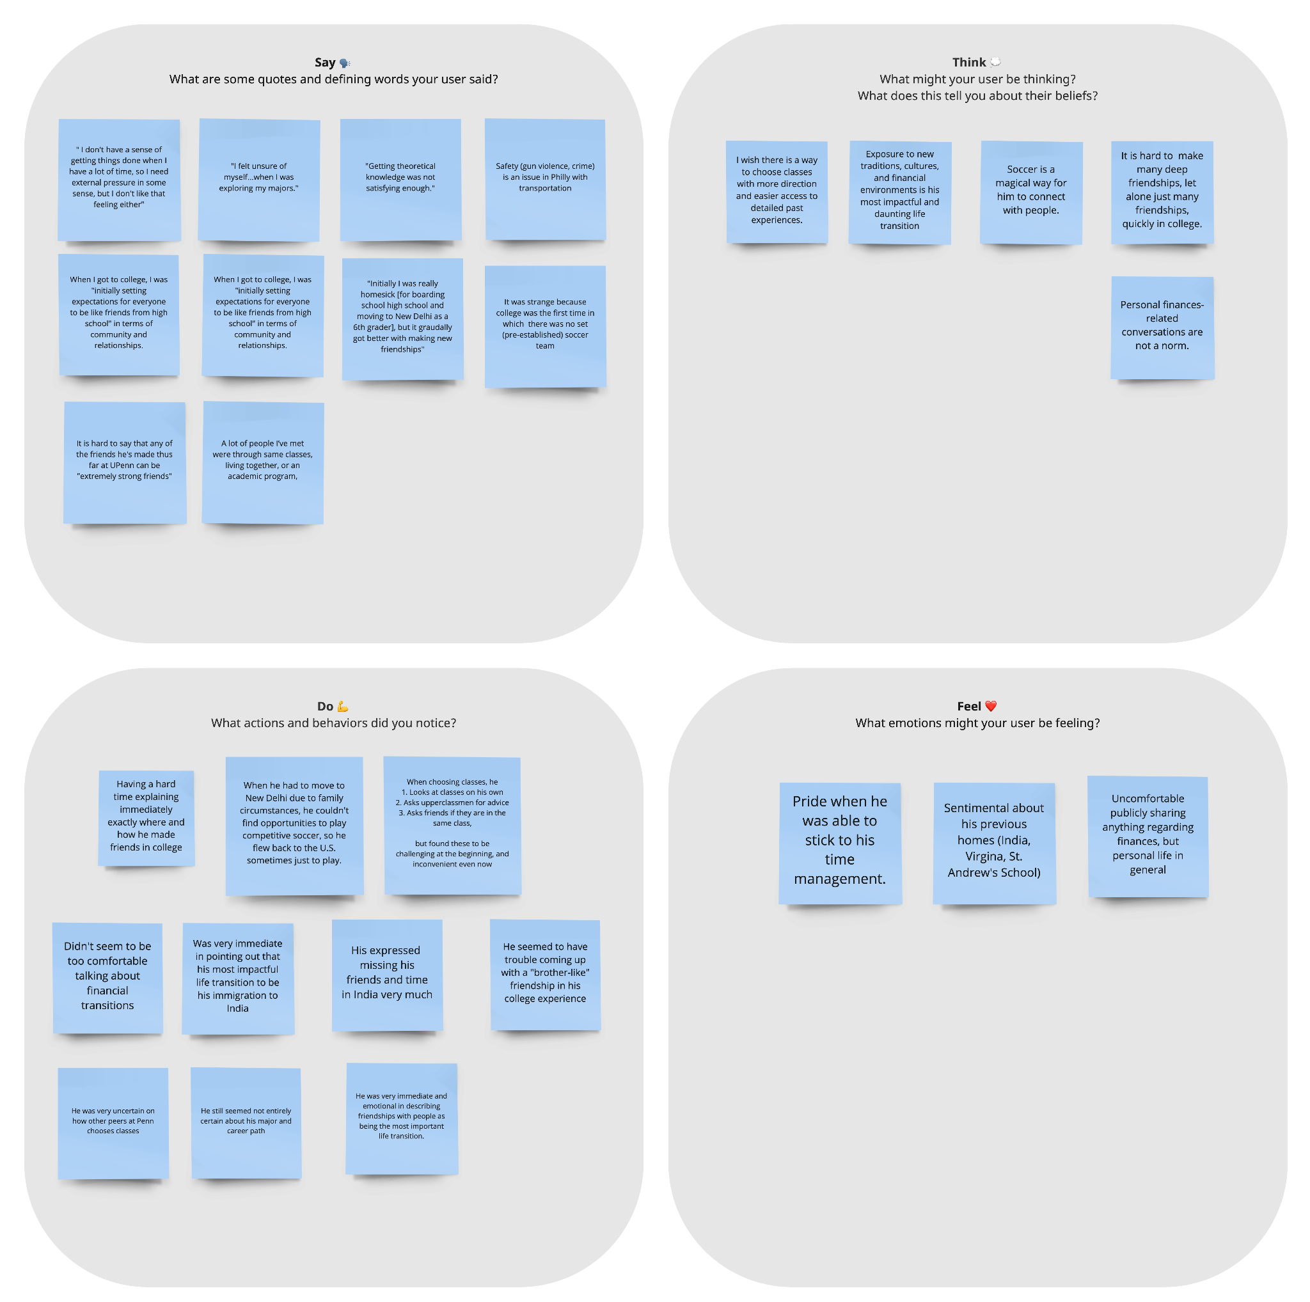
Empathy Maps

Slide 15
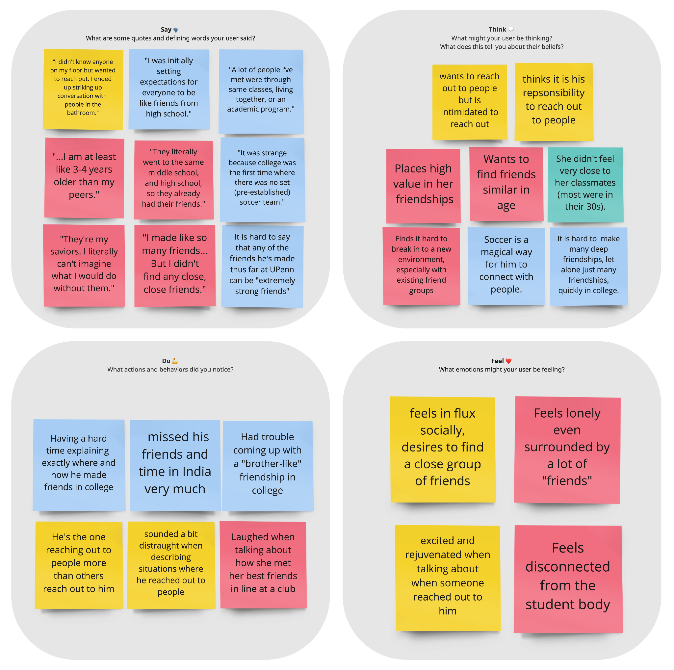
Social Life
TENSIONS
Difficulty making new friends
Missed friends back at home
CONTRADICTIONS
Felt need to reach out and initiate, but gets anxious doing it
Surrounded by people, but lacked strong, genuine relationships
Jacqueline
Christine
Nicholas
Jared
SURPRISES
Wanted friends of same age
Met people often by chance

Slide 16
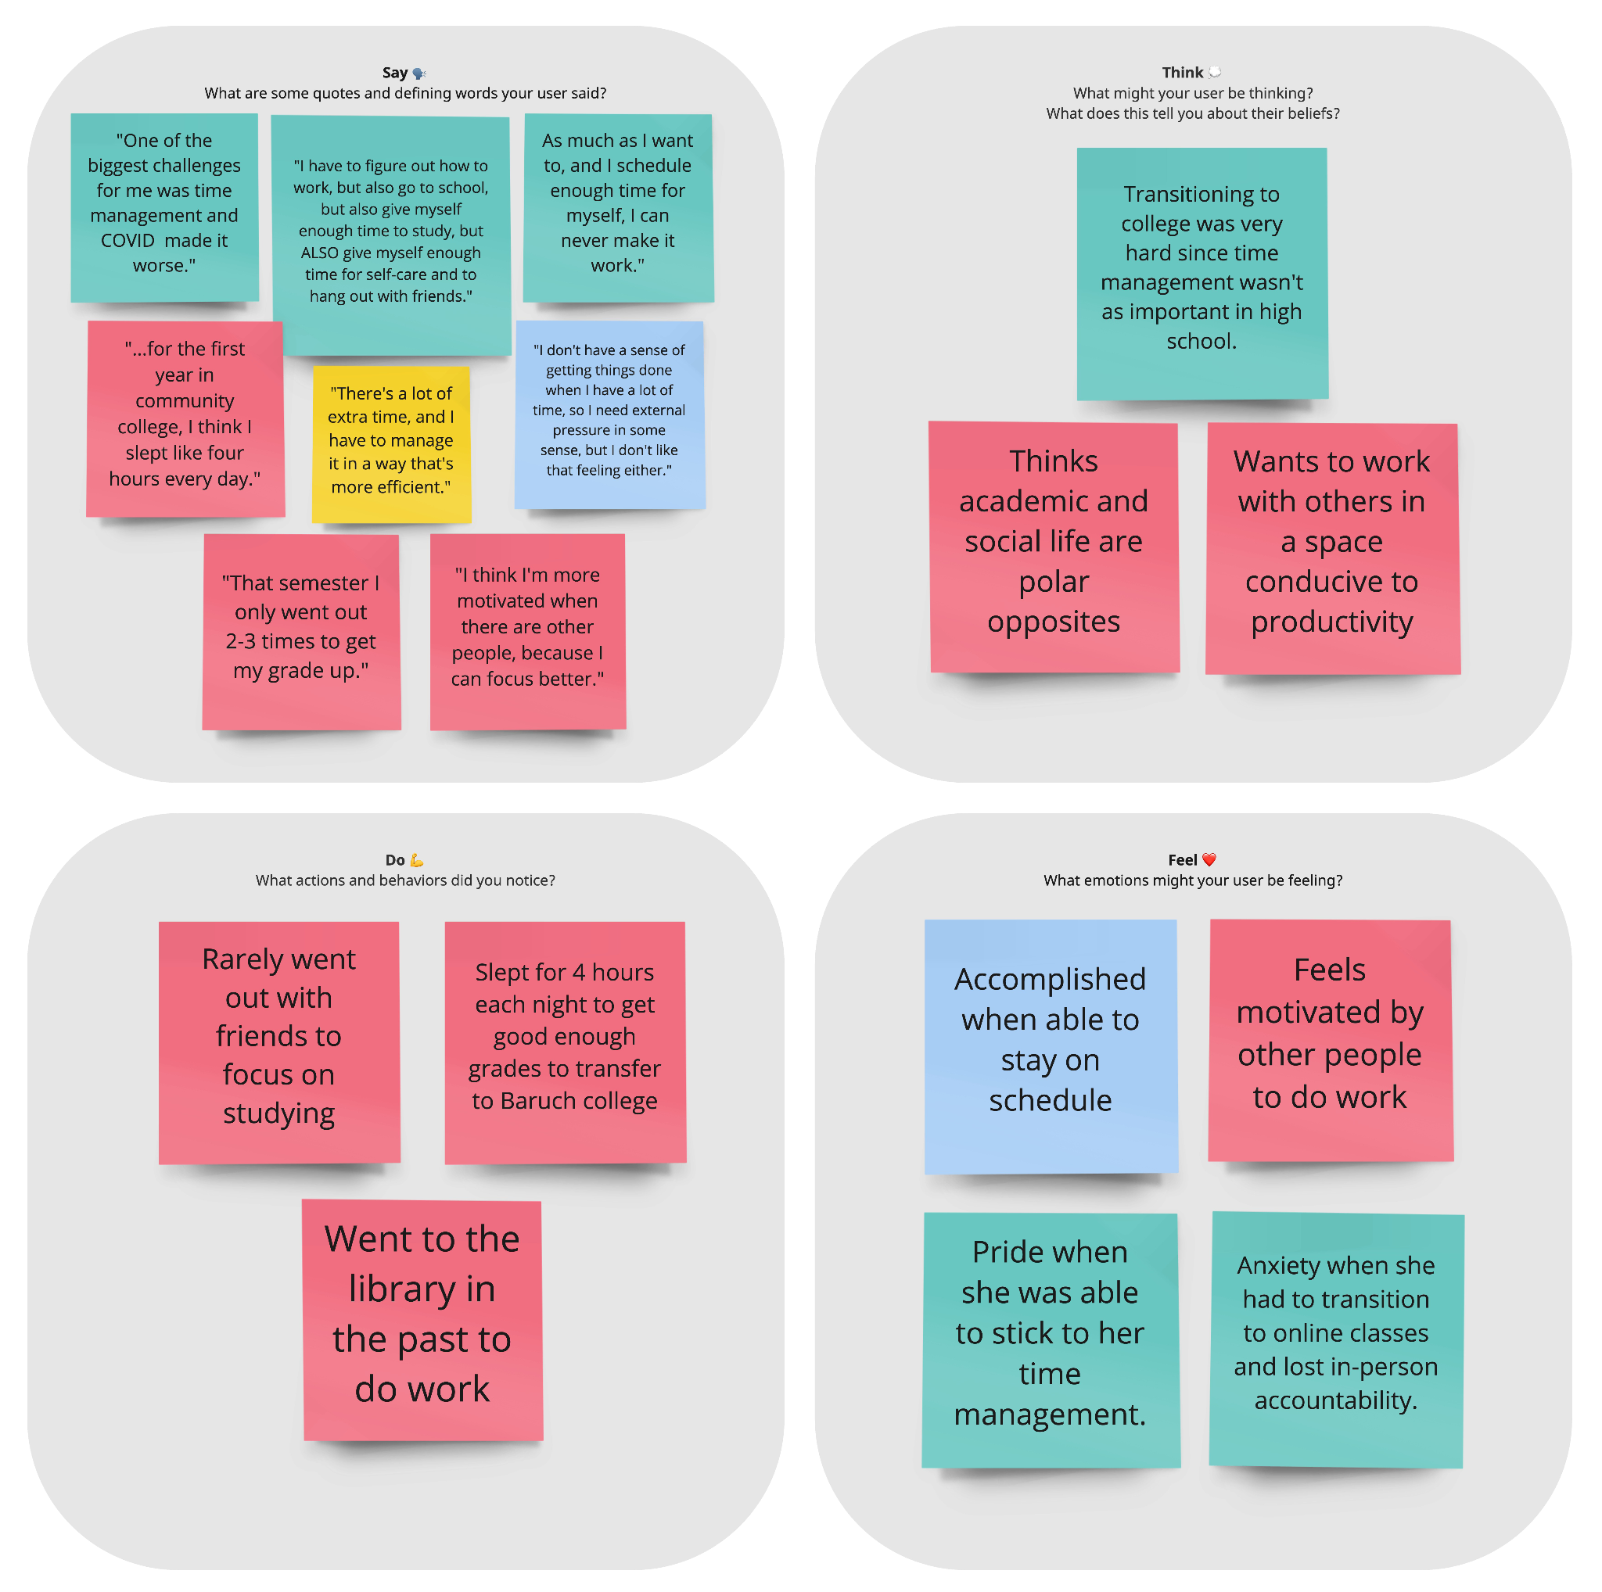
Time/Focus
TENSIONS
Difficulty balancing time across academics, social life, work, and personal health
CONTRADICTIONS
Need pressure to get work done but didn’t like the pressure of deadlines
Both too little and too much time leads to time management concerns
SURPRISES
Harder to manage time when things went online due to COVID
Jacqueline
Christine
Nicholas
Jared

Slide 17
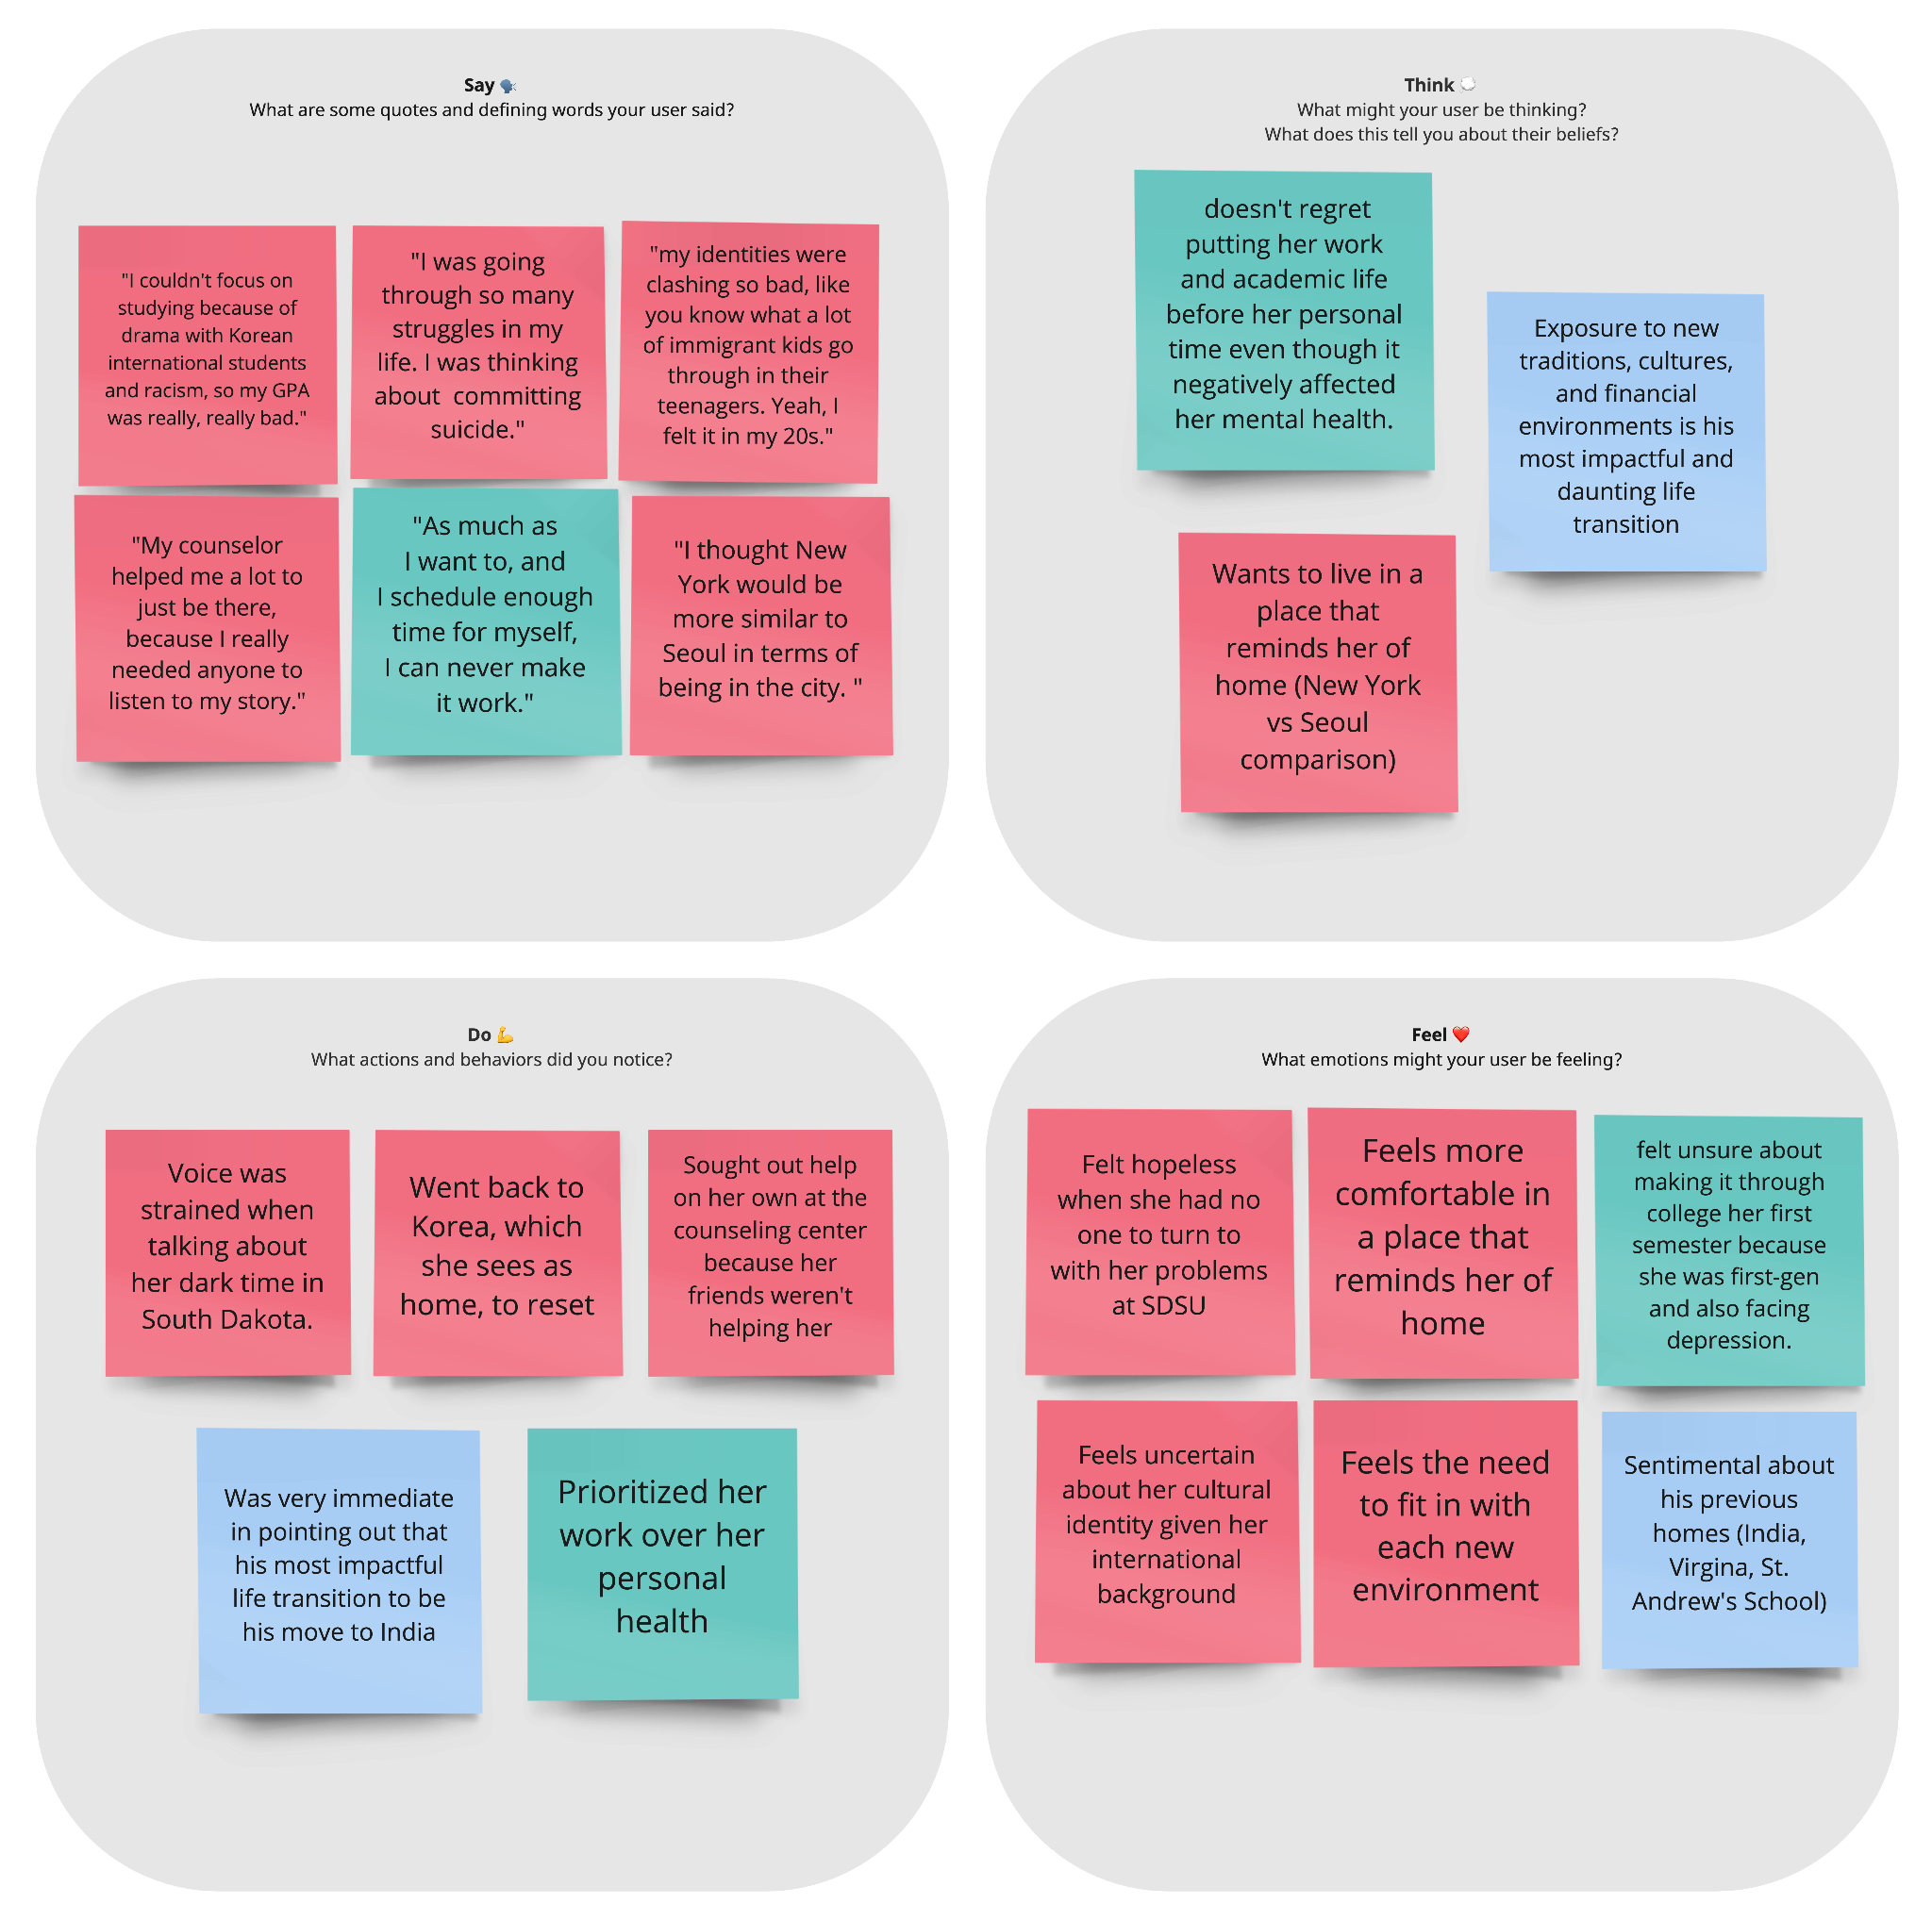
Mental Health
TENSIONS
Cultural anxiety and homesickness when moving to a new country
CONTRADICTIONS
Felt proud when able to juggle so many things, but also didn’t feel supported
SURPRISES
Willing to put work over mental health
No one there for them except counselor
Jacqueline
Christine
Nicholas
Jared

Slide 18
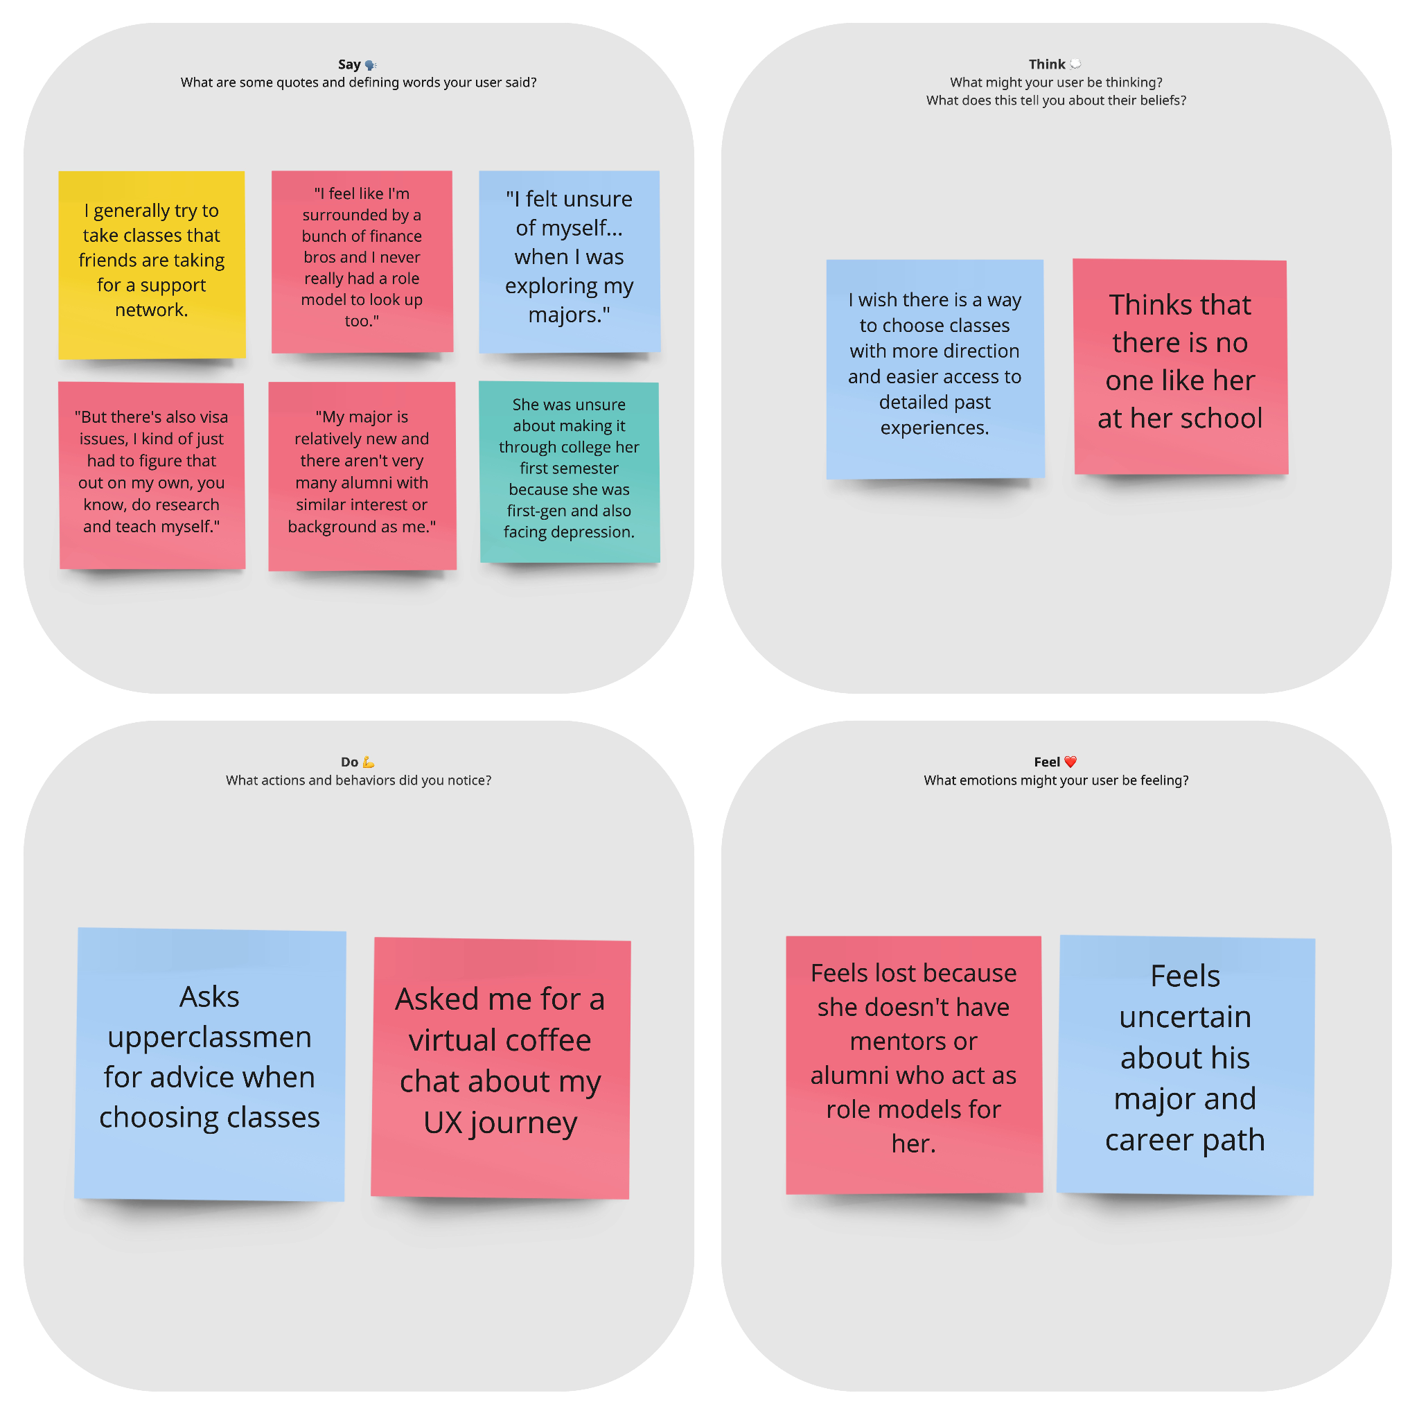
Mentorship
TENSIONS
Difficulty finding role models / mentors for career and academic planning
Feel a lot of uncertainty about the future
Jacqueline
Christine
Nicholas
Jared

Slide 19
Insight
Insight
Insight
In a unstructured environment, people often make friends by chance.
Even existing friendships lacked depth and authenticity.
People need pressure to get work done but don’t like the pressure of deadlines.
Need
Increase opportunities to meet others of similar age.
Need
Overcome the superficiality of fleeting relationships.
Need
Create positive pressure without the stress.

Slide 20
Insight
Insight
Insight
Students are constantly worried about their future academic and career journey.
Students like the feeling of being busy, but get overwhelmed when too busy.
Leaving home creates uncertainty, fear, and inclination to replicate their previous home environment.
Need
Provide reassurance and guidance on next steps.
Need
Help students have a balance of busyness.
Need
Create experiences that make people feel at home.

Slide 21
Summary
Increase opportunities to meet others of similar age.
Overcome the superficiality of fleeting relationships.
Create positive pressure without the stress.
Provide reassurance and guidance on next steps.
Help students have a balance of busyness.
Create experiences that make people feel at home.

Slide 22
Thank you!
Feedback and Q&A

