Slide 1
Assignment 4:
Concept Video

Slide 2
Title: Collide
Value Proposition:
Your next best friend is just around the corner…
Problem/Solution Overview:
Transitioning to a new environment, people find it difficult to make meaningful connections and are fearful of reaching out. We want to solve this by creating opportunities for people, who would have otherwise passed by each other, to stop and talk.

Slide 3
Market Research: Meetup
Similarities:
Leverages proximity to help you find people outside of your current social circle to socialize with
People are linked by a common interests & backgrounds to help you find like-minded people
Differences:
Emphasis on larger group meetups (i.e. explore groups and events)
In contrast, we focus on relationships at the individual level
Users meet people through intentional effort, (i.e. find people/groups on the platform, then meet up)
In contrast, our connections are more passive and unveiled to the users as they go about their daily lives.

Slide 4
Market Research: Meetup
Company Facts / Key Takeaways
App was mostly successful, founded in 2002, raised $18.3M in funding over 5 rounds, and was acquired by WeWork in 2017.
Meetup has over 49 million members and is available in more than 190 countries
One of the initial employees of Meetup explains that their initial traction “came from having an ability to localize people around all sorts of topics very easily… early high traffic topics included Slashdot, witches, Livejournal, etc.”
Based on this point, we must think more about how our app can gain an initial following without group communication, topic-based matching
Solution Novelty
Unlike traditional connection platforms such as Meetup, our app helps users
make connections as they go about their daily lives
connect to past or mutual connections that are close by
Notes:
Sources:
https://www.quora.com/How-did-Meetup.com-get-initial-traction

Slide 5
Task Definition
Simple Task:
The user wants to find potential connections nearby with shared attributes and background.
Moderate Tasks:
The user wants to start a in-person conversation with a potential connection.
The user wants to add connections to their existing network.
Complex Task:
The user wants to reconnect with past friends that are nearby.

Slide 6
Values in Design
Inclusion
We want to create a welcoming experience for everyone in the general public and globally.
Authenticity
We also want depth in user profiles so that people can connect on a deeper level beyond surface level interests.
Privacy
We want users to feel in control of the amount of personal information they share and to which audiences.
Safety
We need to ensure that interactions are safe and appropriate as people may be meeting strangers.
To reconcile potential conflict between authenticity and privacy, we will prioritize privacy but help users find appeal in sharing as much as they are comfortable with to enhance their user experience.

Slide 7
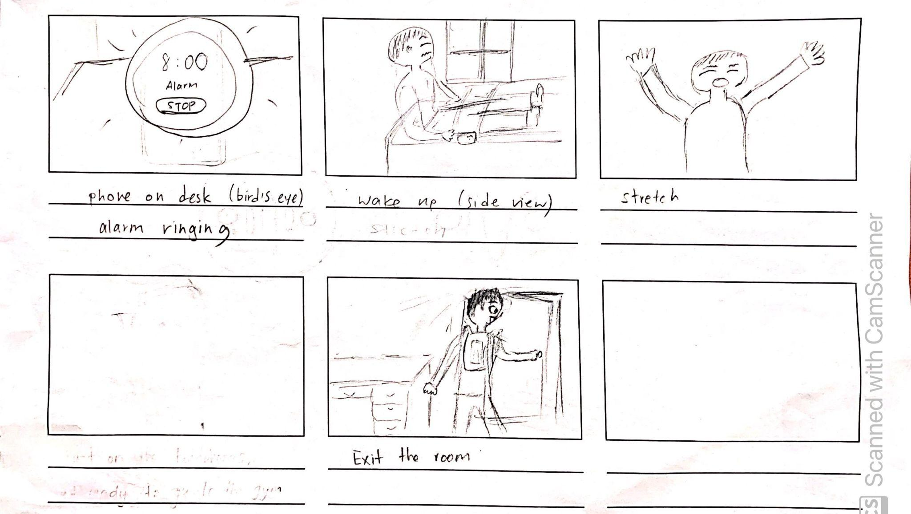
Storyboards: Scene 1

Slide 8
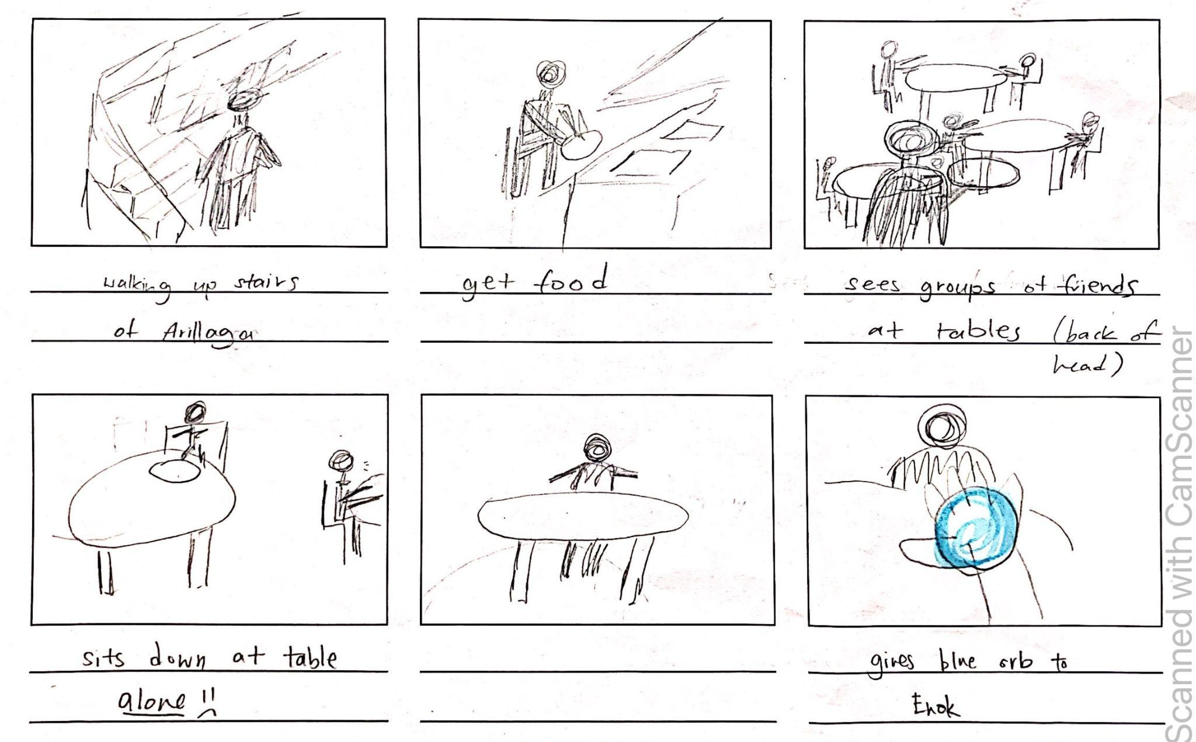
Storyboards: Scene 2

Slide 9
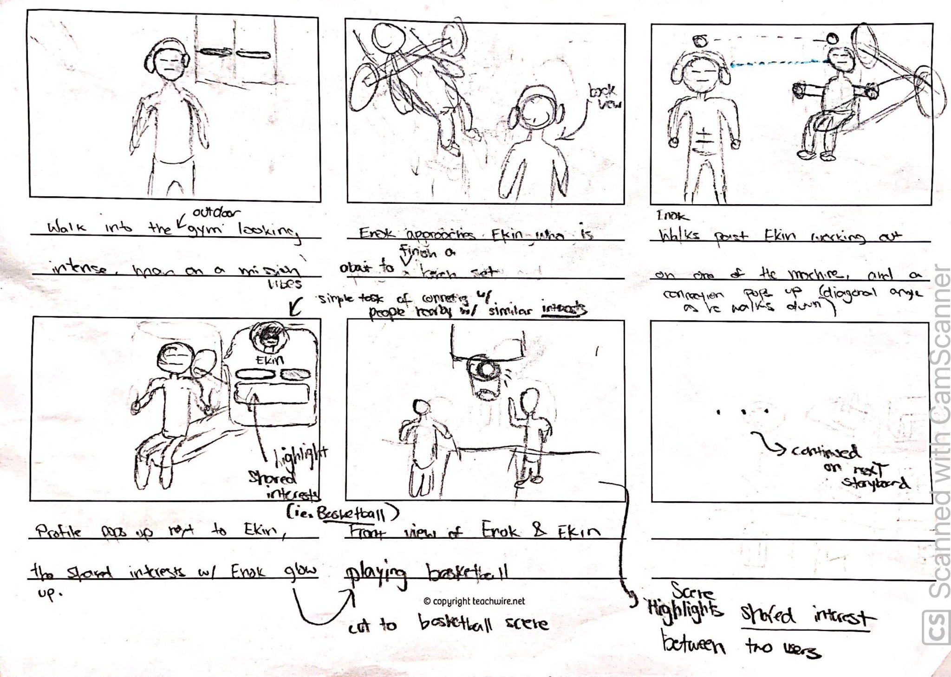
Storyboards: Scene 3

Slide 10
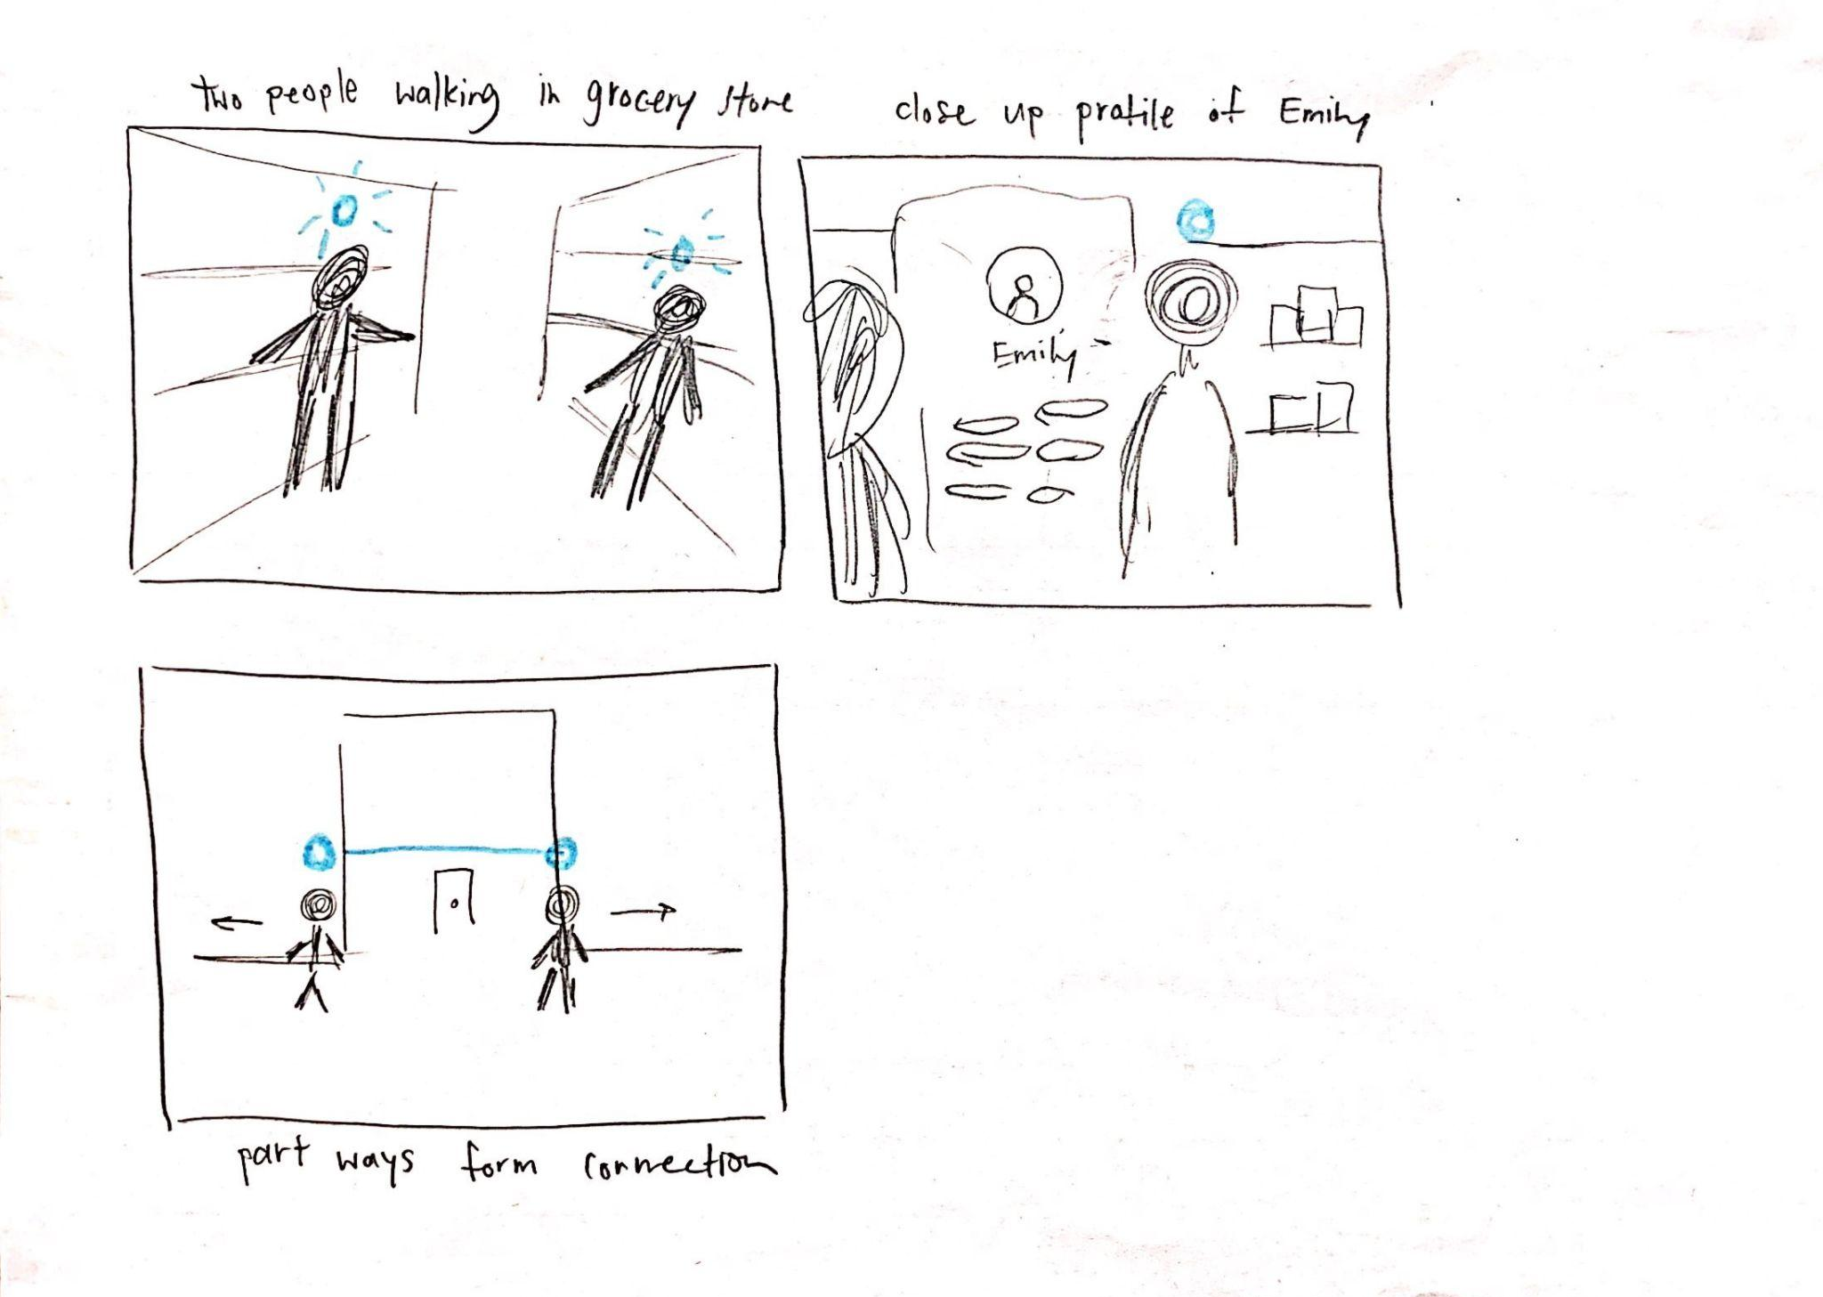
Storyboards: Scene 4

Slide 11
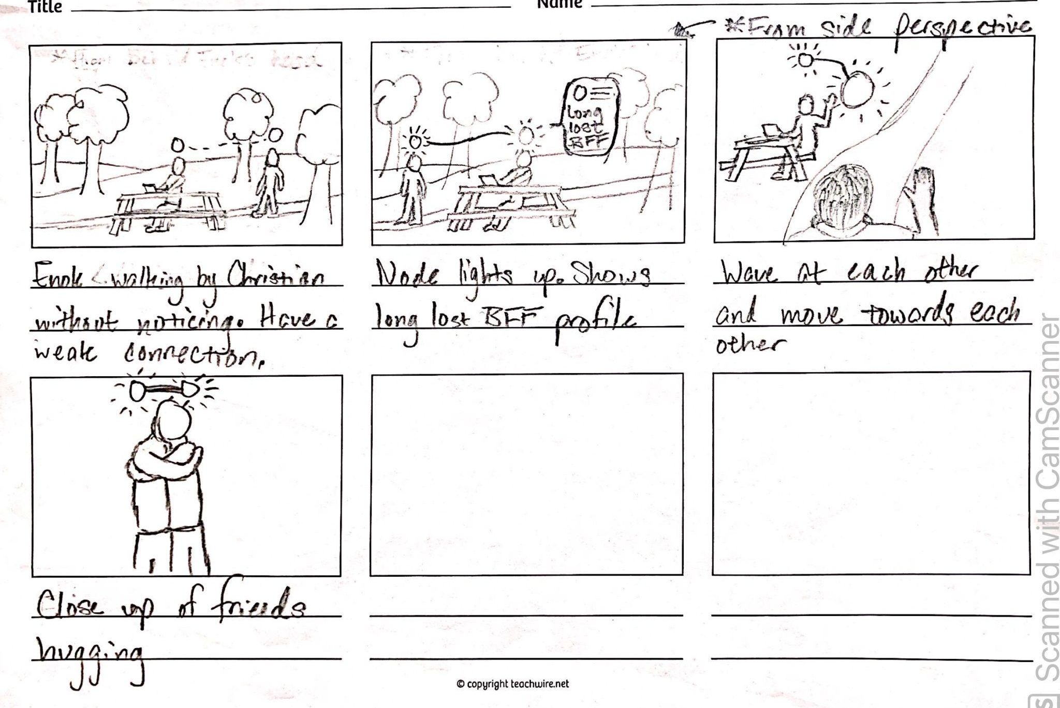
Storyboards: Scene 4

Slide 12
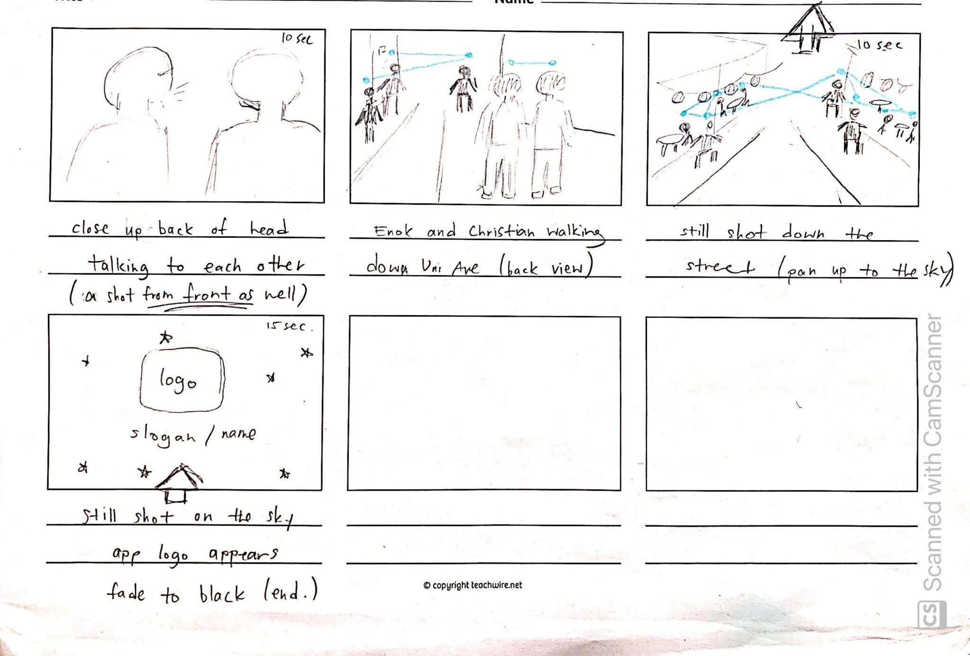
Storyboards: Scene 6

Slide 13
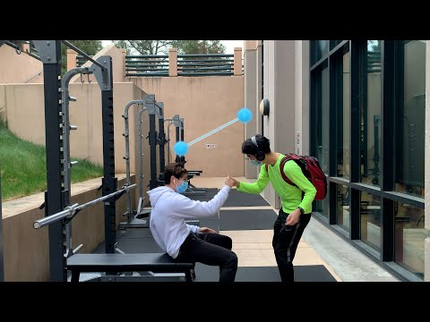
Concept Video

