Slide 1
Team 3:
Mental Health Needfinding

Slide 2

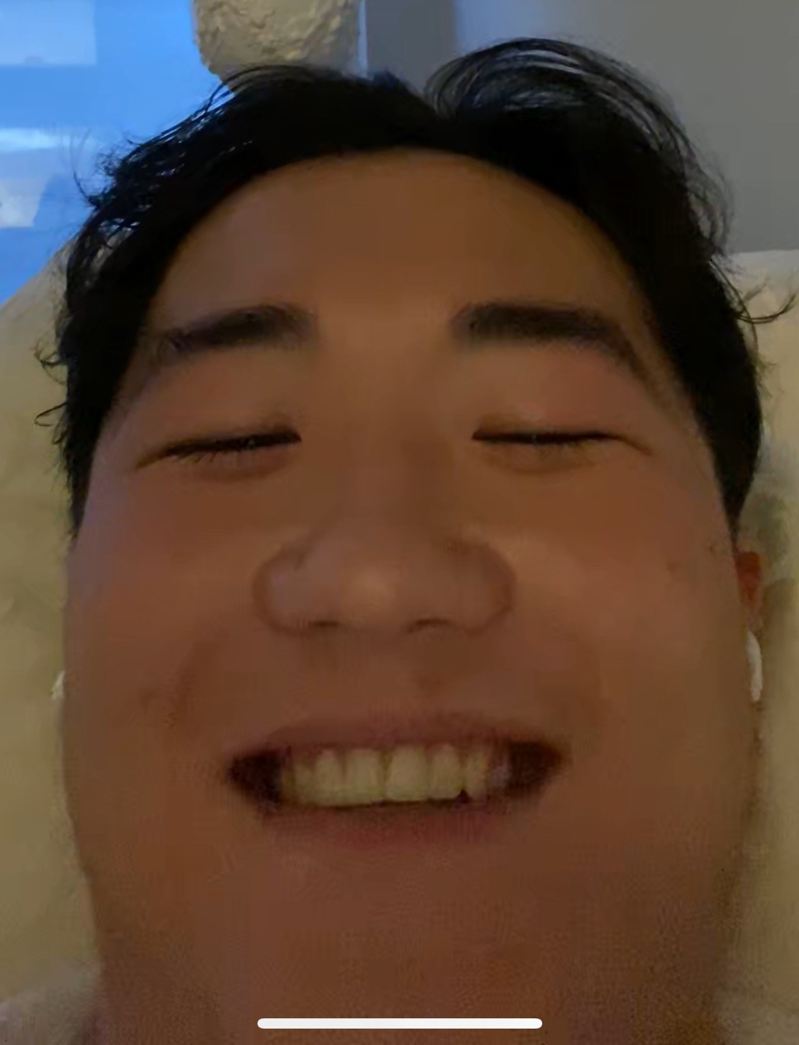
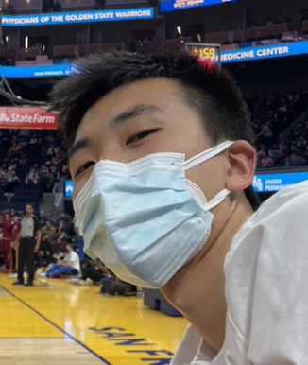
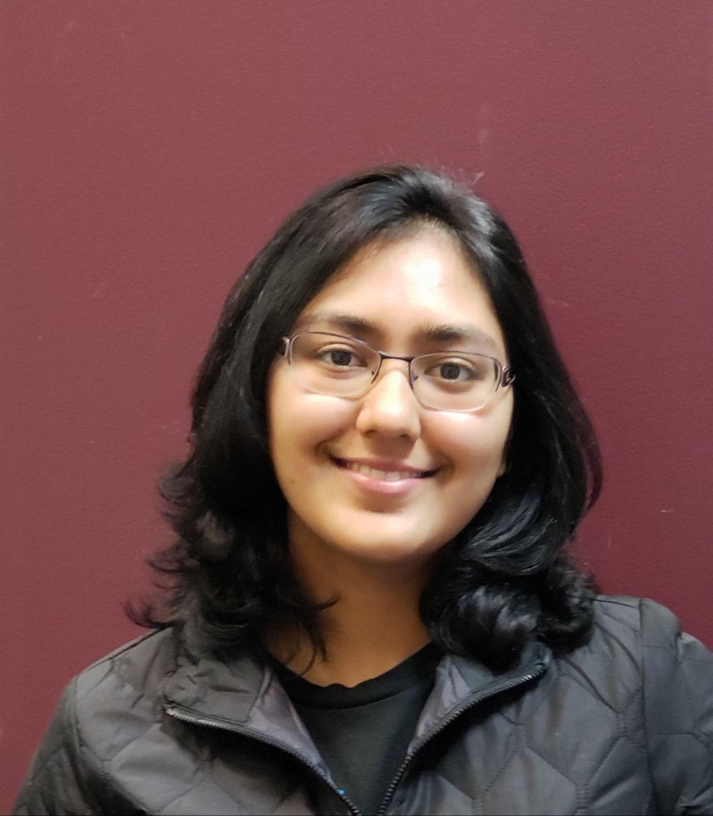
TEAM
SAFIYAH
CS 2023
RAYMOND
BMC 2023
NIKI
CS 2022
ROY
CS 2023
Notes:
To Dos: Each person add their photo,

Slide 3
Three Domains of Focus
Destigmatizing Mental Health
Telehealth
Achieving Goals
&
Habit Building

Slide 4
Needfinding
7
Virtual Interviews
Notes:
Unfortunately due to the pandemic, we had to conduct virtual interviews, so we had 6 on Zoom on one on Omegle

Slide 5
Participant Selection
Ethnicity
Gender
Age
6 out of 7 participants NOT Stanford Students
Notes:
We wanted to make sure we had people of different backgrounds including gender, ethnicity and age!
We had a lot of people in different stages of life: highschoolers, undergrads, grad students, and working professionals!
Since we are a team of stanford students we wanted to focus on people outside of stanford as to not bias results
In future interviews want to diversify socioeconomic status and recruit even older participants

Slide 6

Manaal
“Mental health has been a struggle but unavoidably present for me from a very young age, as I developed an eating disorder when I was 9/10 years old"
Social Work Grad student (20), Aspiring Mental Health Professional, Productivity Blogger
Extreme User!
70 min Zoom Interview
Notes:
Manaal is an extreme user because she is more educated about mental health than the average person. She has gone through extensive therapy but also studies it professionally. She also is a productivity blogger which complements our goal setting domain.

Slide 7
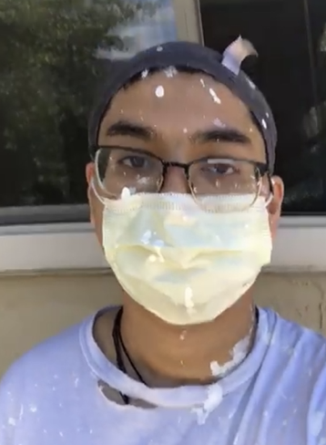
Deepankar
“I didn’t realize how much of a real issue mental health was prior to dealing with it myself. Growing up, in my culture, mental health was not discussed and associated with weakness”
Student at Cornell, Grew up in household where mental health was highly stigmatized.
Extreme User!
40 min Zoom Interview
Notes:
Deepankar is an extreme user since he grew up thinking mental health wasn’t important, on the opposite extreme as manaal

Slide 8

Megan
“I wanted to find a running partner, but I'm nervous about reaching out to people I don't know. The friends I asked weren’t interested.”
Stanford Mechanical Engineering grad (25), ML Engineer, Ran half-marathon,
New to therapy
70 min Zoom Interview

Slide 9
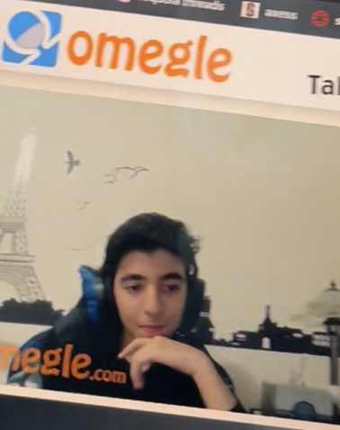
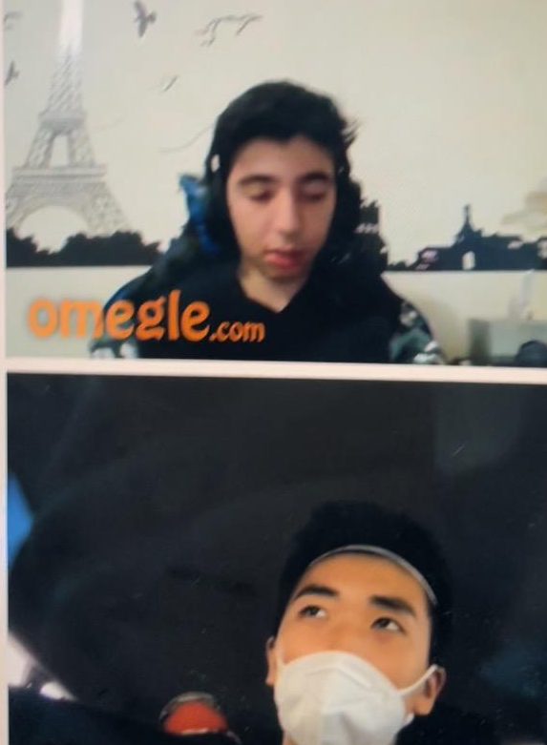
Mike
“In telehealth, there is a lack of human interaction and limited automation capabilities”
30 min
Omegle Interview
College Student (18),
Struggles with anxiety
Notes:
Mike a college student who struggles with anxiety. Used Omegle so we could find a stranger and he gave a 30 min interview

Slide 10
Interview Questions
What kind of relationship do you have with mental health?
Telehealth
Destigmatizing Mental Health
Tell me about your last telehealth visit. Are there specific things you liked and disliked?
How has the pandemic changed the way you perceive mental health?
Have you ever spoken to a mental health professional? How did you feel about the experience?
Does community factor into goal setting? Do you like talking about your goals with others?
Tell me about a time you set a new goal and achieved it? Walk me through the process step by step?
Goal Setting
Tell me about a habit you struggle to break.
Notes:
questions in all domains
Wanted the questions to follow the guidelines discussed in class:
Try to evoke stories and emotions: what’s your experience with telehealth? We asked “describe your last telehealth visit in depth”
Ask basic questions as to not make assumptions “Walk me through the process of goal setting step by step”

Slide 11
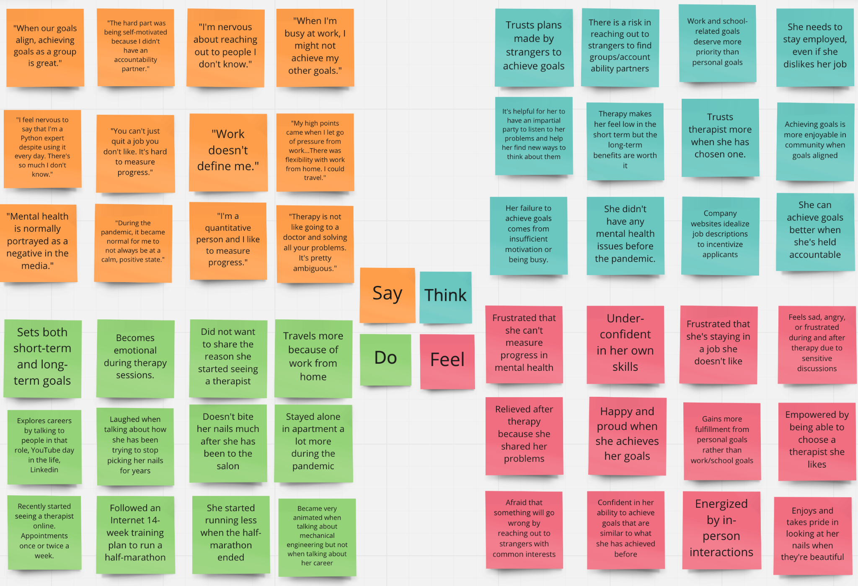
Megan’s Empathy Map
Notes:
This is Megans Empathy Map!

Slide 12
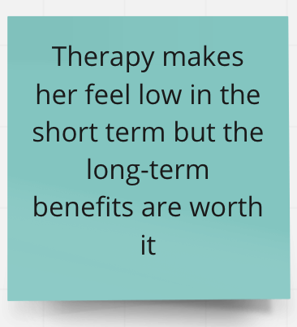
Surprise
Notes:
Expressed that therapy induces both negative and positive emotions. I personally thought of therapy as something that only makes you feel better but didn’t realize that in the actual sessions you can end up feeling worse before you feel better

Slide 13
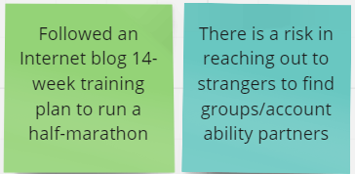
Contradiction
Notes:
WIlling to rely on strangers from the internet for certain aspects of achieving goals but not others

Slide 14
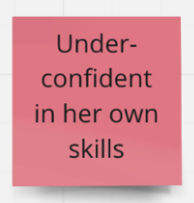
Tension
Notes:
As a student you experience imposter syndrome but I’m surprised to see how many working professionals struggle to be confident in their abilities.

Slide 15
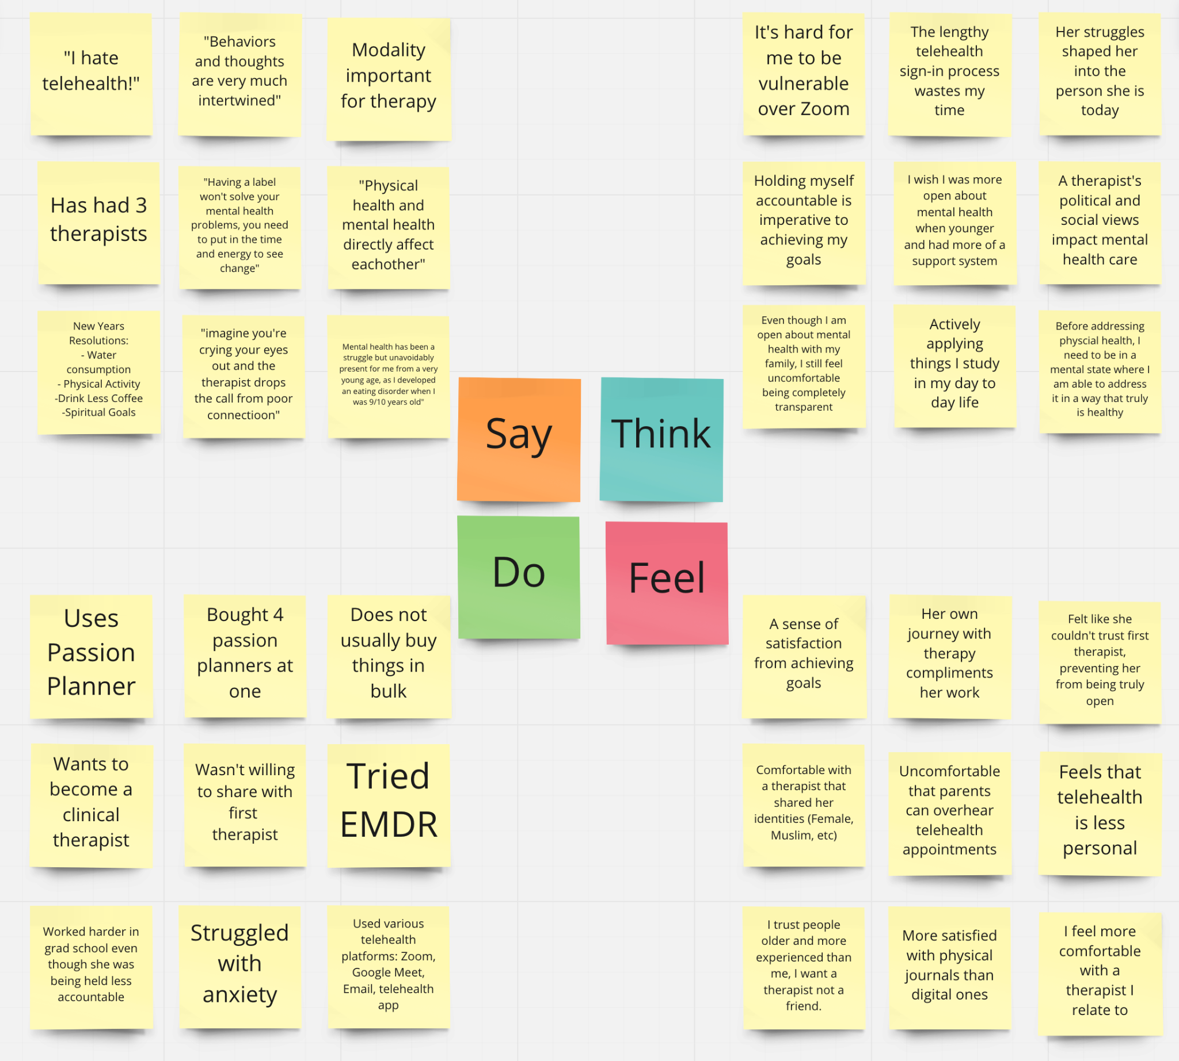
Manaal’s
Empathy
Map
Notes:
Manaal’s Empathy Map

Slide 16
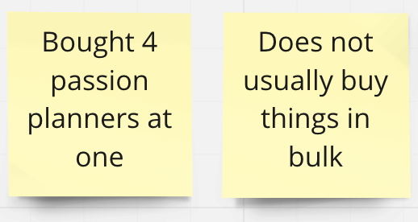
Contradiction
Notes:
When talking about goal setting she brought up passion planners and she mentioned she bought 4 planners at once. I asked her if she usually buys in bulk and she said no!

Slide 17
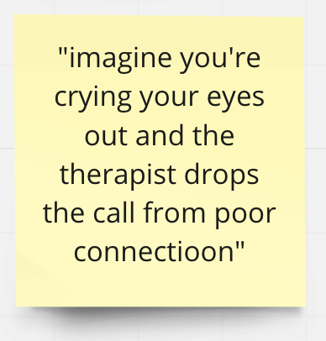
Tension
Notes:
Manaal has been struggling with telehealth as she transitioned to online therapy during the pandemic, this was a quote i found had interesting

Slide 18
Insights, Needs, & Questions
Notes:
Insight: People find it difficult to measure their mental health, causing frustration or leading people to not seek mental health services.
Need: A way to measure and track progress in people’s mental health
Question: Are there precise markers people can use to assess their mental health?
“I'm a quantitative person and I like to measure progress…Therapy is not like going to a doctor and solving all your problems. It's pretty ambiguous.” - Megan

Slide 19
Megan said…
“I'm a quantitative person and I like to measure progress…Therapy is not like going to a doctor and solving all your problems. It's pretty ambiguous.”
Insight
Need
People find it difficult to measure their mental health, causing frustration or leading people to not seek mental health services.
A way to measure and track progress in people’s mental health
?
Are there precise markers people can use to assess their mental health?
Notes:
Insight: People find it difficult to measure their mental health, causing frustration or leading people to not seek mental health services.
Need: A way to measure and track progress in people’s mental health
Question: Are there precise markers people can use to assess their mental health?
“I'm a quantitative person and I like to measure progress…Therapy is not like going to a doctor and solving all your problems. It's pretty ambiguous.” - Megan

Slide 20
Mike said…
“I accomplish things better when my friends are also working on the same goal as me. If I slack off, I’ll feel bad since my friends are all still working towards our mutual goal.”
Insight
Need
Goals are easier to accomplish when tackled as a team due to accountability
To connect and form friendships with others who have a common goal
?
Will people still feel accountable if they are working on their goals in a team, but their teammates are not their friends?
Notes:
Insight: People find it difficult to measure their mental health, causing frustration or leading people to not seek mental health services.
Need: A way to measure and track progress in people’s mental health
Question: Are there precise markers people can use to assess their mental health?
“I'm a quantitative person and I like to measure progress…Therapy is not like going to a doctor and solving all your problems. It's pretty ambiguous.” - Megan

Slide 21
Manaal said…
“I wasn’t able to be open with my first therapist which made the therapy less affective…I’m more comfortable with my current therapist since she is also a Muslim woman”
Need
Insight
A platform that allows you to search and filter therapists based on identities
People value, and are more willing to trust, therapists that share similar identities to them.
?
How can the current process of searching for a therapist be changed to allow one to gauge compatibility before committing?
Notes:
Insight: People find it difficult to measure their mental health, causing frustration or leading people to not seek mental health services.
Need: A way to measure and track progress in people’s mental health
Question: Are there precise markers people can use to assess their mental health?
“I'm a quantitative person and I like to measure progress…Therapy is not like going to a doctor and solving all your problems. It's pretty ambiguous.” - Megan

Slide 22
Summary
People struggle to assess their mental health, which can deter them from using mental health services
People value community and accountability in achieving goals, but may struggle to find others with common goals
Telehealth, especially for therapy, can feel impersonal
Notes:
Sukmary

Slide 23
Appendix

Slide 24
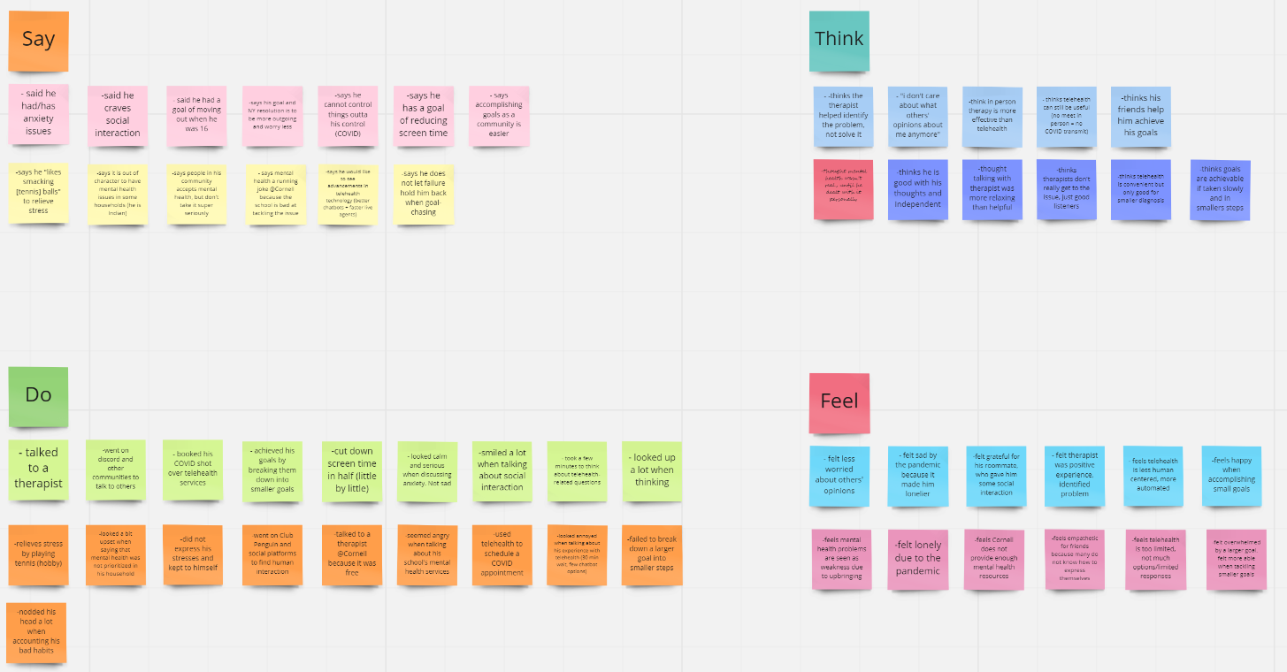
MIKE: Empathy Map

Slide 25
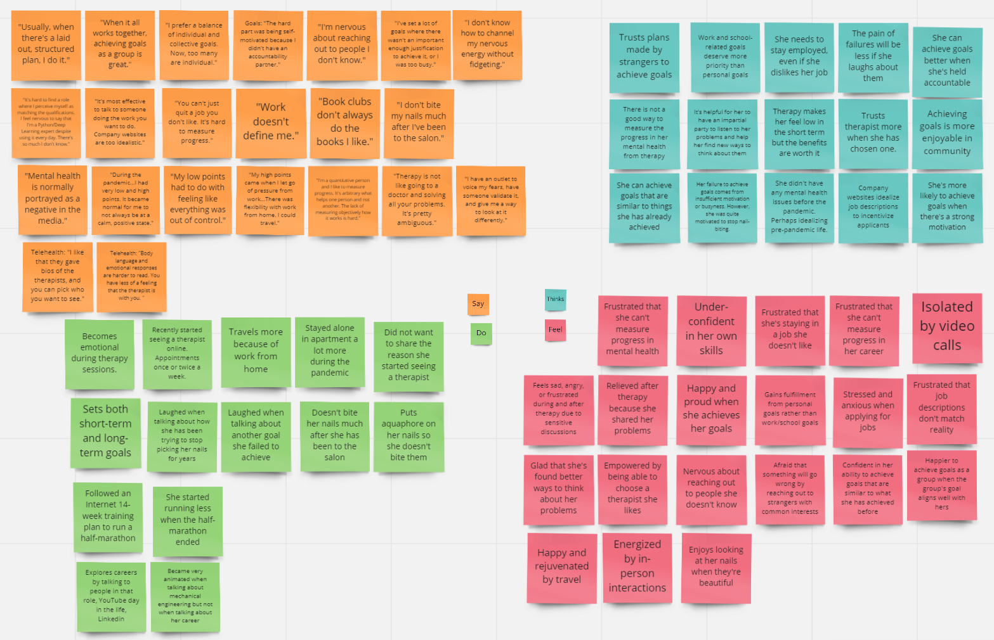
MEGAN: Detailed Empathy Map
Notes:
Complete empathy map for Megan

Slide 26
Megan: Detailed Tensions, Contradictions, Surprises Analysis
Frustrated by lack of clear progress in mental health from therapy. Therapy induces both negative and positive emotions.
Thinks she didn’t have any mental health issues before the pandemic. She might be idealizing her pre-pandemic mental health.
She trusts running plan made by a stranger on the Internet but was nervous to reach out to strangers for a running partner.
What factors are important for building trust?
Claims work doesn’t define her, and putting personal goals first improves happiness, yet doesn’t achieve personal goals when she’s busy at work.
Achieving goals as a group is great when goals align with her own.
Lack of confidence hurts her pursuit of her career goals.
Claims that failure to achieve goals is because of insufficient motivation or being busy, but she’s been trying to stop biting her nails for years.
Notes:
Detailed analysis for Megan

