Slide 1


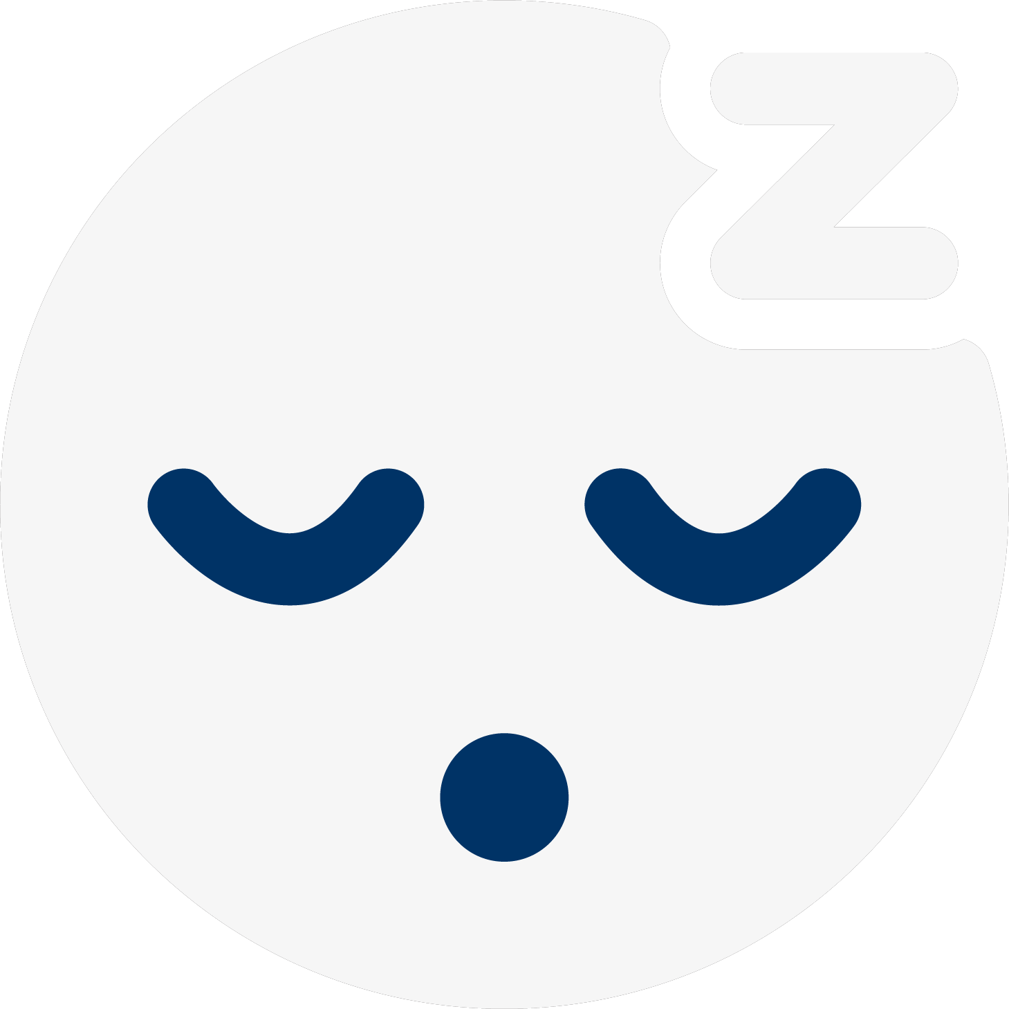
SLEEPMATE
Hi-Fi Prototype
Midway Milestone
Notes:
Hey everyone! This is Tristan from Sleepmate. I’ll be presenting about our midway milestone for the hi-fi prototype.

Slide 2
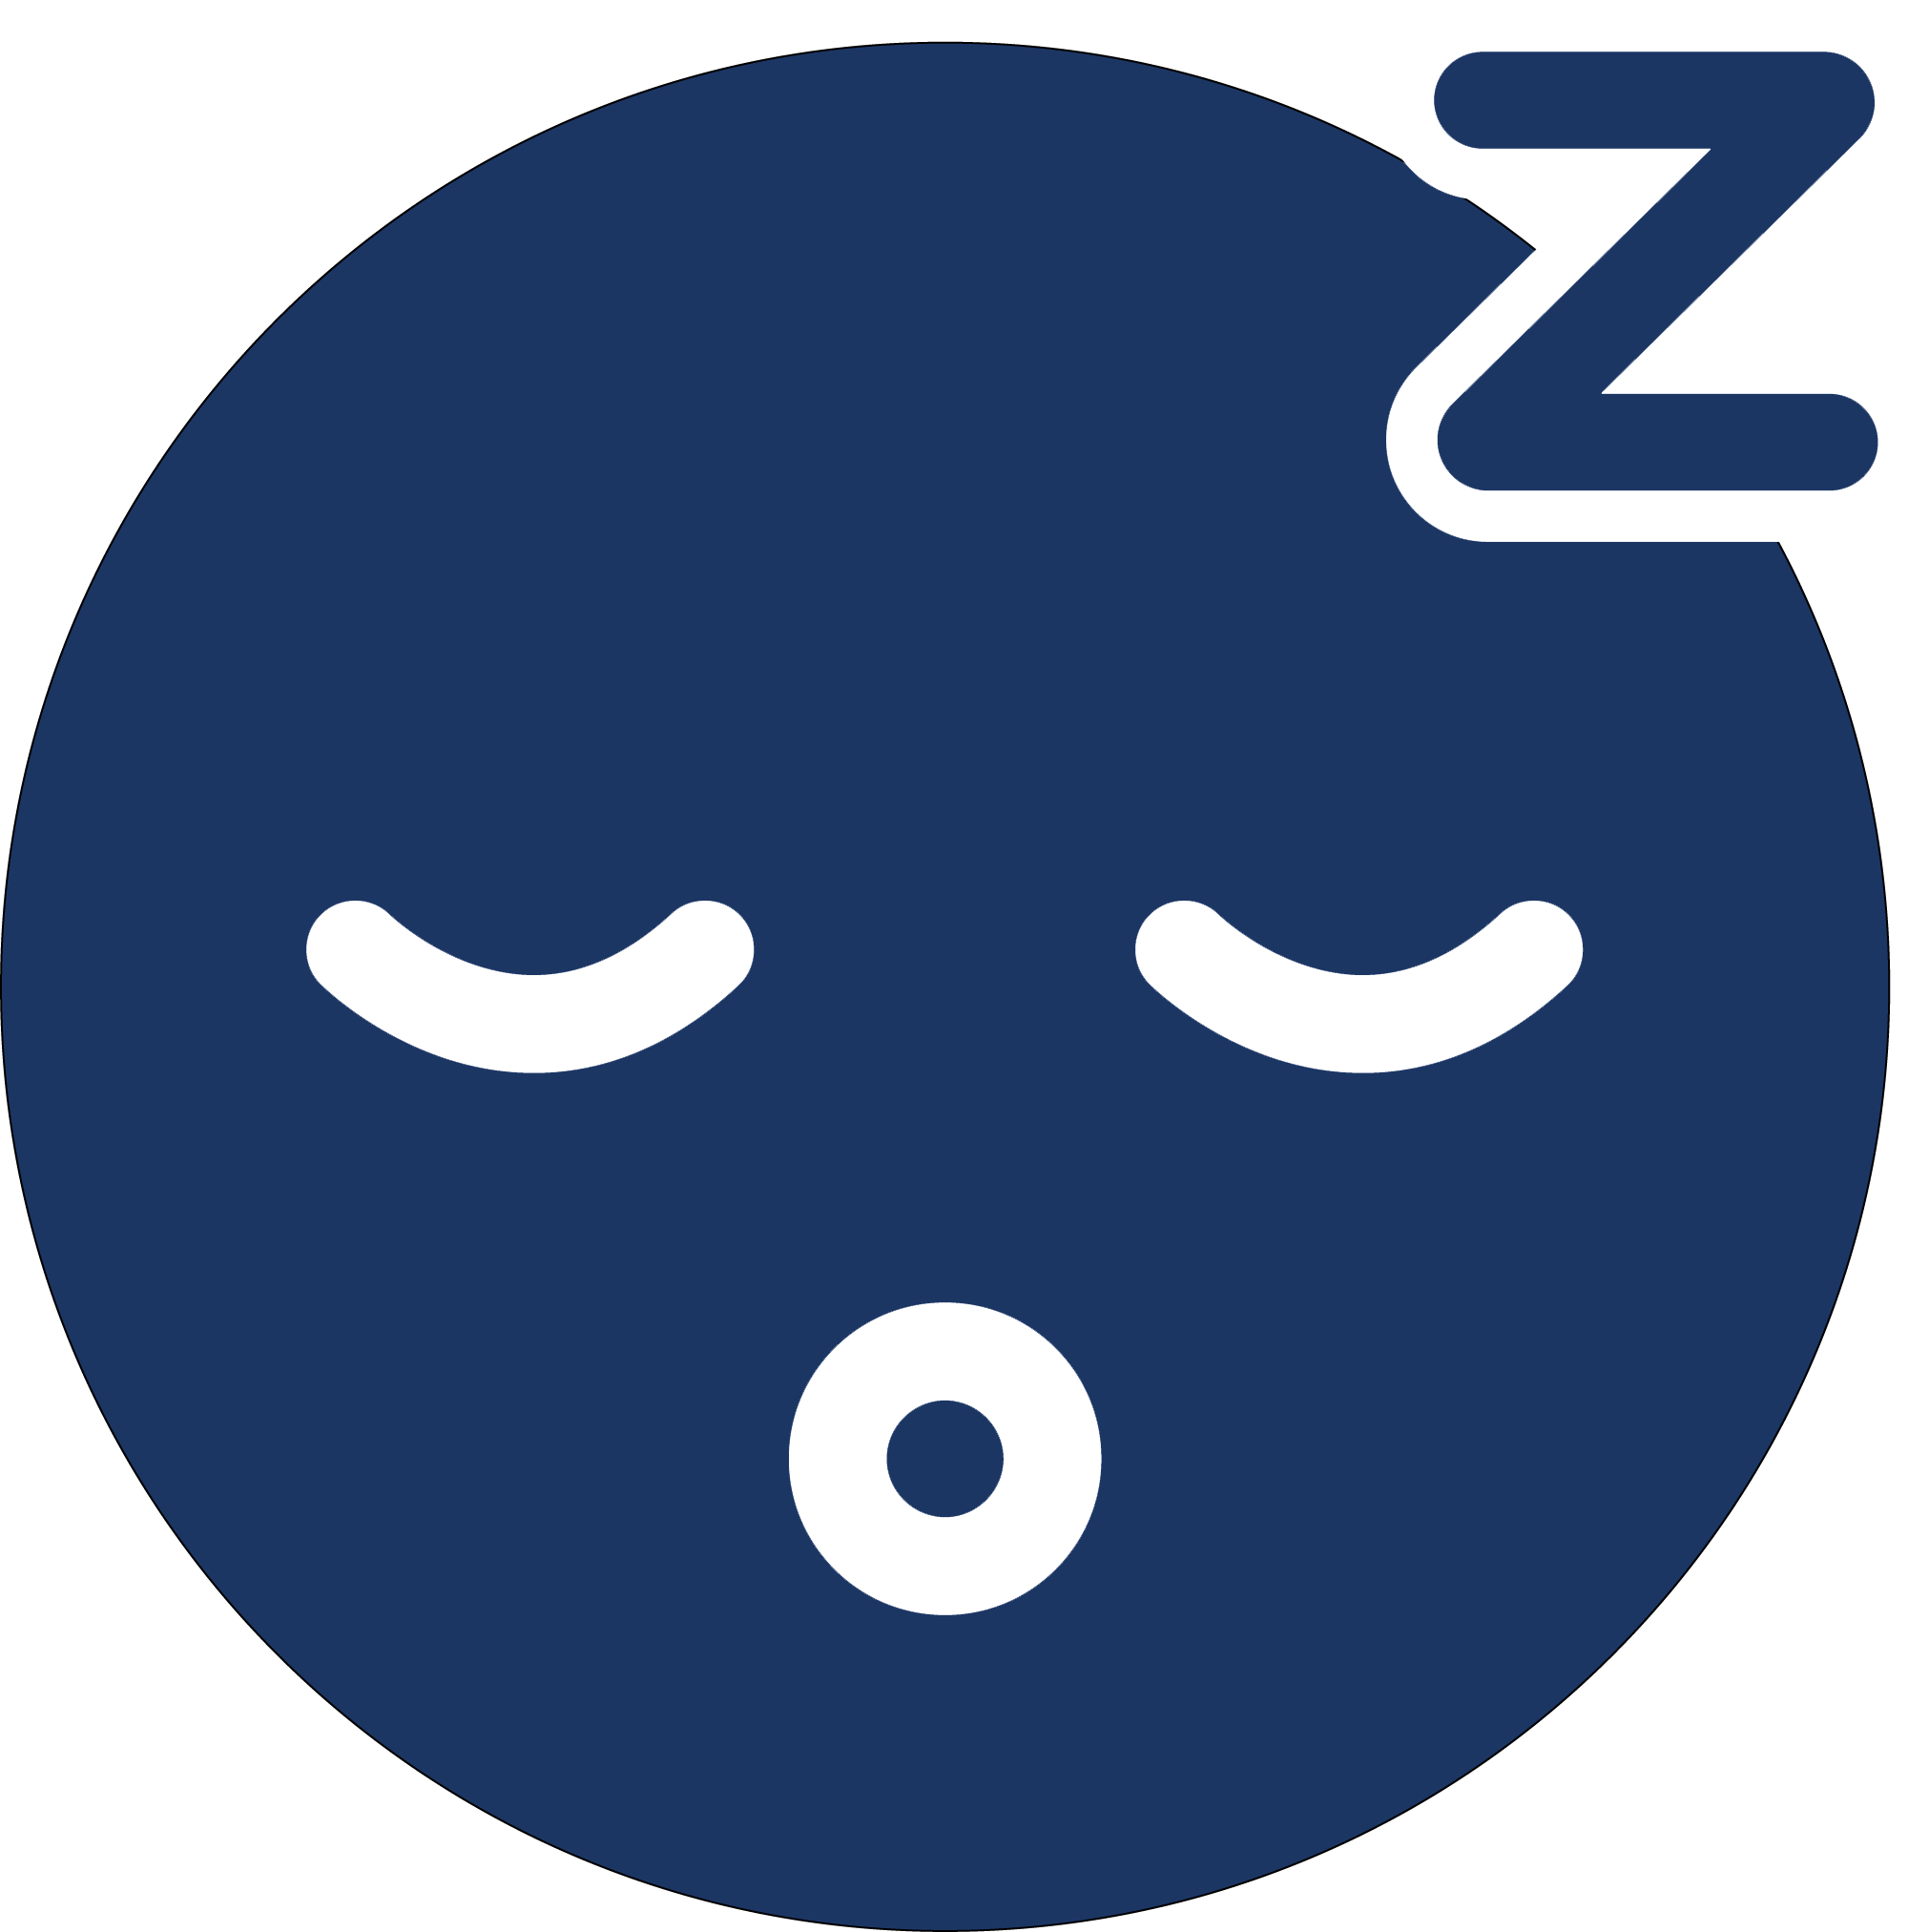
Overview
Introduction
Heuristic Evaluation Results
Revised Designs
Prototype Implementation
Demo Video
Notes:
I’ll start off with introducing our team and our app, just as a quick reminder. We’ll then go through the heuristic evaluation results and how we revised our designs based on that. We’ll also share updates on how we’re implementing our prototype and then watch a quick demo video after.

Slide 3



Notes:
Let’s go through the introductions really quickly:

Slide 4



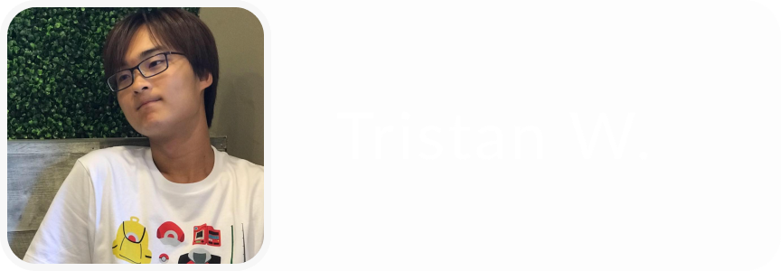
The Team
Notes:
Our team consists of Aaron, Michelle, Derek, and me.

Slide 5


Value Proposition
Mission
Problem Overview
Sleeping easy, made easy.
SleepMate’s mission is to ease anxiety when it comes to sleeping with roommates by reminding roommates to keep noise levels low during sleeping hours.
It can be difficult to tell your roommates over and over again to be quiet when you’re trying to sleep. SleepMate helps you rest at ease by monitoring your roommates’ noise levels and alerting them when they’re being too loud so you don’t have to!
Notes:
Sleepmate’s value proposition is sleeping easy, made easy. We’re aiming to ease anxiety that happens when you live with your roommates, since it can be really difficult to repeatedly tell your roommates to be quiet when you’re trying to sleep.

Slide 6

Notes:
Now our heuristic evaluation results: [next slide]

Slide 7
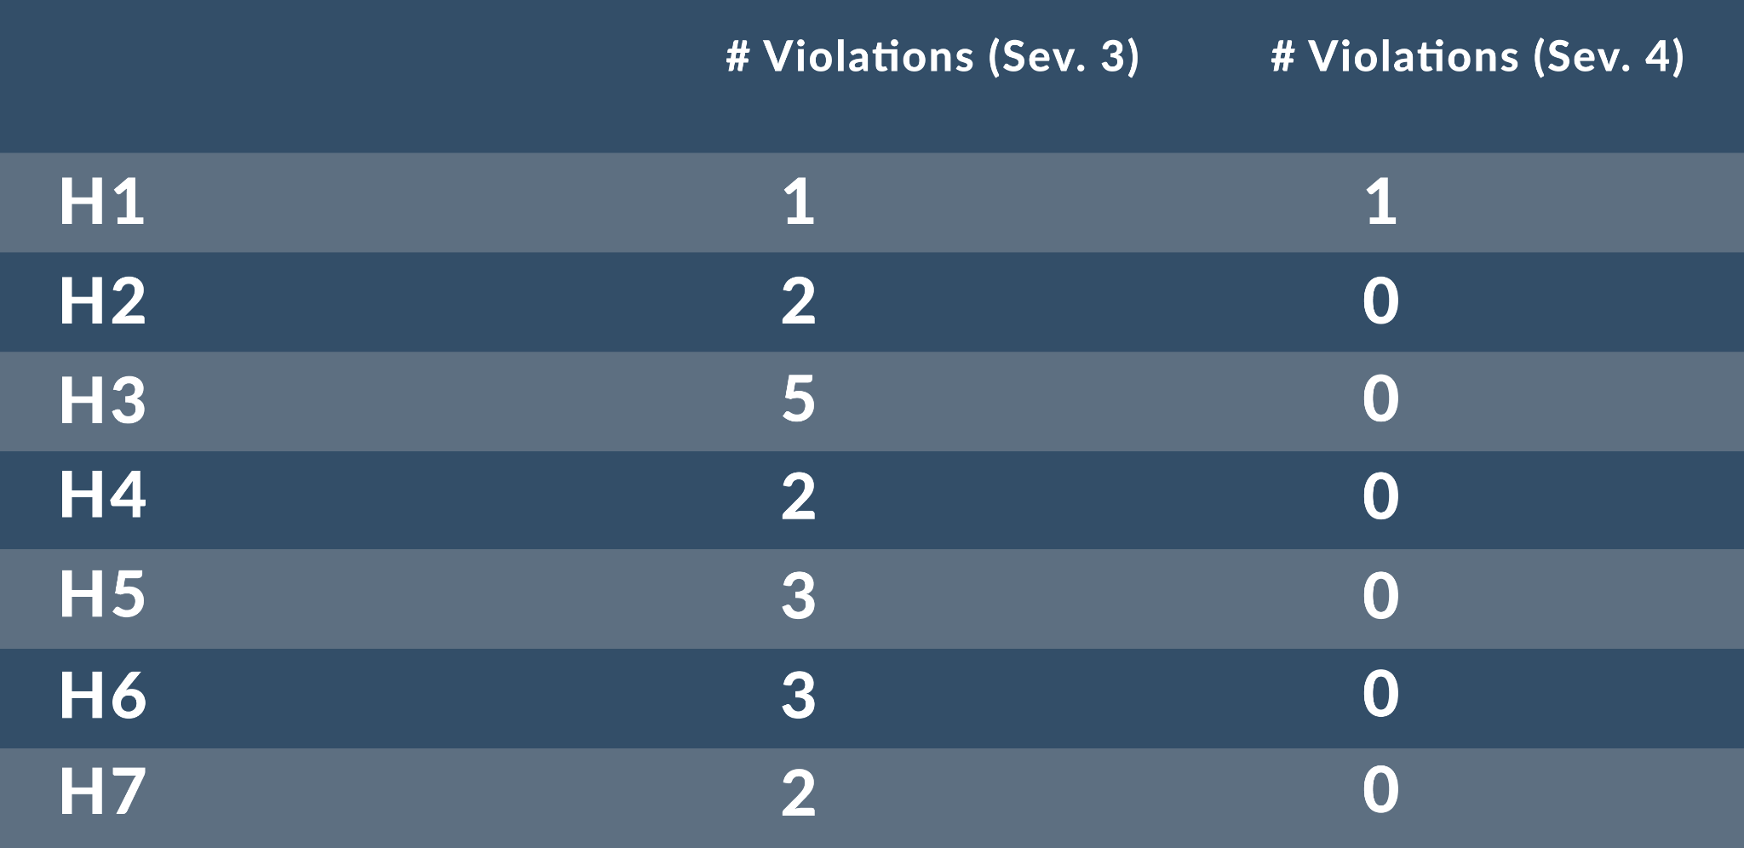
Summary of Heuristic Violations
Notes:
Here is a summary of our heuristic violations of severity 3 and 4 as found by our peers. [go to next slide]

Slide 8
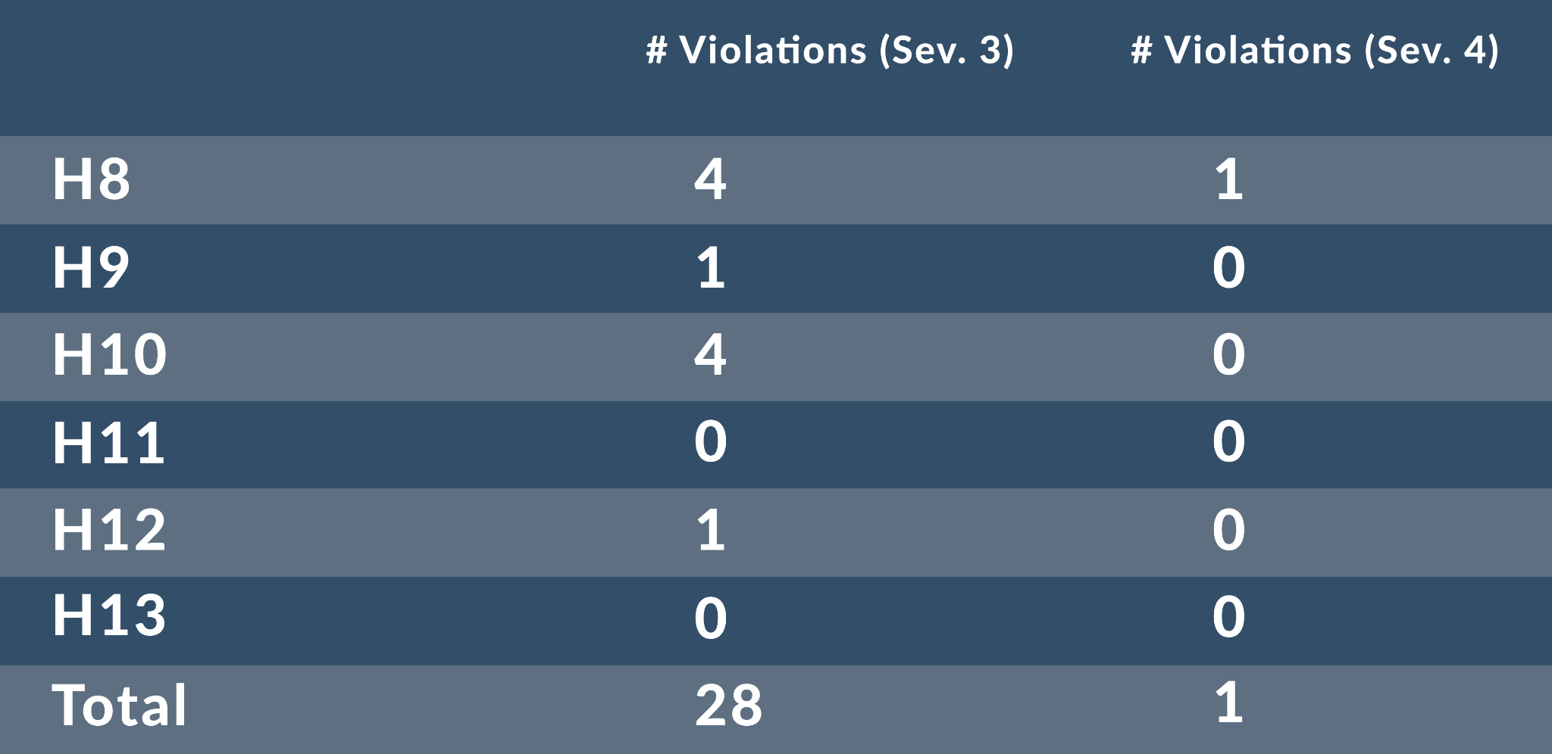
Summary of Heuristic Violations
Notes:
As you can see, the majority of the “severe” heuristic violations fall under severity 3.

Slide 9
Most Common Violations
18.64%
15.25%
13.56%
H8: Aesthetic and Minimalist Design
H3: User Control and Freedom
H4: Consistency and Standards
Notes:
As you can see here, our most common violations fell within the categories of minimalist design, user control, and consistency.

Slide 10

Notes:
For the interest of time, we’ll go over the more significant changes that we made.

Slide 11
Violations: Roomies Page
H1
Average wake-up time isn’t visible for roommates (3)
We’ve added that to the roommate’s profile page.
You either can delete one roommate or have to delete all roommates (3)
We’ve changed the deleting process more akin to the iOS Alarm app’s deleting process.
H4
Roommate adding screen only shows photos and names of people, which can make it difficult identifying the right person (3)
We’ve changed the search criteria to be username only.
H5
The sleeping icon next to roomie’s profile can be confusing (3)
We’ve added clarifying text next to the icon to clearly indicate the roommate is sleeping
H6
Notes:
We had a lot of violations in our roomies page across various heuristics. This is a lot of text, but we’ll explain more in detail with our designs in front of you. [next slide]

Slide 12
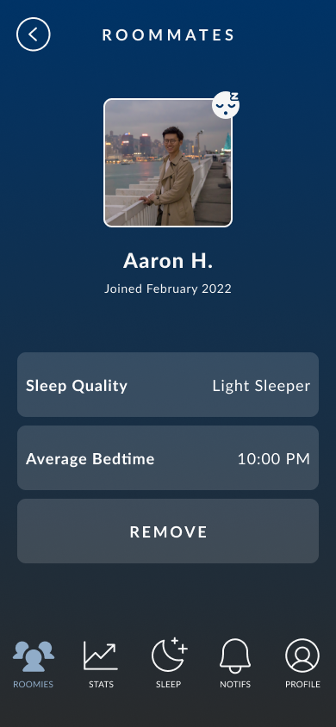
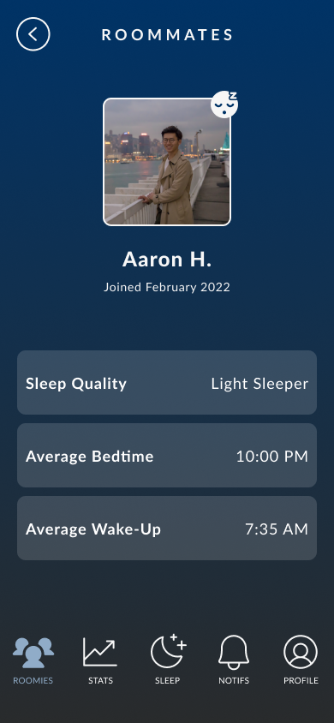
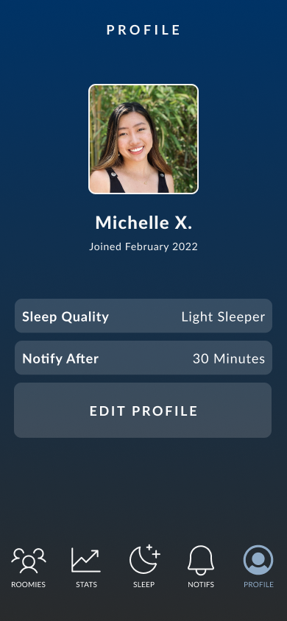
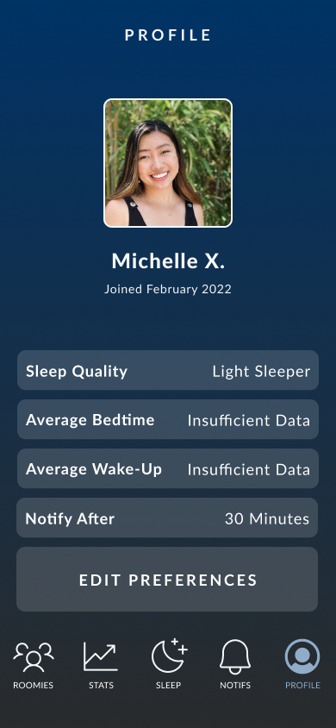
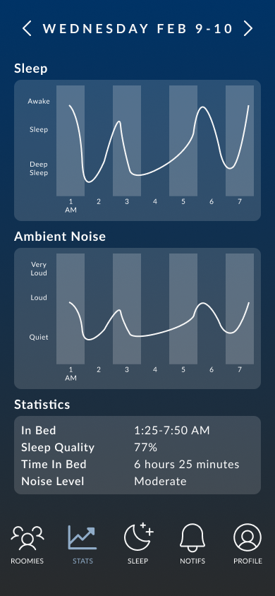
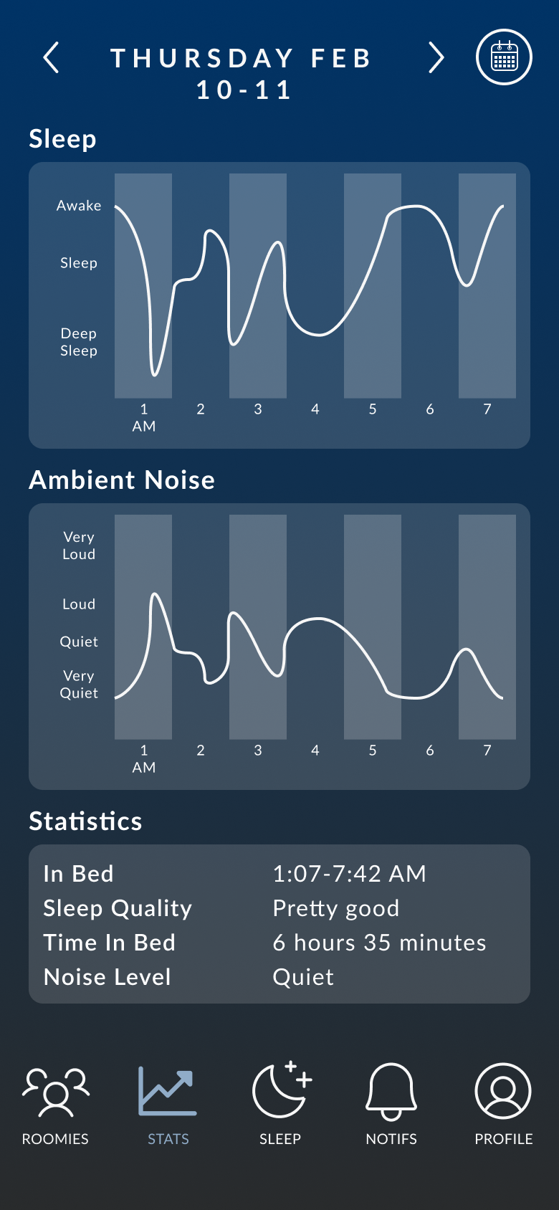
Revision: Roomies Page | Added Avg. Wake-Up Time
Before
After
Notes:
We had a visibility of status violation due to the lack of the wake-up time on the roommate’s profile page even though we showed their average bedtime. We addressed it with a simple fix – we just added the average wake up time.

Slide 13
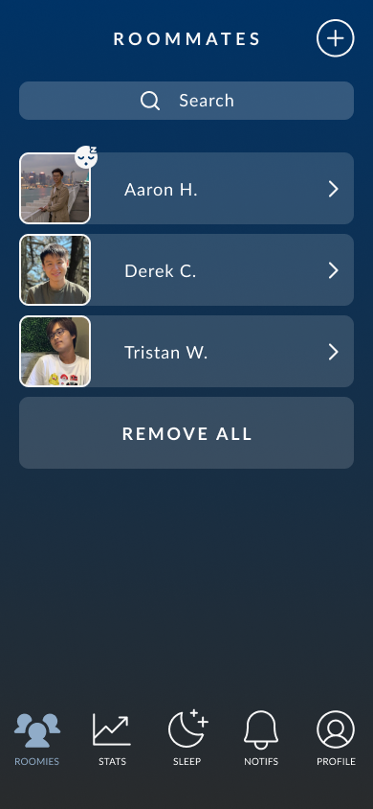
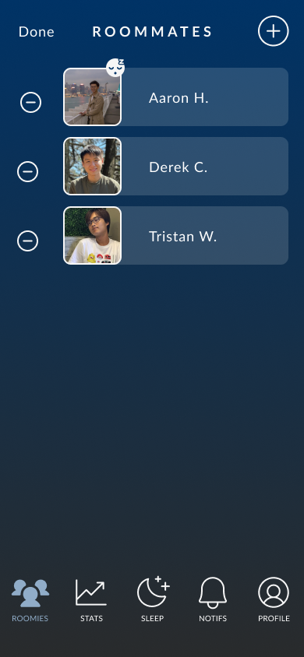
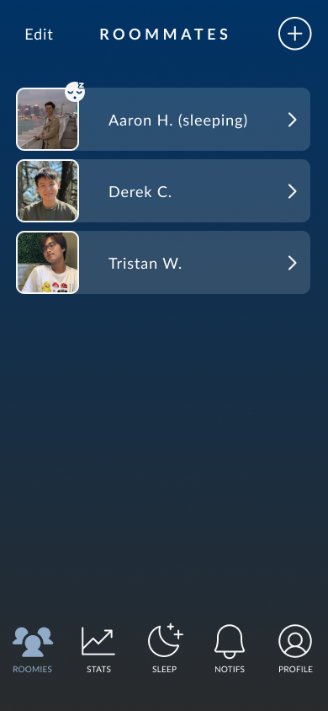
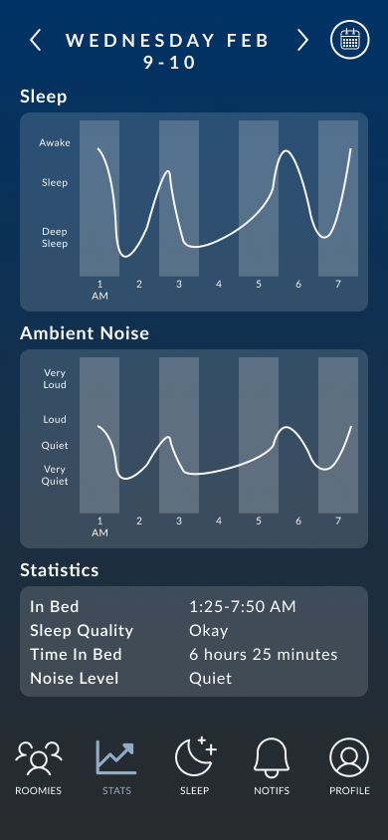
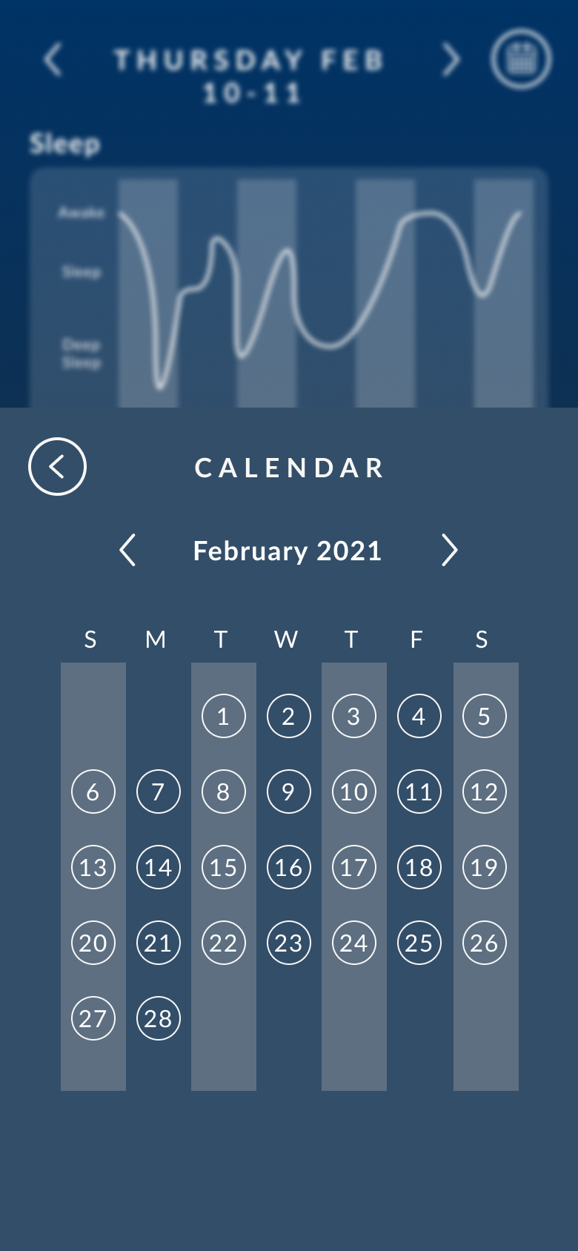
Revision: Roomies Page | Change Roomie Deleting Process
Before
After
Notes:
We had a heuristic violation here that could fall both under consistency & standards as well as efficiency of use. It’s that the user could only remove one roommate by going into their profile or remove all roommates, no in between. We didn’t really think that there would be many instances where you’ll be removing multiple roommates at once – that being said, we still want users to have an easier time removing roommates, so we changed the process to be more similar to the alarm removing process from the iOS Alarm app.

Slide 14
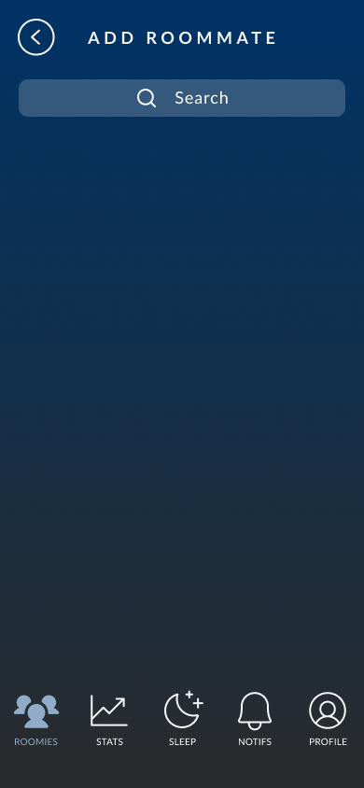
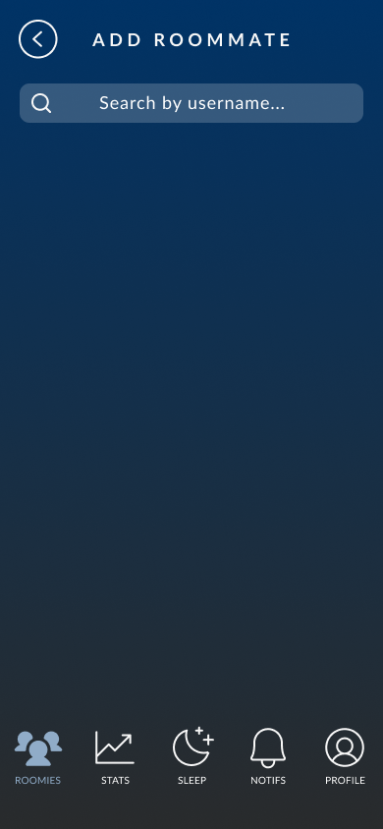
Revision: Roomies Page | Search Criteria to Username Only
Before
After
Notes:
We had an error prevention heuristic violation here since we showed search results based on the user’s profile name, not a unique identifier. To address this, we changed the search criteria to be username only.

Slide 15
Revision: Roomies Page | Clarified Icon Meaning
Before
After
Notes:
Lastly for the roomies page, we had a recognition-not-recall heuristic violation here due to the sleeping icon next to Aaron, as it could be confusing to the user. We added the text next to Aaron to clarify that the icon means that he is sleeping.

Slide 16
Violations: Statistics Page
H2
Word choices for indicating noise levels and sleep quality are confusing (3)
We’re changing the wording so that it’s easier to understand.
H6
Users can’t see their own sleep statistics averages (3)
We’ve added average statistics to the profile page.
H7
It’s difficult to view sleeping statistics from different dates (3)
We’ve added a calendar view that allows users to switch to dates farther away.
Notes:
We also found a few major heuristic violations in our statistics page. We’ll describe them more in detail as we look at the Figma screens. [next slide]

Slide 17
Revision: Statistics Page | Clarified Wording
Before
After
Notes:
There are a few match between system and world violations here – for the figures indicating sleep quality and noise level, it doesn’t really clearly communicate to users on what they mean, especially “77% sleep quality.” We clarified the wording to fit what the users would be used to seeing more.

Slide 18
Revision: Statistics Page | Added User Avg. Stats
Before
After
Notes:
We had another violation here as users couldn’t see their own average bedtime and wake-up time even though they could see their roommate’s. We added it to the user’s profile to address that issue.

Slide 19
Revision: Statistics Page | Added Calendar View
Before
After
Notes:
We also had a efficiency of use violation on the statistics screen, as users would have to tap an inordinate number of times to browse through different dates. By adding the calendar view, users should be able to navigate through the dates and view stats from different days more easily.

Slide 20
Other revisions we’ve made
Users need to hold the sleep button for 5 seconds for sleep mode to activate for error prevention.
We’ve added a confirmation dialog for roommate inviting for error prevention.
We’ve standardized our terminology across different screens.
Notes:
We also have a revision that are hard to show through the Figma changes – our only severity 4 violation was that users could accidentally tap the sleep button and the app would go into sleep mode even if the user did not want it to. We addressed this by making the sleep button timed, which means that the user has to hold and press the sleep button for a few seconds to go into sleep mode.
Some are also relatively menial like adding a confirmation dialog and standardizing terminology.

Slide 21

Notes:
Now for our prototype implementation: [next slide]

Slide 22



Tech Stack
React Native
(application framework)
VSCode
(IDE)
SQLite
(DB)
Notes:
We’re using React native as our application framework and VSCode to code. We’re also using SQLite to build out our database for roommates.

Slide 23
Implemented Features
Home page along with a “timer” when you press the sleep button
Waking up page that displays the time
Notify your roommates that you’re going to bed (task 1)
Statistics page that shows historical sleep sound data (breathing, ambient noise)
Notes:
For the features we’ve implemented so far, we have finished the pages related to our first task, which is notifying your roommates that you’re going to bed. We also finished implementing the stats page, which tracks data of the user’s breathing patterns and the ambient noise levels coming from the roommates.

Slide 24
Unimplemented Features
Roommates page that displays your current roommates
Modify your household by adding/removing roommates (task 2)
Profile page that displays your own sleeping preferences
Update your sleeping preferences to notify your roommates that you’re still awake after X hours (task 3)
Fix any bugs and smooth out transitions
Detailed README to help others use SleepMate
Notes:
Here’s a list of our unimplemented features, mainly revolving around task 2 and task 3.

Slide 25
Wizard of Oz Technique
Hard-coded Data
Pressing the “sleep” button immediately moves the time to 7:59am
Roommates that can be added are hard-coded
Stats page is populated with randomly generated numbers
Notes:
We used one Wizard of Oz technique, where pressing the “sleep” button immediately moves the time to 7:59am. We chose to Wizard-of-Oz this since it wouldn’t make sense for the user to actually wait for multiple hours in sleep mode while testing a prototype.
The hard-coded portions of Sleepmate are the roommates that can be added as well as the stats page, which is populated with randomly generated numbers.

Slide 26
Our Timeline
Implement roommates and profile pages by EOW
Expo woot
Next week
Due Date
Add animations and smooth out transitions
Iron out bugs and final edits
This Week
Expo
Notes:
Our goal for the end of the week is to implement the pages that we haven’t implemented yet. Next week, we aim to add animations and smooth out the transitions. We’ll then have the expo, and we’ll be ironing out bugs and pushing final edits before the due date.

Slide 27

Notes:
We can watch a short demo video of Sleepmate now: [next slide]

Slide 28

(insert video)

Slide 29
Summary
The major heuristic violations have been addressed through the design changes.
Next steps are to implement the other two tasks and make the app look ~nicer~ prior to project expo.
Plan set to finish by deadline!
Notes:
In summary:
The major heuristic violations have been addressed with our design changes.
Our next steps are to implement the other two tasks, and make the app look nicer before the expo. We are on good pace for that, and we’re looking forward to expo!

