Slide 1


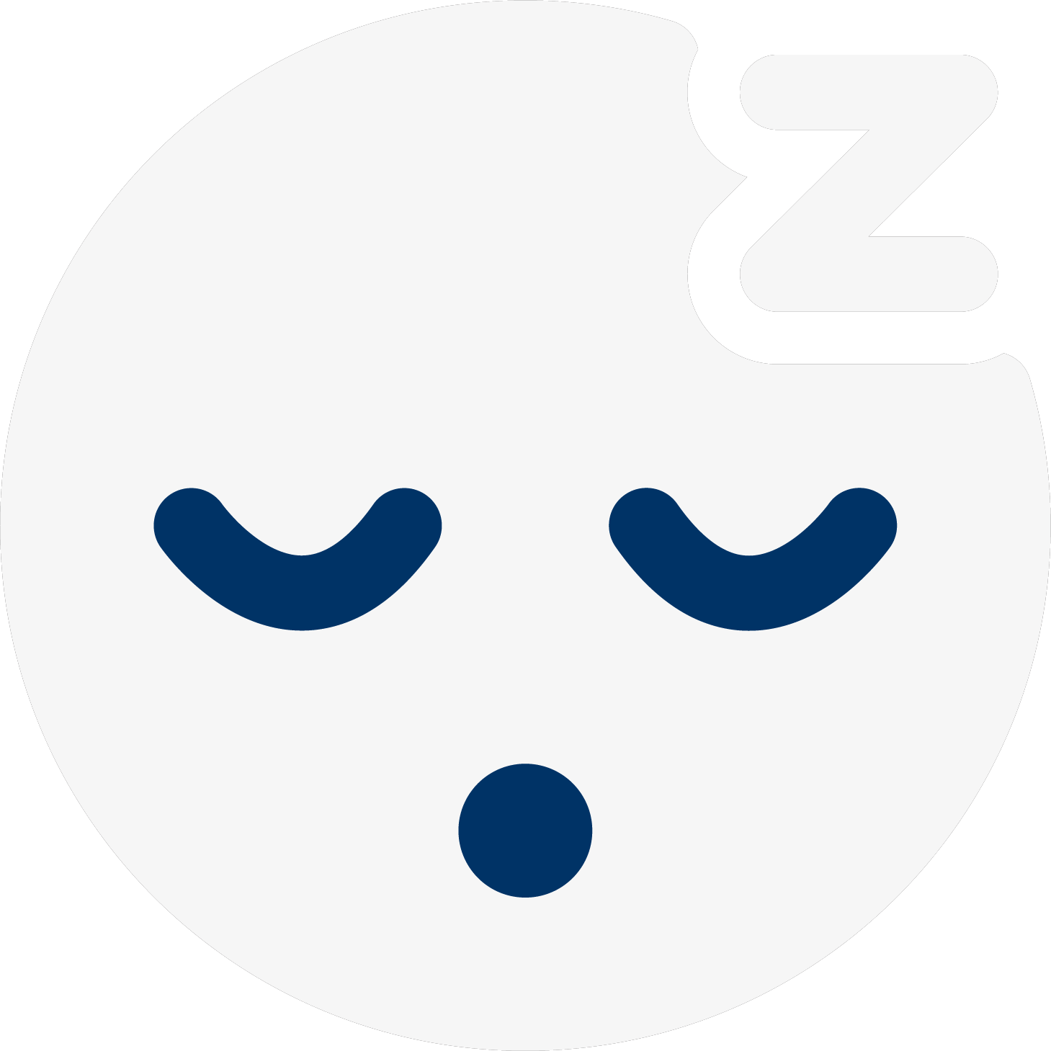
SLEEPMATE
Aaron H., Derek C., Michelle X., Tristan W.

Slide 2




The Team

Slide 3


Value Proposition
Mission
Problem Overview
Sleeping easy, made easy.
SleepMate’s mission is to ease anxiety when it comes to sleeping with roommates by reminding roommates to keep noise levels low during sleeping hours.
It can be difficult to tell your roommates over and over again to be quiet when you’re trying to sleep. SleepMate helps you rest at ease by monitoring your roommates’ noise levels and alerting them when they’re being too loud so you don’t have to!

Slide 4
Value Encoded
Comfort
Communication
Privacy
Physical Health
Cooperation
Respect
Notes:
Implementation of values in design:
For communication:
Allowing roommates to notify each other after a certain amount of time of not falling asleep
Household message board where roommates can post important notifications
For cooperation:
Roommate alerts help household work together
Message board allows roommates to adapt to each other’s needs
For physical health:
Statistics page promotes awareness of one’s sleep patterns
Functionality of alerting roommates can help user fall asleep faster
For comfort:
The auto-notification feature removes discomfort roommates have about telling their housemates to be quiet
Also means user doesn’t have to get out of bed or speak to tell others to be quiet
For privacy:
Friend requests must be accepted before joining household
Other housemate’s profiles don’t show some preferences, such as whether notifications are turned on.
For respect:
When roommates are reminded to be quiet, they are reminded to respect whoever is trying to sleep
Conflicting values:
Sometimes, roommates want to let others know that they’re sleeping, but they don’t want to make their roommates mad. Along the notification feature, there are other aspects within the app that help address the fear of communication. For example, profiles show the average time one goes to bed, so that roommates are aware and are not caught off guard. The announcements page also provides a safe space for roommates to talk about anything impacting their sleep.

Slide 5
Review of Tasks
Simple Task: Notify your roommates you’re going to sleep through the app.
Moderate Task: Modify your household by adding or removing roommates.
Complex Task: Update your sleeping preferences and notify your roommates you’re still awake after X hours.

Slide 6
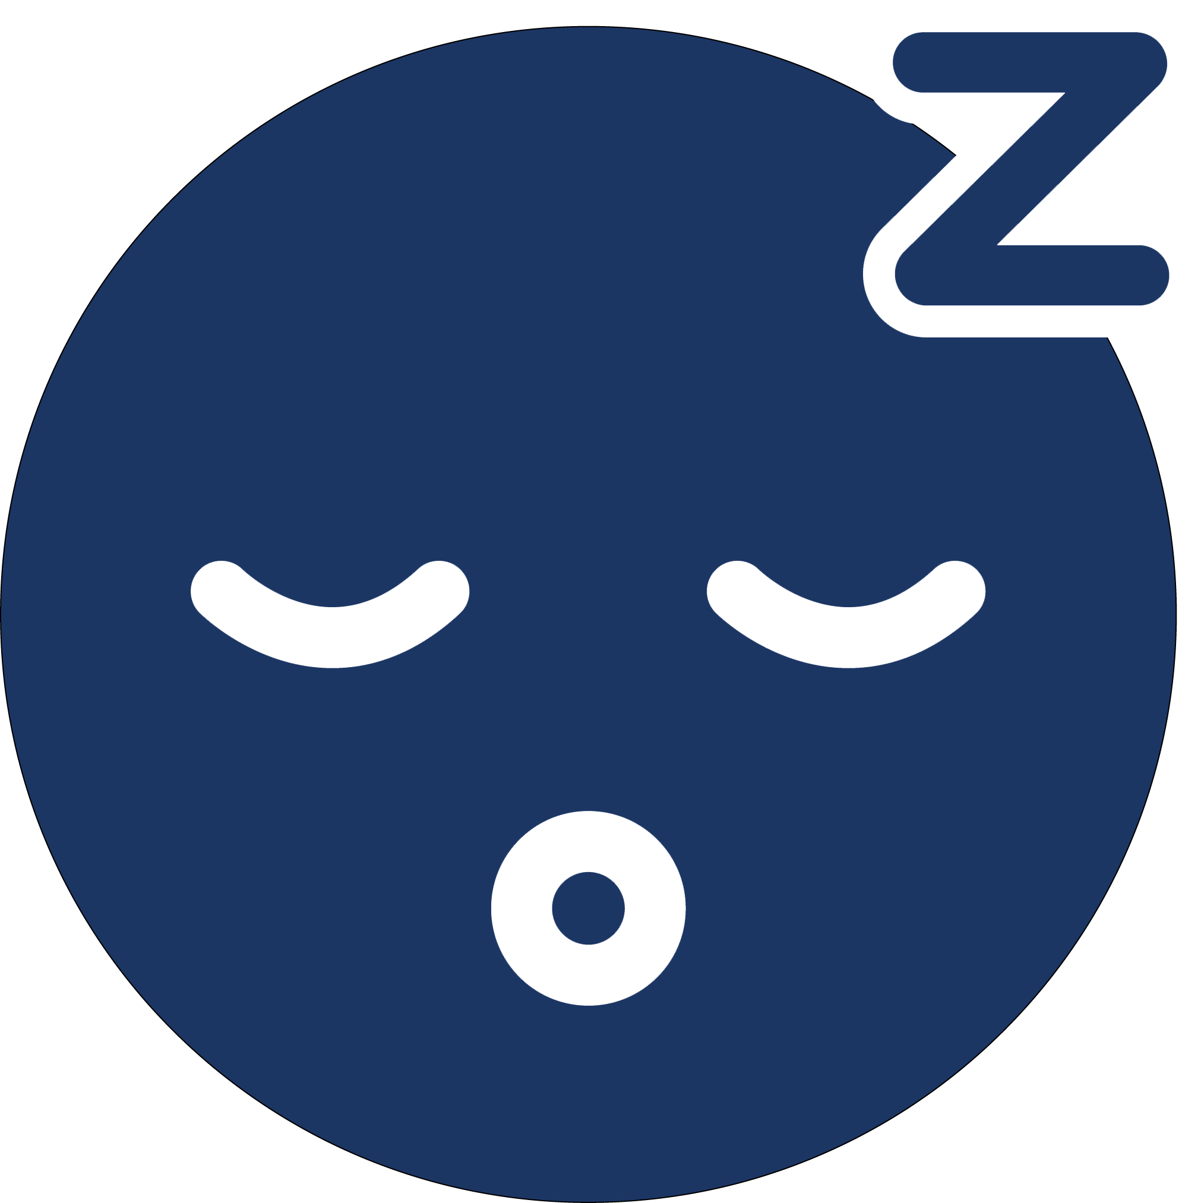
Actionable Feedback from Prototype Testing
Many participants had problems notifying roommates that they’re going to bed by identifying the “go to sleep” button and had problem returning back to the home screen when they were on the sleep tracking page.
One participant noted that it would be nice to be able to notify roommates about special events (travelling for a week, interview the next day, etc.)
One participant thought it would make more sense to be able to send a roommate a request to join a household and spoke about privacy concerns.

Slide 7




Slide 8
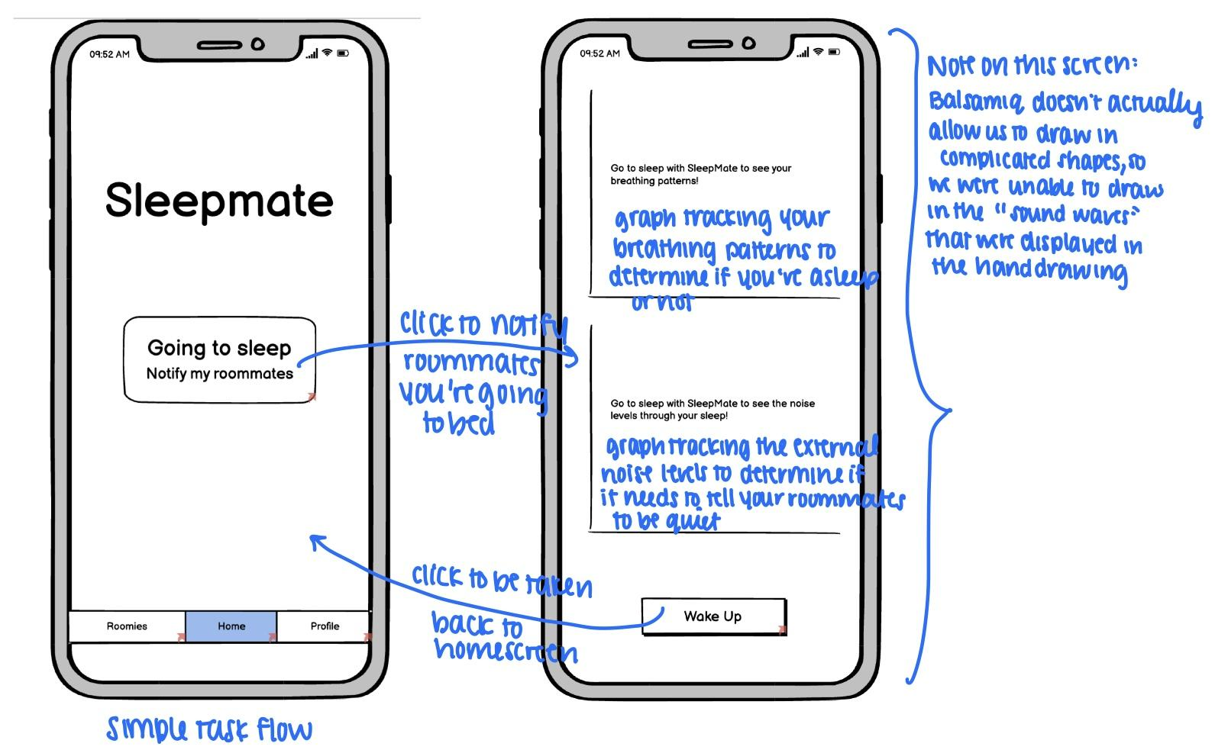
Change 1: Tracking Sleep Stats
Before

Slide 9
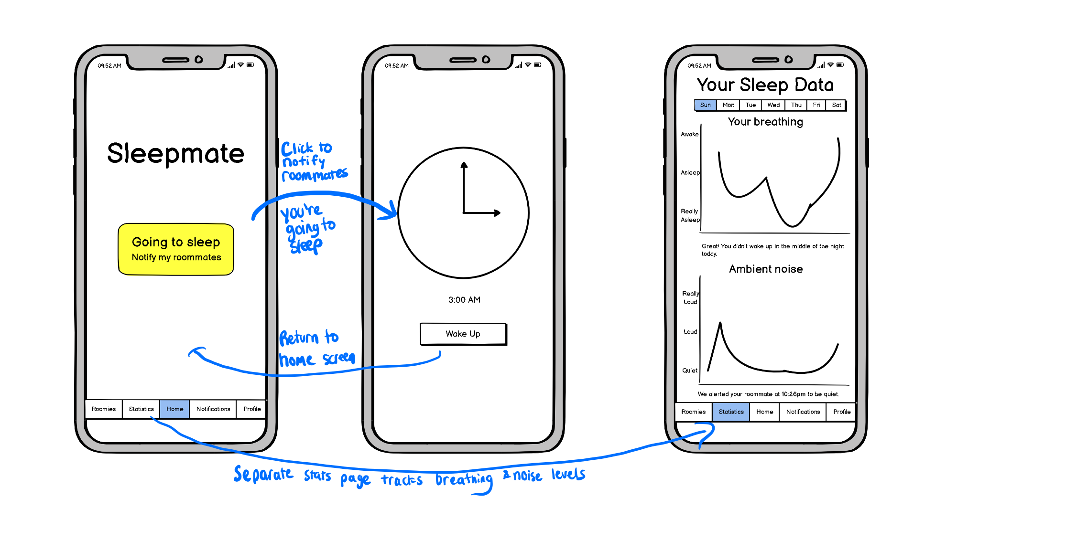
Change 1: Tracking Sleep Stats
After

Slide 10
Change 1: Tracking Sleep Stats
Changes
Add color to the sleep button to highlight the button better
Separate the breathing and noise trackers into a separate “stats” page
Replace the statistics on the sleeping page to a clock that shows current time
Rationale
Participants frequently missed the “go to sleep” button; adding color to highlight the button should lead to easier identification of the button
Participants also did not pay much attention to the sleeping statistics as it was on the sleeping screen, separating it out should bring it more attention
Notes:
We also added options to the menu bar on the bottom to accommodate changes further elaborated on in the other major design changes. The change in the bottom menu bar can be first seen on the previous slide.
Usability goals are also improved by removing clutter and organizing the graphs into their own section.

Slide 11
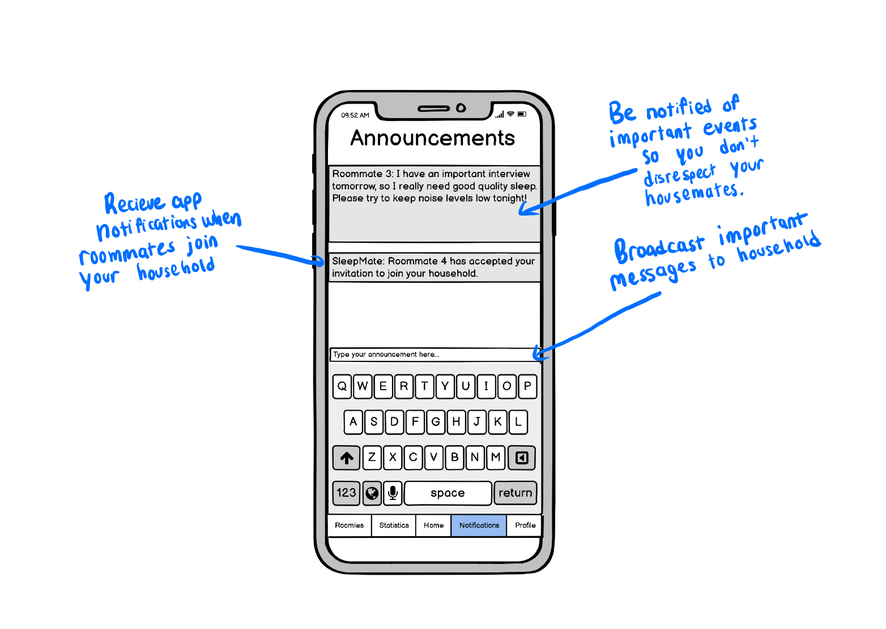
Change 2: Adding Notifications
New section

Slide 12
Change 2: Adding Notifications
Changes
Add a separate notifications tab where roommates can type out announcements
The tab will also contain system notifications, such as new roommates being added or sleep schedules changing
Rationale
A participant said that it’d be helpful to be able to communicate with their roommates beyond just “going to sleep”
A separate notifications tab where roommates can message each other as well as see system notifications (e.g. a new roommate being added to the household) would help users track events in the household

Slide 13
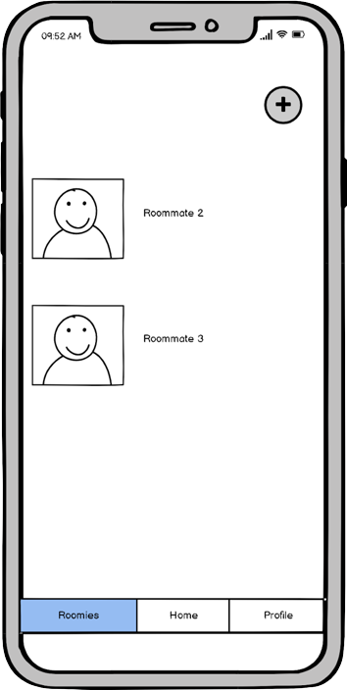
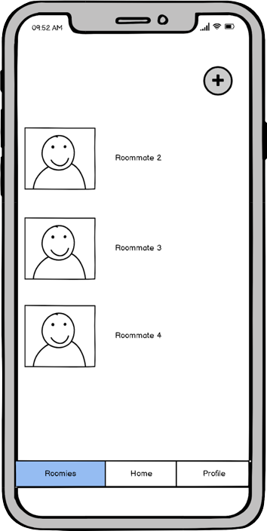
Change 3: Roommates Tab
Adding a new roommate
Before

Slide 14
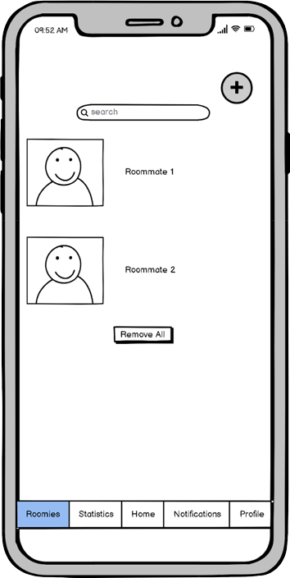
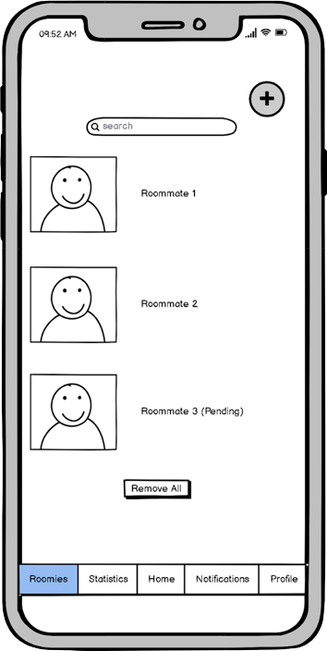
Change 3: Roommates Tab
Adding a new roommate
After

Slide 15
Change 3: Roommates Tab
Changes
Instead of instantly adding a roommate, send roommate requests
Show a roommate to be pending if they have been sent a request and has not accepted yet
Rationale
One participant noted that allowing users to invite whoever and whenever would raise privacy concerns
Changing roommate adding to be on a invite-basis should prevent most abuse that could’ve been caused from the previous design
Notes:
While this is arguably more of a functionality change then an UI change, we spoke to our CA (Emily Y.) and explained that one of our test participants highlighted this as being a major red flag for him. He was concerned that people would start adding the wrong users by accident without the mutual confirmation on both ends. Emily has approved of this functionality change as one of our 3 major changes.

Slide 16

Usability Goal 1: Users perform tasks quickly.
Our low-fi prototype showed that it did not take more than 20 seconds to perform any task, which indicated that this usability goal has been well-met.
The changes we made in the med-fi prototype focused more on maintaining the app’s simplicity. Our 3 main tasks should be unaffected as a result of these changes.

Slide 17
Usability Goal 2: Users perform tasks without error.
The biggest issue in our low-fi prototype was that the users failed to interact with the sleep monitoring screen. To make our simple task (notifying roommates that the user is going to sleep) more straightforward, we made the “go to sleep” button more noticeable to allow users to interact with it more easily.
Users also rarely noticed the sleep statistics, which is an integral part to delivering our value proposition. To fix this, we placed the statistics in a separate tab.

Slide 18


Slide 19
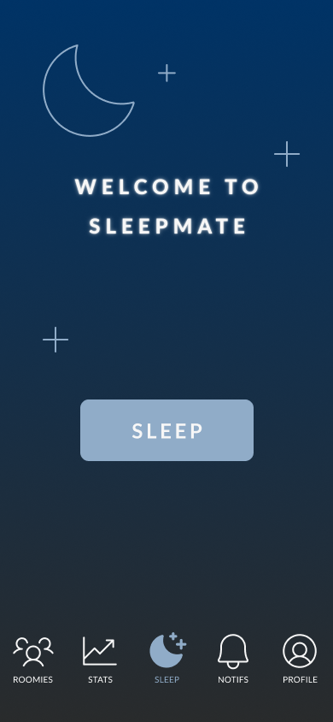
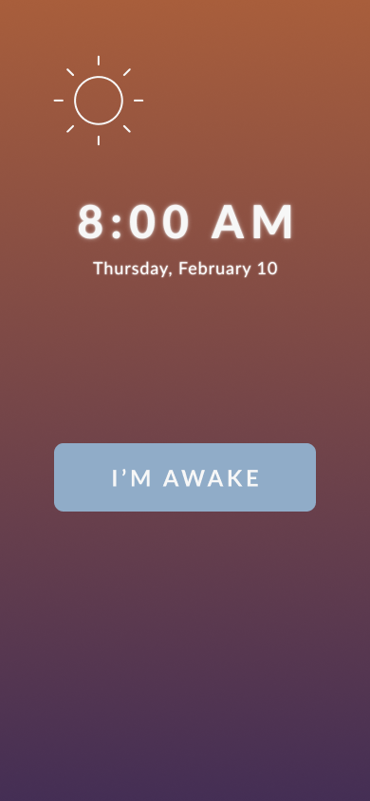
Notify roommates you’re going to sleep through the app
Complexity: Simple
1
Tap “Sleep” to tell roommates you’re going to bed.
2
Tap “I’m Awake” to return to the home screen.

Slide 20
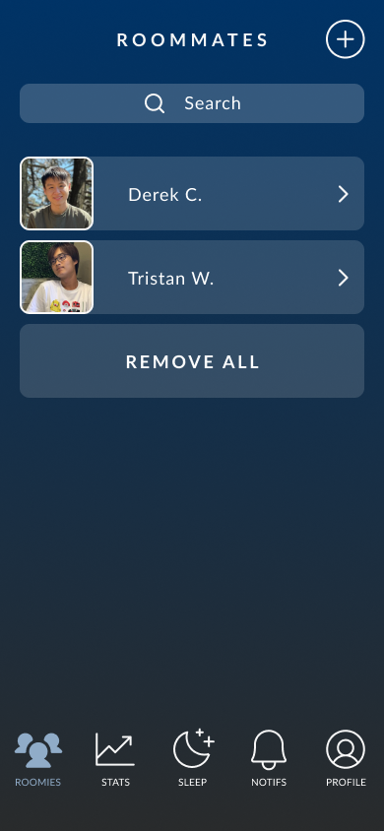
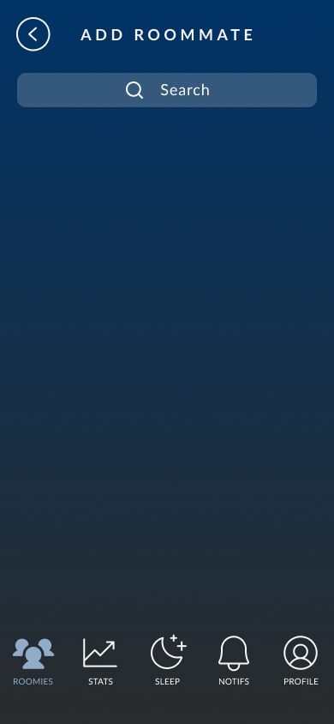
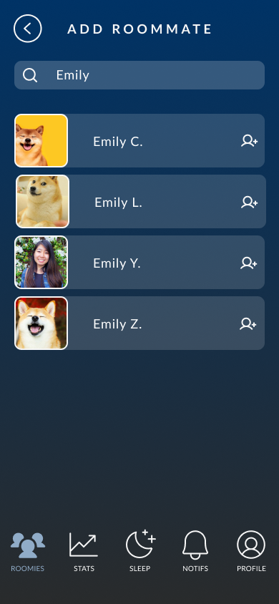
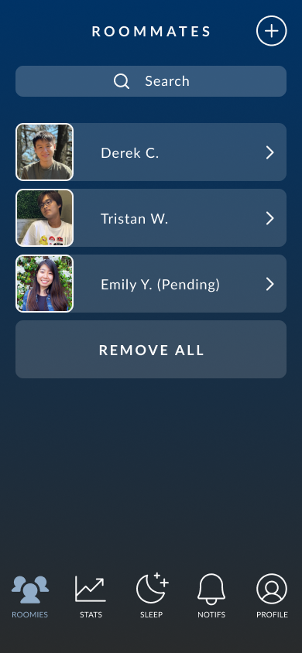
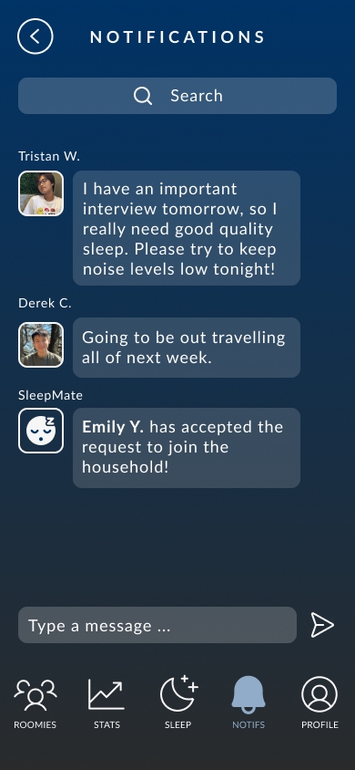
Modify your household by adding/removing roommates
Complexity: Moderate
1
Tap “+” to add a friend.
2
Use the search bar to find your friend.
3
Click the icon to send an invitation.
4
Request will show as pending.
5
Notification sent upon acceptance.

Slide 21
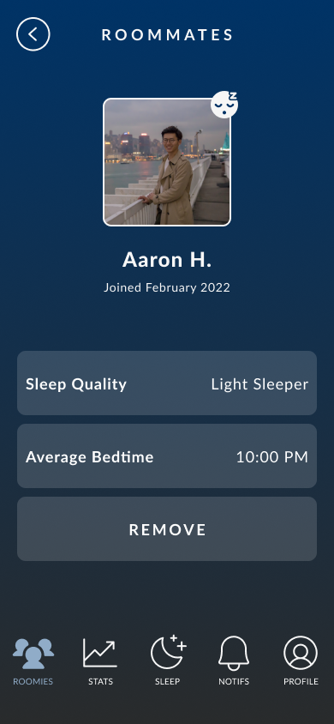
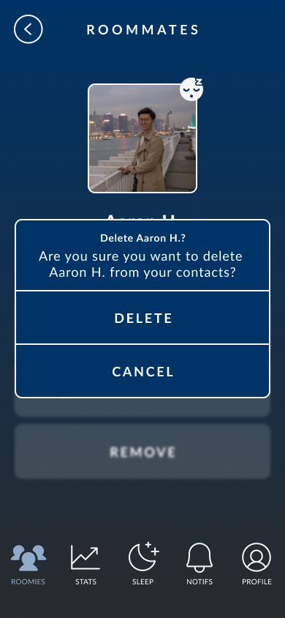
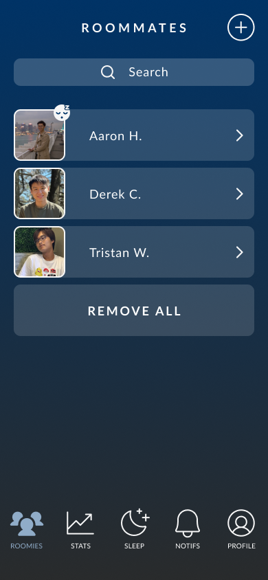
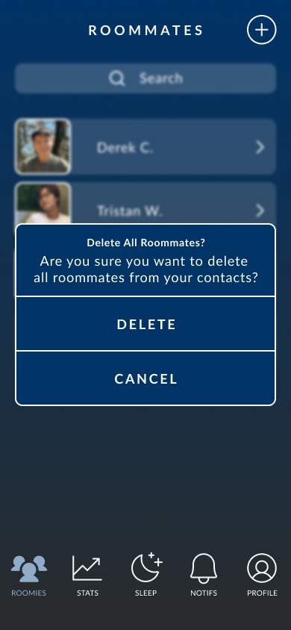
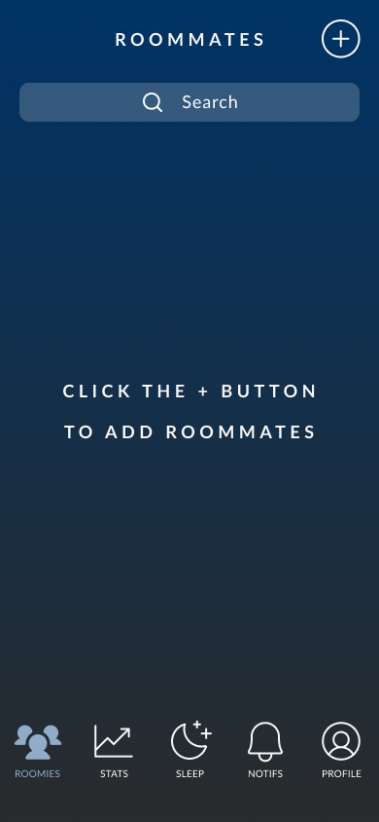
(Continued) Modify your household by adding/removing roommates
Complexity: Moderate
2
Tap “Remove” under profile.
3
Tap to confirm.
4
User removed from household.
1
Remove single roommate or entire household.
2
Tap to confirm.
3
Household removed.

Slide 22
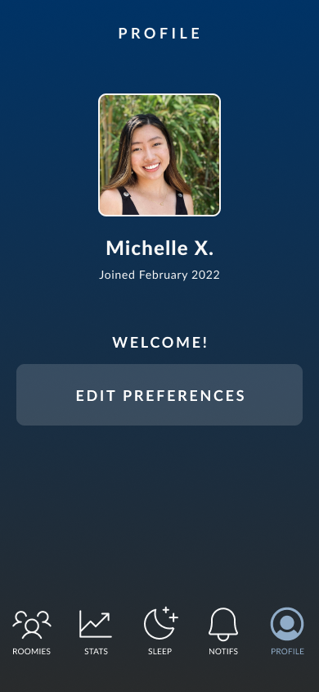
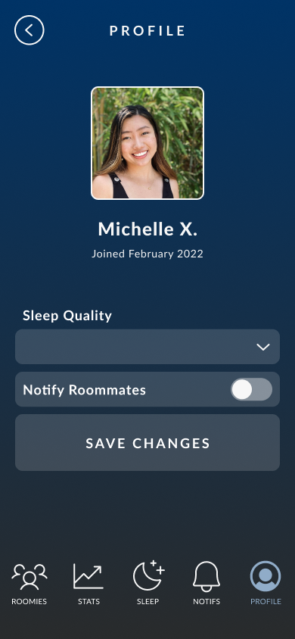
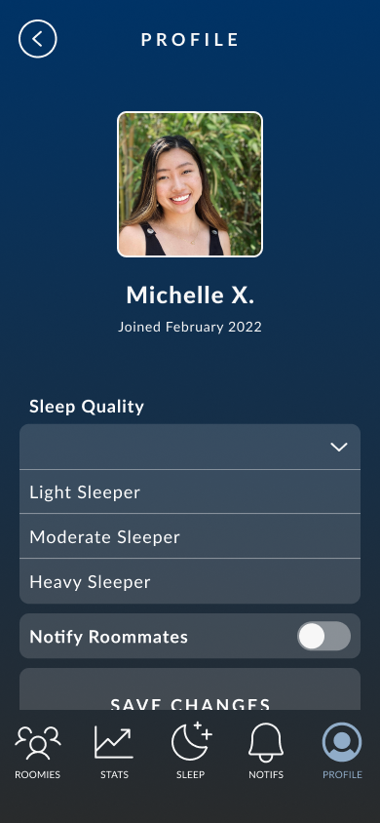
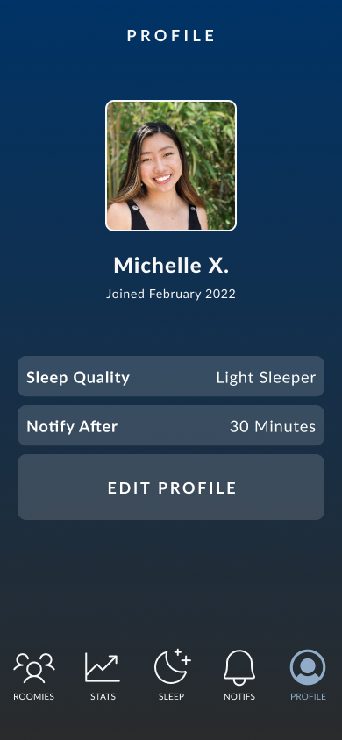
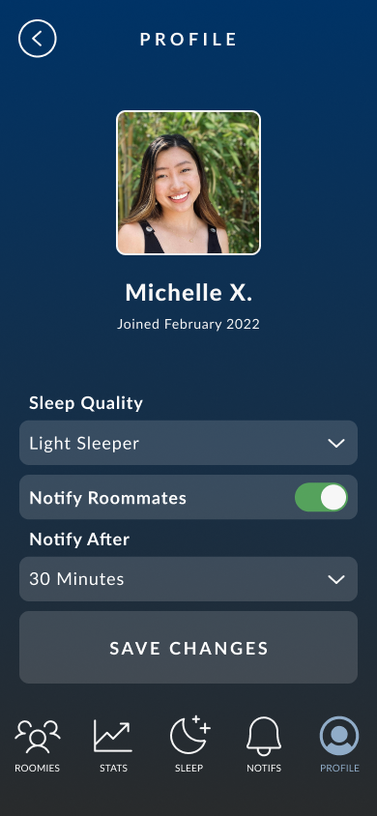
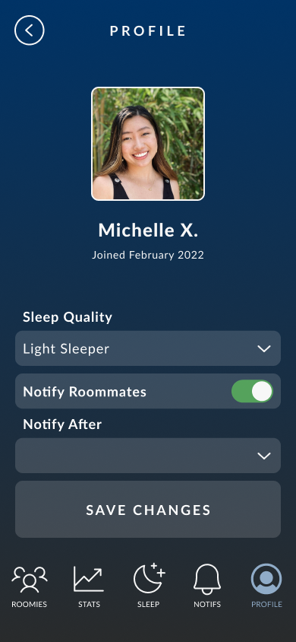
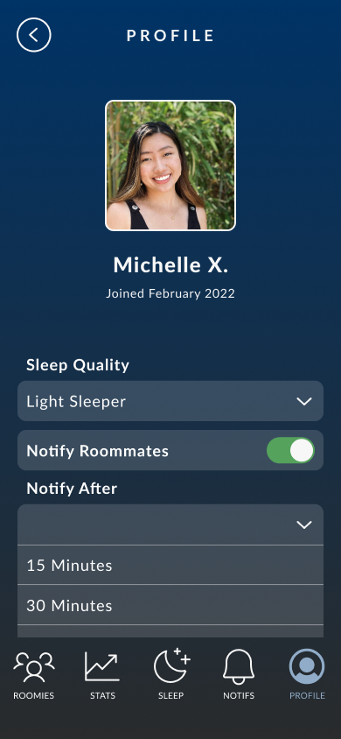
3
Select and choose options from drop down.
Update your sleeping preferences and notify your roommates that you’re still awake
Complexity: Complex
1
Tap “Edit Preferences” to customize your profile.
2
Edit your sleep quality and toggle notifications..
3
Select and choose options from drop down.
4
Save your changes to update your profile.

Slide 23
Prototype Overview

Slide 24

Prototype Overview: Tools
We used Figma to design and demo our prototype.
Pros
Easy collaboration among team members–it’s helpful seeing teammates’ cursors on the page
Ease of copying and pasting elements
Wide expanse of design assets that took our med-fi above and beyond the low-fi
Saves color palette for easy access
Cons
Difficult to generate custom shapes
Copied frames have identical names–sometimes forget to rename manually
Wiring frames is easy to mess up and gets tedious

Slide 25
Prototype Overview: Limitations
No actual ambient noise-tracking feature, so the stats data was “hard-coded”
The Figma prototype does not have typing capabilities, so we had to autofill for search queries and text messages
Too many permutations for functions under the “Roomies” and “Profile” tabs, so only certain functions were implemented (only can add/delete a certain roommate, etc.)
Too many permutations for the menu bar due to five page options, so we ended up wiring each page back to the home page. Users would have to go back to the home page before trying to go to a new page

Slide 26
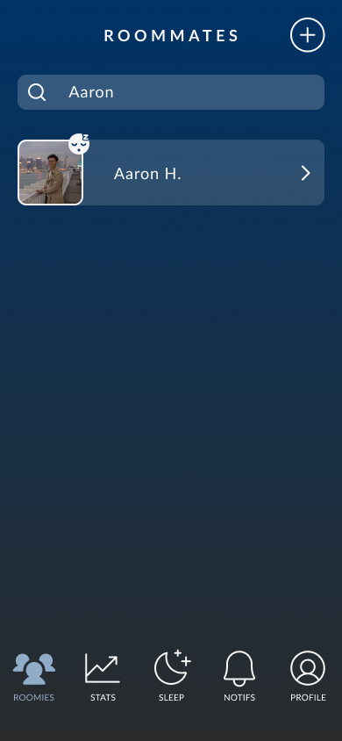
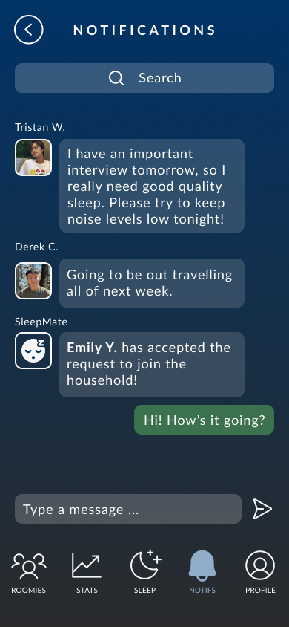
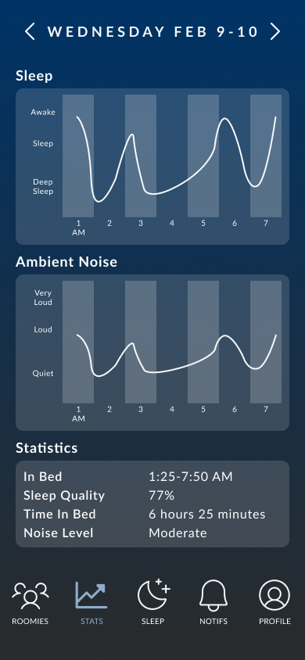
Prototype Overview: Wizard of Oz Techniques
Time travel to 8:00 AM next morning after ‘sleeping’
Simulated noise graphs and sleep statistics
Simulated message responses in “Notifications” Tab
Autofills roommate info for searching, adding, and deleting roommates

Slide 27
Prototype Overview: Hard Coded Features
Time and date of waking up
Roommate & profile information
Household message board content
Sleep statistics graphs
Notes:
Time and date of waking up are hard coded for simplicity; to demo the app, we don’t want to have to wait until someone goes to bed and wakes up.
Roommate and profile information are hardcoded because there aren’t any actual active users on the prototype.
Household message board content chat is hardcoded for the same reason as roommate and profile information.
Sleep statistics graphs are hardcoded because implementing a microphone stream, breathing detector, and analytics feature within the app are beyond the scope of this class.

Slide 28
Appendix

Slide 29
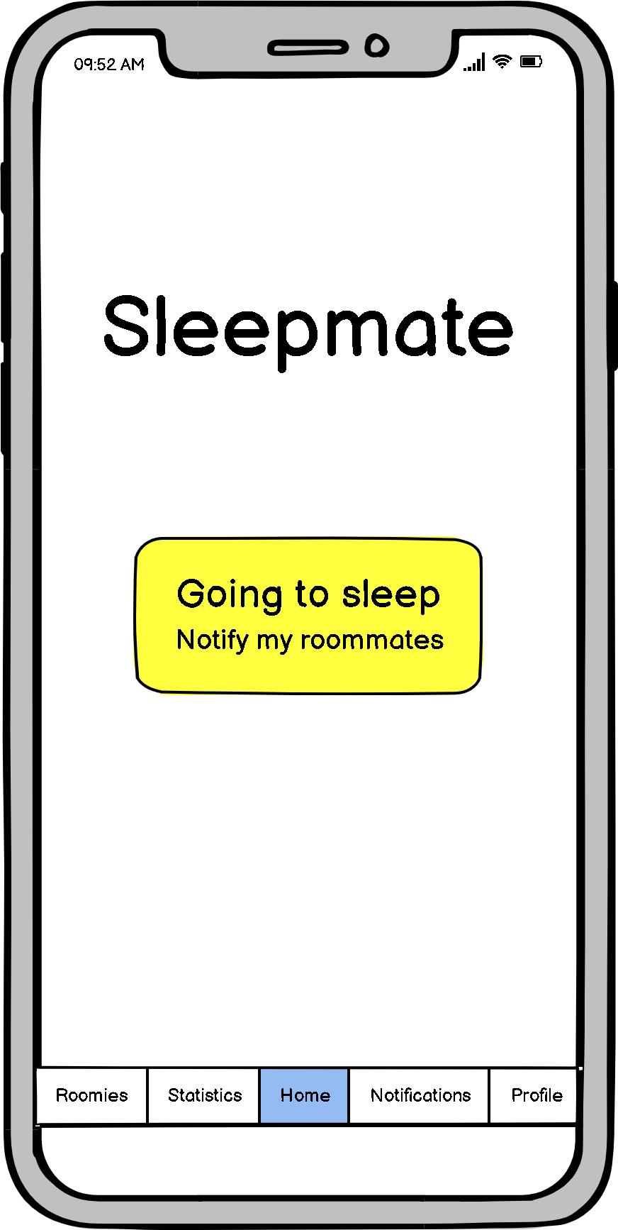
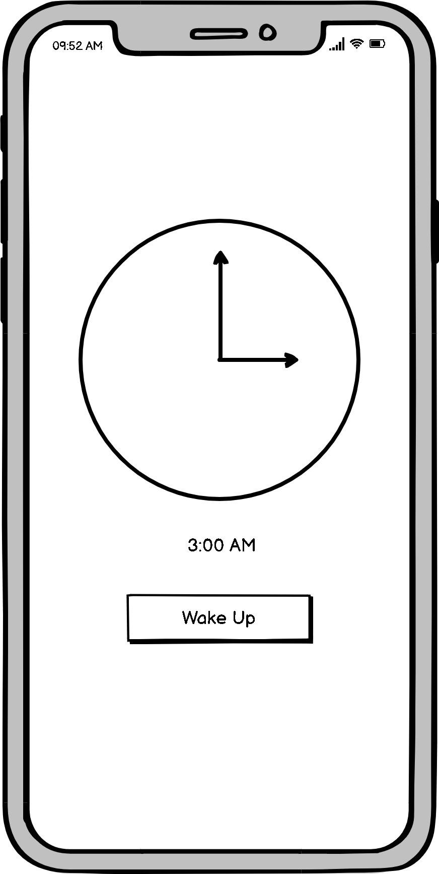
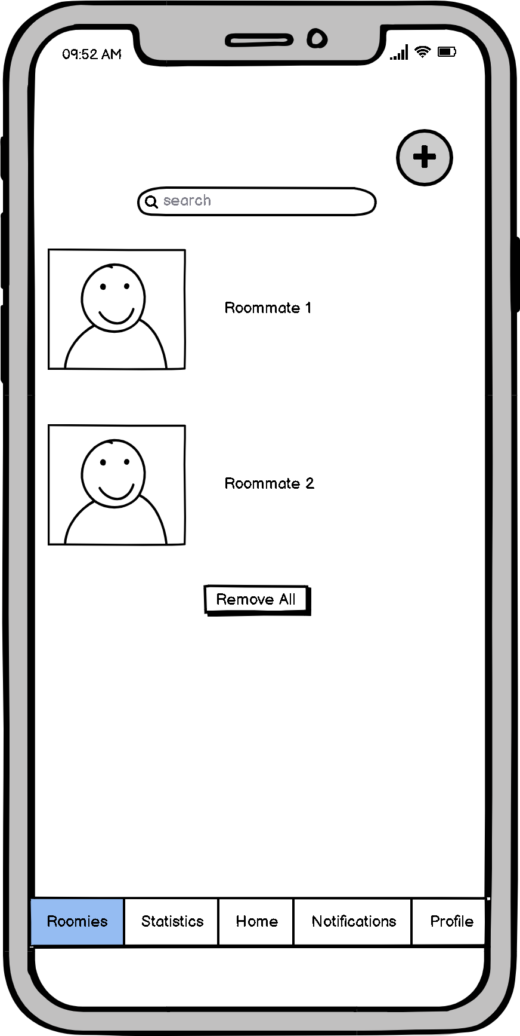

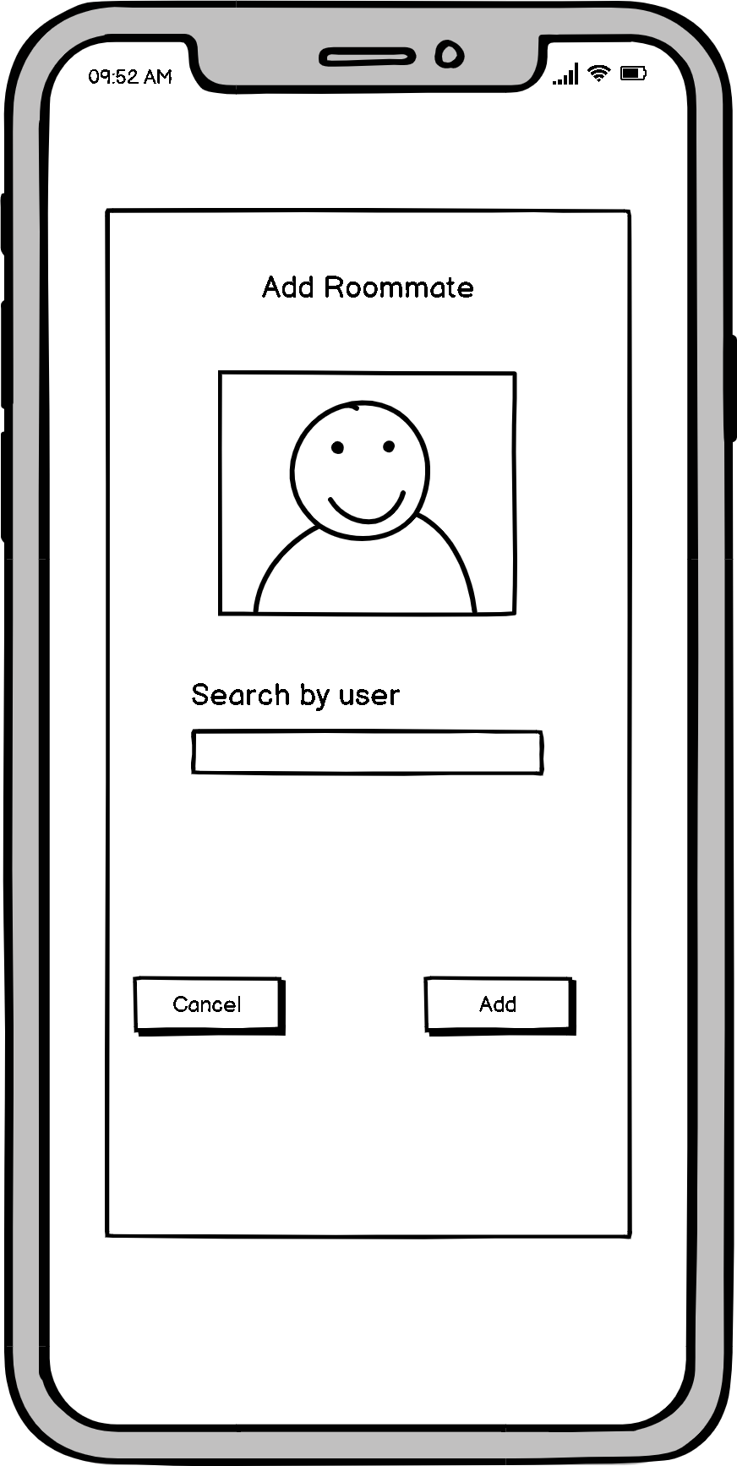
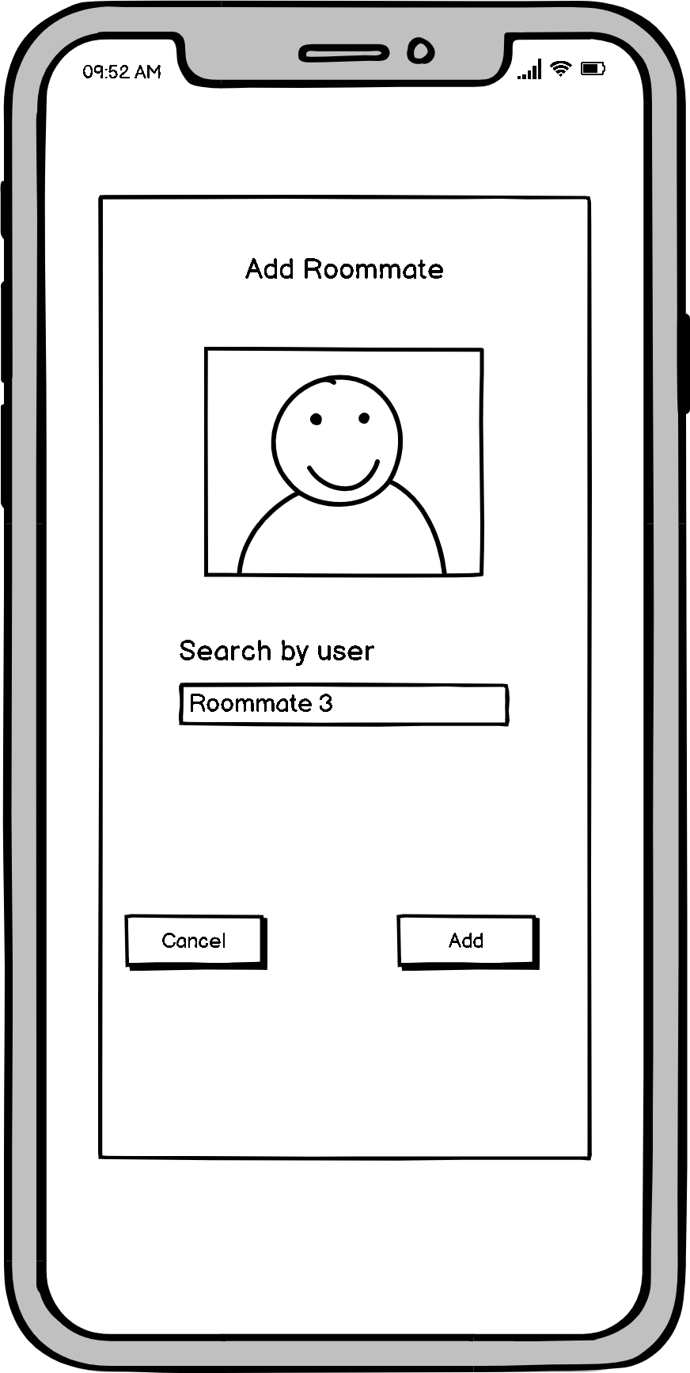
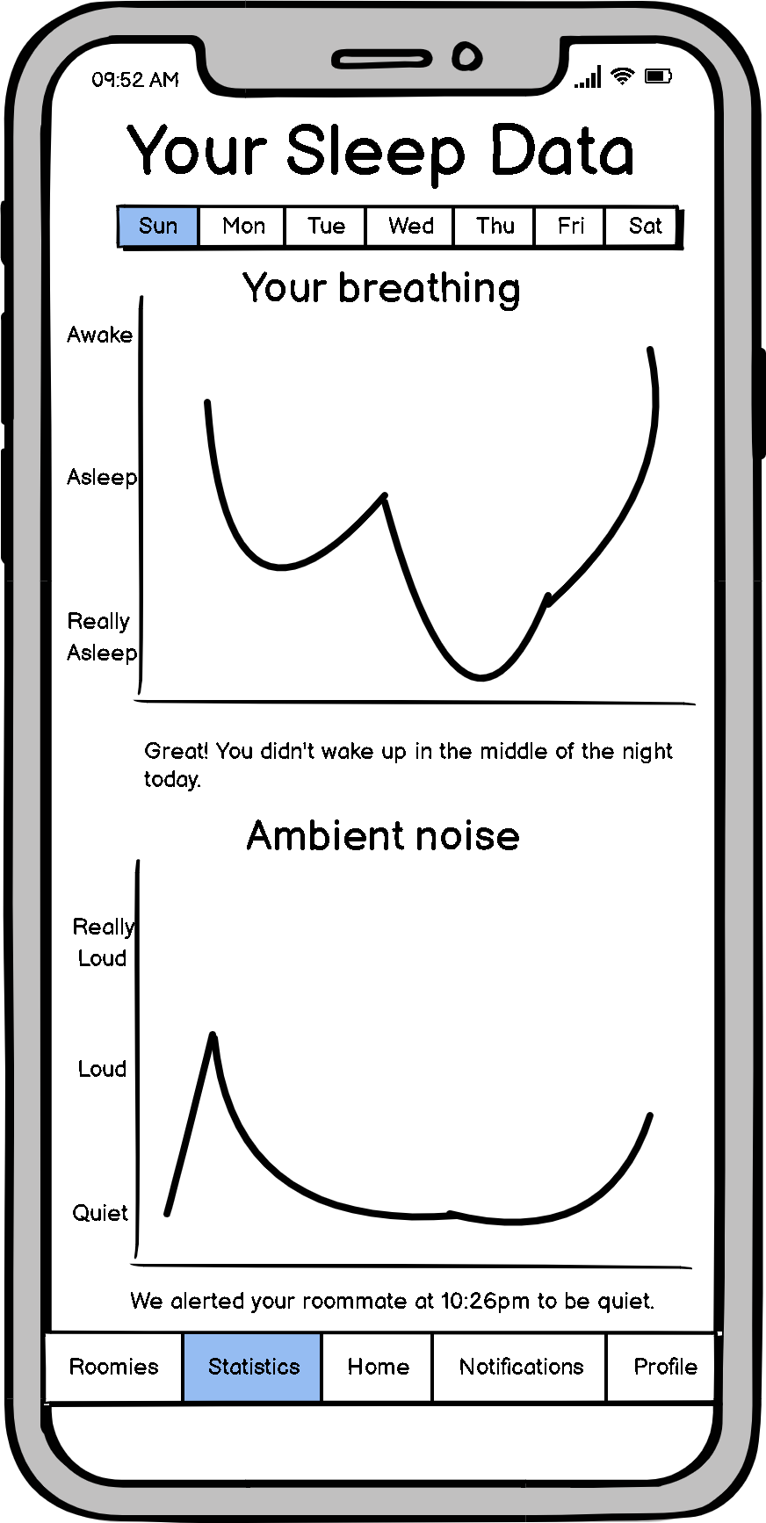
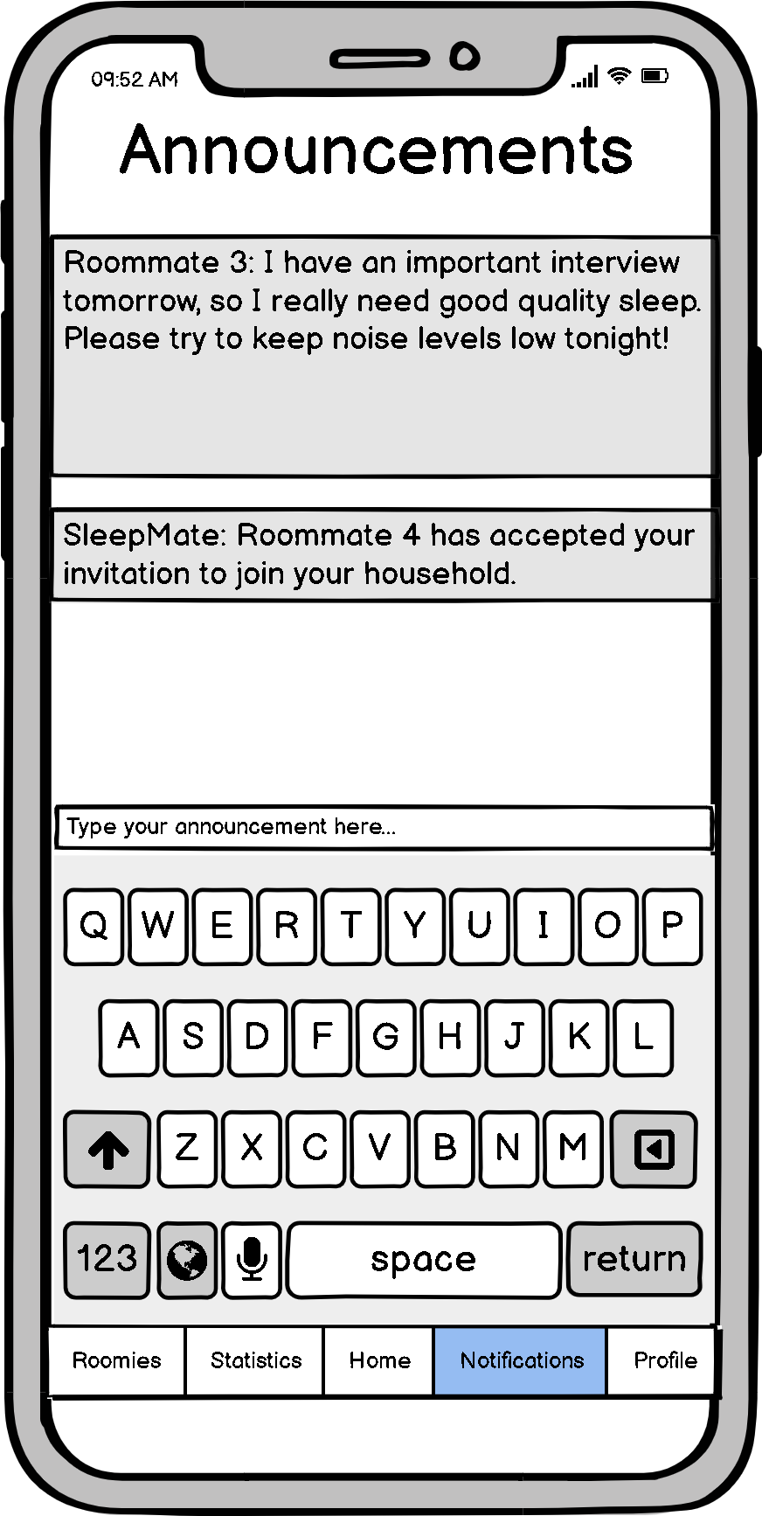
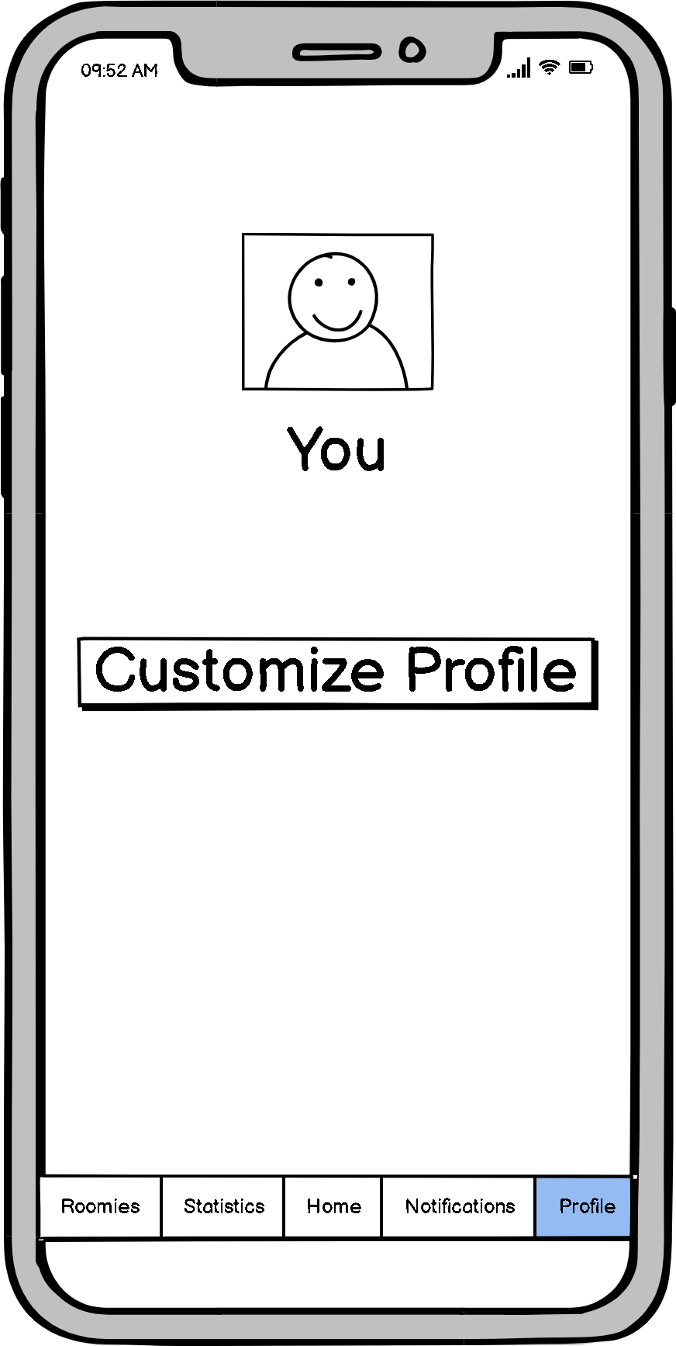
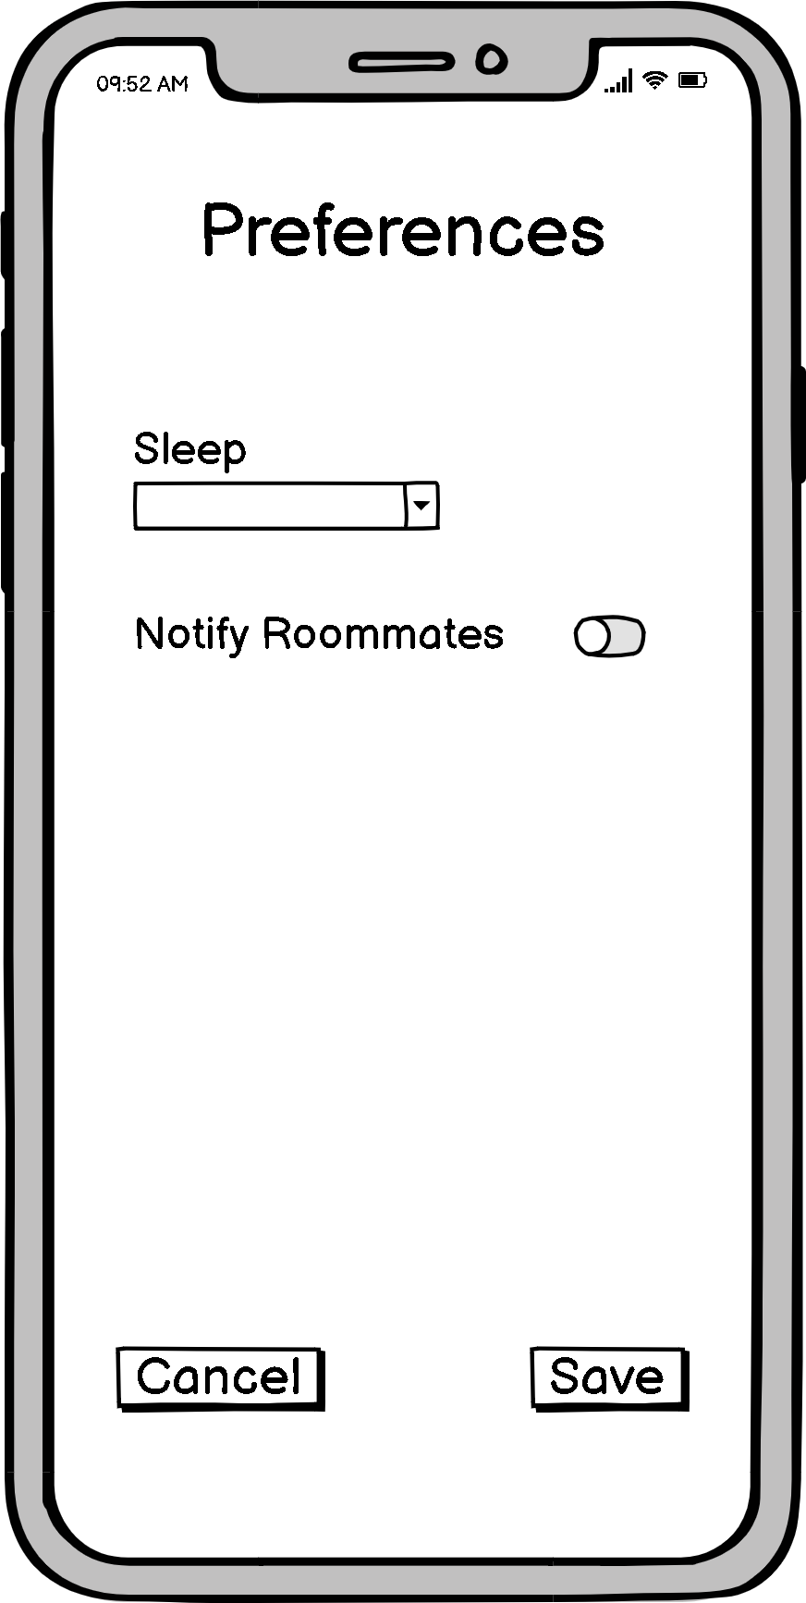
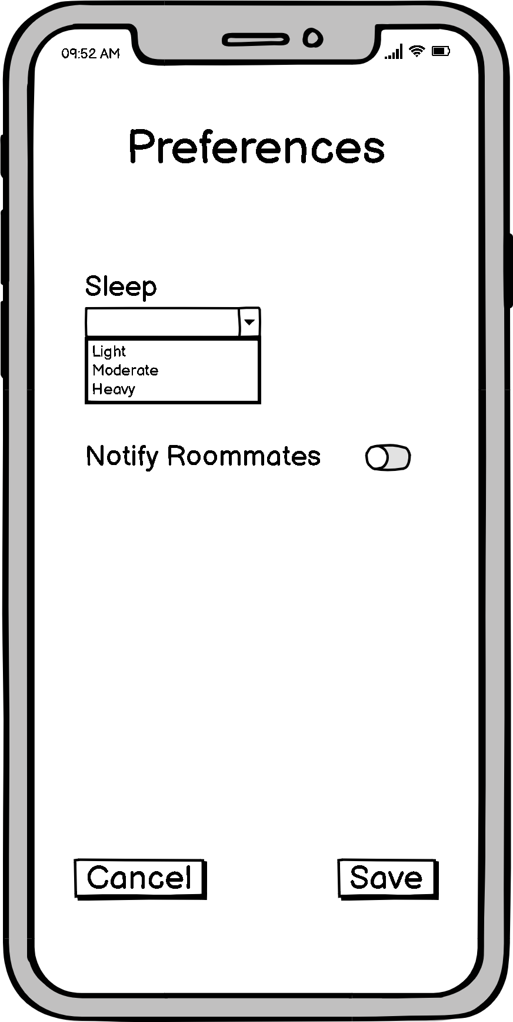
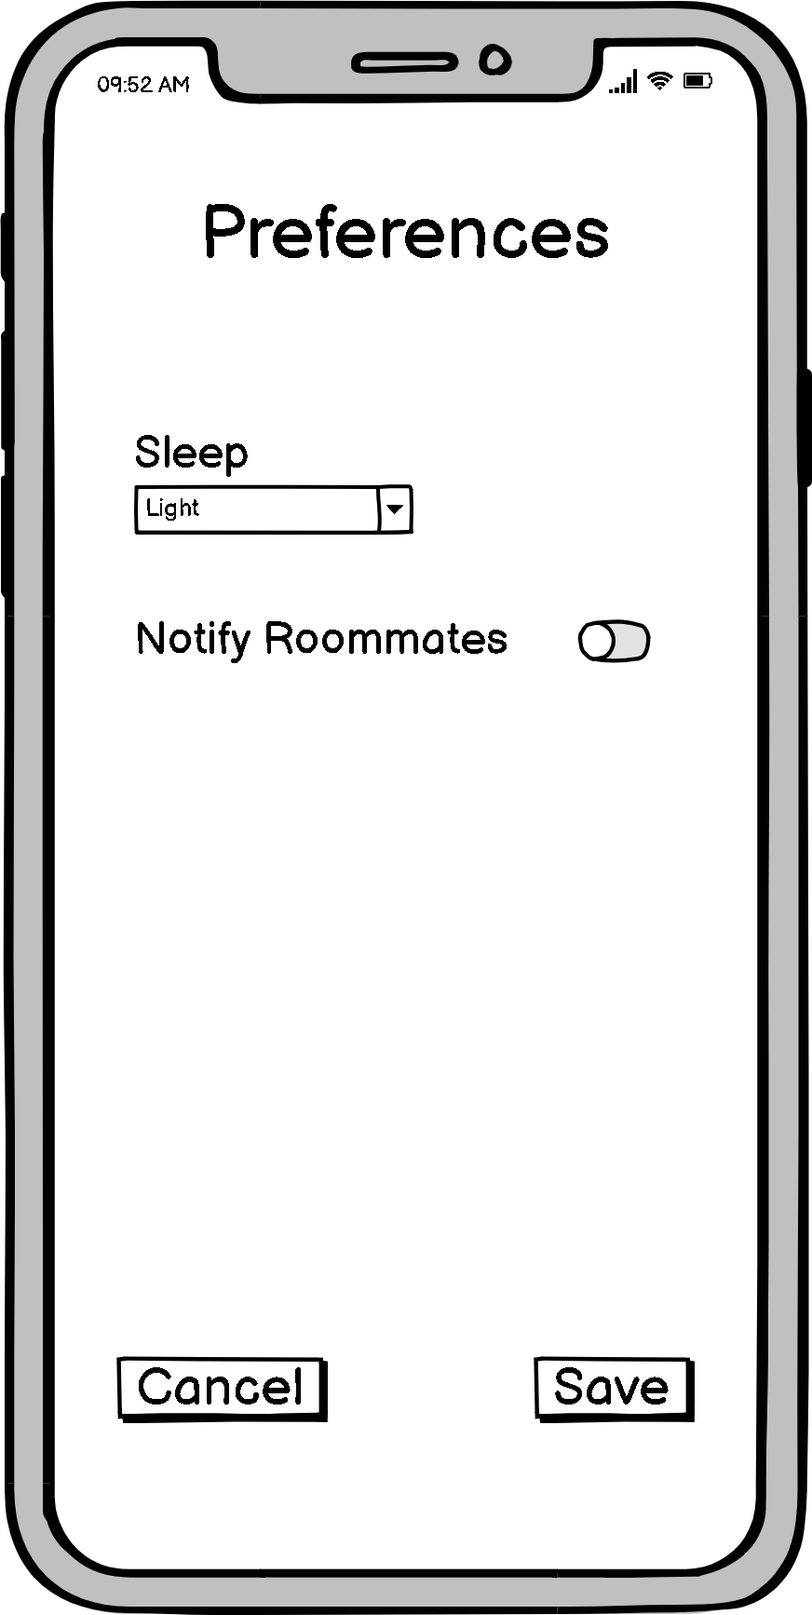
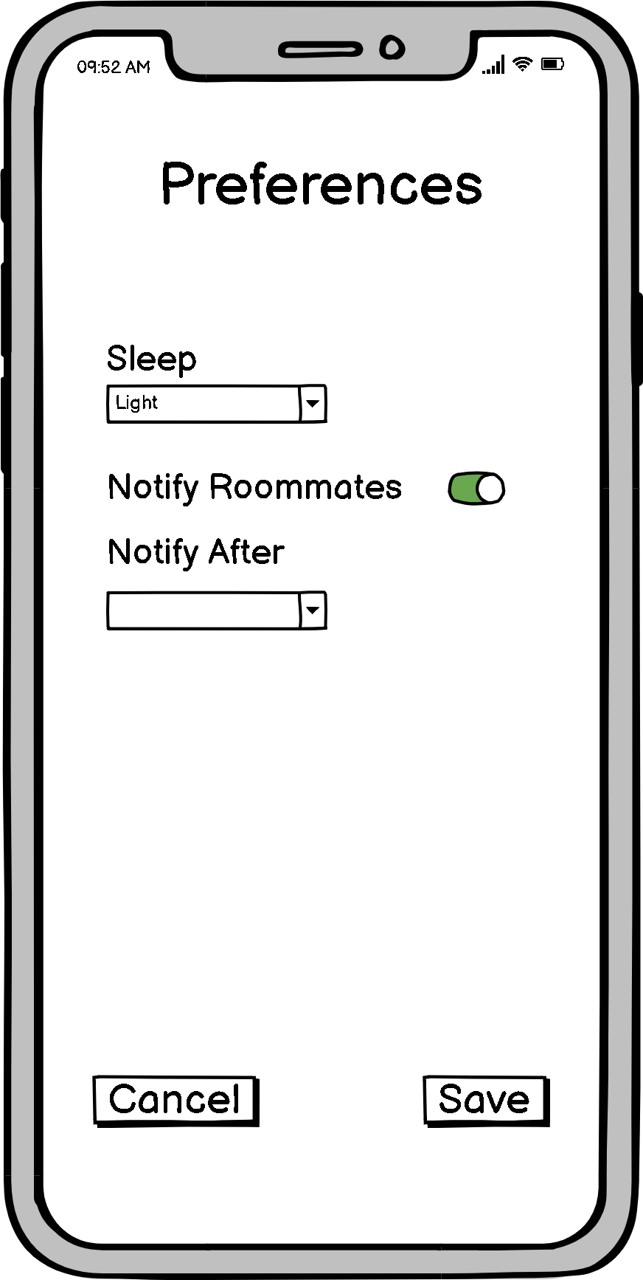
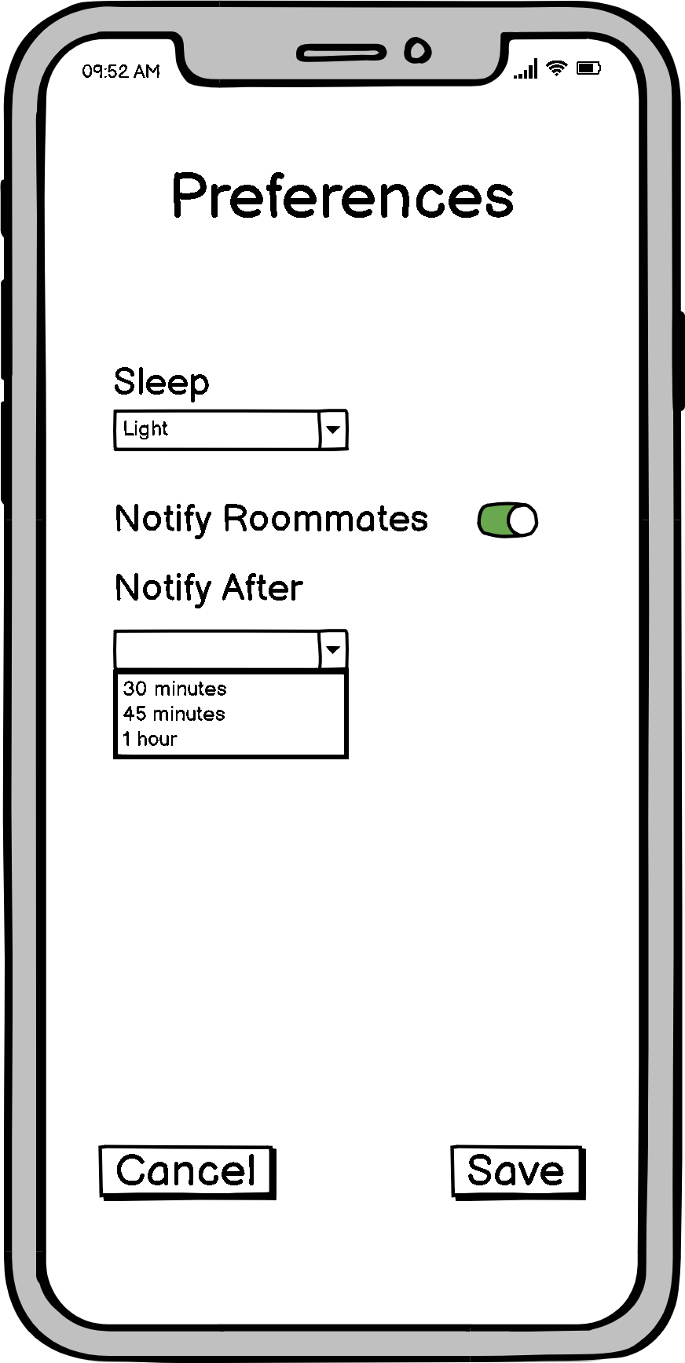
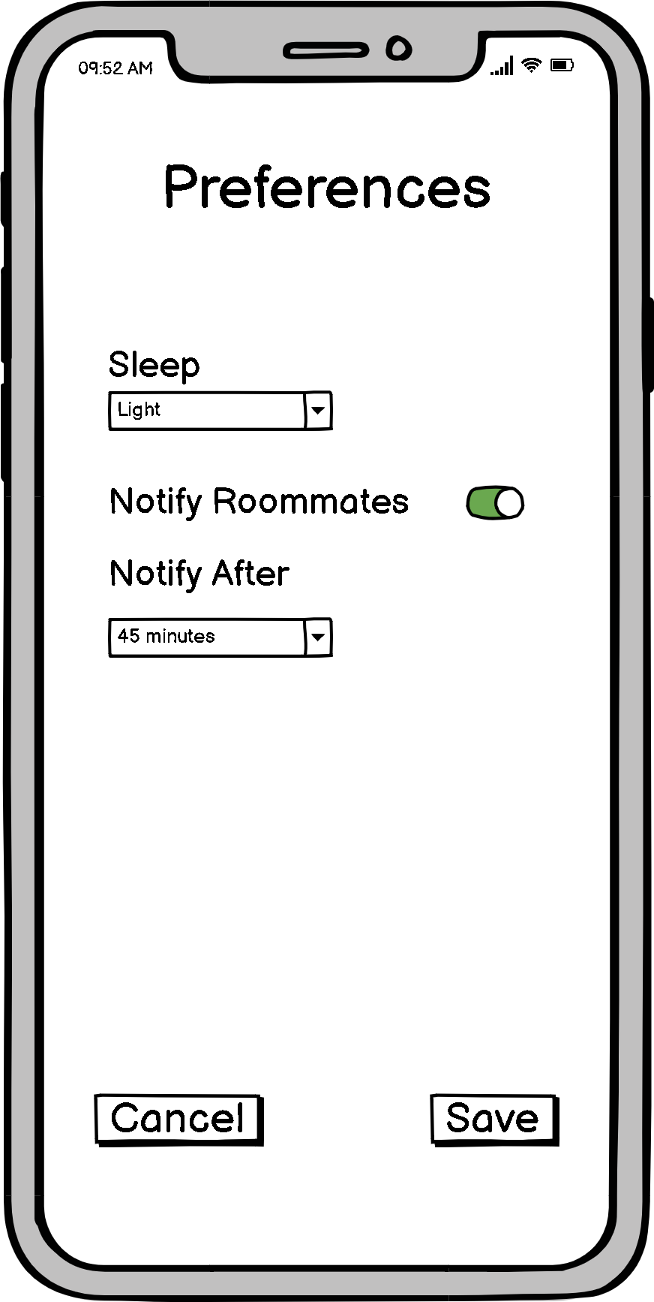
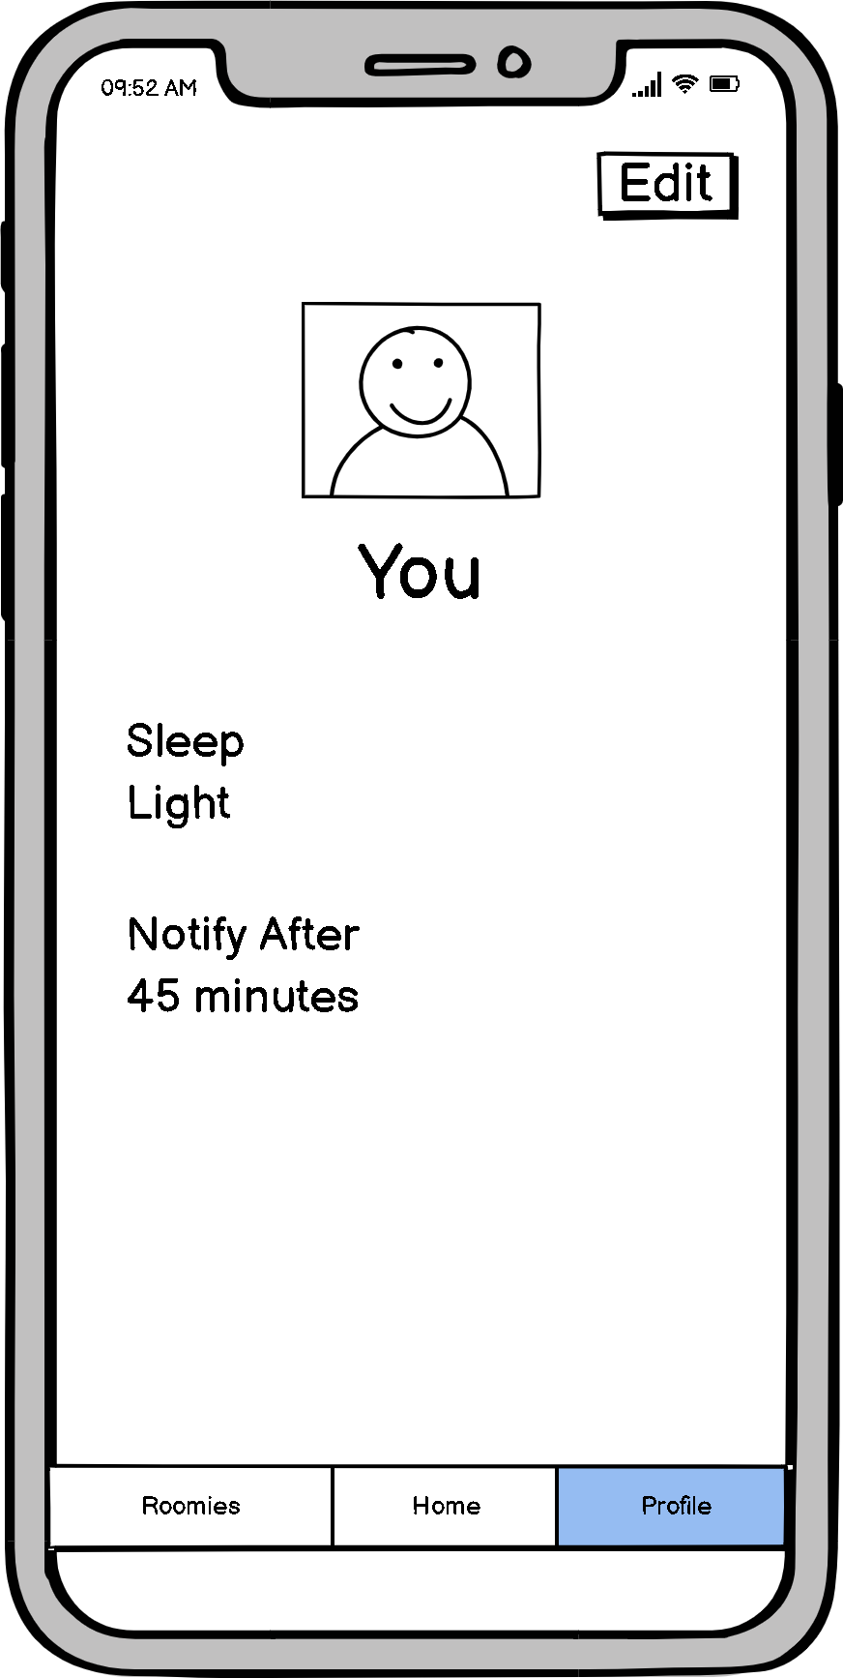
Low-Fi Prototype

Slide 30
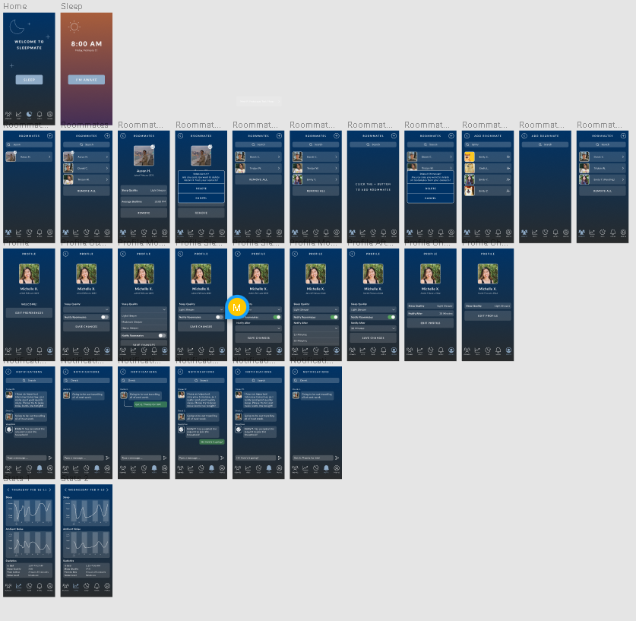
Med-Fi Prototype
Link: https://www.figma.com/proto/pv2AVR3jqo2s9PmkI6wUeE/SleepMate-Med-Fi-Prototype?node-id=56%3A1051&scaling=scale-down&page-id=0%3A1&starting-point-node-id=56%3A1051

Slide 31
Website: http://web.stanford.edu/class/cs147/projects/CaringFromWithin/Sleepmate/

