Slide 1
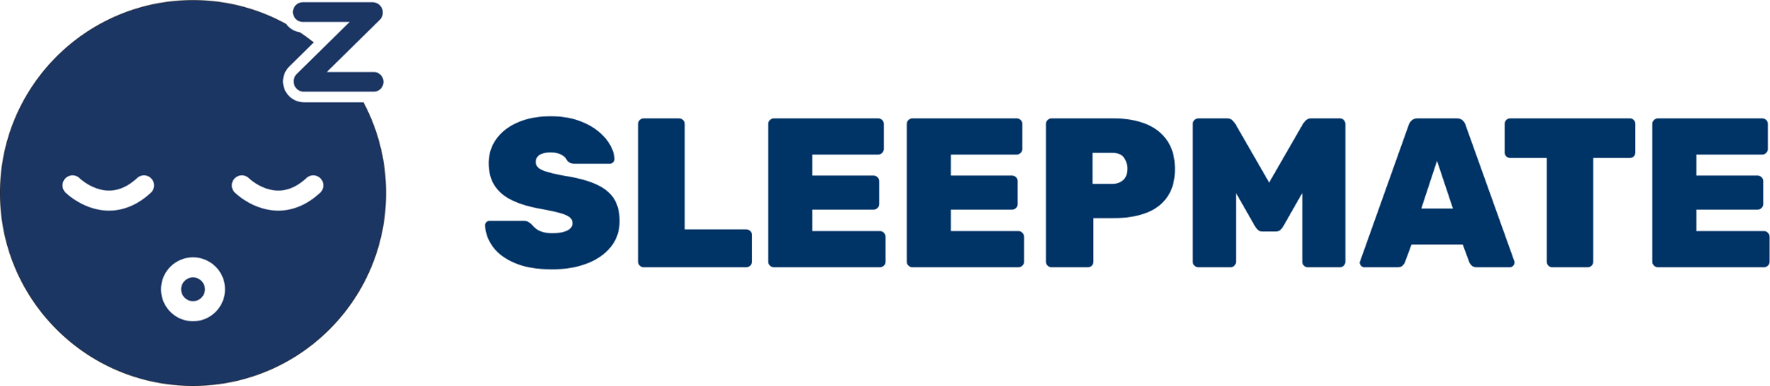
Low-fi prototyping and user-testing
Studio: Caring From Within
Derek Chung, Aaron Han, Tristan Wang, Michelle Xu
Notes:
Hey everyone! This is Aaron from the SleepMate team. I’ll be walking you through our low-fi prototyping and user-testing from this week.

Slide 2
Design ideas
Prototype
User testing
Notes:
First, I’ll go through how we went about ideating for potential designs for our app.
I’ll go through the process of designing our prototype after.
We’ll then wrap up with how we went about user testing, feedback we received, and takeaways.

Slide 3
Value Proposition
Sleeping Easy, Made Easy.
Notes:
Before we dive into our design explorations, we need to go over the goals we wanted to achieve through our design. Our value proposition is “sleeping easy, made easy.” We aim to accomplish this by easing users’ anxiety from repeatedly reminding roommates to keep noise levels low at night.

Slide 4
Design ideas
Notes:
We centered our design ideas around this principle. Here’s a brief look at all of them:

Slide 5
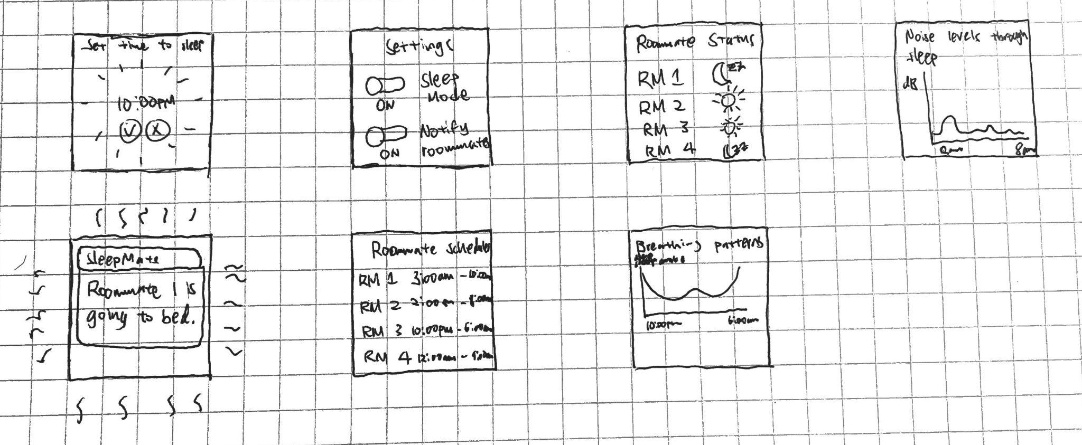
Wearable
Notes:
We thought a wearable app might make sense since most of them have functionalities to track sleep built-in already.

Slide 6
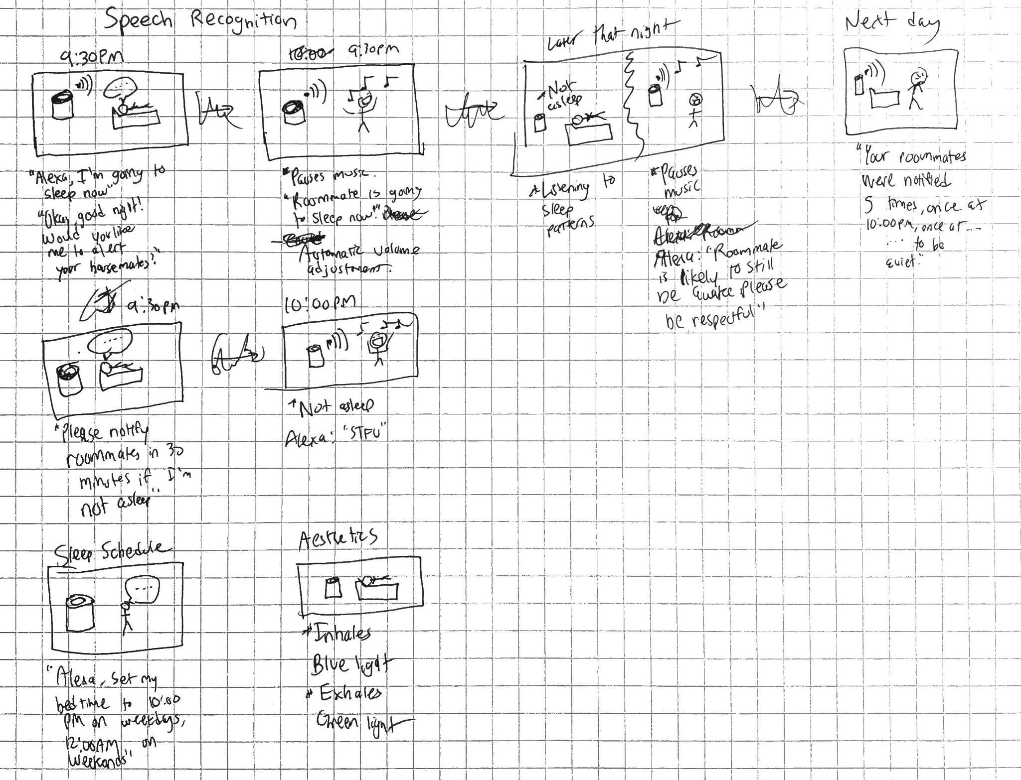
Smart-home Device
Notes:
We also thought a smart-home device, especially voice activated ones, could work for delivering our value prop as well.

Slide 7
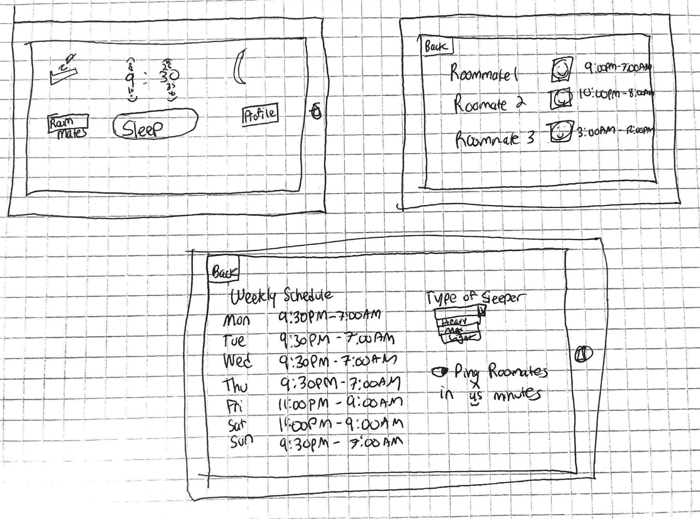
Tablet
Notes:
We also tried ideating a tablet app, where we could display much more information than other devices.

Slide 8
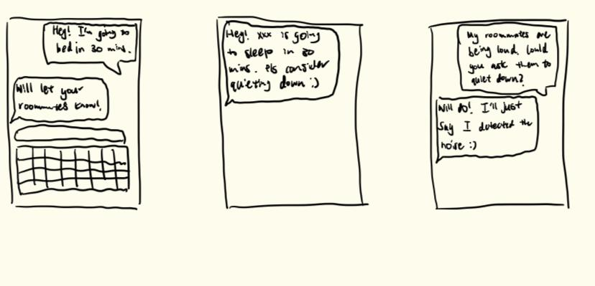
Text-based Mobile App
Notes:
Here’s text-based app. We thought that it would be very intuitive to use.

Slide 9
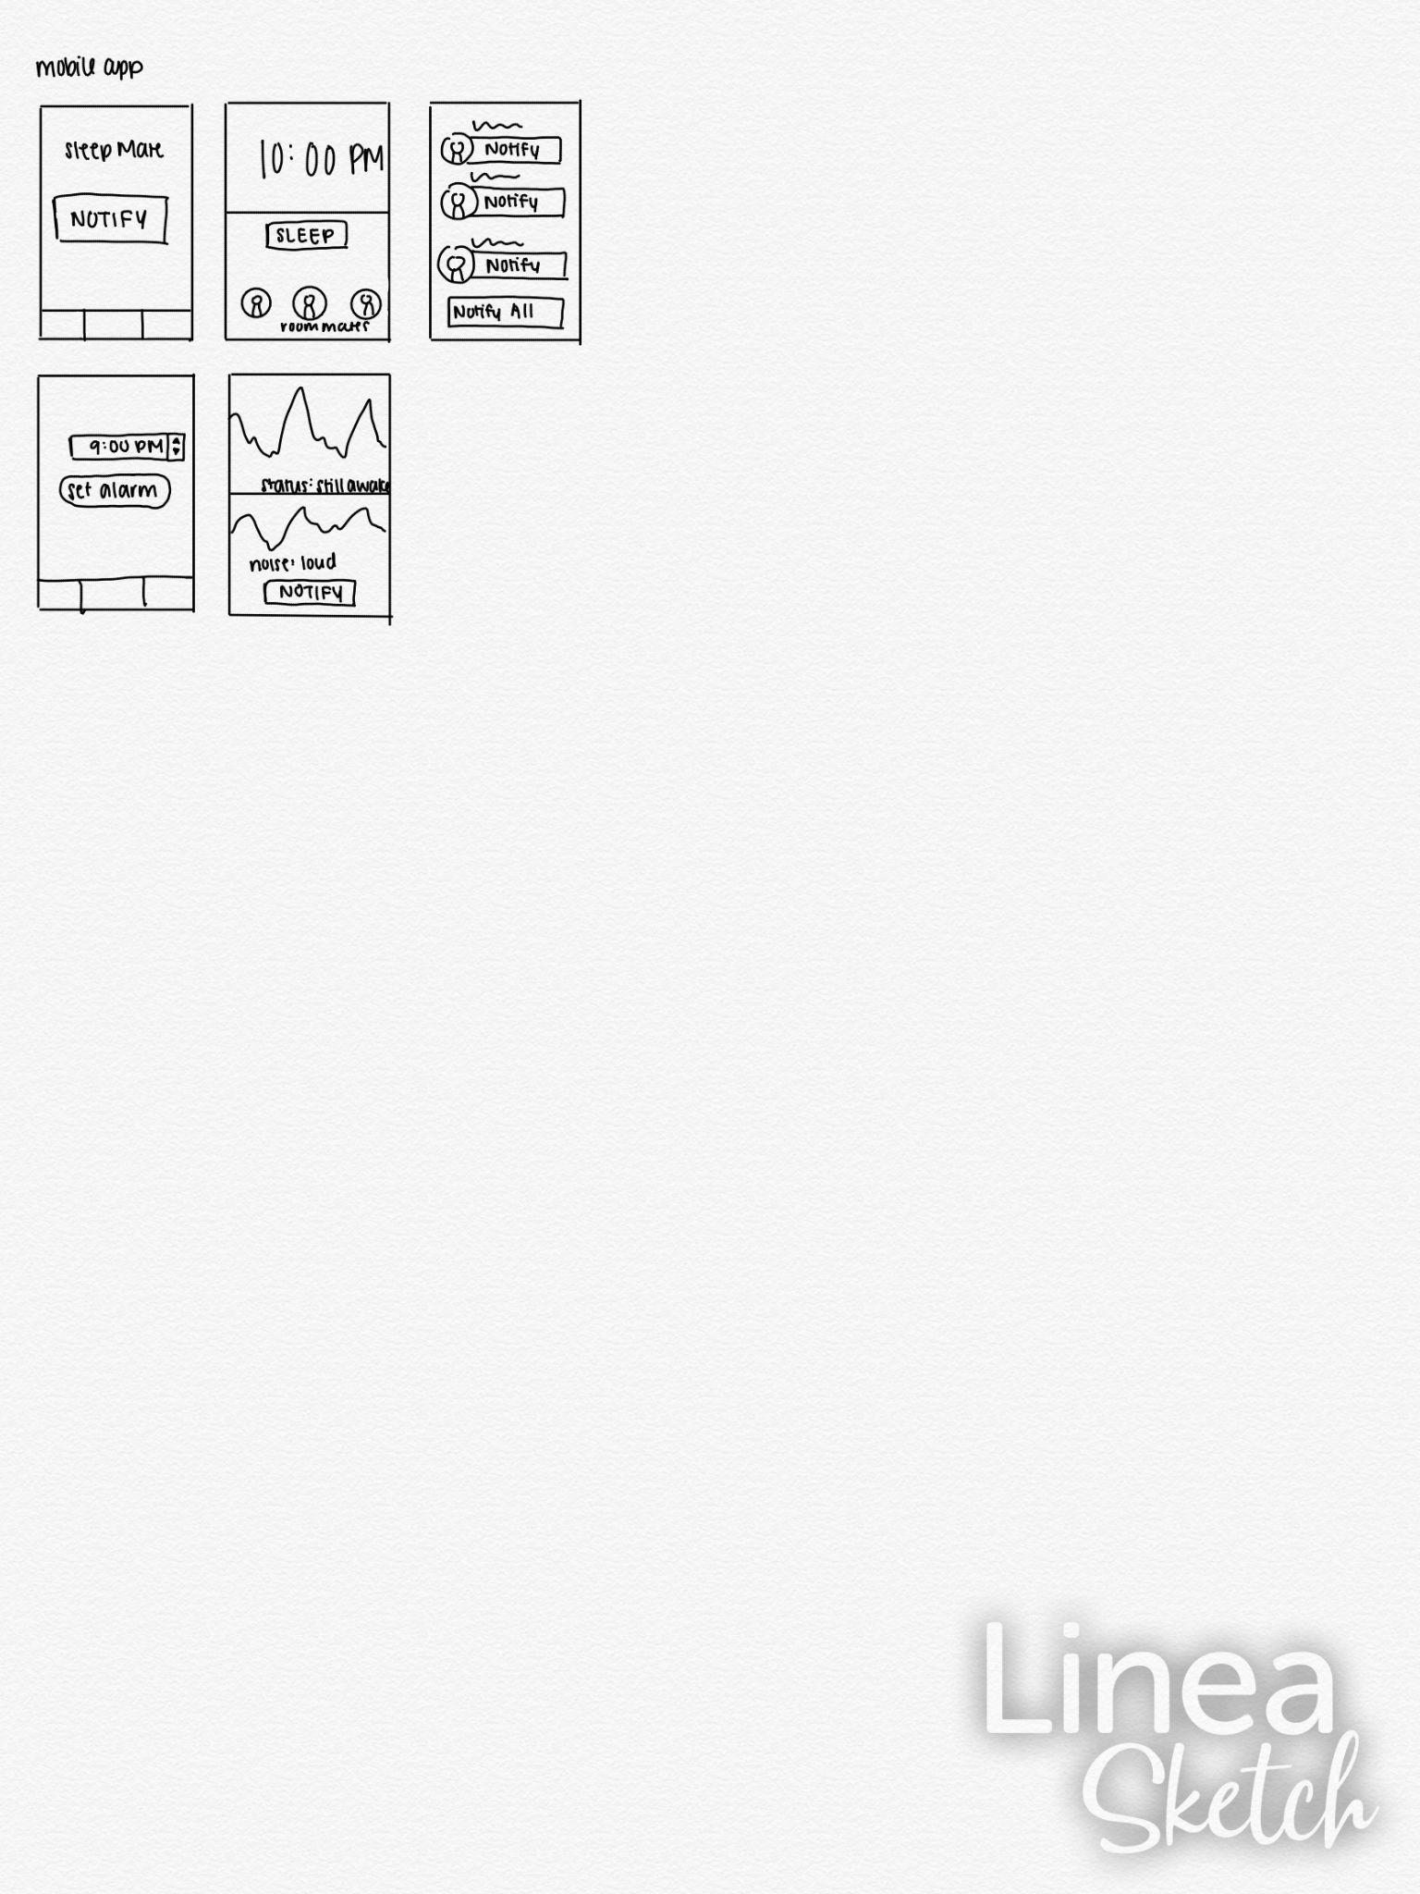
Sleep-tracking Mobile App
Notes:
Lastly, we designed a standard mobile app with a twist that it could track sleeping patterns and surrounding noise levels.

Slide 10
Interface Selection
Wearable
Smart Home Device
Text-based
Sleep-tracking mobile
Tablet
Notes:
Out of these interfaces, we selected

Slide 11

Interface Selection
Wearable
Smart Home Device
Text-based
Noise-tracking mobile
Tablet
Notes:
The text-based app and the noise-tracking mobile app. This decision was primarily based on the accessibility of the devices, since not everyone has a wearable, a tablet, or a smart home device.

Slide 12
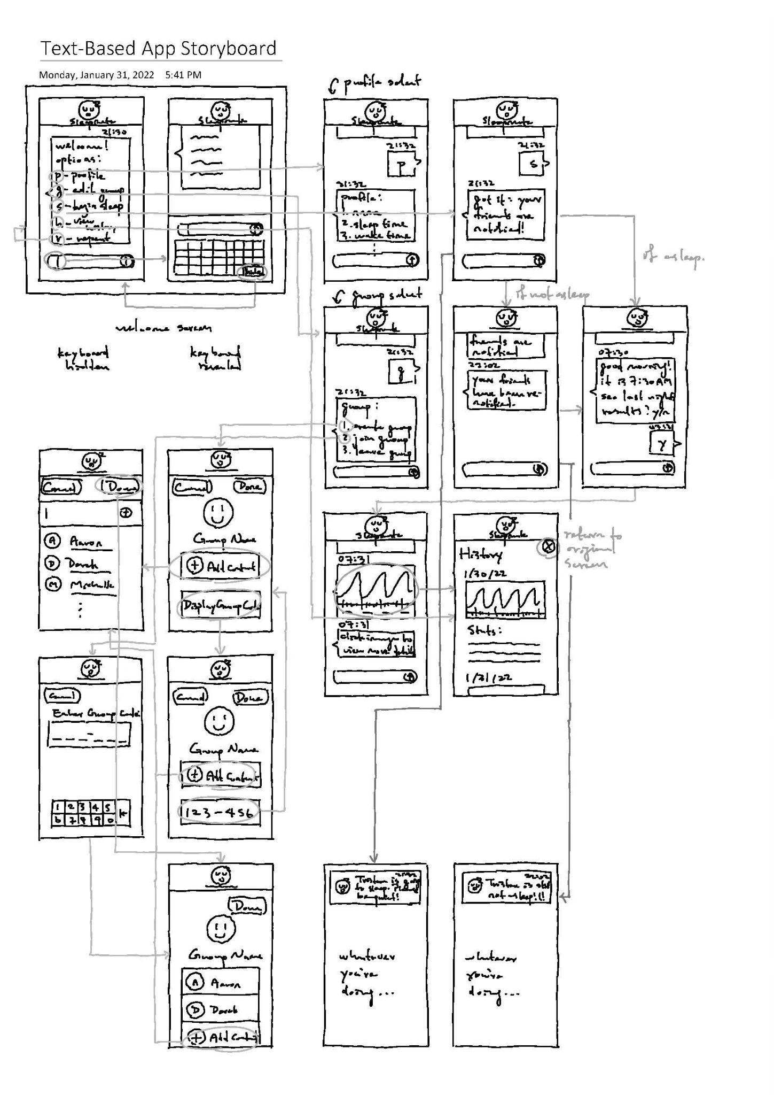
Text-based
Storyboard
Notes:
Let’s go over the storyboard for the text-based app quickly. As the name suggests, its main feature is an interface for texting — similar to messaging apps like iMessage — where the user inputs commands and gets responses from the app, as well as links to other features. Texting “p”, for example, might bring you to your profile page. The app would also feature a contact list, and users in the same group would be notified of each other’s status via notifications.

Slide 13
Text-based: Pros vs. Cons
Memory-efficient
Customizable
Intuitive
Unaesthetic
Incoherent
Difficult to operate
Notes:
Now we can talk about the pros and cons of this storyboard.
Memory efficient: the interface is super minimalistic, so it cuts down memory use.
Customizable: it’s also mostly a text-based interface, which would be easily customizable based on personal preferences.
Intuitive: users can draw on previous experiences using messaging apps and contact lists using the app, making it very easy to learn.
On the downside:
Unaesthetic: most displays are dominated by text bubbles, making it a little unaesthetic.
Incoherent: the UI style would have to jump between chat-based, phonebook-style, and graphic popup displays. This would lead to a pretty incoherent design.
Difficult to operate: many of the functions would require texting precise commands or an NLP model that can accurately parse what the user is asking for, which leaves a large room for error.

Slide 14
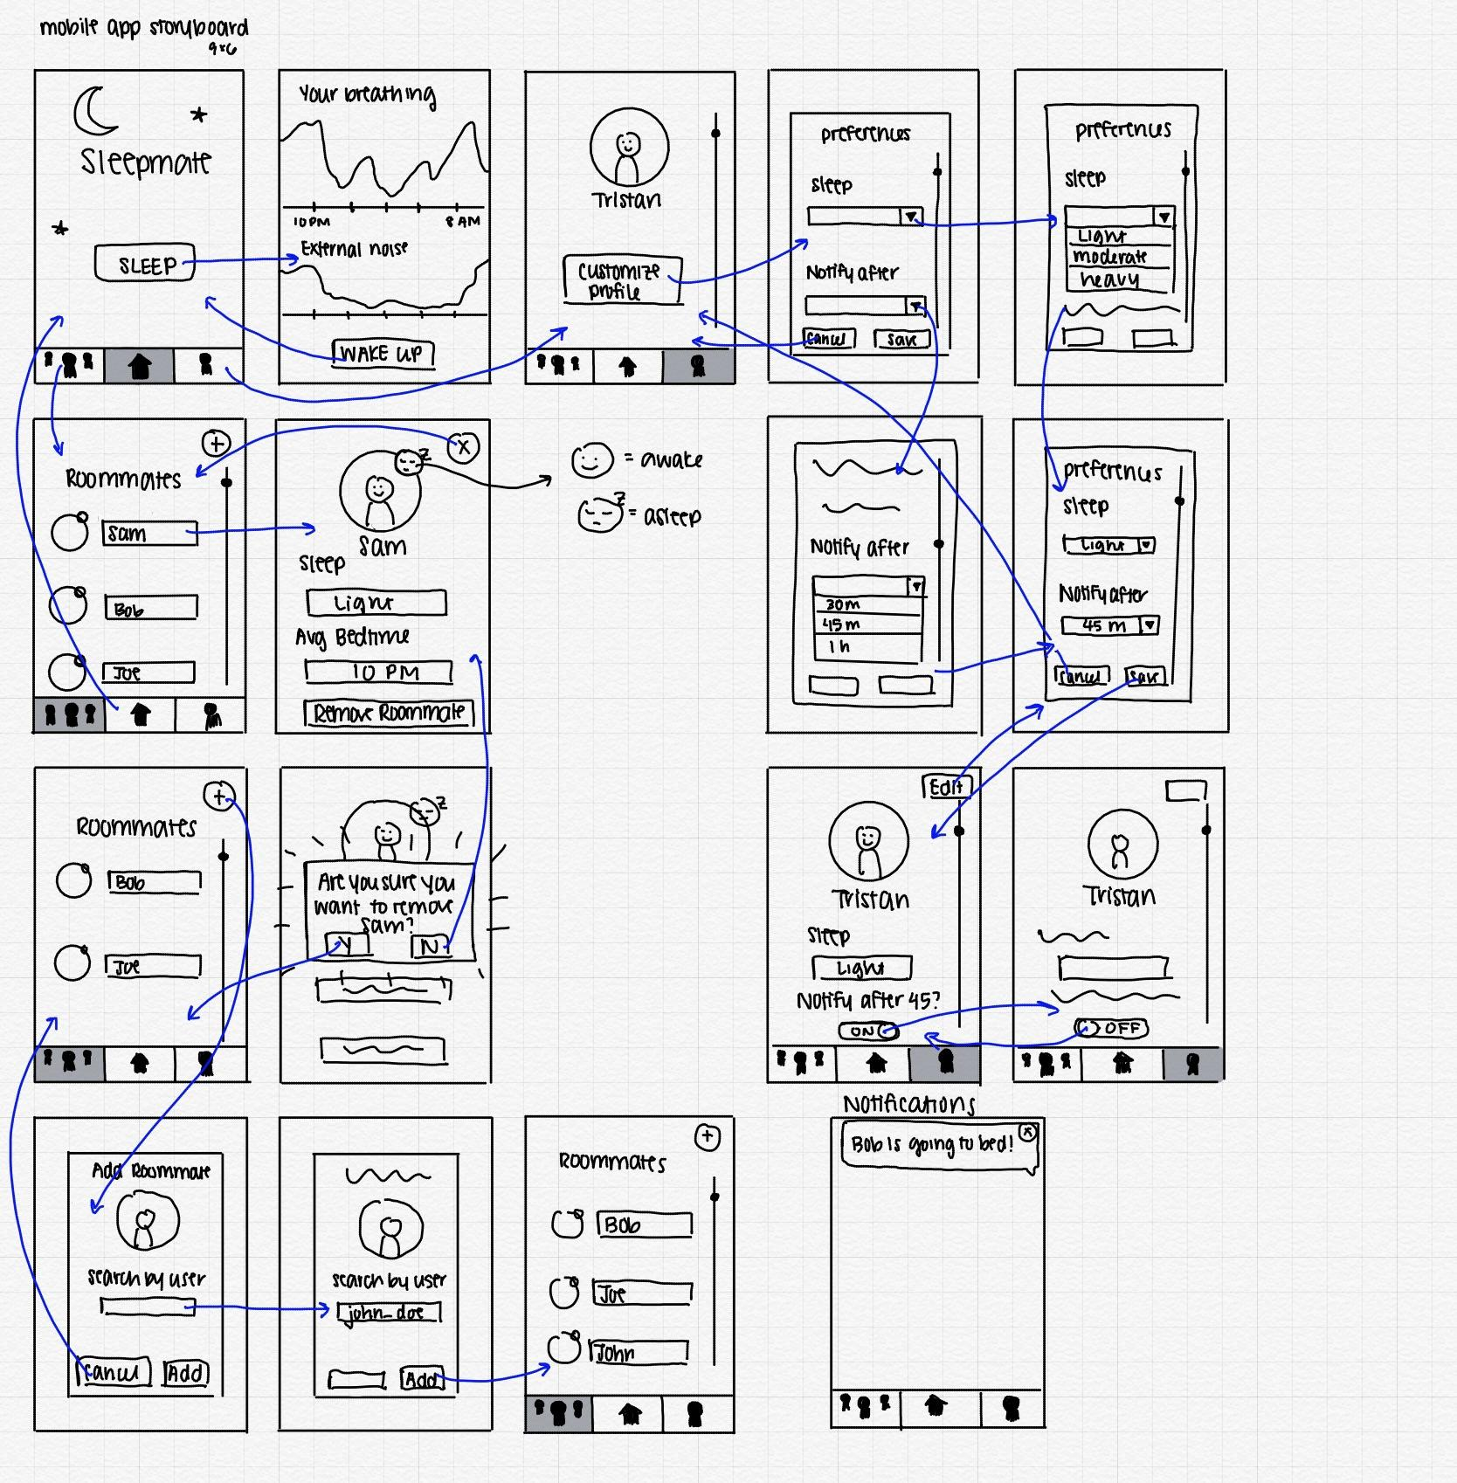
Sleep-tracking
Mobile Storyboard
Notes:
Here we have a general storyboard for the sleep-tracking mobile app. As you can see, it’s more of a visual set-up that aims to track both the user’s breathing while they’re sleeping and any external noises that might keep them up. There are different pages, like the roommate page and the profile page, which makes it easy to keep track of user profiles. The main feature here is a giant “sleep” button that will notify roommates once pressed that you’re going to bed.

Slide 15
Sleep-tracking Mobile: Pros vs. Cons
Visually appealing
Functional
Easy to use
Inaccurate
Easily forget “waking up”
Notes:
To start with the pros for this storyboard:
Visually appealing: we can include the profiles of roommates and the graphs for noise detection and breathing patterns, which would add a lot to the aesthetic value of the app.
Functional: the ability to modify the household and update sleeping preferences would make this a highly-functional app.
Easy to use: a big “sleep” button on the home screen makes notifying roommate easier (or so we thought, but we’ll get into that later).
For the cons:
Inaccurate: some sounds the app detects might not be coming from roommates. If the user snores, that could be falsely detected as noise from roommates and trigger false alarms
Remembering to “wake up”: a user might simply forget to hit the wake up button on the app. We all know how hard mornings are. Turning your alarm off is as hard as it already is.

Slide 16
Selected storyboard:
Noise-tracking
Mobile App Storyboard
Notes:
After weighing the pros and cons of both, we ultimately selected the noise-tracking mobile app to move forward with prototyping. We thought that this storyboard adhered to our mission statement better. Automatically detecting noise levels during sleep and alerting roommates to ask them to control noise levels should ease the anxiety from having to confront them. In contrast, a text-based app would still require a user to prompt the app to notify the roommate. We felt that this would simply be confronting roommates through a proxy.

Slide 17
Prototype
Notes:
Based on this storyboard, we developed our list of tasks.

Slide 18
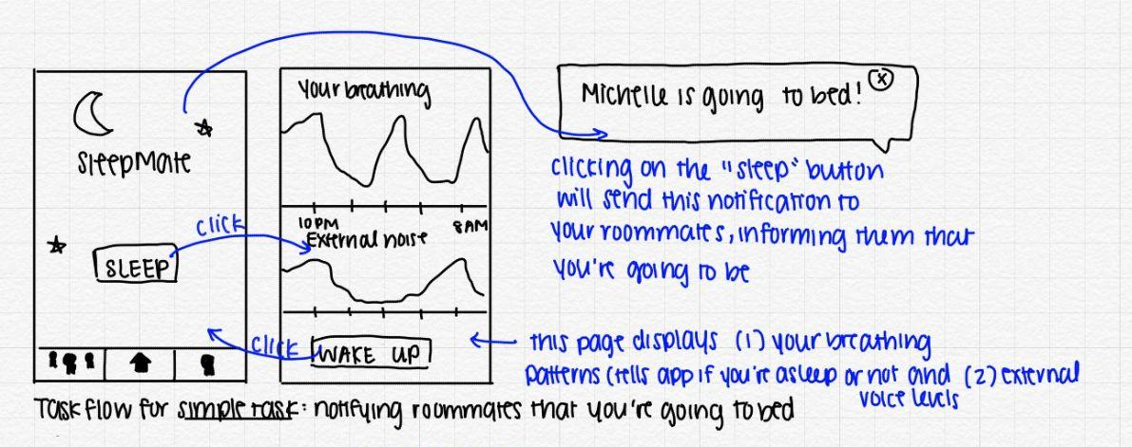
Simple Task
Notify your roommates you’re going to bed through the app
Notes:
Our first task is to notify your roommates you’re going to bed through the app. By clicking on the sleep button, you’ll be able to send notifications to your roommates that you’re going to bed. You’ll also be shown an interface where your breathing and external noises are tracked. To go back to the home screen, you can press “wake up.”

Slide 19
Moderate Task
Modify your household by adding or removing roommates
Notes:
We defined our second task to be “modify your household by adding or removing roommates.” By going to the Roomies tab on the left of the menu bar, you’ll be able to remove or add roommates.

Slide 20
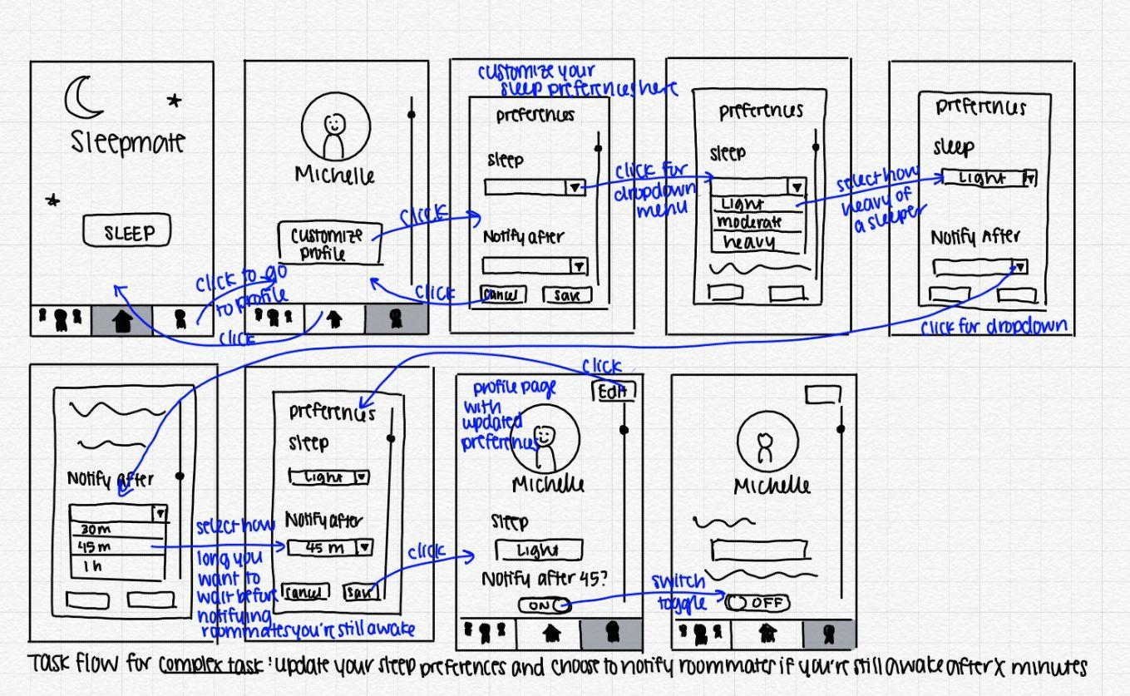
Complex Task
Update your sleeping preferences and notification settings for your roommates
Notes:
Lastly, our complex task is to update your sleeping preferences and notification settings for your roommates. That can be done by going to the profile tab on the bottom right, clicking customize profile, and choosing your sleeping preferences and notification settings from dropdown menus. We also included a toggle for the notification function to be turned on and off.

Slide 21

Notes:
We then used Balsamiq to translate the drawn task-flows into an interactive, online module. We made this choice to make user testing over Zoom as fluid as possible.

Slide 22
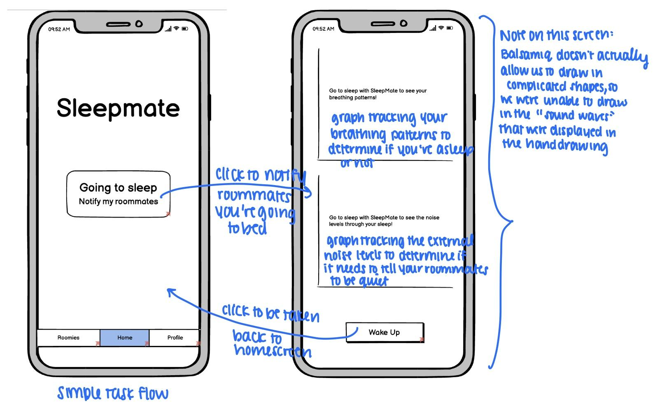
Balsamiq task-flows
Notes:
Here’s a quick look at the task-flows translated into Balsamiq. The first notifying roommates task,

Slide 23
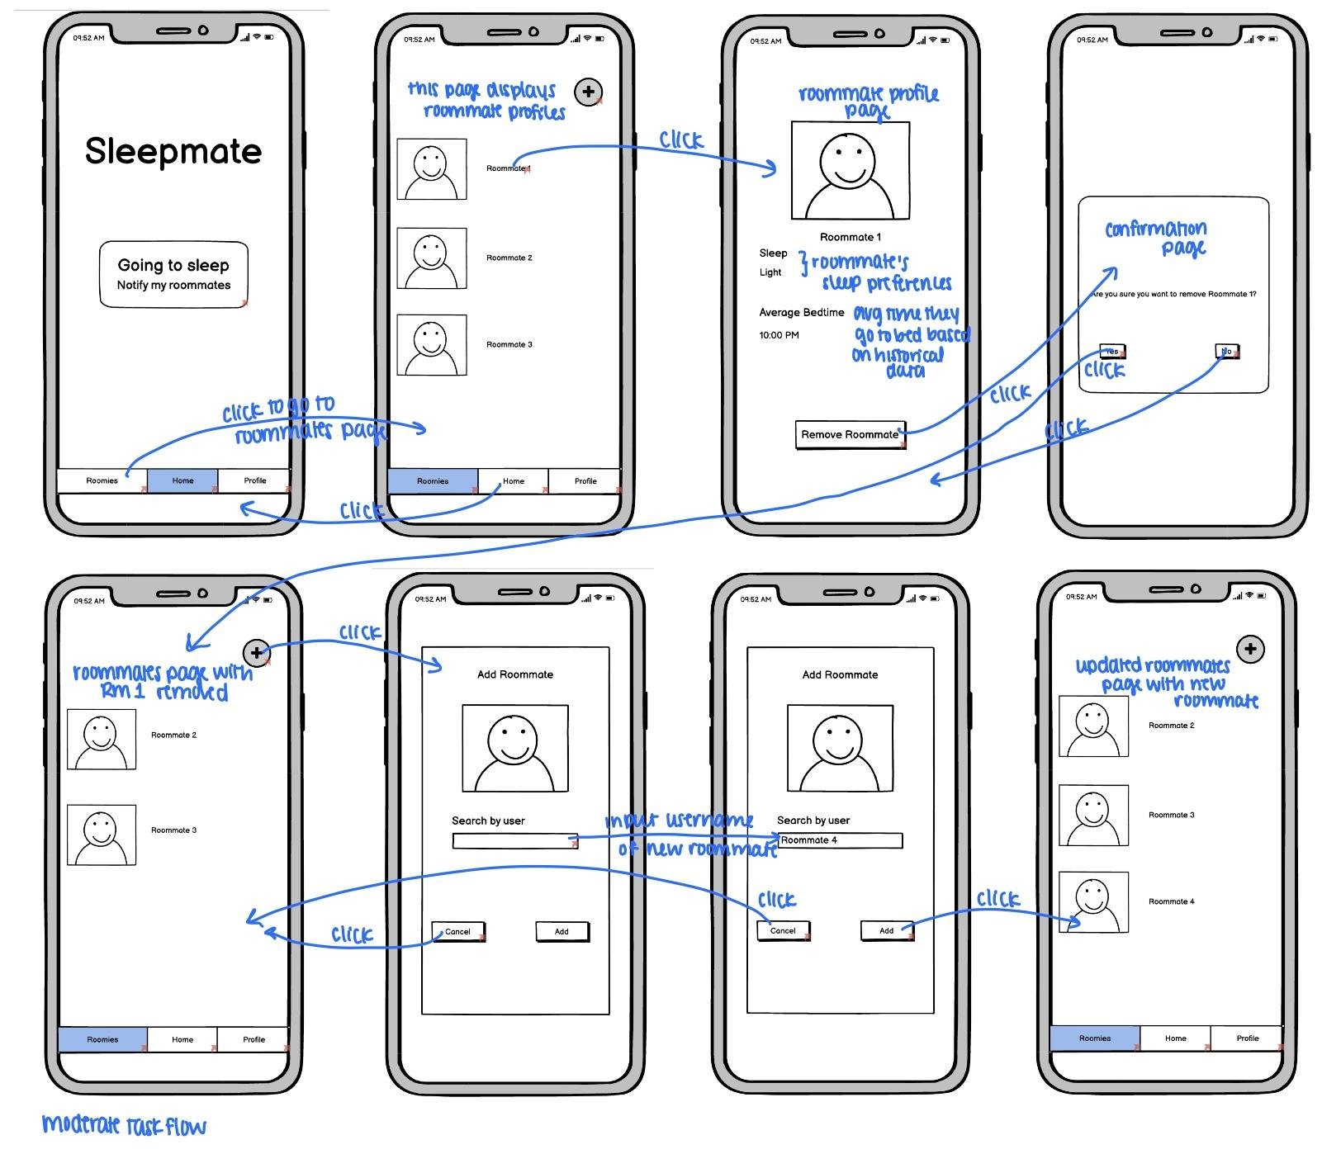
Balsamiq task-flows
Notes:
The second task for removing and adding roommates from the household,

Slide 24
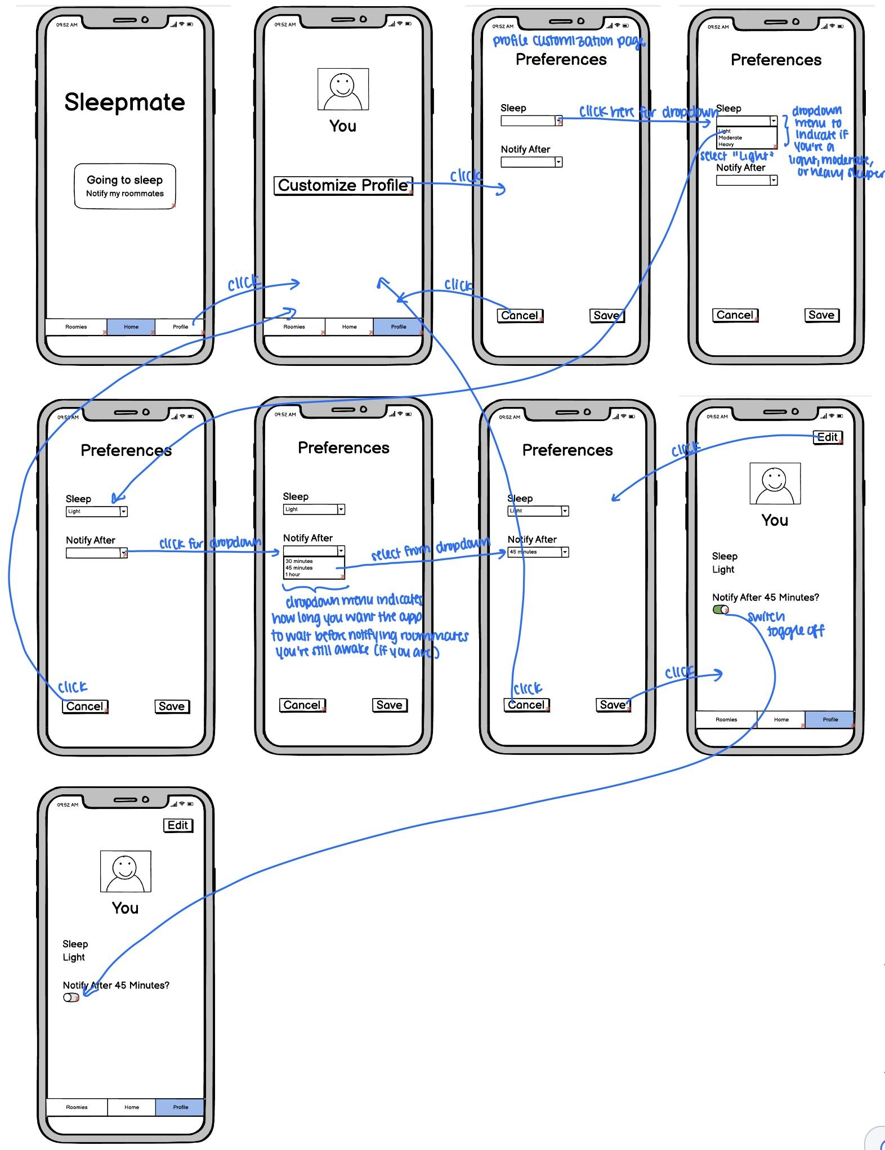
Balsamiq task-flows
Notes:
And the third task for the user to customize their profile. A little hard to see because of size limitations on the slides, but you get the point.

Slide 25
User testing
Notes:
We had the task-flows ready, so we were ready for user testing.

Slide 26
We tested with…
Lauren, a pre-med student living in downtown LA with 4 roommates
Elvis, an engineer in Taiwan who lives with 2 roommates
Nathan, a graduate student at UIUC with 3 roommates
Notes:
We tested with three different young adults: (slide).
We made the conscious choice to focus on young adults since they are the most likely to live with roommates and would use apps like SleepMate. That being said, we ensured the diversity within the group by including people who lived in diverse settings across cities, rural, and international. We made sure they had different backgrounds as well.

Slide 27
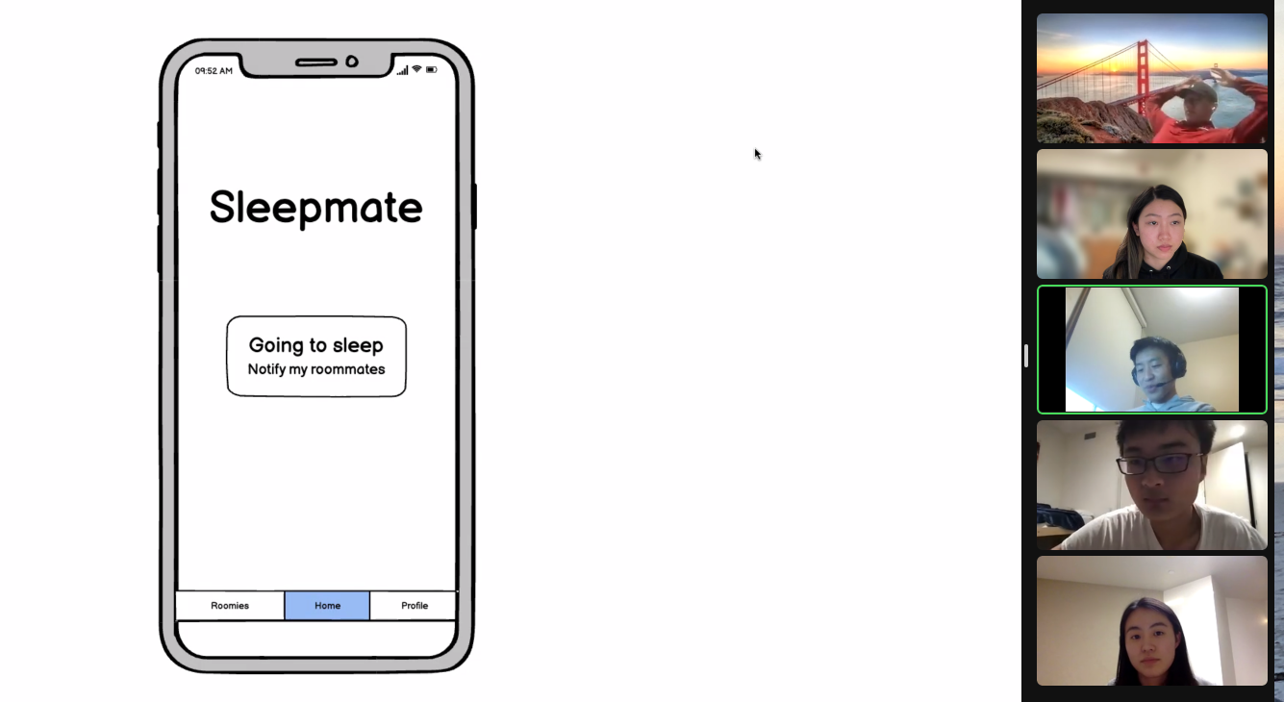
Notes:
Here’s how the test looked. We conducted all of our tests over Zoom. Derek facilitated the tests, I acted as the phone, and Michelle and Tristan took notes.
We started by providing the participants with the context behind SleepMate. We also gave them a hypothetical scenario that they are living with a few roommates and are trying to communicate their sleep schedules. We asked them to complete the three tasks we designed and recorded their behavior. Since we had a “human phone,” we asked them to be very specific in what they were asking me to do. For instance, I wouldn’t do anything if they said “home.” I would only follow if they said something like “press the home button in the menu tab at the bottom.” We primarily focused on measuring whether the participant was able to complete tasks without help and found the UI straightforward and aesthetically pleasing. We also asked participants to give us feedback after completing every task, successfully or not.

Slide 28

Positive Results
The idea behind notifying roommates to be quiet was positively received
All participants succeeded in adding and removing roommates without critical incidents
All participants succeeded in customizing their sleep profiles without any error
Notes:
(first bullet) we were glad to hear feedback from the participants that they would use something like this if noise levels became an issue.
(second and third bullet) they also succeeded in the more complex tasks we designed without any critical incidents, which was a great sign.

Slide 29
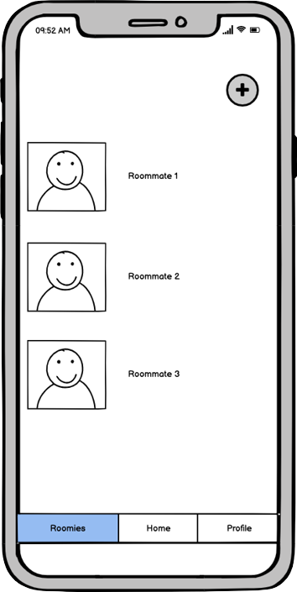
The plus sign on the Roomies tab was easy to recognize
Notes:
This was a very positive quote that we received – the plus sign button made it very easy to recognize what the button was intended to do.

Slide 30

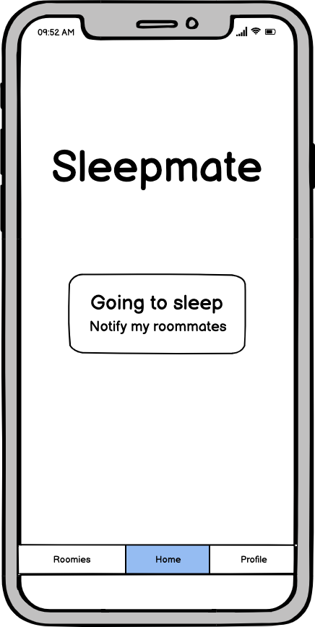
Negative Results
Two participants failed to click on the “go to sleep” button to notify roommates on their first try
Notes:
even though we thought the button was intuitive, two of the participants did not perceive it that way. One of them mentioned lack of clarity for the reason, which is partially due to Balsamiq’s design limitations. On the other hand, another participant went to the “Roomies” tab thinking that he’d be able to message his roommates on the tab. Basically, he thought the app would operate like a messaging app like WhatsApp.

Slide 31
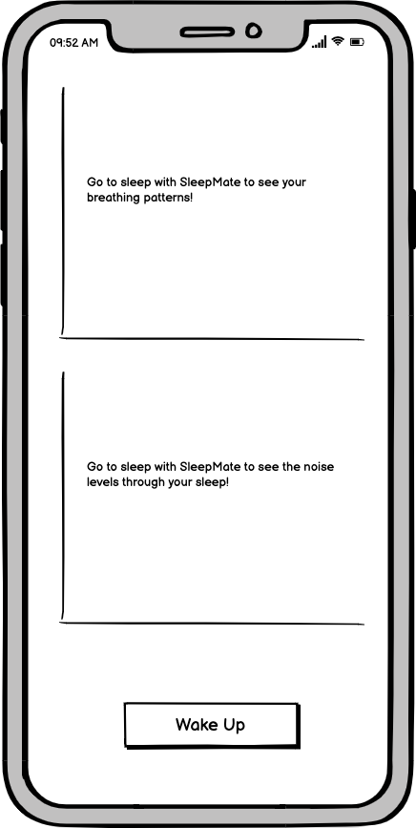
Negative Results
All three participants were confused on how to go back to the home screen from the sleep monitoring screen
Notes:
We also thought it would be intuitive for them to press “wake up” to go back to the home screen, but it definitely wasn’t the case. All three participants got confused on going back to the home screen, which only required pressing the wake up button.

Slide 32
A little confusing to me, maybe if it had “click on this tutorial to see how to navigate this app”
Notes:
I think this quote from one of the participants sums up the experience from that particular screen. I agree that it’s generally good to have a tutorial, but we were hoping that the app is straightforward enough to not need one at all. Clearly, that wasn’t the case.

Slide 33
Negative Results
All three participants glossed over the “sleep tracking” portion of the app
Notes:
We also noticed that none of the participants made a comment about the sleep/noise tracking portion of the app, even though we consider it a very core feature. Some of it may have been due to the design limitations on Balsamiq, which made it practically impossible for us to draw a graph. We chose the “EmptyView” text for the prototype instead, which basically is the screen that would show if there’s no data. Regardless, we’ll have to ideate on how to make this part of the app more eye-catching for users.

Slide 34
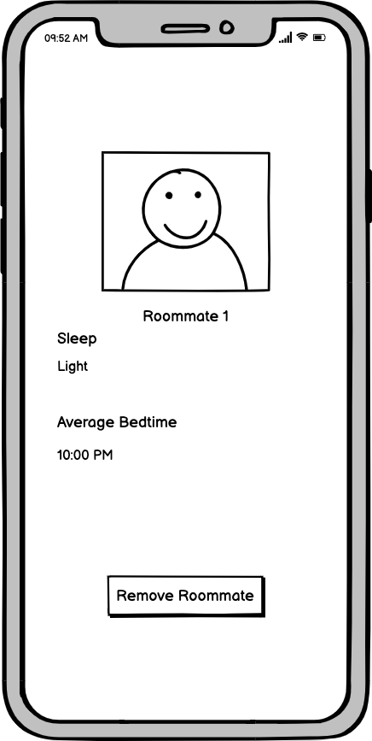
UI change 1: add back button
Notes:
Yeah… we forgot to add a back button where it could be helpful. That will definitely be added.

Slide 35
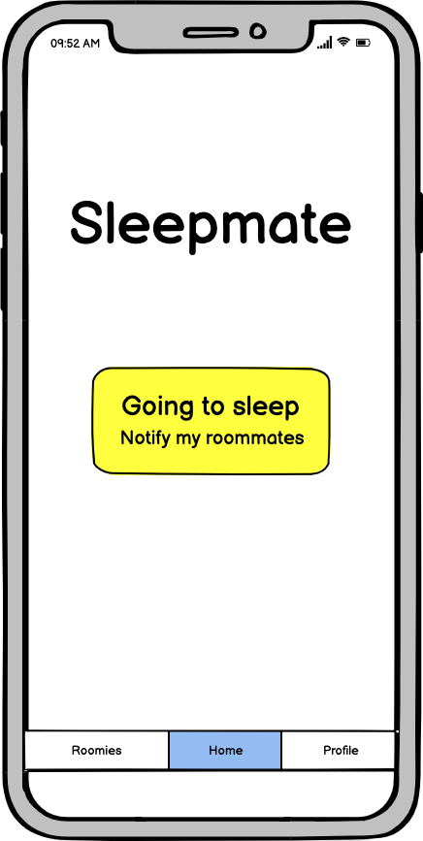
UI change 2: make “go to sleep” button clearer
Notes:
Another suggestion we received is to make the “go to sleep” button clearer. We’ll be making sure to add eye-grabbing characteristics to the button so that users can notice the button on first use.

Slide 36
UI change 3: add menu bar to sleep monitoring screen
Notes:
The last UI-related suggestions we received was to add the menu bar at the sleep monitoring screen. In theory, this should help users navigate the app more easily. We’re concerned about cluttering the app though, and we’ll have to test out more designs to see how this would work.

Slide 37
Summary
Keep Doing
To-Do
Intuitive task-flows
Work on this idea!
Friendlier navigation
Add attention-grabbing features to core elements
Consider onboarding
Notes:
We think some of the things we need to keep doing are:
Keep making intuitive and straightforward task-flows like our moderate and complex tasks.
And also keep working on this idea. We have to for the class anyway, but now we have more motivation to based on the feedback we got.
Some things on our to-do lists are:
Implementing friendlier navigation so users don’t get lost
Adding attention-grabbing features to core elements like the go to sleep button and sleep and noise graphs
And consider onboarding to make user experiences more friendly.

