Slide 1


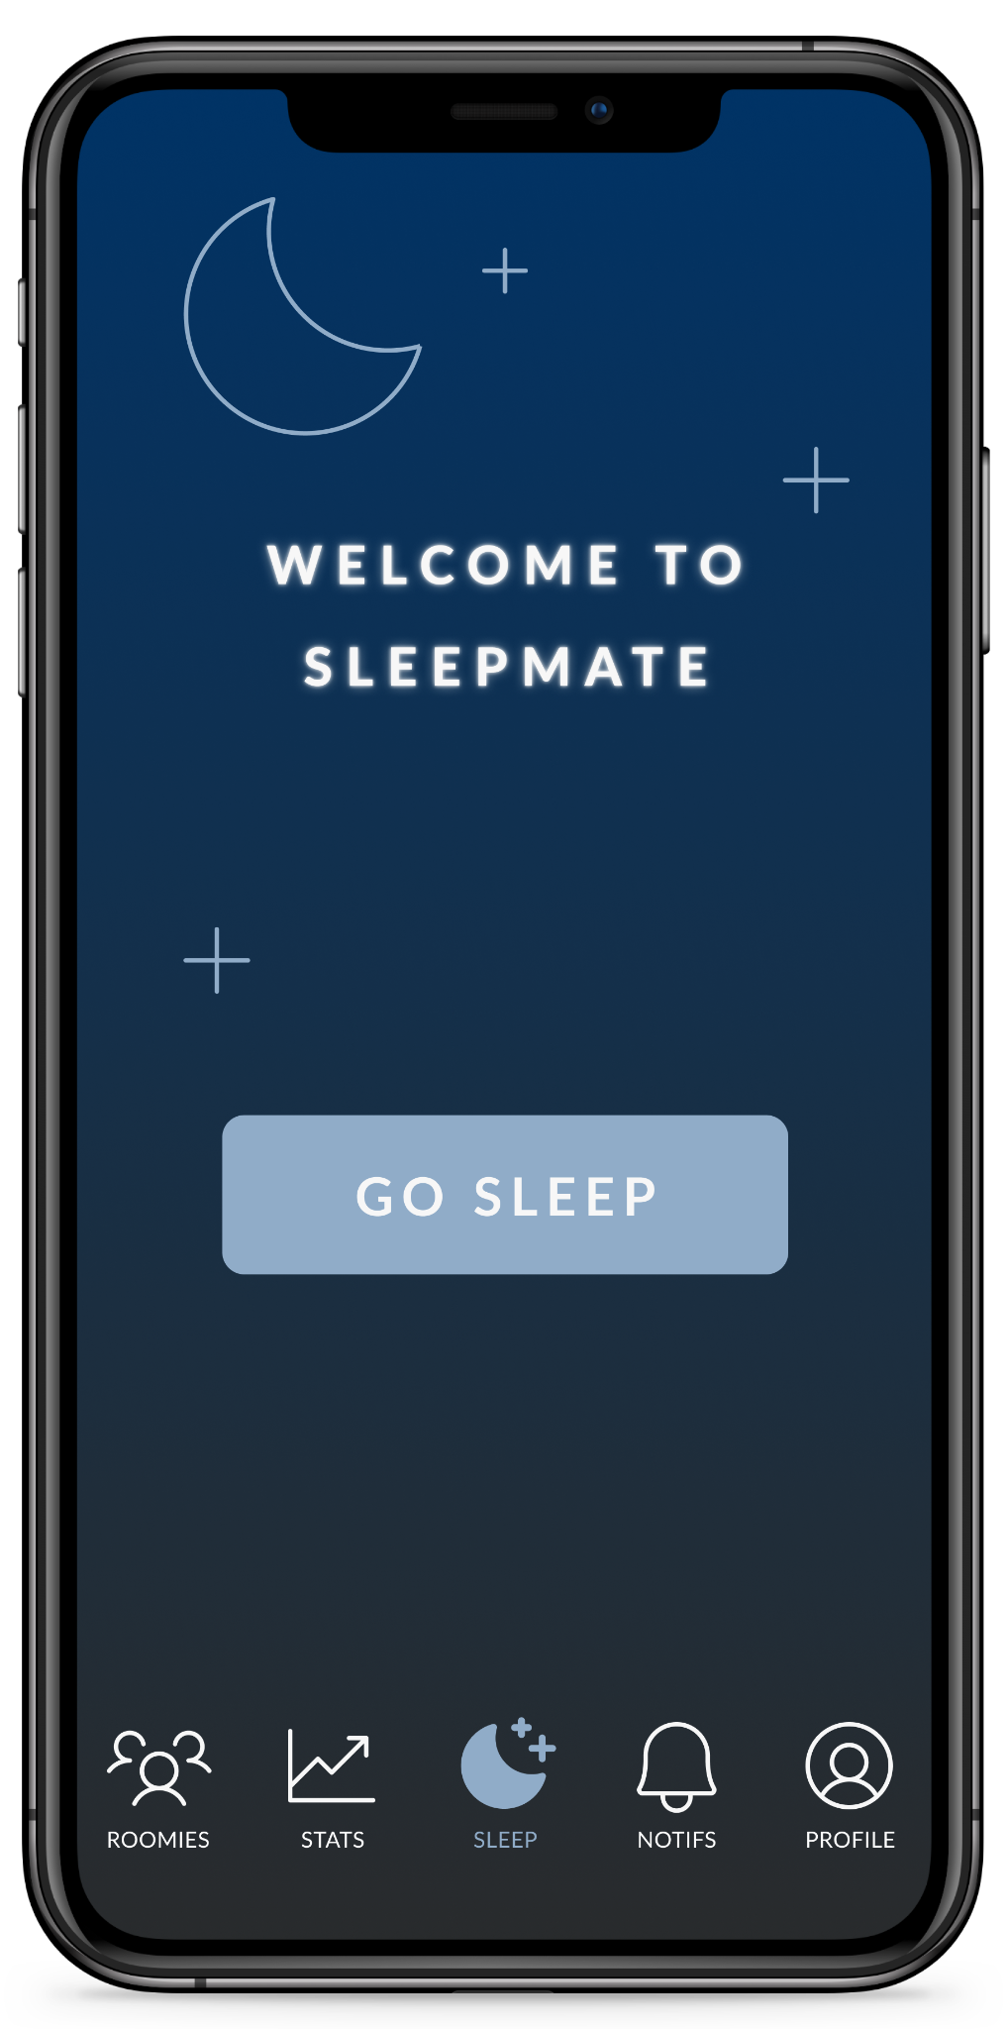
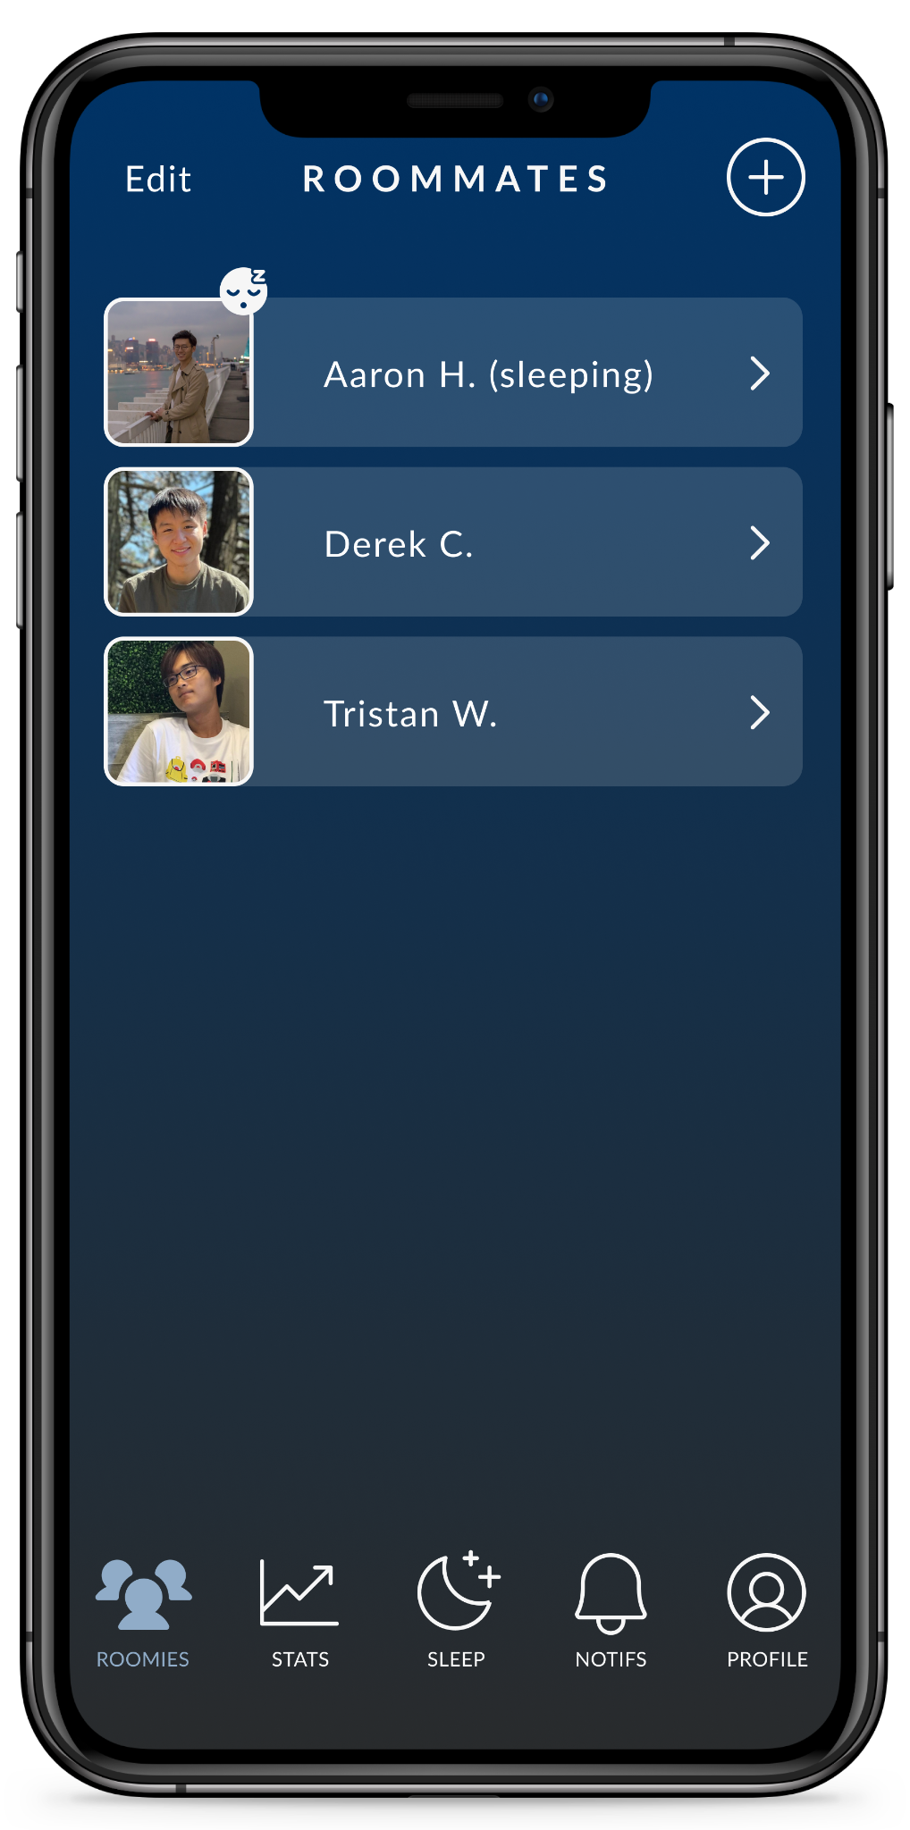
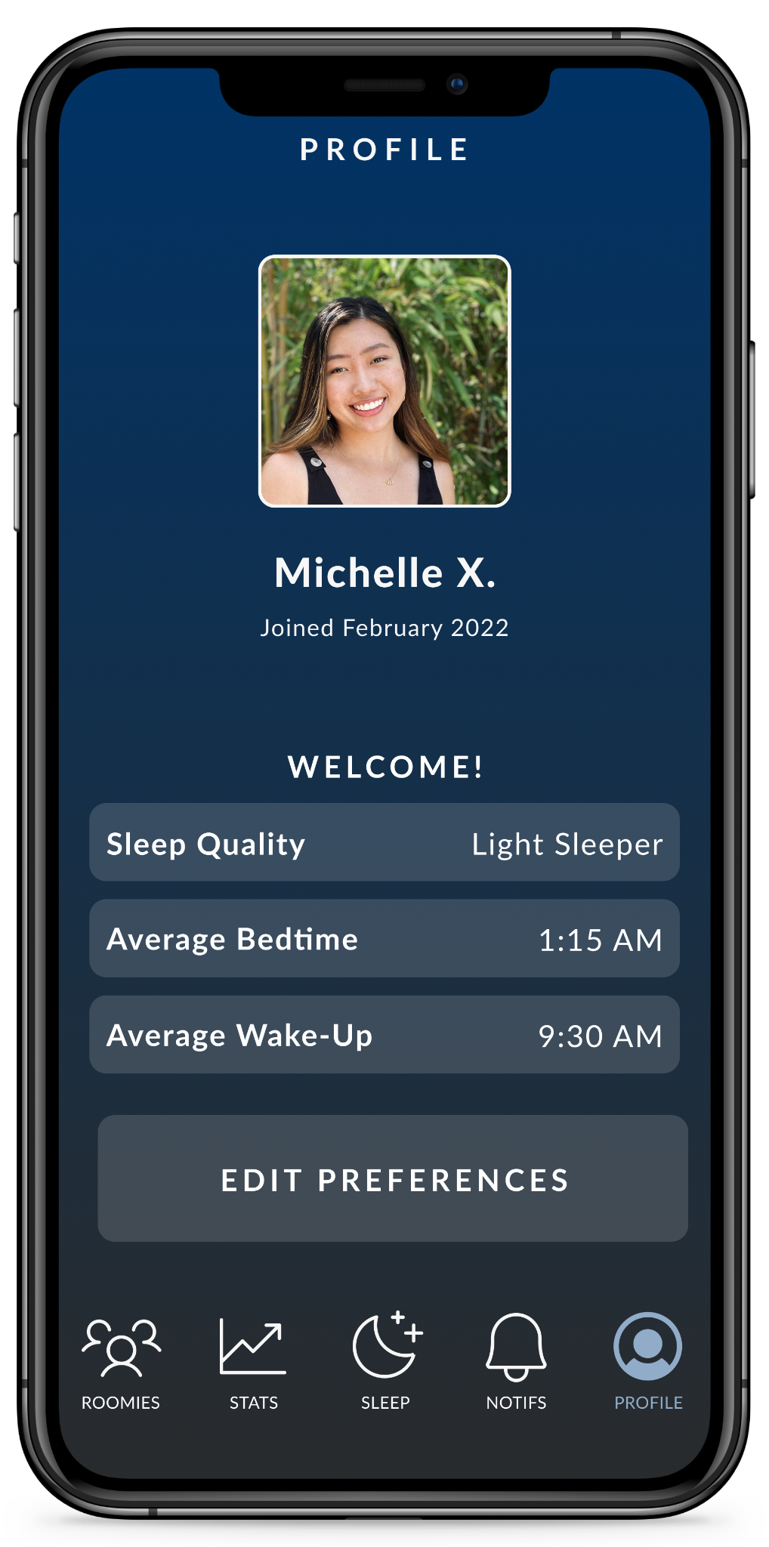
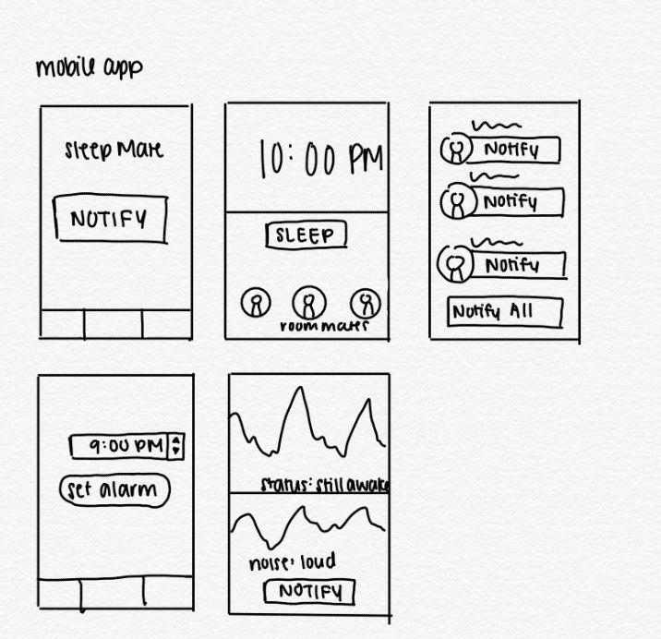
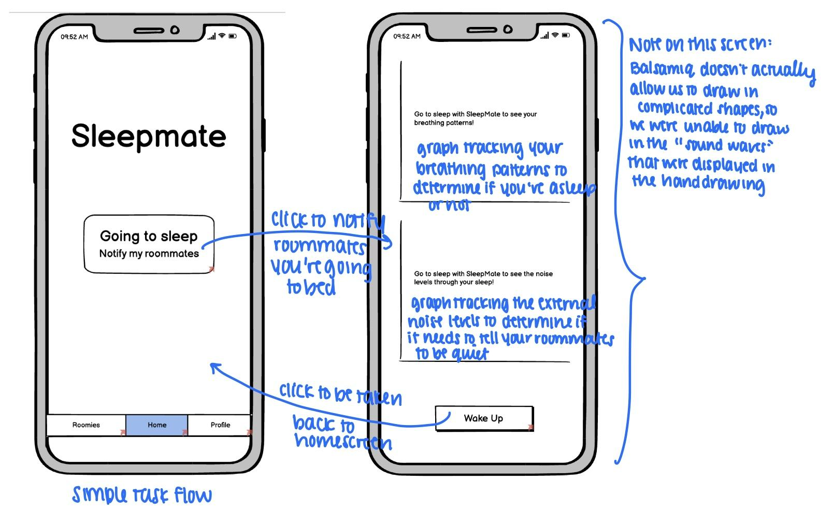

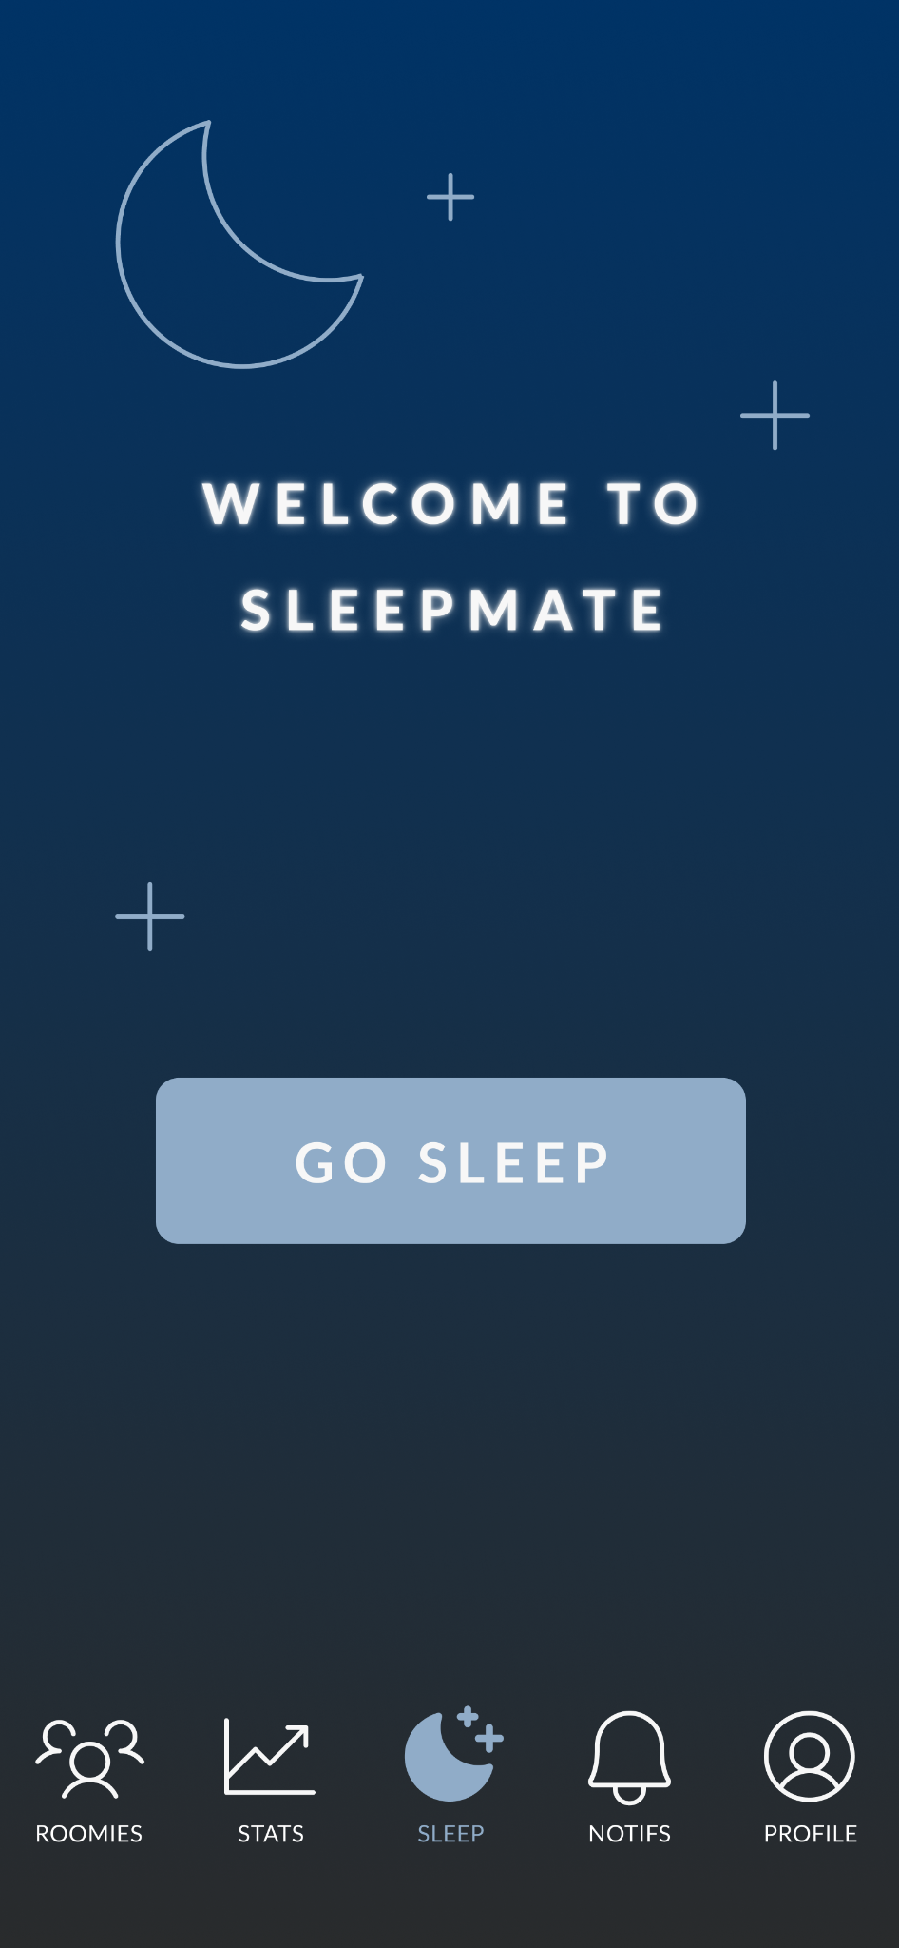
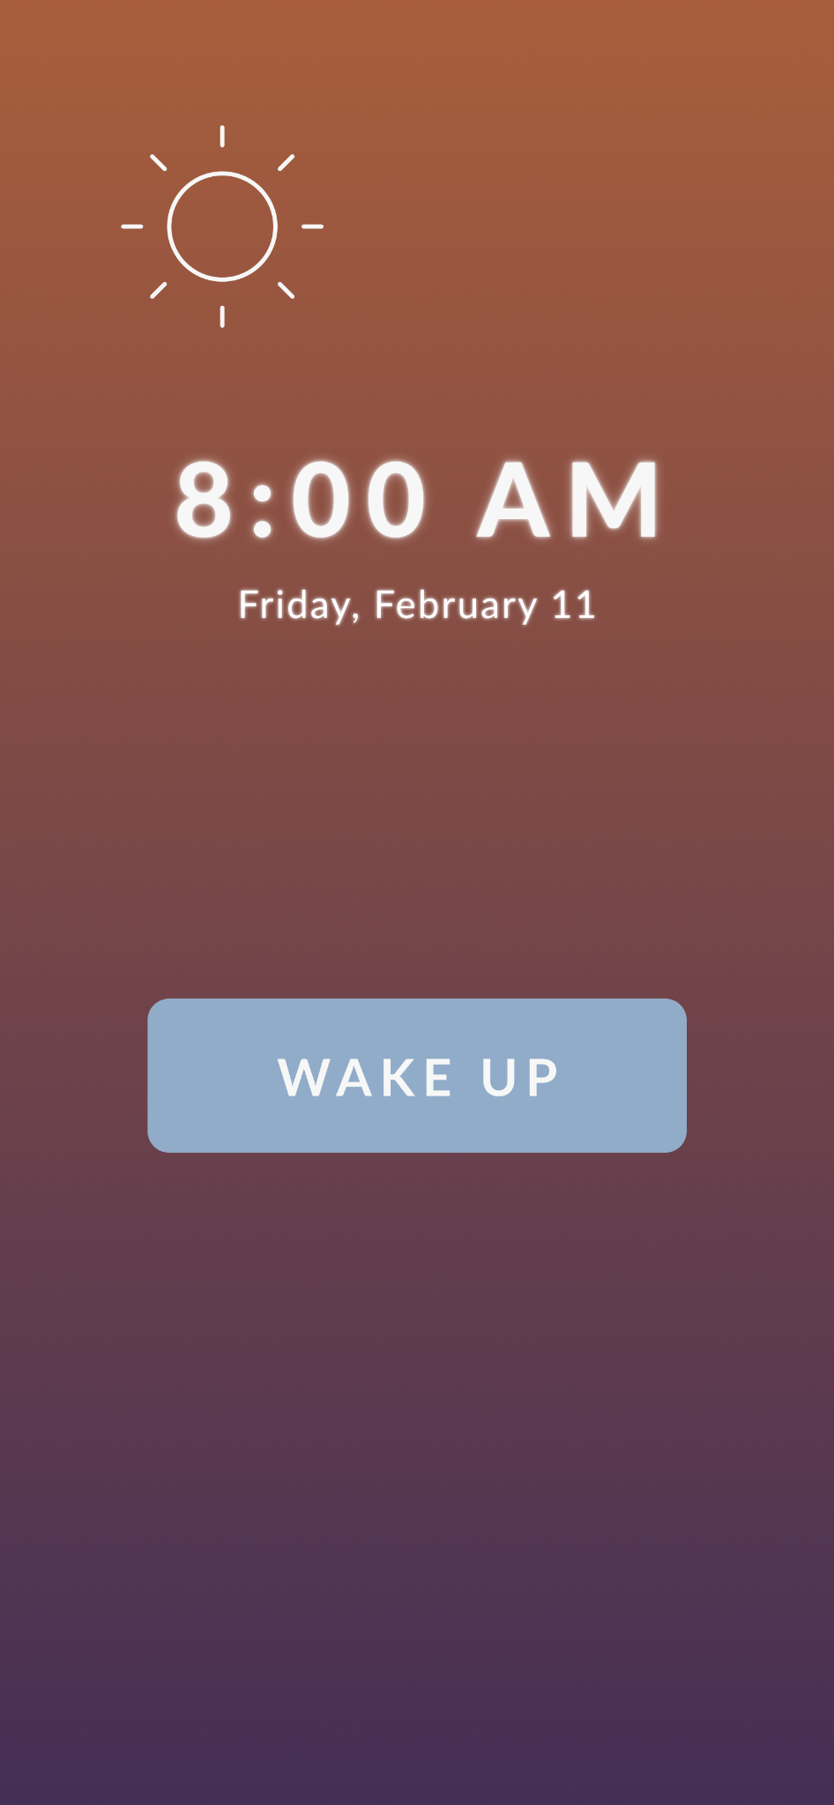
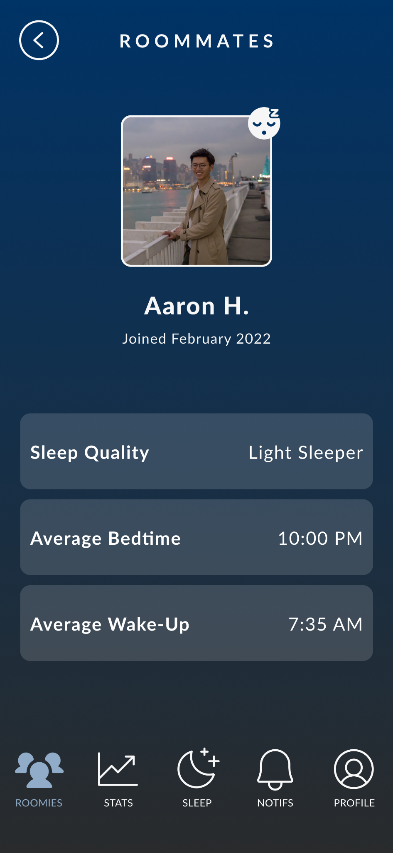
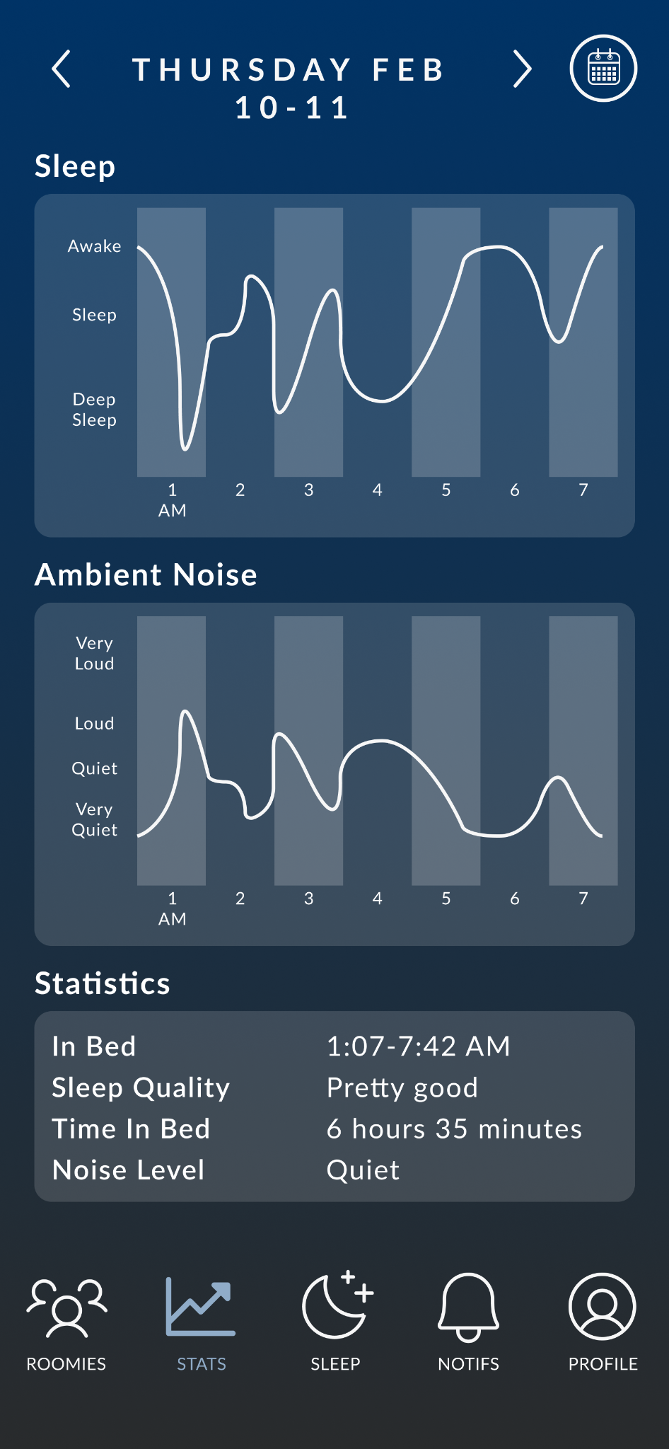
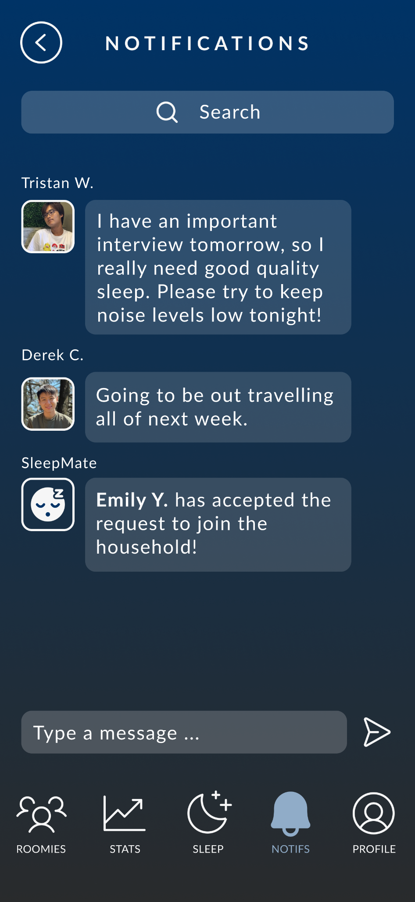
Sleeping easy, made easy.
Derek C, Aaron H, Tristan W, Michelle X | CS 147 Winter 2022
https://hci.stanford.edu/courses/cs147/2022/wi/projects/CaringFromWithin/SleepMate
Problem
Design Iterations
Difficulty falling asleep due to roommates’ noise levels can be anxiety-inducing, and it can be tiring to remind them over and over again to be quiet.
Idea Concept Sketches
Solution
SleepMate helps you rest at ease by monitoring your roommates’ noise levels and alerting them when they’re being too loud so you don’t have to!
Balsamiq Low-Fidelity Prototype
Figma Medium-Fidelity Prototype
Notify your roommates that you’re going to bed through the app
Modify your household by adding or removing roommates
Update your sleeping preferences and notify your roommates you’re still awake after X minutes

