Slide 1


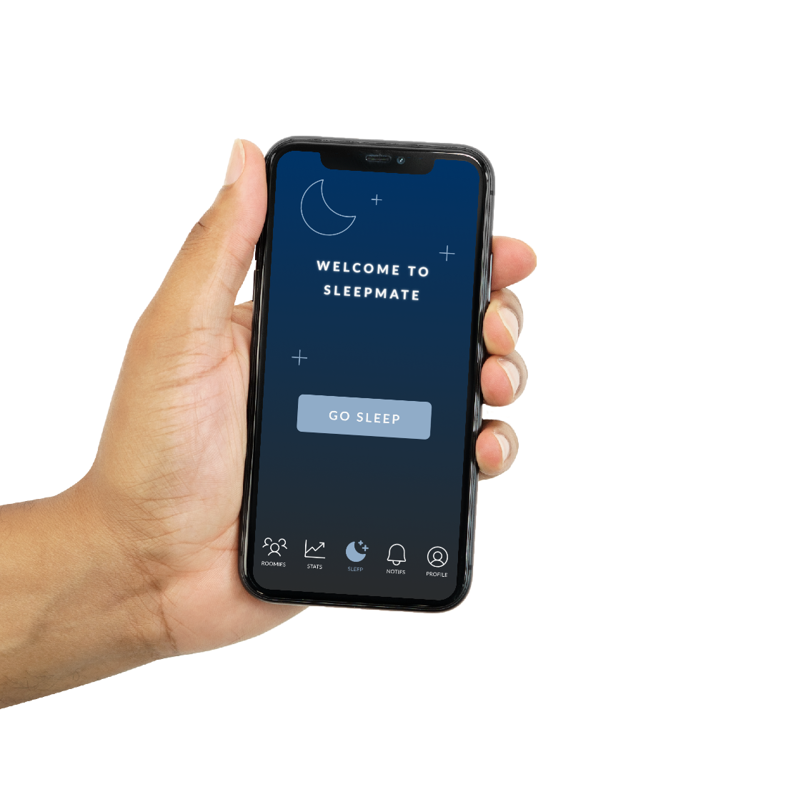



Sleeping easy, made easy.

