Slide 1
Amble
Give your projects some direction!
How might we motivate people to learn and pursue creative activities in a way that utilizes their existing interests?
Many people struggle with finding creative outlets and staying motivated when learning new skills. Amble provides direction by giving users a personalized roadmap to achieve their artistic goals.

Slide 2
Core Tasks
Simple:
Input and save ideas into one platform
Medium:
Explore interests in a friendly, easy to use manner
Complex:
Build on previous hobbies by receiving suggestions from the platform on what to explore next

Slide 3
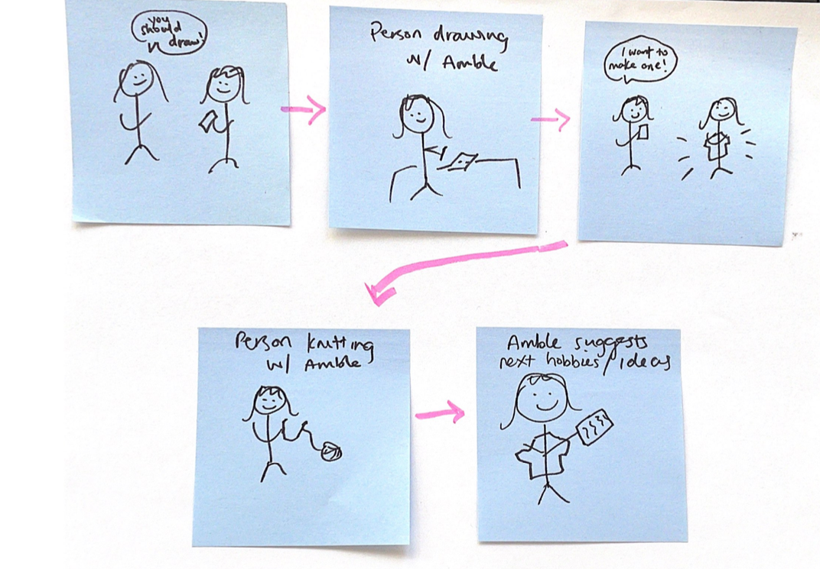
Storyboards

Slide 4
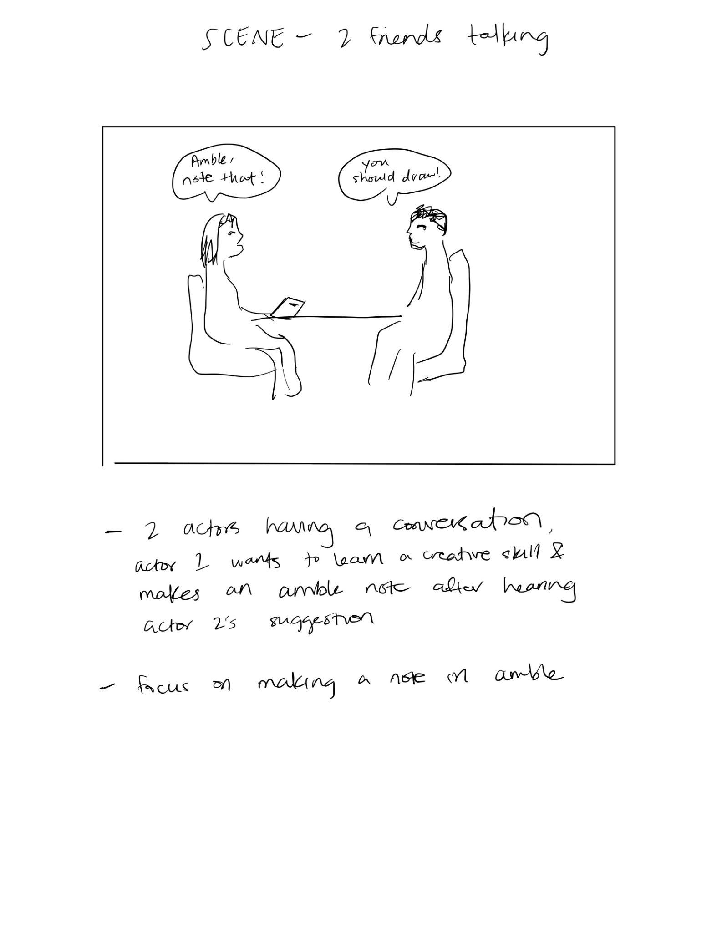
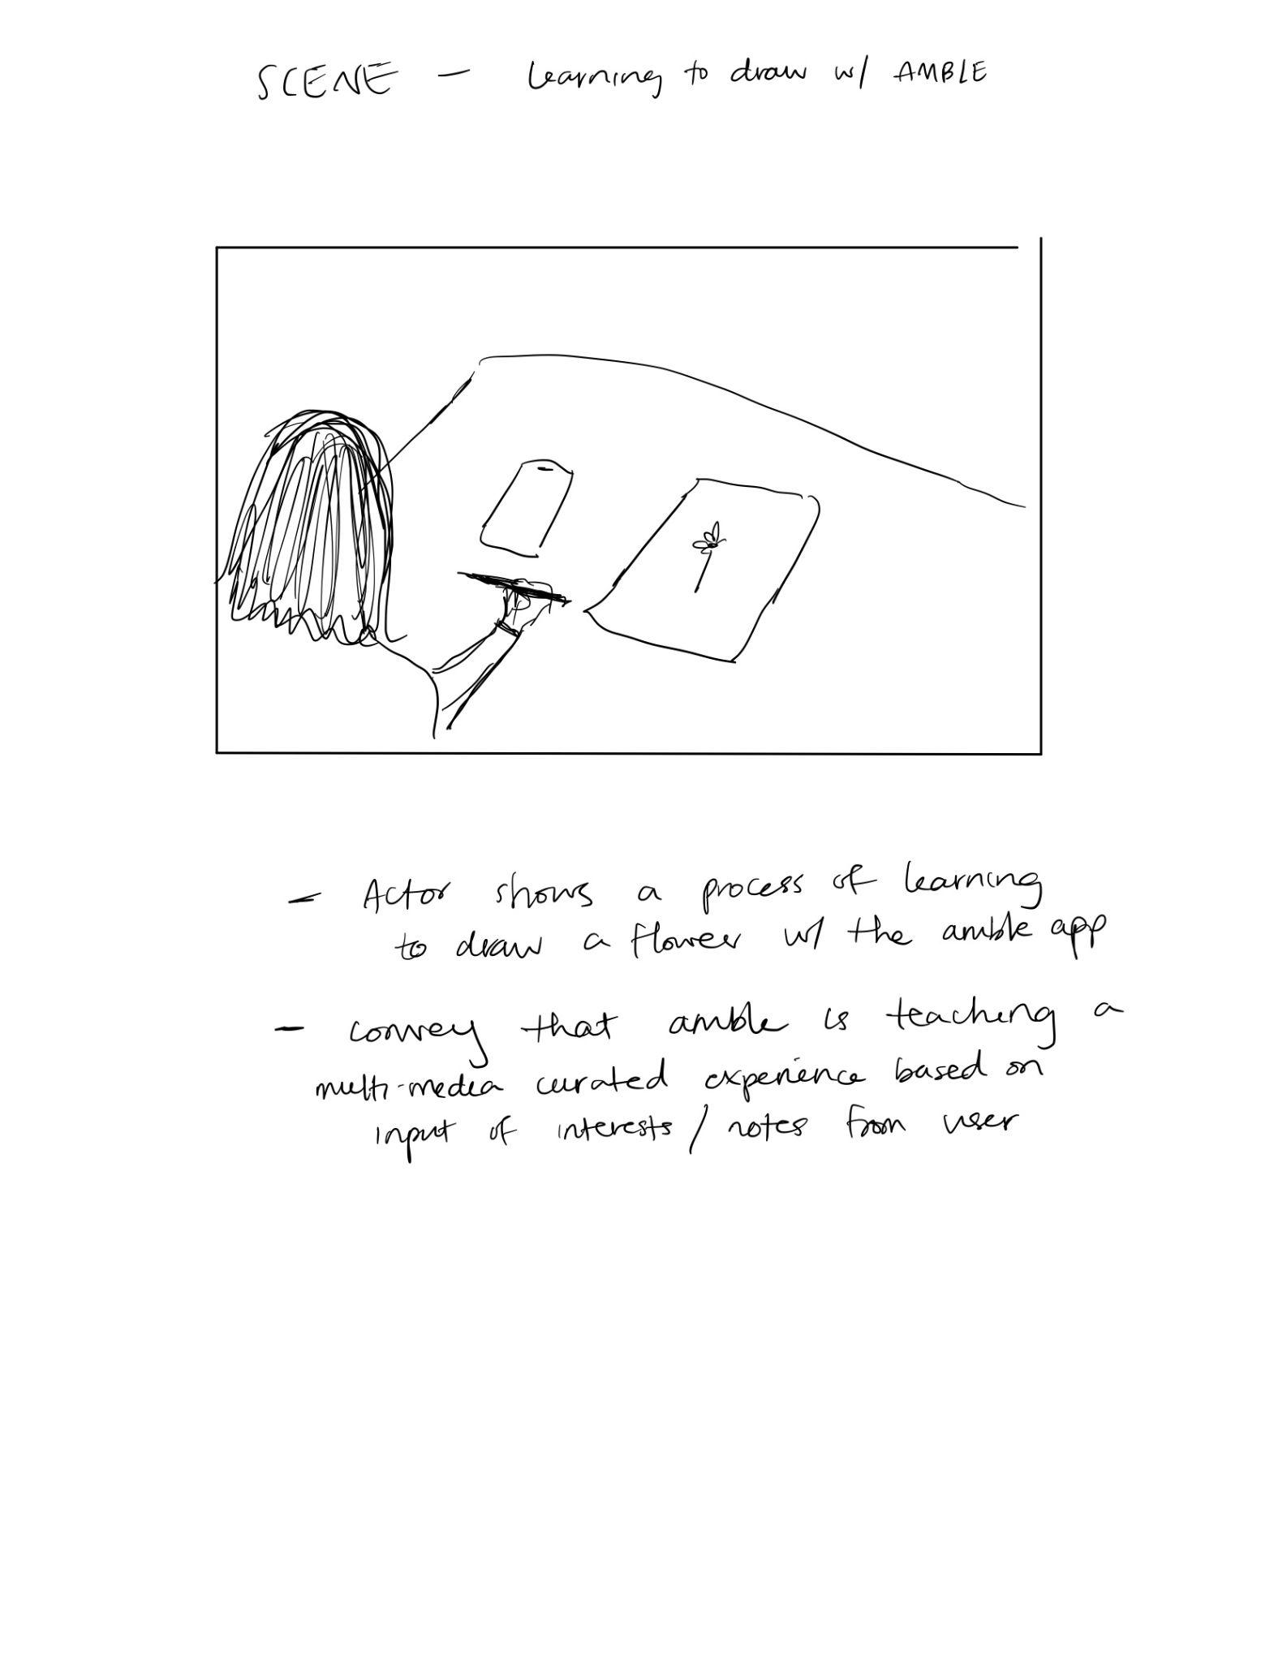
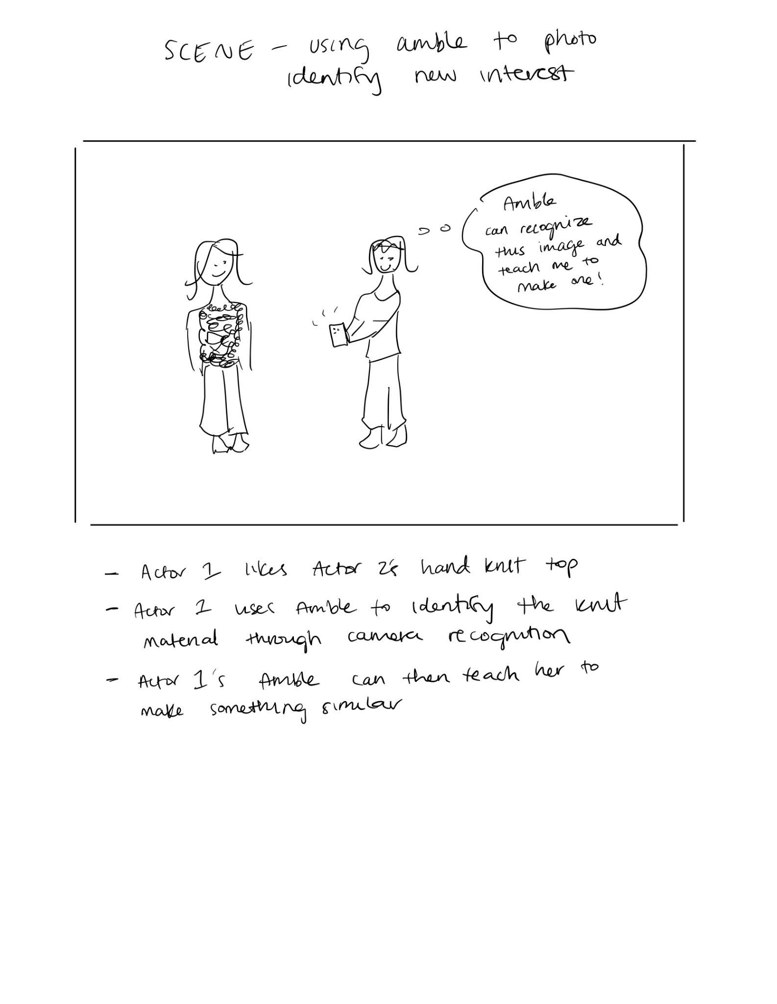

Slide 5
Values in Design
We have three goals:
We wish to make pursuing creative hobbies as painless and barrier-free as possible, making them more accessible and equitable.
We wish to avoid choice paralysis and information overload, so we care about the efficiency with which information is organized.
We wish to get more people engaged in creative activities, since it improves well-being and increases productivity.

Slide 6
Market Research
Pinterest: Pinterest provides examples and inspiration (often through images) based on a user’s searches and activity within the platform. Our solution differs in that it provides curated multimedia experiences for how to pursue and learn a particular interest.
Roam: Roam organizes information that users directly provide e.g., notes, for the main purpose of productivity and professional organization. Our solution focuses on creative skills, consolidating information from outside sources into a user specific learning experience.

