Slide 1
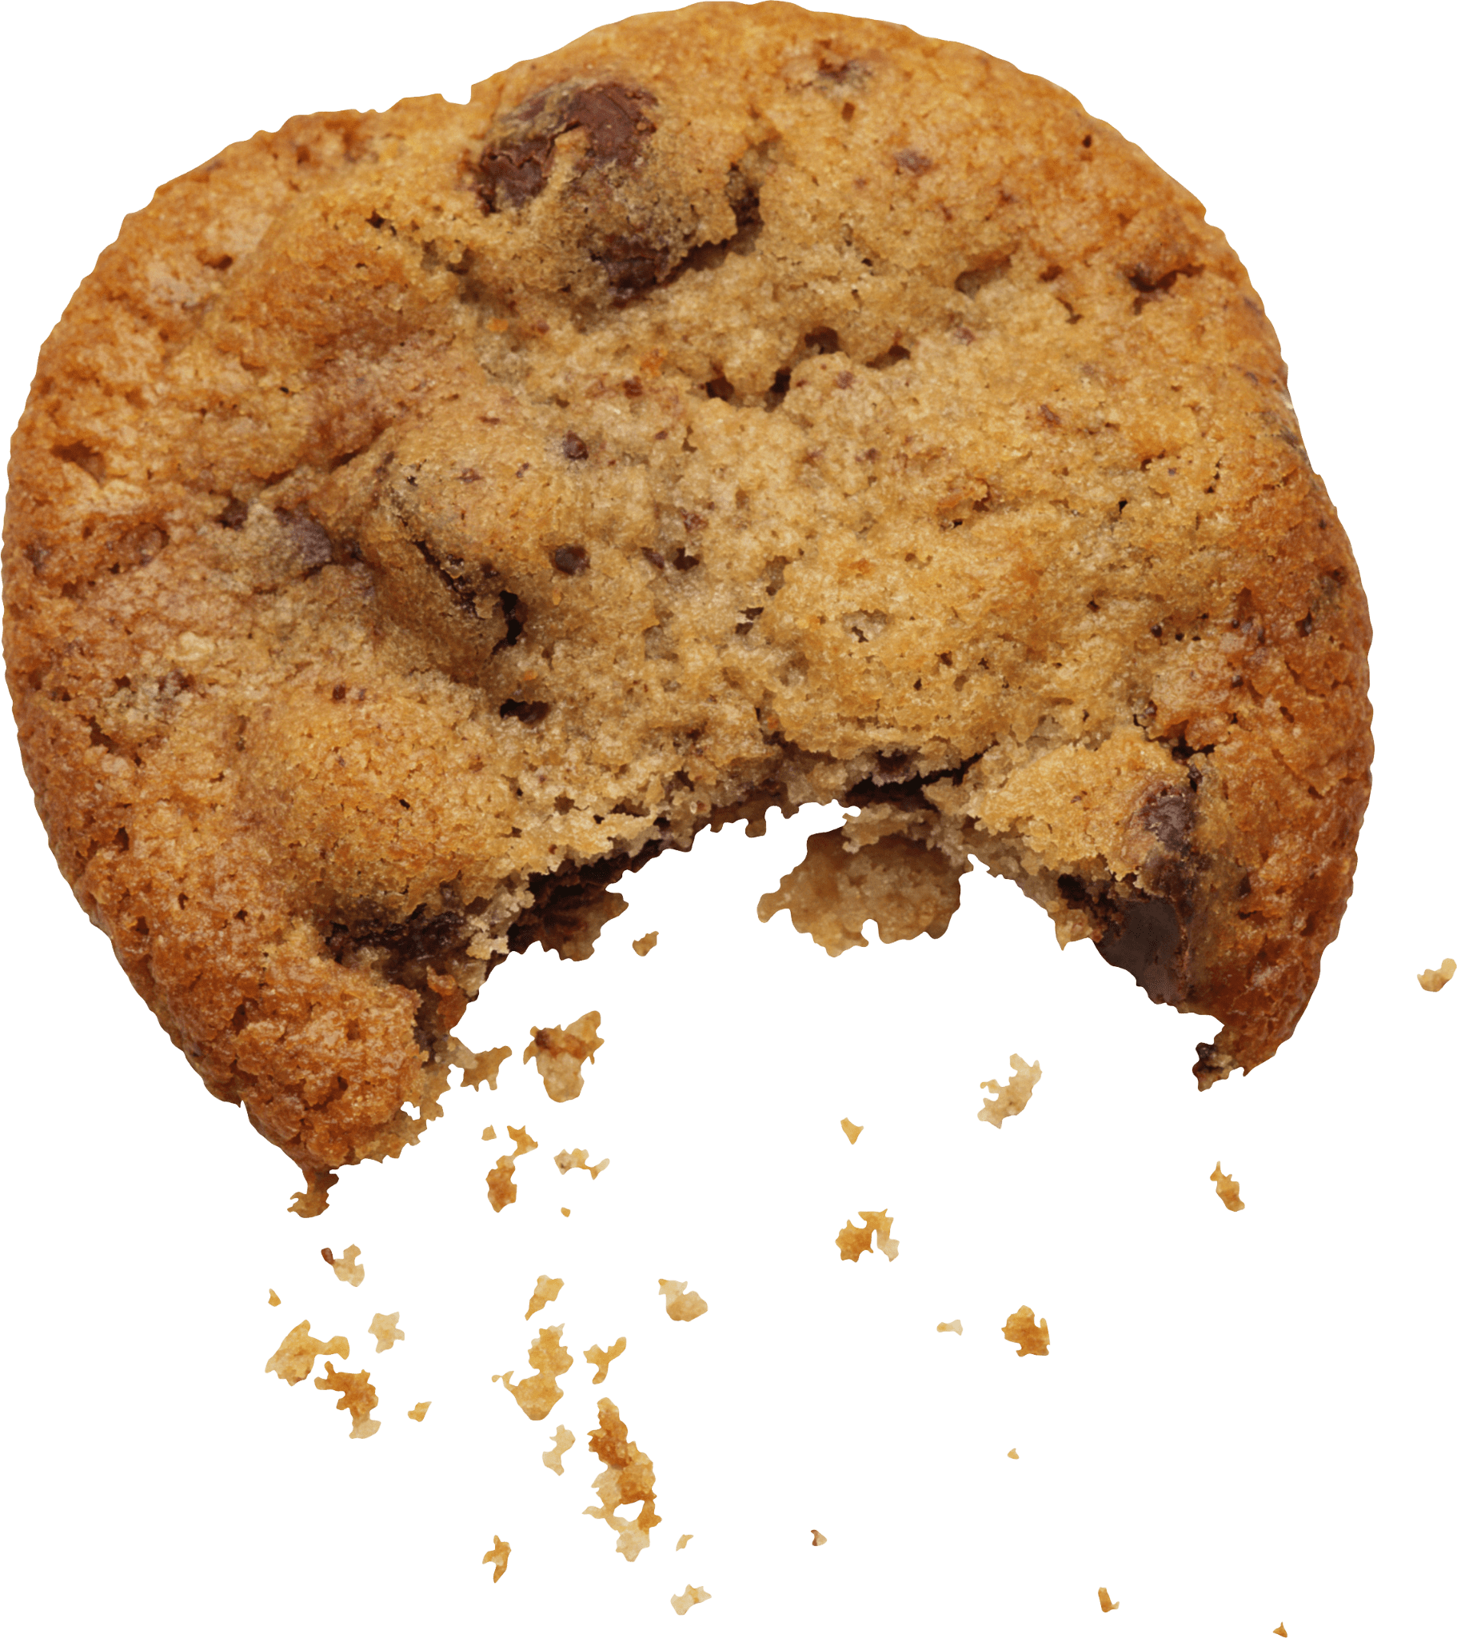
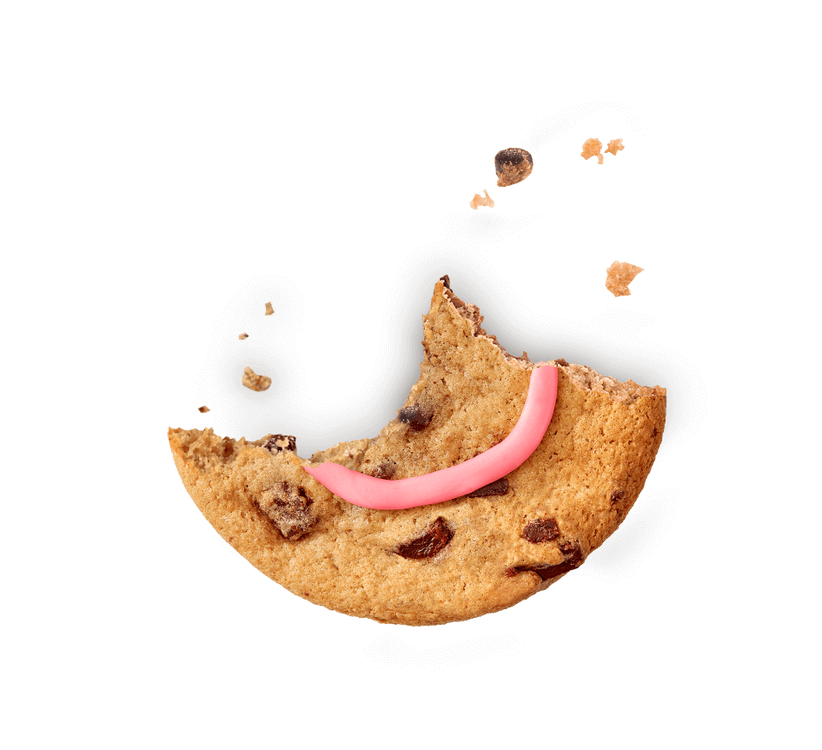
POVs & Experience Proto-bites

Slide 2
Introduction

Slide 3
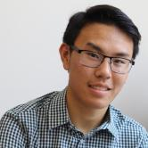
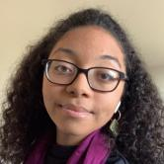
Meet the Team: Foodies!
Andy H. ’23
Dax D. ’22
Star D.
’23
Kyle N.
’23

Slide 4
Domain Selection
IRON MAN
How can we involve the senses? Is it relatable?
FOOD
Common interest, broad market
PREP
Interviewee passions
Notes:
The domain of becoming iron man is a large space, and we wanted to scope it down.

Slide 5
Initial POV

Slide 6
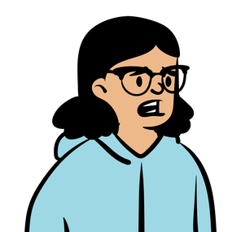
Initial POV
We met Tyler, a professional cook and amateur boxer who connects to his Filipino culture through food.
We were surprised to notice that he bought instant pancit (Filipino noodles) but still hasn’t eaten it for 4 weeks.
We wonder if this means he impulse buys certain food for nostalgia but then forgets about it.
It would be game-changing to help people find emotional value from food in a practical way.
Notes:
This POV focuses on the sentimental value of food. Our interviewee Tyler, who connects with his Filipino culture through food, bought a pack of instant Filipino noodles because they reminded him of his mom, but then hasn’t eaten it for 4 weeks and counting. We want to see if we can help people like him find emotional value from food in more practical way

Slide 7
Additional Needfinding Results

Slide 8
Finding MORE participants
Non-Stanford students
Food makers
Culturally connected
Getting out of our bubble.
Focusing on passion.
Following a common thread.

Slide 9
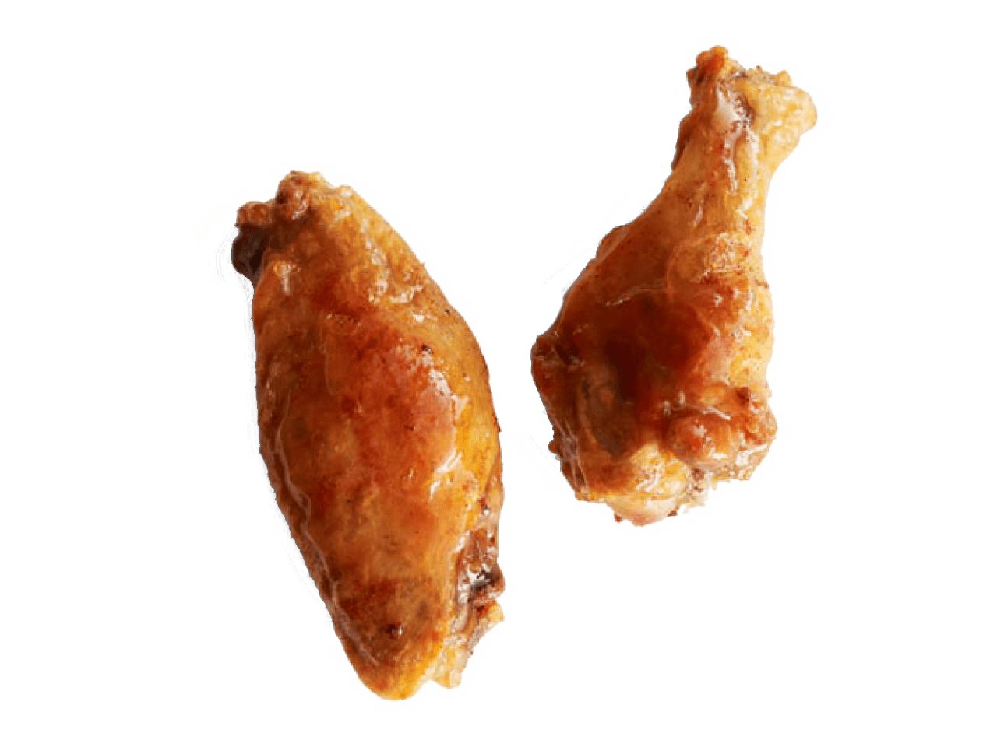
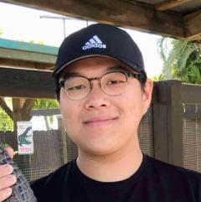
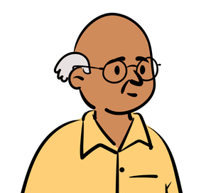
We spoke to…
Daniel
Gap-year student, research associate
San Francisco, CA
Bac Tran
Vietnamese language professor
Bay Area, CA

Slide 10
Daniel Key Takeaways
Recent college graduate, medical research assistant
Lives with parents, primary cook for his family
People shifts his cooking priorities based on who he cooks for: taste vs. health
People may be more comfortable experimenting when a recipe is unfamiliar, since there’s less pressure

Slide 11
Bac Tran Key Takeaways
First-generation Vietnamese-American in his 60s
Lives with his wife of 33 years, whose cooking he loves
Cooks with his wife every day, calls himself “assistant chef”
Inexperienced cooks are happy to relinquish control to a source of authority
People deeply enjoy cooking with a companion

Slide 12
Three Revised POVs

Slide 13
Revised POV #1
We met Julia, a young female college student who carefully plans her meals to maximize the enjoyment she gets from eating.
We were surprised to find that even though she meticulously plans her eating schedule, she laughs off how important it is to her when sharing it with us.
We wonder if this means that Julia thinks being “too serious” about food is something to be embarrassed about, even though it’s what she likes to do.
It would be game-changing to normalize people taking pride in taking what they eat seriously.
Notes:
This POV focuses on how people feel they are perceived based on their food choices. Julia is a college student who meticulously plans her eating schedule but seems embarrassed that people might think she takes her food too seriously. We want to see if we can remove this embarrassment for people like her.
HMW make scheduling food a social activity instead of an individual one?
HMW make taking your food seriously something to be proud of instead of embarrassed by?
HMW help people find other people who care about food planning?
HMW gamify the food planning process?
HMW keep people from making judgements about personal choices?
HMW make the food planning process take less time?
HMW automate the food planning process?
HMW use food tracking to recommend next meals?
HMW show what every dining hall and near restaurant has in the near vicinity?
HMW locate and report rare events?
HMW show people the benefits of planning food?
HMW cancel people for making fun of someone for planning food?
HMW introduce norms in dining spaces that planning is normal?
HMW show people that everyone plans their food proces?
HMW make food planning like a scavenger hunt?
HMW we make her feel comfort in choosing her meals?
HMW make meal planning a form of relaxation like playing an instrument?
HMW remove people who are making her feel ashamed?
HMW let her enjoy her meals without having to plan?
HMW set people’s eating schedule weeks in advance?
HMW let people share their food planning process?
HMW make Julia not want to plan her food anymore and go more with the flow?

Slide 14
Revised POV #2
We met Alyssa (Aly), a 20-year-old female who has Type 1 Diabetes and loves learning new recipes.
We were surprised to hear that in spite of her diabetes, she is unafraid to experiment with new recipes even if she doesn’t know the exact nutrition contents or how much she’s making.
We wonder if this means that although she wants to be careful, Aly does not want to let this uncertainty deter her from trying new things because she is willing to risk her health for something novel.
It would be game-changing to give people a way to manage uncertainty when experimenting in the kitchen.
Notes:
This POV focuses on uncertainty in cooking. Alyssa has Type 1 Diabetes, which inhibits her ability to experiment and makes her especially concerned with the exact nutrition contents of the food she’s making. We want to see if we can help her manage this uncertainty when experimenting in the kitchen.
HMW provide people more accurate information about recipes?
HMW make new recipes more accessible?
HMW we assure people about what they are cooking?
HMW eliminate recipes entirely when experimenting in the kitchen?
HMW get rid of the need for accurate recipes at all while still preserving safety?
HMW help people manage uncertainty safely in the kitchen?
HMW leverage group cooking to manage uncertainty when experimenting in the kitchen?
HMW make the uncertainty of trying a new recipe a more positive element?
HMW make the risk of cooking an asset instead of an acceptable risk?
HMW we make fear a good thing, instead of something to be ignored when experimenting with risk?
HMW let people experiment in the kitchen without learning entirely new recipes?
HMW enforce providing nutrition information on all recipes as a part of the law?
HMW make portion size and nutrition contents less of a concern when cooking?

Slide 15
Revised POV #3
We met Tyler, a male professional cook and amateur boxer who connects to his Filipino culture through food.
We were surprised to hear that he bought a pack of instant pancit (Filipino noodles) at the Asian supermarket because it reminded him of his mom, but still has not eaten the noodles after 4 weeks.
We wonder if this means he is driven to impulse buy cultural foods by nostalgia, but then forgets about them.
It would be game-changing to help people find sentimental value from food in a practical way.
Notes:
This POV focuses on the sentimental value of food. Our interviewee Tyler, who connects with his Filipino culture through food, bought a pack of instant Filipino noodles because they reminded him of his mom, but then hasn’t eaten it for 4 weeks and counting. We want to see if we can help people like him find emotional value from food in more practical way
HMW help people remember what food they have in their inventory?
HMW make it acceptable for food to have value beyond being practical?
HMW help people manage their urges to impulse buy?
HMW make impulse buying a more acceptable or valuable practice?
HMW help people practically connect with their culture through food?
HMW help people share their cultural connections with food?
HMW make finding sentimental connection to food a communal activity instead of a personal one?
HMW remind people about their families and their connection to food?
HMW make it easier for people to connect with their culture through food?
HMW make food into something that isn’t eaten??
HMW make going to the grocery store more like going to a toy/souvenir/gift store?
HMW make buying an ingredient/food a significant part of the cooking experience?
HMW let people enjoy the sentimental value of food without them buying real, perishable food?

Slide 16
Top Three HMWs

Slide 17
How might we make scheduling food a social/communal activity instead of an individual one?
Notes:
Maybe making food a social activity would ease Julia’s embarrassment
Daniel derived a lot of value from sharing his food and culture with others as well as learning about others’ cultures through their food

Slide 18
How might we help people manage uncertainty safely in the kitchen?
Notes:
Uncertainty was a recurring theme in many of our interviews
Alyssa faced uncertainty when it came to the nutrition facts of recipes she was experimenting with
Daniel was uncertain about how long the food he made would last
Bac Tran was uncertain about how to cook on his own, without his wife’s guidance

Slide 19
How might we make going to the grocery store more like going to a museum?
Notes:
Both Tyler and Daniel derived sentimental value from objects they found at grocery stores. Pancit and White Rabbit candy. It was almost like they were going to a museum that reminded them of memories

Slide 20
Three Best Solutions

Slide 21
How might we make scheduling food a social/ communal activity instead of an individual one?
An app focused on college students that collects all meal options at dining halls, nearby restaurants, etc. and lets people easily tap on what they plan to eat that day, using user-user similarity it will pair you up with someone to have your meals with

Slide 22
How might we help people manage uncertainty safely in the kitchen?
An app where you
put in your diet limitations, and it tracks and warns
you as you add things to a
recipe if you’re close to your
limits but otherwise lets
you explore / A cooking companion app that watches as you cook and gives you safety suggestions as you modify the recipe

Slide 23
How might we make going to the grocery store more like going to a museum?
An AR app where you scan a food item and it will show you memories from your camera roll or social media that involve that food item. If you have friends on the app it will also show memories from their camera roll or social media that involve that food item.

Slide 24
Experience Prototypes

Slide 25
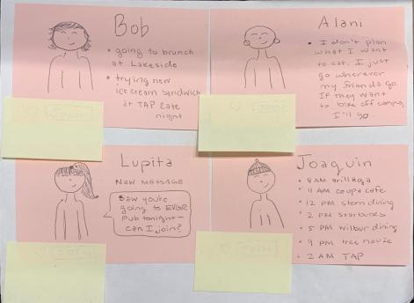
Prototype 1: Bite Buddies
Go with the flow
I like to try new things too
Assumption: People use social perception as the guiding factor when planning their meals.
Methodology:
Interacting with people with different views of meal-planning
How do you identify with these people?
How does seeing these plans make you feel about your planning?
Stranger?
Very detailed

Slide 26
Bite Buddies Results
Things that worked:
Identifying w/people → more excitement
Surprises
Identified with conflicting personalities
People can plan meals with differing specificity
Things that didn’t work:
Meals with strangers
“Plans for the food not for the people”
Time constraints
New Learnings
Easier to line up schedules than food preferences
Interest in reviews
Validity: ❌
New assumption 💡 People prioritize the food itself over social perception when planning their meals
Notes:
-When identifying with people, he felt more excited to talk about his plans
-Identified with both people who are detailed and with people who are more “go-with-the-flow” -People can plan meals with differing specificity — from times to places to specific meals
-Would like to hear about people’s reviews about where to have meals
-Not exactly. People can identify with other people’s meal planning but not rely on others for social acceptance

Slide 27
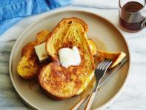
Prototype 2: Cooking Companion
Assumption: Having a cooking assistant closely monitoring users while cooking won’t feel annoying or intrusive.
Methodology:
“Cooking companion” monitors them via “feedback cards”
Participant prepares recipe in their home kitchen
🔊
👀
Audio/visual cues create interruption
Notes:
Justin made a french toast recipe, which was a recipe we previously agreed he was familiar with but wasn’t quite sure he had all the ingredients for/wasn’t planning on making (to introduce some experimentation aspect). Kyle observed him via a Zoom call on Justin’s laptop, which was set up in the corner of Justin’s kitchen facing the cooking process.
In addition, Kyle was following along the recipe and shared his Zoom screen with three feedback cards that he switched between based on when Justin deviated from the recipe. Whenever Justin made a deviation (even logical/small ones) Kyle switched the card (visual cue) and played a corresponding sound (audio cue) that alerted Justin. Justin usually walked over, and Kyle asked him about what deviation he made/sometimes asked him to type it in the Zoom chat/just tried to create a small distraction to see if it would become annoying or inhibit Justin’s cooking.

Slide 28
Notes:
Interface

Slide 29
Cooking Companion Results
Things that worked:
Continuous checking-in created a fun, social dynamic
Not annoying or intrusive
Surprises
The substitutions that people make are typically mild and don’t need feedback.
Things that didn’t work:
Checking-in didn’t produce a change in the cooking process.
New Learnings
People enjoy having a cooking partner accompany them
We should channel this fun partner aspect in a more useful way
Validity: ✅
New assumption 💡 People’s experimentation in the kitchen doesn’t often need feedback
Notes:
Summary:
Justin seemed to have fun and enjoy having a companion to check in with while cooking. He looked for the screen for approval throughout the process, was generally laughing/having fun when the companion checked in with him.
However, he said he personally feels comfortable with what he likes to substitute already, so he didn’t need checking-in with. The substitutions he made (coconut sugar for sugar, honey for maple syrup, and oat milk for whole milk) didn’t create health risks, and didn’t really need comment.

Slide 30
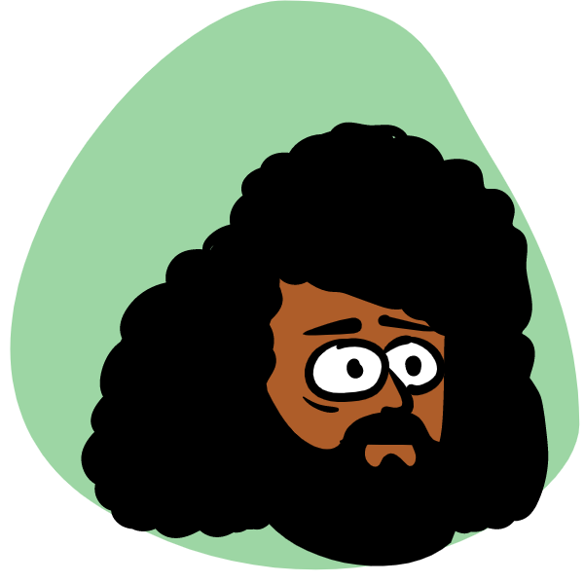
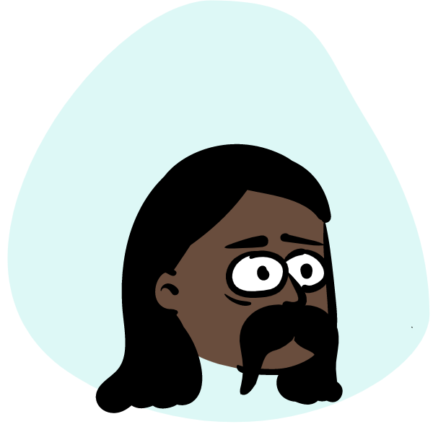
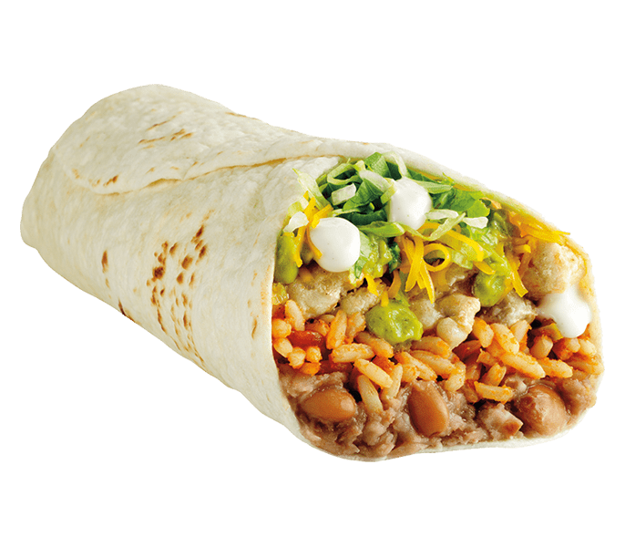
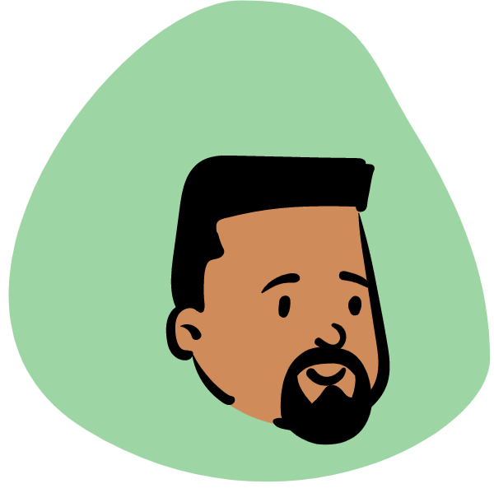
Prototype 3: Munching Memories
Assumption: People are willing to pause an ongoing activity to look at pictures on their phones.
Methodology: Ask people how they feel while they look at previous photos they have with a food they are currently interacting with

Slide 31
Munching Memories Results
Things that worked:
People are willing to talk about food while eating
Surprises
NO ONE was interested in looking at food photos on their phone while eating
Things that didn’t work:
Looking at photos is a disruption
New Learnings
Sharing personal photos felt intrusive
Validity: ❌
New assumption 💡 When actively engaging with food, people like to minimize their phone use

Slide 32
Solution

Slide 33
Solution
Best Solution: Cooking Companion ✅ enhanced user experience ✅ successfully alerted user about deviations
Why: Other solutions fell short Bite Buddies: ❌ social perception’s role in planning meals ❌ eating with strangers Munching Memories: ❌ having to use phone while eating
Communities Left Out: People who don’t cook, people who want to cook alone, people who don’t need help cooking, people who don’t have access to mobile devices

Slide 34
Summary

Slide 35
Key Learnings
A solution should strive to
Minimize phone use
since people find it takes them out of the moment
When cooking with a partner,
Companionship
might be more important than feedback
When dealing with food,
Social pressure
is a consideration, but not necessarily a guiding principle

Slide 36
NEXT STEPS
THANK YOU FOR VISITING!
QTY | ITEM | AMT
00 | Begin focusing exploration on Cooking Companion | HIGH
01 | Identify people, context, and solution | HIGH
02 | Create concept video to communicate our vision | HIGH
03 | Create website to compile our findings | HIGH
ITEM COUNT: |  | 04
WEEKS REMAINING: |  | 07
1 47147 14714 7

Slide 37
Thanks!

Slide 38
Appendix

Slide 39
HMW Brainstorming #1
Julia
We met Julia, a young female college student who carefully plans her meals to maximize the enjoyment she gets from eating. We were surprised to find that even though she meticulously plans her eating schedule, she laughs off how important it is to her when sharing it with us. We wonder if this means that Julia thinks being “too serious” about food is something to be embarrassed about, even though it’s what she likes to do. It would be game-changing to normalize people taking pride in taking what they eat seriously.
HMW make scheduling food a social activity instead of an individual one?
HMW make taking your food seriously something to be proud of instead of embarrassed by?
HMW help people find other people who care about food planning?
HMW gamify the food planning process?
HMW keep people from making judgements about personal choices?
HMW make the food planning process take less time?
HMW automate the food planning process?
HMW use food tracking to recommend next meals?
HMW show what every dining hall and near restaurant has in the near vicinity?
HMW locate and report rare events?
HMW show people the benefits of planning food?
HMW cancel people for making fun of someone for planning food?
HMW introduce norms in dining spaces that planning is normal?
HMW show people that everyone plans their food proces?
HMW make food planning like a scavenger hunt?
HMW we make her feel comfort in choosing her meals?
HMW make meal planning a form of relaxation like playing an instrument?
HMW remove people who are making her feel ashamed?
HMW let her enjoy her meals without having to plan?
HMW set people’s eating schedule weeks in advance?
HMW let people share their food planning process?
HMW make Julia not want to plan her food anymore and go more with the flow?

Slide 40
HMW Brainstorming #2
Alyssa
We met Alyssa (Aly), a 20-year-old female who has Type 1 Diabetes and loves learning new recipes. We were surprised to hear that in spite of her diabetes, she is unafraid to experiment with new recipes even if she doesn’t know the exact nutrition contents or how much she’s making. We wonder if this means that although she wants to be careful, Aly does not want to let this uncertainty deter her from trying new things because she is willing to risk her health for something novel. It would be game-changing to give people a way to manage uncertainty when experimenting in the kitchen.
HMW provide people more accurate information about recipes?
HMW make new recipes more accessible?
HMW we assure people about what they are cooking?
HMW eliminate recipes entirely when experimenting in the kitchen?
HMW get rid of the need for accurate recipes at all while still preserving safety?
HMW help people manage uncertainty safely in the kitchen?
HMW leverage group cooking to manage uncertainty when experimenting in the kitchen?
HMW make the uncertainty of trying a new recipe a more positive element?
HMW make the risk of cooking an asset instead of an acceptable risk?
HMW we make fear a good thing, instead of something to be ignored when experimenting with risk?
HMW let people experiment in the kitchen without learning entirely new recipes?
HMW enforce providing nutrition information on all recipes as a part of the law?
HMW make portion size and nutrition contents less of a concern when cooking?

Slide 41
HMW Brainstorming #3
Tyler
We met Tyler, a male professional cook and amateur boxer who connects to his Filipino culture through food. We were surprised to hear that he bought a pack of instant pancit (Filipino noodles) at the Asian supermarket because it reminded him of his mom, but still has not eaten the noodles after 4 weeks. We wonder if this means he is driven to impulse buy cultural foods by nostalgia, but then forgets about them. It would be game-changing to help people find sentimental value from food in a practical way.
HMW help people remember what food they have in their inventory?
HMW make it acceptable for food to have value beyond being practical?
HMW help people manage their urges to impulse buy?
HMW make impulse buying a more acceptable or valuable practice?
HMW help people practically connect with their culture through food?
HMW help people share their cultural connections with food?
HMW make finding sentimental connection to food a communal activity instead of a personal one?
HMW remind people about their families and their connection to food?
HMW make it easier for people to connect with their culture through food?
HMW make food into something that isn’t eaten??
HMW make going to the grocery store more like going to a toy/souvenir/gift store?
HMW make buying an ingredient/food a significant part of the cooking experience?
HMW let people enjoy the sentimental value of food without them buying real, perishable food?

Slide 42
Solution Brainstorming #1
HMW help people manage uncertainty safely in the kitchen?
A kitchen coach that guides you through the cooking process
An app where you put in your diet limitations, and it tracks and warns you as you add things to a recipe if you’re close to your limits but otherwise lets you explore
A cooking companion app that watches as you cook and gives you safety suggestions as you modify the recipe
An app for more accessible recipes
A chatbot on what you do when you hit a barrier
An app that scans your fridge and gives you X amount of ingredients that you can use in a recipe safely; otherwise, you can experiment as much as you want.
An app that assigns “points” to each ingredient in your pantry, and you can make whatever recipe you want as long as your points are in a certain range.
It can scan recipes and calculate points from those, as well.
An app that connects you to a nutritionist/chef to consult whenever you’re starting a new recipe
An app where people can make comments/tips relating to food safety on recipes
An app that scans recipes and calculates the nutrition facts for you
An app that detects whether you made too much food?
Detects nutrition levels in a recipe
An app that all connects cooks, food production companies, nutritionoists, etc.

Slide 43
Solution Brainstorming #2
HMW make scheduling food a social/communal activity instead of an individual one?
An app where you enter your eating schedule and you’re paired with similar “eating partners”
An app that lines up your eating schedule with other people’s
A social media app focused around meal prep
An app that helps people find others who meal prep
A dating app that pairs people with similar interests
Scavenger hunt for food planning
A choose your own adventure sort of game where you do quests and what not
An app where people can share their meal prep schedules so others can provide feedback/derive inspiration etc.
An app that schedules time with you and your friends to sit down and plan out communal meals
Yelp + Facebook, a review app that’s more of a social media platform
An app focused on college students that collects all meal options at dining halls, nearby restaurants, etc. and lets people easily tap on what they plan to eat that day, using user-user similarity it will pair you up with someone to have your meals with

Slide 44
Solution Brainstorming #3
HMW make going to the grocery store more like going to a museum?
An app that provides you with historical/cultural information on a product at the grocery store
An AR app where you walk around the grocery store and in live time if it detects food you have eaten before it shows pictures of that moment and is like “Remember when you ate this? Lol so fun!!”
A social app where you can share thoughts/memories about foods with your family/friends
An app where you can “collect” photos of food findings that you’ve seen, similar to iBird
An app that lets people collect food findings like they collect state quarters: “Gotta collect them all”
An app where you can add your favorite/most meaningful foods and when people scan things it’ll tell them if their friends have the same favorite/most meaningful foods
An app that sends you random reminders of food you’ve eaten by listening in on your conversations and uses intensive data mining on your search history
An app that can scan a food product and recommend you other products that have a similar cultural significance
An app that lets you window-shop a grocery store but framed not for buying, remembering
An app that will scan a product and tell you users’ average rating of it

Slide 45
Assumption Brainstorming #1
Munching Memories
(From group session) Collecting helps people sufficiently derive sentimental value
People are willing to pull out their phone to use AR at the grocery store
People take pictures of their food
People download apps
People have the technology to do this
People document all their moments with food
People collect things that make them nostalgic
Nostalgia makes people want to collect things
Being reminded of something via a phone is as satisfying as impulse buying
Being remind of something via phone will stop impulse buying
When driven by nostalgia, collecting something virtually is as satisfying as collecting it physically
People want to remember when they’ve eaten food before
People enjoy collecting photos of food findings
People are motivated to collect all the foods/it is possible to collect all the foods
People are willing to take photos of specific foods/moments with that food
People want to engage with this app while they are grocery shopping (instead of just focusing on their grocery shopping) – in any food moment
People will insert enough experiences with food into the app that it works
People are willing to let their phone/this app track their grocery shopping in real time
There will not be an overwhelming number of foods that the user has eaten before
People are willing to pause their grocery shopping to look at the pictures that this app shows them/People are willing to take the time to look at these pictures later
It is possible to make virtual foods of all the foods in all the grocery stores
VIewing memories of foods will have a (positive) impact on users’ emotions

Slide 46
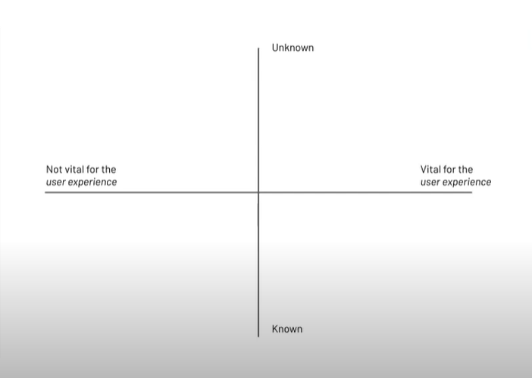
16
11
2
1
8
22
7
6
5
12
3
13
4

