Slide 1
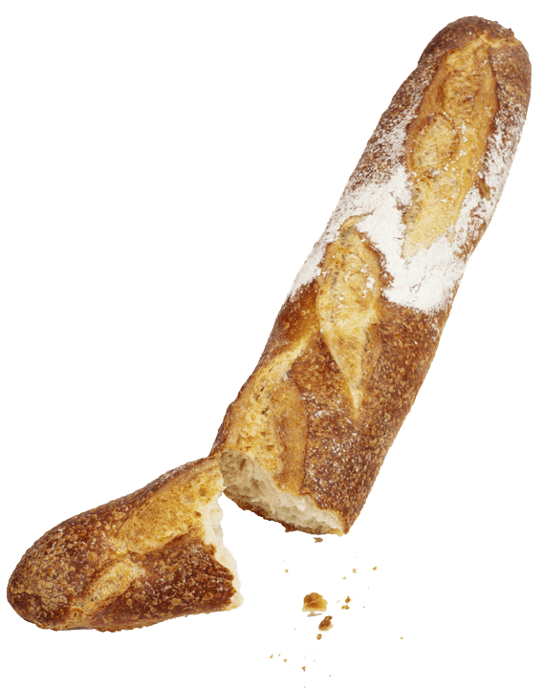
Breaking B(re)ad
Needfinding Report
Notes:
Extra slides here: https://docs.google.com/presentation/d/1zlUljxOgLHaM1BRzyld4ebkV7-EBjb0JOCUpcX8ZF2o/edit?usp=sharing

Slide 2
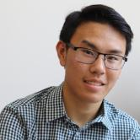
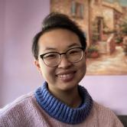
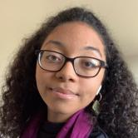
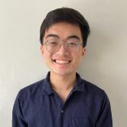
Meet the Team!
Andy Huynh ’23
Arlington, TX
Dax Duong ’22
San Diego, CA
Star Doby
’23
Santa Monica, CA
Kyle Nguyen
’23
St. Petersburg, FL
Notes:
Do we need cities? Does it contribute?
It’s kind of cute. Humanizes us?
Allow team to introduce themselves

Slide 3
Domain Selection
How can we involve the senses?
Are we interested in it?
Food!
Is it a relatable experience?
Notes:
The domain of becoming iron man is a large space, and we wanted to scope it down. We named these things as our top priorities.
Senses, internally: are we interested, externally: will other people be interested

Slide 4
Finding participants
Non-Stanford students
Unique eaters
Diversity
Getting out of our bubble.
Allergies? Diets? Chefs?
Age, culture, gender
Notes:
These were some of our core values with participant recruitment.
By getting outside of our bubble, we wanted to discover ideas we couldn’t come up with on the edge of our bed.
Eating is such a personal experience, and lots of people have different relationships to food. One of our interviewees has diabetes, One is a chef and an athlete, these are our extreme users. And we sought out these perspectives to sort of magnify the pain points people have with food.
Food especially brings to light the importance of diversity, as genders and cultures particularly participate in food differently.

Slide 5
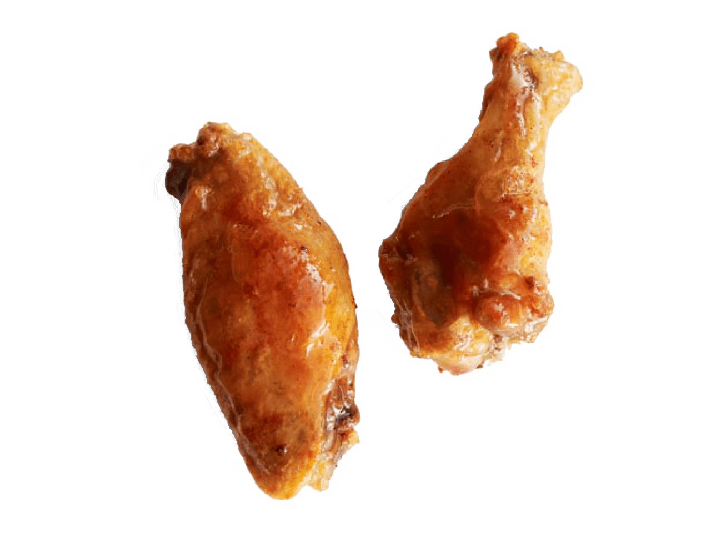
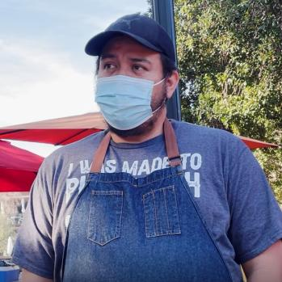
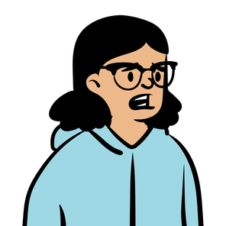
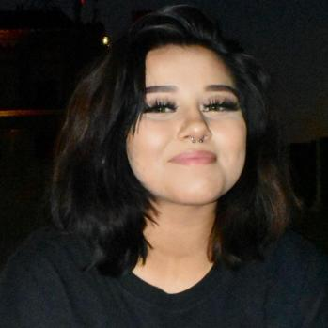
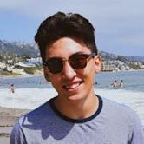
We spoke to…
Eduing
Food vendor, business owner
Bay Area, CA
Julia
20-year-old college student Bay Area, CA
Alyssa
20-year-old
graphic designer Bakersfield, CA
Tyler
24-year-old
cook, boxer Detroit, MI
Notes:
Eduing, a taco vendor and business owner
Julia, a college student who never has enough options
Alyssa, an home cook who has diabetes
Tyler, a boxer and a chef

Slide 6
… and asked them
?
Can you walk me through your last meal?
What do you
like most about cooking?
What does your pantry look like?
Can you walk me through the last time you cooked?
What challenges do you face when cooking?
What would be
helpful for you when making food?
How does cooking make you feel?
Do you have any hot takes on food?
Notes:
These are just some of the questions we asked them. We focused on questions that would evoke stories, particularly around food: walk me through the last time you cooked, or tell me about what’s in your pantry, for example.

Slide 7
“I will not serve to my customers anything that I wouldn’t serve to my kids.”
Eduing
food vendor, business owner
Outside his business, 20 min
Notes:
Eduing is a taco vendor who quit his job to become make food because he finds personal satisfaction in making food for others.
For him, quality and craft are important, maybe even more than the money, and he loves his customer.

Slide 8
Say
Think
“You have to hope you have a good day in sales”
On working at his own business, “It makes a huge difference”
Food is one of the bes things to bring people together
He’s providing something that people likes
Cooking for business “is very similar [to cooking at home] but at a much larger scale.”
“Somewhat set your own hours”
Quality is very important to making food
Fusion food is not appropriation
“I will not serve to my customers anything that I wouldn’t serve to my kids.”
The most difficult part is not having “enough business some days.”
Difficult to find a good place to eat
Foods can “belong” to certain people
Serving quality food is more important than making the most money
“You can be creative with your own business”
“SATISFACTORY”
2x
People try to appropriate other foods
Cooking for business “is very similar” to at home “just a much larger scale
“Students are not back yet”
The satisfaction of running a business is not the money.
On working at his own business, “You don’t have to listen to anyone.”
Running your own business is doing something that comes from you
“QUALITY” of work and product
Sometimes “Has a lot of food left over”
“The pandemic is starting to rise up again”
Restaurants should be clean and prepare food well
Working for himself is much better despite any hardships
Takes time to think and gestures to emphasize when he talks about customers
Comes to farmer market to make a living
Gives away food at the end of the day if there is extra food
Satisfaction from helping people
Pride in forging his own path
Started working at 3:00AM in order to prep
Finishes the day at 5:00PM
Cooking and working long hours gets exhausting
Gets tired from the work
Has to feel happy about what he gives to his customers
Has to set up tent and mobile kitchen at farmer’s market
Despair? Worry? About current business
Goes to very few places when eating out
Gestures unconfidently when he says “somewhat set your own hours”
Continues with interview despite customers waiting for food
Prep food in commercial kitchen for 4-5 hours
The duty to be kind, patient, and polite
Loves to cook
Weight of responsibility to provide for his family
Enjoys and is very satisfied to work at his own business
Used to work for another company, now owns his own business
Tries to bring practices from cooking at home to his business
Laughs uncomfortably after asked how business can be hard
Brings what he does at home to work
Changed business strategy after losing co0k
Do
Feel

Slide 9
Say
Think
“You have to hope you have a good day in sales”
On working at his own business, “It makes a huge difference”
Food is one of the bes things to bring people together
He’s providing something that people likes
Cooking for business “is very similar [to cooking at home] but at a much larger scale.”
“Somewhat set your own hours”
Quality is very important to making food
Fusion food is not appropriation
“I will not serve to my customers anything that I wouldn’t serve to my kids.”
The most difficult part is not having “enough business some days.”
Difficult to find a good place to eat
Foods can “belong” to certain people
Serving quality food is more important than making the most money
“You can be creative with your own business”
“SATISFACTORY”
2x
People try to appropriate other foods
Cooking for business “is very similar” to at home “just a much larger scale
“Students are not back yet”
The satisfaction of running a business is not the money.
On working at his own business, “You don’t have to listen to anyone.”
Running your own business is doing something that comes from you
“QUALITY” of work and product
Sometimes “Has a lot of food left over”
“The pandemic is starting to rise up again”
Restaurants should be clean and prepare food well
Working for himself is much better despite any hardships
Takes time to think and gestures to emphasize when he talks about customers
Comes to farmer market to make a living
Gives away food at the end of the day if there is extra food
Satisfaction from helping people
Pride in forging his own path
Started working at 3:00AM in order to prep
Finishes the day at 5:00PM
Cooking and working long hours gets exhausting
Gets tired from the work
Has to feel happy about what he gives to his customers
Has to set up tent and mobile kitchen at farmer’s market
Despair? Worry? About current business
Goes to very few places when eating out
Gestures unconfidently when he says “somewhat set your own hours”
Continues with interview despite customers waiting for food
Prep food in commercial kitchen for 4-5 hours
The duty to be kind, patient, and polite
Loves to cook
Weight of responsibility to provide for his family
Enjoys and is very satisfied to work at his own business
Used to work for another company, now owns his own business
Tries to bring practices from cooking at home to his business
Laughs uncomfortably after asked how business can be hard
Brings what he does at home to work
Changed business strategy after losing co0k
Do
Feel

Slide 10
Say
Think
Cooking for business “is very similar [to cooking at home] but at a much larger scale.”
“You have to hope there are customers”
On working at his own business, “It makes a huge difference”
Fusion food is not appropriation
“I will not serve to my customers anything that I wouldn’t serve to my kids.”
Quality is very important to making food
“You can be creative with your own business”
On working at his own business, “It makes a huge difference”
Difficult to find a good place to eat
“[When working for yourself], you don’t have to listen to anyone.”
On working at his own business, “You don’t have to listen to anyone.”
People try to appropriate other foods
Food is one of the best things to bring people together
“You can be creative with your own business”
The most difficult part is not having “enough business some days.”
Restaurants should be clean and prepare food well
Comes to farmer market to make a living
Started working at 3:00AM in order to prep
Gives away food at the end of the day if there is extra food
Cooking and working long hours gets exhausting
Goes to very few places when eating out
Used to work for other companies, but now owns his own business
Has to feel happy about what he gives to his customers
Satisfaction, Pride
Prep food in kitchen, brings to farmer market, sell food, pack up, clean up
Enjoys and is very satisfied to work at his own business
Tries to bring practices from cooking at home to his business
Loves to cook
Continues with interview despite customers waiting for food
Used to work for another-her company, now owns his own business
Do
Feel
Notes:
The most surprising thing about Edguin is the pride he takes in his business.
That might not be surprising, but one of the things he told us was that for him, food quality was important, even when it came against his business interests.

Slide 11
Insight
Chefs who prepare food with personal commitment are much more fulfilled than cooking solely for practical reasons.
Need!
Chefs want ways to be creative and bring a aspect of their own lives to the kitchen when cooking for others.
Notes:
NOTES:
For insight: “emotional connection”, “personal motivation”, “intrinsic motivation”
For need: “make their own choices”, “have agency”, “be in control”

Slide 12
“I tend to really like choosing food. So I take my sweet time.
Julia
busy college student
Eating at farmer’s market, 30 min
Notes:
Julia was eating a naan wrap at the same farmer’s market, she’s a junior at Stanford.
Having agency when it comes to her food is important to her, evidenced by this quote.

Slide 13
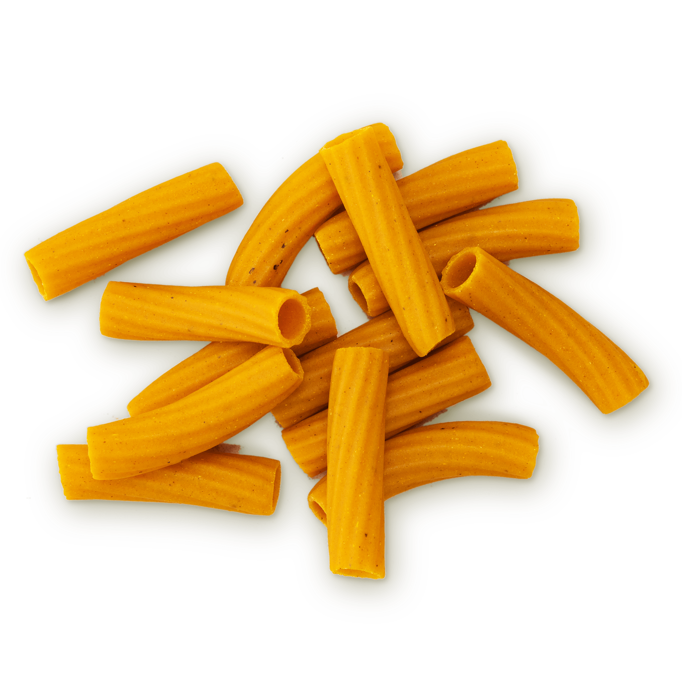
Say
Think
I’m kind of a miserable cook at home.
I like to try new stuff.
When it’s a meal I don’t like, I usually eat half of it and finish off the rest with snacks.
I basically have no food problems at home.
“I don’t want to be interrupted while I’m eating…”
“I take my food seriously. But I also can go with the flow.”
Sometimes I’m just busy. I find myself in that situation. But—but I try not to be.
Variety and newness are as important as the food
“I’m so happy getting away from classes to eat this wrap!”
I don’t like wraps. I think they’re messy
At home we have all the ingredients. It’s more convenient.
I tend to really like choosing food. So I take my sweet time.
Food shouldn’t be taken super seriously.
It requires a bit more planning [at school].
[The dining hall] serves baked chicken and cod for 4 days straight.
Sometimes life takes priority over food.
Eating the same as everyone else is boring!
[The naan wrap] is great, it’s warm, it’s well-done.
“Food should feel like a special occasion.”
My academics are just as important as eating well.
I go to the farmer’s market whenever it’s open because it’s a ‘rare’ occurrence.
For the kind of cuisine that I like to cook you need…
There’s significantly lots of planning around cooking food.
Planning [what I eat] isn’t really explicit… I kind of just feel it out.
I know what I like, and I will get it.
“I’ve earned this treat [naan wrap].”
I’m so restricted with my options at school!
Comes out to the farmer’s market every Tuesday.
Laughs when talking about how much chicken she’s ate
Takes the Marguerite to get food from off campus, buys bread, cheese, snacks
Empowerment from being allowed to have preferences about her food
Feels disempowered by dining hall food being out of her control
Frustrated when she eats food she doesn’t like out of convenience
Proud of how she schedules her diet carefully
Looks at every single menu, weighs her options carefully.
Buys “emergency” food (frozen)
When food is bad, will refuse to eat it.
Feels a sense of pride about cooking food from her culture
Anxious about being left without options for food
Too overwhelmed to prioritize her diet
Satisfied with eating warm, “premium” food
Goes to different dining halls for specialties
Stays on campus because she doesn’t have a car
Separates lamb from the naan before eating.
Air-quotes the word “rare” when talking about farmer’s market
Doesn’t cook at school because of financial barriers
Amused at how boring her diet is
A little indifferent about getting her way every time (still easygoing)
Embarrassed about being too particular about her food. Sheepish?
Do
Feel

Slide 14
Say
Think
I’m kind of a miserable cook at home.
I like to try new stuff.
When it’s a meal I don’t like, I usually eat half of it and finish off the rest with snacks.
I basically have no food problems at home.
“I don’t want to be interrupted while I’m eating…”
“I take my food seriously. But I also can go with the flow.”
Sometimes I’m just busy. I find myself in that situation. But—but I try not to be.
Variety and newness are as important as the food
I tend to really like choosing food. So I take my sweet time.
“I’m so happy getting away from classes to eat this wrap!”
I don’t like wraps. I think they’re messy
At home we have all the ingredients. It’s more convenient.
I tend to really like choosing food. So I take my sweet time.
Food shouldn’t be taken super seriously.
It requires a bit more planning [at school].
[The dining hall] serves baked chicken and cod for 4 days straight.
Sometimes life takes priority over food.
Eating the same as everyone else is boring!
[The naan wrap] is great, it’s warm, it’s well-done.
“Food should feel like a special occasion.”
My academics are just as important as eating well.
I go to the farmer’s market whenever it’s open because it’s a ‘rare’ occurrence.
For the kind of cuisine that I like to cook you need…
There’s significantly lots of planning around cooking food.
Planning [what I eat] isn’t really explicit… I kind of just feel it out.
I know what I like, and I will get it.
“I’ve earned this treat [naan wrap].”
I’m so restricted with my options at school!
Comes out to the farmer’s market every Tuesday.
Laughs when talking about how much chicken she’s ate
Takes the Marguerite to get food from off campus, buys bread, cheese, snacks
Empowerment from being allowed to have preferences about her food
Feels disempowered by dining hall food being out of her control
Frustrated when she eats food she doesn’t like out of convenience
Proud of how she schedules her diet carefully
Looks at every single menu, weighs her options carefully.
Air-quotes the word “rare” when talking about farmer’s market
Pride?
Buys “emergency” food (frozen)
When food is bad, will refuse to eat it.
Feels a sense of pride about cooking food from her culture
Anxious about being left without options for food
Too overwhelmed to prioritize her diet
Satisfied with eating warm, “premium” food
Goes to different dining halls for specialties
Stays on campus because she doesn’t have a car
Sheepishness?
Separates lamb from the naan before eating.
Air-quotes the word “rare” when talking about farmer’s market
Doesn’t cook at school because of financial barriers
Amused at how boring her diet is
A little indifferent about getting her way every time (still easygoing)
Embarrassed about being too particular about her food. Sheepish?
Do
Feel
Notes:
Contradiction: cares a lot about her food and likes the process of choosing and planning.
However, does a lot of hedging. AIr quotes around ‘rare’, laughs about how much she plans. There’s a sense of pride about her process, but she downplays it.

Slide 15
Insight
People want to eat well, but don’t want to be perceived by others as “trying too hard.”
Need!
People want a way to plan out the food they eat without being judged.
Aspirational > practical!
Notes:
There’s a social aspect of food, and a point of friction where people care about what they eat, how it tastes… but at the same time want to “go with the flow”
You can care about what you eat, but you can’t try too hard. The need we identified here is a way to have both: plan out your food and get what you like, but without the judgement that comes with eating.
It’s an aspirational need.

Slide 16
“I personally love to add my own flavors. It always feels better when I’m cooking myself.”
Alyssa
graphic designer
Zoom interview, 45 min
Notes:
We sought unique perspectives—Alyssa has a unique relationship with food as all of us do, but her diabetes means she thinks especially carefully about planning what to eat.

Slide 17
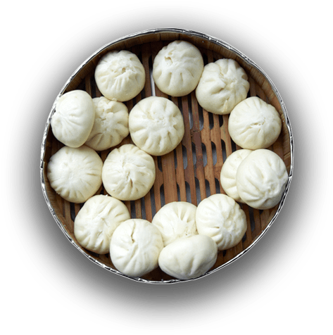
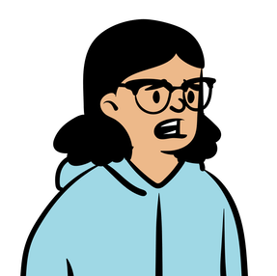
Say
Think
Wants to control how much salt or sugar
Has Type-1 Diabetes
Cooking is
very
enjoyable
Important to know sugar and carbs
Food staff don’t like when customers customize
Doesn’t like onions
AT ALL
Making too much food is bad
Sizes and proportions are important
Loves learning recipes from her grandma
Doesn’t know why she doesn’t like onion
Doesn’t want to make too much food
Hard to tell when soup is done
People should be more explicit about carbs in recipes
Translating recipes in Spanish to English
Didn’t know English word for pozole meat
Nutrition labels are helpful
Wants to know how much sugar and carbs in food
Food controlling blood sugar spikes
Worries about portions because she has diabetes
Wish recipes had nutrition labels
BIG
GARLIC FAN
How to be creative with her meals
Cooks many Mexican Traditional dishes
Used Provence spice from ratatouille in her dumpling recipe
Cooked Traditional Mexican Pozole
Annoyed with recipes that don’t specify portions
Curious about other spices in recipes
Cooks a lot at home, doesn’t feel the need to go out
more secure making her own food
Concerned with making sure meat is not undercooked
Very attentive to her family cooking
Anxious
when asking waiters to take off onions
Content while cooking
Happy learning recipes from others
Asks to take onion of at restaurants
Overwhelming love for garlic
Removes onions from her foods herself
Snacking when no time to cook
Experiments with
spices
Controls salt content in recipes
Confused about portions in some recipes
More confident about what is in her food when she cooks
Do
Feel
Self-conscious about her preferences

Slide 18
Say
Think
Has Type-1 Diabetes
Cooking is
very
enjoyable
Important to know sugar and carbs
Wants to control how much salt or sugar in her meals
Food staff don’t like when customers customize
Doesn’t like onions
AT ALL
Making too much food is bad
Sizes and proportions are important
Loves learning recipes from her grandma
Doesn’t know why she doesn’t like onion
Hard to tell when soup is done
Doesn’t want to make too much food
people should be more explicit about carbs in recipes
Translating recipes in Spanish to English
Didn’t know English word for pozole meat
How to be creative with her meals
Nutrition labels are helpful
Wants to know how much sugar and carbs in food
Worries about portions because she has diabetes
Wish recipes had nutrition labels
Food controlling blood sugar spikes
BIG
GARLIC FAN
Cooks many Mexican Traditional dishes
Cooked Traditional Mexican Pozole
Annoyed with recipes that don’t specify portions
Curious about other spices in recipes
Used Provence spice from ratatouille recipe she did 1 year ago in her dumpling recipe
More confident and secure about what is in her food when she cooks herself
Concerned with making sure meat is not undercooked
Cooks a lot at home, doesn’t feel the need to go out
Very attentive to her family cooking
Anxious
when asking waiters to take off onions
Asks to take onion of at restaurants
Anxious
when asking waiters to take off onions
Content while cooking
Overwhelming love
for garlic
Happy learning recipes from others
Removes onions from her foods herself
Snacking when no time to cook
Experiments with
spices
Confused about portions in some recipes
More confident about what is in her food when she cooks
Controls salt content in recipes
Self-conscious about her preferences
Do
Feel
Notes:
She has to put a lot of thought into what she eats, similar to Julia, but for different reasons.
At the same time, she’s a home cook who loves to experiment and put her own twist on things

Slide 19
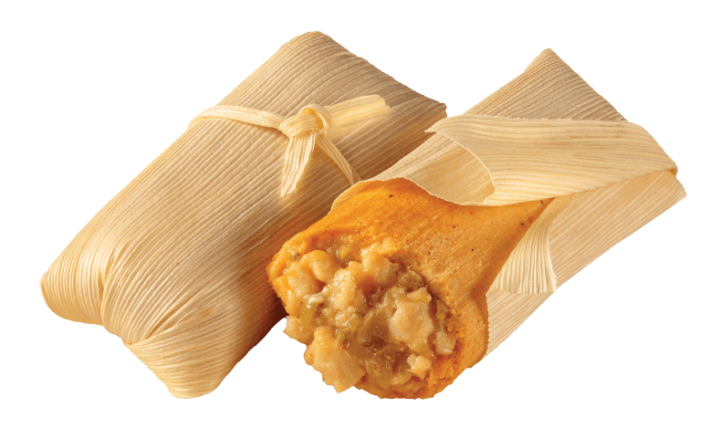
Insight
People find it frustrating that not all recipes are explicit with portions, nutrition, etc.
Need!
People want to feel confident and secure when they are exploring new foods and recipes
Notes:
For Julia, the important thing is freedom to explore in the kitchen. But, she’s hindered by not knowing exactly what’s in her food. There’s an aspirational need here

Slide 20
Insight
People find it frustrating that not all recipes are explicit with portions, nutrition, etc.
Need!
People want to have more information about what’s inside their food.
Notes:
We also should note that there’s a very practical need here of people simply needing more
This insight was brought about by an extreme user like Julia, but we feel being better informed about what’s in food is a need everyone can relate to.

Slide 21
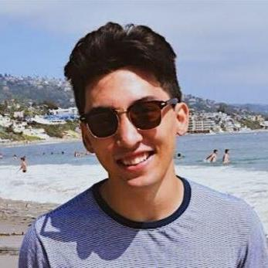
“What really brought me to cooking is trying to be more tied in to my Filipino culture.”
Tyler
cook, amateur boxer
Zoom interview, 50 min
Notes:
Our last interviewee was another extreme user, someone who takes his diet seriously twofold: as a chef and an amateur boxer. However, Tyler’s interview brought us in a different direction, where we focused a lot on his cultural identification with food.

Slide 22
Say
Think
I’m a perfectionist when it comes to cooking
Cooking is a craft you can hone by practicing
High quality ingredients are really expensive
I don’t know why I overeat sometimes
Cooks have a responsibility to limit food waste
Life’s too short to not eat good food
I connect with my grandmother and mother through cooking
Culture is important
Fresh ingredients > frozen ingredients or powder
I want to try more Filipino food
I have an emotional relationship with food
Nutrition is important enough to be tracked
I think I can be controlling in the kitchen
I cook to be closer to my culture
I want to use good ingredients
Cutting/ preparing food is my favorite part
Finances play a part in determining meals
I would love to go to culinary school
I can prep ingredients better than meal prep packages
The types of ingredients I use depends on the situation
I’m not super strict about my diet unless I’m training for something
I like cooking and providing for myself and others
I approach cooking the way I approach life
My girlfriend doesn’t like cooking with me b/c I’m a perfectionist
I don’t like going out to eat unless it’s on a date or with friends
Eating unhealthy food is okay if it’s cultural
The things in my pantry can make a really good meal
Posts his food on Instagram
Goes “kitchen shopping” to make food out of what’s in his kitchen
Tracks his calories and nutrition on an app or mentally
Proud when he’s especially resourceful/ reduces waste with a dish
Bad when he overeats or binges on unhealthy foods
Limited by pre=portioned and =prepped meal prep packages
Wishes food wouldn’t go bad so quickly
Tries to learn Filipino recipes and buy Filipino snacks
Prepares ingredients with precision
Connected to his culture when he makes Filipino food
Dislikes how freezing/ preserving food can reduce quality
Overeats at night
Frustrated when he has to buy more food than he needs
Good when he plans his meals out a week in advance
Puts his own spin on recipes
Quit his job to pursue cooking
Cooks TikTok recipes with his girlfriend
Strays from diet only when he can afford it
Avoids instant/ processed food
Values having freedom and control when cooking
Truer to the art of cooking when his cuts are precise
Good when he makes Asian dishes, like Filipino food
Do
Feel

Slide 23
Say
Think
I’m a perfectionist when it comes to cooking
Cooking is a craft you can hone by practicing
High quality ingredients are really expensive
I don’t know why I overeat sometimes
Cooks have a responsibility to limit food waste
Life’s too short to not eat good food
I connect with my grandmother and mother through cooking
Culture is important
Fresh ingredients > frozen ingredients or powder
I want to try more Filipino food
I cook to be closer to my culture.
I have an emotional relationship with food
Nutrition is important enough to be tracked
I think I can be controlling in the kitchen
I cook to be closer to my culture
I want to use good ingredients
Cutting/ preparing food is my favorite part
Finances play a part in determining meals
I would love to go to culinary school
I can prep ingredients better than meal prep packages
The types of ingredients I use depends on the situation
I’m not super strict about my diet unless I’m training for something
I like cooking and providing for myself and others
I approach cooking the way I approach life
My girlfriend doesn’t like cooking with me b/c I’m a perfectionist
I don’t like going out to eat unless it’s on a date or with friends
Eating unhealthy food is okay if it’s cultural
The things in my pantry can make a really good meal
Posts his food on Instagram
Goes “kitchen shopping” to make food out of what’s in his kitchen
Tracks his calories and nutrition on an app or mentally
Proud when he’s especially resourceful/ reduces waste with a dish
Bad when he overeats or binges on unhealthy foods
Limited by pre=portioned and =prepped meal prep packages
Buys foods at the store specifically because they’re Filipino.
Wishes food wouldn’t go bad so quickly
Tries to learn Filipino recipes and buy Filipino snacks
Feels truer to the art of cooking when his cuts are precise
Prepares ingredients with precision
Connected to his culture when he makes Filipino food
Dislikes how freezing/ preserving food can reduce quality
Overeats at night
Frustrated when he has to buy more food than he needs
Good when he plans his meals out a week in advance
Puts his own spin on recipes
Puts his own spin on recipes
Quit his job to pursue cooking
Cooks TikTok recipes with his girlfriend
Strays from diet only when he can afford it
Avoids instant/ processed food
Values having freedom and control when cooking
Truer to the art of cooking when his cuts are precise
Good when he makes Asian dishes, like Filipino food
Do
Feel
Notes:
One of the interesting stories that Tyler told us is of buying this instant noodle called pancit canton.
He bought the noodles, but didn’t actually eat them

Slide 24
Insight
Tyler makes an effort to engage with Filipino cuisine because of his personal connection.
Need!
People want to express and retain their cultural identities through food.
Notes:
So sometimes we found that people buy food not because they want to eat it, but because they feel a personal connection to it.

Slide 25
Insight
People like to prepare their own food to ensure precision and add their own spin to it.
Need!
People want control and ownership over their food, even when following recipes.
Notes:
The other side of Tyler was the chef, who told us he feels unsatisfied with HelloFresh and precut ingredients. Why, when it’s so convenient?
We found that for Tyler, it was the loss of control and ownership over the food he was eating. So very similarly to Julia, the home cook, Tyler wants to see himself in his food, even to the point of inconvenience.

Slide 26
Insight
Tyler makes an effort to engage with Filipino cuisine because of the nostalgic value not just taste
Need!
People want to revisit fond memories through food
Aspirational > practical!

Slide 27
Insight
People like to be resourceful…
Need!
People want to feel good about []
Aspirational > practical!

Slide 28
Putting it all together
It’s about more than food!
Waste and environment
Agency and ownership
over food is just as important as the food itself
Health
People feel that food is part of their
Social identity
and use food to define themselves socioculturally
Nostalgia
Fear of judgement
Notes:
Eduing, who risked his career and started cooking for love of serving other people.
Tyler, who buys pancit (Filipino noodles) not to eat it, just because it reminds him of home.
Julia, who wants to express herself through food, so explores new recipes even in spite of the challenges to her diabetes.
People want to own their food. People want to identify with their food, culturally or whatever way that means.

Slide 29
NEXT STEPS
THANK YOU FOR VISITING!
QTY | ITEM | AMT
00 | Expand our interview scope to new types of eaters | HIGH
01 | Continue unpacking interview data | HIGH
02 | Narrow down problem domain within food | HIGH
03 | HMW statements and experience prototyping | HIGH
ITEM COUNT: |  | 04
WEEKS REMAINING: |  | 08
1 47147 14714 7

Slide 30
Thanks!

