Slide 1
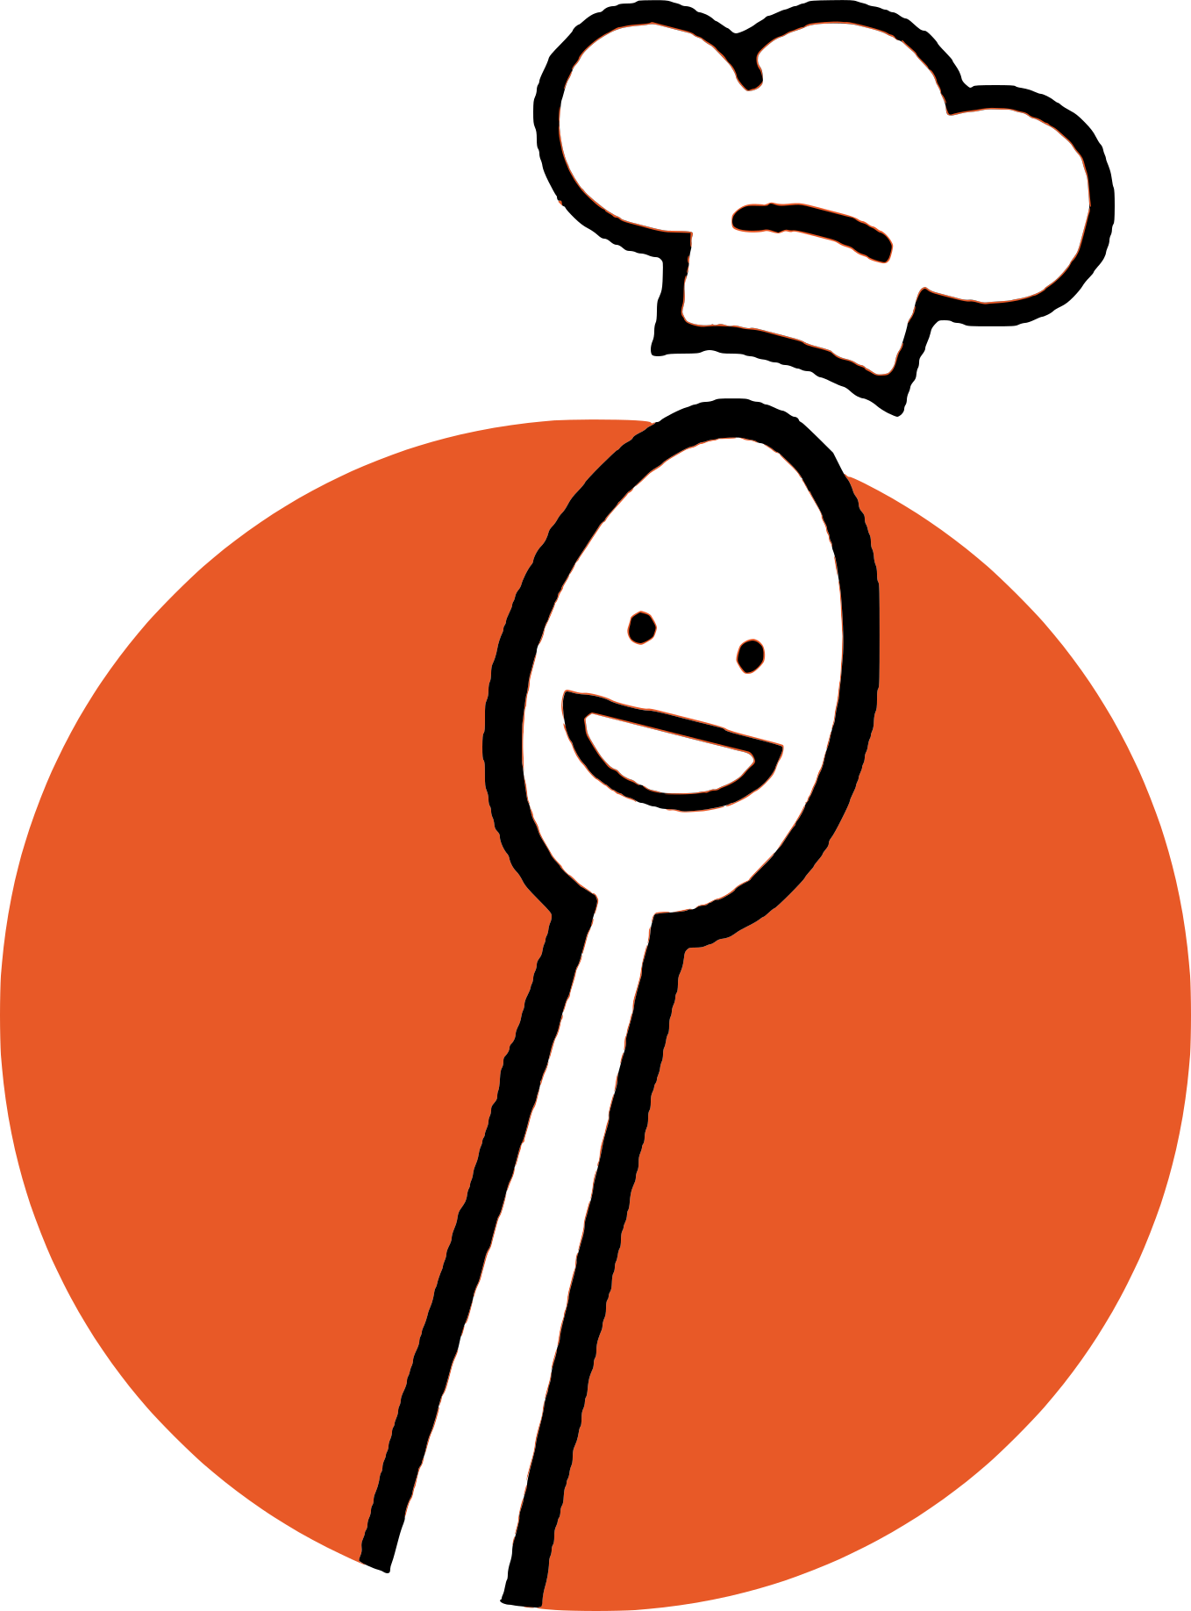
Recipal
Assignment 6: Med-fi Prototype

Slide 2
Value Proposition
Problem/Solution Overview
Helping you cook recipes your way
Recipal aims to help users overcome uncertainty about the recipes they are making by helping them understand nutritional value, make modifications, and learn cooking techniques. By making cooking fun and informed, Recipal creates a more welcoming and approachable cooking environment.

Slide 3
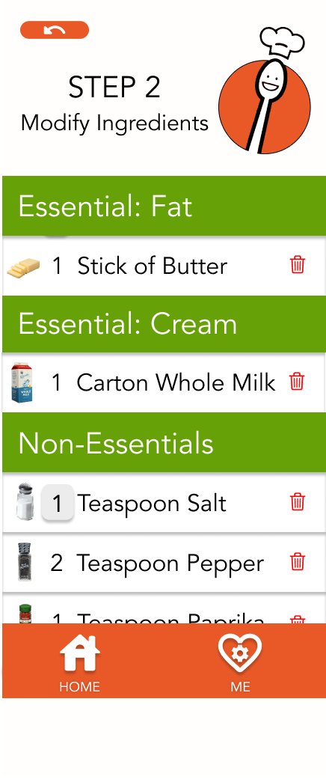
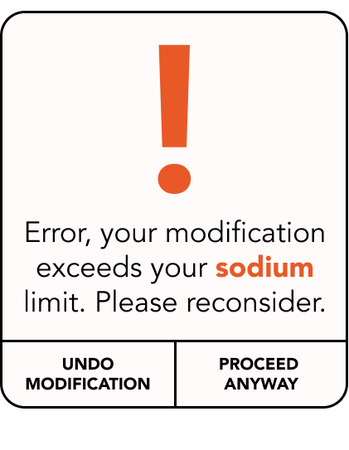
Values Encoded
We are designing Recipal with the guiding values of health, inclusion, wellness.
Recipal promotes health by helping people cook meals that meet their individual nutrition goals.
Users are alerted when making a recipe modification that conflicts with their defined goals.

Slide 4
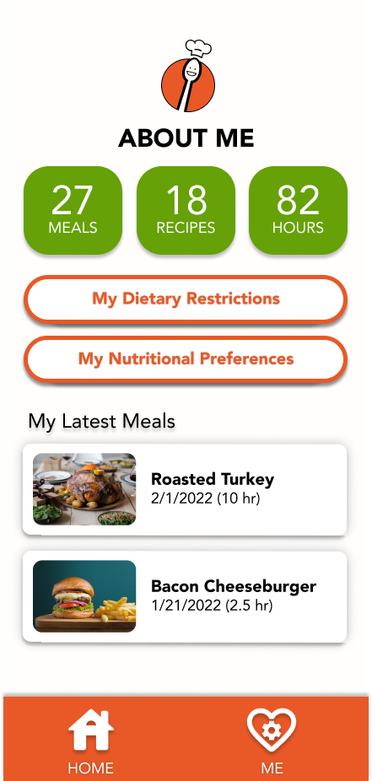
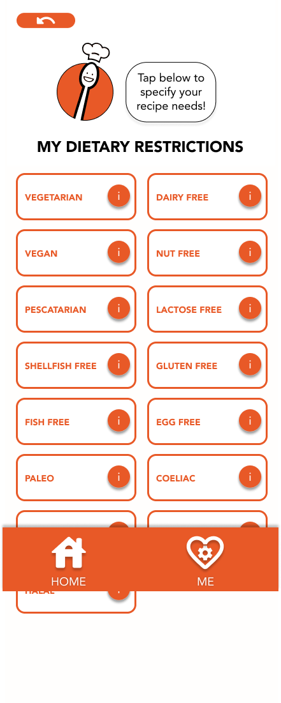
We promote inclusion by recognizing that everyone eats uniquely and therefore can customize Recipal to their diet.
On our Profile Hub, each user can input their specific dietary restrictions and nutritional preferences.

Slide 5
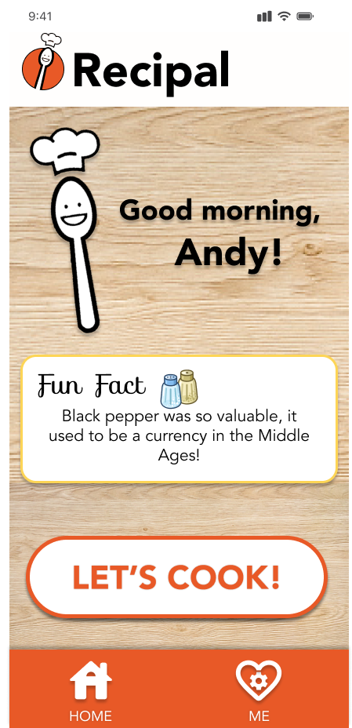
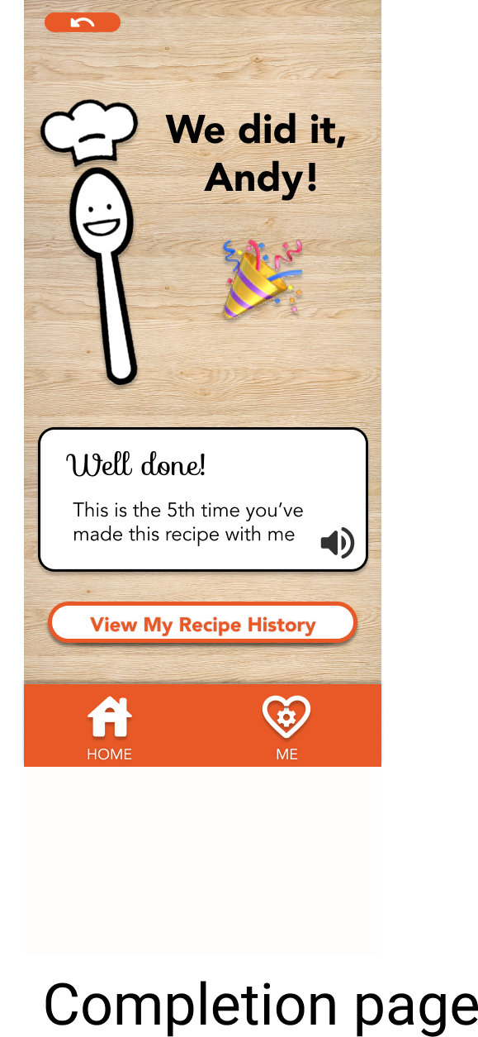
We also recognize that wellbeing is holistic and extends beyond nutrition. Therefore, we promote wellness via the social companionship that Recipal offers.
Spoonie, our friendly mascot, remembers your name and how many times you’ve cooked together.

Slide 6
Values Conflicts
Health might conflict with inclusion. It is difficult for a truly inclusive cooking app to adopt universal standards for what is “healthy” for all people. Health needs vary, and if we want to include all users, we have to take special care to consider what we promote as “healthy” or “unhealthy” to our users.
Even with this many diet categories, it’s difficult to capture everyone’s diet needs. What if someone is allergic to only red apples?

Slide 7
Values Conflicts
Health may also conflict with wellness. It might be appropriate for a person to occasionally cook meals that would be considered unhealthy if it contributes to their wellbeing. What if, for example, a person wants to make a meal that impresses their friends and family (wellness) but in the process might sacrifice taste for nutrition (health)?
It’s difficult to make diet suggestions without knowing the context of users’ decisions.

Slide 8
Usability Goals & Key Measurements

Slide 9
Usability Goal
Key Metric
Is it faster to make a modification to a recipe the 2nd time?
Do users learn from the nutritional advice Recipal gives (i.e. don’t make the same mistake twice?)
Learnability
When a user goes to enter a diet preference, is it there?
When the user wants to make a modification to a recipe, are they able to?
Flexibility

Slide 10
Representative Tasks
Simple
Browse a database of recipes and select one.
Moderate
Navigate through the steps of a recipe to completion, performing a basic modification.
Complex
Input nutritional limits and navigate through the steps of a specified recipe, performing modifications that are accepted/rejected intelligently based on the user’s nutritional limits.

Slide 11
We changed one!
Based on studio feedback, we decided to simplify our most basic task.
Simple (Old)
Select a specified recipe from the database and navigate through the steps to recipe completion (with no modifications)
Simple (New!)
Browse a database of recipes and select one.

Slide 12
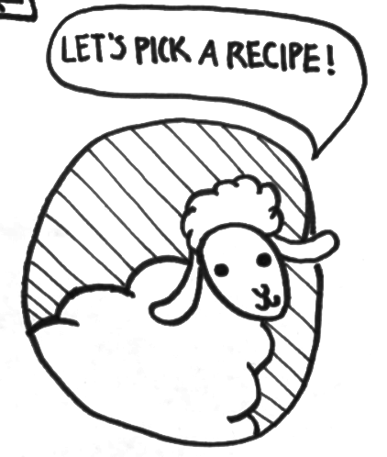
UI Changes
We’ve changed our mascot based on studio feedback!

Slide 13
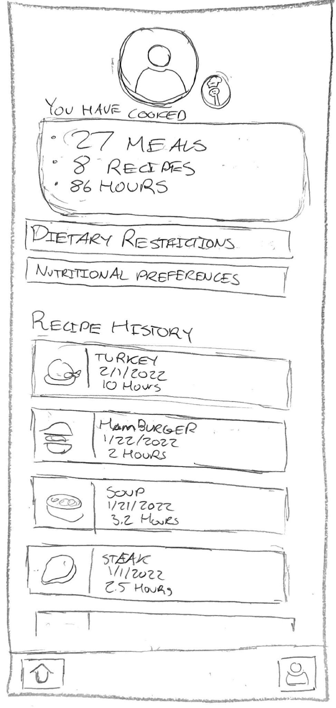
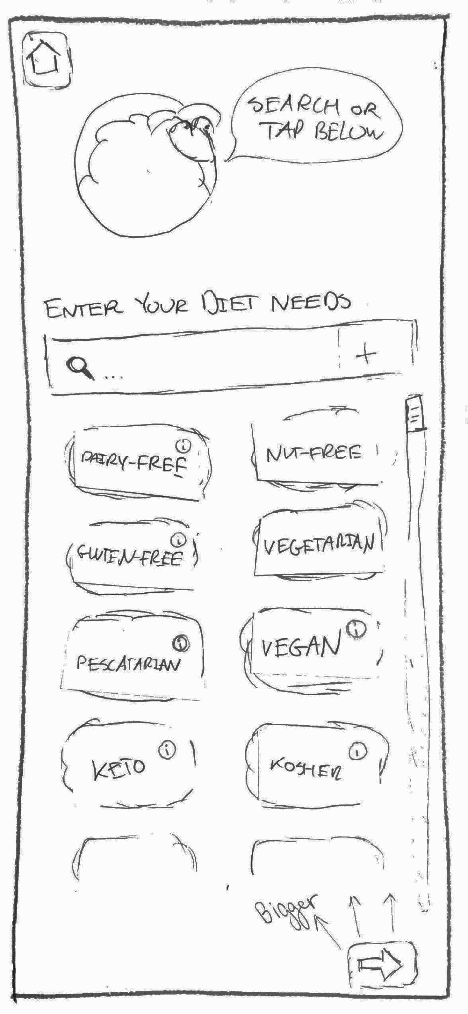
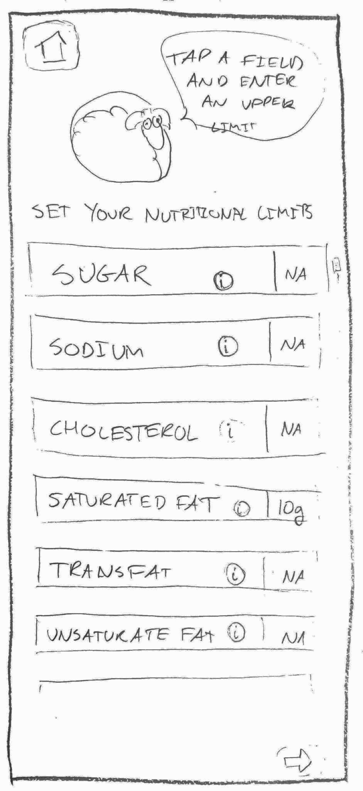
1. Refining Personalization
User Feedback
Studio Feedback
Learnability Goals
We’ve added a Hub page to make personzalitions easier.
Adding diet needs happened in two stages in our lo-fi.
This Hub page helps not hide the second page!
With a new recipe history, we’re striving towards our learnability goal.
But users didn’t know there was a second page behind the first!
We’ve also moved the profile page to a tab in a toolbar.
Lo-Fi
Revised

Slide 14
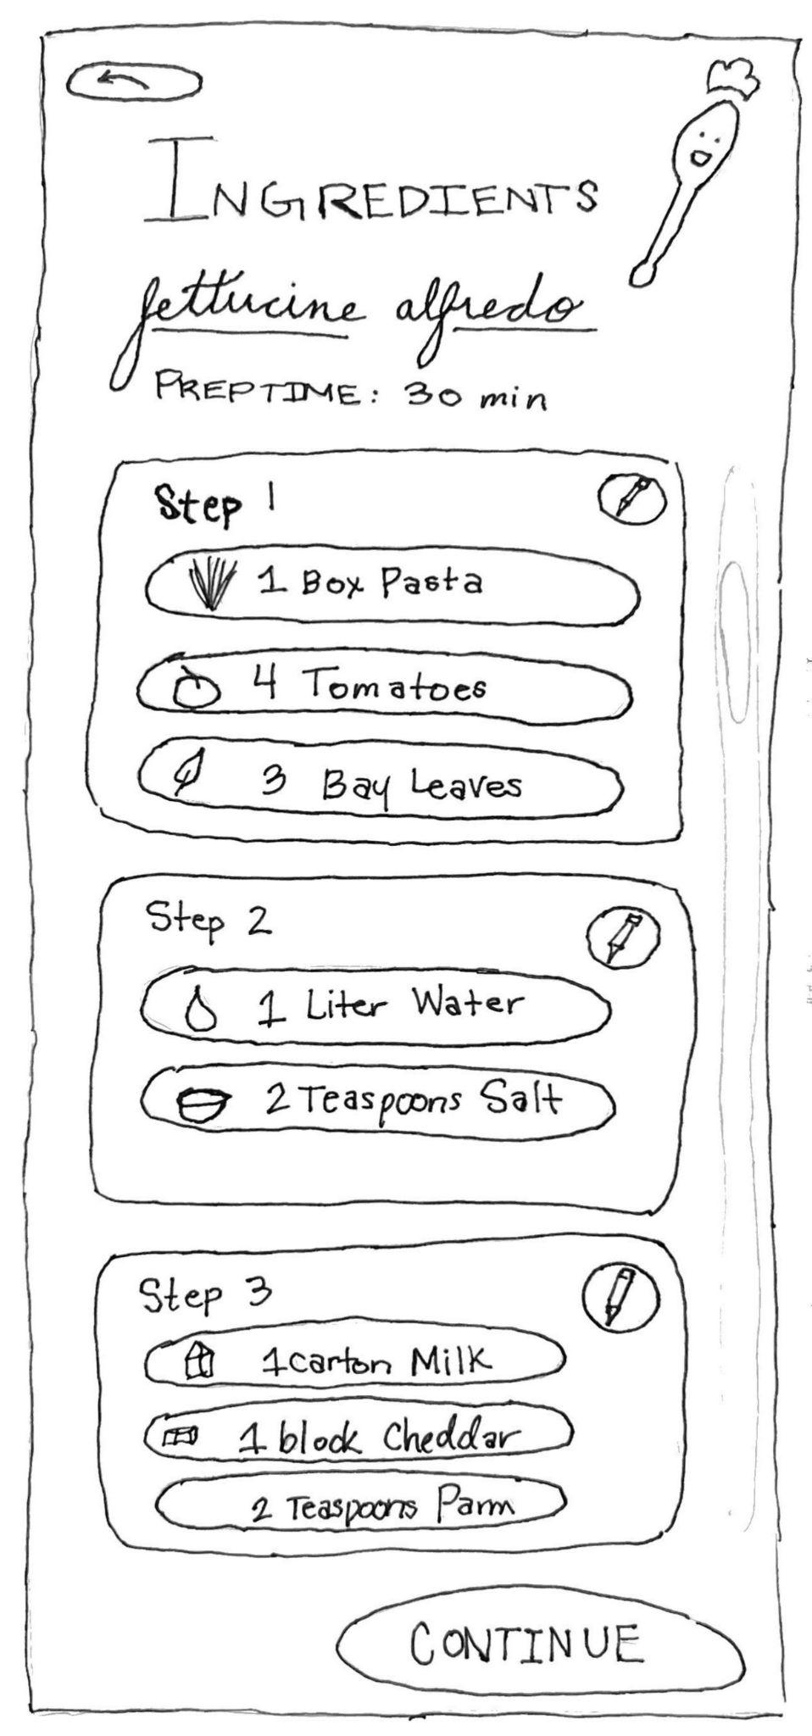
2. Adding an Ingredients Page
User Feedback
Studio Feedback
Learnability Goals
We’ve added a new page based on user/studio feedback.
This page lets users view ingredients before starting.
We didn’t have an ingredients page before!
Several users requested to see the ingredients before they started a recipe.
This page didn’t exist.
Photos of ingredients add some life.
They can also make modifications at this stage, with respect to our flexibility goal.
Lo-Fi
Revised

Slide 15
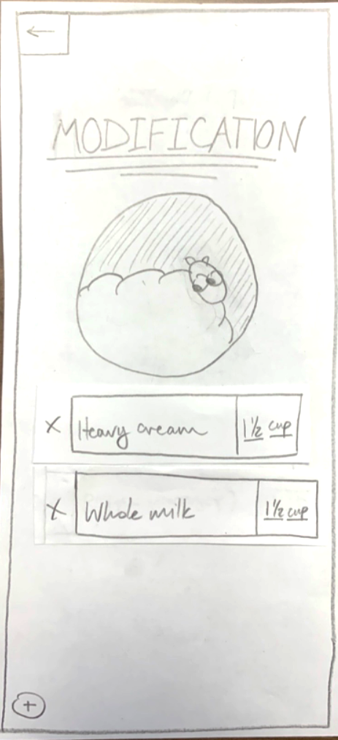
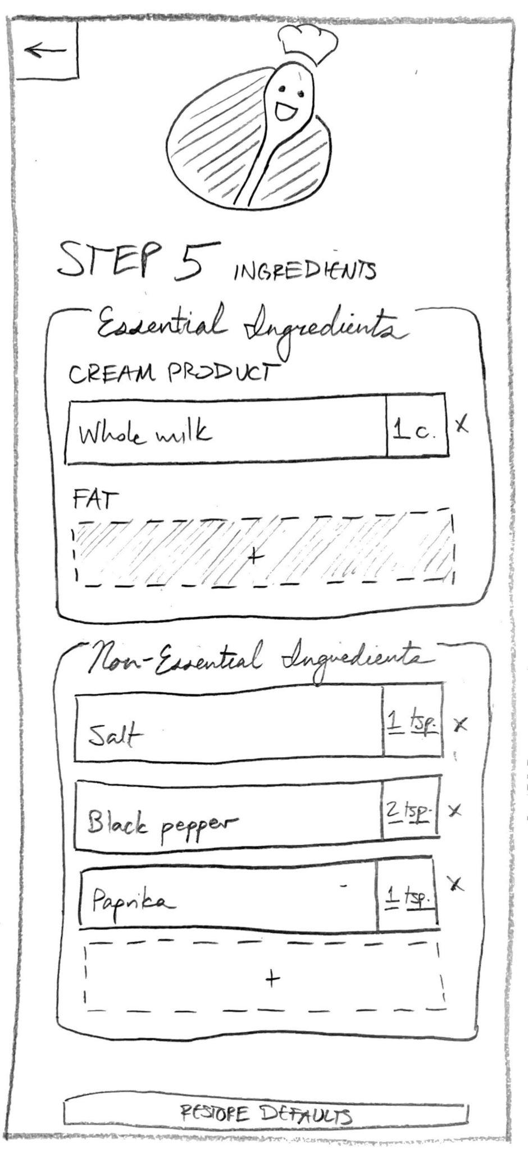
3. Restructuring Modifications
User Feedback
Studio Feedback
Learnability Goals
Modifications are the core of Recipal, so we want to get it right.
We’re debuting our new spoon mascot!
The mascot is also much smaller, based on user and studio feedback.
Users who were less familiar with technology found the modifications page confusing.
Users found that there was too little structure, and didn’t know what changes to make.
With extra structure, we hope to aid the somewhat confusing task of making a modification.
We sacrifice some flexibility for learnability here.
Lo-Fi
Revised

Slide 16
Usability Goal
Grade
Lo-Fi
Learnability
Med-Fi
With the addition of info bubbles and more structure on the modifications page, we’ve made Recipal a lot easier to learn since the lo-fi.
Lo-Fi
Flexibility
Med-Fi
We’ve digitized, which means we can enumerate a lot more modifications than we could on paper. It’s still not code-level, but Recipal is a lot better at making modifications a user wants now.

Slide 17
Task Flows

Slide 18
Simple
Browse a database of recipes and select one.
swipe up
tap
tap
tap
tap
Home
Category Select
Category Select
Recipe Select
Ingredients

Slide 19
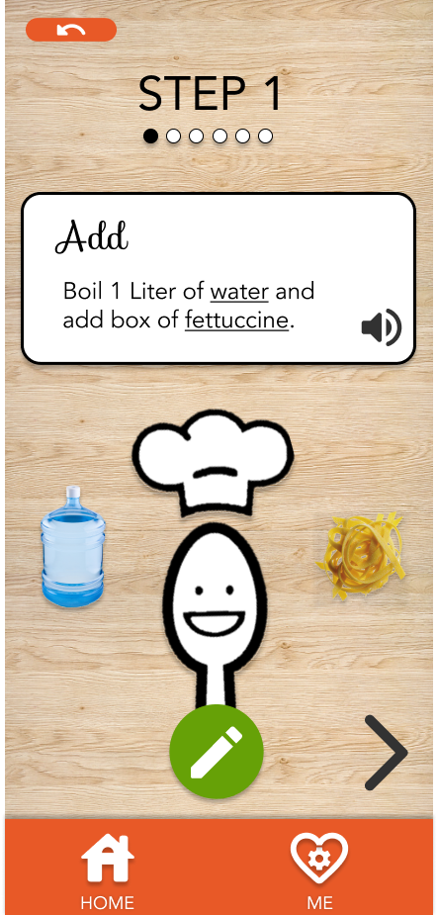
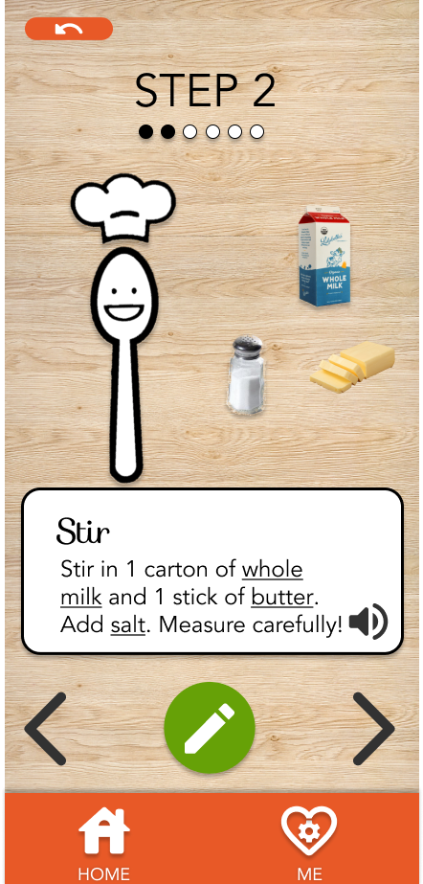
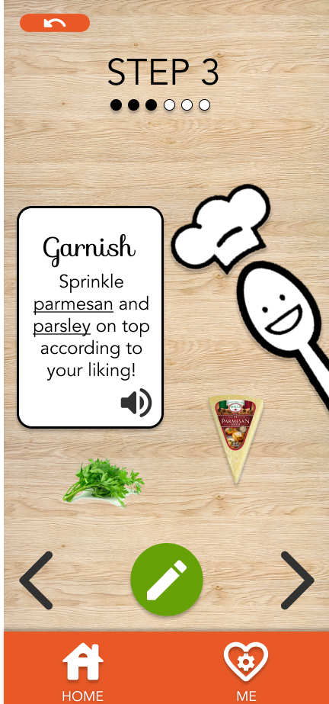
Moderate
Navigate through the steps of a recipe to completion, performing a basic modification.
tap
tap
tap
tap
tap
tap (to subtask)
Ingredients
Recipe Steps
Success!
To make a modification to the recipe, users can tap the edit icon on any step. Here, we modify step 2.
Notes:
Note that the moderate task flow also includes the recipe select (from the simple task flow). In this diagram, the user has just finished selecting a recipe. From here, they cook the recipe step-by-step, making a modification to Step 2.

Slide 20
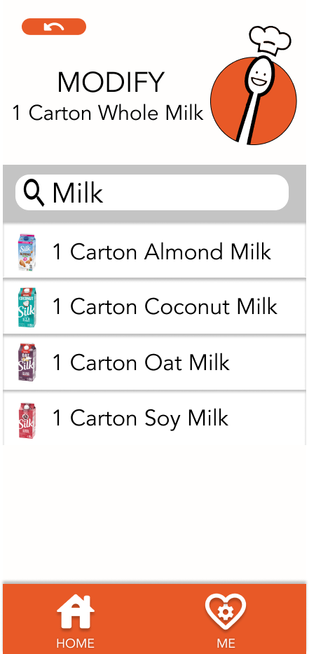
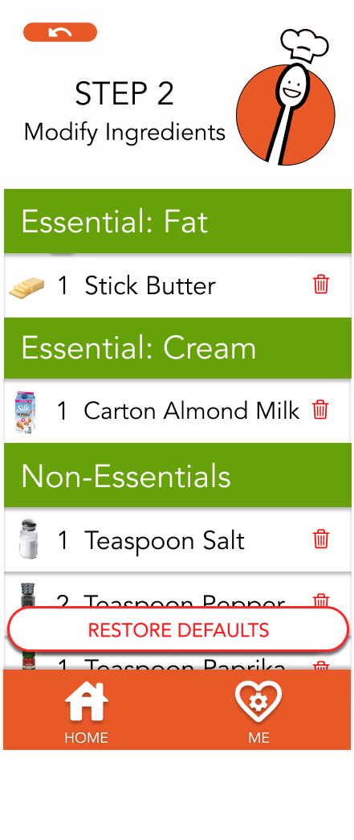
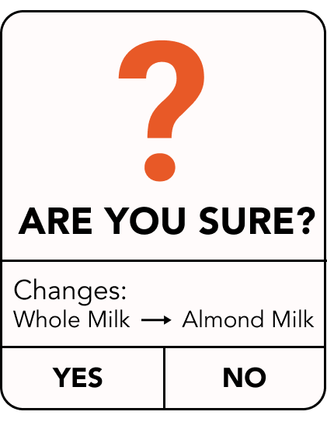
Subtask: making a modification
This is part of the moderate task flow. Here, users modify the second step of the recipe.
Tap (exit subtask)
tap
tap
tap
tap
Step 2
Step 2 Details
Select Modif.
Confirm
Step 2 Details

Slide 21
Complex
Input nutritional limits and navigate through the steps of a specified recipe, performing modifications that are accepted/rejected intelligently based on the user’s nutritional limits.
select
tap
tap
tap (to recipe select)
input
tap
tap
Home
Profile Page
Nutrition Limits
Recipe select and navigating through the recipe are included in the complex task, but we’ve omitted them for brevity.

Slide 22
Later: users’ modifications are evaluated against their specified goals.
Here, a user tries to add too much salt, which exceeds their sodium limit.
tap (back to recipe)
Recipe select (simple) and recipe steps (moderate) omitted for brevity.
tap
tap
tap
Step 2
Step 2 Details
Rejected!
Step 2 Details

Slide 23
Tools & Tradeoffs

Slide 24
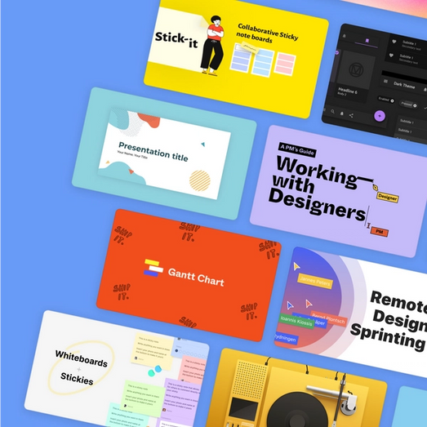
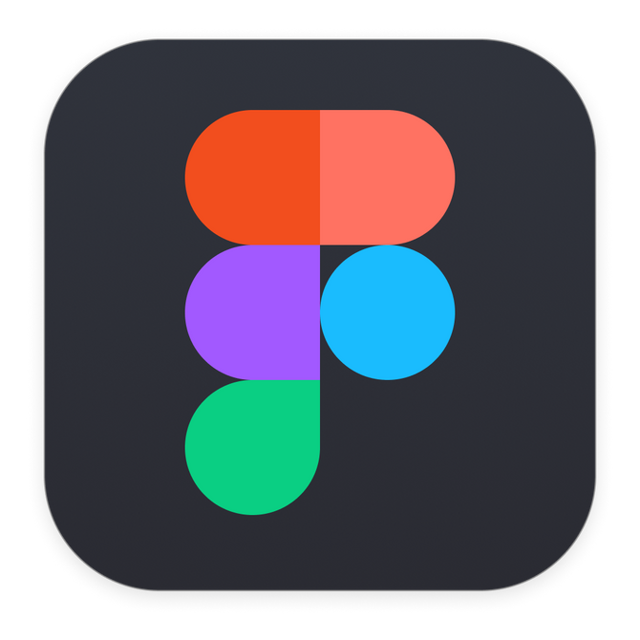
Tools – What Worked
Figma
PowerPoint
Figma Community
wireframing, graphic design
graphic design
icons, UI kits, inspiration
We used Figma for 80% of our med-fi graphic design, and only had to design a few elements outside of the app.
PowerPoint was a surprisingly strong graphic design tool. We made our spoon mascot with it!
We used community UI kits to standardize classic components like pop-ups and search bars.
Notes:
Worked:
Figma: wireframing, graphic design
Figma community: icons, inspiration, UI kits
PowerPoint: graphic design
Didn’t work:
Adobe Color: color picking tools were less useful
Photoshop: learning curve vs. payoff wasn’t worth it

Slide 25
Tools – What Didn’t Work
Photoshop
Adobe Color
learning curve vs. payoff wasn’t worth it
color picking tools were less useful
Ultimately, PowerPoint and Figma had enough power for our med-fi, so we forwent Photoshop altogether.
We found the color theory tools to be less effective in practice, so we picked colors that worked for our cooking theme.
Notes:
Worked:
Figma: wireframing, graphic design
Figma community: icons, inspiration, UI kits
PowerPoint: graphic design
Didn’t work:
Adobe Color: color picking tools were less useful
Photoshop: learning curve vs. payoff wasn’t worth it

Slide 26
What was left out of this prototype?
Hardcoded/Wizard of Oz techniques 🧙‍♂️🪄
Rejecting modifications based on nutritional goals isn’t “smart” yet
We simply reject when the user inputs too much sodium. This was a necessary choice, since intelligent rejection would require managing the state of wireframe.
Recipe history is hardcoded
Our recipe history doesn’t work yet, since it would require a data store, which wireframing doesn’t support!
Search is hardcoded
Ingredient search doesn’t allow user input, since this would require a whole database of ingredients, which wireframing doesn’t support!

Slide 27
What was left out of this prototype?
Limitations 😶
Only 1 recipe is shown end-to-end
Ultimately, all recipes follow the same structure, so we only show one recipe from start to finish. Other recipes are on the UI, just aren’t clickable!
Only showed 3 steps of recipe
We’re focusing on the core modifications interaction, so we decided to only show 3 steps out of the recipe.
Not all modifications can be made yet
We only allow the user to modify the milk type and salt amount of a step. Combining different modifications would require a lot of different wireframes, one for each permutation, so it wasn’t feasible.

Slide 28
Thanks!

Slide 29
Appendix
Test the prototype or view the full storyboard on Figma.

Slide 30
Appendix: All Major Changes from Lo-Fi Feedback
Major Changes
Hierarchy of scale
Smaller sheep, bigger buttons, bigger menu etc.
Maybe half a page of a book instead of the whole book(?)
Add search bar to search for keywords in menus
Enhanced substitutions
Which ingredients to substitute/redesign page to give it more structure
More feedback/confirmation
Updating modifications
Updating diet preferences
Effects of substitution?
Ingredients list
Change sheep mascot (to inanimate object?)

Slide 31
Appendix: All Minor Changes from Lo-Fi Feedback
Minor Changes
Change wording of “edit diet”
Show graphics of step
More clarity with/revisions to edit diet section
Information about different diets
Automatically filter recipes that exceed nutrition limits/don’t align with diet(?)
And automatically modify recipes
Min AND max amount instead of just max
Recipe history (of recipes you’ve made)

