Slide 1
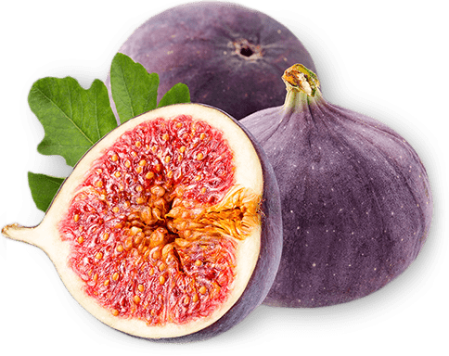
Lo-Fig Prototyping
& Usability Testing

Slide 2
Overview
Notes:
[kyle + dax]

Slide 3
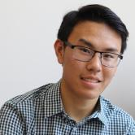
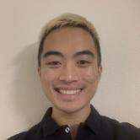
Team Foodies
Andy H. ’23
Dax D. ’22
Star D.
’23
Kyle N.
’23

Slide 4
Needfinding Agency, Ownership, & Social Identity
Research & Values
More personalizable and fostering inclusion
Sketching
Solidified mobile design interface
1
3
5
2
4
6
POV & Experience Managing uncertainty to having a companion
Concept Video
Visualizing our companion and tasks
Lo-Fi Prototype
Constructed & digitized the best mobile UI

Slide 5
Experimental Methods More female representation!
Suggested UI Changes
The Sheep
NOW
Ready to design website and Med-Fi prototype
8
10
12
7
9
11
Testing Results
Captured insight from up to 5 new users
Redesigning
Implementing feedback
Tasks
Imagined three cooking-related tasks for testing

Slide 6
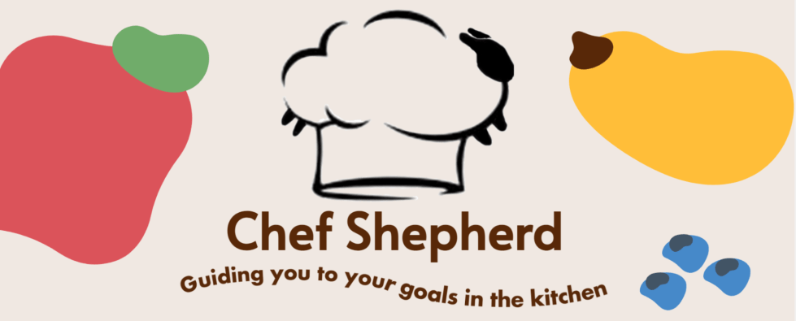
Notes:
Based on our studio feedback, we are no longer Chef Shepherd

Slide 7
Notes:
Say hello to our new friend Recipal!

Slide 8
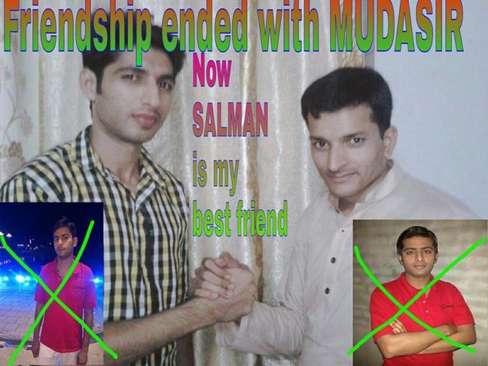
Chef Shepherd
Recipal

Slide 9
Team Mission
Statement
Notes:
[Dax] Value Prop - 1 line
Mission statement - 3 line

Slide 10
Value Proposition Helping you cook recipes your way
Mission Statement Recipal aims to help users overcome uncertainty about the recipes they are making by helping them understand nutritional value, make modifications, and learn cooking techniques. By making cooking fun and informed, Recipal creates a more welcoming and approachable cooking environment.

Slide 11
Selected Interface
Notes:
[Andy] Selected Interface + Rationale

Slide 12
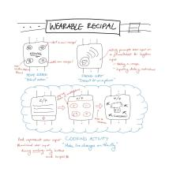
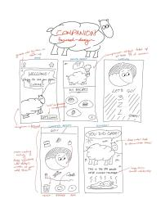
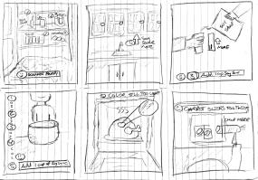
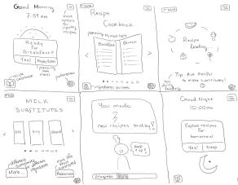
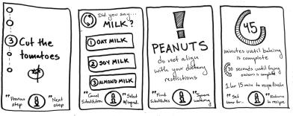
augmented reality
wearable
companion-based
5 Interfaces
hands-free
context-based

Slide 13
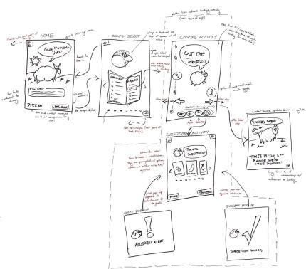
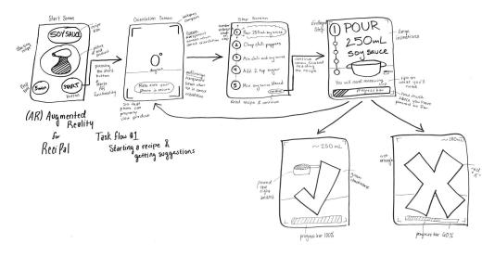
SELECTED INTERFACE
Companion-based, AR

Slide 14
Lo-Fi Prototype
Notes:
[Andy]

Slide 15
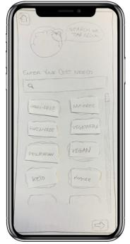
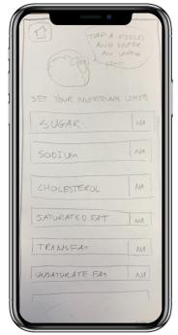
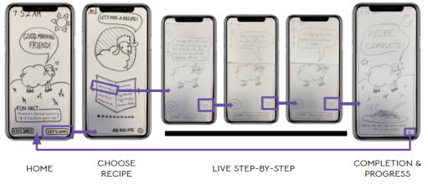
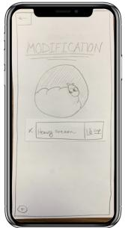
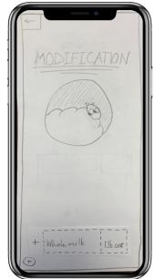
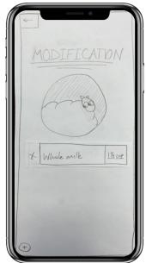
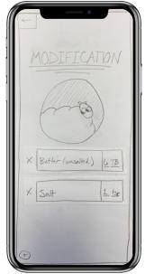
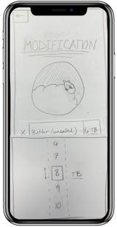
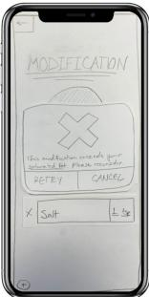
START
CHOOSE/MAKE RECIPE
EDIT DIET
SELECT
DIETARY NEEDS
SET
NUTRITIONAL LIMITS
MAKE MODIFICATION
W/ CUSTOM DIET
MAKE MODIFICATION
DELETE INGREDIENT
ADD
INGREDIENT
BACK TO
RECIPE
CHOOSE INGREDIENT
CHAGE MEASUREMENT
CUSTOM DIET NOTIFICATION

Slide 16
Tasks
Notes:
task flows shown carrying out each task [star]

Slide 17
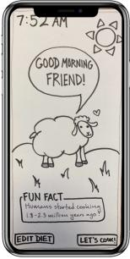
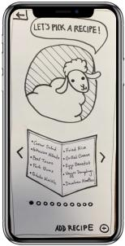
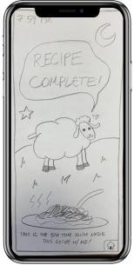
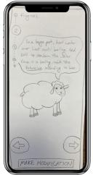
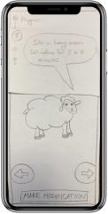
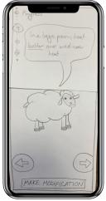
Task #1
Simple: Select a specified recipe from the database and navigate through the steps to recipe completion (with no modifications)
START
FINISH
CHOOSE RECIPE
COMPLETION & PROGRESS
HOME
LIVE STEP-BY-STEP
Notes:
Browse

Slide 18
(Modified) Task #1
Simple: Browse database of recipes and select one
START
FINISH
CHOOSE RECIPE
COMPLETION & PROGRESS
HOME
LIVE STEP-BY-STEP
Notes:
Browse

Slide 19
Task #2
Moderate: Navigate through the steps of a recipe to completion, performing a basic modification
START
FINISH
DELETE INGREDIENT
ADD
INGREDIENT
BACK TO
RECIPE
MAKE MODIFICATION

Slide 20
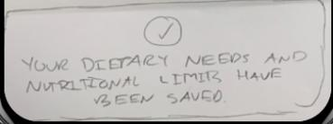
Task #3 (pt. 1)
Complex: Input nutritional limits and navigate through the steps of a specified recipe, performing modifications that are accepted/rejected intelligently based on their dietary restrictions.
START
SELECT
DIETARY NEEDS
SET
NUTRITIONAL LIMITS

Slide 21
Task #3 (pt. 2)
Complex: Input nutritional limits and navigate through the steps of a specified recipe, performing modifications that are accepted/rejected intelligently based on their dietary restrictions.
FINISH
SELECT
INGREDIENT
CHANGE
MEASUREMENT
CUSTOM DIET NOTIFICATION
MAKE MODIFICATION W/ CUSTOM DIET

Slide 22
Experimental
Method
Notes:
[star]

Slide 23
5 new testing participants
More female-identifying participants
Diversifying the age-range
Testing Methodology
20
51
21
15
19
Notes:
Female, college freshman from Bowdin University
Male, highschool sophomore from Sacramento, CA
Female, college senior from California Institute of the Arts
Female, 51-year-old elementary school teacher from Tampa, FL
Female, college junior from University of Southern California
virtually via Zoom and asked each participant to share their screen with our digitized prototype on Marvel

Slide 24
Measurement & Goals
We were all notetakers and facilitators at some point!
Timing
Aesthetics
Feedback
Movement
Companionship
Accessibility
Learnability and Flexibility

Slide 25
Experimental
Results
Notes:
[dax]

Slide 26
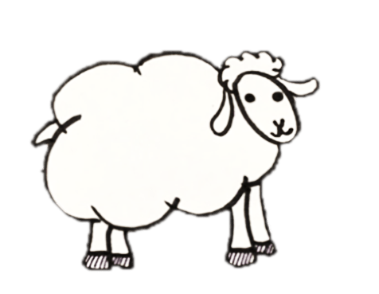
✅ Things That Worked
Enjoyed cooking w/sheep
“Friendly,” “fun,” “cute,” “positive,” “motivational”
Generally, users were able to make modifications to the recipe successfully
Notes:
“Let’s cook!” and the characterization of sheep, our UI was intuitive,

Slide 27
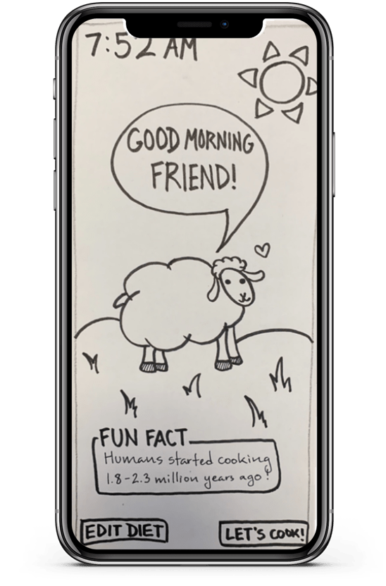
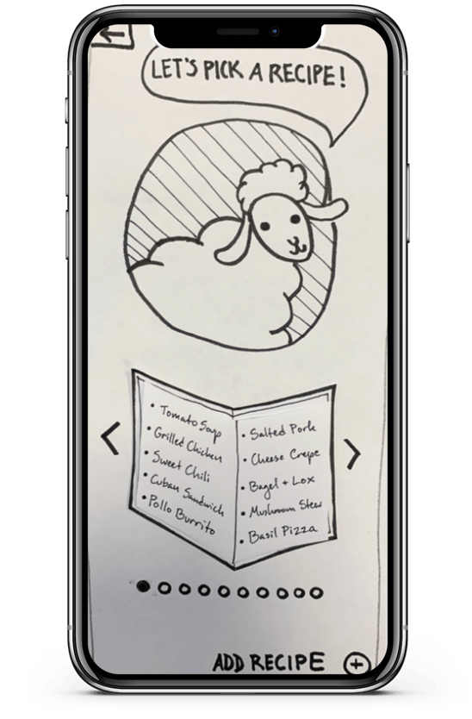
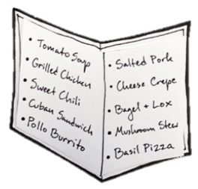
❌ Things That Didn’t Work
Hierarchy of Scale
Sheep too big, buttons too small
Sheep too big, menu too small
Menu Needs organization
Notes:
Hierarchy of scale, menu organization/size (organize/filter by meal type, food type, difficulty, pricing, number of ingredients needed)

Slide 28
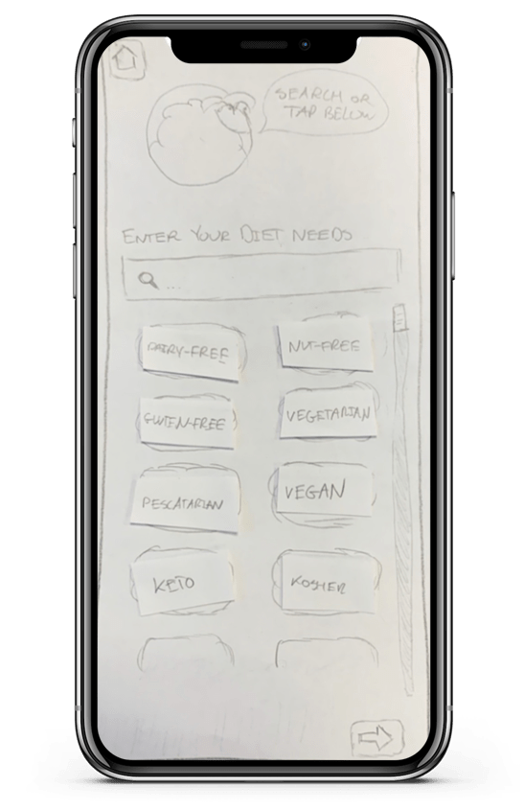
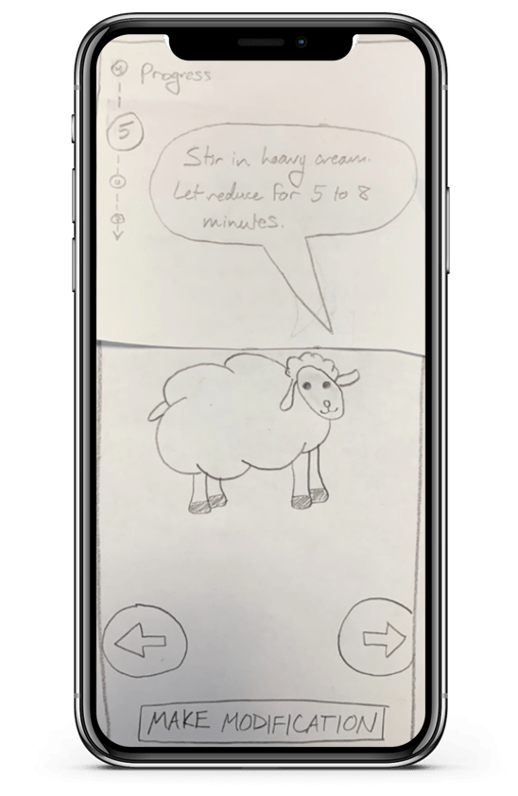
❌ Things That Didn’t Work
Edit Limits Unclear
Got lost on first page of Edit Diet
Nutritional Limits Options hidden on second page
Substitution Confusion
Unsure if substitution went through
Ingredient text didn’t change
No msg/confirmation
Notes:
First page of Edit Diet options, there are multiple pages for preferences
indication that substitution was successful, confirmation pages
more information about substitutions and also dietary restrictions

Slide 29
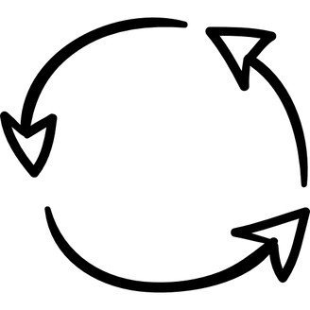
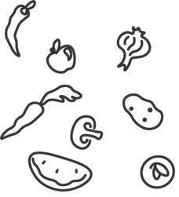
💡 Things That Participants Wanted
Substitutions
Ingredients + Steps
Additional Features
Substitution effects
Substitute at beginning of recipe
Ingredient information
Images of ingredients/ steps
Notepad
Estimated calorie counts for ingredients/recipe
Notes:
substitution effects on my recipe - how does it make the meal different
more information about substitutions and also dietary restrictions
option to substitute at beginning of recipe, images of steps/ingredients, list of ingredients,
estimated calorie counts, notepad

Slide 30
Suggested Ul
Changes
Notes:
[Kyle]

Slide 31
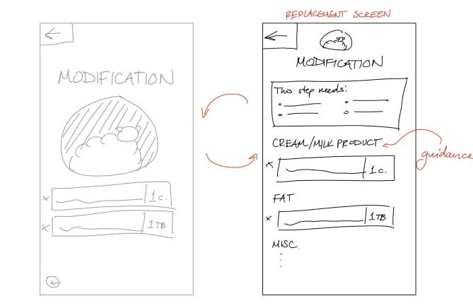
Improving Substitutions
Notes:
Modifications could provide more feedback, you can substitute multiple ingredients in each step, confirmation of substitutions page,
Adding ingredients you would use the plus button

Slide 32
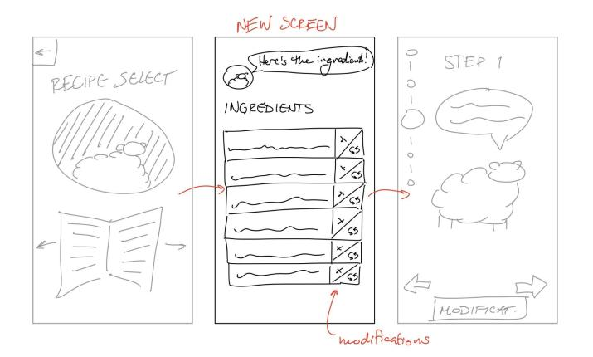
Adding an Ingredients Screen
Notes:
To have ingredients before the recipe starts, you can modify the ingredients before you start

Slide 33
Summary

Slide 34
Key Takeaways
We learn more from people!
Hierarchy
Of
Scale
“Fun &
motivational!”
People want more
Information
About ingredients, how to make substitutions, dietary preferences
People enjoy
Cooking Companions
and find it very
entertaining
People want more
Confirmation
from the UI after doing certain tasks
“Easy to use”

Slide 35
Thanks!

