Slide 1
Recipal
Helping you cook recipes your way

Slide 2
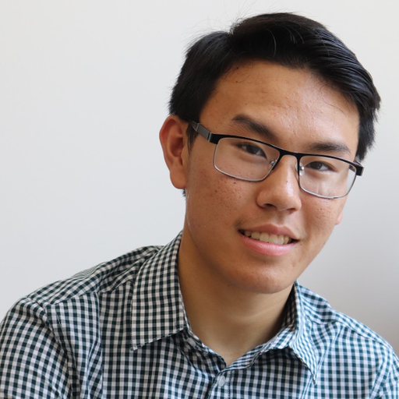
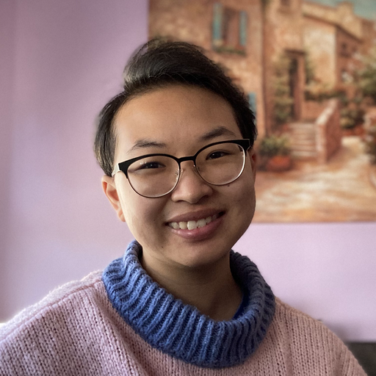
Our Team
Andy H
Dax D
Star D
Kyle N
Notes:
Diverse backgrounds, making recipes, cooking is personal,

Slide 3
?
Health Limitations
Uncertain Ingredient Swaps
Nutrition
Concerns
Notes:
Allergies, don’t have, add some more

Slide 4
Problem
People who cook can have difficulty finding recipes that align with their dietary restrictions and preferences.
Making modifications to recipes to fit their needs complicates the process of figuring out what nutrients are in the food they make and eat.

Slide 5
Clear Restrictions
Easy Recipe
Modifications
Informative Nutrition
Warnings

Slide 6
Solution
Recipal aims to help users overcome uncertainty about the recipes they are making by helping them understand nutritional value, make modifications, and learn cooking techniques.
By making cooking fun and informed, Recipal creates a more welcoming and approachable cooking environment.

Slide 7
Overview of Talk
1
2
3
4
5
Heuristic Evaluation
Results
Overview
of Revised Design
Prototype Implementation Status
Demonstration of Prototype
Summary and Questions

Slide 8
Heuristic Evaluation Results
!
1

Slide 9
64 total violations
1 severity 0
19 severity 1
24 severity 2
14 severity 3
1 severity 4
!

Slide 10
Most violated heuristics
User Control
(9/64)
Minimalist Design
(13/64)
!
H3
H8
Notes:
Complex navigation due to modifications, busy screens - white space

Slide 11
Severity 3 + 4
Type of Heuristic | Description | Action
H1 Visibility of System Status | Unclear if recipe search is based on dietary restriction/nutritional preference filters | Fix: If the recipe violates one of the user’s diet, it will appear with an exclamation point
H2 Match between System and World | Cannot change the units into what I am familiar with. | Fix: Add a customary/metric toggle on the Me page
H3 User Control and freedom | Cannot navigate freely through recipe, skipping steps by tapping on progress dots | Will not fix: We are following convention about dots not being functional
H3 User Control & Freedom | User may want to quit out of the recipe and save progress but can not. | Fix: Add “save progress” button when prompting for exit
H3 User Control and Freedom | User not given visual prompt of how to change increments, can’t decrease quantity | Fix: the inclusion of either a scroll menu or increment/decrement arrows to modify quantity
H4 Consistency and Standards | Back button in “Recipe Steps” cancels whole recipe instead of going back to ingredients page | Fix: Change the back button to an exit button
Notes:
Focus on severity issues 3-4
Explain colors
navigation

Slide 12
H7 Flexibility & Efficiency of Use | Home page has no purpose other than fun fact | Fix: Combine home page and recipe category select into one page
H7 Flexibility & Efficiency of Use | Users have to click on each recipe or each ingredient to learn more | Fix: Include high-level nutritional facts and information about recipe on label
H7 Flexibility and efficiency of use | Cannot save the modified recipe. | Will not fix: Cannot implement in timeframe, requires accounts/cloud database
H8 Aesthetic and Minimalist Design | “Add” and other directives are in different font than other text | Fix: Rely on one or two default fonts
H9 Help users recognize, diagnose, and recover from errors | No error message alerting that ingredient is essential, user should add ingredient back. | Fix: Add an error message that alerts the user to add the essential ingredient back
H9 Help Users Recognize, Diagnose, and Recover From Errors | Modification warning message doesn’t state the exact nature of the violation | Fix: Specify that limits will be per meal. Error message will include what the exceeded limit was/how this modification exceeds it
H11 Accessible | All pages purely visual and don’t offer text-based alternatives for users with low vision. | Will not fix: Text has screen readers. For the icons, we plan to provide alt-text.
Notes:
Focus on severity issues 3-4
Faster to use for regular users

Slide 13
Overview of Revised Design
2
Notes:
This section does not need to necessarily be segmented into “reasoning for changes” and “progress towards usability goals” by slide—each slide may be dedicated to specific/groups of changes in the revised design, touching on reasoning and progress towards usability goals on each slide

Slide 14
Renovating the Home Page
Clearly informing how recipe search uses user restrictions
Clearly indicating how modifications violate user preferences

Slide 15
Usability Goals
Learnability
Learning to use app, Learning from the app
Flexibility
Friendly to all users

Slide 16
Renovating the Home Page
H1 Visibility of System Status
Violation: Home page has no purpose other than fun fact
Fix: Combine home page and recipe category select into one page
Med-Fi Prototype

Slide 17
Renovating the Home Page
Learnability: Improved
Flexibility: Same
Learnability: Less navigation makes the app easier to learn to use
Med-Fi Prototype

Slide 18
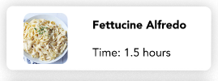
2. Clearly informing how recipe search uses user restrictions
H7 Flexibility & Efficiency of Use
Violation: Unclear if recipe search is based on dietary restriction/nutritional preference filters
Fix: If the recipe violates one of the user’s diet, it will appear with an exclamation point
!

Slide 19
2. Clearly informing how recipe search uses user restrictions
Learnability: Improved
Flexibility: Improved
Learnability: Better warning icons lets users learn what they can and cannot do and why
Flexibility: New warning icon makes choosing recipes more safe for all users
!

Slide 20
3. Clearly indicating how modifications violate user preferences
H9 Help Users Recognize, Diagnose, and Recover From Errors
Violation: Modification warning message doesn’t state the exact nature of the violation
Fix: Specify that limits will be per meal. Error message will include what the exceeded limit was/how this modification exceeds it
Med-Fi Prototype

Slide 21
3. Clearly indicating how modifications violate user preferences
Learnability: Improved
Flexibility: Improved
Learnability: Better explanation lets users learn what they can and cannot do and why
Flexibility: Better explanation makes making modifications more safe for all users
Med-Fi Prototype

Slide 22
Prototype Implementation Status
3

Slide 23
Framework/Tools Used
React Native
Expo
Git
Mobile Development
Mobile Development
Version Control, Collaboration
✔️ Building UI/UX ❌ New language
✔️ Easy testing ❌ Needs wifi
✔️ Sharing workload ✔️ Easy learning curve
Notes:
(e.g., React Native, Xcode, and particular design tool)

Slide 24
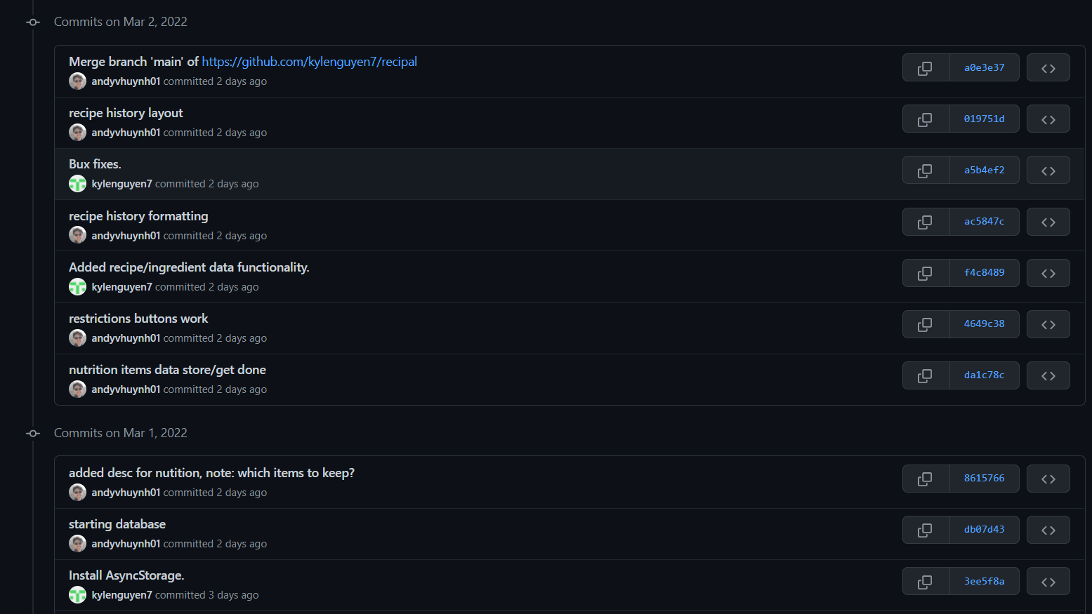
Implemented Features
Page layouts and navigation
User input data storage
Modifications
Nutritional limit warnings
Notes:
what you have done so far

Slide 25
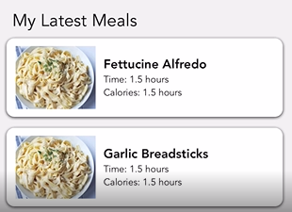
Unimplemented Features & Plan
Restrictions showing up as exclamation points on recipe select
Recipe history
Recipe and ingredient databases
!
Notes:
i. What has yet to be implemented ii. Plan to finish

Slide 26
Remaining Timeline
1
2
3
4
Restriction Functionality
Recipe
History
Polishing,
Small Details
More Recipes, Ingredients
By 3/6
By 3/6
By 3/9
By 3/11
Notes:
i. What has yet to be implemented ii. Plan to finish

Slide 27
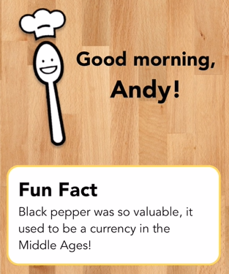
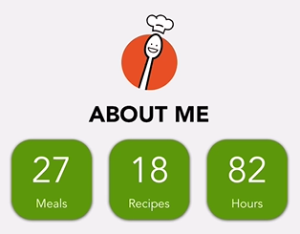
Hard-coded Data
Personal Progress Counters
Greeting
Recipe History
Fun Fact

Slide 28
Wizard of Oz Techniques
Issues/Questions
Nutrition limits are not calculated faithfully and use crude estimates
Each ingredient is pre-labeled with a nutrient per unit ratio
e.g. fettuccine pasta: 7g carbohydrates / oz
Switching between customary and metric
Varies by ingredient (weight vs. volume)
e.g. a cup of feathers is heavier than a cup of marbles
Notes:
Any wizard of Oz techniques you plan to use

Slide 29
Demonstration of Prototype
4
Notes:
Maybe ask Andy to see if he can airplay his phone while he presents it

Slide 30
Summary & Questions
?
5

Slide 31
Summary
Heuristic Evaluation
Results
Overview of
Revised Design
Prototype Implementation Status
Demonstration of Prototype
15 total severity 3-4 issues found (one 4 and fourteen 3’s)
Will address most of the issues
Home page
Clear indications of how user restrictions and preferences are used
Completed layout, modifications, and nutrition warnings
Need restriction indications and more recipes
Making a recipe
Making a modification
Setting a personal diet
Notes:
Hiding this slide because after I looked at example presentations, I realized that the “Overview of Talk” slide was just a road map slide without a lot of copy on it, just a list of the broad topics that would be covered. Maybe we can use this as a template for our summary slide

Slide 32
Questions?

Slide 33
Thanks!

